Slide 1
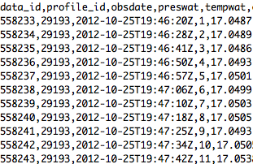
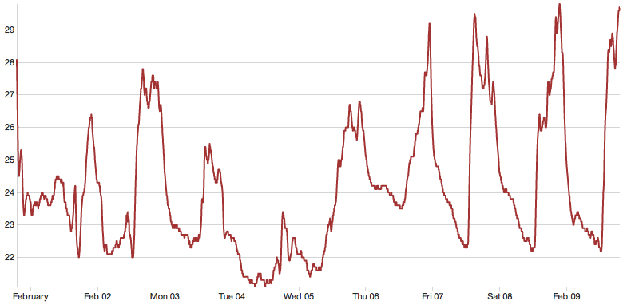
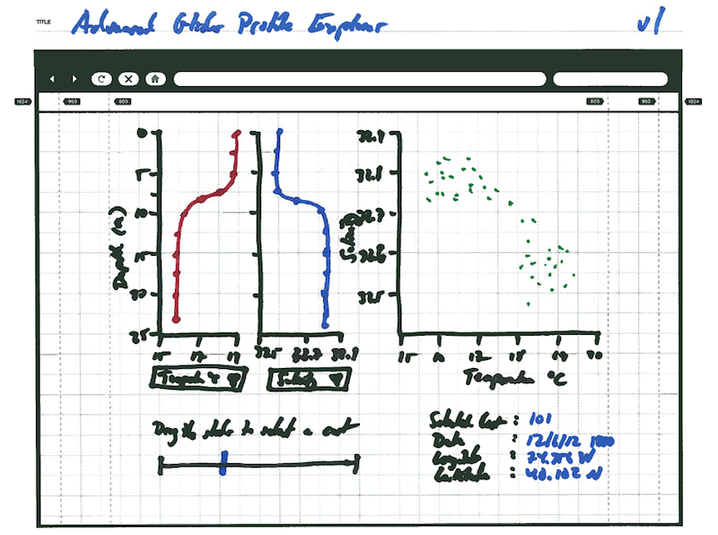
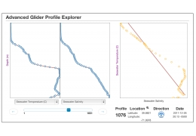
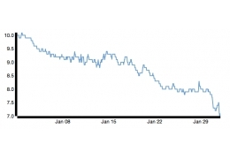
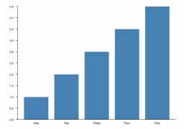
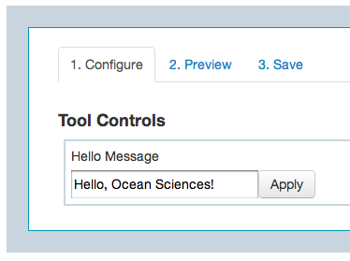
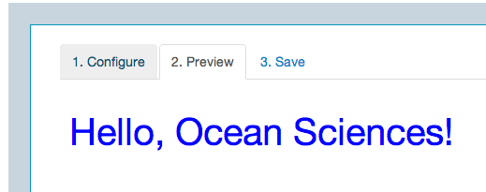
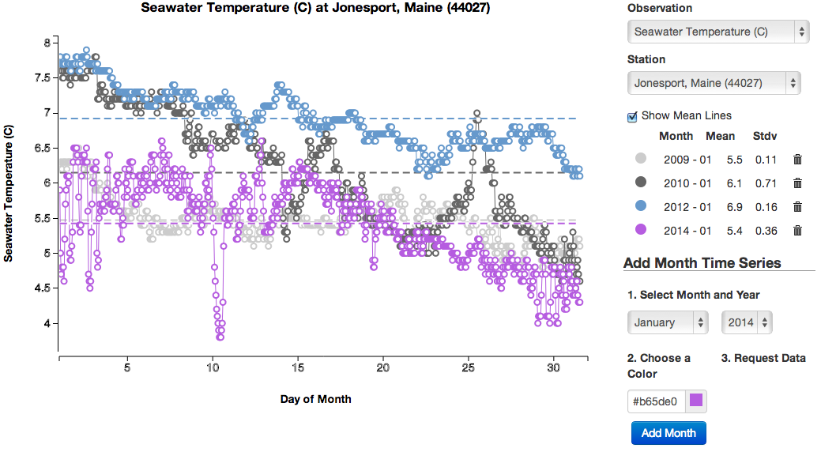
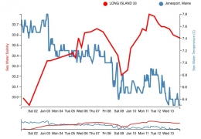
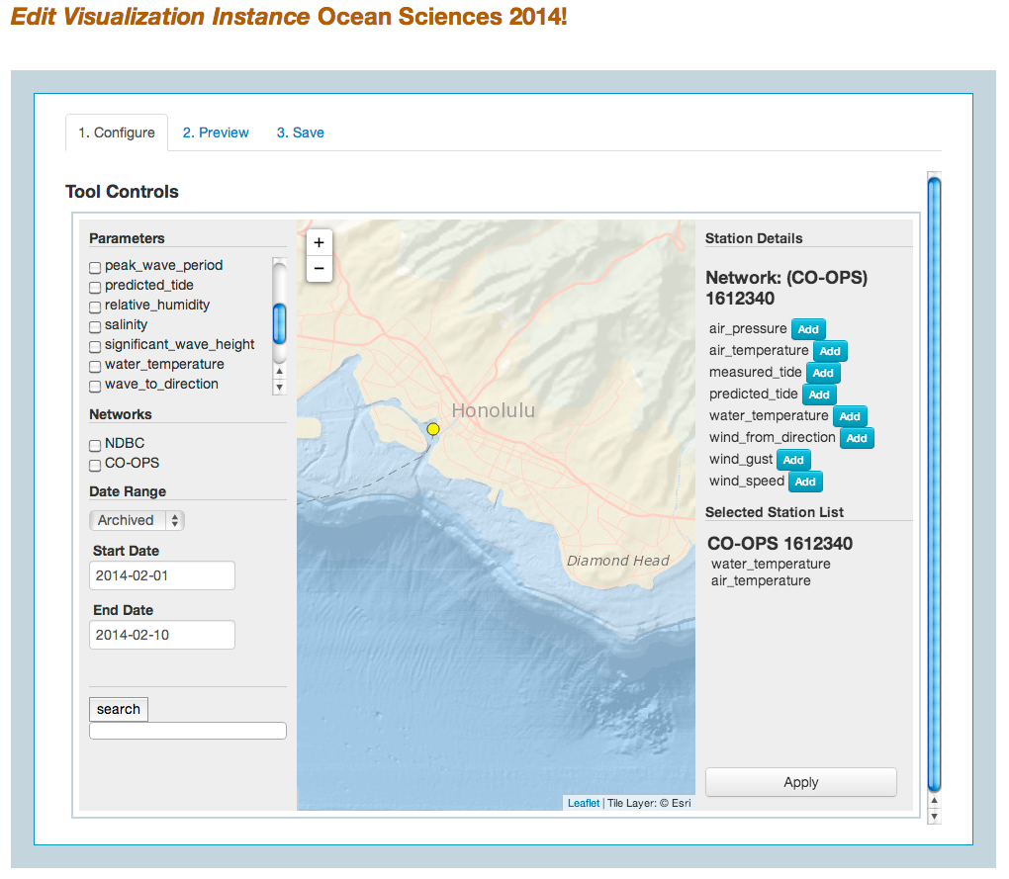
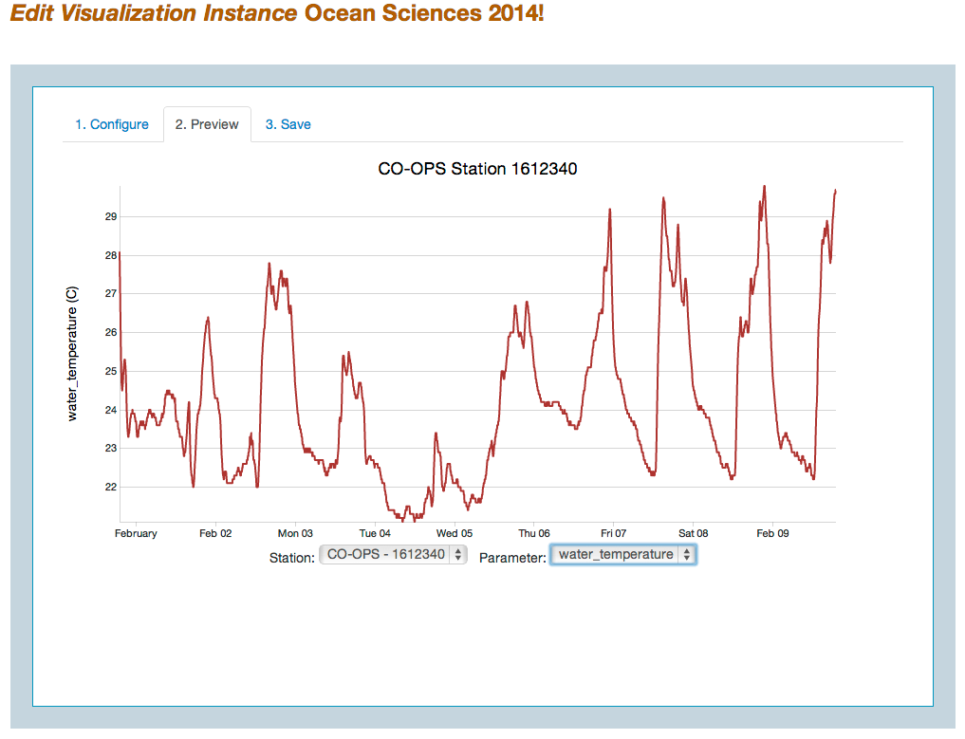
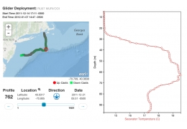
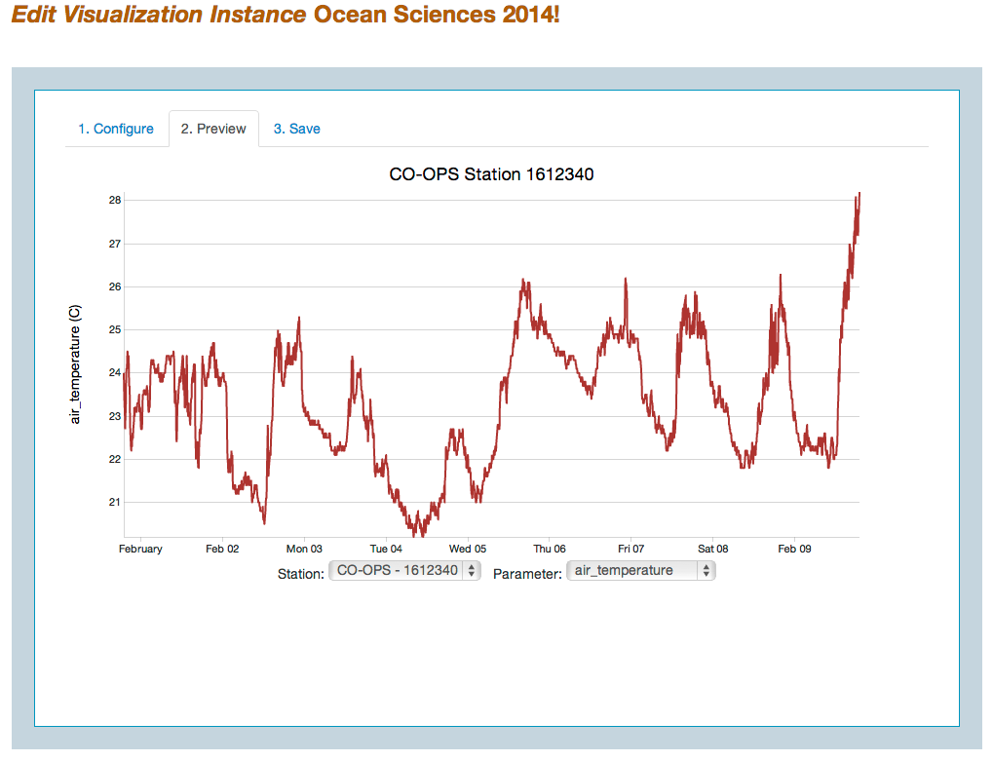
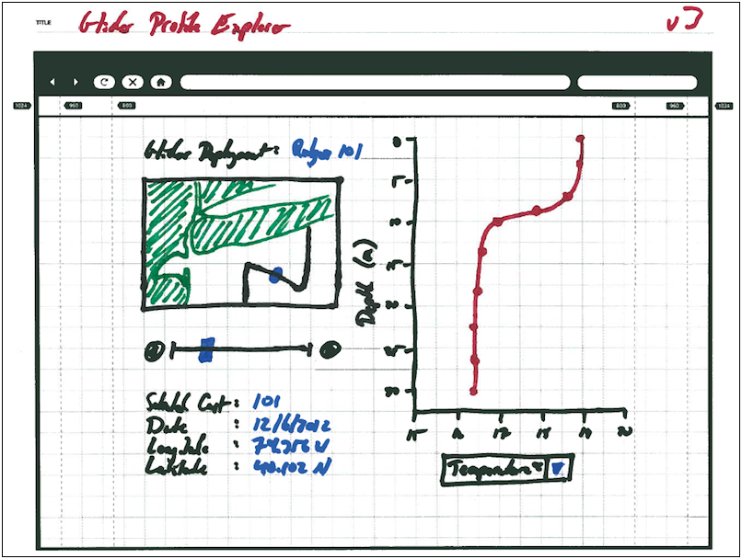
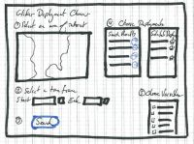
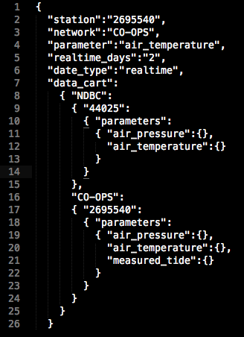
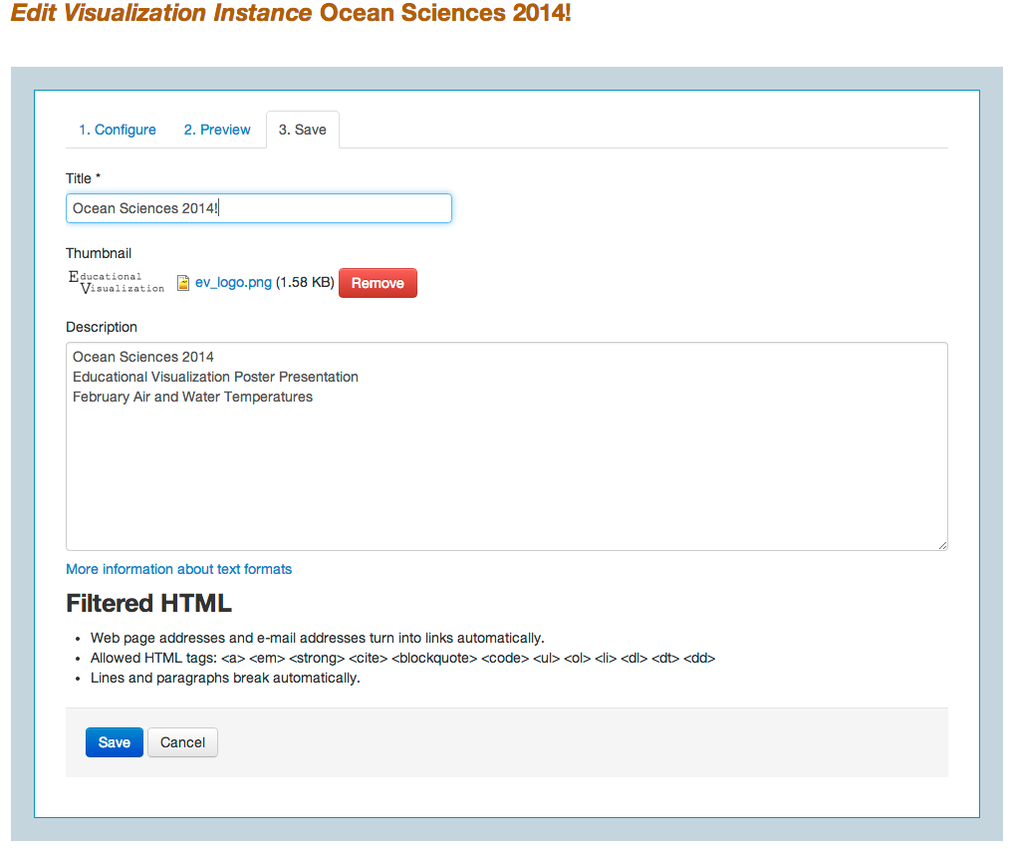
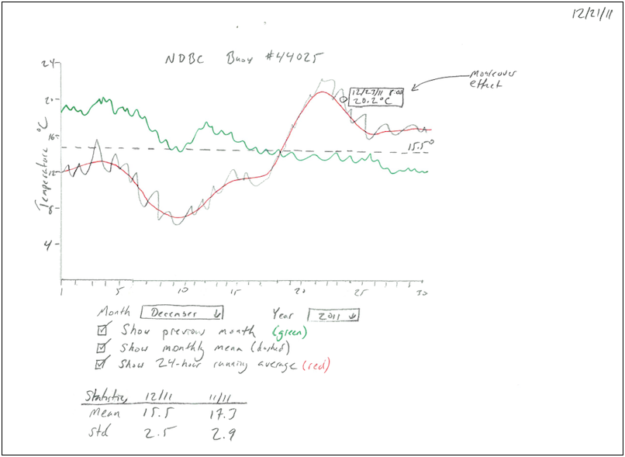
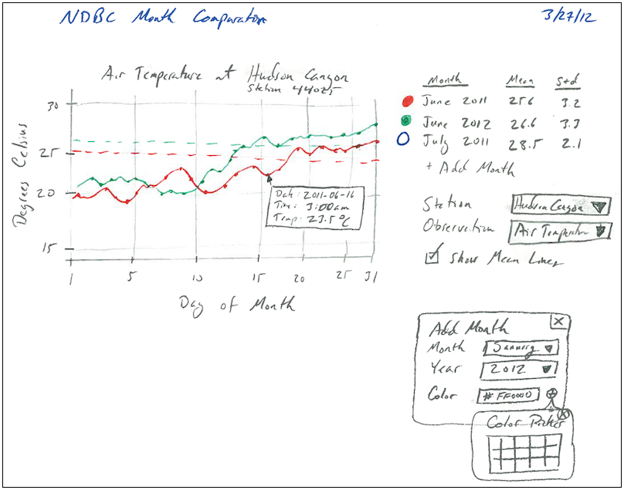
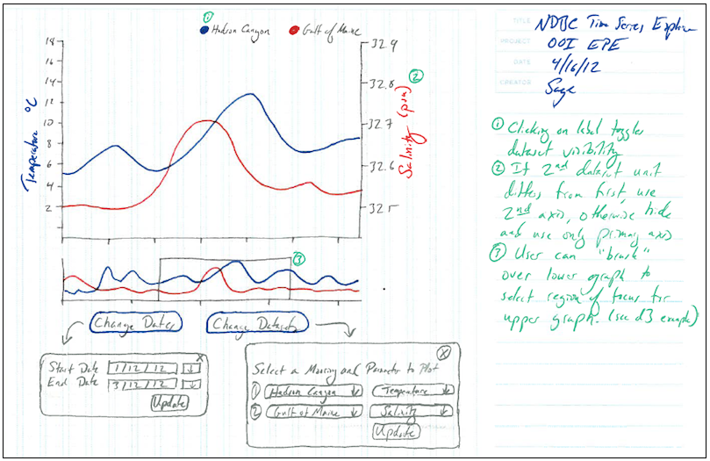
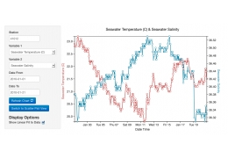
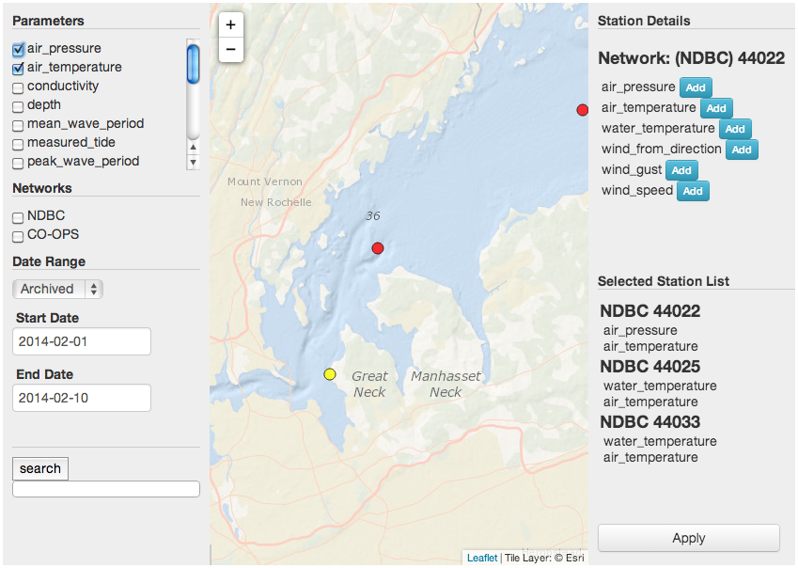
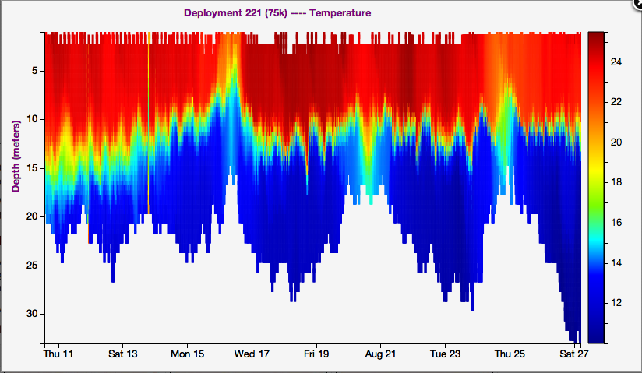
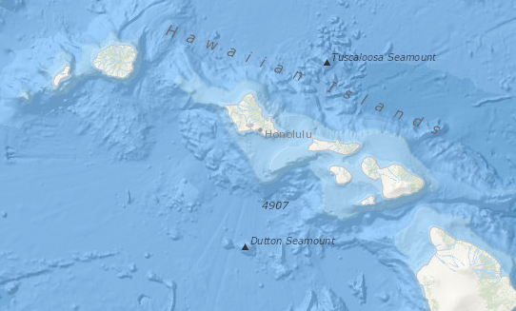
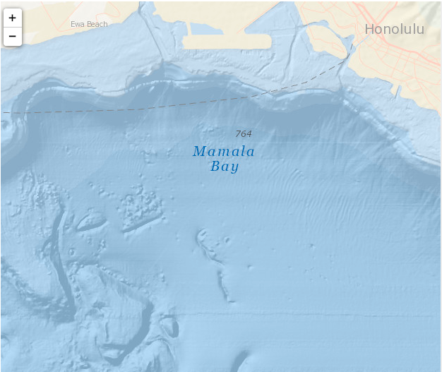
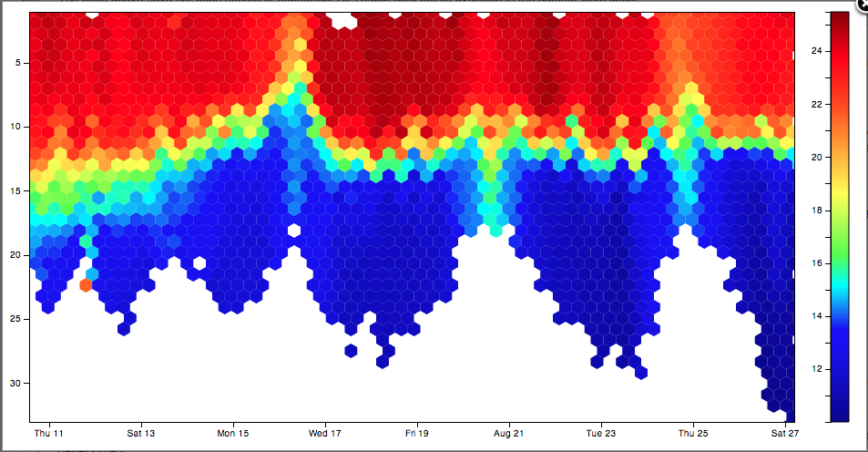
Developing Online Tools To Support The Visualization Of Ocean Data For Educational Applications
Poster #1767
Michael Mills, S. Lichtenwalner, J. McDonnell, M. Crowley, S. Glenn
Rutgers University Institute of Marine & Coastal Sciences
Summary
Data from Ocean Observing Systems can be used to provide rich opportunities for students to learn about ocean processes much as scientists do, provided students are able to interact with and visualize data in meaningful ways. As part of the Ocean Observatories Initiative (OOI), we have developed an Educational Visualization (EV) framework that provides a platform for web developers to build interactive tools to support the ocean sciences community.
Developers can use the framework to build new and exciting web-based tools. Educators can use these tools to generate custom interactive data visualizations, personalizing the data students use based on location or areas of interest. And students can interact with the visualization tools, at varying levels of complexity.
The Educational Visualization framework is built using open-source JavaScript-based libraries, including jQuery (which provides the core functionality for data requests, layout arrangement, and styling) and D3 (which provides the easy-to-use foundation for the interactive visualization elements). The system supports the latest web standards, including HTML5, CSS3, and SVG and can easily be extended as technology continues to evolve.
Design and Development Process
Conceptual Design
Prototyping & Exploration
Tool Development
Testing and Feedback
1. Design Process
As part of the development process for
each tool, a “Design Specification” is created
that includes each of the following components:
Educational Goals – The design team works with educators, students and scientists to identify data visualizations and tools that can serve a unique educational purpose.
Data and Data Sources – Appropriate data that would be relevant to a tool is identified, along with available web services that make this data available.
Configurable Properties – Designers consider the purpose of each tool and determine how much control educators and students need to accomplish their goals. Usability issues are also considered in determining how tools can be customized.
Sketches and Wireframes – Designers mock up tools using design sketches to assist developers in prototyping and programming the final tools.
3. Development Considerations
Educational Visualization Tools
Several prototype tools have been developed to test the capabilities of the system and available data visualization libraries. These prototypes were also used to assist educators understand the kind of functionality that will be available, so they can help identify visualization techniques and tools that will meet their educational needs.
Data Integration
Archived and real time data feeds are configured for each tool. Tools primarily use CSV and JSON data from available web services, but they can be configured for many other types of data.
User Interface Design
The developer adapts the design sketches into a working tool. Layouts are comprised of HTML5, CSS, and SVG are rendered with a combination of jQuery, jQueryUI, D3, and other libraries.
Time Series
This simple time series tool shows data from a predefined date range and sensor.
Bar Chart
A simple bar chart built with user provided data.
Hello World
A basic tool that converts text to SVG. Used for system testing and as a developer tutorial.
Customization Ability
Tools can be customized on the web portal, allowing educators to choose datasets, specify settings, colors, etc. How end users can control and interact with a tool are also considered.
Monthly Comparator
Overlay and compare time series data from multiple months for a selected sensor.
Time Series Explorer
Compare two NDBC time series datasets. The “focus” and “context” charts allow the user to zoom in on one chart, while the other shows a longer date range for context..
Design
Prototype
Develop
Test
4. Testing and Feedback
All tools are tested for functionality and usability by developers, educators, and students. Errors, bugs, and suggested improvements are logged and relayed to the tool designers and developers to be incorporated in future enhancements and other tools.
User Interface
Customized tools can be created using the OOI Ocean Education portal. Tool instance configurations are saved as JSON objects in the system. Configuration objects can be loaded from a database, or coded directly in a tool load event. Users use the following steps to create their customized tool.
1. Configure
Tool “Controls” are used to modify a tool’s configuration The level of configuration ability is entirely up to the tool developer. This example shows the Dataset Browser, which enables an educator to search for and select datasets relevant to their lesson plan.
Glider Profile Explorer
Explore individual ocean profiles from autonomous underwater gliders using a map, jQuery slider or arrow buttons.
Advanced Glider Profile Explorer
Explore and compare profiles of two parameters from a single glider profile while using the scatterplot to identify possible correlations in the data.
2. Preview
The tool preview is updated when the user applies the modified configuration, and allows a user to see what the published version of the tool will look like. The user can also specify the default view on this page.
3. Save
To save the current instance, a user enters a title and description, and uploads a thumbnail. The current state of the tool, as seen in the preview, is saved in a tool configuration JSON object. Associated tool metadata is also saved.
The tool can now be edited, copied, and shared!
Data Comparison Tool
Analyze correlations between two NDBC time series datasets in either time series or scatter plot view. Data points are animated when the view is switched.
Dataset Browser
This tool allows users to explore and select available stations and parameters to be use in customized visualization tools.
Frameworks, APIs, and Services
The following open-source frameworks and libraries are used extensively to developing online interactive data visualization tools.
Data visualization framework
Esri’s Open Basemap MapService is used to provide ocean basemaps
2. Prototyping
During the prototyping phase, the following activities are
conducted:
Experiment with unfamiliar technologies
Research new visualization techniques
Explore data sources and data feeds
Prototype Example
A Hovmoller diagram, created by drawing tens of thousands of individual data points as overlapping rectangles, often froze the browser.
With hexagonal binning, the visualization render time was decreased significantly and the browser was no longer impacted by the large number of graphical elements.
Advanced JavaScript helper functions
Feature-rich UI elements
Layout functions, icons, UI elements
Relevant labeling
Simple, effective web mapping functionality
We invite you to help us improve these prototype tools by joining our site today, playing with the tools, and letting us know what you think. -> http://education.oceanobservatories.org
Bathymetry and marine relevant labels
Detailed bathymetry

