Slide 1
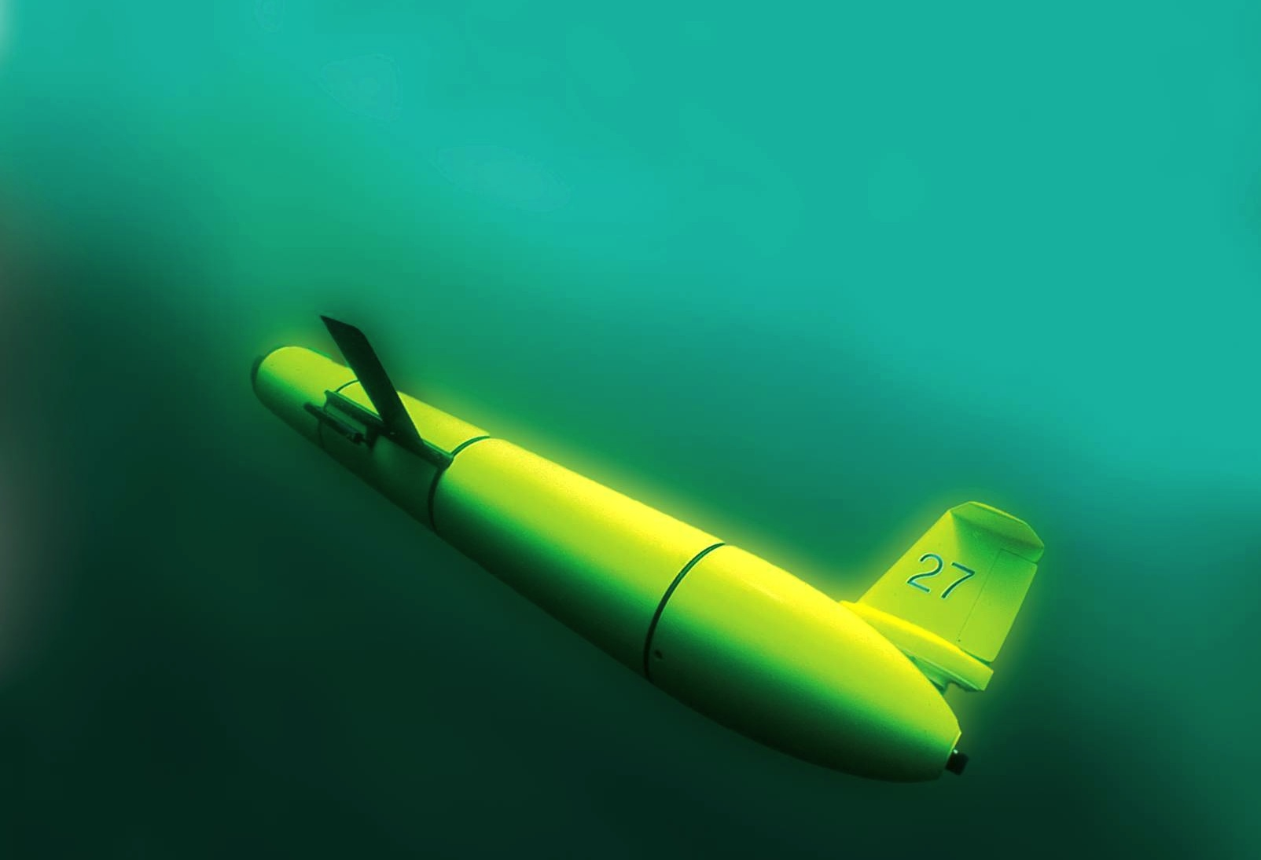
Leveraging Ocean Observatories and Web-Based Educational Tools for Sustained Undergraduate Research
in Ocean Science
Scott Glenn,
Oscar Schofield,
Josh Kohut &
Janice McDonnell
Rutgers University
“The Ocean is Our Classroom”

Slide 2
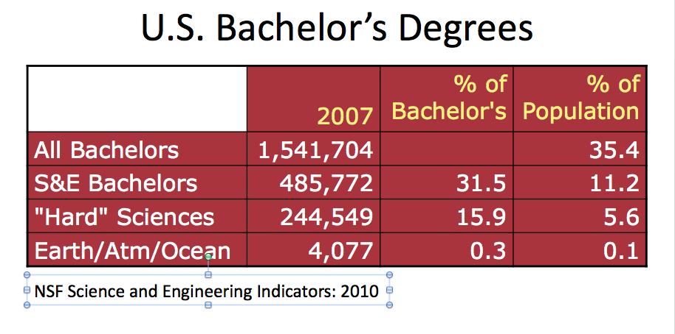
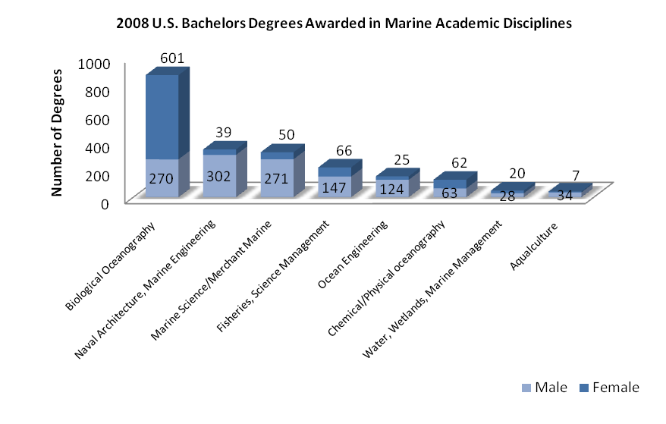
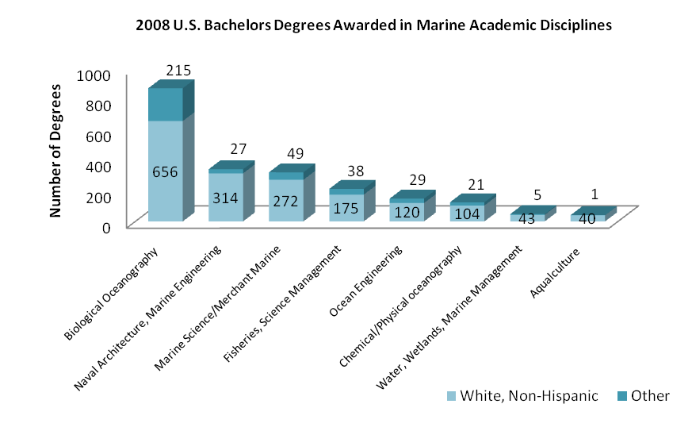
Today’s Grand Challenge as Geoscience Teachers:
Undergraduate Education Statistics
41% Female
59% Male
18% Other
82% White, Non-Hispanic
Off by 400 Students
Off by 800 Students

Slide 3
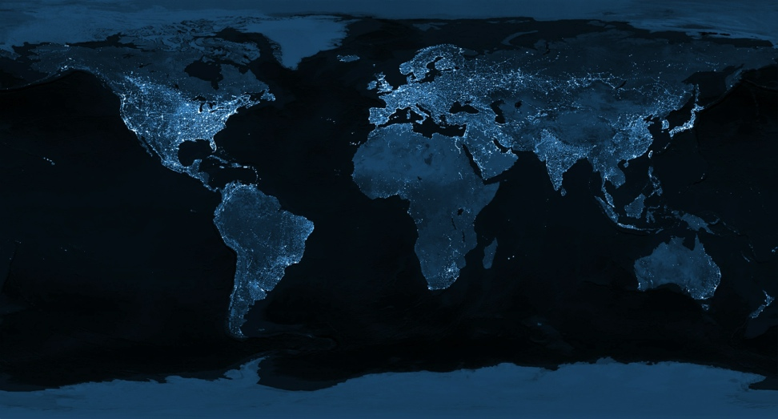
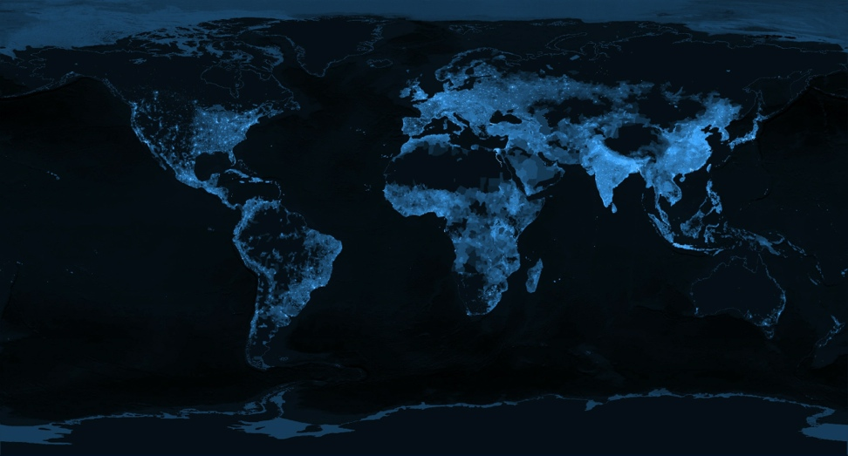
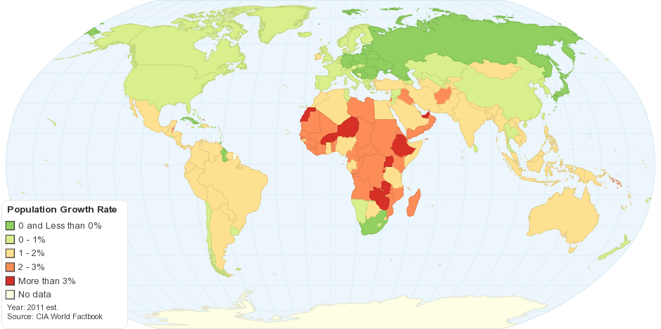
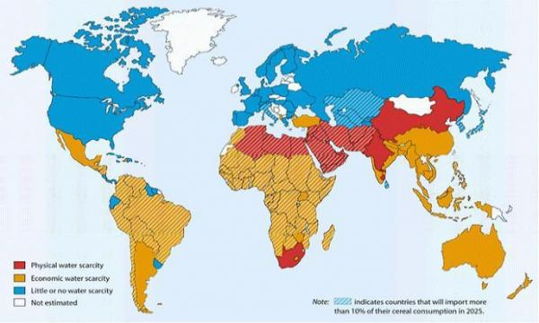
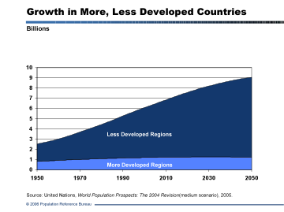
The 2050 Grand Challenge for our Students
During the Professional Lifetimes of Today’s Undergraduates,
Transform This (The Earth at Night)
Into This (Global Population)
7 Billion to 9 Billion
When the Human Population is Growing
And the Earth is Changing

Slide 4
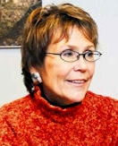
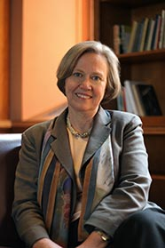
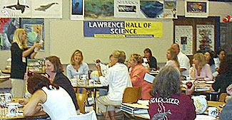
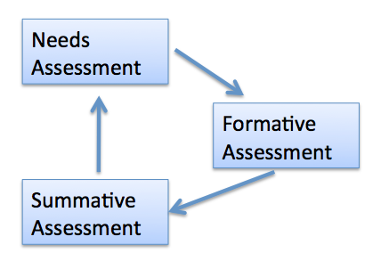
Advice from some Friends
Margaret Leinen –
Marine Geology – Director, Scripps Institute of Oceanography
Good news – Geoscience Majors are more likely to remain in their field.
Key to success – Mentorship – But there remains a mentorship gender gap.
Shirley Tilghman –
Molecular Biology - President, Princeton U.
Good news – We know what works.
Keys to success – Turn the pyramid upside down.
Start living the life of a scientist early.
Distribution classes taught within discipline.
Catherine Halversen –
Lawrence Hall of Science – COSEE Network
Good news – We know how people learn.
Key to success – Teach Communicating Ocean Science
Chris Parsons –
Education Evaluator – COSEE Network
Good News – We know how to improve.
Key to success – The assessment cycle.

Slide 5
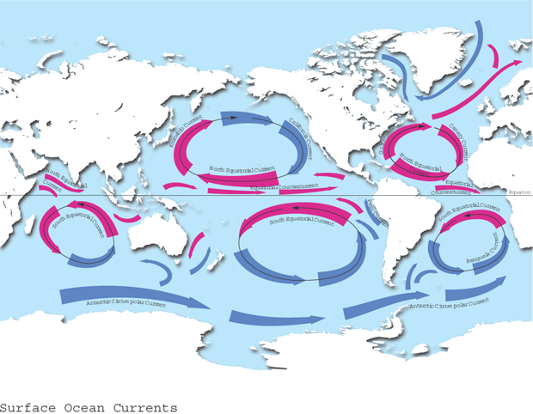
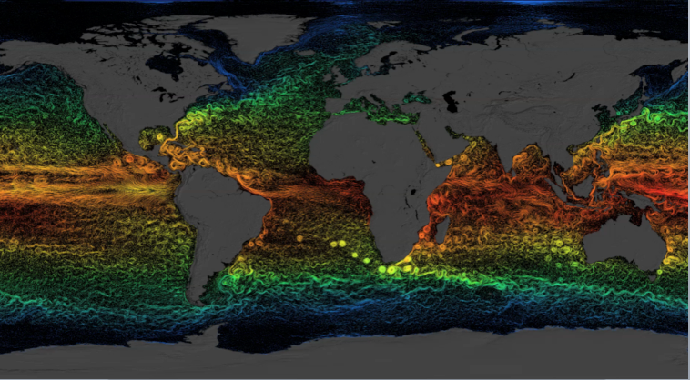
Ocean Circulation – From our college classrooms
What we teach: 5 ocean gyres
Data-Enhanced Learning Experiences
Include:
Students collect and interpret their own data, and/or
Explore research databases
Use data to answer questions
Can:
Prepare students to address real-world complex problems
Develop students’ ability to use scientific methods
Teach students how to critically evaluate data and evidence
Provide training in scientific, technical, quantitative & communication skils
Manduca & Mogk, 2002. Using Data in Undergraduate Classrooms. NSF-0127298.
What we miss: Energetic mesoscale

Slide 6
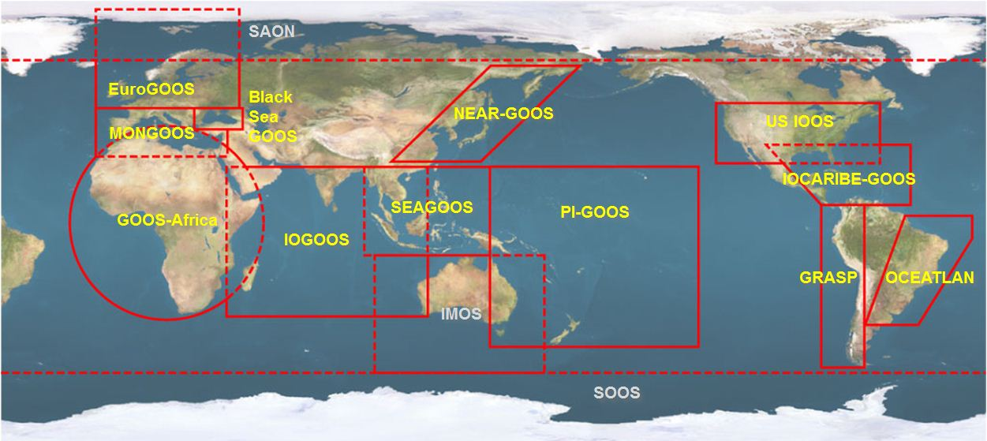





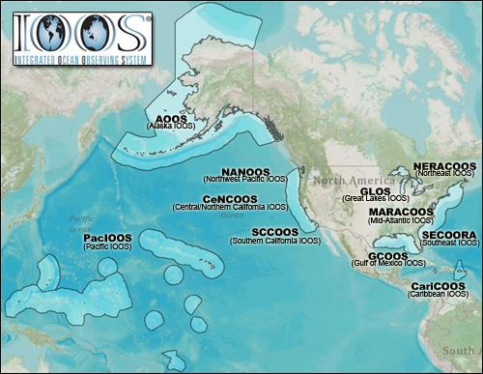


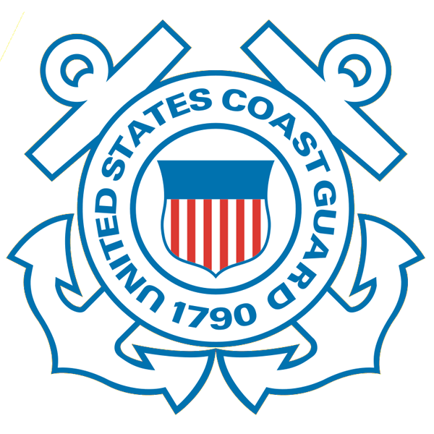









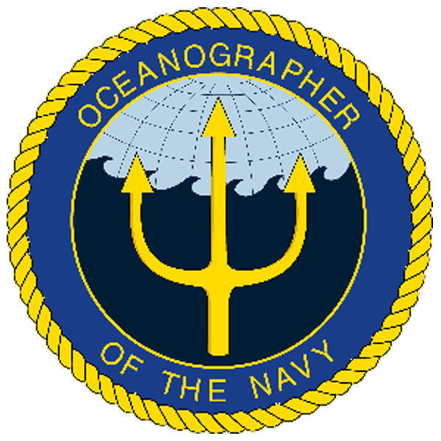
U.S. Integrated Ocean Observing System (IOOS)
Global Component
National Component
Regional Component
15 Regional Alliances in GOOS
Vessels -
Satellite
Satellite
CODAR
Ships/ Vessels
Glider
REMUS
Data Vis.
Modeling
Security
Leadership
Education
11 Regional Associations
17 U.S. Federal Agencies
http://ioos.gov

Slide 7
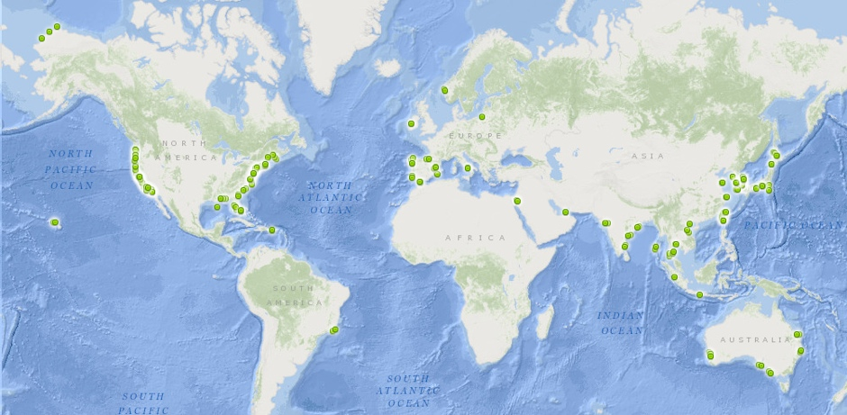
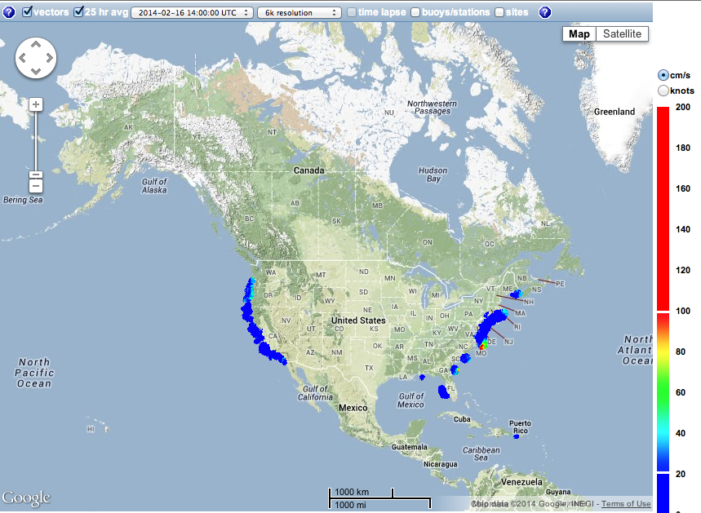
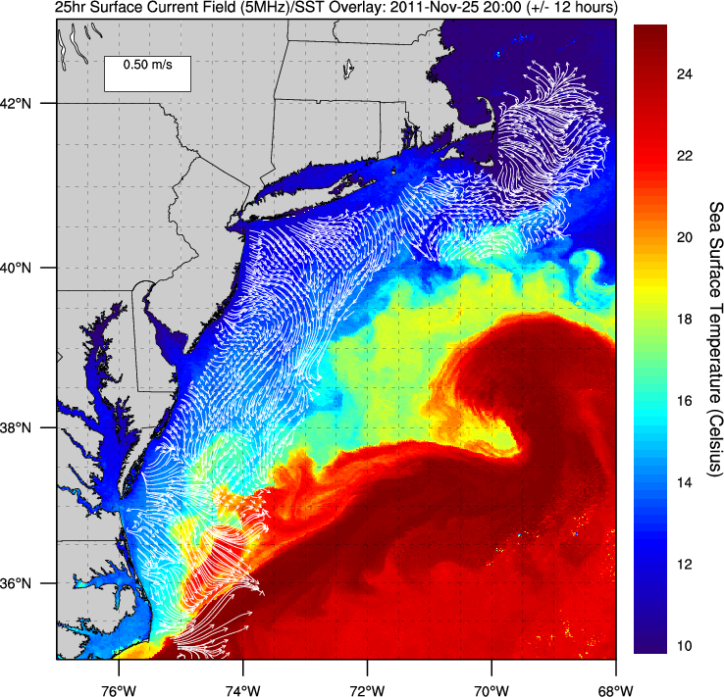
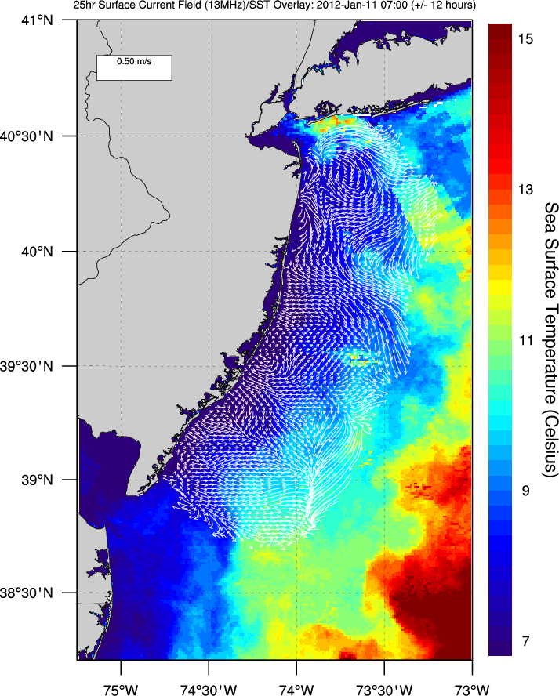
U.S. Integrated Ocean Observing System (IOOS)
Global Component
National Component
Regional Component
Positions
Global HF Radar Network
Vessels -
Satellite
Multistatic
Nested
Monostatic
Mid-Atlantic HF Radar Network
U.S. National HF Radar Network
http://ioos.gov

Slide 8
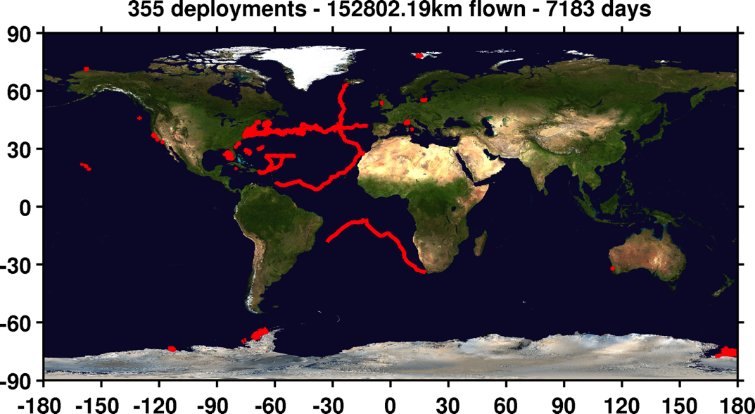
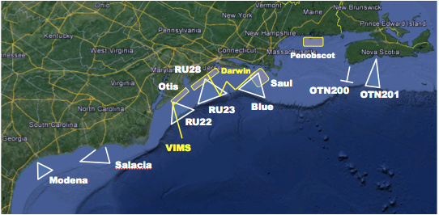
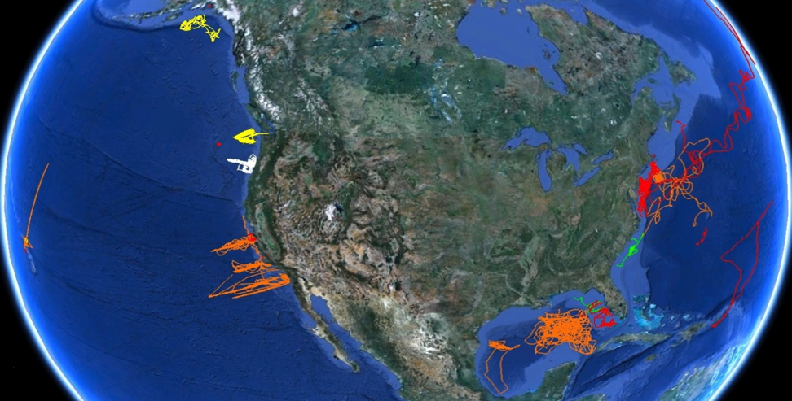
U.S. Integrated Ocean Observing System (IOOS)
Global Component
National Component
Regional Component
Vessels -
Satellite
Global Glider Networks
Multistatic
Nested
Mid-Atlantic Glider Network
U.S. National Glider Network
http://ioos.gov

Slide 9
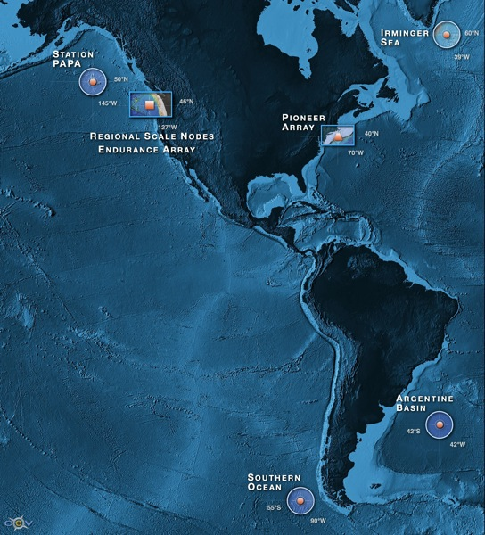


NSF Ocean Observing Initiative
Five Integrated Transformational Activities
High Latitude Global Sites
Regional Plate-scale Cable
Coastal Dynamics Arrays
Cyber-Space Data Delivery & Sensor Interactivity
Education and Public Engagement
9
Notes:
They are specific

Slide 10
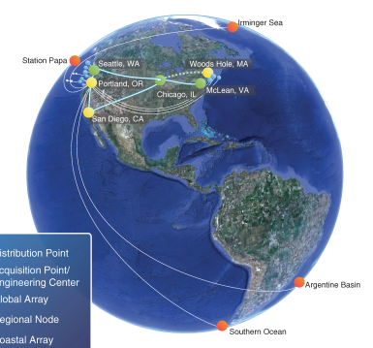
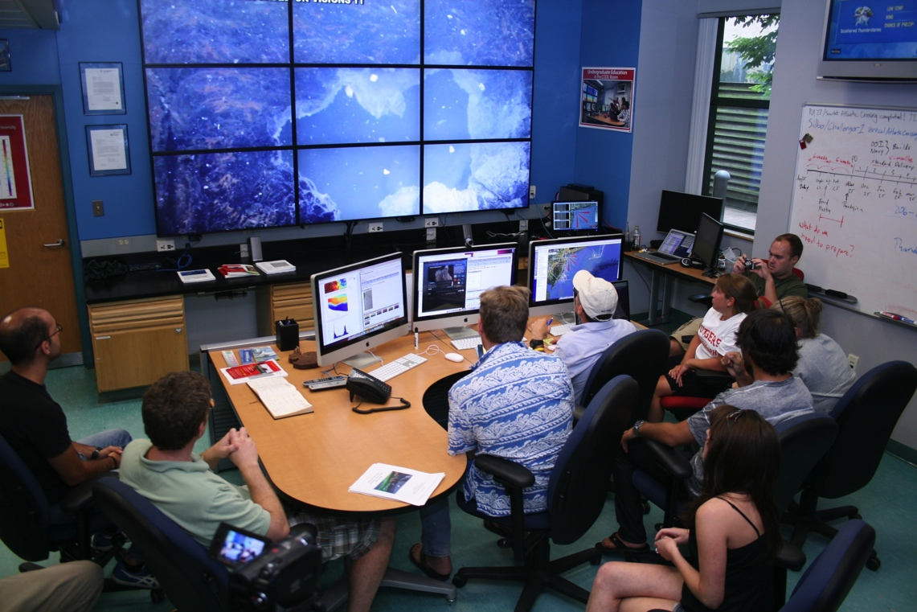
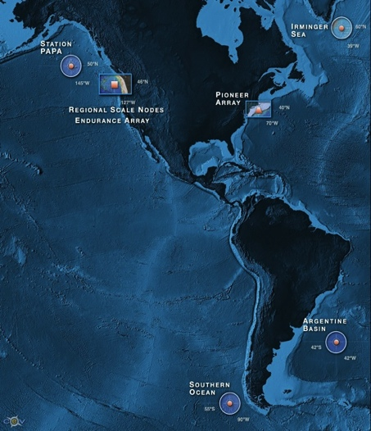


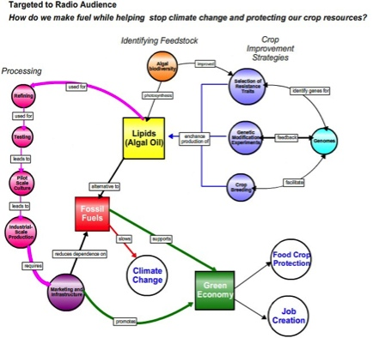
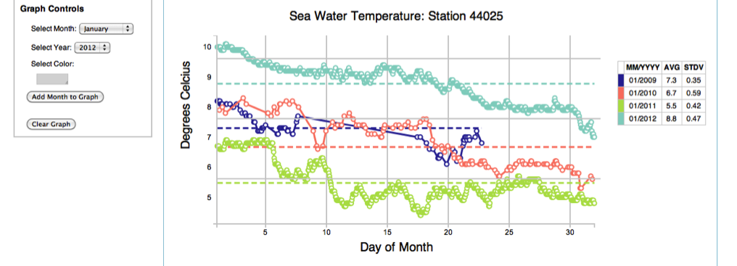
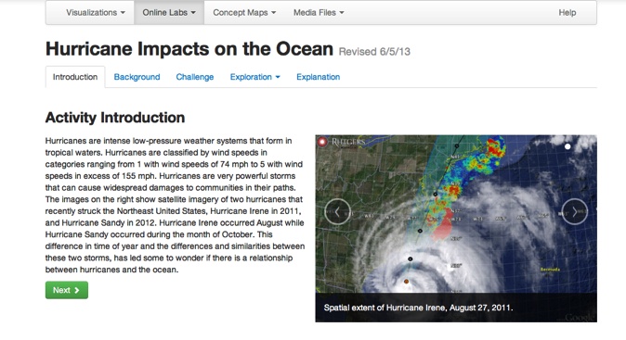
OOI – Enabling the Undergraduate Classroom
Concept Maps
Data Visualization Tools
Investigaton Builder

Slide 11

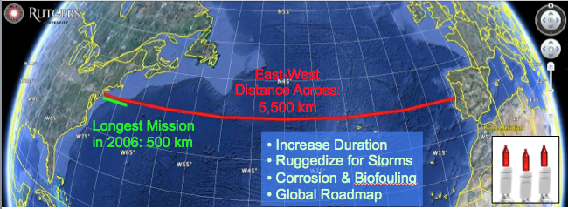
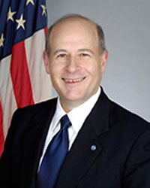

Trans-Atlantic Glider Challenge – May 24, 2006 –
UNESCO E.U./U.S. Baltic Sea Conference in Lithuania
Dr. Rick Spinrad
Assistant Administrator
NOAA
Office of Oceanic and Atmospheric Research
RU27: 7,400 km in 221 days
“I have something you need to do for the good of your country.”
“Take one of your gliders, modify it, and fly it across the Atlantic, inspiring students along the way.”

Slide 12
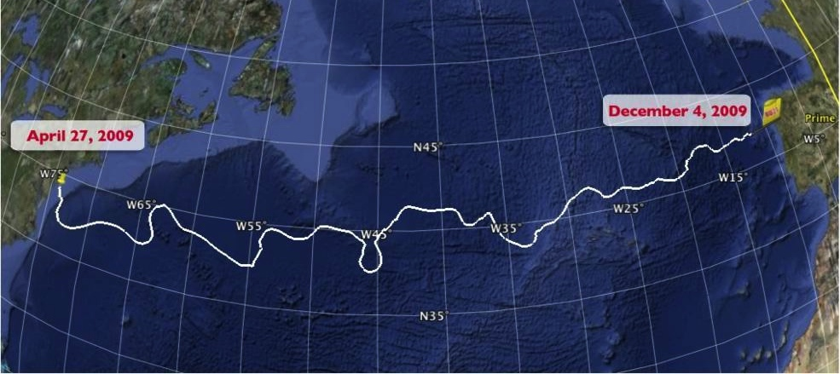
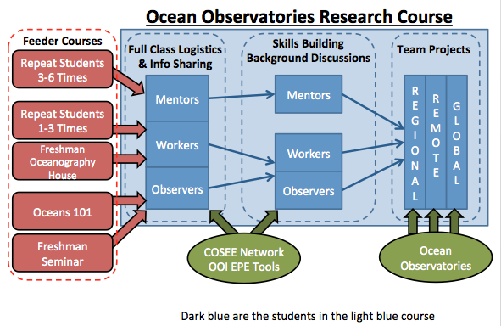
Trans-Atlantic Glider Challenge – May 24, 2006 –
UNESCO E.U./U.S. Baltic Sea Conference in Lithuania
Dr. Rick Spinrad
Assistant Administrator
NOAA
Office of Oceanic and Atmospheric Research
RU27: 7,400 km in 221 days
RU27: 7,400 km in 221 days
“I have something you need to do for the good of your country.”
“Take one of your gliders, modify it, and fly it across the Atlantic, inspiring students along the way.”

Slide 13
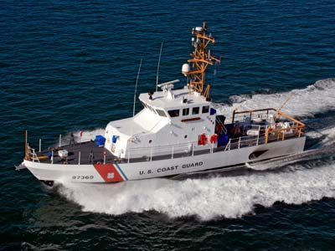
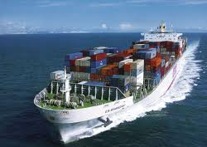
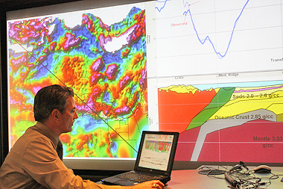
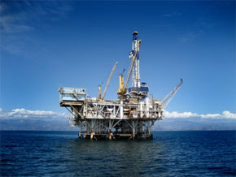
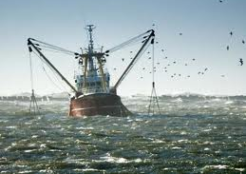
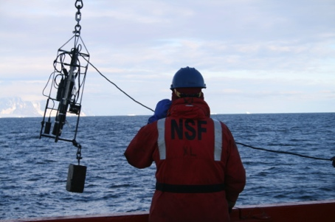
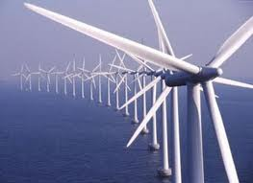
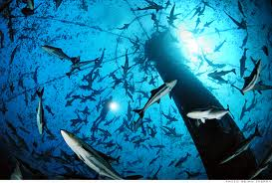
Needs Assessment
- Example: How should universities educate the future ocean workforce?
COSEE: Assessment of Marine related jobs
Graduate Programs: need strong science/math backgrounds, and increasingly look for research experience.
Federal Agencies: Also needs Bachelors & Masters graduates. Not just Ph.D. Researchers.
Companies: seeking people with a range of technical
abilities and Team Working Skills. Not just Ph.D. Researchers.
Nationally in 2007, only 4000 (0.3% of the 1,542,000) Bachelors Degrees were in Earth/Ocean/Atmospheric Sciences.
Need to increase STEM interest within a diverse K-12 pipeline.
Provide Undergrads real-world working-team experience.
Cognitive Apprenticeship.
Strong written and verbal communication skills emphasized by employers
Cross-disciplinary training highly desired (Oceanography combined with other disciplines Atmospheric Science, Computer Science, Engineering, Economics, Communication)
Workforce of future industries

Slide 14
Formative Assessment –
Continuous Re-evaluation and Redesign of Undergraduate Curriculum
Theory Courses
Feeder Courses
Marine
Ecosystem
Dynamics
Urban
Estuaries
Graduate Intro to
PO, BO, CO or GS
Oceanography
101
Courses
Skills Courses
Freshman
Seminars
Ocean Methods &
Data Analysis
Communicating
Ocean Science
Oceanography
House – Learning Community
Team-based Research Apprenticeships
Ocean Observatories Research Course –
a) Regional, b) Remote, c) Global
Independent Research
Summer
Internships
Senior
Thesis
2-Way International Exchange

Slide 15
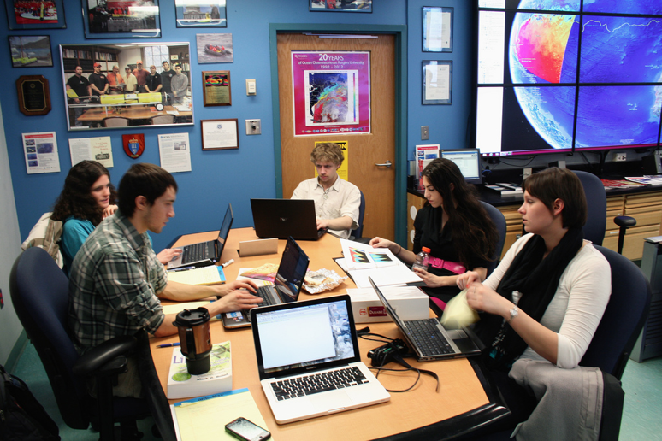
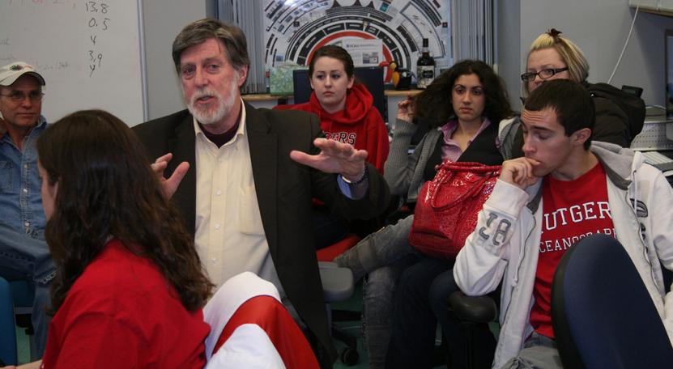
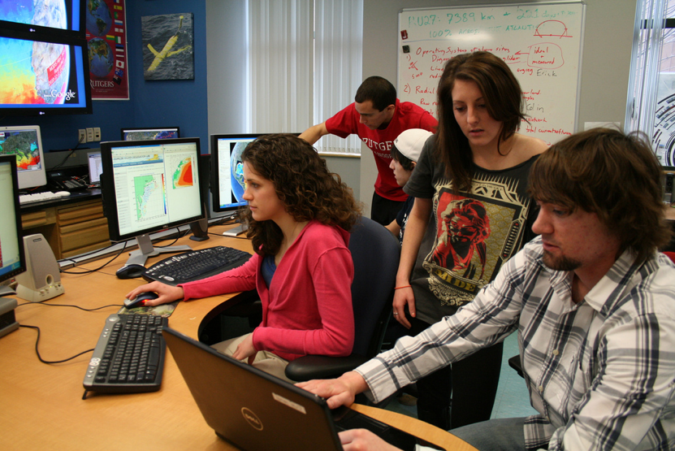
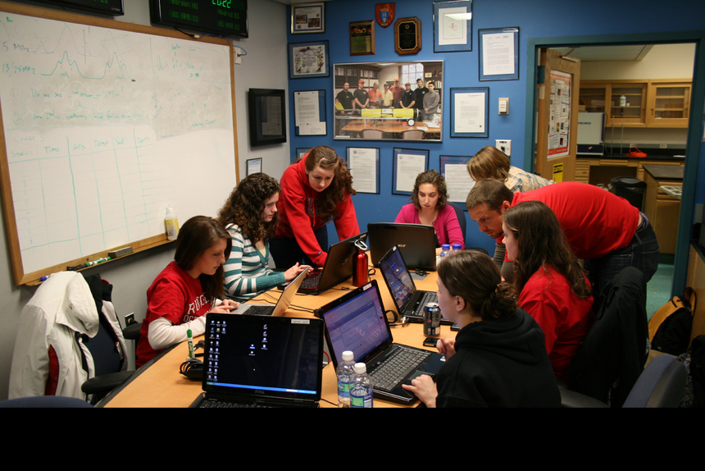
Team-Based Research Projects
Course Mechanics:
Marine Science Major requires 6 credits of Research.
Ocean Observatories course is 1.5 credits –one 80-minute class period per week.
Students can sign up multiple times.
What we (the teachers) do:
1) Mentorship Model – Cognitive Apprenticeship – Experiential
Watch One -> Do One -> Teach One
(Observer -> Worker -> Mentor)
2) Grand Challenges can only be achieved through sustained teamwork – research now bridges semesters and summers.
3) We do not fear failure – Undergraduate Education is a time for exploration and risk-taking.
What the students do:
Divide into research teams led by a mentor (teach one), and consisting of a few workers (do one) and a few observers (watch one).
Propose and conduct a team research project based on ocean observatory data.
Communicate results through blogs and presentations.

Slide 16
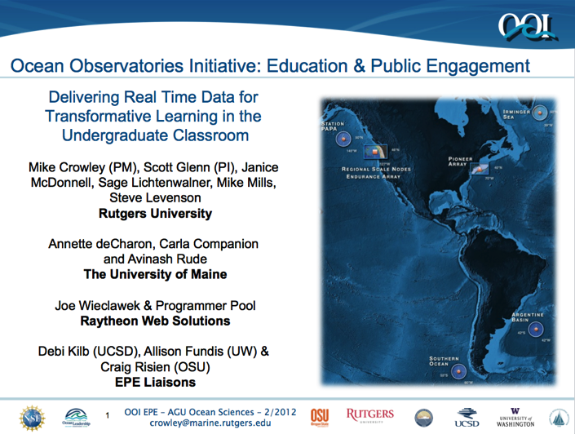
Barriers Encountered,
and
Ocean Observing Initiative (OOI)
Education and Public Engagement (EPE)
Tools to Respond
1) Barrier: Data Visualization – The Ability to Create New Knowledge.
All Groups actively & effectively use Google Earth for horizontal mapping.
All Groups reported frustration with Matlab for data analysis and visualization.
OOI EPE Tool: Data Visualization Services – Developed to specifically enable undergraduates to explore OOI datasets and create new knowledge.
2) Barrier: Team Organization – Providing the structure to organize a team research project.
OOI EPE Tool: Concept Mapper – Being used in class to organize research concepts and the people working on them.
3) Barrier: Course Organization – Providing a flexible structure to organize and share course activities, background material, and feedback.
OOI EPE Tool: Investigation Builder – Will be used to organize across team projects both locally and with companion courses taught elsewhere.

Slide 17


Summative Assessment – Did we have an impact?
Increase in Number & Scope of Research Internships
Locations: Australia, Antarctica, Svalbard, Spain, Canaries, Azores, California, Florida, New Jersey
Sponsors: NSF, DHS, Alumni
Trans-Atlantic Glider Challenge
Spring 2012 Course: >70 Students
Number of Marine Science Majors

Slide 18

Summative Assessment – Did we have an impact?
Trans-Atlantic Glider Challenge
Spring 2012 Course: >70 Students
Marine Technology Journal

Slide 19





A Global Challenge – The Challenger Glider Mission
December 9, 2009 – Baiona, Spain
Ralph Rayner & Rick Spinrad’s Global Challenge:
Build a Global Glider Fleet
and Coordinate the First
Robotic Circumnavigation.
Revisit the Historic Track of the
HMS Challenger –
And inspire a global network
of students along the way.
HMS Challenger Voyage
First Scientific
Circumnavigation
1872-1876
128,000 km =
= 16 gliders
x 8,000 km/glider

Slide 20

For Our Students:
Ocean Observatories Expanding
Cyber-enabled Ocean Science
The Ocean is Your Classroom
“Work Hard, Have Fun,
Change the World”
- Doug Webb’s advice to students,
Baiona, Spain, 8 Dec 2009.

