Slide 1
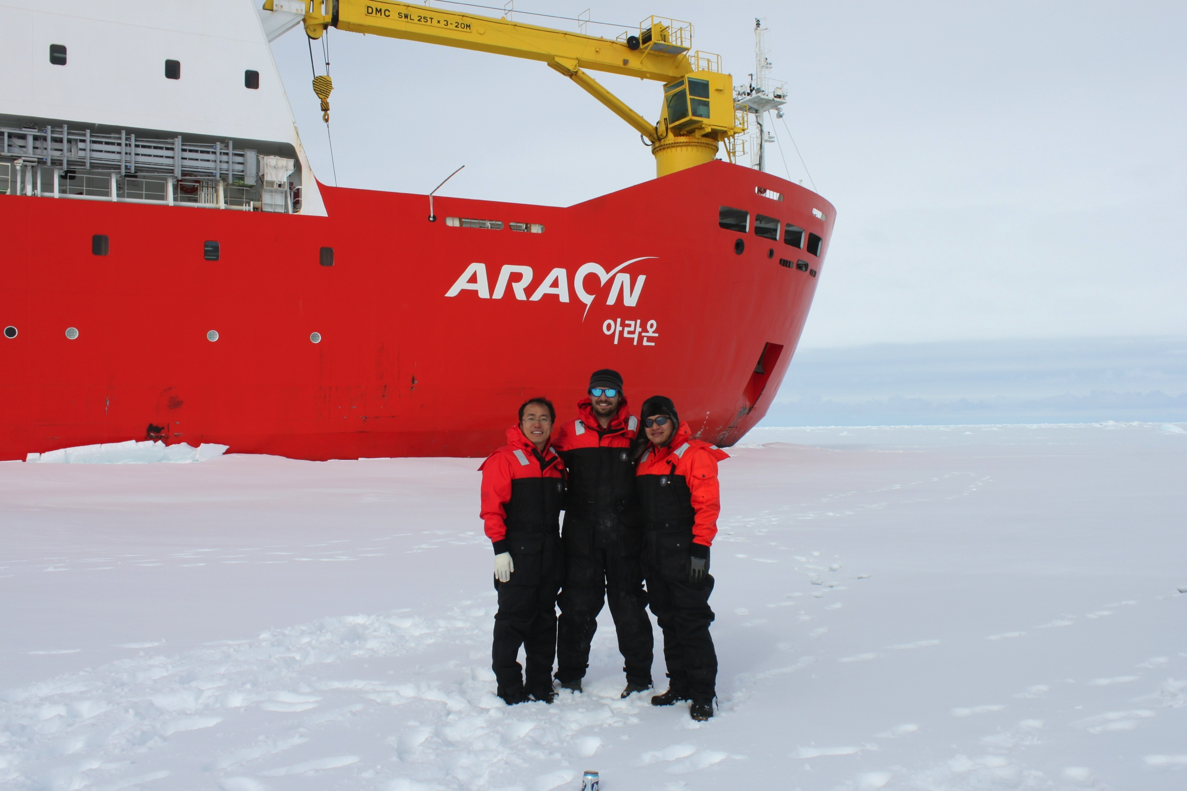
Korea-U.S. Collaborations in Ocean Observing to Improve Environmental Forecasting
San Hoon Lee, Ho Kyung Ha, Tae Wan Kim, Doshik Hahm, Jisoo Park, KOPRI
Hak Soo Lim, KIOST
Sang-Ho Lee, KNU
Byoung-Jui Choi, KNU
Jung Sik Han, KHOA
Kwang Nam Han, KHOA
Sik Huh, KIOST
Scott Glenn,
Oscar Schofield,
Josh Kohut &
Hugh Roarty
Rutgers University

Slide 2
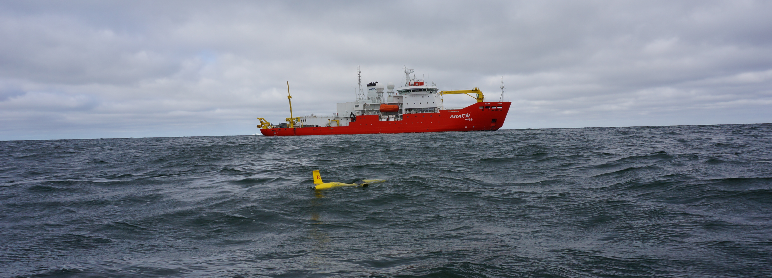
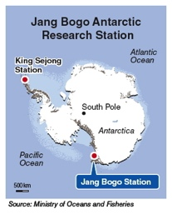
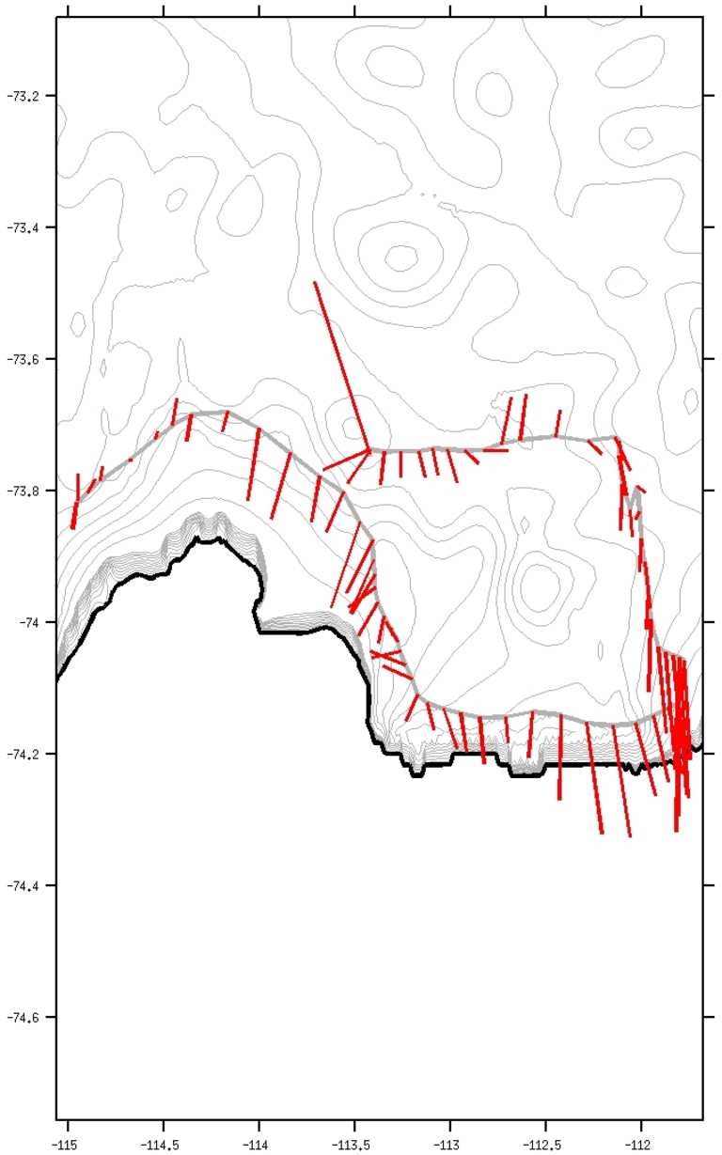
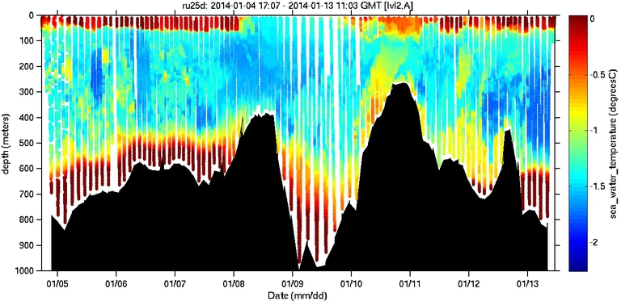
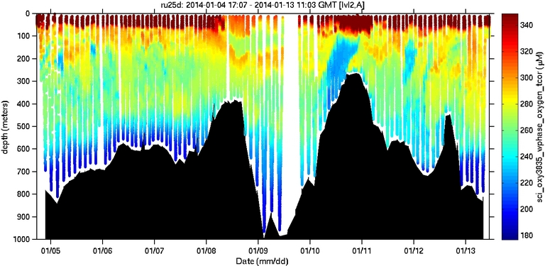
Rutgers Glider Deployment from Korea’s Araon
2013-2014, Amundsen Sea, Antarctica
2 Gliders deployed
1/4/14 to 1/13/14
421 kilometers flown
Measurements of:
Temperature
Salinity
Depth-averaged current
Chlorophyll fluorescence
CDOM fluorescence
Optical backscatter
Fast Repetition Fluorescence
Temperature
Depth-averaged
Current
Oxygen

Slide 3
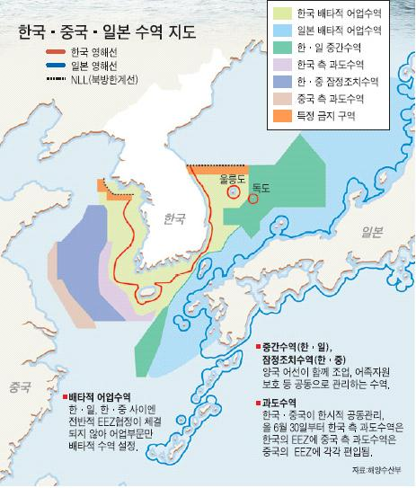
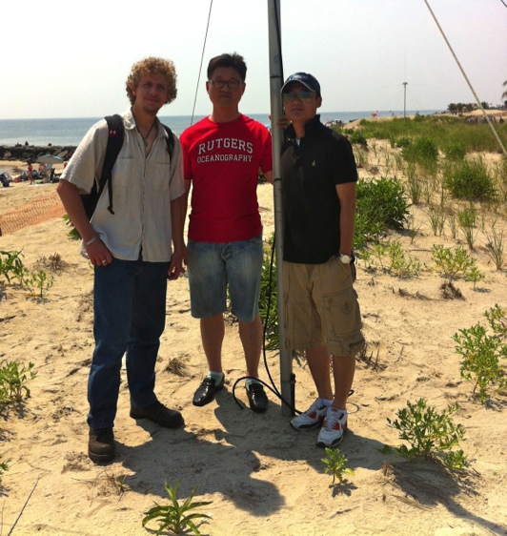
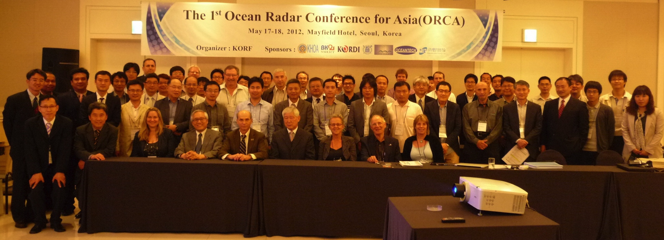
Korea & United States HF Radar Collaboration

Slide 4
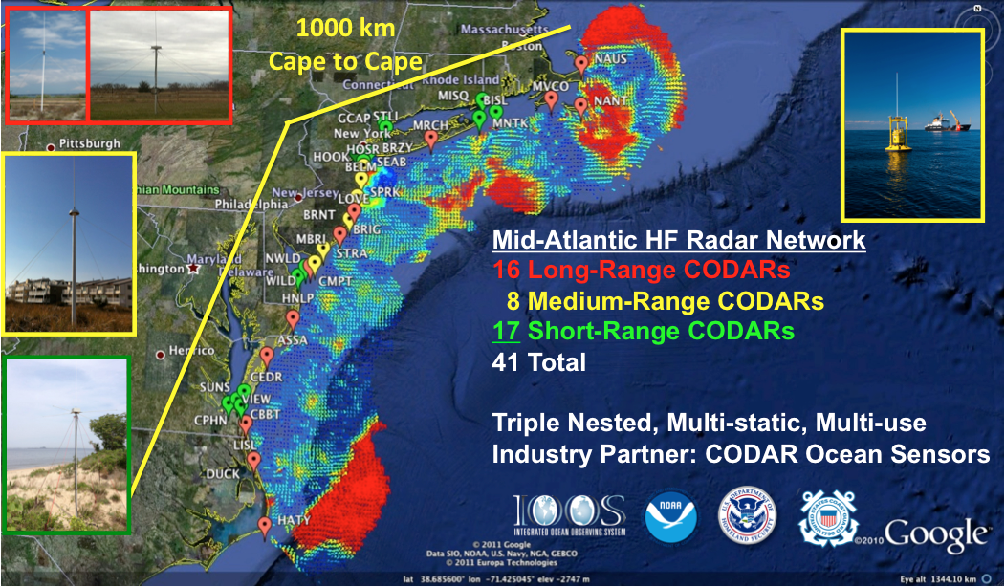
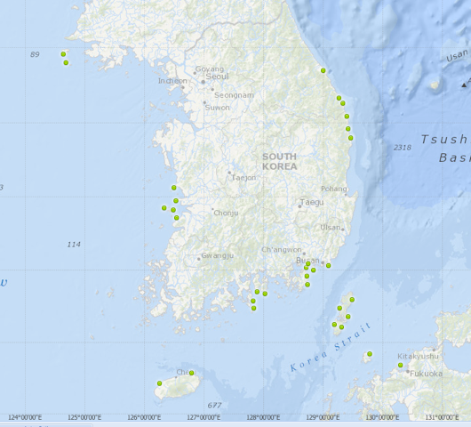
U.S. & Korea
National HF Radar Networks –
World’s largest networks
MAB & Korea similar in scale
U.S. - Korea
Collaborations in:
Network Operations
Data Quality Control
Product Development
Science
1000 km

Slide 5
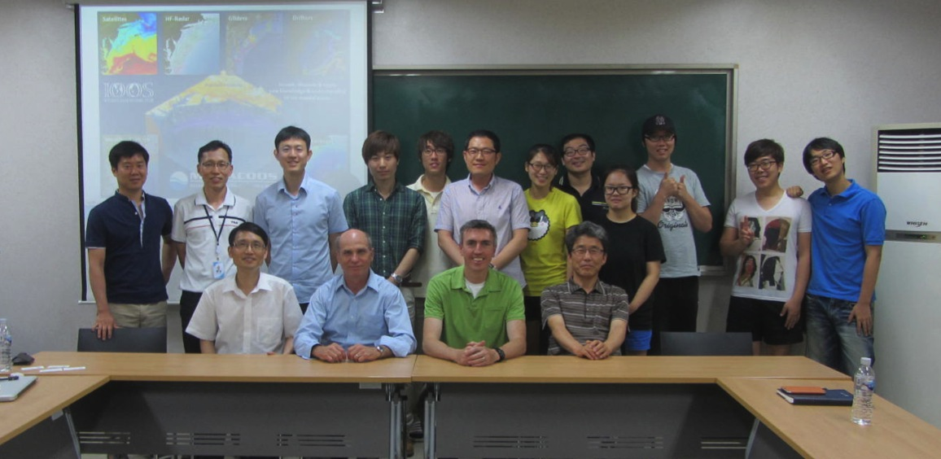
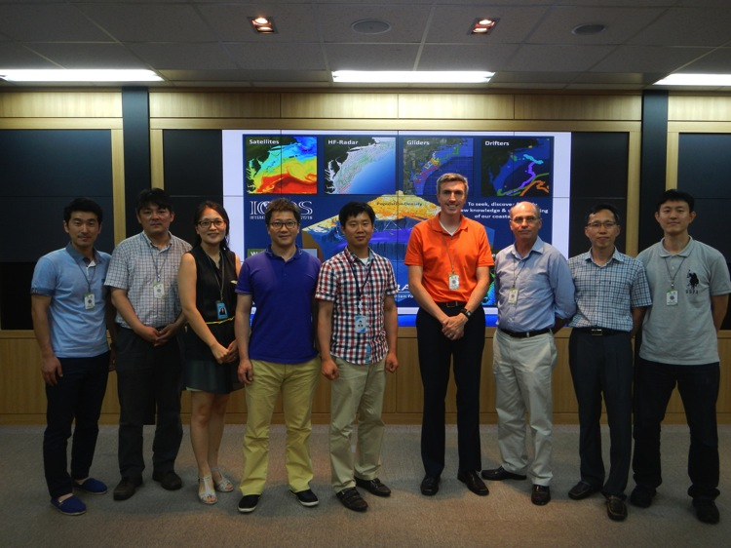
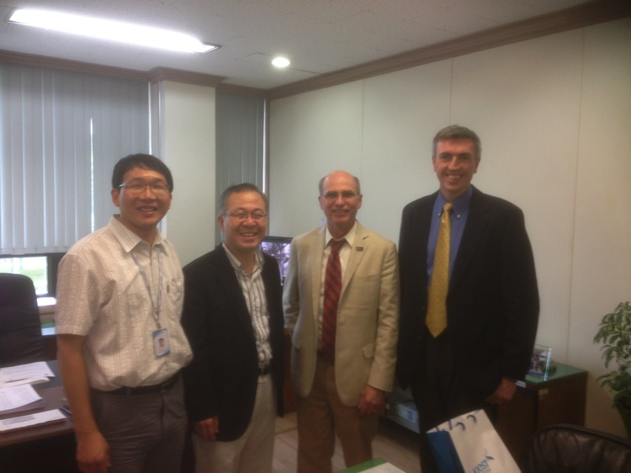
Rutgers visit to Korea HF Radar Centers

Slide 6
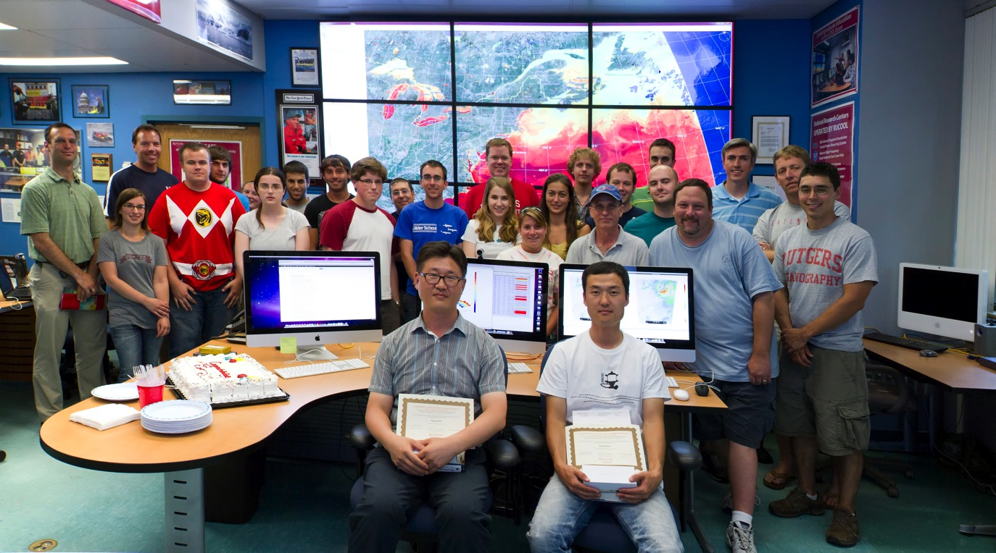
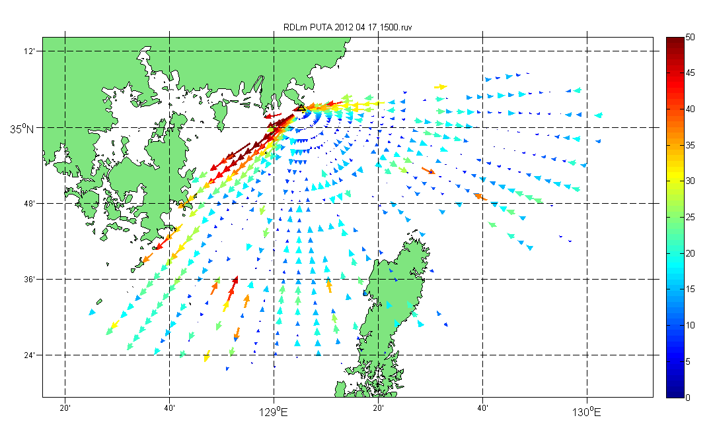
Korea & United States HF Radar Collaboration
2012

Slide 7
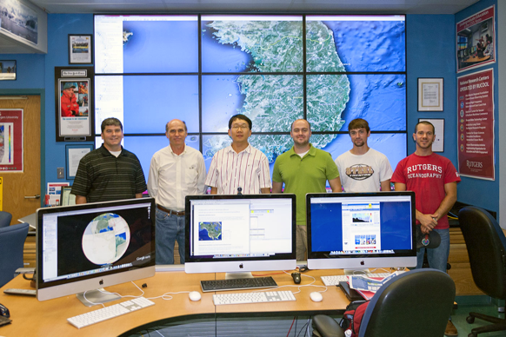
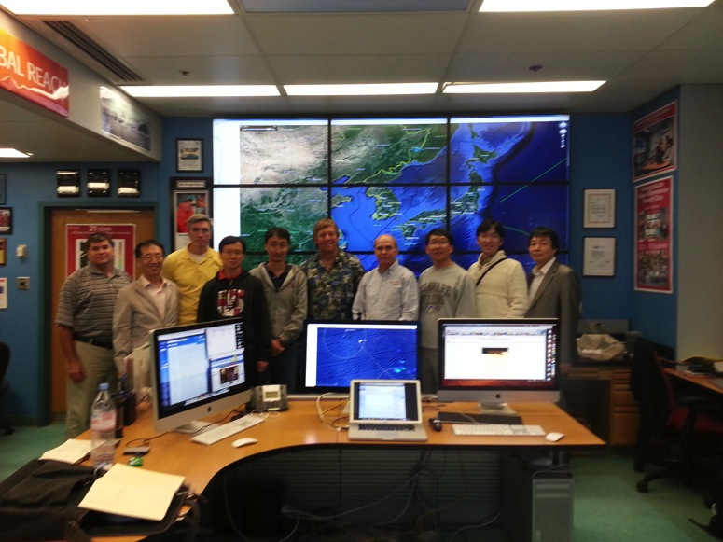
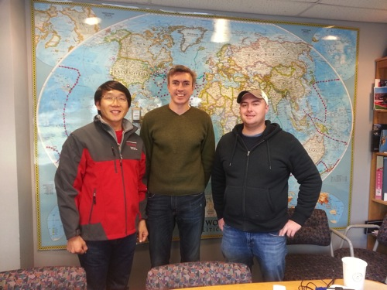
Korea & United States HF Radar Collaboration
2012
2013
2013
Korean Visits to Rutgers

Slide 8
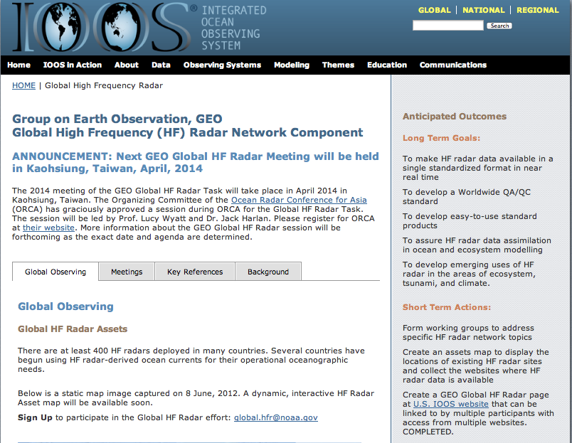
Next Steps for Korea-U.S. HFR Collaboration - 2015
3rd GEO Global HF Radar Meeting, Kaohsiung, Taiwan

Slide 9
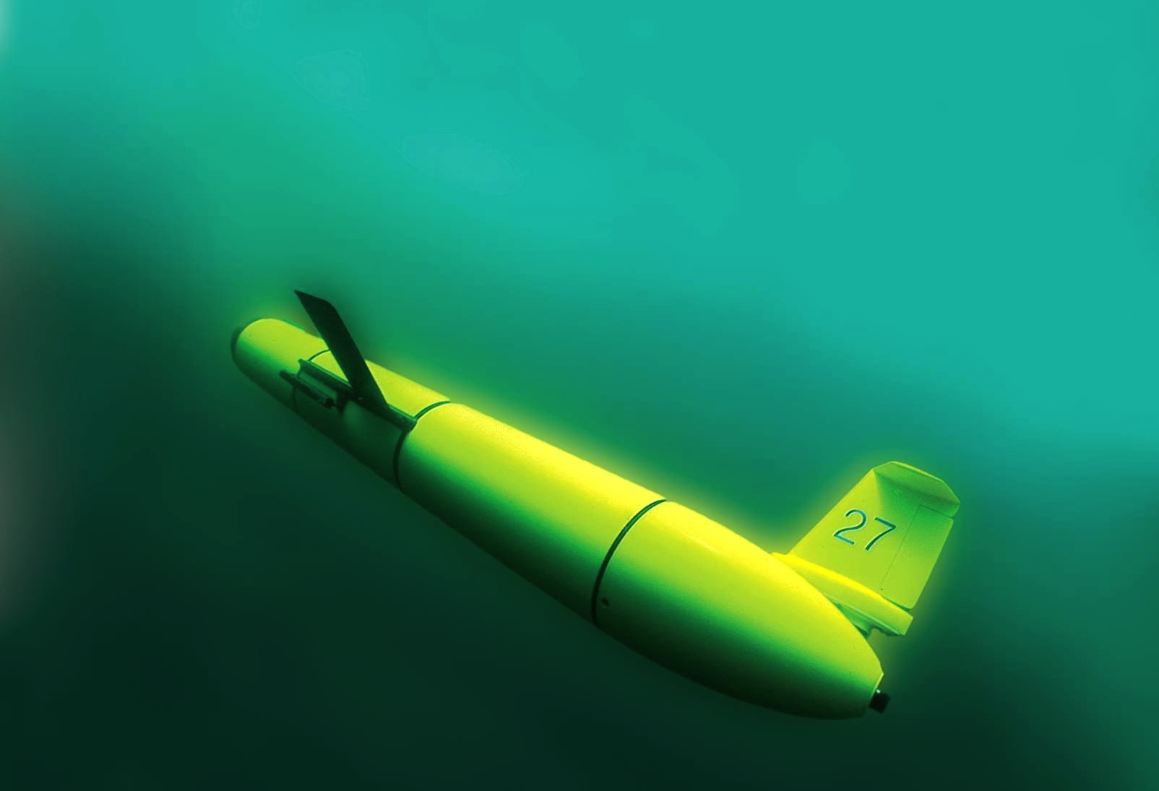
The Challenger Glider Mission:
Enhancing Korea’s Global Autonomous Underwater Glider Fleet
Scott Glenn,
Oscar Schofield &
Josh Kohut
Rutgers University
Dr. Sik Huh
KIOST-NOAA Lab
NOAA-MOF JPA 2014

Slide 10
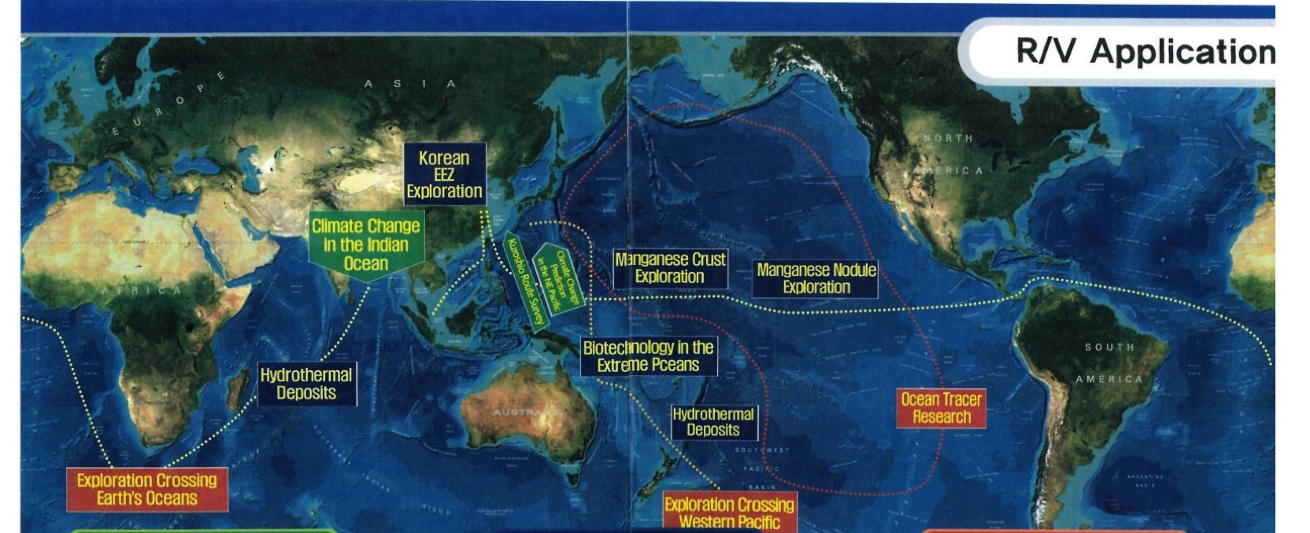
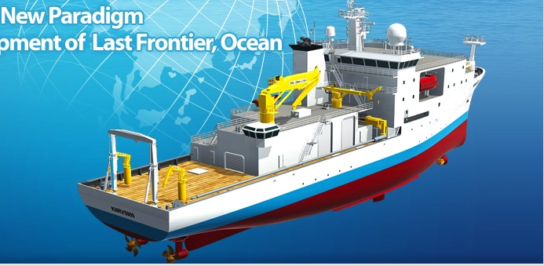
Global KNRV5000 Mission

Slide 11
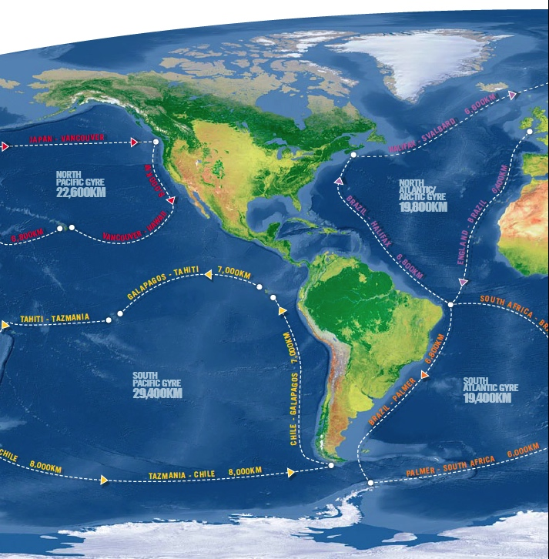
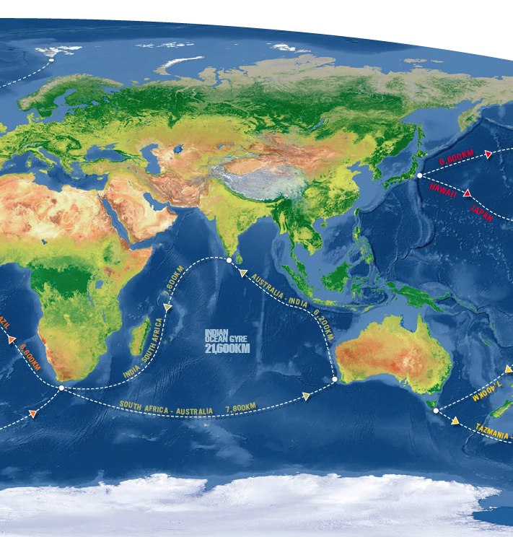
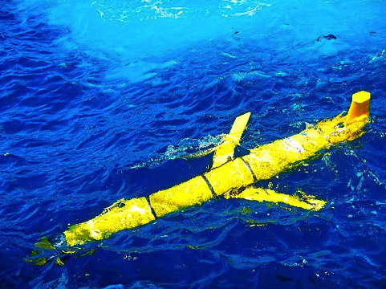
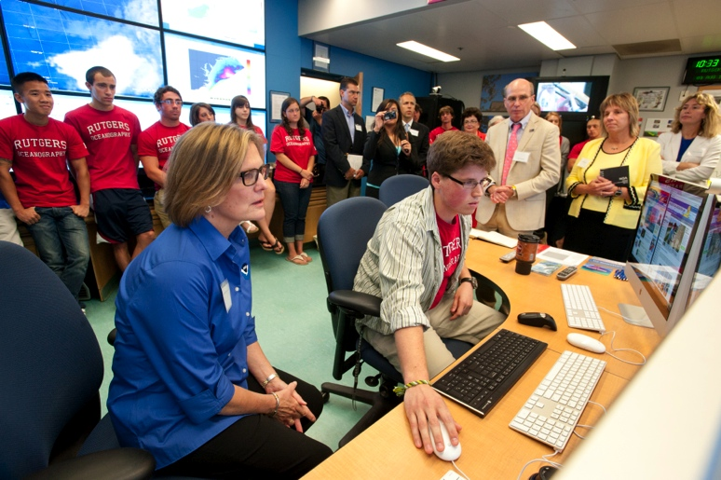
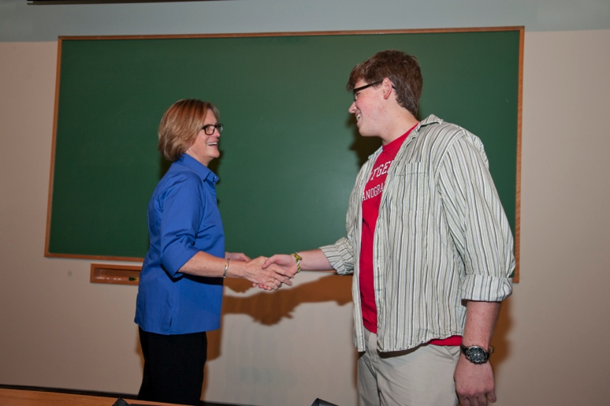
Global Challenger Glider Mission
16 Global-Class Gliders

Slide 12
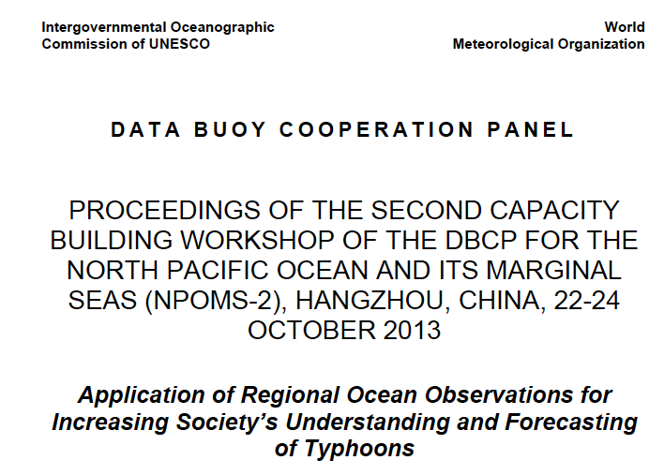
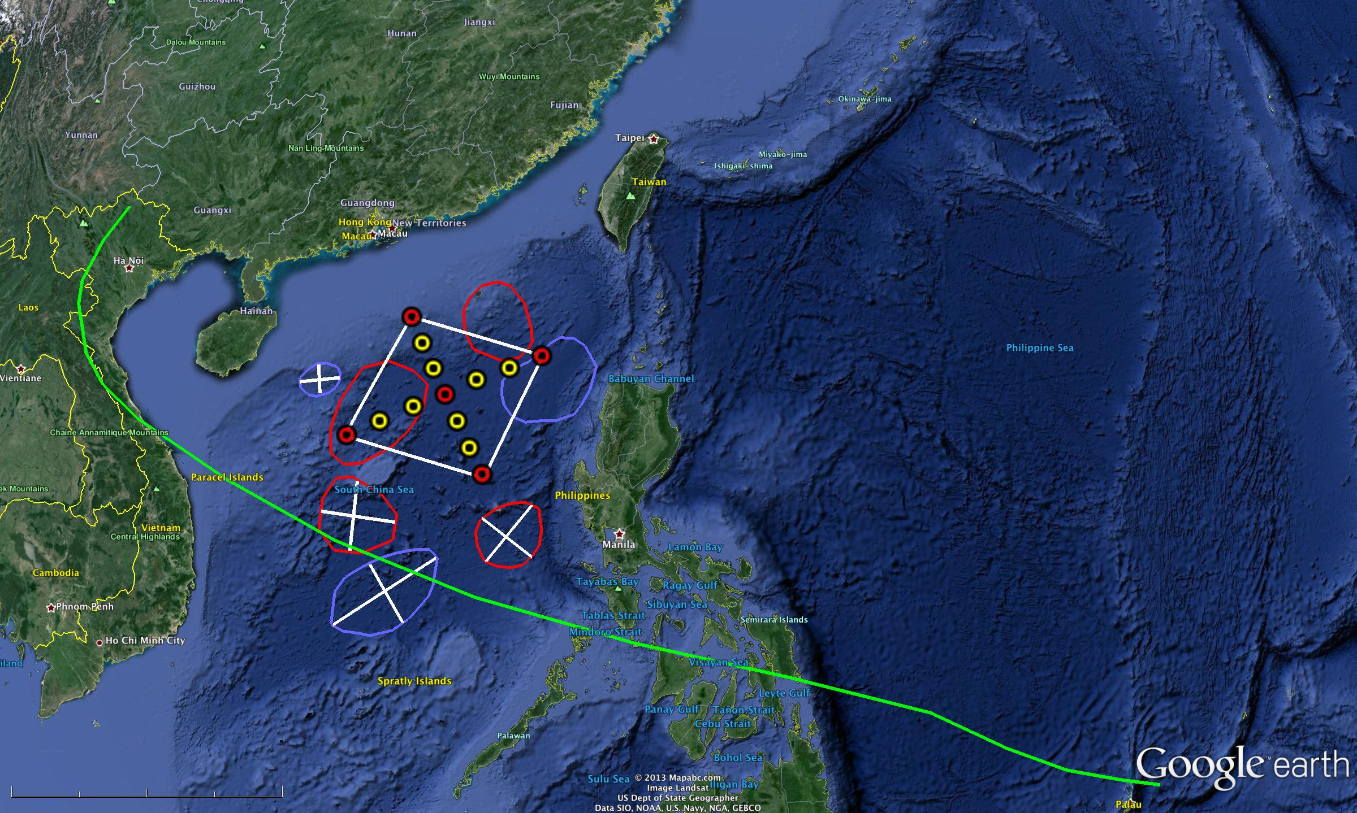
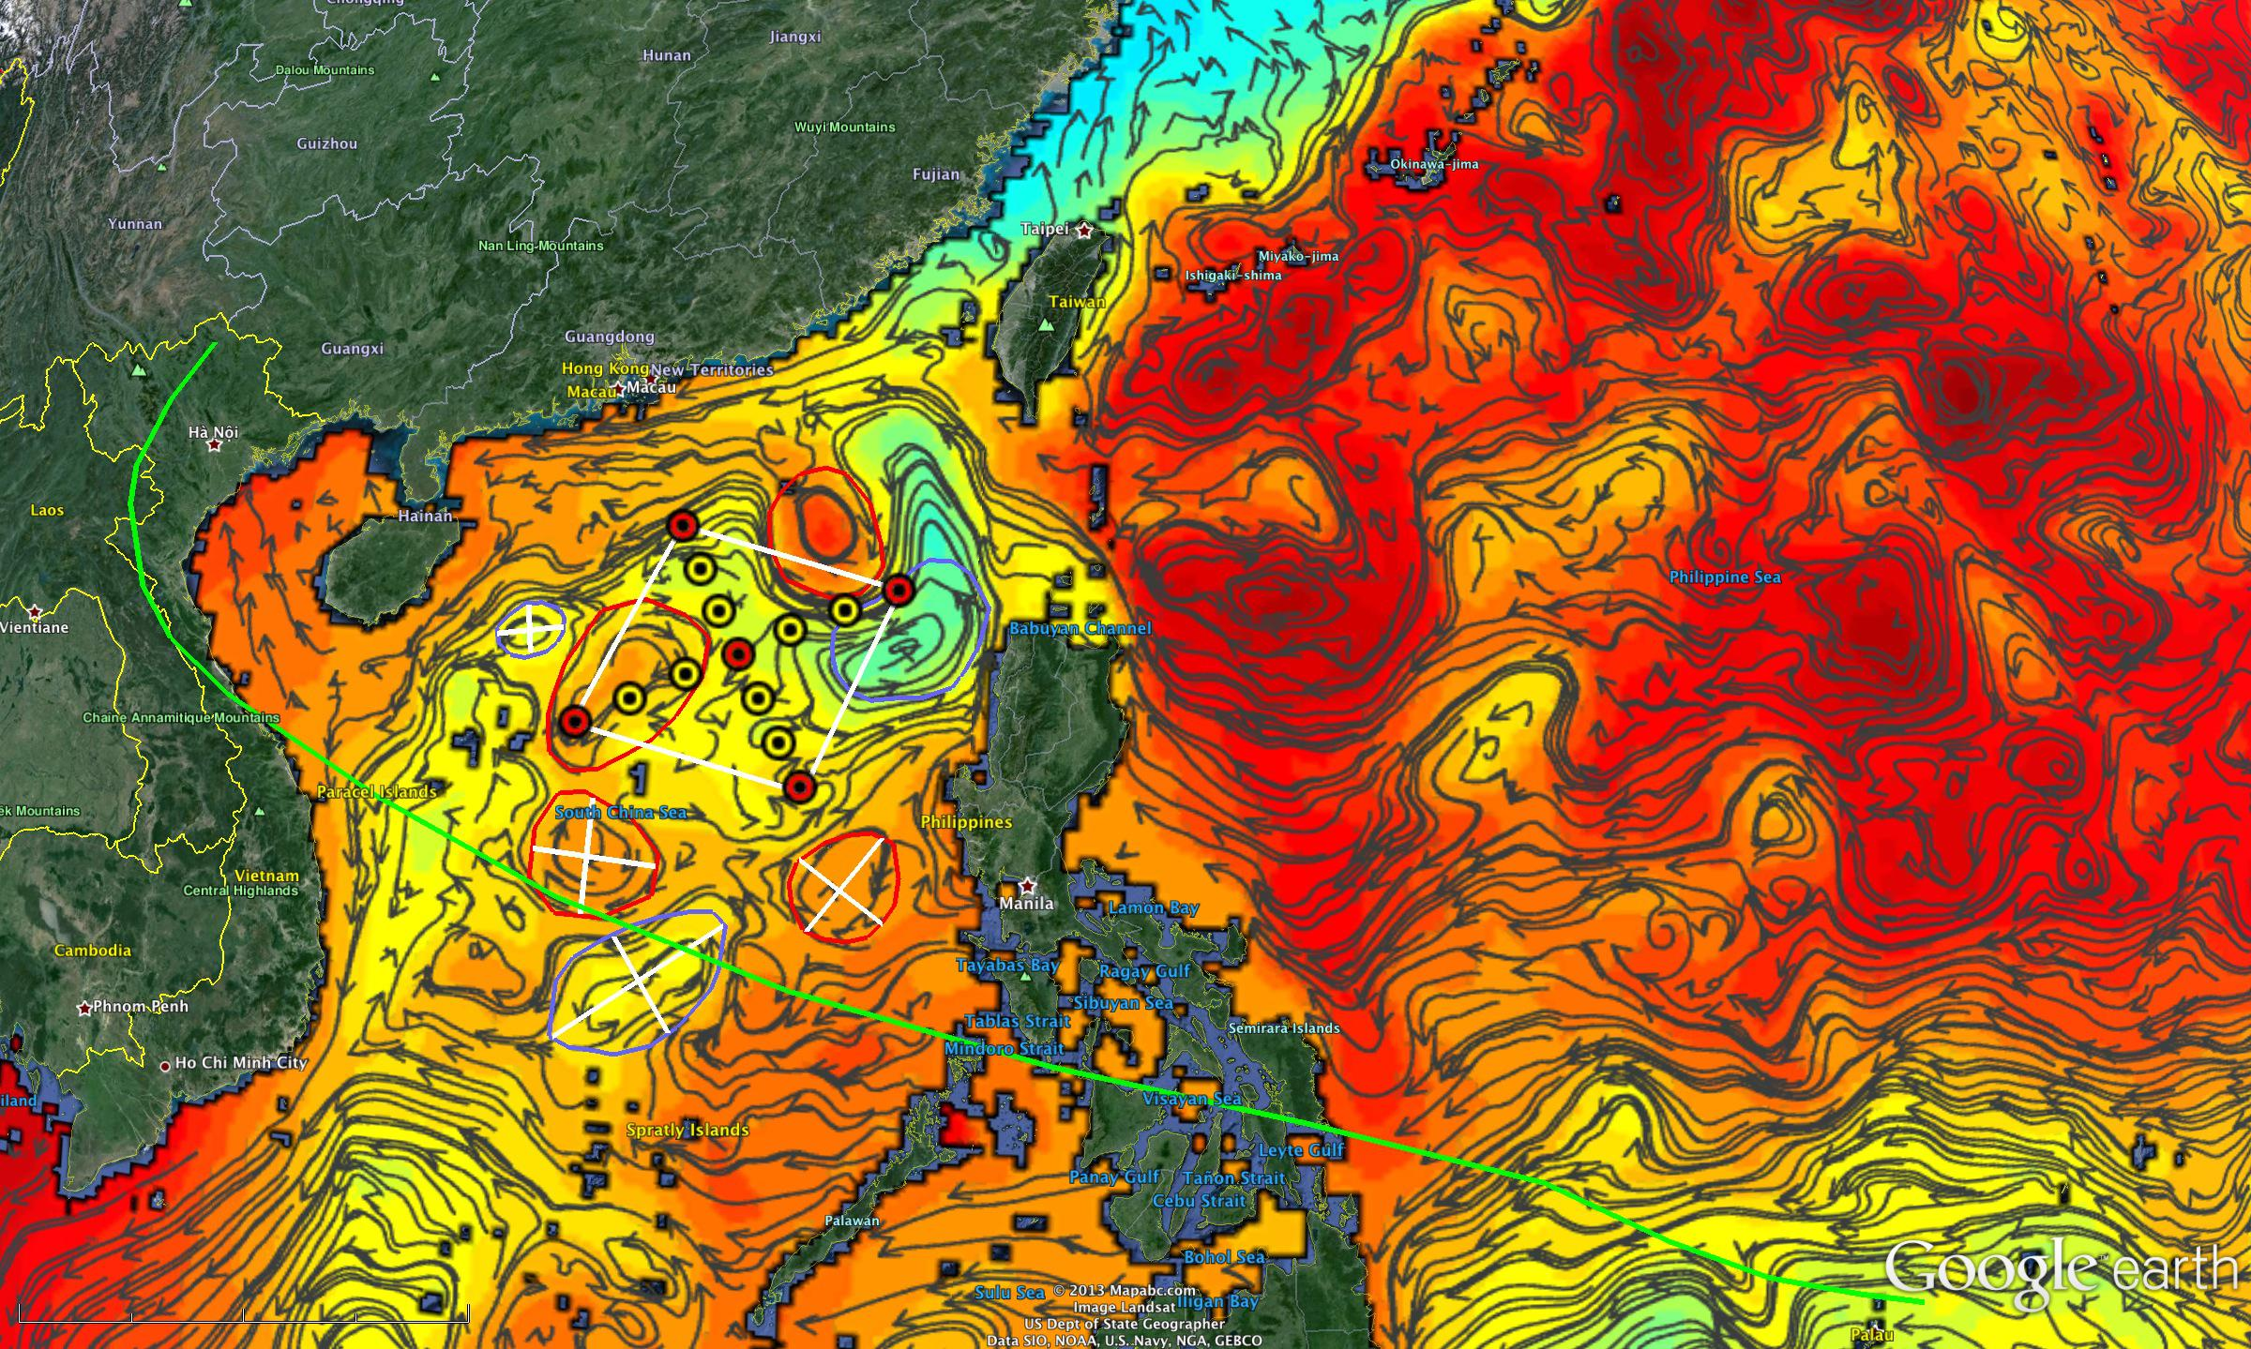
2013 International Typhoon Workshop
Dr. Louis Uccellini, Director
National Weather Service
Crowd-sourced comparisons between
U.S. & European Models & Gliders

Slide 13
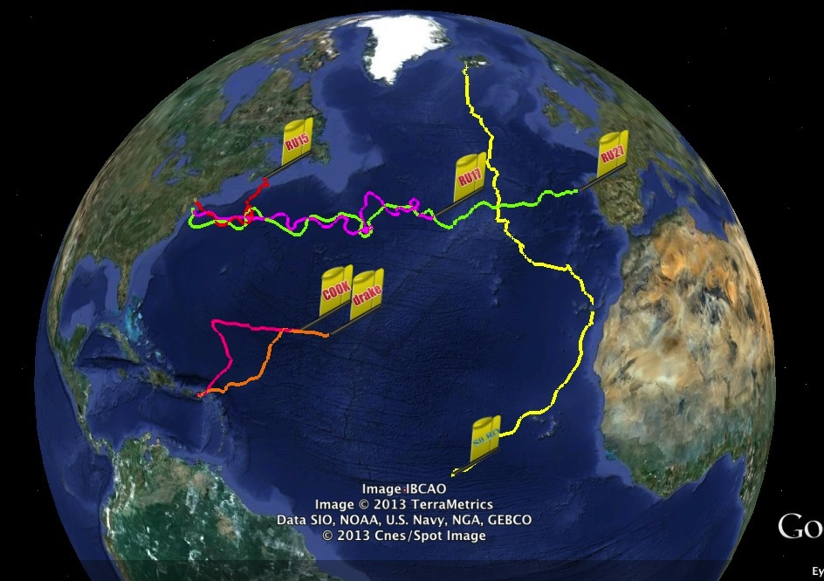
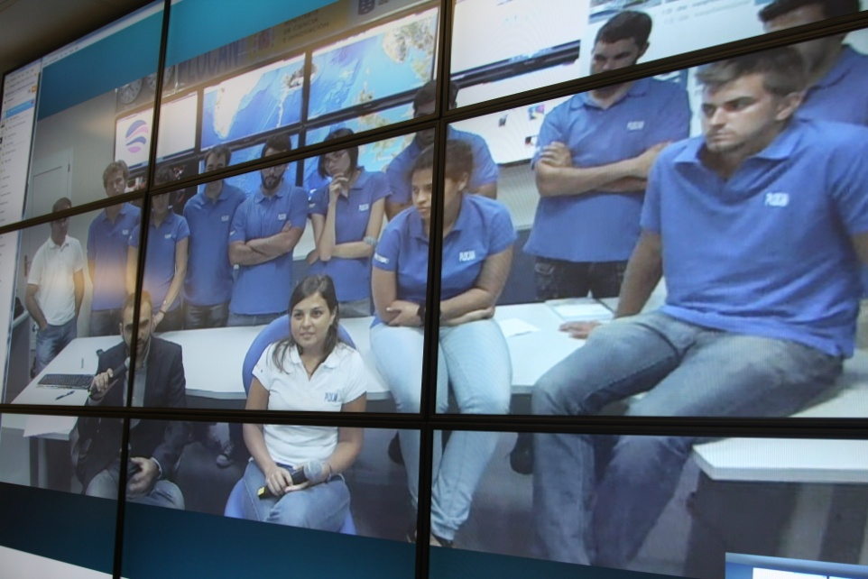
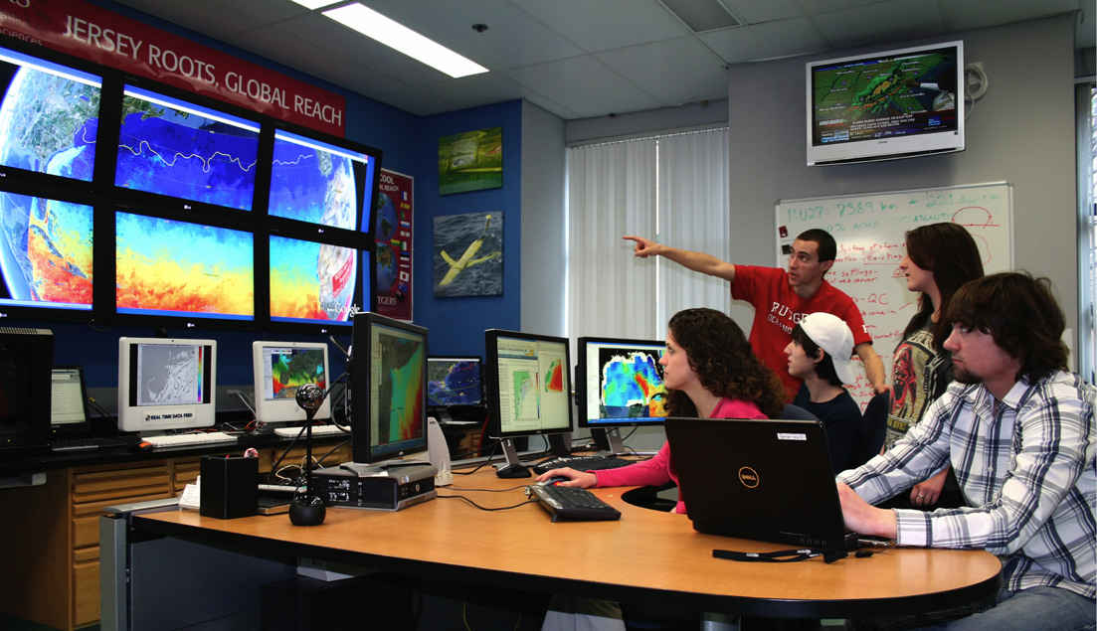
Companion Course at
Plataforma Oceanica de Canarias
Shared Glider Missions – Iceland to Azores; Azores to Canaries; Canaries to Caribbean
Skype Sessions between classes
Two-way International Exchange programs
Students Learn Science from their teachers
Students Learn Culture from their peers

Slide 14
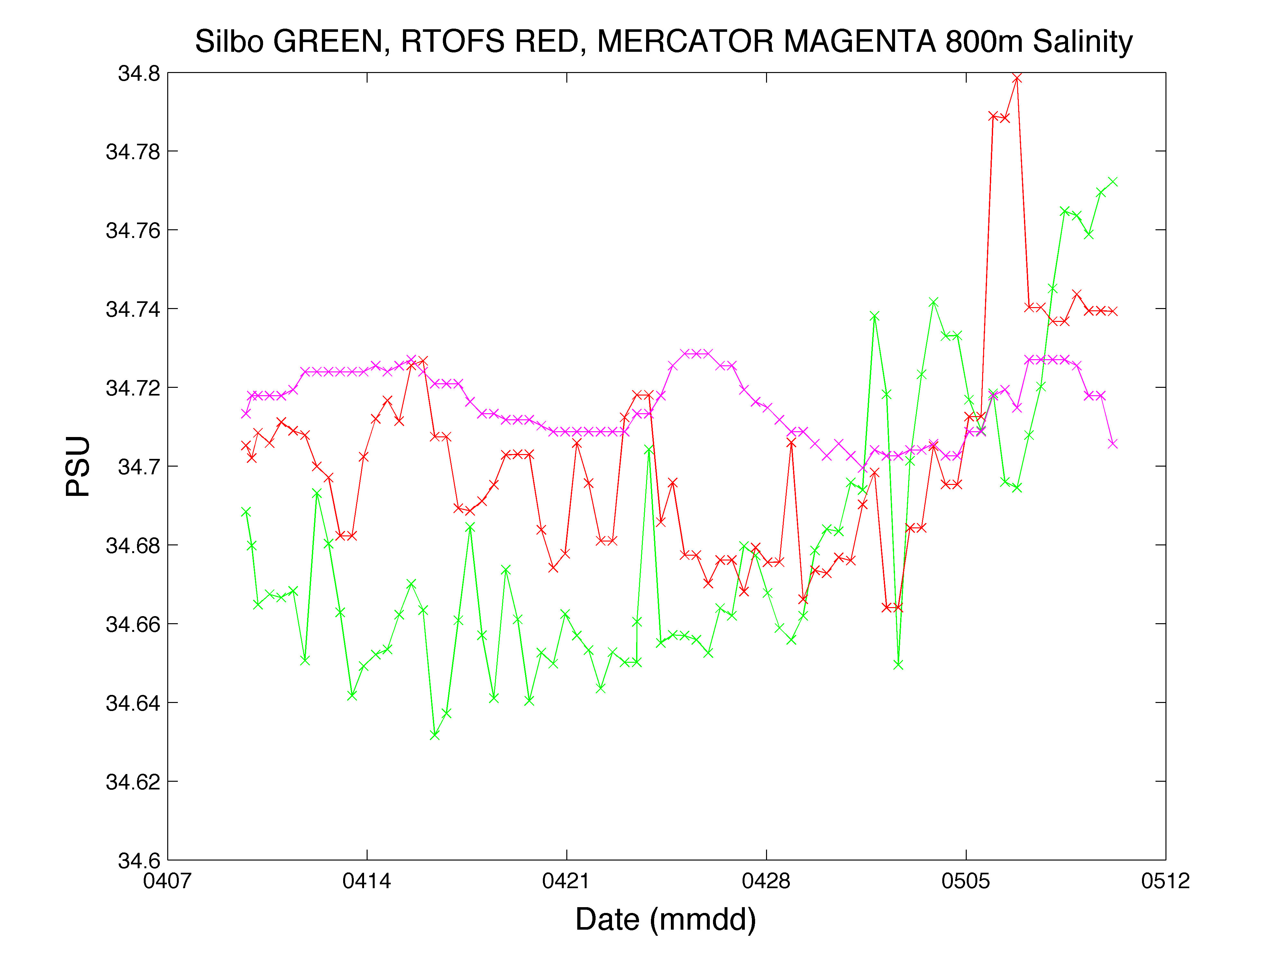
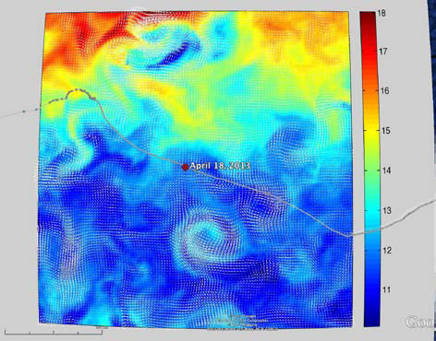
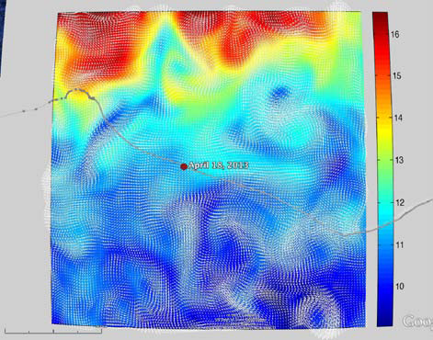
RTOFS and MERCATOR
Temperature and Current Maps at 200 m
200m temperature and currents on April 18th, 2013. The glider position is marked by the red dot.
RTOFS
200 m
800 m
MERCATOR

Slide 15
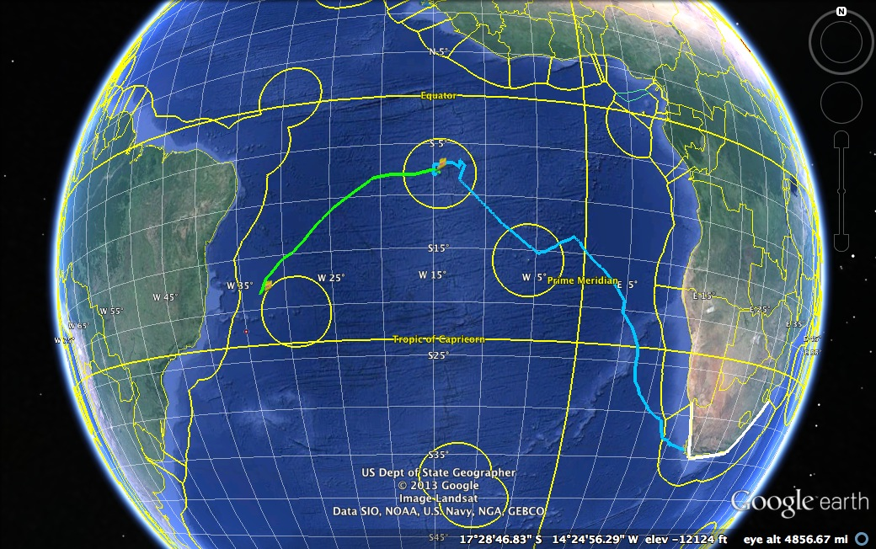
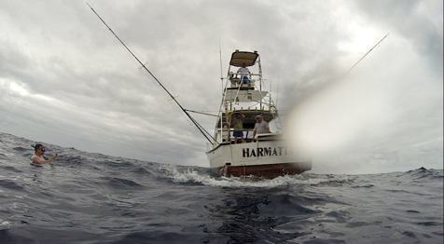
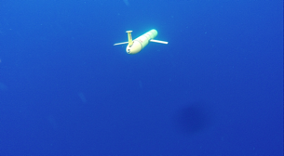
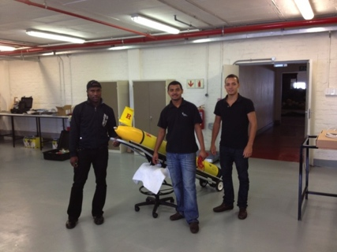
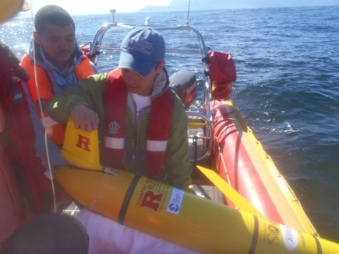
Glider RU29: Launched from Cape Town 11 Jan 2013, flown >8,125 km
South African Coast
2400 km

Slide 16
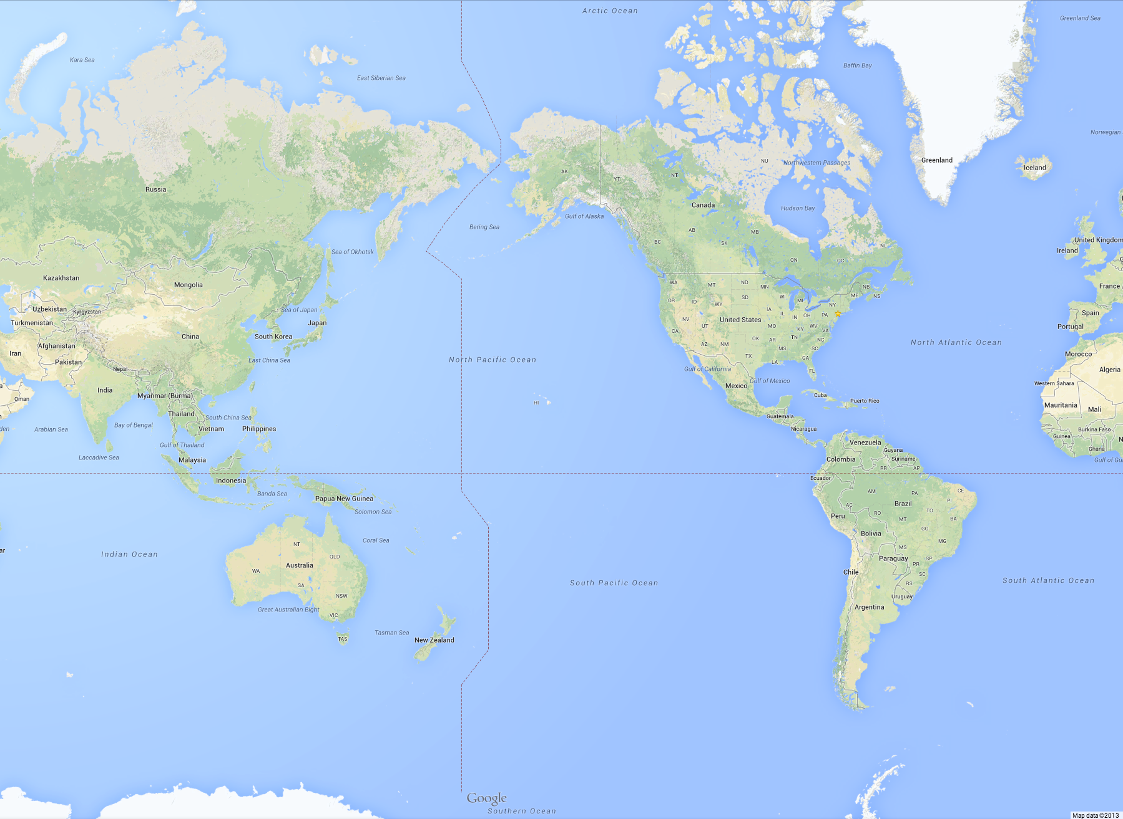
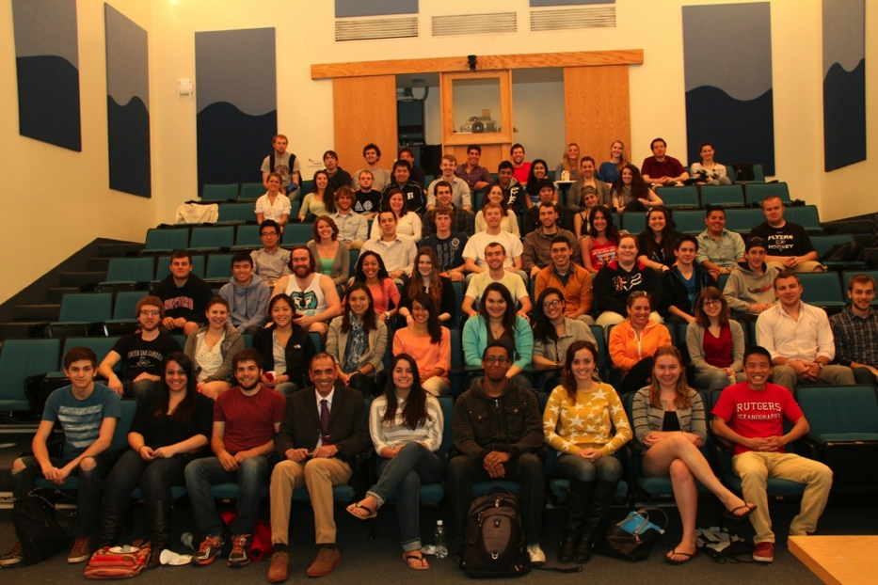
Arctic Ocean
Potential Korean Glider Paths
KNRV5000 Circumnavigation + 2015-2016 Glider Deployments
(Proposed by Rutgers students in response to Dr. Sik Huh)
NOAA/PMEL
Chuuk, Micronesia
Lima, Peru
Antarctica

Slide 17
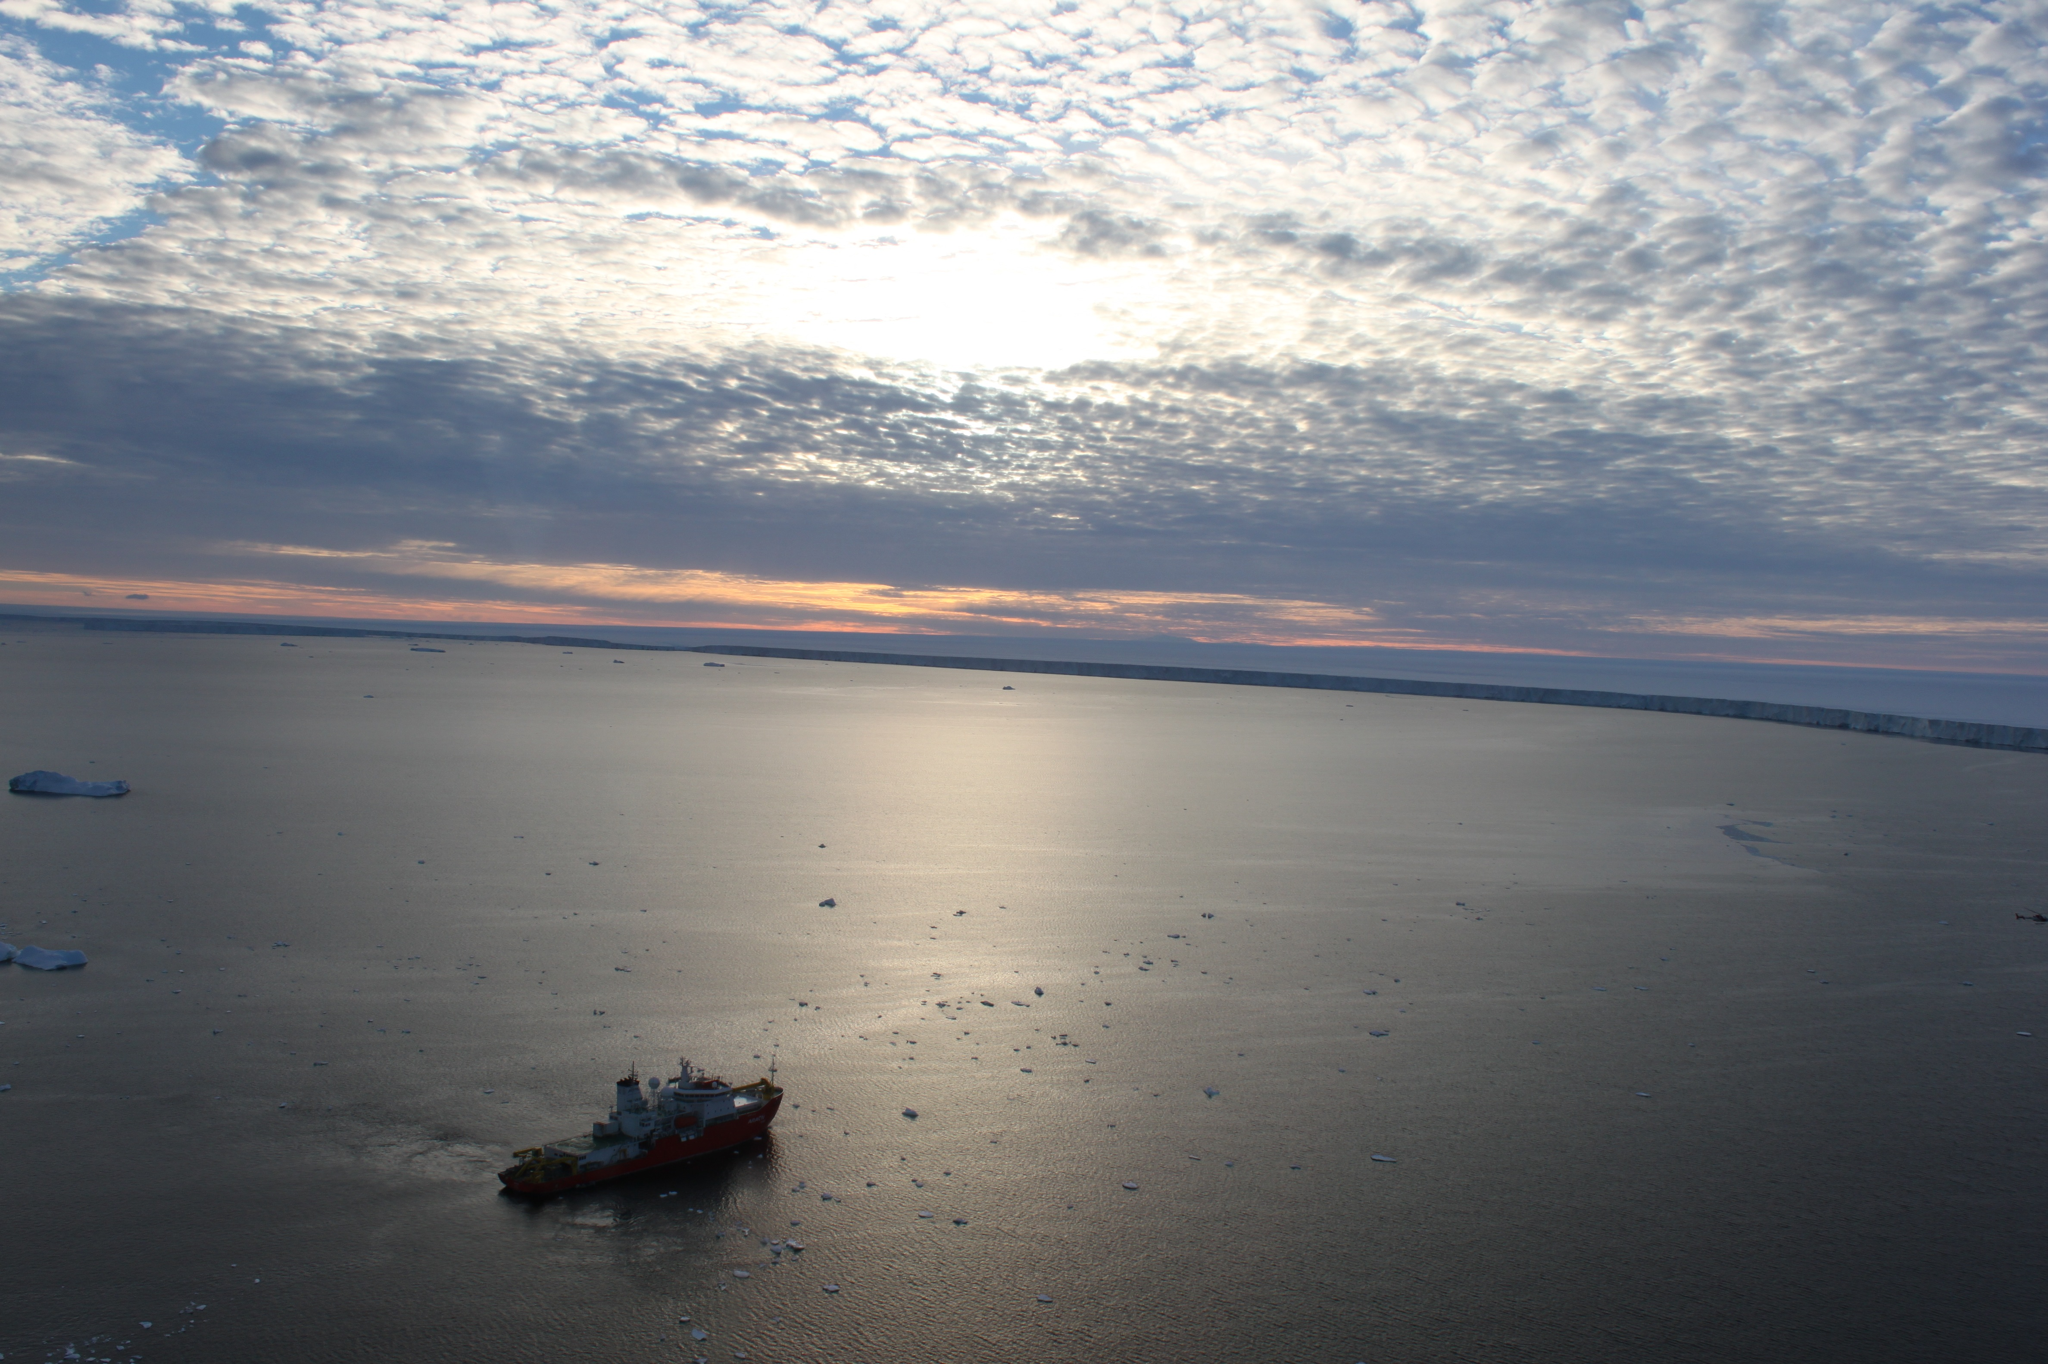
Future Plans:
Planning is underway for the 2014-2015 Antarctic field season with at least 2 gliders to be deployed.
HF Radar proposal submitted for 2015 start.
Global Glider capability meetings planned for 2014.

