Slide 1
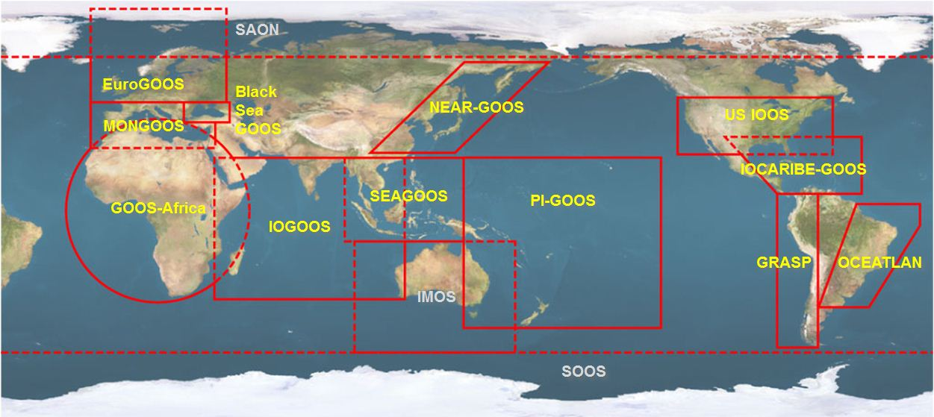





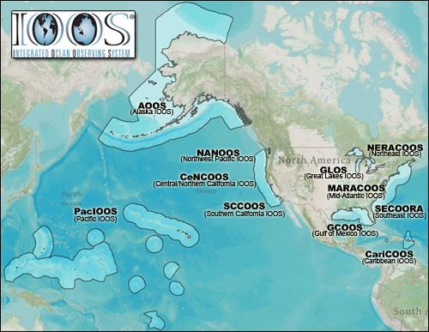


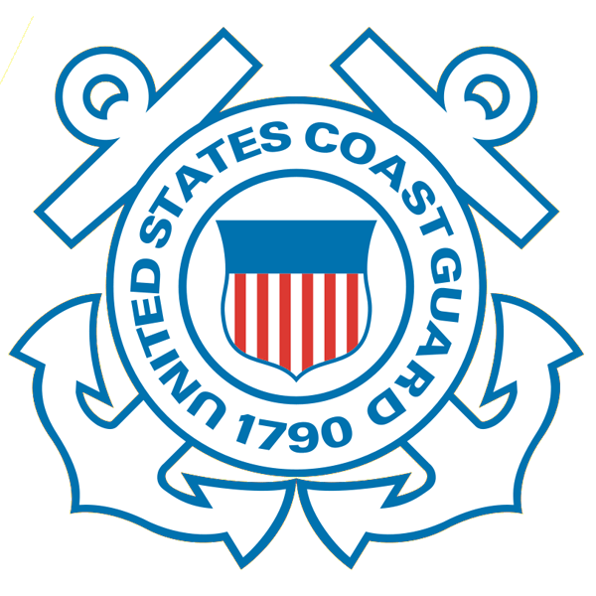









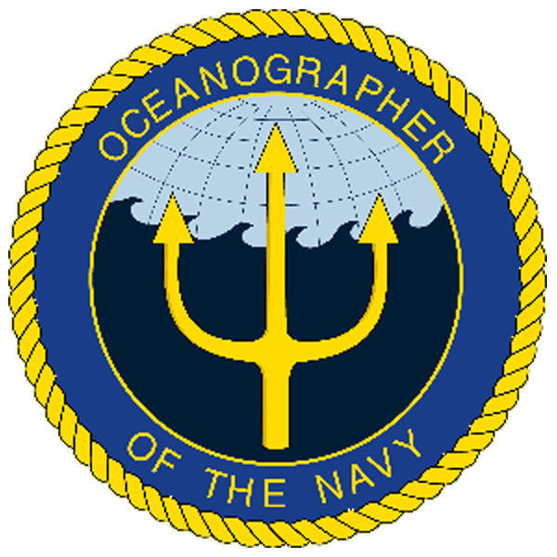
U.S. Integrated Ocean Observing System (IOOS)
Global Component
National Component
Regional Component
15 Regional Alliances in GOOS
Vessels -
Satellite
Satellite
CODAR
Ships/ Vessels
Glider
REMUS
Data Vis.
Modeling
Security
Leadership
Education
11 Regional Associations
17 U.S. Federal Agencies
http://ioos.gov

Slide 2
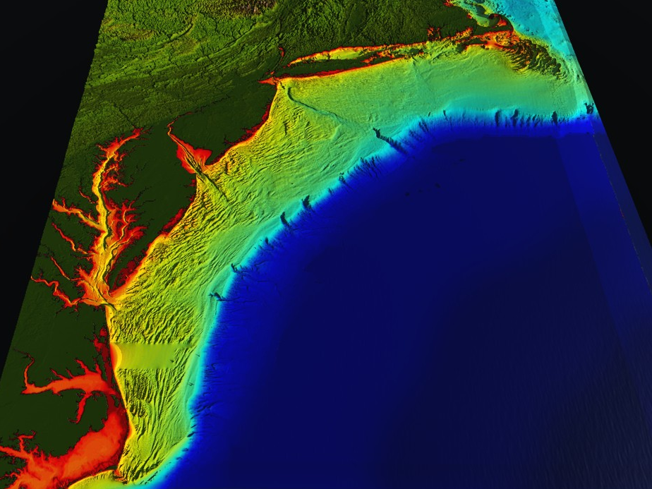
















RI
U..
Middle Atlantic
Regional Association
Coastal
Ocean Observing System
10 States - 76 Million People
1000 km Cape to Cape
CT
Cape
Cod
MA
NY
PA
NJ
MARACOOS:
A Sustained Real-time Observation & Forecast System
DE
MD
>40 PIs
>20 Institutions
>50 Members
>2000 Contacts
Scott Glenn + Many
VA
NC
Cape
Hatteras
Notes:
2

Slide 3
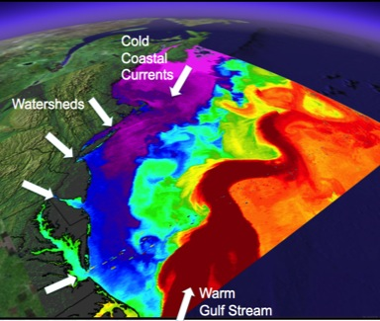
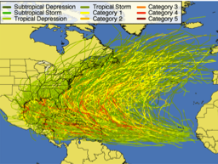
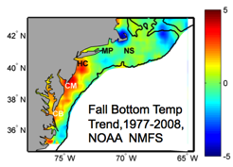
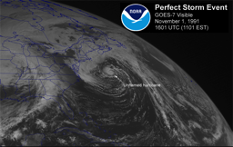
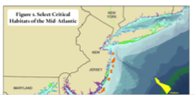
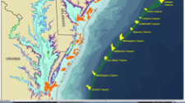
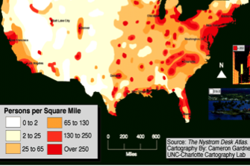
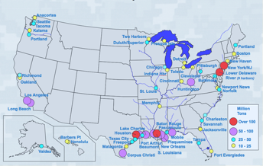
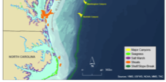
MID-ATLANTIC REGIONAL DRIVERS
Tropical Storms
Climate Change
Ocean Circulation
Critical Habitat
Northeasters
Population
Ports

Slide 4
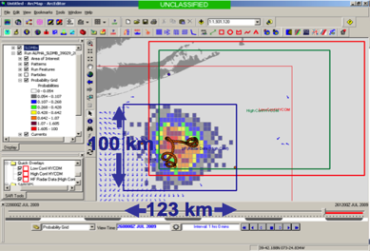
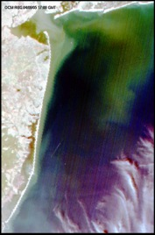
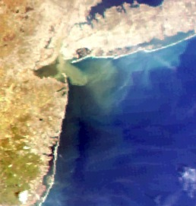
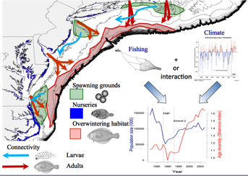
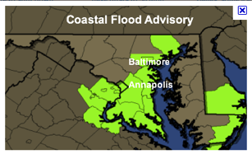
MARACOOS REGIONAL THEMES
1) Maritime Operations – Safety at Sea
3) Water Quality – a) Floatables, b) Hypoxia, c) Nutrients
2) Ecosystem Decision Support - Fisheries
5) Energy – Offshore Wind
4) Coastal Inundation - Flooding

Slide 5
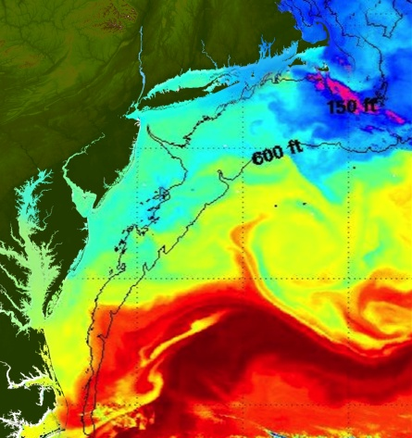
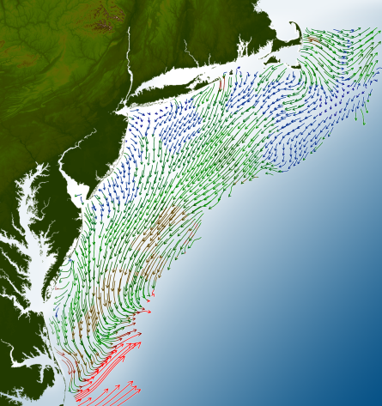
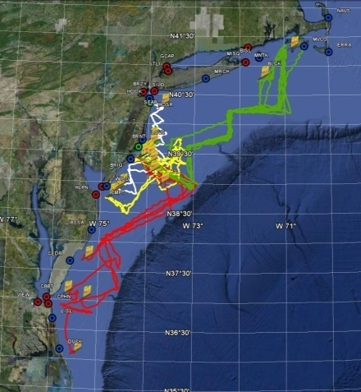
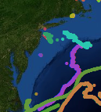
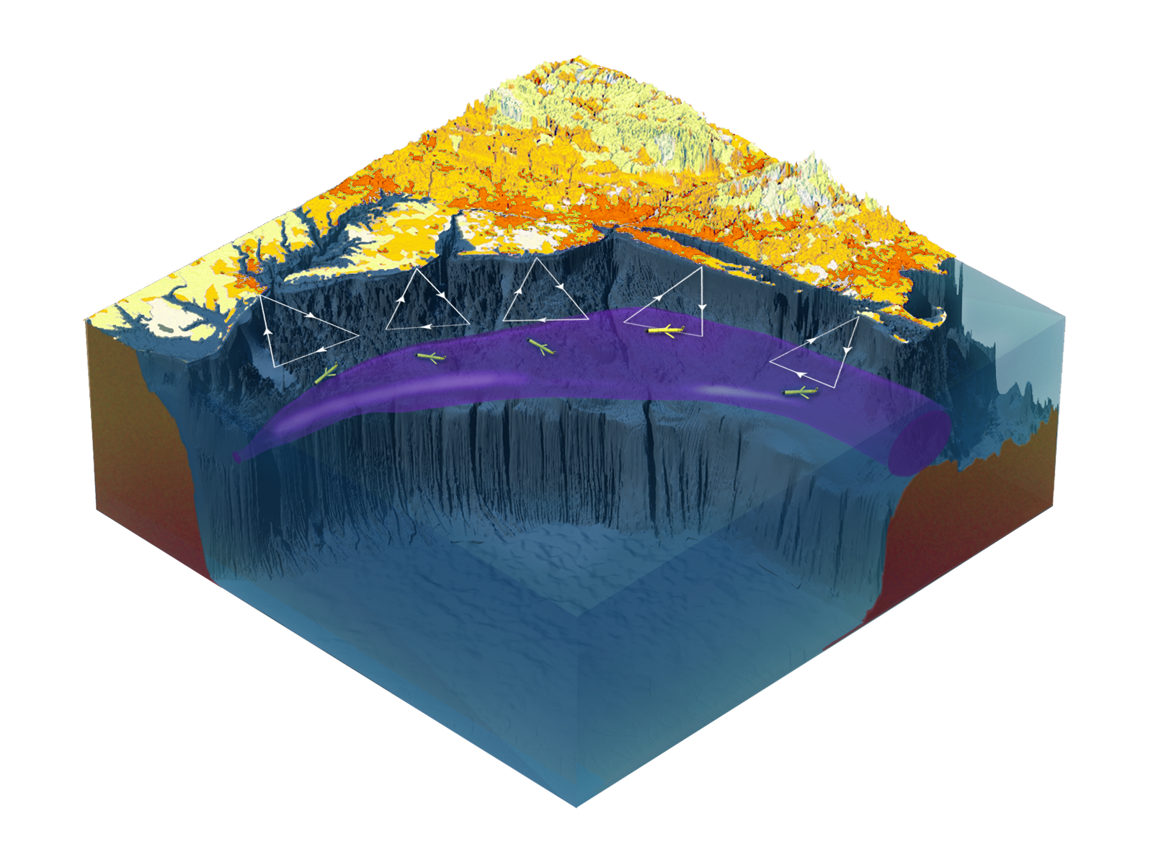

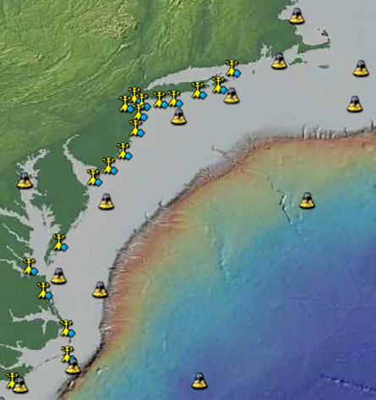
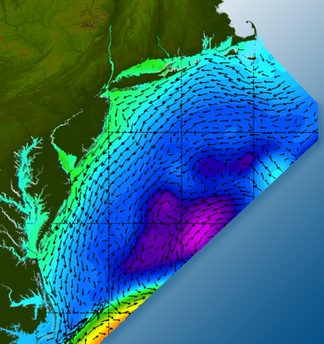

Satellites
HF-Radar
Gliders
Drifters
Population Density
To seek, discover & apply
new knowledge & understanding
of our coastal ocean
Weather Stations
Ocean Forecast Ensemble
Notes:
Need to cut off cold pool in south and bend offshore
Need to experiment with dulling down the colors in the pop density. Maybe orange/tan to white like the box I put in?
Put gliders just below the lines in 3 of them, and increase their angles facing up and down randomly. I stuck in cheesy examples
I already put the shadow and 80% clear line around the two new maps in the upper right, so we are good there.

Slide 6
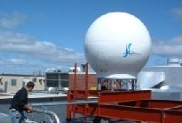
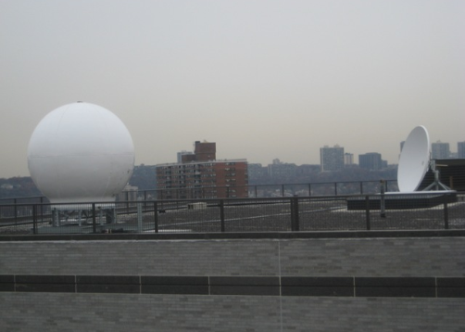
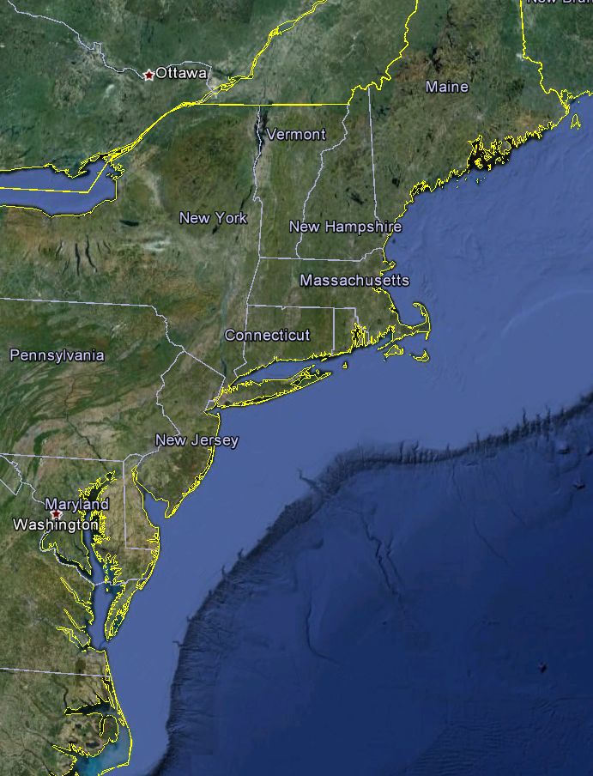
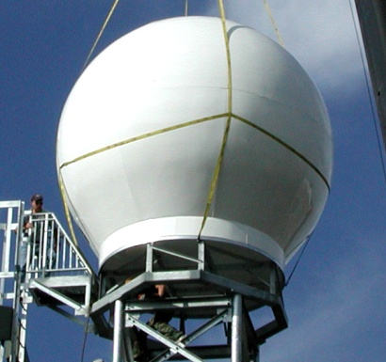
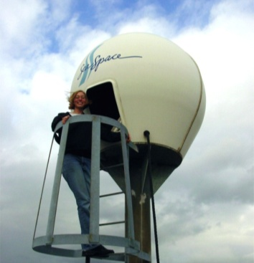
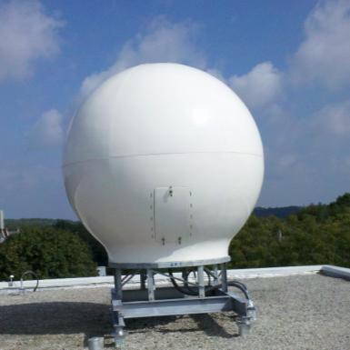
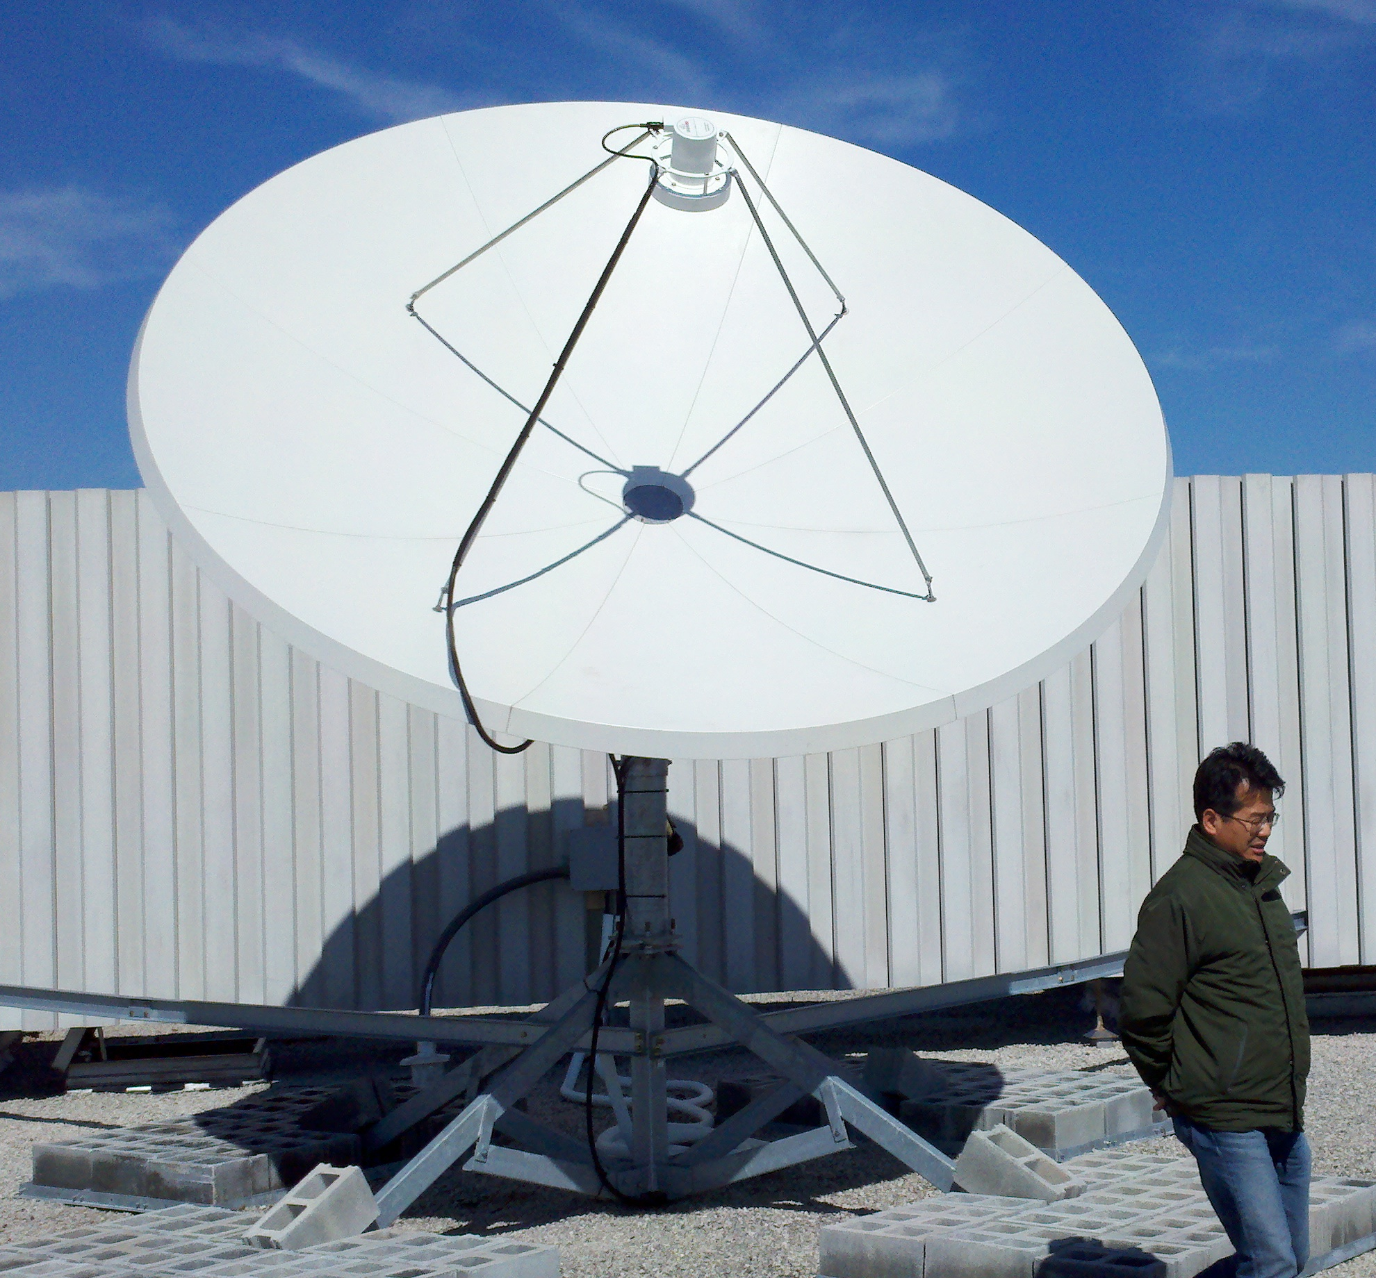
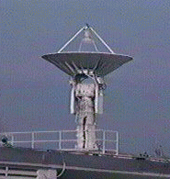
Real-Time Satellite Ground Stations in the Northeast U.S.
Satellites: NPP, Terra, Aqua, NOAA Polar Orbiters, Metop & GOES
U. Maine
City College of N.Y.
Rutgers
U. Delaware
Johns Hopkins

Slide 7
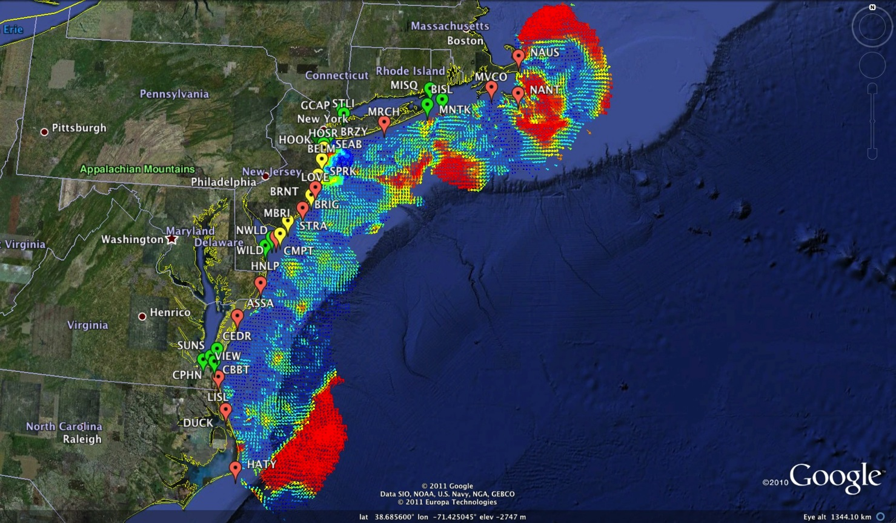
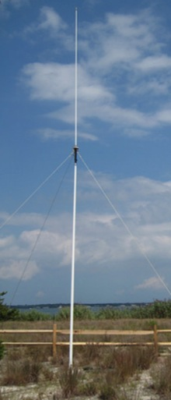
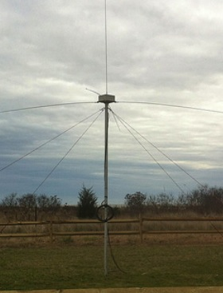
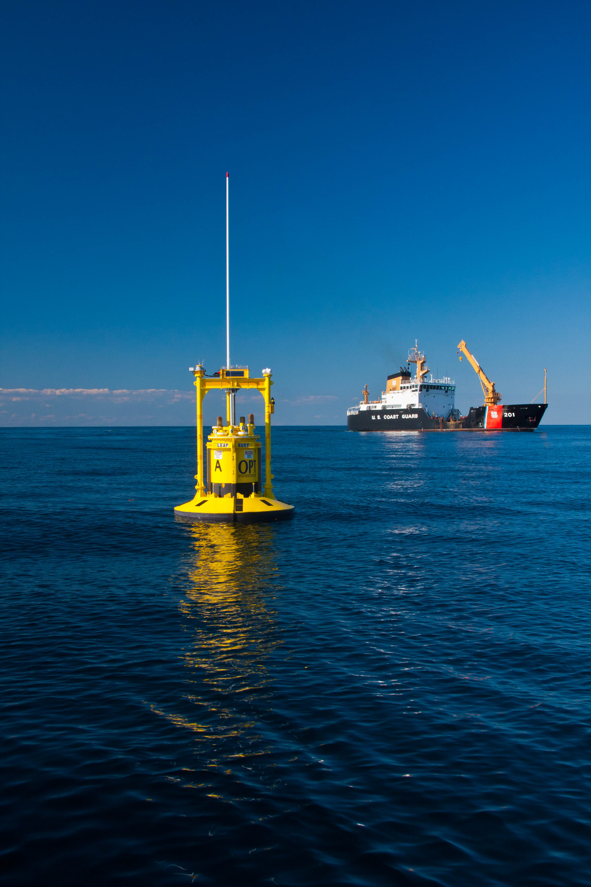
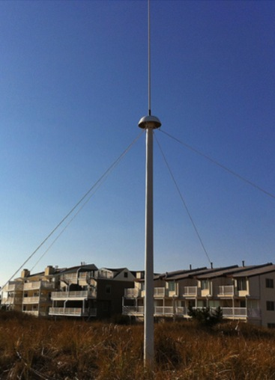
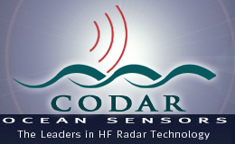
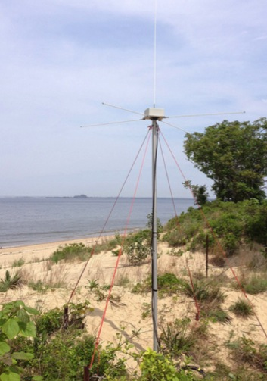
Mid-Atlantic Bight HF Radar Network
1000 km
Cape to Cape
Mid-Atlantic HF Radar Network
16 Long-Range CODARs
8 Medium-Range CODARs
17 Short-Range CODARs
41 Total (Pre-Sandy)
Triple Nested, Multi-static, Multi-use
Industry Partner: CODAR Ocean Sensors

Slide 8
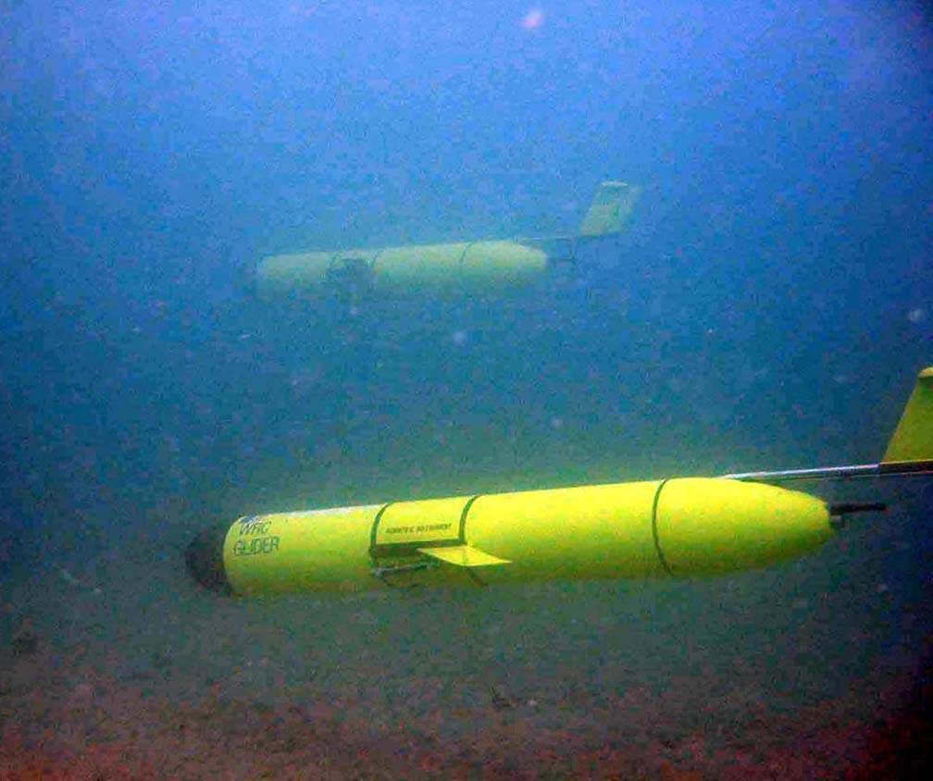
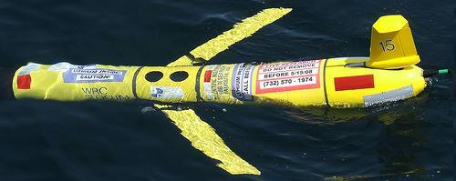
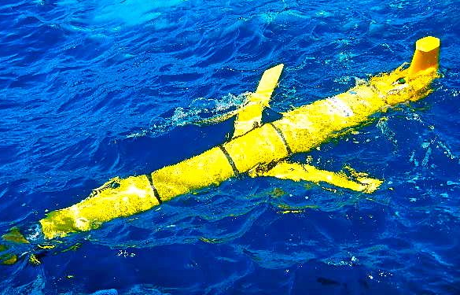
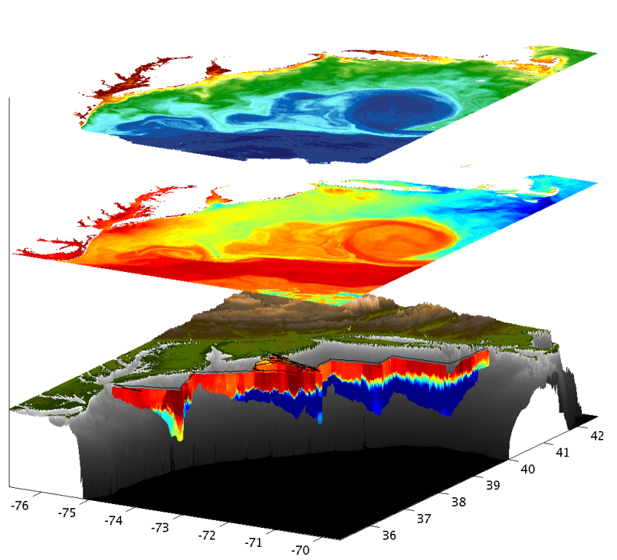
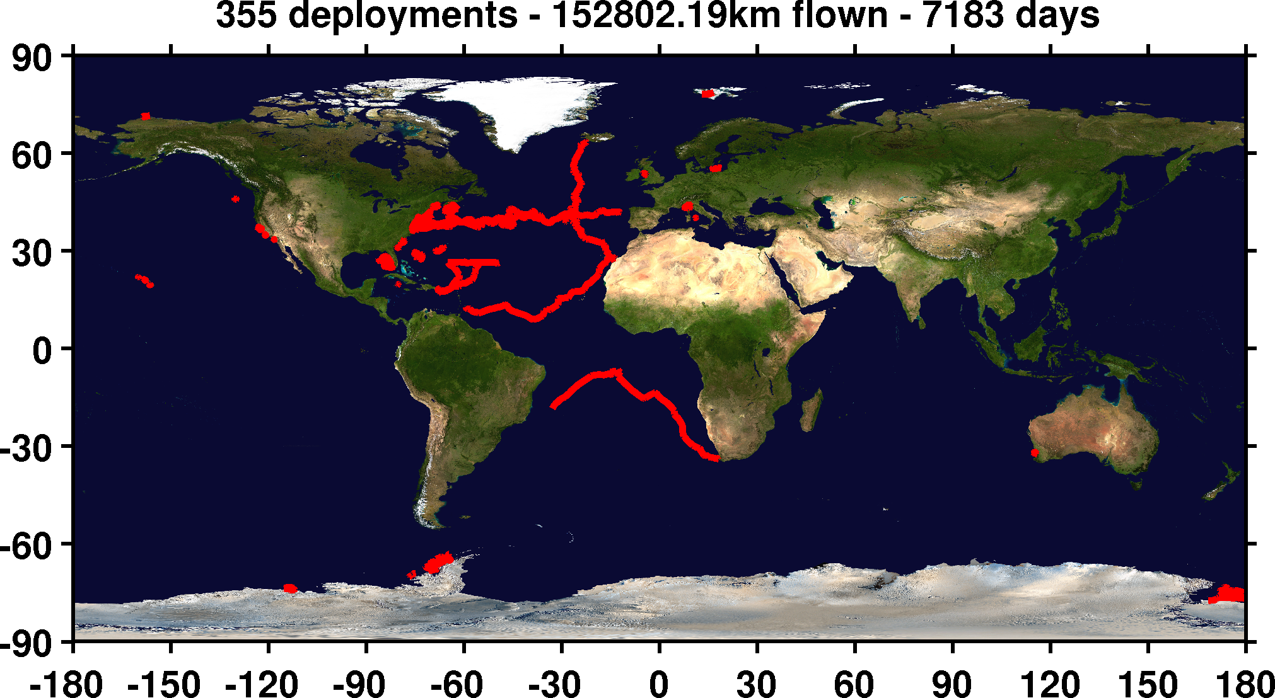
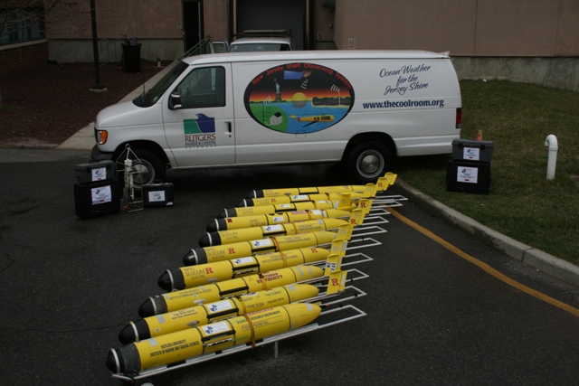

Mid-Atlantic Bight Glider Network
RU01
RU15
RU29
G1
G1-Ruggedized
G2
Satellite Ocean Color
Satellite SST
Subsurface
Glider
Data
Industry Partner: Teledyne Webb Research

Slide 9
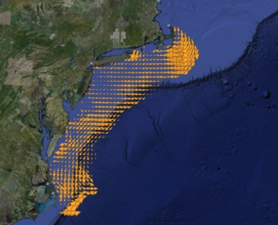
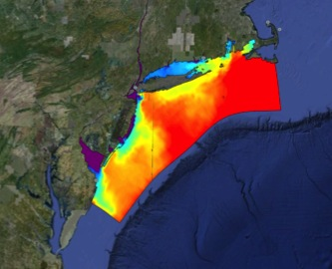
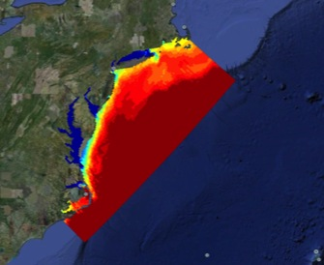

Improved Predictive Modeling and Data Assimilation
1) STPS
U. Connecticut
2) NYHOPS
Stevens Institute of Technology
3) ROMS
Rutgers University
4) HOPS
U. Massachusetts, Dartmouth

Slide 10






MARACOOS Operations Center
Rutgers University - Coastal Ocean Observation Lab
Satellite Data Acquisition Stations
CODAR Network
Glider Fleet
3-D Forecasts

Slide 11

Korea-U.S. Collaborations in Ocean Observing to Improve Environmental Forecasting
San Hoon Lee, Ho Kyung Ha, Tae Wan Kim, Doshik Hahm, Jisoo Park, KOPRI
Hak Soo Lim, KIOST
Sang-Ho Lee, KNU
Byoung-Jui Choi, KNU
Jung Sik Han, KHOA
Kwang Nam Han, KHOA
Sik Huh, KIOST
Scott Glenn,
Oscar Schofield,
Josh Kohut &
Hugh Roarty
Rutgers University

Slide 12





Rutgers Glider Deployment from Korea’s Araon
2013-2014, Amundsen Sea, Antarctica
2 Gliders deployed
1/4/14 to 1/13/14
421 kilometers flown
Measurements of:
Temperature
Salinity
Depth-averaged current
Chlorophyll fluorescence
CDOM fluorescence
Optical backscatter
Fast Repetition Fluorescence
Temperature
Depth-averaged
Current
Oxygen

Slide 13









Korea & United States
HF Radar Collaboration

Slide 14


U.S. & Korea
National HF Radar Networks –
World’s largest networks
MAB & Korea similar in scale
U.S. - Korea
Collaborations in:
Network Operations
Data Quality Control
Product Development
Science
1000 km

Slide 15







Rutgers visit to Korea HF Radar Centers

Slide 16




Korea & United States
HF Radar Collaboration
2012

Slide 17



Korea & United States
HF Radar Collaboration
2012
2013
2013
Korean Visits to Rutgers

Slide 18



Next Steps for Korea-U.S. HFR Collaboration - 2015
3rd GEO Global HF Radar Meeting, Kaohsiung, Taiwan

Slide 19


The Challenger Glider Mission:
Enhancing Korea’s Global Autonomous Underwater Glider Fleet
Scott Glenn,
Oscar Schofield &
Josh Kohut
Rutgers University
Dr. Sik Huh
KIOST-NOAA Lab
NOAA-MOF JPA 2014

Slide 20




Global KNRV5000 Mission

Slide 21







Global Challenger Glider Mission
16 Global-Class Gliders

Slide 22




2013 International Typhoon Workshop
Dr. Louis Uccellini, Director
National Weather Service
Crowd-sourced comparisons between
U.S. & European Models & Gliders

Slide 23




Companion Course at
Plataforma Oceanica de Canarias
Shared Glider Missions – Iceland to Azores; Azores to Canaries; Canaries to Caribbean
Skype Sessions between classes
Two-way International Exchange programs
Students Learn Science from their teachers
Students Learn Culture from their peers

Slide 24




RTOFS and MERCATOR
Temperature and Current Maps at 200 m
200m temperature and currents on April 18th, 2013. The glider position is marked by the red dot.
RTOFS
200 m
800 m
MERCATOR

Slide 25









Glider RU29: Launched from Cape Town 11 Jan 2013, flown >8,125 km
South African Coast
2400 km

Slide 26




Arctic Ocean
Potential Korean Glider Paths
KNRV5000 Circumnavigation + 2015-2016 Glider Deployments
(Proposed by Rutgers students in response to Dr. Sik Huh)
NOAA/PMEL
Chuuk, Micronesia
Lima, Peru
Antarctica

Slide 27

Future Plans:
Planning is underway for the 2014-2015 Antarctic field season with at least 2 gliders to be deployed.
HF Radar proposal submitted for 2015 start.
Global Glider capability meetings planned for 2014.

