Slide 1
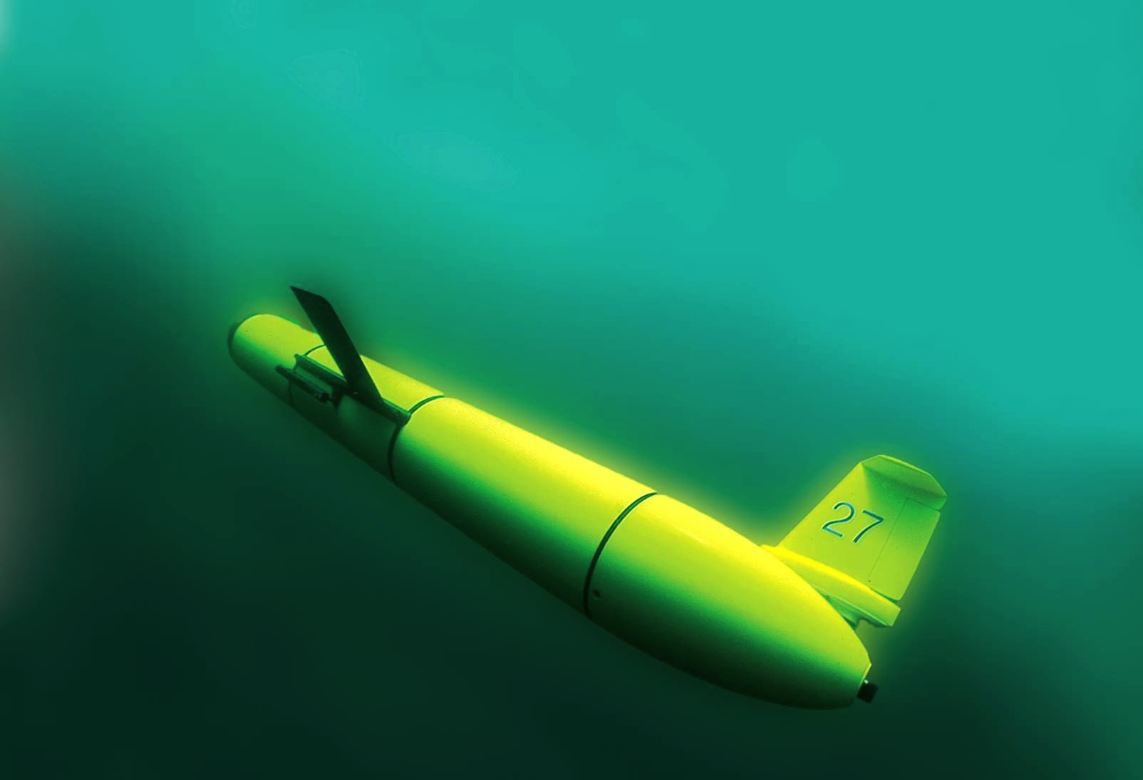
The Challenger Glider Mission:
Enhancing Korea’s Global Autonomous Underwater Glider Fleet
Scott Glenn,
Oscar Schofield &
Josh Kohut
Rutgers University
Dr. Sik Huh
KIOST-NOAA Lab
NOAA-MOF JPA 2014

Slide 3
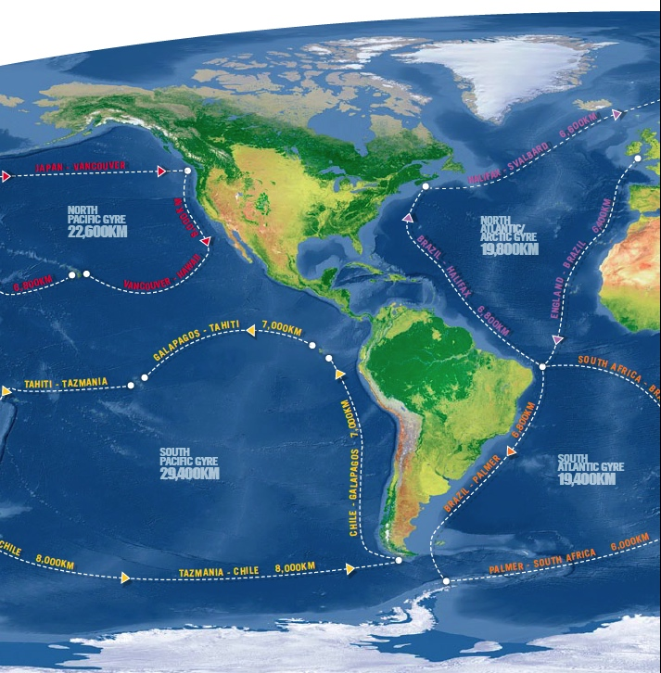
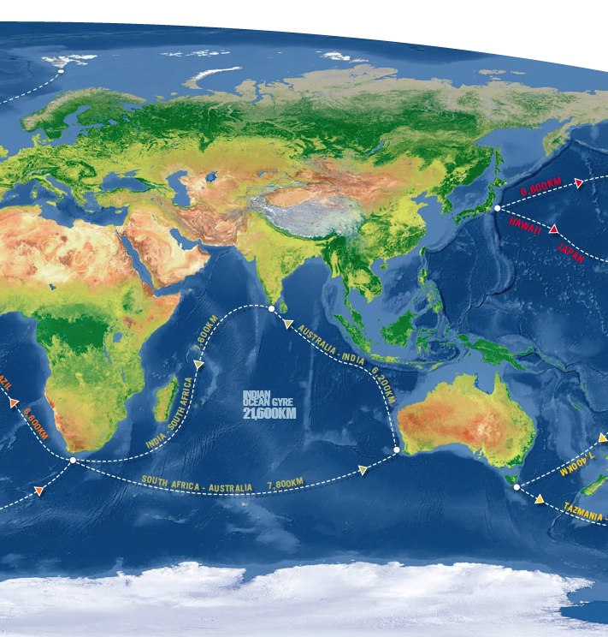
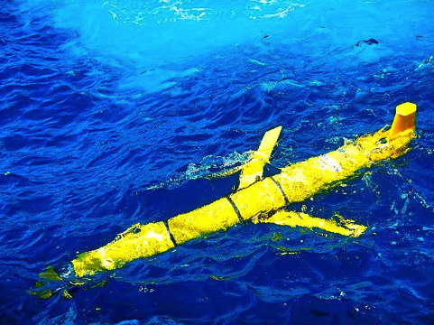
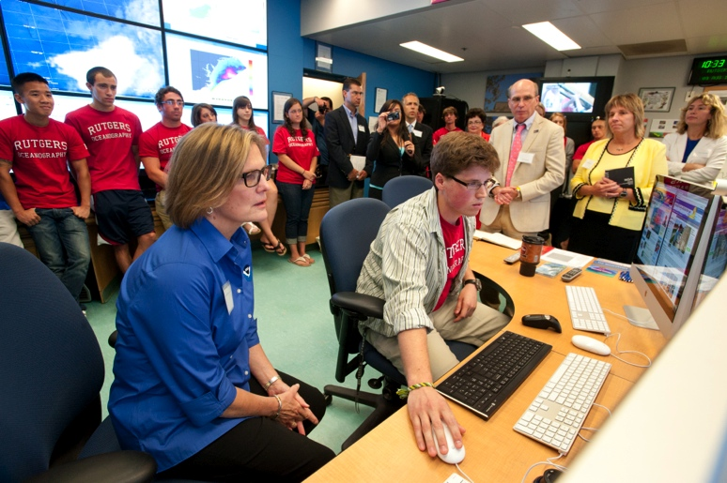
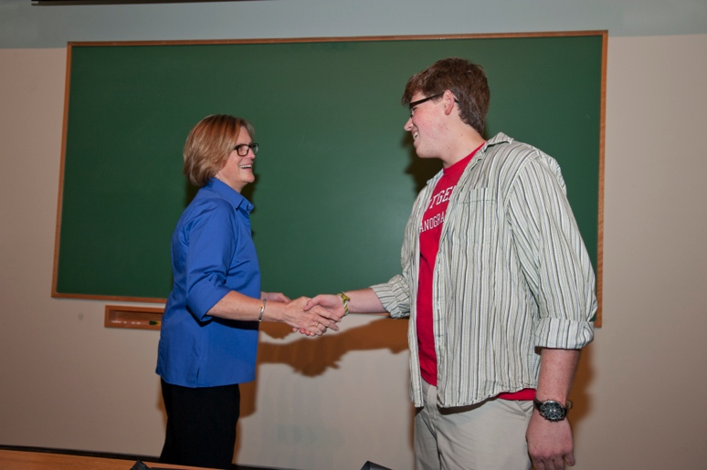
Global Challenger Glider Mission
16 Global-Class Gliders

Slide 4
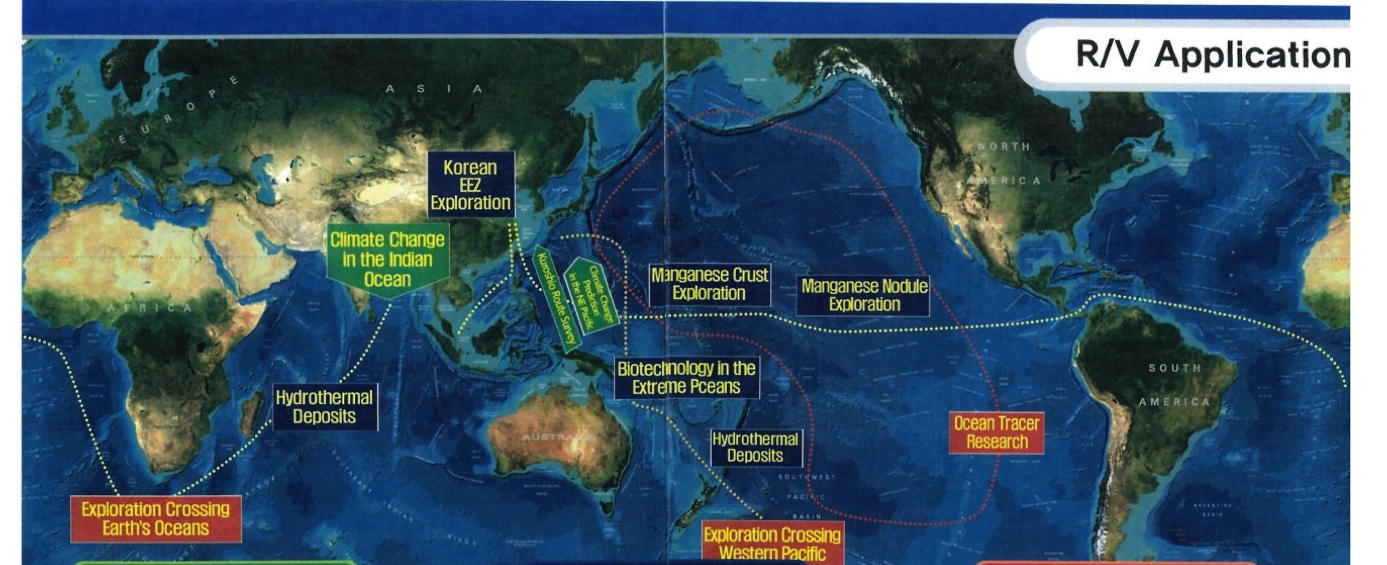
Global KNRV5000 Mission

Slide 5
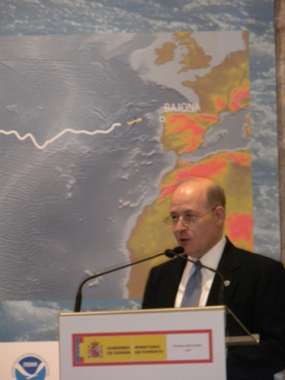
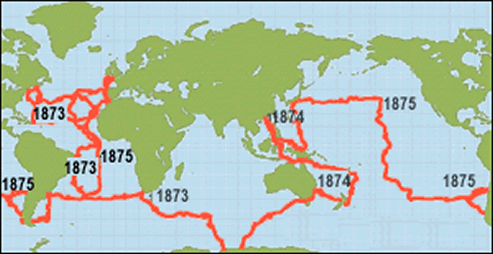
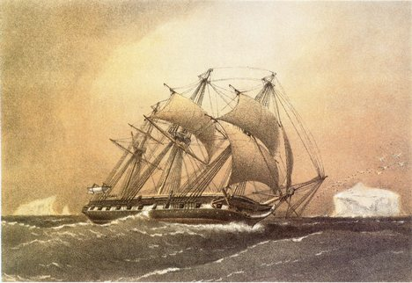
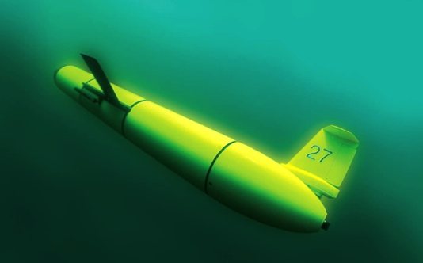
A Global Challenge – The Challenger Glider Mission
December 9, 2009 – Baiona, Spain
Dr. Rick Spinrad
AA of NOAA Office of
Oceanic & Atmospheric Research
Dr. Spinrad’s
Global Challenge:
Build a Global Glider Fleet
and Coordinate the First
Robotic Circumnavigation.
Revisit the Historic Track of the
HMS Challenger –
And inspire a global network
of students along the way.
HMS Challenger Voyage
First Scientific
Circumnavigation
1872-1876
128,000 km =
= 16 gliders
x 8,000 km/glider

Slide 6
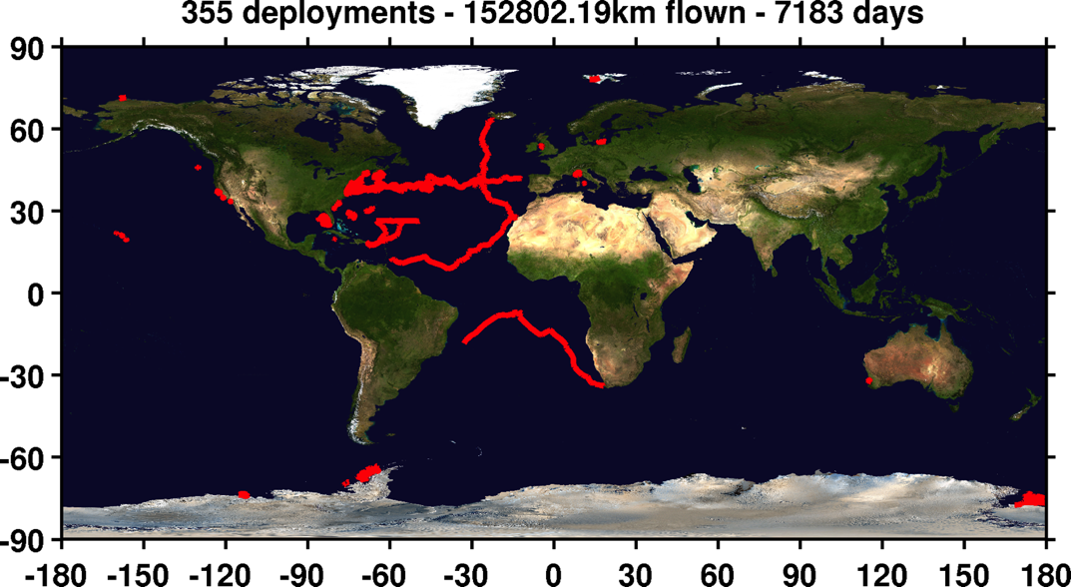
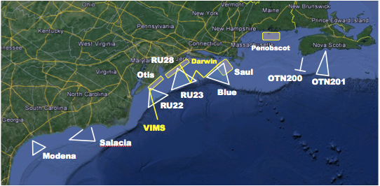
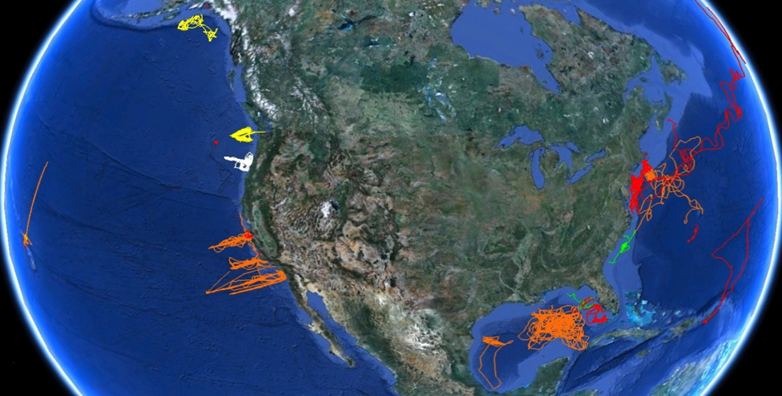
U.S. Integrated Ocean Observing System (IOOS)
Global Component
National Component
Regional Component
Vessels -
Satellite
Global Glider Networks
Multistatic
Nested
Mid-Atlantic Glider Network
U.S. National Glider Network

Slide 7
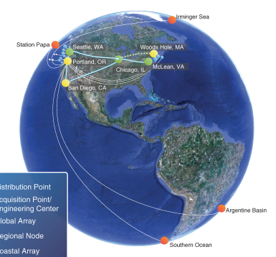
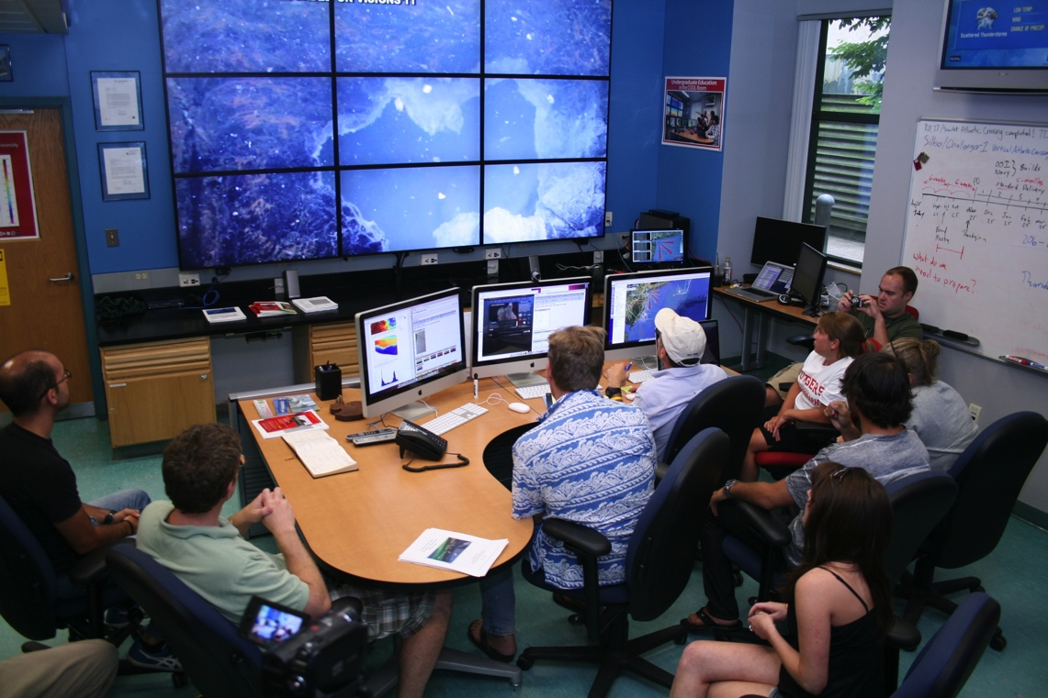
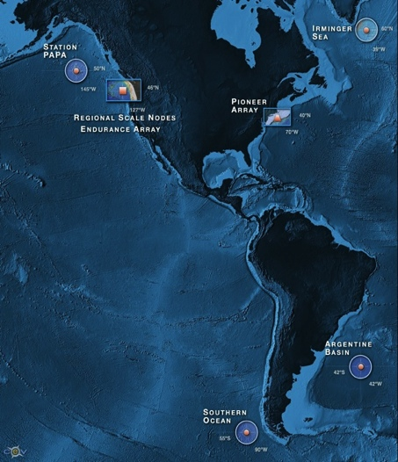
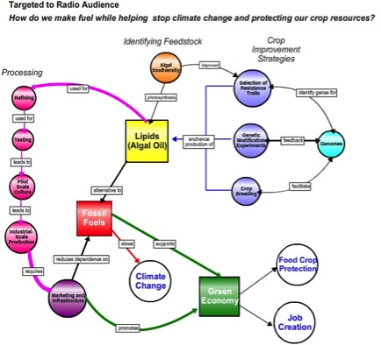
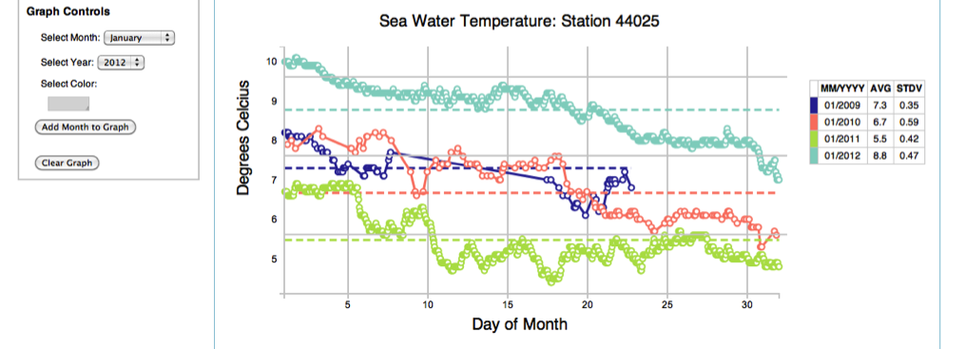
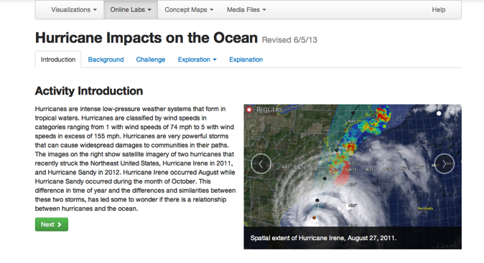
Expanding the model
Developing tools to increase crowd sourcing & educational opportunities with OOI Education and Public Engagement (EPE) team
Concept Maps
Data Visualization Tools
Lab Lesson Builder

Slide 8
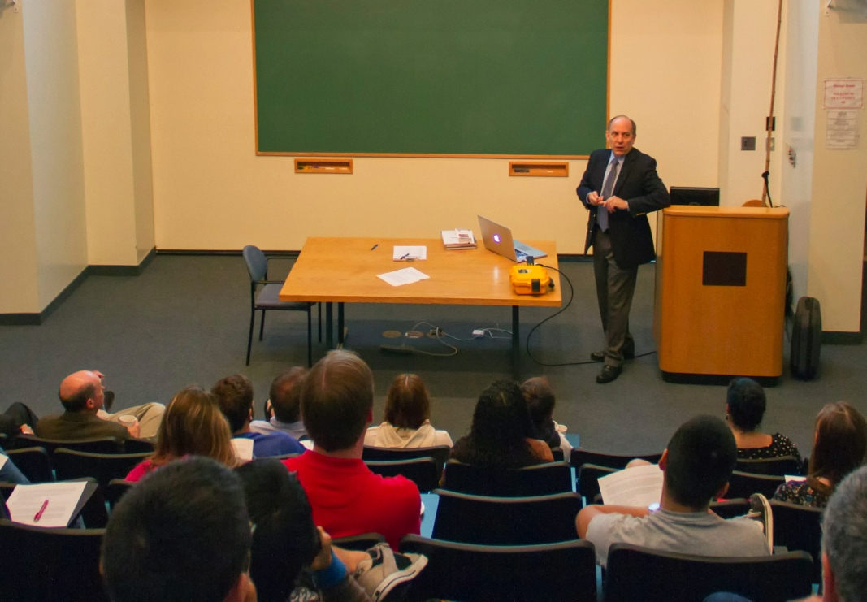
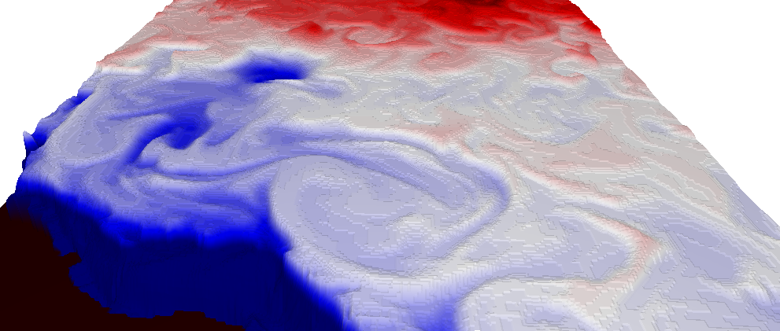
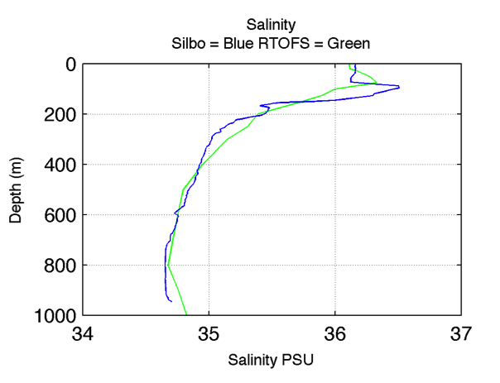
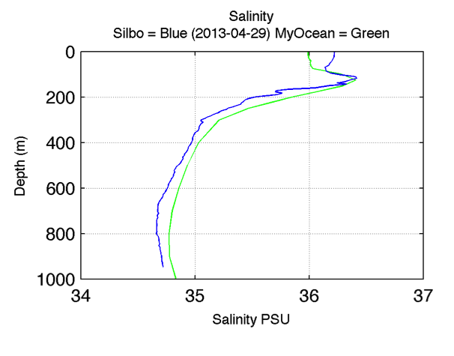
Dr. Louis Uccellini, Director
National Weather Service
Crowd-sourced comparisons between
U.S. & European Models & Gliders
SALINITY 8 APR 2013
Visualization by
Universidad de Las Palma de Gran Canaria
Model-Glider comparisons of the Amazon outflow fresh water distribution
with NSF OOI EPE Visualization Tools.

Slide 9
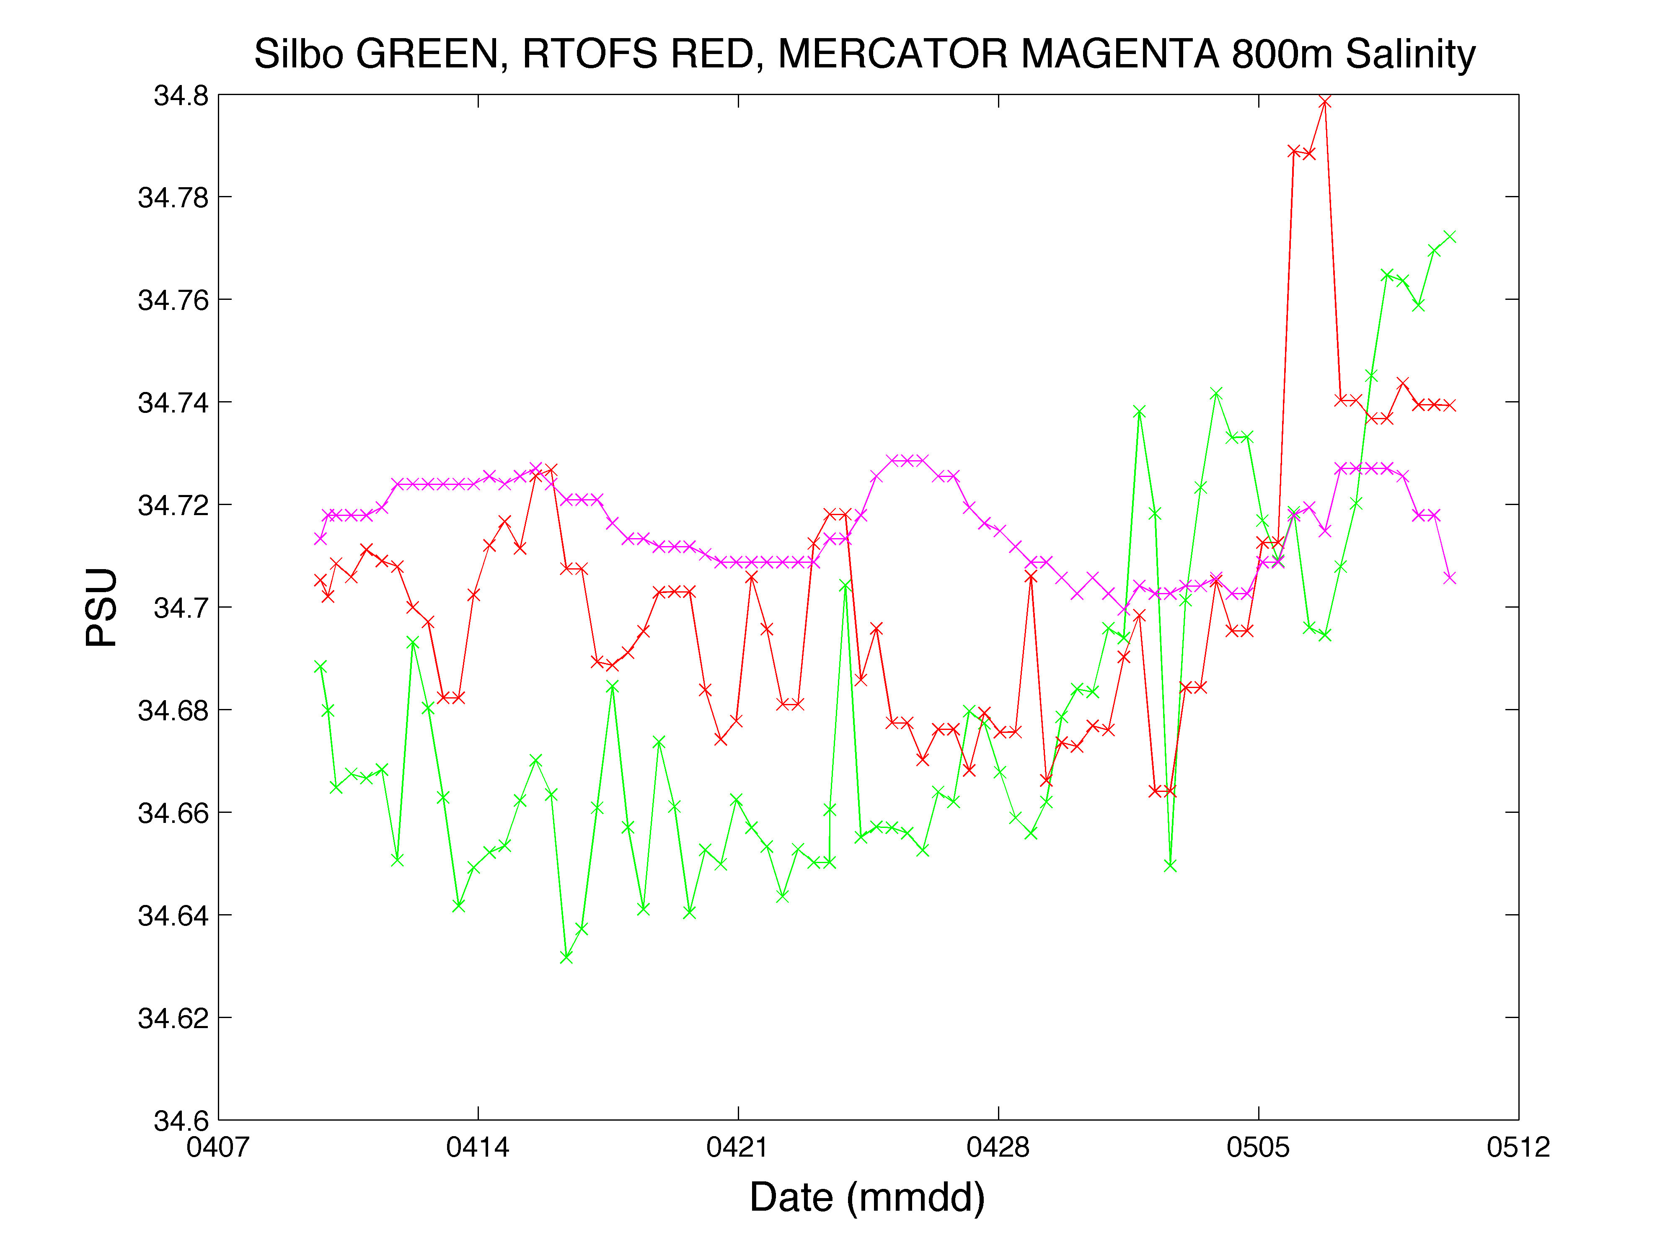
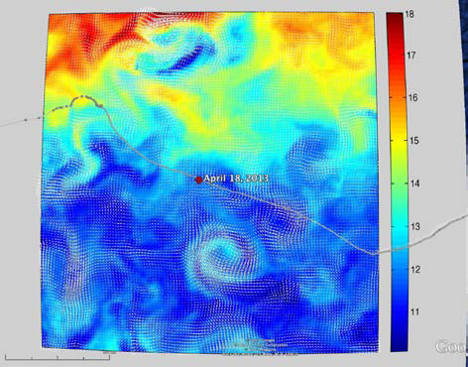
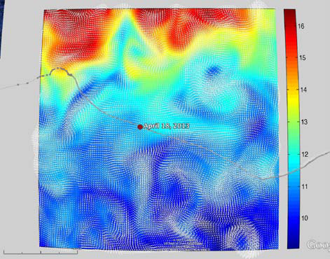
RTOFS and MERCATOR
Temperature and Current Maps at 200 m
RTOFS 200m temperature and currents on April 18th, 2013. The glider position is marked by the red dot.
MyOcean 200m temperature and currents on April 18th, 2013. The gliders position is marked by a red dot.

Slide 10
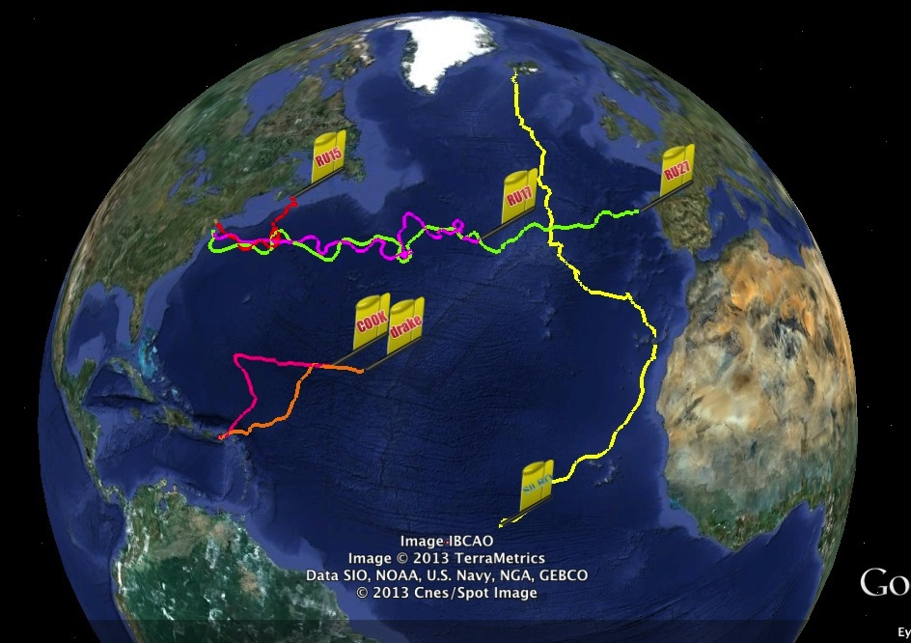
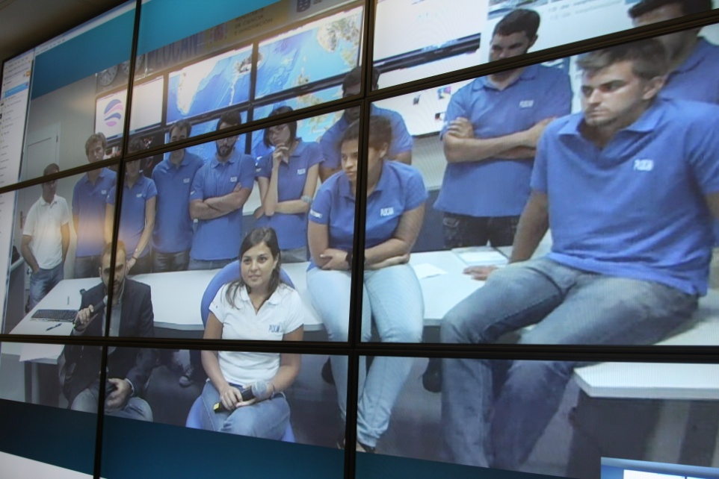
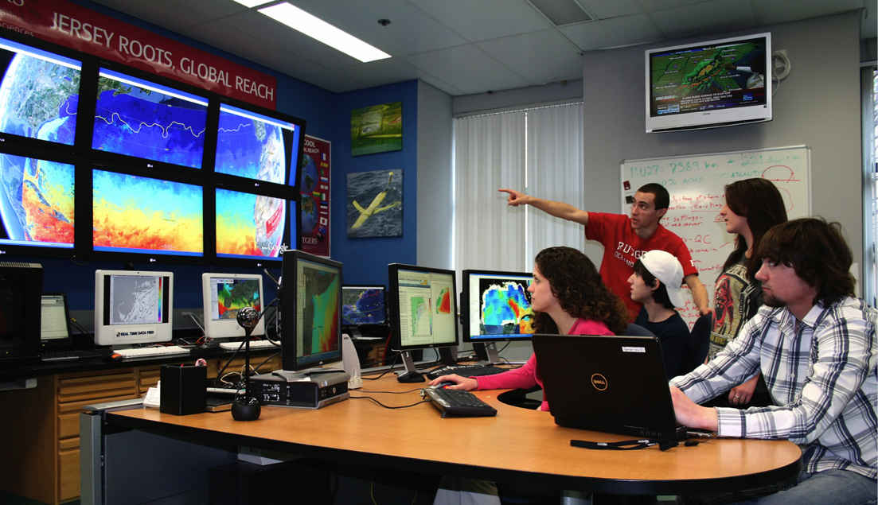
Companion Course at
Plataforma Oceanica de Canarias
Shared Glider Missions – Iceland to Azores; Azores to Canaries; Canaries to Caribbean
Skype Sessions between classes
Two-way International Exchange programs
Students Learn Science from their teachers
Students Learn Culture from their peers

Slide 11
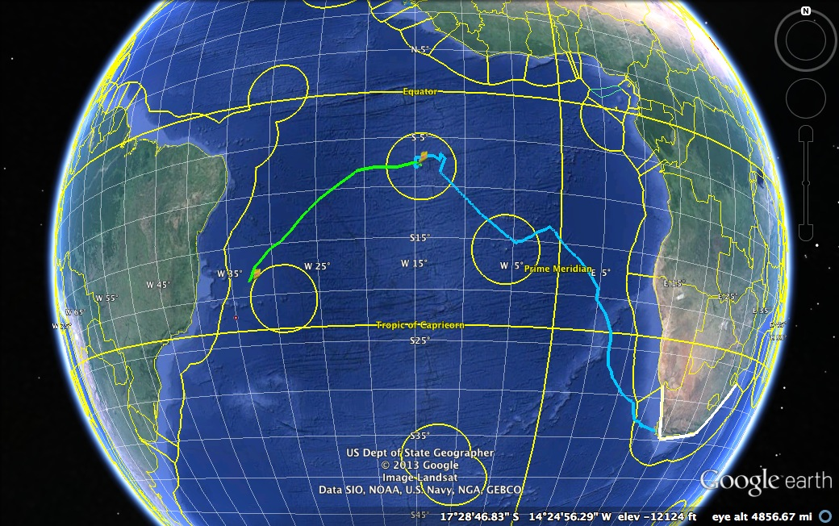
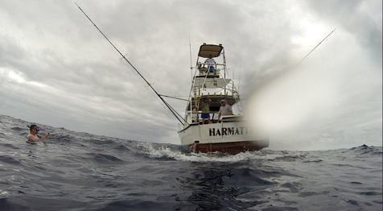
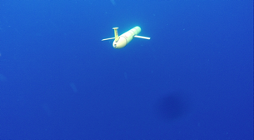
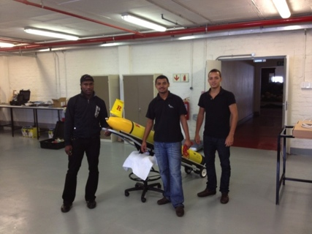
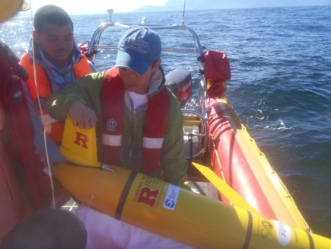
Glider RU29: Launched from Cape Town 11 Jan 2013, flown >8,125 km
South African Coast
2400 km

Slide 12
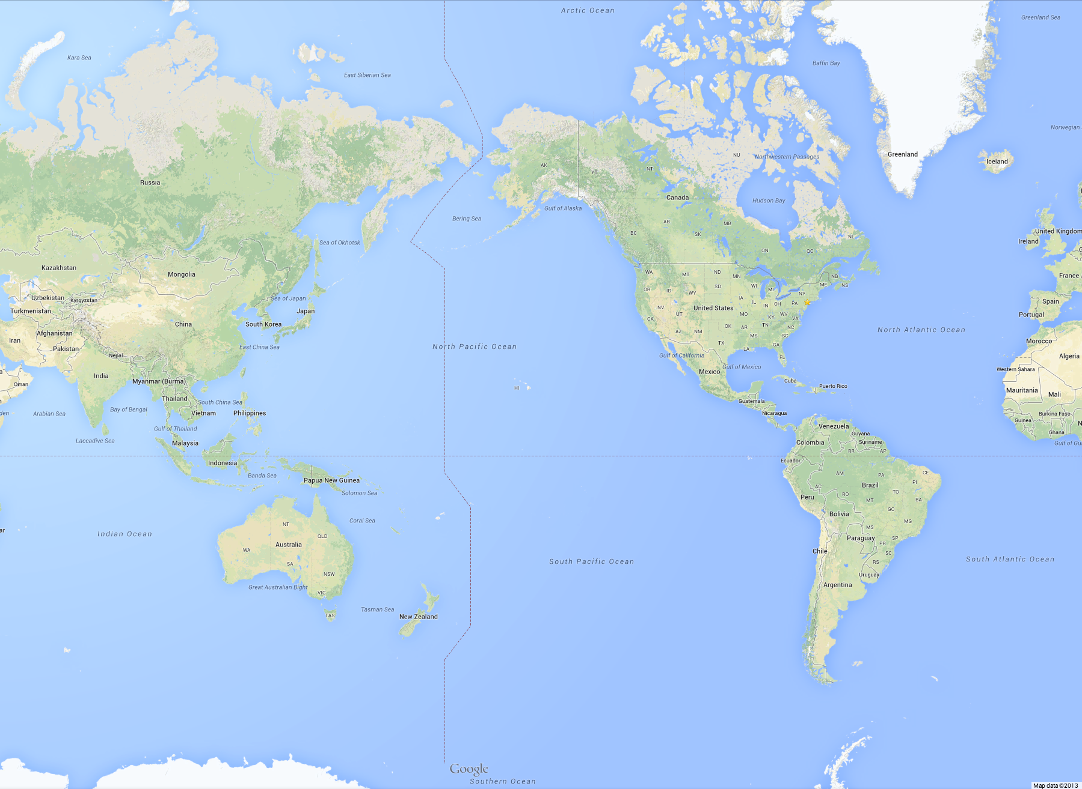
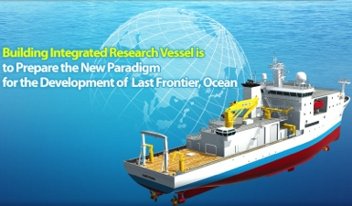
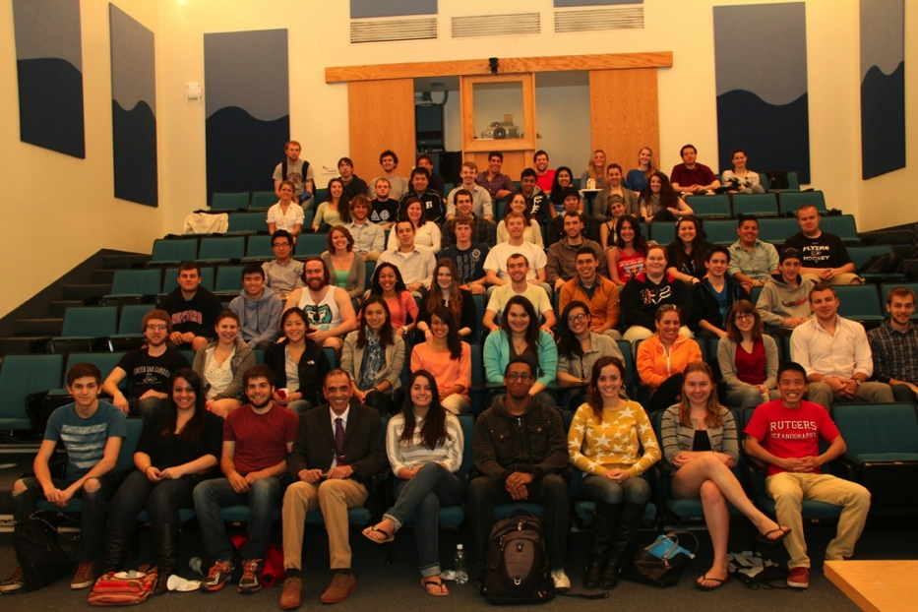
Arctic Ocean
Potential Korean Glider Paths
KNRV5000 Circumnavigation + 2015-2016 Glider Deployments
(Proposed by Rutgers students in response to Dr. Sik Huh)
NOAA/PMEL
Chuuk, Micronesia
Lima, Peru
Antarctica

Slide 13
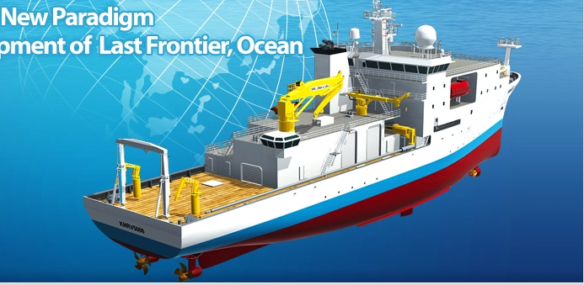
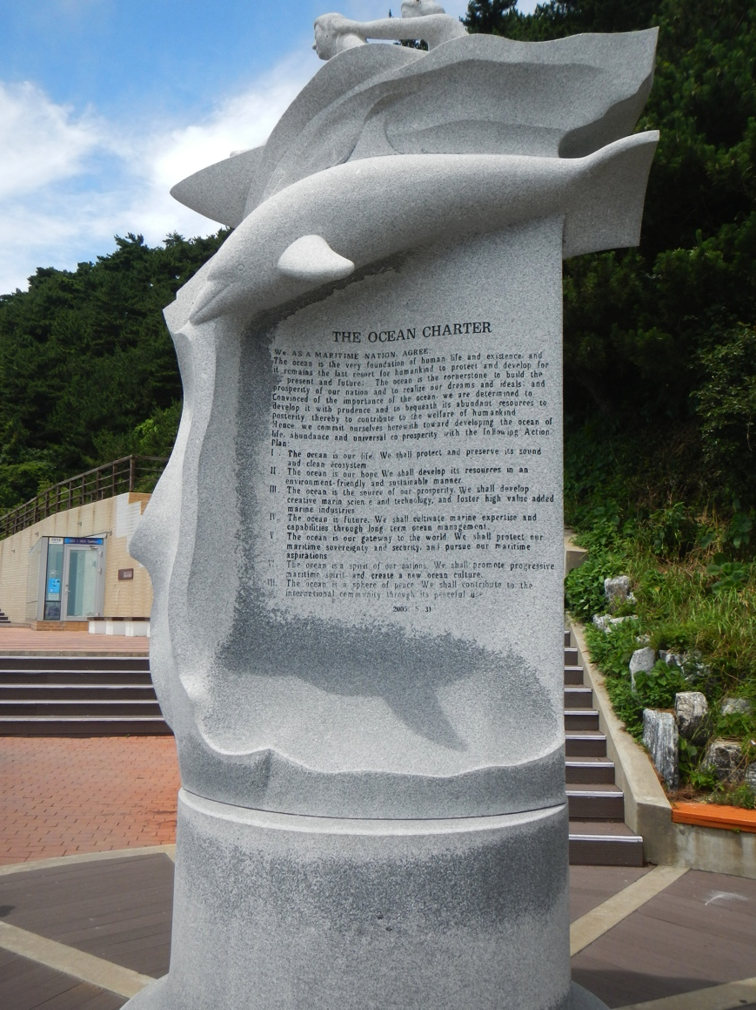
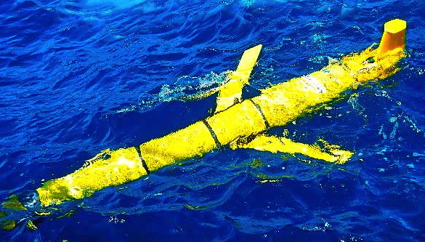
Summary:
We look forward to our visit to Korea, and
Thank you for your interest and support.

