Slide 1
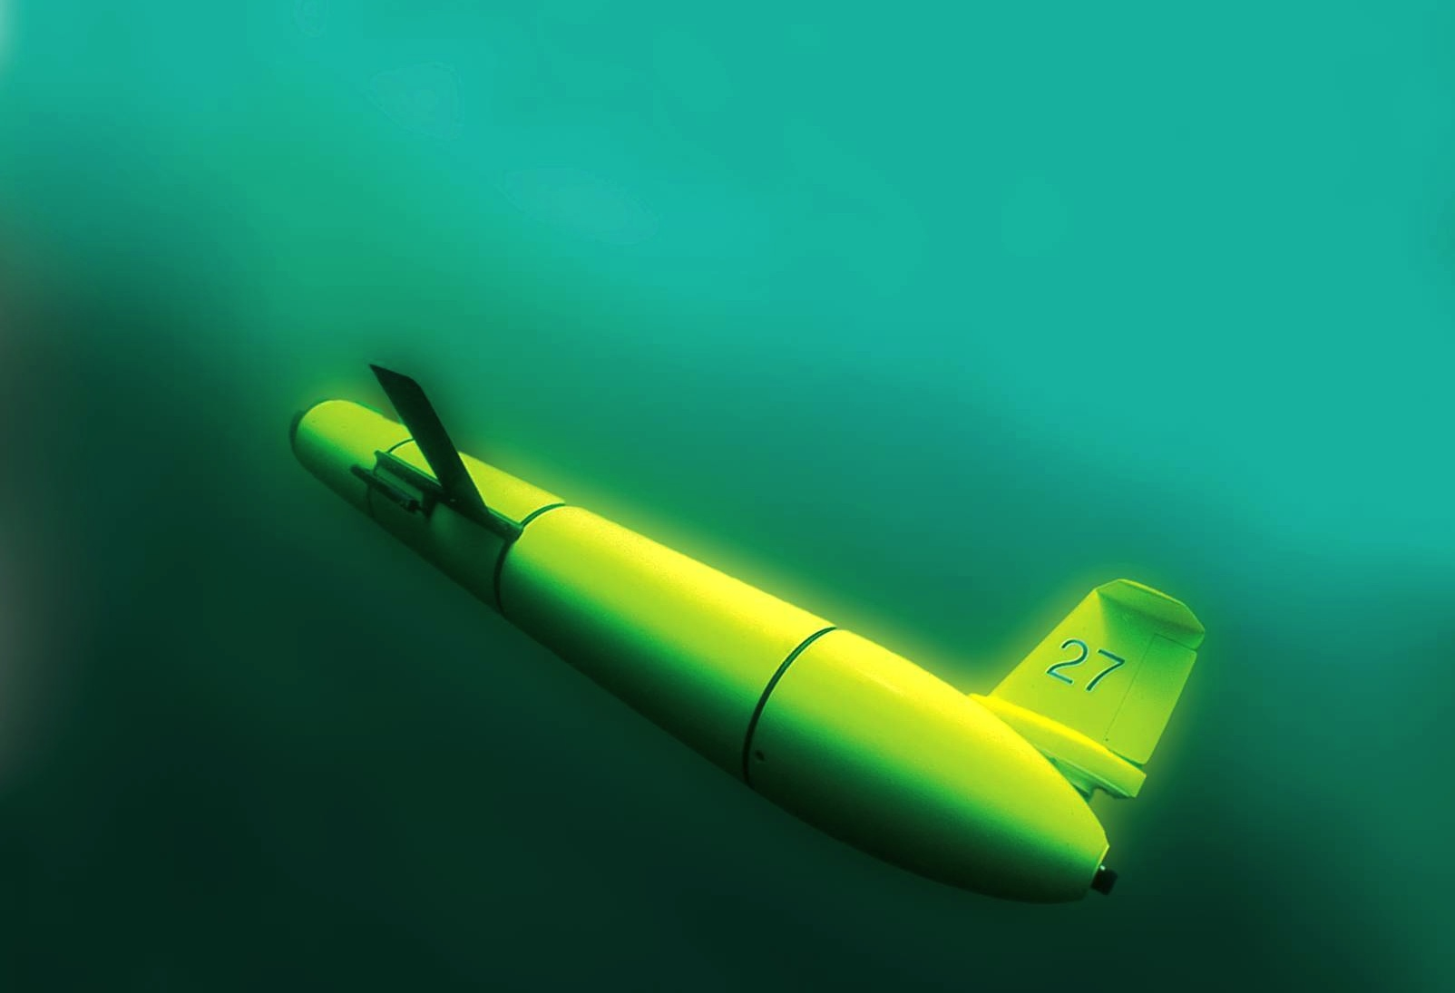
Leveraging Ocean Observatories and Web-Based Educational Tools for Sustained Undergraduate Research
in Ocean Science
Part 2
Scott Glenn,
Oscar Schofield,
Josh Kohut &
Janice McDonnell
Rutgers University
“The Ocean is Our Classroom”

Slide 2
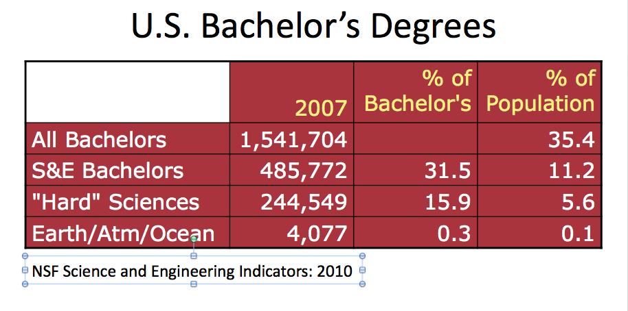
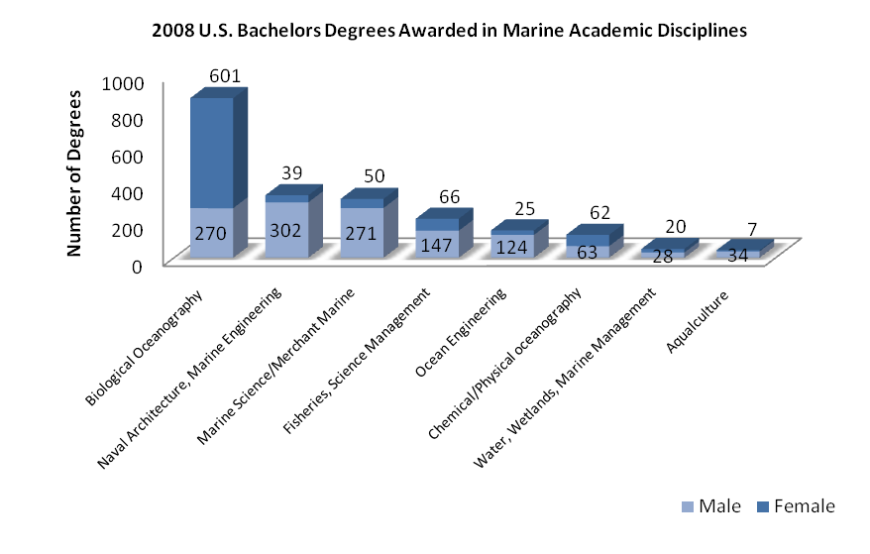
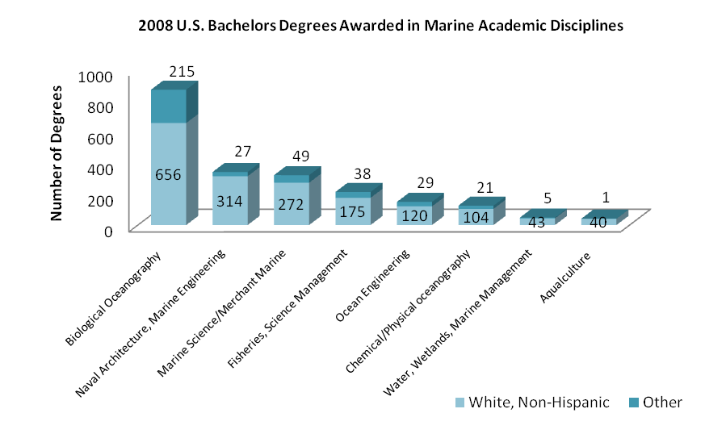
Today’s Grand Challenge as Geoscience Teachers:
Undergraduate Education Statistics
4,000 total students
41% Female
59% Male
18% Other
82% White, Non-Hispanic
Imbalance: 400 Students
Imbalance: 800 Students

Slide 3
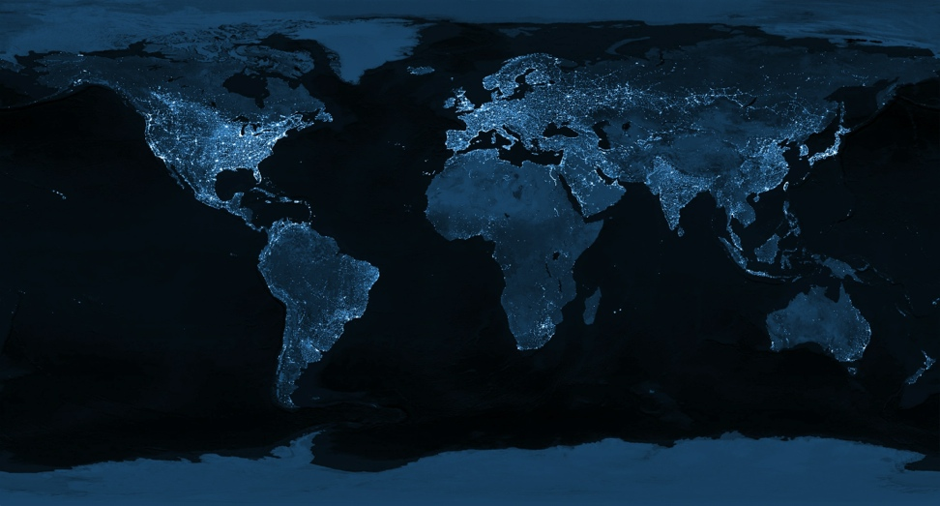
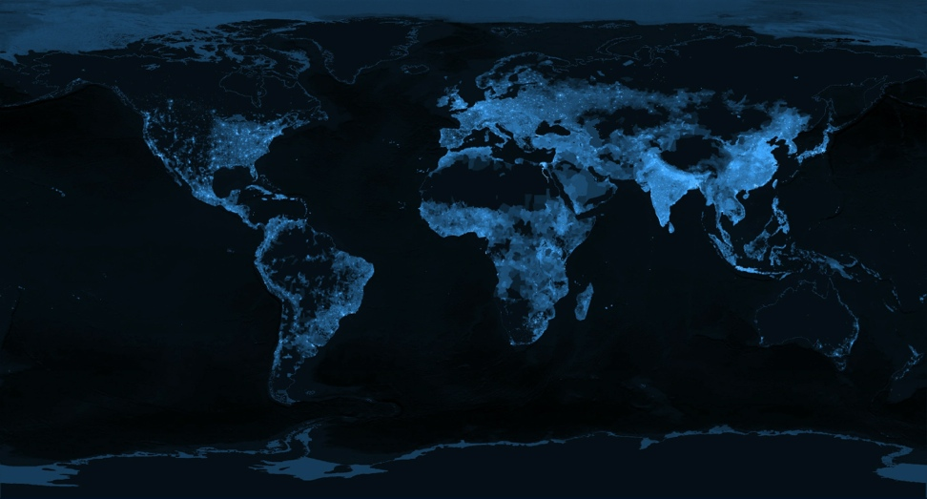
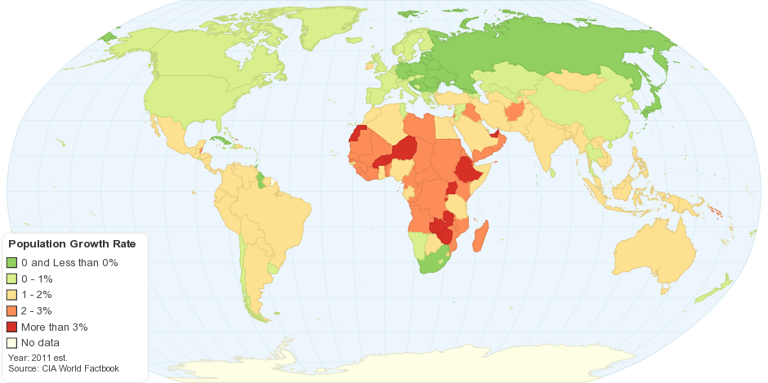
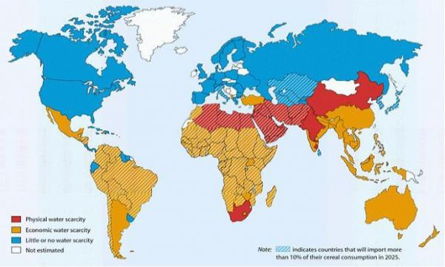
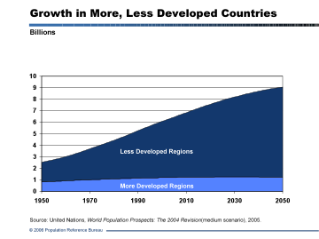
The 2050 Grand Challenge for our Students
During the Professional Lifetimes of Today’s Undergraduates,
Transform This (The Earth at Night)
Into This (Global Population)
7 Billion to 9 Billion
When the Human Population is Growing
And the Earth is Changing

Slide 4

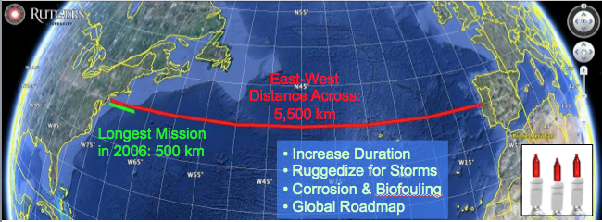
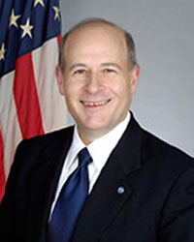
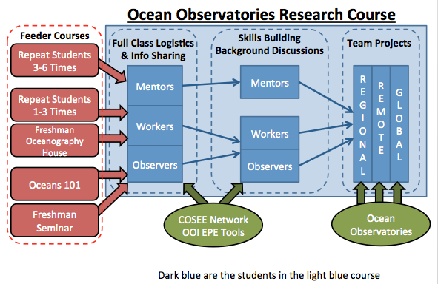
Trans-Atlantic Glider Challenge – May 24, 2006 –
UNESCO E.U./U.S. Baltic Sea Conference in Lithuania
Dr. Rick Spinrad
Assistant Administrator
NOAA
Office of Oceanic and Atmospheric Research
RU27: 7,400 km in 221 days
RU27: 7,400 km in 221 days
“I have something you need to do for the good of your country.”
“Take one of your gliders, modify it, and fly it across the Atlantic, inspiring students along the way.”

Slide 5
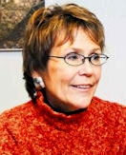
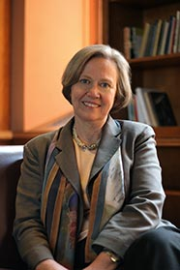
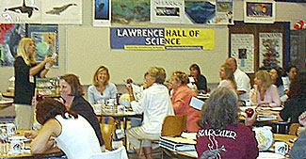
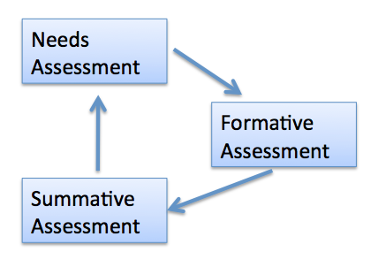
Advice from some Friends
Margaret Leinen –
Marine Geology – Director, Scripps Institute of Oceanography
Good news – Geoscience Majors are more likely to remain in their field.
Key to success – Mentorship – But there remains a mentorship gender gap.
Shirley Tilghman –
Molecular Biology - President, Princeton U.
Good news – We know what works.
Keys to success – Turn the pyramid upside down.
Start living the life of a scientist early.
Distribution classes taught within discipline.
Catherine Halversen –
Lawrence Hall of Science – COSEE Network
Good news – We know how people learn.
Key to success – Teach Communicating Ocean Science
Chris Parsons –
Education Evaluator – COSEE Network
Good News – We know how to improve.
Key to success – The assessment cycle.

Slide 6
On the Importance of Mentoring
From Margaret Leinan
Ocean Sciences Meeting, Honolulu, 2002
Having a mentor as a graduate student increased the probability of finishing graduate school from 60% to 100%
13.5% of the women interviewed had a mentor in undergraduate school; 20.5% had a mentor in graduate school
40% of the men interviewed had a mentor in undergraduate school; 65.7% had a mentor in graduate school

Slide 7
Advice from some Friends
Margaret Leinen –
Marine Geology – Director, Scripps Institute of Oceanography
Good news – Geoscience Majors are more likely to remain in their field.
Key to success – Mentorship – But there remains a mentorship gender gap.
Shirley Tilghman –
Molecular Biology - President, Princeton U.
Good news – We know what works.
Keys to success – Turn the pyramid upside down.
Start living the life of a scientist early.
Distribution classes taught within discipline.
Catherine Halversen –
Lawrence Hall of Science – COSEE Network
Good news – We know how people learn.
Key to success – Teach Communicating Ocean Science
Chris Parsons –
Education Evaluator – COSEE Network
Good News – We know how to improve.
Key to success – The assessment cycle.

Slide 8
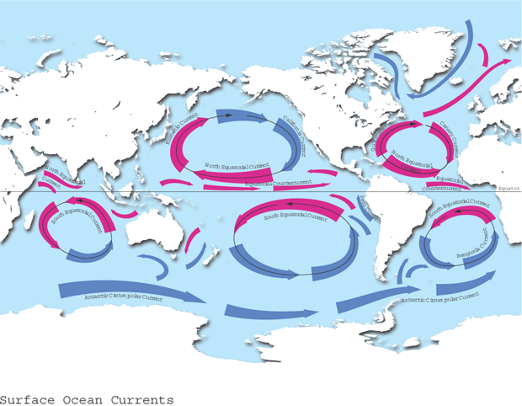
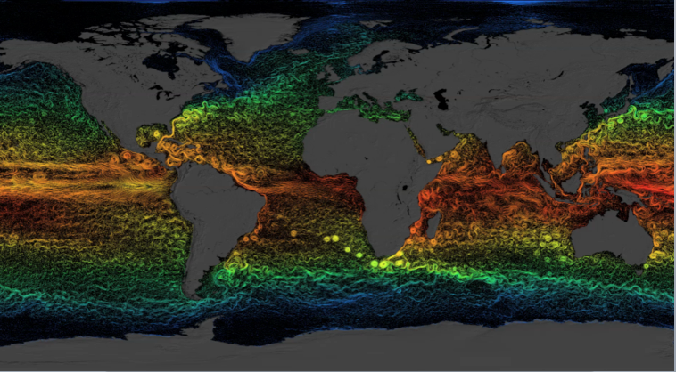
Ocean Circulation – From our college classrooms
What we teach: 5 ocean gyres
Data-Enhanced Learning Experiences
Include:
Students collect and interpret their own data, and/or
Explore research databases
Use data to answer questions
Impacts:
Prepare students to address real-world complex problems
Develop students’ ability to use scientific methods
Teach students how to critically evaluate data and evidence
Provide training in scientific, technical, quantitative & communication skils
Manduca & Mogk, 2002. Using Data in Undergraduate Classrooms. NSF-0127298.
What we miss: Energetic mesoscale

Slide 9
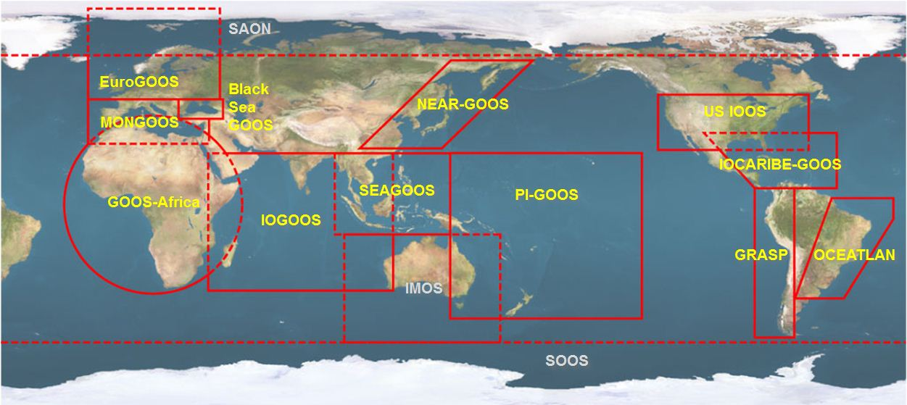





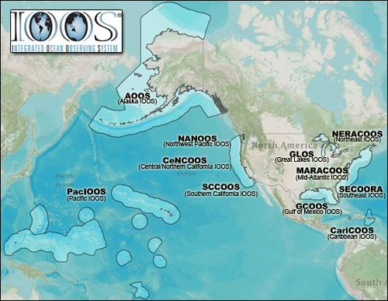


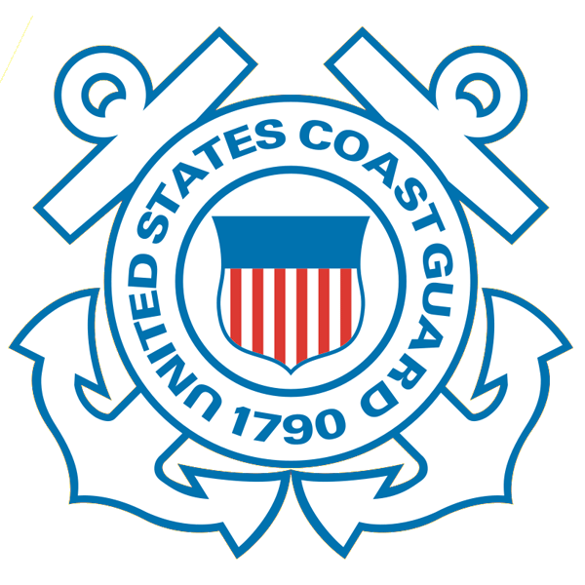








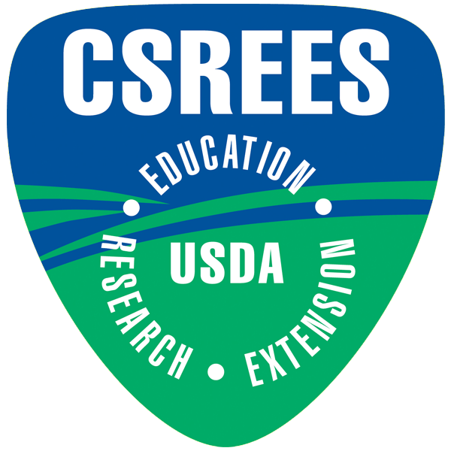
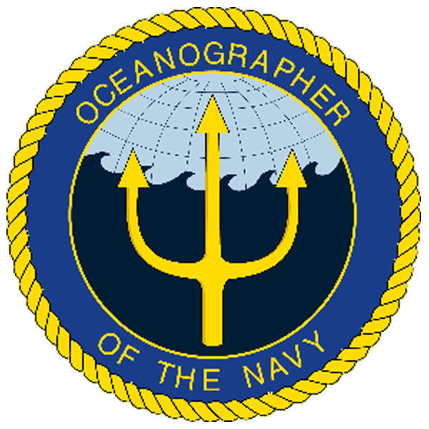
U.S. Integrated Ocean Observing System (IOOS)
Global Component
National Component
Regional Component
15 Regional Alliances in GOOS
Vessels -
Satellite
Satellite
CODAR
Ships/ Vessels
Glider
REMUS
Data Vis.
Modeling
Security
Leadership
Education
11 Regional Associations
17 U.S. Federal Agencies
http://ioos.gov

Slide 10
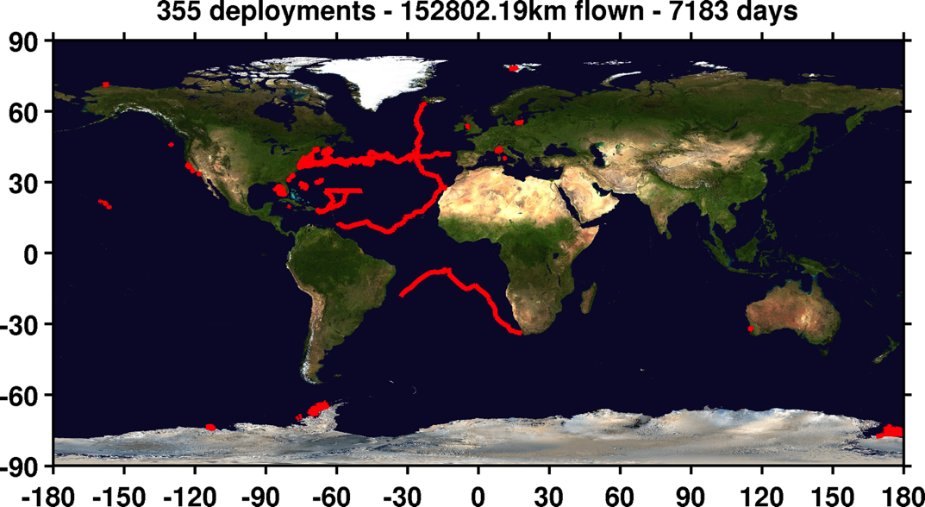
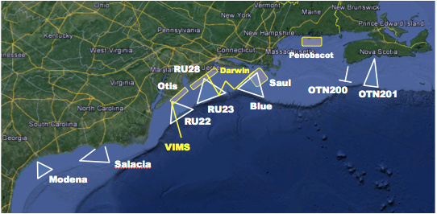
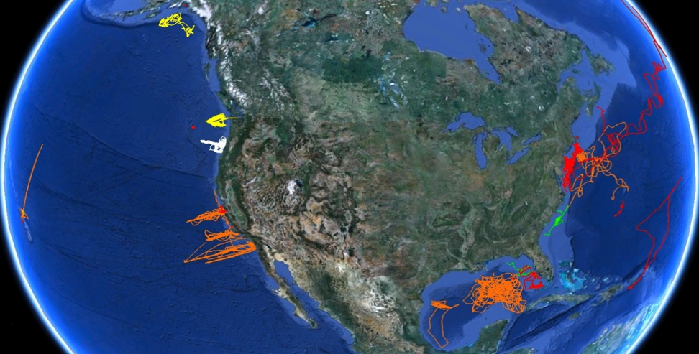
U.S. Integrated Ocean Observing System (IOOS)
Global Component
National Component
Regional Component
Vessels -
Satellite
Global Glider Networks
Multistatic
Nested
Mid-Atlantic Glider Network
U.S. National Glider Network
http://ioos.gov

Slide 11
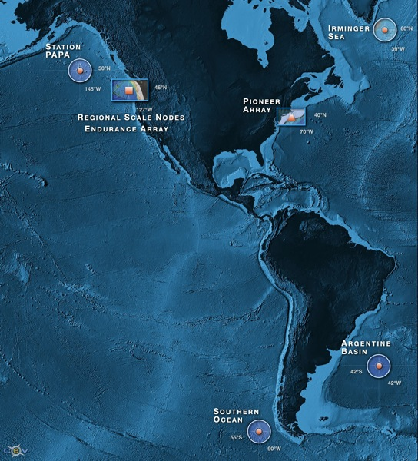


NSF Ocean Observing Initiative
Five Integrated Transformational Activities
High Latitude Global Sites
Regional Plate-scale Cable
Coastal Dynamics Arrays
Cyber-Space Data Delivery & Sensor Interactivity
Education and Public Engagement
11
Notes:
They are specific

Slide 12
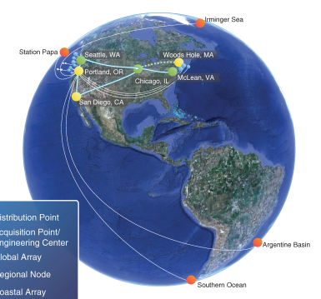
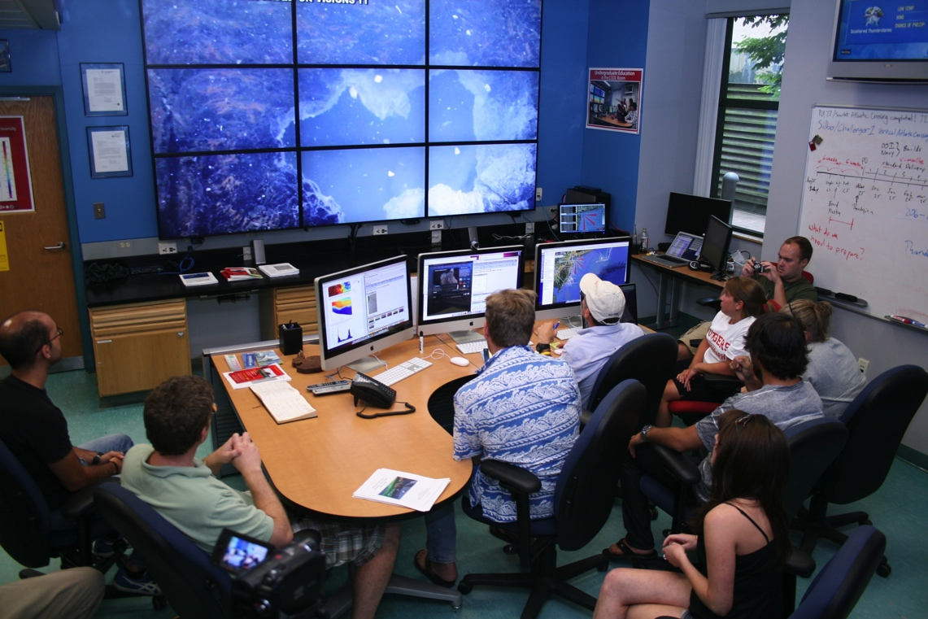
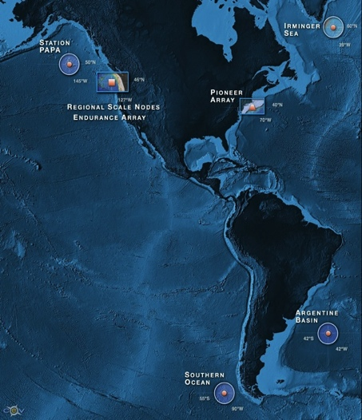


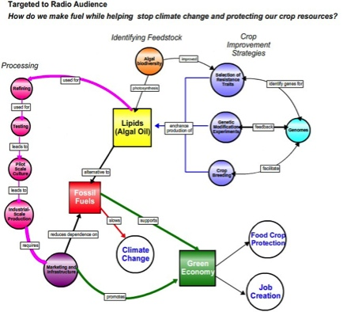
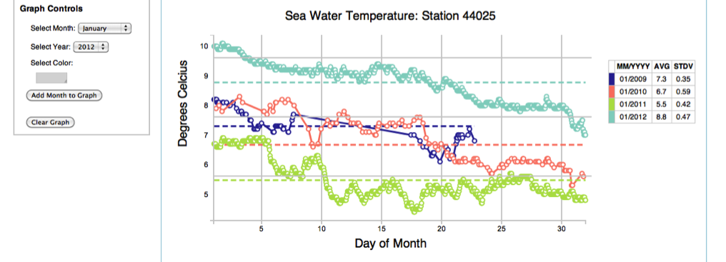
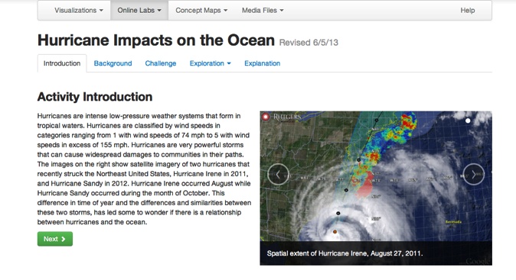
OOI – Enabling the Undergraduate Classroom
Concept Maps
Data Visualization Tools
Investigation Builder

Slide 13
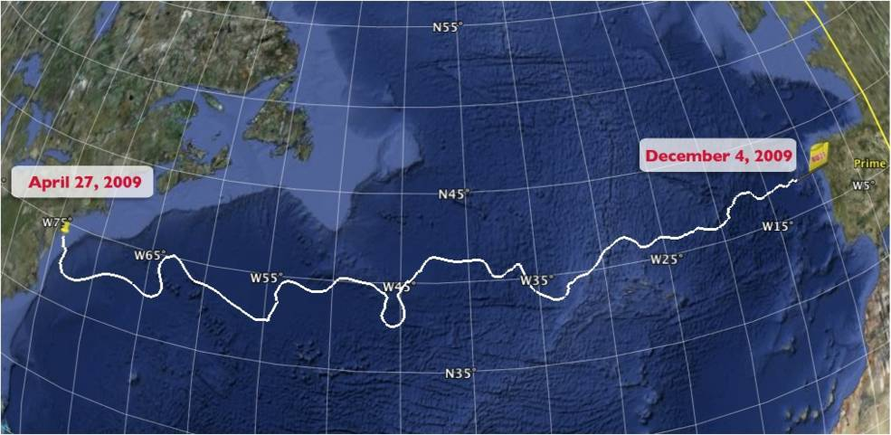
Trans-Atlantic Glider Challenge – May 24, 2006 –
UNESCO E.U./U.S. Baltic Sea Conference in Lithuania
Dr. Rick Spinrad
Assistant Administrator
NOAA
Office of Oceanic and Atmospheric Research
RU27: 7,400 km in 221 days
“I have something you need to do for the good of your country.”
“Take one of your gliders, modify it, and fly it across the Atlantic, inspiring students along the way.”
Trans-Atlantic Glider Challenge

Slide 14
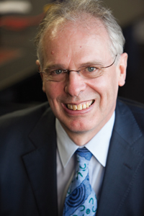
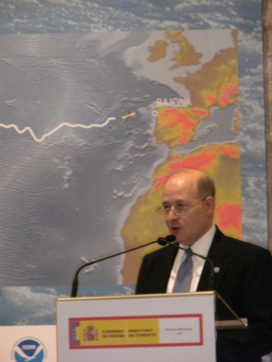
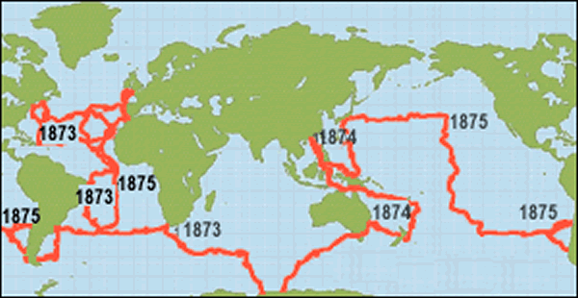
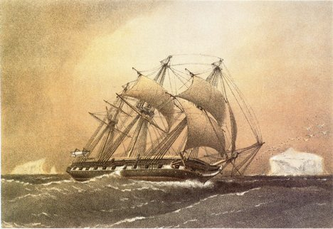
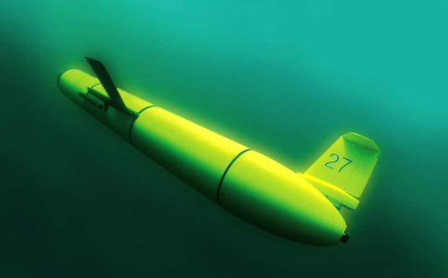
A Global Challenge – The Challenger Glider Mission
December 9, 2009 – Baiona, Spain
Ralph Rayner & Rick Spinrad’s Global Challenge:
Build a Global Glider Fleet
and Coordinate the First
Robotic Circumnavigation.
Revisit the Historic Track of the
HMS Challenger –
And inspire a global network
of students along the way.
HMS Challenger Voyage
First Scientific
Circumnavigation
1872-1876
128,000 km =
= 16 gliders
x 8,000 km/glider

Slide 15
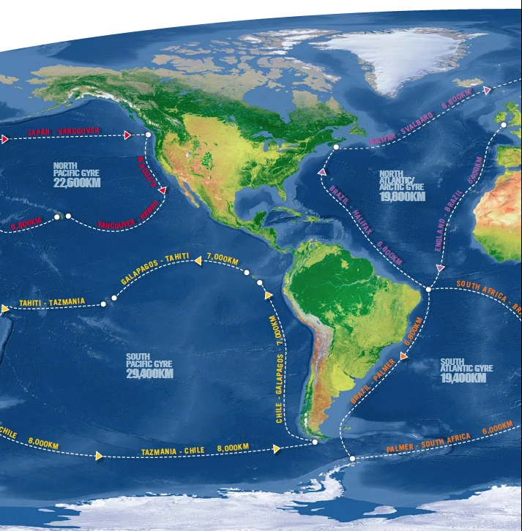
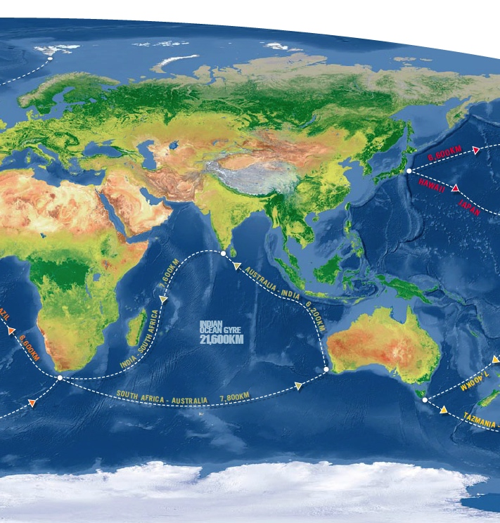
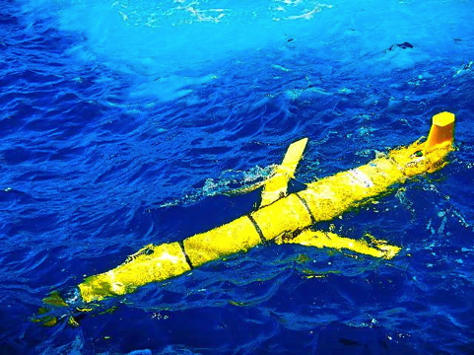
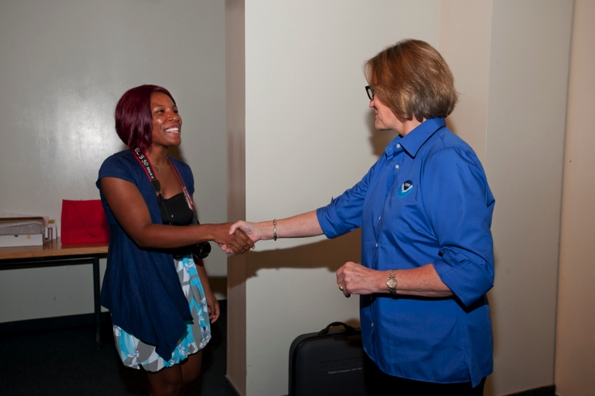

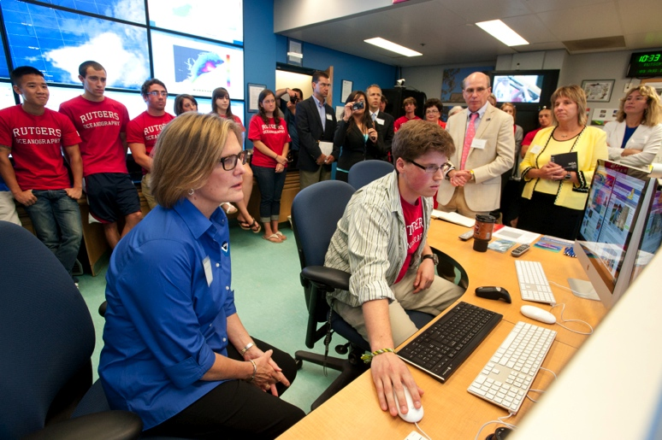
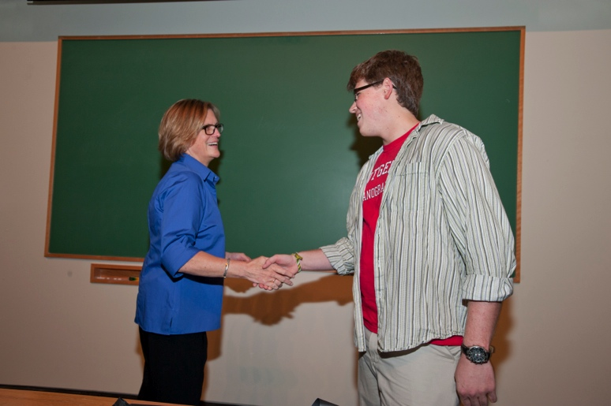
Global Challenger Glider Mission
16 Global-Class Gliders

Slide 16
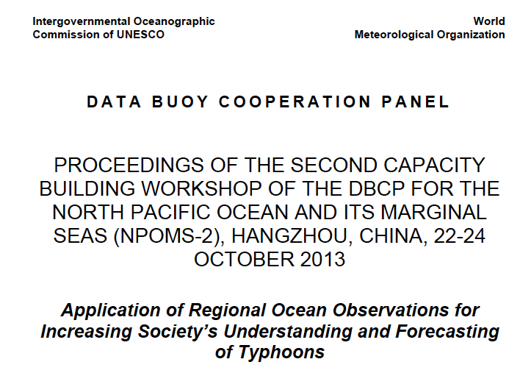
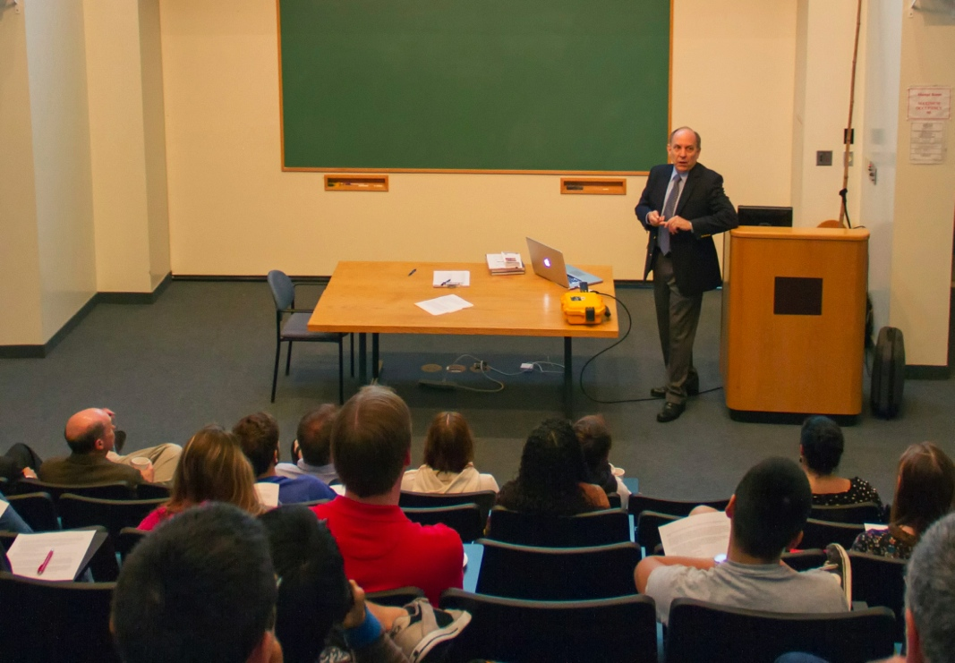
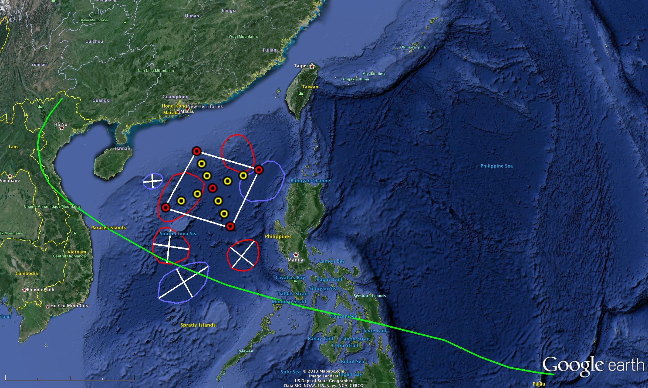
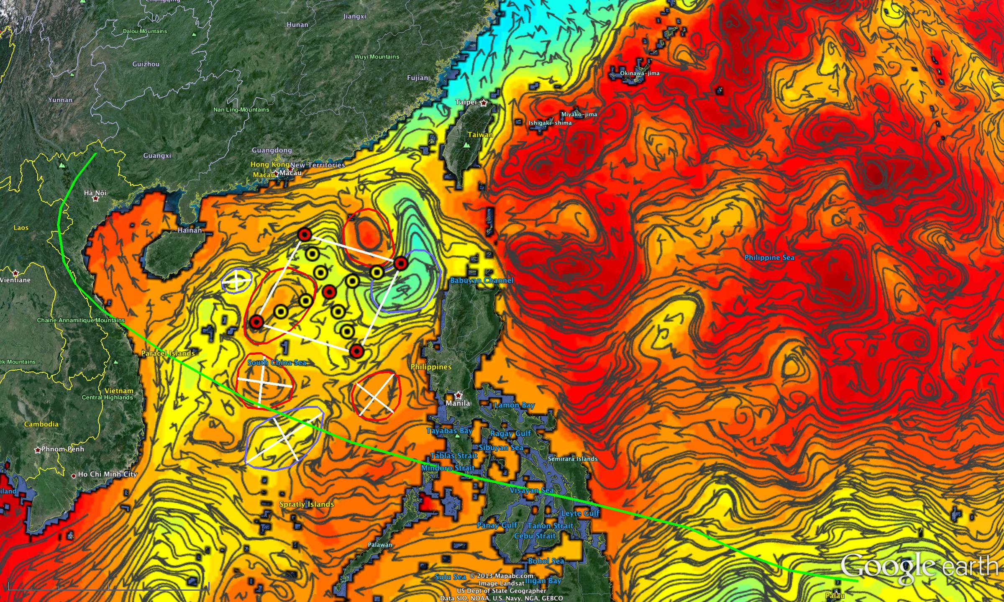
2013 International Typhoon Workshop
Dr. Louis Uccellini, Director
National Weather Service
Crowd-sourced comparisons between
U.S. & European Models & Gliders

Slide 17
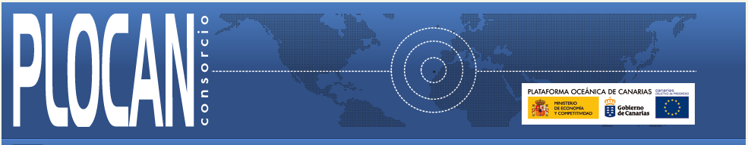



Companion Course at
Plataforma Oceanica de Canarias
Shared Glider Missions – Iceland to Azores; Azores to Canaries; Canaries to Caribbean
Skype Sessions between classes
Two-way International Exchange programs
Students Learn Science from their teachers
Students Learn Culture from their peers

Slide 18




RTOFS and MERCATOR
Temperature and Current Maps at 200 m
200m temperature and currents on April 18th, 2013. The glider position is marked by the red dot.
RTOFS
200 m
800 m
Green – Glider
Red – US
Blue - Europe
MERCATOR

Slide 19









Glider RU29: Launched from Cape Town 11 Jan 2013, flown >8,125 km
South African Coast
2400 km

Slide 20






Arctic Ocean
New Participants – Korea
KNRV5000 Circumnavigation + 2015-2016 Glider Deployments
NOAA/PMEL
Chuuk, Micronesia
KNRV5000
Lima, Peru
Antarctica

Slide 21





Engaging Community Colleges
CCURI – OOI Early Adopters:
Finger Lakes Community College, NY
McLennan Community College, TX
Florida Keys Community College, FL
Everett Community College, WA
Inquiry-based Teaching Model:
Real-world Science Case Study
Hands-on Research Experience
CCURI – OOI Demonstration Project:
1) Evaluation from student perspective
2) Evaluation from teacher perspective
3) Contribute to the lesson database

Slide 22





South Africa – Workforce Development for HF Radar
South African Coast
2400 km
Full Semester Research Course
Intense 1-2 week teacher in residence
Skype sessions with research teams
Jobs in the SA Weather Service

Slide 23


What we need: Power Up! for Undergraduates
Industry Opportunity Workshops

Slide 24

For Our Students:
Ocean Observatories Expanding
Cyber-enabled Ocean Science
The Ocean is Your Classroom
Thank you COSEE!
“Work Hard, Have Fun,
Change the World”
- Doug Webb’s advice to students,
Baiona, Spain, 8 Dec 2009.

