Slide 1
Assessment and Quantification of HF Radar Uncertainty
Fearghal O’Donncha
Sean McKenna
Emanuele Ragnoli
Teresa Updyke
Hugh Roarty

Slide 2
Outline
Introduction to team members
Introduction to High Frequency Radar
Discussion of the Study Area and Data Record
Explanation of Principal Component Analysis
Sensitivity Analysis of the Number of Modes and Window Length
Conclusions

Slide 3
IBM/Rutgers/ODU
IBM Deep Current: High resolution, real-time ocean circulation forecasts to support critical operations for marine based businesses
Transportable algorithm for establishing uncertainty in real-time measuring system prior to assimilation into circulation model
Rutgers and ODU are leading operators of HF radar in the Mid Atlantic and looking for applications of their measurements

Slide 4
Introduction to High Frequency Radar

Slide 5
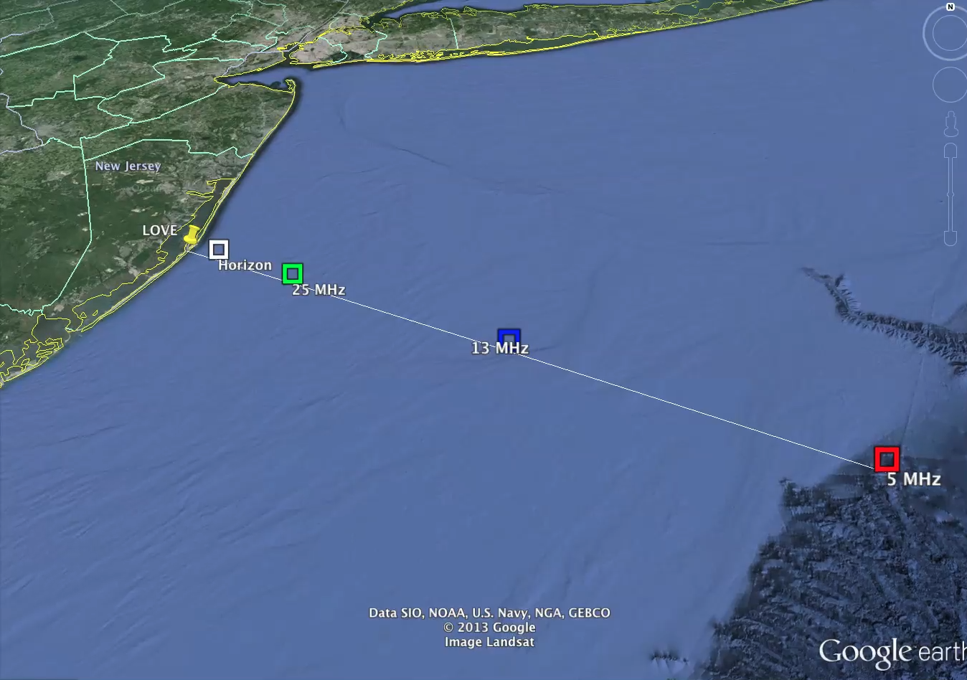
Benefit of HF Radar

Slide 6
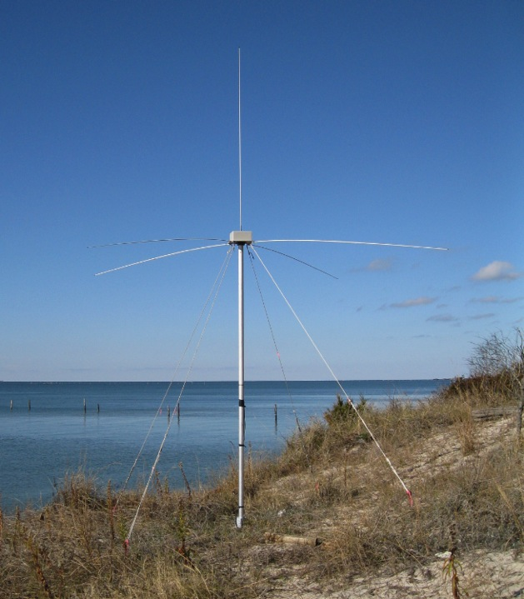
25 MHz Transmit and Receive Antenna
4 meters

Slide 7
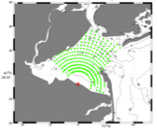
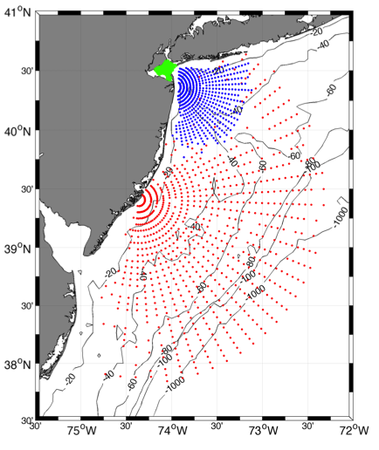
Surface Current Mapping Capability
25 MHz
Radar λ: 12 m Ocean λ: 6 m
Range: 30 km Resolution: 1 km
13 MHz
Radar λ: 23 m Ocean λ: 12 m
Range: 80 km Resolution: 3 km
05 MHz
Radar λ: 60m Ocean λ: 30 m
Range: 180 km Resolution: 6 km

Slide 8
Study Area

Slide 9
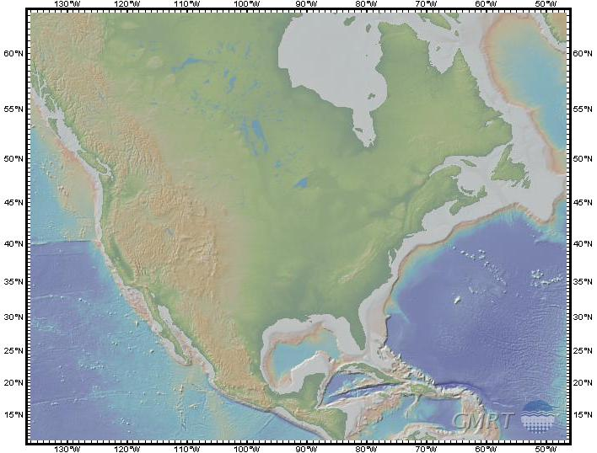

Slide 10
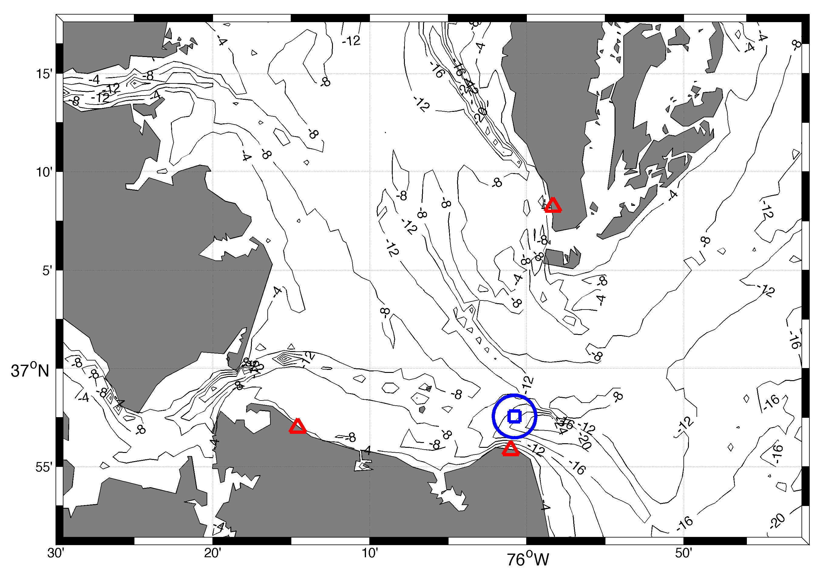
One Year of Data Jan – Dec 2012

Slide 11
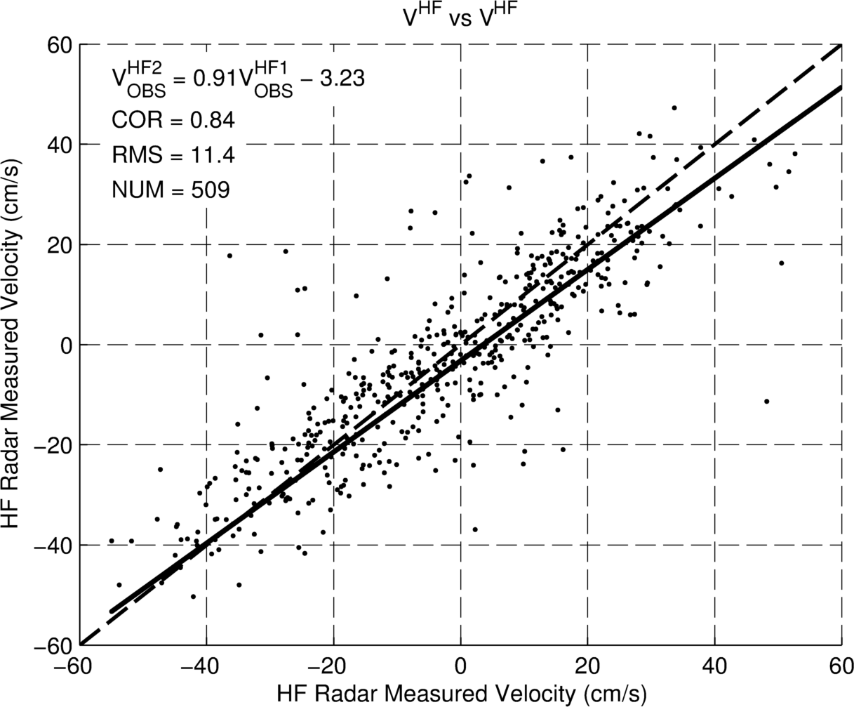
Baseline Comparison
Direct comparison velocity measured by individual radar station
Assess system performance without additional sensor requirements
Localize data uncertainty and preliminary anomaly identification

Slide 13
Principal component Analysis

Slide 14
Tools for Geophysical Data Analysis
Normal Mode Analysis (NMA)
Open Bounday Modal Analysis (OMA)
Empirical Orthogonal Functions (EOF)
Principal Components Analysis (PCA)
Lagrangian Coherent Structures (LCS)

Slide 15
What does PCA do?
Finds spatial patterns of variability and their time variation
A common use is to reconstruct a “cleaner” data set by truncating at some number of modes

Slide 16
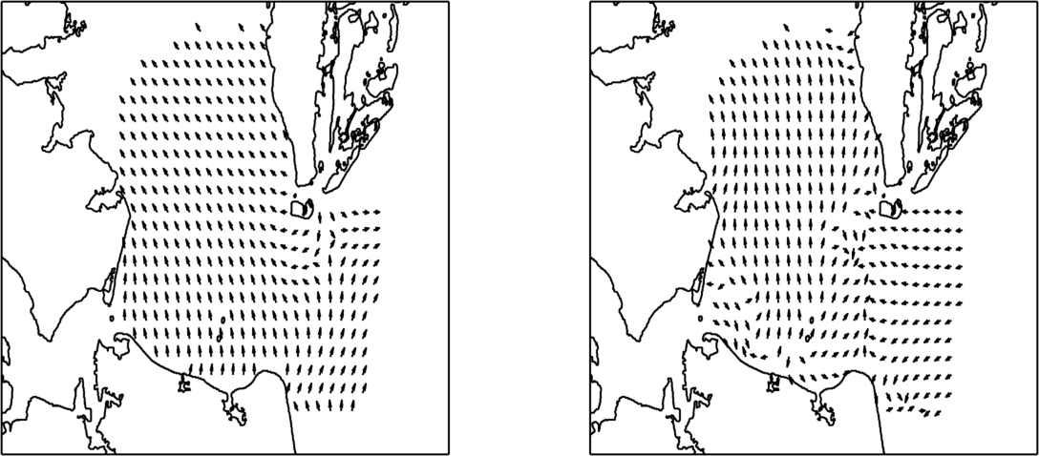
Graphical Representation
54% Variance explained
13% Variance explained
PC₁
PC₂
Spatial consistency of PC₁ implies tidal forcing
Higher frequency influences evident in PCs

Slide 17
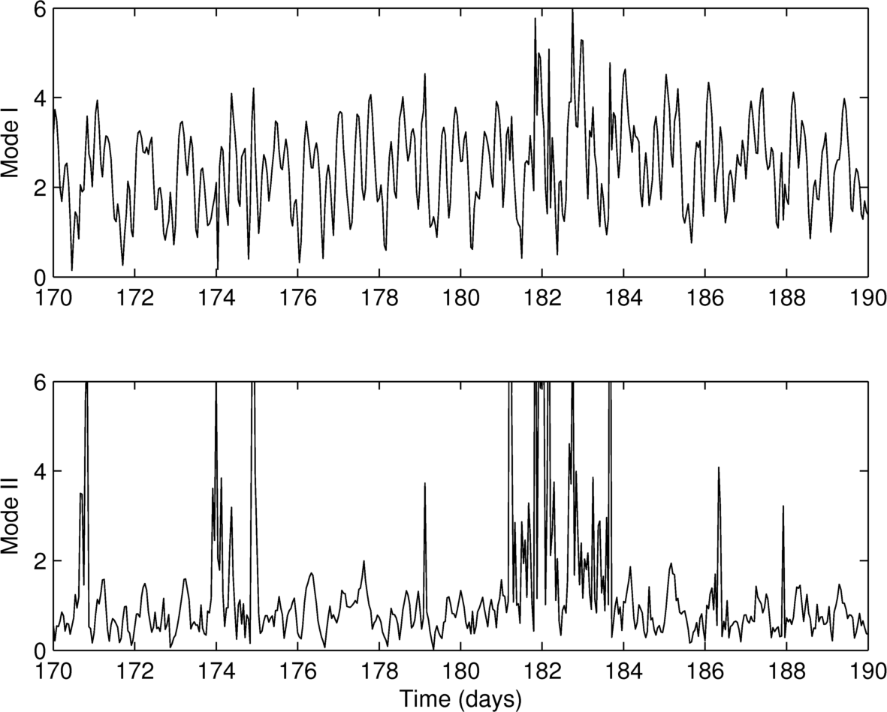
Temporal Categorization
Evolution in time of PC₁ & PC₂
Increased dynamicity captured at days 182 - 184

Slide 18
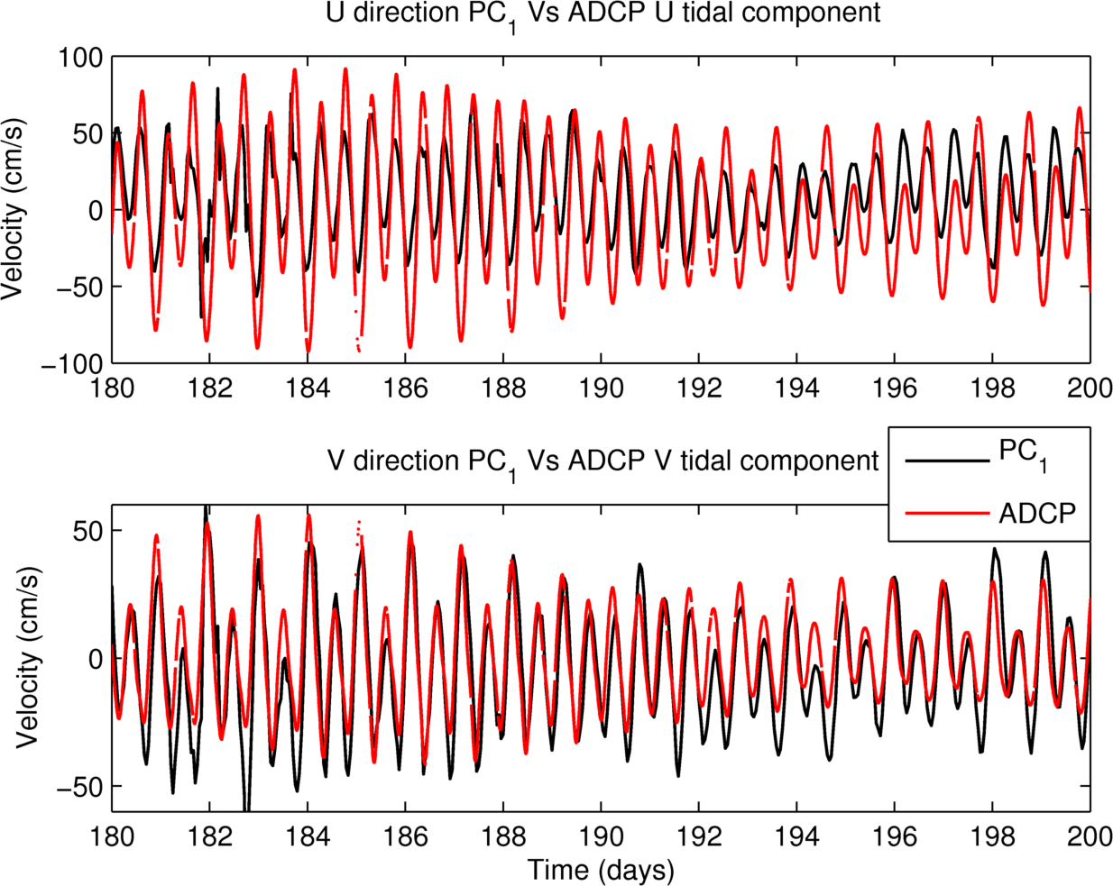
ADCP Comparisons
Reconstructed PC₁ flows plotted against ADCP harmonic component

Slide 19
Number of Modes to Include
Fraction of Variance 70% - 2 modes 90% - 12 modes 95% - 29 modes
Residual Percent Variance – 7 modes
Guttman-Kaiser criterion – 20 modes
North’s rule of thumb – 9 modes

Slide 20
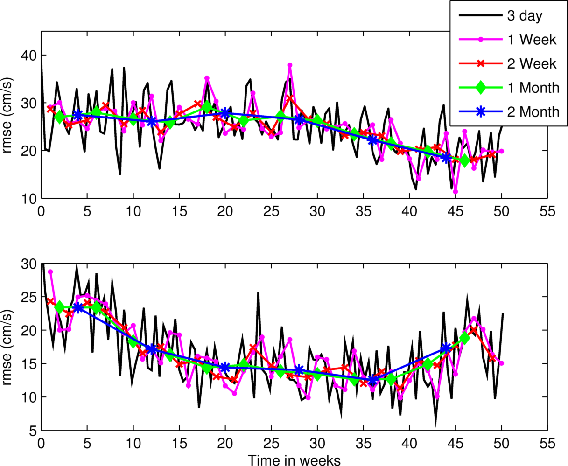
Temporal Window Width
RMSE PC1 reconstruction and ADCP harmonic component
Window width influences how well model captures shorter-term fluctuations

Slide 21
Number of PCA modes and Window Length
HIGH
General Circulation
Window Length
Fine Scale model,
Sea Breeze Events
LOW
LOW
HIGH
# of PCA Modes

Slide 22
Conclusion
A year of HF radar was analyzed using Principal Component Analysis
The number of modes to retain and length of temporal window were tested
We envision this as a preconditioning method for assimilation of HF radar data into a numerical model

