Slide 1
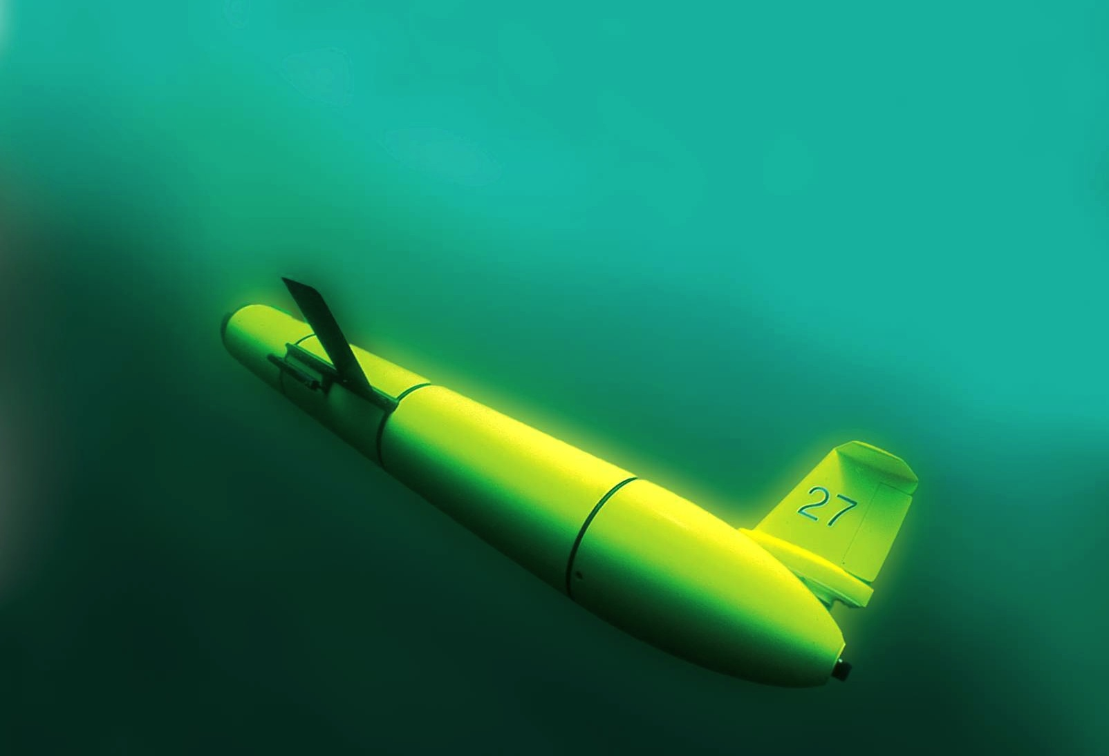



The Challenger Glider Mission: Ocean Predictive Skill Assessment in the South Atlantic, Crowd Sourcing of Student Based Discovery
R. Sacatelli, T. Schofield, K. Todoroff, A. Carandang, A. Eng, I. Lowry, H. Mather, Travis Miles, Scott Glenn, Oscar Schofield & Josh Kohut
“The Ocean is Our Classroom”

Slide 2
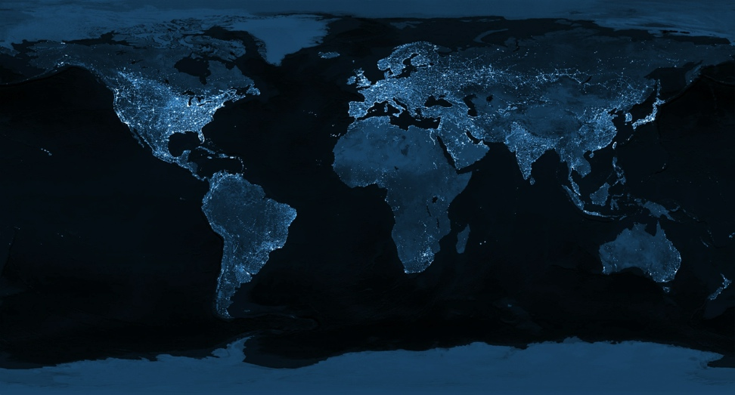
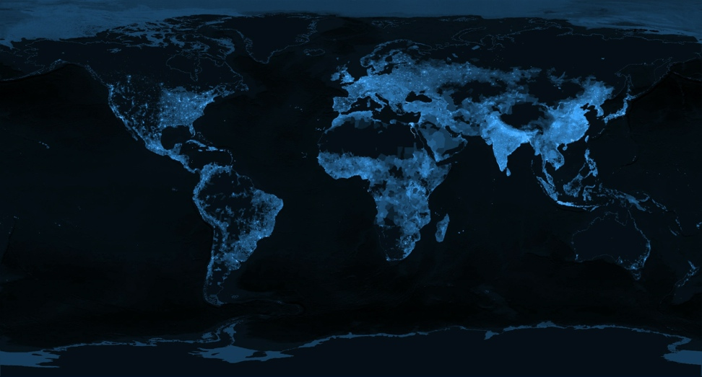
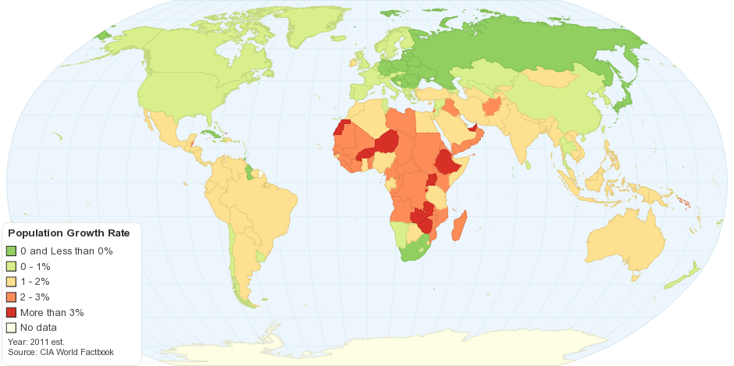
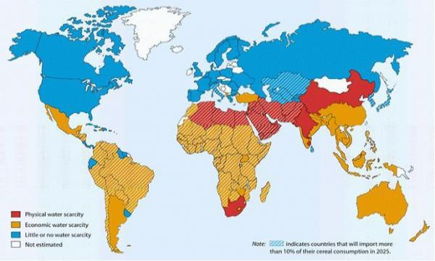
The 2050 Grand Challenge for our Students
During the Professional Lifetimes of Today’s Undergraduates,
The Earth at Night
Global Population
Transform This
Into This
Projected Population Growth
Projected Water Scarcity
When the Human Population is Growing
And the Earth is Changing
Notes:
About a billion people that don’t have enough electricity/food/water 7 billion people only 6 billion or less are living at the standard that we’re used. As the population increases over the lifetime of todays undergraduate students at a time when the earth is changing, growing seasons changing, water scarcity is changing. Need to get them

Slide 3

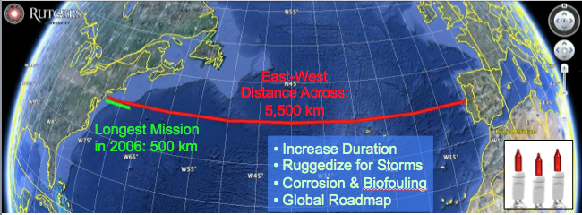
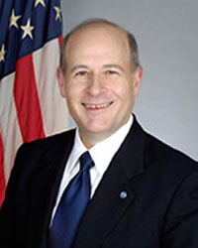
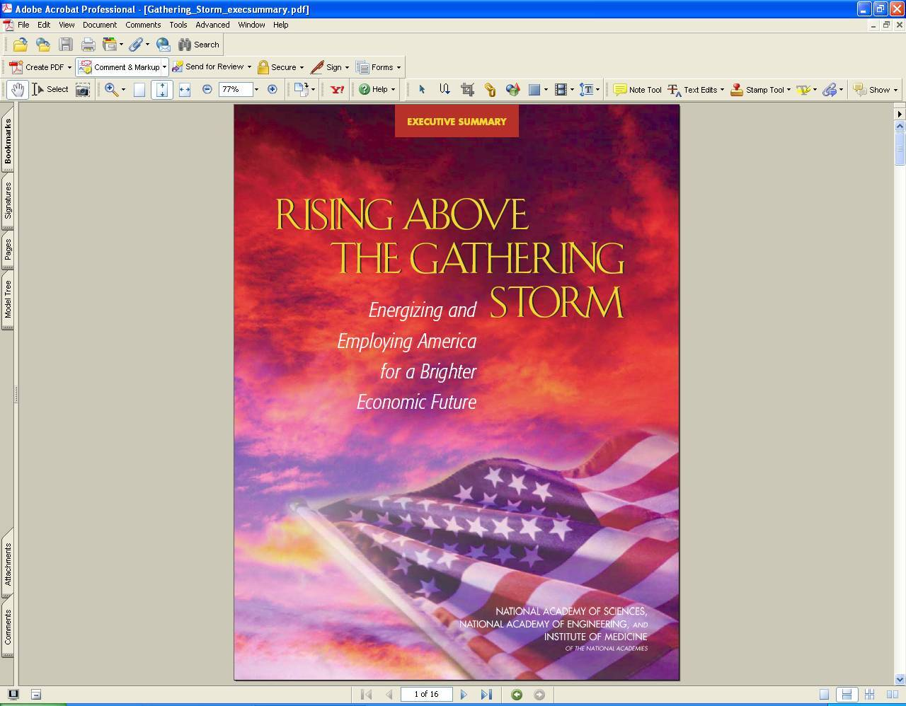
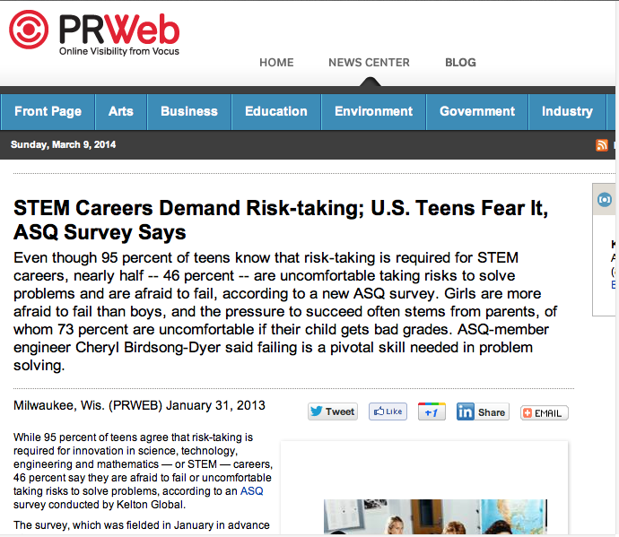
Trans-Atlantic Glider Challenge – May 24, 2006 –
UNESCO E.U./U.S. Baltic Sea Conference in Lithuania
Dr. Rick Spinrad
Assistant Administrator
NOAA
Office of Oceanic and Atmospheric Research
RU27: 7,400 km in 221 days
RU27: 7,400 km in 221 days
“I have something you need to do for the good of your country.”
“Take one of your gliders, modify it, and fly it across the Atlantic, inspiring students along the way.”
Positive risk-taking is required for innovation in STEM careers!
Notes:
Facing that slide before: “what keeps him up the most at night?” Answer: “Our education system, worried we’re not training our students to be technology innovators, which requires risk taking” To solve these problems it will require innovation
Wants us to take some of those risks, encourage students to take some of those risks to meet these challenges. Innovation requires positive risk taking.
We want to inspire those students to address those challenges, by encouraging them to take risks and be part of the process.

Slide 4
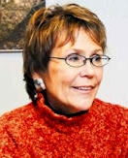
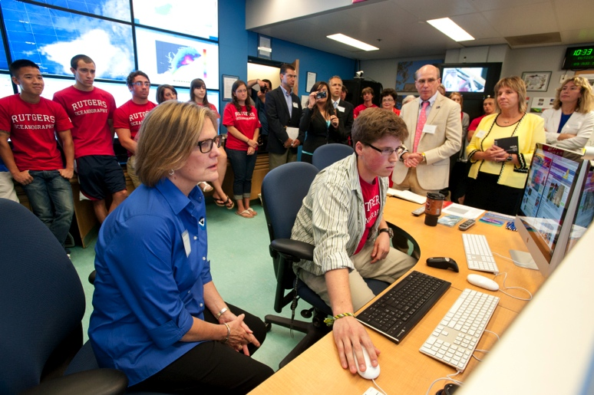
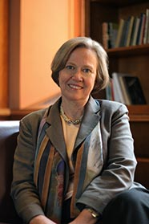
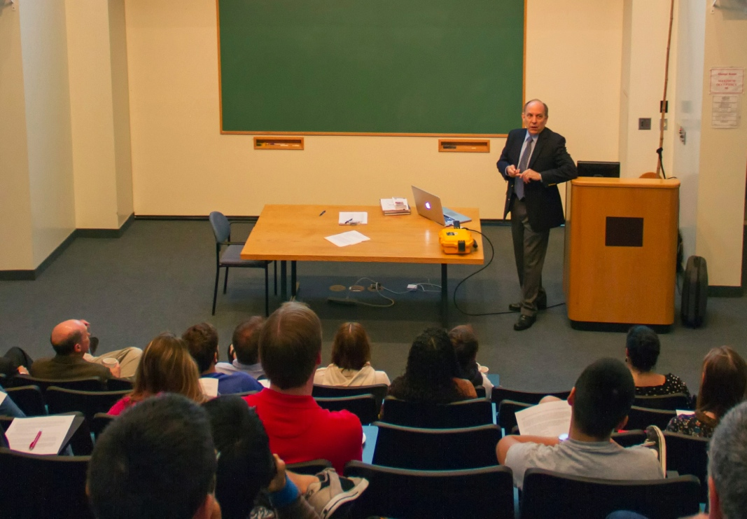
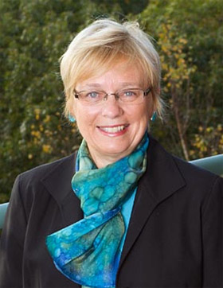
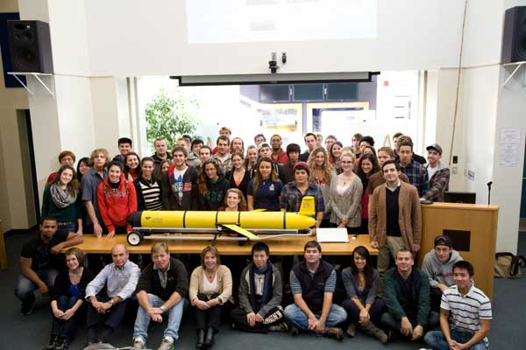
Advice from Some Friends
Margaret Leinen – Director, Scripps Institute of Oceanography
Mentorship – Mind the gender gap
Shirley Tilghman – Former President, Princeton University
Turn the pyramid upside down -
Start living the life of a scientist early
Susan Avery – Director, Woods Hole Oceanographic Institution
Present and publish scientific results
Kathy Sullivan – Administrator, NOAA
Be explorers
Louis Uccellini – Director, National Weather Service
Explore our global models
Zdenka Willis – Director, U.S. IOOS
Communicate what you’ve learned
Notes:
Margaret Leinen – Mentorship is very important for our young people, incredibly important to students success: Including increasing mentorship of females and under represented groups
Turn the pyramid upside down: Start being a scientist as a Undergraduates, doing research right away ,better retention, better grades, better interactions. sent undergraduates to Antarctica, large research classes for 1st year students.
“We’re going to fly a glider across the Atlantic” Z: “Have you told anyone about this?”
Susan Avery – Get undergraduates presenting results and publishing scientific papers: we’ve had many undergraduate research presentations, culminates in publishing and often presenting at MTS conferences.

Slide 5
Advice from Some Friends
Margaret Leinen – Director, Scripps Institute of Oceanography
Mentorship – Mind the gender gap
Shirley Tilghman – Former President, Princeton University
Turn the pyramid upside down -
Start living the life of a scientist early
Susan Avery – Director, Woods Hole Oceanographic Institution
Present and publish scientific results
Kathy Sullivan – Administrator, NOAA
Be explorers
Louis Uccellini – Director, National Weather Service
Explore our global models
Zdenka Willis – Director, U.S. IOOS
Communicate what you’ve learned
Notes:
Margaret Leinen – Mentorship is very important for our young people, incredibly important to students success: Including increasing mentorship of females and under represented groups
Turn the pyramid upside down: Start being a scientist as a Undergraduates, doing research right away ,better retention, better grades, better interactions. sent undergraduates to Antarctica, large research classes for 1st year students.
“We’re going to fly a glider across the Atlantic” Z: “Have you told anyone about this?”
Susan Avery – Get undergraduates presenting results and publishing scientific papers: we’ve had many undergraduate research presentations, culminates in publishing and often presenting at MTS conferences.

Slide 6
Advice from Some Friends
Margaret Leinen – Director, Scripps Institute of Oceanography
Mentorship – Mind the gender gap
Shirley Tilghman – Former President, Princeton University
Turn the pyramid upside down -
Start living the life of a scientist early
Susan Avery – Director, Woods Hole Oceanographic Institution
Present and publish scientific results
Kathy Sullivan – Administrator, NOAA
Be explorers
Louis Uccellini – Director, National Weather Service
Explore our global models
Zdenka Willis – Director, U.S. IOOS
Communicate what you’ve learned
Notes:
Margaret Leinen – Mentorship is very important for our young people, incredibly important to students success: Including increasing mentorship of females and under represented groups
Turn the pyramid upside down: Start being a scientist as a Undergraduates, doing research right away ,better retention, better grades, better interactions. sent undergraduates to Antarctica, large research classes for 1st year students.
“We’re going to fly a glider across the Atlantic” Z: “Have you told anyone about this?”
Susan Avery – Get undergraduates presenting results and publishing scientific papers: we’ve had many undergraduate research presentations, culminates in publishing and often presenting at MTS conferences.

Slide 7
Advice from Some Friends
Margaret Leinen – Director, Scripps Institute of Oceanography
Mentorship – Mind the gender gap
Shirley Tilghman – Former President, Princeton University
Turn the pyramid upside down -
Start living the life of a scientist early
Susan Avery – Director, Woods Hole Oceanographic Institution
Present and publish scientific results
Kathy Sullivan – Administrator, NOAA
Be explorers
Louis Uccellini – Director, National Weather Service
Explore our global models
Zdenka Willis – Director, U.S. IOOS
Communicate what you’ve learned
Notes:
Margaret Leinen – Mentorship is very important for our young people, incredibly important to students success: Including increasing mentorship of females and under represented groups
Turn the pyramid upside down: Start being a scientist as a Undergraduates, doing research right away ,better retention, better grades, better interactions. sent undergraduates to Antarctica, large research classes for 1st year students.
“We’re going to fly a glider across the Atlantic” Z: “Have you told anyone about this?”
Susan Avery – Get undergraduates presenting results and publishing scientific papers: we’ve had many undergraduate research presentations, culminates in publishing and often presenting at MTS conferences.

Slide 8
Advice from Some Friends
Margaret Leinen – Director, Scripps Institute of Oceanography
Mentorship – Mind the gender gap
Shirley Tilghman – Former President, Princeton University
Turn the pyramid upside down -
Start living the life of a scientist early
Susan Avery – Director, Woods Hole Oceanographic Institution
Present and publish scientific results
Kathy Sullivan – Administrator, NOAA
Be explorers
Louis Uccellini – Director, National Weather Service
Explore our global models
Zdenka Willis – Director, U.S. IOOS
Communicate what you’ve learned
Notes:
Margaret Leinen – Mentorship is very important for our young people, incredibly important to students success: Including increasing mentorship of females and under represented groups
Turn the pyramid upside down: Start being a scientist as a Undergraduates, doing research right away ,better retention, better grades, better interactions. sent undergraduates to Antarctica, large research classes for 1st year students.
“We’re going to fly a glider across the Atlantic” Z: “Have you told anyone about this?”
Susan Avery – Get undergraduates presenting results and publishing scientific papers: we’ve had many undergraduate research presentations, culminates in publishing and often presenting at MTS conferences.

Slide 9
Advice from Some Friends
Margaret Leinen – Director, Scripps Institute of Oceanography
Mentorship – Mind the gender gap
Shirley Tilghman – Former President, Princeton University
Turn the pyramid upside down -
Start living the life of a scientist early
Susan Avery – Director, Woods Hole Oceanographic Institution
Present and publish scientific results
Kathy Sullivan – Administrator, NOAA
Be explorers
Louis Uccellini – Director, National Weather Service
Explore our global models
Zdenka Willis – Director, U.S. IOOS
Communicate what you’ve learned
Notes:
Margaret Leinen – Mentorship is very important for our young people, incredibly important to students success: Including increasing mentorship of females and under represented groups
Turn the pyramid upside down: Start being a scientist as a Undergraduates, doing research right away ,better retention, better grades, better interactions. sent undergraduates to Antarctica, large research classes for 1st year students.
“We’re going to fly a glider across the Atlantic” Z: “Have you told anyone about this?”
Susan Avery – Get undergraduates presenting results and publishing scientific papers: we’ve had many undergraduate research presentations, culminates in publishing and often presenting at MTS conferences.

Slide 10
Advice from Some Friends
Margaret Leinen – Director, Scripps Institute of Oceanography
Mentorship – Mind the gender gap
Shirley Tilghman – Former President, Princeton University
Turn the pyramid upside down -
Start living the life of a scientist early
Susan Avery – Director, Woods Hole Oceanographic Institution
Present and publish scientific results
Kathy Sullivan – Administrator, NOAA
Be explorers
Louis Uccellini – Director, National Weather Service
Explore our global models
Zdenka Willis – Director, U.S. IOOS
Communicate what you’ve learned
Notes:
Margaret Leinen – Mentorship is very important for our young people, incredibly important to students success: Including increasing mentorship of females and under represented groups
Turn the pyramid upside down: Start being a scientist as a Undergraduates, doing research right away ,better retention, better grades, better interactions. sent undergraduates to Antarctica, large research classes for 1st year students.
“We’re going to fly a glider across the Atlantic” Z: “Have you told anyone about this?”
Susan Avery – Get undergraduates presenting results and publishing scientific papers: we’ve had many undergraduate research presentations, culminates in publishing and often presenting at MTS conferences.

Slide 11
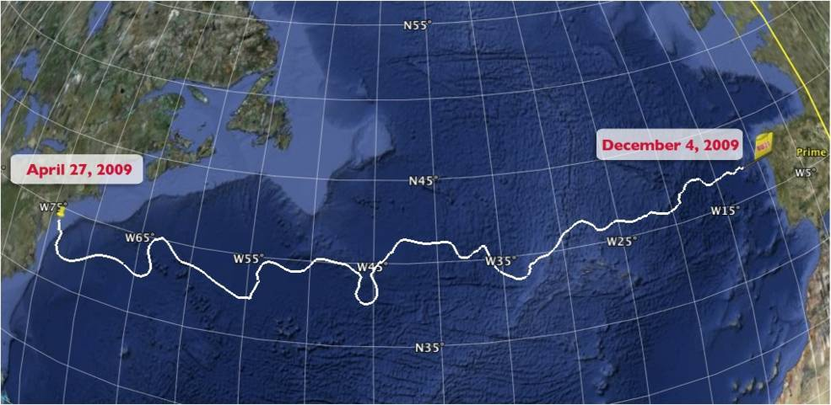
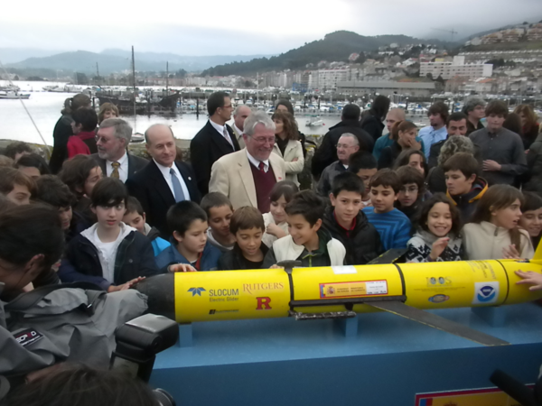
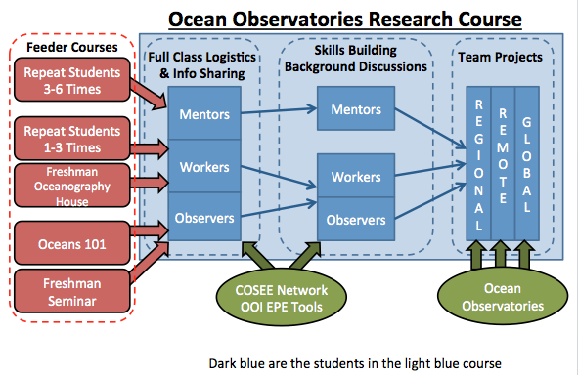
The Trans-Atlantic Glider Challenge
December 9, 2009 – Baiona, Spain
RU27: 7,400 km in 221 days
Trans-Atlantic Glider Challenge
Notes:
Letters from students to Spanish schools
Watch one, do one teach one. Borrowed best practices from COSEE, used data from ocean observatories. Increased students by over 400% with between 50 and 100 undergrads involved in the lab and research on a consistent basis. Reached carrying capacity.

Slide 12
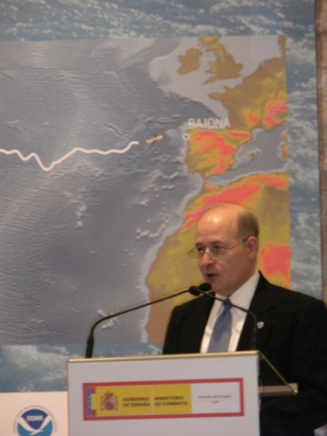
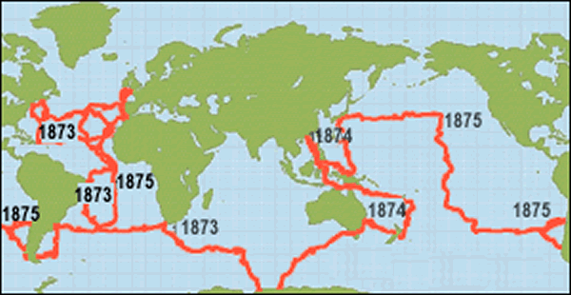
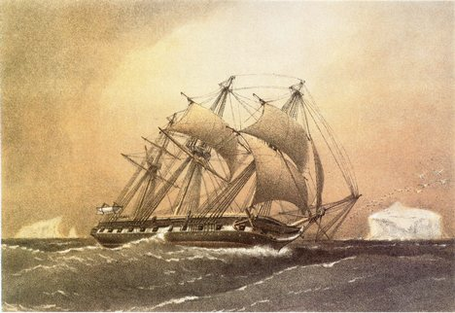
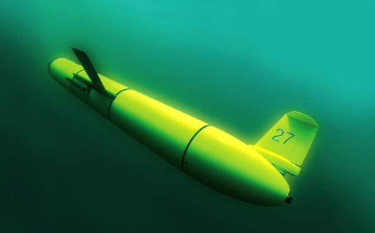
A Global Challenge – The Challenger Glider Mission
December 9, 2009 – Baiona, Spain
Dr. Rick Spinrad
AA of NOAA Office of
Oceanic & Atmospheric Research
Notes:
Framework
128,000 km = 16 gliders X 8,000 km/glider
One glider over 16 years, 16 gliders over one year or anywhere in between.
HMS challenger – first global circumnavigation for science. Start of modern oceanography
How do we start the next generation of oceanography, where robots and autonomous platforms collect the data, and cyber infrastructure brings that data into the lab and more importantly into the classroom.

Slide 13
A Global Challenge – The Challenger Glider Mission
December 9, 2009 – Baiona, Spain
Dr. Rick Spinrad
AA of NOAA Office of
Oceanic & Atmospheric Research
Dr. Spinrad’s
Global Challenge:
Build a Global Glider Fleet
and Coordinate the First
Robotic Circumnavigation.
Revisit the Historic Track of the
HMS Challenger –
And inspire a global network
of students along the way.
HMS Challenger Voyage
First Scientific
Circumnavigation
1872-1876
128,000 km =
= 16 gliders
x 8,000 km/glider
Notes:
Framework
128,000 km = 16 gliders X 8,000 km/glider
One glider over 16 years, 16 gliders over one year or anywhere in between.
HMS challenger – first global circumnavigation for science. Start of modern oceanography
How do we start the next generation of oceanography, where robots and autonomous platforms collect the data, and cyber infrastructure brings that data into the lab and more importantly into the classroom.

Slide 14
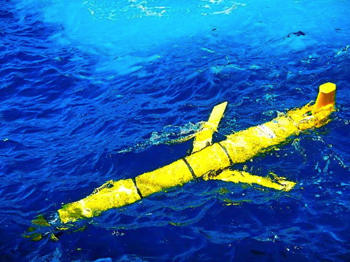
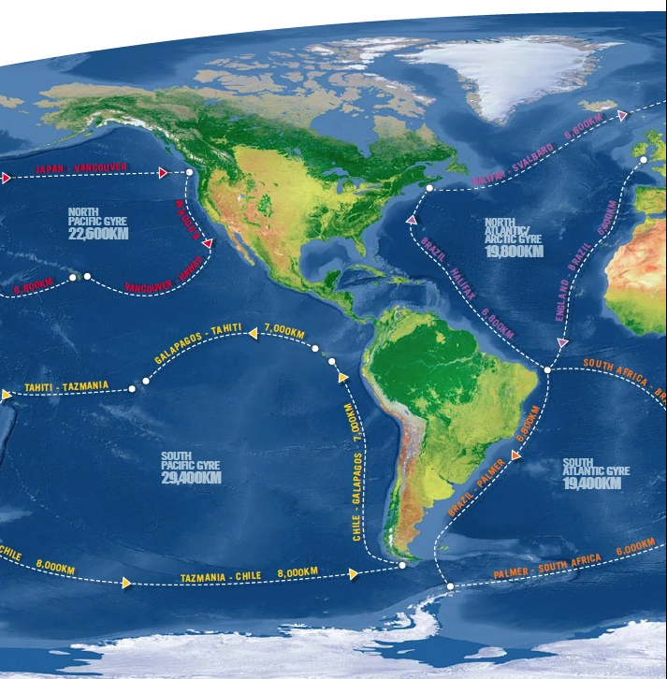
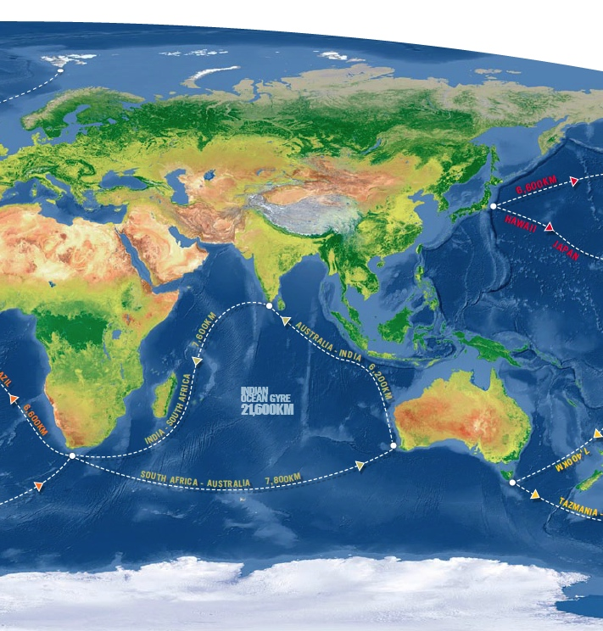
Global Challenger Glider Mission
16 Global-Class Gliders
Outcomes:
A distributed fleet of global class gliders
A global network of glider ports
A global assessment of ocean forecasts
Notes:
128,000 kilometers
Put that on a map, this is what that might look like. Planning map for 16 glider legs, each about 8000 kliometers long around the ocean.
To maximize the efficiency of these flights and collect information in the most energetic areas, we aim to stick to the paths of the gyres
To complete this mission, one question that came up when Scott was having lunch/dinner with Zdenka and the head of IMON in Australia: What are the expected outcomes.
Developed a distributed fleet of global class gliders, respond to oil spill, respond to tsunami, called upon needed
Developed a global network of glider ports: Global scale partners: Ubatuba Brazil – knowledge and spare parts distributed across the globe
Global assessment of the ocean forecasts: How good are our global models, that many regional and atmospheric modelers use in their own research work, as well as governments use for forecasting extreme weather and other applications for typhoons and hurricanes etc.
Groups in Asia have identified the importance of cold or warm oceanic eddies in typhoon development, and we need to assess how well these eddies are resolved in our global models.

Slide 15
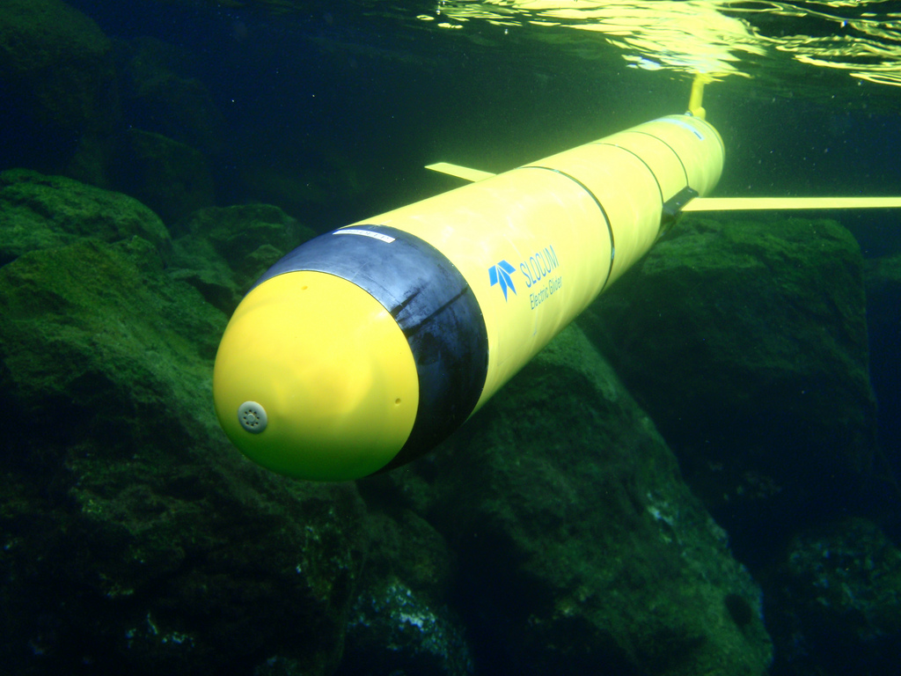
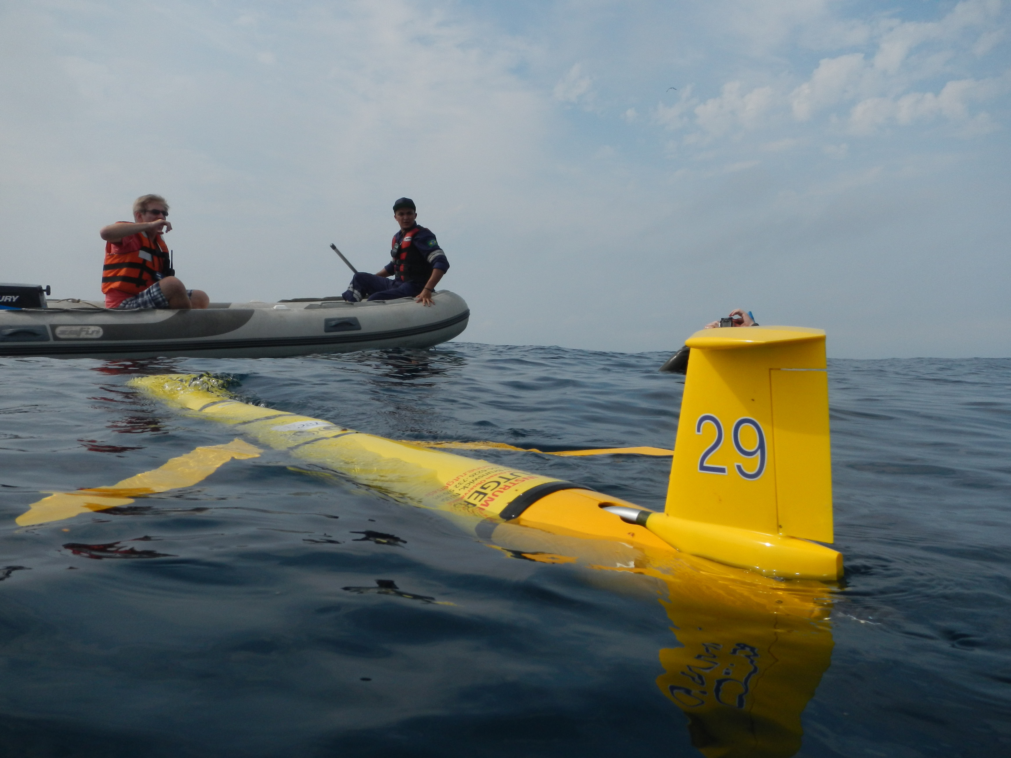
Challenger Mission Totals
GLIDER | START | END | DAYS | KILOMETERS
SILBO LEG 1 | 6/23/2011 | 12/03/2011 | 163.5 | 3,941
SILBO LEG 2 | 3/7/2012 | 5/22/2012 | 76 | 1,706
SILBO LEG 3 | 7/24/2012 | 5/19/2013 | 303 | 4,390
RU 29 LEG 1 | 1/11/2013 | 10/26/2013 | 289 | 5,667
RU29 LEG 2 | 11/10/2013 | 5/18/2014 | 189 | 4,720
TOTAL: |  |  | 1,020.5 | 20,424
Global Glider Ports: New Jersey, USA; Canary Islands; Ascension Island;
Cape Town, South Africa; Sao Paulo, Brazil; Perth, Australia
Global Model Assessments: Published in MTS/IEEE Oceans’13 & Oceans’14
Notes:
We’ve already started the mission, Silbo was presented at the MTS last year. Data is available to students, up to 20,000 kilometers. 2 gliders participating, established glider ports around the world. Building our global gldier feet. Global ports:
Published student lead papers in MTS/IEEE Oceans’13
Dive by off of the Canaries/Azores/ Cape Verde - independent

Slide 16
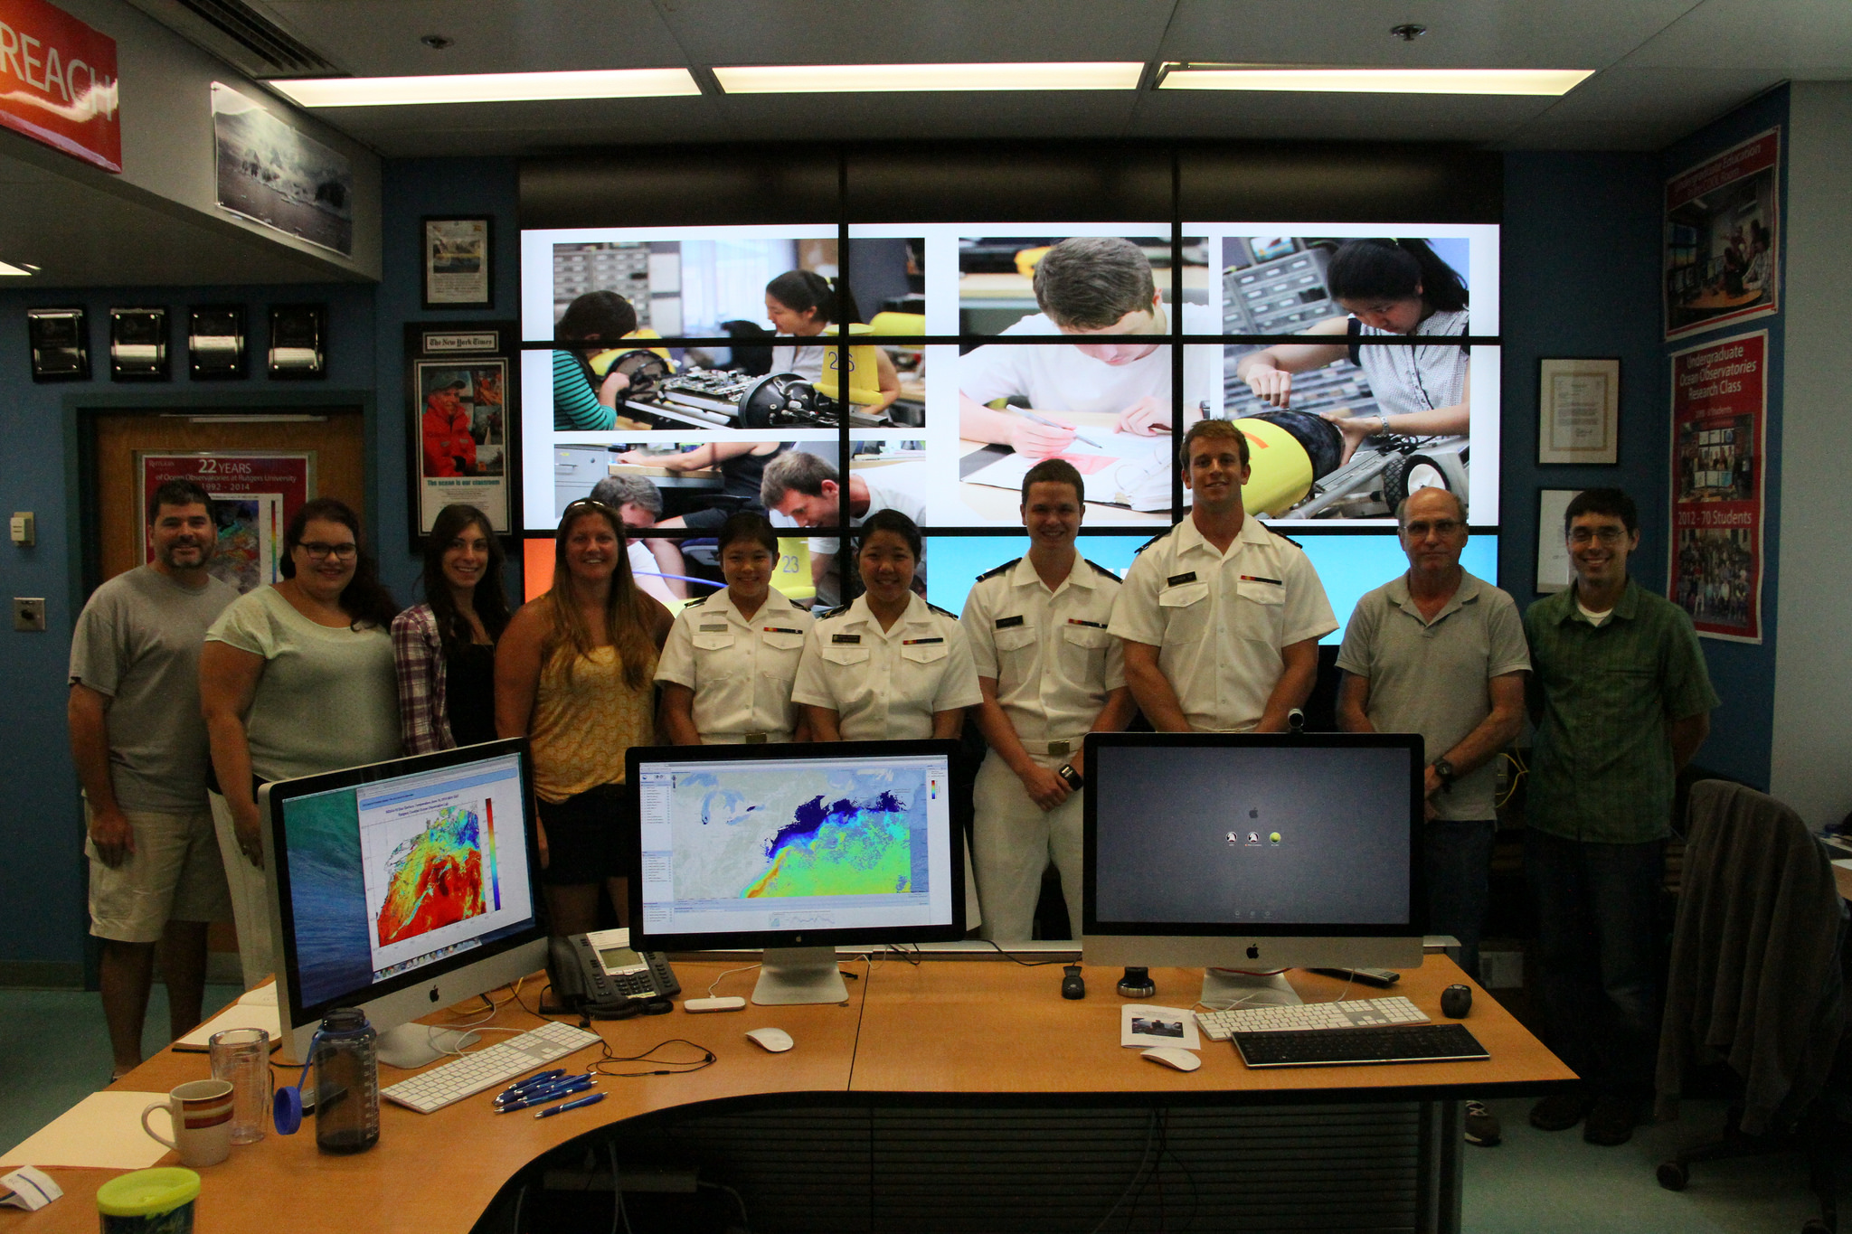
Ocean Model Analysis Using Glider Collected Data
Notes:
Add Navy Students, team from Rutgers and the U.S. Naval Academy

Slide 17
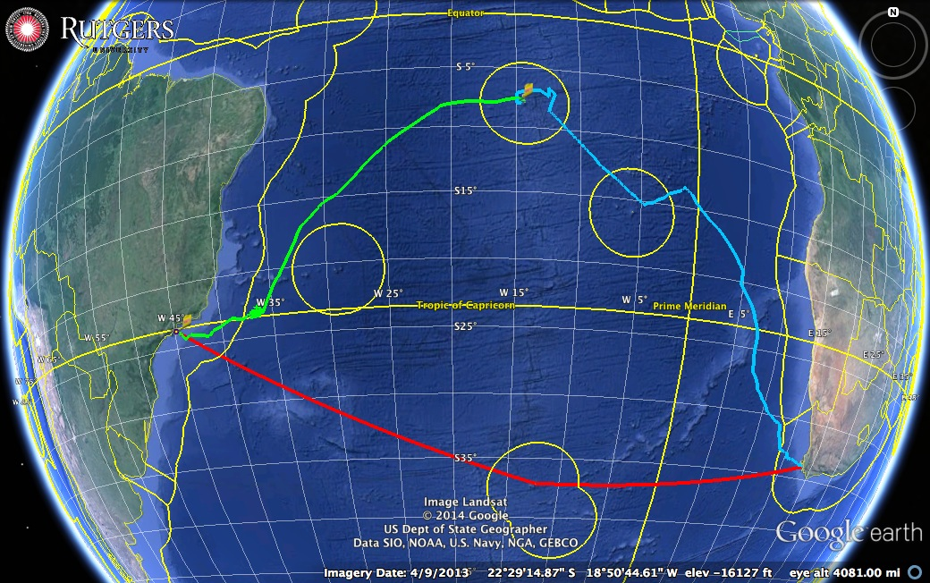
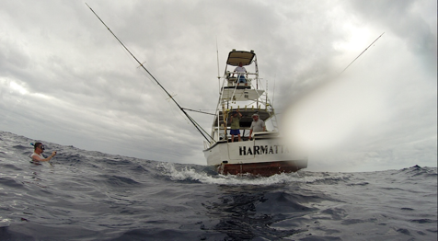

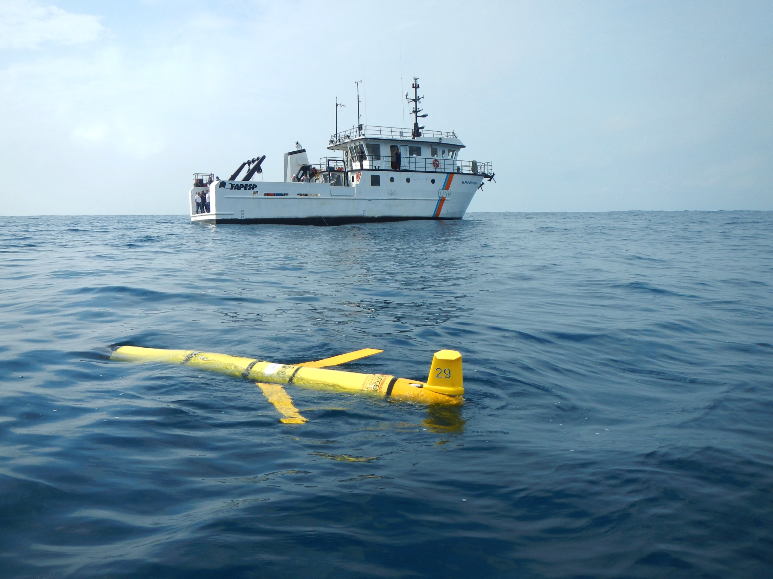
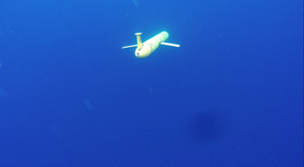
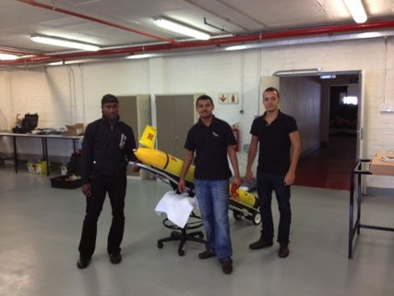

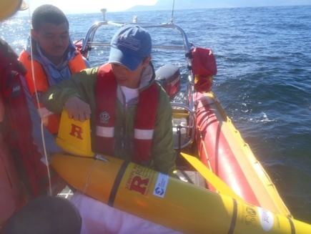



Glider RU29: Launched at Cape Town 11 Jan 2013, flown >10,000 km
Notes:
In the south Atlantic – South Africa, January of 2013 from Cape Town. Went to Ascension Island, completed a leg from Ascension to Brazil. Glider is due to be launched in the next couple of months and will take the Red path from Brazil to South Africa.

Slide 18
RTOFS and MERCATOR Comparison to Glider RU29
Ascension Island to Ubatuba, Brazil
Turtle Tracks
Deep Eddy
Cabo Frio Eddy
Full Track Temp Difference
Argo Validation
Mid-Gyre “Turtle Tracks”
Deep Ocean Eddy
Cabo Frio Coastal Eddy
Notes:
RTOFS - Cooler than Glider at surface – U.S. HYCOM – Real Time Ocean Forecasting System (Navy does data assimilation MODAS- Modular Ocean Data Assimilation System) assimilates all the AVHRR/ARGOS and other data sources. Navy and NOAA move their version of the model forward using different wind fields. NOAA version RTOFS is available online.
MyOcean uses the Mercator model – European Global model
Mercator – Warmer by about a degree throughout the deep ocean
Three features –
Turtle Tracks- migratory pathway from ascension back to Brazil, region where tagged turtles. – Mercator gets subsurface salinity max, but RTOFS doesn’t
Deep Ocean Eddy – Along the yellow track, RTOFS gets the Eddy doesn’t
Cabo Frio Eddy – Shelf eddy, somewhat picked up in Mercator, not in RTOFS
Compared with the nearet ARGO drifter to assess whether our sensor was drifting or the models were actually off. Above 200 meters you see the mesoscale variability in the upper 200 - 300 meters.
Far offshore in Deep Ocean Eddy RTOFS is getting eddy structure, MyOcean not, much richer eddy structure in RTOFS, similar to what we saw in SILBO measurements in the North Atlantic. MyOcean is much smoother so the eddy is not apparents. Not perfectly the same in RTOFS but it’s present
Looking at the CABO Frio eddy- RTOFS does not provide a good boundary condition for nested regional models. MyOcean provides better boundary condition, but doesn’t get the Cabio Frio Eddy in the wrong place. RTOFS does better
This is some of the student led science being done, This type of data will
Advantages over ARGOS – High temporal and spatial resolution, able to move relative to features instead of being passive drifters – complimentary, not competetive. Shelf measurements etc.
Inverted Pyramid

Slide 19
Glider RU29: Launched at Cape Town 11 Jan 2013, flown >10,000 km
Notes:
In the south Atlantic – South Africa, January of 2013 from Cape Town. Went to Ascension Island, completed a leg from Ascension to Brazil. Glider is due to be launched in the next couple of months and will take the Red path from Brazil to South Africa.

Slide 20

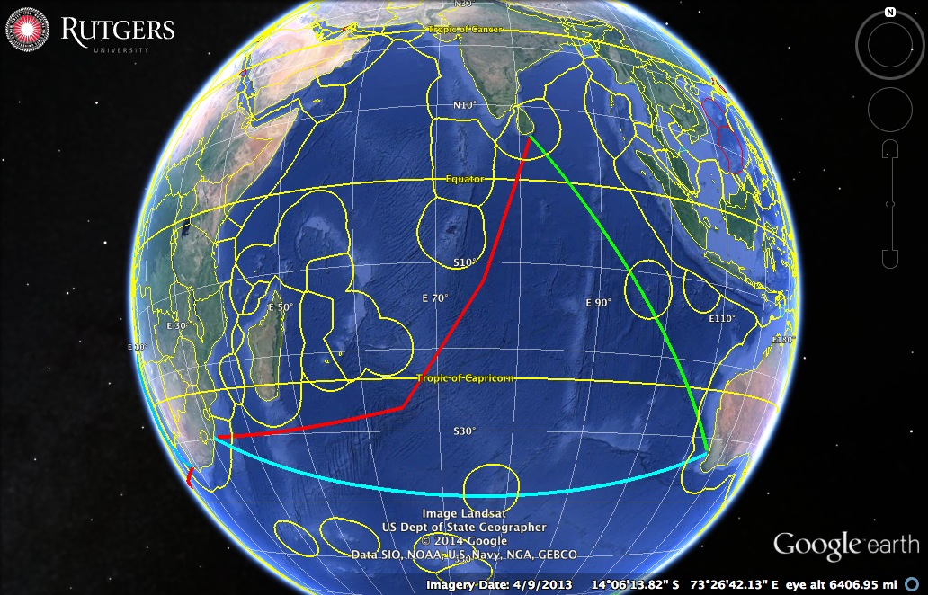

Potential Indian Ocean Glider Tracks
Notes:
Once we get to South Africa, the next potential leg will be from Durban South Africa to Perth Australia, and hopefully covering an important World Ocean Circulation Experiment (WOCE). 30 Degrees south. ILE Amsterdam
Australian glider from Perth to Sri Lanka from university of west Australia and IMOS
Another potential path would be from Sri Lanka to Durbin EEZ issues

Slide 21
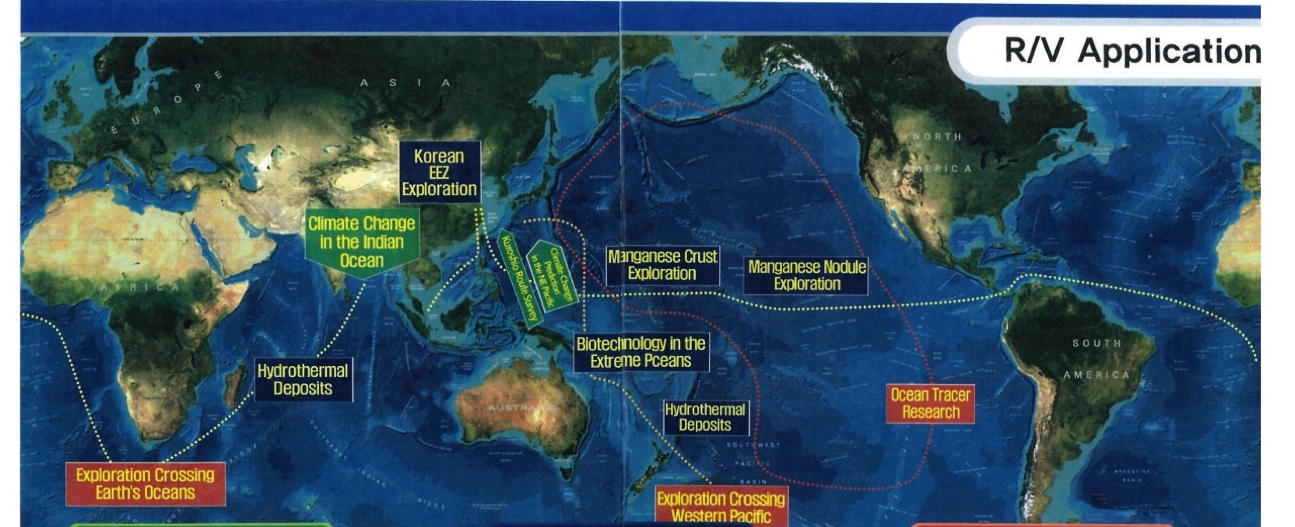


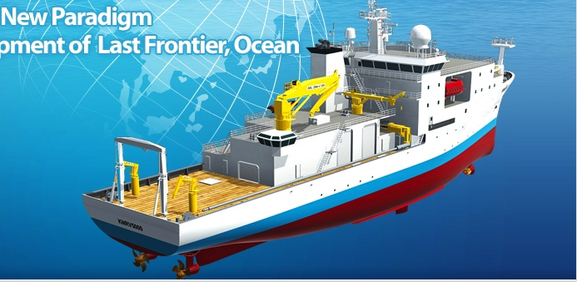

Global KNRV5000 Mission
Notes:
In the pacific we have interest with Korea with the launch of the KNRV5000 and it’s global mission. They have many field stations around the Pacific and are looking to participate on the Pacific Leg.

Slide 22
Challenger Glider Mission
16 Global-Class Gliders
Active Participants Today:
Challenger Society
POGO
U.S. IOOS
NOAA
ONR
NSF
Teledyne
Rutgers
Vetlesen
PLOCAN
ANFOG
KIOST
U. Las Palmas
U. Cape Town
U. Sao Paulo
USNA
CLS
Iridium
Notes:
WE have all these partners, we’re looking for more Partners

Slide 23
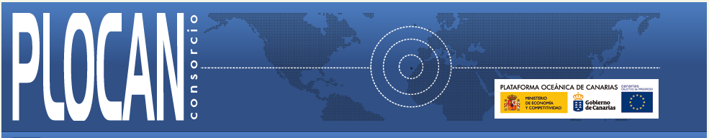
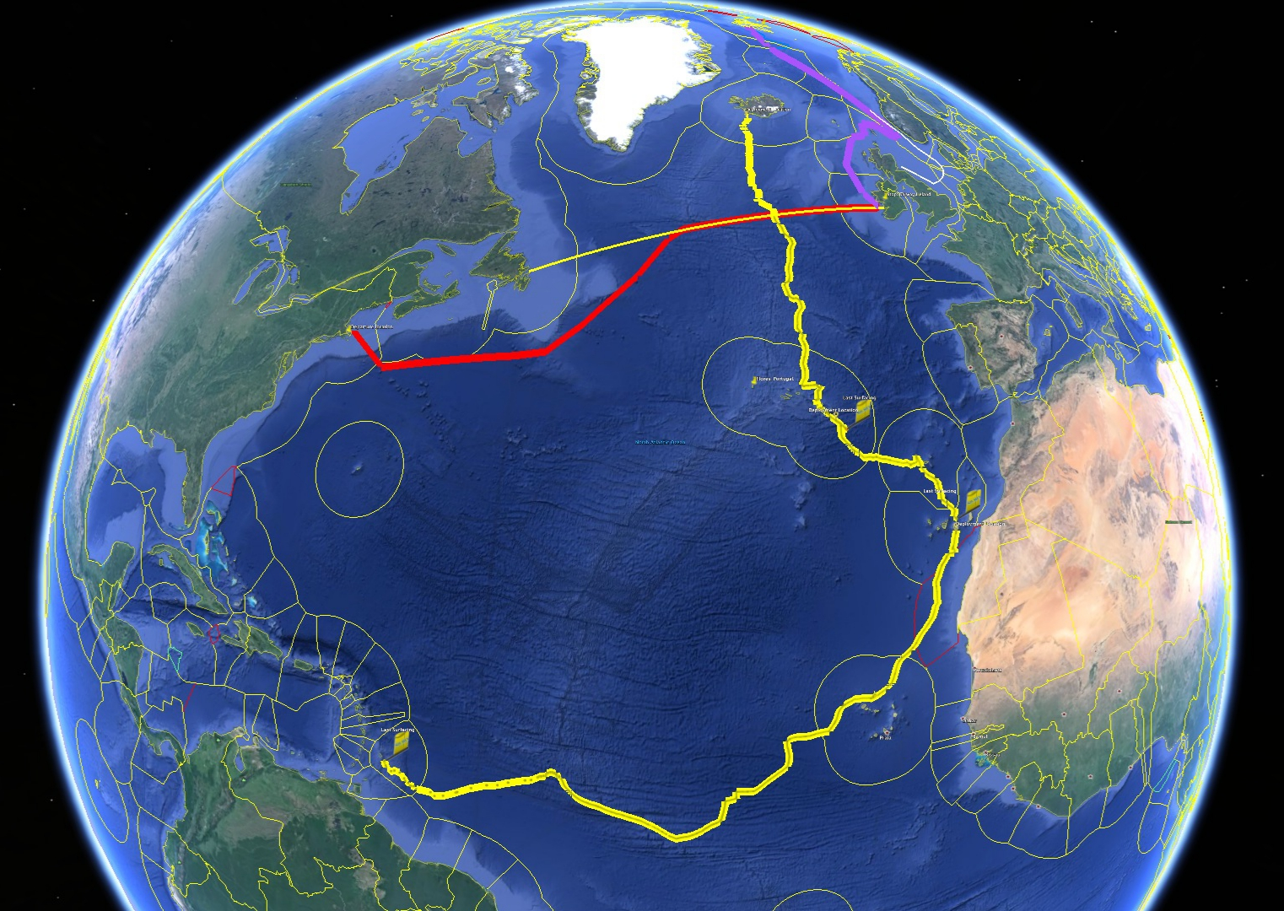
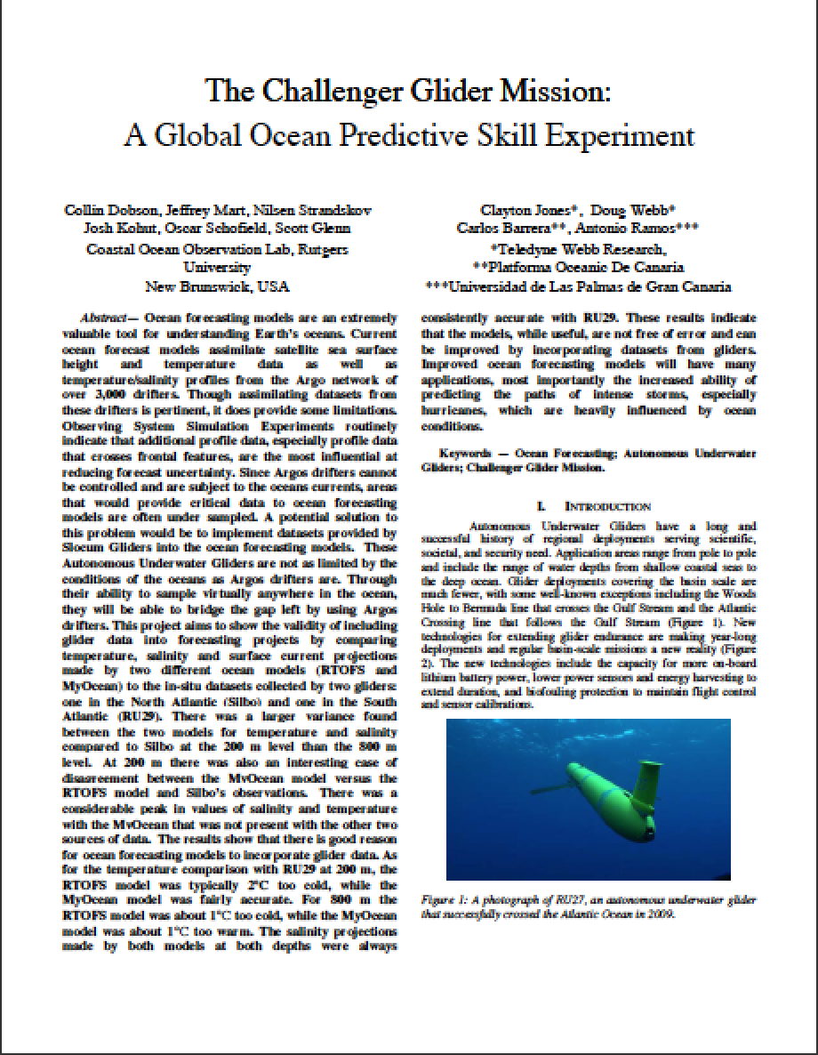
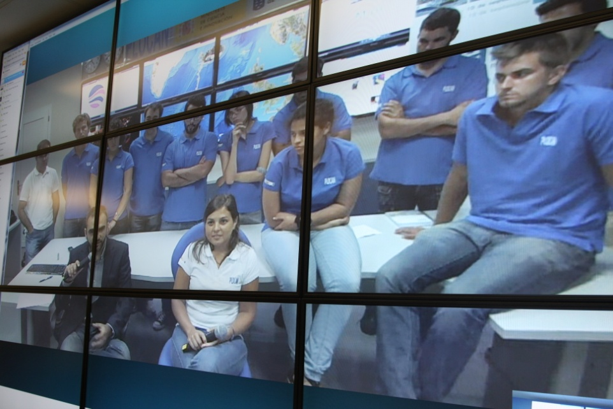
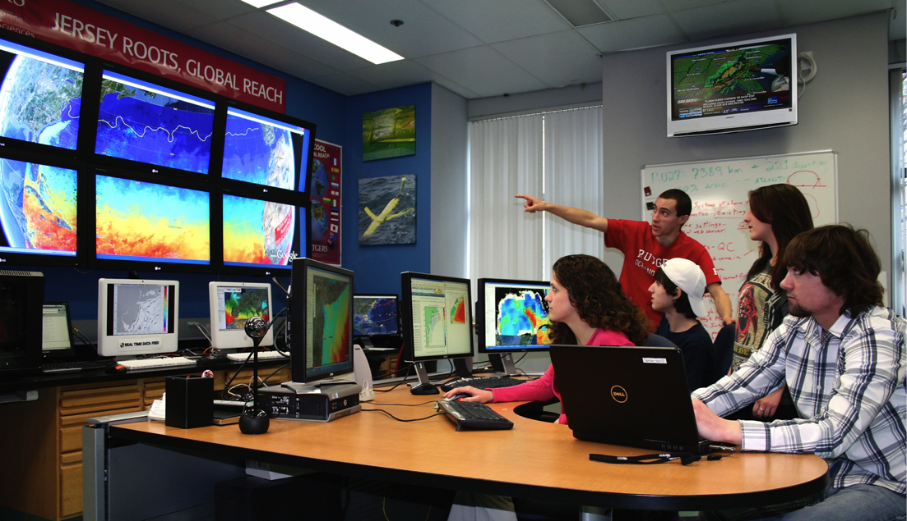
Companion Course at
Plataforma Oceanica de Canarias
Shared Glider Missions – Iceland to Azores; Azores to Canaries; Canaries to Caribbean
Skype Sessions between classes
Two-way International Exchange programs
Students Learn Science from their teachers
Students Learn Culture from their peers
Glider Silbo >10,000 km flown
Oceans’13 MTS/IEEE
Notes:
North Atlantic- Silbo from Iceland in 2011, donated by Teledyne Webb Research (reykavyk) to Barbados in Carribean. Working with PLOCAN students in Spain and Portugal to pilot gliders. Silbo is due to launch again this fall on the red path.
Looking for partners to help
Want to build classrooms at other locations everywhere that we make a glider port.
Published Papers with MTS: Thank you MTS

Slide 24


Thank you!
R. Sacatelli, T. Schofield, K. Todoroff, A. Carandang, A. Eng, I. Lowry, H. Mather, Travis Miles, Scott Glenn, Oscar Schofield & Josh Kohut
“The Ocean is Our Classroom”

