Slide 1
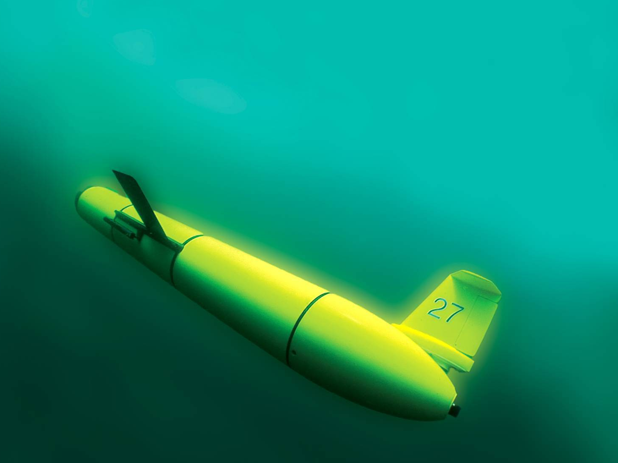
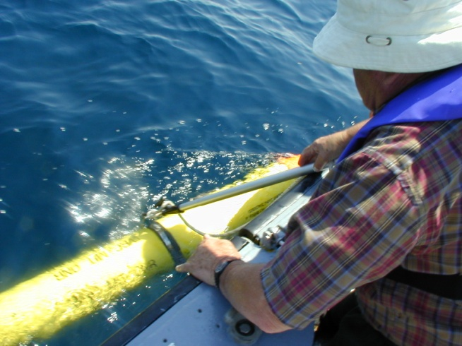
Gliderpalooza 2013 to Modelpalooza 2014: Joint US & Canadian Ocean Glider Operations Supporting Multidisciplinary Scientific Research and Education
Mike Crowley, Scott Glenn,
Oscar Schofield, Fred Whorisky and many, many, many more
Crowley@rutgers.edu
Since
July 26, 1999

Slide 2
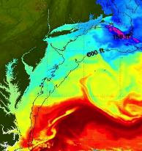
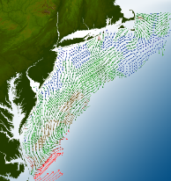
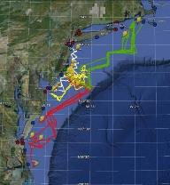
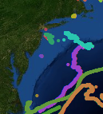
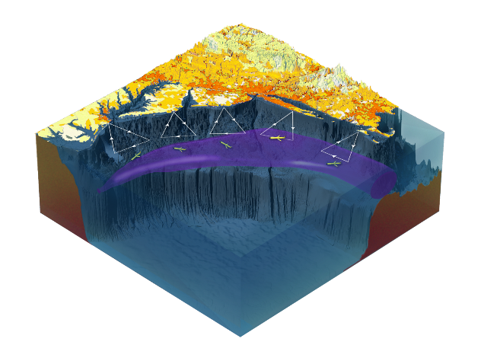

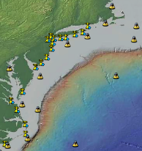
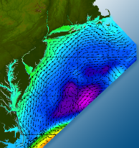

Satellites
HF-Radar
Gliders
Drifters
Population Density
To seek, discover & apply
new knowledge & understanding
of our coastal ocean
Weather Stations
Ocean Forecast Ensemble
Notes:
Need to cut off cold pool in south and bend offshore
Need to experiment with dulling down the colors in the pop density. Maybe orange/tan to white like the box I put in?
Put gliders just below the lines in 3 of them, and increase their angles facing up and down randomly. I stuck in cheesy examples
I already put the shadow and 80% clear line around the two new maps in the upper right, so we are good there.

Slide 3
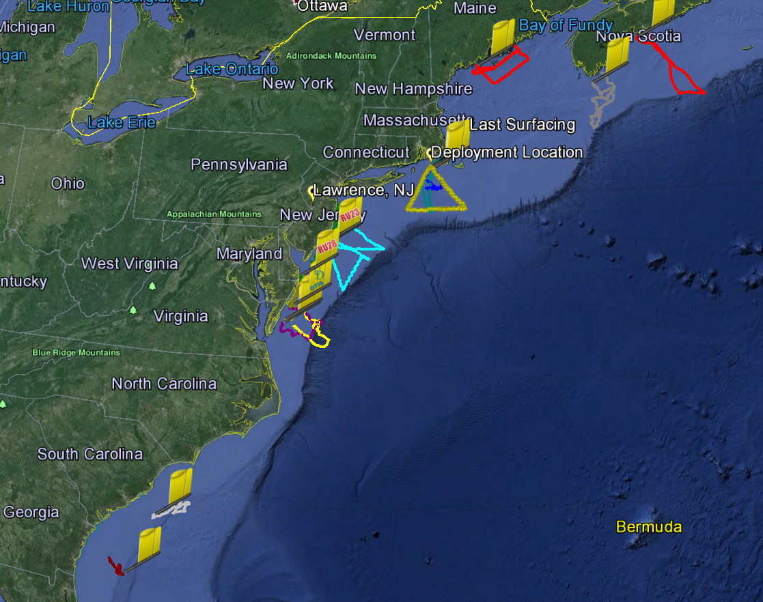
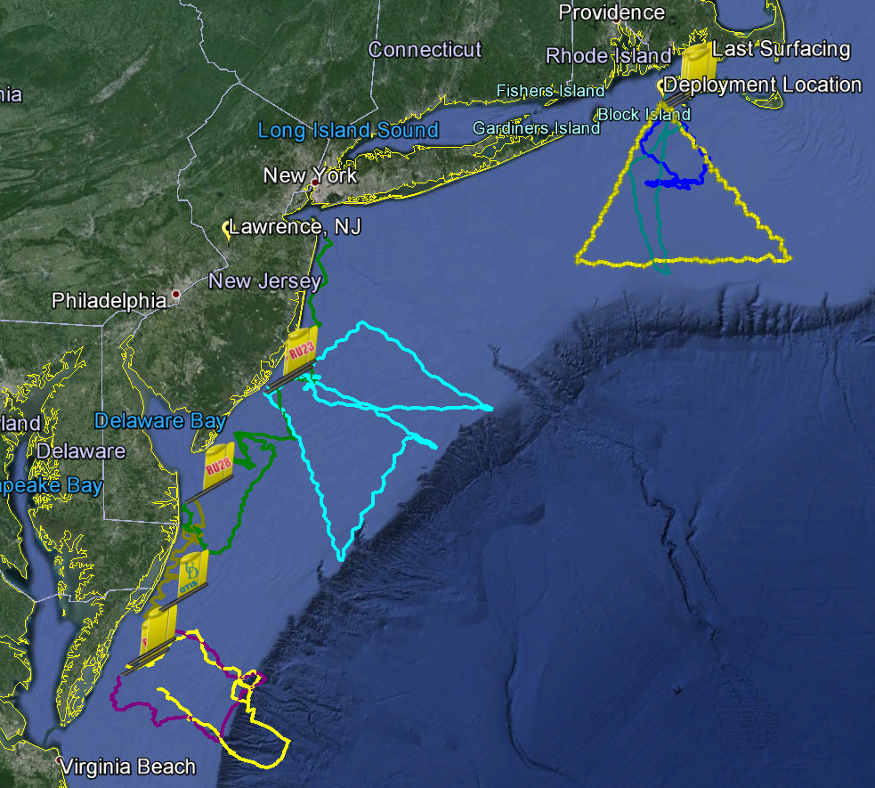
2013 Gliderpalooza Partners & Funders
Penobscot
OTN200
OTN201
Saul
Darwin
Salacia
RU28
Blue
Modena
RU23
RU23
Otis
RU22
Amelia
A true grass-roots effort: 14 gliders, 2.5 months, 17 deployments

Slide 4
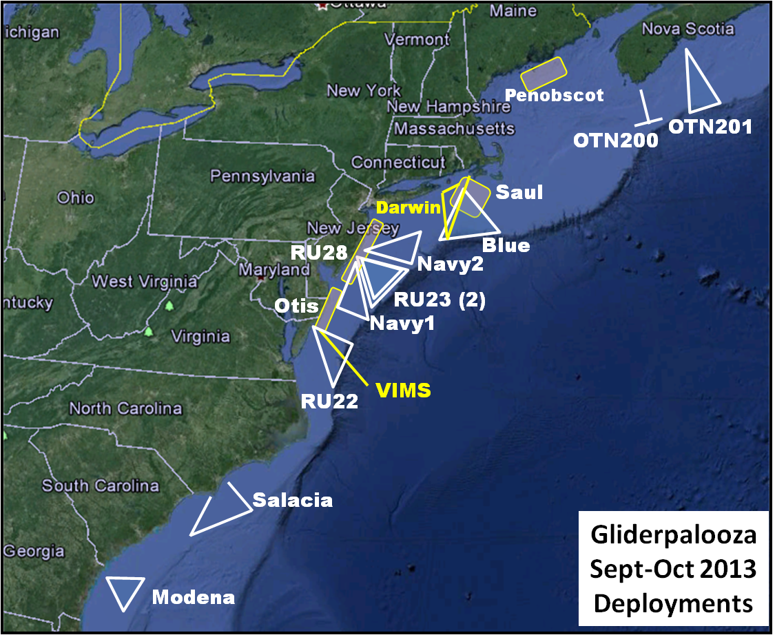
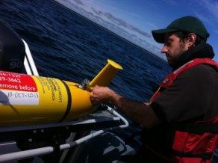
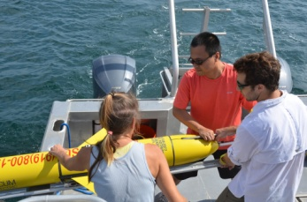
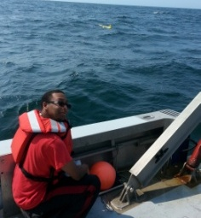
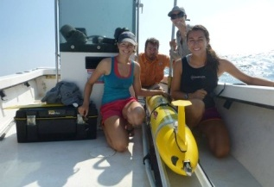
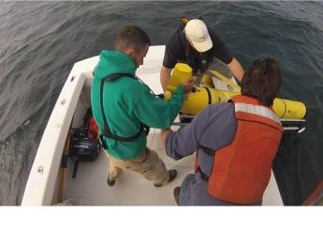
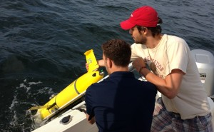
Gliderpalooza 2013: So much more than gliders
Provide a unique data set to modelers
Provide standardized dataset a over ecological scales and information on fish/mammal migrations
Provide a 3-D snapshot of the MAB cold pool
Provide an extensive distributed network through the peak period of fall storms, demonstrating "surge" capacity
Demonstration of a national glider network
Proof of data flow through IOOS to NDBC via DMAC
Engage undergraduates in ocean observing efforts.

Slide 5
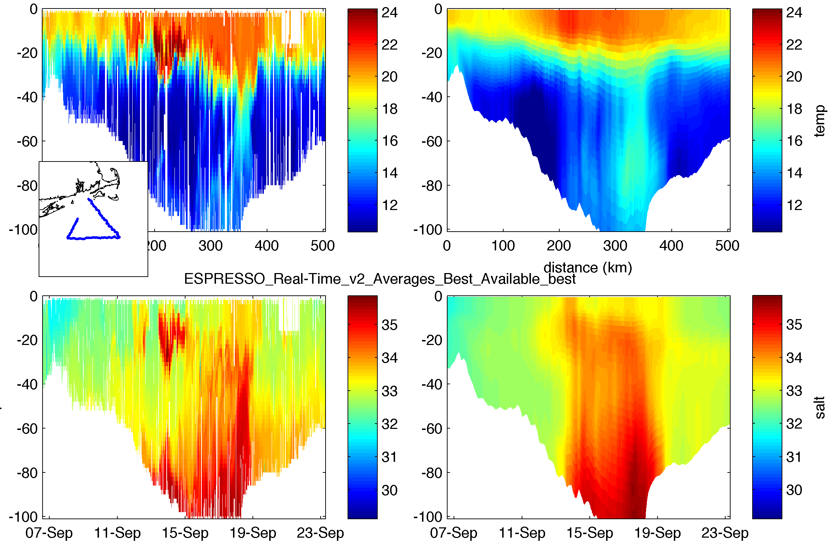
Goal 1: Unique dataset for modelers
Observed (left) and ROMS ESPRESSO model (right) temperature (top) and salinity (bottom) following glider BLUE. Inset shows the glider path. In deep waters a column of relatively warm water delineates the offshore limit of the Cold Pool.

Slide 6
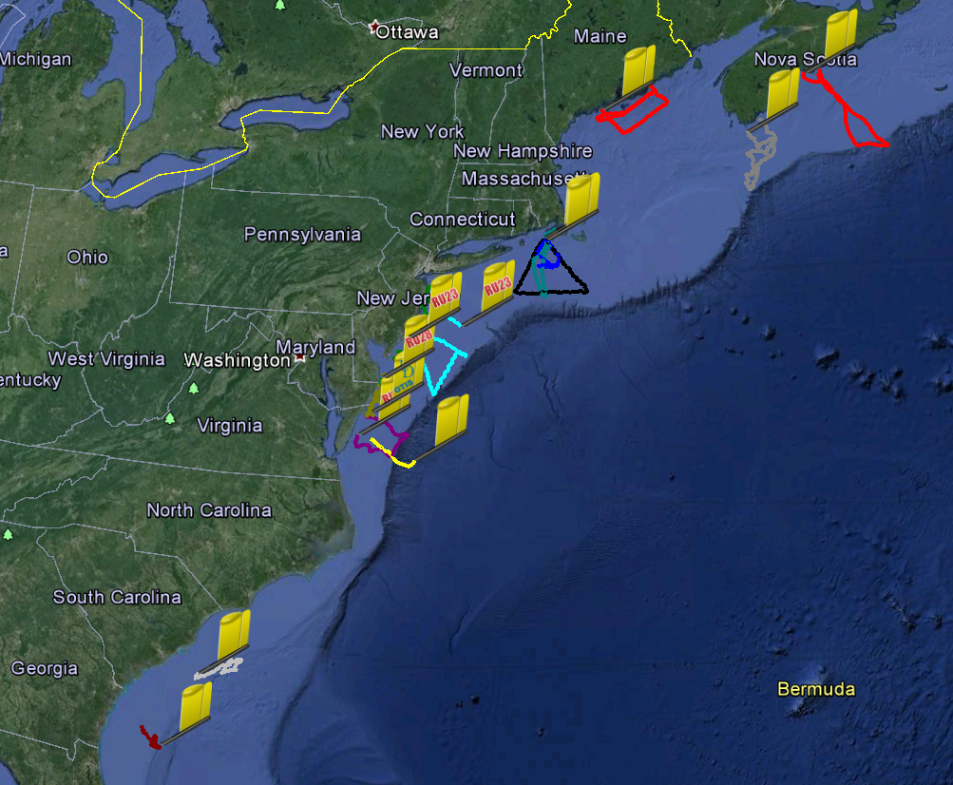
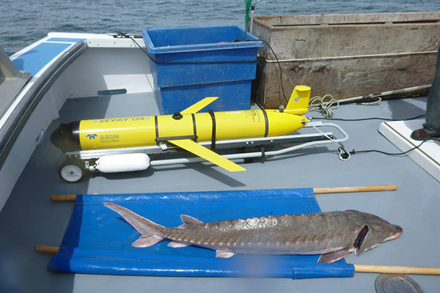
Goal 2: Fish/Mammal Migrations
Vemco receivers deployed on 9 of 16 gliders
Key Species: Right Whales, tiger sharks, Atlantic sturgeon, Atlantic Salmon
Data will be organized by OTN
Deployments to date

Slide 7
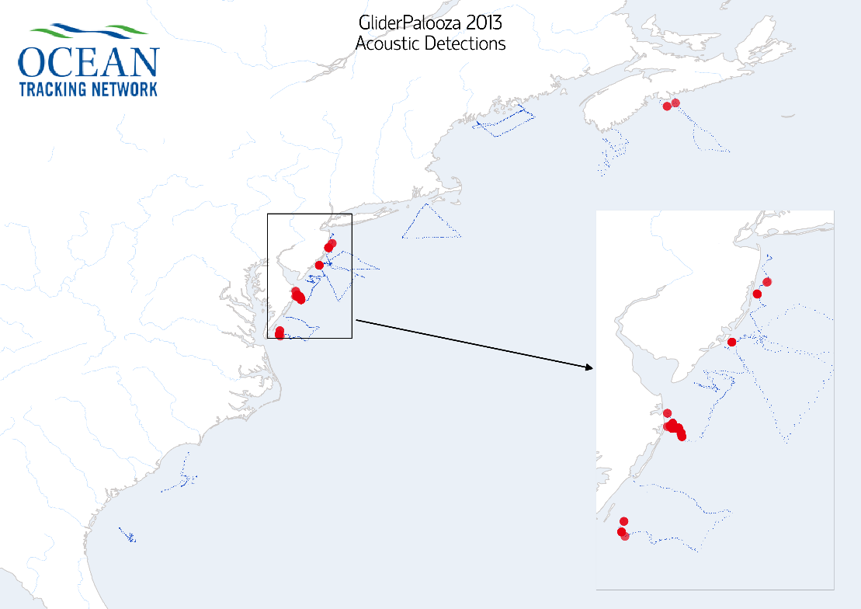
Goal 2: Fish/Mammal Migrations Continued
Vemco receivers detected 16 animals
Species: Blue Shark and Atlantic Sturgeon.
Group | Glider Name | Species | #
Dalhousie | OTN200 | No detections | 0
 | OTN201 | Blue shark | 2
U Maine | Penobscot | Not reported yet | 0
U Mass | Blue | No detections | 0
Rutgers | RU28 | Atlantic sturgeon | 10
 | RU22 | Atlantic sturgeon | 3
 | RU23 | Atlantic sturgeon | 1
U Delaware | Otis | Glider lost at sea | --
NC State | Salacia | No detections | 0
U Georgia | Modena | No detections | 0
Deployments to date

Slide 8
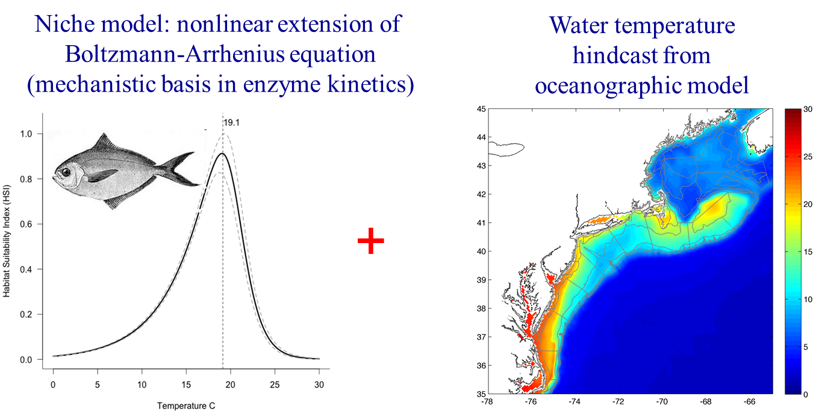
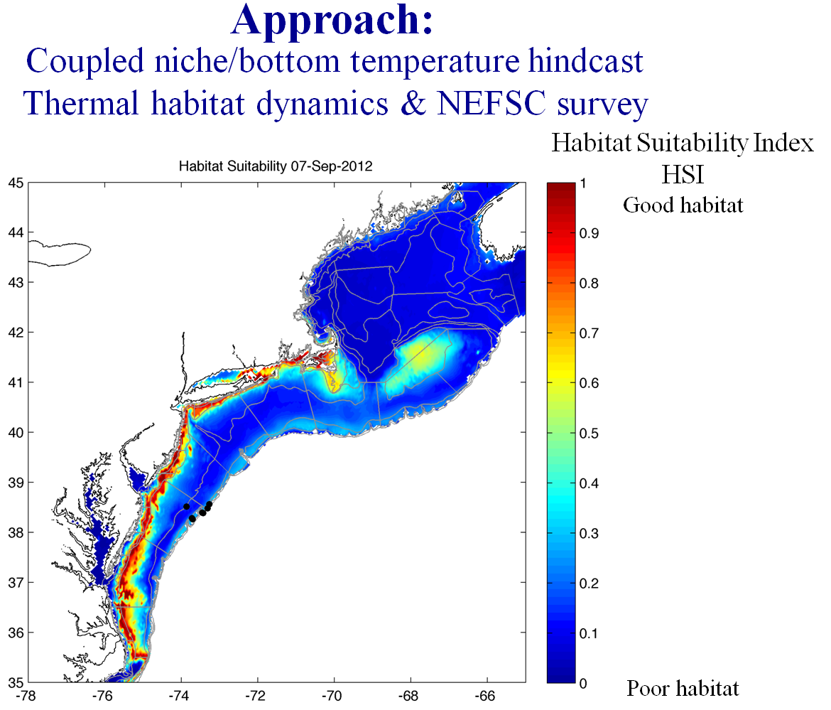
Goal 2: Fish/Mammal Migrations Continued
Approach:
Use thermal niche model + temperature hindcasts
~ estimate habitat distribution in NW Atlantic
=
Conclusion: The ocean moves!

Slide 9
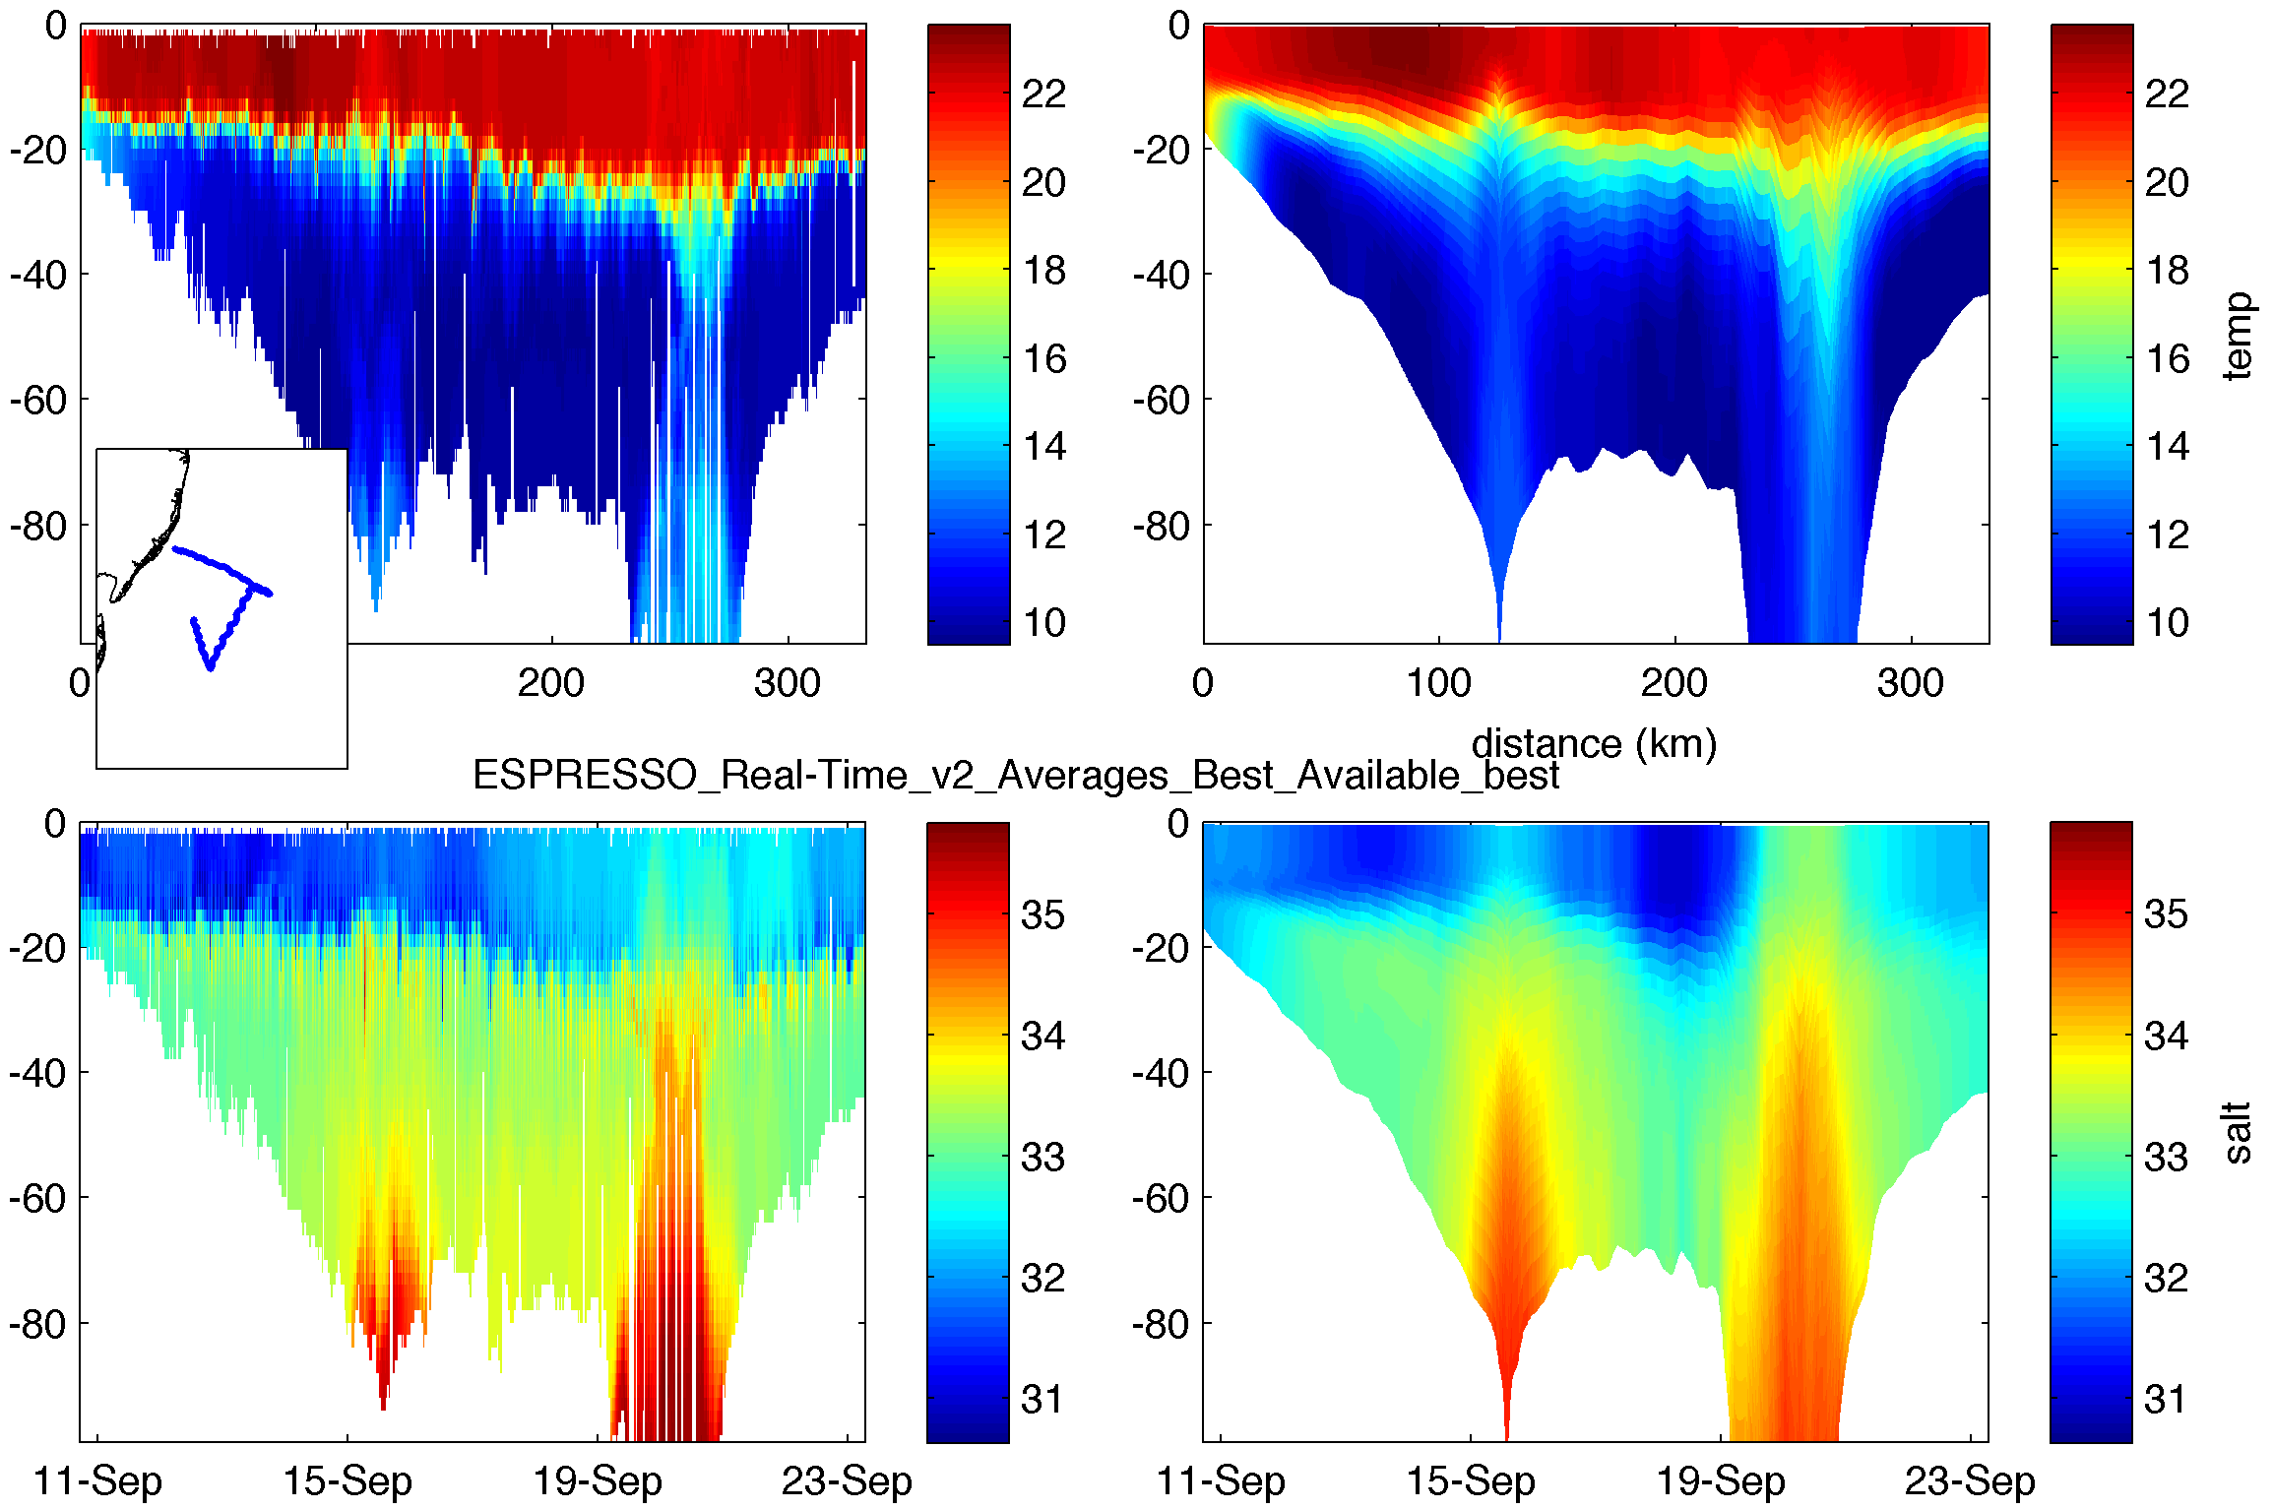
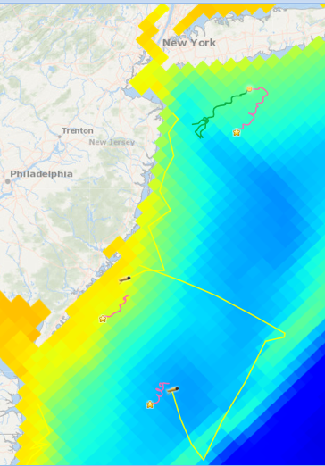
Goal 3: 3D Snapshot of Coldpool
Espresso Bottom Temps
Observed and modeled temperature and salinity following the trajectory of glider RU23

Slide 10
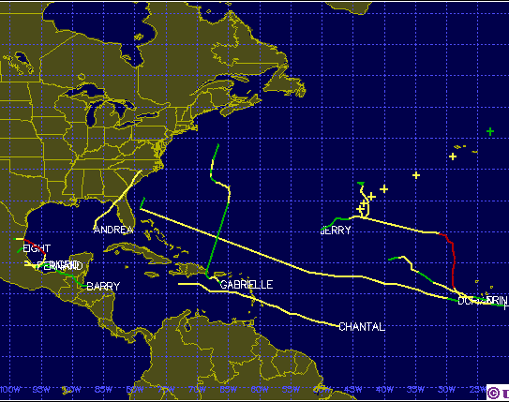
Goal 4: Fall Mixing Storms
2013 Tropical Storms
2013 will serve as a baseline for a calm season
CINAR funding for 2014 & 2015 focused on severe Tropical & Winter storms
CINAR Observations: Rapid profiler drifters, storm gliders and rapid-deployable buoys
CINAR Models: nested ROMS & FVCOM

Slide 11
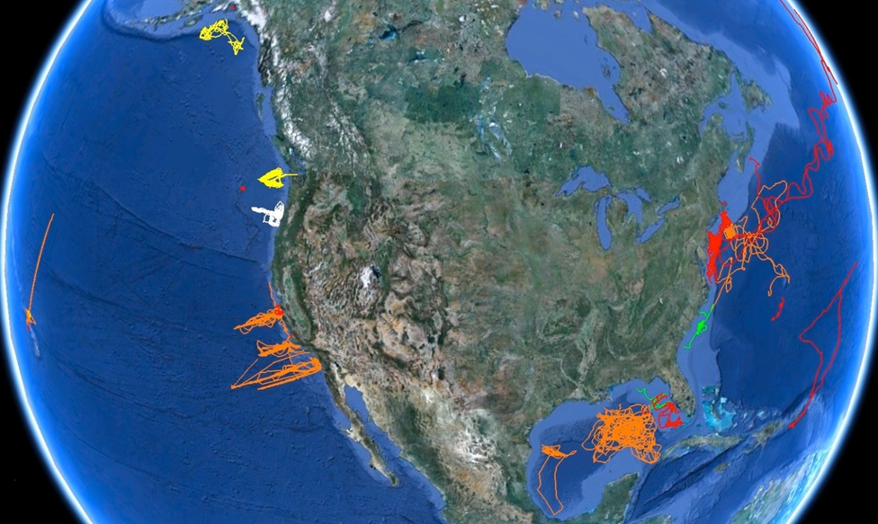
Goal 5: Demo of National Glider Network
Persistence allows climate studies, model assimilation and for event sampling
Gliderpalooza is an example of surge capacity on east coast
A test case for a future international collaboration?

Slide 12
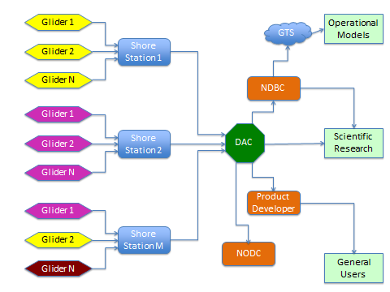

Goal 6: Data Flow from IOOS to GTS
Data flow through as defined in the upcoming National Glider Network Plan
Operators to shore station to DAC to world
Successful transfer to GTS!

Slide 13
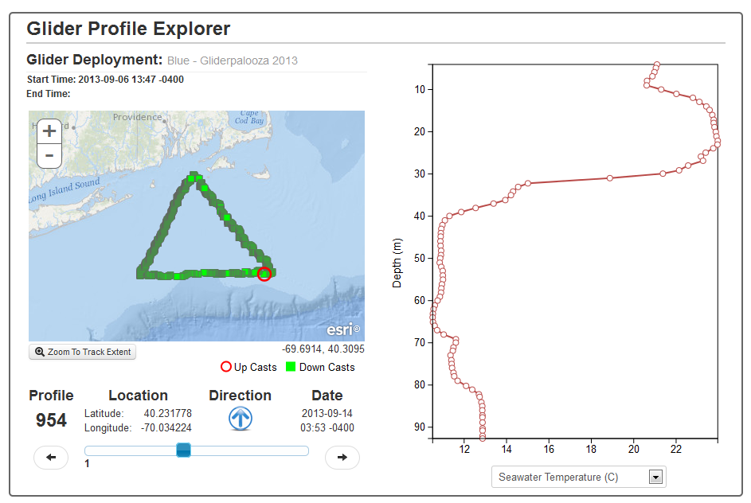
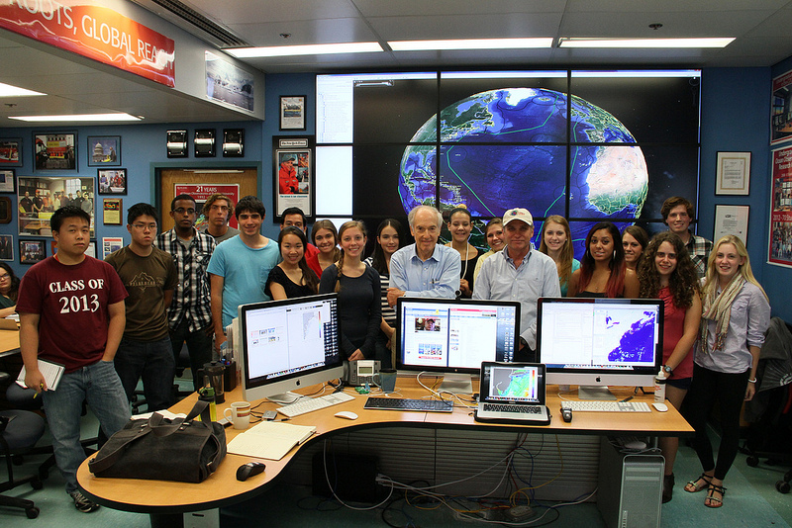
Goal 7: Undergraduate Education
Using data from U.S. IOOS gliders in NSF OOI EPE tools for undergraduate education in the fall of 2013

Slide 14
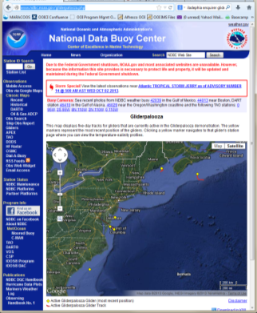
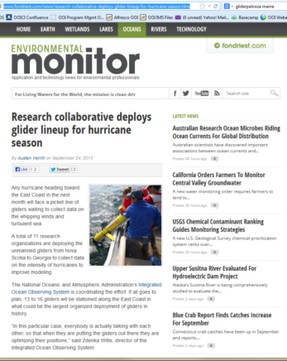
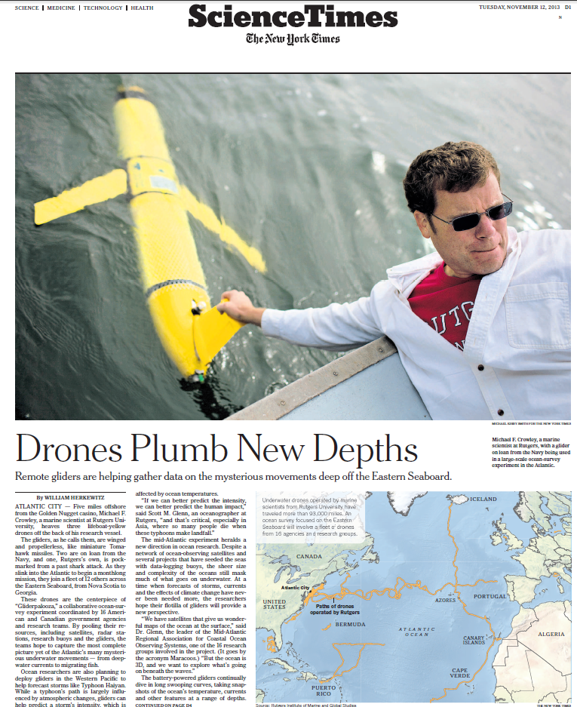
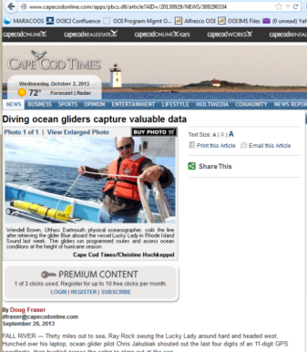
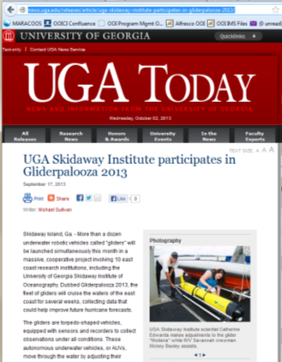
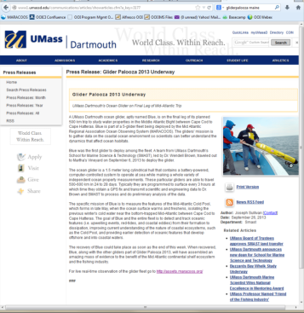
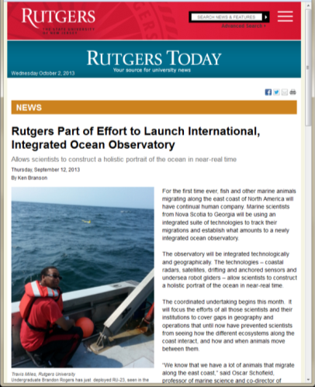
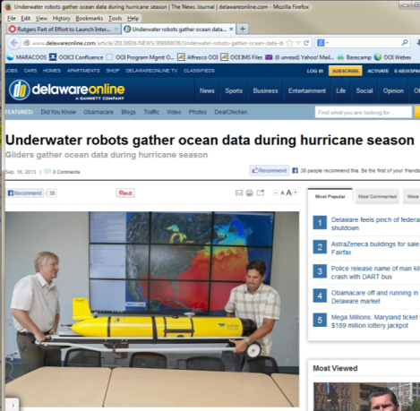

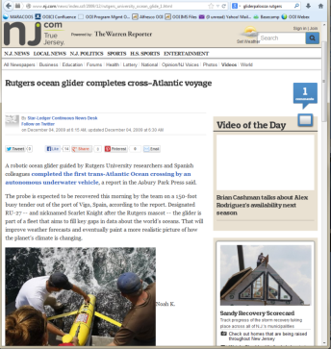
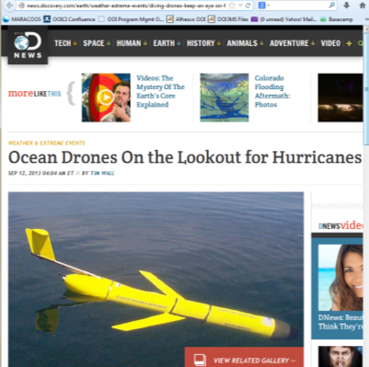
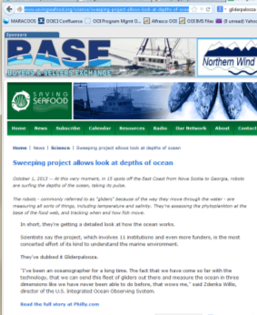
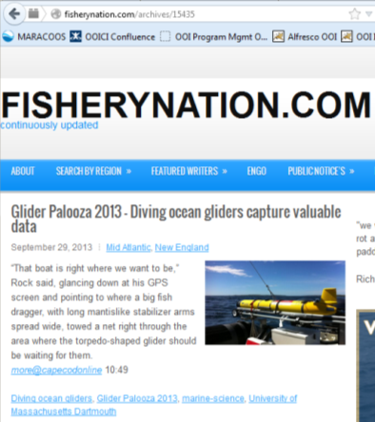
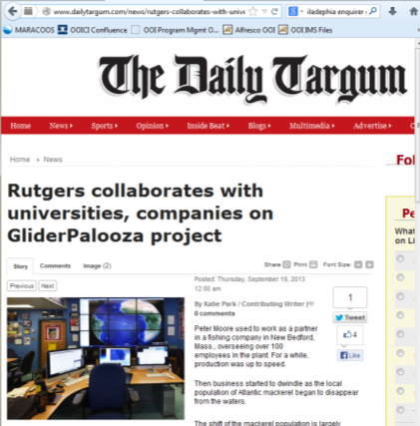
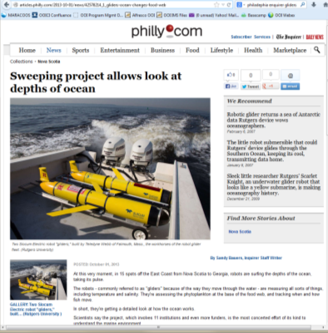
Gliderpalooza Press
Numerous articles in the press
Oct 10 – NY Times, Discovery, CNN on 3 glider deployment (Navy1, Navy2, RU23)

Slide 15
GLIDERPALOOZA 2014: Glide Harder!
(aka Modelpalooza)

Slide 16
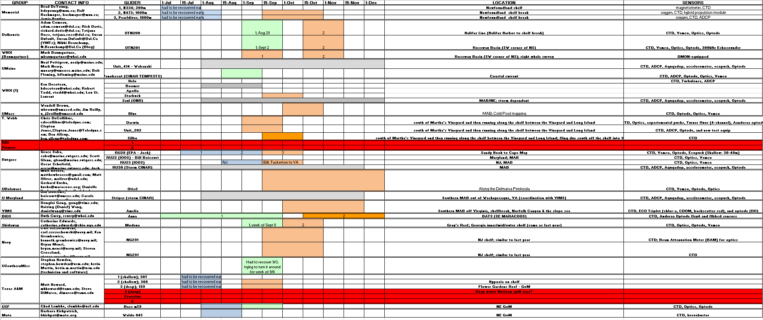
2014 Gliderpalooza Schedule

Slide 17
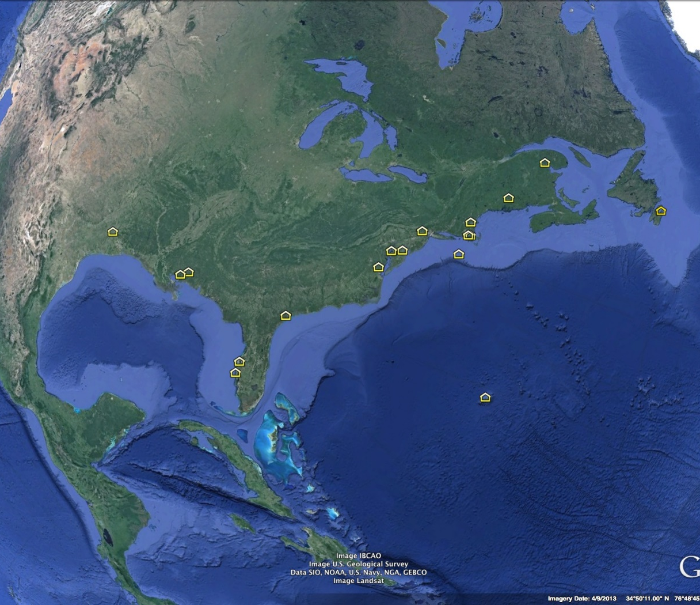
2014 Gliderpalooza Partners

Slide 18
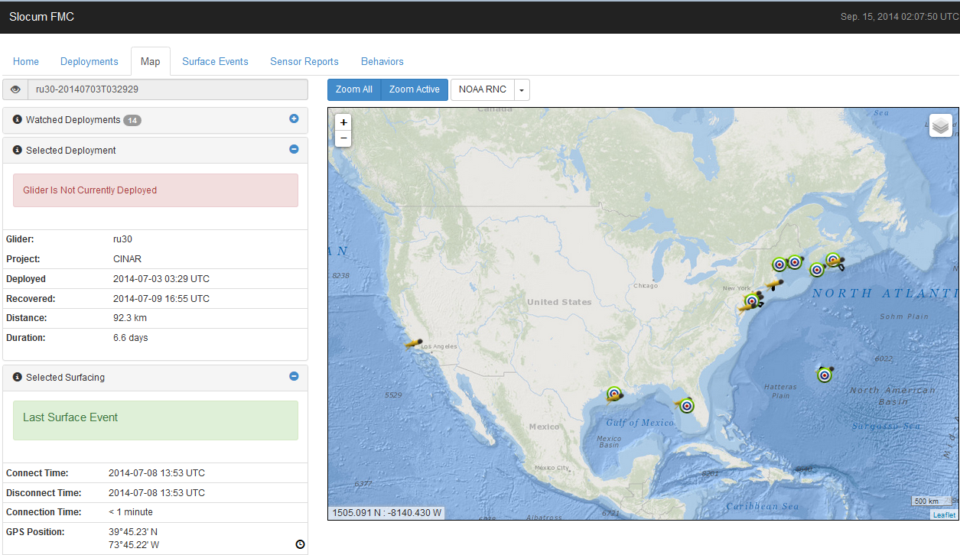
Current Deployments: 8

Slide 19
Deployments This Week: ~13
Memorial (2), Pioneer (1-2), Teledyne (2), Rutgers (2), Navy (2), U. Del., WHOI, Skidaway, Texas A&M,

Slide 20
The Models vs The Glider

Slide 21
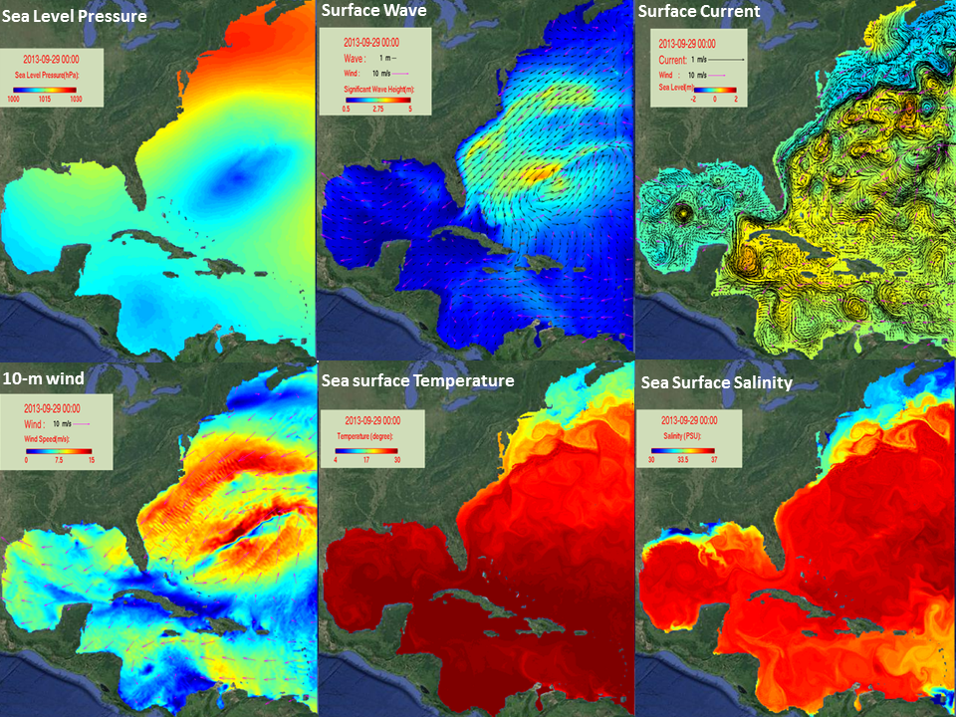
Gliderpalooza Science: Ensemble of Modeling Studies

Slide 22
Model Bottom Temperature Improvements from Glider Assimilation (ROMS ESPRESSO)
Sept. 2013 Oct. 2013 Nov. 2013
No Assim
Assimilation
Difference
Note that models typically overestimate bottom temps in shallow regions.
This holds true for most models globally (eg. Brazil coast RTOFS)

Slide 23
Model Bottom Temperature Improvements from Glider Assimilation (ROMS ESPRESSO)
Note that models typically overestimate bottom temps in shallow regions.
This holds true for most models globally (eg. Brazil coast RTOFS)

Slide 24
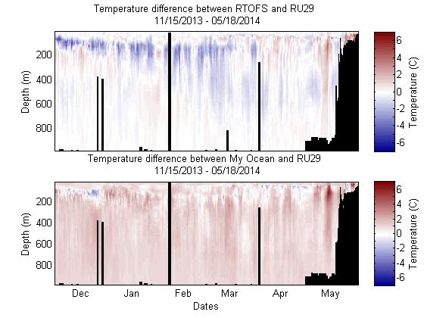

Observed Model vs Glider Differences
(Results from undergrad summer research)
Most variation between the two models and RU29 exist within the first 300 meters of the water column
MyOcean model has a fairly consistent 1˚C to 2˚C difference in temperature from RU29
RTOFS model was fairly consistent with the RU29 data at lower depths but had very large discrepancies in magnitude at certain locations.

Slide 25
Conclusions
Leveraging numerous programs for the good of all
Building a research community
Enabling availability of new datasets to global models
Improving models through assimilation and validation especially along bottom in shallow water
The ocean moves!

Slide 26

Acknowledgements
Funding:
IOOS (MARACOOS & SECOORA), Ocean Tracking Network, NJ DEP, EPA, Univ. Delaware, NASA, ONR, OTN, Univ. Maine, College of William and Mary, Univ. of Georgia, Teledyne Webb, NMFS and the U.S. Navy.
Co-Conspirators
J. Kerfoot, C. Haldeman, D. Aragon, T. Haskins, T. Miles, S. Lichtenwalner, M. Mills, G. Saba, J. Wilkin, A. Comeau, R. Davis, J. Pye, N. Beauchamp, S. Default, K. Morton, N. Fisher, M. Neary, N. Pettigrew, L. St. Laurent, J. Reilly, K. Decoteau, C. Jones, C. DeCollibus, B. Allsup, C. Jacubiak, J. Kohut, N. Strandskov, M. Breece, M. Oliver, D. Haulsee, G. Kuska, W. Boicourt, D. Gong, D. Wang, R. He, W. Woods, C. Edwards and the U.S. Navy Team headed by C. Szczechowski, B. Kirkpatrick, C. Lembke, M. Howard, S. DiMarco, S. Howden, K. Martin, R. Curry, M. Baumgartner, B. DeYoung, J. Paulter, R. Bachmayer

Slide 27

“Work hard.
Have fun.
Change the world.”
Doug Webb
Data from Gliderpalooza are available at:
  http://assets.maracoos.org/ - MARACOOS asset Map, Glider tracks and data cross sections , model data, SST, ocean color, HF-RADAR, atmospheric data, drifters, buoy data, etc
  http://gliders.oceantrack.org/ - Ocean Tracking Network Glider Page
  http://www.ndbc.noaa.gov/gliders.php - NDBC glider Page
  http://marine.rutgers.edu/cool/auvs/ - Rutgers Glider site

Slide 29



Ocean Observatories Initiative
Cyberinfrastructure Team
Manish Parashar, Scott Glenn, Oscar Schofield, Mike Crowley, Ivan Rodero, Maxwell Chen, Sage Lichtenwalner, Mike Mills, Steve Levenson, John Kerfoot
Rutgers University
Luke Campbell, Dan Maher, Guy deWardener and many others
The University of Maine
Leslie Smith
Consortium for Ocean Leadership

