Slide 1
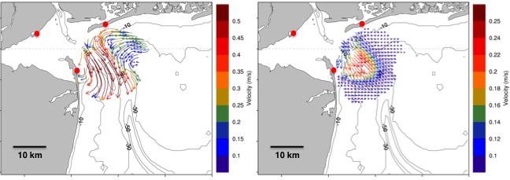
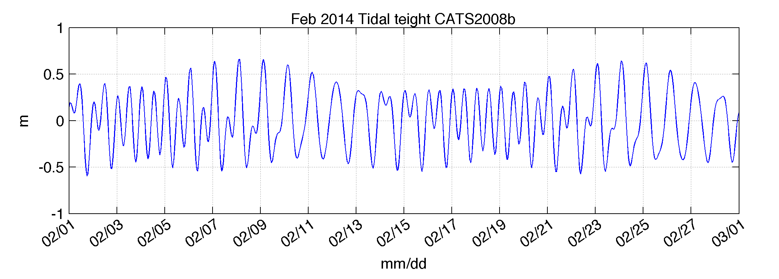
HF Radar
(Physics – Spatial / Time)
Schedule:
Jan 2014: Deploy PAL Site and Scout JOU and WAU sites
Nov/Dec 2014: Deploy PAL, JOU, and WAU sites
Mar 2015: Recover PAL, JOU and WAU sites
Notes:
What is codar? Essentially Doppler radar, similar to a radar gun used by police officers. Sends out a frequency that bounces off waves to give a speed measurement. Requires multiple codar stations to accurately map currents due to the fact that each antenna can only measure the waves velocity coming towards it

Slide 2
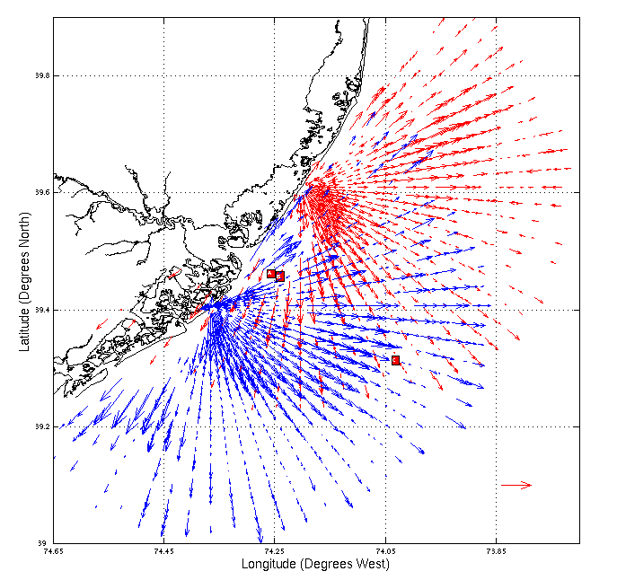
CODAR Site
Moored ADCP
25 km
25 cm/s
Notes:
Raw data, over lapping zone is where current map is created

Slide 3
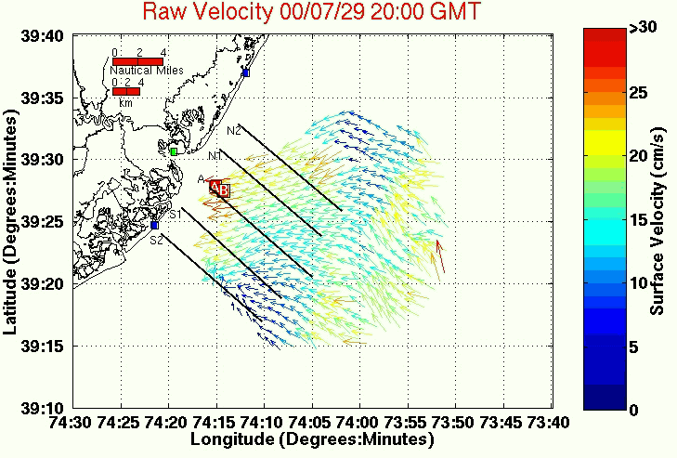

Slide 4
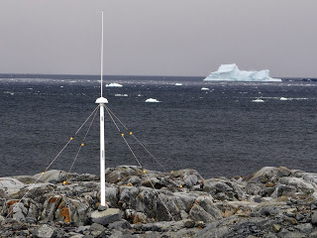

Slide 5
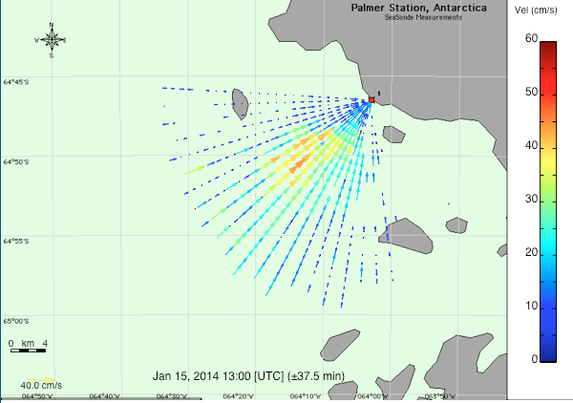

Slide 6
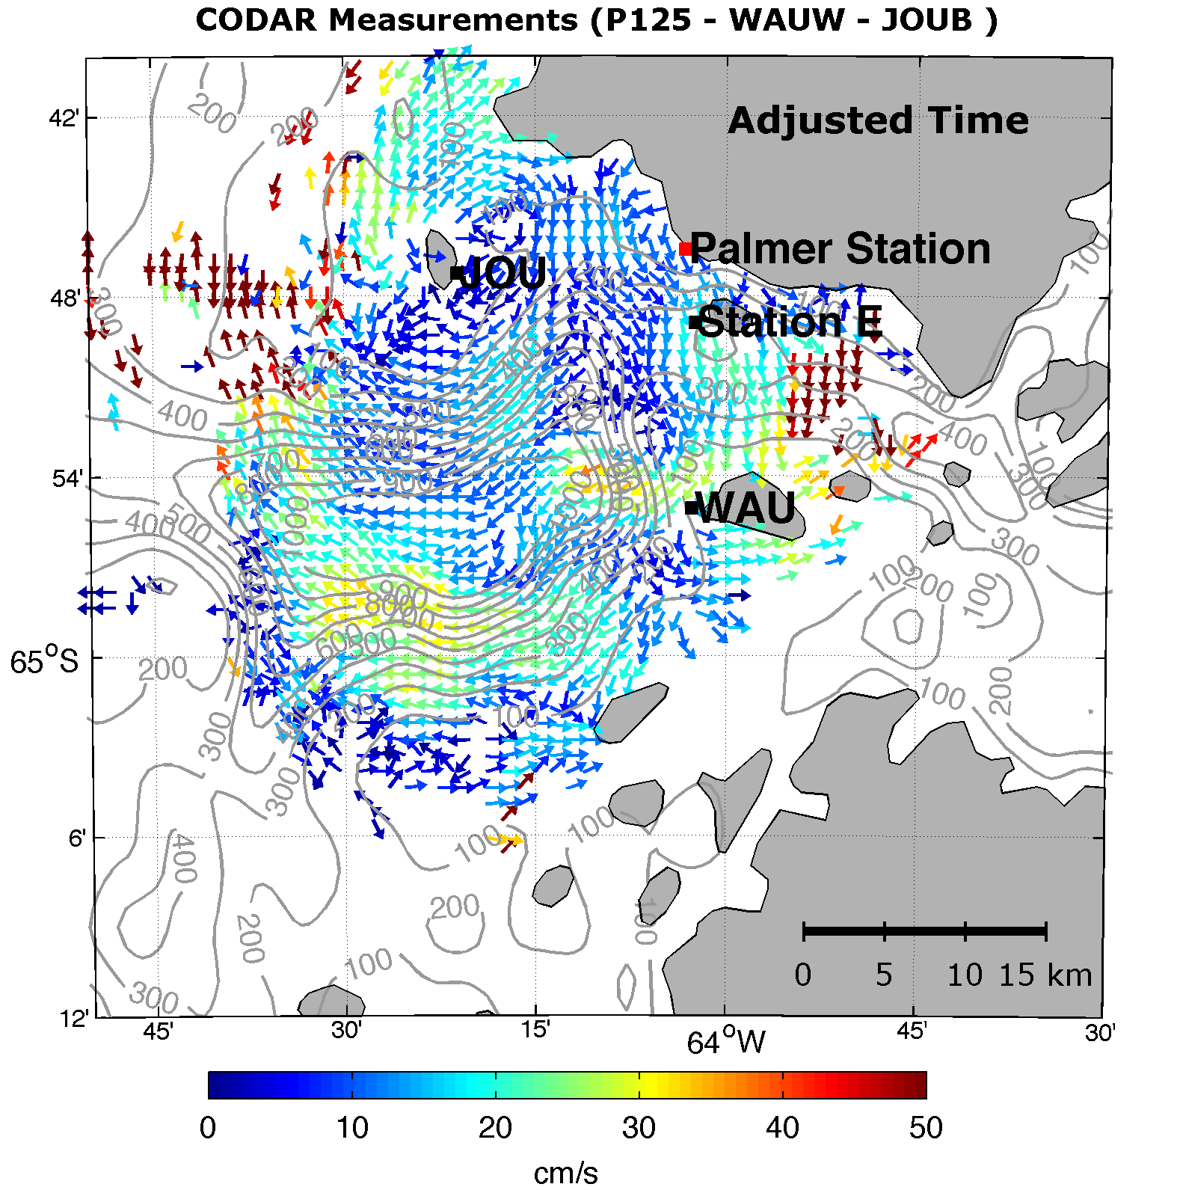
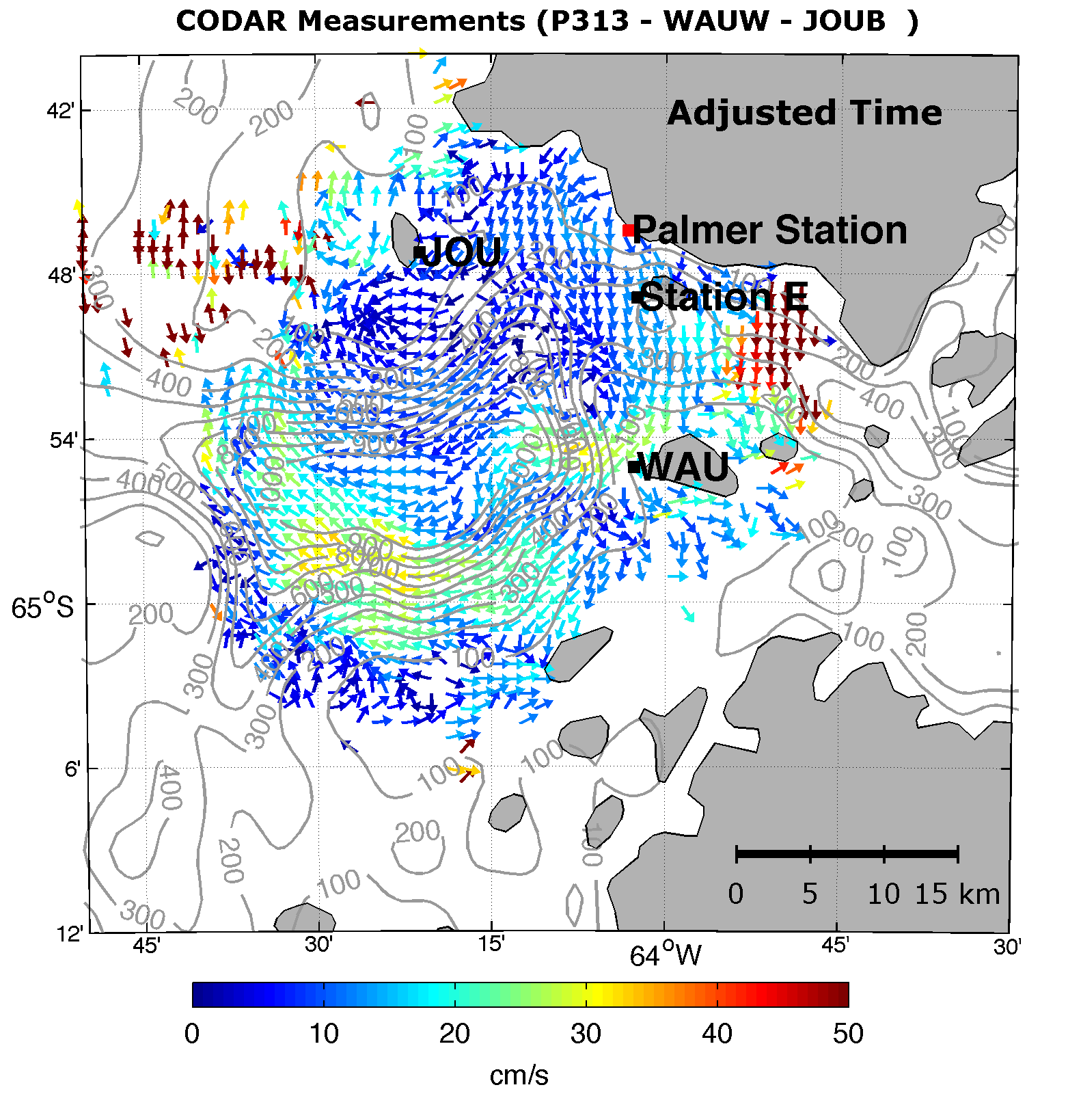
Total Vectors Combined from Sites
at Palmer Station (P125, P313), Joubin Islands(JOUB) and Wauwerman Islands (WAUW)
2 Frequencies at Palmer (P125-25 MHz, P313-13 MHz)
(**Some liberties taken to adjust JOUB time to match WAUW, P125, and P313 time)

Slide 7
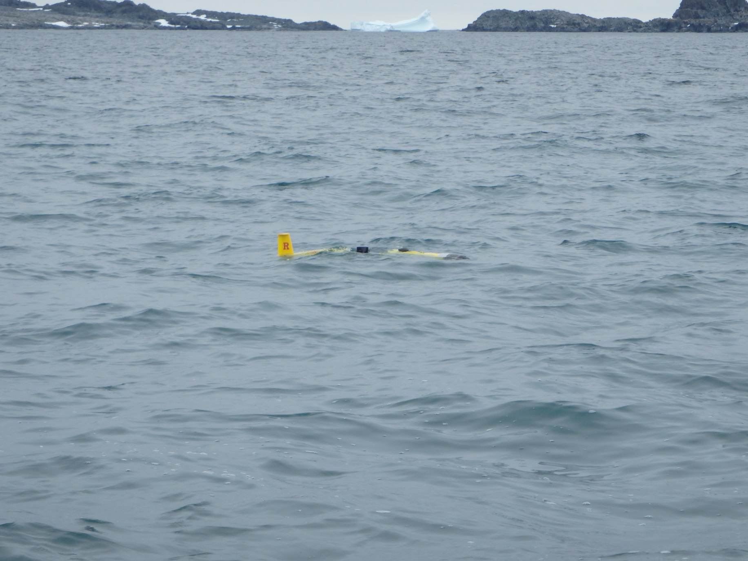
GLIDER OPS
Notes:
By the time I head home, RU01 should be in the middle her third and final mission of the season. She is the first double payload glider to be flown in Antarctica

Slide 8
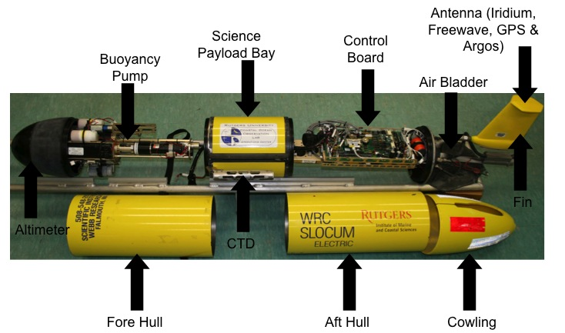
The picture below shows the basic anatomy of a Glider, which has only 3 moving parts making it very energy efficient. photo by: Tina Haskins
Notes:
Three battery types. Lithium primary, lithium secondary, and alkaline. Does “yo’s” through water column using buoyancy pump to change its density. It is ballasted carefully to be neutrally buoyant. This allows it to make itself heavier or lighter by pulling in or pushing out sea water from the nose. Which gives it a V shaped flight path. To call in, air bladder inflates to lift tail out of the water.

Slide 9
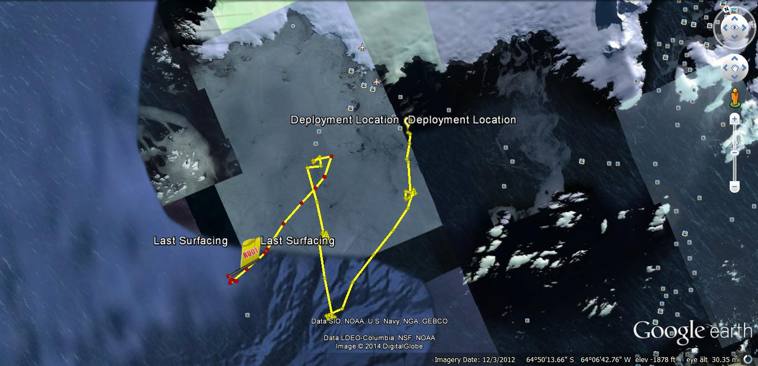
The above Google Earth image shows RU01’s track from its deployment at sampling site E, into the canyon, and back in towards shallow water. She will complete this hourglass pattern a couple more times before we pick her up at the end of the week.
Notes:
The above Google Earth image shows RU01’s track from its deployment at sampling site E, into the canyon, and back in towards shallow water. She is zig-zagging across known penguin foraging zones recording the phytoplankton population’s health and size, giving us a good look at the base of the food chain.

Slide 10
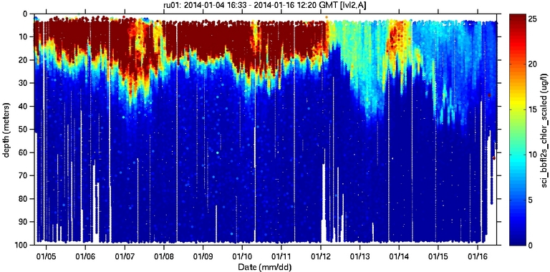
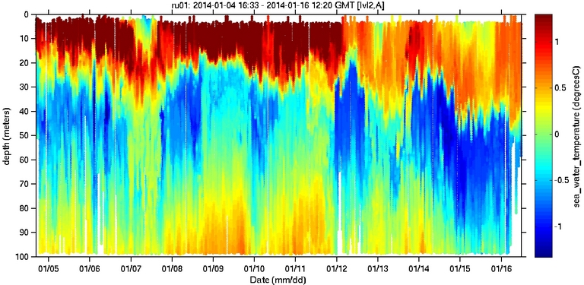
The plot on the top shows the chlorophyll concentrations in the water column. RU01 was able to capture the end of the summer bloom.
The bottom plot is the temperature data recorded by the glider showing some mixing occurring parallel to the end of the bloom
Notes:
Ru01 captured the summer bloom, around january 12th. There was no sampling from that date due to heavy sea ice in the harbor preventing us from using zodiacs.

Slide 11
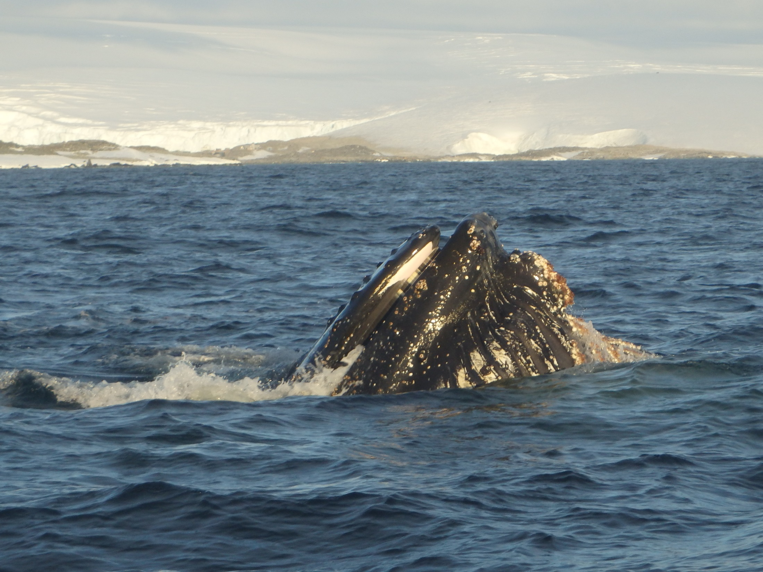
QUESTIONS?

