Slide 1





Update and evolution in the Southern Ocean Observing System?
Why SOOS?
What is SOOS?
What has it been doing?
Oscar Schofield (oscar@marine.rutgers.edu)
Louise Newman, Anna Wåhlin, Sebastiaan Swart, Andrew Constable

Slide 2
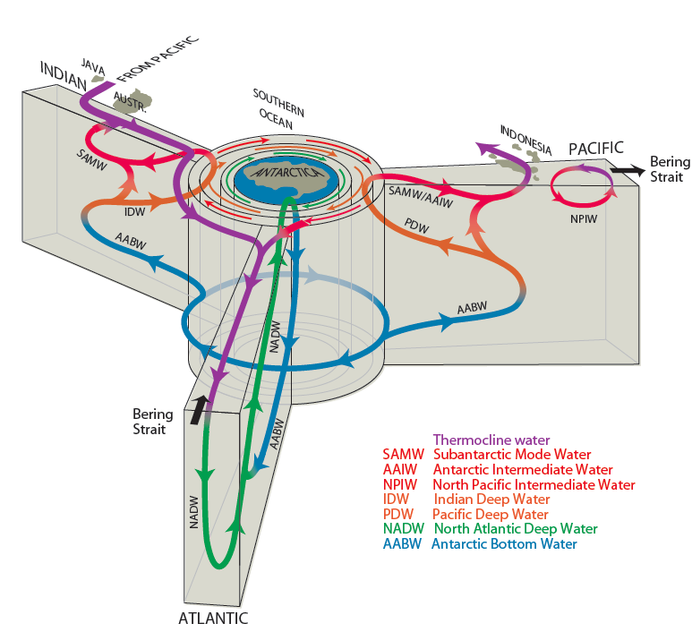
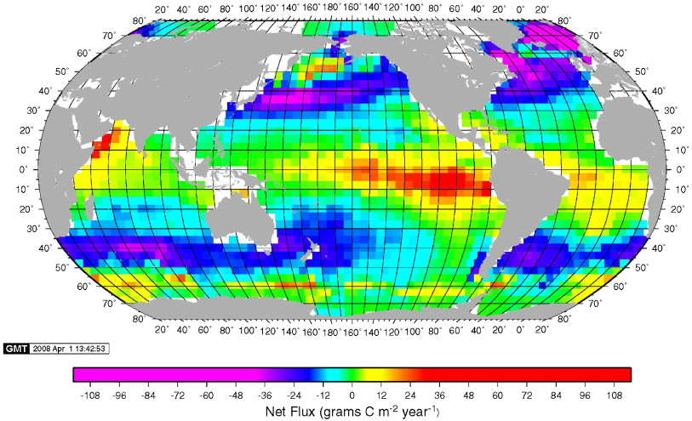
WHY SOOS?
The Southern Ocean is central to the circulation of the ocean (major regions of deep ocean water mass formation, upwelling of deep water masses)
Thanks Kevin Spear
The Southern Ocean is disproportionately important to global carbon fluxes (Carbon flux: Net ocean carbon uptake (blue) and outgas (red), including natural (biological, solubility pump) and anthropogenic)
Takahashi et al. 2009

Slide 3
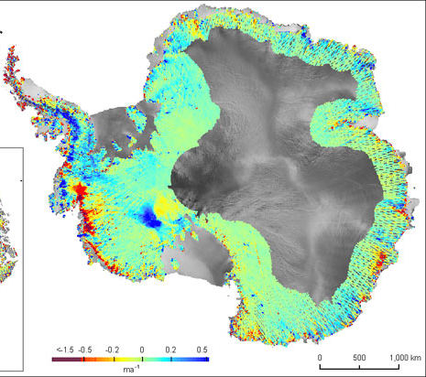
WHY SOOS?
System is changing as regionally, there are shifting in the atmospheric temperatures, likely driven by the circulation and heat delivery from the deep sea.
System is changing as the ice sheets are rapidly thinning

Slide 4
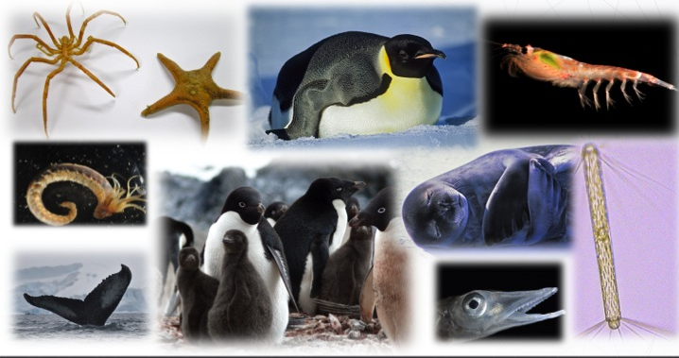
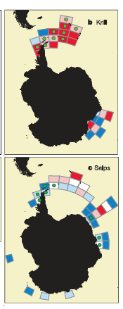
WHY SOOS?
The Southern Ocean is home to diverse organisms that contain a range of unique evolutionary innovations
Many of the ecosystems appear to be undergoing significant shifts over recent decades

Slide 5
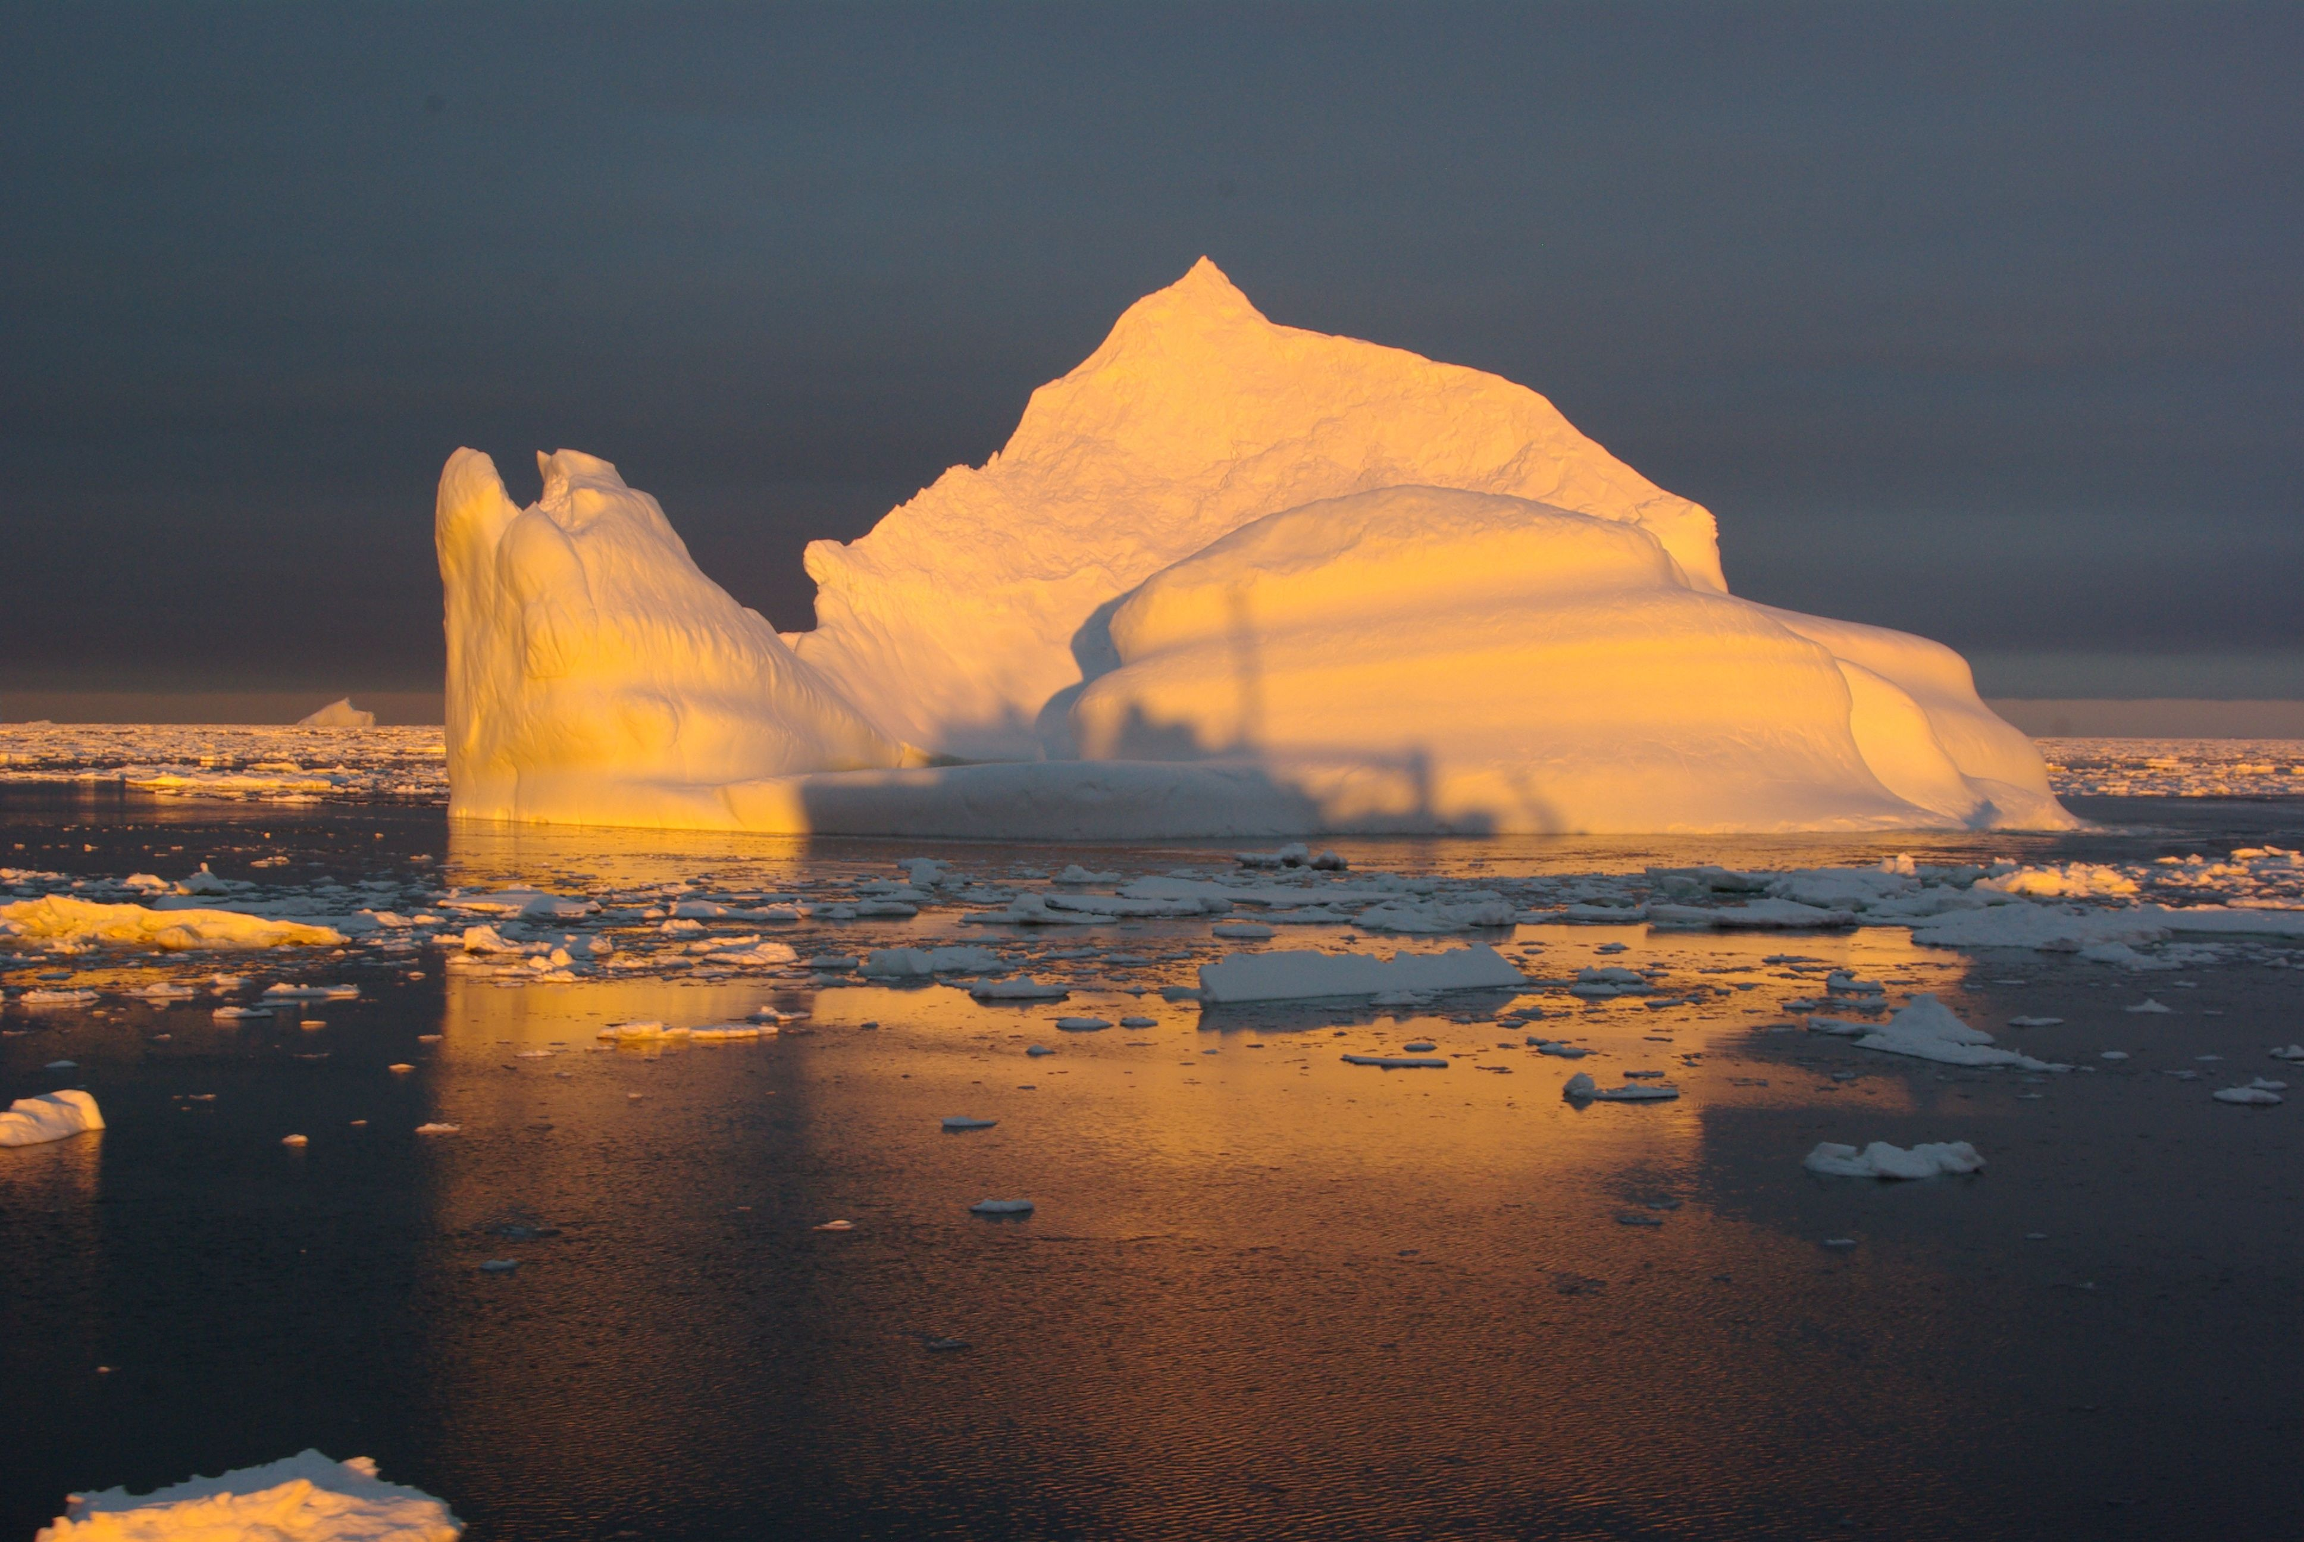
WHAT IS THE SOOS MOTIVATION?
MISSION: To establish a multidisciplinary system to deliver the sustained observations of the Southern Ocean that are needed to address key challenges of scientific and societal relevance, including climate change, sea-level rise and the impacts of global change on marine ecosystems.

Slide 6
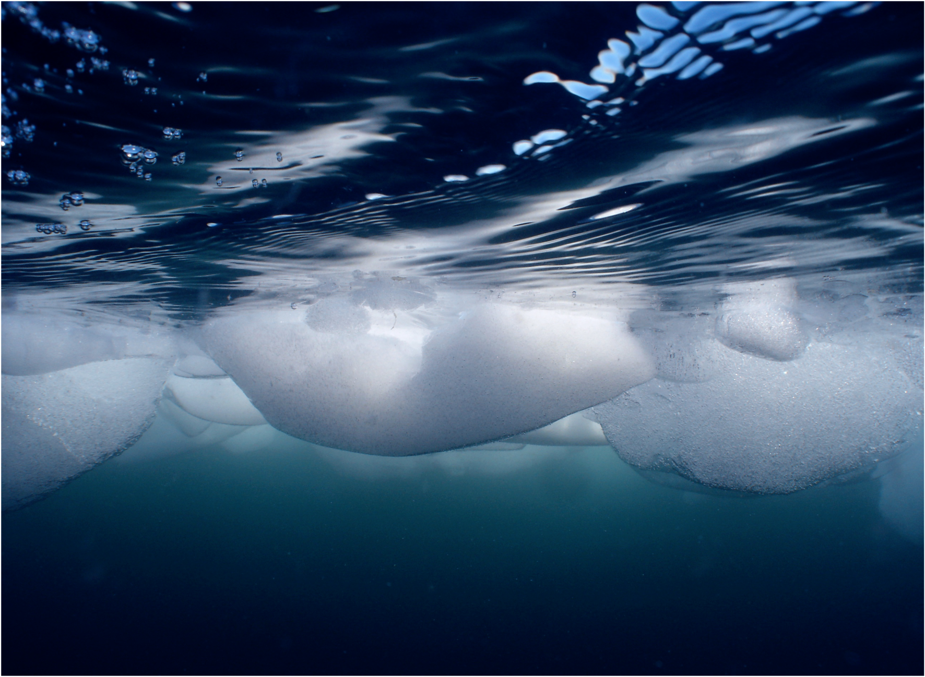
WHAT IS THE SOOS?
- Many (mono-disciplinary) programmes in SO research, all with individual infrastructure, data routes etc. SOOS will connect across disciplines and programmes to ensure a coordinated approach to observing the SO.
- Sponsored by SCAR (Scientific Committee on Antarctic Research) and SCOR (Scientific Committee on Oceanic Research)
  SOOS Initial Science and Implementation Strategy – developed by SCAR/SCOR Expert Group on Oceanography and the SCAR/CLIVAR/CliC Southern Ocean Panel.
- International Project Office opened August 2011, hosted by the Institute for Marine and Antarctic Studies (University of Tasmania), with additional support from the Australian Antarctic Division.

Slide 7
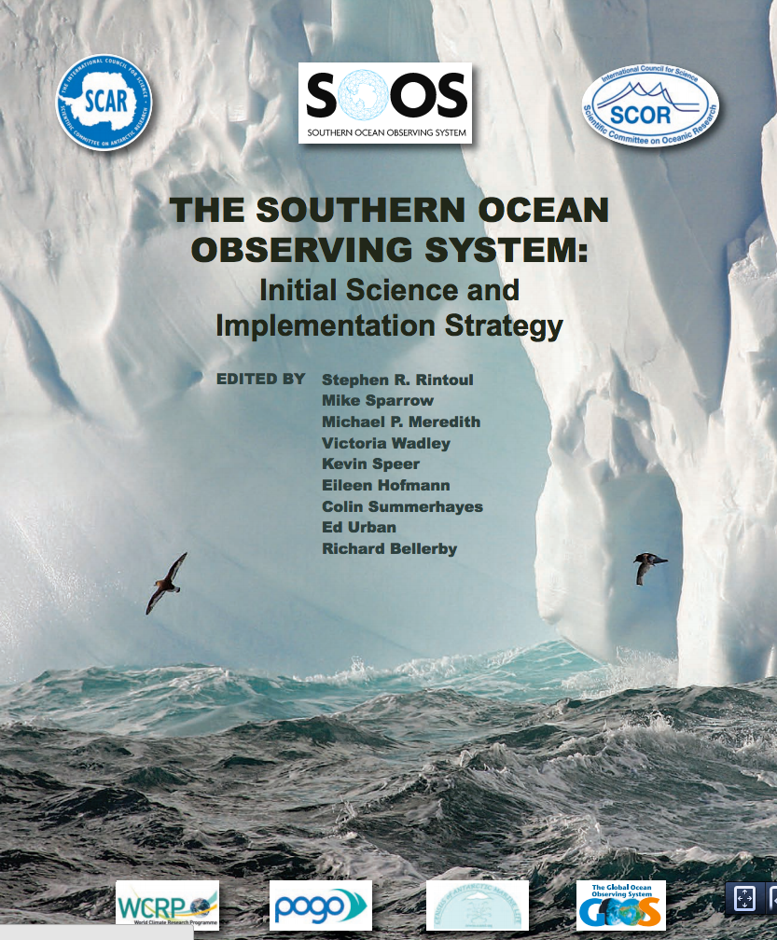
Design Phase
Community identified high priority of science requiring a full Southern Ocean observing capability
Role of Southern Ocean in global freshwater and heat balance
Stability of Southern Ocean overturning circulation
Stability of Antarctic ice sheet and future contribution to sea-level rise
Future of Southern Ocean carbon uptake
Future of Antarctic sea ice
Impacts of global change on Antarctic ecosystems

Slide 8
The SOOS Engineering Needs Moving Forward
Pre-print also available from SOOS product database www.soos.aq
Clarification of vision has enabled ID of steps required to achieve vision:
What are the advances in technology required?
What activities need to be coordinated?
What needs to be initiated now, in 2 years, or in 10?
What is the infrastructure and required funding?

Slide 9
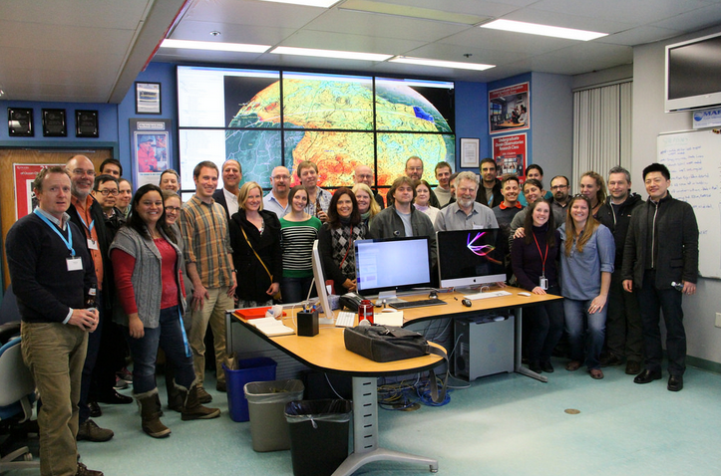
Design Phase
What are the key variables that must be observed to address the key questions of your Science Theme? What is the “Readiness” level of each variable for being part of an observing system?
Ecosystem Sciences further behind in identifying the essential variables. SOOS helped catalyse progress
- Held a very successful international workshop (Rutgers, USA, March 2014)
- Submitted report to ICSU (website)
- Presented outcomes at IMBER OSC
- Presented outcomes at ICED
- Holding a Town Hall meeting alongside SCAR (Aug 27th)
- Submitting SCOR Working Group proposal
April 2014
eEOV workshop

Slide 10
Changes to SOOS governance to now begin network design
2014 Scientific Steering Committee meeting was held in Tromsö, Norway, in June.
This meeting was very successful, and put in place a new governance structure to support implementation activities of SOOS.
All SOOS activities (strategic or field; SSC-defined or bottom-up, community driven) will be implemented through SOOS Working Groups. General Operating Principals and Working Group Terms of Reference are in development. Working Groups will need to be approved by the SOOS SSC, will generally be short-term outcome/product driven, and will undergo annual review by the SOOS SSC.
Leaders of all SOOS Working Groups will form an Implementation Panel. This panel will meet opportunistically for cross-fertilisation of knowledge/ideas. It is proposed that this panel will meet officially once every 3 years.

Slide 11
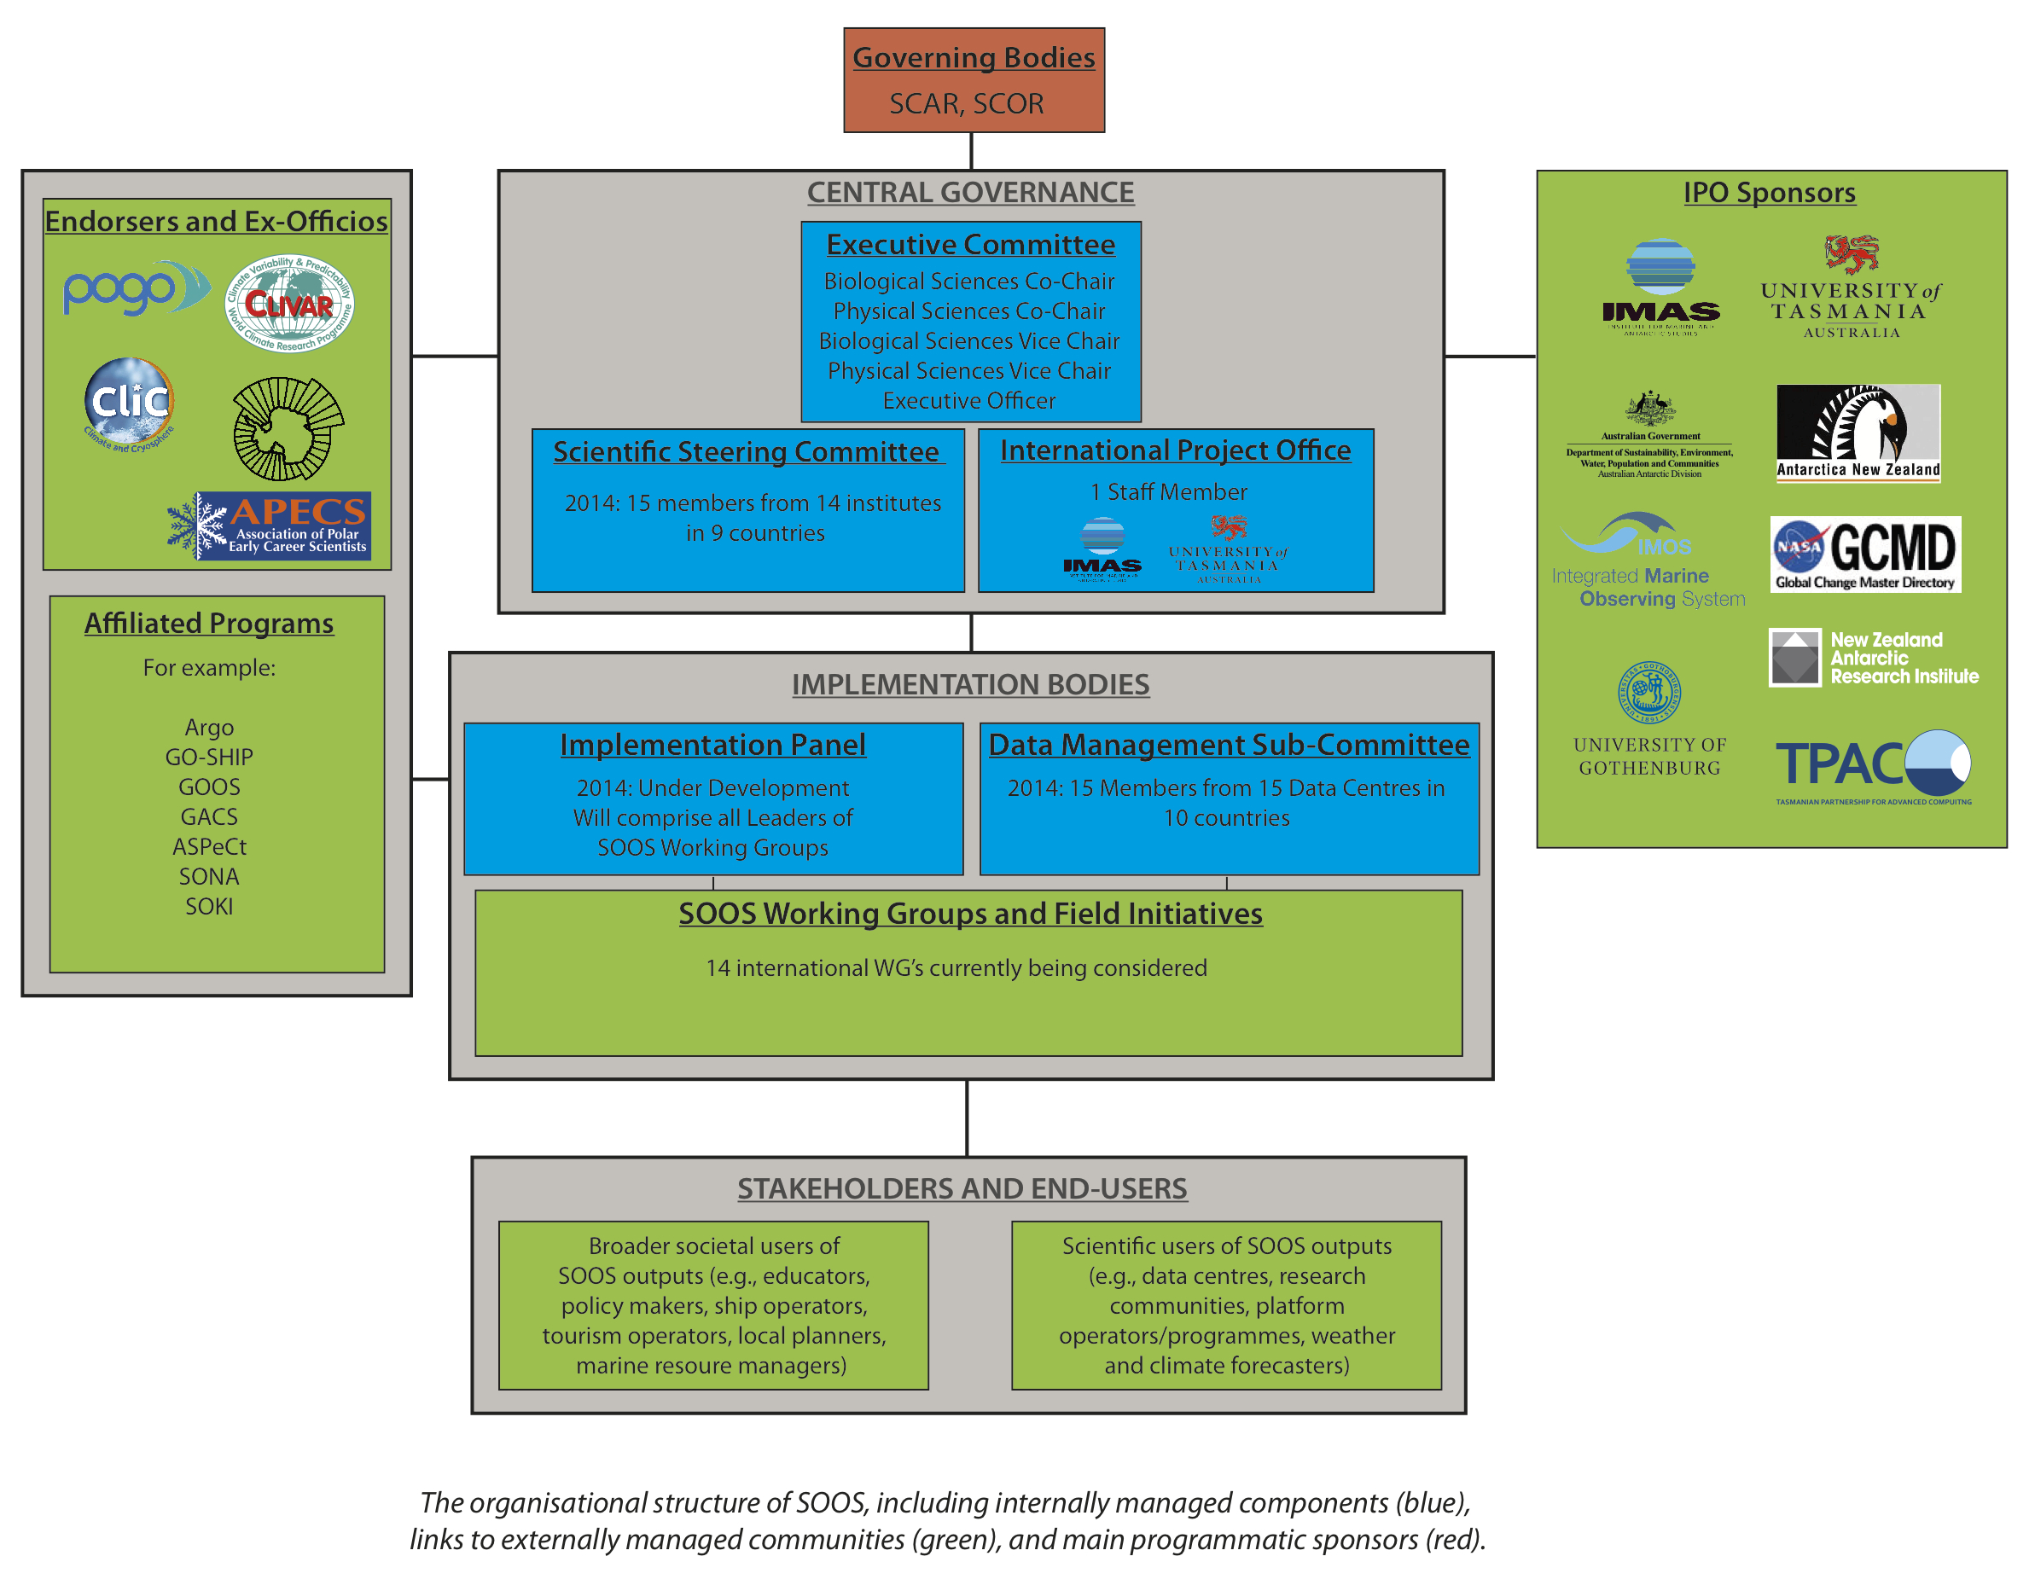

Slide 12
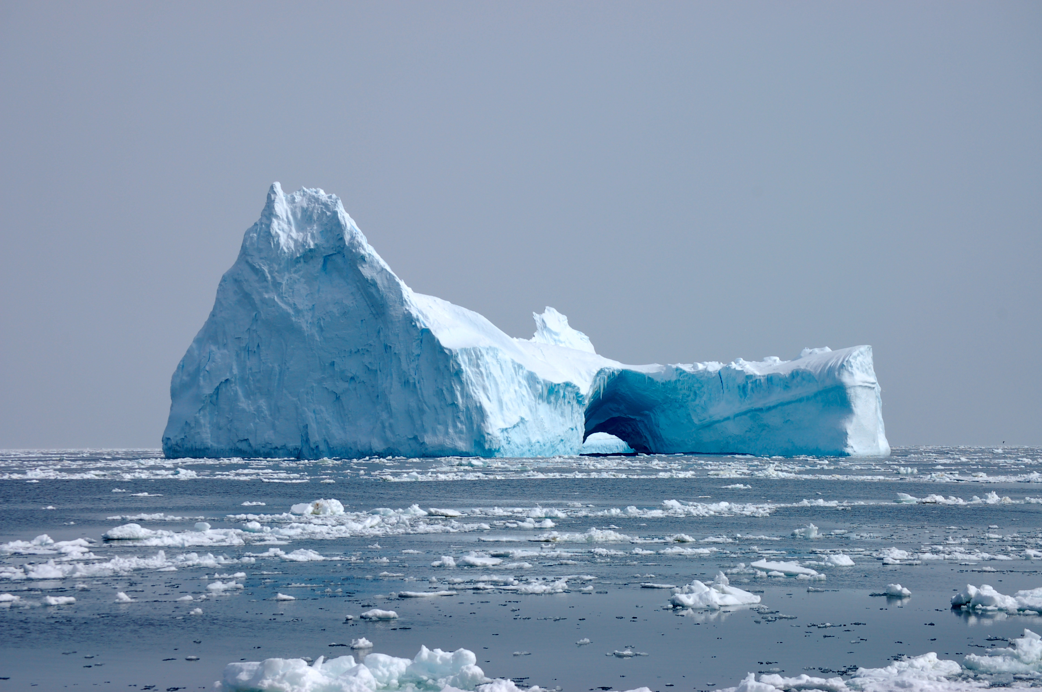
SOOS will work to make sure:
Ensures working groups have enough specificity so as to be a specific contribution
Not redundant with other working groups, if so it might be asked to join a working group
Has an international cross-section to ensure it fulfills SOOS goals
Small groups with great ideas could be a working group
Working groups could have a regional focus, technical focus, process focus, education/outreach focus, cyberinfrastructure/data focus
Goal of Working group? Develop either a product of high value and/or provide a basis for a program that might be funded by national programs and/or foundations, etc.

Slide 13
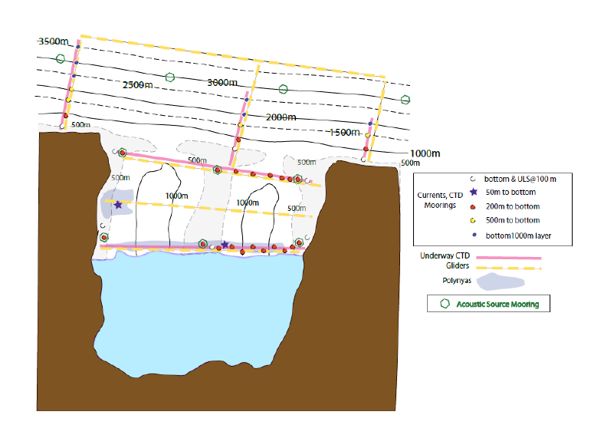
Example: Design Phase what networks do we need?
Open for Comment: SOOS International Strategy for Under Ice Observations
An international strategy for coordinated observations under ice shelves and sea ice. This document is the key result of the SOOS Under Ice workshop (Hobart, Oct 2012).
Currently requesting comments from the community. See www.soos.aq/science/under-ice

Slide 14
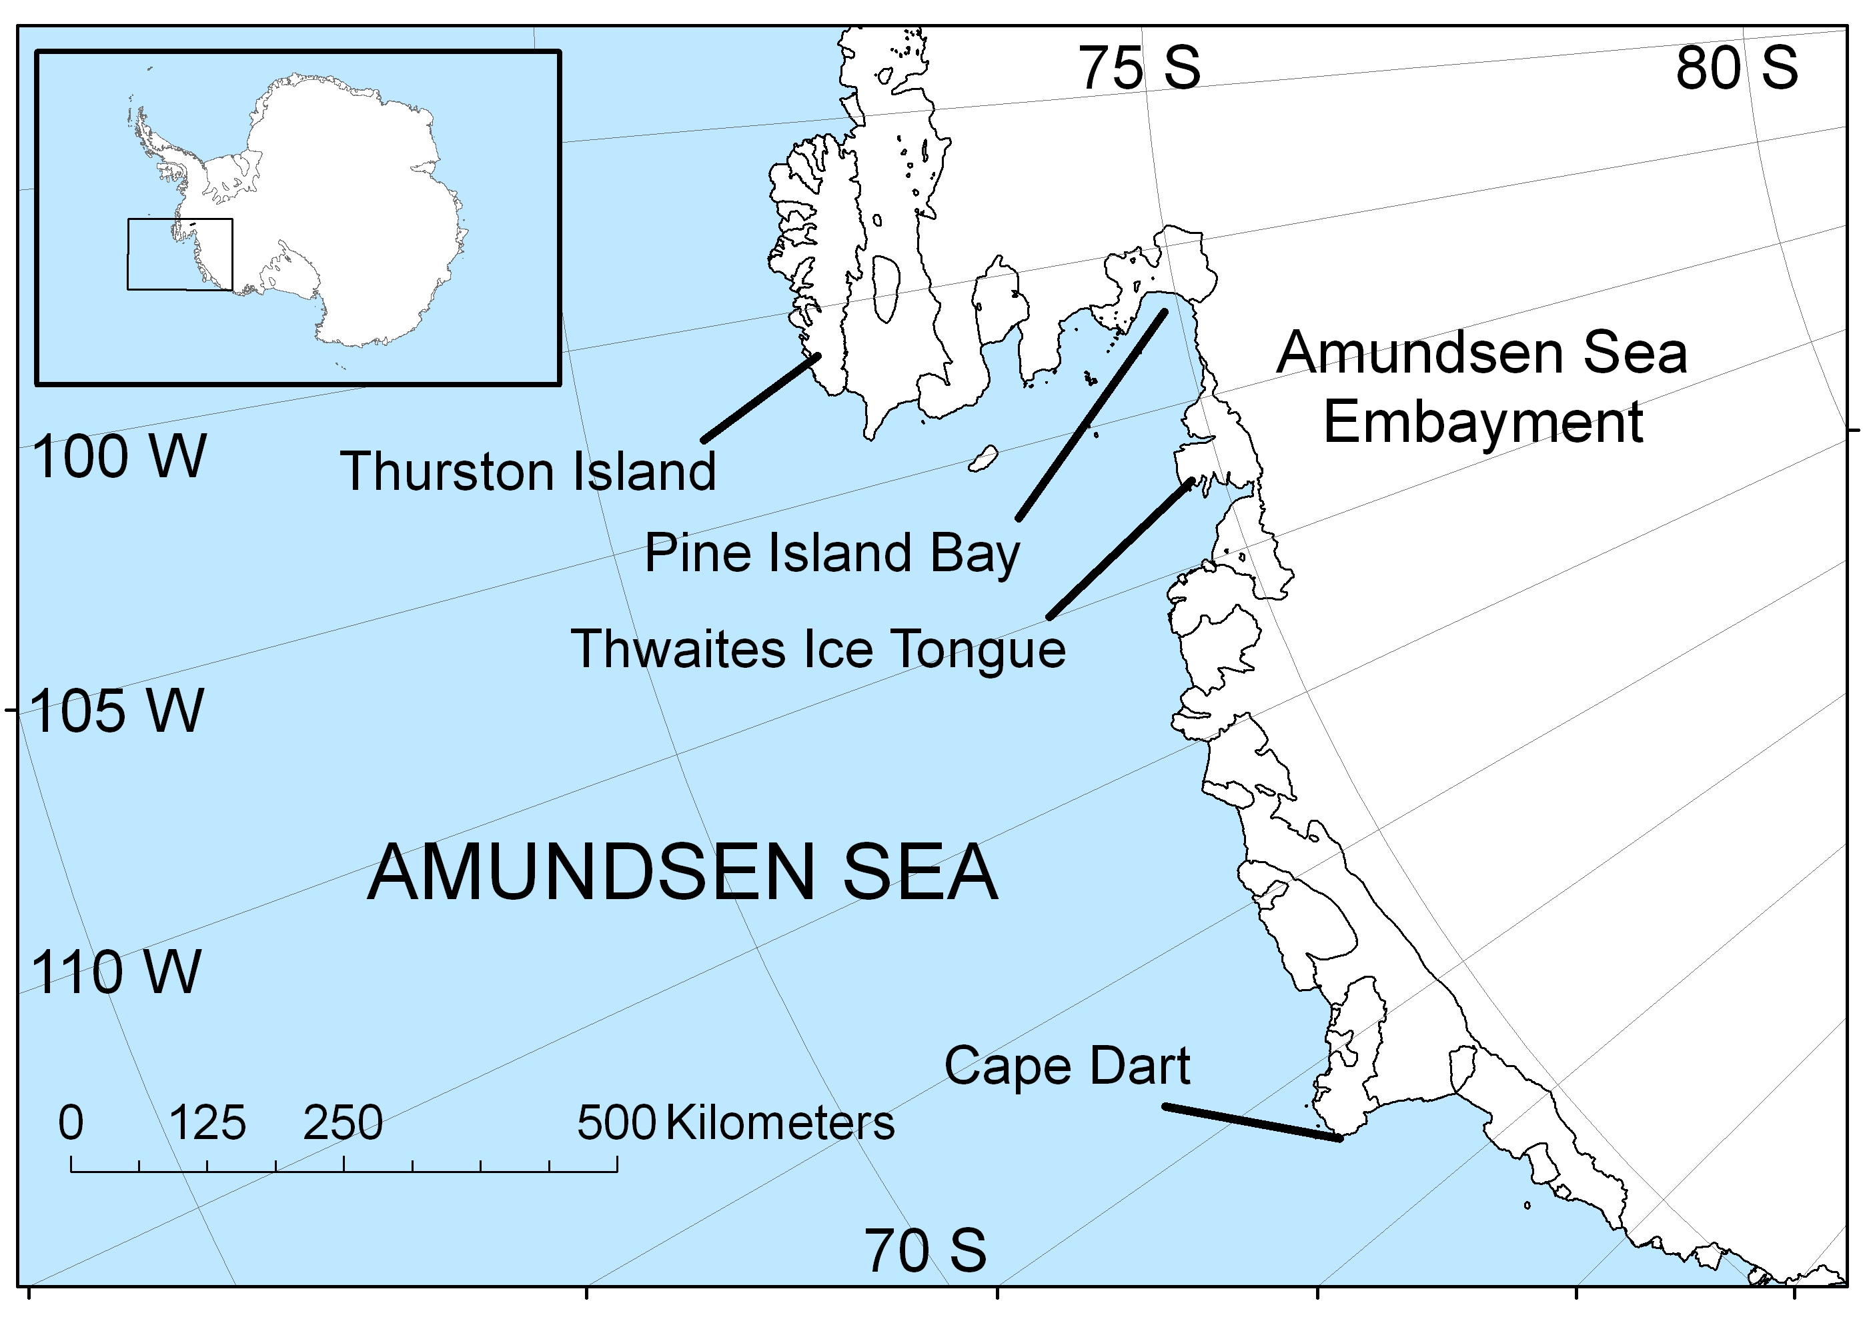
Flagship Projects: Focused on a chronically under-sampled region, little or no existing infrastructure, extensive international coordination of logistics required.
Benefits: As little is known about the region, any level of observation enhancement will significantly increase our understanding
Amundsen Sea
3rd largest ice drainage basin of WAIS
Area of high primary production in polynyas
Significant glacial retreat and melt input, and decrease in sea-ice extent.
Region may be a weak link in stability of WAIS.
No Antarctic bases nearby, no regular ship transects – therefore logistically demanding
Researchers from a number of nations now looking to enhance observations in this critical area – will need significant logistical and operational support

Slide 15
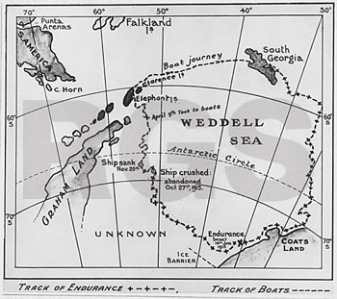
Flagship Projects: Focused on a chronically under-sampled region, little or no existing infrastructure, extensive international coordination of logistics required.
Benefits: As little is known about the region, any level of observation enhancement will significantly increase our understanding
Weddell Sea
Critical region for thermohaline circulation
Important region to understand sea ice-ice sheet dynamics
Limited access and very difficult operating area
Researchers (AWI particularly interested) from a number of nations now looking to enhance observations in this critical area – will need significant logistical and operational support

Slide 16
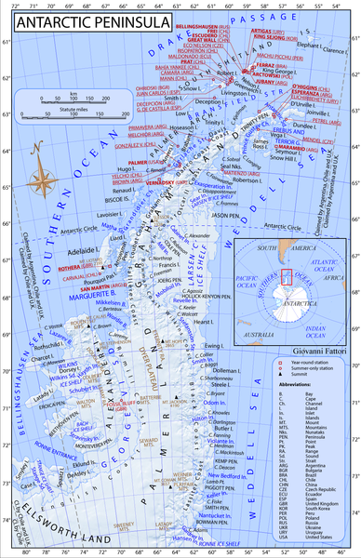
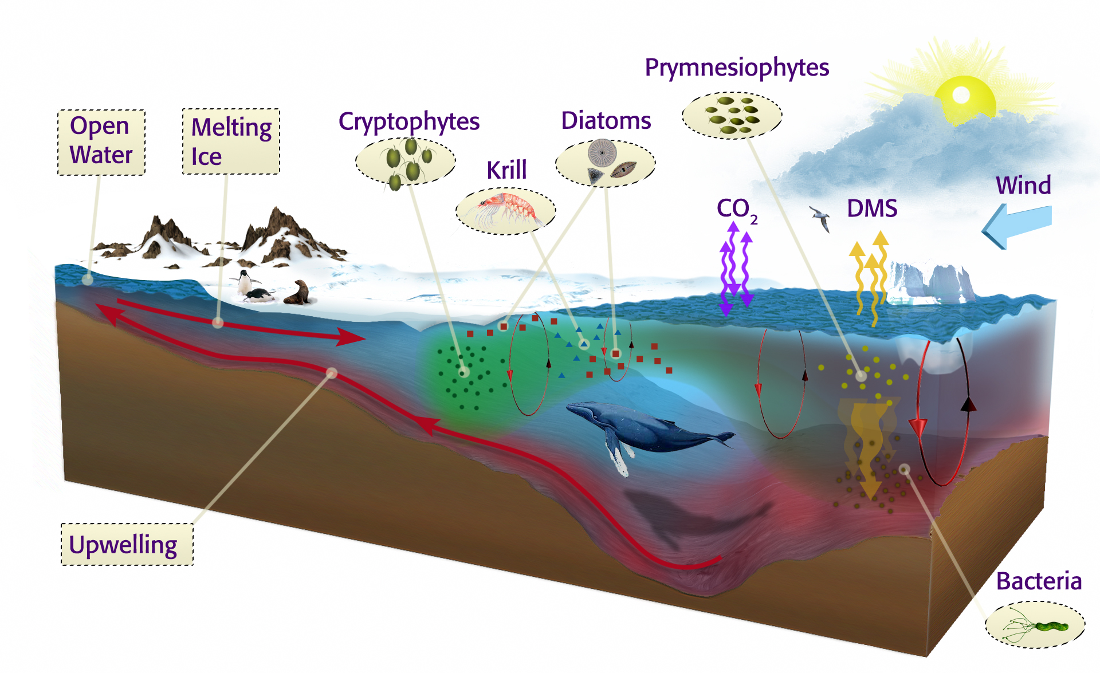
Enhanced Regional Study: Focused on a region with significant history of observations, has existing infrastructure and potential for many nations to be involved.
Benefits: Logistically “easy”, high potential to push the envelope with regard to the technology, will provide a “test-case” for SOOS vision
Antarctic Peninsula
Significant levels of infrastructure present
Many nations already work in region, therefore many international efforts that can be pulled together
Area of rapid change from physics to ecosystems driven by deep ocean.
Region of rapid climate change

Slide 17
Regionally Constrained Study: Region is constrained by unique physical feature, important biological/chemical/physical problems, variable logistical cooperation required.
Benefits: Logistical considerations are secondary, driven by a specific science question
Kerguelen Plateau – Ecosystem Study
Iron fertilisation from Plateau driving observed variability in productivity
Transects designed to sample upstream, on and downstream of the Kerguelen Plateau
Current project plans are ecosystem-based, but huge potential for international collaboration for a total-system study
Micronutrient control with potential geoengineering considerations
Mean Chlorophyll-a

Slide 18
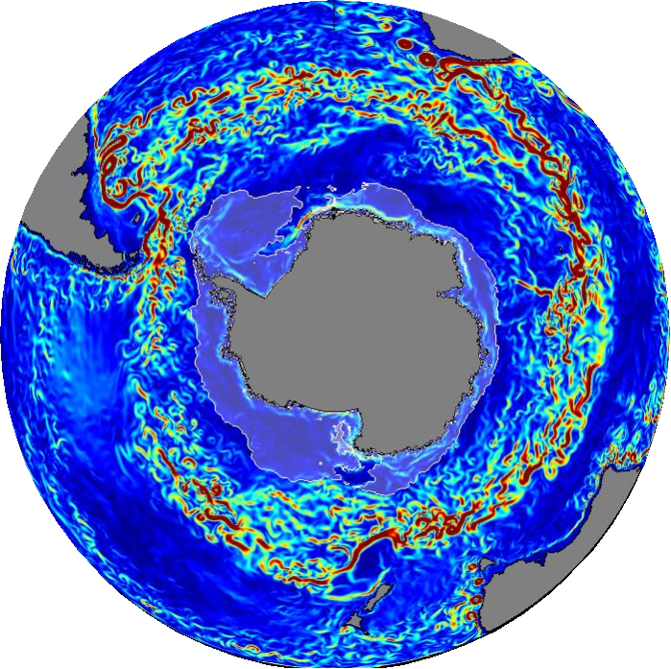
Regionally UnConstrained Study: Region is constrained by unique physical feature, important biological/chemical/physical problems, variable logistical cooperation required.
Benefits: Logistical considerations are secondary, driven by a specific science question
Circumpolar Circulation and Carbon Dynamics
Circulation drives heat budget of coastal seas around the continent
Disproportionately important for global carbon dynamics
Critical to global climate system

Slide 19
Example of the potential working groups
In progress development of a West Antarctic Peninsula Working Group
Terms of Reference currently being developed.
- Coordinate activities, methods, plans
and data between all nations currently
involved in observations on the WAP (red on map)
Standardize measurements at stations and ships
Coordinate technology upgrades
Improve international science discussion to expand the development of collaborative programs

Slide 20
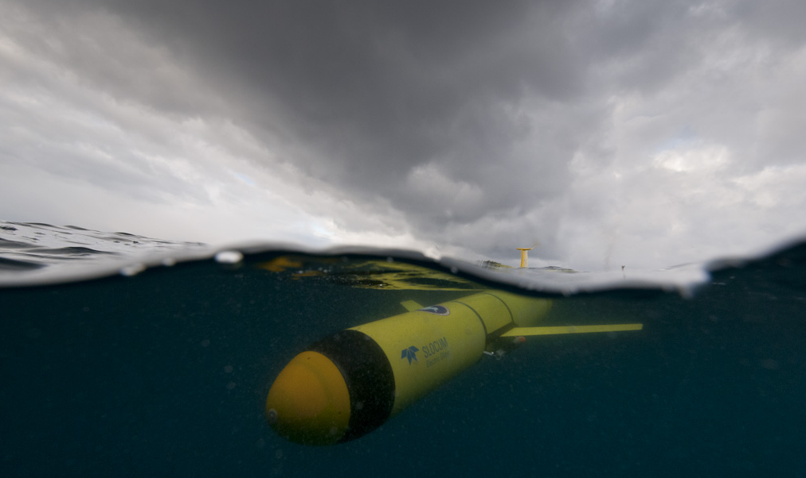
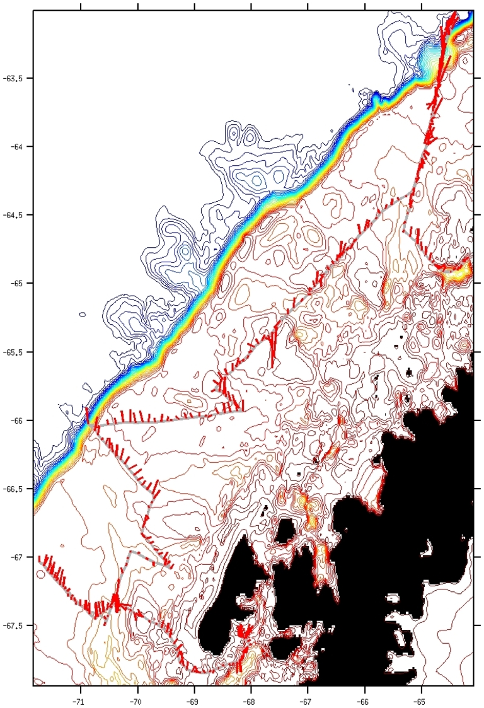
Working group would help design longer term
Plans utilizing evolving technology
Example: Link field stations with networks of gliders?
LTER 2012
Palmer
Rothera

Slide 21
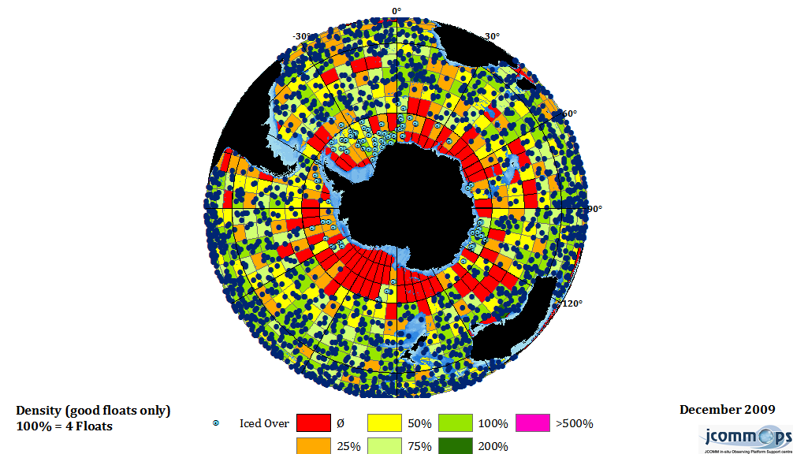
Building blocks of the SOOS: enhanced Argo

Slide 22
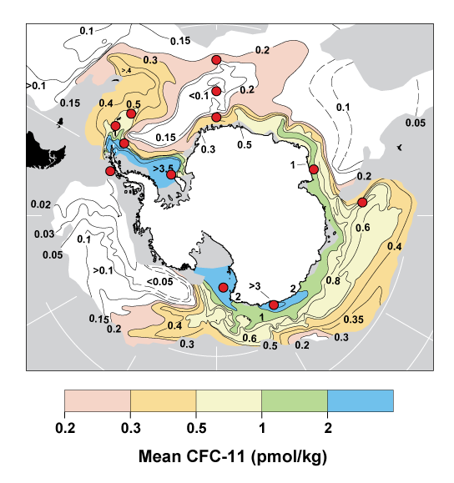
Building blocks of the SOOS: moored time series

Slide 23
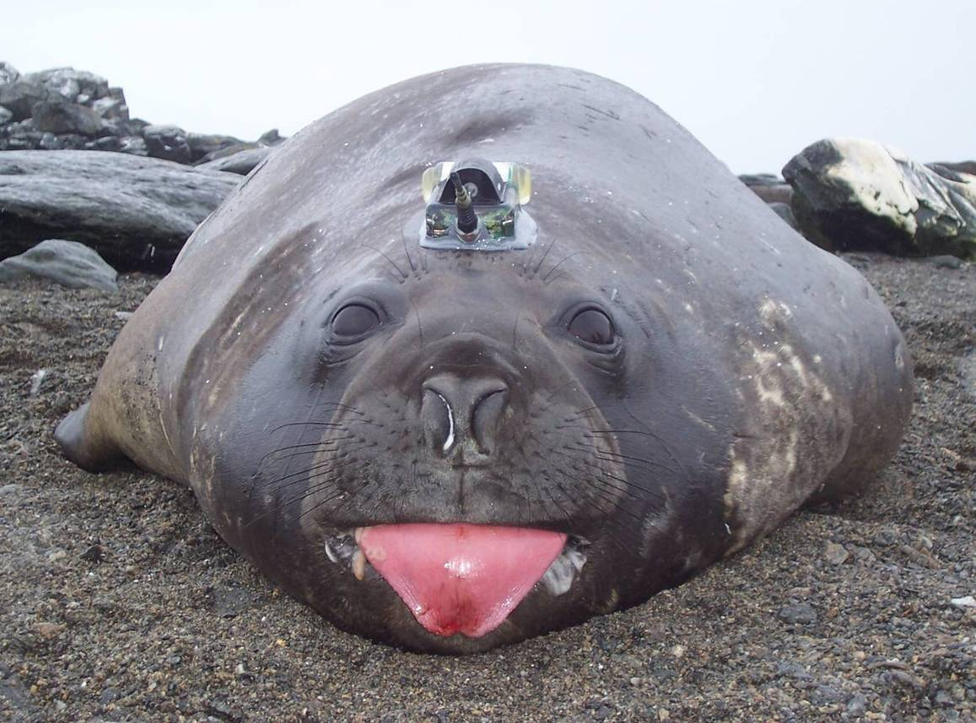
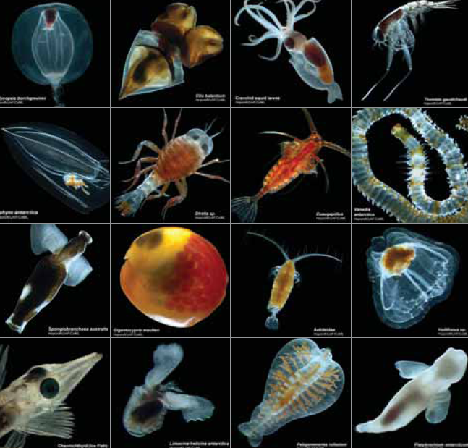
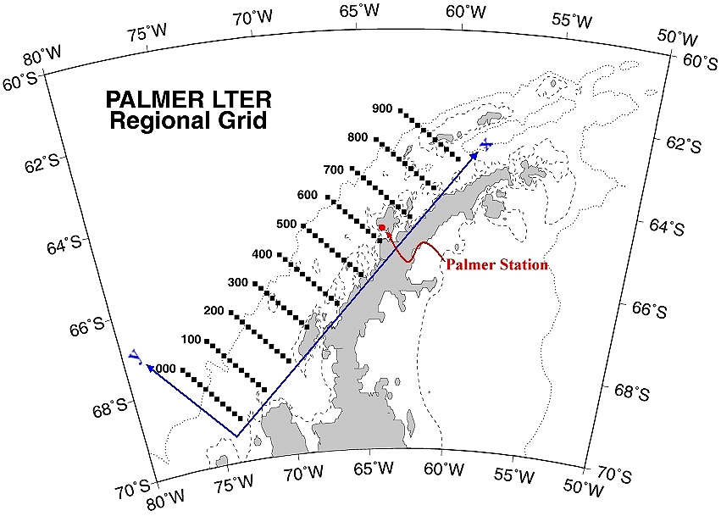
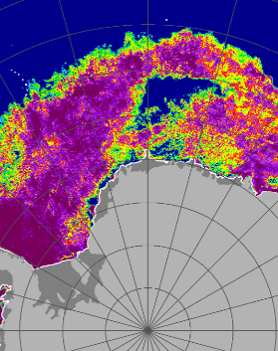
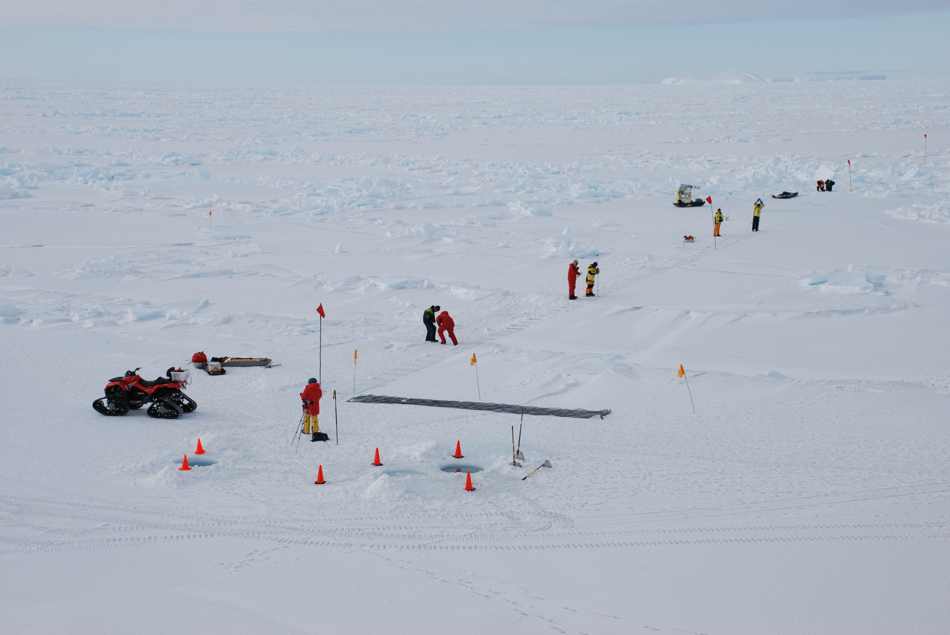
Building blocks of the SOOS: seal tags, biology, satellite, sea ice, data system…

Slide 24
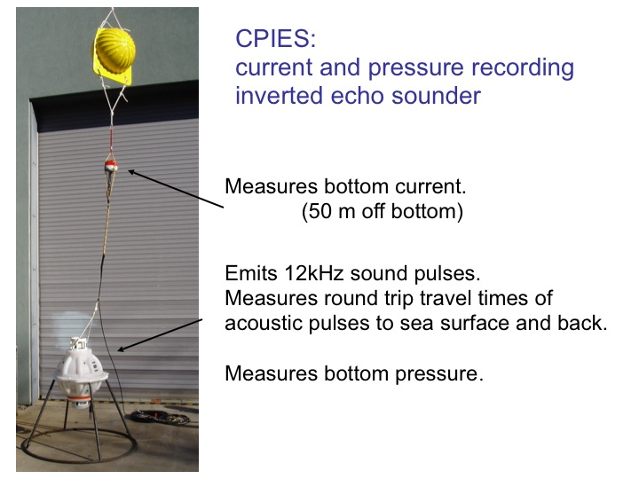
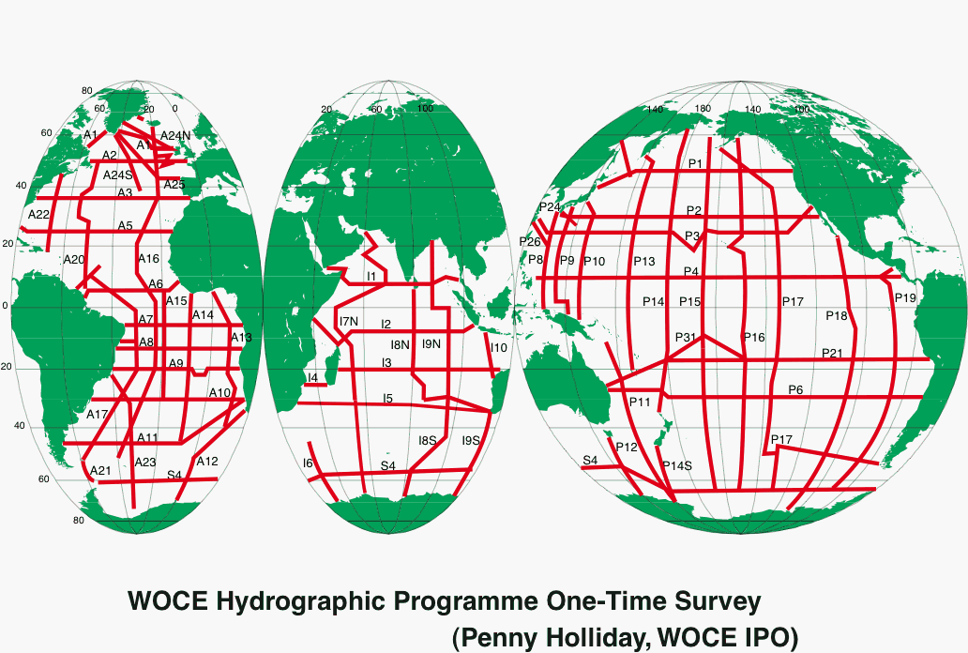
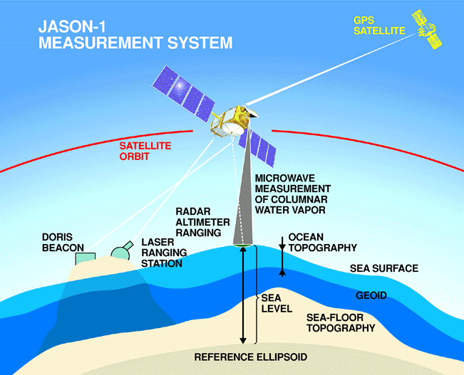
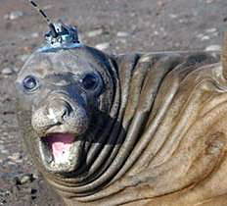
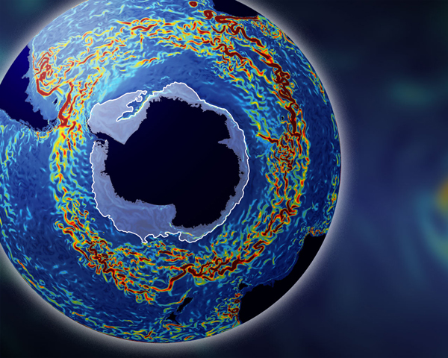
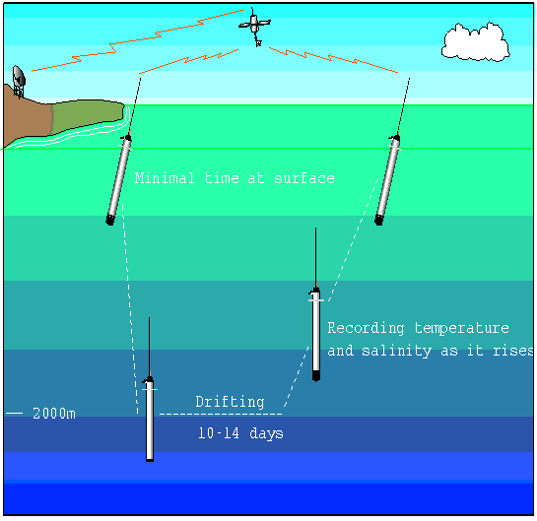
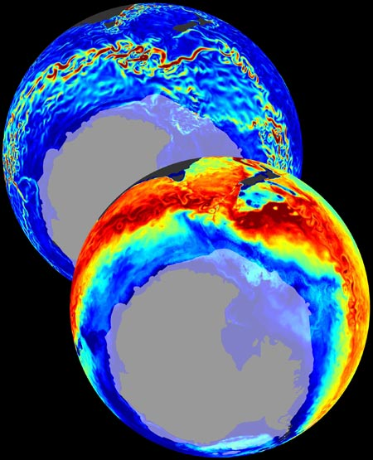
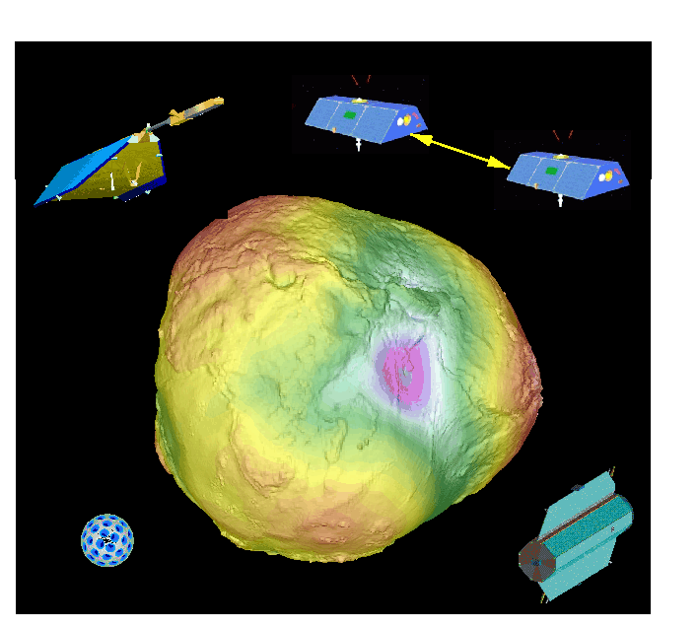

SOOS will require and support advanced assimilative models
Southern Ocean
State Estimate

Slide 25
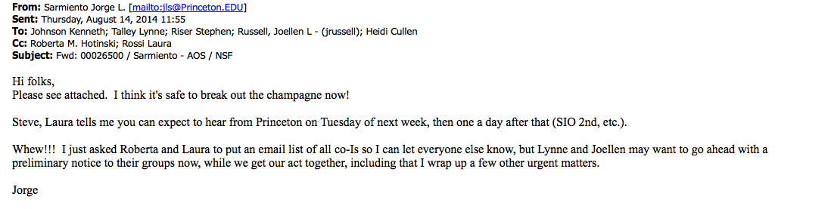
Leveraging national investments: Example from two programs
SOCCUM: Program focused on
biogeochemistry of ACC
WAP Programs focused on
biogeochemistry of ACC
Heat delivered by the ACC
structures the
continental shelf

Slide 26
SOOS leadership has changed considerably over the last year:
Mike Meredith (BAS, UK) stepped down as Physical Sciences Co-Chair (new work commitments) but remains on the Scientific Steering Committee (SSC).
Anna Wåhlin (Gothenburg Uni, Sweden) was elected Physical Sciences Co-Chair, and now serves with Oscar Schofield (Rutgers, USA) as Biological Sciences Co-Chair
Sebastiaan Swart (CSIR, S. Africa) was elected Physical Sciences Vice Chair, and Andrew Constable (AAD, Aus) was elected Biological Sciences Vice Chair
Kim Finney (AADC, Aus) stepped down as chair of SOOS Data Management Sub-Committee (retired), Steve Diggs (CCHDO, USA) was elected new Chair.
Four new SSC members were elected (Matthew Mazloff (Scripps, USA), Jean-Baptiste Sallee (CNRS, France), Mike Williams (NIWA, NZ), SangHoon Lee (KOPRI, Korea)) and will replace Steve Rintoul (CSIRO, Aus) and Bronte Tilbrook (CSIRO, Aus) when they rotate off the SSC at the end of 2014.

Slide 27
Where are we? SOOS is just beginning, so open for all as
the journey is just beginning
For more info go to www.soos.aq

