Slide 1





Funded for the next 6 years, $21 Million

Slide 2

The opportunity
A transformative observing system
                Profiling floats
          Biogeochemical sensors
          A transformative data analysis system
            State estimation in eddy resolving models
            Now adding biogeochemistry
            A transformative prediction system
            Ultra high resolution climate model simulations

Slide 3
NSF funding will enable ~30 to 40 floats/y with pH, O₂, NO₃⁻, ~200 total
NOAA will provide half of the basic CTD floats
NASA will provide biooptics (WETLabs FLBB or MCOM - ~FLBBCDOM) for ~1/2 of floats
Support for one Biogeochemical Argo data manager at UW
CLIVAR quality calibration of chemical sensors at deployment

Slide 4
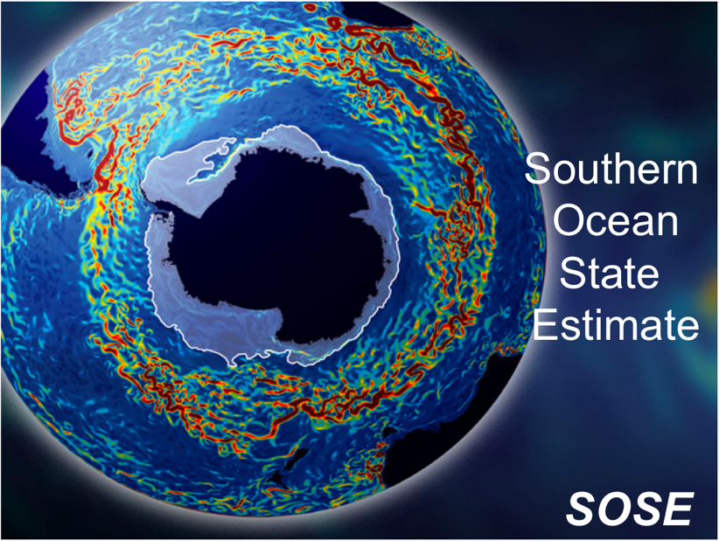

Observations assimilated in BGC State Estimate (Mazloff, Verdy)
Currently:
• 78º to 24.7ºS
• 1/6º resolution
• 42 depth levels
• Atmospheric boundary layer scheme (ERA-Interim first guess atmos. state)
• full sea-ice model
• KPP parameterization
• 2005 – 2010
• sose.ucsd.edu

Slide 5
Why?
The Southern Ocean comprises only about 30% of the world’s ocean area, it accounts for half the ocean’s uptake of anthropogenic carbon from the atmosphere.

Slide 6
Why?
Vertical exchange in the Southern Ocean supplies nutrients that fertilize up to three-quarters of the biological production in the global ocean north of 30°S

Slide 7
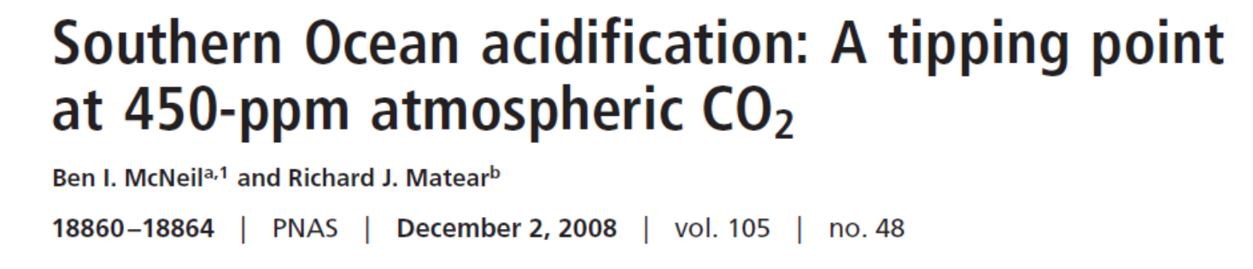
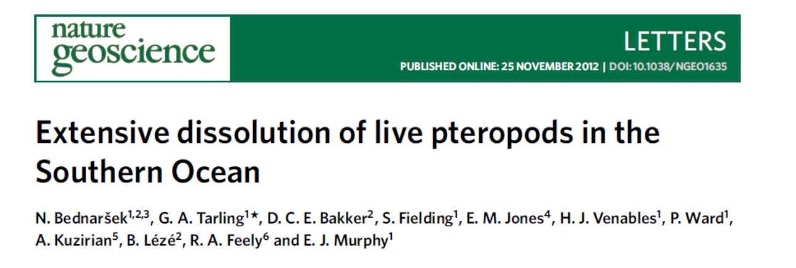
Why?
The Southern Ocean south of ~60°S is highly sensitive to acidification due to low carbonate ion concentrations at cold temperatures.

Slide 8


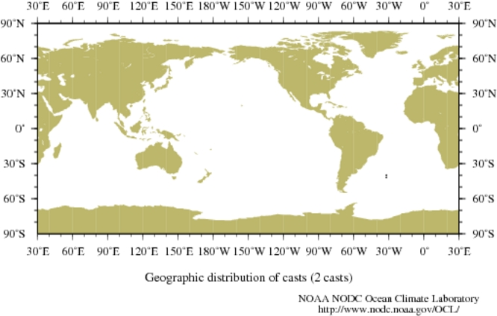
254,000 pH profiles from ships in US National Ocean Database.
55,584 pH profiles since measurements were standardized during the WOCE/JGOFS era (since 1990).
For 1990 – 2014 there are only 2 pH profiles found South of 40ºS in the database for the Austral Winter (June 21- Sep 22).
COPY OF YOUR SEARCH CRITERIA:
OBSERVATION DATES: | Year from 1990 to 2014; Month from 6 to 9; Day from 21 to 22
GEOGRAPHIC COORDINATES: | Longitude from -180.0000 to 180.0000; Latitude from -40.0000 to -90.0000
DATASET: | OSD,CTD,XBT,MBT,PFL,DRB,MRB,APB,UOR,SUR,GLD
MEASURED VARIABLES (must): | pH
MEASURED VARIABLES (extract): | pH

Slide 9
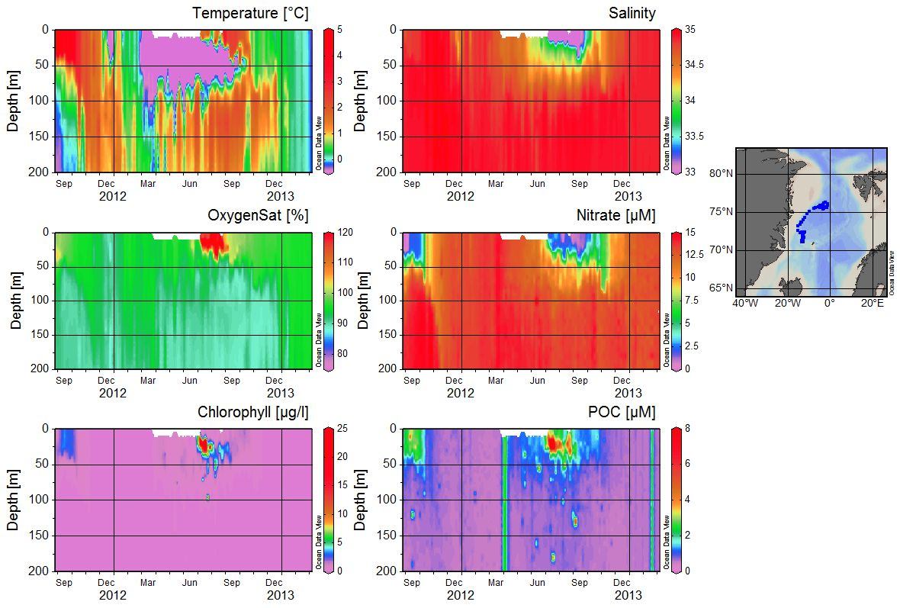
UW float 7564

Slide 10
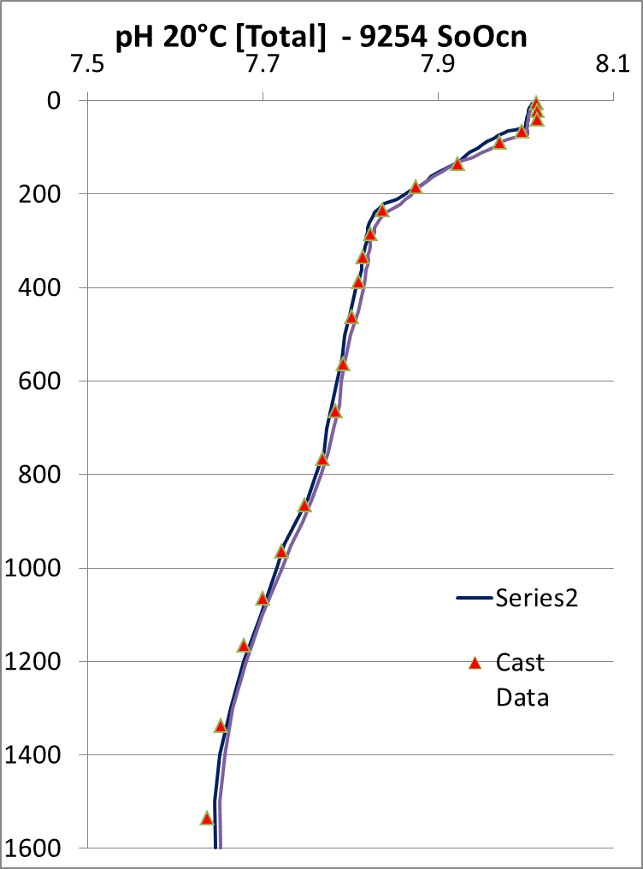
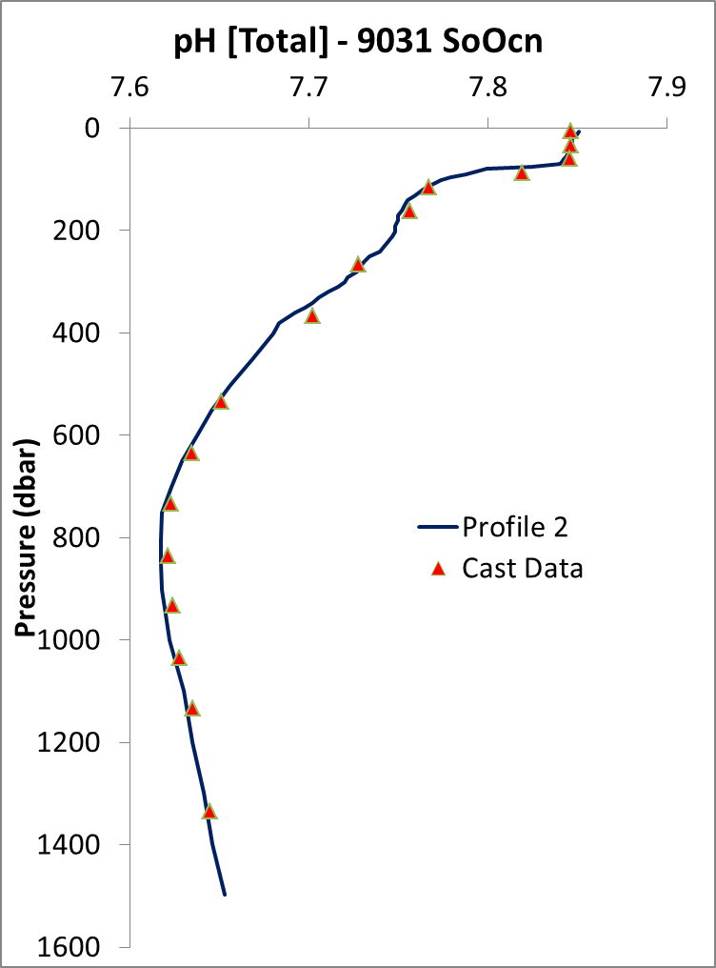
Sensor pH + 0.017
55 South
40 South
Sensor pH -0.050
Notes:
pH sensors contaminated during calibration and drifted on first 1 or 2 profiles. That messed up calibration and made first profile or 2 unreliable – calibrated on profile 3 below 400 m.

Slide 11
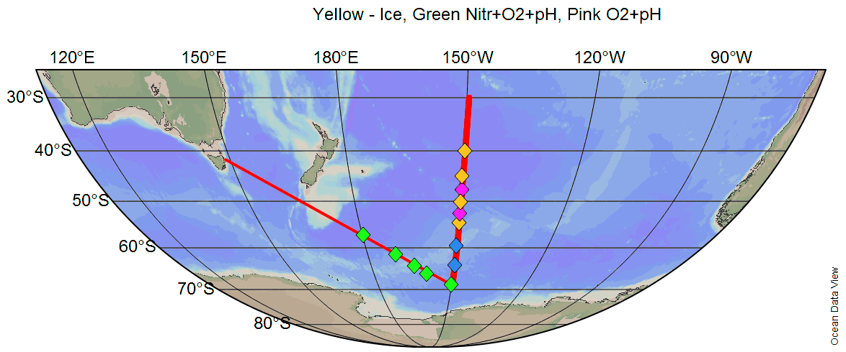
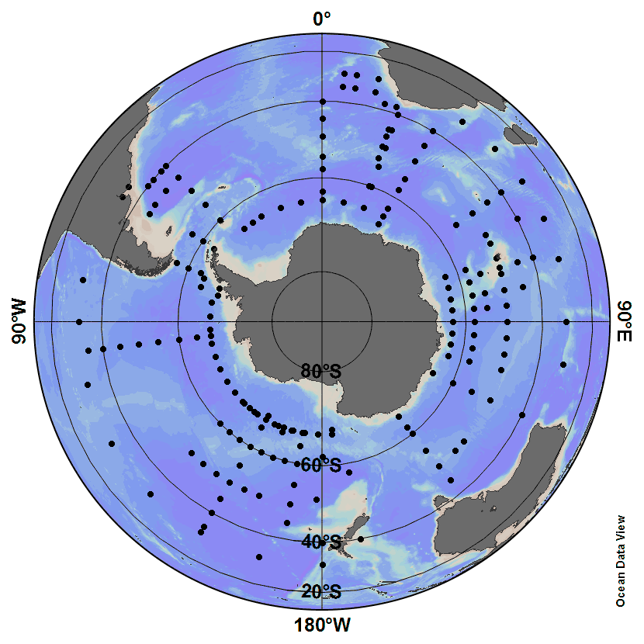
Pre-SOCCOM floats deployed
Array will grow to be ~200 floats with pH, O₂, NO₃⁻, biooptics, 5 to 7 year life, year-round coverage

Slide 12





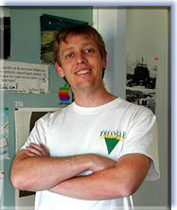


Southern Ocean Carbon and Climate Observations and Modeling (SOCCOM), $21 million, 6 years
Directorate
Theme I
Observations
Theme II
Modeling
Theme III
Education & Outreach
Jorge Sarmiento,
Princeton
Lynne Talley,
SIO
Joellen Russell,
U. Arizona
Heidi Cullen,
Climate Central
Biooptics (Emmanuel Boss, Maine, Oscar Schofield, Rutgers)
Ken Johnson
Steve Riser, U. W.

