Slide 1
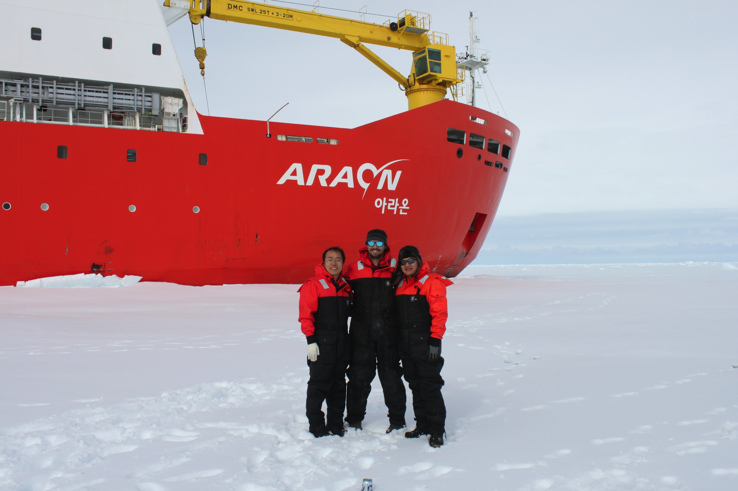
Korea-U.S. Collaborations in Ocean Observing
San Hoon Lee, Ho Kyung Ha, Tae Wan Kim, Doshik Hahm, Jisoo Park, KOPRI
Sang-Ho Lee, KNU
Byoung-Jui Choi, KNU
Hak Soo Lim, KIOST
Jung Sik Han, KHOA
Kwang Nam Han, KHOA
Sik Huh, KIOST
Oscar Schofield,
Scott Glenn,
Josh Kohut &
Hugh Roarty
Rutgers University

Slide 2
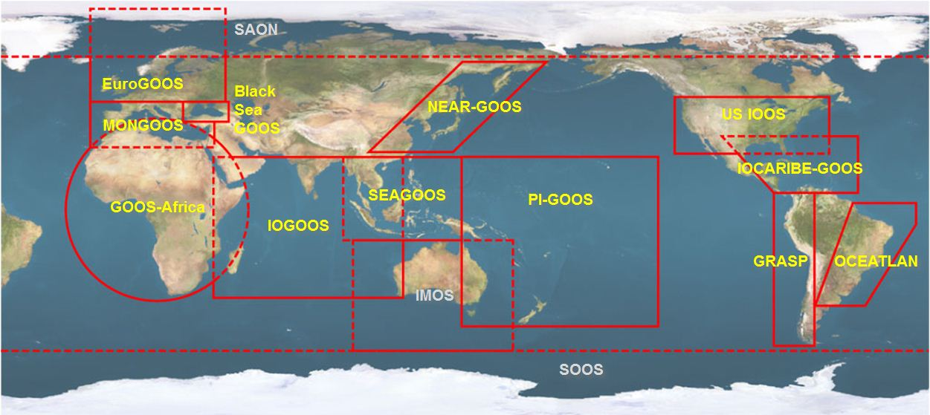





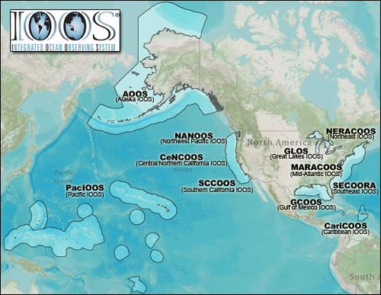












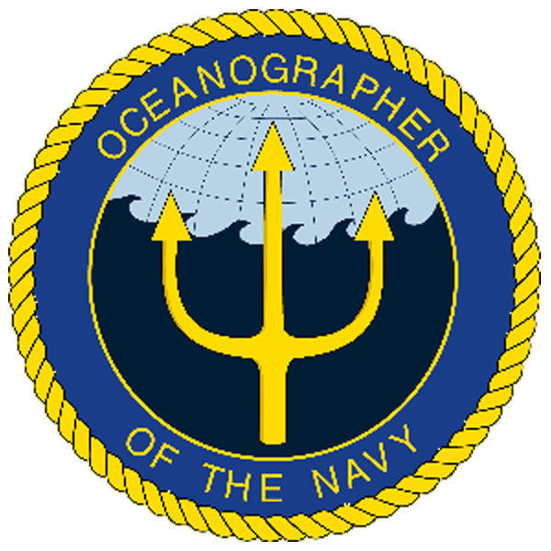
U.S. Integrated Ocean Observing System (IOOS)
Global Component
National Component
Regional Component
15 Regional Alliances in GOOS
Vessels -
Satellite
Satellite
CODAR
Ships/ Vessels
Glider
REMUS
Data Vis.
Modeling
Security
Leadership
Education
11 Regional Associations
17 U.S. Federal Agencies
http://ioos.gov

Slide 3
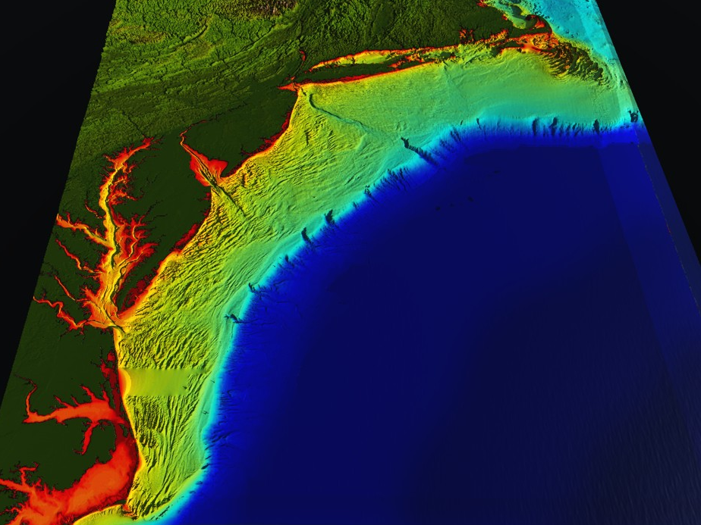
















RI
U..
Middle Atlantic
Regional Association
Coastal
Ocean Observing System
10 States - 76 Million People
1000 km Cape to Cape
CT
Cape
Cod
MA
NY
PA
NJ
MARACOOS:
A Sustained Real-time Observation & Forecast System
DE
MD
>40 PIs
>20 Institutions
>50 Members
>2000 Contacts
Scott Glenn + Many
VA
NC
Cape
Hatteras
Notes:
3

Slide 4
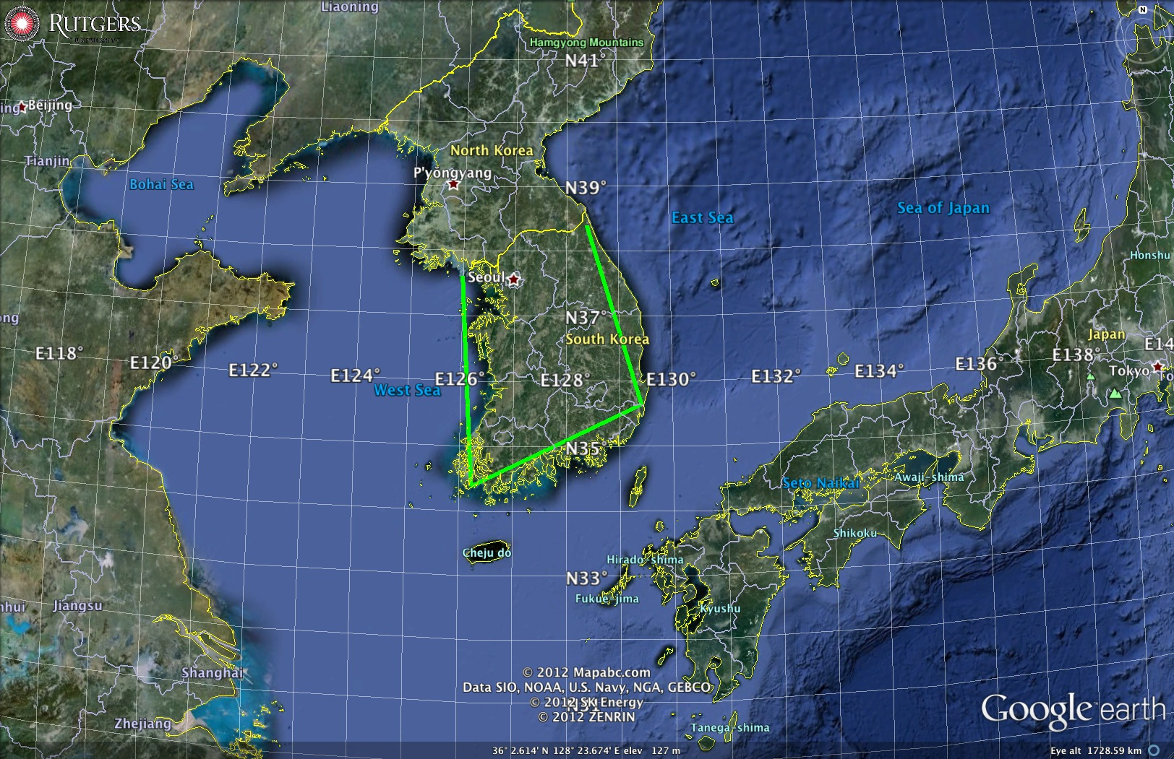
Regional Seas surrounding South Korea
1000 km Alongshore Length Scale

Slide 5
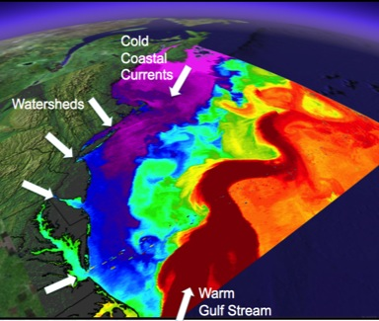
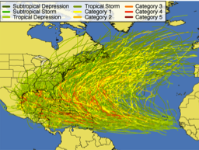
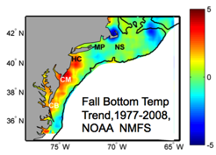
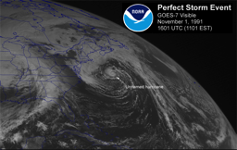
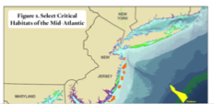
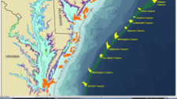
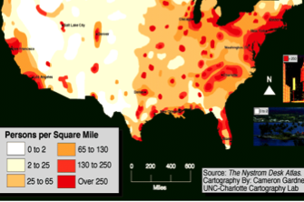
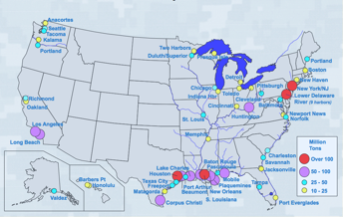
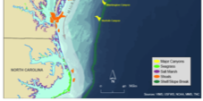
MID-ATLANTIC REGIONAL DRIVERS
Tropical Storms
Climate Change
Ocean Circulation
Critical Habitat
Northeasters
Population
Ports

Slide 6
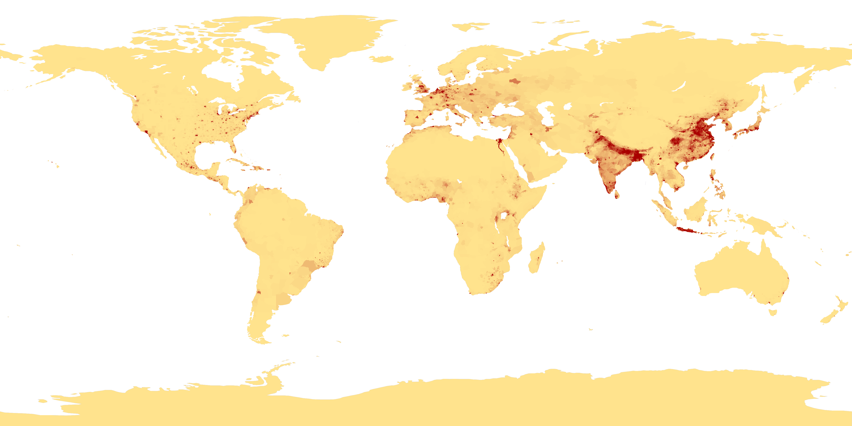
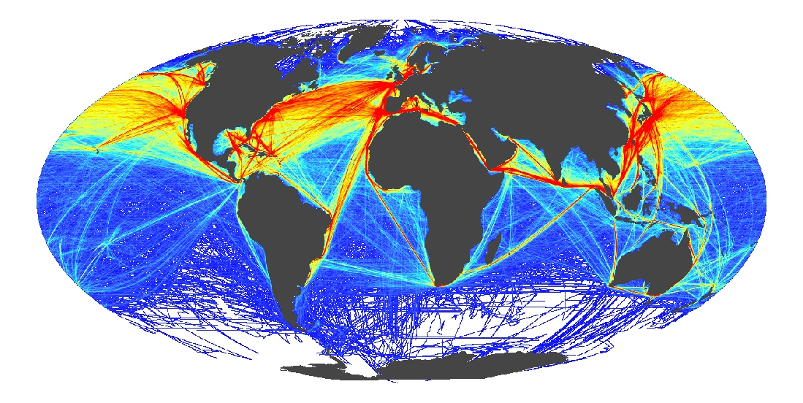
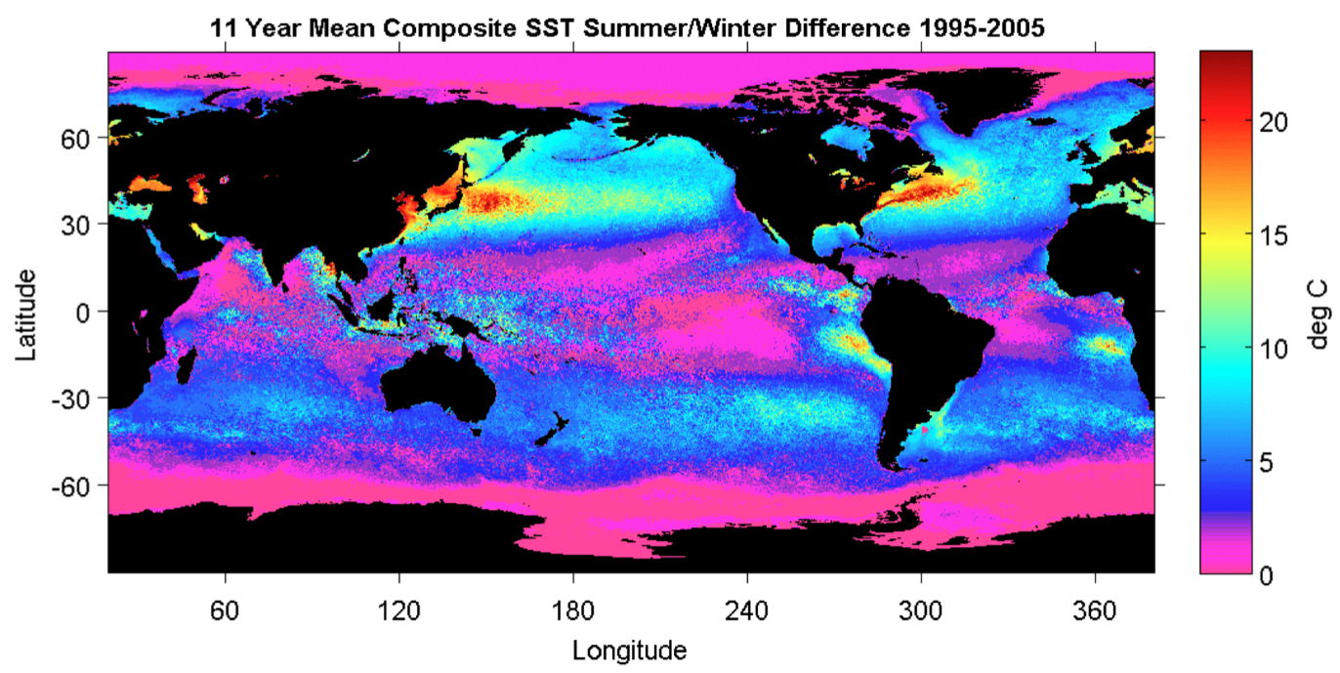
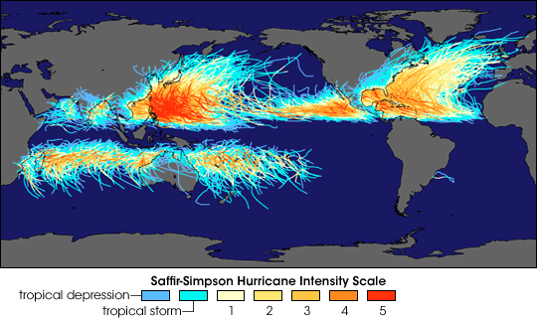
Global Drivers
Coastal Population Centers
International Commerce
Ocean Seasonality
Tropical Cyclones

Slide 7
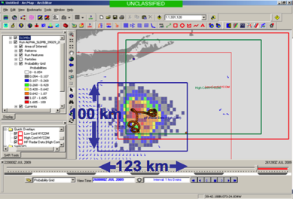
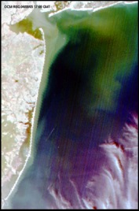
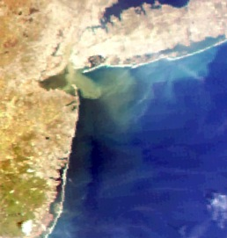
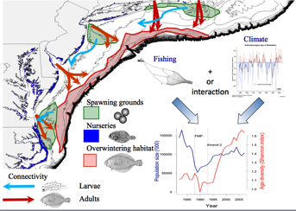
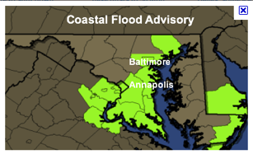
MARACOOS REGIONAL THEMES
1) Maritime Operations – Safety at Sea
3) Water Quality – a) Floatables, b) Hypoxia, c) Nutrients
2) Ecosystem Decision Support - Fisheries
5) Energy – Offshore Wind
4) Coastal Inundation - Flooding

Slide 8
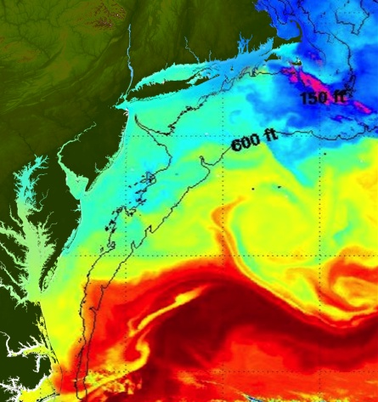
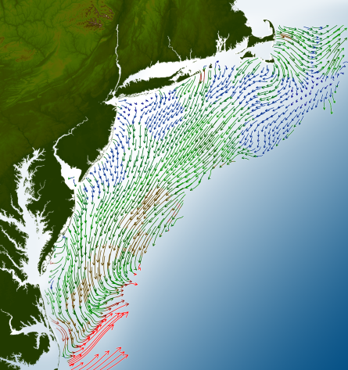
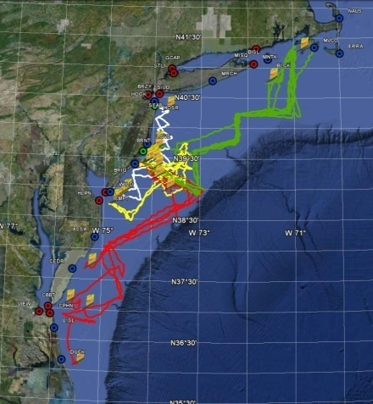
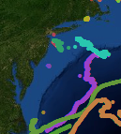
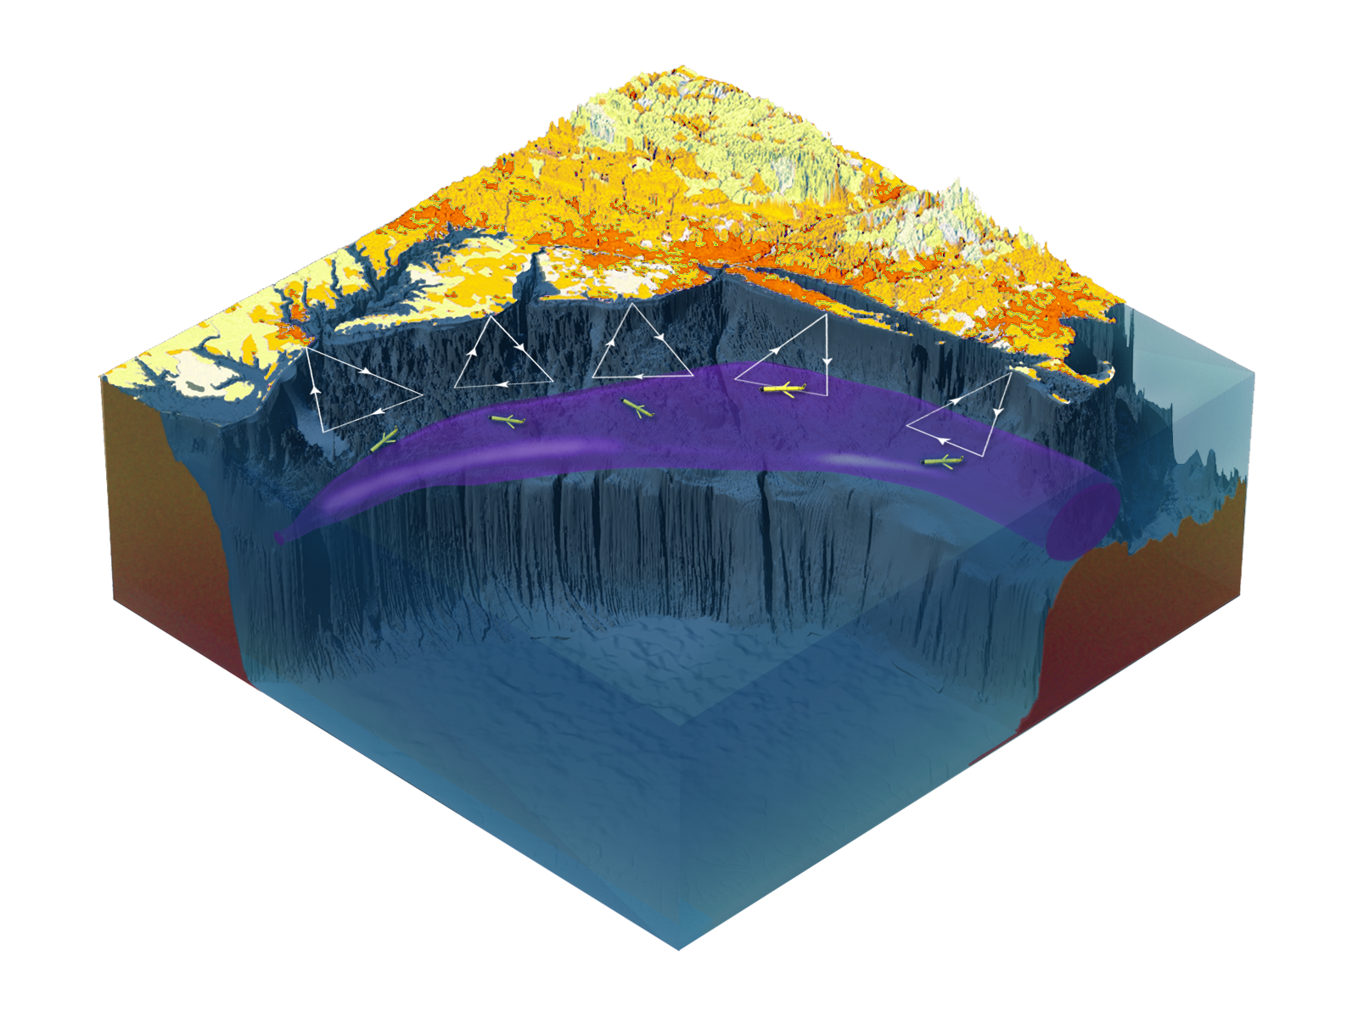

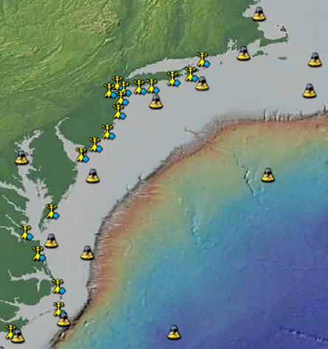
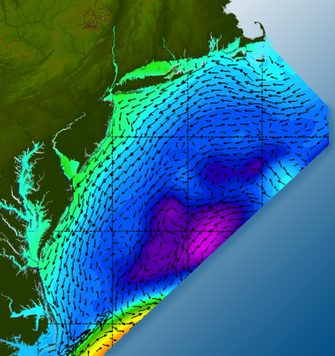

Satellites
HF-Radar
Gliders
Drifters
Population Density
To seek, discover & apply
new knowledge & understanding
of our coastal ocean
Weather Stations
Ocean Forecast Ensemble
Notes:
Need to cut off cold pool in south and bend offshore
Need to experiment with dulling down the colors in the pop density. Maybe orange/tan to white like the box I put in?
Put gliders just below the lines in 3 of them, and increase their angles facing up and down randomly. I stuck in cheesy examples
I already put the shadow and 80% clear line around the two new maps in the upper right, so we are good there.

Slide 9
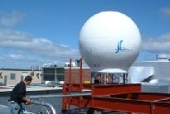
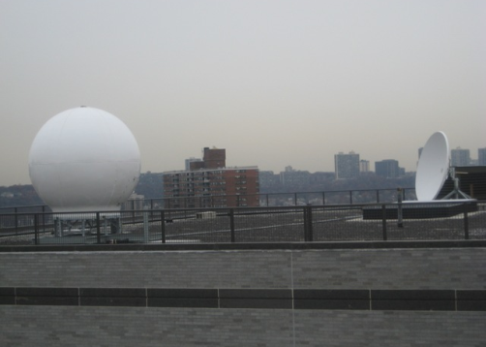
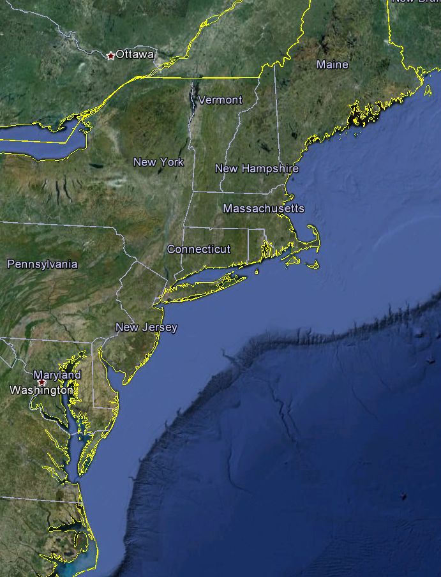
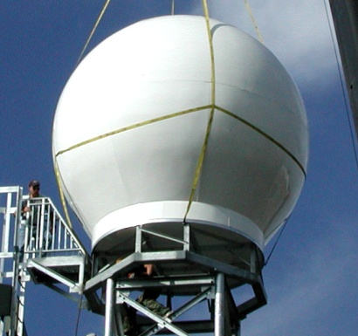
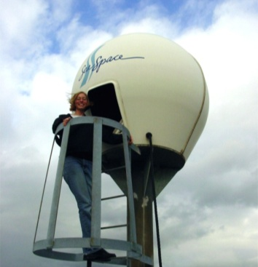
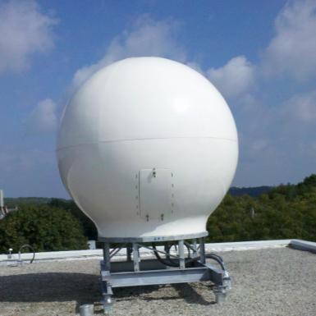
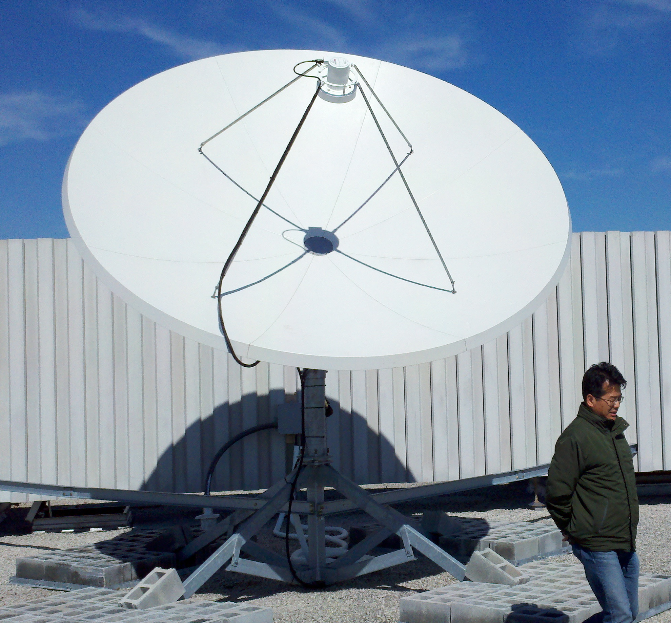
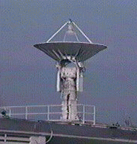
Real-Time Satellite Ground Stations in the Northeast U.S.
Satellites: NPP, Terra, Aqua, NOAA Polar Orbiters, Metop & GOES
U. Maine
City College of N.Y.
Rutgers
U. Delaware
Johns Hopkins

Slide 10
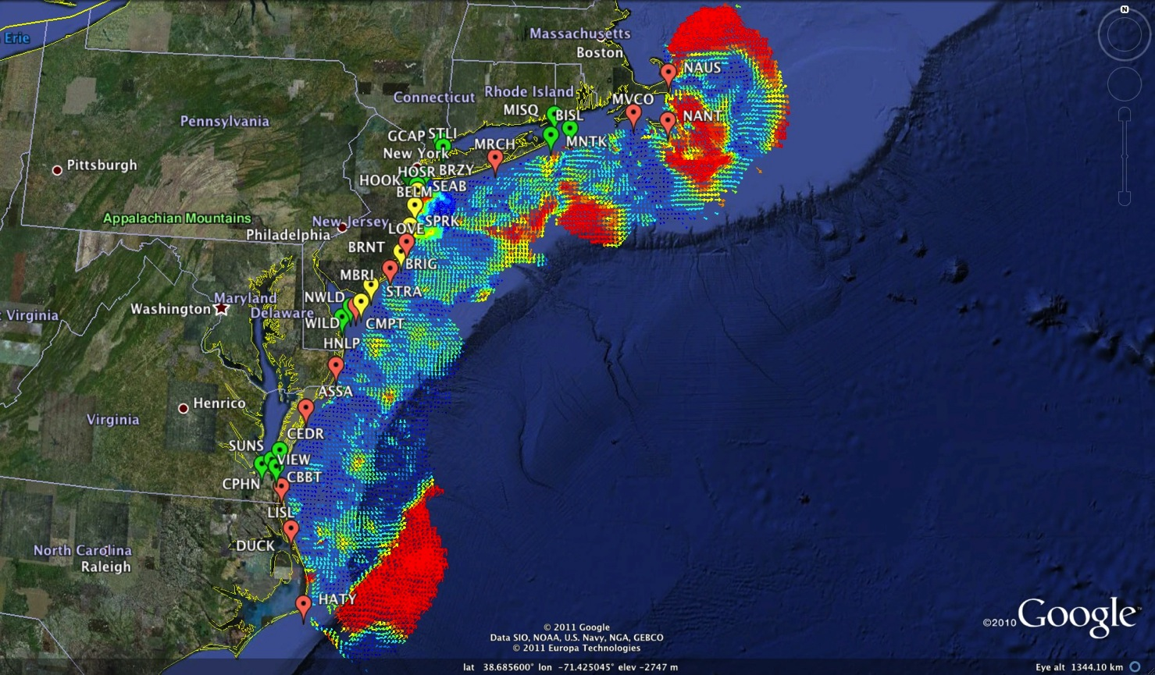
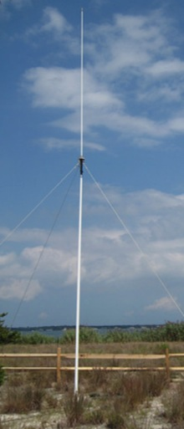
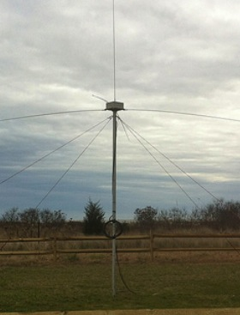
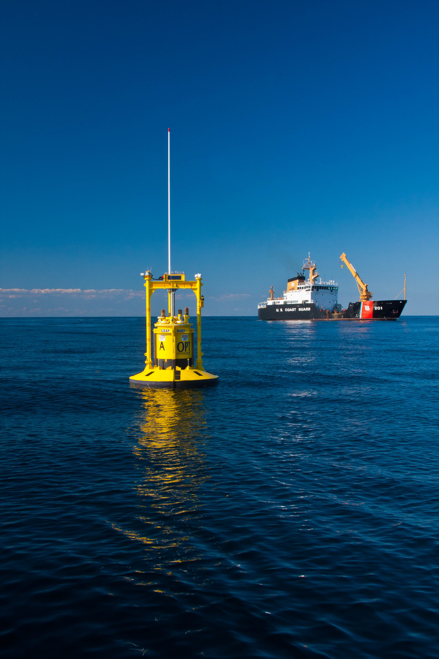
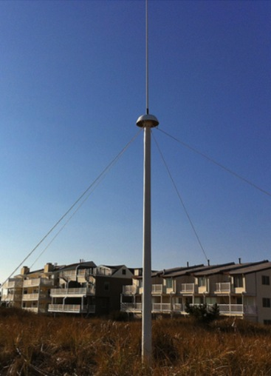
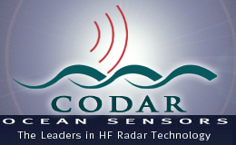
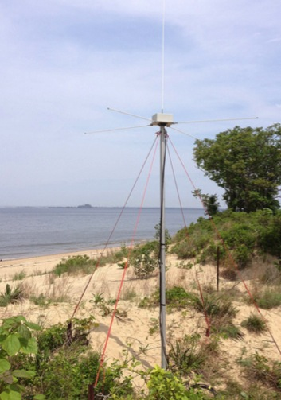
Mid-Atlantic Bight HF Radar Network
1000 km
Cape to Cape
Mid-Atlantic HF Radar Network
16 Long-Range CODARs
8 Medium-Range CODARs
17 Short-Range CODARs
41 Total (Pre-Sandy)
Triple Nested, Multi-static, Multi-use
Industry Partner: CODAR Ocean Sensors

Slide 11
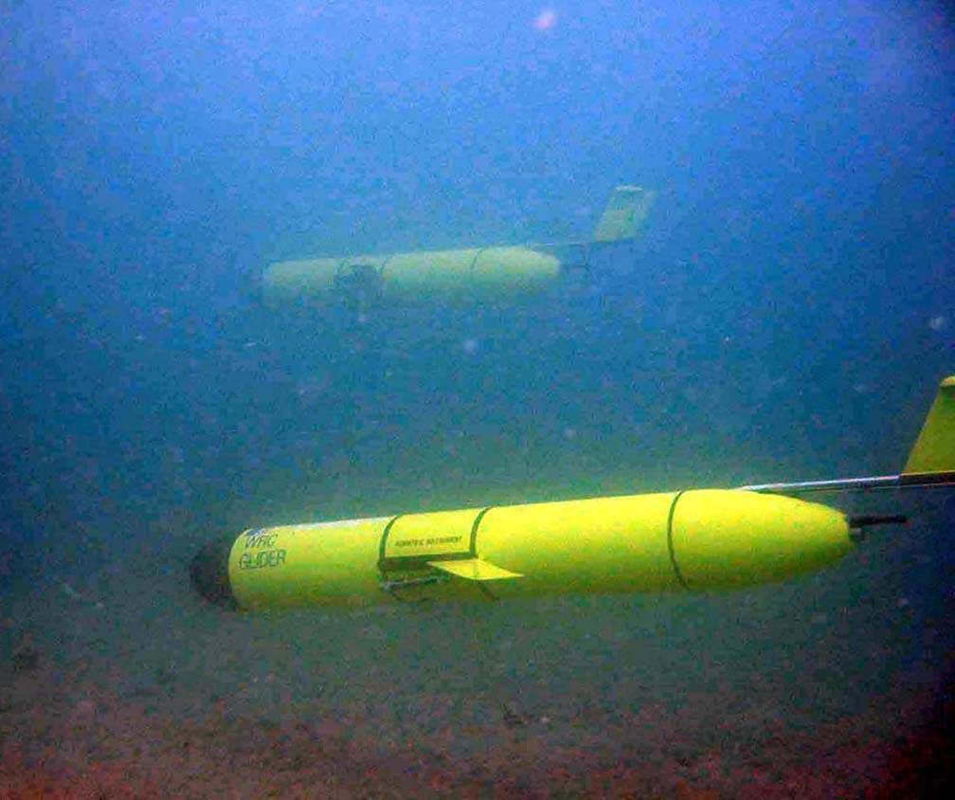
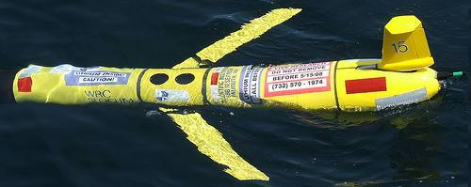
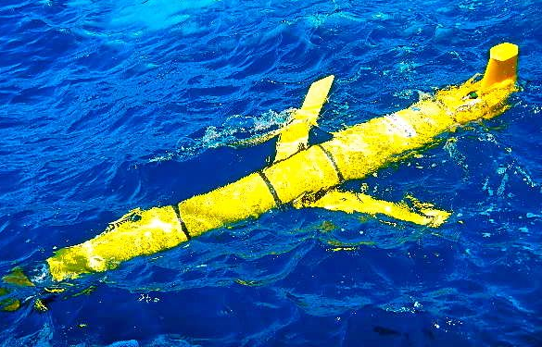
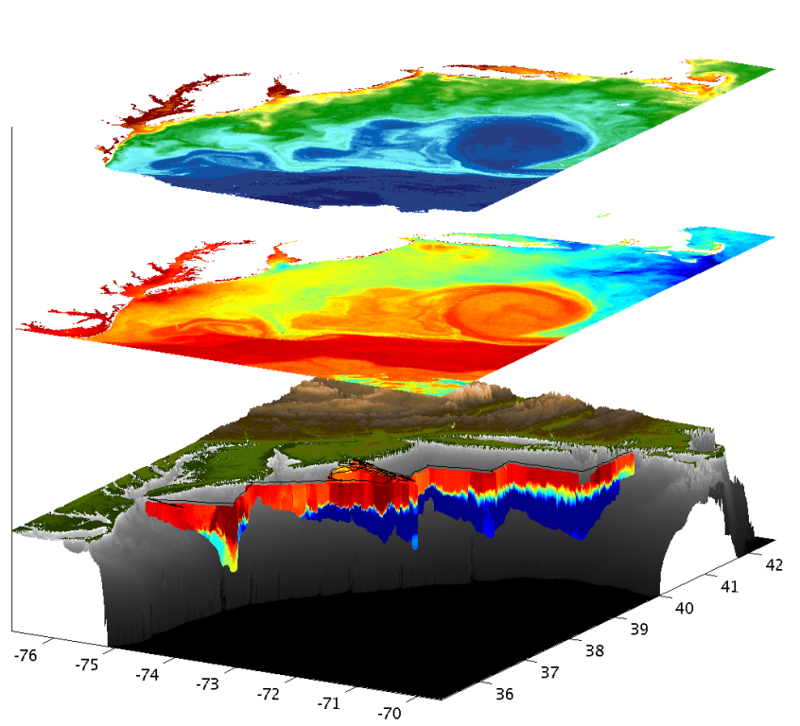



Mid-Atlantic Bight Glider Network
RU01
RU15
RU29
G1
G1-Ruggedized
G2
Satellite Ocean Color
Satellite SST
Subsurface
Glider
Data
Industry Partner: Teledyne Webb Research

Slide 12




Improved Predictive Modeling and Data Assimilation
1) STPS
U. Connecticut
2) NYHOPS
Stevens Institute of Technology
3) ROMS
Rutgers University
4) HOPS
U. Massachusetts, Dartmouth

Slide 13






MARACOOS Operations Center
Rutgers University - Coastal Ocean Observation Lab
Satellite Data Acquisition Stations
CODAR Network
Glider Fleet
3-D Forecasts

Slide 14









Korea & United States
HF Radar Collaboration

Slide 15


U.S. & Korea
National HF Radar Networks –
World’s largest networks
MAB & Korea similar in scale
U.S. - Korea
Collaborations in:
Network Operations
Data Quality Control
Product Development
Science
South Korea HF Radar Network
1 Long-Range CODARs
7 Medium-Range CODARs
11 Short-Range CODARs
2 Short-Range WERAs
4 VHF CODARs
25 Total

Slide 16





Korea & United States
HF Radar Training at Rutgers
2012

Slide 17






Rutgers visit to Korea HF Radar Centers
2013

Slide 18



Korea & United States
KIOST visits Rutgers
2012
2013
2013
Korea Repeat Visits

Slide 19



Next Steps for Korea-U.S. HFR Collaboration - 2015
3rd GEO Global HF Radar Meeting, Kaohsiung, Taiwan

Slide 20



Presentations on QA/QC Procedures
from Australian & U.S. National Networks

Slide 21




Joint Project Agreement 2014
Proposed Fall 2014 Visit to KNU
Scott Glenn & Hugh Roarty

Slide 22

Australia | 12
Brazil | 2
China | 4
India | 10
Indonesia | 2
Ireland | 2
Israel | 2
Italy | 3
Japan | 22
Jordan | 1
Mexico | 1
Norway | 2
Portugal | 2
Russia | 1
South Korea | 25
Spain | 16
Taiwan | 15
Thailand | 6
USA | 125
United Arab Emirates | 2
Vietnam | 3
TOTAL | 258
Global High Frequency Radar Sites
Frequency | Number
Long Range | 86
Standard Range | 83
High Resolution | 69
VHF | 20

Slide 23


Slide 24
Circle size proportional to mass loss per year
Colors indicate basal melt rates
Amundsen Sea is major drainage basin for West Antarctic Ice Sheet
PIG 16.2 m/year
Thwaites 17.7 m/year
Dotson 7.8 m/year
Getz 4.3 m/year
Notes:
“Second goal and what I’ll be focusing on today is to work toward understanding water mass transformation as it erodes Ice sheets” Water mass CDW
Drainage basin for the West Antarctic Ice Sheet, PIG/THW and KOH/DOT have some of the highest estimated basal melt rates out of all Antarctic Glaciers using grounding line estimates from satellite interferometry

Slide 25


Focus on understanding the carbon
biogeochemical cycling in the Amundsen polyna. International team anchored by Korea aboard the Aaron. Field season 2013-2014.

Slide 26

The Amundsen Sea Polynya
Arrigo & Dikjen 2003
December open area
Fourth largest Antarctic polynya
Up to 40,000 km²
Highest peak and seasonally averaged Chla
Greatest primary productivity per unit area
Greatest interannual variability

Slide 27

Processes on the shelf: Atmospheric cooling and sea ice processes, glacial ice interactions
Flow of cooler & fresher water away from shelf
Flow of warm water onto shelf
Water mass modification on the shelf
Severe (=> dense water formation) or moderate
Melting glacier ice
(and refreezing)
Schematic Courtesy of Anna Wahlin

Slide 28

Central Chanel
Western Channel
Eastern Channel
GIS
DIS

Slide 29




RU25 – Deep glider Rated to 1000 Meters depth
Seabird CTD – Temperature, Conductivity, Depth
Aandera Oxygen 3835 Optode – Oxygen concentration and saturation: 0-500 uM Range, < 8 uM accuracy.
Wetlabs Ecopuck – Chlorophyll Fluoresence, Colored Dissolved Organic Material (CDOM), and Optical Backscatter.
DIS
Notes:
Depth Averaged Current Map
Small tide map

Slide 30


III
IIII
II
I
I
II
IIII
III
Notes:
“We don’t see any evidence of”

Slide 31


III
IIII
II
I
I
II
IIII
III

Slide 32


4 Glider Deployments
ASPIRE: 2 shallow water missions (0-200 m)
16 days & 380 km
Aaron: 1 shallow and 1 deep (0-1500 m)
16 days and 420 km
Planning ongoing in Korea this week for 2014-2015 Antarctic Field Season

Slide 33


The Challenger Glider Mission:
Enhancing Korea’s Global Autonomous Underwater Glider Fleet
Scott Glenn,
Oscar Schofield &
Josh Kohut
Rutgers University
Dr. Sik Huh
KIOST-NOAA Lab
NOAA-MOF JPA 2014

Slide 34




Slide 35




A Global Challenge – The Challenger Glider Mission
December 9, 2009 – Baiona, Spain
Dr. Rick Spinrad
AA of NOAA Office of
Oceanic & Atmospheric Research
Dr. Spinrad’s
Global Challenge:
Build a Global Glider Fleet
and Coordinate the First
Robotic Circumnavigation.
Revisit the Historic Track of the
HMS Challenger –
And inspire a global network
of students along the way.
HMS Challenger Voyage
First Scientific
Circumnavigation
1872-1876
128,000 km =
= 16 gliders
x 8,000 km/glider

Slide 36







Global Challenger Glider Mission
16 Global-Class Gliders

Slide 37




2013 International Typhoon Workshop
Dr. Louis Uccellini, Director
National Weather Service
Crowd-sourced comparisons between
U.S. & European Models & Gliders

Slide 38




Companion Course at
Plataforma Oceanica de Canarias
Shared Glider Missions – Iceland to Azores; Azores to Canaries; Canaries to Caribbean
Skype Sessions between classes
Two-way International Exchange programs
Students Learn Science from their teachers
Students Learn Culture from their peers
Glider Silbo >10,000 km flown

Slide 39




RTOFS and MERCATOR
Temperature and Current Maps at 200 m
200m temperature and currents on April 18th, 2013. The glider position is marked by the red dot.
RTOFS
200 m
800 m
MERCATOR
Student
Research
Published
Oceans ’13
Proceedings

Slide 40










Glider RU29: Launched at Cape Town 11 Jan 2013, flown >10,000 km

Slide 41


Challenger Mission Totals
GLIDER | START | END | DAYS | KILOMETERS
SILBO LEG 1 | 6/23/2011 | 12/03/2011 | 163.5 | 3,941
SILBO LEG 2 | 3/7/2012 | 5/22/2012 | 76 | 1,706
SILBO LEG 3 | 7/24/2012 | 5/19/2013 | 303 | 4,390
RU 29 LEG 1 | 1/11/2013 | 10/26/2013 | 289 | 5,667
RU29 LEG 2 | 11/10/2013 | 7/17/2014 | 194 | 4877
TOTAL: |  |  | 1339 | 28,551

Slide 42



Potential Indian Ocean Glider Tracks

Slide 43


Global KNRV5000 Mission

Slide 44






Student Glider Path
Planning in the Pacific
-Propose 3 gliders be deployed from the KNRV5000:
*one in the west pacific as they enter international waters heading north to Adak Alaska and on to the arctic
*one in the east pacific at the manganese nodule heading west to hawaii and on to micronesia
*one in the east pacific at the manganese nodule heading to Lima Peru and on to Antarctica
-Propose one glider be shipped to Micronesia to then fly from Chuuk, Micronesia to Seattle by way of Adak Alaska
-Propose one glider be shipped to Seattle to be deployed and flown to Lima, Peru via Baja Mexico

Slide 45
Future Plans:
Planning is underway for the 2014-2015 Antarctic field season with at least 2 gliders to be deployed.
HF Radar planned visit 2014 & proposal submitted for 2015 start.
Global Glider capability meetings scheduled for 2014.

Slide 46


Summary:
We look forward to our 2014 Korea visits
Thank you for your interest and support

