Slide 1
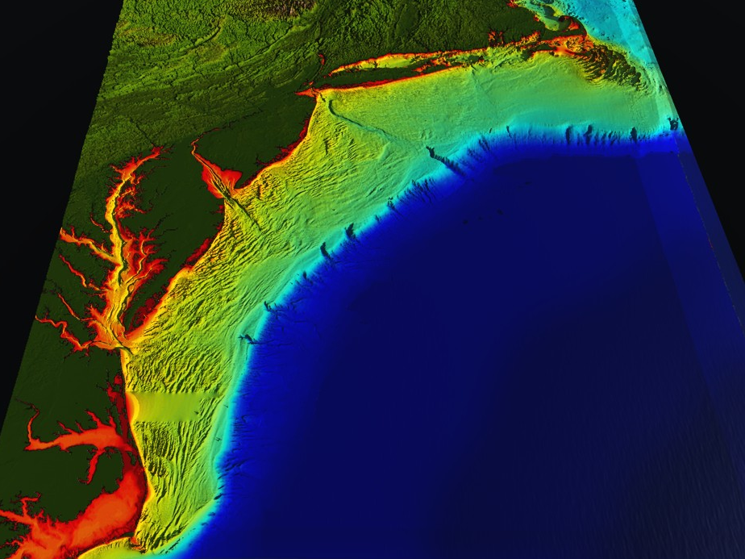









RI
U..
Middle Atlantic
Regional Association
Coastal
Ocean Observing System
10 States - 76 Million People
1000 km Cape to Cape
CT
Cape
Cod
MA
NY
PA
NJ
DE
MD
MARACOOS:
A Sustained Real-time Ocean Observation & Forecasting System
>40 PIs
>20 Institutions
>50 Members
>2000 Contacts
VA
Scott Glenn + Many
NC
Cape
Hatteras
Notes:
1

Slide 2
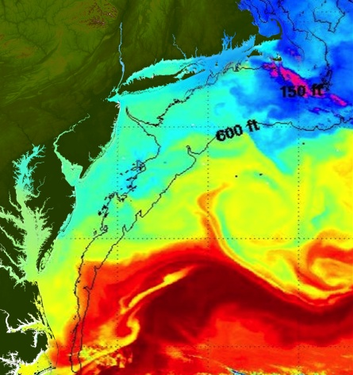
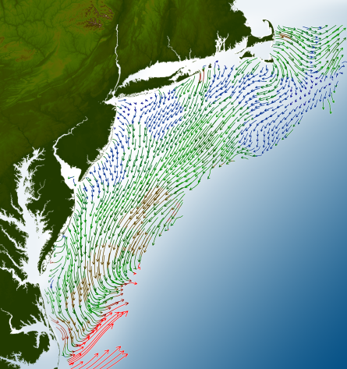
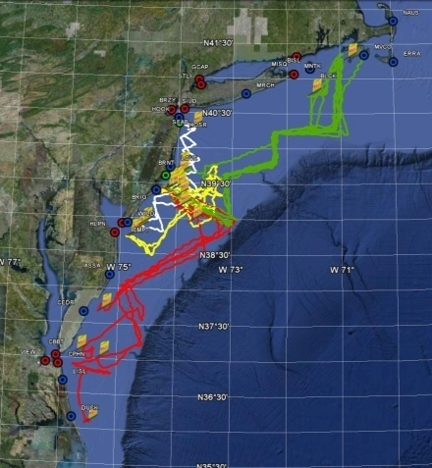
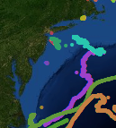
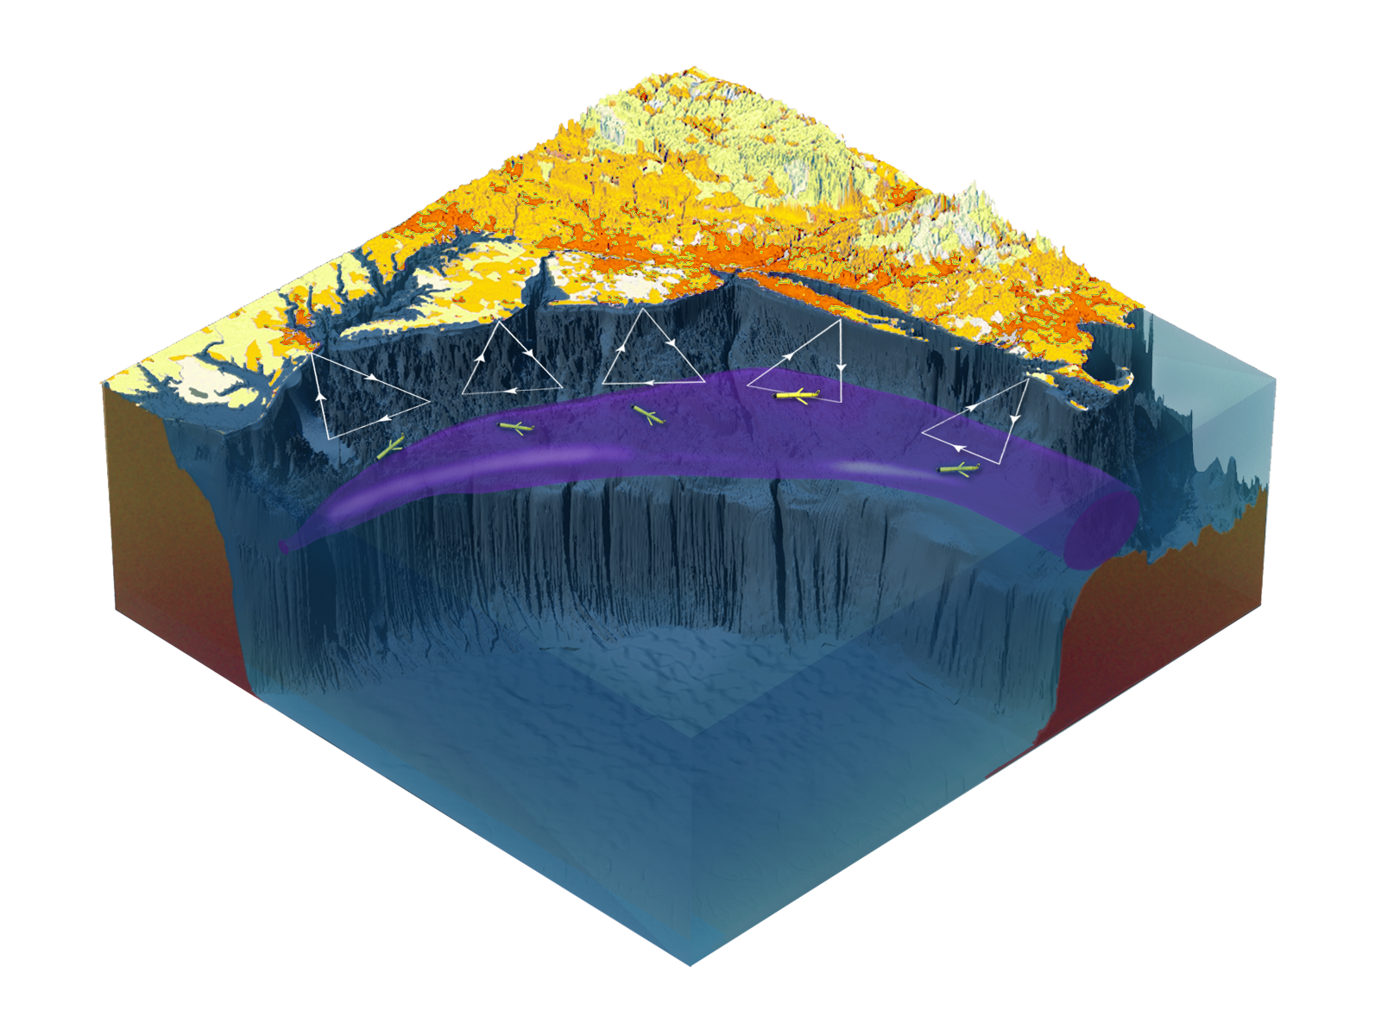

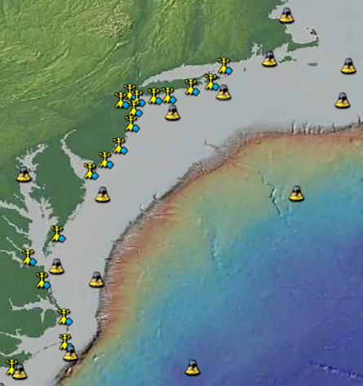
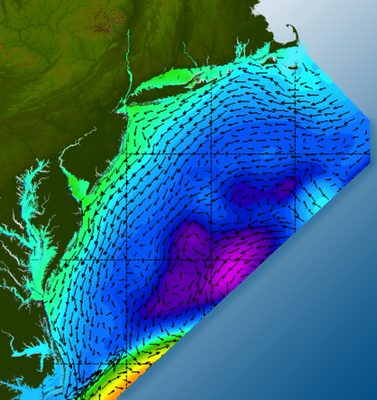

Satellites
HF-Radar
Gliders
Drifters
Population Density
To seek, discover & apply
new knowledge & understanding
of our coastal ocean
Weather Stations
Ocean Forecast Ensemble

Slide 3
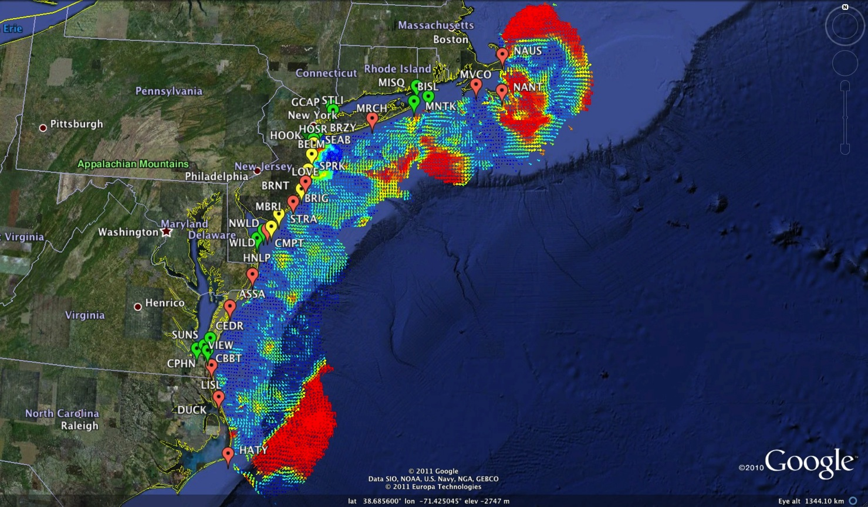
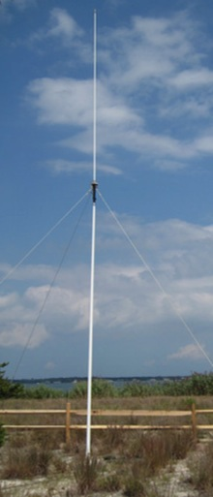
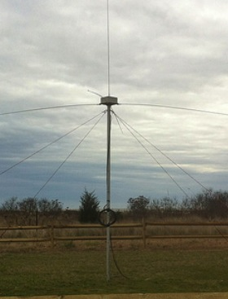
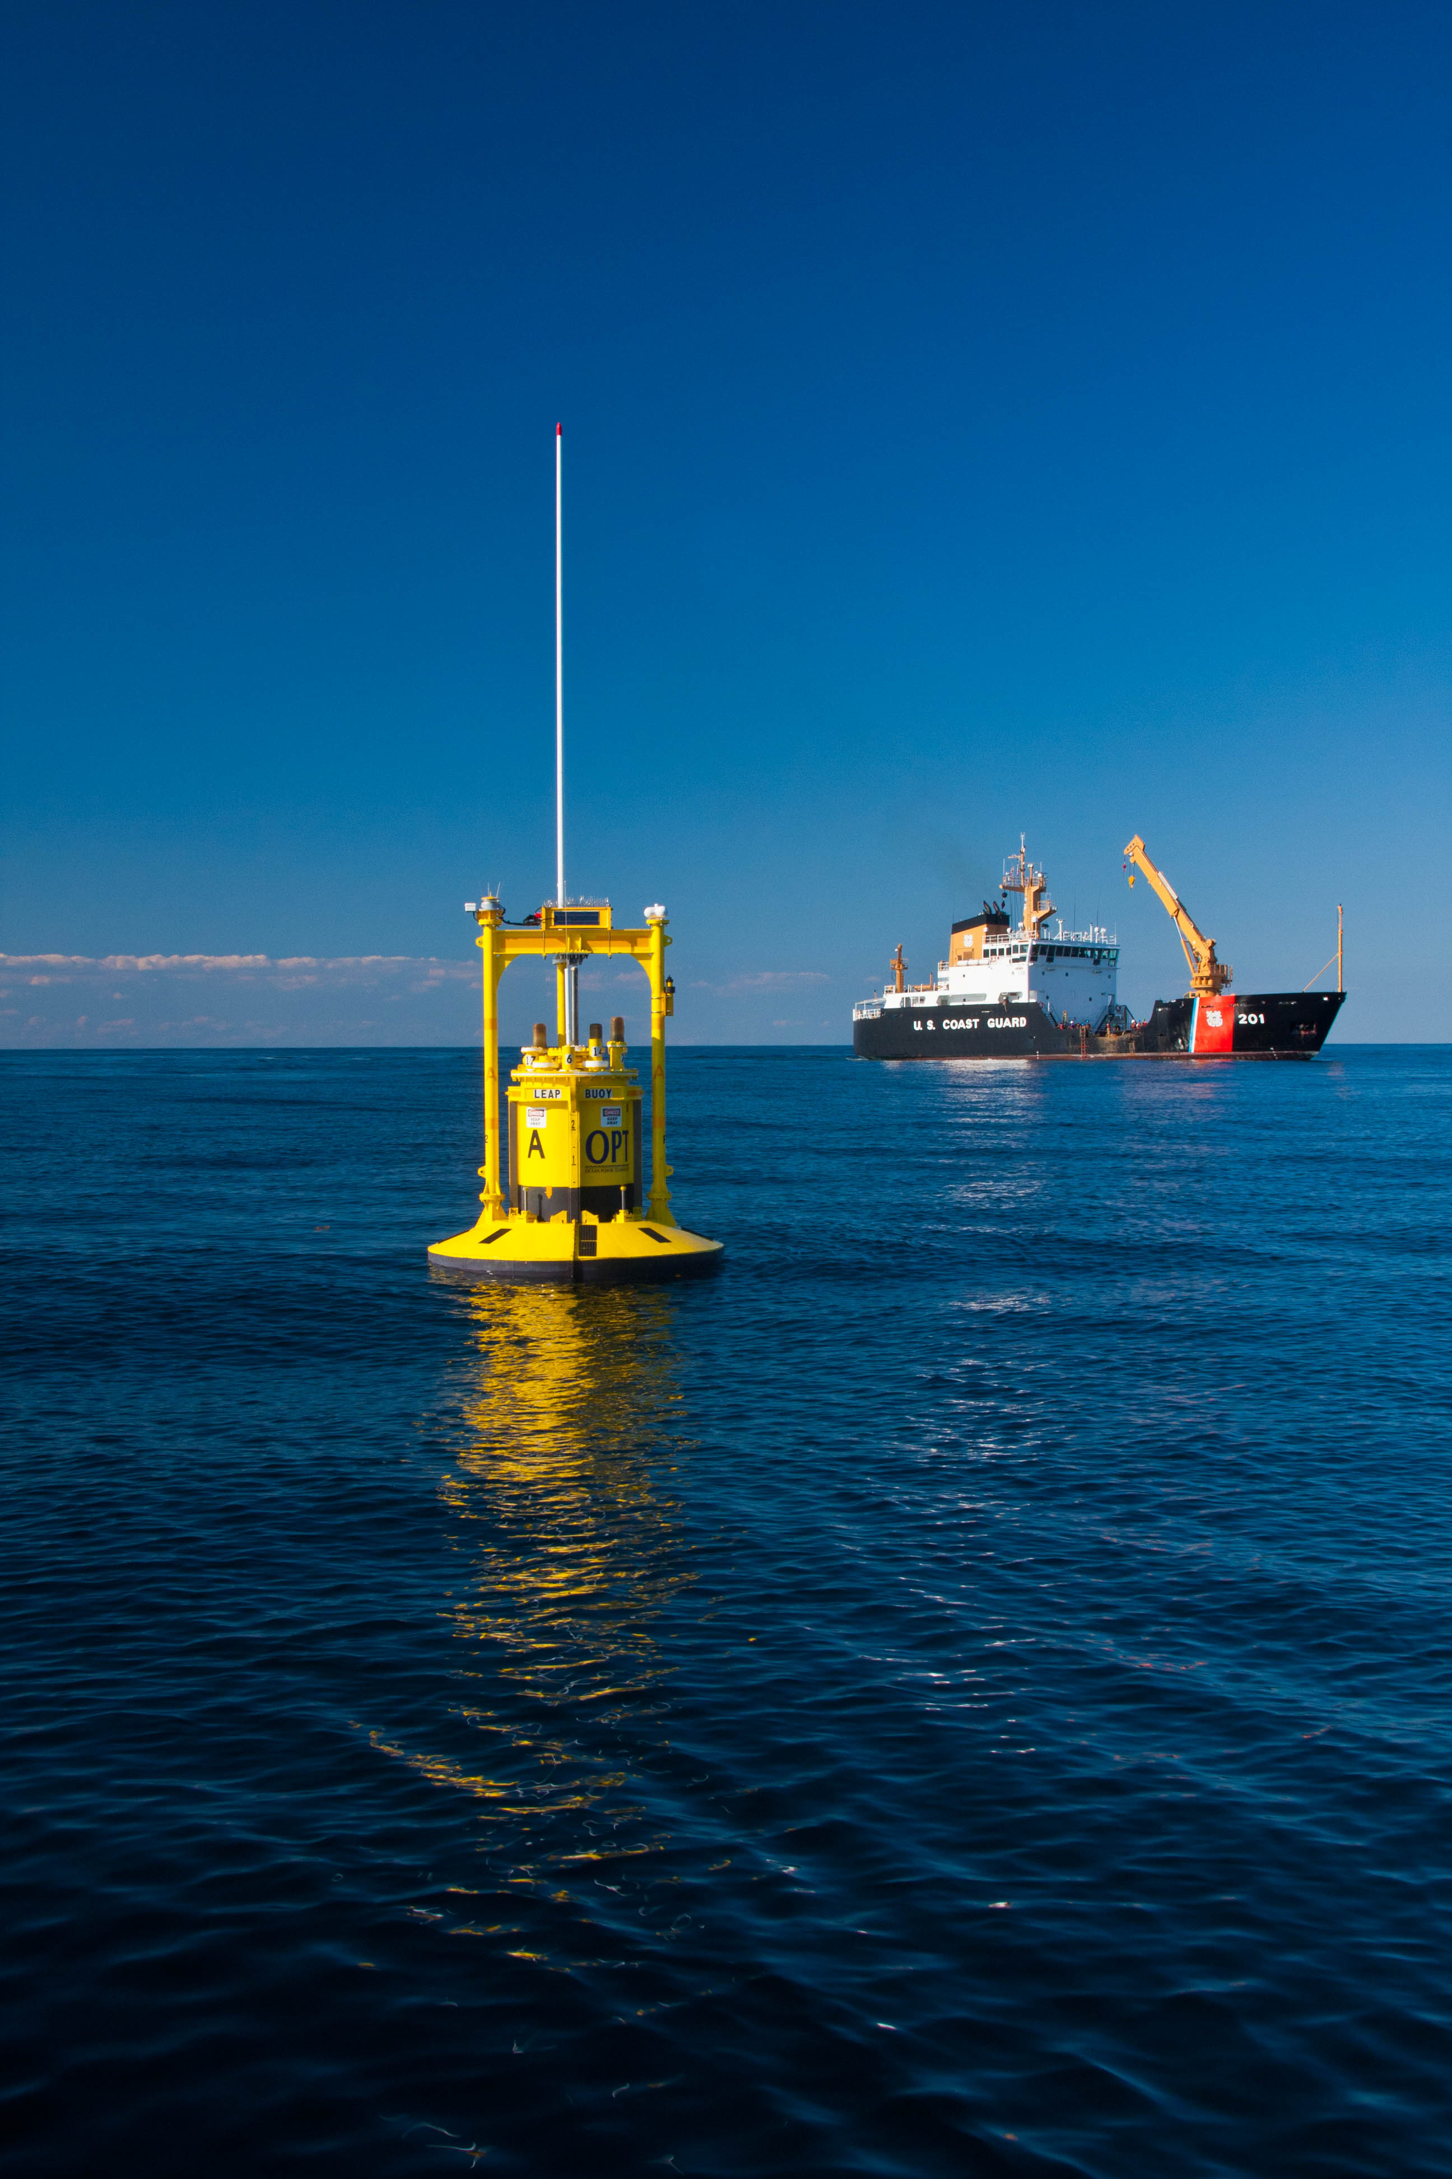
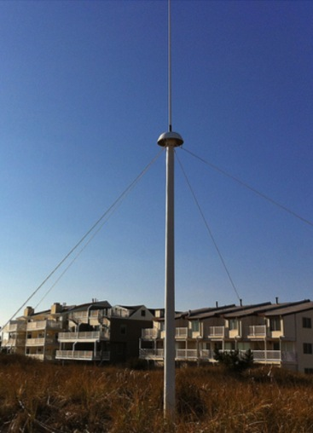
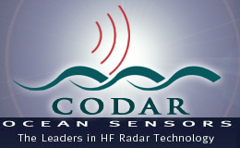
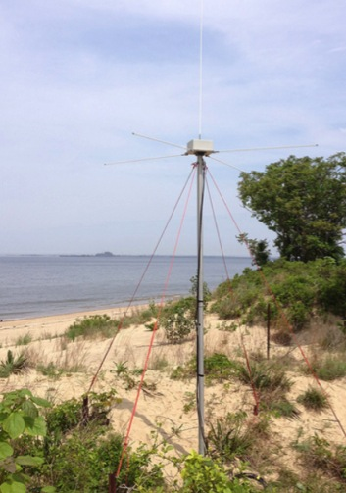

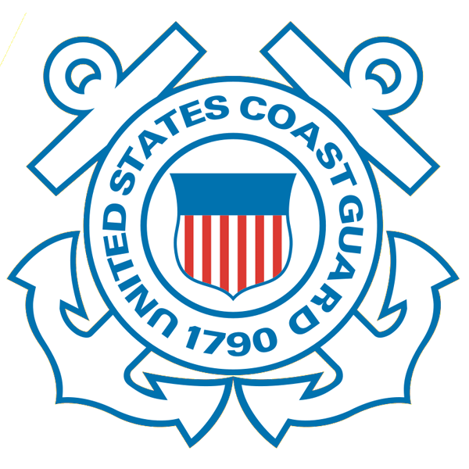
Mid-Atlantic Bight HF Radar Network
1000 km
Cape to Cape
Mid-Atlantic HF Radar Network
16 Long-Range CODARs
8 Medium-Range CODARs
17 Short-Range CODARs
41 Total
Triple Nested, Multi-static, Multi-use
Industry Partner: CODAR Ocean Sensors

Slide 4

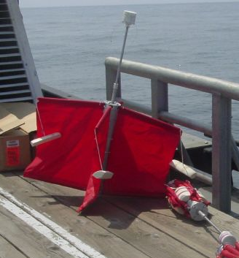
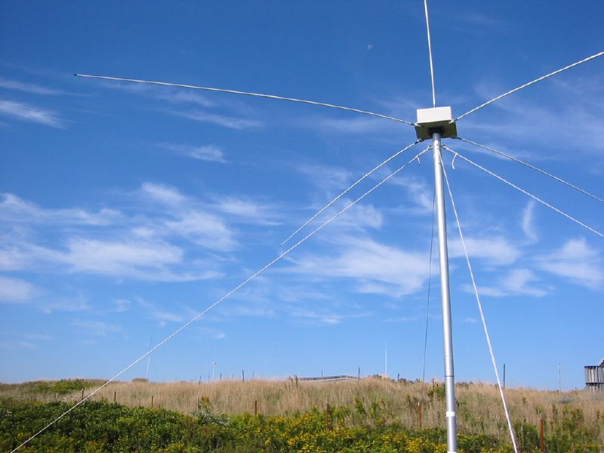
Success Stories – Making a Difference
Optimizing HF Radar for SAR using USCG Surface Drifters
Art Allen
U.S. Coast Guard
Scott Glenn
Rutgers University
Mid-Atlantic Regional Association
Coastal Ocean Observing System

Slide 5
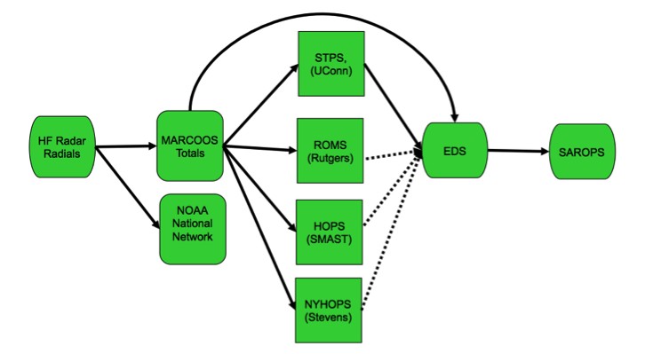
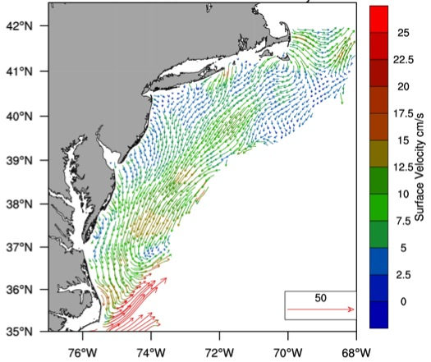

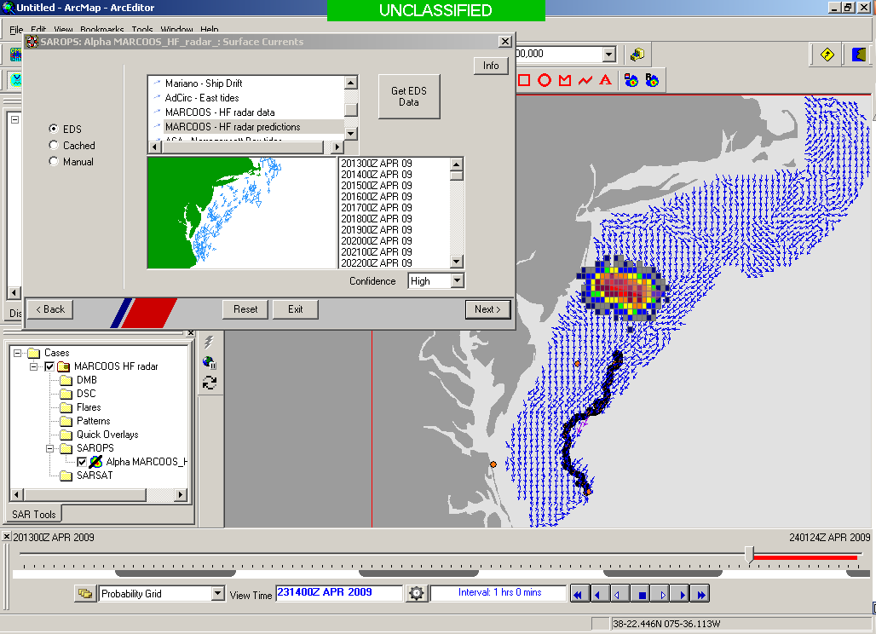
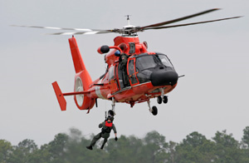

Transition Objective –
Operational Use of HF Radar Surface Currents for Search And Rescue
Surface Currents
Data Acquisition
Data Product Generation & Management
Search And Rescue Optimal Planning System (SAROPS)

Slide 6
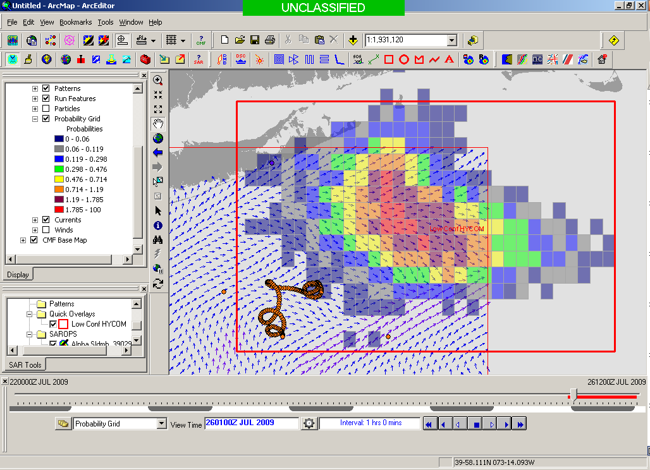
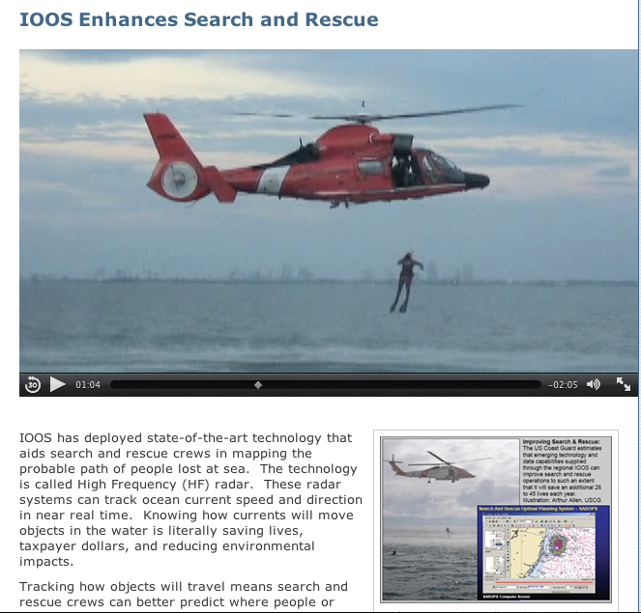

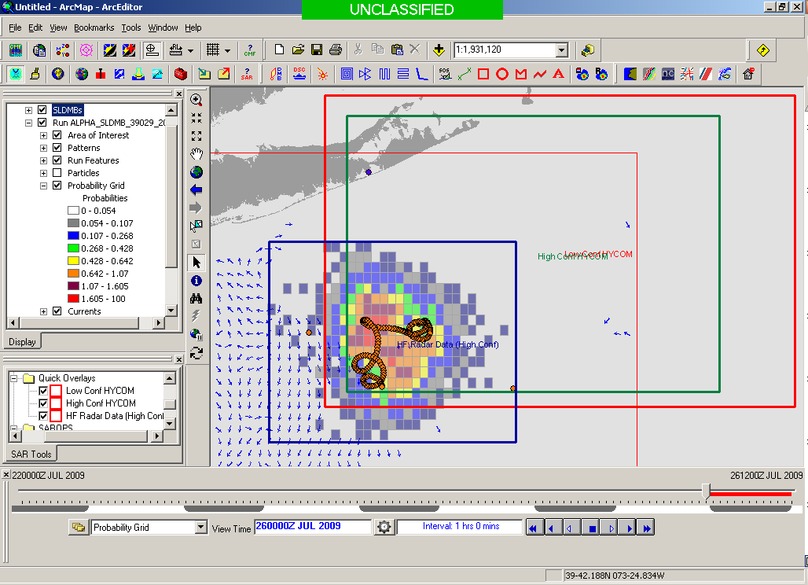
Search And Rescue Optimal Planning System
SAROPS
Global Ocean Model
Search Area = 36,000 km²
http://www.ioos.noaa.gov/ioos_in_action/
benefits/improving_search_rescue.html
Surface Current Mapping Network
Search Area = 12,000 km²

Slide 7
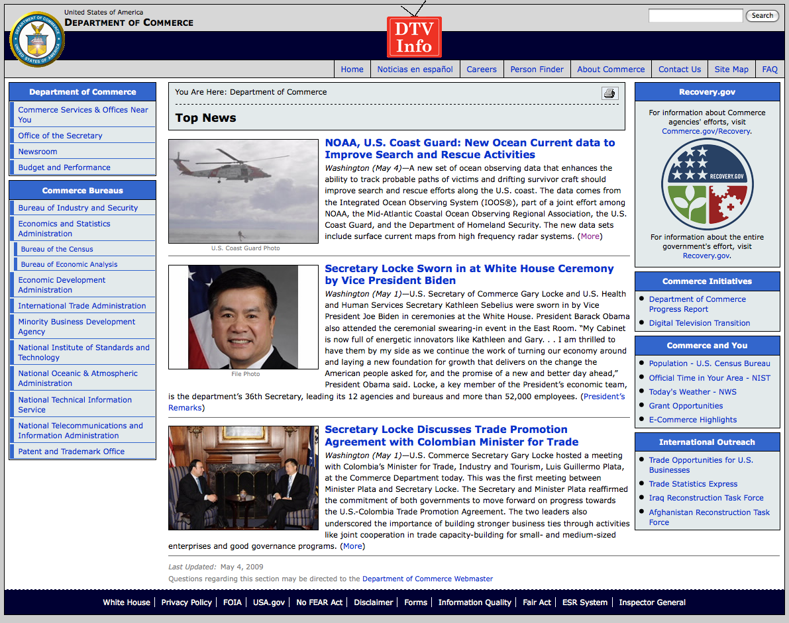
May 4, 2009: After a year of testing, NOAA Announces on
U.S. Department of Commerce Website that
MARACOOS CODAR is Operational in SAROPS
Next step in 2009:
Bring all
sustained regional-scale HFR networks up to operational status in USCG SAROPS

Slide 8
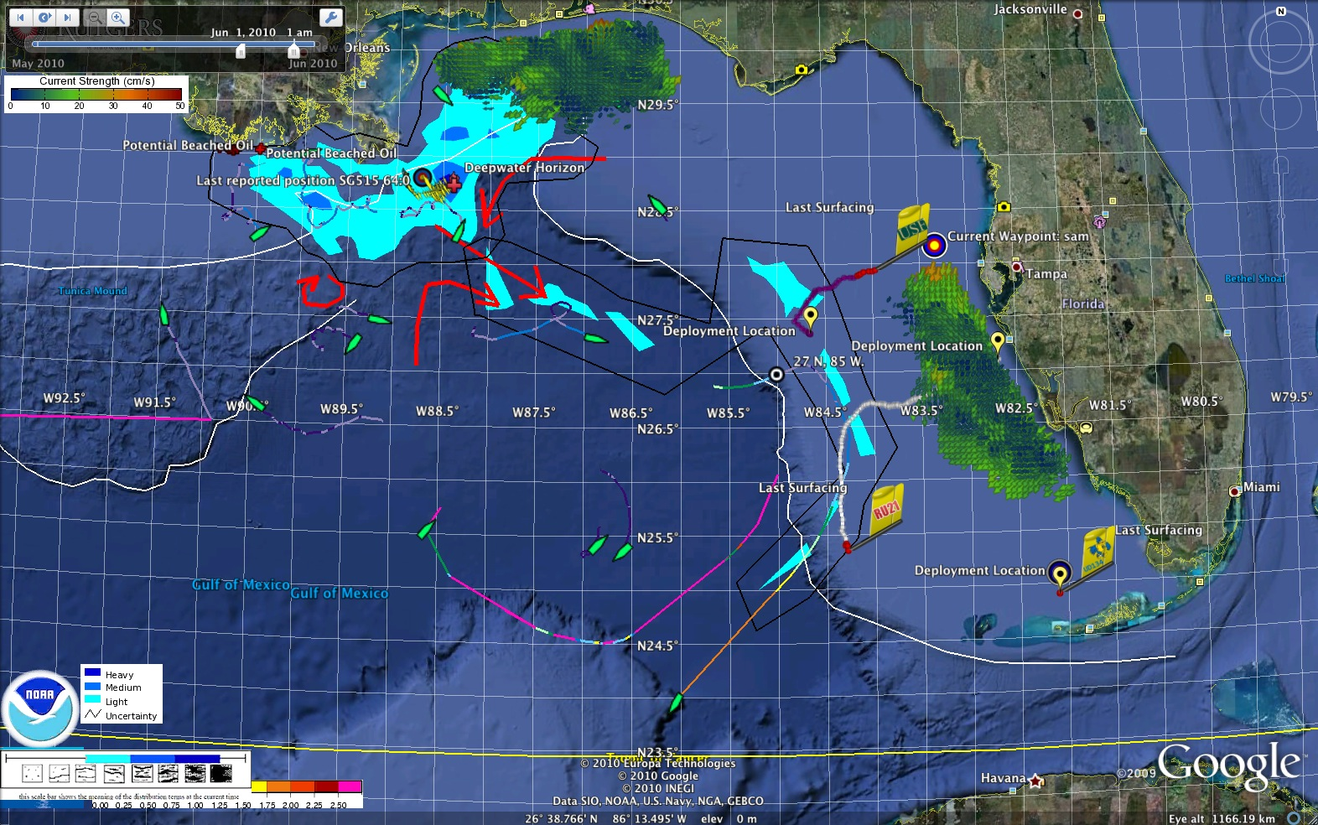
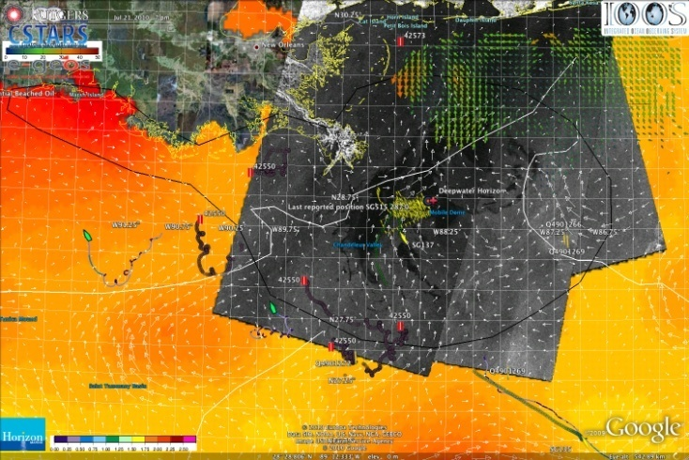
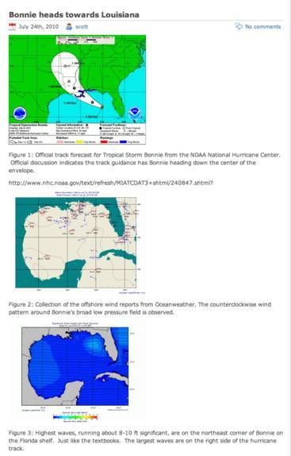
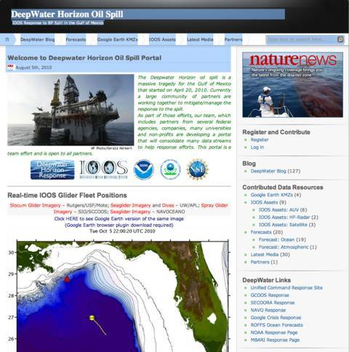
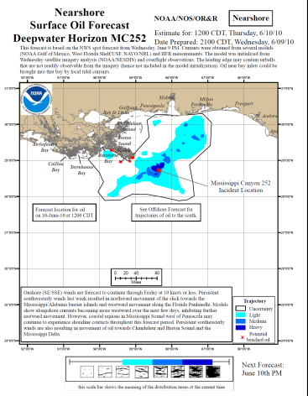
Responding to Crisis: Deepwater Horizon - 2010
U.S. IOOS partnership demonstrated ability to:
Quickly deploy technologies: Gliders and HF radar, saving resources/improving safety
Models/Imagery ingested into NOAA/Navy models
Data assimilation improved spill response decision-making and public understanding
USM HFR
USF HFR
June 2
HFR validation of SABGOM Forecast combined with satellite detected oil slicks
Briefing Blog
127 Briefs
Web Portal
HFR data informed NOAA
trajectory forecasts

Slide 9
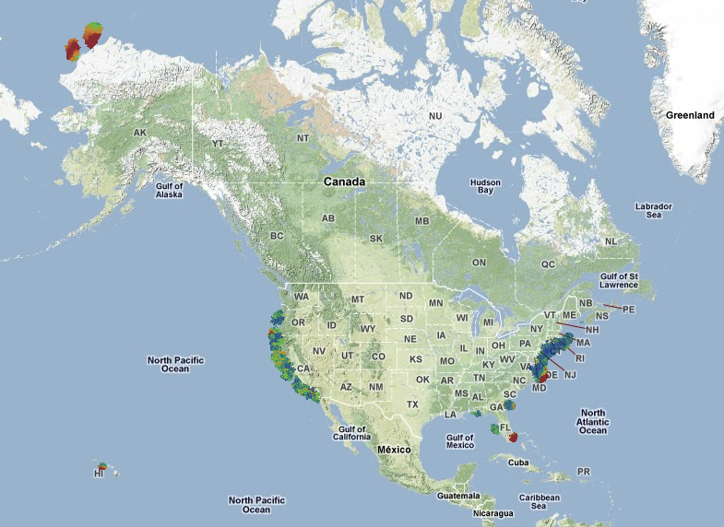
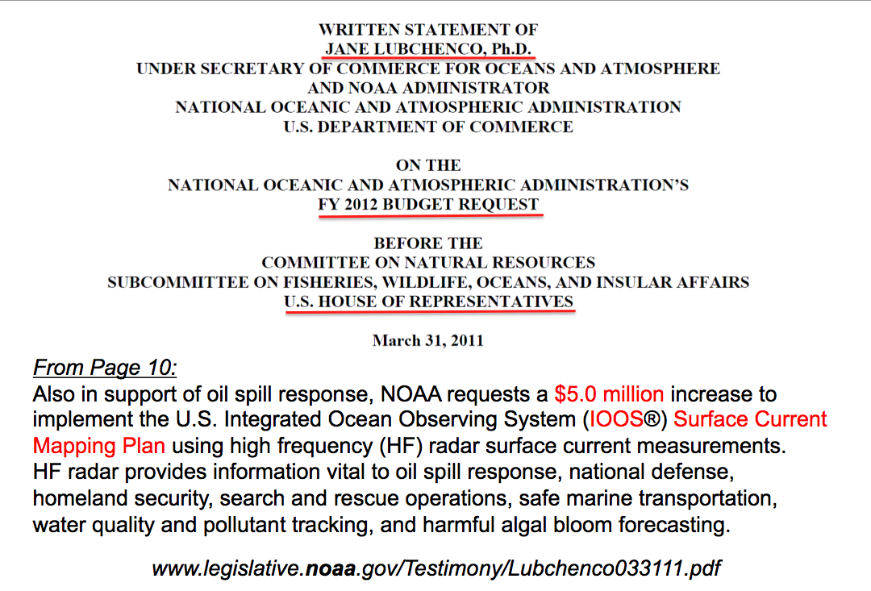
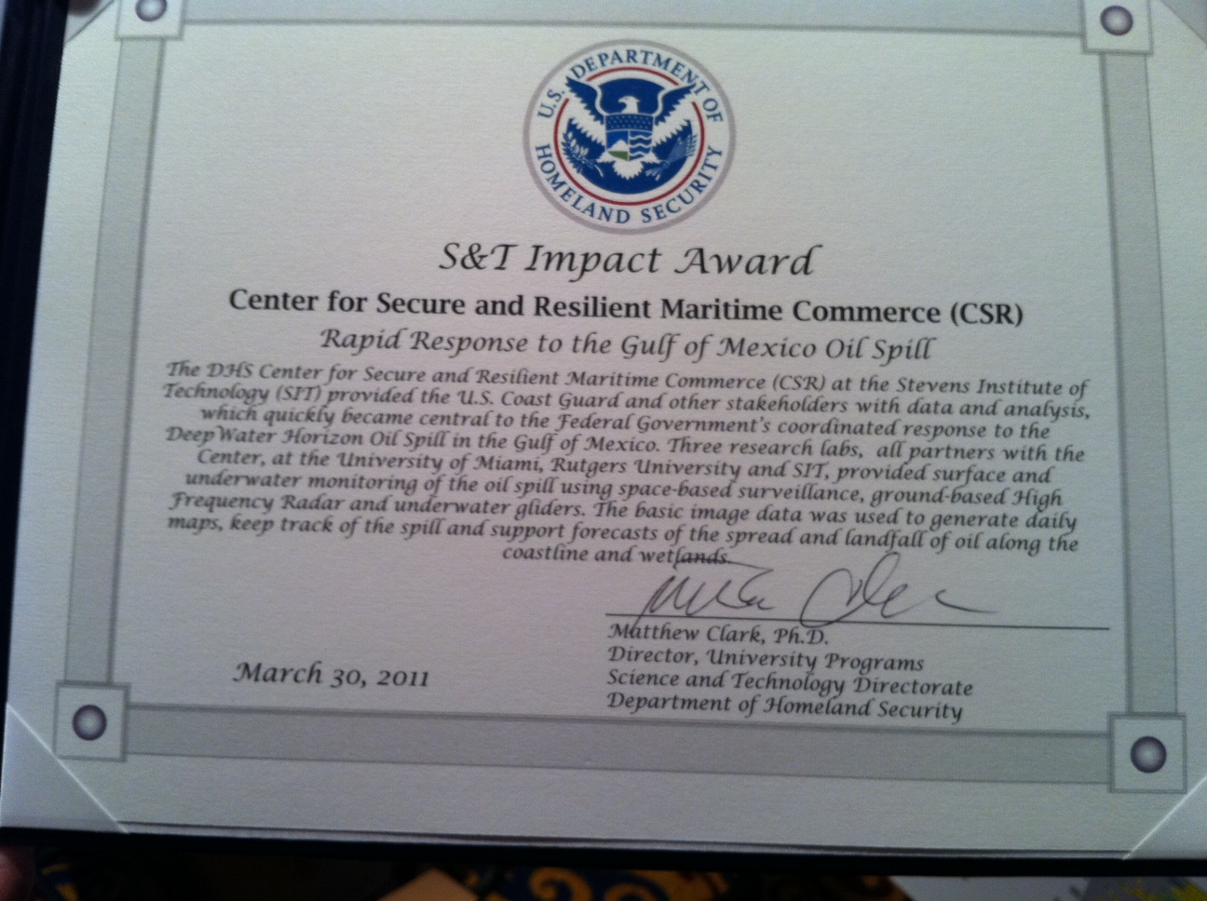
U.S. National Surface Current Mapping Network
Summer
2011 Coverage
131 Radars

Slide 10
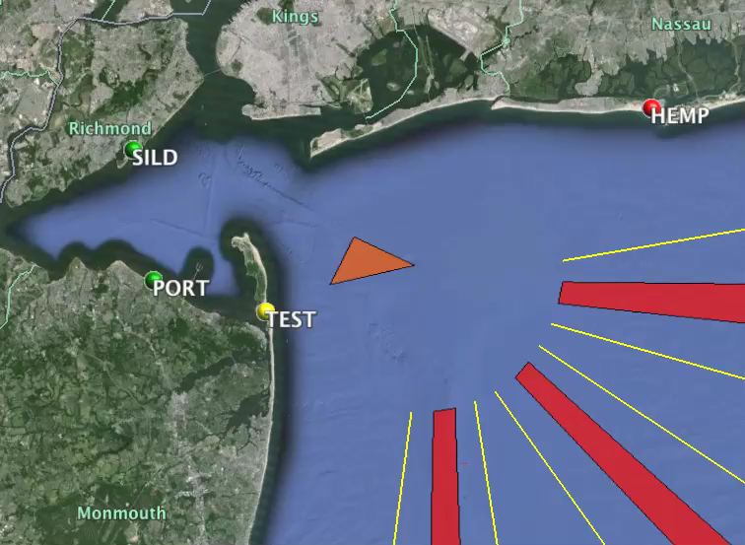
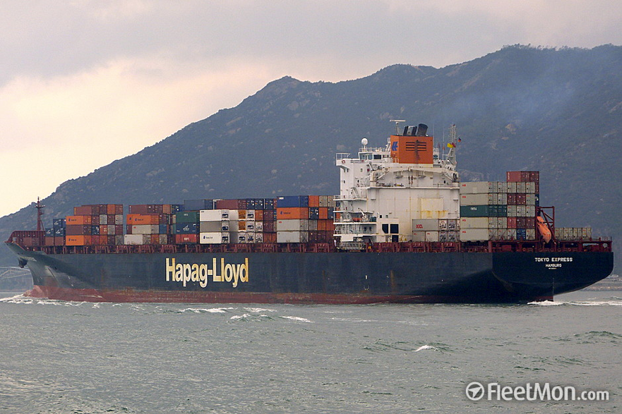
HF Radar Dual Use:
Detections by a Network of Radars
Tokyo Express
November 23, 2013
15:30 – 18:30
Red – AIS
Blue – Radar

Slide 11
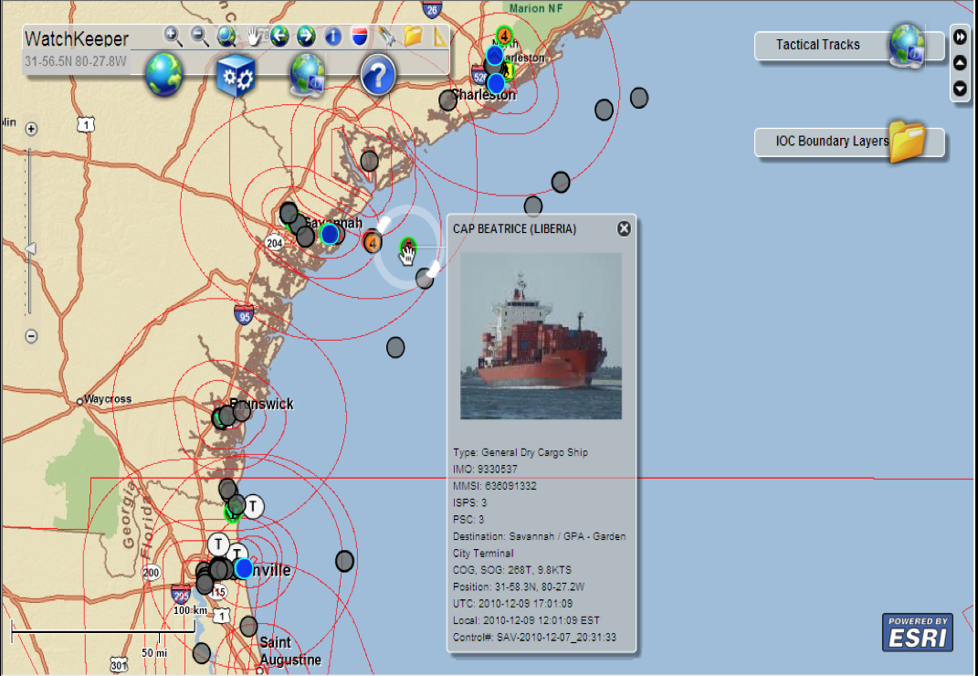
USCG WatchKeeper - “State of the Port”
Integrated Vessel Targeting, Operations Planning & Monitoring

Slide 12
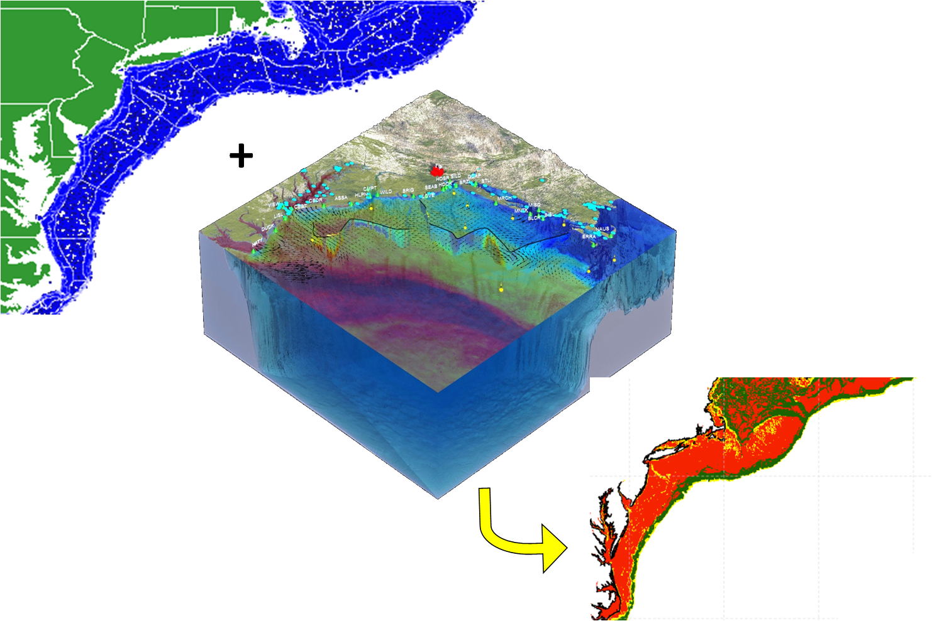
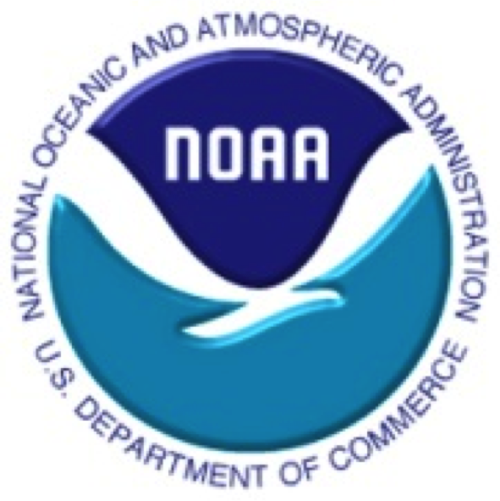
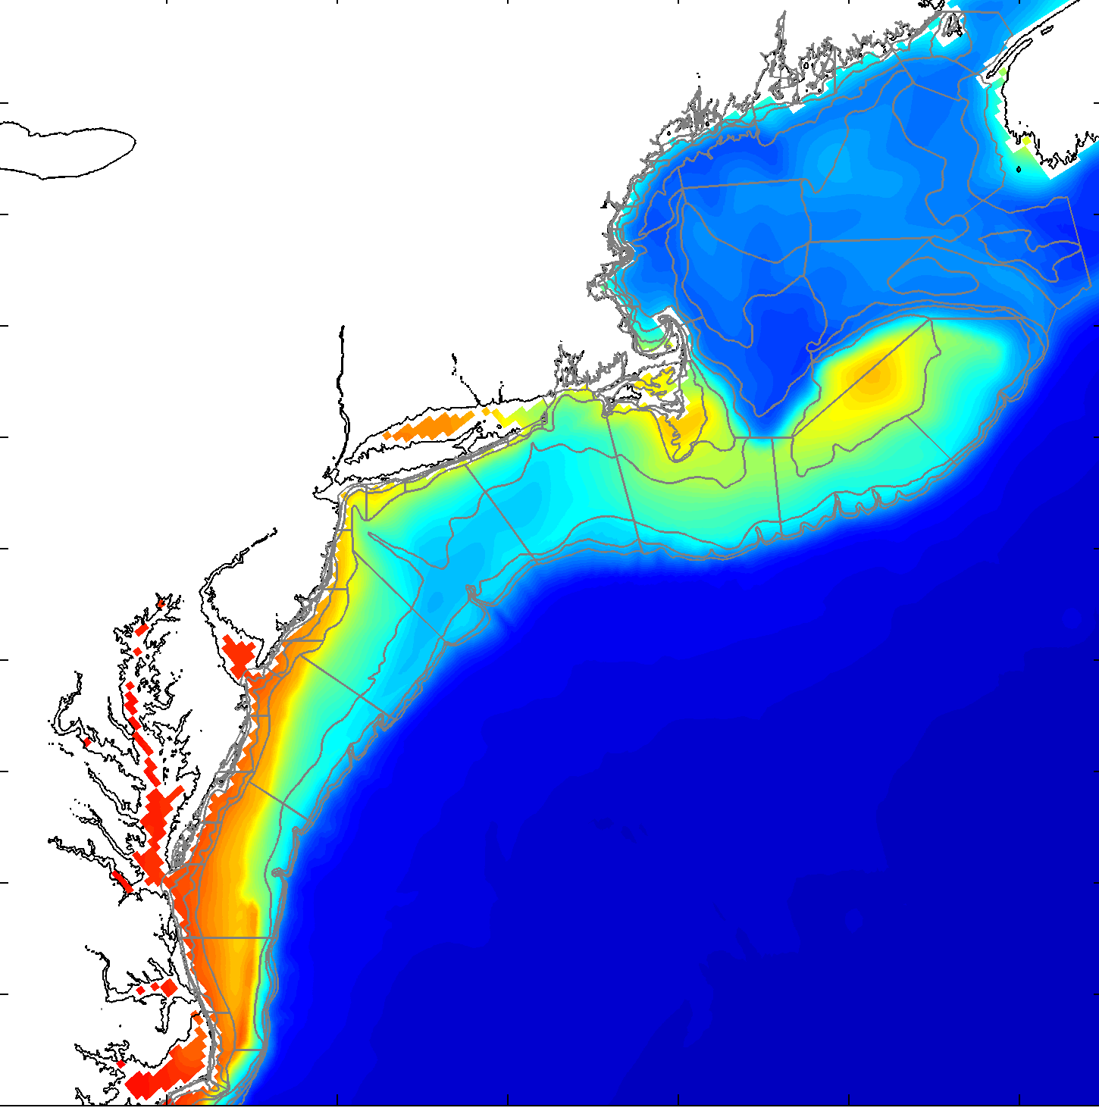
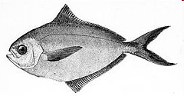
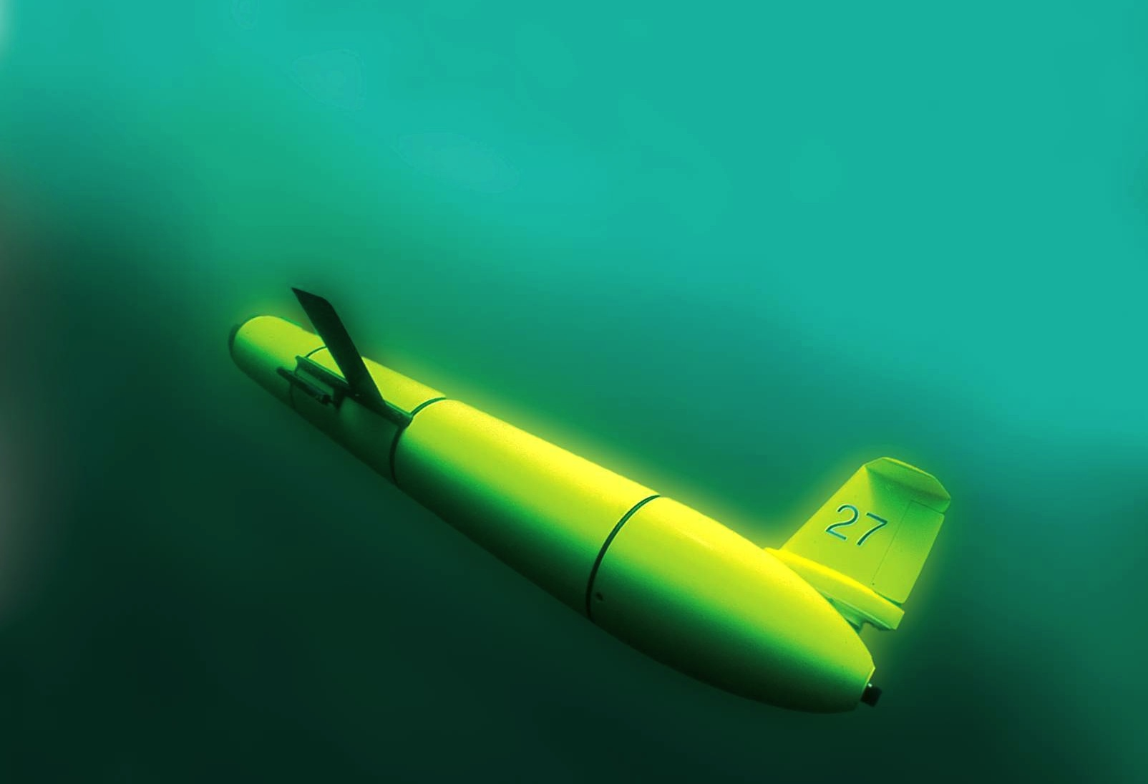


NOAA US
Fishery Data
OpenOcean Workgroup
Science, Management, and
Industry Partnership
Regional
Habitat
Projections
3D Ocean
Observations
+
Physical Models
Catchability = availability * detectability
To Inform Existing Single Species
Stock Assessment Models
(Catchability/Availability)

Slide 13
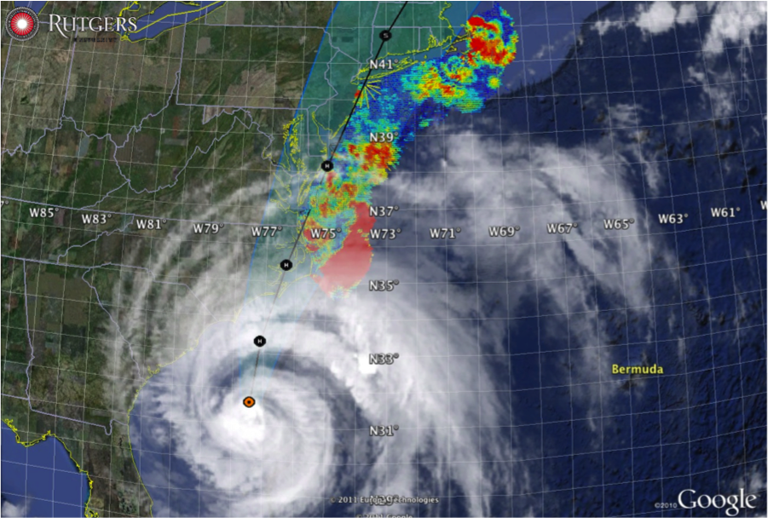
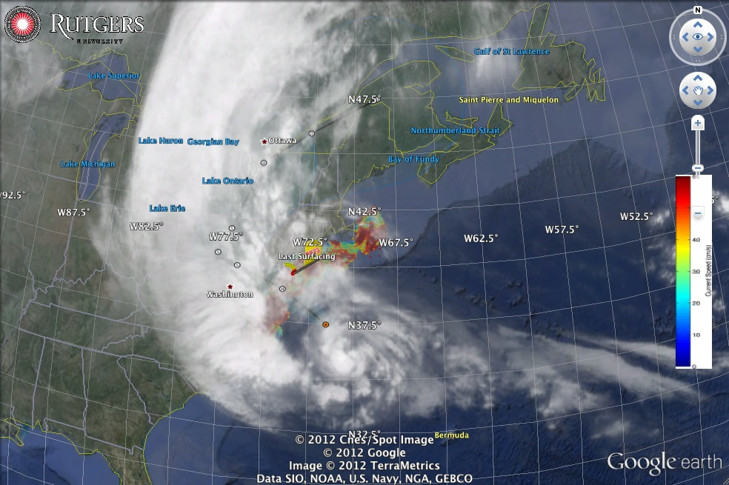
Hurricane Irene
August 26, 2011
NOAA/NHC Damage:
#8 with >$15 Billion.
Track Accurate;
Intensity Over-predicted.
Hurricane Sandy
October 29, 2012
NOAA/NHC Damage:
#2 with >$60 Billion.
Track Accurate;
Impact Under-predicted.

Slide 14
Hurricane Irene
August 26, 2011
Strong Stratification
Limited storm surge
Mixing cooled surface
Limited intensity
Hurricane Sandy
October 29, 2012
After fall transition
Single layer ocean
No mixing/cooling
No escape for surge

Slide 15
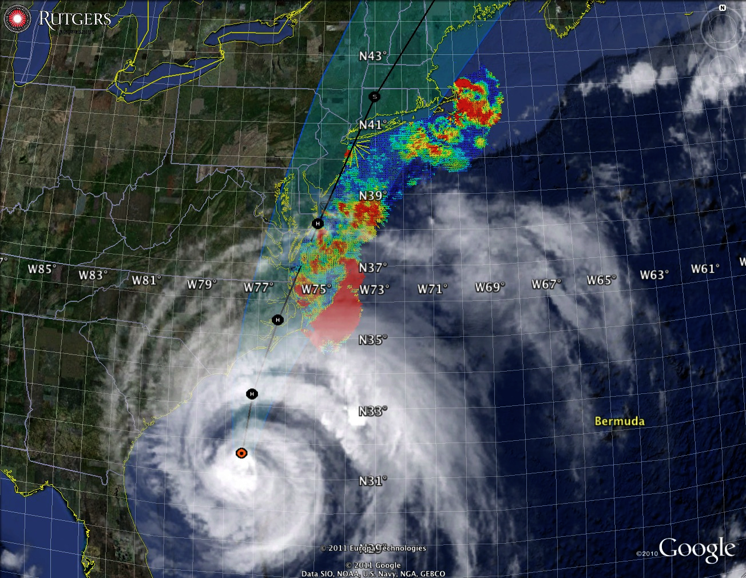
U.S. IOOS
Unique
Demonstrated Value
Plan to Move Forward
Hurricane Irene
August 26, 2011
Strong Stratification
Limited storm surge
Mixing cooled surface
Limited intensity
Hurricane Sandy
October 29, 2012
After fall transition
Single layer ocean
No mixing/cooling
No escape for surge

