Slide 1
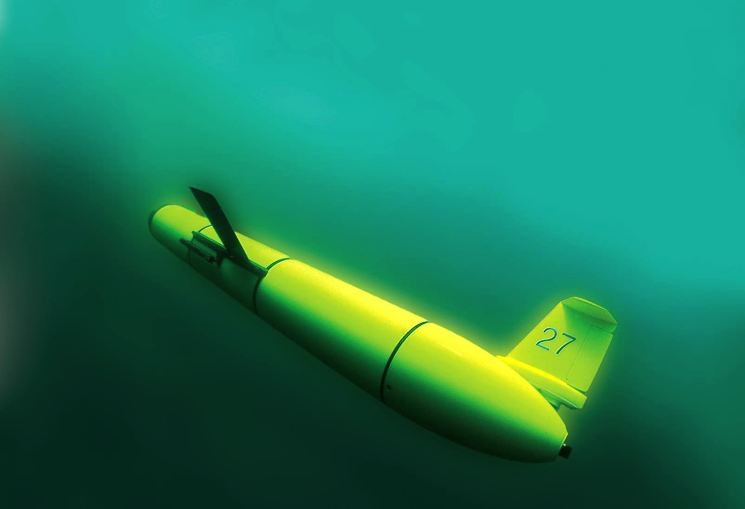
The Challenger Glider Mission:
Teaching a Generation to Dream
Scott Glenn,
Oscar Schofield &
Josh Kohut
Rutgers University
“The Ocean is Our Classroom”

Slide 2
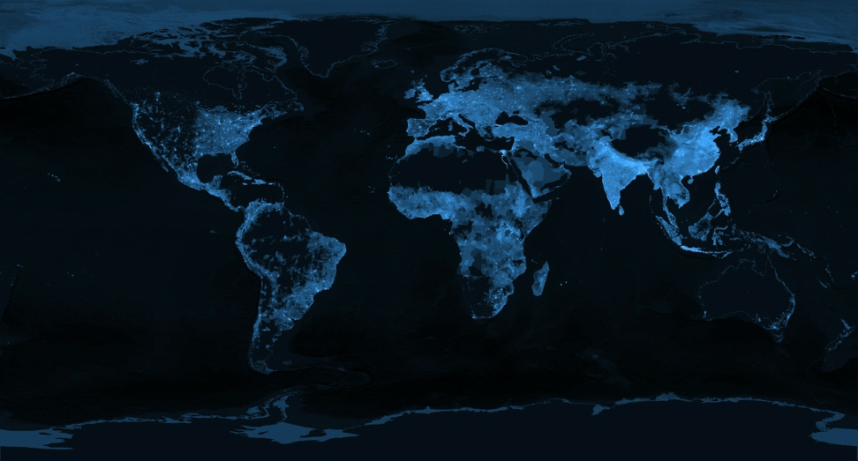
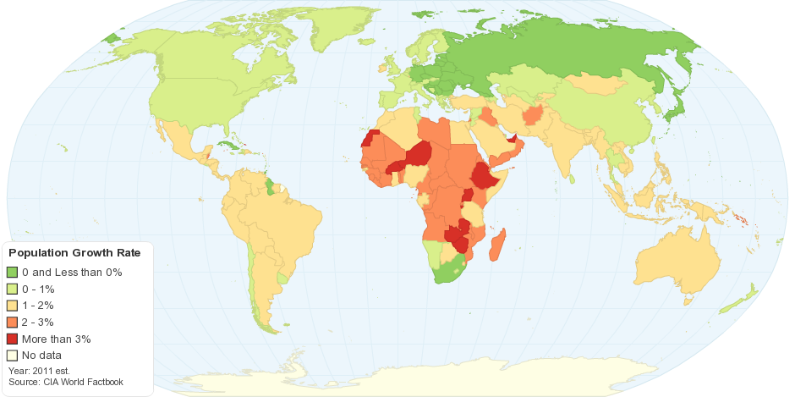
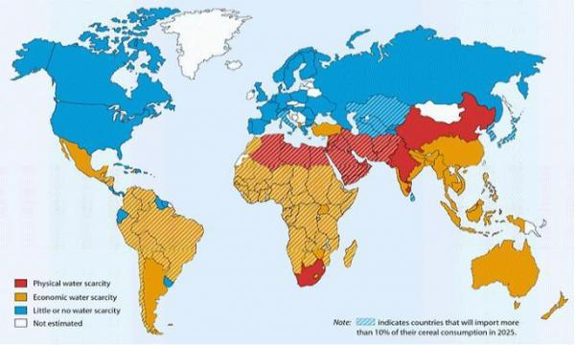
The 2050 Grand Challenge for our Students
During the Professional Lifetimes of Today’s Undergraduates,
Transform This (The Earth at Night)
Into This (Global Population)
Projected Population Growth
Projected Water Scarcity
When the Human Population is Growing
And the Earth is Changing

Slide 3
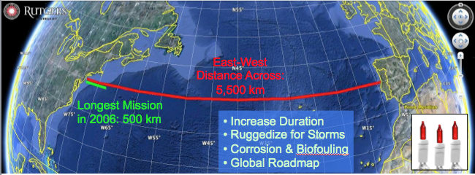
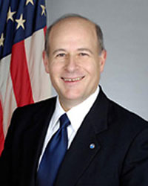
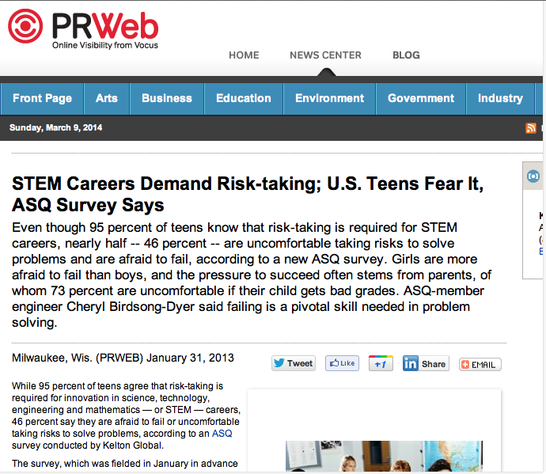
Trans-Atlantic Glider Challenge – May 24, 2006 –
UNESCO E.U./U.S. Baltic Sea Conference in Lithuania
Dr. Rick Spinrad
Assistant Administrator
NOAA
Office of Oceanic and Atmospheric Research
RU27: 7,400 km in 221 days
RU27: 7,400 km in 221 days
“I have something you need to do for the good of your country.”
“Take one of your gliders, modify it, and fly it across the Atlantic, inspiring students along the way.”
Positive risk-taking is required for innovation in STEM careers!

Slide 4
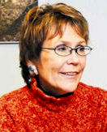
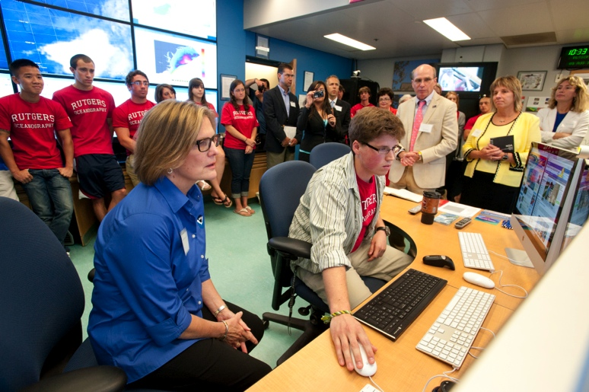
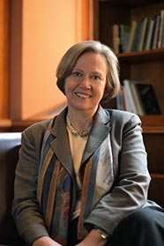
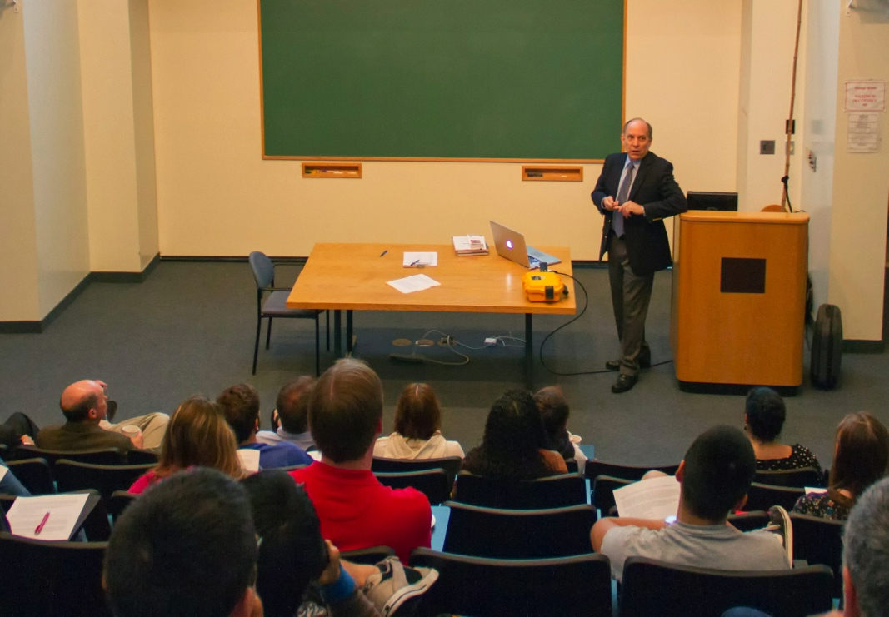
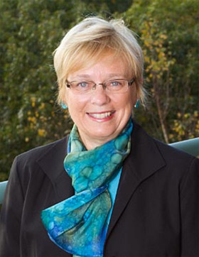
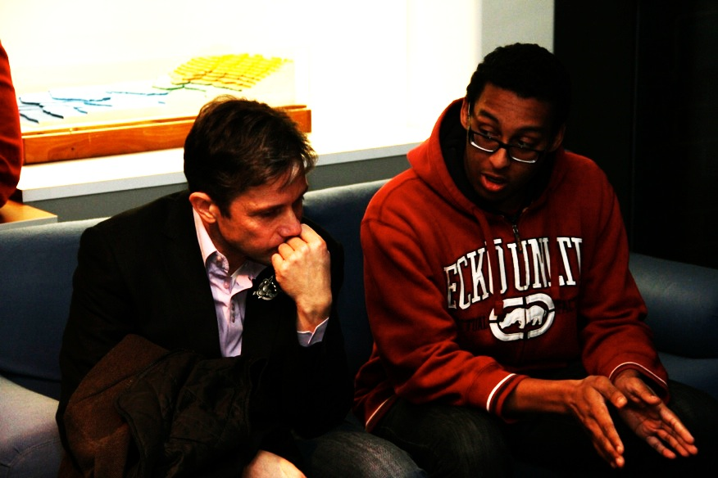
Advice from Some Friends
Margaret Leinen – Director, Scripps Institute of Oceanography
Mentorship – Mind the gender gap
Shirley Tilghman – Former President, Princeton University
Turn the pyramid upside down -
Start living the life of a scientist early
Susan Avery – Director, Woods Hole Oceanographic Institution
Present and publish scientific results
Kathy Sullivan – NOAA Administrator
Be explorers
Louis Uccellini – Director, NWS
Explore our global models
Fabien Cousteau – Plant-a-fish
Communicate what you learn

Slide 5
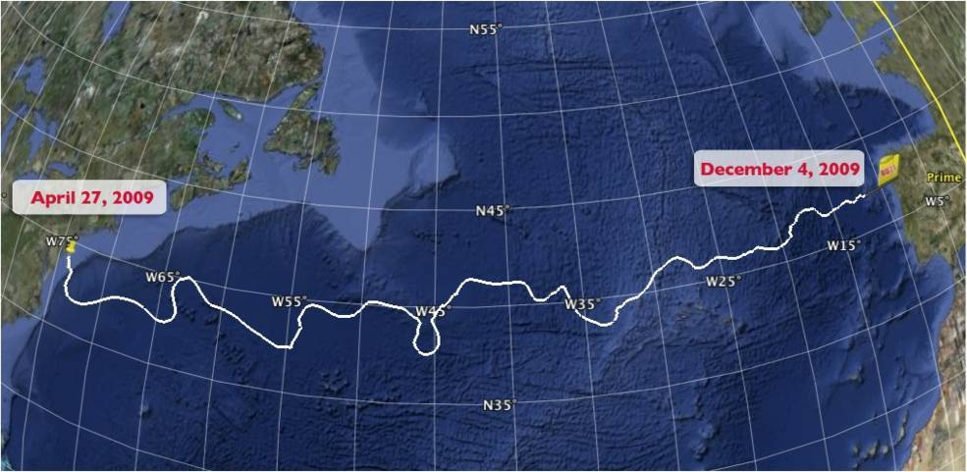
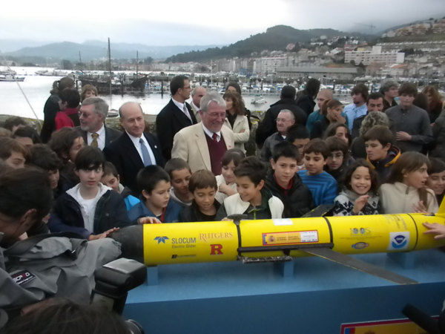
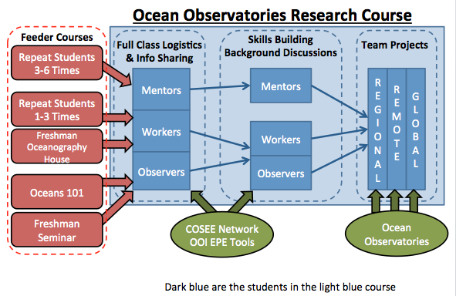
The Trans-Atlantic Glider Challenge
December 9, 2009 – Baiona, Spain
RU27: 7,400 km in 221 days
Trans-Atlantic Glider Challenge

Slide 6
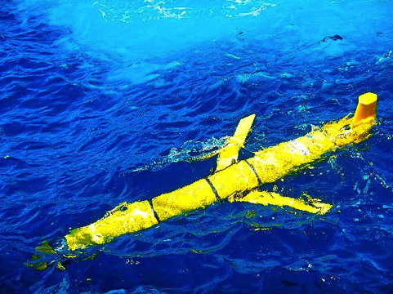
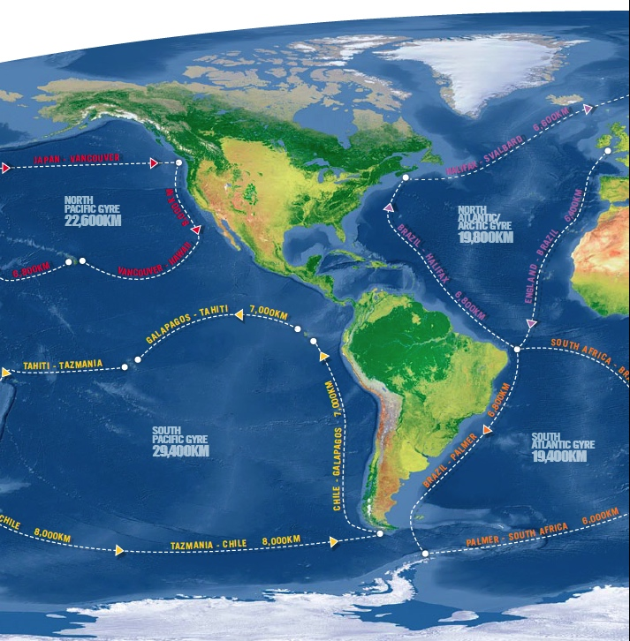
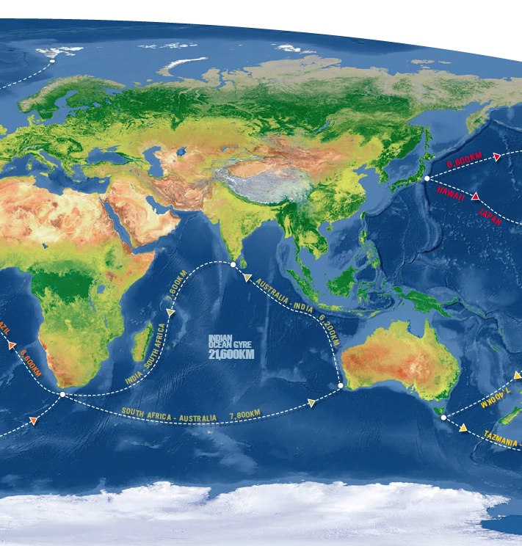
Challenger Glider Mission
16 Global-Class Gliders
Active Participants Today:
Challenger Society
POGO
U.S. IOOS
NOAA
ONR
NSF
Teledyne
Rutgers
Vetlesen
PLOCAN
ANFOG
KIOST
U. Las Palmas
U. Cape Town
U. Sao Paulo
USNA
CLS
Iridium

Slide 7
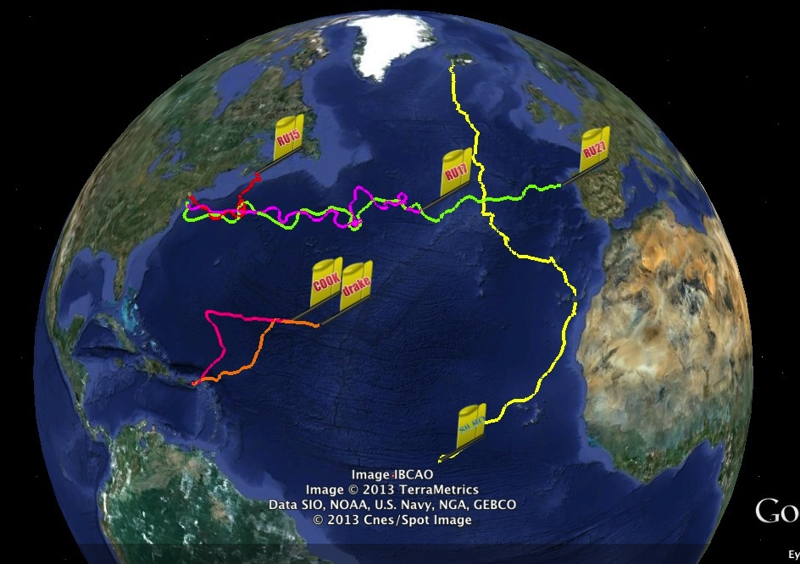
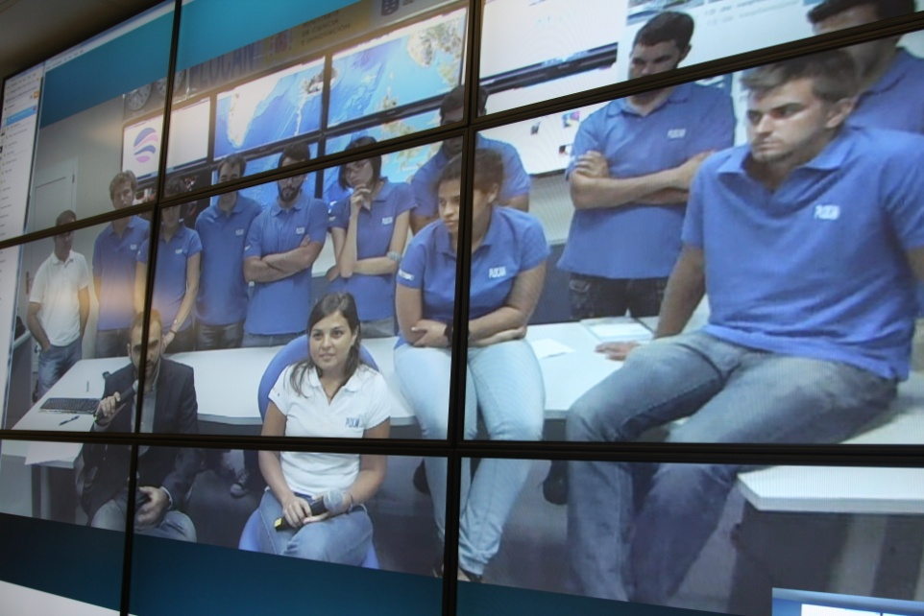
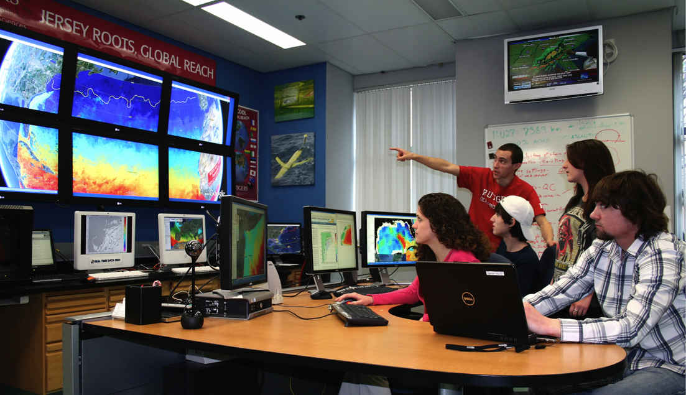
Glider Silbo (yellow): Flown >10,500 km in 540 days
Silbo
Companion Course at
Plataforma Oceanica de Canarias
Shared Glider Missions – Iceland to Azores; Azores to Canaries; Canaries to Caribbean
Skype Sessions between classes
Two-way International Exchange programs
Students Learn Science from their teachers
Students Learn Culture from their peers

Slide 8
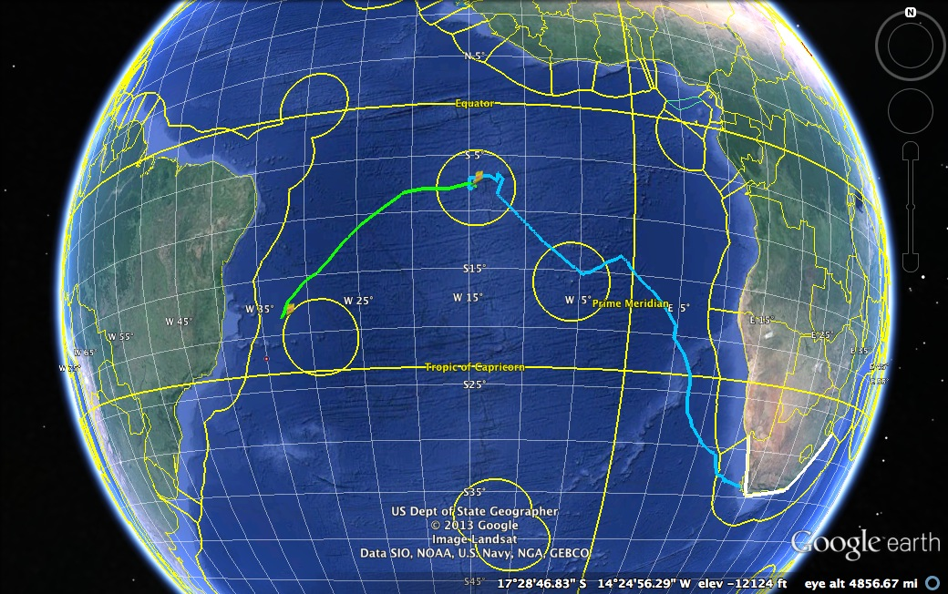
Glider RU29: Launched from Cape Town 11 Jan 2013, flown >8,700 km
RU29
South African Coast
2400 km

Slide 9
Visit us at Oceanology International…
Challenger Society, Booth A-125.
CLS Group, Booth H-301, Tuesday, 5-7 pm.
Teledyne, Booth D-100, Wednesday, 3:30 pm.

Slide 10
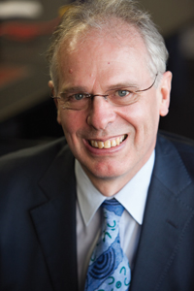
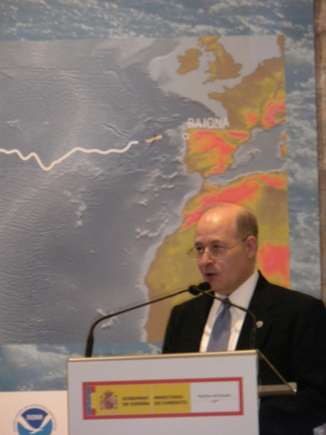
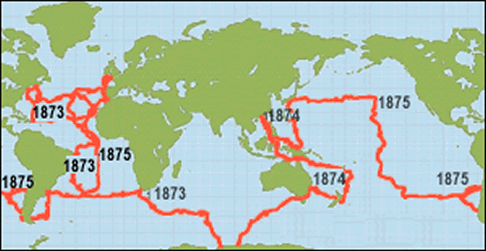
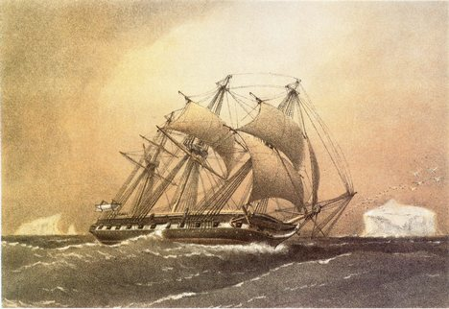
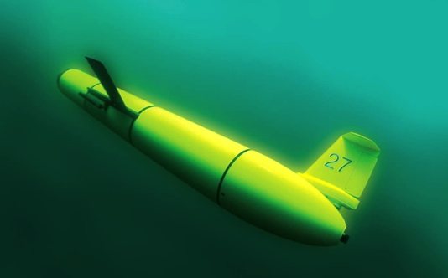
A Global Challenge – The Challenger Glider Mission
December 9, 2009 – Baiona, Spain
Ralph Rayner & Rick Spinrad’s Global Challenge:
Build a Global Glider Fleet
and Coordinate the First
Robotic Circumnavigation.
Revisit the Historic Track of the
HMS Challenger –
And inspire a global network
of students along the way.
HMS Challenger Voyage
First Scientific
Circumnavigation
1872-1876
128,000 km =
= 16 gliders
x 8,000 km/glider

