Slide 1
Anomalous Propagation Experiment
Briefing
Alion Science and Technology
Nathan Hall
240-646-3571
January 24, 2014

Slide 2
Overview of Briefing
Slide 1
Background
Purpose
Anomalous Propagation
Test Plan
Proposed Transmit Site Locations
Transmit Site Equipment
Monitoring Equipment at WCDAS
Support
Way Forward
Data Beneficial to Rutgers

Slide 3
Background
Slide 2
Slide 2
  NOAA’s weather satellite communications spectrum being encroached upon (National Broadband Plan)
  NTIA to auction off 1695 – 1710 MHz (NOAA’s band is 1670 – 1710 MHz)
  Alion analyzed NTIA plan to share 1675 – 1710 MHz with proposed 4G mobile broadband cellular systems
  NTIA determined a relatively small coordination zone (26 km) for one of NOAA’s main ground stations, Wallops Command and Data Acquisition Station (WCDAS), located in Wallops, VA
  Alion believes WCDAS downlinks will receive radio frequency interference (RFI) from sources outside the 26 km coordination zone

Slide 4
Purpose
Alion wants to investigate anomalous propagation in the area around WCDAS
  Prove anomalous propagation occurs around WCDAS area
  Prove that weather data received at WCDAS could be compromised by RFI generated by 4G mobile broadband cellular systems/networks that are located along the east coast

Slide 5
Anomalous Propagation
Slide 4
Slide 4
Phenomena that occur when non-standard atmospheric conditions enhance signal propagation
One form known as “ducting”
Often occurs near water when atmospheric conditions create a marine layer or duct that allows microwave signals to refract along distances longer than line-of-sight (LOS)

Slide 6
Test Plan
Slide 5
Slide 5
Deploy multiple low-power (3 – 5 Watts) L-band (1688 – 1690 MHz) transmitters in coastal regions near the WCDAS (within several hundred miles)
  Transmitters located beyond LOS from WCDAS
  Each transmitter uniquely tagged for identification
Monitoring equipment set up at WCDAS to receive transmissions
12 month (or longer) duration
Begin with close-proximity transmit locations and eventually branch out to greater distances

Slide 7
Oceanographic Radar (MARACOOS) Sites
Table shows MARACOOS sites proposed and the phases of the experiment in which they would be used as transmitter sites

Slide 8
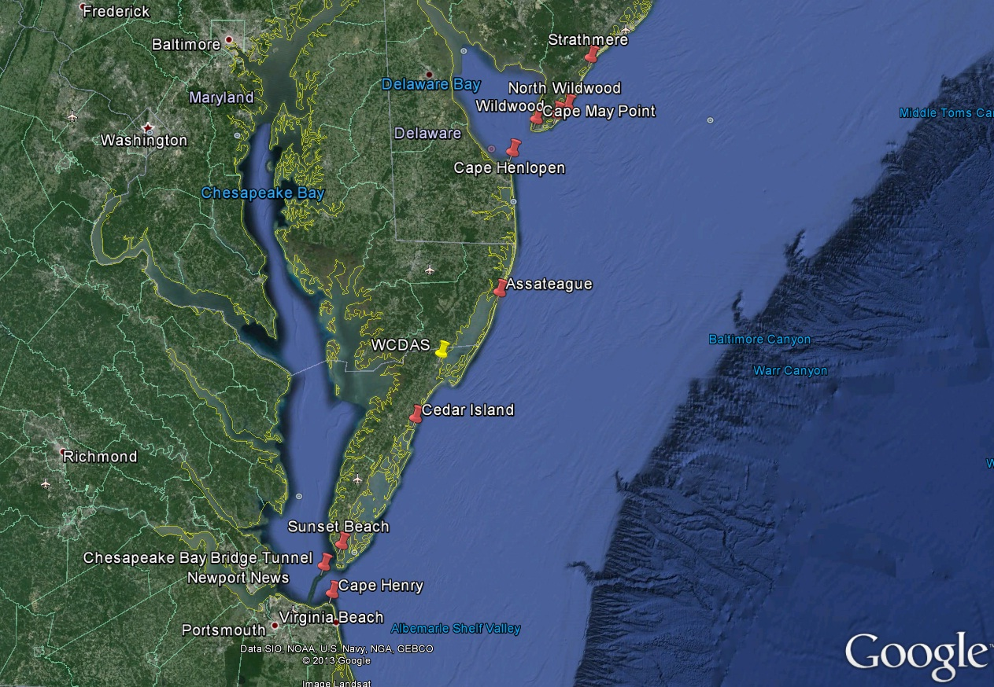
Proposed Transmit Site Locations (Phase A)

Slide 9
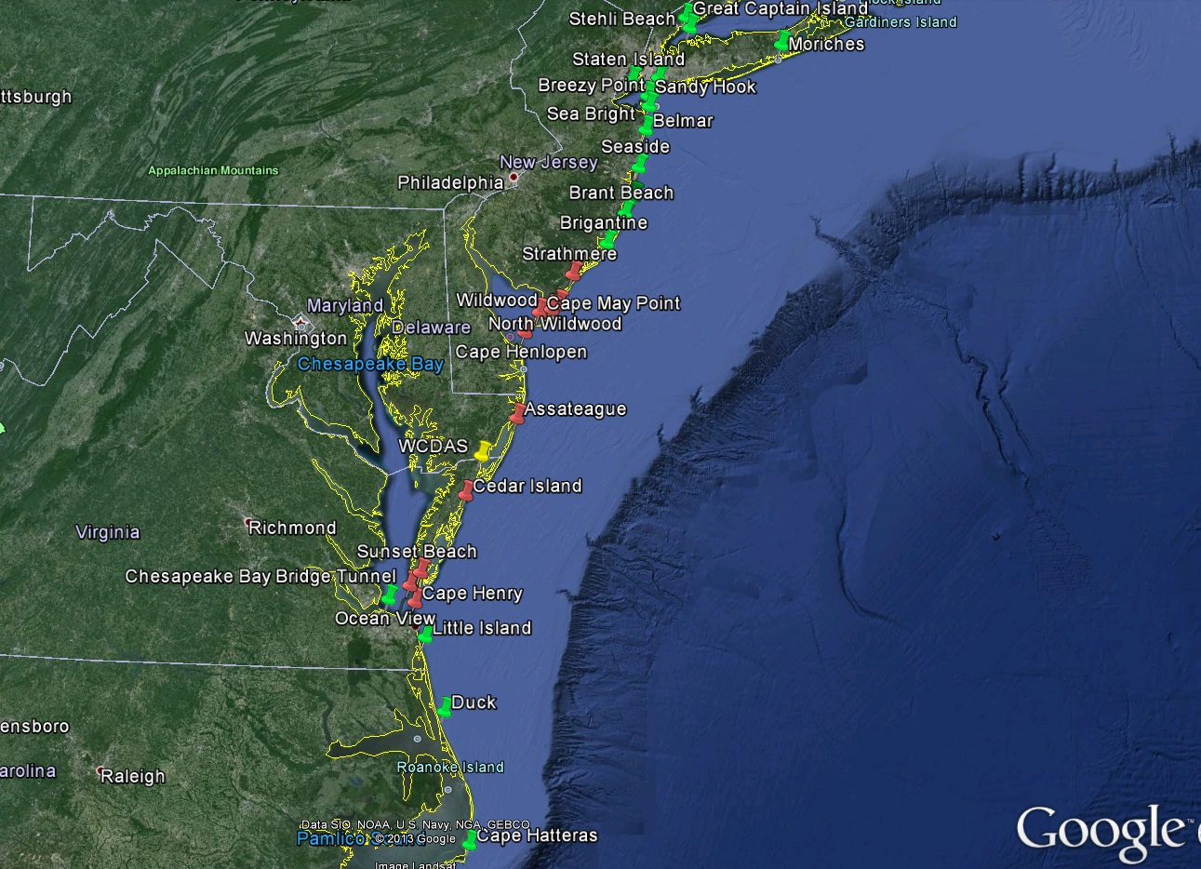
Proposed Transmit Site Locations (Phase B)

Slide 10
Transmit Site Equipment
Steel Tower - 10 to 15 ft high
  Solar panel
  Log-periodic array antenna
  12 VDC battery
  NEMA box that houses radiosonde transmitter, solar panel, controller, 3 – 5 W power amplifier
Transmit cycles 2 mins; 3 – 4 times an hour, 24 hrs/day
  Frequencies (Phase A): 1688.1, 1688.5, 1689, 1689.5, 1689.9 MHz
  Longer term frequencies (Phase B): Every 100 kHz, (e.g. 1688.2, 1688.3, 1688.4, etc. up to 1689.9 MHz)

Slide 11
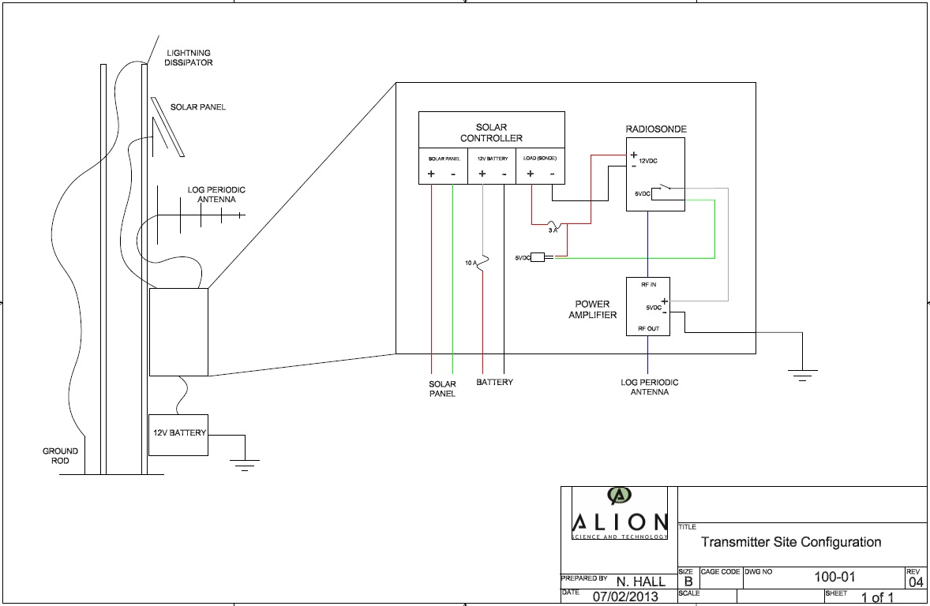
Transmit Site Equipment (cont’d)

Slide 12
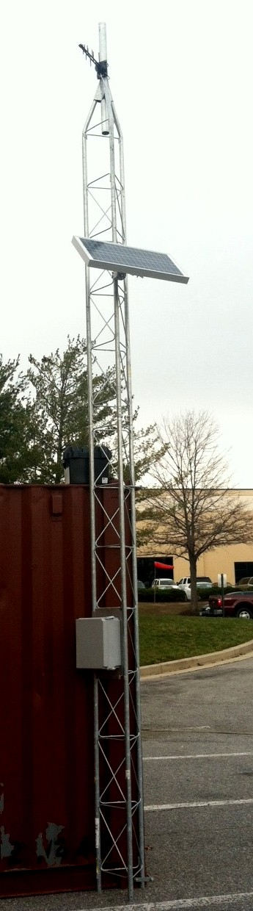
Transmit Site Equipment (cont’d)
Antenna
Solar panel
Battery
NEMA Box

Slide 13
Monitoring Equipment at WCDAS
Place Yagi antennas on 150-foot tower in antenna field
  Twelve antennas total (4 at each level)
  Low-noise amplifier (LNA) after each antenna
  Four antennas at heights of 50 ft, 100 ft, and 150 ft (pointed in different azimuth sectors)
  Antennas at each level summed into one output
  Separate receiver for each height
Monitoring equipment shelter at base of tower
  Monitor 1688 – 1690 MHz transmit band 24 hours a day
  Identify transmission ID, time, and location (temperature, pressure, and humidity data also received)
Data can be remotely retrieved nearly instantaneously

Slide 14
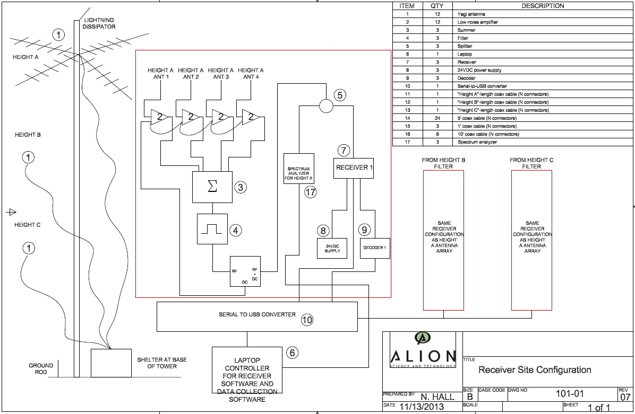
Monitoring Setup at WCDAS

Slide 15
Rutgers/MARACOOS Support
Permission to place transmitter towers at proposed MARACOOS sites
  Understand that none of the property is owned by MARACOOS or Rutgers
  In that case, any information that would assist in gaining permission from property owners

Slide 16
Way Forward
Gain permission from Rutgers/MARACOOS/site property owners to use MARACOOS sites
Deploy Phase A transmitters
  Currently have 10 transmitter configurations ready
Set up monitoring equipment at WCDAS
Monitor Phase A transmitters for several months
Deploy Phase B transmitters

Slide 17
Data Beneficial to Rutgers
Radiosonde transmitters that Alion is using as their test transmitters are regularly used in weather balloons to collect various weather data
  Temperature, pressure, and humidity
Radiosondes also contain GPS
Alion has no problem sharing this weather data that would be collected over the duration of our experiment with Rutgers if they find they have a use for it

Slide 18
Contacts
Nathan Hall, engineer, 240-646-3571; nhall@alionscience.com
Lawrence Crippen, project manager, 410-703-0078; lcrippen@alionscience.com

