Slide 1
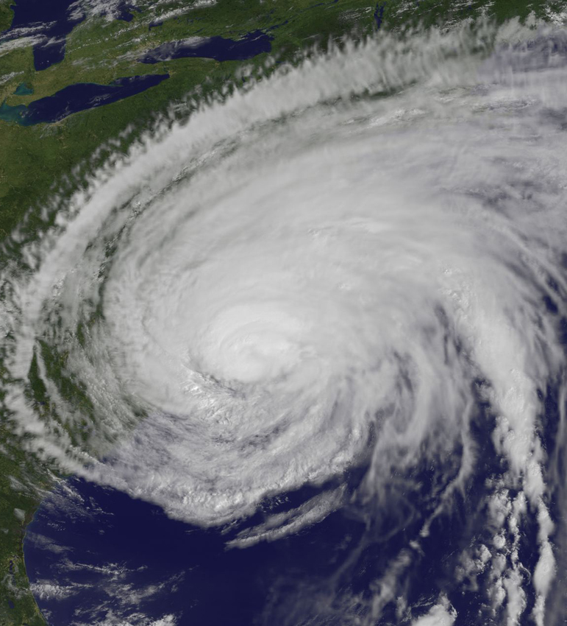
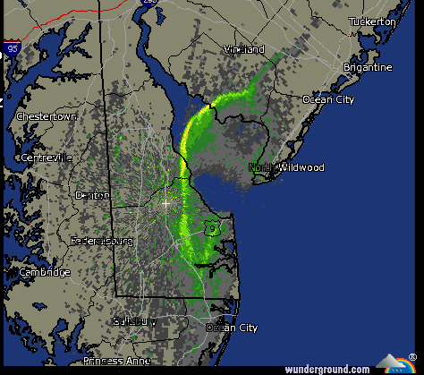
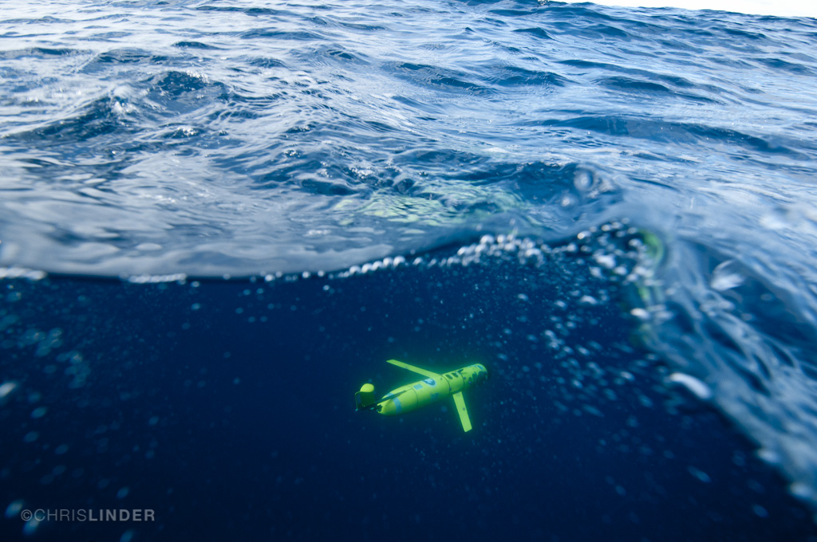
From hurricanes to the sea breeze: air-sea interaction in the coastal zone
Greg Seroka

Slide 2
Part I
Hurricane Irene

Slide 3
Motivation
In August 2011, Hurricane Irene’s intensity was over-predicted by several hurricane models and over-forecast by the National Hurricane Center (NHC)
Notes:
Case study (Irene)

Slide 4



Governing factors of hurricane intensity
dry air intrusion
Question:
Did the upper ocean thermal structure and evolution contribute to Irene’s intensity over-prediction?
vertical wind shear
Hypothesis:
upper ocean thermal structure and evolution
Models handled well:
hurricane track
vertical wind shear
dry air intrusion
But not:
upper ocean thermal
structure and evolution
hurricane track
After Emanuel et al. (2004)

Slide 5
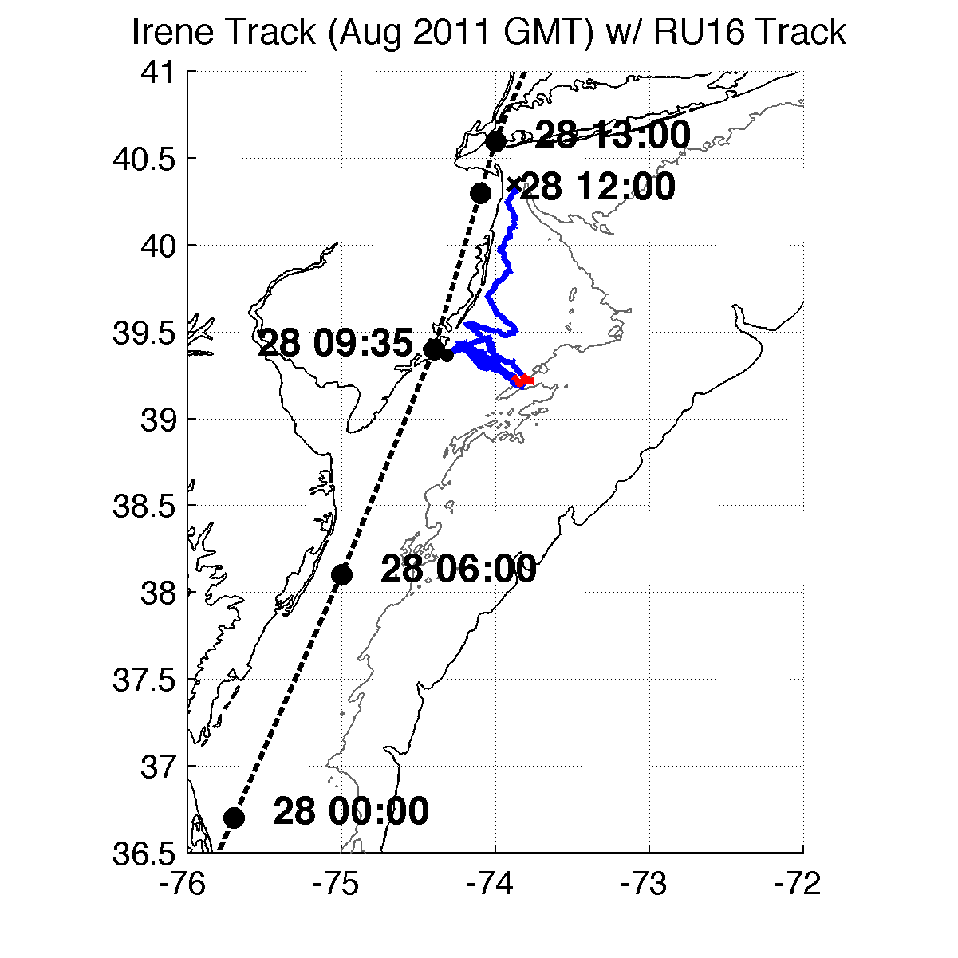
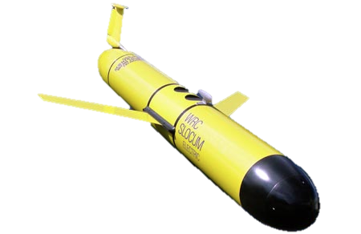


Methods – Observations and Model
RU16 Glider
Satellite: New sea surface temperature, SST
Model: Weather Research
and Forecasting (WRF)
Full RU16 Glider Track
Irene RU16 Glider Track
40m isobath
200m isobath (shelf break)
Notes:
SST product is IR/near IR (AVHRR); SPoRT is IR/near IR as well
GFS 0.5 degree 08/27/11 06Z for boundary conditions
Modeling is semi-realistic/semi-idealized

Slide 6
Results
Glider data revealed surface cooling before passage of hurricane eye

Slide 7
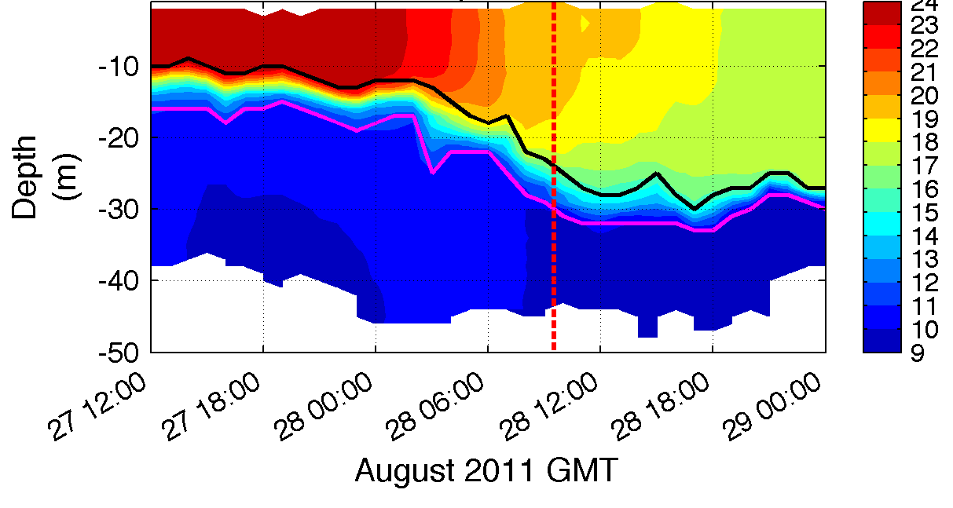
1. Glider revealed “ahead-of-eye” cooling
warm SSTs before storm
passage of eye
T (°C)
Notes:
**HF radar for surface currents onshore, glider depth-averaged currents near zero, infer offshore bottom currents
BUOYS CORROBORATED AHEAD OF EYE COOLING
Coastal downwelling circulation, which resulted in shear across thermocline, turbulence/entrainment, and finally surface cooling
Fire escape at bottom for less storm surge, fire extinguisher at top for weakening storm
Inertial response likely cooled remaining waters post-storm

Slide 8
Results
Glider data revealed surface cooling before passage of hurricane eye
Improved satellite SST product revealed that this surface ocean cooling was not captured by:
  Basic satellite products
  Ocean models used for forecasting hurricane intensity

Slide 9
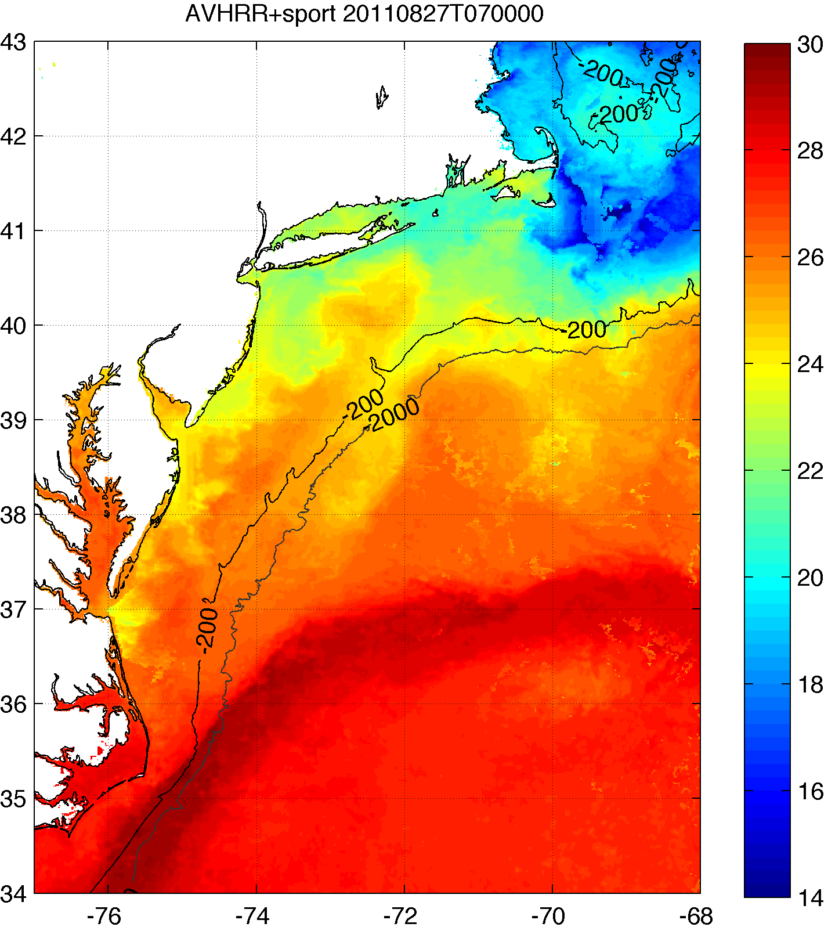
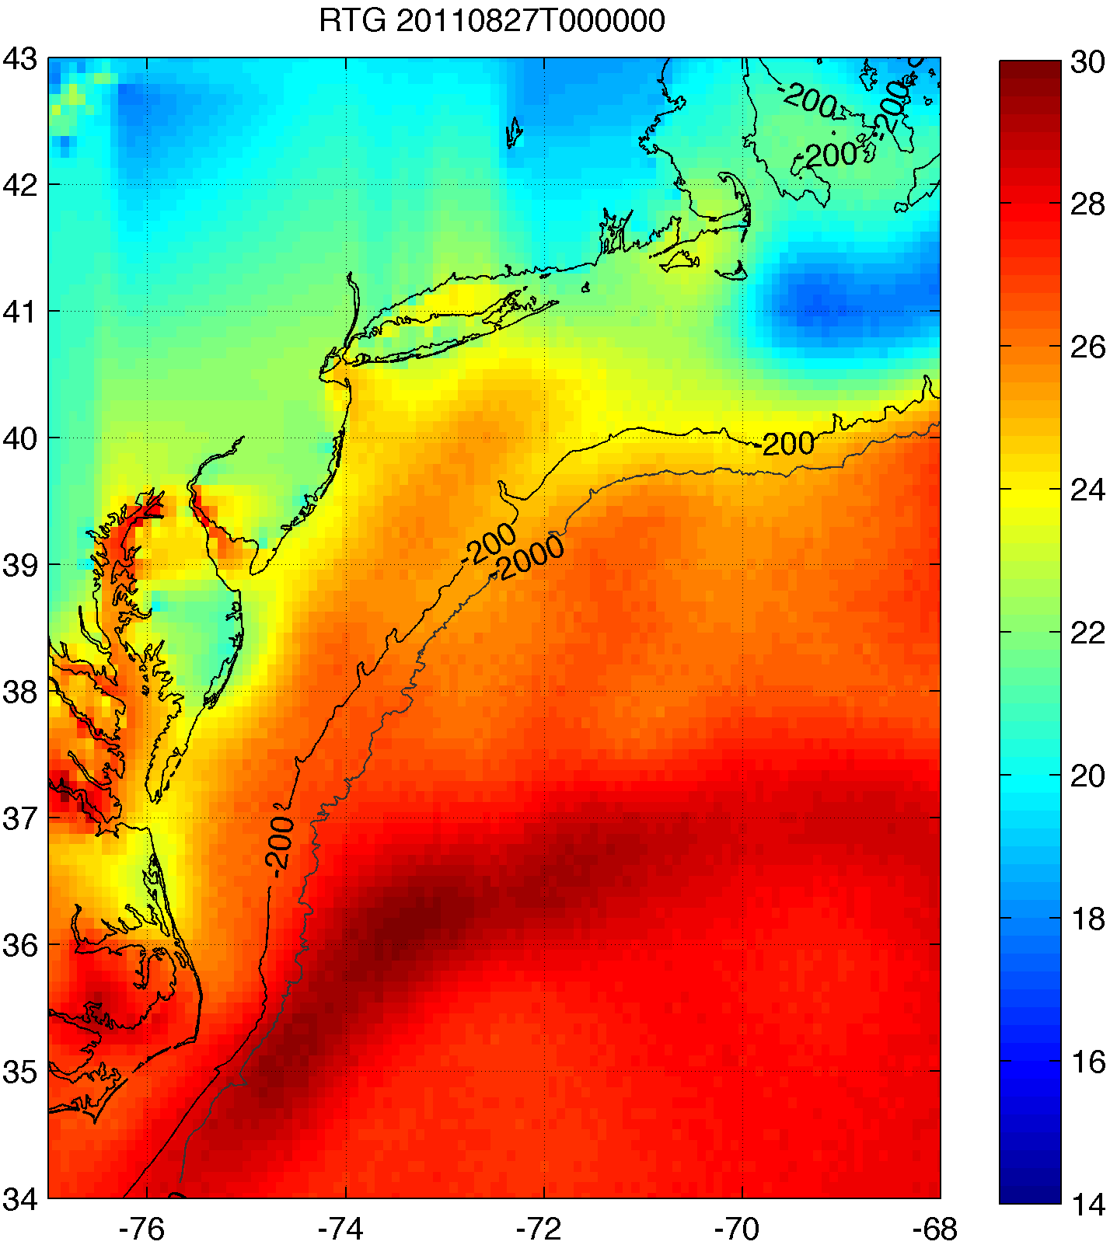
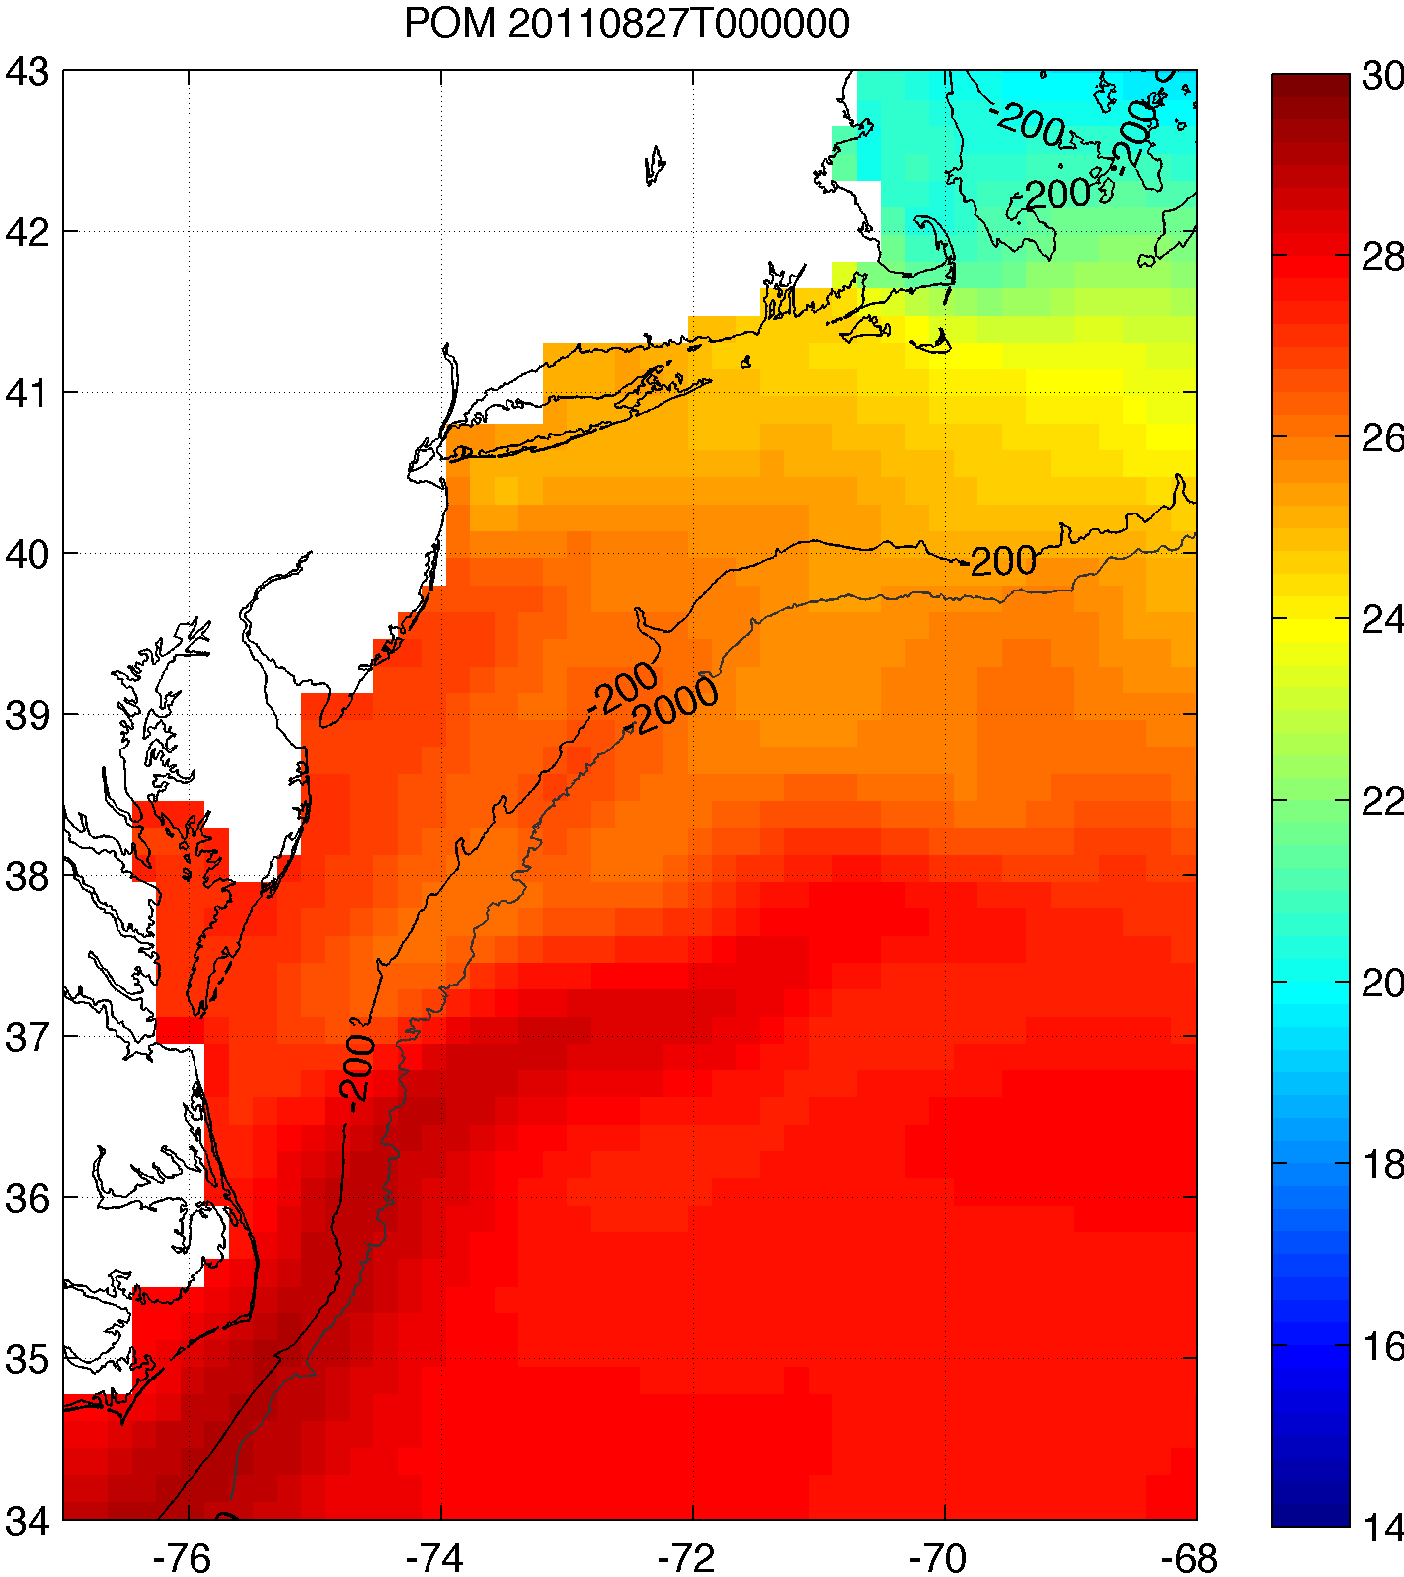
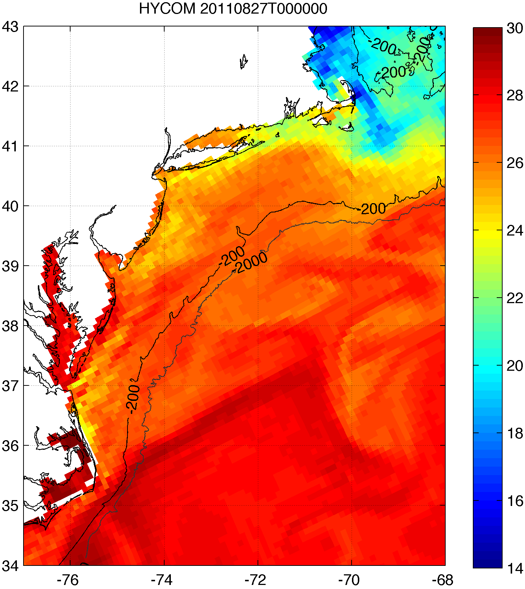
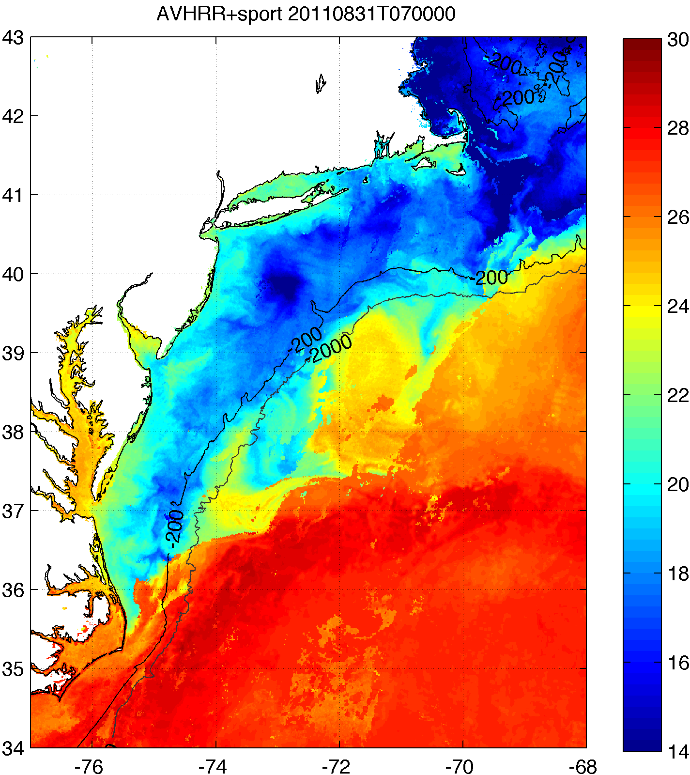
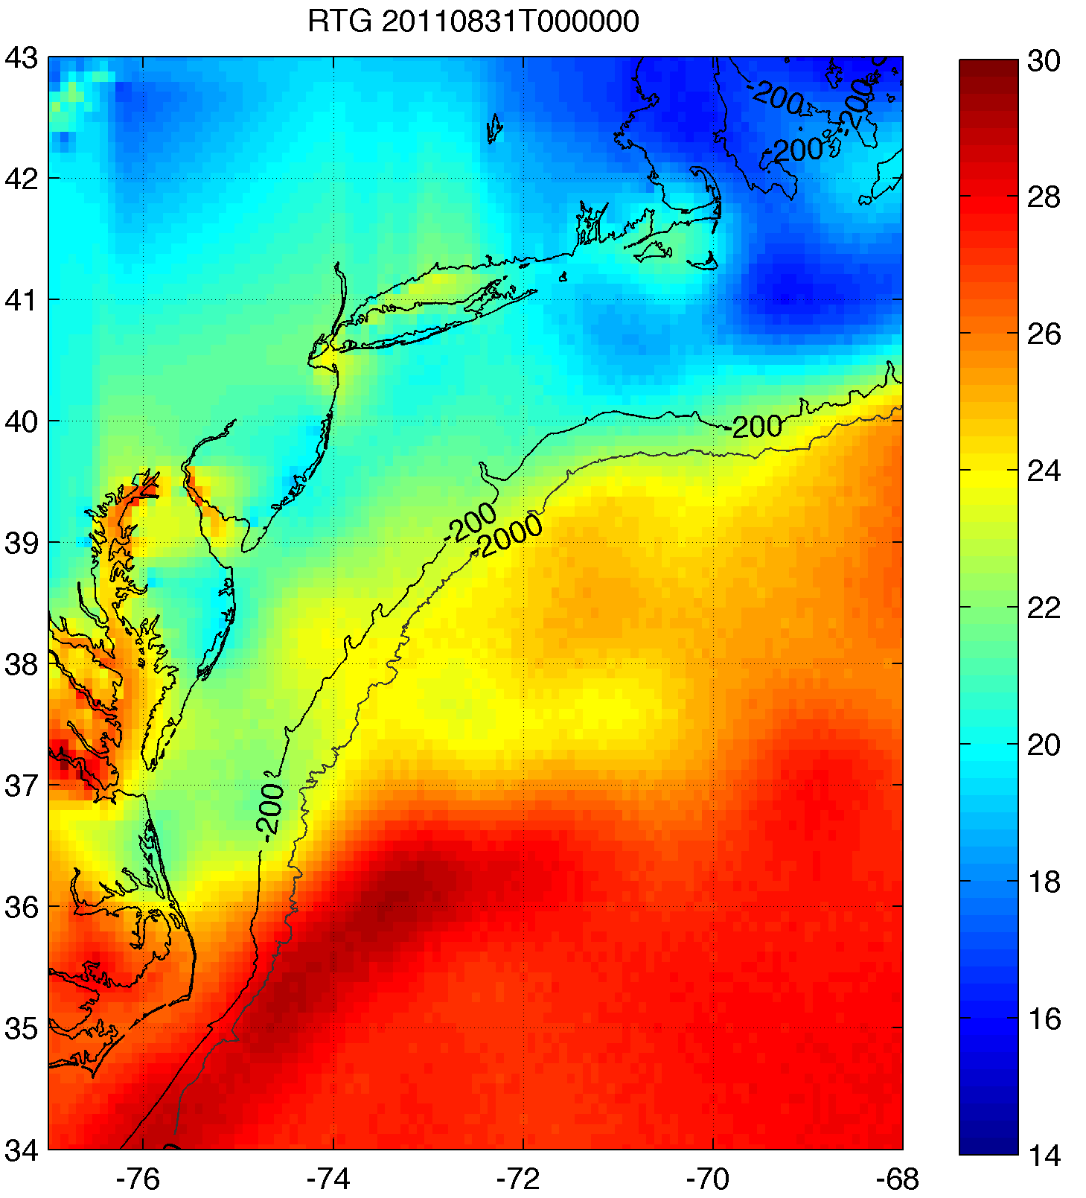
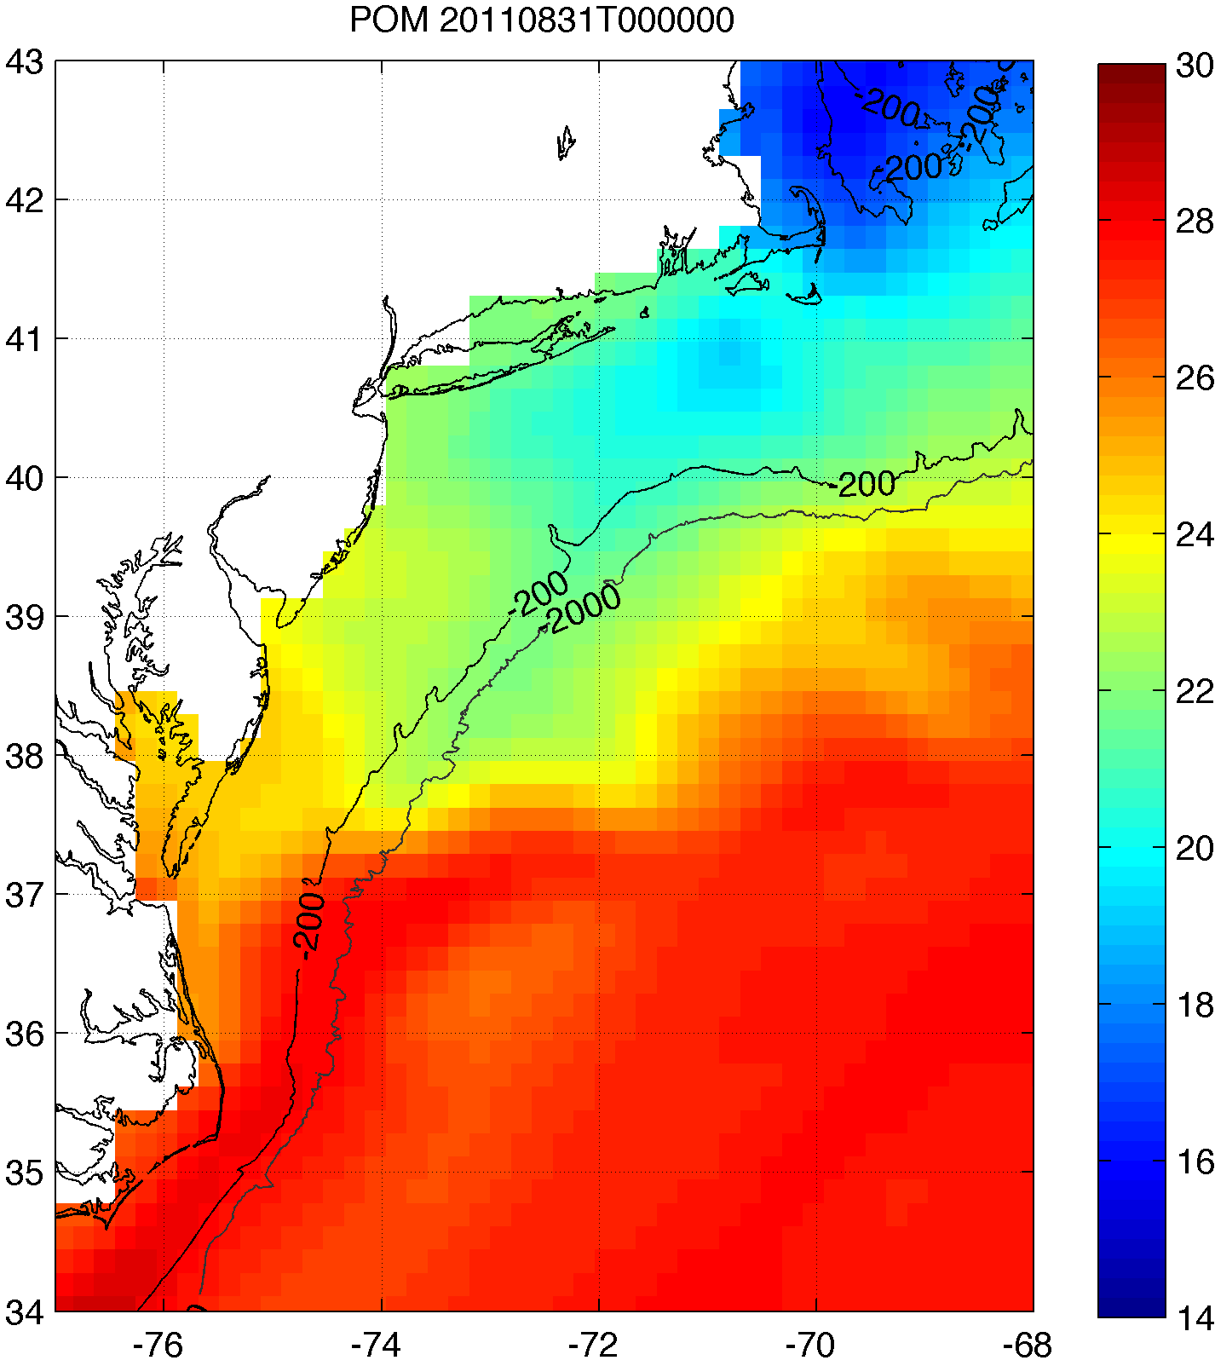
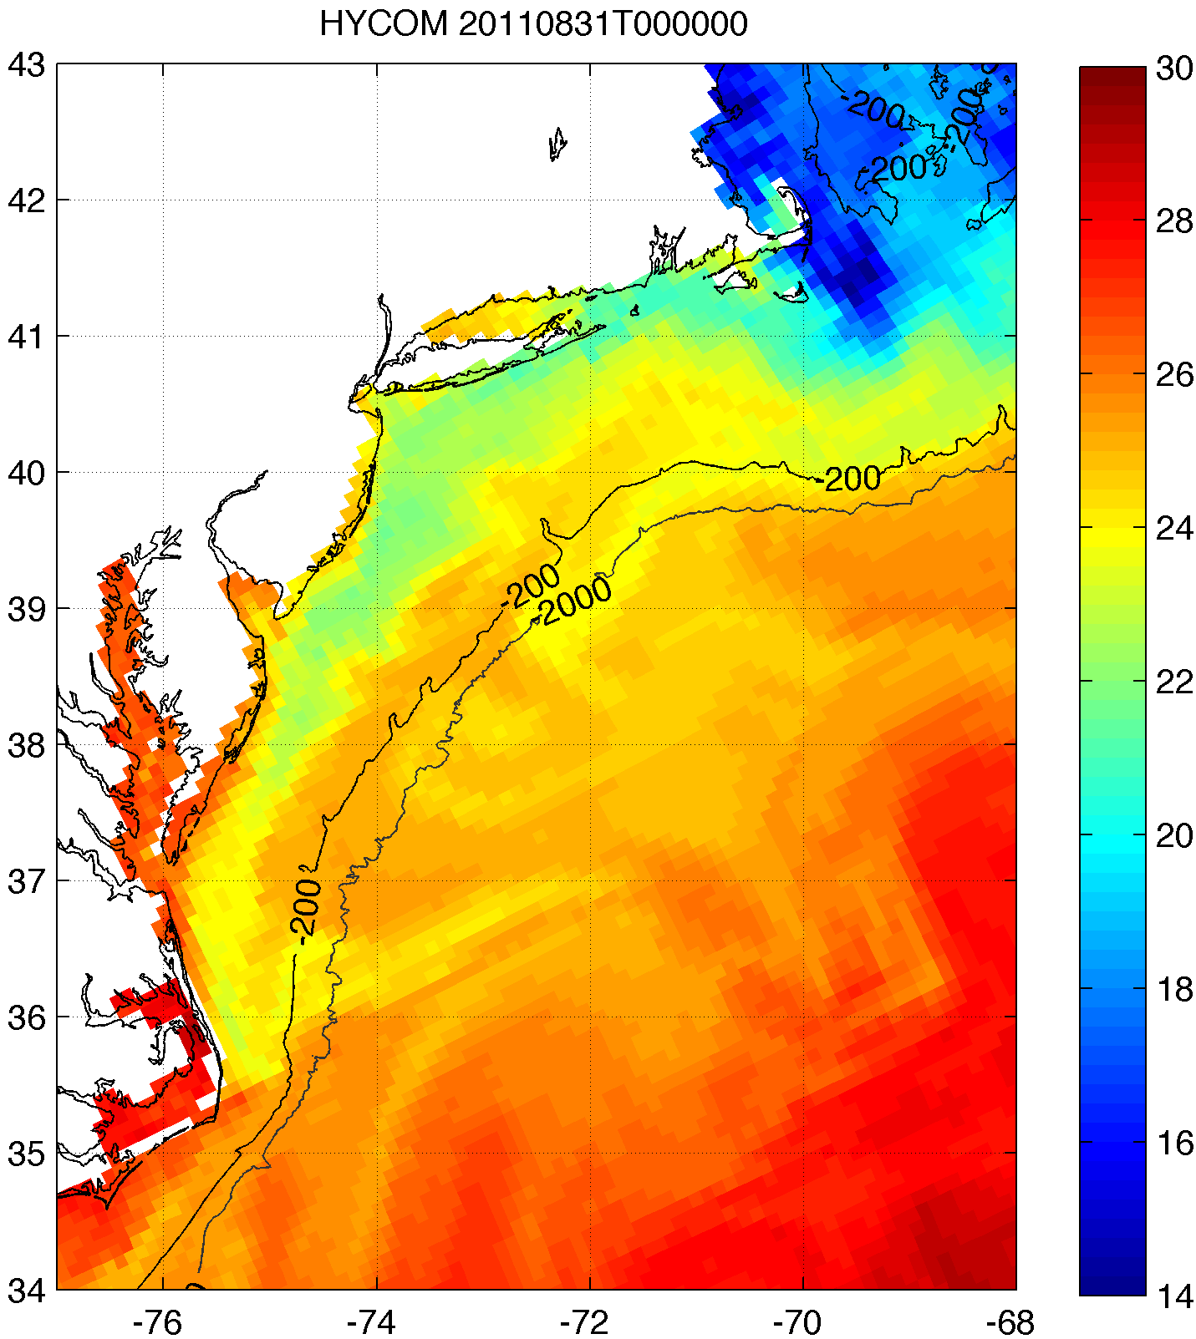
2. Improved satellite SST product revealed that this cooling was not captured by:
basic satellite product
ocean models used for forecasting hurricane intensity
Rutgers SST
RTG HR SST
NAM model
HWRF-POM
low res
HWRF-HYCOM
medium res
BEFORE IRENE
AFTER IRENE
Notes:
Caveats: different atmospheric forcing, etc.
Rutgers SST: 2km, RTG: 1/12 deg, ~9 km, HWRF-POM: 18km, HWRF-HYCOM: 1/12 deg, ~9km

Slide 10
Results
Glider data revealed surface cooling before passage of hurricane eye
Improved satellite SST product revealed that this surface ocean cooling was not captured by:
  Basic satellite products
  Ocean models used for forecasting hurricane intensity
Over 100 sensitivity tests with model showed that Hurricane Irene intensity is very sensitive to this “ahead-of-eye” SST cooling

Slide 11

3. >100 sensitivity tests showed Irene intensity very sensitive to this “ahead-of-eye” SST cooling
Minimum pressure

Slide 12
3. >100 sensitivity tests showed Irene intensity very sensitive to this “ahead-of-eye” SST cooling
Maximum wind

Slide 13
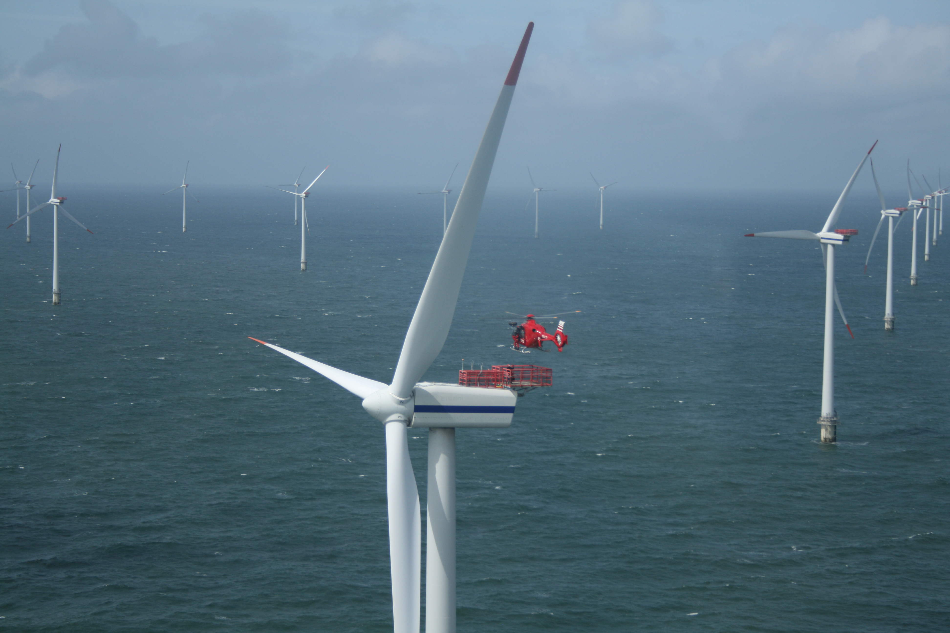






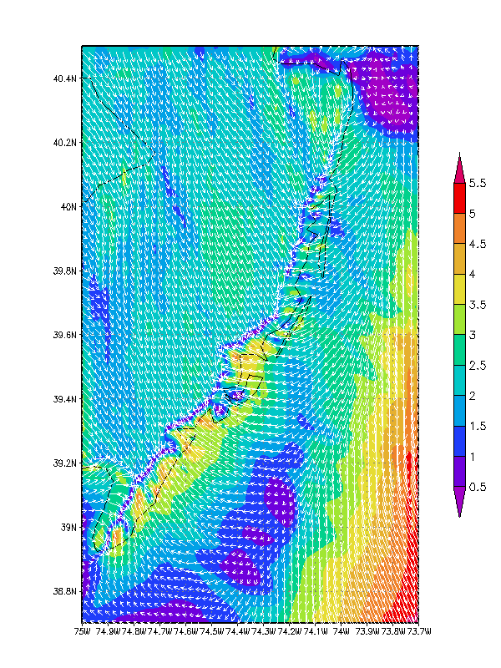
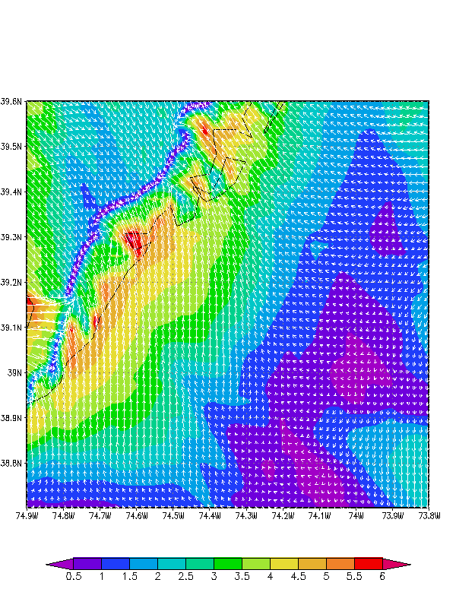
State of New Jersey
New Jersey Board of Public Utilities (NJBPU)
An Advanced Atmosphere/Ocean Assessment Program:
Reducing the Risks Associated with Offshore Wind Energy Development
As Defined by The NJ Energy Master Plan and
The NJ Offshore Wind Energy Economic Development Act
Principal Investigators: Dr. Scott Glenn and Dr. Rich Dunk, CCM
Team Members: Dr. Josh Kohut, Dr. Hugh Roarty, Louis Bowers, Greg Seroka,
John Kerfoot, Laura Palamara, Mike Crowley, Ethan Handel, Colin Evans
New Ocean Data
Hi-Res Weather Model
Spatial Validation Data
Wind Power Statistics
rucool.marine.rutgers.edu/bpu
Notes:
-Demonstrate variability of the offshore wind resource for designated study area by using high resolution nested atmospheric WRF model
-Validate modeling efforts with existing data as well as with developer’s coastal/offshore data (scanning LIDAR, axis LIDAR, three 60m coastal met towers)
-NJ sea breeze has large impact on wind resource during peak energy demand season
-Sea surface temperature is a critical input variable to the atmospheric model for producing accurate wind resource assessments; RUCOOL has developed a unique technique for declouding satellite imagery to ensure that coastal upwelling and storm mixing processes can be resolved
-CODAR is a unique monitoring system for detecting surface currents and the associated spatial wind variability within the study area; wave data and spatial variability of the waves from CODAR can also be used to determine surface roughness features which is an input to the atmospheric model
-This work can be used as a basis for a representative forecasting/predicting program

Slide 14
End

Slide 15
Part II
Sea Breeze for
Offshore Wind Energy

Slide 16
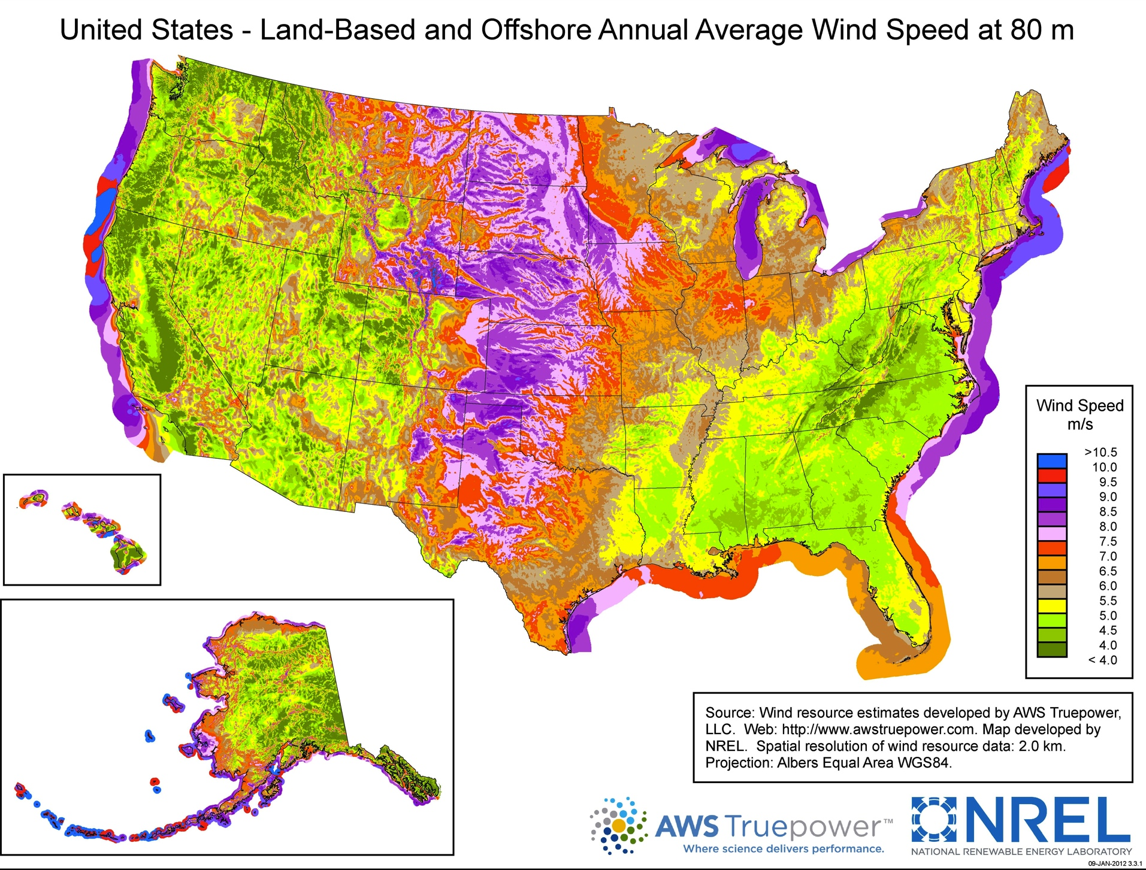
Notes:
-annual average! Smooths out any temporal variation!
-however, as stated before, wind (and solar) power is a variable renewable energy source- need to understand when, where, how often variability occurs (characterize, quantify major sources of variability, e.g. sea breeze occurring during peak energy demand season)

Slide 17
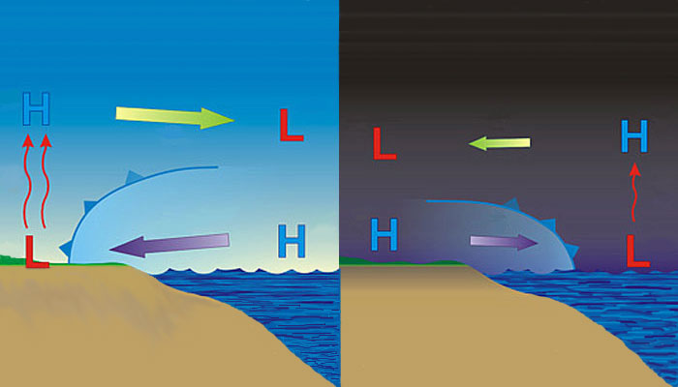
Sea breeze
Well known
Notes:
-day: warmer over land, cooler over water→ seabreeze
-night: cooler over land, relatively warmer over water→ landbreeze
-little known about offshore component of sea/land breeze due to dearth of observations/monitoring
-coastal upwelling changes dynamics

Slide 18
Sea breeze
Cold upwelling
Little known
(fewer obs)
Notes:
-day: warmer over land, cooler over water→ seabreeze
-night: cooler over land, relatively warmer over water→ landbreeze
-little known about offshore component of sea/land breeze due to dearth of observations/monitoring
-coastal upwelling changes dynamics

Slide 19
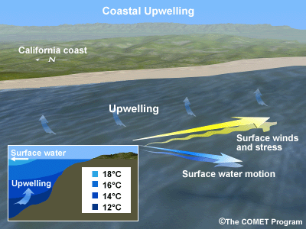
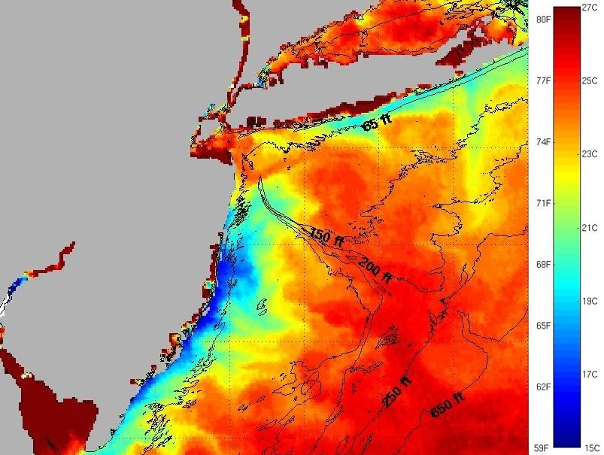
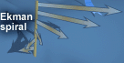
Coastal Upwelling
Schematic
Sea surface temperatures

Slide 20
Sea breeze
?
?
Cold upwelling
Little known
(fewer obs)
→ Models can be used to investigate little known offshore component
Notes:
-day: warmer over land, cooler over water→ seabreeze
-night: cooler over land, relatively warmer over water→ landbreeze
-little known about offshore component of sea/land breeze due to dearth of observations/monitoring
-coastal upwelling changes dynamics

Slide 21
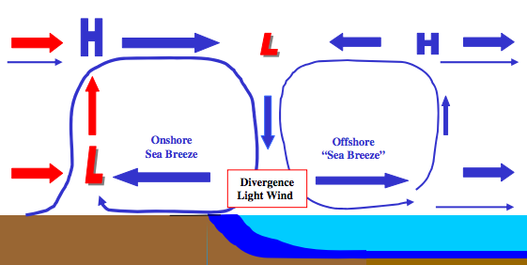
Sea breeze w/ offshore component:
a hypothesis
Cold upwelling

Slide 22
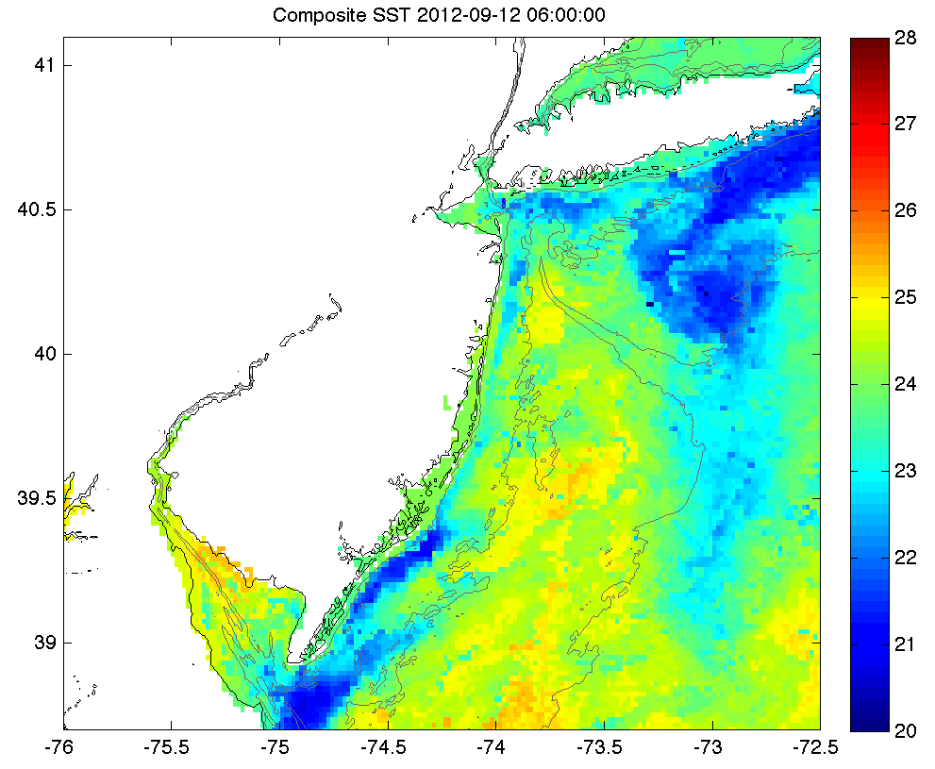
Case Study: Sept. 12, 2012: Upwelling
Sept. 4-8: persistent southerly winds→
NJ coastal upwelling
N
°C
W

Slide 23
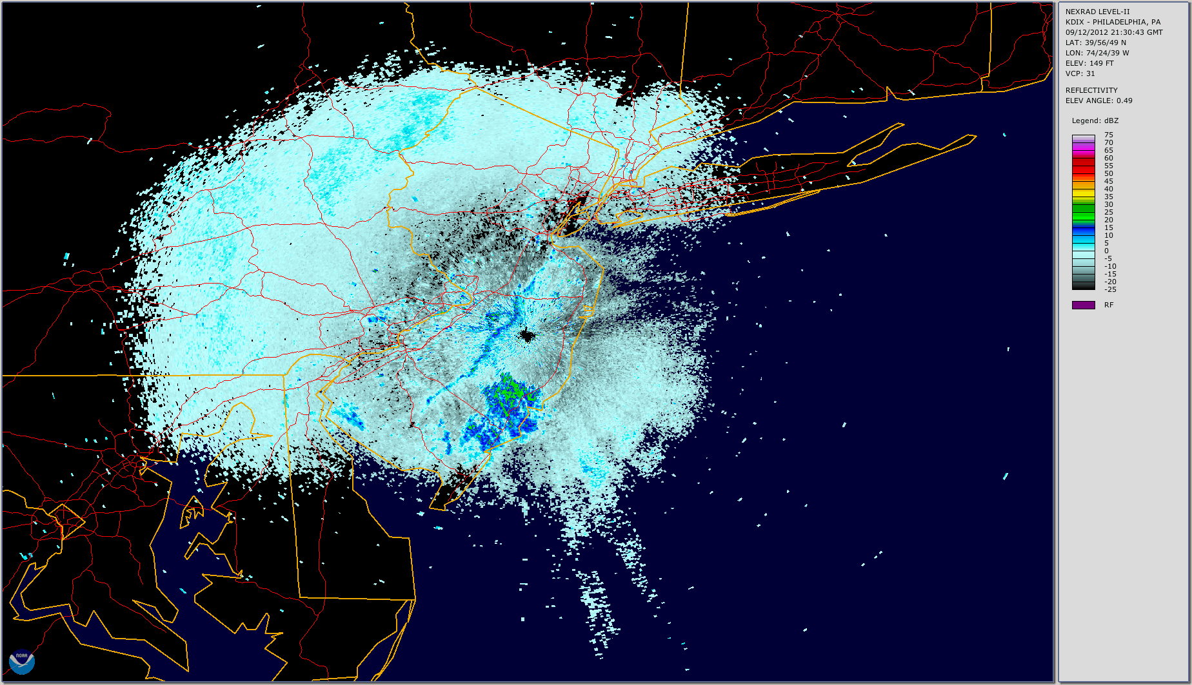
Case Study: Sept. 12, 2012: Sea breeze
dBZ

Slide 24
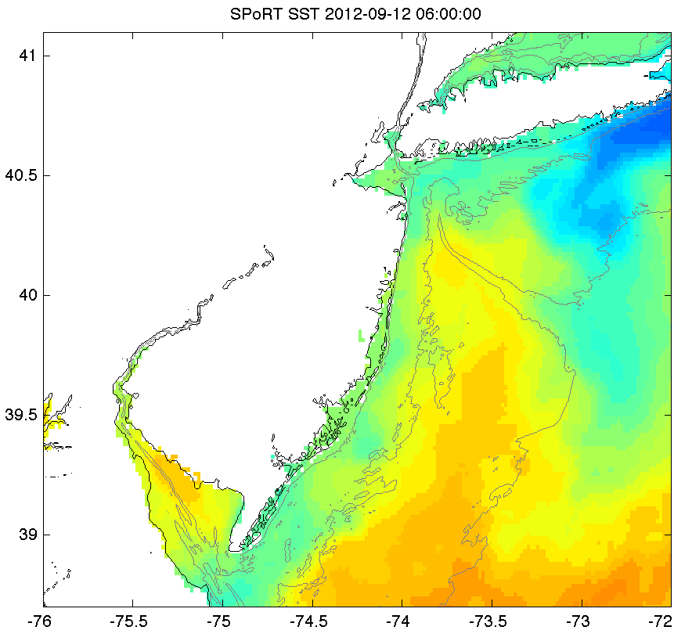
Sea Surface Temperature (SST)
Control SST
New SST
N
°C
N
W
W

Slide 25
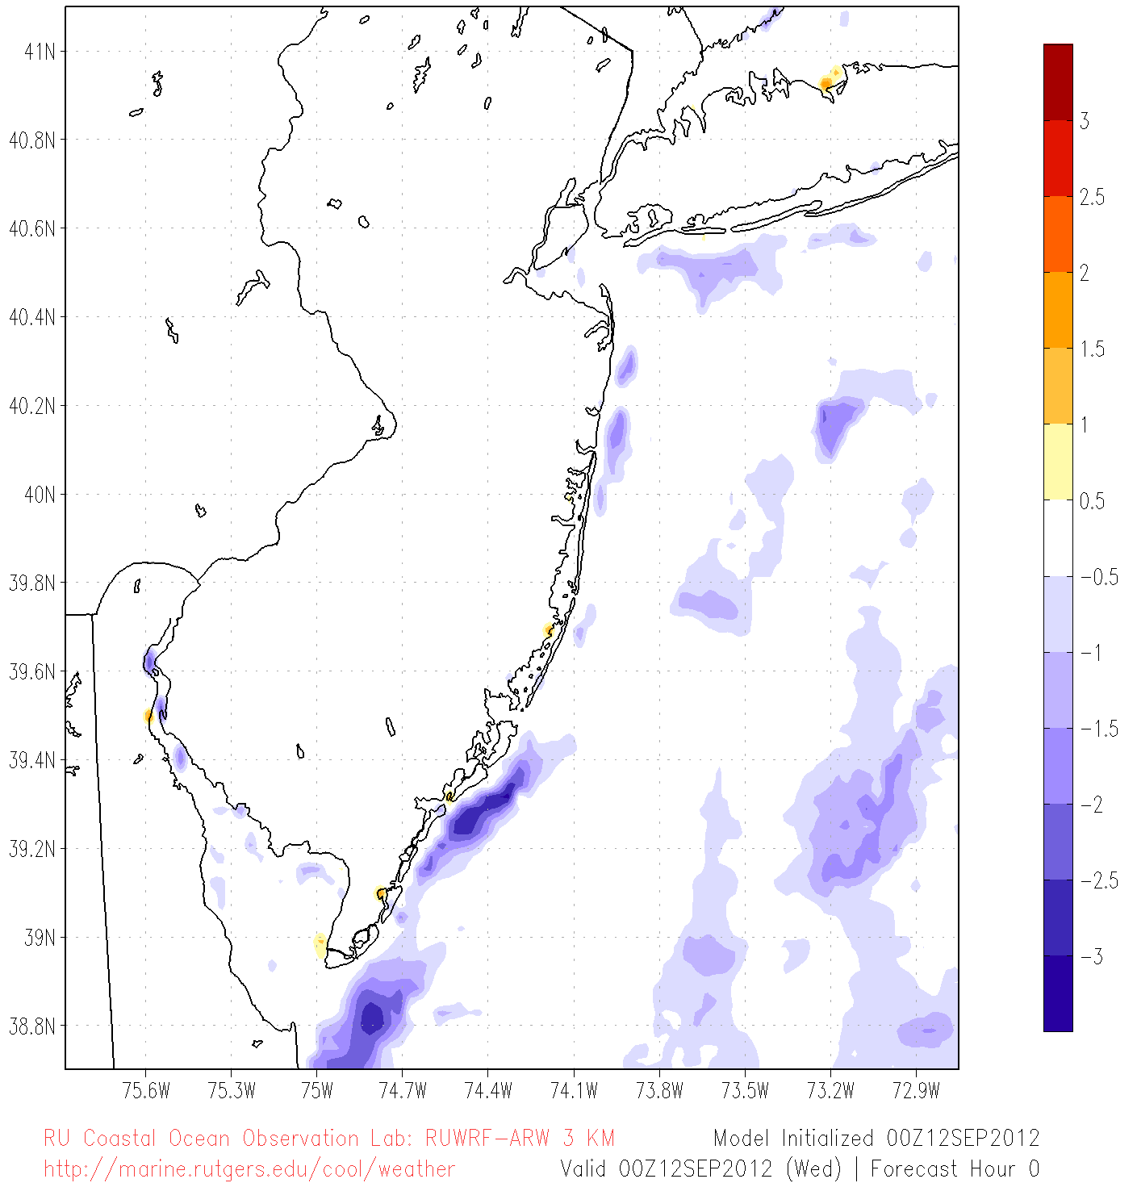
SST Difference:
New SST– Control SST
N
°C
W

Slide 26
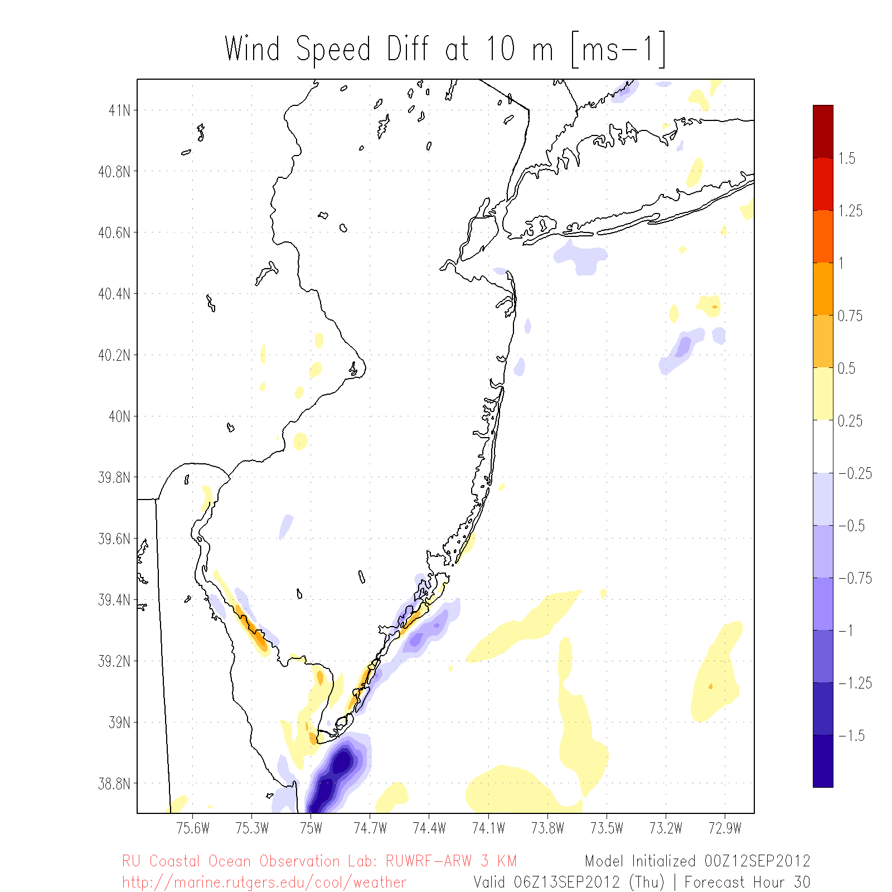
Wind Speed Difference:
New SST– Control SST
N
m/s
Cross section
X
W

Slide 27
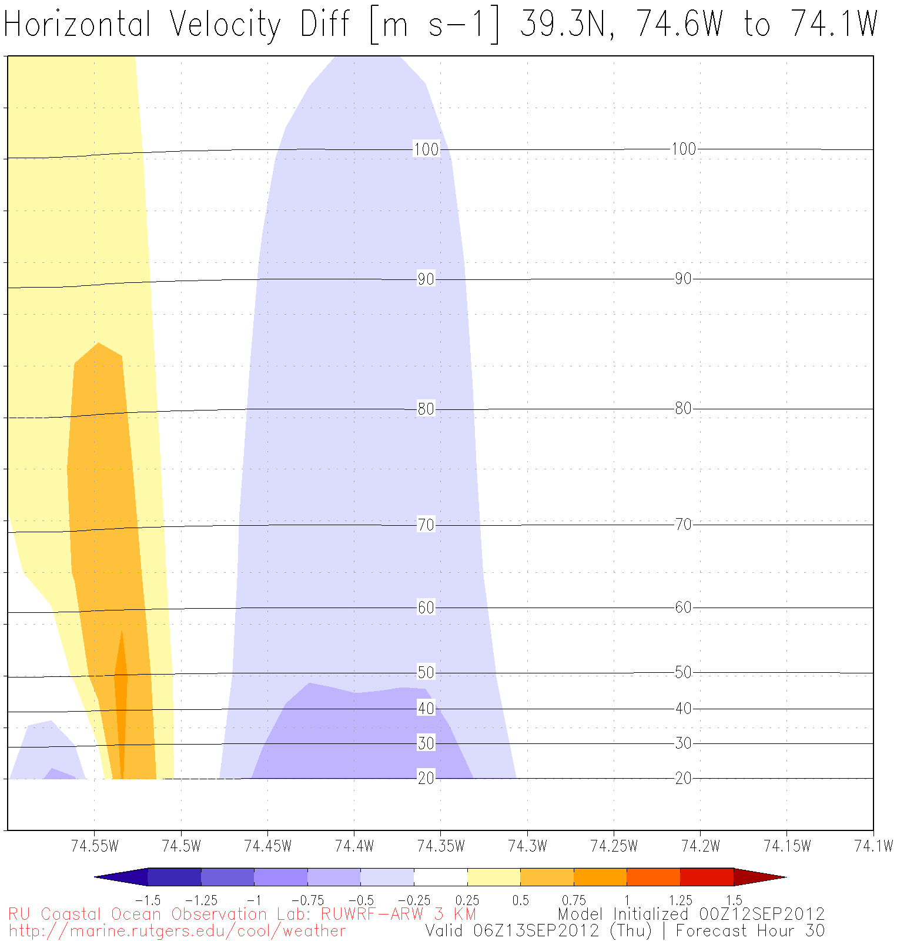

110+ m
Z
(altitude)
40 m
X

Slide 28
Sea breeze
?
?
Cold upwelling
Little known
(fewer obs)
→ Models can be used to investigate little known offshore component
Notes:
-day: warmer over land, cooler over water→ seabreeze
-night: cooler over land, relatively warmer over water→ landbreeze
-little known about offshore component of sea/land breeze due to dearth of observations/monitoring
-coastal upwelling changes dynamics

