Slide 1
RU Earth Science 2U: Ocean Data and NGSS Science Practices in Your Classroom
Greg Seroka
Kristin Hunter-Thomson
Carrie Ferraro
New Jersey Science Convention
October 14, 2014

Slide 2
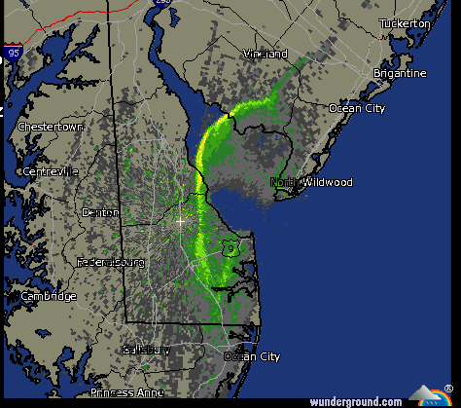
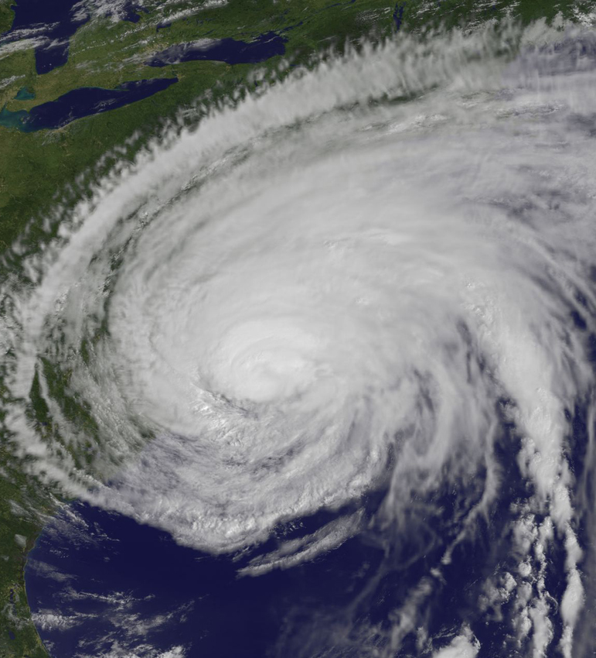
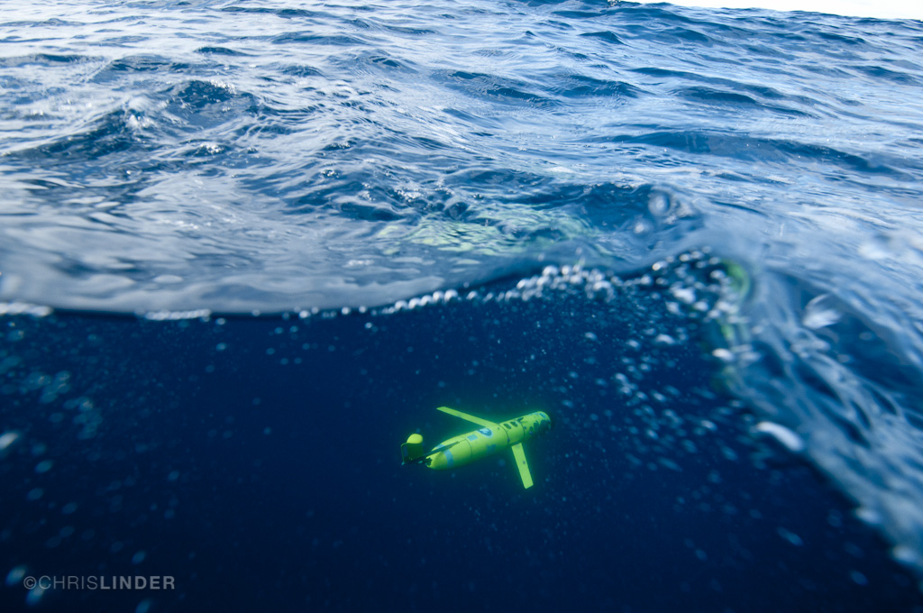
From the sea breeze to hurricanes: how the ocean affects the weather
Greg Seroka

Slide 3
Part I
Overview: The ocean impacts the weather

Slide 4
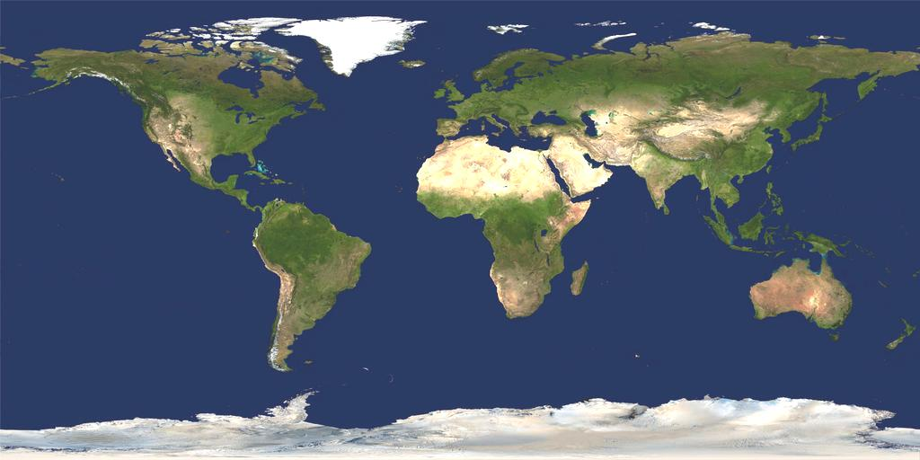
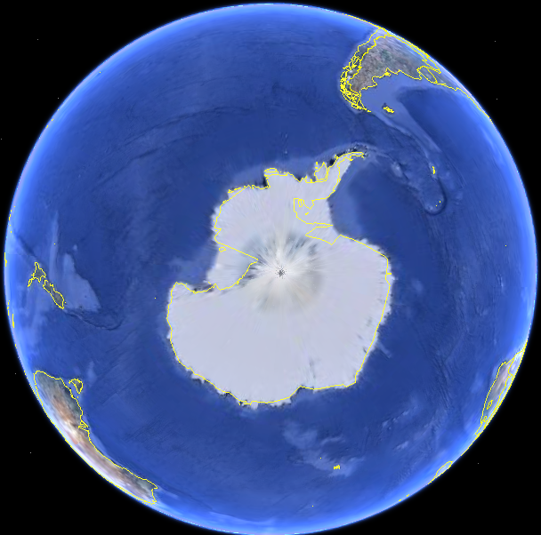
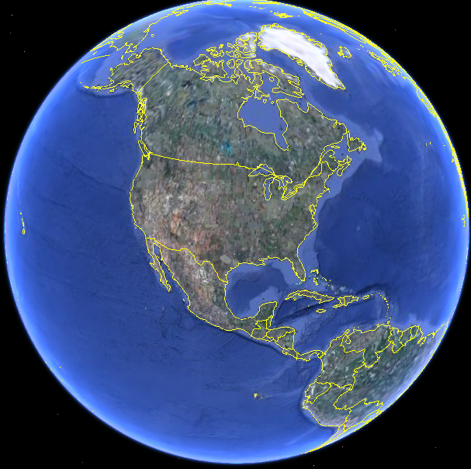
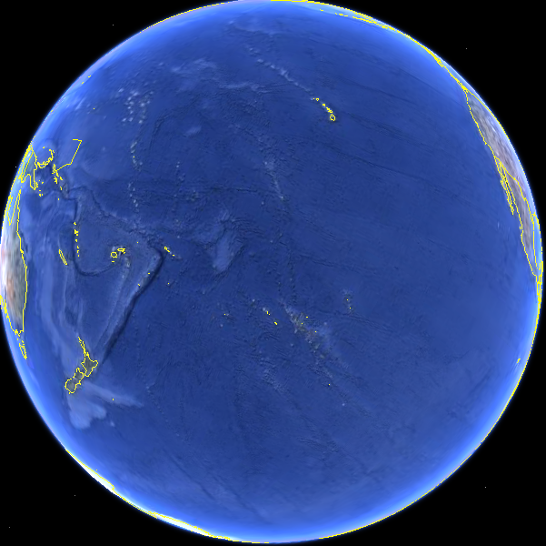
How Many Oceans Are There?
Our Global Ocean…
Covers 71% of the Earth's surface.
Contains 97% of the Earth's water.
Supports a great diversity of life.
Is a major influence on weather and climate, making earth habitable.

Slide 5
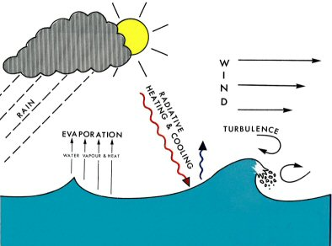
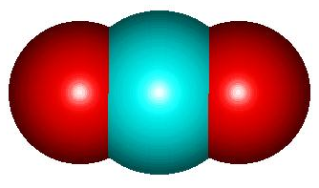
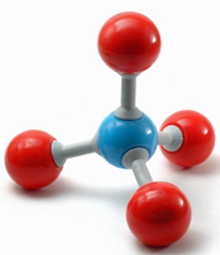
Air-Sea Interaction
Gases (CO2, methane, etc.)
Source: National Oceanography Centre (UK)

Slide 6
Why are these important?
Transfer energy, water, and gases between ocean and atmosphere
Transfers shape weather and climate
  Hurricanes
  Storms
  Ocean currents
  Climate change
Gases (CO2, methane, etc.)
Source: National Oceanography Centre (UK)

Slide 7
Air-sea fluxes
What’s exchanged
Diagram
Why it’s important
Storms & hurricanes, ocean circulation, general weather
Heat
Storms & hurricanes, clouds
Fresh water
Gases (CO2,
methane, etc)
Ocean acidification, climate change, photosynthesis
Currents and waves, storms, hurricanes
Momentum
Sea spray
Clouds, hurricanes
Source: National Oceanography Centre (UK)

Slide 8









Air-sea weather processes
Rainfall
Nor’easters
Lake Effect Snow
L
Sea Breeze
Hurricanes
El Nino
Waterspouts
H
Thunderstorms
& Lightning
High Pressure Systems
Sea Spray

Slide 9
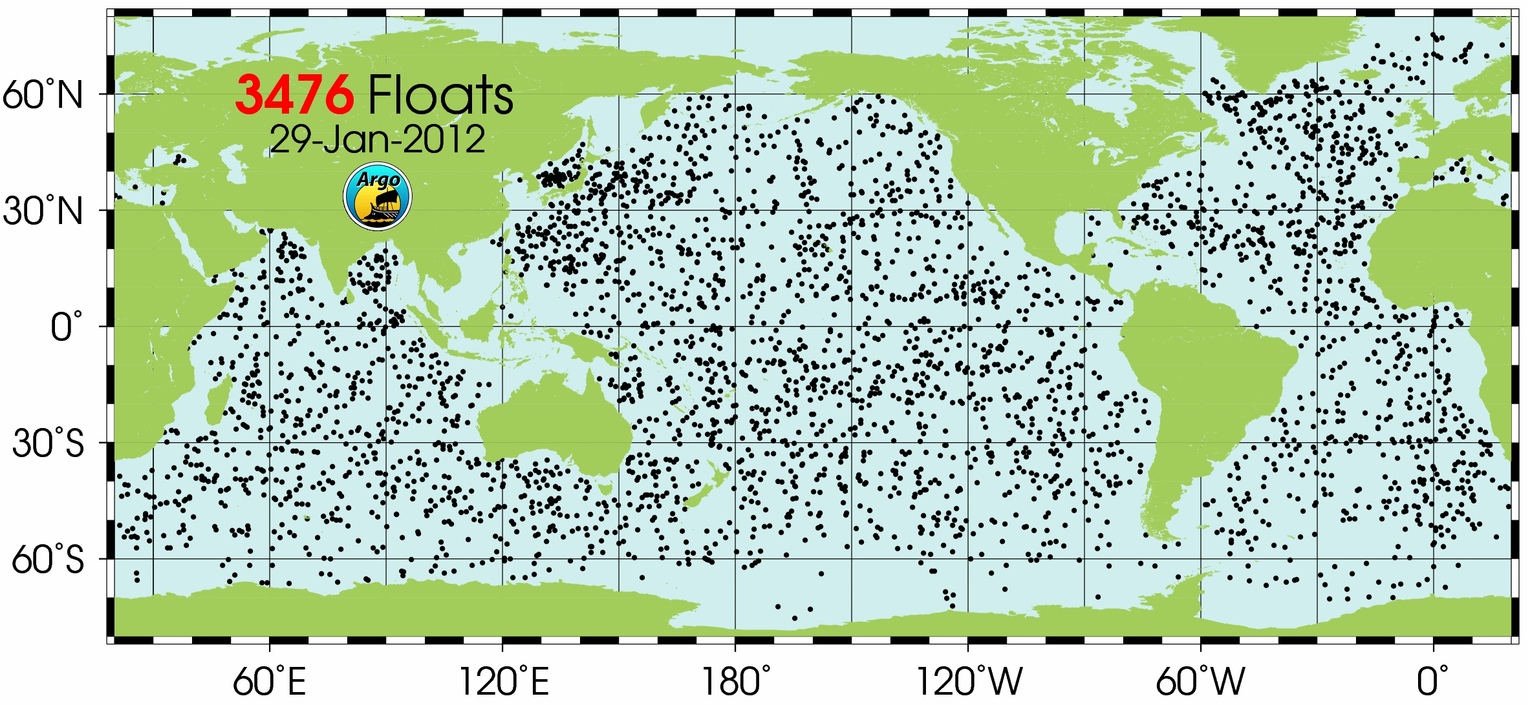
Surface observations
over ocean are plentiful
scarce!

Slide 10
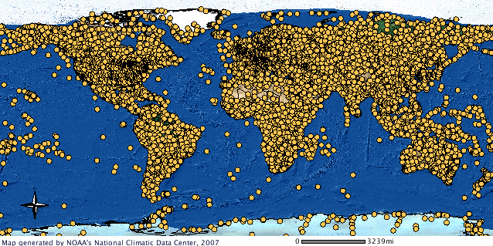
Surface observations
over ocean are plentiful
scarce!

Slide 11

Need models to fill in gaps
Bridge gap between observations
Experiments
“What-if” scenarios
Sensitivities
Predictions
Notes:
Bridge gap between obs. (scattered in space & time) and real world
Experiments without harming system
Atmosphere, ocean too large to perform “lab” experiments
“What-if” scenarios
Sensitivities (control vs.
independent variable)
Predictions

Slide 12
If we were going to develop a model to investigate air-sea weather processes, what variables would we need to include?
SEP 2: Developing and Using Models - In science, models are used to represent a system (or parts of a system) under study, to aid in the development of questions and explanations, to generate data that can be used to make predictions, and to communicate ideas to others.
Notes:
Have the teachers think to themselves and jot down some notes about what variables to include when modeling air-sea weather processes to better understand weather patterns and the oceans influence on weather. After a few minutes have the teachers share out some of the variables they thought of. Write them on the chalk board as the teachers are sharing.
Variables: -wind speed, SST, air temperature, humidity, wave heights, air density, for air-sea fluxes
-air, water density; u,v, w velocities (wind, current speed and direction); temperature (ocean, atmosphere); time; x,y,z distance; gravity (x,y,z); viscosity (x,y,z for friction)

Slide 13
Air-sea weather processes
Rainfall
Nor’easters
Lake Effect Snow
L
Sea Breeze
Hurricanes
El Nino
Waterspouts
H
Thunderstorms
& Lightning
High Pressure Systems
Sea Spray

Slide 14
Part II
Example 1: The Sea Breeze

Slide 15
Air-sea weather processes
Rainfall
Nor’easters
Lake Effect Snow
L
Sea Breeze
Hurricanes
El Nino
Waterspouts
H
Thunderstorms
& Lightning
High Pressure Systems
Sea Spray

Slide 16
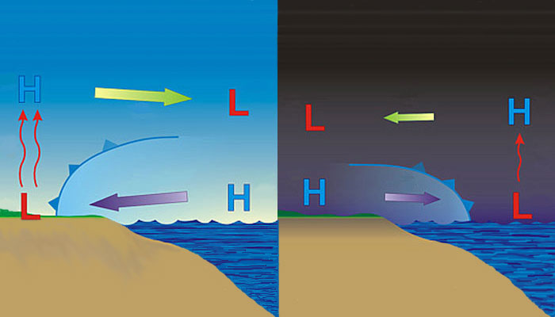
Sea breeze
Well known
Notes:
-day: warmer over land, cooler over water→ seabreeze
-night: cooler over land, relatively warmer over water→ landbreeze
-little known about offshore component of sea/land breeze due to dearth of observations/monitoring
-coastal upwelling changes dynamics

Slide 17
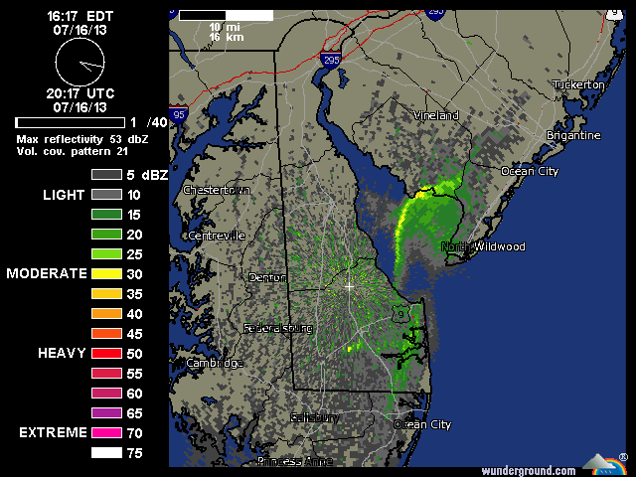
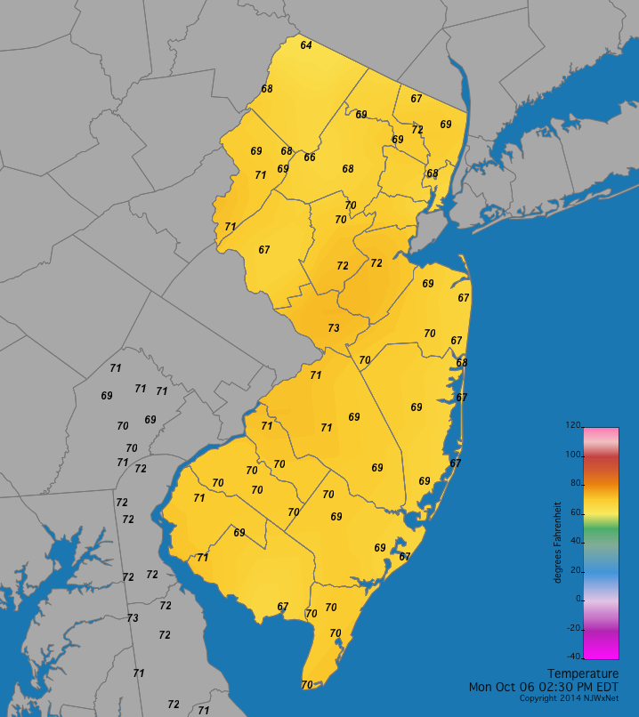
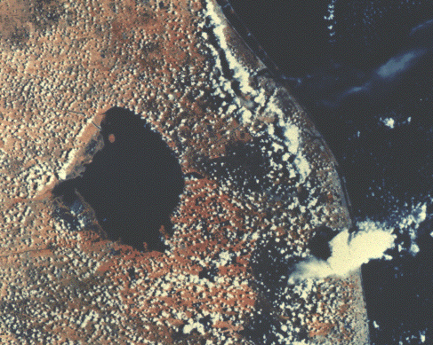
Weather radar
Land
observations
Satellites

Slide 18
Sea breeze
Cold upwelling
Little known
(fewer obs)
Notes:
-day: warmer over land, cooler over water→ seabreeze
-night: cooler over land, relatively warmer over water→ landbreeze
-little known about offshore component of sea/land breeze due to dearth of observations/monitoring
-coastal upwelling changes dynamics

Slide 19
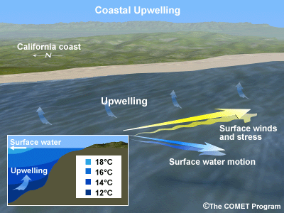
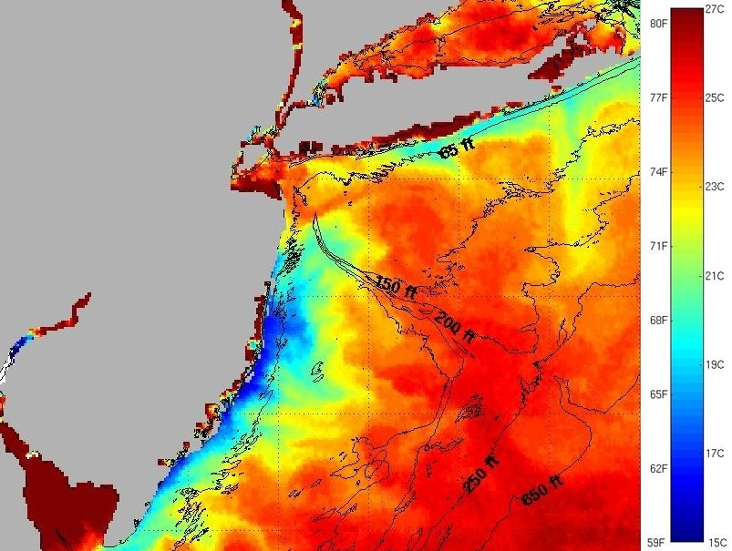
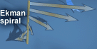
Coastal Upwelling
Schematic
Sea surface temperatures

Slide 20
Sea breeze
?
?
Cold upwelling
Little known
(fewer obs)
→ Models can be used to investigate little known offshore component
Notes:
-day: warmer over land, cooler over water→ seabreeze
-night: cooler over land, relatively warmer over water→ landbreeze
-little known about offshore component of sea/land breeze due to dearth of observations/monitoring
-coastal upwelling changes dynamics

Slide 21
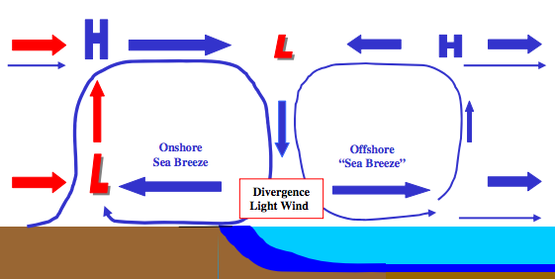
Sea breeze w/ offshore component:
a hypothesis
Cold upwelling
→ Models can be used to investigate scientific hypotheses

Slide 22

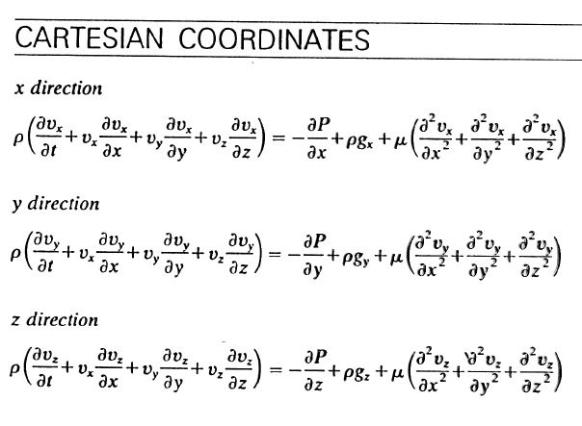
Model Setup
Weather Research and Forecasting (WRF) model, Advanced Research core (ARW) (Michalakes et al., 2001)
Sea Surface Temperature (SST): Independent Variable
Physics + math
Physics + math
Notes:
-NWP is cost-effective way to achieve accurate wind resource assessments and representative wind forecasts→ cost reductions
-minimize “risks” by determining variability in offshore wind resource
-mesoscale and local influences of sea breeze- one of primary microclimate circulations that affect offshore environment, during peak energy demand periods with ACs running on hot summer afternoons

Slide 23
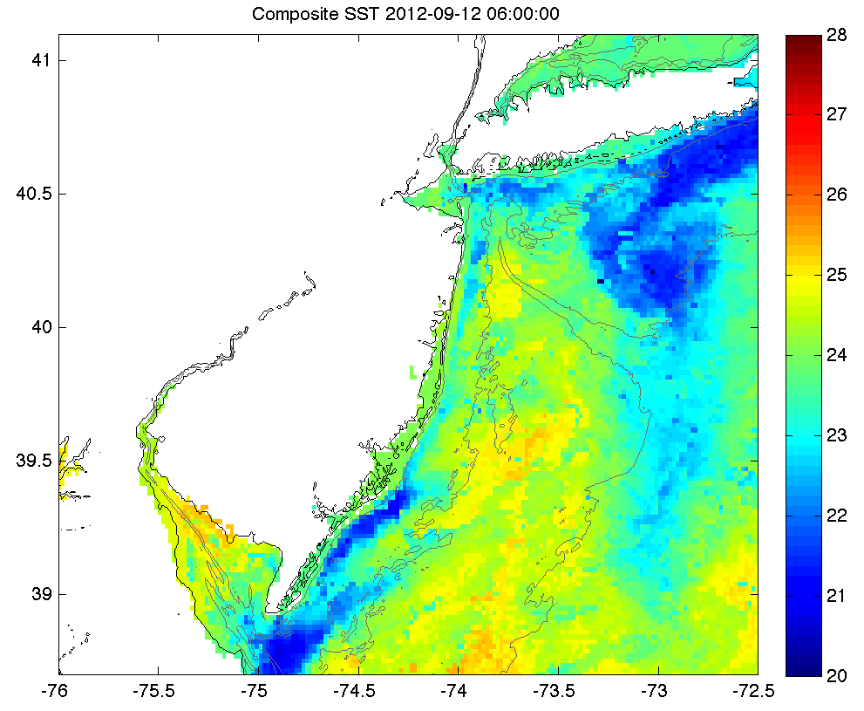
Case Study: Sept. 12, 2012: Upwelling
Sept. 4-8: persistent southerly winds→
NJ coastal upwelling
N
°C
W

Slide 24
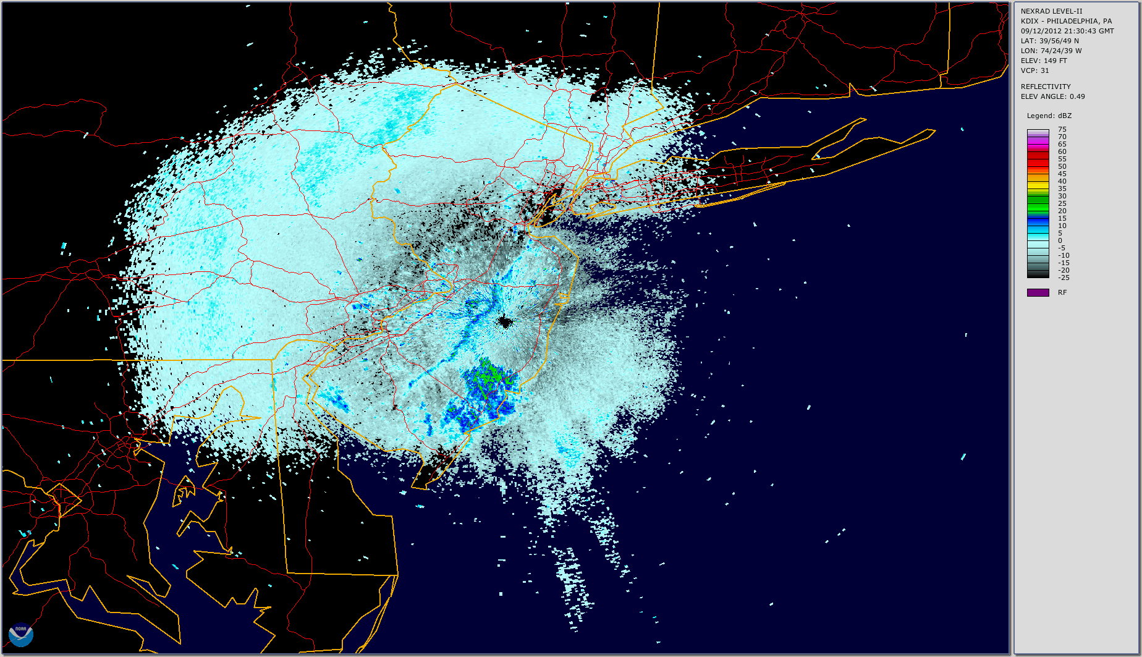
Case Study: Sept. 12, 2012: Sea breeze
dBZ

Slide 25
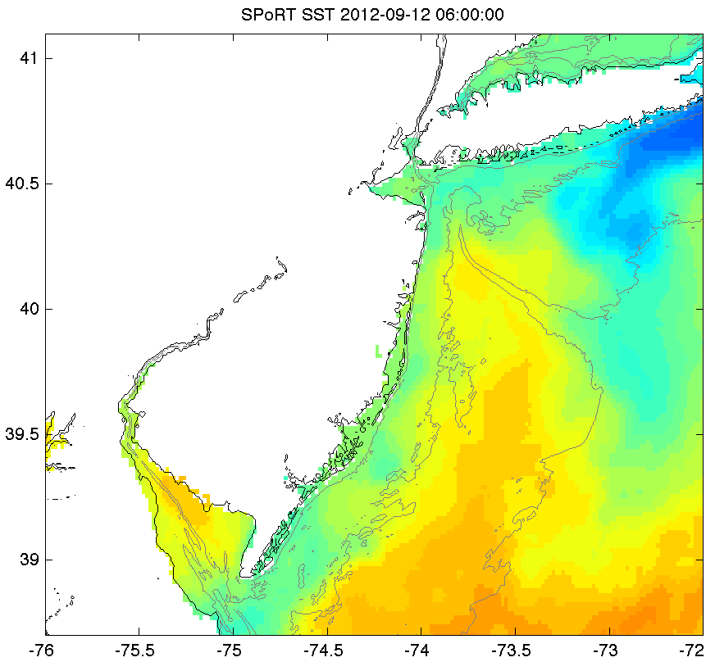
Sea Surface Temperature (SST)
Control SST
New SST
N
°C
N
W
W

Slide 26
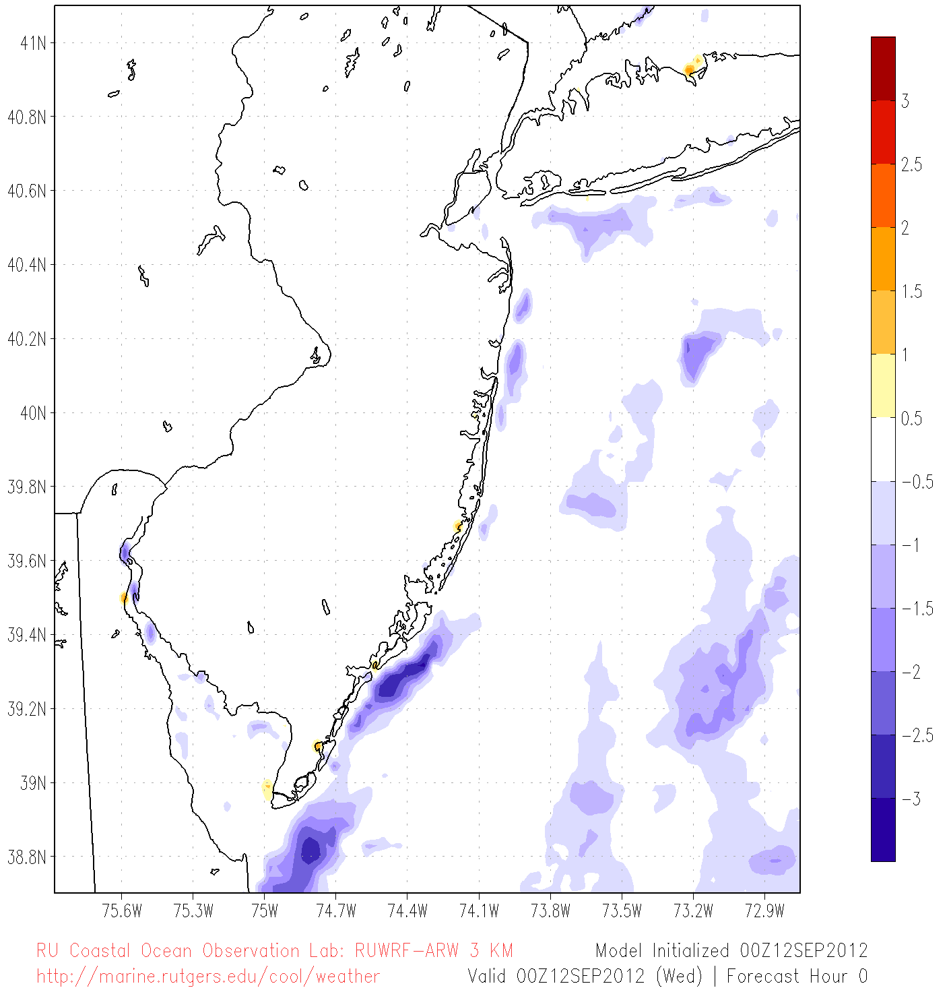
SST Difference:
New SST– Control SST
N
°C
W

Slide 27
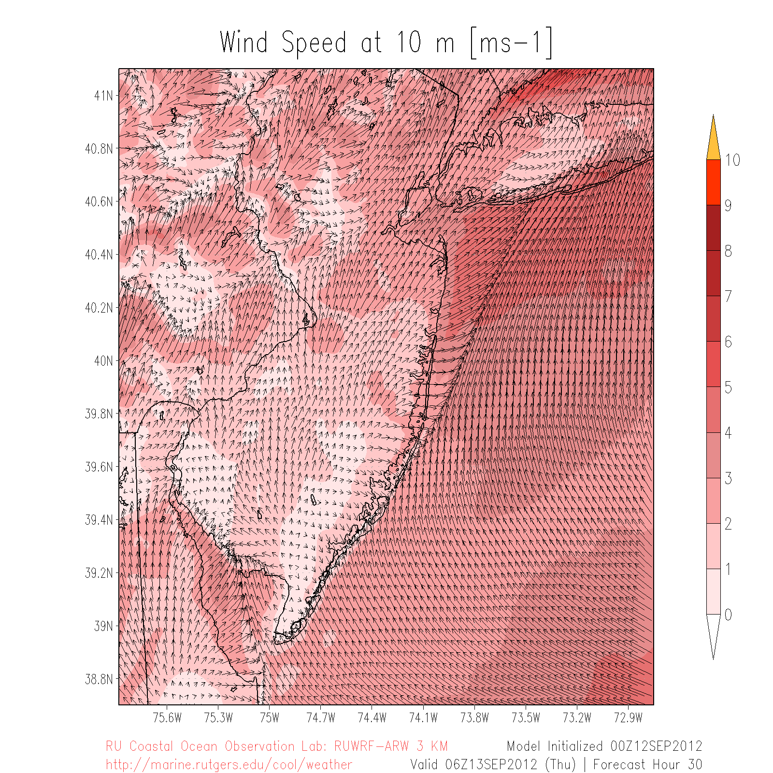
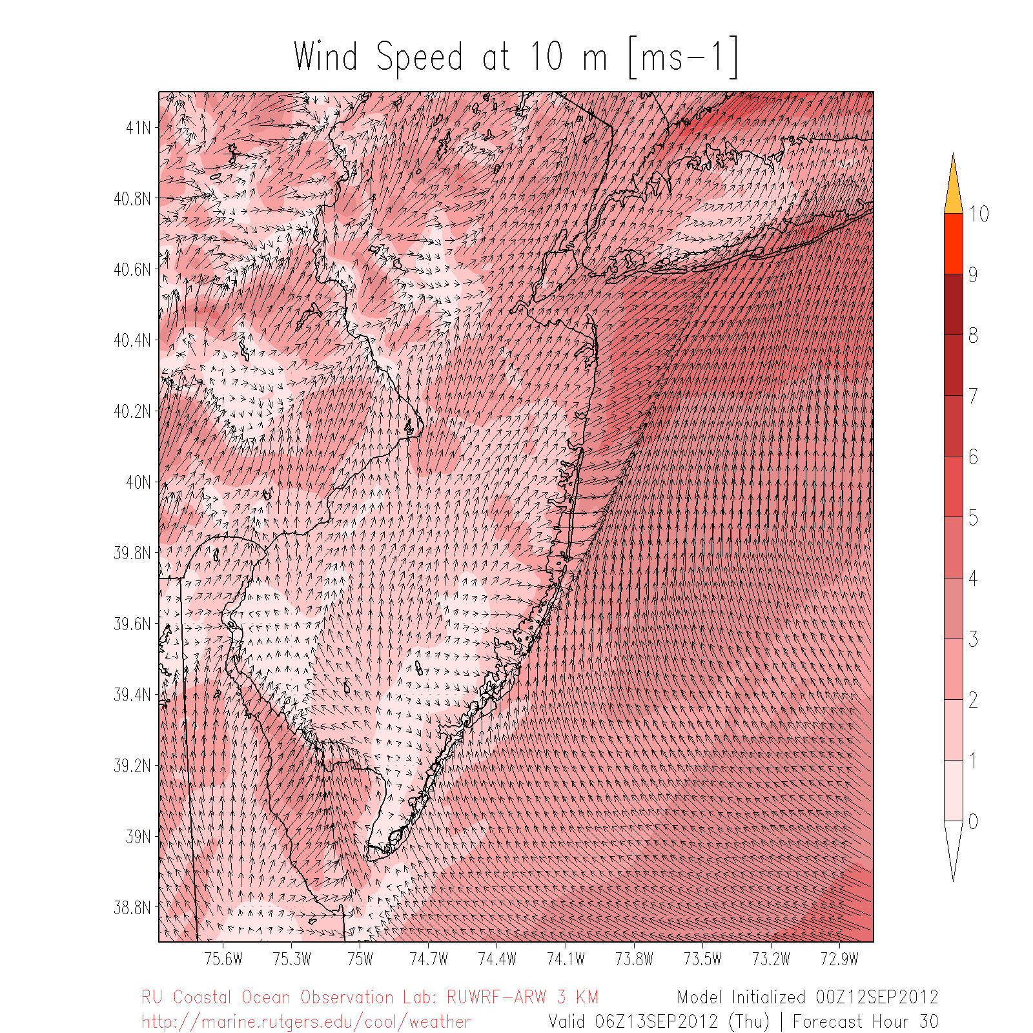
Wind Speeds at 10 m
Control SST
New SST
N
N
m/s
m/s
W
W

Slide 28
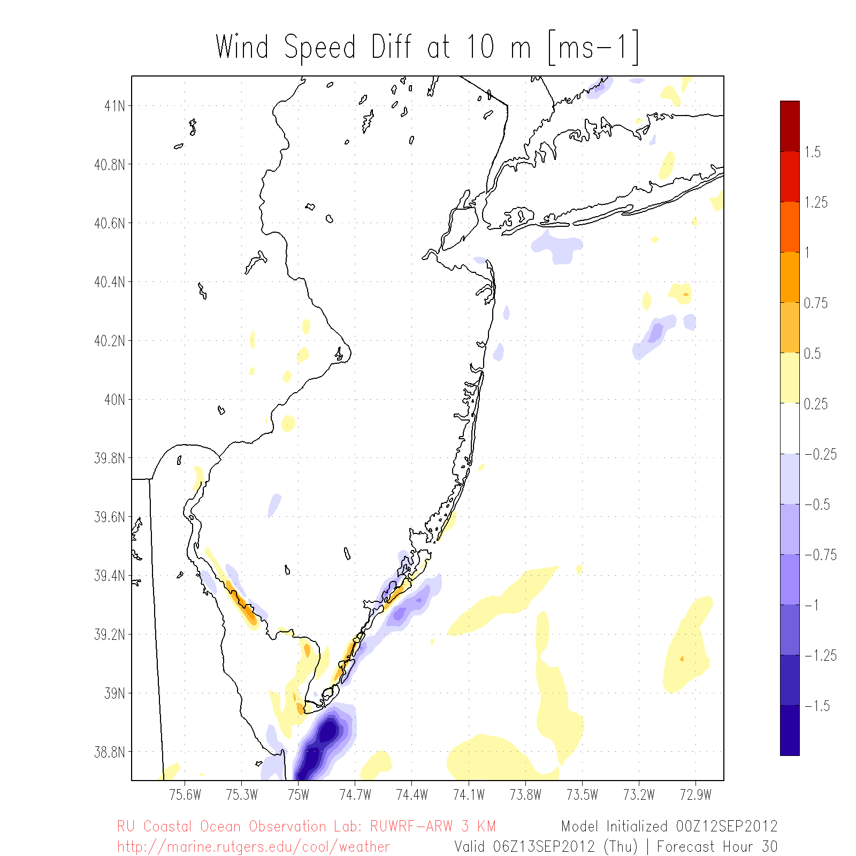
Wind Speed Difference:
New SST– Control SST
N
m/s
Cross section
X
W

Slide 29
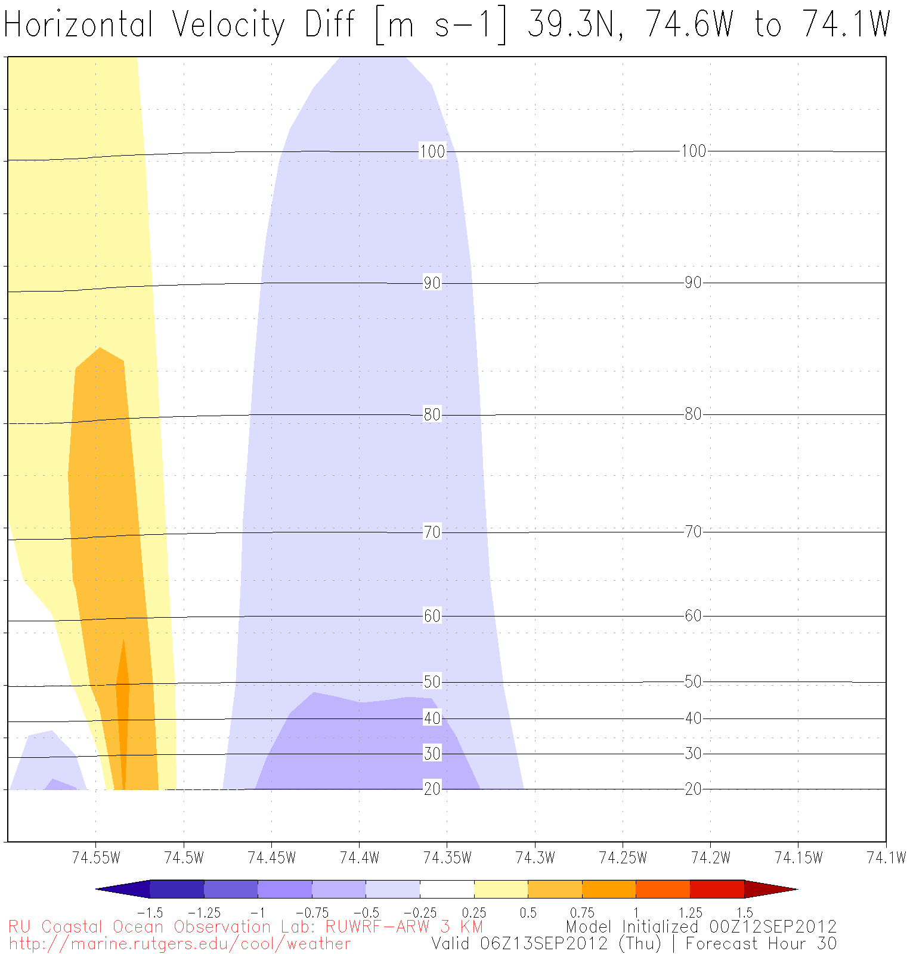

110+ m
Z
40 m
X

Slide 30
Sea breeze
?
?
Cold upwelling
Little known
(fewer obs)
→ Models can be used to investigate little known offshore component
Notes:
-day: warmer over land, cooler over water→ seabreeze
-night: cooler over land, relatively warmer over water→ landbreeze
-little known about offshore component of sea/land breeze due to dearth of observations/monitoring
-coastal upwelling changes dynamics

Slide 31
Use the maps to identify spatial relationships of the difference in wind speed south of Cape May, New Jersey in mid-September 2012.
SEP 4: Analyzing and Interpreting Data - Students are expected to interpret data by identifying significant features and patterns, use mathematics to represent relationships between variables, and take into account sources of error. It is important students present data as evidence to support their conclusions.
Notes:
Pass out the XX maps to the group, making sure each small group gets a different map. Have the teachers work in small groups to analyze their data. After a few minutes have one group present to the others what they found and then have more groups build on that to develop a working relationship of the temporal and spatial pattern off of Cape May. Make sure they site the evidence.

Slide 32
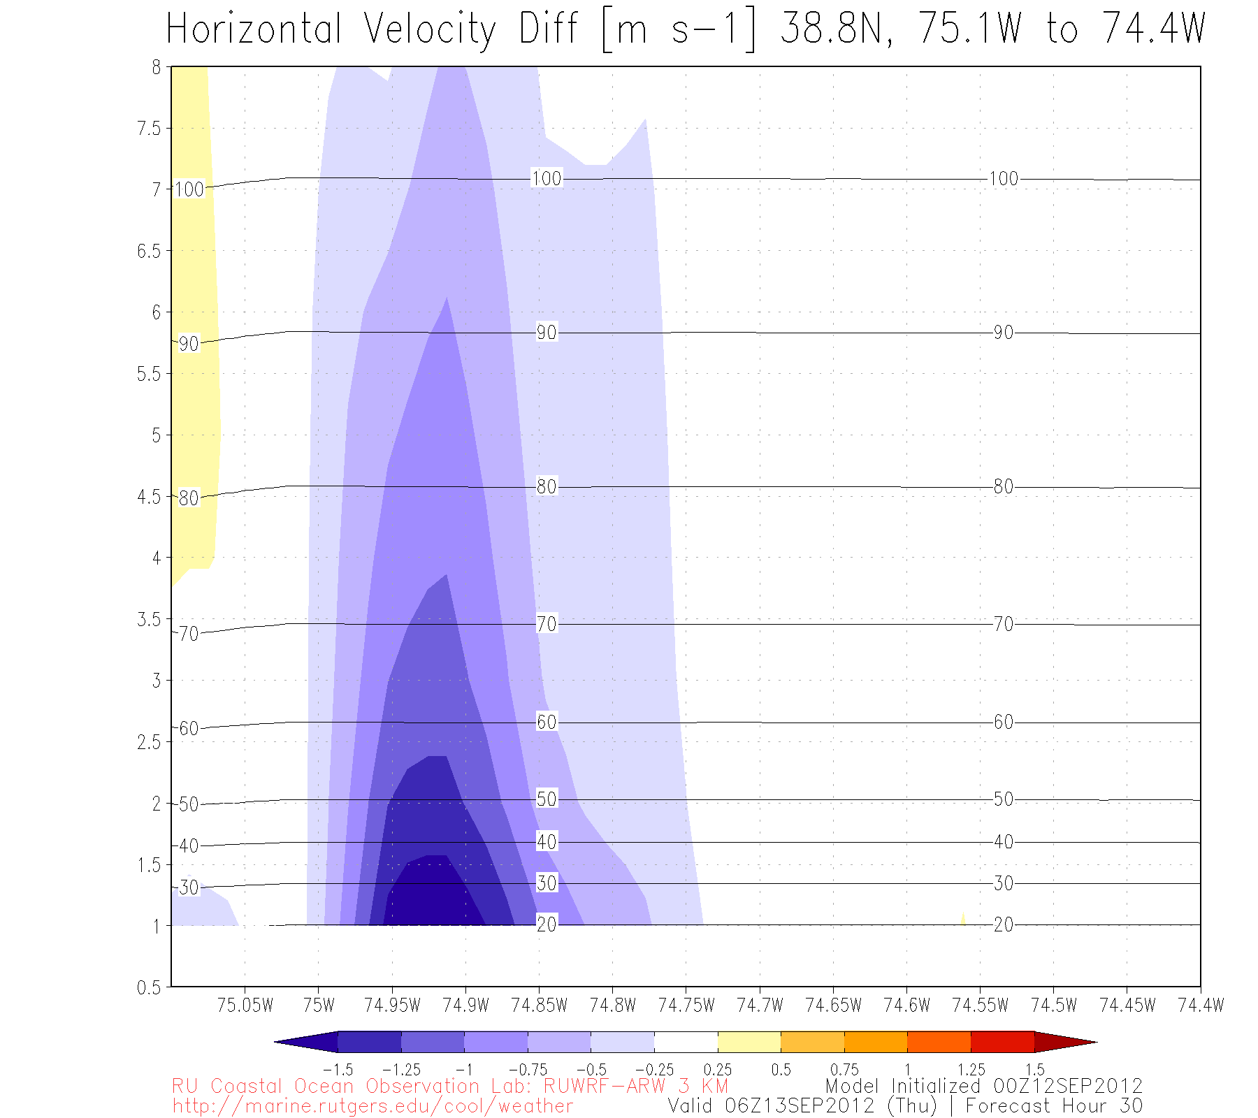

Slide 33
Part III
Example 2: Hurricanes

Slide 34
Air-sea weather processes
Rainfall
Nor’easters
Lake Effect Snow
L
Sea Breeze
Hurricanes
El Nino
Waterspouts
H
Thunderstorms
& Lightning
High Pressure Systems
Sea Spray

Slide 35
Motivation
In August 2011, Hurricane Irene’s intensity was over-predicted by several hurricane models and over-forecast by the National Hurricane Center (NHC)
Notes:
Case study (Irene)

Slide 36



Governing factors of hurricane intensity
dry air intrusion
Question:
Did the upper ocean thermal structure and evolution contribute to Irene’s intensity over-prediction?
vertical wind shear
Hypothesis:
upper ocean thermal structure and evolution
Models handled well:
hurricane track
vertical wind shear
dry air intrusion
But not:
upper ocean thermal
structure and evolution
hurricane track
After Emanuel et al. (2004)

Slide 37
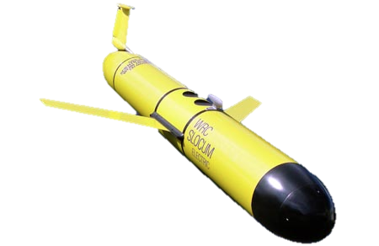
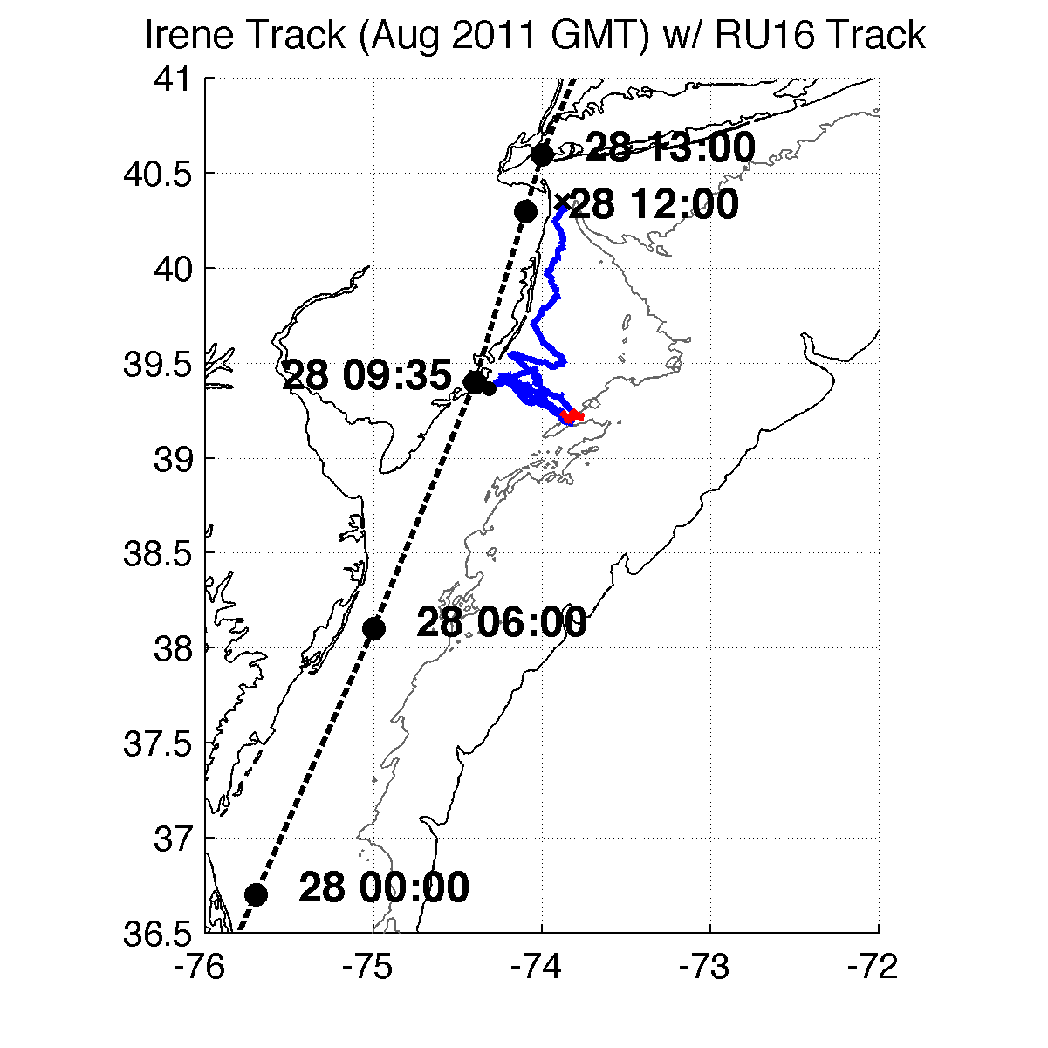
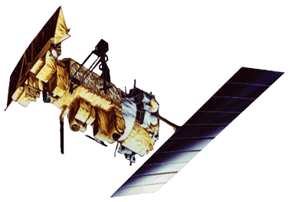

Methods – Observations and Model
RU16 Glider
Satellite (New sea surface temperature, SST)
Model: WRF
Full RU16 Glider Track
Irene RU16 Glider Track
40m isobath
200m isobath (shelf break)
Notes:
SST product is IR/near IR (AVHRR); SPoRT is IR/near IR as well
GFS 0.5 degree 08/27/11 06Z for boundary conditions
Modeling is semi-realistic/semi-idealized

Slide 38
Results
Glider data revealed surface cooling before passage of hurricane eye

Slide 39
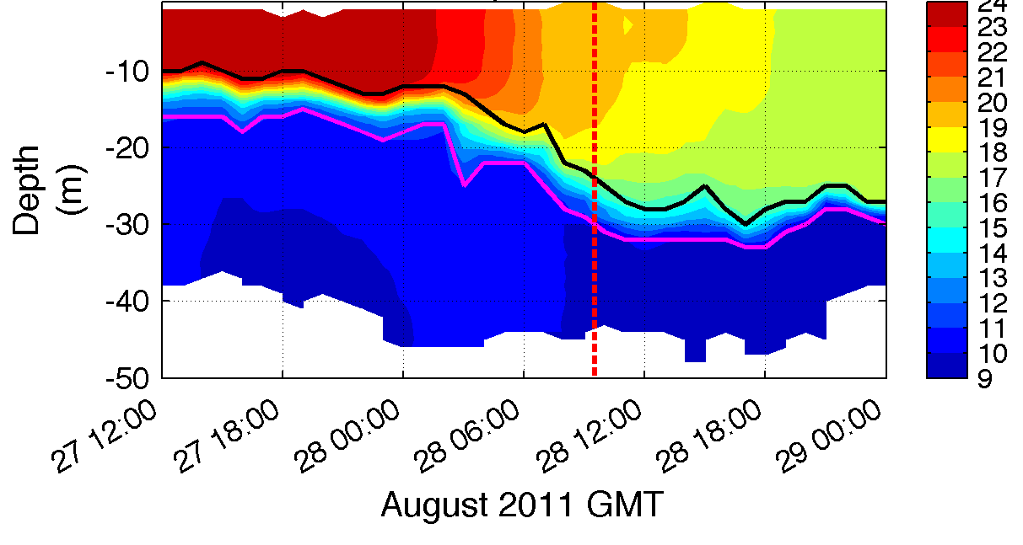
1. Glider revealed “ahead-of-eye” cooling
warm SSTs before storm
passage of eye
T (°C)
Notes:
**HF radar for surface currents onshore, glider depth-averaged currents near zero, infer offshore bottom currents
BUOYS CORROBORATED AHEAD OF EYE COOLING
Coastal downwelling circulation, which resulted in shear across thermocline, turbulence/entrainment, and finally surface cooling
Fire escape at bottom for less storm surge, fire extinguisher at top for weakening storm
Inertial response likely cooled remaining waters post-storm

Slide 40
Results
Glider data revealed surface cooling before passage of hurricane eye
Improved satellite SST product revealed that this surface ocean cooling was not captured by:
  Basic satellite products
  Ocean models used for forecasting hurricane intensity

Slide 41
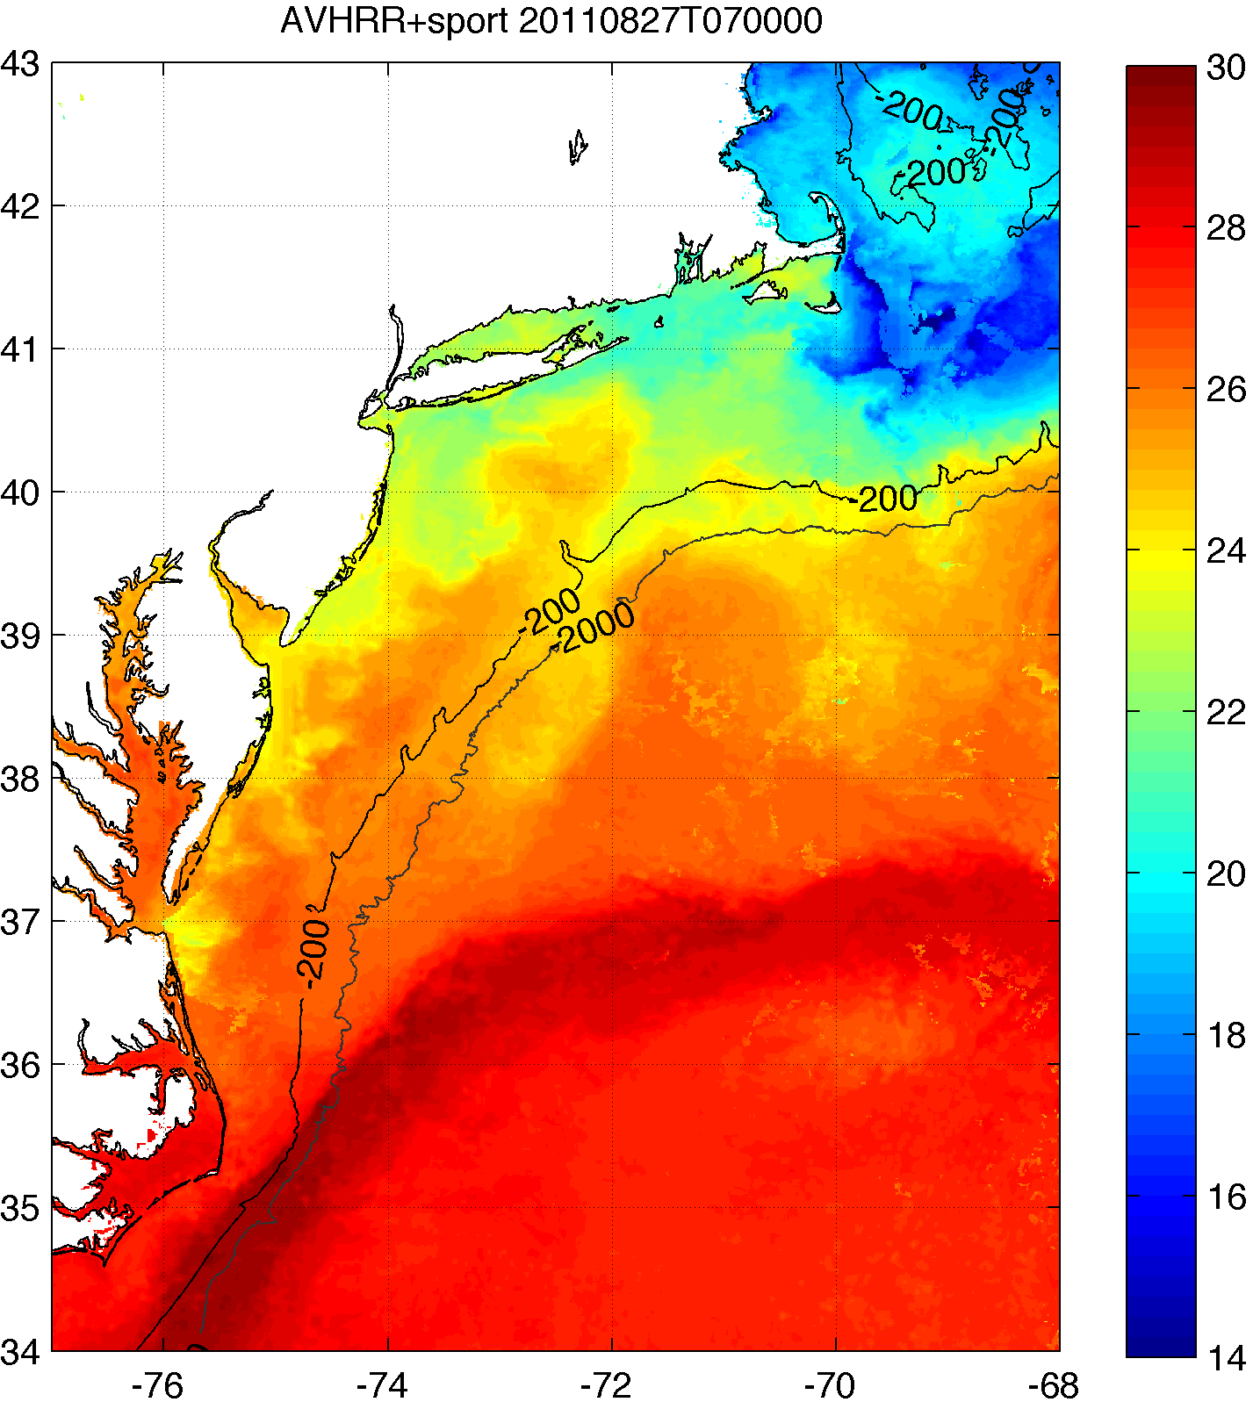
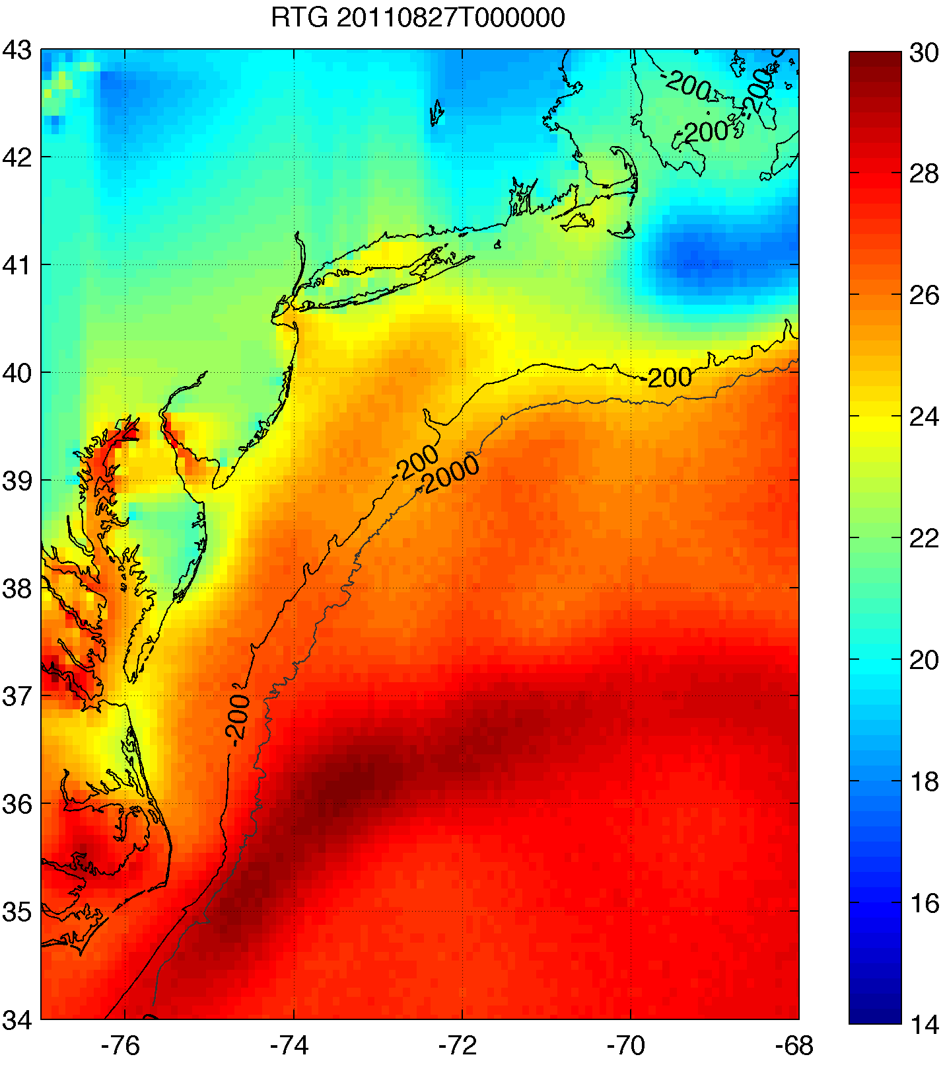
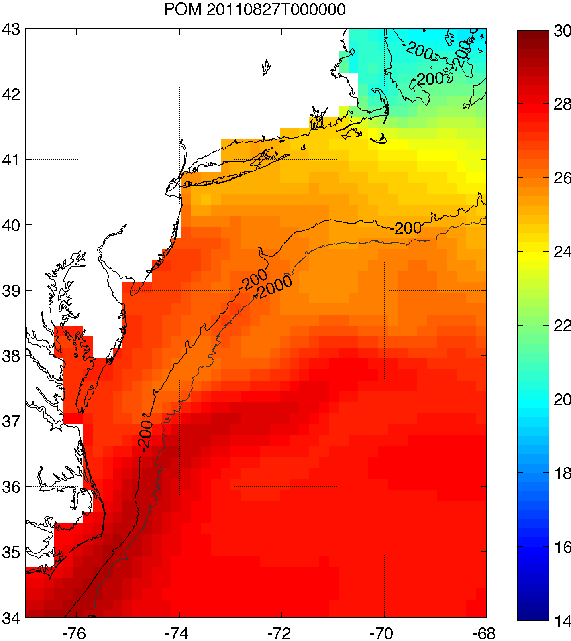
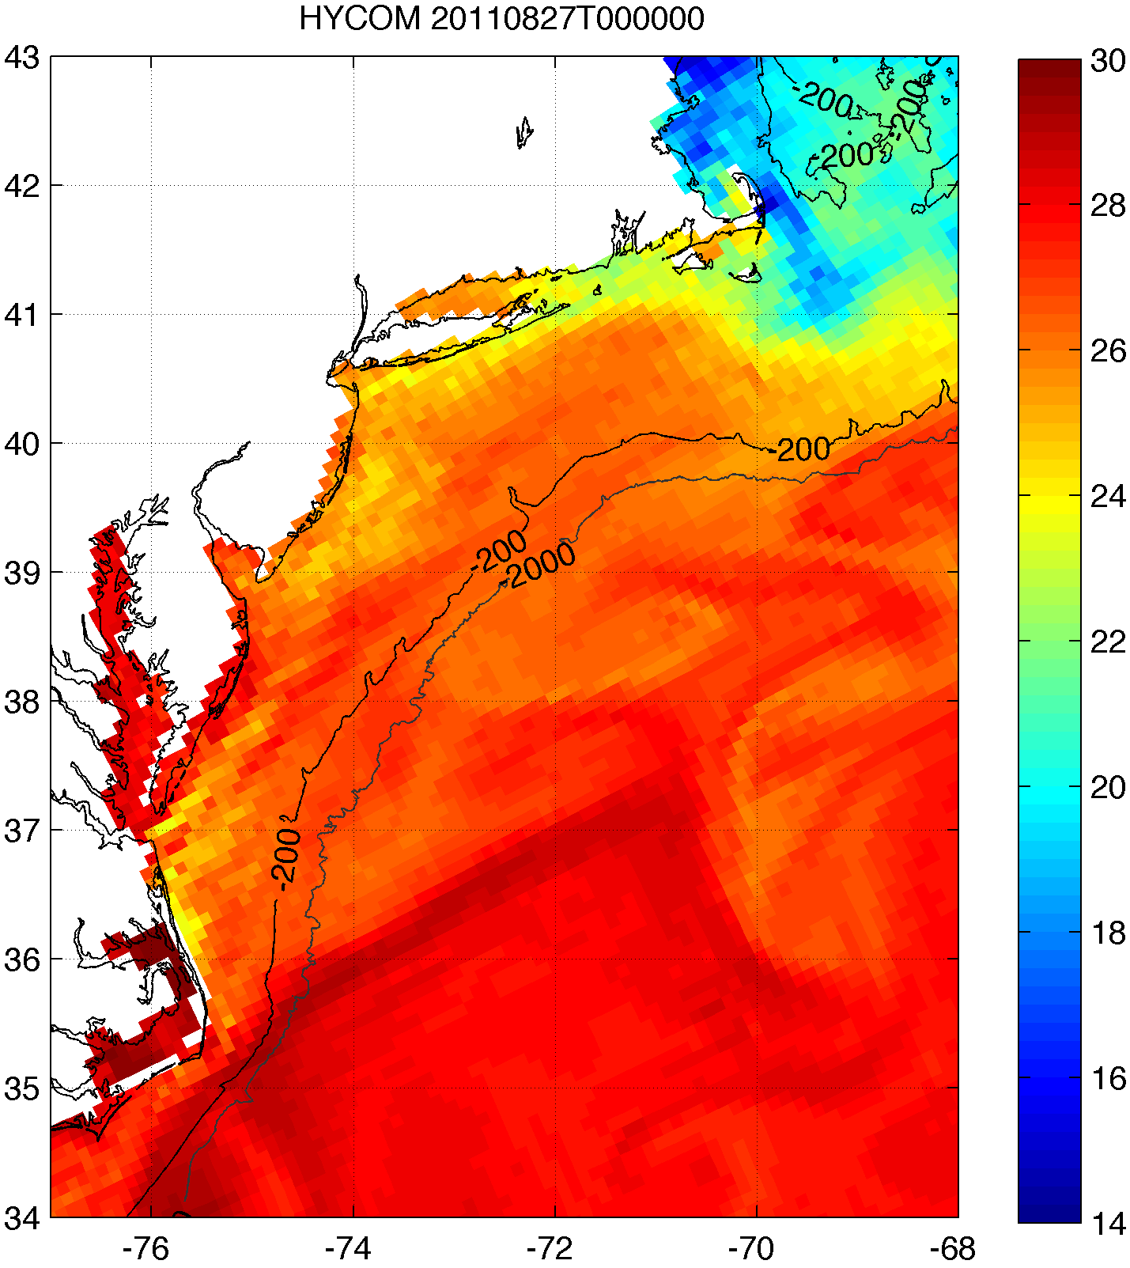
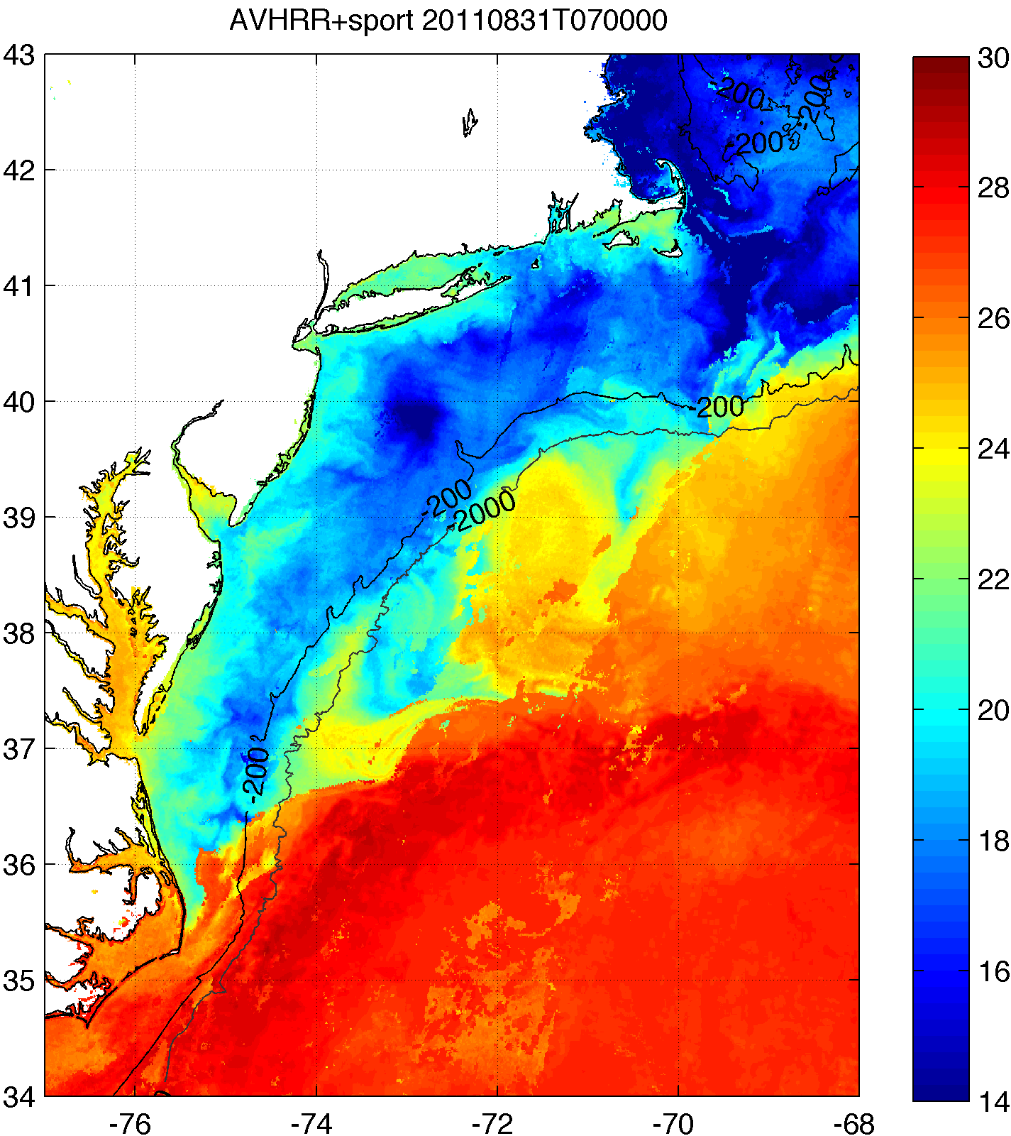
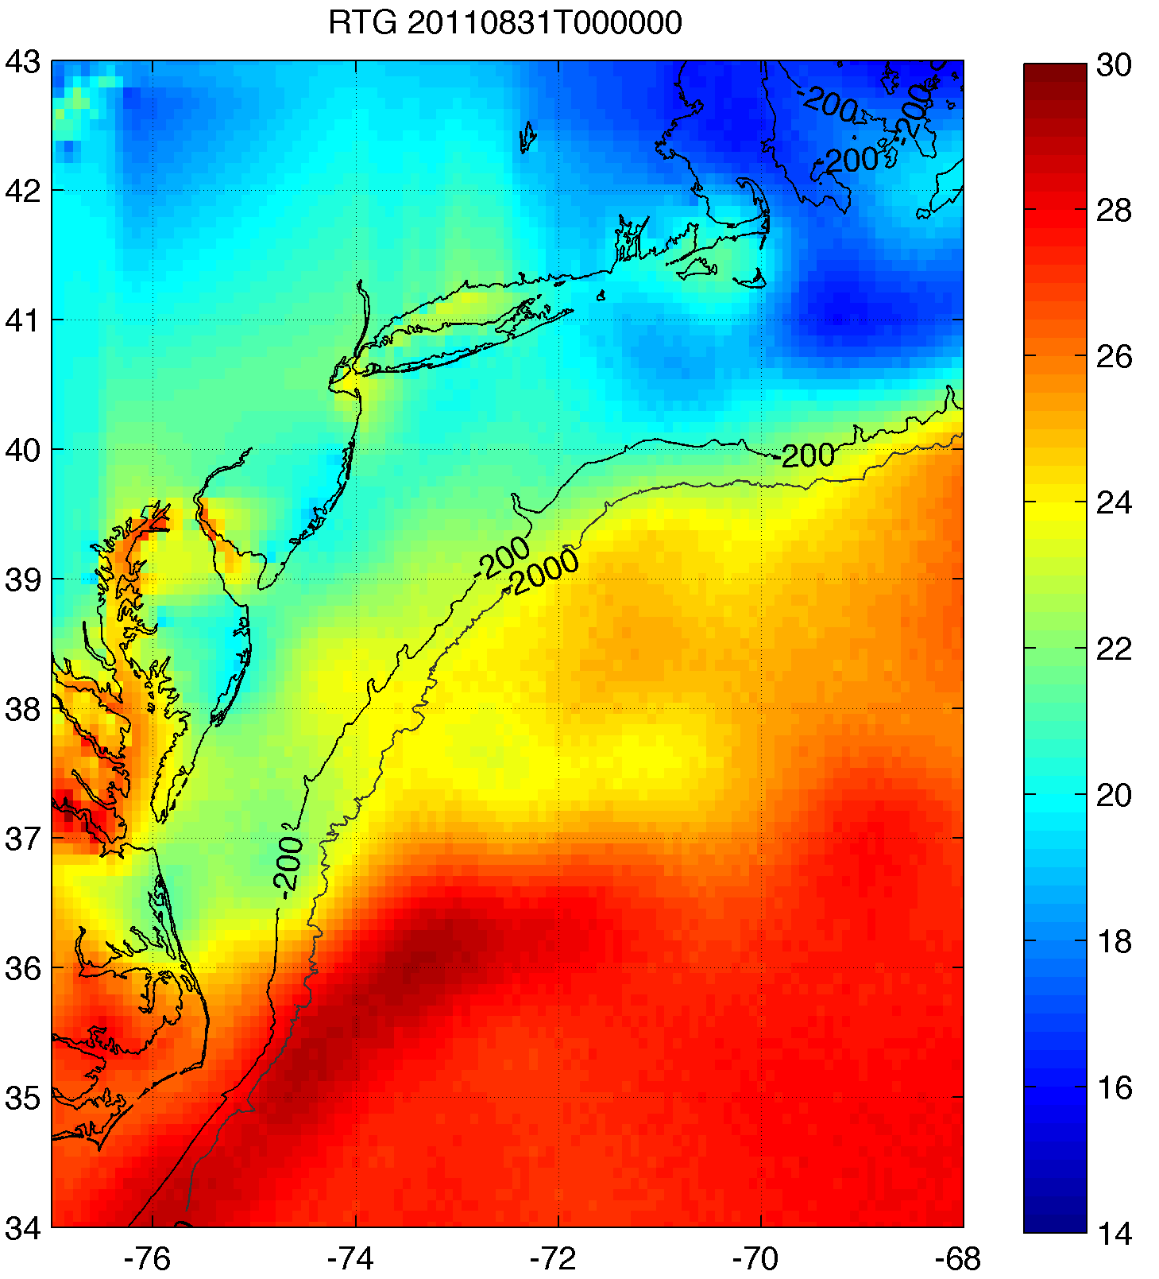
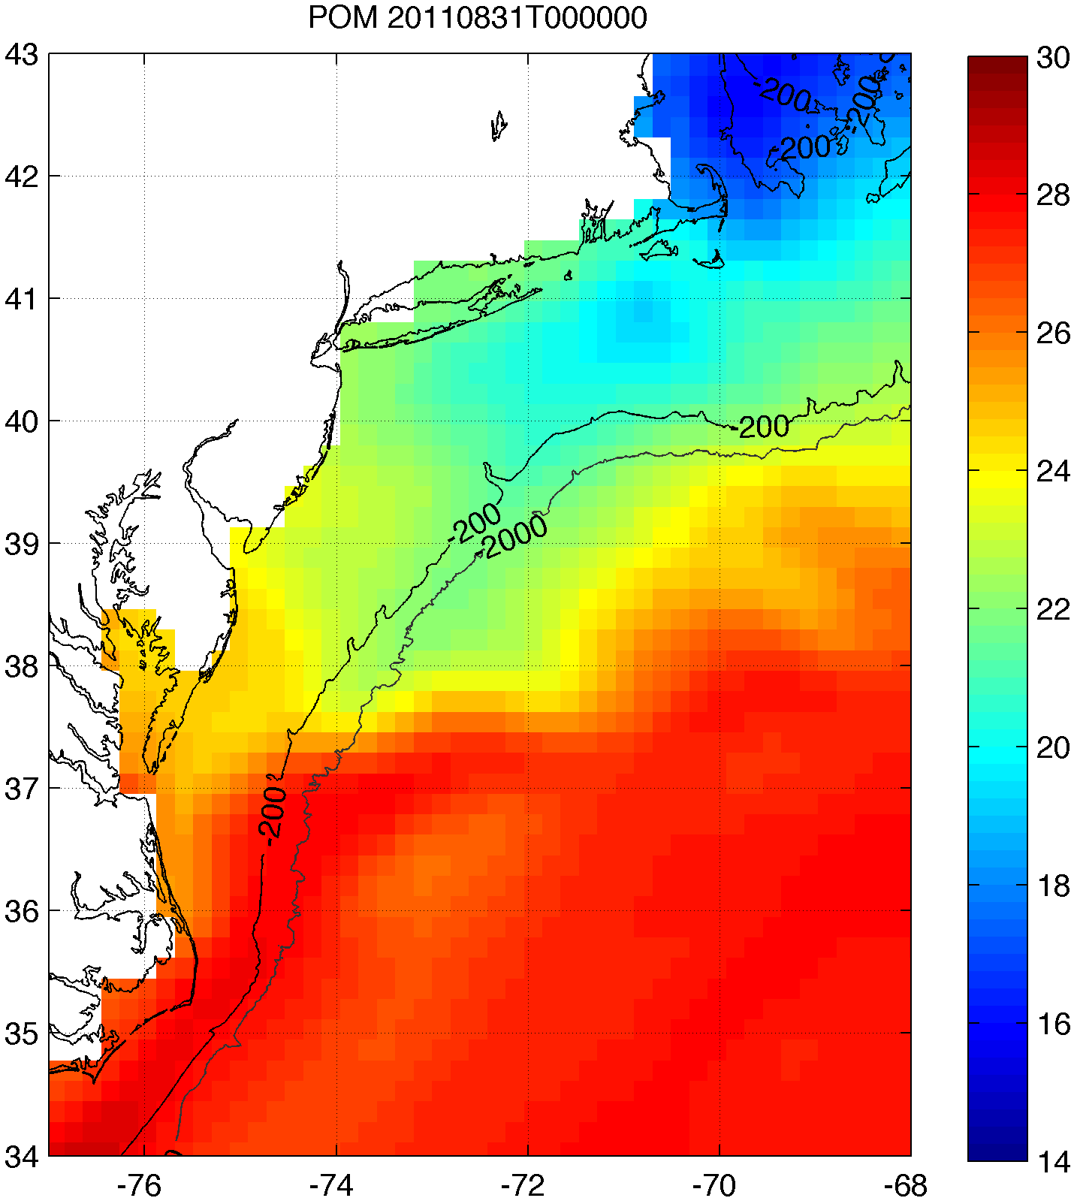
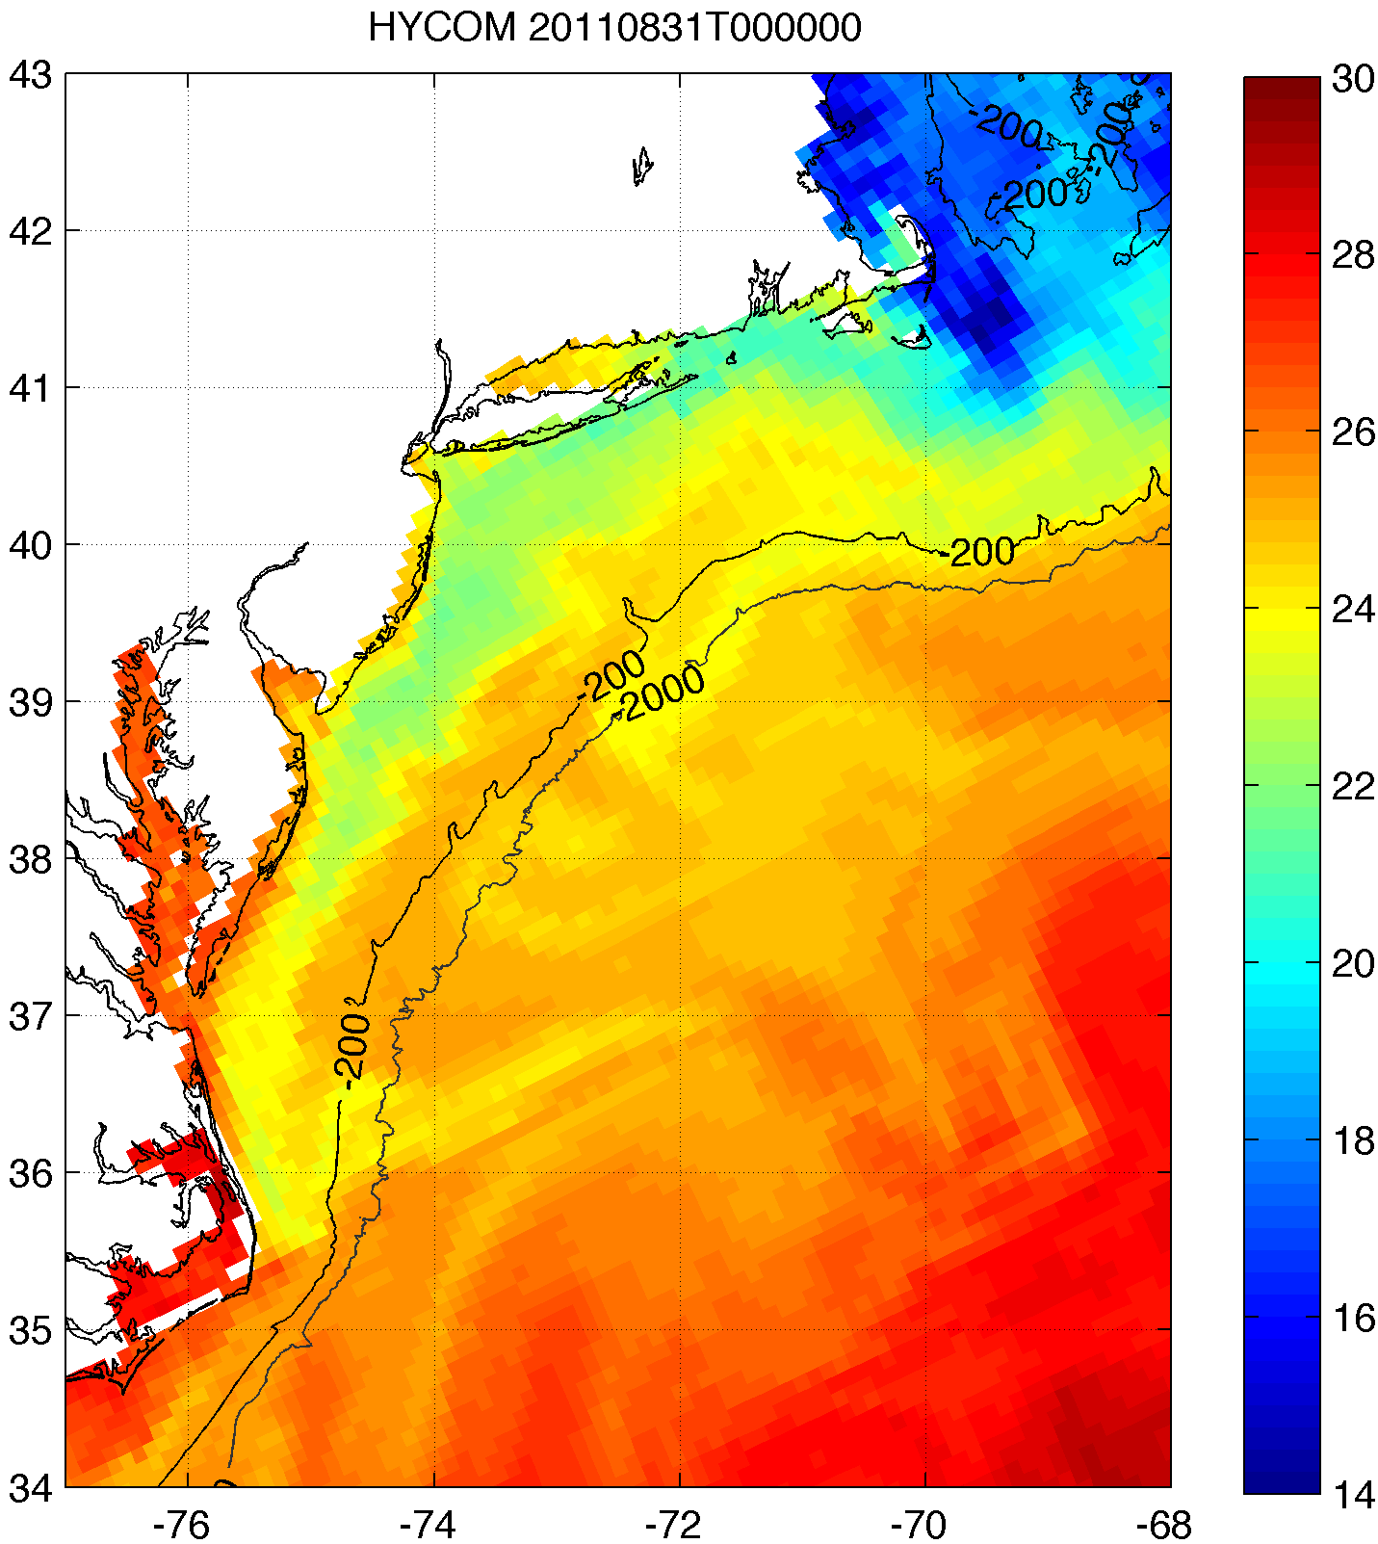
2. Improved satellite SST product revealed that this cooling was not captured by:
basic satellite product
ocean models used for forecasting hurricane intensity
Rutgers SST
RTG HR SST
NAM model
HWRF-POM
low res
HWRF-HYCOM
medium res
BEFORE IRENE
AFTER IRENE
Notes:
Caveats: different atmospheric forcing, etc.
Rutgers SST: 2km, RTG: 1/12 deg, ~9 km, HWRF-POM: 18km, HWRF-HYCOM: 1/12 deg, ~9km

Slide 42
Results
Glider data revealed surface cooling before passage of hurricane eye
Improved satellite SST product revealed that this surface ocean cooling was not captured by:
  Basic satellite products
  Ocean models used for forecasting hurricane intensity
Over 100 sensitivity tests with model showed that Hurricane Irene intensity is very sensitive to this “ahead-of-eye” SST cooling

Slide 43
3. >100 sensitivity tests showed Irene intensity very sensitive to this “ahead-of-eye” SST cooling
Minimum pressure

Slide 44
3. >100 sensitivity tests showed Irene intensity very sensitive to this “ahead-of-eye” SST cooling
Maximum wind

Slide 45
Conclusion
Ocean is critical element in forecasting hurricanes!

Slide 46
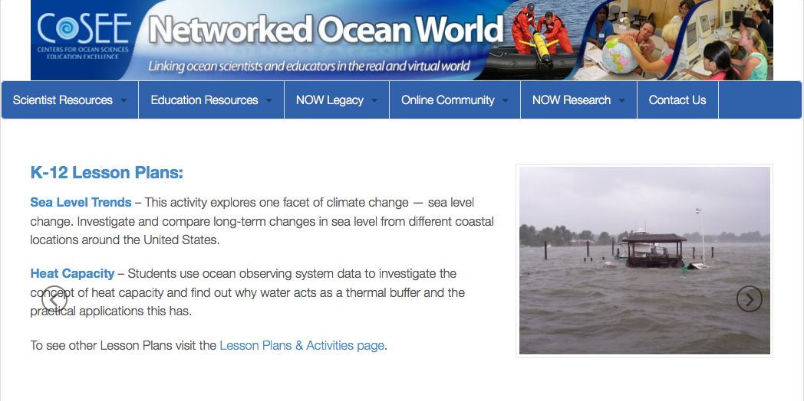
http://coseenow.net/

Slide 47
Teacher Appreciation Event
Come share your thoughts, suggestions, and opinions!
Tuesday October 28th 5-7pm
Marine Science Building (71DudleyRd., New Brunswick, NJ)
We will provide appetizers, capture your feedback, and give tours of the Rutgers Glider Lab
https://rutgers.qualtrics.com/SE/?SID=SV_4JASiwaDodvIcl

