Slide 1
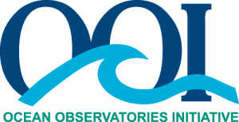
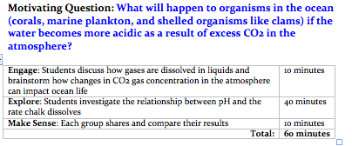
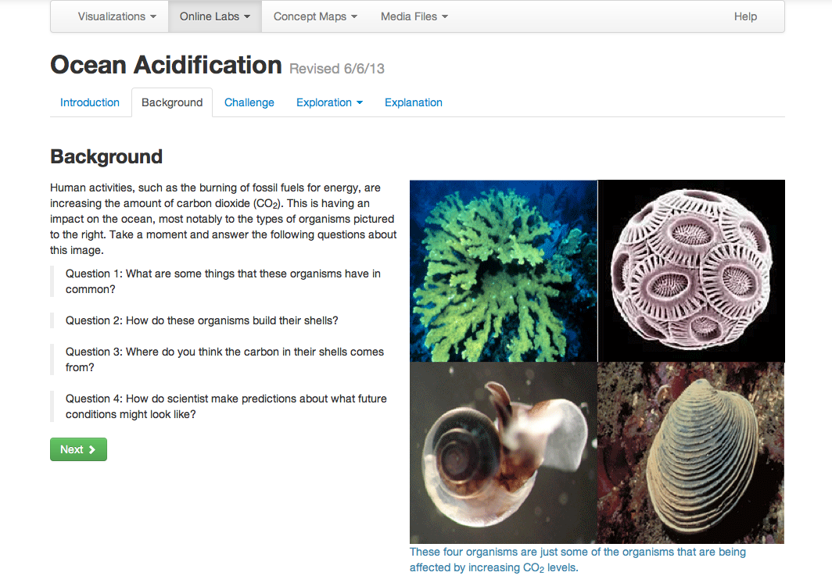
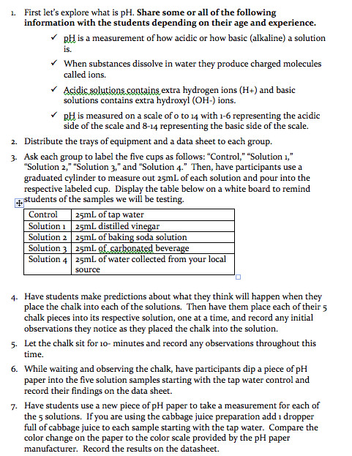
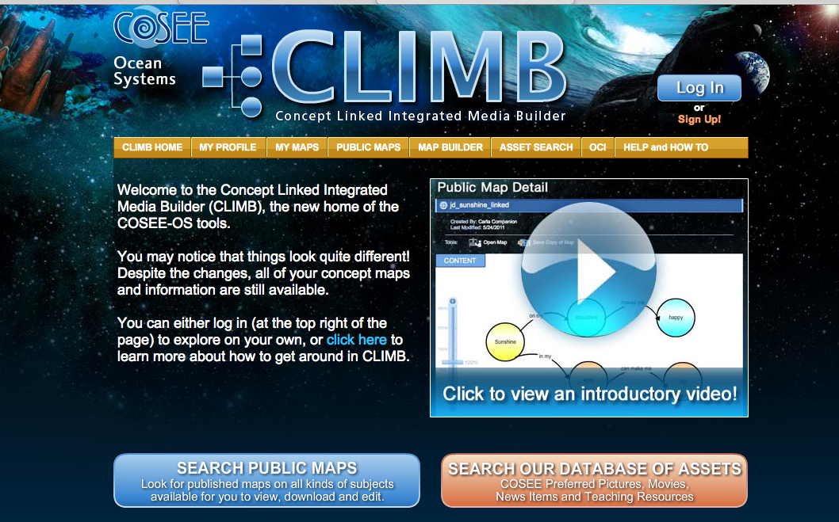
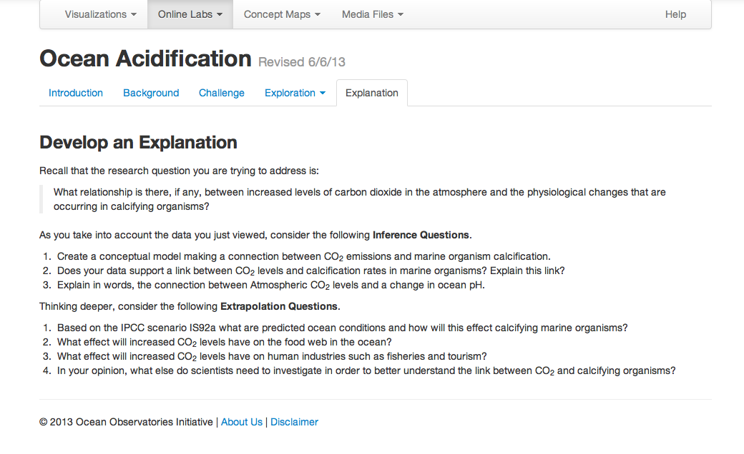
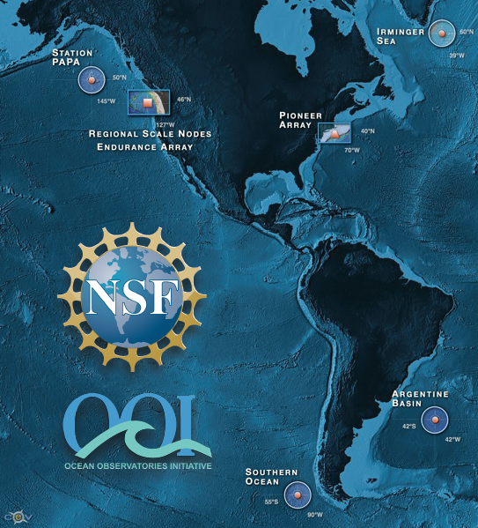
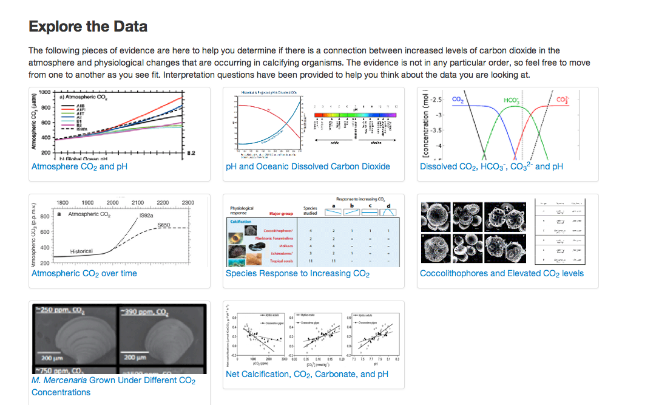
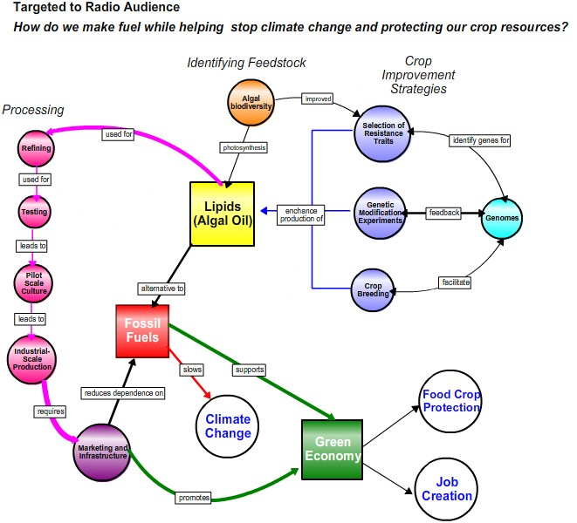
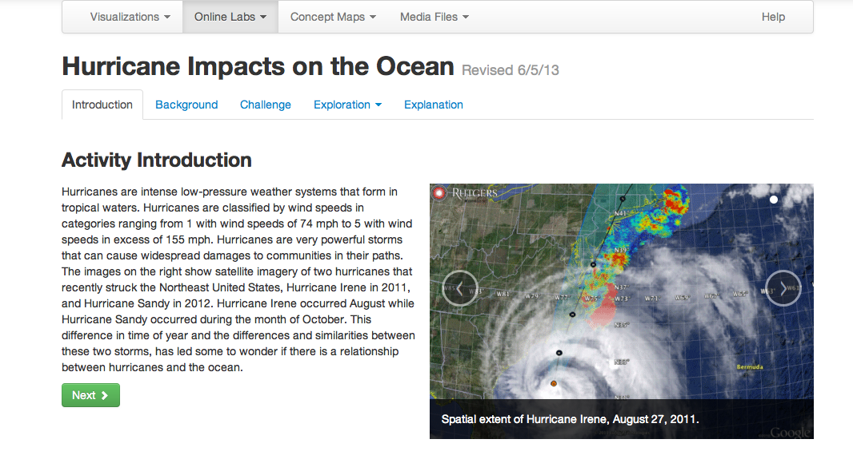
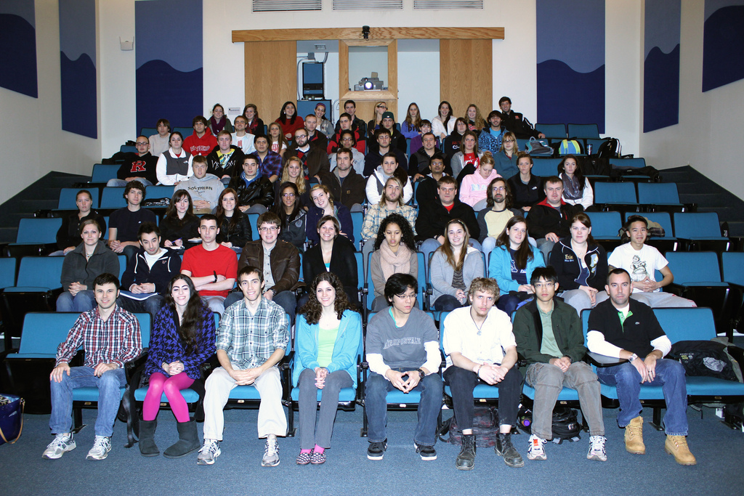
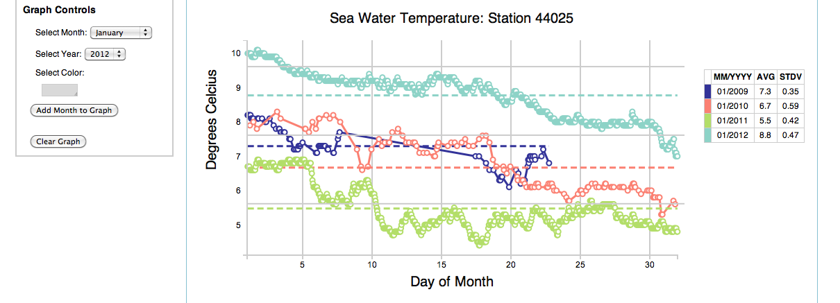
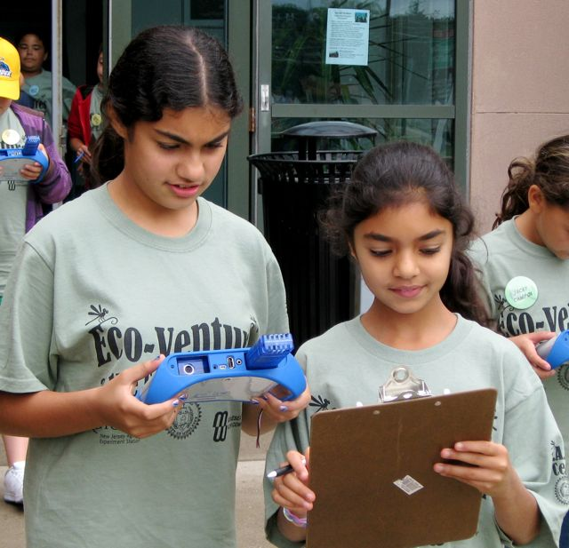
Developing a Range of Ocean Acidification Learning Tools
Oscar Schofield, Paul Falkowski, Kyle Richter, Janice McDonnell
Rutgers University
The Challenge: Responding to a changing climate is a defining challenge for the next generation. This will require a scientifically literate population, requiring a strong focus on improving the public’s ocean literacy of environmental problems and solutions. Ocean acidification provides an unique focus for such efforts given the inherent interdisciplinary nature of the problem. We have focused on developing undergraduate teaching materials that can be utilized and shared to increase understanding and applications of scientific data.
Our Strategy: To meet a growing need for quality undergraduate teaching materials, we focused on developing blended learning tools to provide cost effective educational platforms that combines classroom training, e-learning, mentoring, and information sharing capability. With a focus on developing ocean acidification materials we have leveraged opportunities through existing programs, including the NSF-funded Centers for Ocean Science Education Excellence Networked Ocean World (COSEE NOW), the Rutgers University 4-H Youth Development program, and the Ocean Observing Initiative Education and Public Engagement Program (OOI EPE).
Web-based learning OA products: Our tools provide 1) context with online video lecture modules for ocean acidification, 2) engage the students using the concept mapping, 3) have students explore using a series of data visualization modules, and 4) synthesize the materials through a series of guided inquiry materials. The entire system is integrated into a single online lab lesson.
In class learning OA products: In collaboration with the Lawrence Hall of Science (Berkeley, CA) and the Rutgers 4-H Youth Development Department an inexpensive ocean acidification lesson activity was developed with complementary reader to guide teachers.
OOI EPE Tools: The EPE team is currently in the construction phase. Our group is an “Early Adopter” for the OOI EPE team, allowing us to utilize and “test” the learning tools being constructed by OOI. The three major tools being developed by the OOI include:
This lesson was adapted from a lesson developed by the NSF sponsored Centers for Ocean Science Education Excellence West http://www.usc.edu/org/cosee-west/resources.html#co2 with additional materials and information provided by the Lawrence Hall of Science.
Online concept mapping tools allow student to visually define critical concepts.
A Lab Lesson Builder provides an integrated online tool to assist the development of online curricula
Testing and iterating the online OA products: We have tested online OA materials in a series of educational workshops. The information is being used to refine the materials before general release in early 2014.
Scaling the Products for Alternative Audiences: Our team is working on repurposing the lesson for use in additional learning environments including in and out of school programs for middle and high school age students, informal learning centers such as the Liberty Science Center, and in teacher professional development workshops. Our goal is to increase the use of scientific data in teaching and learning.
Venue 1: Ocean observatory class (75 students/term) is a class focused on having student work with data. The OA module was assigned.
Venue 2: “Teaching Oceanography” workshop (San Francisco June 2013, 65 teaching faculty from around the US) tested the OA tools. Response was positive with suggested improvements.
Venue 3: “COSEE-PP Summer 2013 Community College Faculty Institute (Charleston OR, July 2013) tested the OA tools. Response was positive with another list of suggested improvements.
Data visualization tools allowing time series and spatial data be explored by undergraduates.

