Slide 1
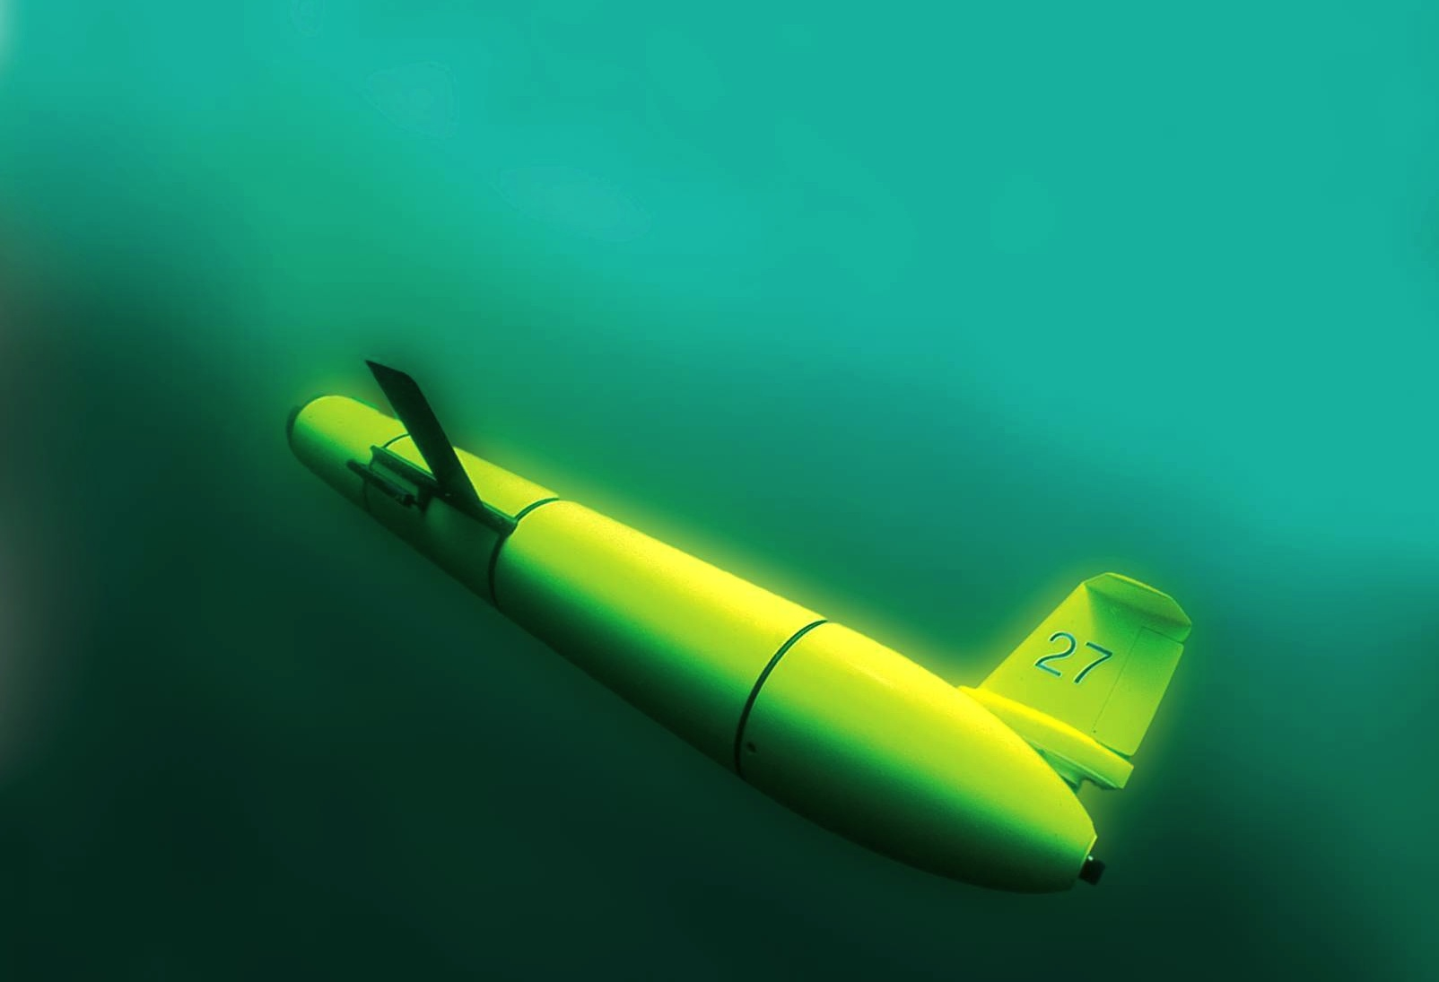
The Challenger Glider Mission:
A Collaborative Global Network for Ocean Science and Education
Scott Glenn,
Oscar Schofield,
Josh Kobut &
Janice McDonnell
Rutgers University
Coastal Ocean Observation Lab
http://rucool.marine.rutgers.edu/

Slide 2
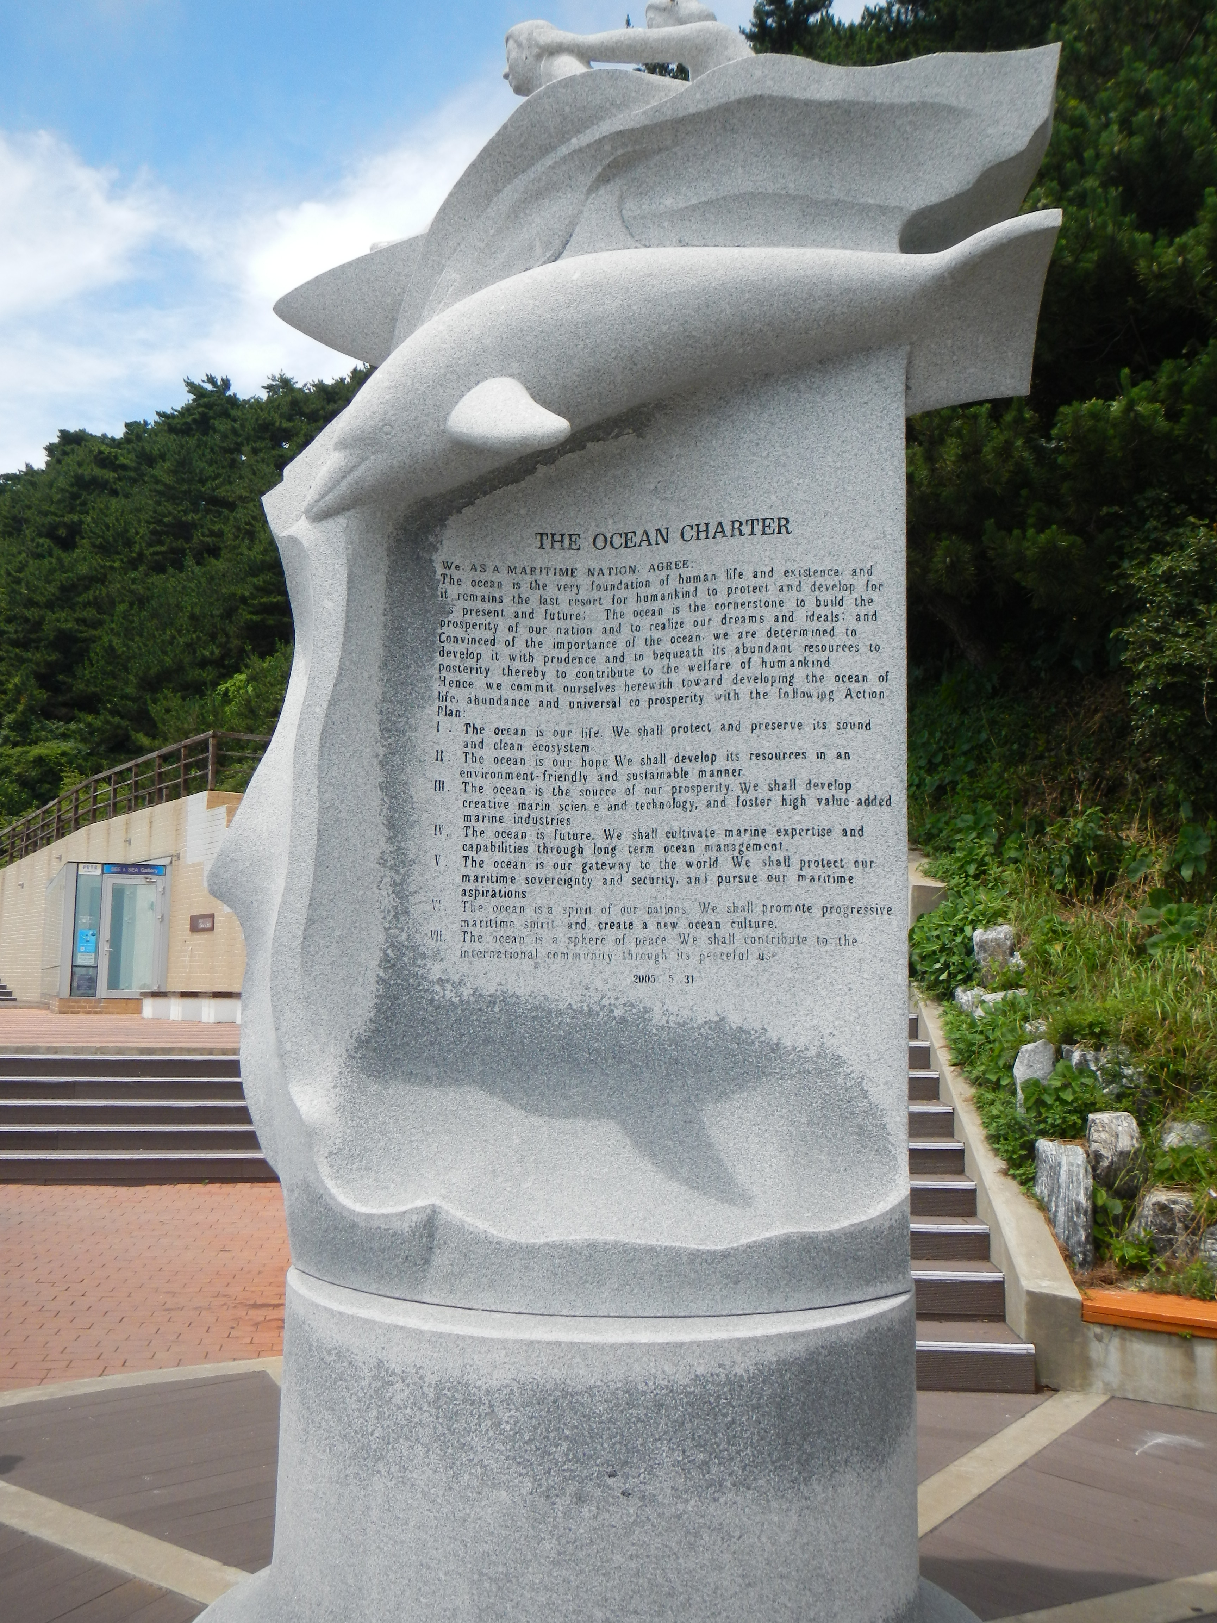
The Challenger Glider Mission:
A Collaborative Global Network for Ocean Science and Education
Scott Glenn,
Oscar Schofield,
Josh Kobut &
Janice McDonnell
Rutgers University
Coastal Ocean Observation Lab
http://rucool.marine.rutgers.edu/

Slide 3
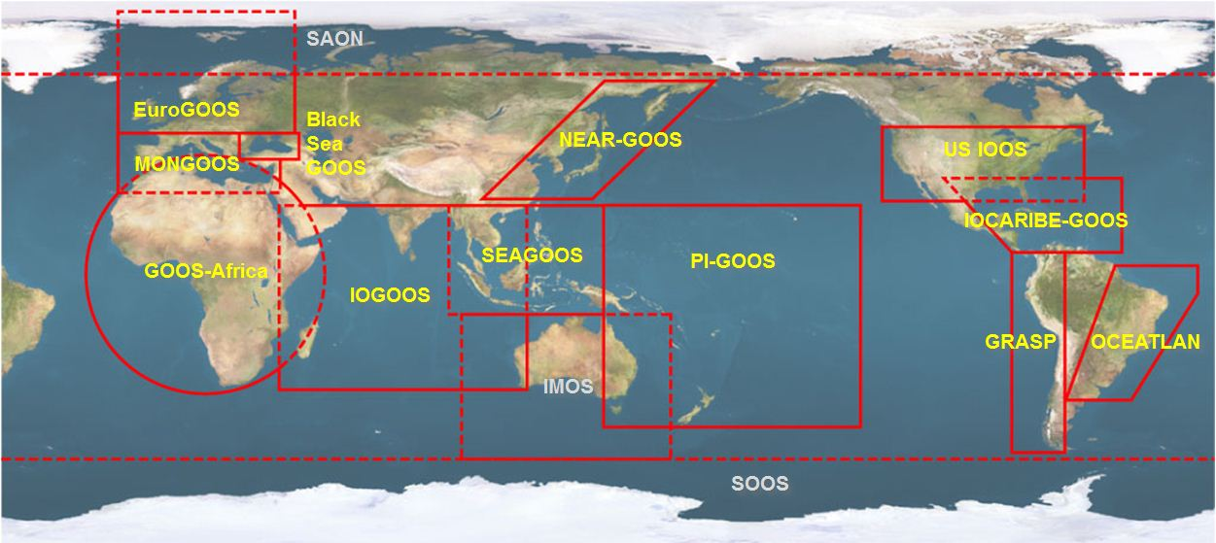





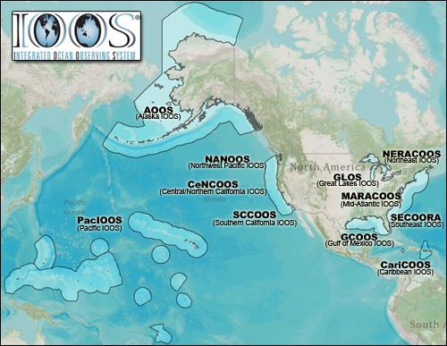


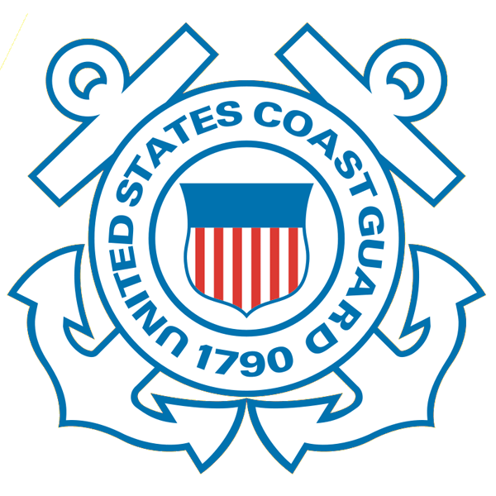










U.S. Integrated Ocean Observing System (IOOS)
Global Component
National Component
Regional Component
15 Regional Alliances in GOOS
Vessels -
Satellite
Satellite
CODAR
Ships/ Vessels
Glider
REMUS
Data Vis.
Modeling
Security
Leadership
Education
11 Regional Associations
17 U.S. Federal Agencies
http://ioos.gov

Slide 4
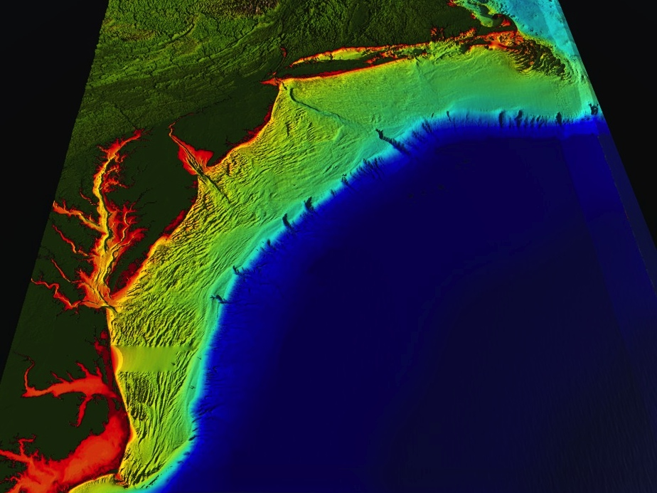
















U..
Middle Atlantic
Regional Association
Coastal
Ocean Observing System
1000 km
Cape to Cape
CT
RI
Cape
Cod
MA
NY
10 States
PA
NJ
MARACOOS:
Sustained Real-Time
Regional-Scale Observation and Forecast System
MD
DE
>40 PIs
>20 Institutions
>50 Members
Scott Glenn + Many
VA
NC
Cape
Hatteras
Notes:
4

Slide 5
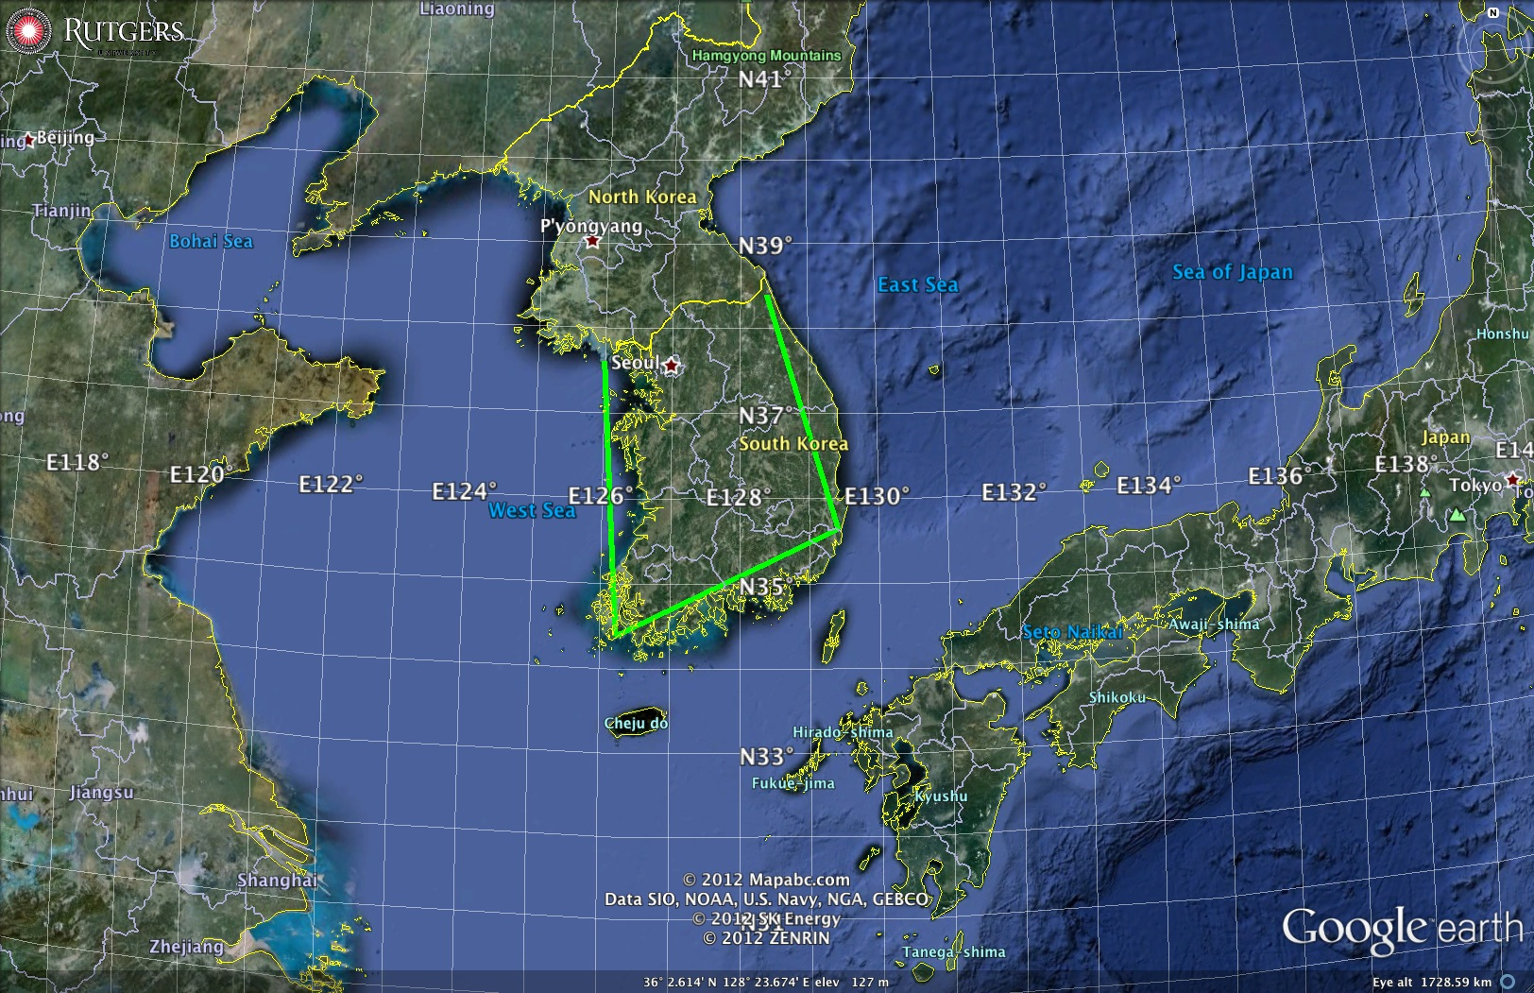
Regional Seas around Korea
1000 km Alongshore Length Scale

Slide 6
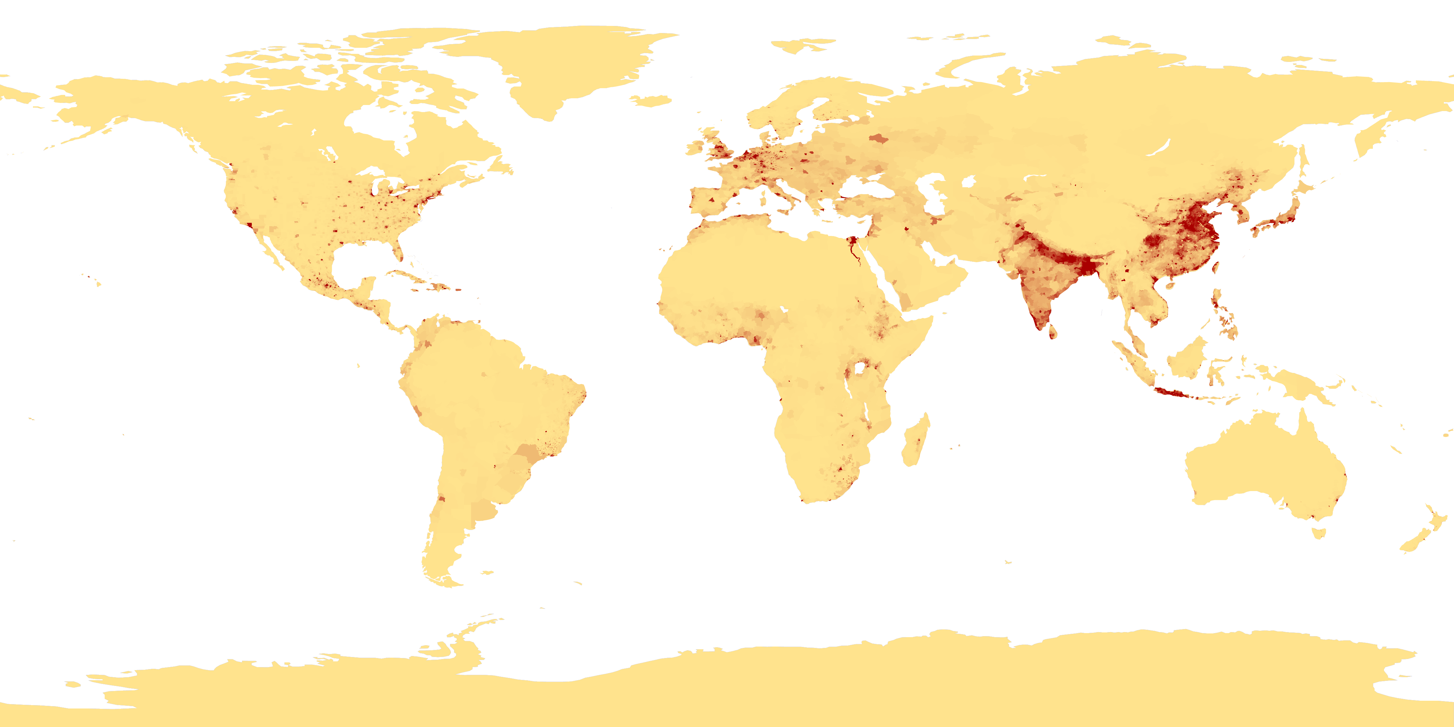
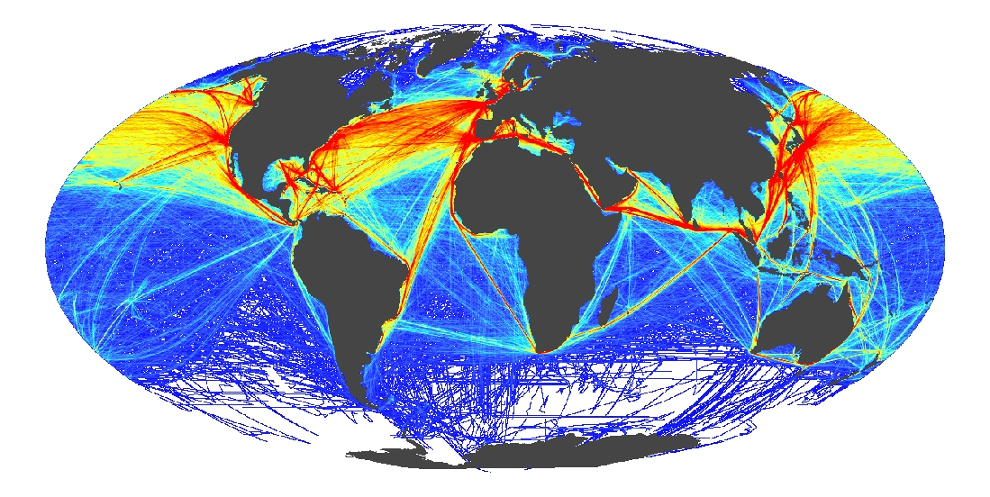
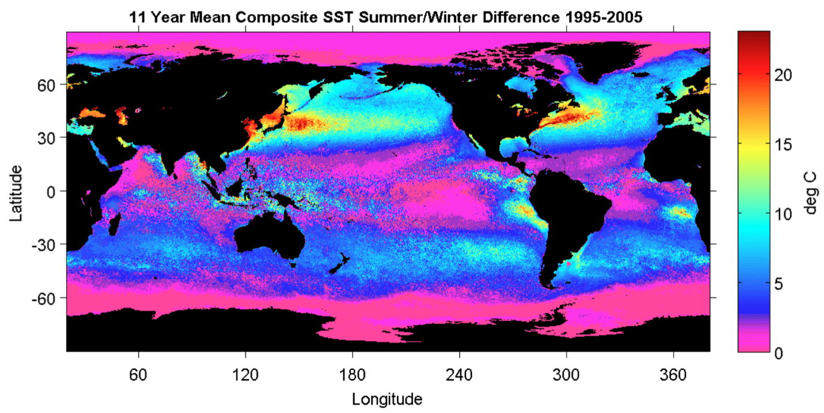
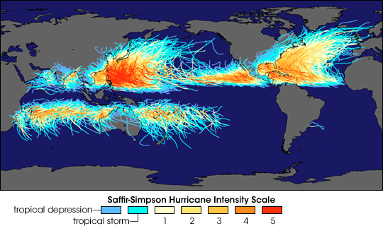
Global Drivers
Coastal Population Centers
International Commerce
Ocean Seasonality
Tropical Cyclones

Slide 7
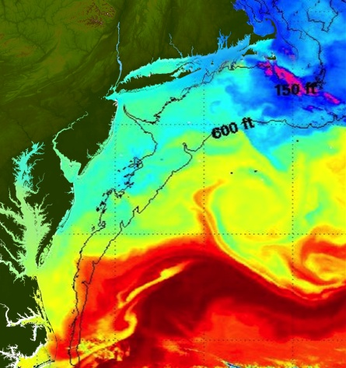
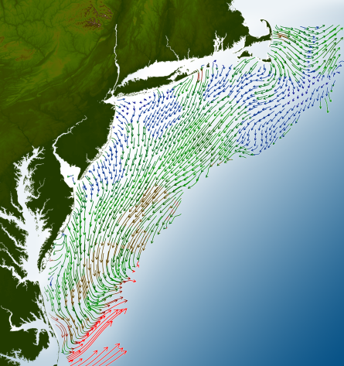
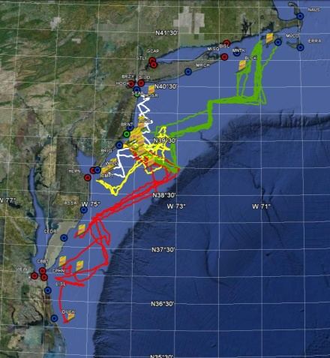
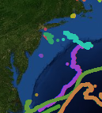
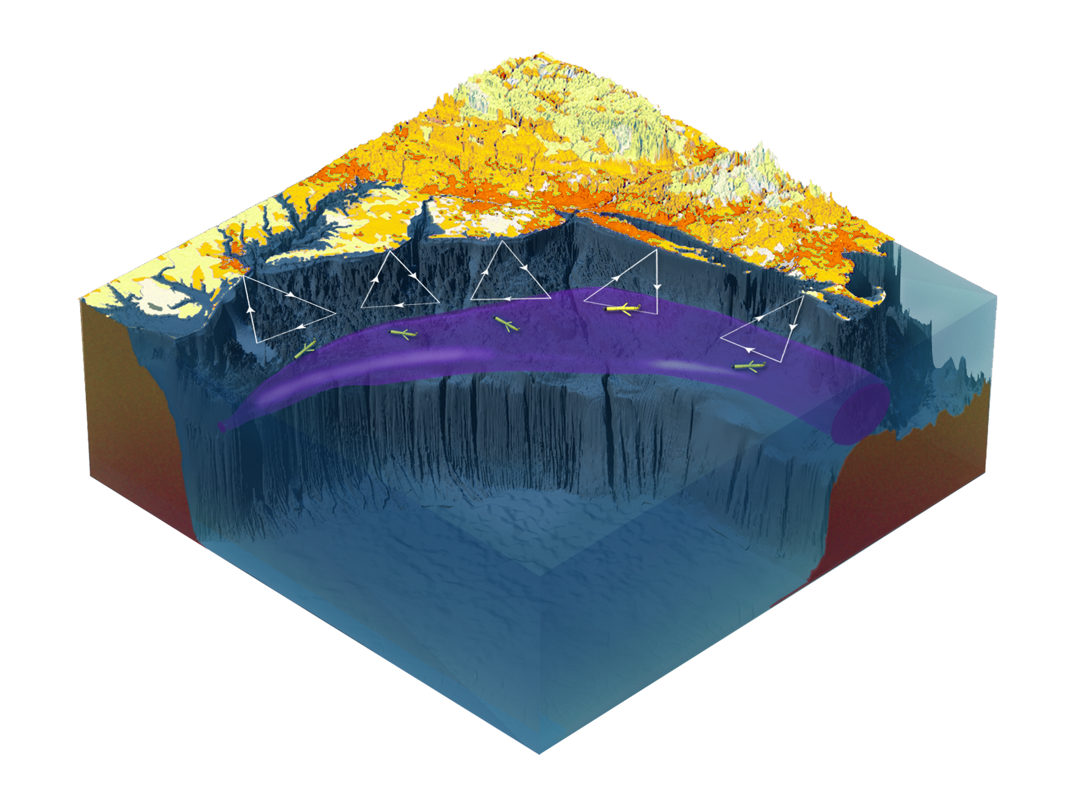

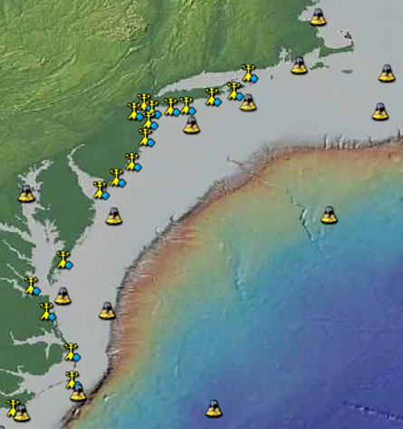
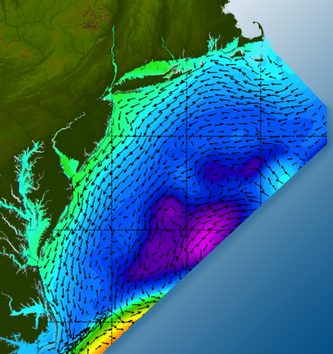

Satellites
HF-Radar
Gliders
Drifters
Population Density
To seek, discover & apply
new knowledge & understanding
of our coastal ocean
Weather Stations
Ocean Forecast Ensemble
Notes:
Need to cut off cold pool in south and bend offshore
Need to experiment with dulling down the colors in the pop density. Maybe orange/tan to white like the box I put in?
Put gliders just below the lines in 3 of them, and increase their angles facing up and down randomly. I stuck in cheesy examples
I already put the shadow and 80% clear line around the two new maps in the upper right, so we are good there.

Slide 8
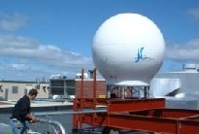
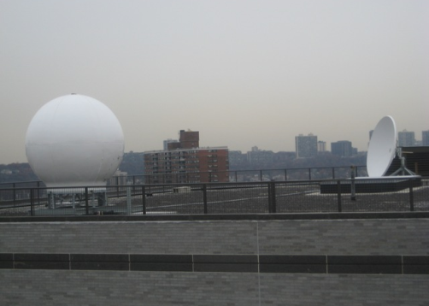
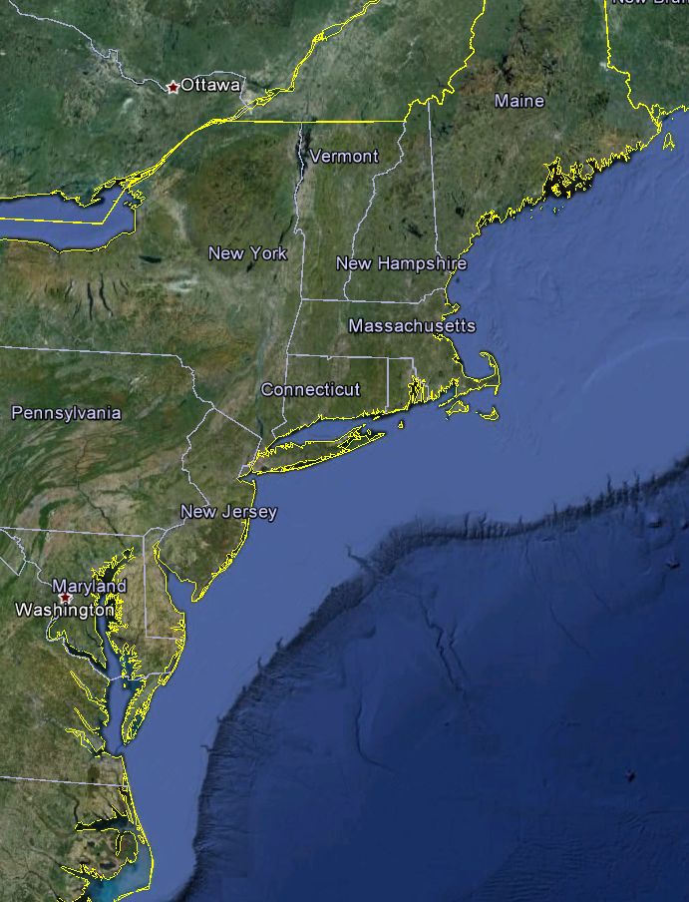
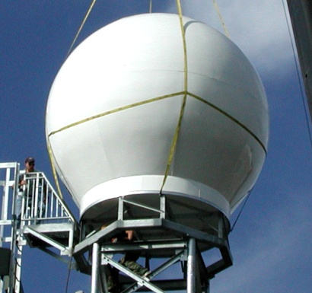
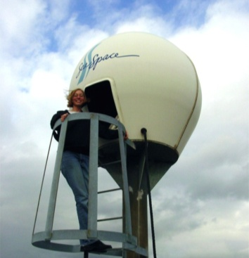
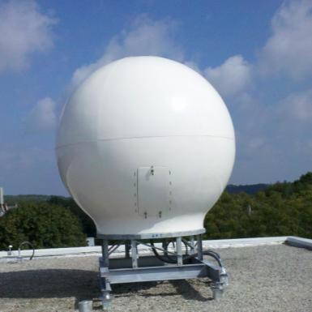
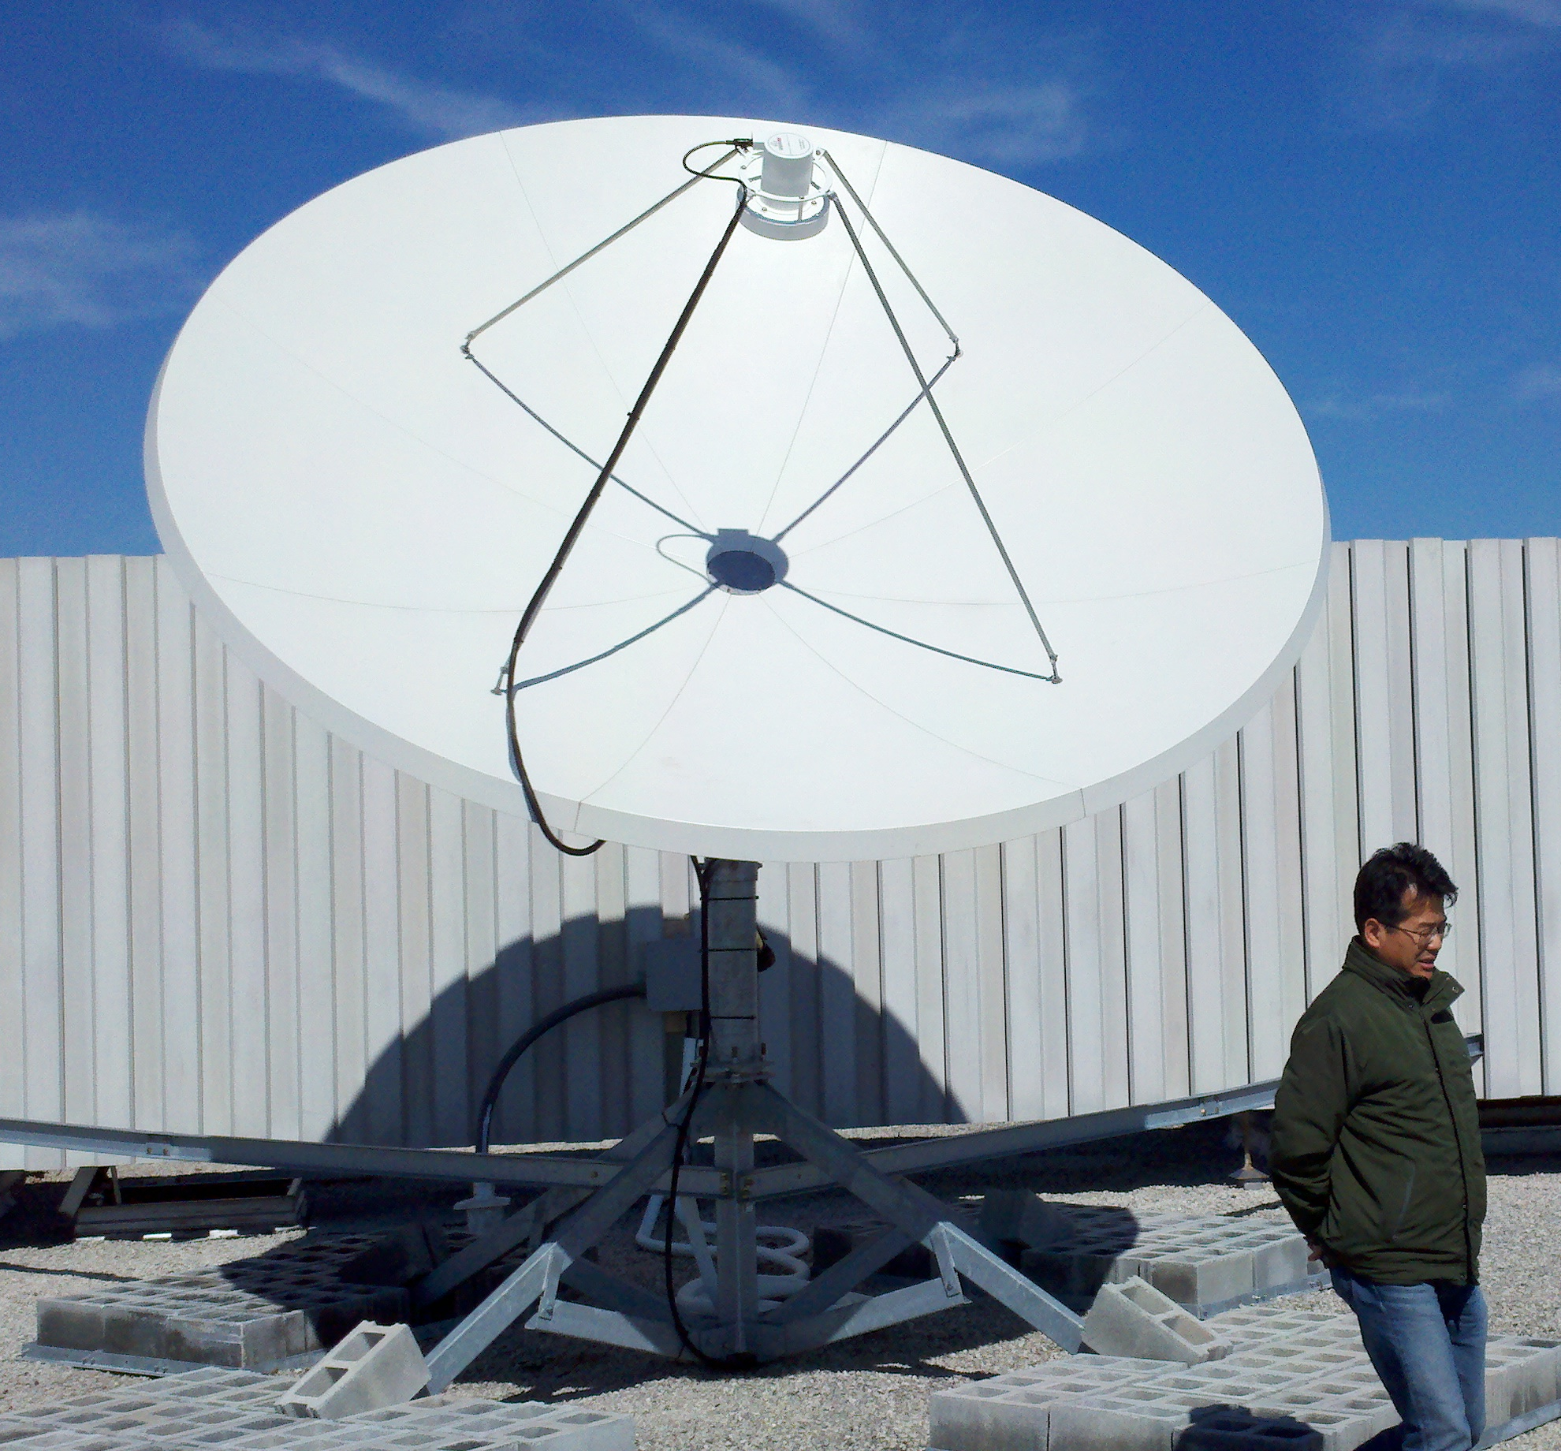
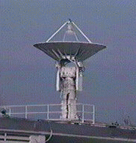
Real-Time Satellite Ground Stations in the Northeast U.S.
Satellites: NPP, Terra, Aqua, NOAA Polar Orbiters, Metop & GOES
U. Maine
City College of N.Y.
Rutgers
U. Delaware
Johns Hopkins

Slide 9
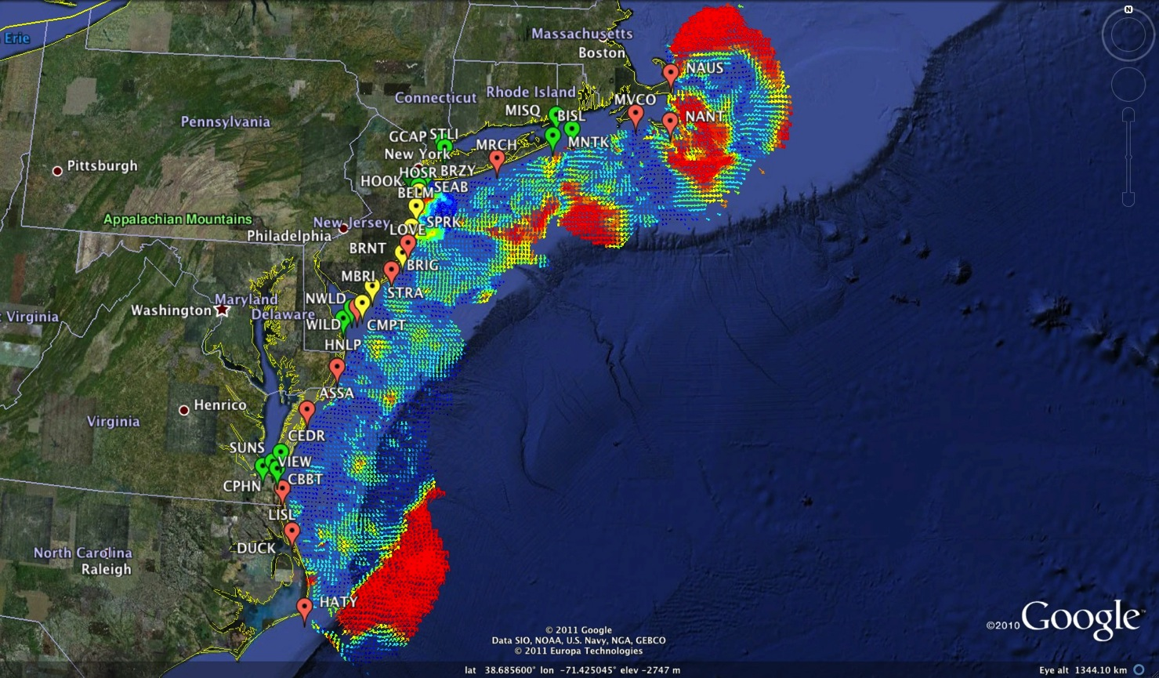
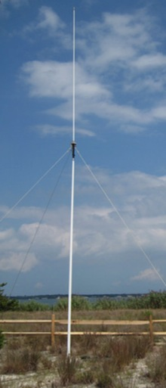
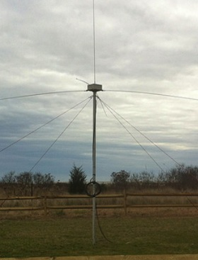
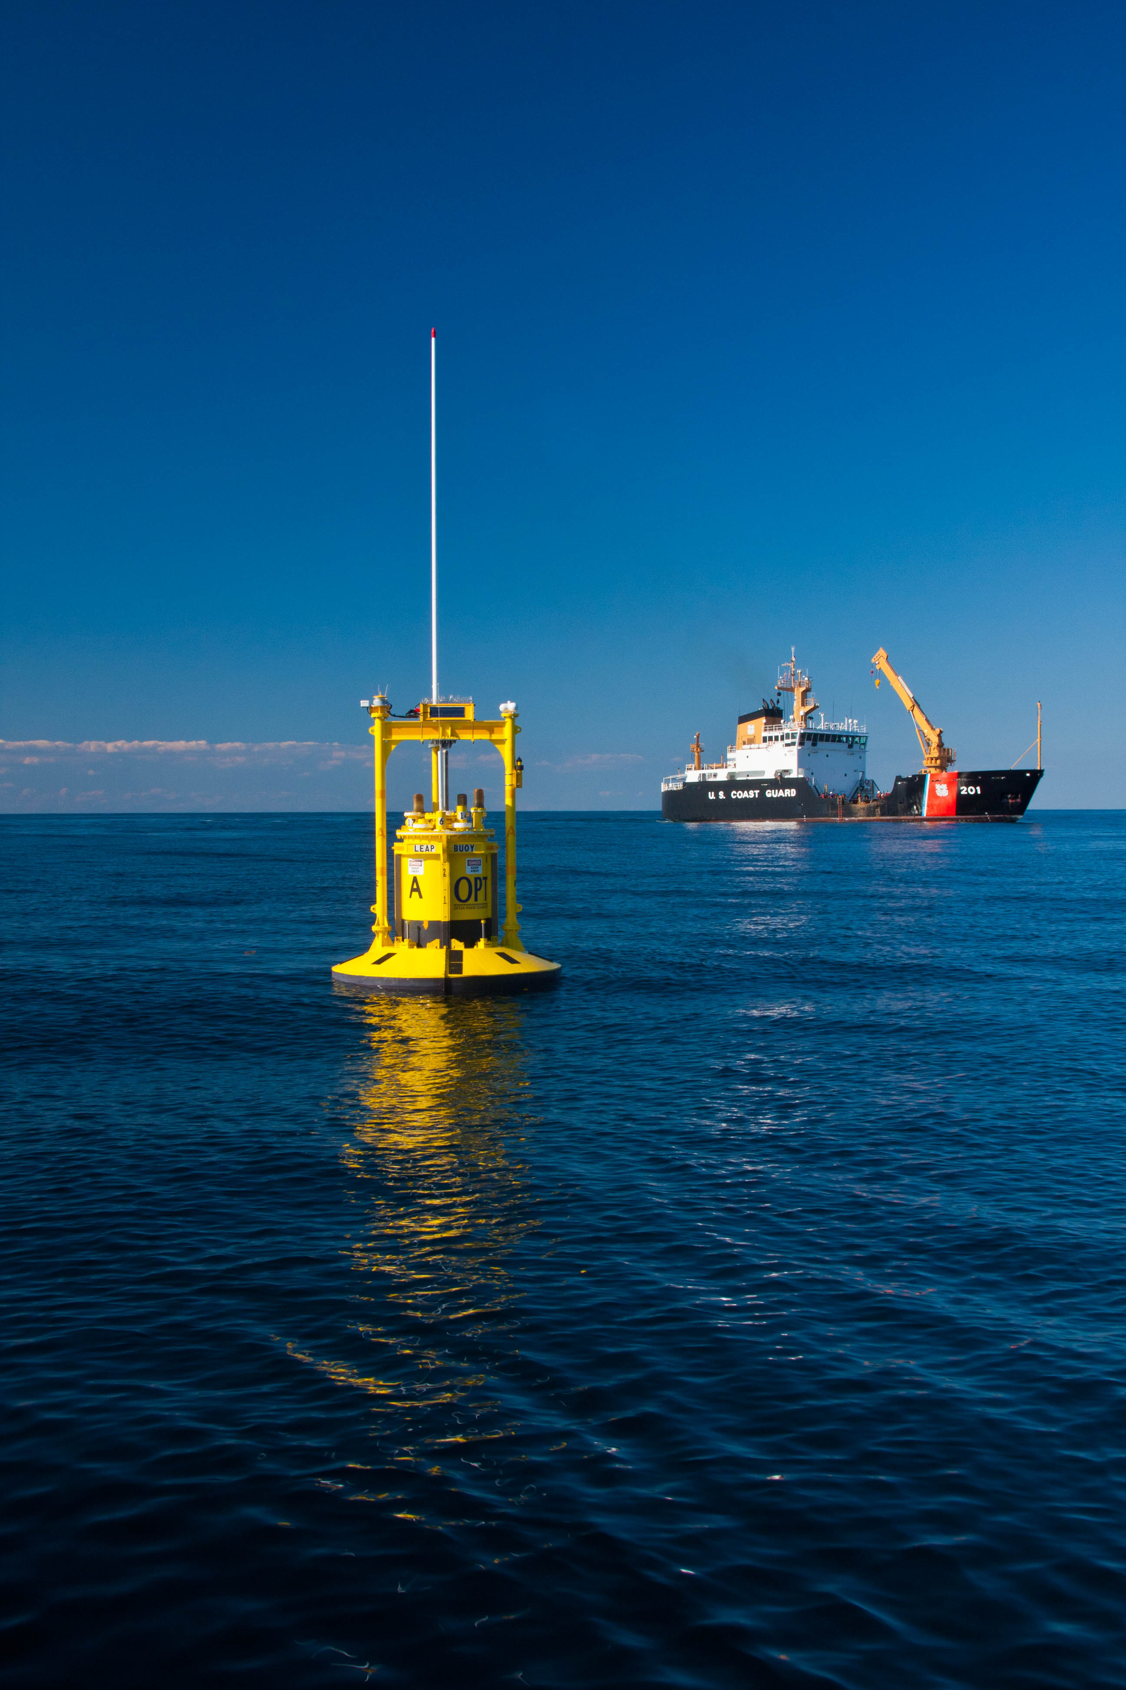
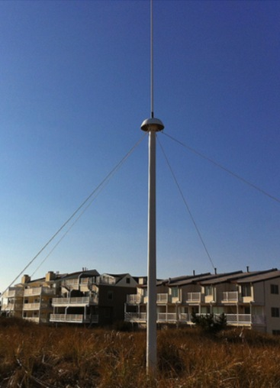
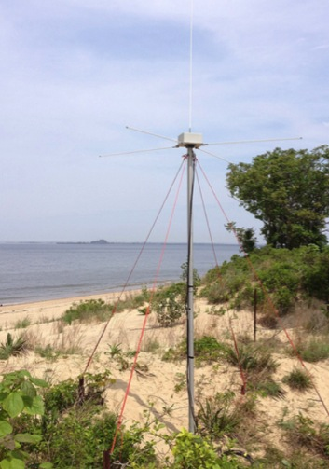


Mid-Atlantic Bight HF Radar Network
1000 km
Cape to Cape
Mid-Atlantic HF Radar Network
16 Long-Range CODARs
8 Medium-Range CODARs
17 Short-Range CODARs
41 Total
Triple Nested, Multi-static, Multi-use
Industry Partner: CODAR Ocean Sensors

Slide 10
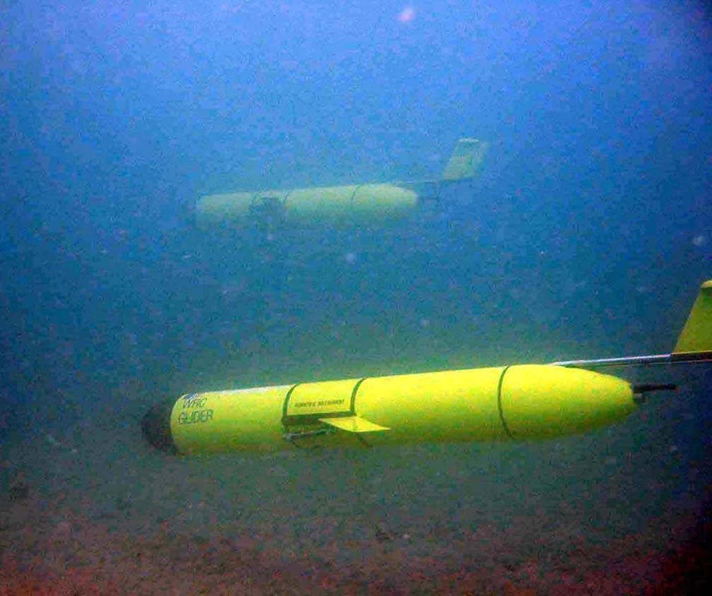
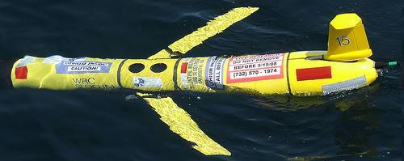
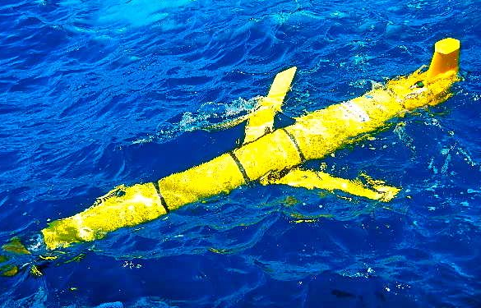
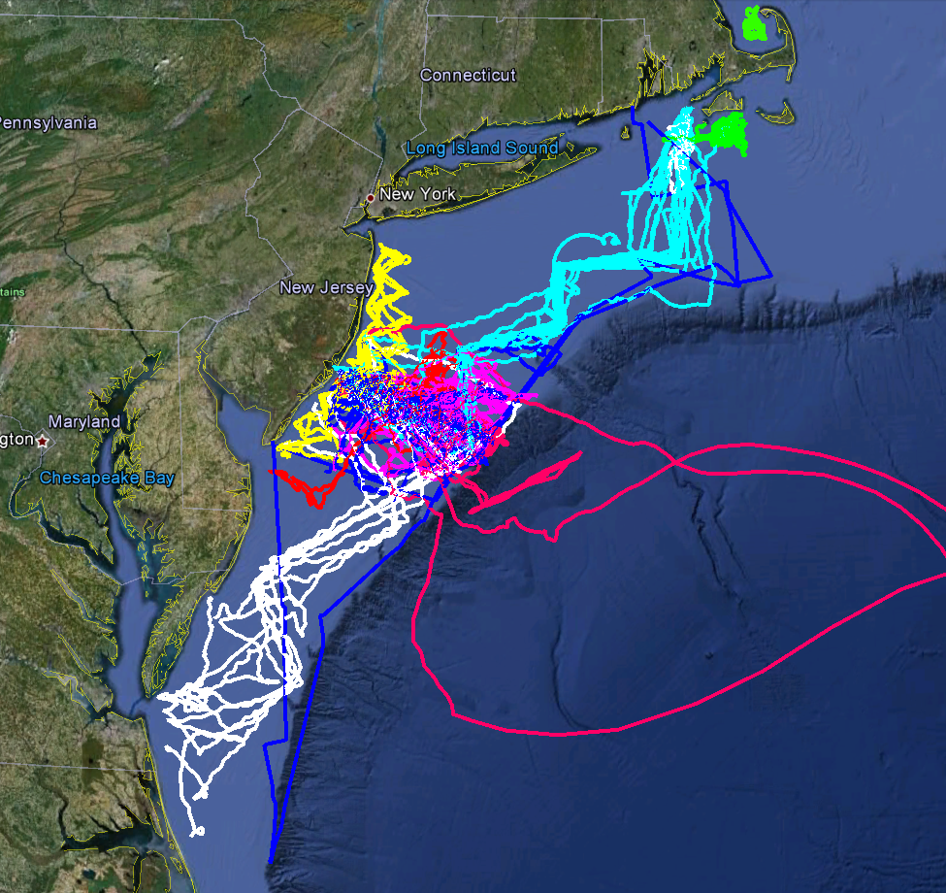
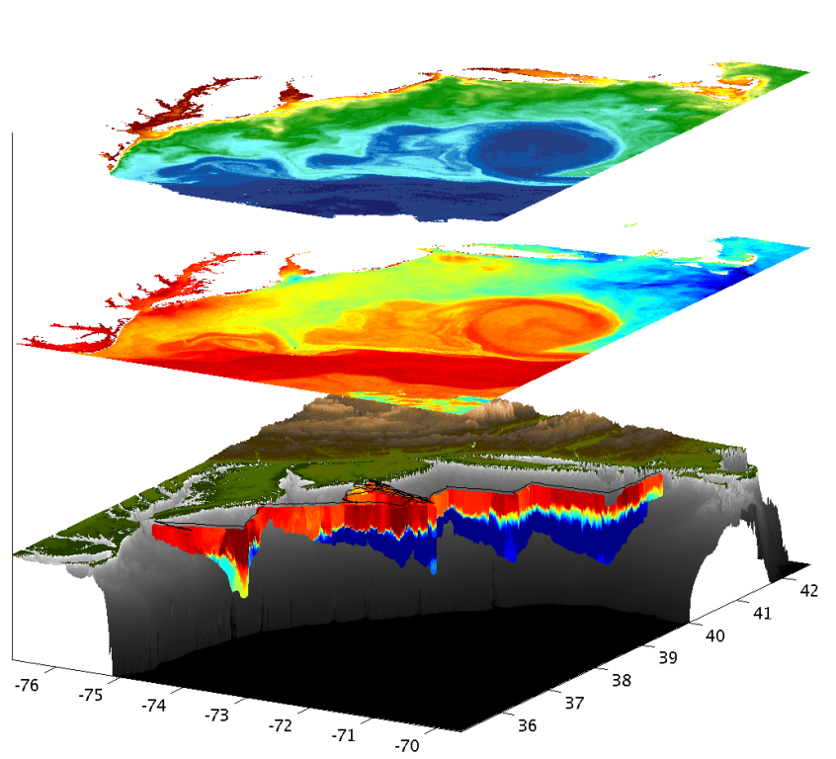
Mid-Atlantic Glider Network
Satellite Ocean Color
MARACOOS
MURI
Intl. Missions
EPA & NJDEP
Cblast
Endurance
OSSE
SW06
Satellite SST
Subsurface
Glider
Data
Many Missions,
Many Agencies
Industry Partner: Teledyne Webb Research

Slide 11
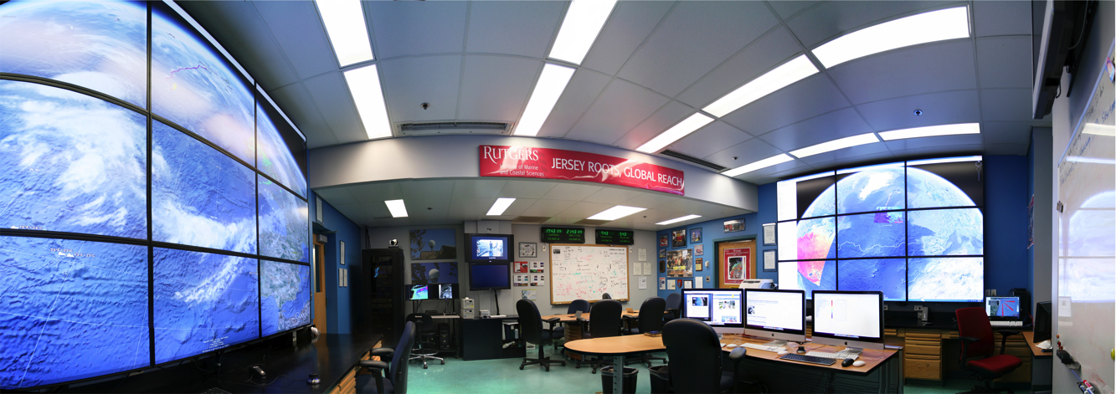
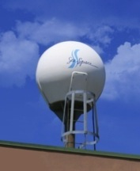
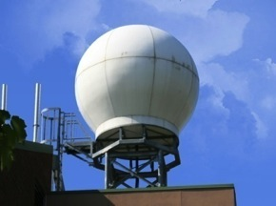
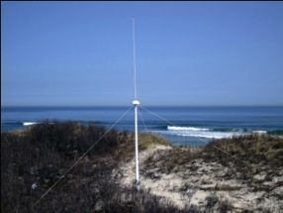
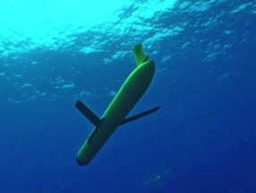
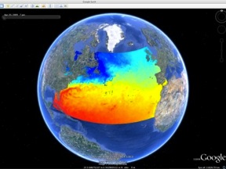
MARACOOS Operations Center
Rutgers University - Coastal Ocean Observation Lab
Satellite Data Acquisition Stations
CODAR Network
Glider Fleet
3-D Forecasts

Slide 12
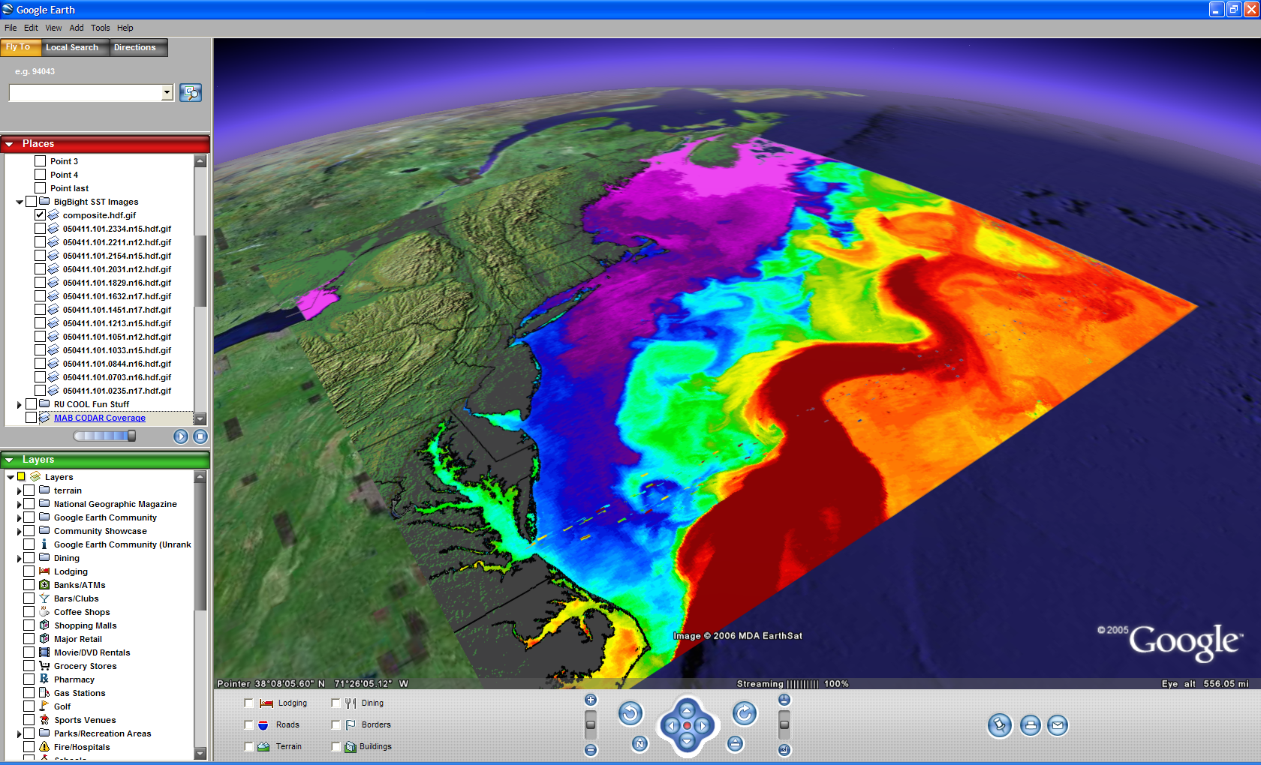

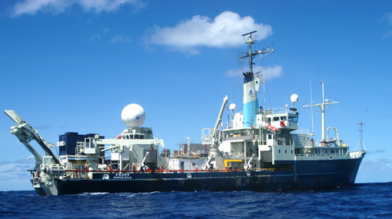
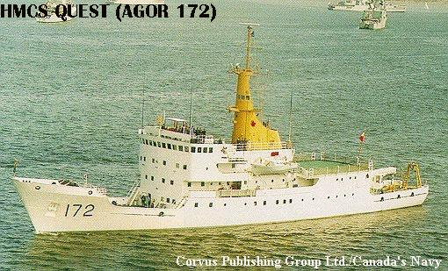
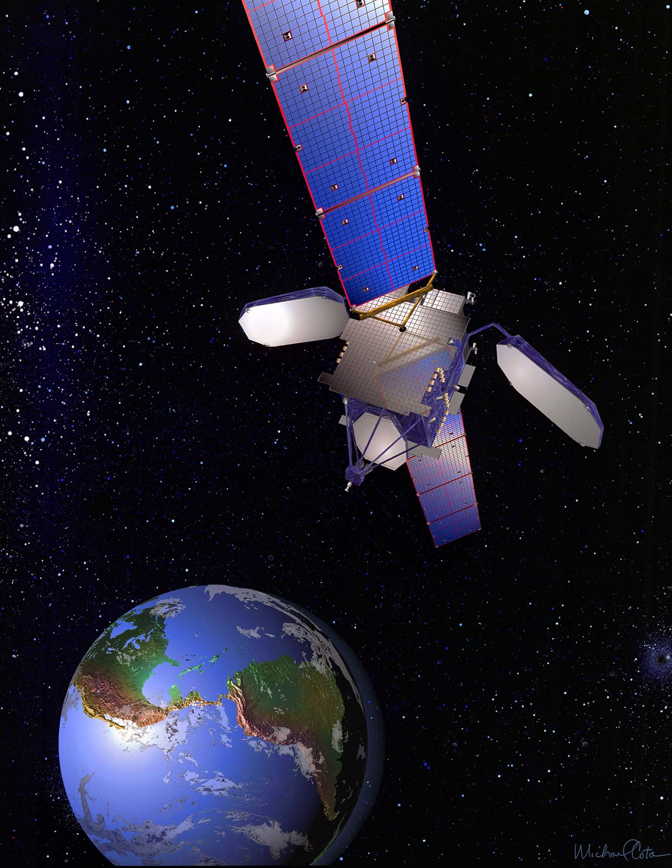
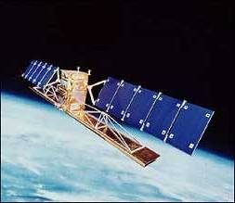
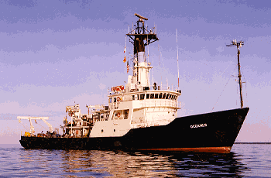
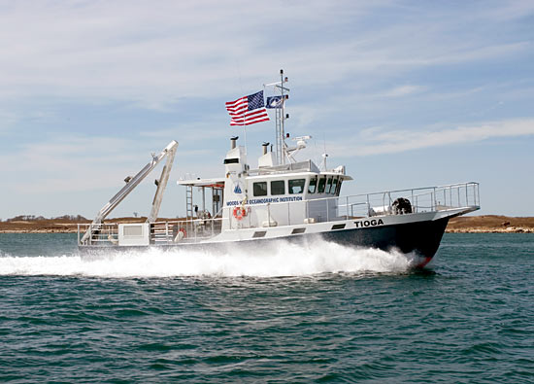




ONR Shallow Water 2006 Joint Experiment
HiSeasNet
>12 Satellites
48 Senior
PI’s & PM’s
Communication
7 Ships
3 Groundstations
10 Gliders
1 Aircraft
62 Moorings

Slide 13









Korea & United States
HF Radar Collaboration

Slide 14

Korea & United States
HF Radar Collaboration
July 2013
Planning Meetings

Slide 15








Korea & United States
Antarctic Glider Collaboration
RU Glider w/FIRe
RU Glider w/ ADP

Slide 16






RI
U..
Middle Atlantic
Regional Association
Coastal
Ocean Observing System
10 States
76 Million People
CT
Cape
Cod
MA
NY
PA
NJ
U.S. IOOS
Responds to
Hurricanes Irene
and Sandy
MD
DE
Sandy
>40 PIs
>20 Institutions
>50 Members
>2000 Contacts
Irene
VA
NC
Cape
Hatteras
Notes:
16

Slide 17


Hurricane Irene
August 26, 2011
NOAA/NHC Damage:
#8 with >$15 Billion.
Track Accurate;
Intensity Over-predicted.
Hurricane Sandy
October 29, 2012
NOAA/NHC Damage:
#2 with >$60 Billion.
Track Accurate;
Intensity Under-predicted.

Slide 18


Hurricane Irene in the News:
Track accurately forecast days in advance.
Intensity was over-predicted.

Slide 19


Report from National Hurricane Center: Track Error & Skill
Reduction in forecast track error & Increase in forecast track skill
over the last 2 decades.
Significant Drivers: 1) Improvement in Global Forecast Models
2) Super-Ensemble
Production Suite Review: December 4, 2012

Slide 20


Report from National Hurricane Center: Intensity Error & Skill
“Long-term trend is flat.” “Skill trend is flat, little skill.”
Production Suite Review: December 4, 2012

Slide 21

Report from National Hurricane Center: Intensity Skill in 2012
Coupled atmosphere-ocean model reduced skill!
Production Suite Review: December 4, 2012

Slide 22

Hurricane Irene: Track (August 2011)

Slide 23



Hurricane Irene
39.5N 73W Surface Current Time Series
Total Current Near-Inertial Current
Wave & Wind Direction Time Series
Eye crosses NJ mid-day on Aug 28

Slide 24

Two Gliders
Deployed by MARACOOS
in Hurricane Irene
RU23
Deployed for MARACOOS.
Map subsurface T/S structure for fisheries.
Damaged early - drifter
Recovered by fisherman
Provided data on inertial currents during storm.
RU16
Deployed for EPA.
Map bottom dissolved oxygen.
Provided data on mixing during storm.

Slide 25





Hurricane Irene: Glider Sampling Through the Storm
Hurricane Irene
0
26
depth
Temperature
RU16
Deployed for EPA.
Map bottom dissolved oxygen.
Provided data on mixing during storm.
55
14
0
33
depth
Salinity
55
29
0
105
depth
% Saturation
(DO)
55
60
Aug 12
date
Sep 07

Slide 26




Hurricane Irene: Glider Sampling Through the Storm

Slide 27


Before
After
Offshore
Onshore
Surface (CODAR) Depth Avg (Glider) Bottom (Difference)

Slide 28



Hurricane Irene: Our Modeled Ocean (ROMS)
Offshore
Onshore
Glider Temperature
ROMS Temperature
ROMS Cross-Shore

Slide 29






ROMS Model
Depth-averaged across-shelf
momentum & heat balance terms
Depth-averaged across-shelf momentum terms(m s⁻²)
Onshore
Offshore
De-tided free surface height (m)

Slide 30
Pre- and Post-Hurricane Irene
Sea Surface Temperatures
Before
After
Difference
The 6C -9C Cooling occurred:
With the outer wind bands
Before the eye passed over

Slide 31


Sea Surface Temperature Difference
(After – Before Irene)
Real-Time MARACOOS Real-Time Global

Slide 32


Hurricane Irene SST Sensitivity Hindcast
Global Warm SST
Regional Cold SST
Maximum Wind Speed Skill Score | Official Forecast | Warm SST Hindcast | Warm SST + OML Model Hindcast | Cold SST Hindcast
RMS Error (knots) | 9.43 | 7.13 | 7.09 | 3.61

Slide 33





Slide 34


Summer 2013: Current
Mid-Atlantic
Temperature
Glider data compared to Global Model Forecasts

Slide 35

UM
September 2013
IOOS Coordinated
Glider Deployments
Blue
28
Otis
23
22
UNC
Gliderpalooza
Sept. 2013 IOOS
Deployments
8 gliders, 30 days
UG

Slide 36

Gliders Enable a Global Presence
Rutgers Gliders since 2003

Slide 37



Trans-Atlantic Glider Challenge – May 24, 2006 –
UNESCO E.U./U.S. Baltic Sea Conference in Lithuania
Dr. Rick Spinrad
Assistant Administrator
NOAA
Office of Oceanic and Atmospheric Research
“I have something you need to do for the good of your country.”
“Take one of your gliders, modify it, and fly it across the Atlantic, inspiring students along the way.”

Slide 38



Scarlet Knight’s Trans-Atlantic Mission Summary
Baiona, Spain
Tuckerton, New Jersey
Time at Sea: 221 days
Track Length: 7,400 kilometers
Undulations: >11,000
Students Directly Involved: >40

Slide 39





Scarlet Knight’s Landfall in Baiona, Spain
Same Port where Columbus’ Pinta made landfall in 1493
Baiona’s Mayor unveils Scarlet Knight’s Plaque
Scarlet Knight’s victory lap around the Pinta
U.S. & Spanish Secretaries of Commerce
Scarlet Knight swarmed by Baiona’s school children

Slide 40



The Scarlet Knight’s Ribbon Cutting Ceremony
at the Smithsonian: Dec. 9th, 2010
Rutgers Students are welcomed by White House Science & Technology Advisor Shere Abbott
Rutgers Students share Ocean Exploration stories with Fabien Cousteau
The Scarlet Knight in her display case at the Smithsonian’s
National Museum of Natural History, Ocean Hall, Washington, DC

Slide 41


Summative Assessment – Did we have an impact?
Increase in Number & Scope of Research Internships
Locations: Australia, Antarctica, Svalbard, Spain, Canaries, Azores, California, Florida, New Jersey
Sponsors: NSF, DHS, Alumni
Trans-Atlantic Glider Challenge
Spring 2012 Course: >70 Students
Number of Marine Science Majors

Slide 42





A Global Challenge – The Challenger Glider Mission
December 9, 2009 – Baiona, Spain
Ralph Rayner & Rick Spinrad’s Global Challenge:
Build a Global Glider Fleet
and Coordinate the First
Robotic Circumnavigation.
Revisit the Historic Track of the
HMS Challenger –
And inspire a global network
of students along the way.
HMS Challenger Voyage
First Scientific
Circumnavigation
1872-1876
128,000 km =
= 16 gliders
x 8,000 km/glider

Slide 43

Operational Models for Global Circulation and Heat Transport
Science &
Education
Drivers
How accurate are these global models?
Do I need to embed a regional model?
How much data do I need to assimilate?
Broaden the workforce
Improve ocean literacy
Develop a global perspective
http://polar.ncep.noaa.gov
/global/nctest/viewer.shtml

Slide 44



Global Challenger Glider Mission
16 Global-Class Gliders
5 Ocean Gyres: 16 gliders x 8,000 km/glider = 128,000 km

Slide 45




Companion Course at
Plataforma Oceanica de Canarias
Shared Glider Missions – Iceland to Azores; Azores to Canaries; Canaries to Brazil?
Skype Sessions between classes
Two-way International Exchange programs
Students Learn Science from their teachers
Students Learn Culture from their peers

Slide 46







Temperature
North Atlantic Gyre: Silbo
Deployments: 3
Initial Deployment: June 23, 2011
Days at Sea: 164 + 76 + 294 = 534
Kilometers Flown: 10,404
Speed: 20 km/day
1
2
3
Salinity
1
2
3

Slide 47

Challenger Glider Mission:
A Global Ocean Predictive Skill Experiment
The portion of Silbo’s track that was used for comparison to the models, beginning at the green dot and ending at the red dot. This track represents an east to west section along the southern side of the North Atlantic Gyre.

Slide 48



Glider Silbo
RTOFS &
MERCATOR
Temperature
Sections

Slide 49

Glider Silbo, RTOFS & Mercator Temperature and Salinity Time Series

Slide 50



RTOFS and MERCATOR Temperature and Current Maps at 200 m
(bottom) MyOcean 200m temperature and currents on April 18th, 2013. The Gliders position is marked by a red dot.
(top) RTOFS 200m temperature and currents on April 18th, 2013. The glider position is marked by the red dot.

Slide 51





Korean & United States
Potential Collaborations

Slide 52

Conclusions:
MARACOOS / IOOS has developed and sustained a
Regional Scale Observation & Forecasting System.
Demonstrated value for Science & Education.
Global HF Radar & Glider Networks are emerging.
Challenger Glider Mission:
2 Gliders deployed
Leverage existing programs
Build a global community
http://challenger.marine.rutgers.edu

