Slide 1





Dawn in the new age of robotic oceanography
Oscar Schofield (oscar@marine.rutgers.edu)
Mike Meredith, and Louise Newman

Slide 2
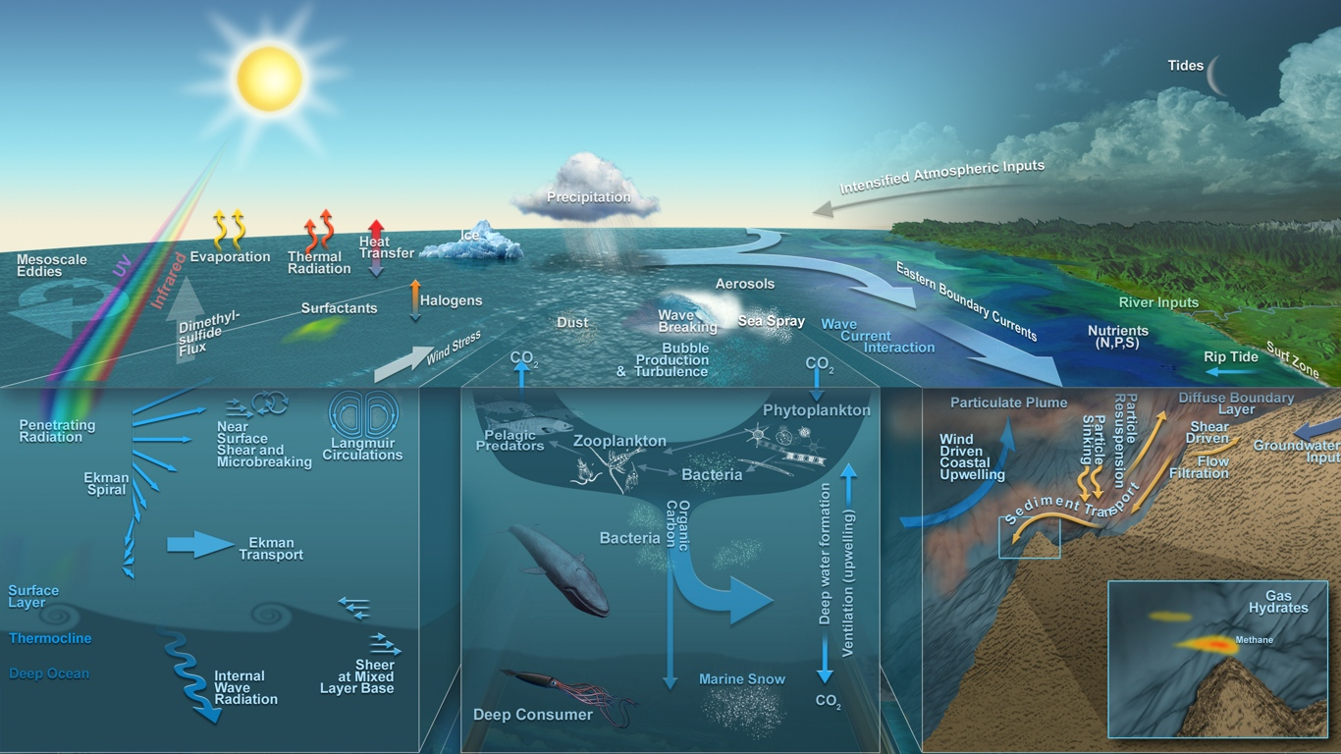
Thanks to Neptune, John Delaney, and Mark Stoermer

Slide 3
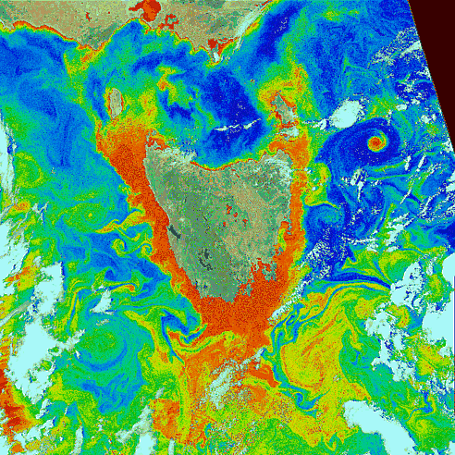
GSFC, NASA

Slide 4
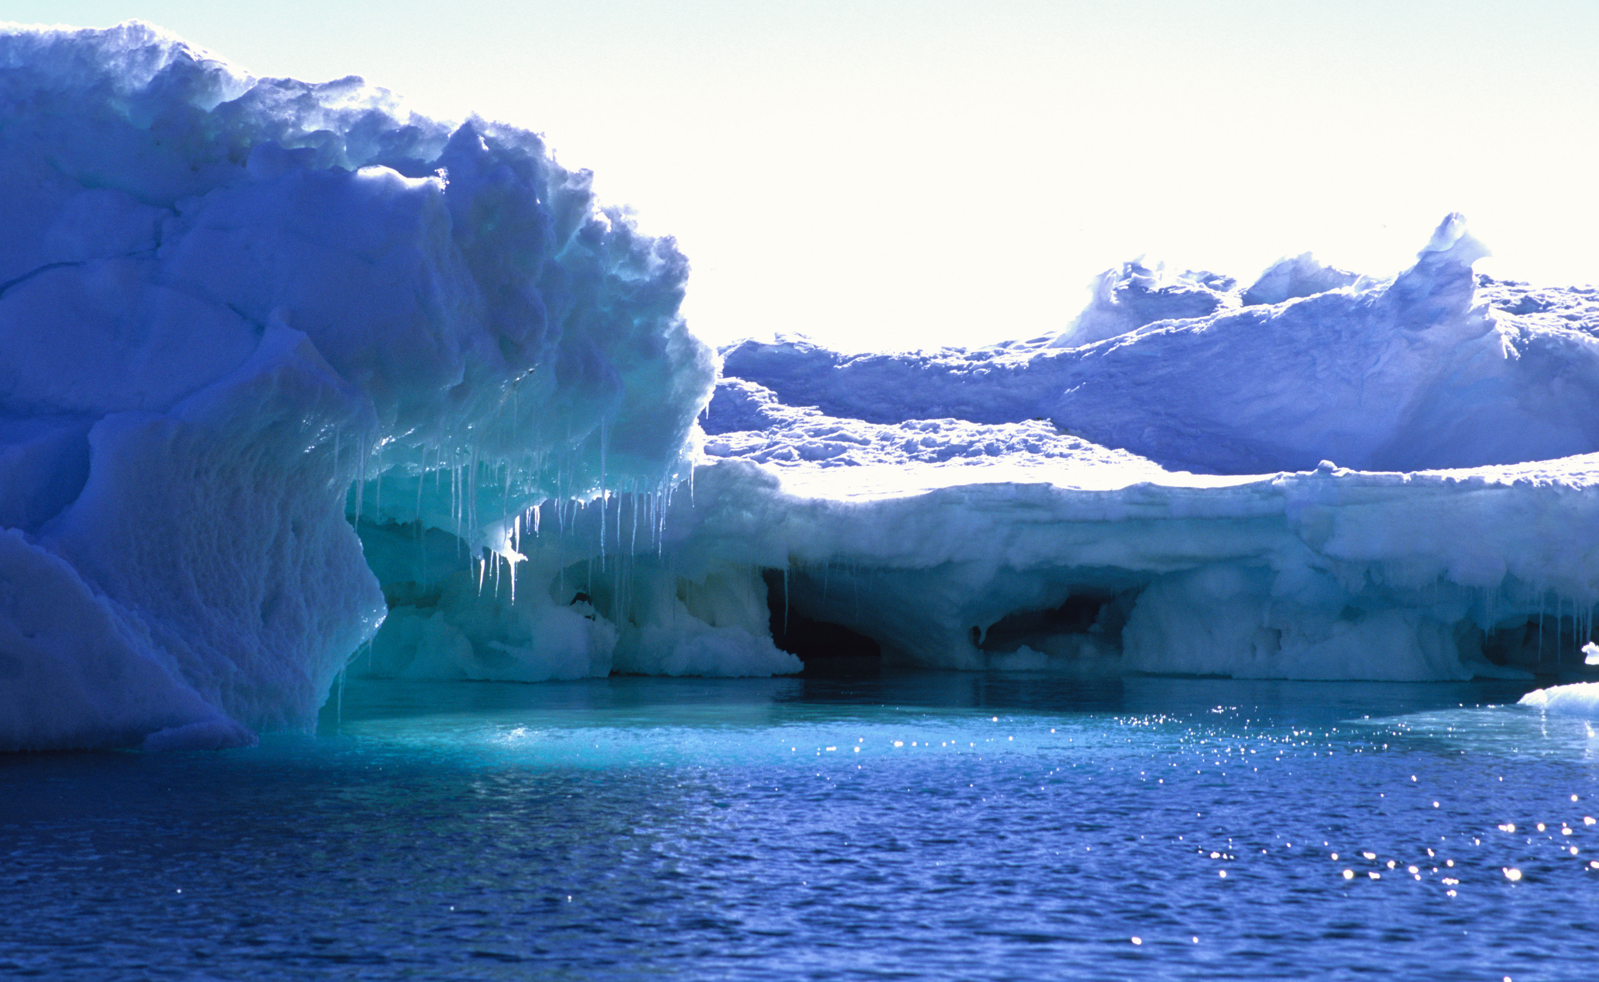
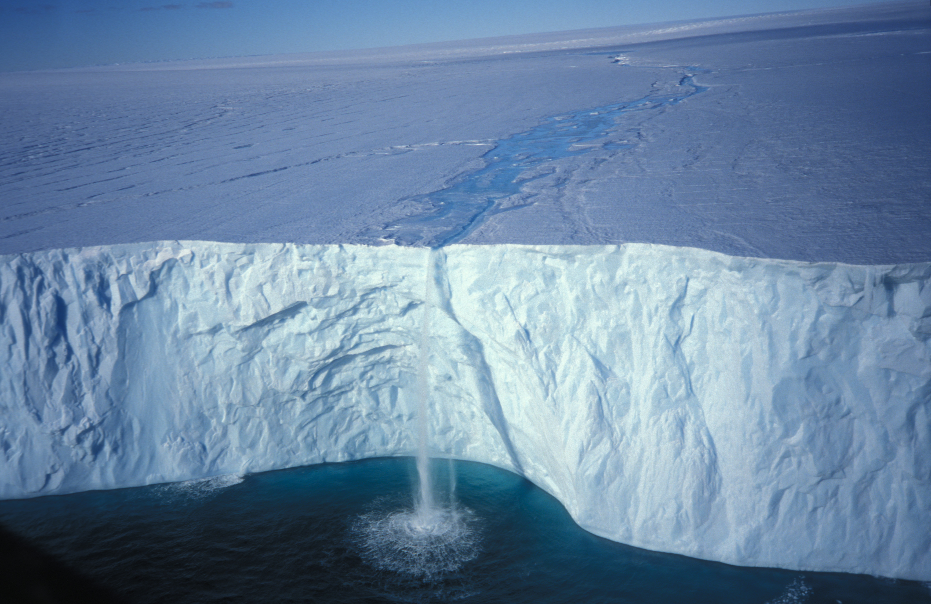

Slide 6
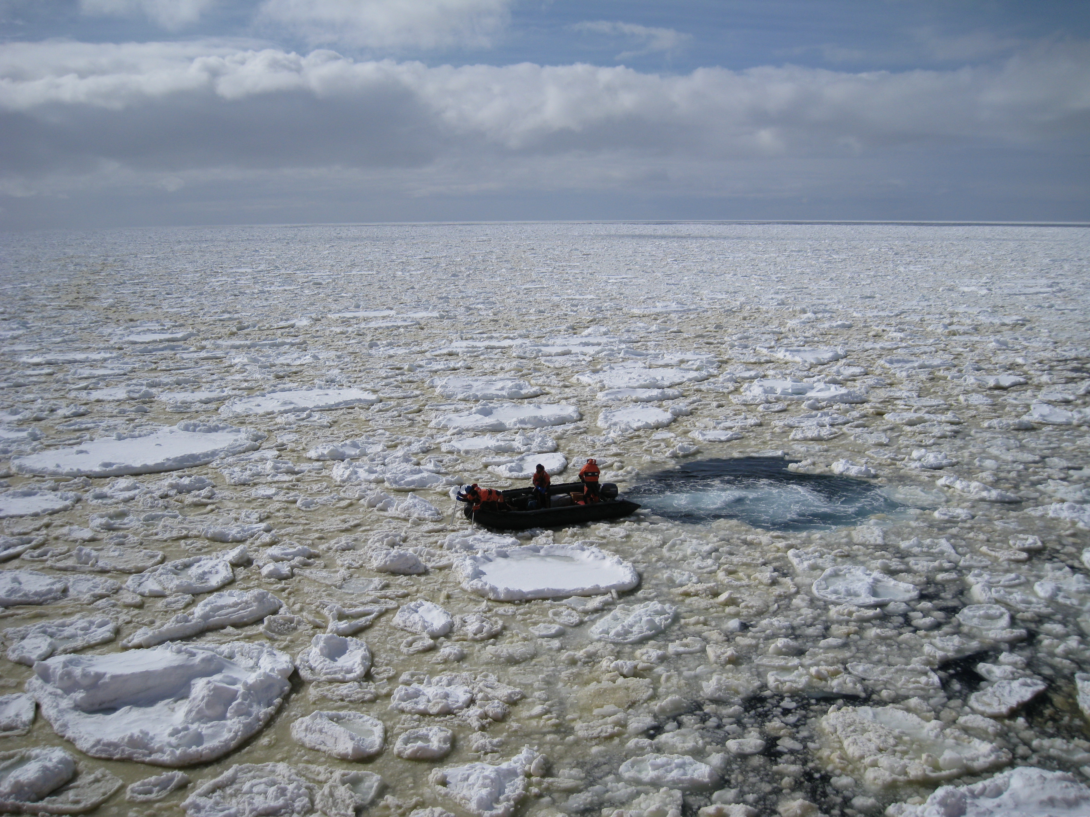

Slide 7
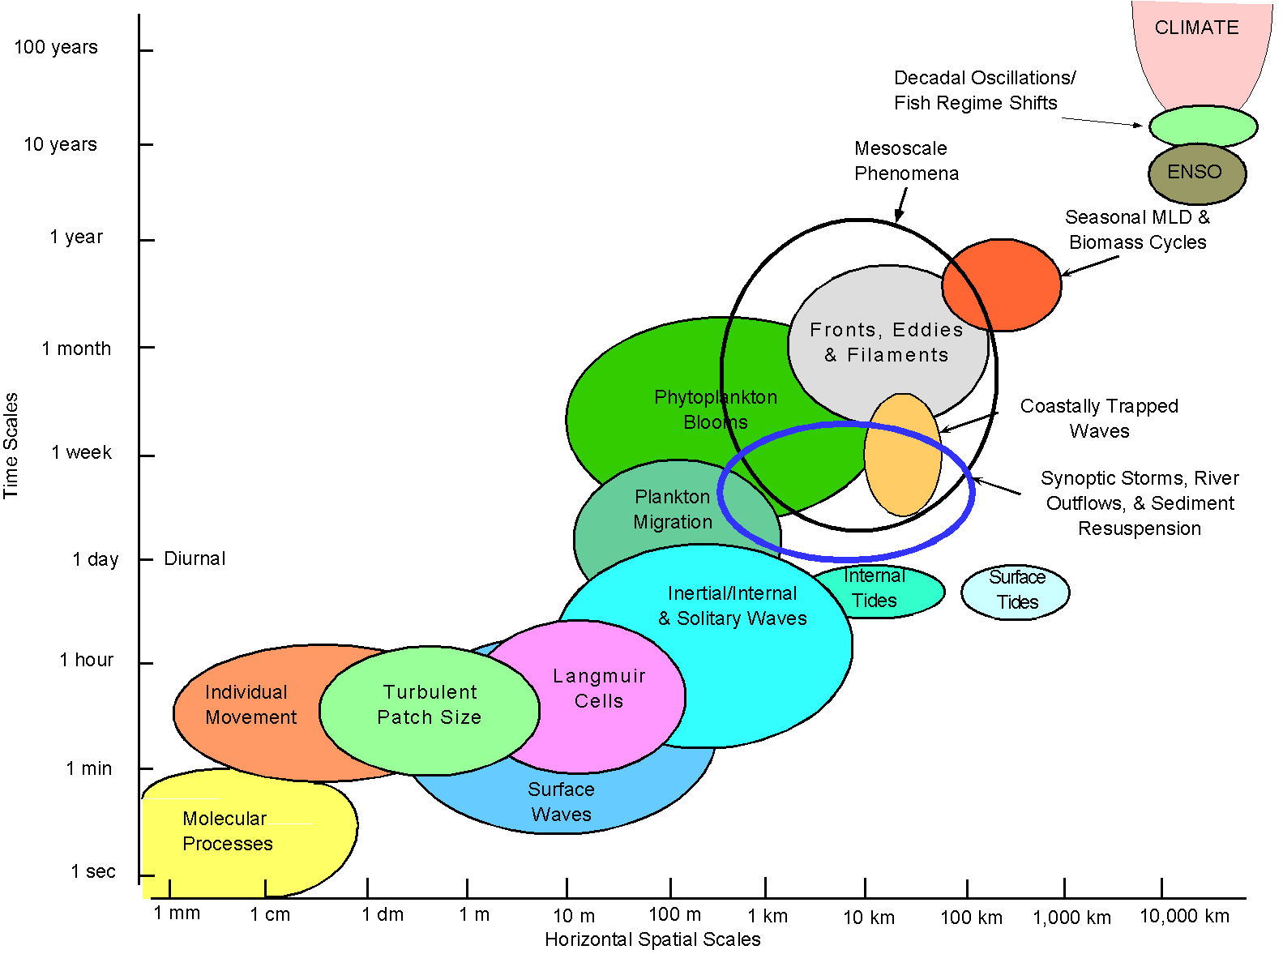
Moorings, tripod
cable nodes
HF radar
Satellites
AUVs
planes
Drifters, Floats, Gliders
model

Slide 8
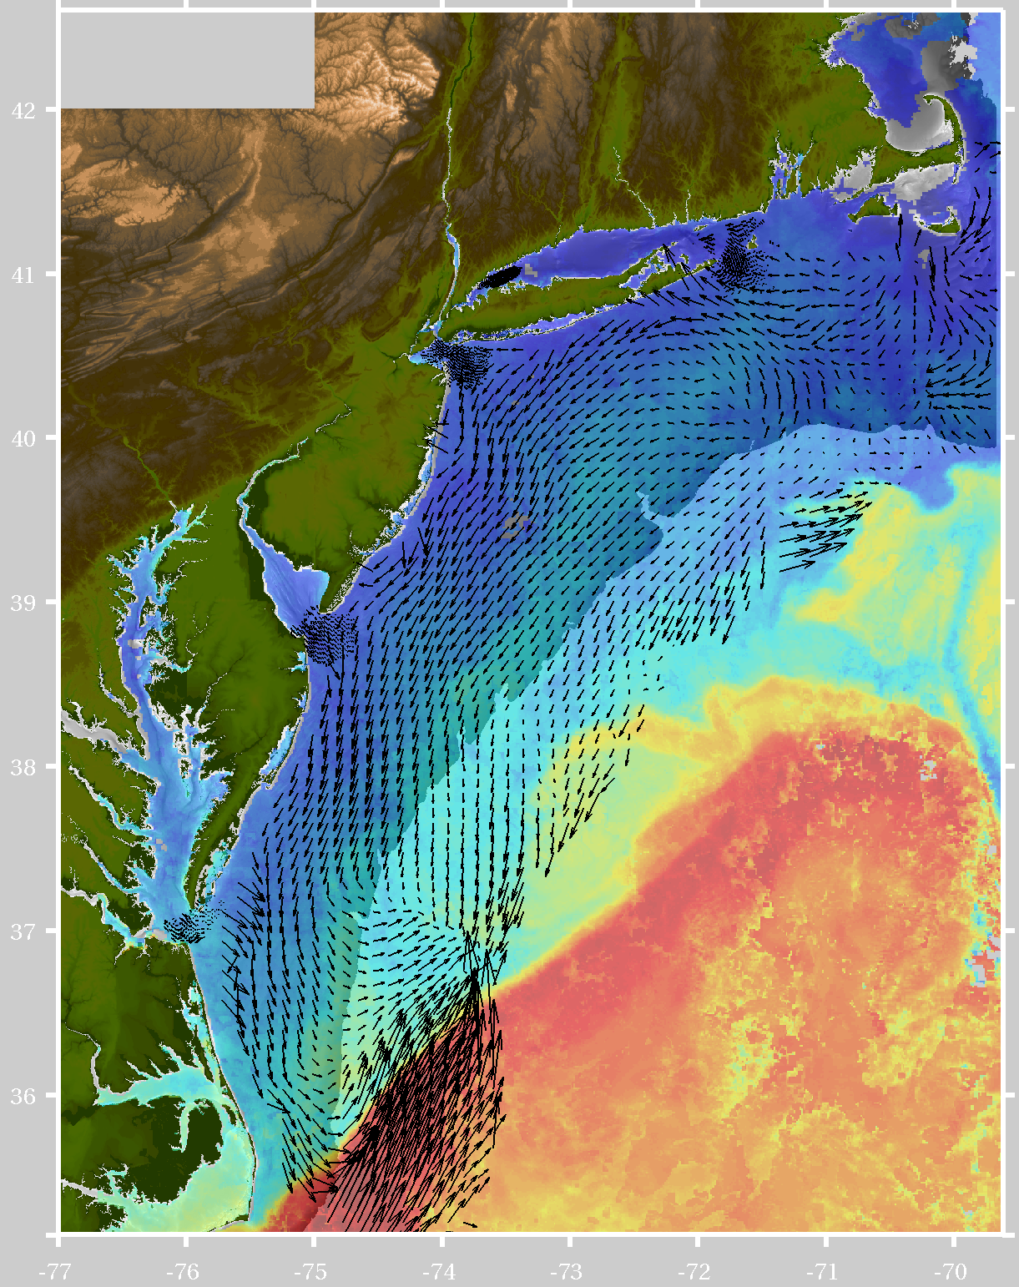
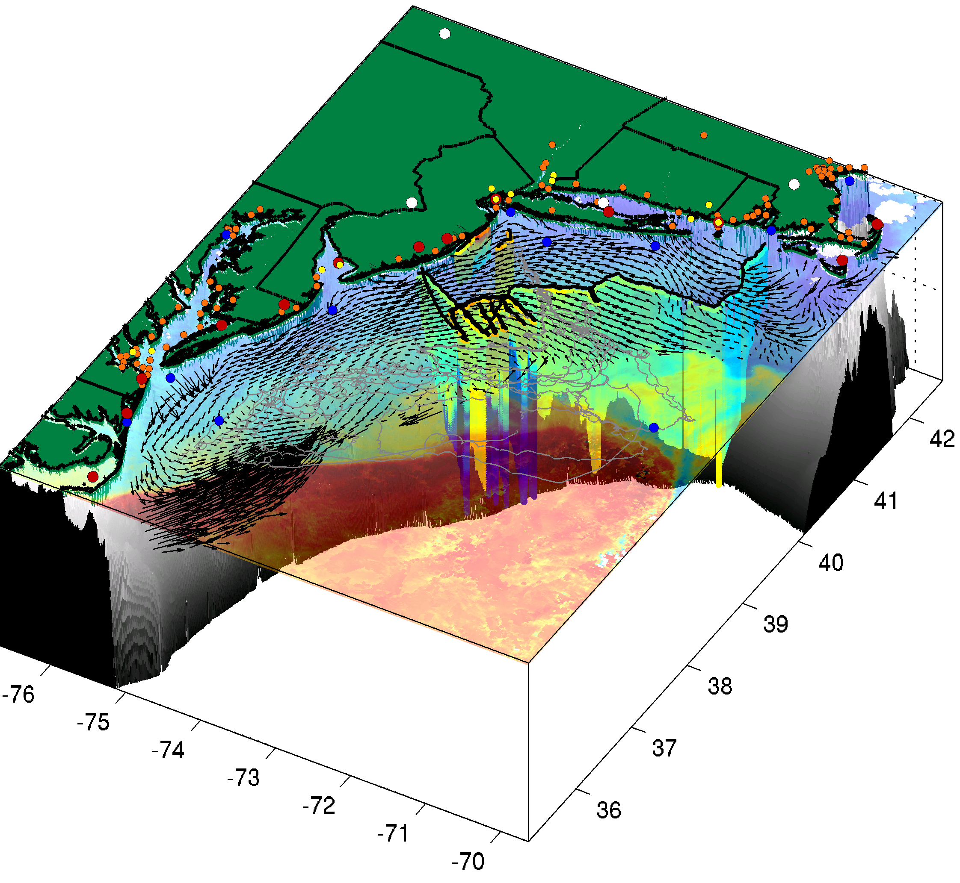
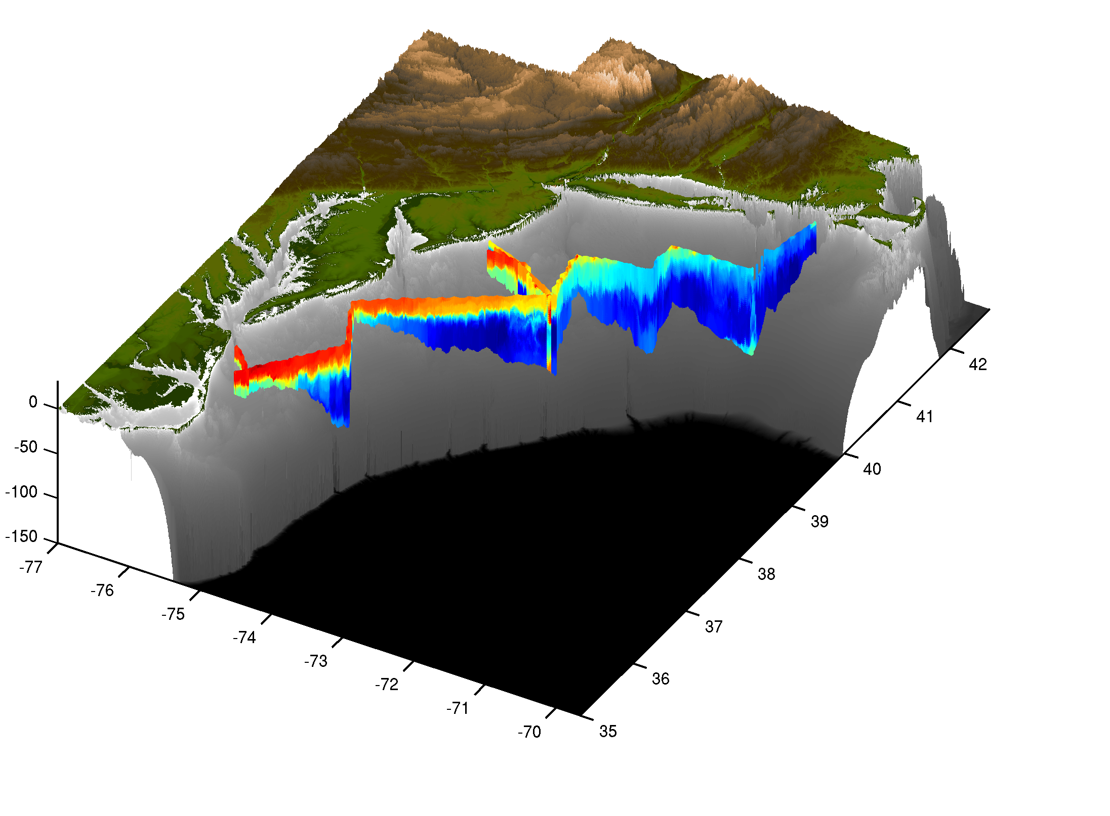
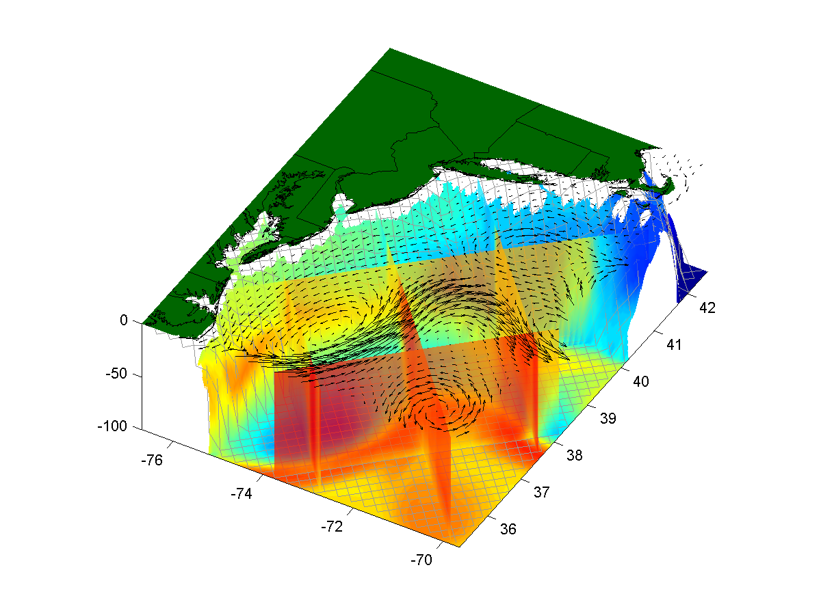
The future is coupled observation & modeling networks
+
=
Remote Sensing
Gliders
3-D Nowcasts
+
=
Nested Models
Data Assimilation
4-D Forecasts

Slide 9
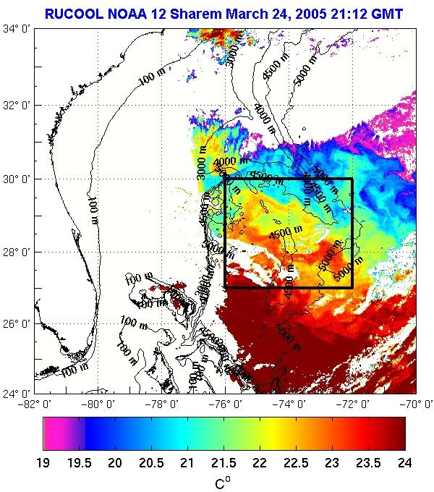
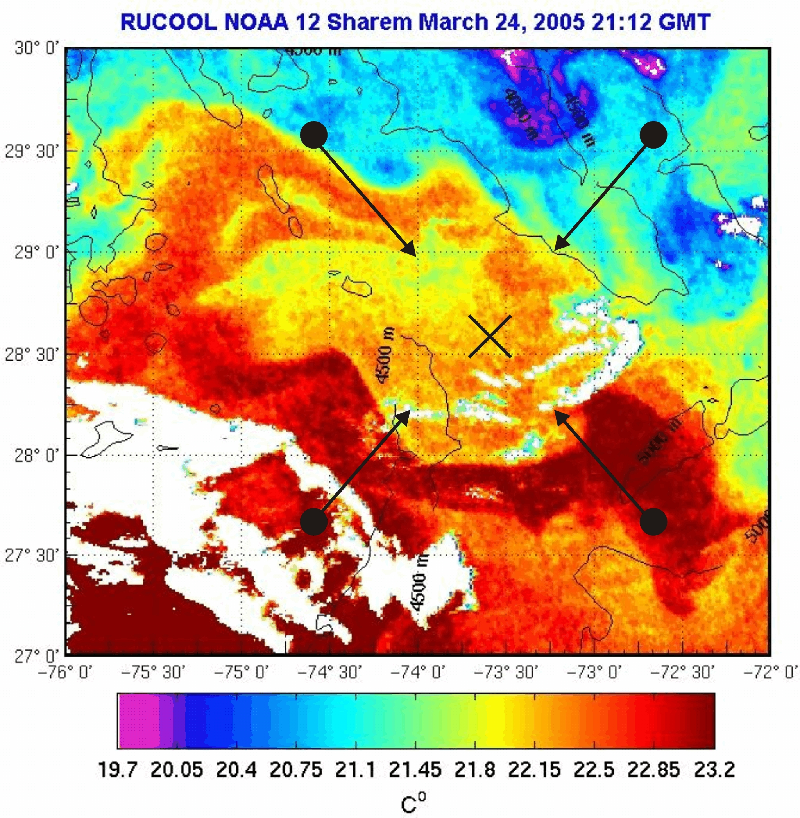
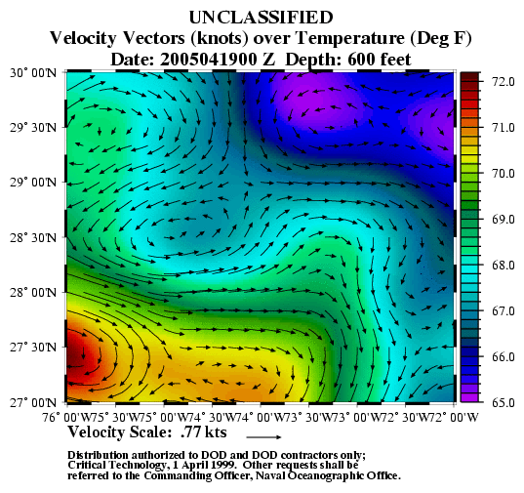
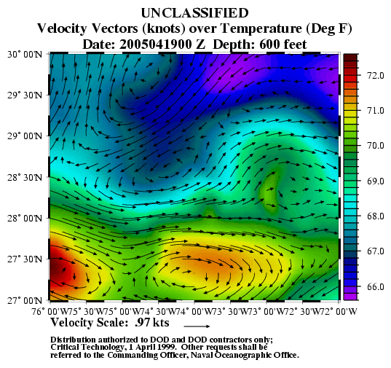
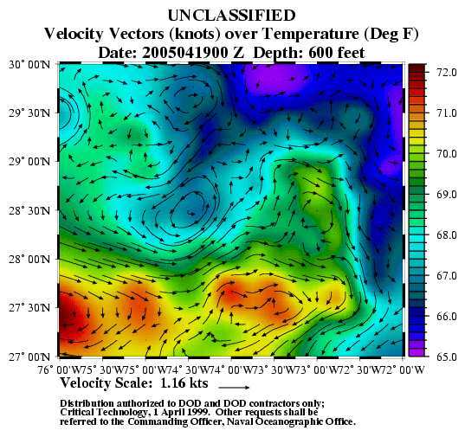
Example of the impact of observations on predictive skill of models
Sargasso Sea Front
Sargasso Sea Front
Sargasso Sea Front
Cold Core Eddy
Warm Core Remnant
Warm Core Remnant
Cold Core Eddy
Cold Core Eddy
Warm Core Remnant
SHAREM 150 (Glenn et al)

Slide 10
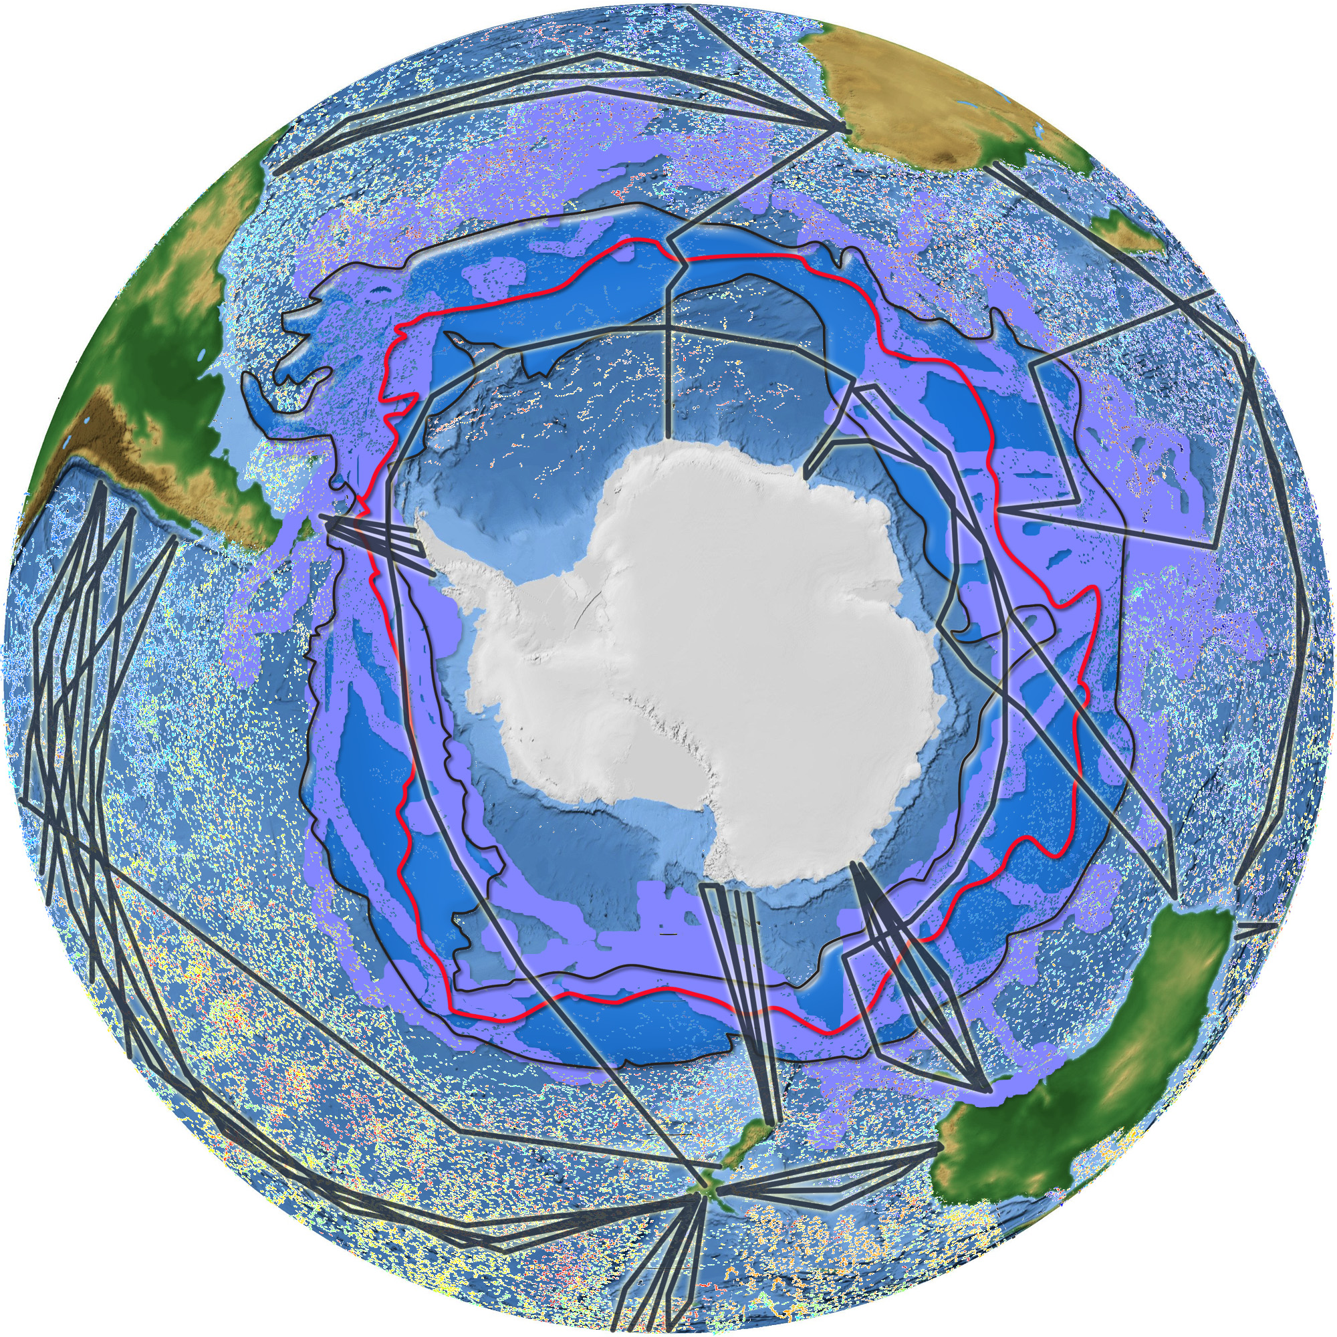
New observations now allow us to collect the data on a scale which can improve global scale models
-Data sets can be provided by ships, profilers, gliders, satellites and animals

Slide 11
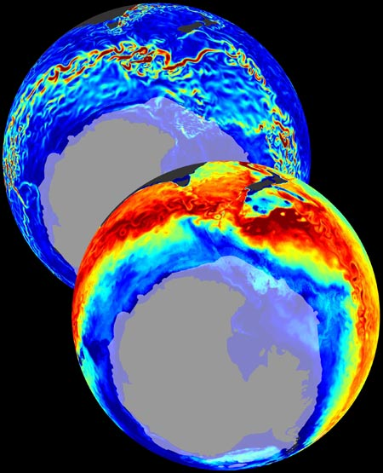
This will enable new
high resolution biogeochemical
models that will allow for climate scale simulations
Velocity
C_{anthro}

Slide 12
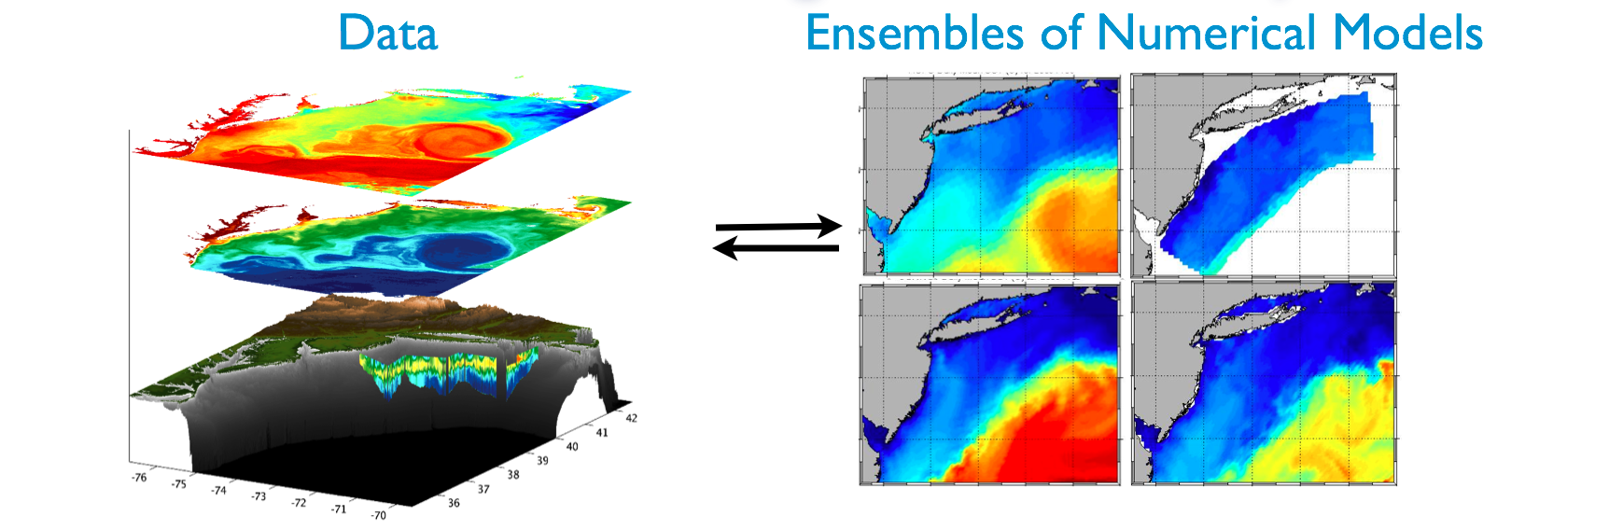

Slide 13
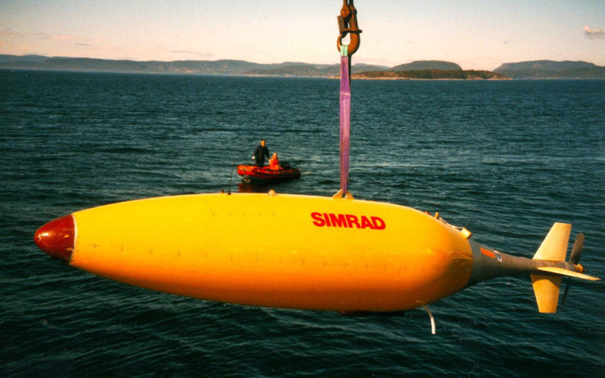
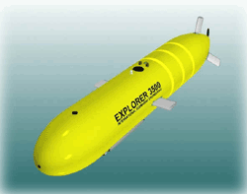
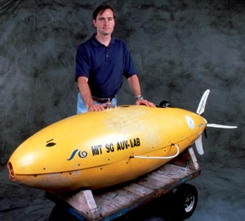
Robots are here: They can be large and medium-sized
Hugin Kongsberg Simrad, Norway
Autosub Southampton Oceanography Centre, UK
Explorer family
ISE Research, Canada
Odyssey
Bluefin Robotics, USA
Martin-600
Maridan, Denmark

Slide 14
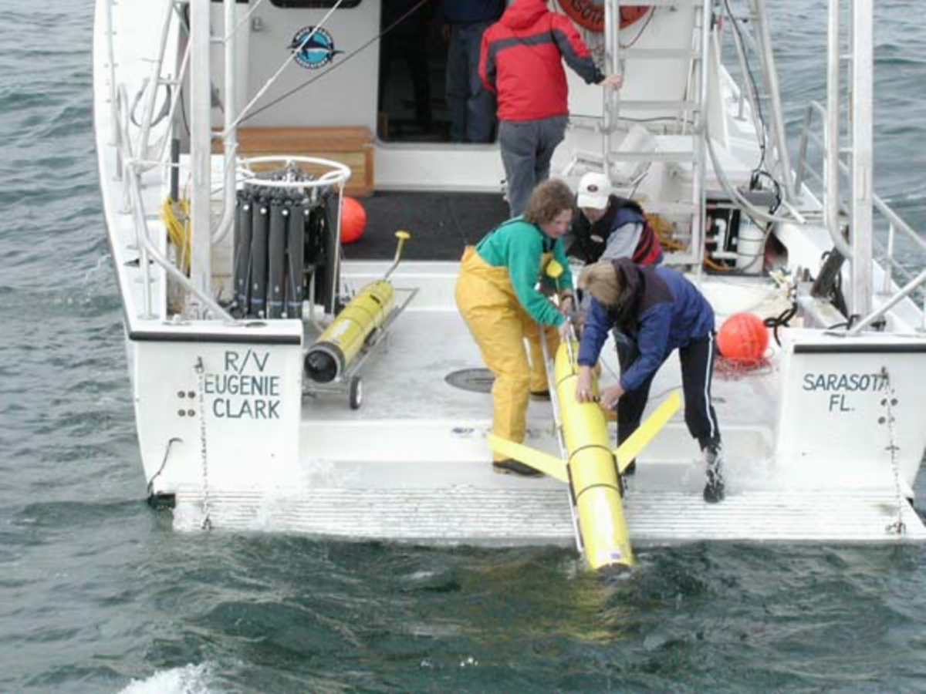
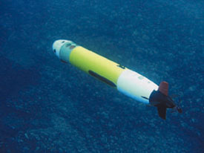
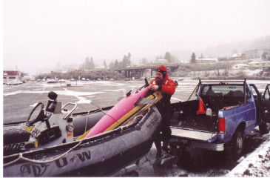
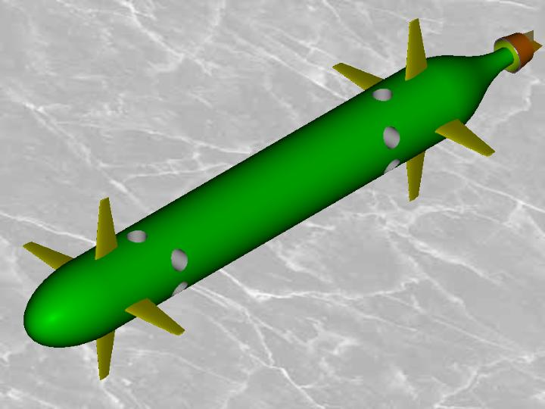
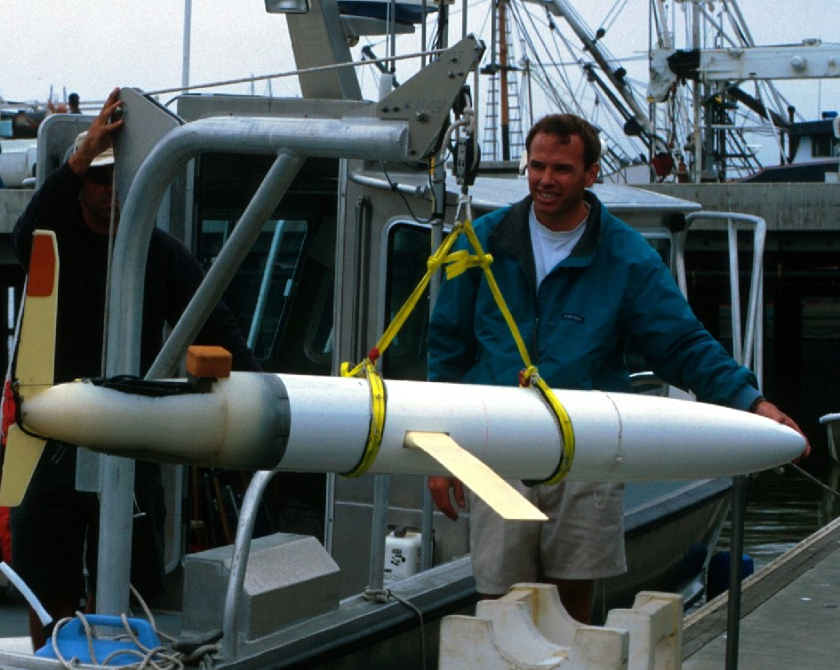
Slocum glider Rutgers University, USA
Remus - a 1.8 m long AUV
Hydroid Inc., USA
The Mauve AUV
France
Sea glider U. Washington & APL, USA
C-Scout, IMD, Canada
Gavia - a one person AUV
Hafmynd, Iceland
Spray glider, Scripps Inst.

Slide 15
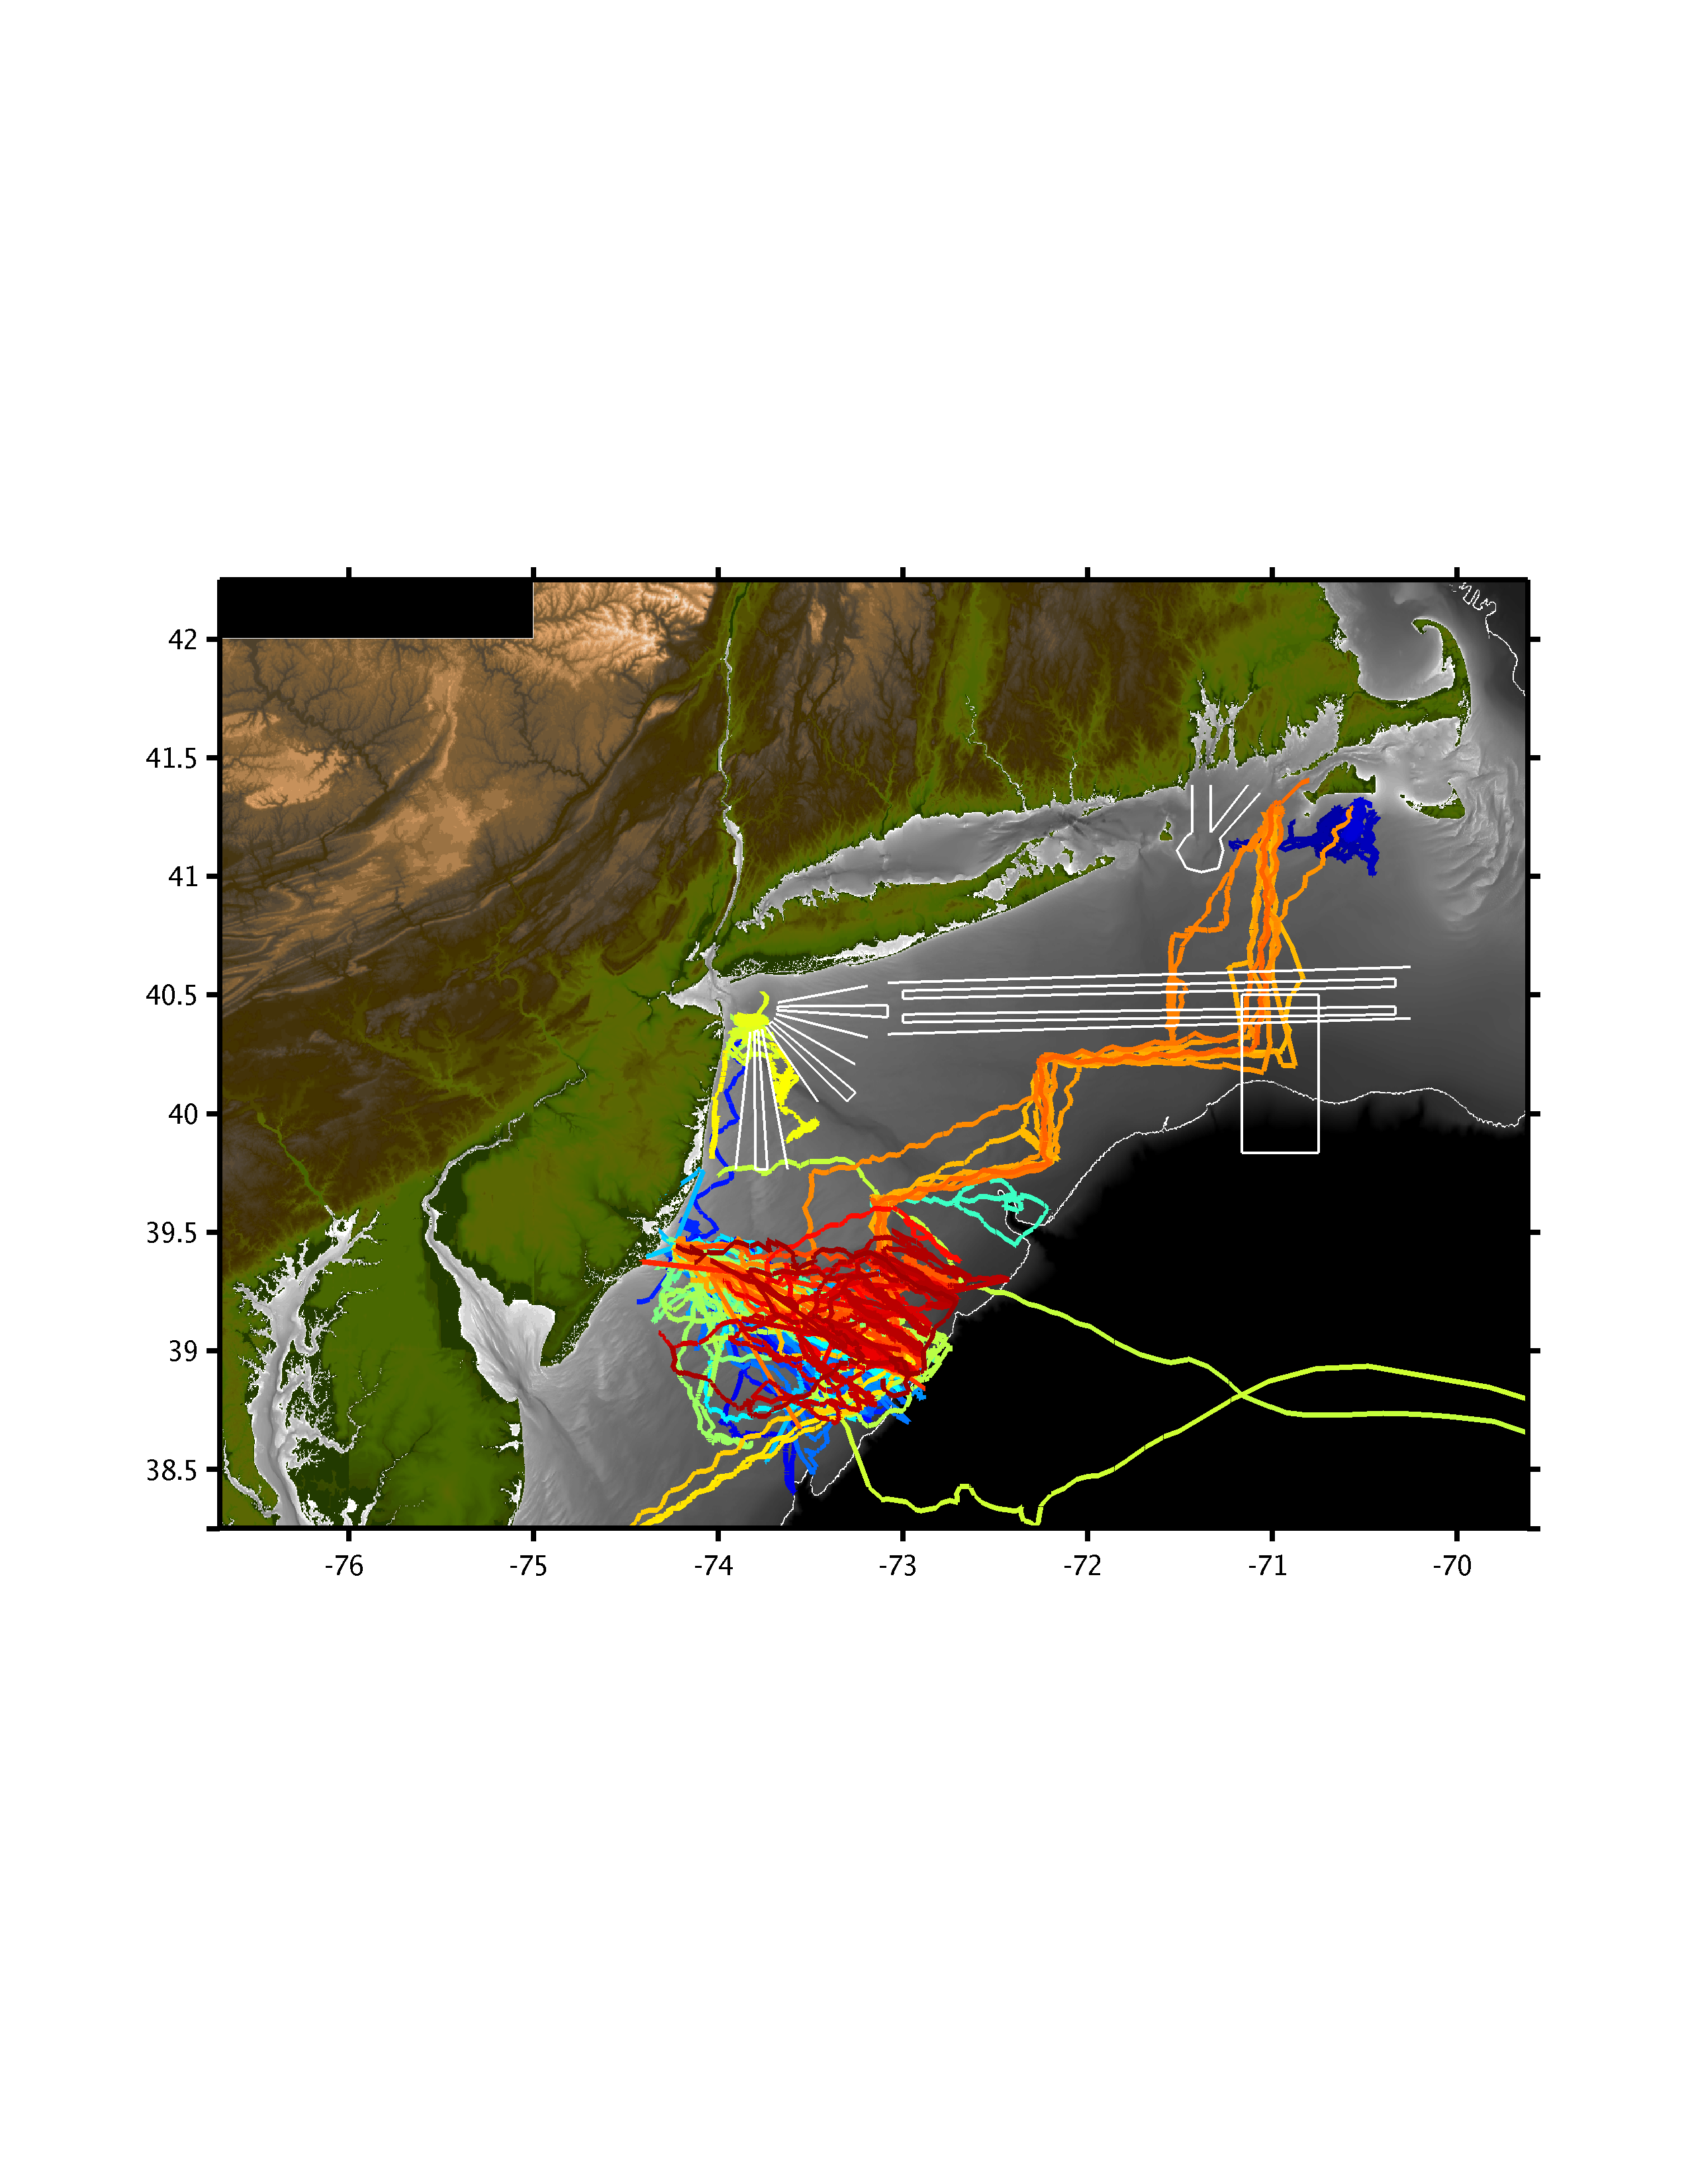
These systems can provide a sustained ocean presence.
To date (my lab)
-missions 262
-distance (km) 109150
-days at sea 5331

Slide 17
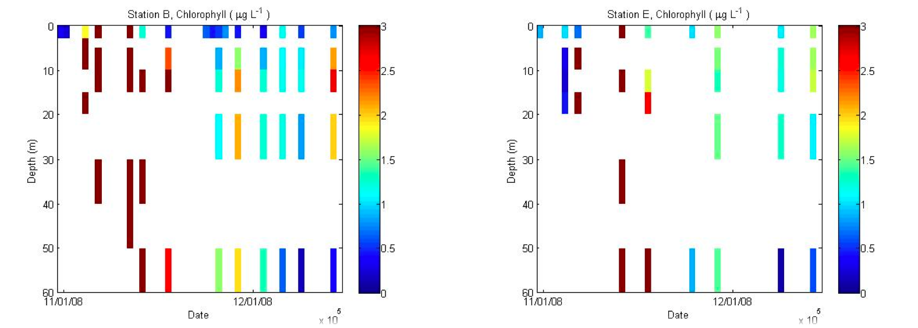
Phytoplankton data collected using traditional modes from Palmer Station by a HARD working graduate student. Discrete samples collected by zodiac.

Slide 18
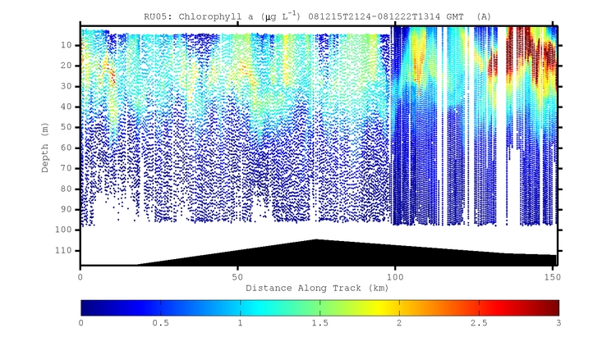
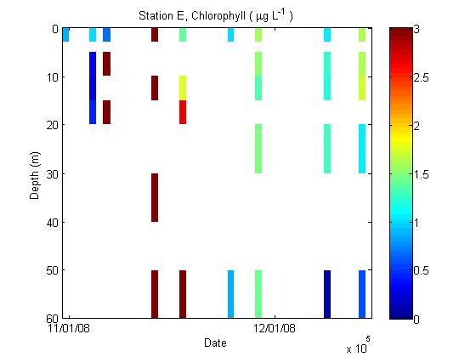

Slide 19
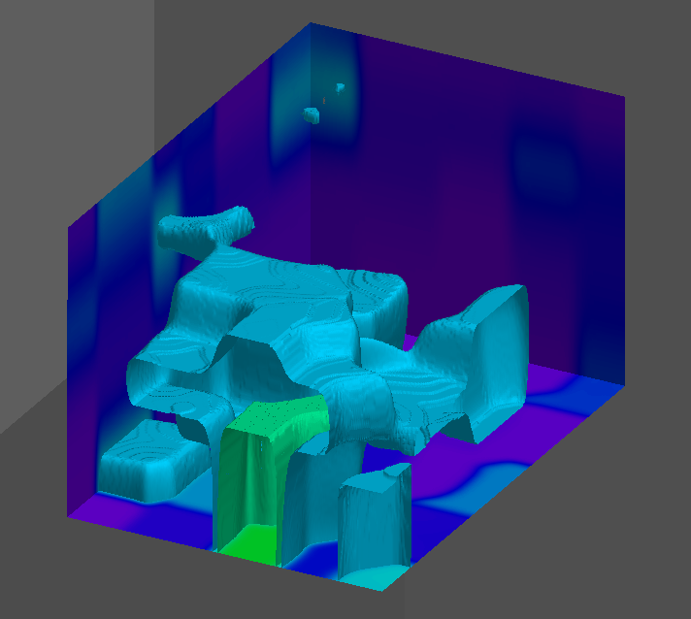
BL Isosurfaces
1E¹⁰ ph/s/35L
0
3E¹¹ ph/s/.35L
Depth (m)
15
Latitude
(~5km)
Longitude (~2km)

Slide 20
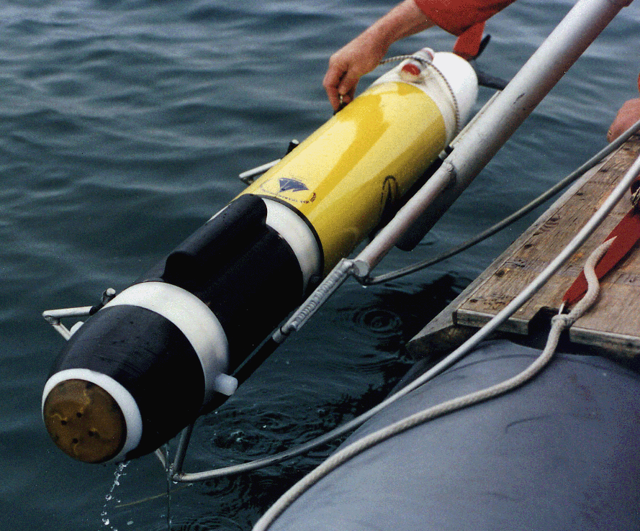
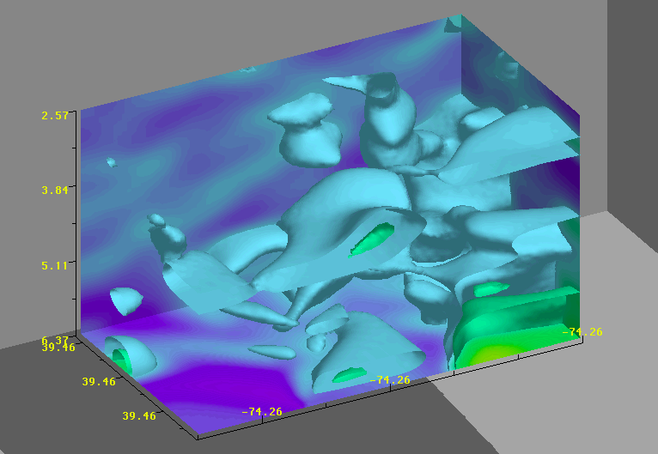
BL Isosurfaces
5E¹⁰ph/s/.35L
1E¹¹ph/s/.35L
Depth (m)
Latitude
(~300m)
Longitude (~500m)

Slide 21

These networks are fully linked to the new global digital networks. This will change the culture of oceanography. Anybody can be an oceanographer, developing the tools to engage these communities will be critical to garner the support required.

Slide 22
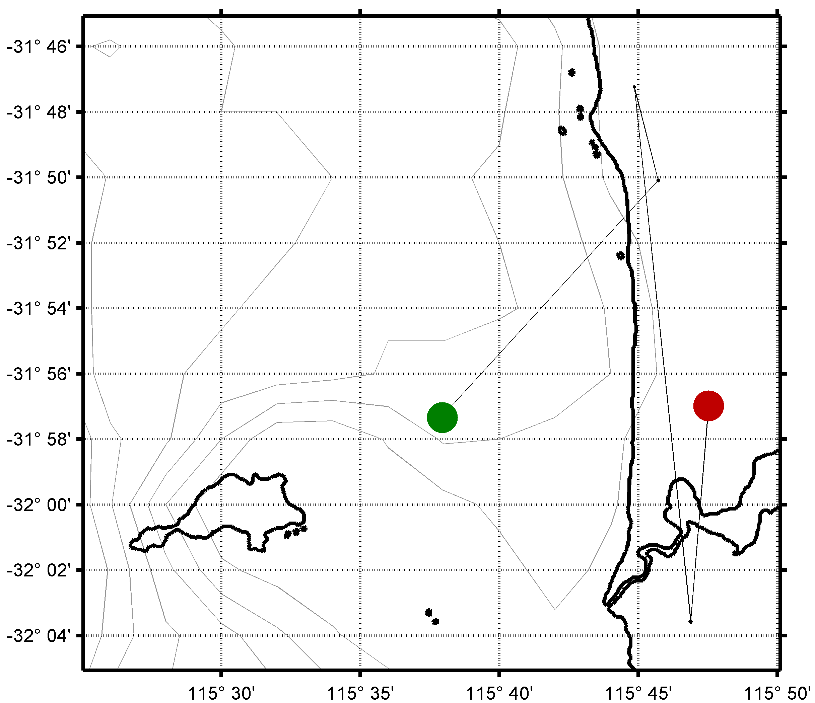
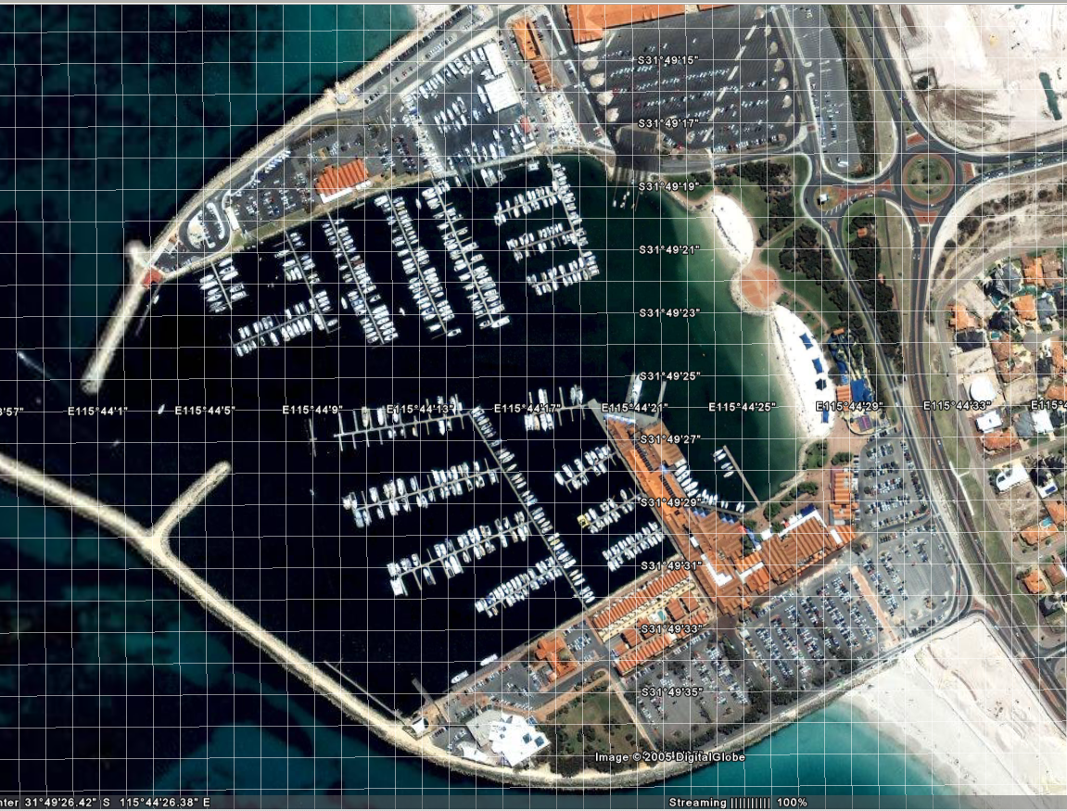
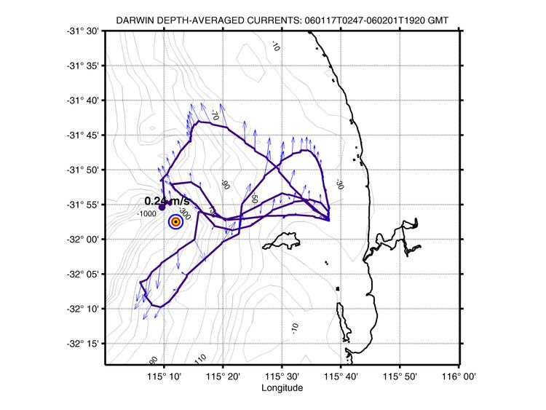
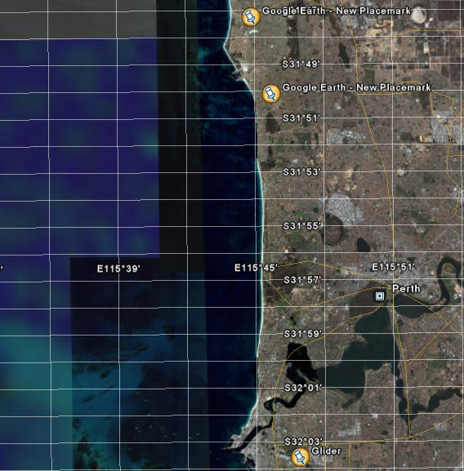
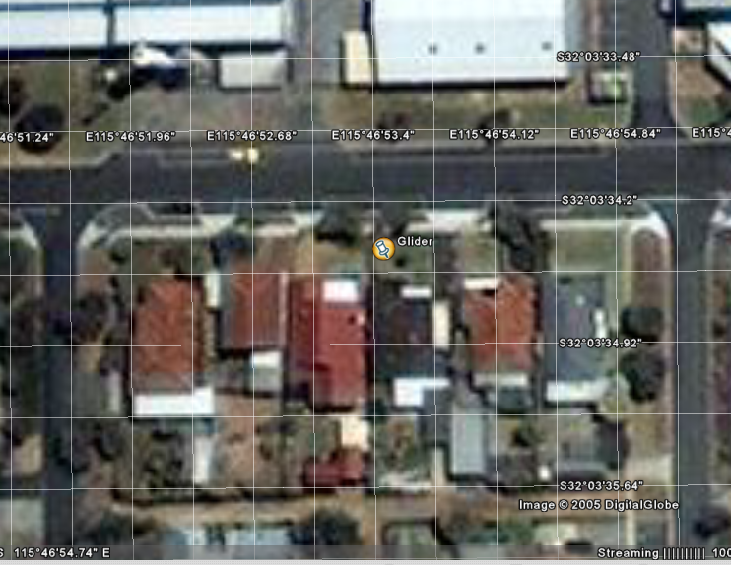
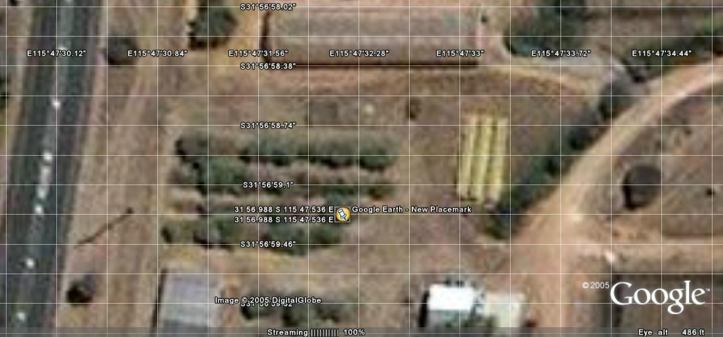

Slide 23
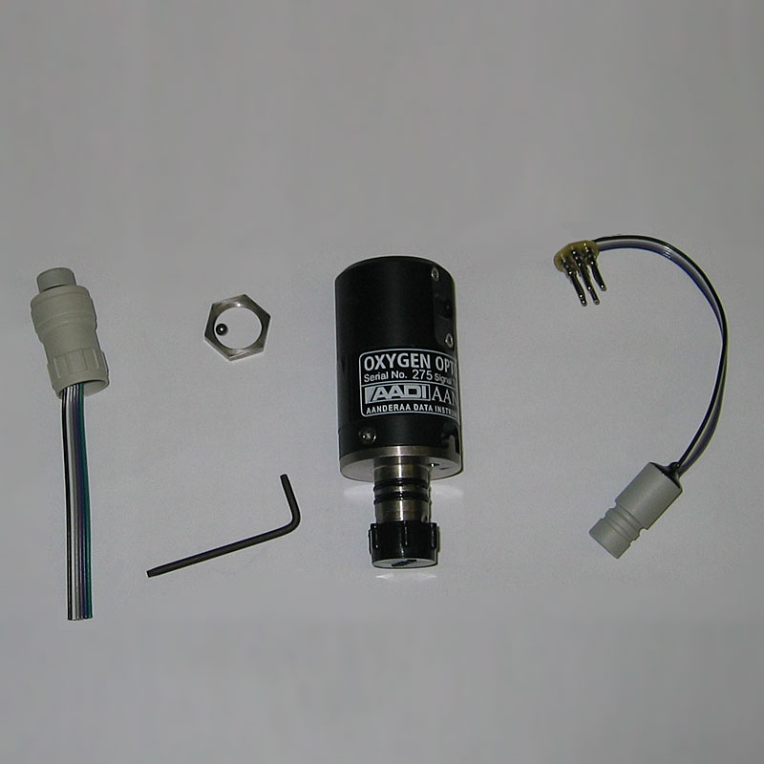
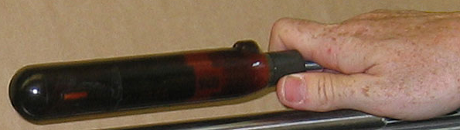
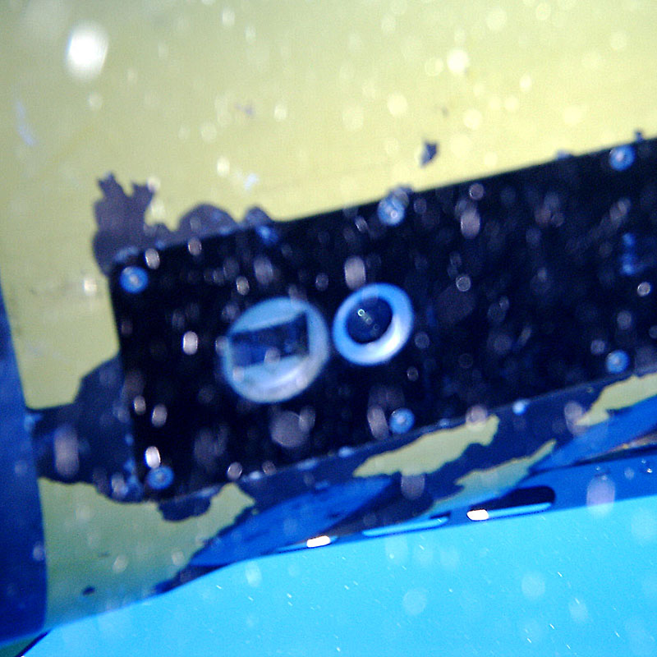
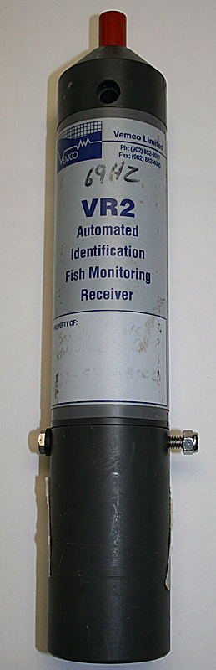
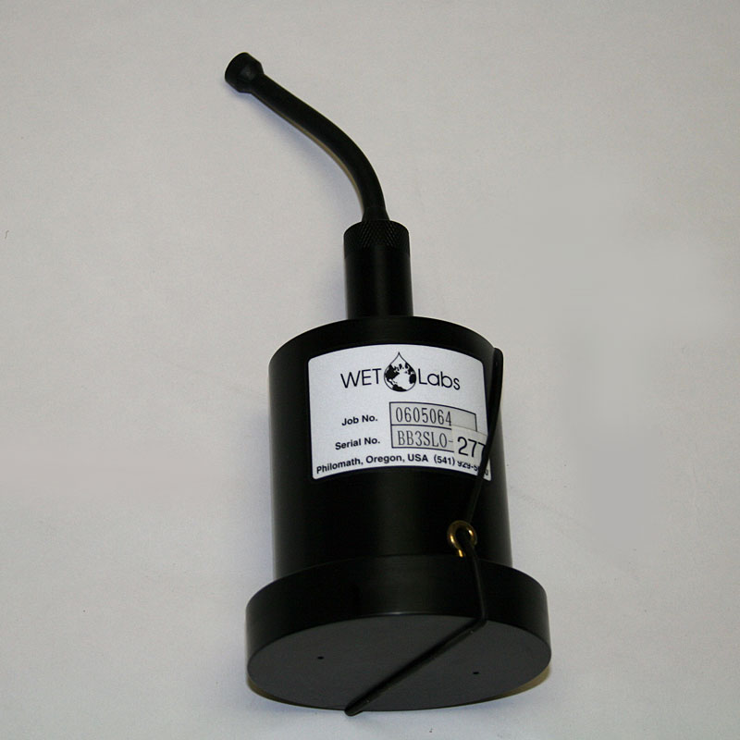
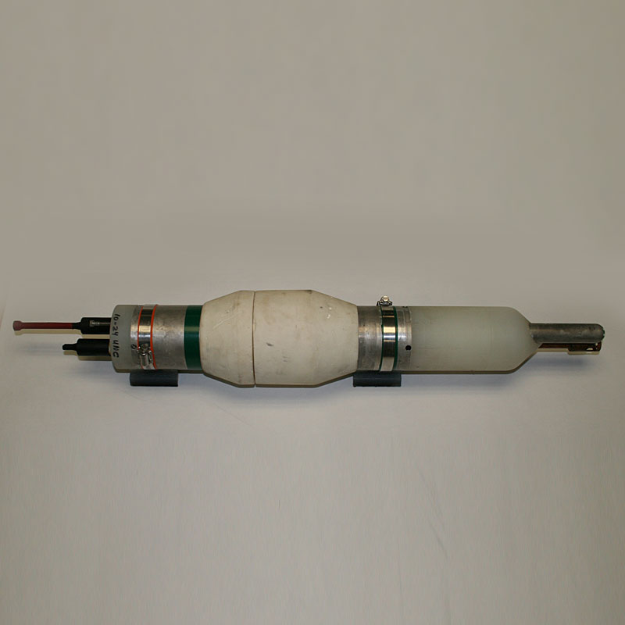
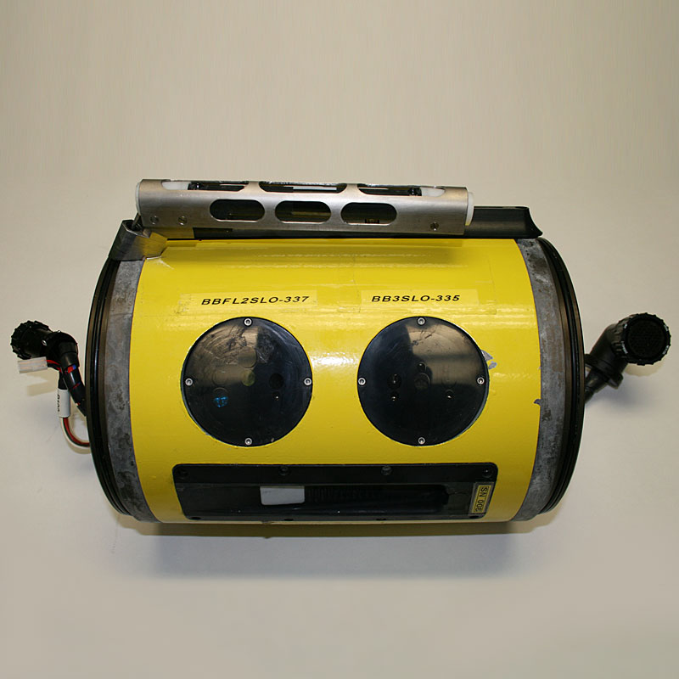
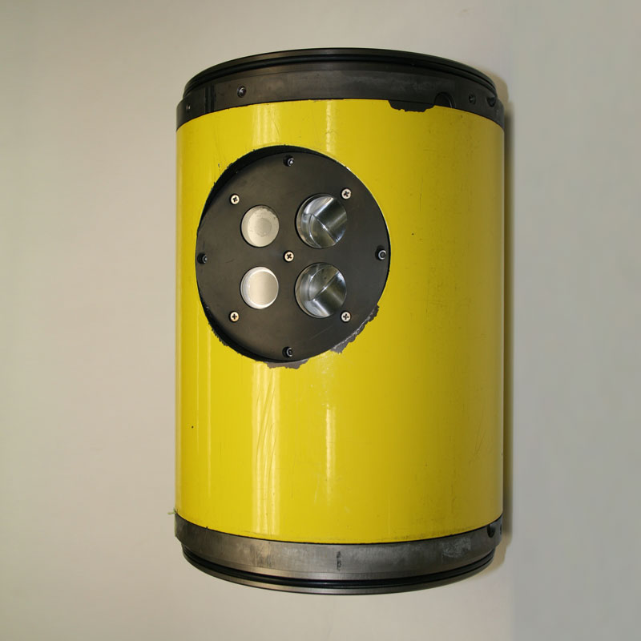
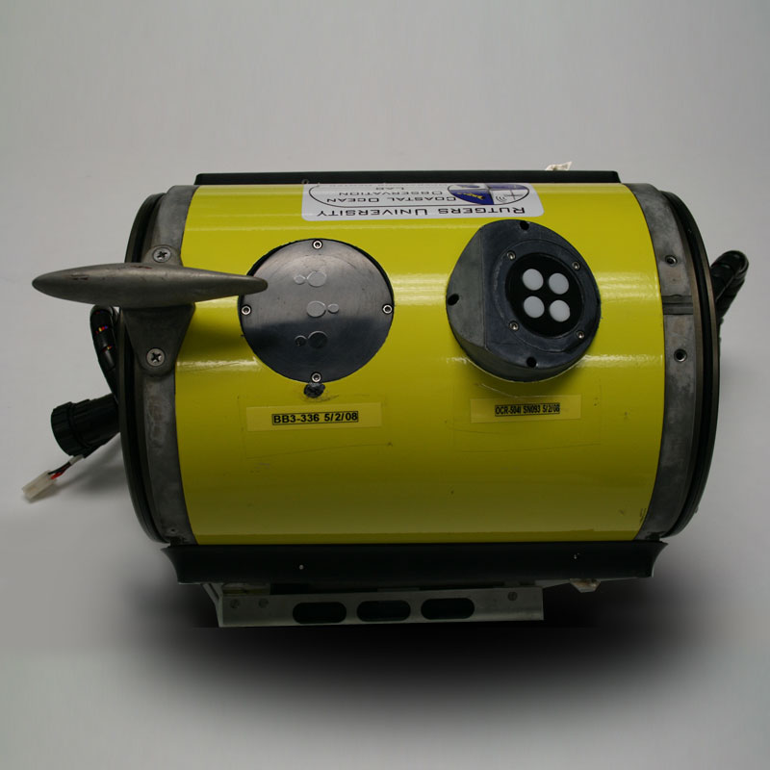
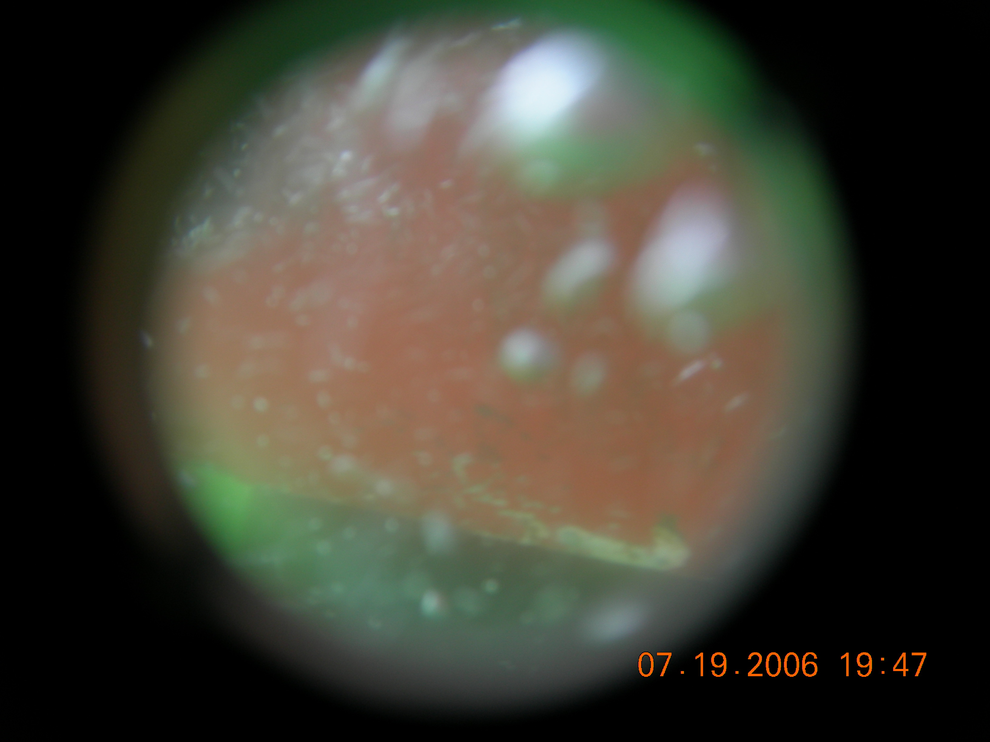
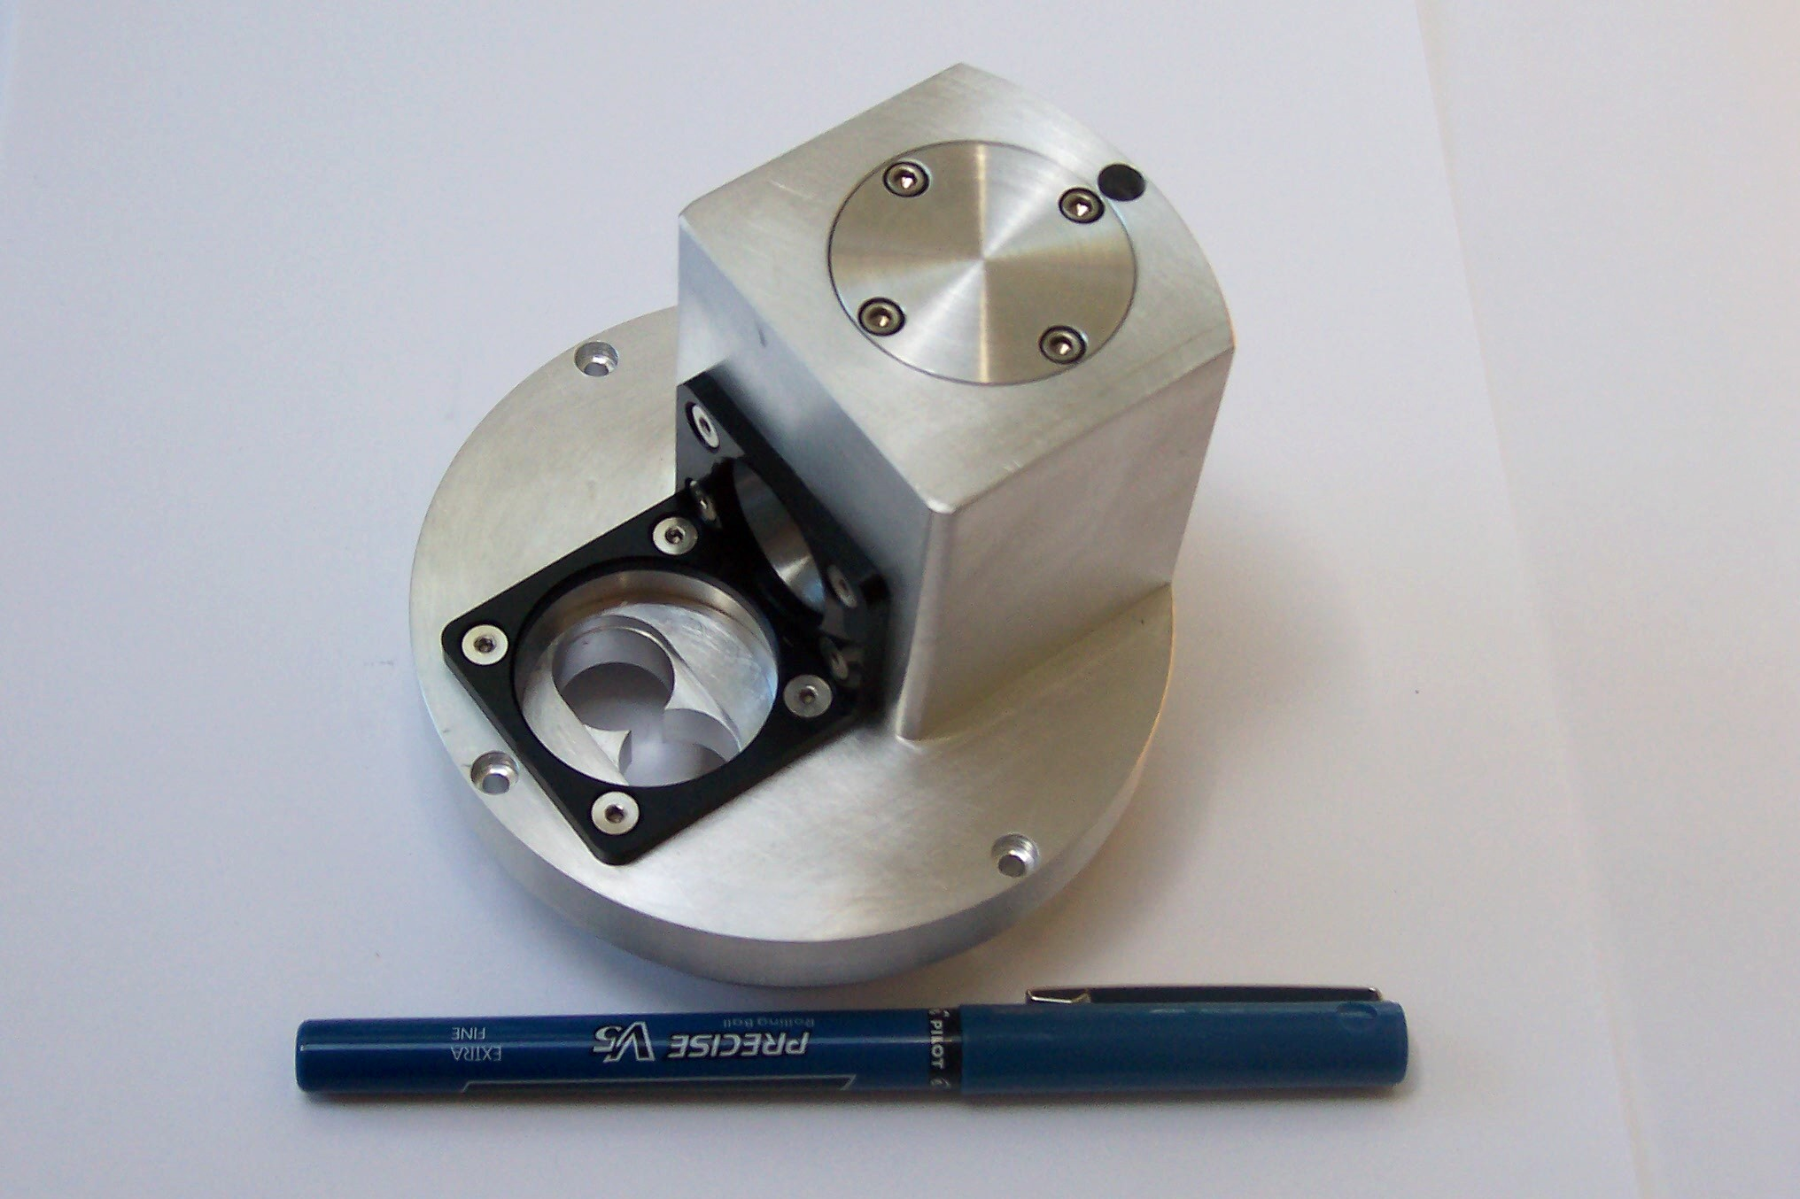

These mobile systems are capable of carrying any sensor if it is small and not too power hungry.
Sensors integrated into gliders

Slide 24


Slide 25


Slide 26


Slide 27







Example data from WHOI dock – December 2004
-Fluorescence / scattering signature
-Associated images
(all same scale)
Heidi Sosik, et al.
WHOI
Note: Davis-Gallagher VPR
for larger scale organisms

Slide 28


USF
SIPPER
Imaging
System

Slide 29



Slide 30


For a global footprint and fleet of robots it would be nice for them to be smart: development of the glider brain, feature tracking
Here glider looked at its own data to make a decision underwater on its own.
The glider brains will be key to provide adaptive sampling of ocean features of high science priority

Slide 31







Observing System Experiment (OSE)
Design, Testing and Deploy
Observatory (simulated) data
Models
Sensor &
Platform
~3 km
~100 m
Virtual Ocean
Data Assimilation
Data
Analysis
Science Questions & Drivers
Data Synthesis: Nowcast & Data Impact

Slide 32


Slide 33

PLANNING IN THE FUTURE

Slide 34


Science Alerts
Scientists
Science Campaigns
Science
Agents
Science Event Manager
Processes alerts and
Prioritizes response observations
EO-1 Flight Dynamics
Tracks, orbit, overflights,
momentum management
Observation
Requests
ASPEN
Schedules observations on EO-1
Hyperion
on EO-1
Updates to onboard plan
34

Slide 35

Increase model resolution
Reduce forecast error

Slide 36


Slide 37



Slide 38


