Slide 1

Phytoplankton Community Dynamics: Need to think about species
Open questions, strategies and goals for the coming 6 years
Oscar Schofield, Grace Saba, Alex Kahl, Travis Miles, Tina Haskins, Nicole Cuoto, Ana Filipa Carvhlo, Kaycee Coleman, Mike Garzio, Mikela Provost
Progress the last 5 years
Thoughts moving forward
“It’s not my job to tell the American people what to think. Our job in Washington is to listen to the American people” Speaker Boehner

Slide 2
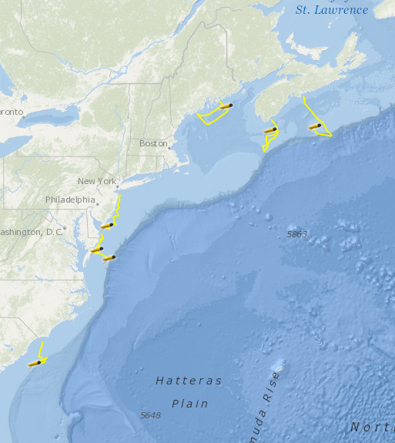



Slide 3
Phytoplankton Biomass
We have evidence of decadal shifts of the phytoplankton biomass in the WAP, trends reflect shifting sea ice extent, increasing clouds and wind in the north (Montes et al. Science)
The bloom magnitude is largely forced by the magnitude of preceding sea ice season (Montes et al. JGR, Saba et al. in prep)
The positive “big” chlorophyll anomalies are associated with krill recruiting events, and result in increased with penguin chick weight (Saba et al in prep)

Slide 4
SAM (DJF) and SeaWiFS Chl
SAM (SON) and SeaWiFS Chl
(Saba et al. in prep)
Blue: significant negative correlation
Red: significant positive correlation
White/blank: no correlation
NOTE:
CUT-OFF REGION
PC1 SeaWiFS Chl-a (EOF 1)

Slide 5
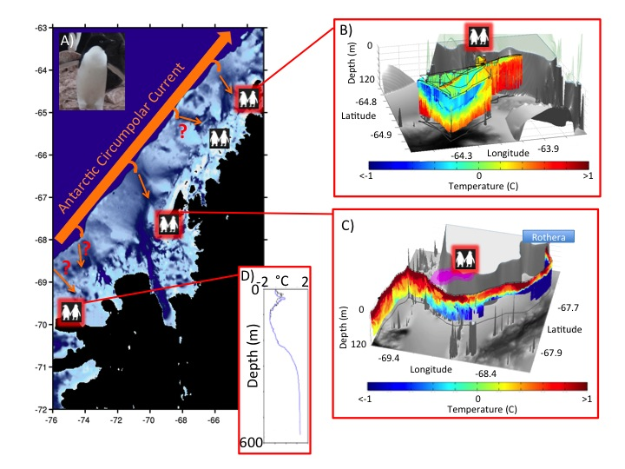
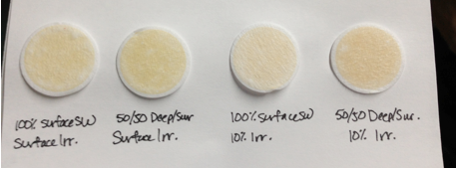
Phytoplankton Biomass
Penguin feeding in the water column is focused in the chlorophyll maximum (Kahl et al. ICB)
Chlorophyll values are high at the canyon heads, consistent with the idea that they provide a region of recurrent food availability, and the canyons do have the signature of warm deep water (Schofield et al. Am. Sci., Oceanogr.)
Driver of the enhanced chlorophyll at canyon head remains an open question (Carvalho In prep)
Variance in the penguin in the foraging at the canyon heads is a influenced by tidal dynamics (Oliver et al. Oceangr., Plos One). Led to a new NSF project for Kohut

Slide 6
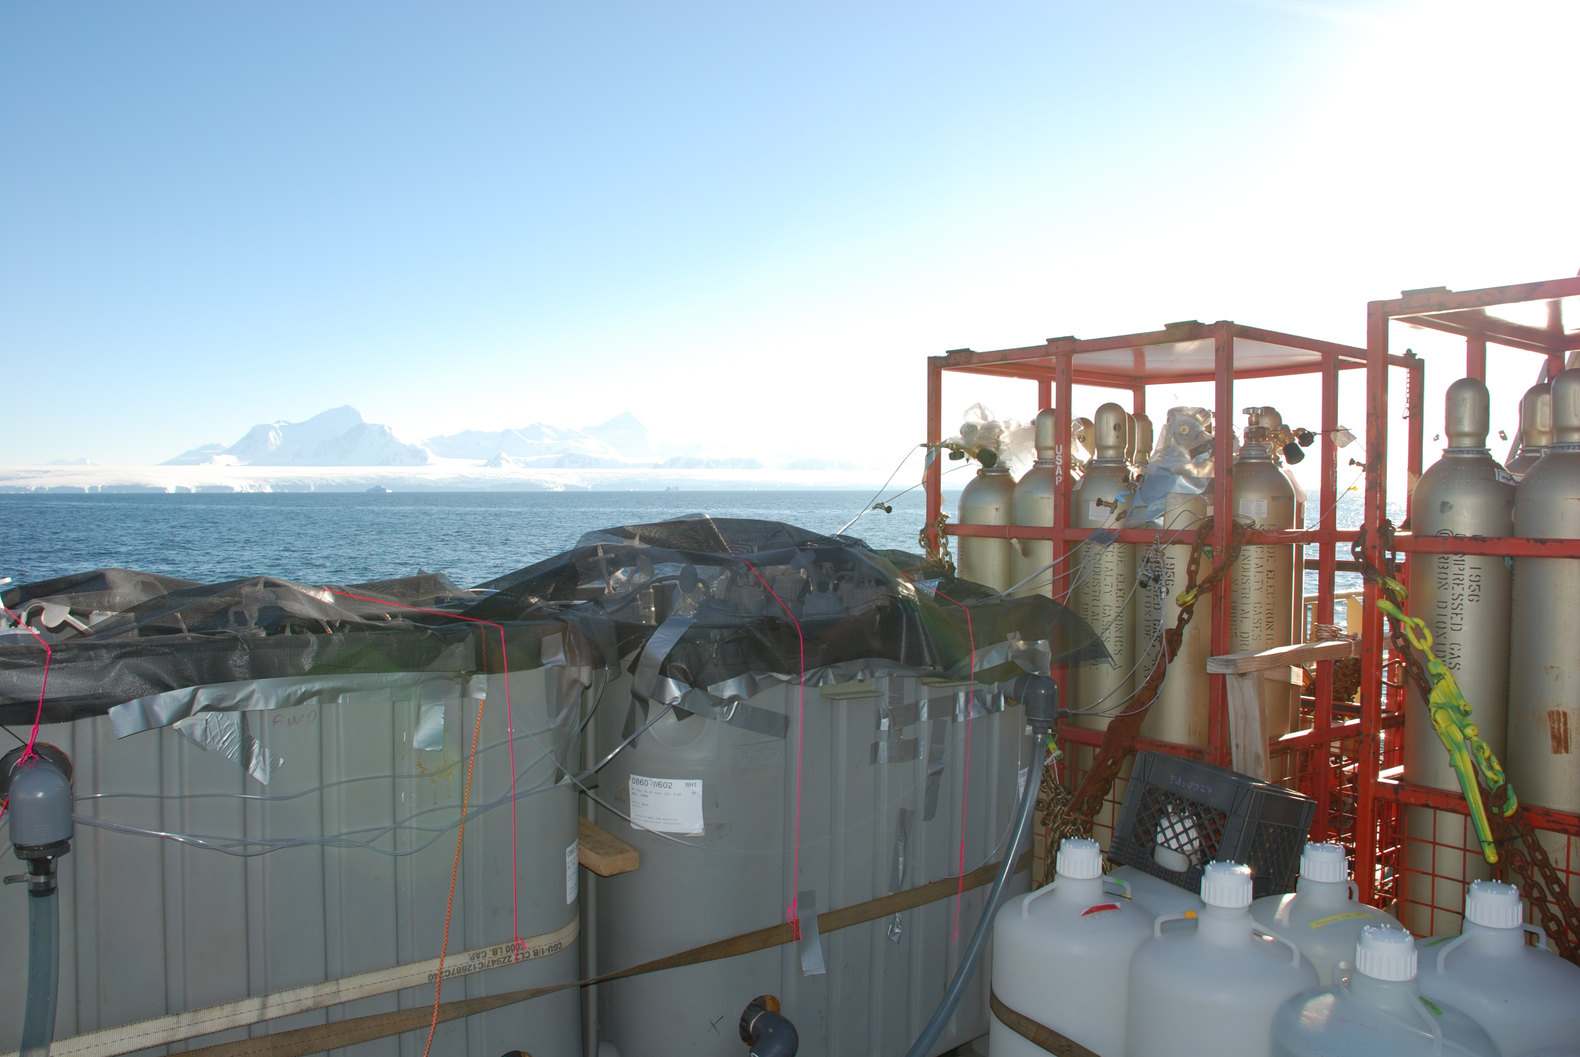
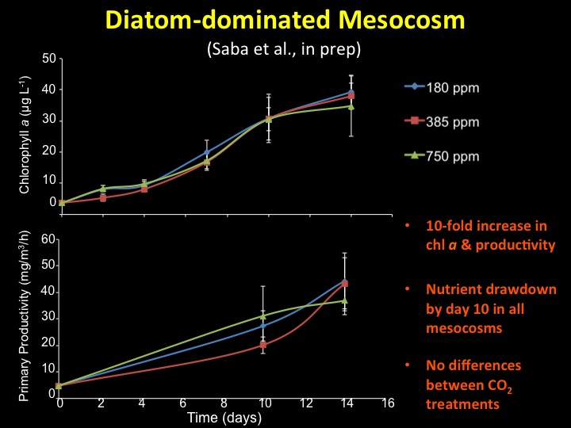
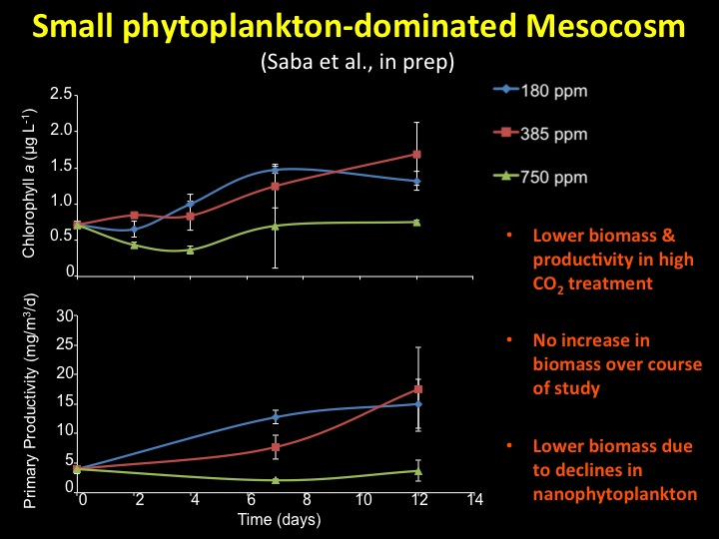
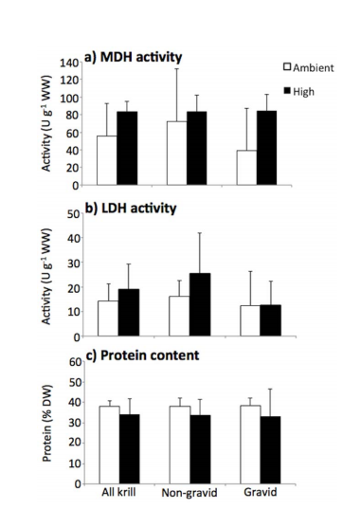
Process Studies: ocean acidification (other stressors?)
Diatoms/
netphytoplankton
Ocean acidification is a significant stressor for phytoplankton. Incubations suggest that small flagellates disproportionately impacted (Saba et al. in prep).
Ocean acidification is a significant stressor for zooplankton with pregnant krill showing stress with increasing ocean acidification (Saba et al. Plos One). Led to a new NSF project for Saba
flagellates/
nanophytoplankton
3) So far: Phyto exudate (low), OA effects (significant), nutrients in UCDW (prelimn significant), temperature (this year)

Slide 7
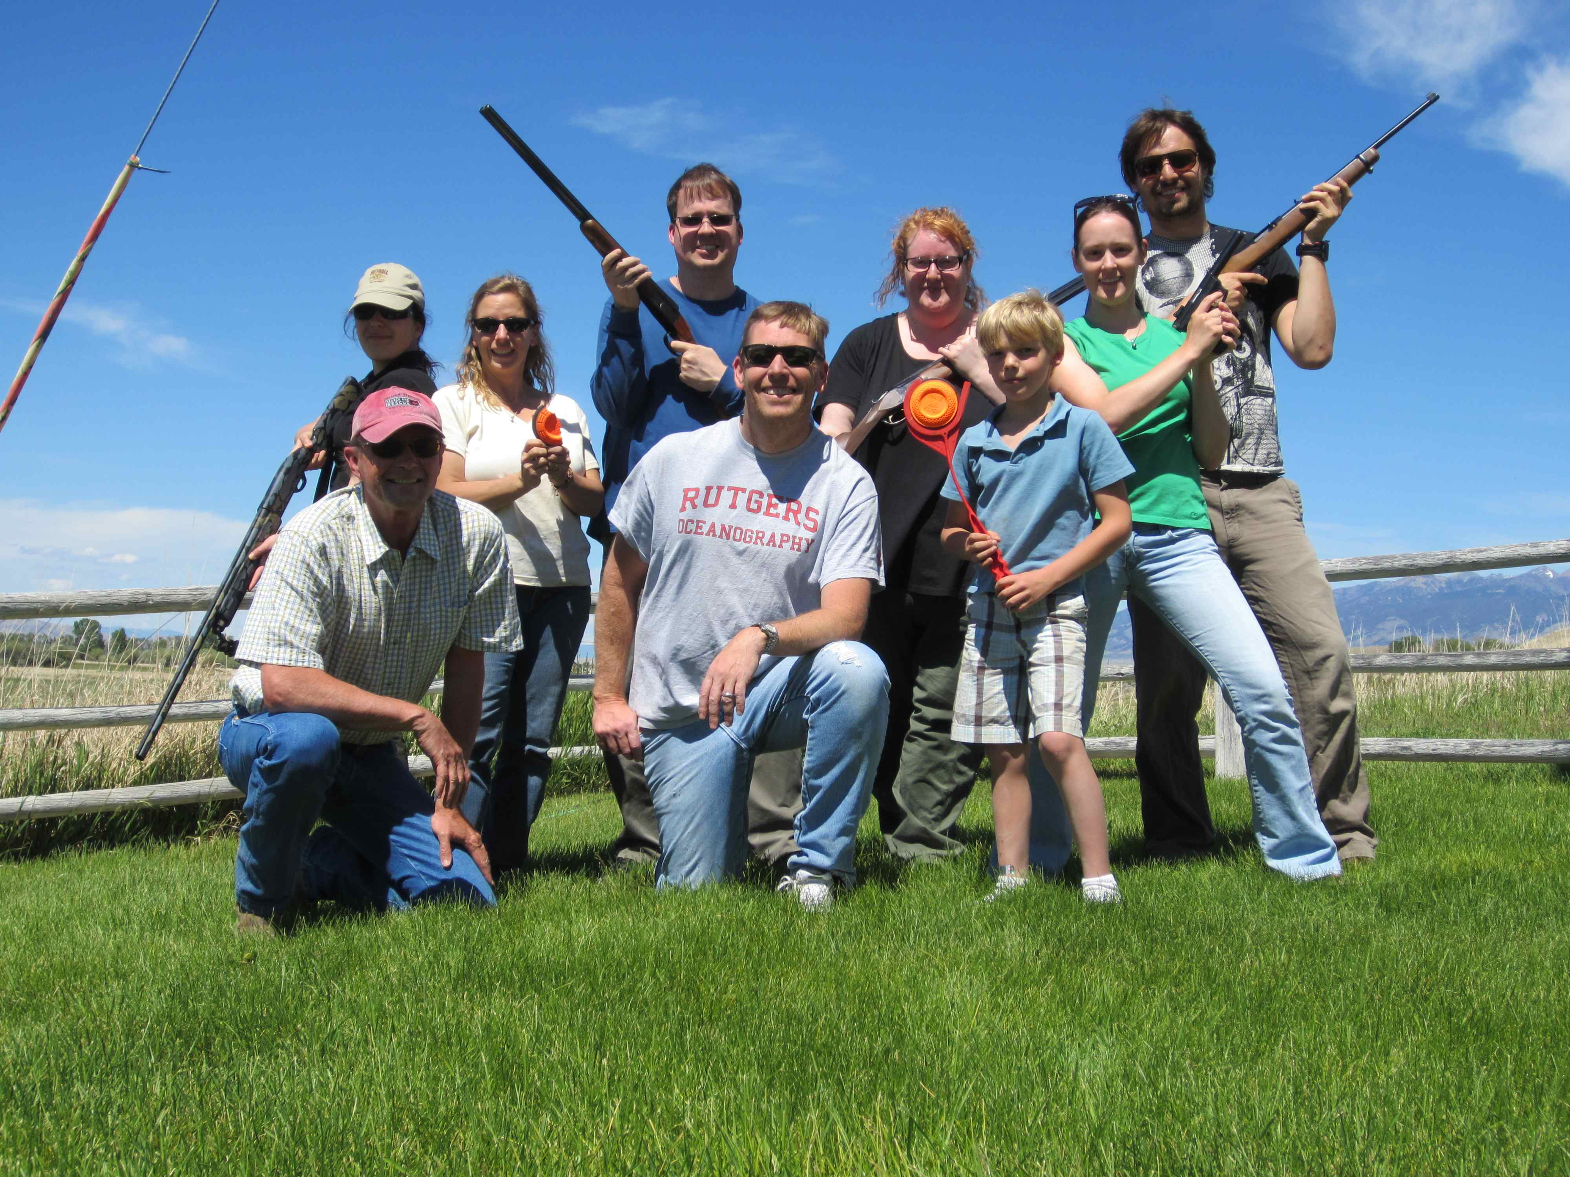
Montana Nerd Posse Workshop
“We have data and bullets…..”

Slide 8
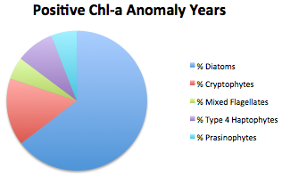
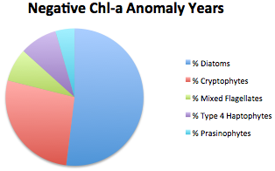
Phytoplankton Community Composition (Schofield et al in prep)
Diatoms account for the majority of the chlorophyll biomass. The “small” chlorophyll years are associated with a decline in the diatoms.
At Palmer, presence or absence can be sorted in T/S space. Note, not the case looking at full WAP ship grid, will discuss later
Palmer Station
Ship

Slide 10
Historical literature suggest a size spectrum shift

Slide 12
Phytoplankton Community Composition (Schofield et al in prep)
Seasonal average
water column
fucoxanthin
(Stn E)
Seasonal diatom patterns best described by the depth of seasonal upper mixed layer depth
At Palmer, presence or absence can be sorted in T/S space. Note, not the case looking at full WAP ship grid, will discuss later
Seasonal upper mixed layer depth
Seasonal average
water column
alloxanthin
(Stn E)
Dec. sigma-theta

Slide 13
So what is up between the difference between the ship and Palmer community time series?
Flow Cam data collected by Andrew Irwin in 2011-2012 field season

Slide 15
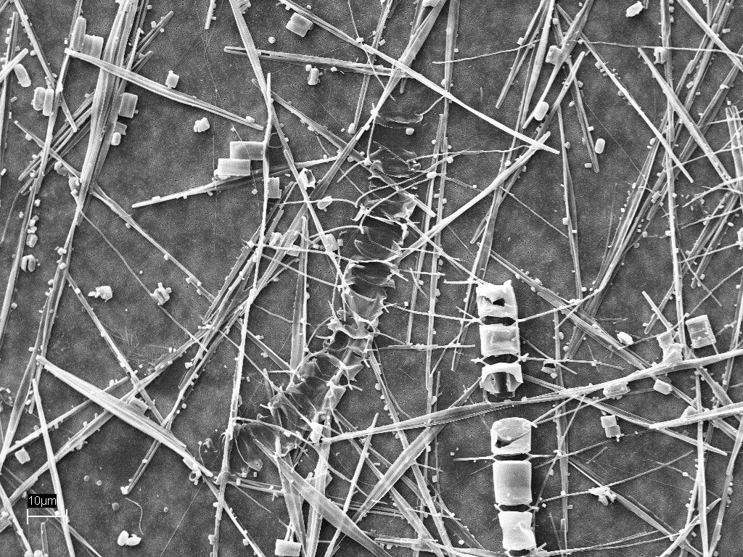
Given this, we may need to move from the HPLC taxon analysis for phyto.
Next 6 years: Expand to to a species approach. Microscope slides
(limit the number of samples to be collected) and hopefully complement the
spotty samples to be collected with Flow-Cam data (or whatever is the best option at the time). Will look at MRI or equivalent program to get one dedicated to the LTER.
-Expand on the automated classification system Andrew built to allow full grid data sets
-Slides have been requested from Amy Leventer to provide baseline for the paleoproxies
-Link to ongoing genomic efforts (Saba project in collab with Debashish Battacharya for mass sequencing of the Antarctic cryptophyte genome)
-Assess physiological profiles of individual taxa

Slide 16
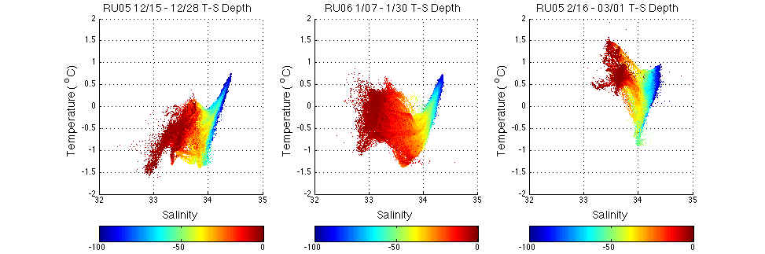
Gliders (What we have done, 37 missions, 438 days at sea)
Palmer Efforts
Canyon dynamics (Filipa & Nicole) recurrent blooms.
Enhanced physiology (Fv/Fm) with the high blooms (Tina)
Circulation linked to foraging dynamics of penguins, and the maybe krill
Great deal of topographic mixing/circulation, seasonal warming (Travis)

Slide 17
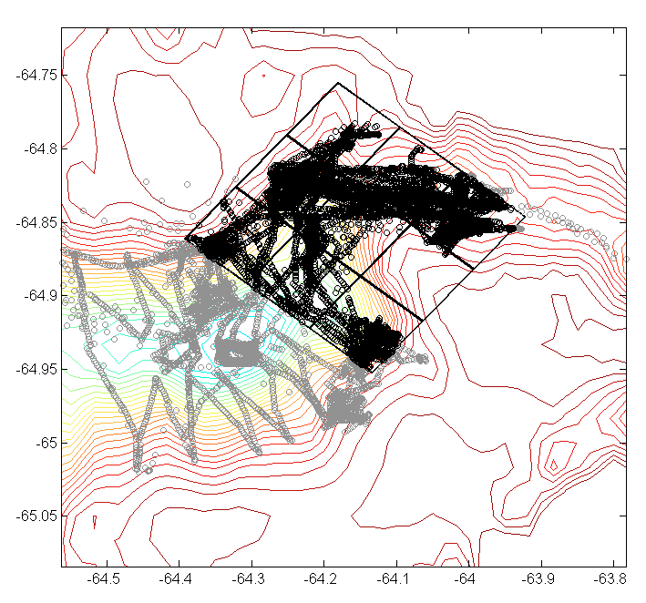
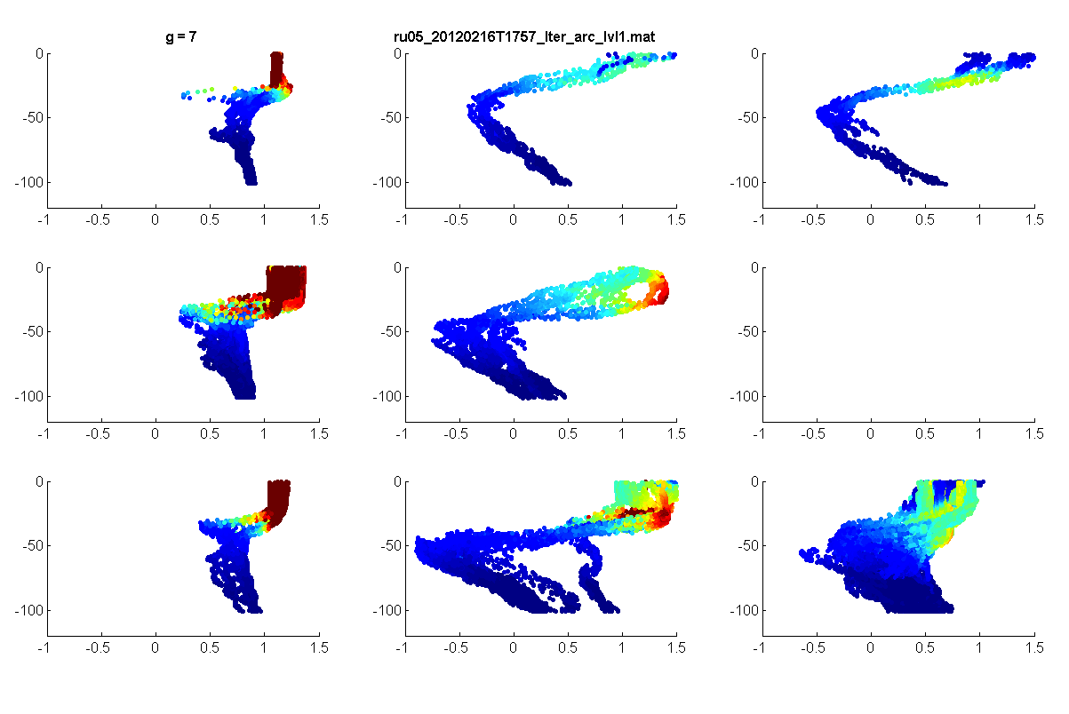
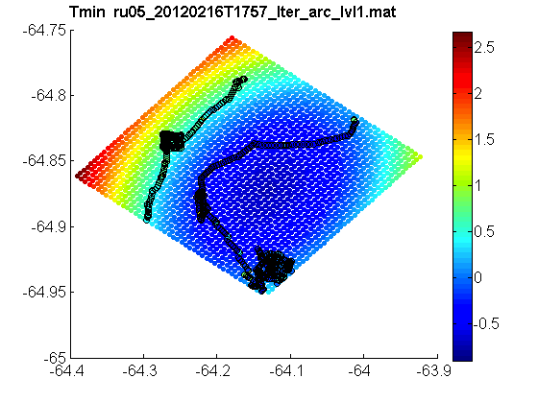
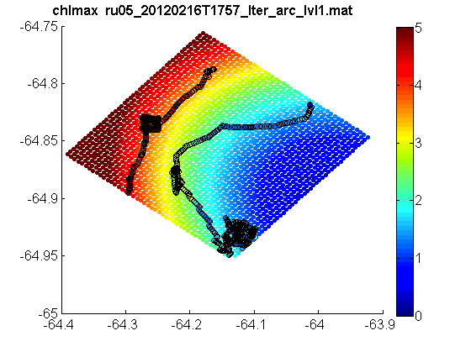

Slide 18
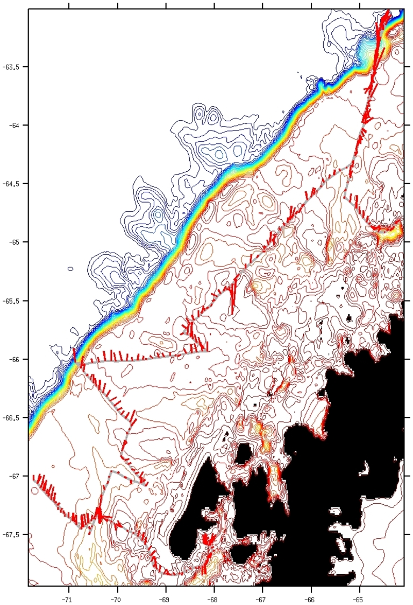
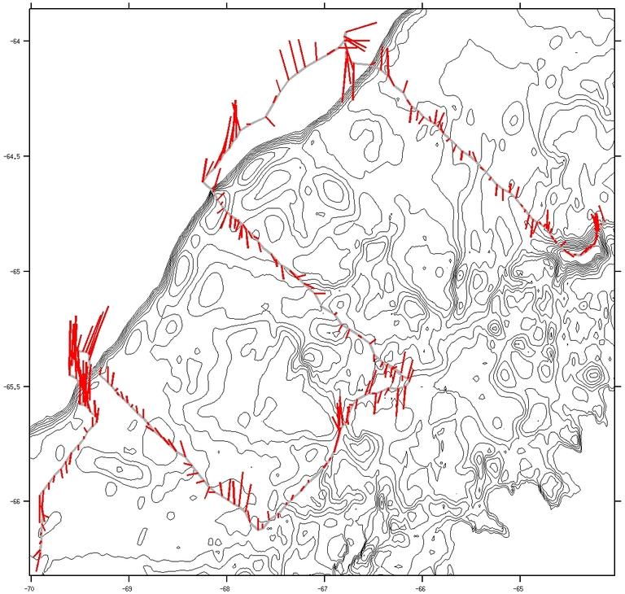
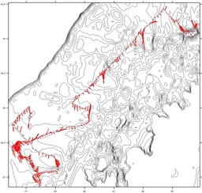
Priorities Moving Forward
Shelf Efforts
Link stations to fill in the gaps when ship not here
Use the gliders to replace the old survey lines
Adaptive sampling of the features of interest
Mission 1
Missions 2
Missions 3

Slide 19
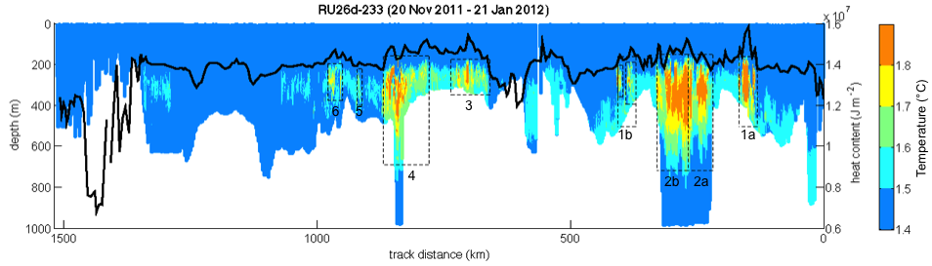
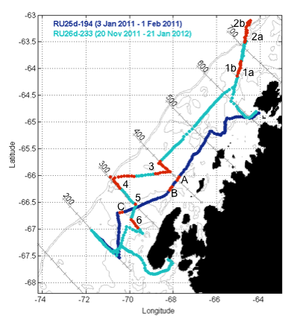
Couto et al in prep.

Slide 20

Westerlies/Northerlies
Cont. Atm
Lows/High
(SAM)
Shifting Polar Systems
Seals
Krill
Silverfish
Salps
&
Microheterotrophs
Whales
Polar Baseline:
-Sea ice dynamics drive ecosystem
Productivity, leads to formation of winter water (boundary to many sub polar species)
-Microbial dynamics driven by surface and bottom topography
-Strong seasonality results in strongly tuned life history strategies in higher trophic levels
King Crabs
& Lantern Fish

Slide 21
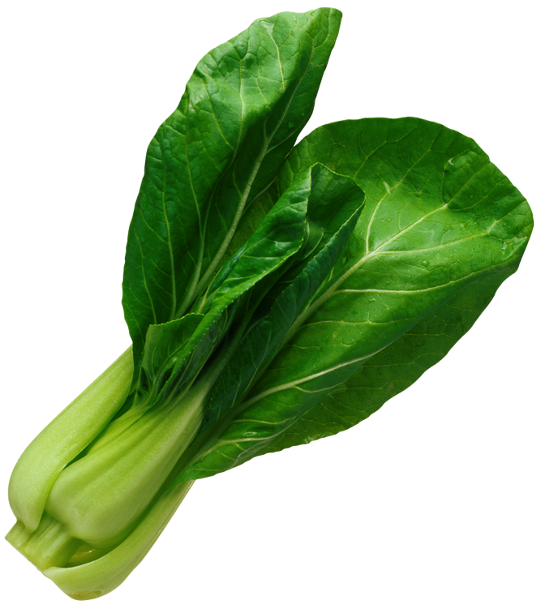
Cont. Atm
Lows/High
(SAM)
Westerlies/Northerlies
Shifting Polar Systems
Seals
Krill
Salps
&
Microheterotrophs
Whales
King Crabs
& Lantern Fish
SubPolar Baseline:
-Boundaries associated with sea ice removed,
Invasive species, more pelagic system
-Increased land margin interactions combined with coastal outflows

Slide 22
Seasonal marginal-ice phytoplankton bloom
Doney
Warm
CDW
Winter
Sea-ice
Adelies
Gentoos
Gentoos
Ice fish
Adelies
Adelies &
Gentoos
Gentoos
Ice fish
Ice fish
Adelies
Adelies
Adelies &
Gentoos
Ice fish
Ice fish
Adelies
Adelies
Adelies
Ice fish
Ice fish
Ice fish
Glaciers
Melting
Glaciers
Glaciers
Canyons
Pre-LTER
“unknown” baseline
Current LTER
baseline
Mid-21st Century

