Slide 1
Distributed Ocean Observation and Prediction
Oscar Schofield, Scott Glenn, Josh Kohut, Uli Kremer

Slide 2
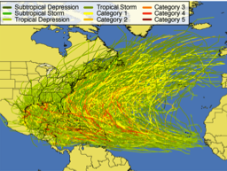
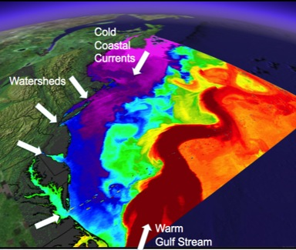
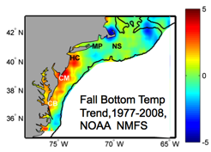
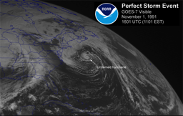
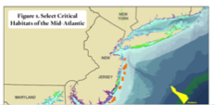
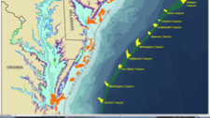
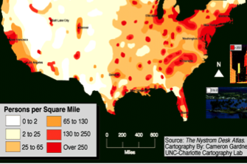
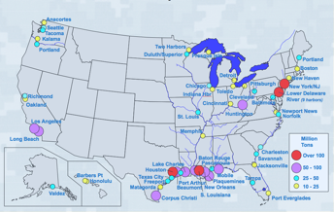
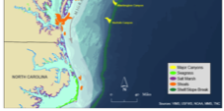
The NEED: MID-ATLANTIC REGIONAL DRIVERS
Tropical Storms
Climate Change
Ocean Circulation
Critical Habitat
Northeasters
Population
Ports

Slide 3
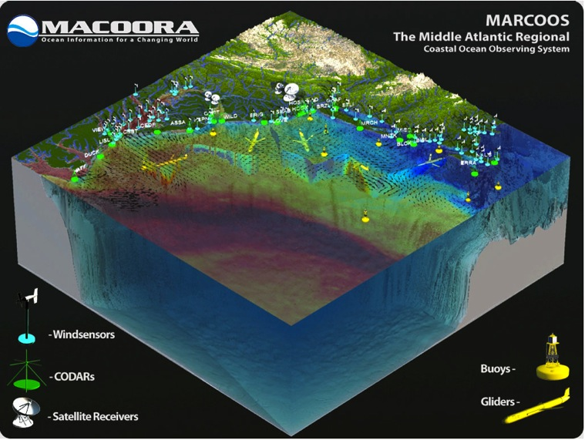
THE NEW TEST-BED: Mid-Atlantic Regional Association Coastal Ocean Observing System
Merged 2011: >40 Co-PIs, >20 Institutions, 10 States (&DC),
25% of US population, 25% of US GDP, 111 Congr. districts
Sustained regional observing networks a
Societal priorities drive development
MARACOOS supports the R&D continuum throughout the region

Slide 4
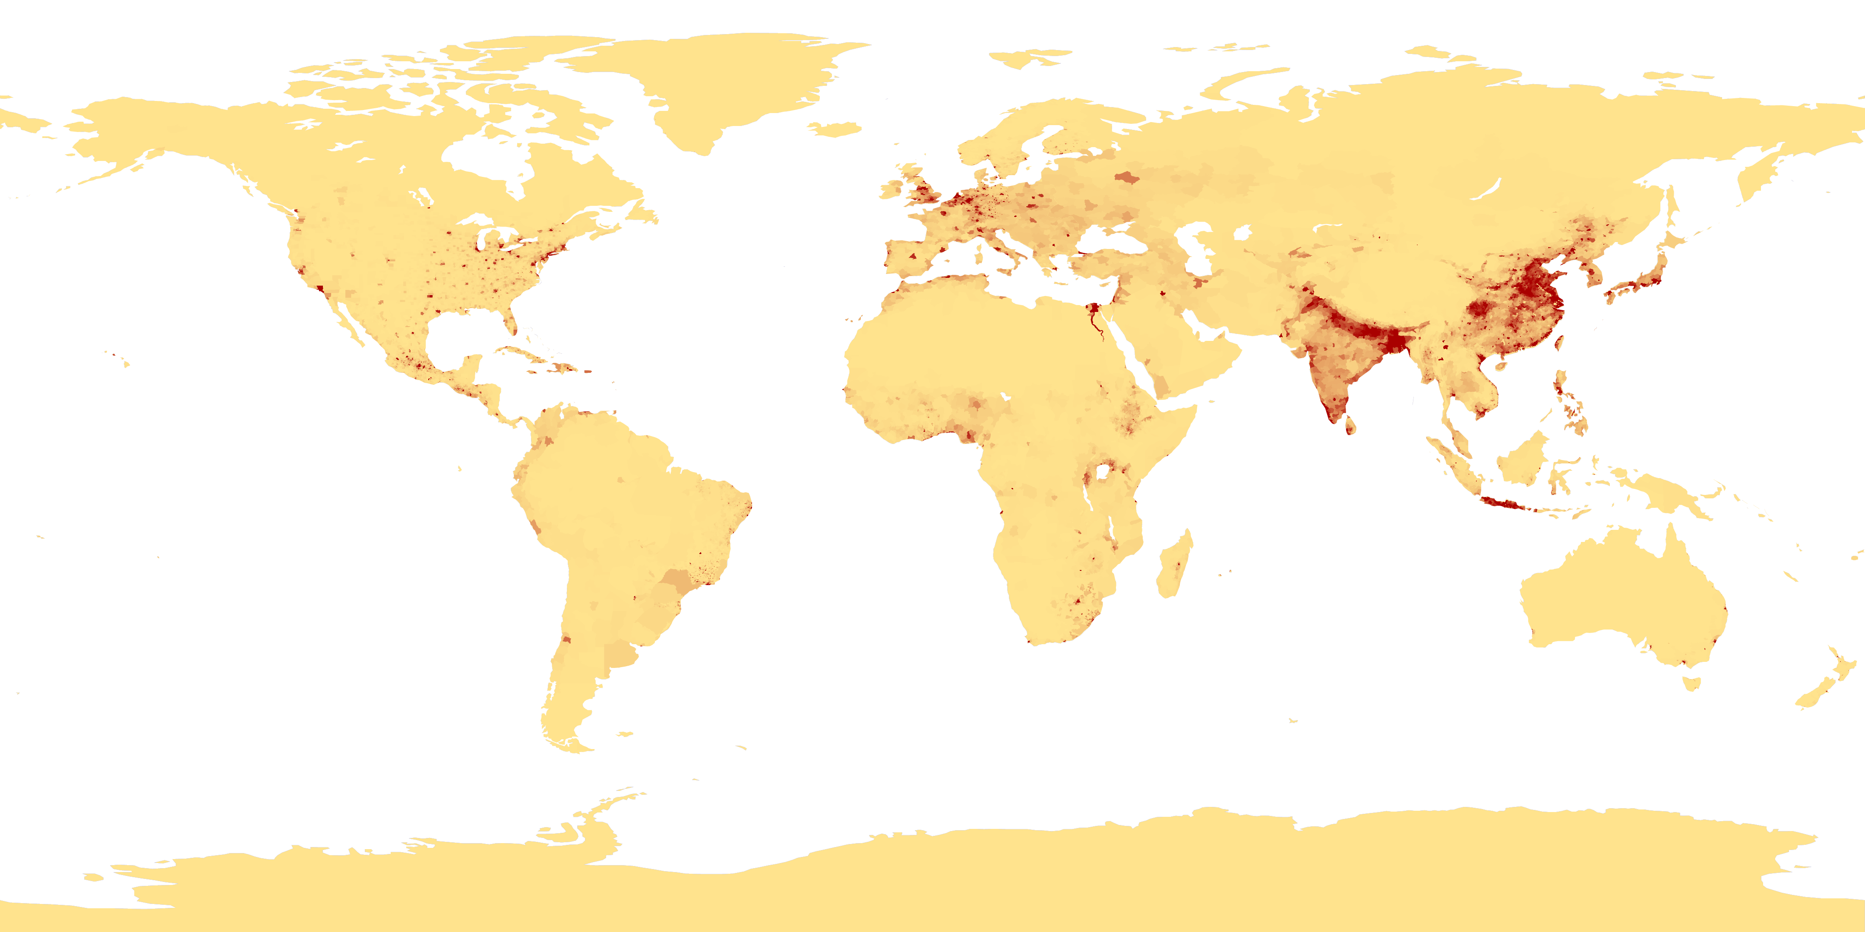
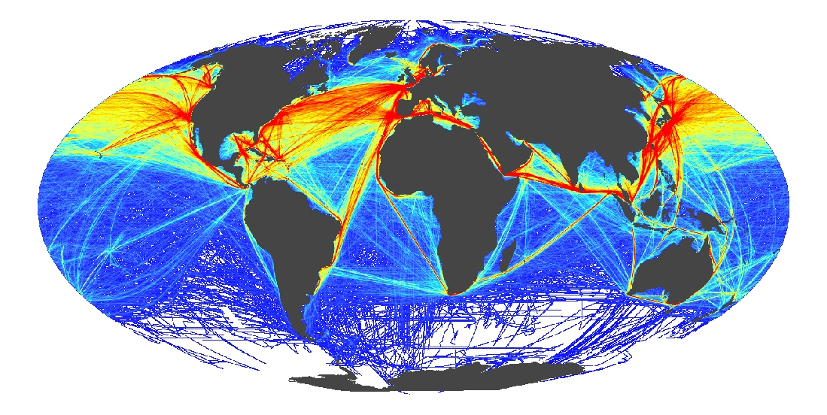
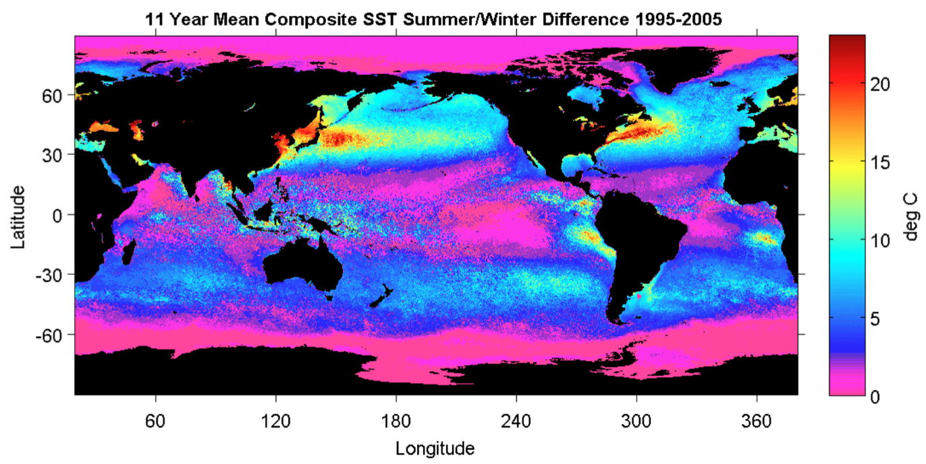
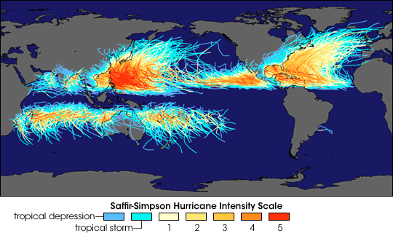
The Need: Global Drivers
Coastal Population Centers
International Commerce
Ocean Seasonality
Tropical Cyclones

Slide 5
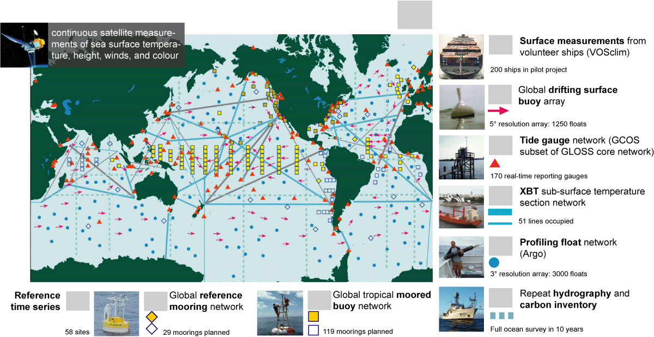


THE NEW TEST-BED: Operational networks (GOOS)
Global Ocean Observing System for Climate
Total in situ networks
61%
87%
100%
59%
81%
100%
48%
34%
73%
62%

Slide 6
Given the challenges and current new capabilities, hurdles to be overcome:
Improve technologies to observe and model ocean systems
Deploy multi-use omnipresent networks throughout the world’s oceans
Develop an event response capability
Integrated data networks to allow for data fusion and selective crowd sourcing to provide a community for new product development
Development new training pipeline for the future workforce, scientists and engineers

Slide 7
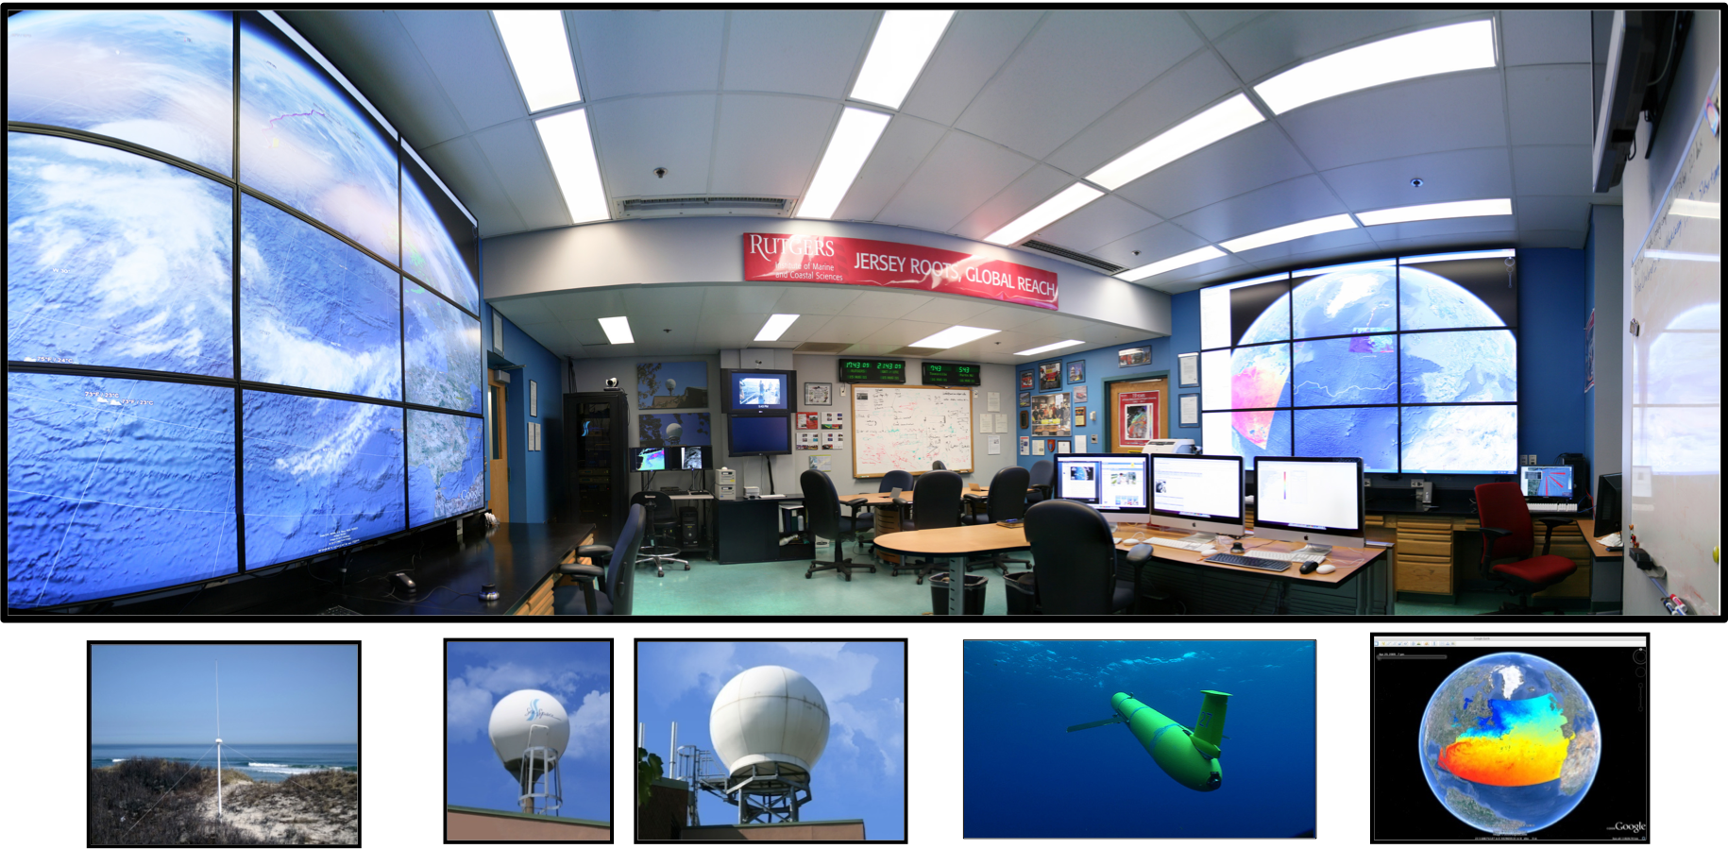
Coordinated through command centers
CODAR
Satellites
Gliders
Models

Slide 8
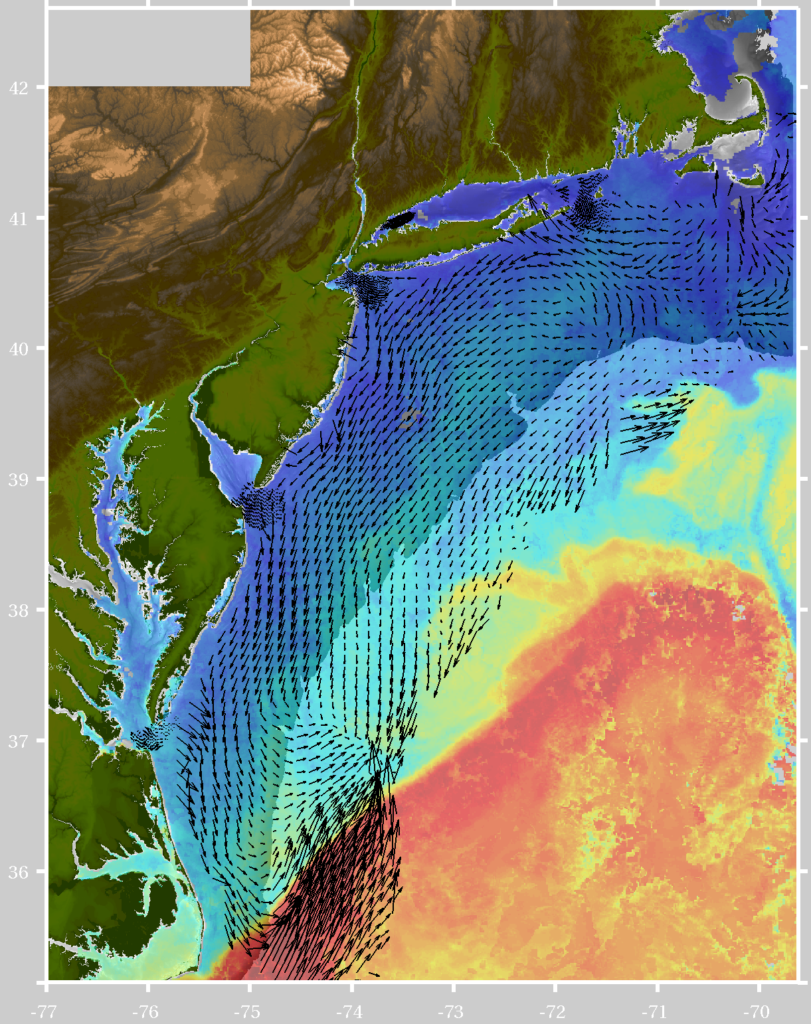
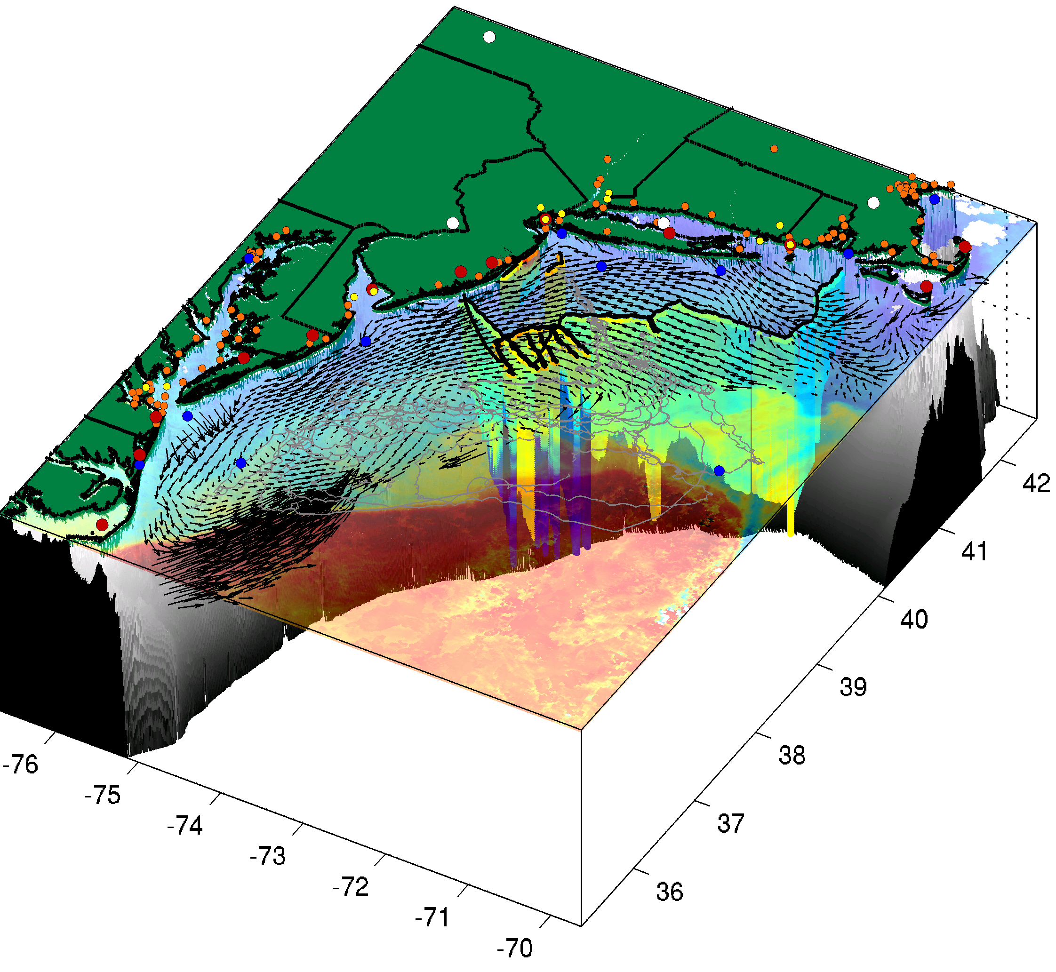
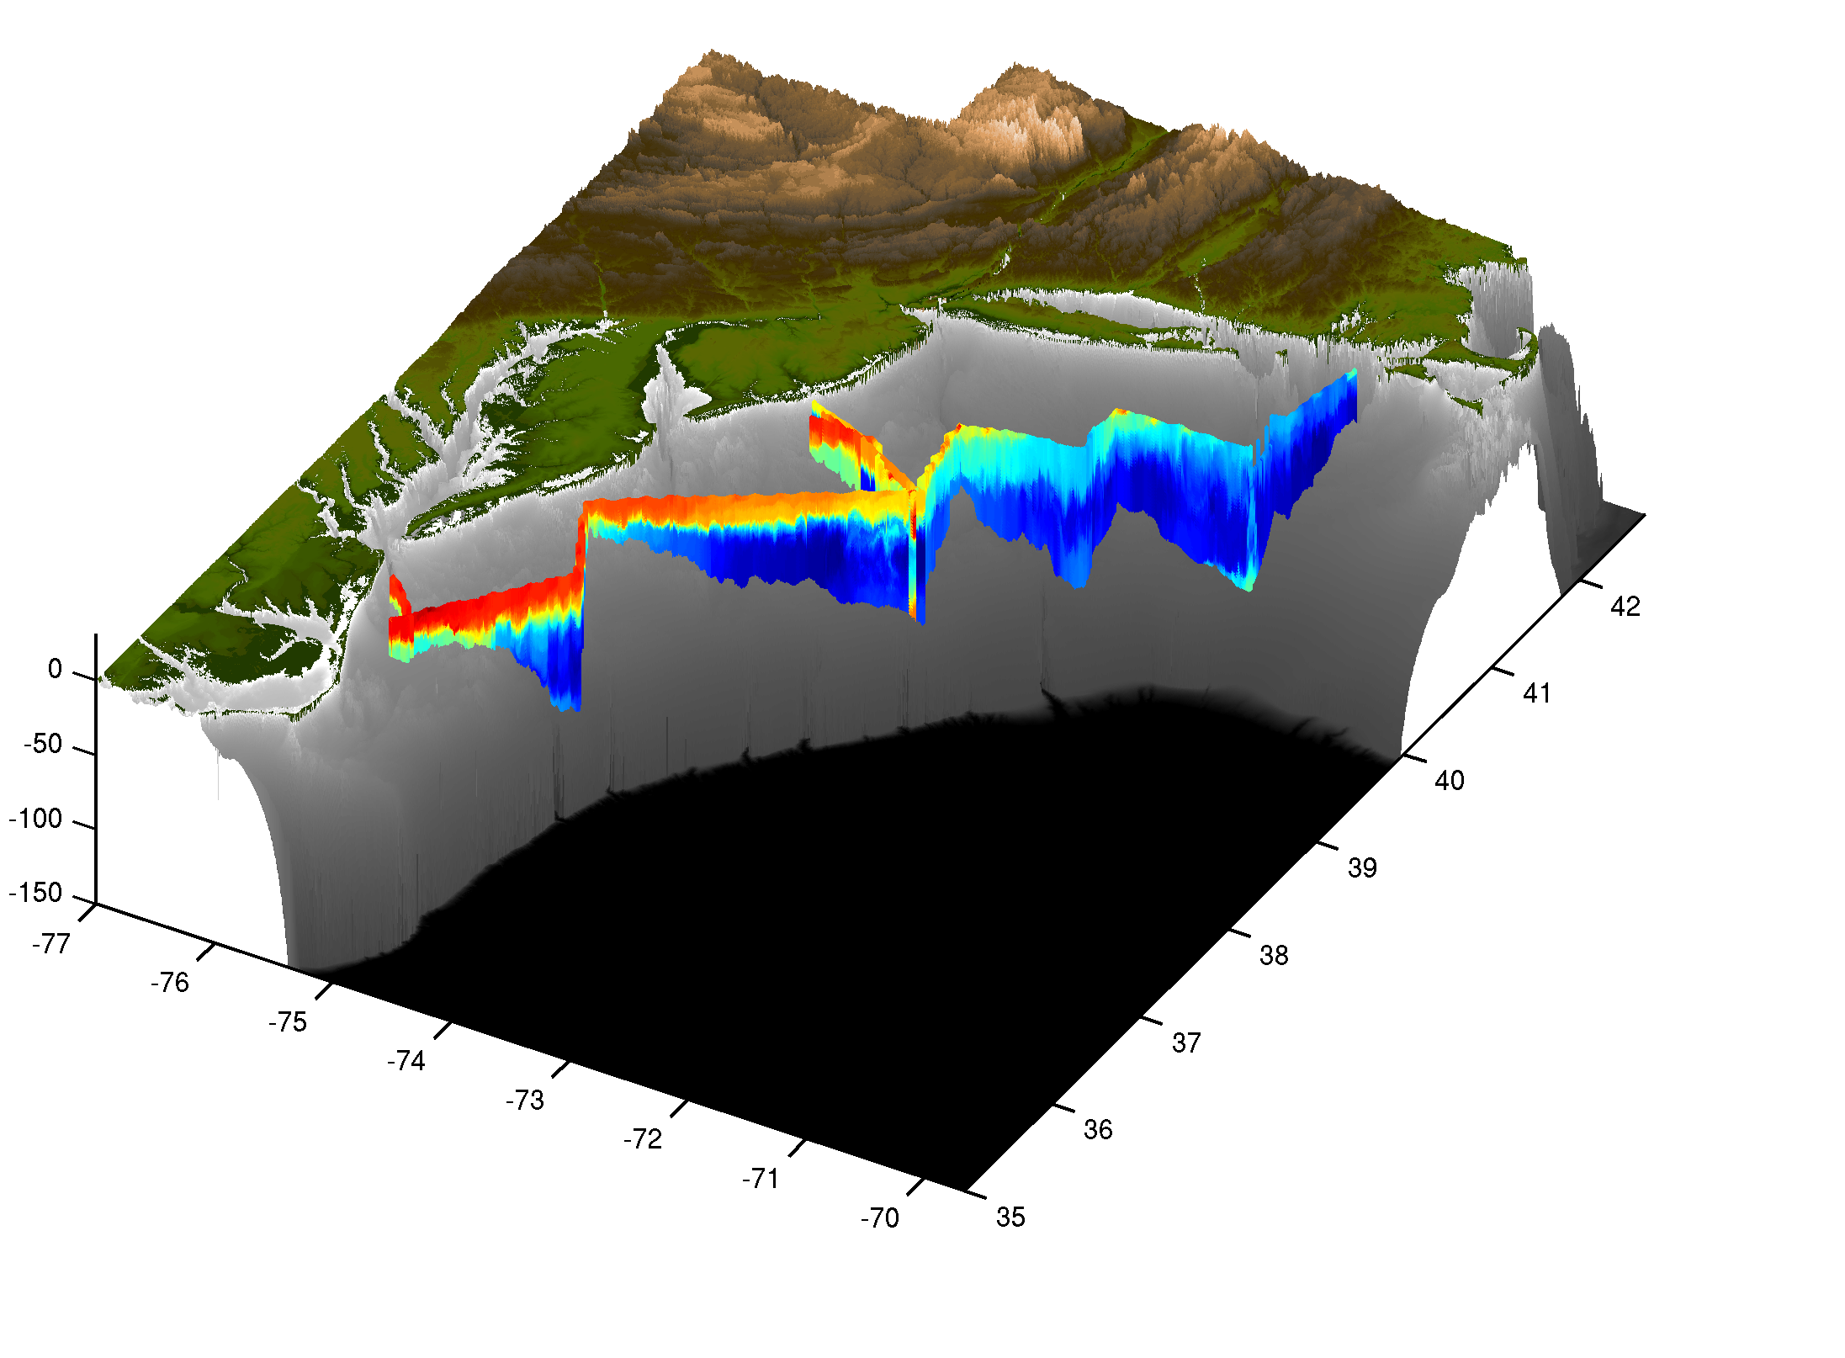
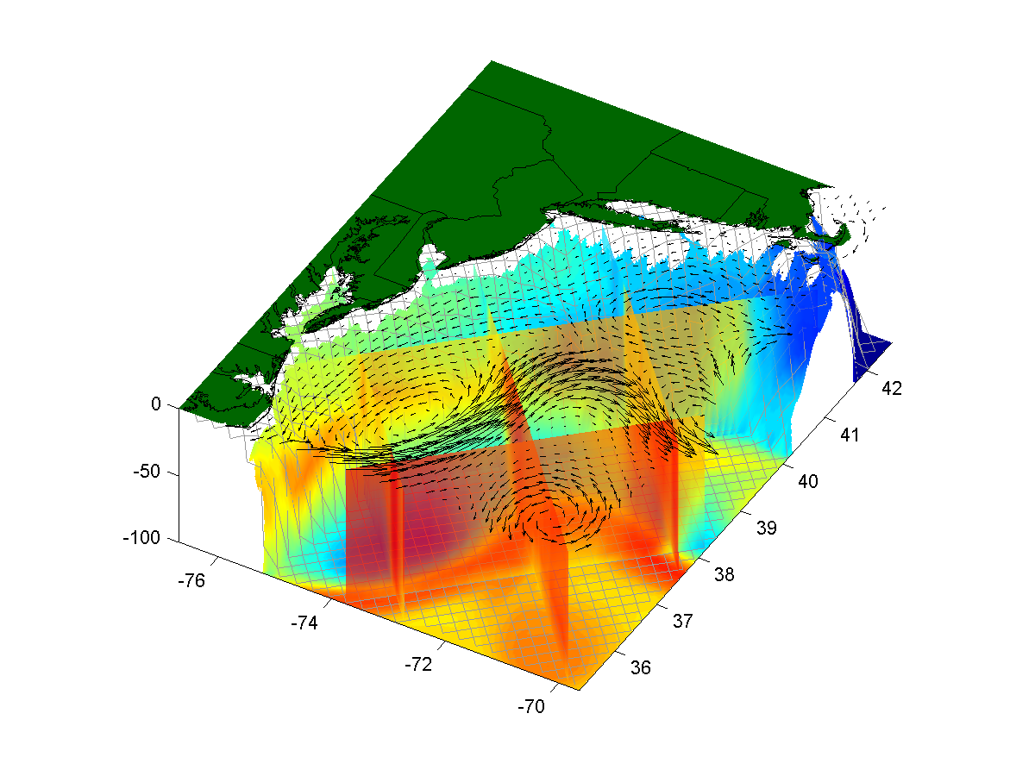
The future is coupled observation & modeling networks
=
+
Remote Sensing
Gliders
3-D Nowcasts
+
=
Nested Models
Data Assimilation
4-D Forecasts

Slide 9
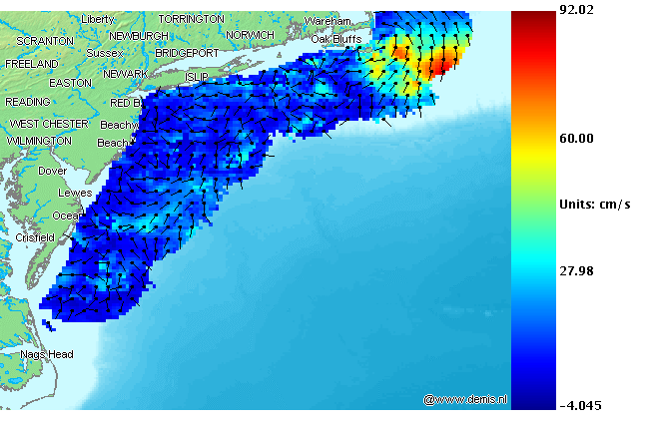
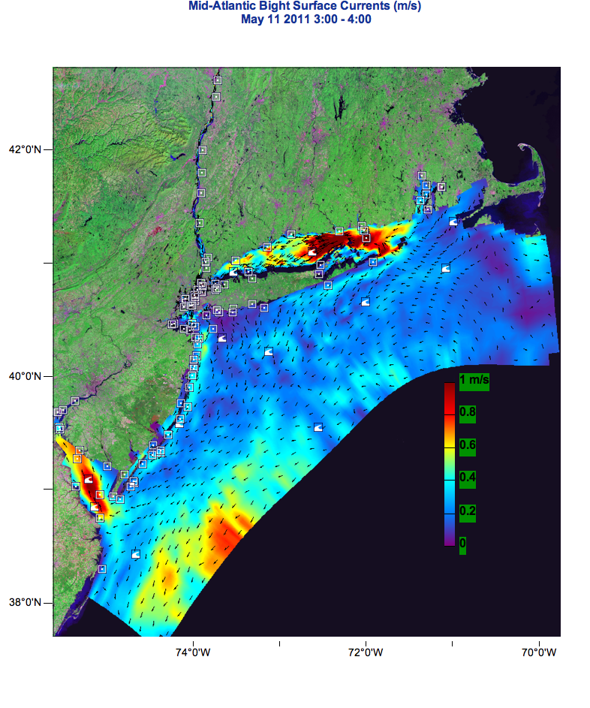
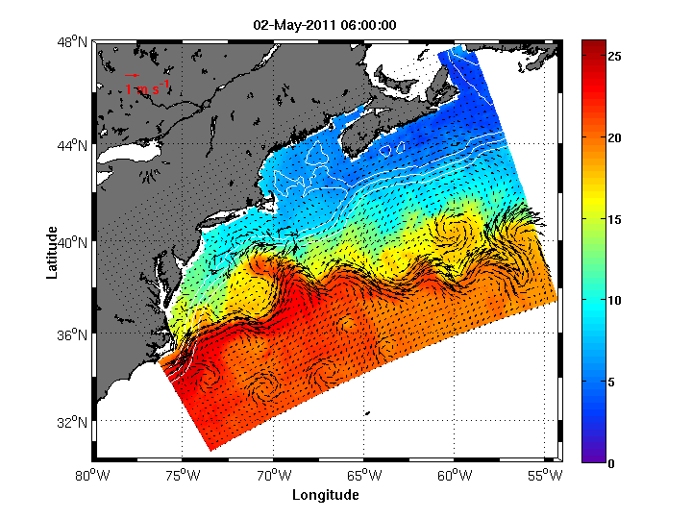
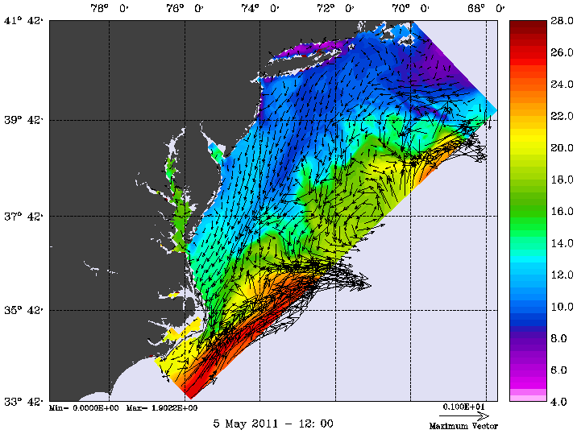
Need for Ensemble models MARACOOS Ocean Forecast Models
NY-HOPS
Stevens
Institute
Technology
Short Term
Prediction System
U. Connecticut
ROMS
ESPRESSO
Rutgers
HOPS
U Massachusetts

Slide 10
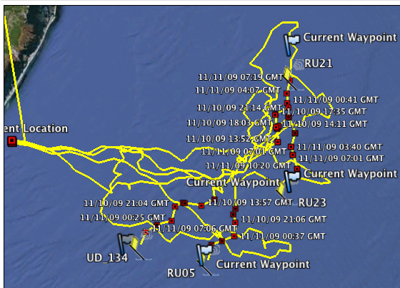
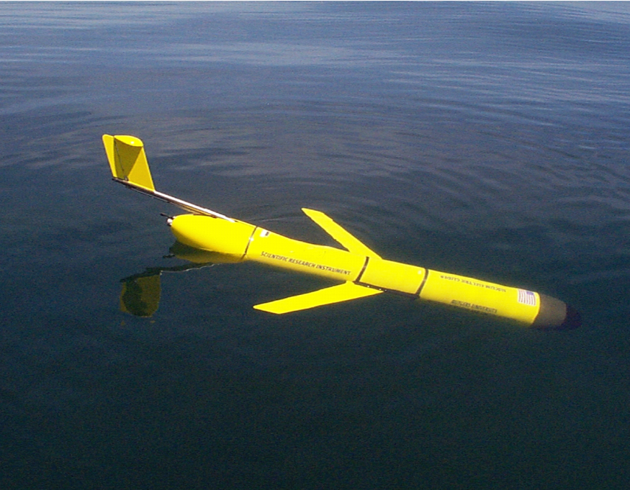
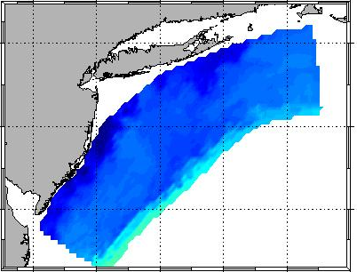
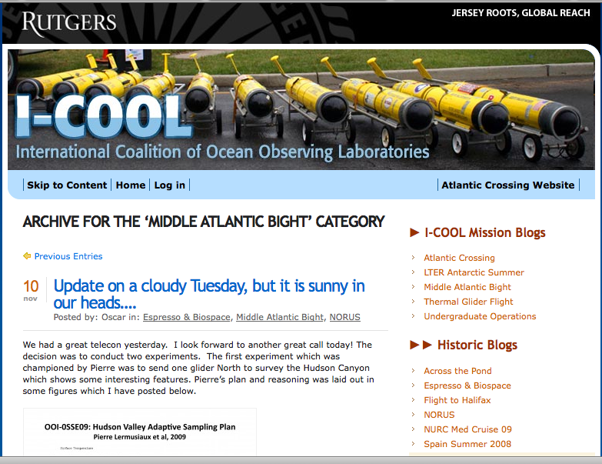
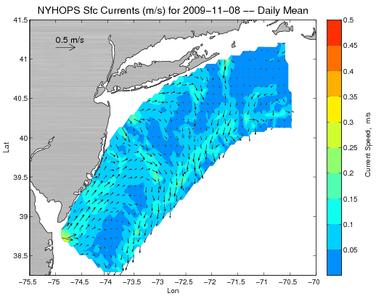
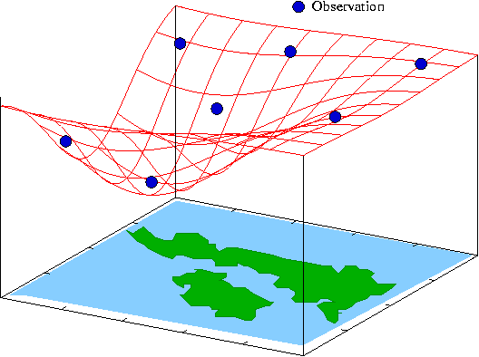
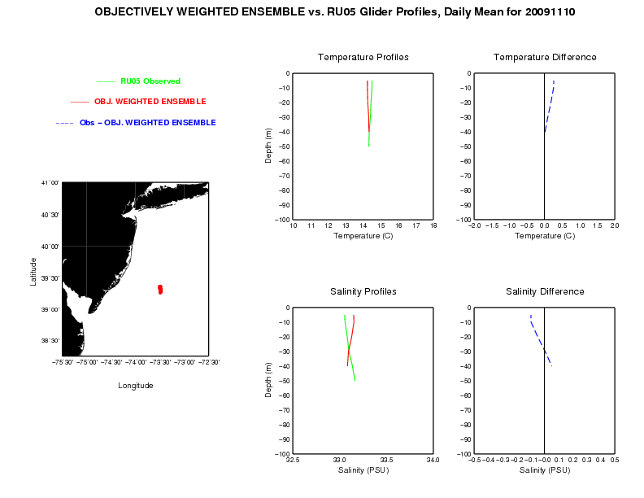
Hurdle of Scalable Machine to Machine Networks
Design, Testing and Deploy
Observatory (simulated) data
Models
Sensor &
Platform
~3 km
~100 m
Virtual Ocean
Data Assimilation
Data
Analysis
Science Questions & Drivers
Data Synthesis: Nowcast & Data Impact

Slide 11
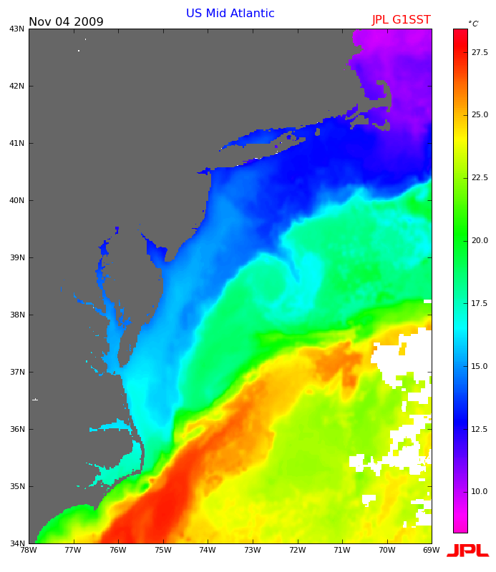
COMBINING THE FIELD ASSETTS WITH OCEAN FORECASTS
FOR PLANNING AND PROSECUTION EFFORTS
Known constraints (slow 0.5 knot, Battery, shipping lanes)
Uncertain constraints (time-varying 3D currents)
Operate autonomously & re-plan daily
From A to B in the shortest time
Follow a time-varying feature (shelf-slope salinity intrusion)

Slide 12
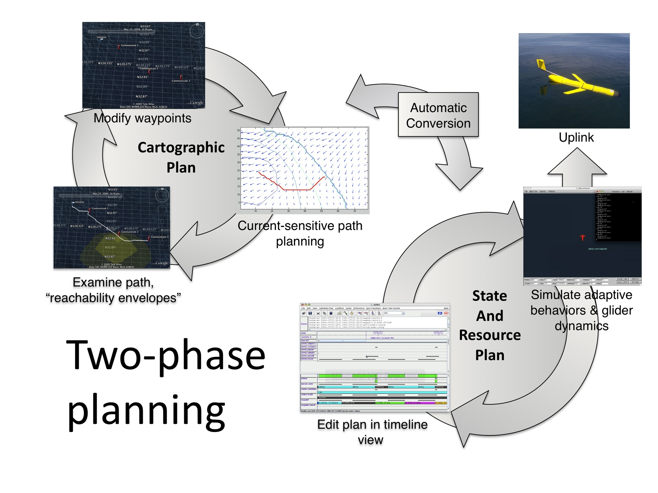

Slide 13
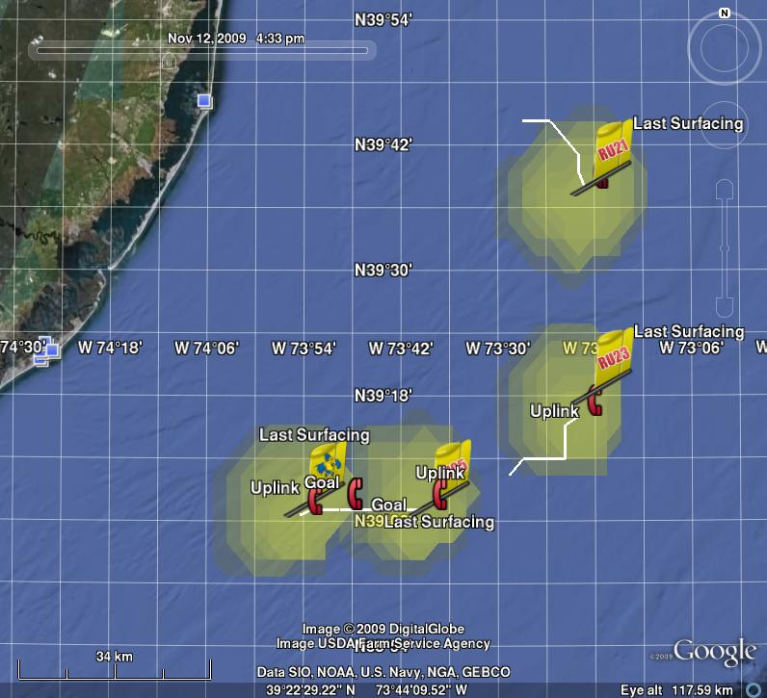
EVENT PLANNING IN THE FUTURE

Slide 14
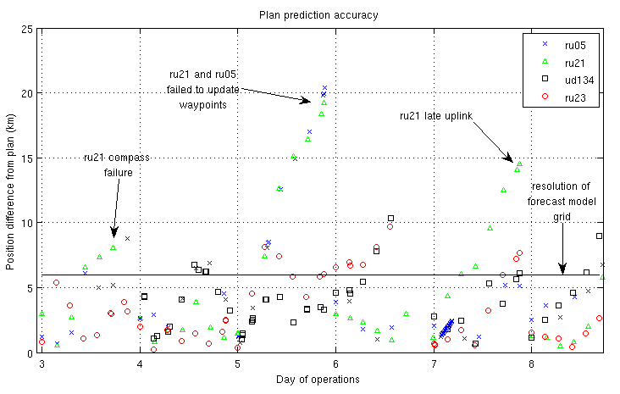
Increase model resolution
Reduce forecast error

Slide 15
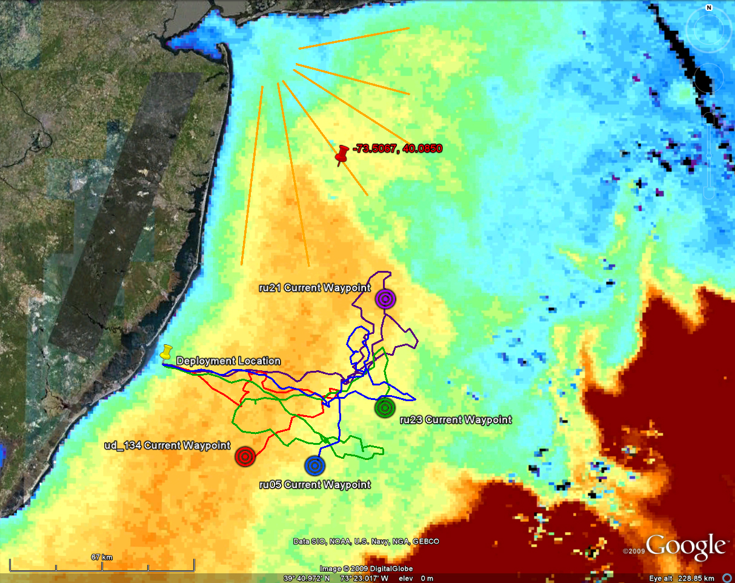
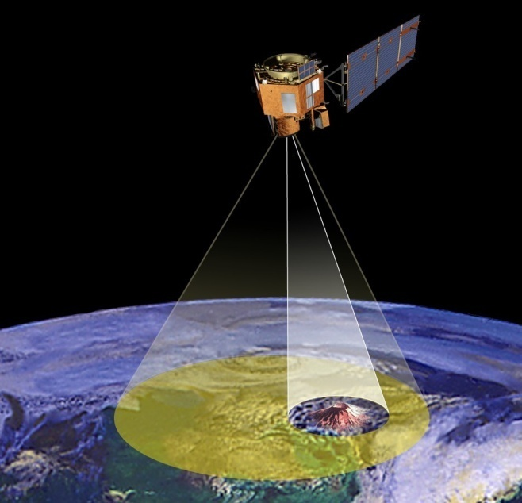
Science Alerts
Scientists
Science Campaigns
Science
Agents
Science Event Manager
Processes alerts and
Prioritizes response observations
EO-1 Flight Dynamics
Tracks, orbit, overflights,
momentum management
Observation
Requests
ASPEN
Schedules observations on EO-1
Hyperion
on EO-1
Updates to onboard plan
15

Slide 16
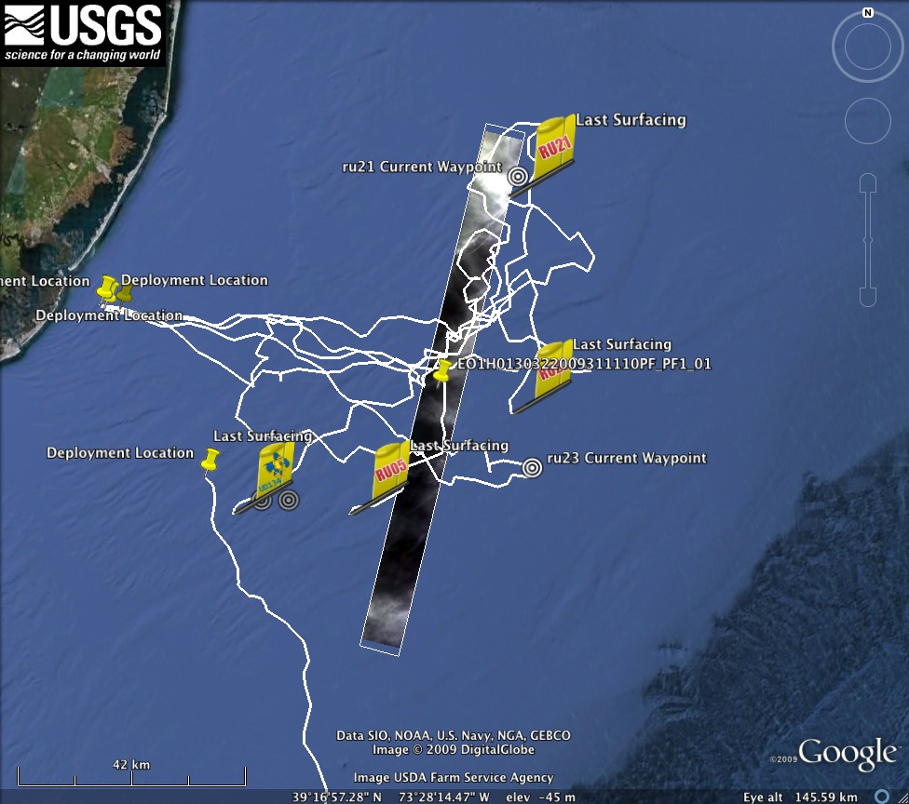

Slide 17
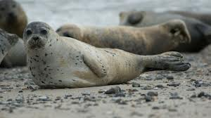
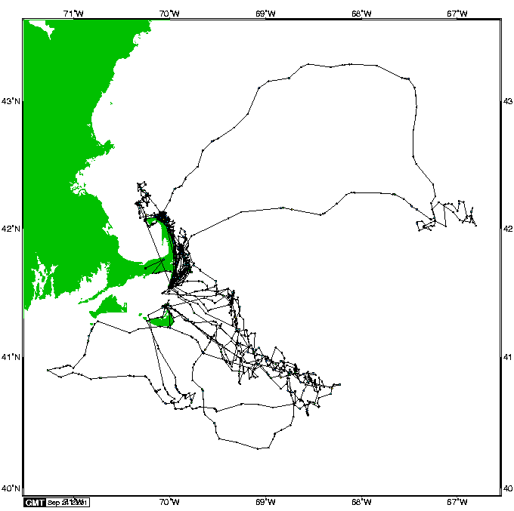
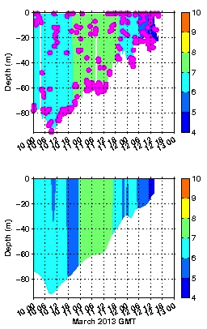
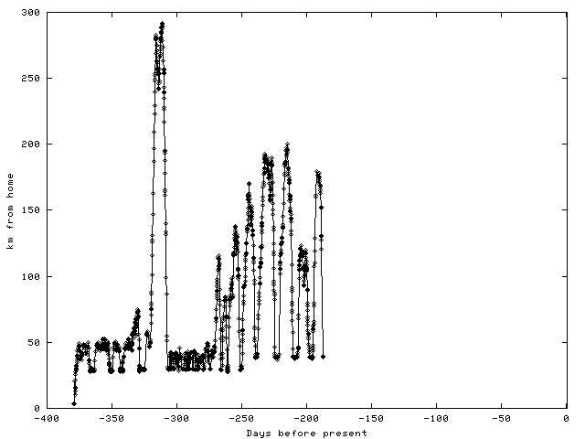
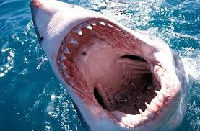
Augmenting with cheap “smart” sensor networks
Animal internet: Use behavior to structure sampling
Animal data
Model data

Slide 18

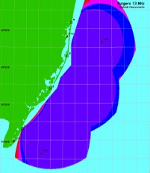
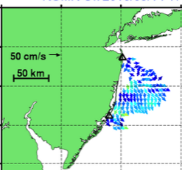
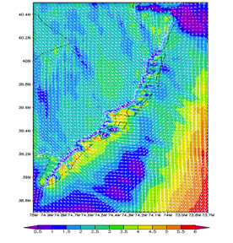
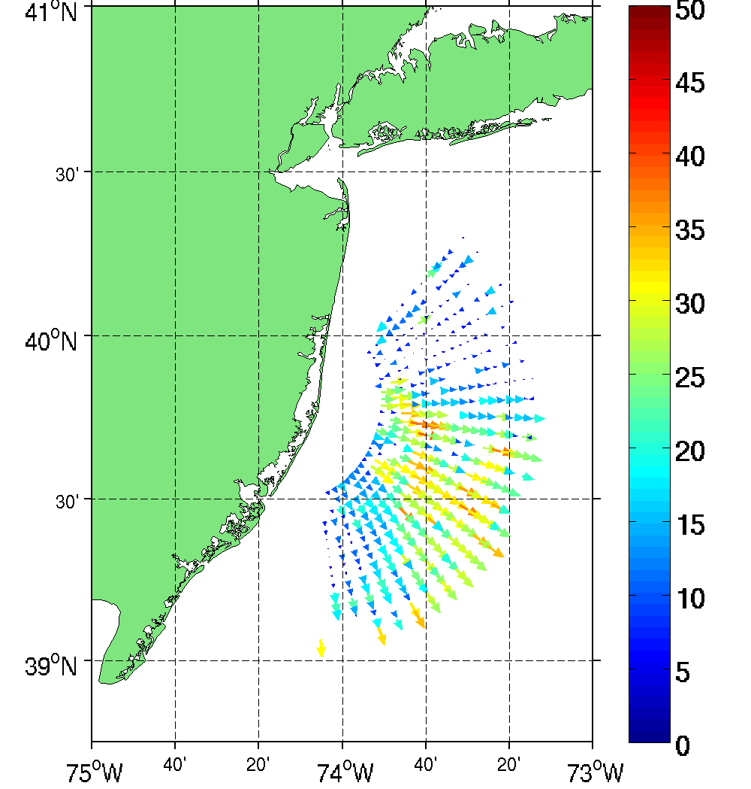
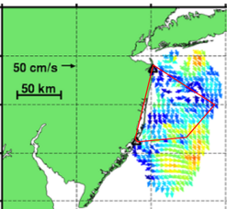
Benficials: Multi-Use Offshore Wind Energy
High Resolution Atmospheric Forecast validated with HF radar
Additional Radar Sites
Spatial validation of Atmospheric Model with 13 MHz Multi-static
HF Radar Array
2-Site Mono-static Coverage
High Resolution Wind Resource
670 m horizontal resolution
Bi-static Geometries
2-Site Multi-static Coverage

Slide 19
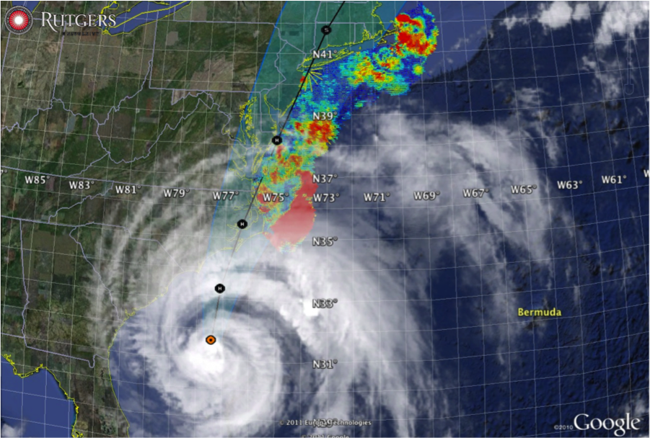
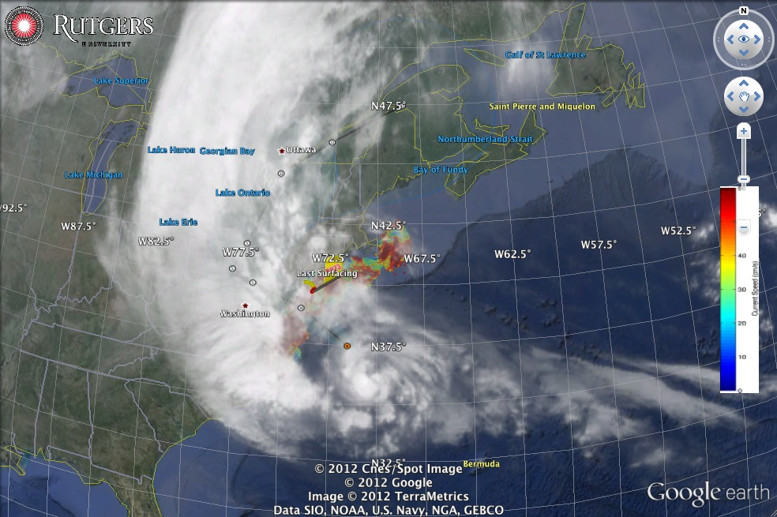
Hurricane Irene
August 26, 2011
NOAA/NHC Damage:
#8 with >$15 Billion.
Track Accurate;
Intensity Over-predicted.
IMPROVED
EXTREME
EVENTS
Hurricane Sandy
October 29, 2012
NOAA/NHC Damage:
#2 with >$60 Billion.
Track Accurate;
Intensity Under-predicted.

Slide 20






National system serving many needs: Storm Physics
Hurricane Irene
Hurricane Sandy
Hurricane Sandy
glider measurements

Slide 21



Relocatable event response capability
Deepwater Horizon Oil Spill: Coordinated Rapid Response
Contributed Assets:
HF Radar Networks
USF, USM
Gliders
iRobot, Mote, Rutgers,
SIO, UDel, USF, Navy
Drifters & Profilers
Horizon Marine, Navy
Satellite Imagery
CSTARS, UDel, Rutgers
Ocean Forecasts
Navy, NCSU
Data/Web Services
ASA, Rutgers, SIO
Tropical Storm Bonnie crosses the Gulf of Mexico
USM HFR
TS Bonnie
USF HFR
USM HFR validation of SABGOM Forecast
in region with satellite detected oil slicks
HFR used for Oil Slick Forecasts by NOAA/NOS/OR&R

Slide 22


Integrated data networks and crowd sourcing linked to workforce development
Increase in Number & Scope of Research Internships
Locations: Australia, Antarctica, Svalbard, Spain, Canaries, Azores, California, Florida, New Jersey
Sponsors: NSF, DHS, Alumni
Trans-Atlantic Glider Challenge
Spring 2012 Course: >70 Students
Number of Marine Science Majors

Slide 23





Undergraduates provide research given the right tools
RTOFS and MERCATOR
Temperature and Current Maps at 200 m
IEEE, MTS Oceans ‘13
(San Diego, USA)
RTOFS 200m temperature and currents on April 18th, 2013. The glider position is marked by the red dot.
MyOcean 200m temperature and currents on April 18th, 2013. The Gliders position is marked by a red dot.

Slide 24






Expanding the model
Developing tools to increase the crowd sourcing & educational opportunities with OOI Education and Public Engagement team (EPE)
Concept Maps
Data Visualization Tools
Lab Lesson Builder

Slide 25




Integrated data networks crowd sourcing and innovation for international cooperation
Example: Challenger Mission
Current countries: USA, Canada, Australia, UK, Japan, Indonesia, Korea, Brazil, Spain, Portugal, South Africa, Ireland, Norway

Slide 26

Conclusions:
Nested Ocean Observation & ensemble Forecasting Systems have matured to potentially meet science, commercial, and management needs.
They are revolutionizing science education.
These networks are consortia of academic, government, and commercial partners.
New disruptive technologies will enhance global observations & forecasts
Challenger Glider Mission can kick-start global science education
(http://challenger.marine.rutgers.edu)
US technology will rise to meet growing global challenges

