Slide 1
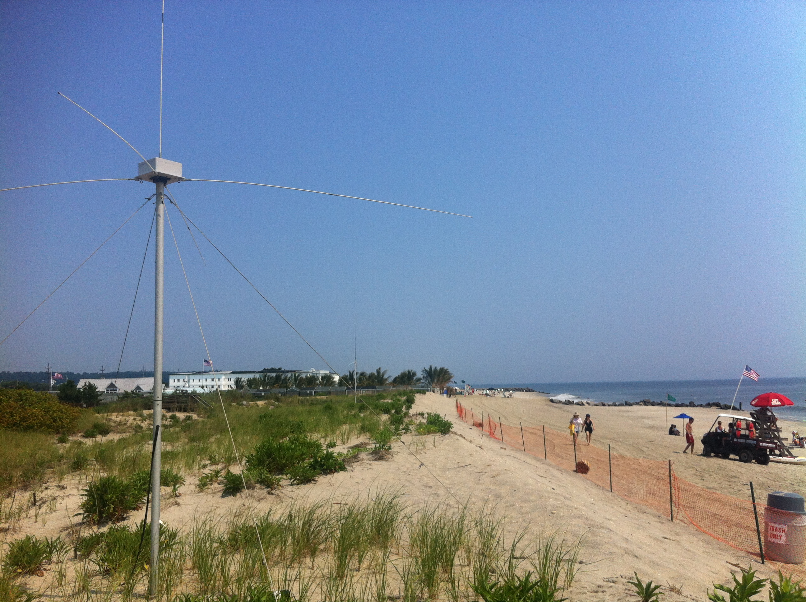

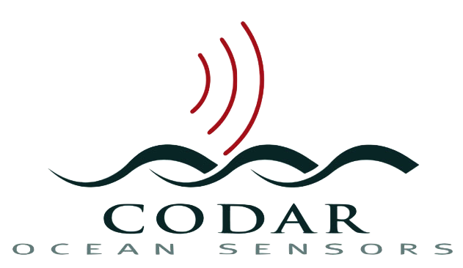




Real-Time Beyond the Horizon Vessel Detection
Hugh J. Roarty
Michael Smith
Scott M. Glenn
Donald E. Barrick

Slide 2
Talk Outline
Introduction to RUCOOL
Introduction of HF radar
Application of HF radar for Search and Rescue (SAR)
Use of HF radar for vessel detection
Real-time results for NY Harbor

Slide 3
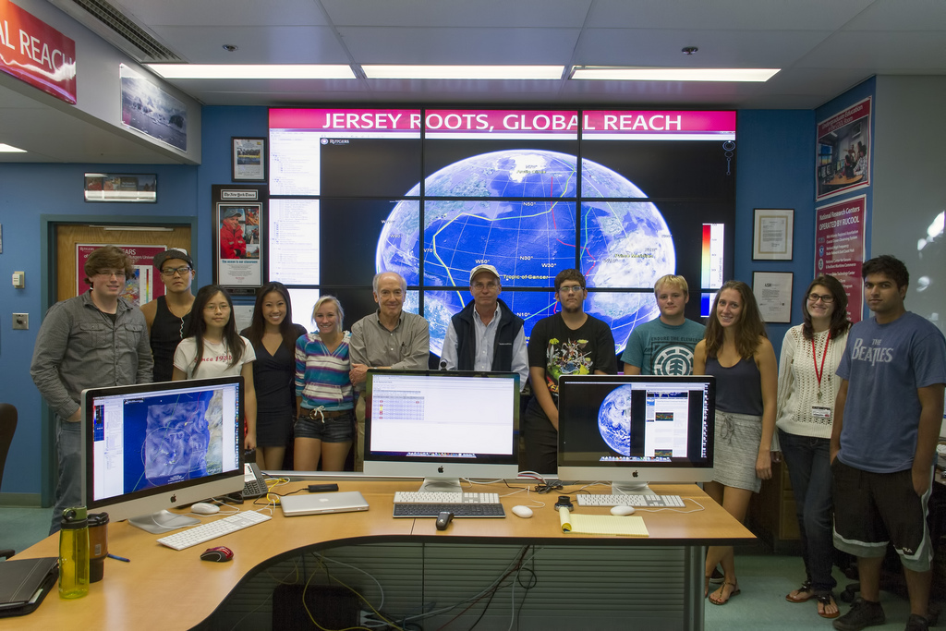
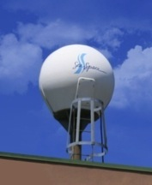
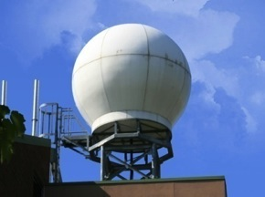
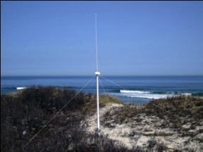
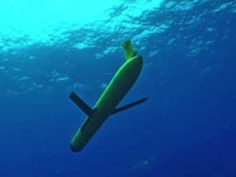
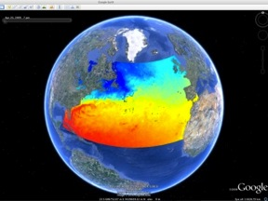
Rutgers University
Coastal Ocean Observation Lab
Satellite Data Acquisition Stations
CODAR Network
Glider Fleet
3-D Forecasts

Slide 4
Introduction to hf Radar

Slide 5
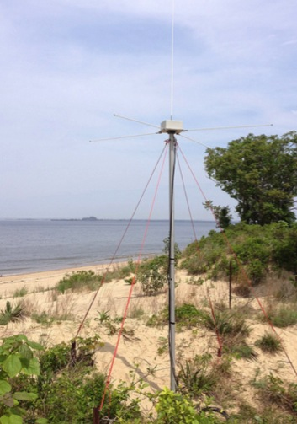
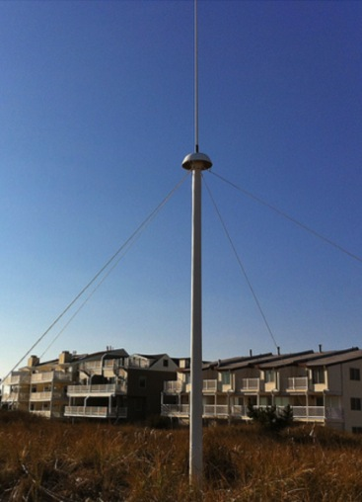
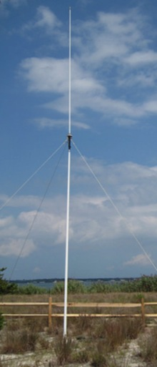
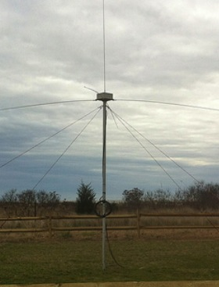
CODAR Compact HF Radar Antennas
25 MHz
13 MHz
5 MHz
Combined Transmitter & Receiver
Separate Transmitter & Receiver
FMCW Doppler Radar Average Power 50 watts

Slide 6
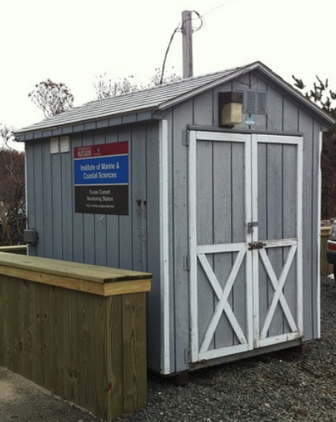
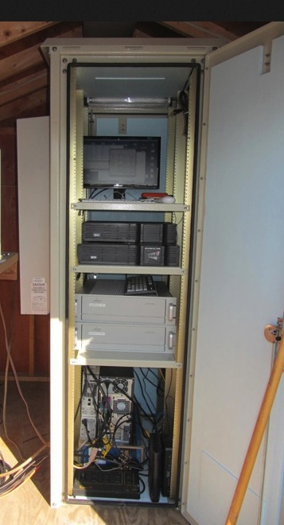
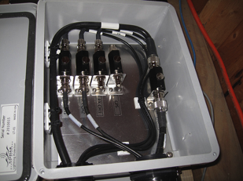
Standard CODAR Shore Site:
Shed, Enclosure, Tx/Rx, Comms, Power, GPS, AIS
monitor
computer & external hard drive
A.C. unit
UPS system
transmitter
receiver
Two lines of Communication
Shed
Enclosure
Lightning Protection

Slide 7
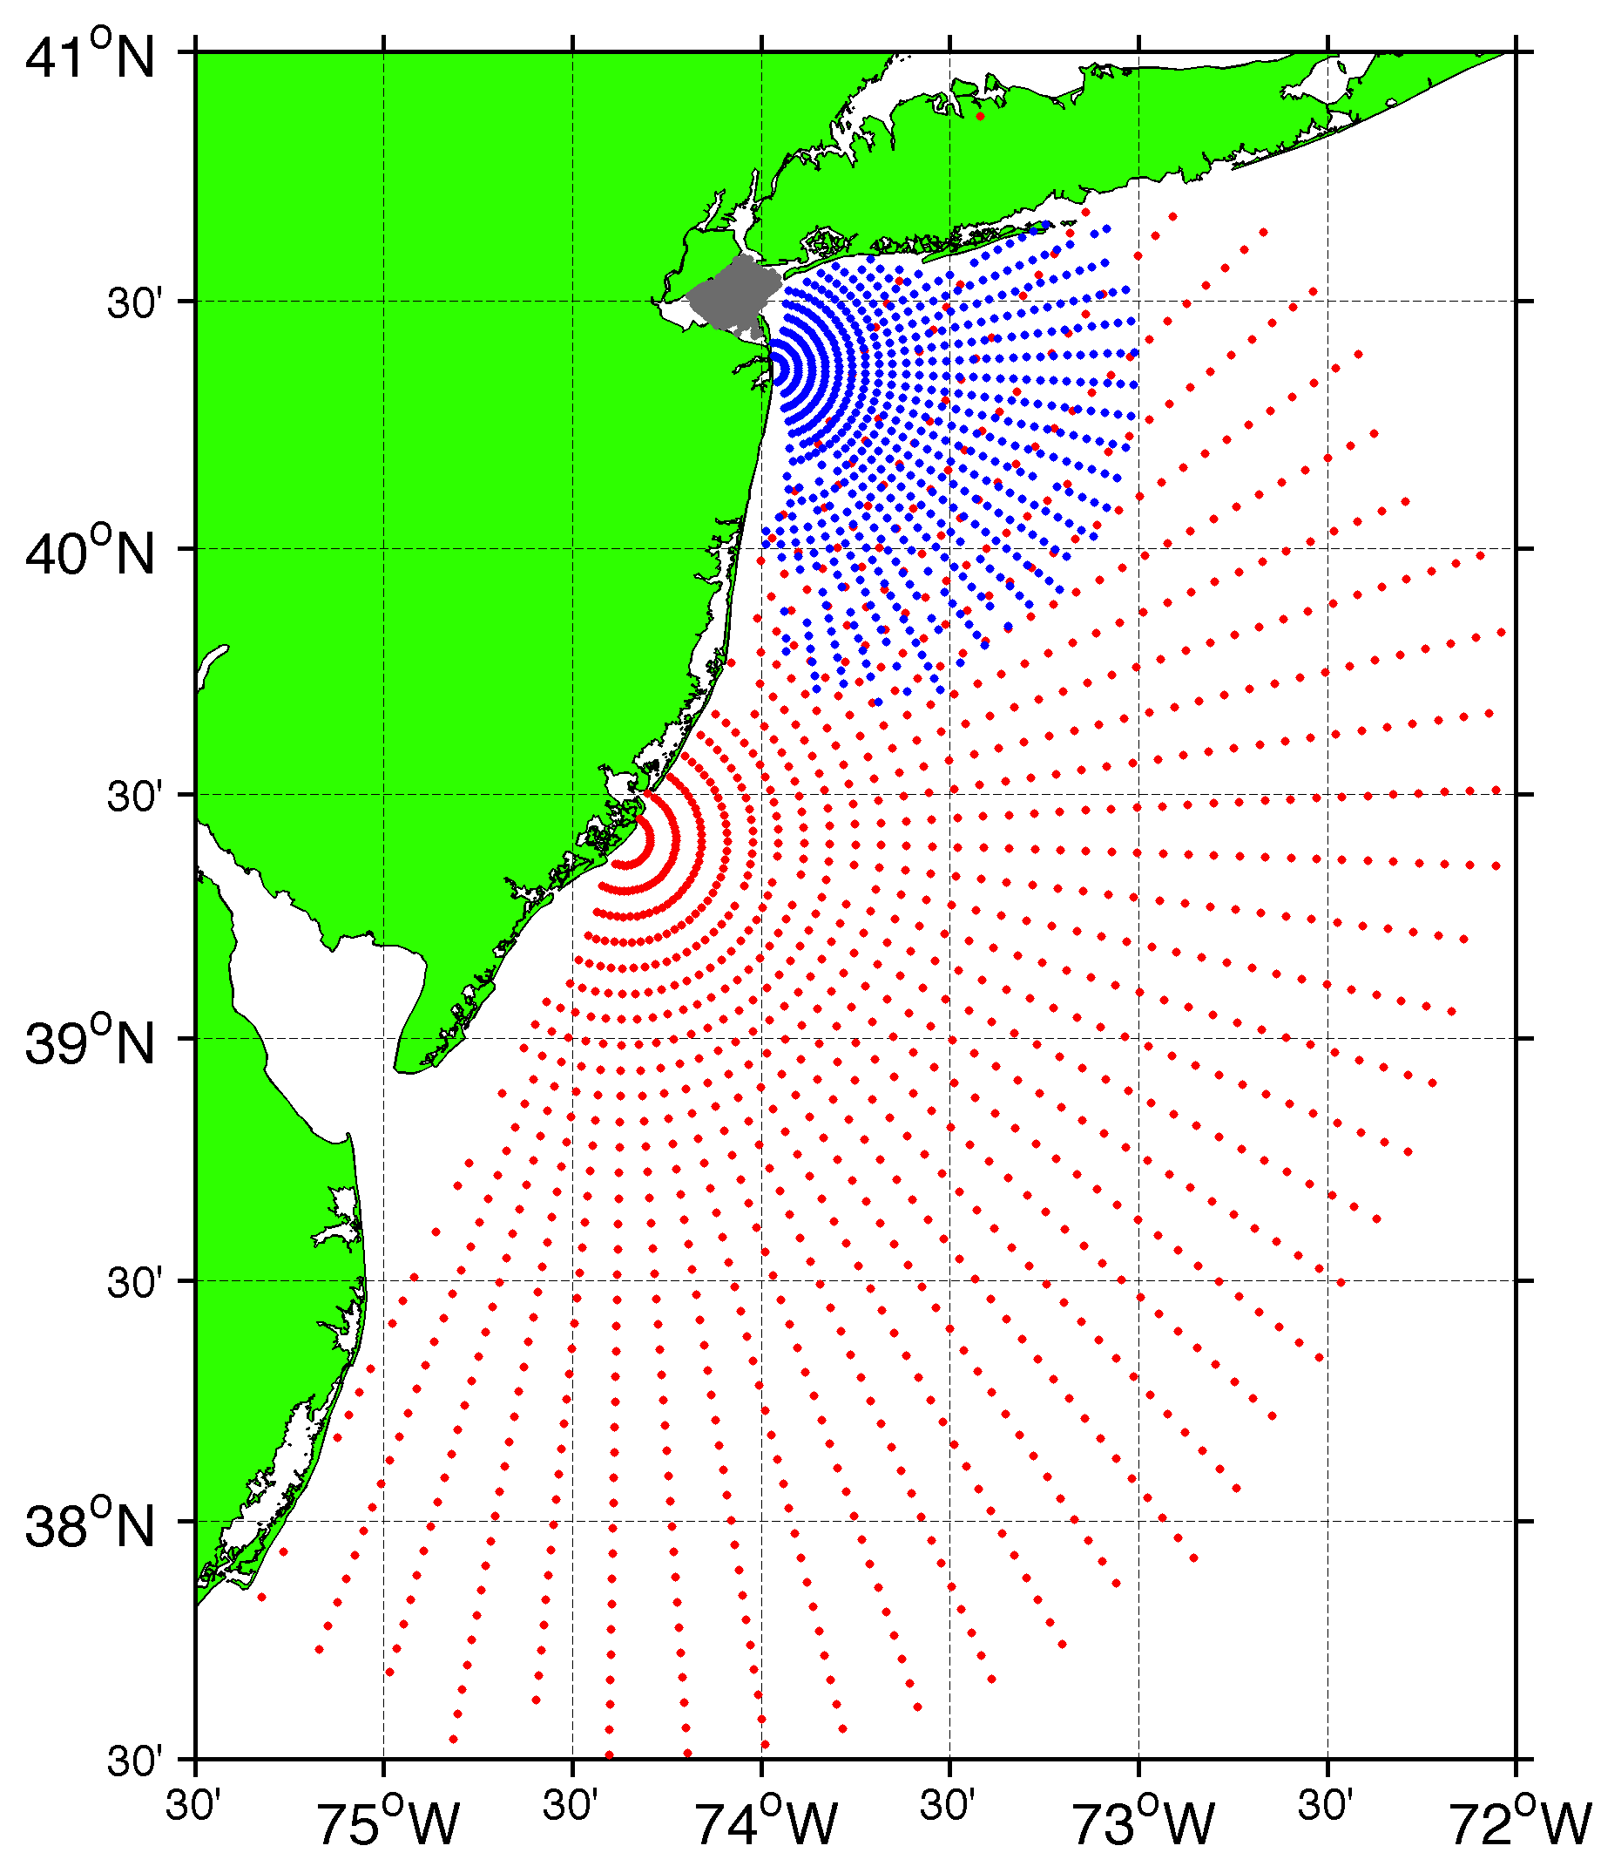
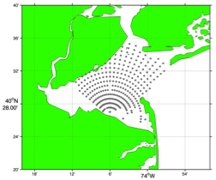
Surface Current Mapping Capability
25 MHz
Radar λ: 12 m Ocean λ: 6 m
Range: 30 km Resolution: 1 km
13 MHz
Radar λ: 23 m Ocean λ: 12 m
Range: 80 km Resolution: 3 km
05 MHz
Radar λ: 60m Ocean λ: 30 m
Range: 180 km Resolution: 6 km

Slide 8
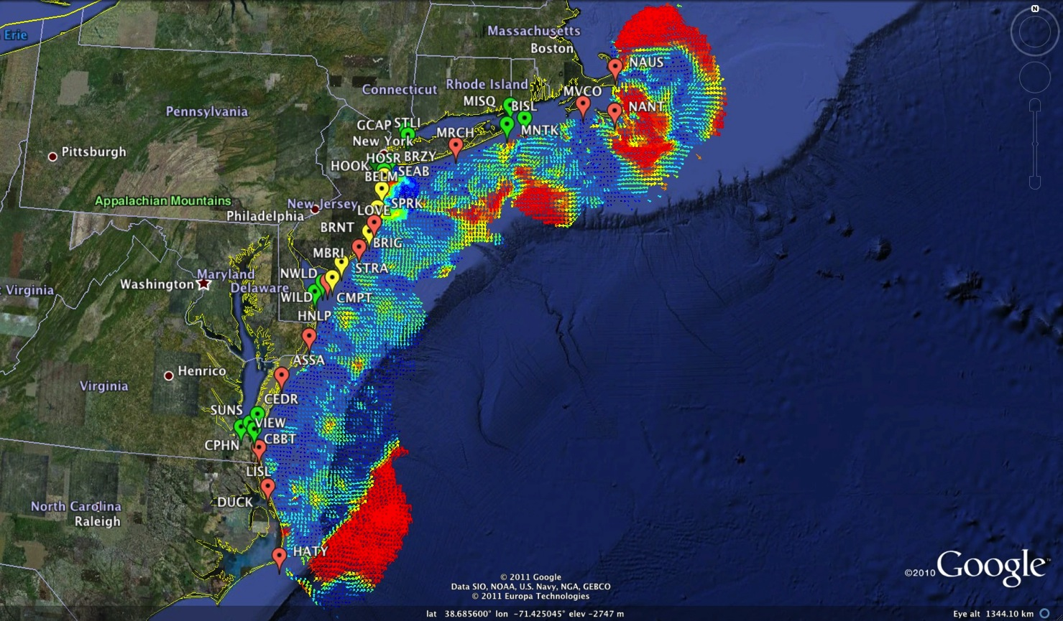






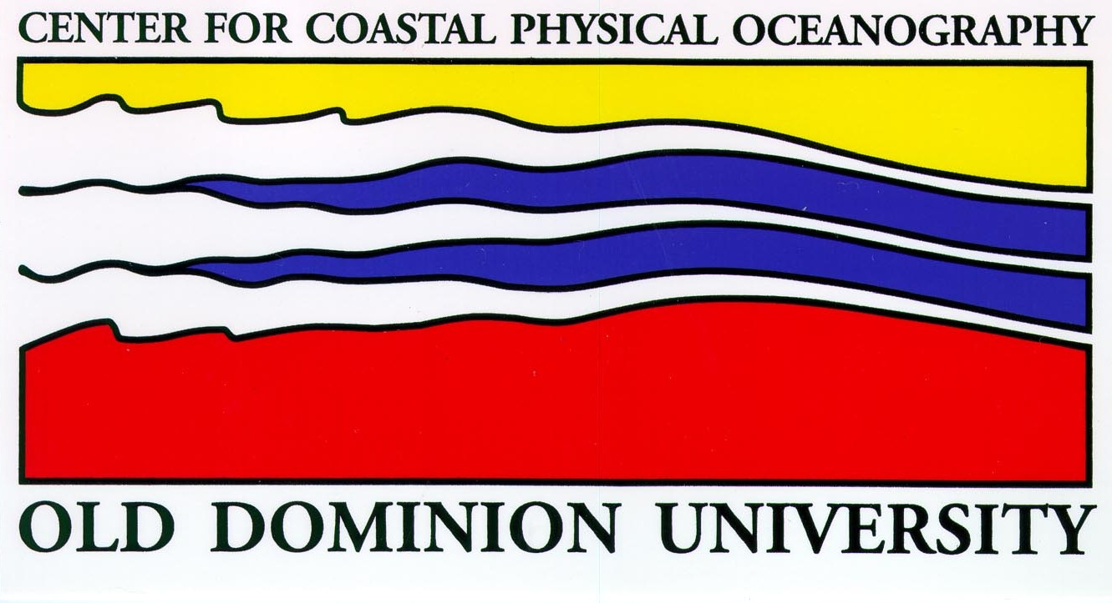
Mid-Atlantic Bight HF Radar Network
1000 km Alongshore Length Scale
Mid-Atlantic HF Radar Network
16 Long-Range CODARs
8 Medium-Range CODARs
17 Short-Range CODARs
41 Total
Triple Nested & Multistatic

Slide 9
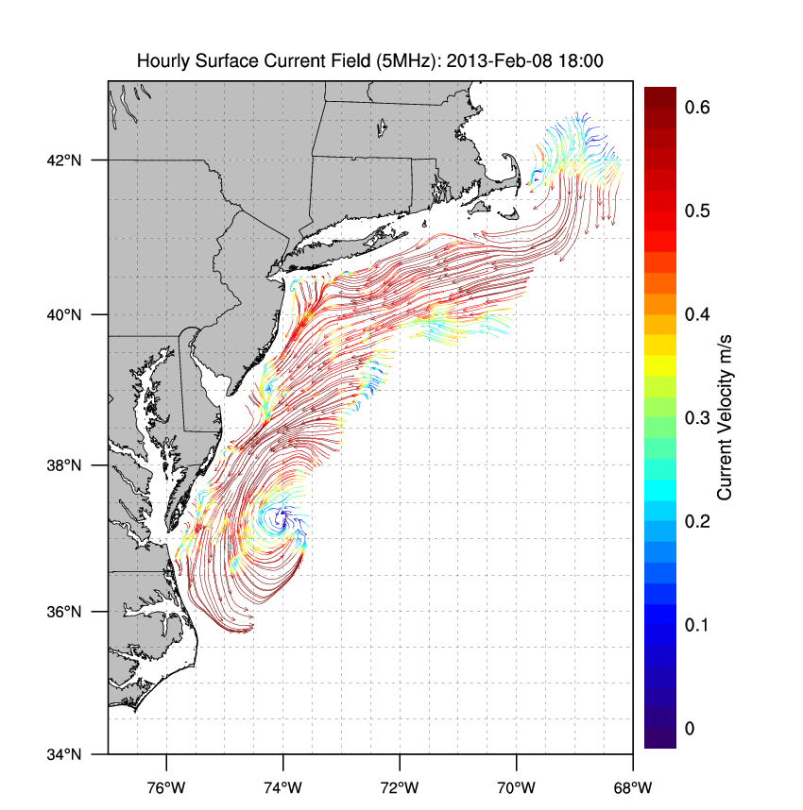
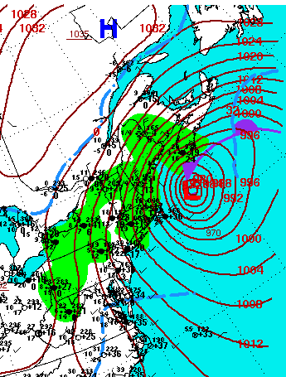

Winter Storm Nemo
February 9, 2013

Slide 10
Application of hf Radar to Search and Rescue

Slide 11
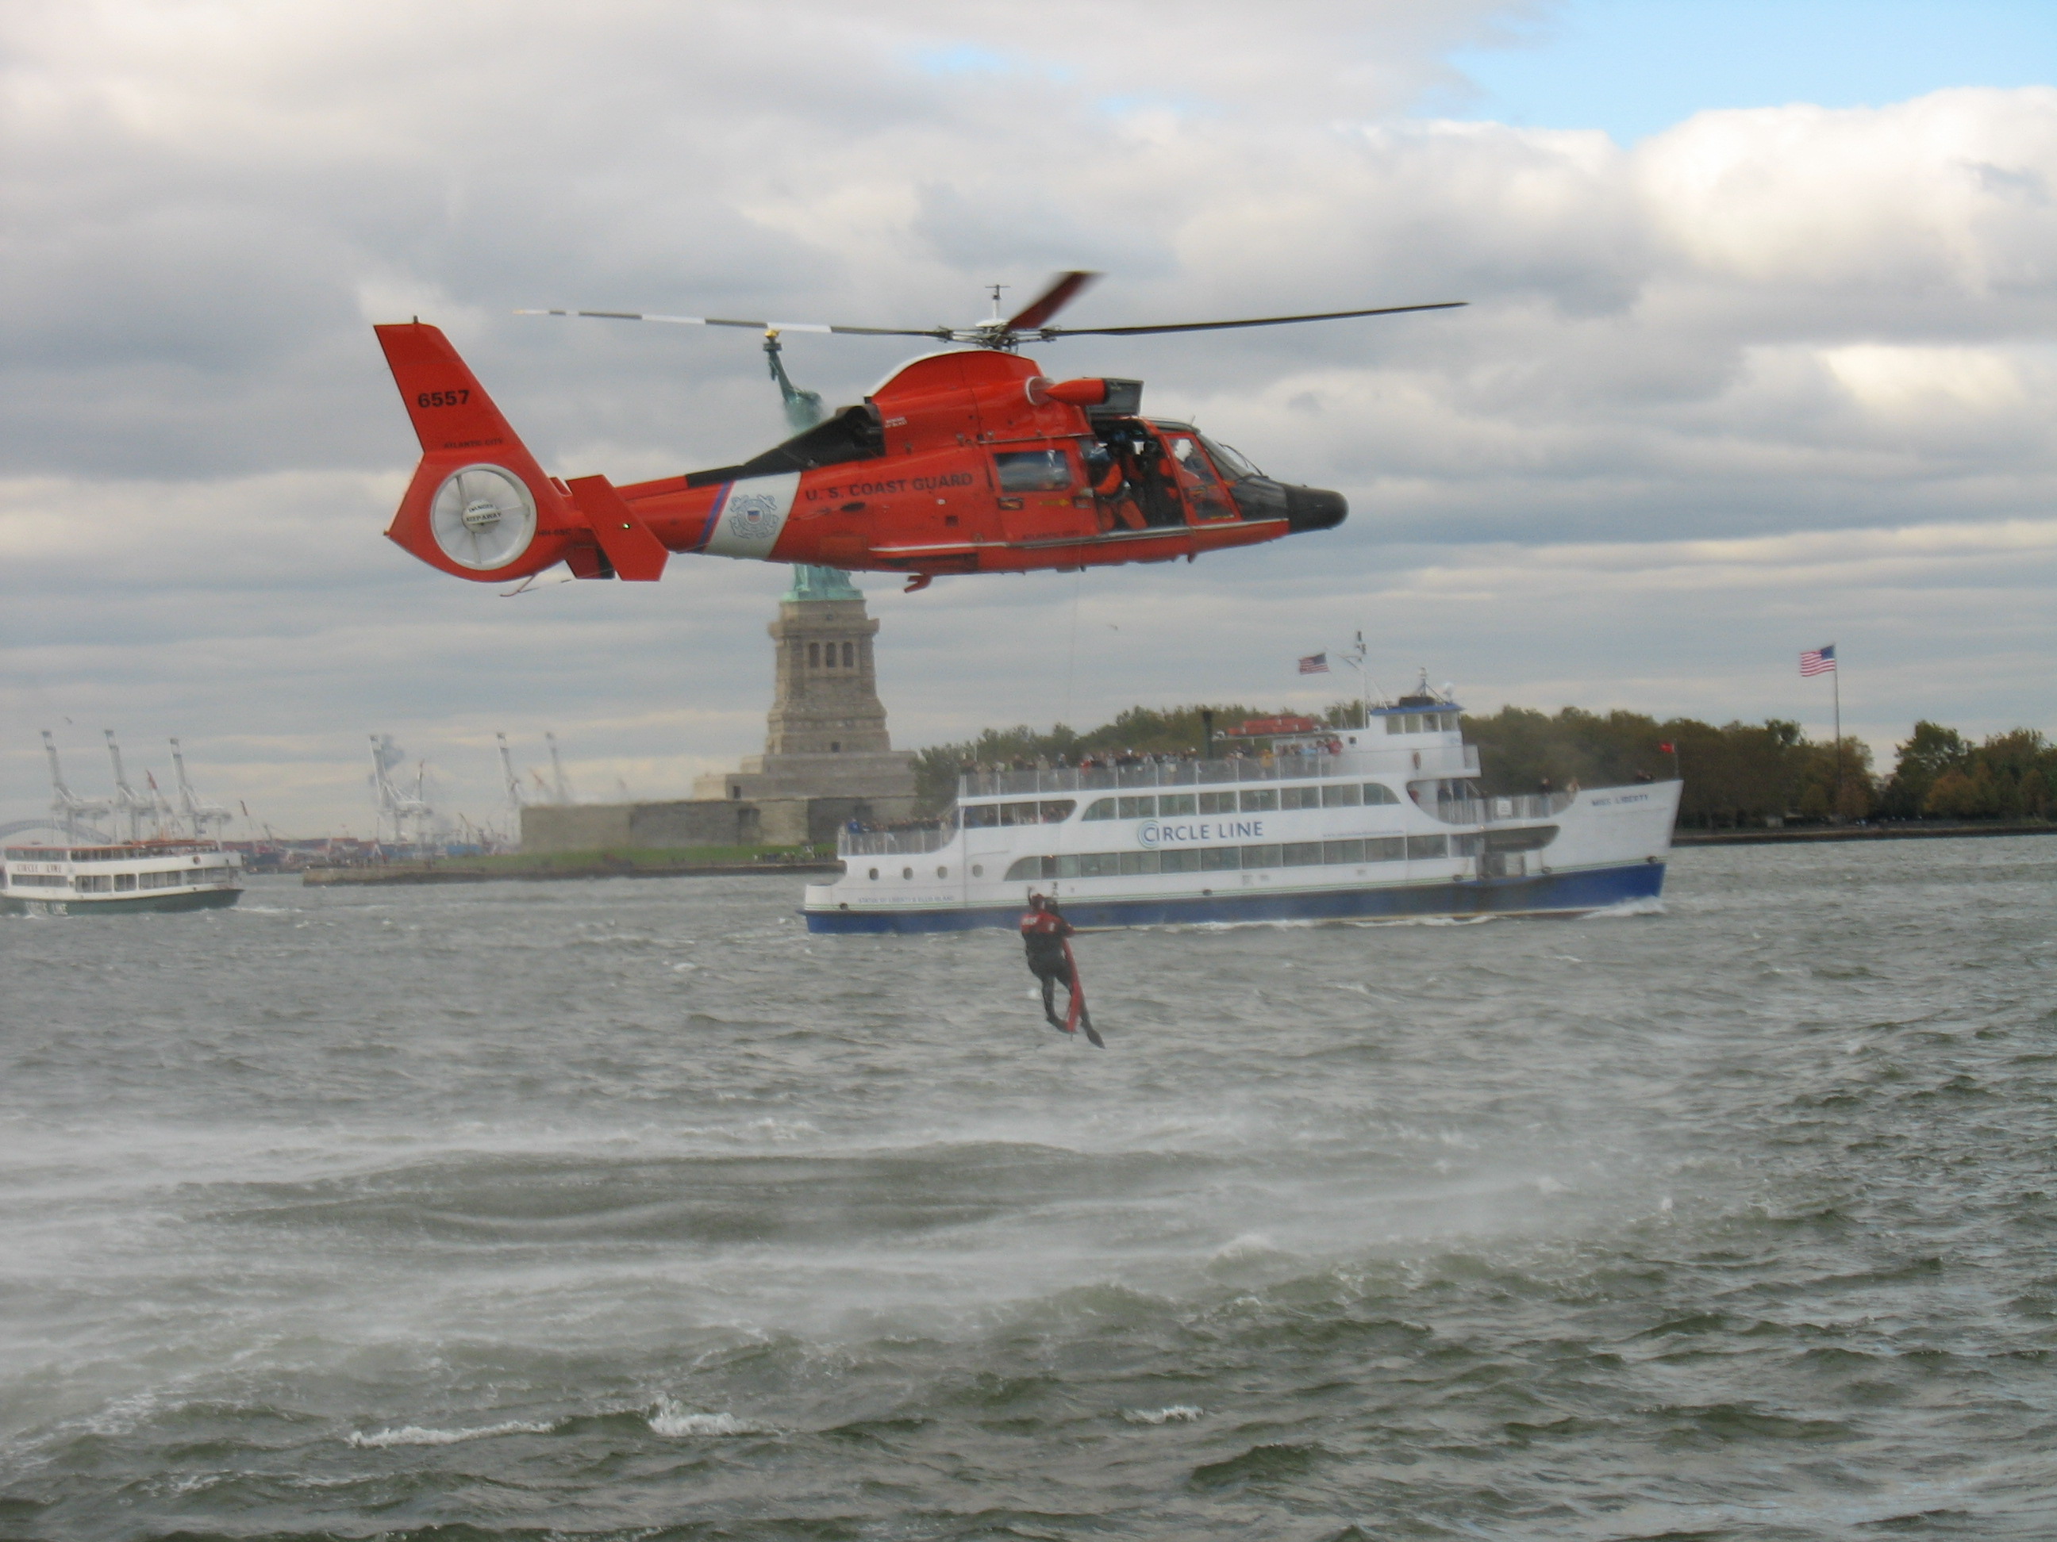
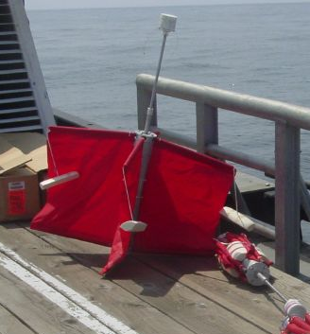
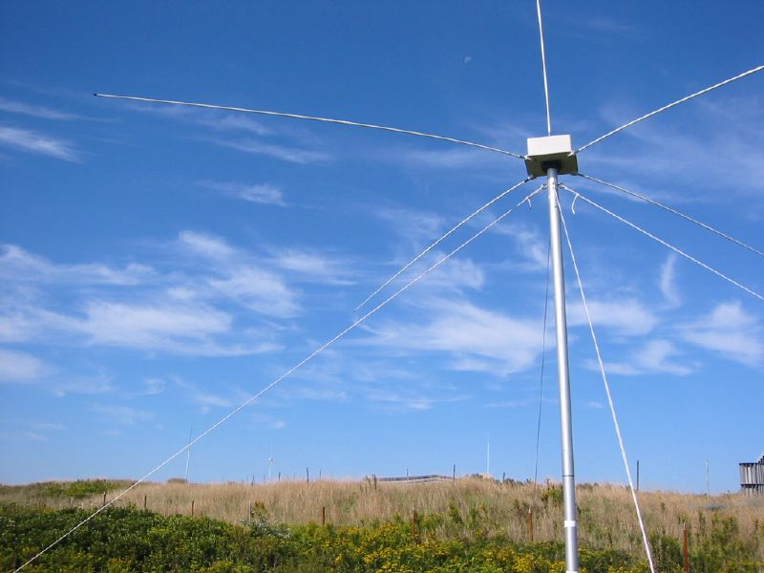
Transition Success Stories – Making a Difference
Optimizing HF Radar for SAR using USCG Surface Drifters
Art Allen
U.S. Coast Guard
Scott Glenn
Rutgers University
Mid-Atlantic Regional Association
Coastal Ocean Observing System

Slide 12

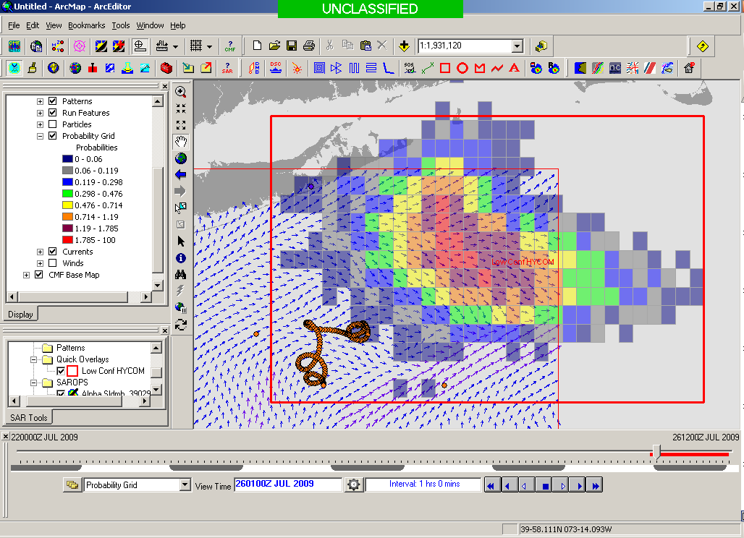
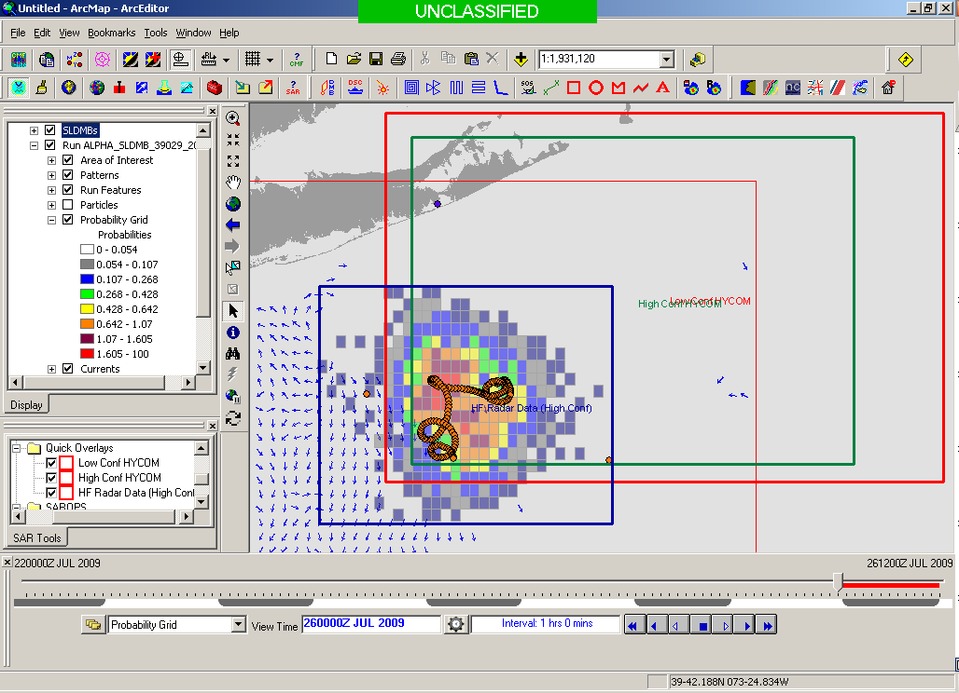
SAROPS Test Case
5000 Virtual Drifters +
1 Real Drifter (Black Line):
Search Area After 96 Hours
154 km
100 km
232 km
123 km
HYCOM (Ocean model)
Search Area: 36,000 km²
HF Radar (Measurements)
Search Area: 12,000 km²
Notes:
HYCOM (Low Conf) 48 hours

Slide 13
hf Radar for Vessel Detection

Slide 14
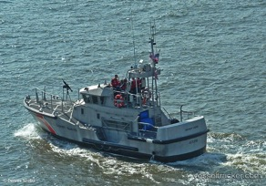
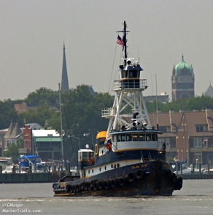
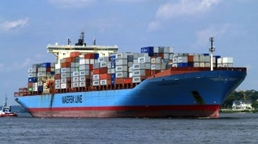
Vessel Detection Capability
25 MHz
Range: 11 nmi
Height >10 ft
13 MHz
Range: 43 nmi
Size: >19 ft
05 MHz
Range: 65 nmi
Size: >49 ft

Slide 15
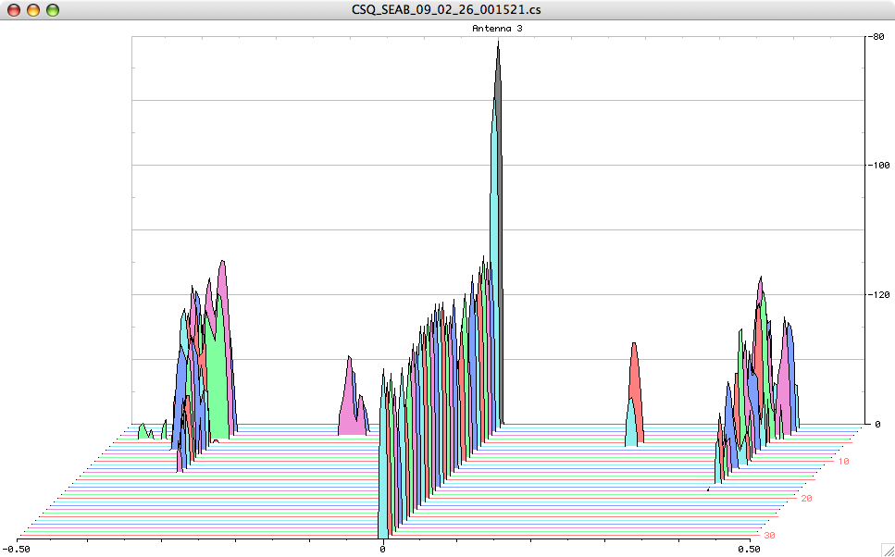
Doppler Spectra from all Range Cells
with Detection Threshold above Background Applied
Fixed Objects & Direct Signals
Bragg Waves
Bragg Waves
Vessel
Vessel
Range
Doppler Frequency
(Target Speed)

Slide 16
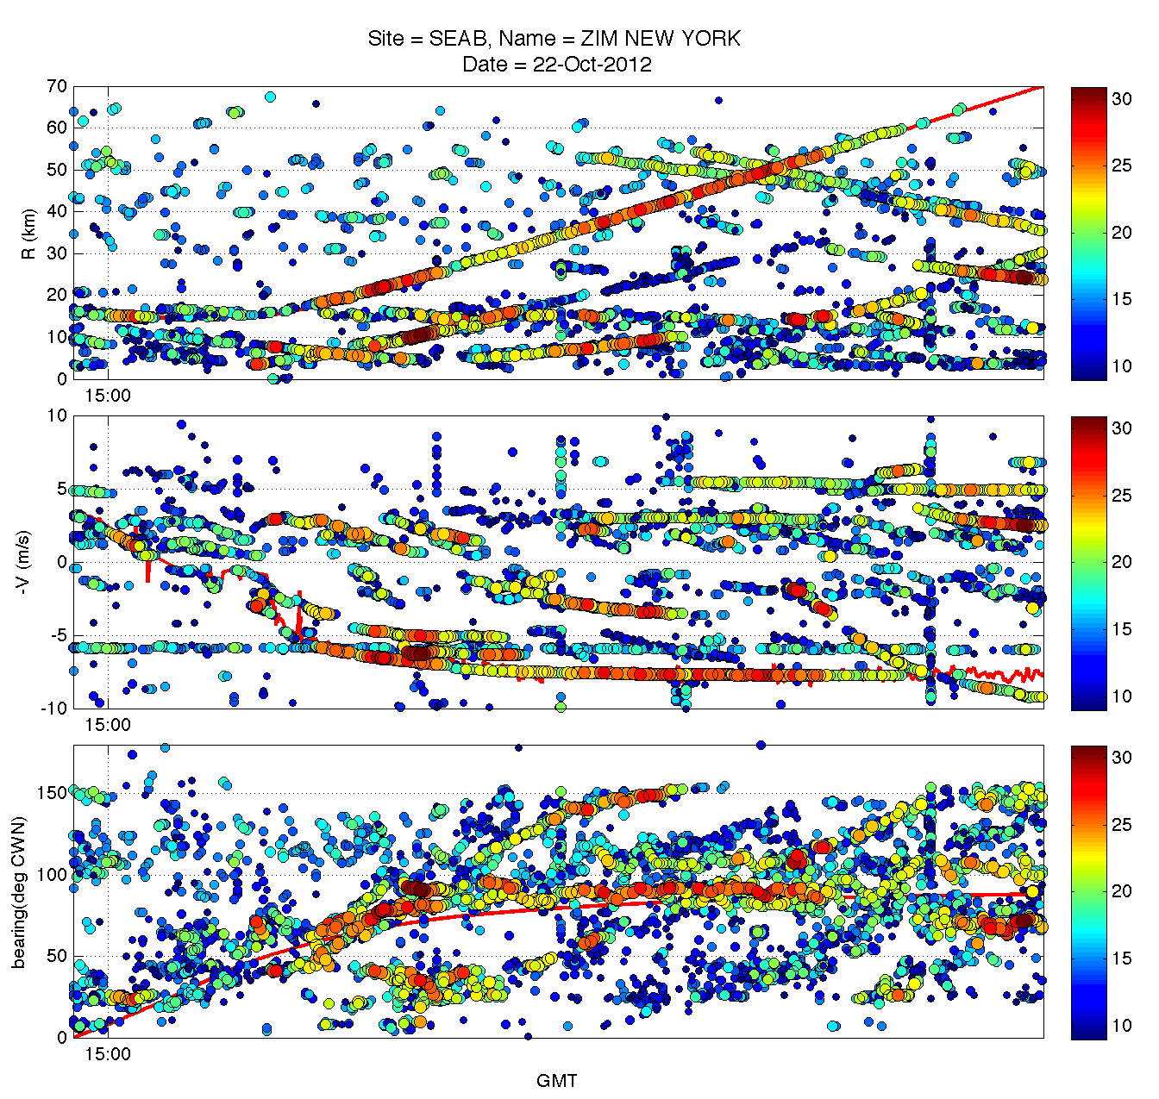
Step 1
Raw Detections
From each HFR:
Radial Velocity (most accurate)
Range
Bearing (least accurate)
Range (km)
Radial Velocity (m/s)
Bearing (°CWN)

Slide 17
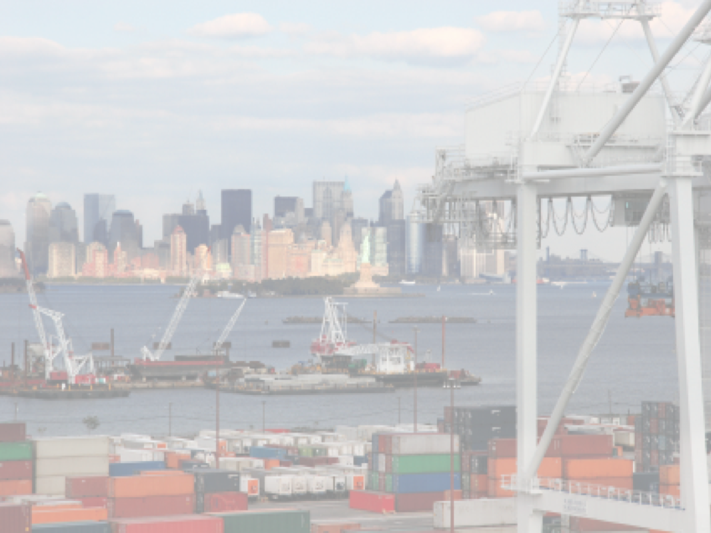



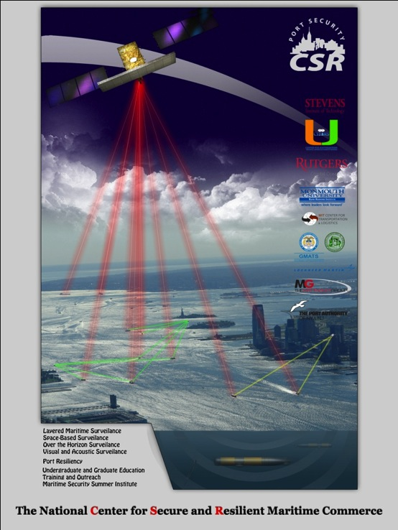






The Center for Secure and Resilient Maritime Commerce (CSR)
DHS Center of Excellence for Port Security
10 Institutions – Maritime Domain Awareness & Resiliency
Maritime Domain Awareness
Approach –
Dual Use Technologies
Demonstrate Nested Vessel Detection
Global > Approaches > Port
University of Miami –
Global Satellite Coverage,
Visible & Microwave
Rutgers University –
Over-the-Horizon Compact
High Frequency Radar Networks
Stevens Institute of Technology –
Local High-Resolution Optics &
Shallow Underwater Acoustics

Slide 18
NY HARBOR RECENT RESULTS

Slide 19
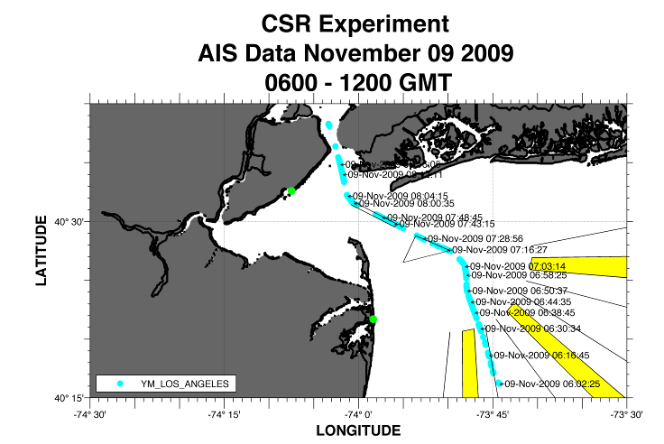
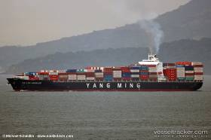
GPS Track YM Los Angeles
Notes:
19

Slide 20
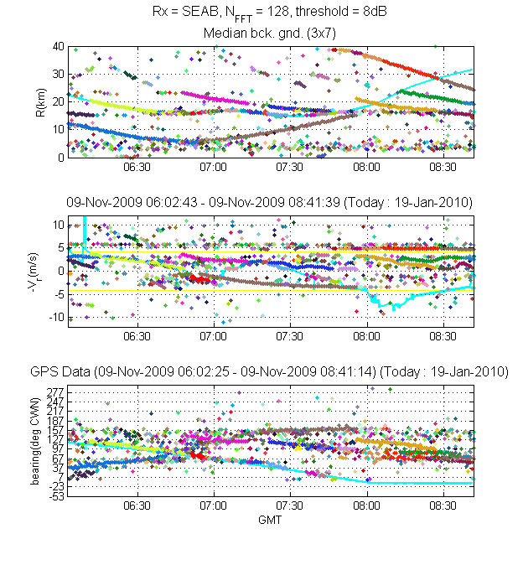
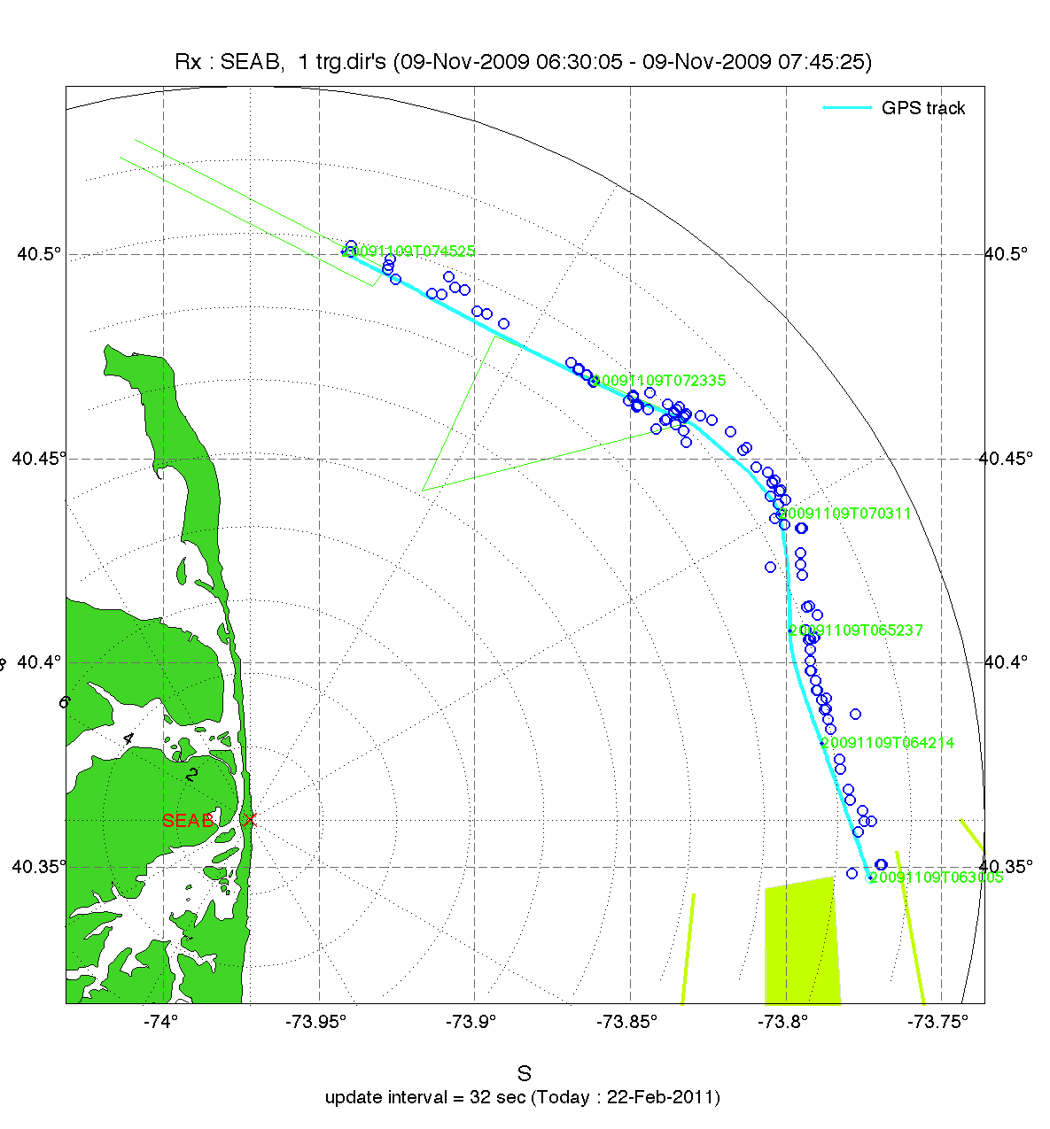
Pepper Plot
Detections on a Map
Notes:
20

Slide 21
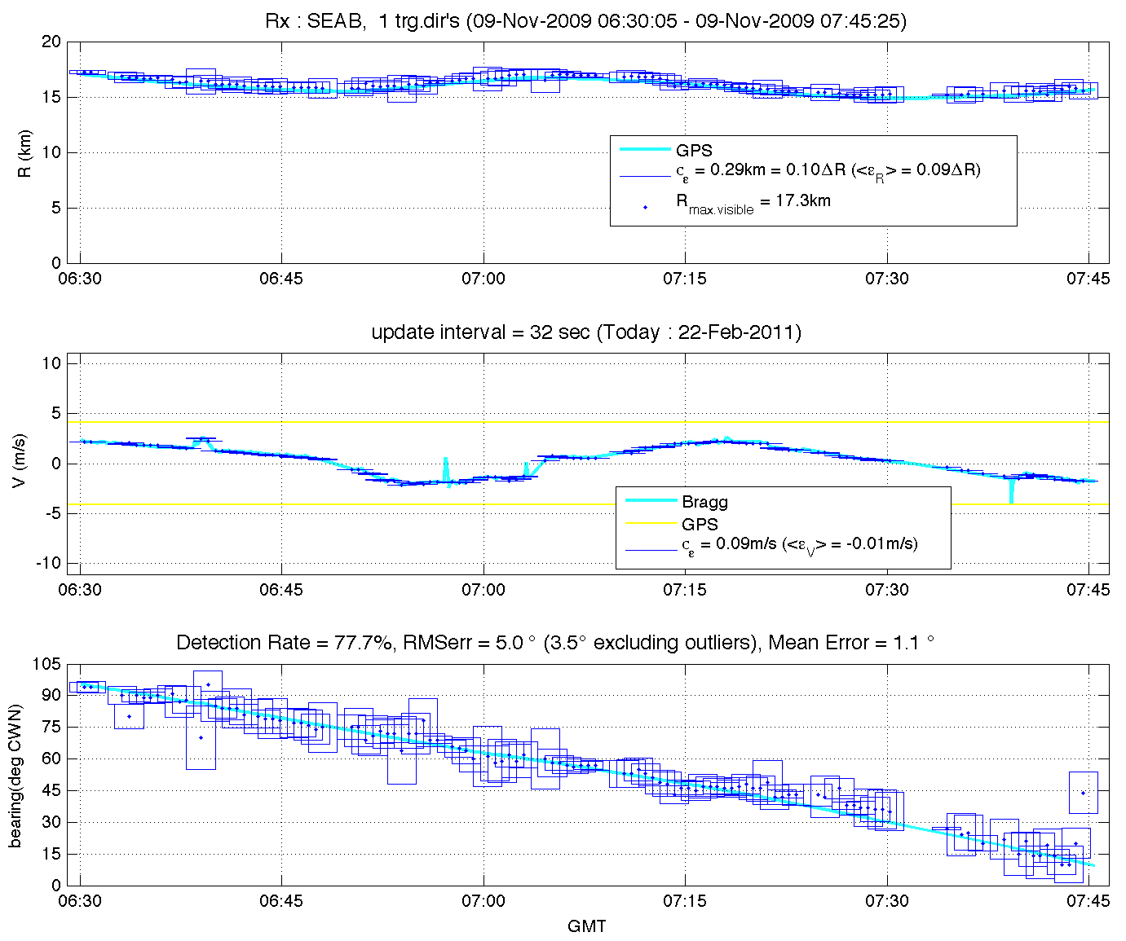
Association of GPS with Detections
Notes:
21

Slide 22
NY HARBOR 2012 RESULTS

Slide 23
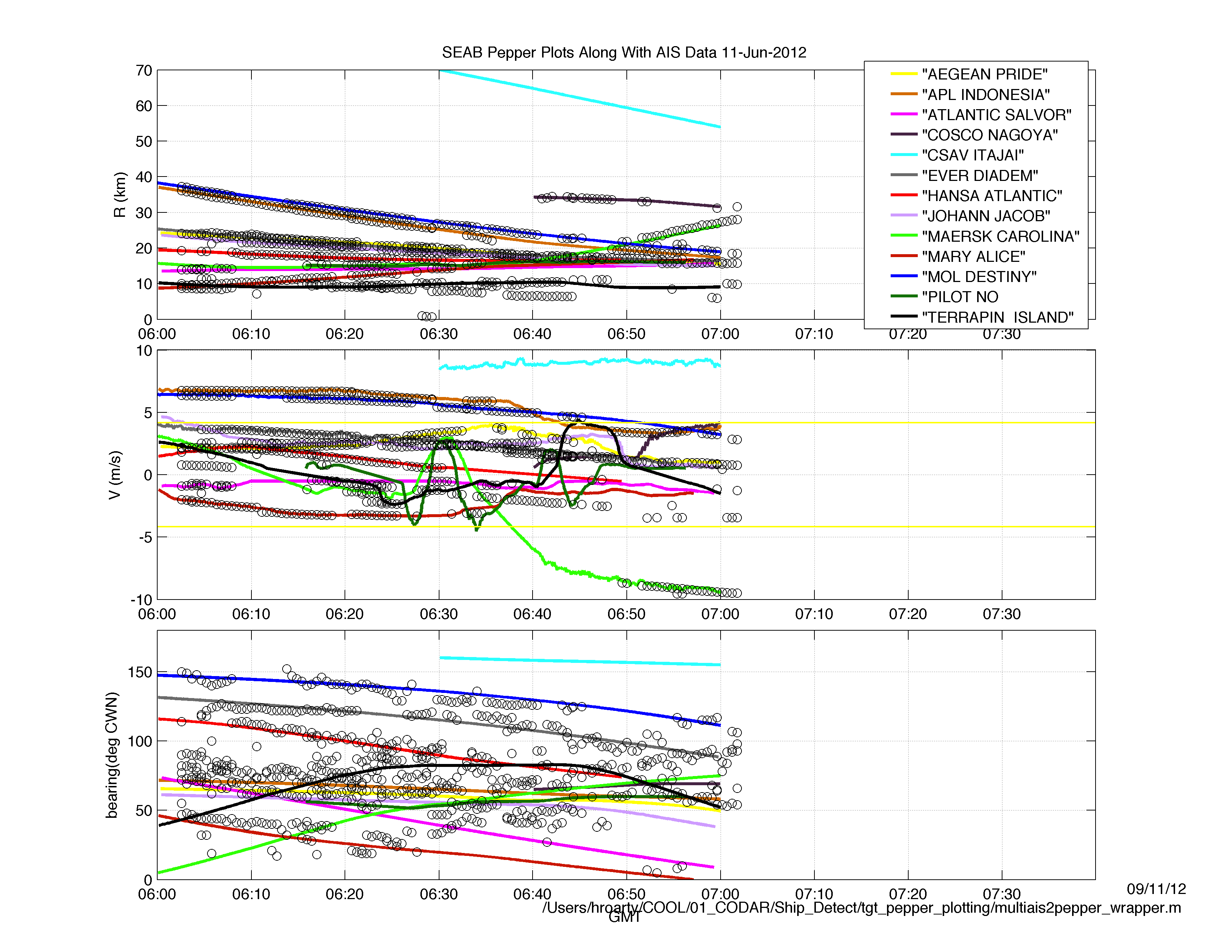
Detections Overlaid on AIS
June 11, 2012
06:00-07:00 GMT
Median Background
512 pt. FFT
14 dB SNR detection threshold
13 vessels on AIS

Slide 24
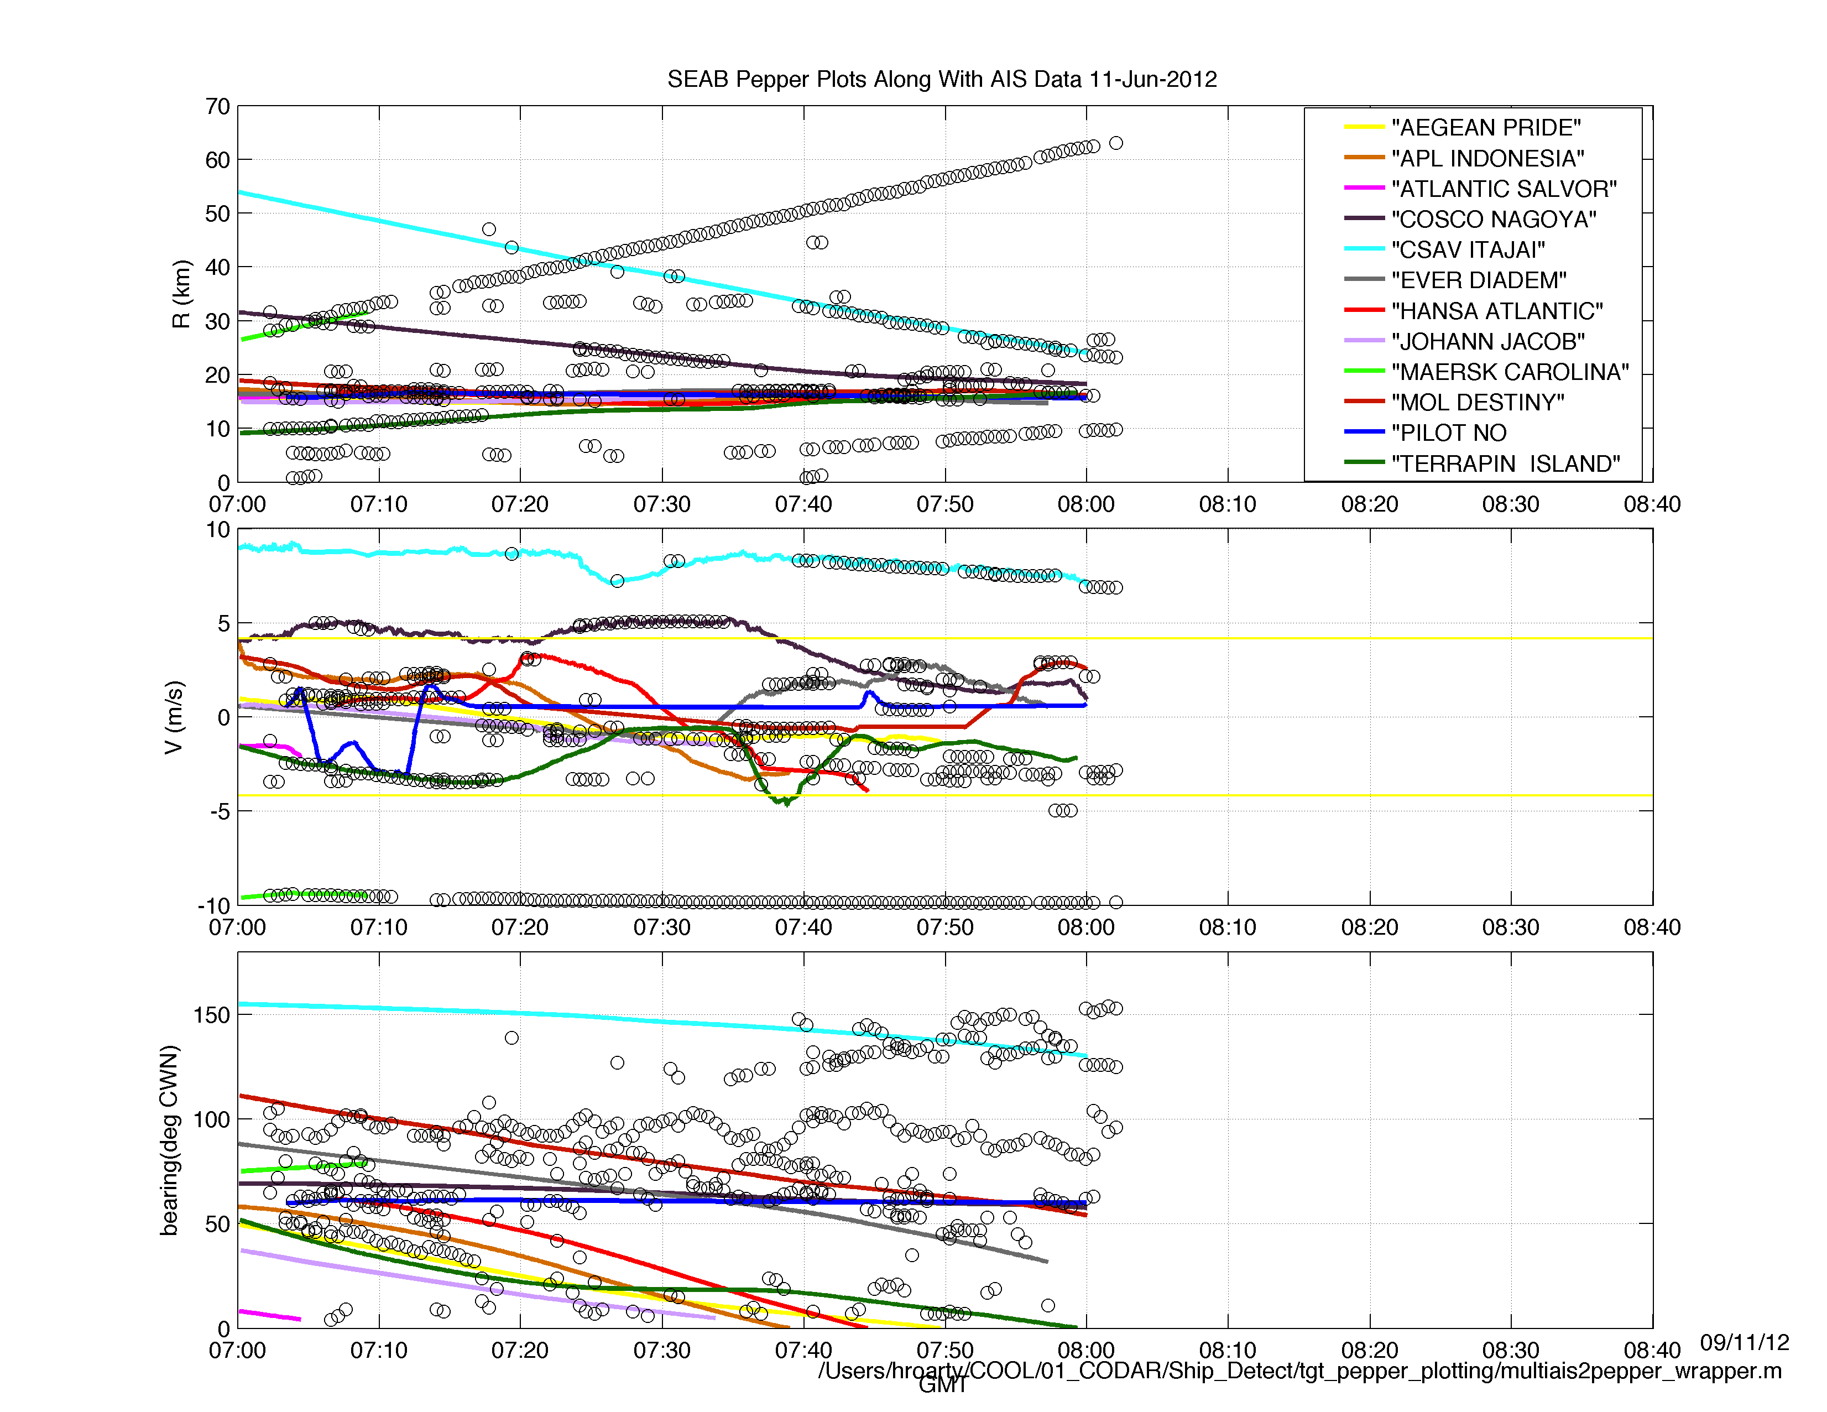
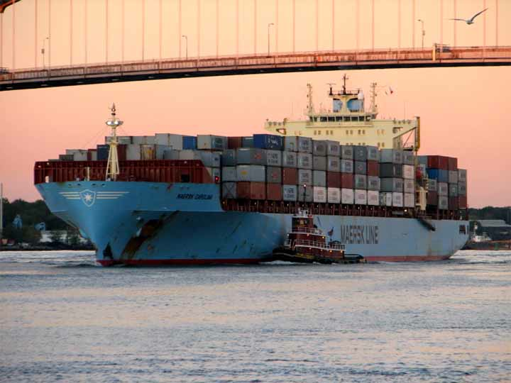
Detections Overlaid on AIS
June 11, 2012
07:00-08:00 GMT
Median Background
512 pt. FFT
14 dB SNR detection threshold
12 vessels on AIS

Slide 25
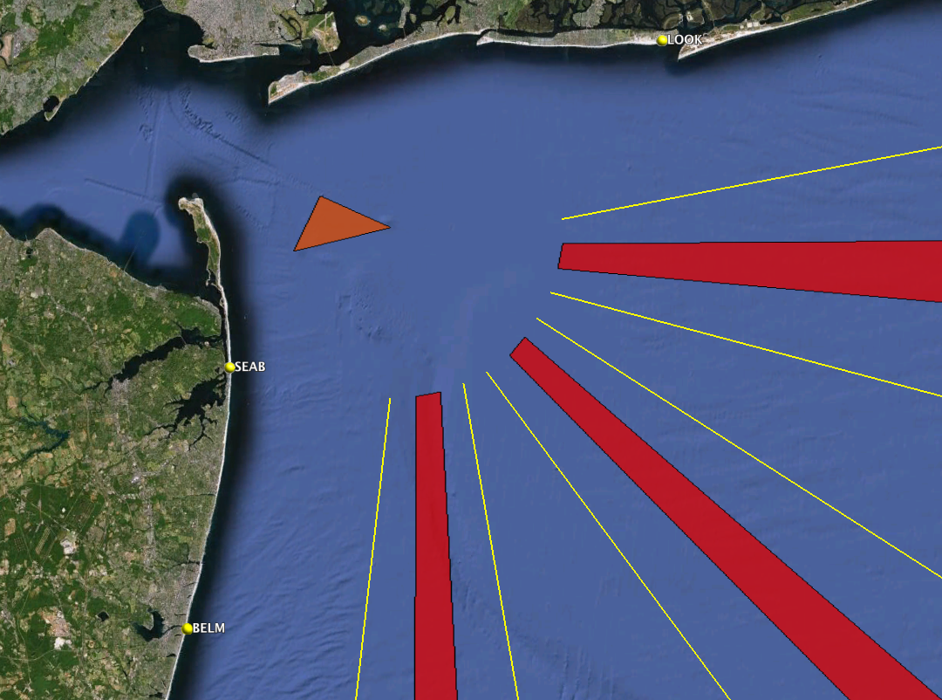





31% of
HF Radar Detections NOT on AIS
Approaches to New York Harbor
16 Vessels per Hour in HFR
5 Vessels NOT on AIS

Slide 26
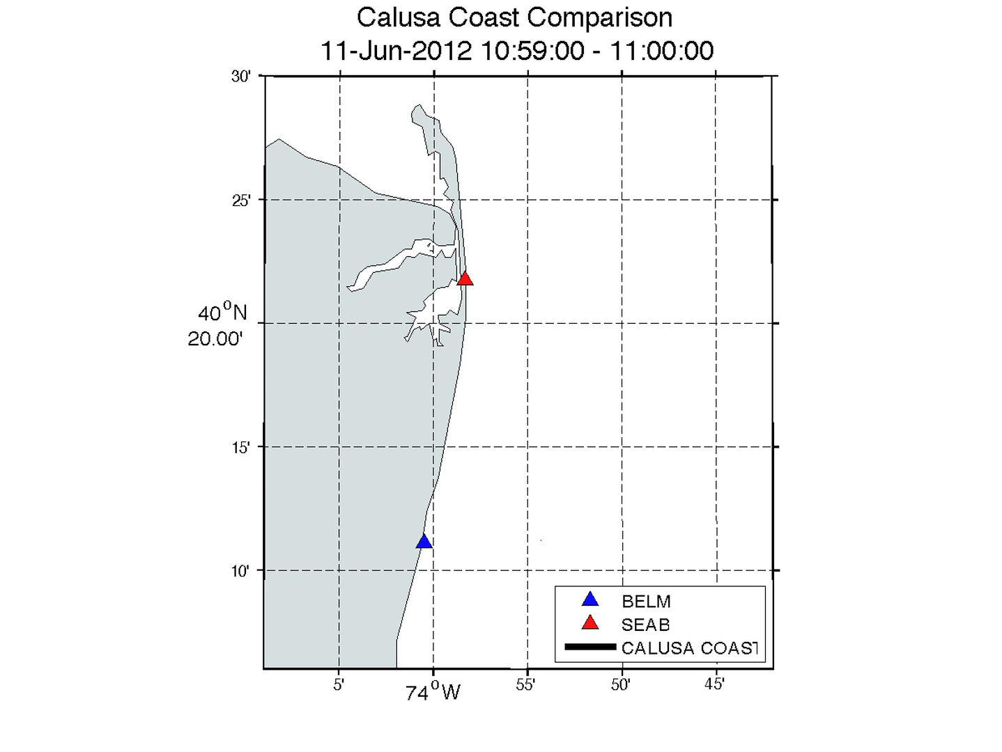
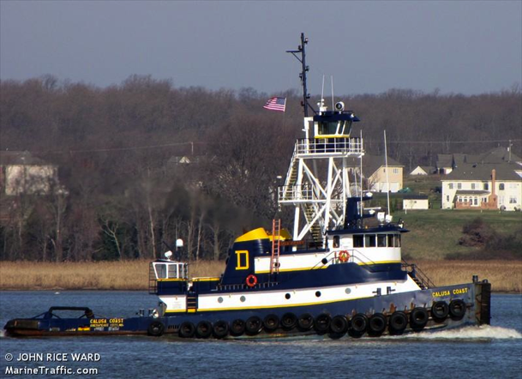
Calusa Coast Test Case

Slide 27
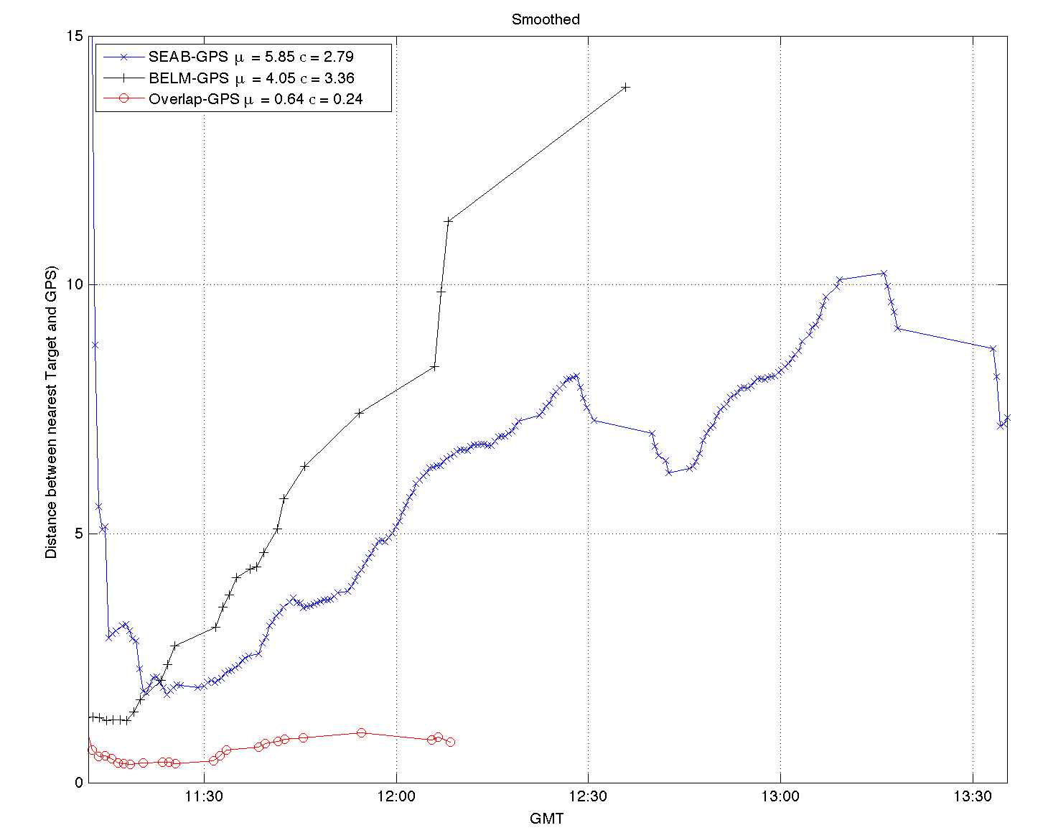
15
10
Location Error (km)
5
Intersecting Ranges
0

Slide 28
National hf Radar network

Slide 29
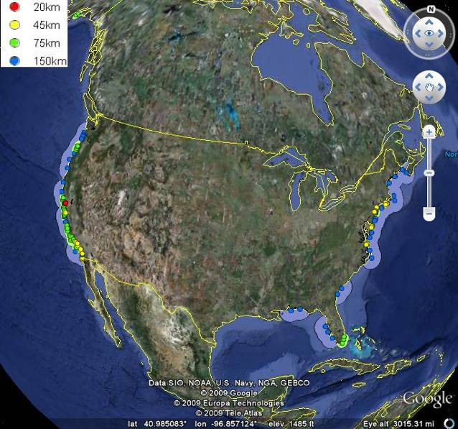
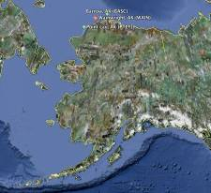
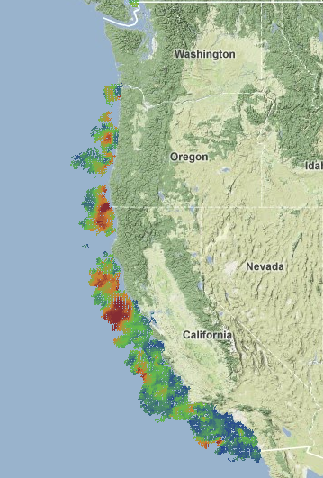
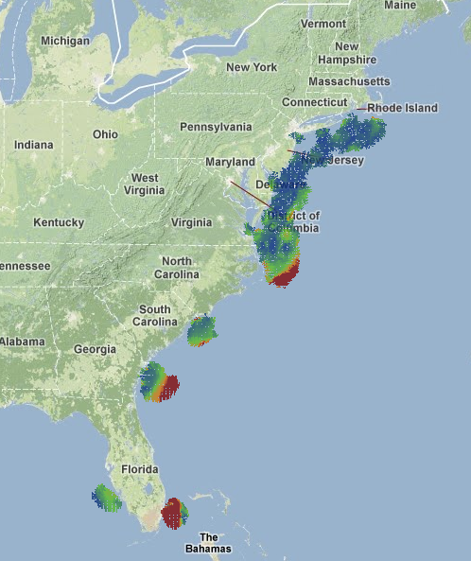
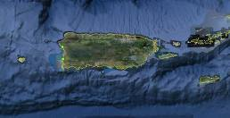

NOAA National Network: Existing Sites
Alaska - 3
Puerto Rico - 2
CONUS - 104
Hawaii - 3

Slide 30




NOAA National Network: Proposed Sites
Alaska - 17
Puerto Rico - 20
CONUS - 262
Pacific Islands - 21

Slide 31
Next Steps
Conclusions
HF radar being used by Coast Guard for Search and Rescue
Can also be used for Maritime Domain Awareness
Utilize bistatic data
Develop tracker for detections
Questions?

