Slide 1


Slide 2

National Science Foundation (NSF) in the United States holds
competitions to focus efforts on problems of high science value. Large scale investments on the order of 25 million over a 10 year period (2 five year awards)
Competition is help between all NSF directorates. One such competition began in 2011, and is coming to the end.
C-SOBOM (Center of Southern Ocean Biogeochemical Observations and Modeling) is one of the 4 Centers of the 269 proposals that remain. It is expected that 4 will be awarded.
Revised strategic plan, IP agreements being constructed. Hopefully a formal announcement in late August.

Slide 3
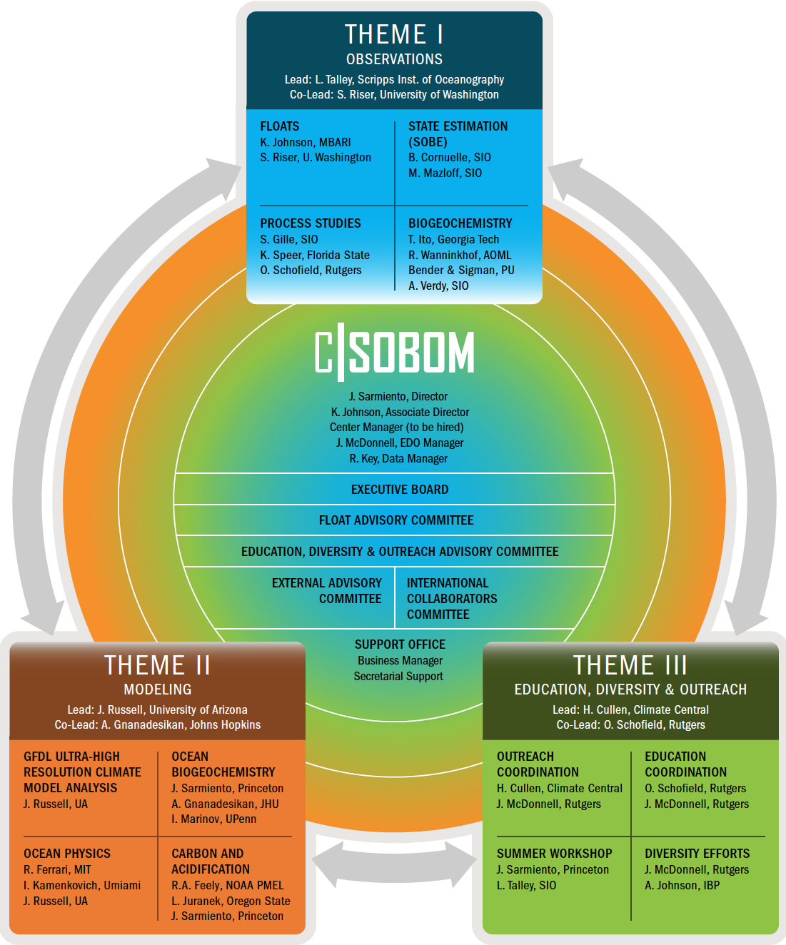

Slide 4
Central observation program built around deploying ~200 Biogeochemical Argo profiles for one month
Yellow line is the Polar Front

Slide 5
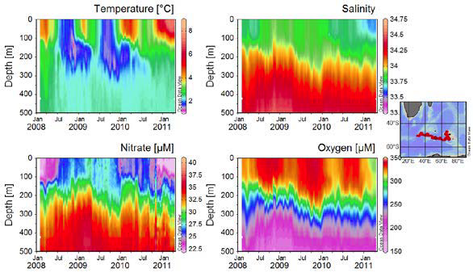
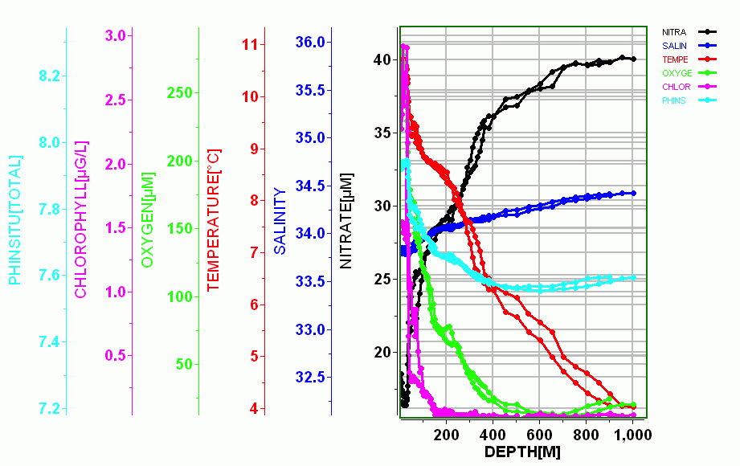
Examples of the time series
collected by time series.
Examples of the full data complement of the proposed SOBOM profilers

Slide 6
Nitrate profiles south of 30°S
The goal of C-SOBOM is to measure 740 profiles per month every month of the year

Slide 7
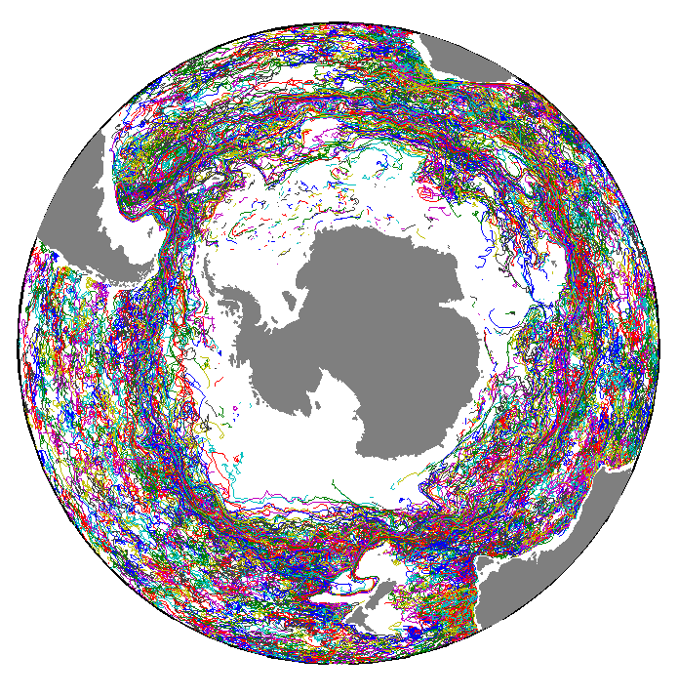
Profiling float trajectories in the Southern Ocean from 2005 to 2010
The Southern Ocean, especially under seasonal sea ice cover, remains very undersampled.
Floats that sense sea ice have been developed and are now being deployed.

Slide 8
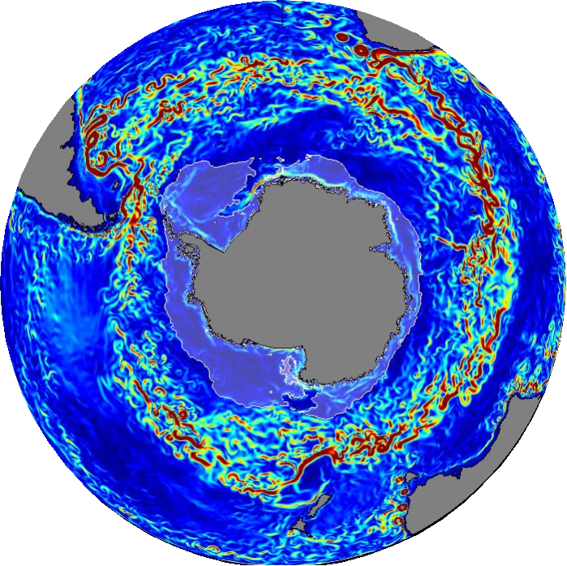
Southern Ocean: a paradigm shift – Transformative analysis methods
Ocean State Estimation: similar to atmospheric reanalysis (merging of data into models through various techniques), to produce full 4D estimate of ocean properties
Developed over the past 2 decades. MIT and SIO have played seminal role in development. Southern Ocean State Estimate is the first eddy-resolving large-scale state estimate, developed by M. Mazloff.
Currently adding biogeochemistry (Princeton-SIO, NASA funding)

Slide 9
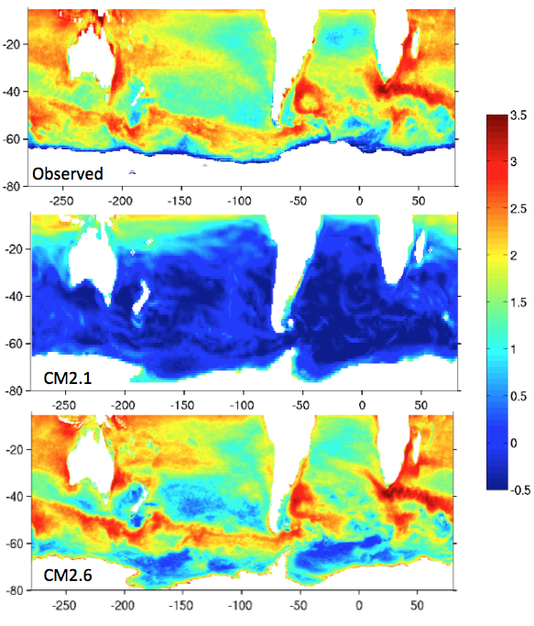
Eddy kinetic energy in the Southern Ocean
(cm² s⁻²)
Observed
CM2.1 has
1° resolution
CM2.6 has
0.1° resolution

Slide 10
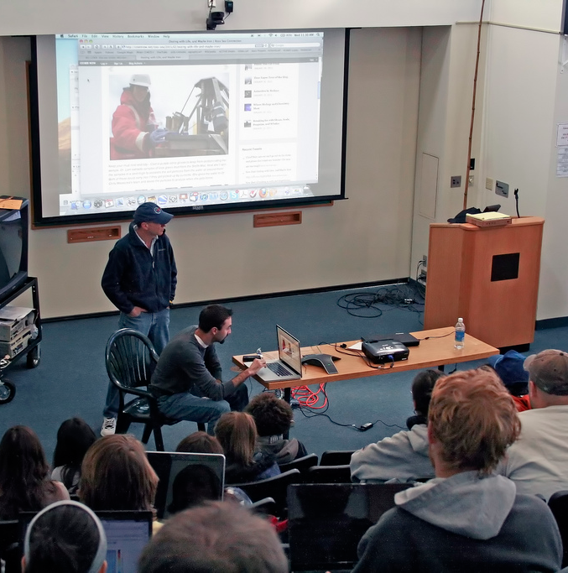
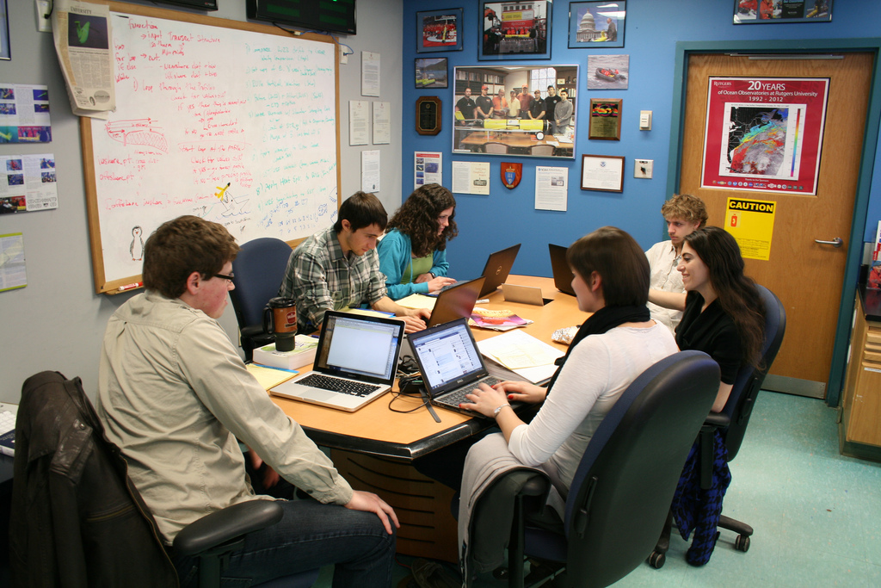
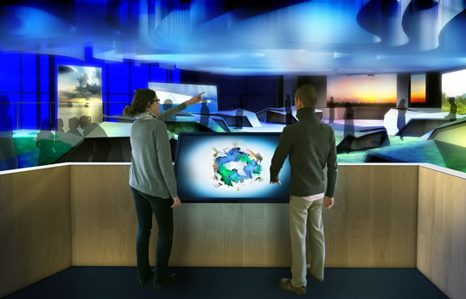
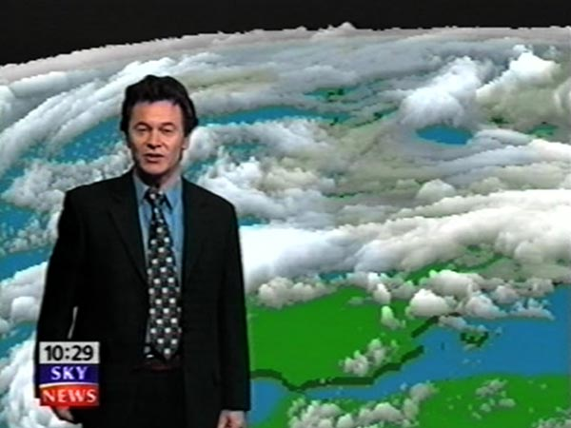
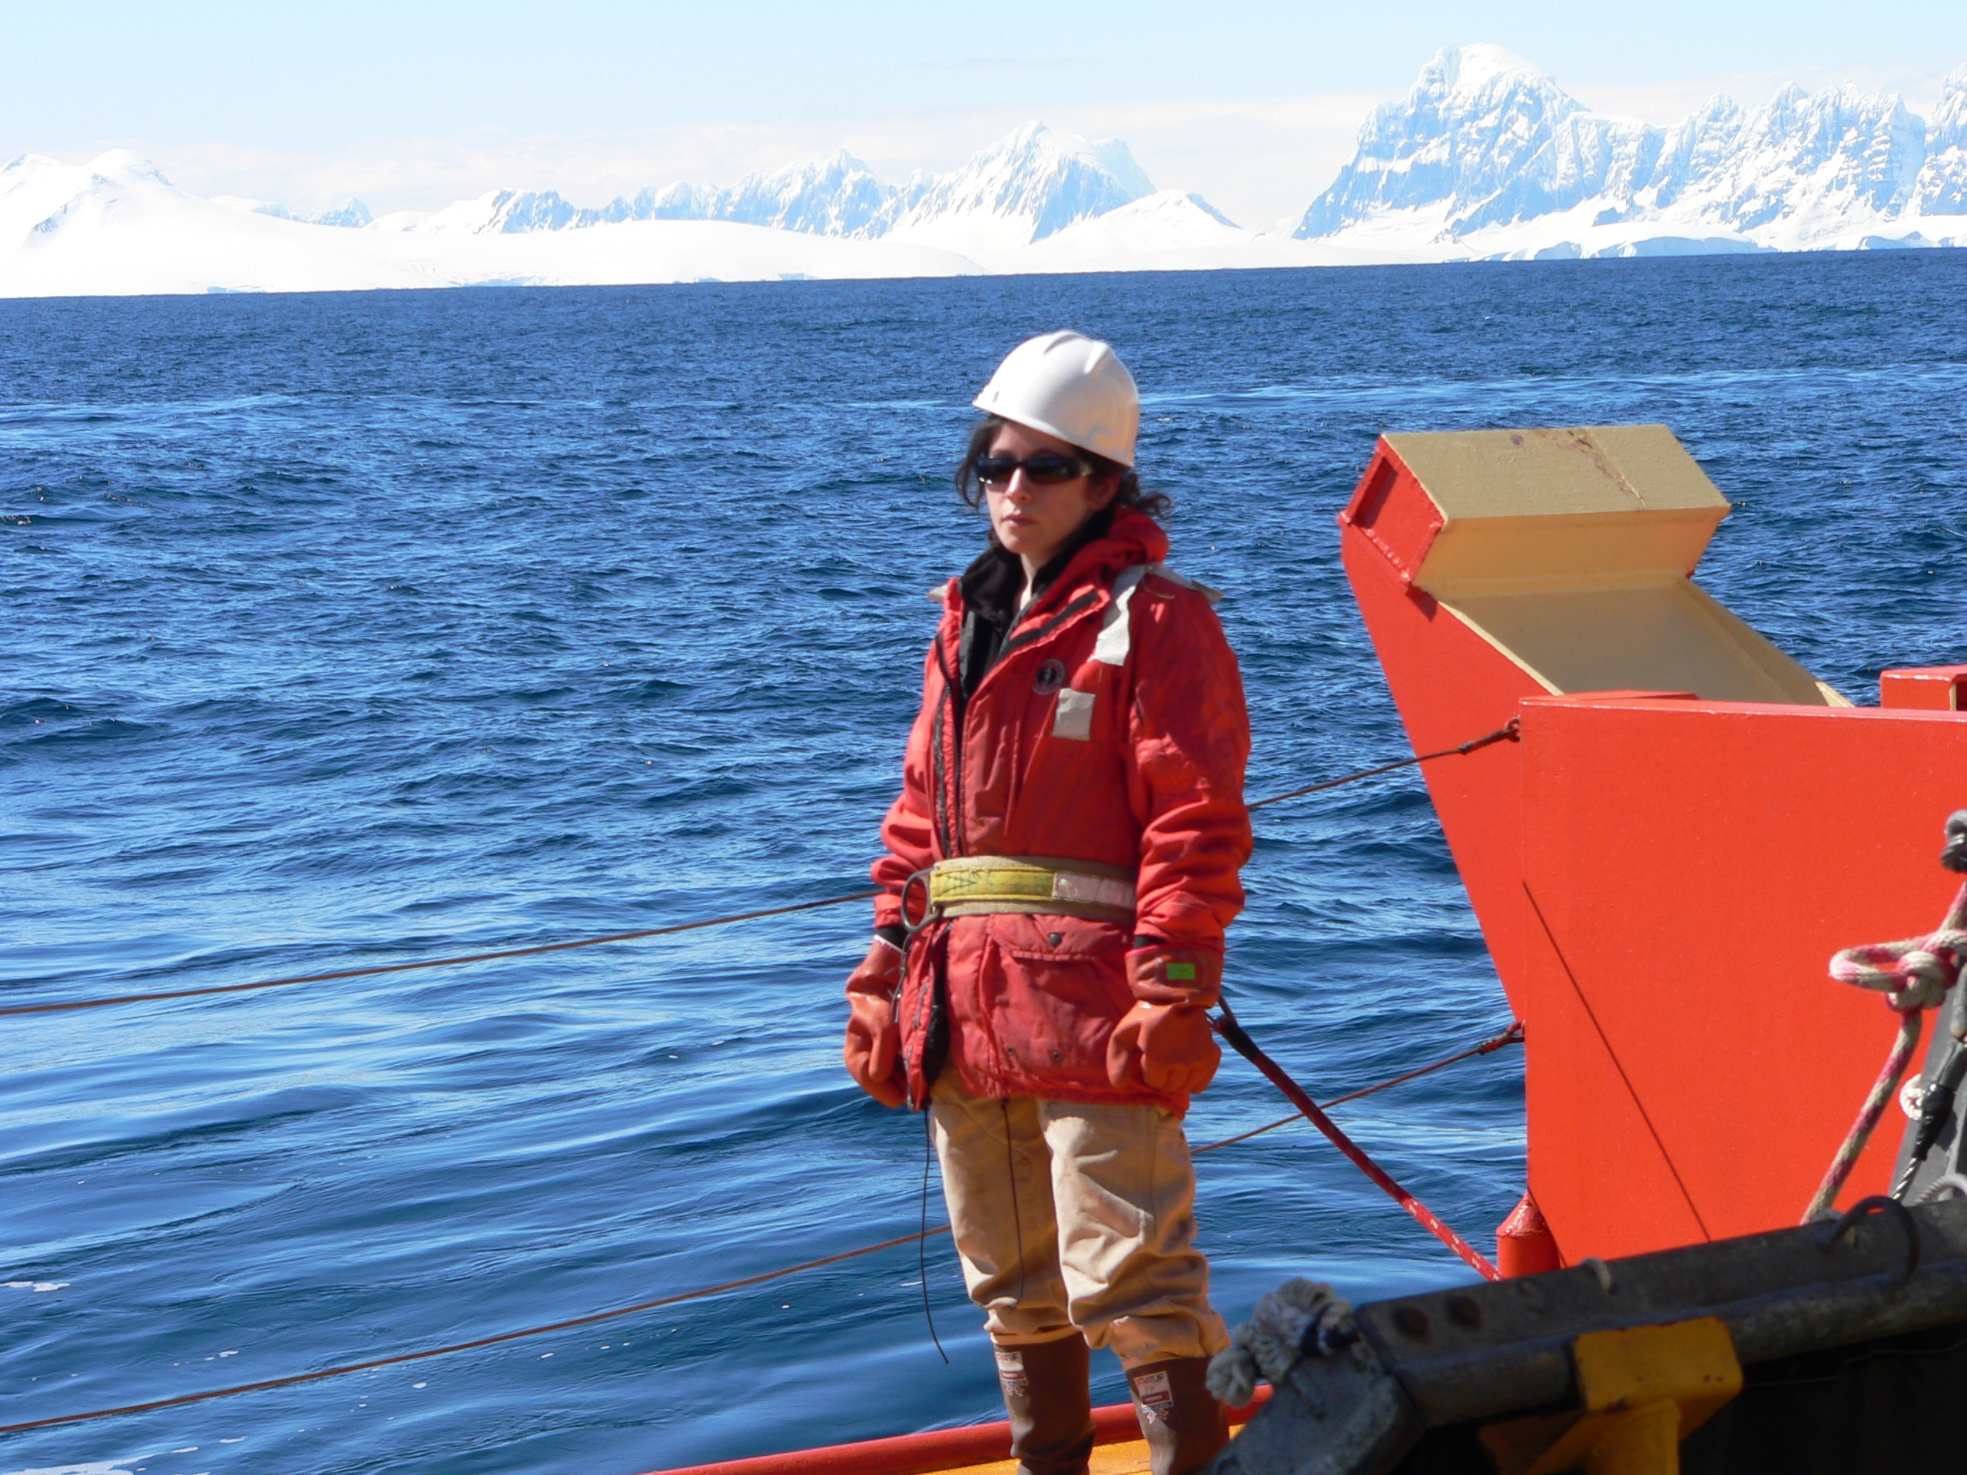
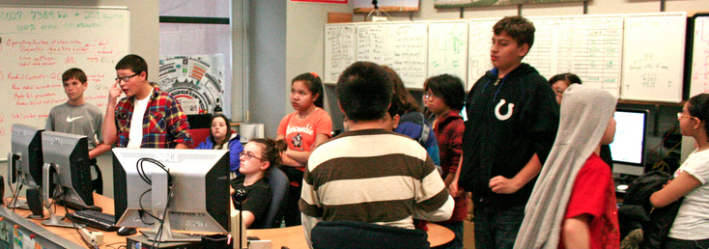
Expansive education program coupled to the research program
Informal Learning Centers
Faculty
(Universities &
Community Colleges)
Undergraduates
Media
Graduate Students & Postdocs
K-12

