Slide 1





The
Southern Ocean Observing System
Oscar Schofield, Louise Newman, Mike Meredith
On behalf of the SOOS community

Slide 2
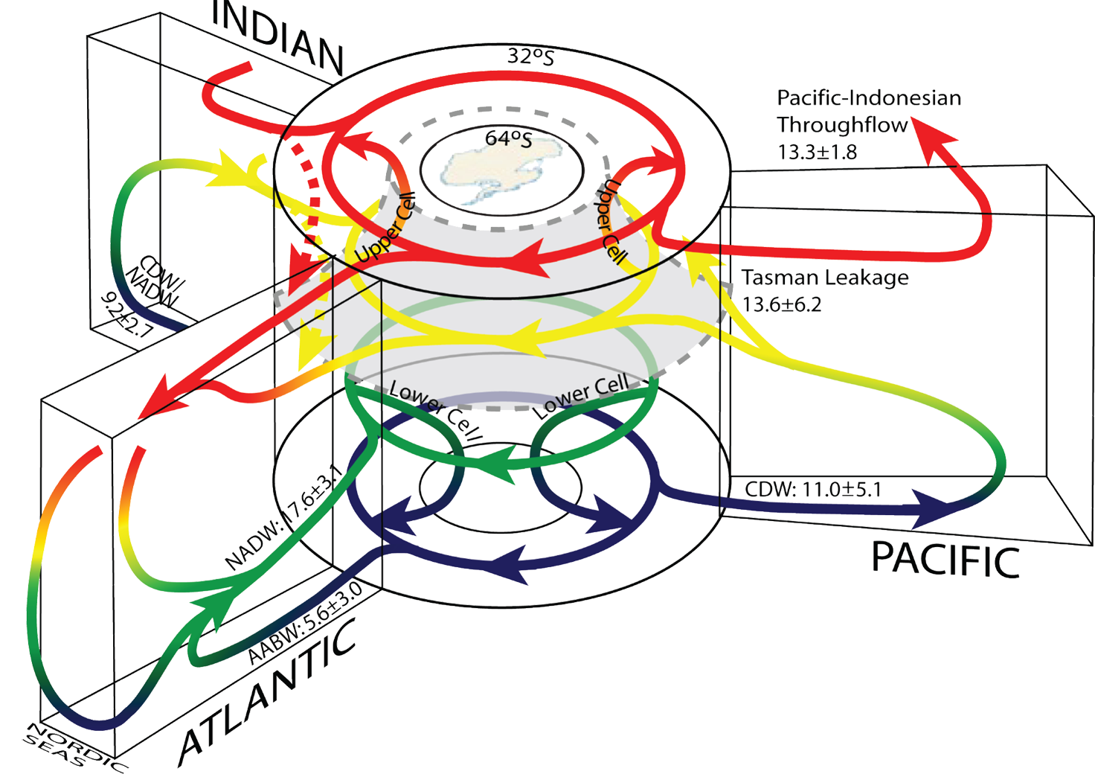
The Southern Ocean matters – for science and society
Connects all ocean basins
Site of key water mass formation
Drives global ocean circulation
Significant drawdown of CO₂
Effects global sea level
Has unique, vulnerable ecosystems
Lumpkin and Speer 2007
Notes:
- the Southern Ocean connects all other ocean basins, and is the site of formation of key water masses in the global ocean circulation, with impacts on planetary-scale climatic systems and biogeochemical cycles
overturning circulation in the Southern Ocean is a major control on carbon drawdown from the atmosphere, and hence global climate
the Southern Ocean controls the rate of deglaciation in parts of Antarctica, and hence global sea level
the Southern Ocean is home to some unique and vulnerable ecosystems, within which some species are commercially valuable

Slide 3
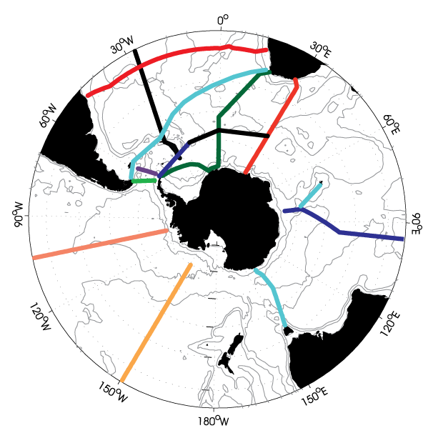
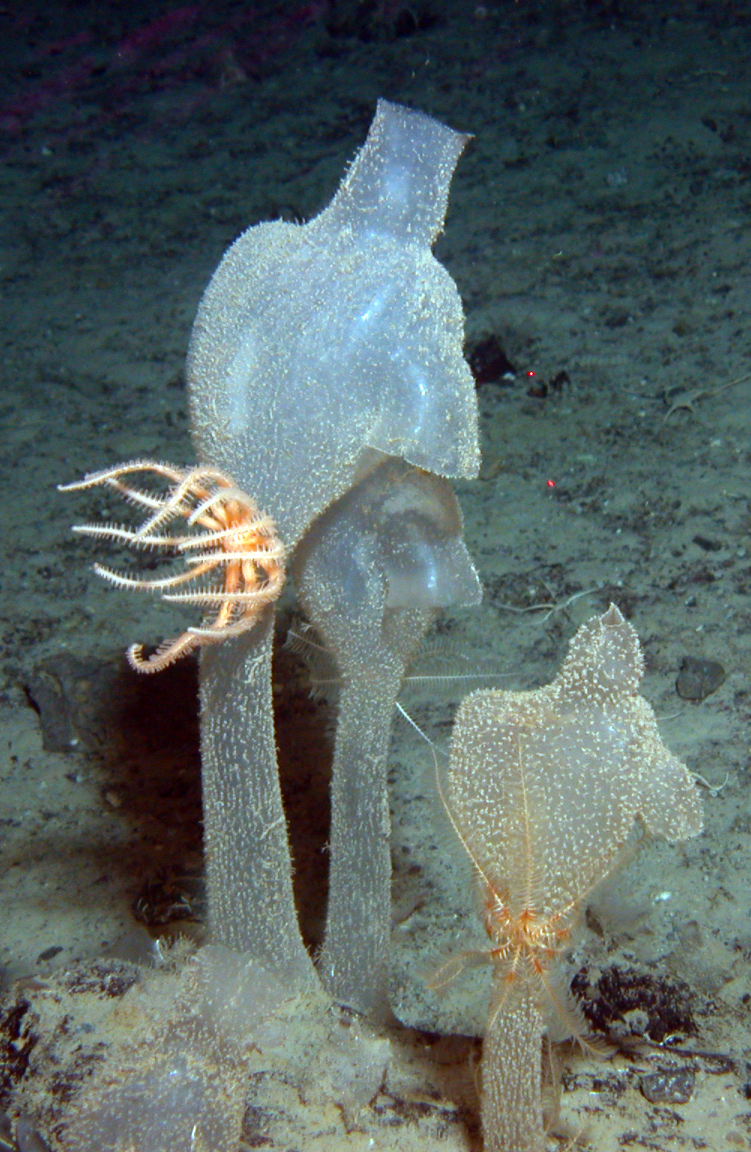
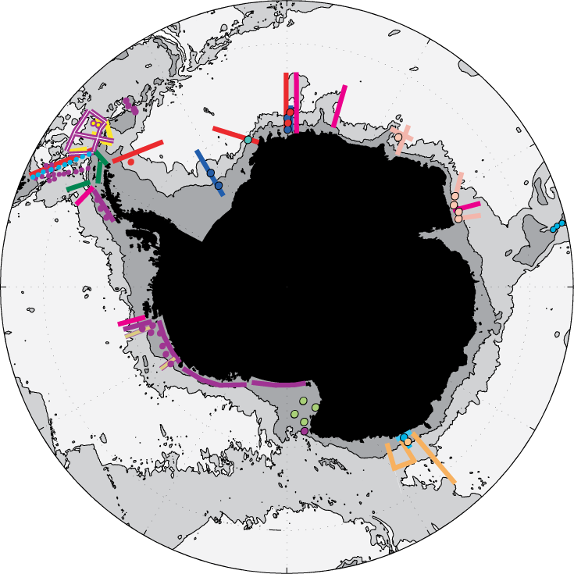
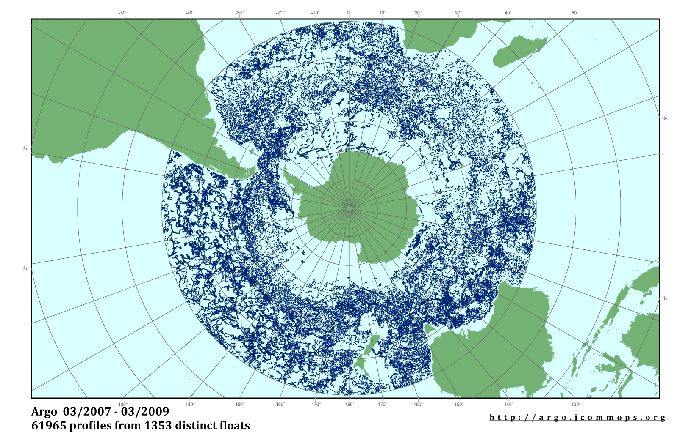
IPY demonstrated the SOOS is feasible
CASO
SASSI
CAML
ARGO
MEOP

Slide 4
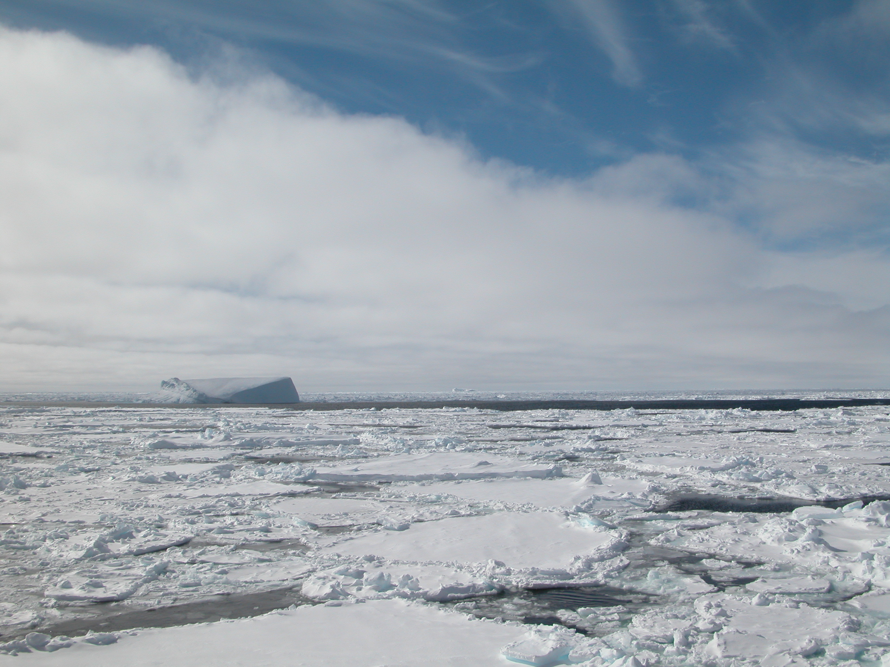
SOOS Motivation
- Many (mono-disciplinary) programmes in SO research, all with individual infrastructure, data routes etc. SOOS will connect across disciplines and programmes to ensure a coordinated approach to observing the SO.
- Sponsored by SCAR (Scientific Committee on Antarctic Research) and SCOR (Scientific Committee on Oceanic Research)
SOOS Initial Science and Implementation Strategy – developed by SCAR/SCOR Expert Group on Oceanography and the SCAR/CLIVAR/CliC Southern Ocean Panel.
International Project Office opened August 2011, hosted by the Institute for Marine and Antarctic Studies (University of Tasmania), with additional support from the Australian Antarctic Division.
Notes:
various (mostly mono-discipline) programmes have existed in the Southern Ocean for some time, each with their own infrastructures, data routes etc. Each are worthy, but the gains from genuinely cross-discipline working and shared data access have not been realised. SOOS aims to achieve these, and also chart the course for the future of sustained, strategic observations in the Southern Ocean. (Then the detail about SCAR, SCOR, IPO etc can come)

Slide 5
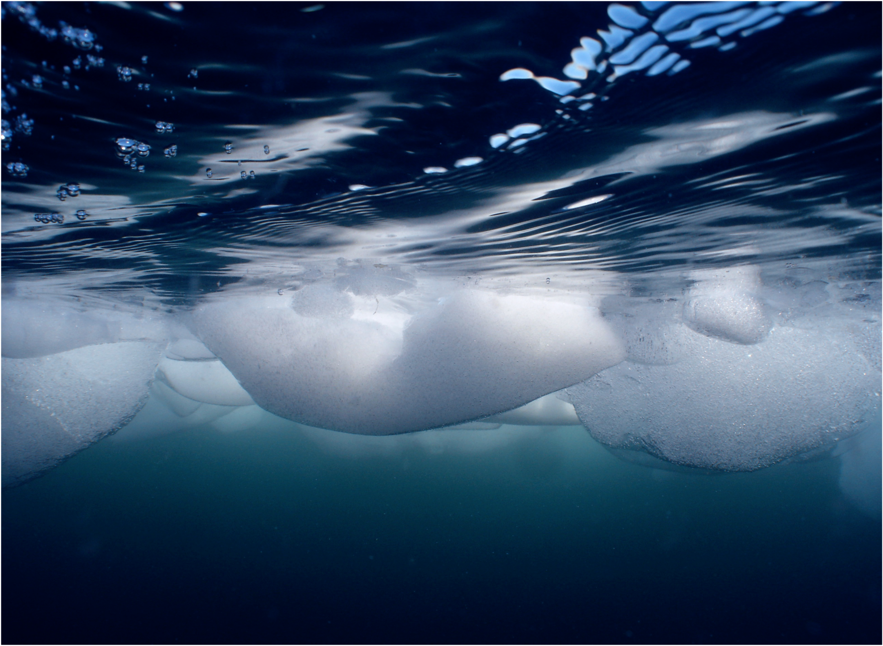
MISSION: To establish a multidisciplinary system to deliver the sustained observations of the Southern Ocean that are needed to address key challenges of scientific and societal relevance, including climate change, sea-level rise and the impacts of global change on marine ecosystems.
B. Wallis AAD

Slide 6
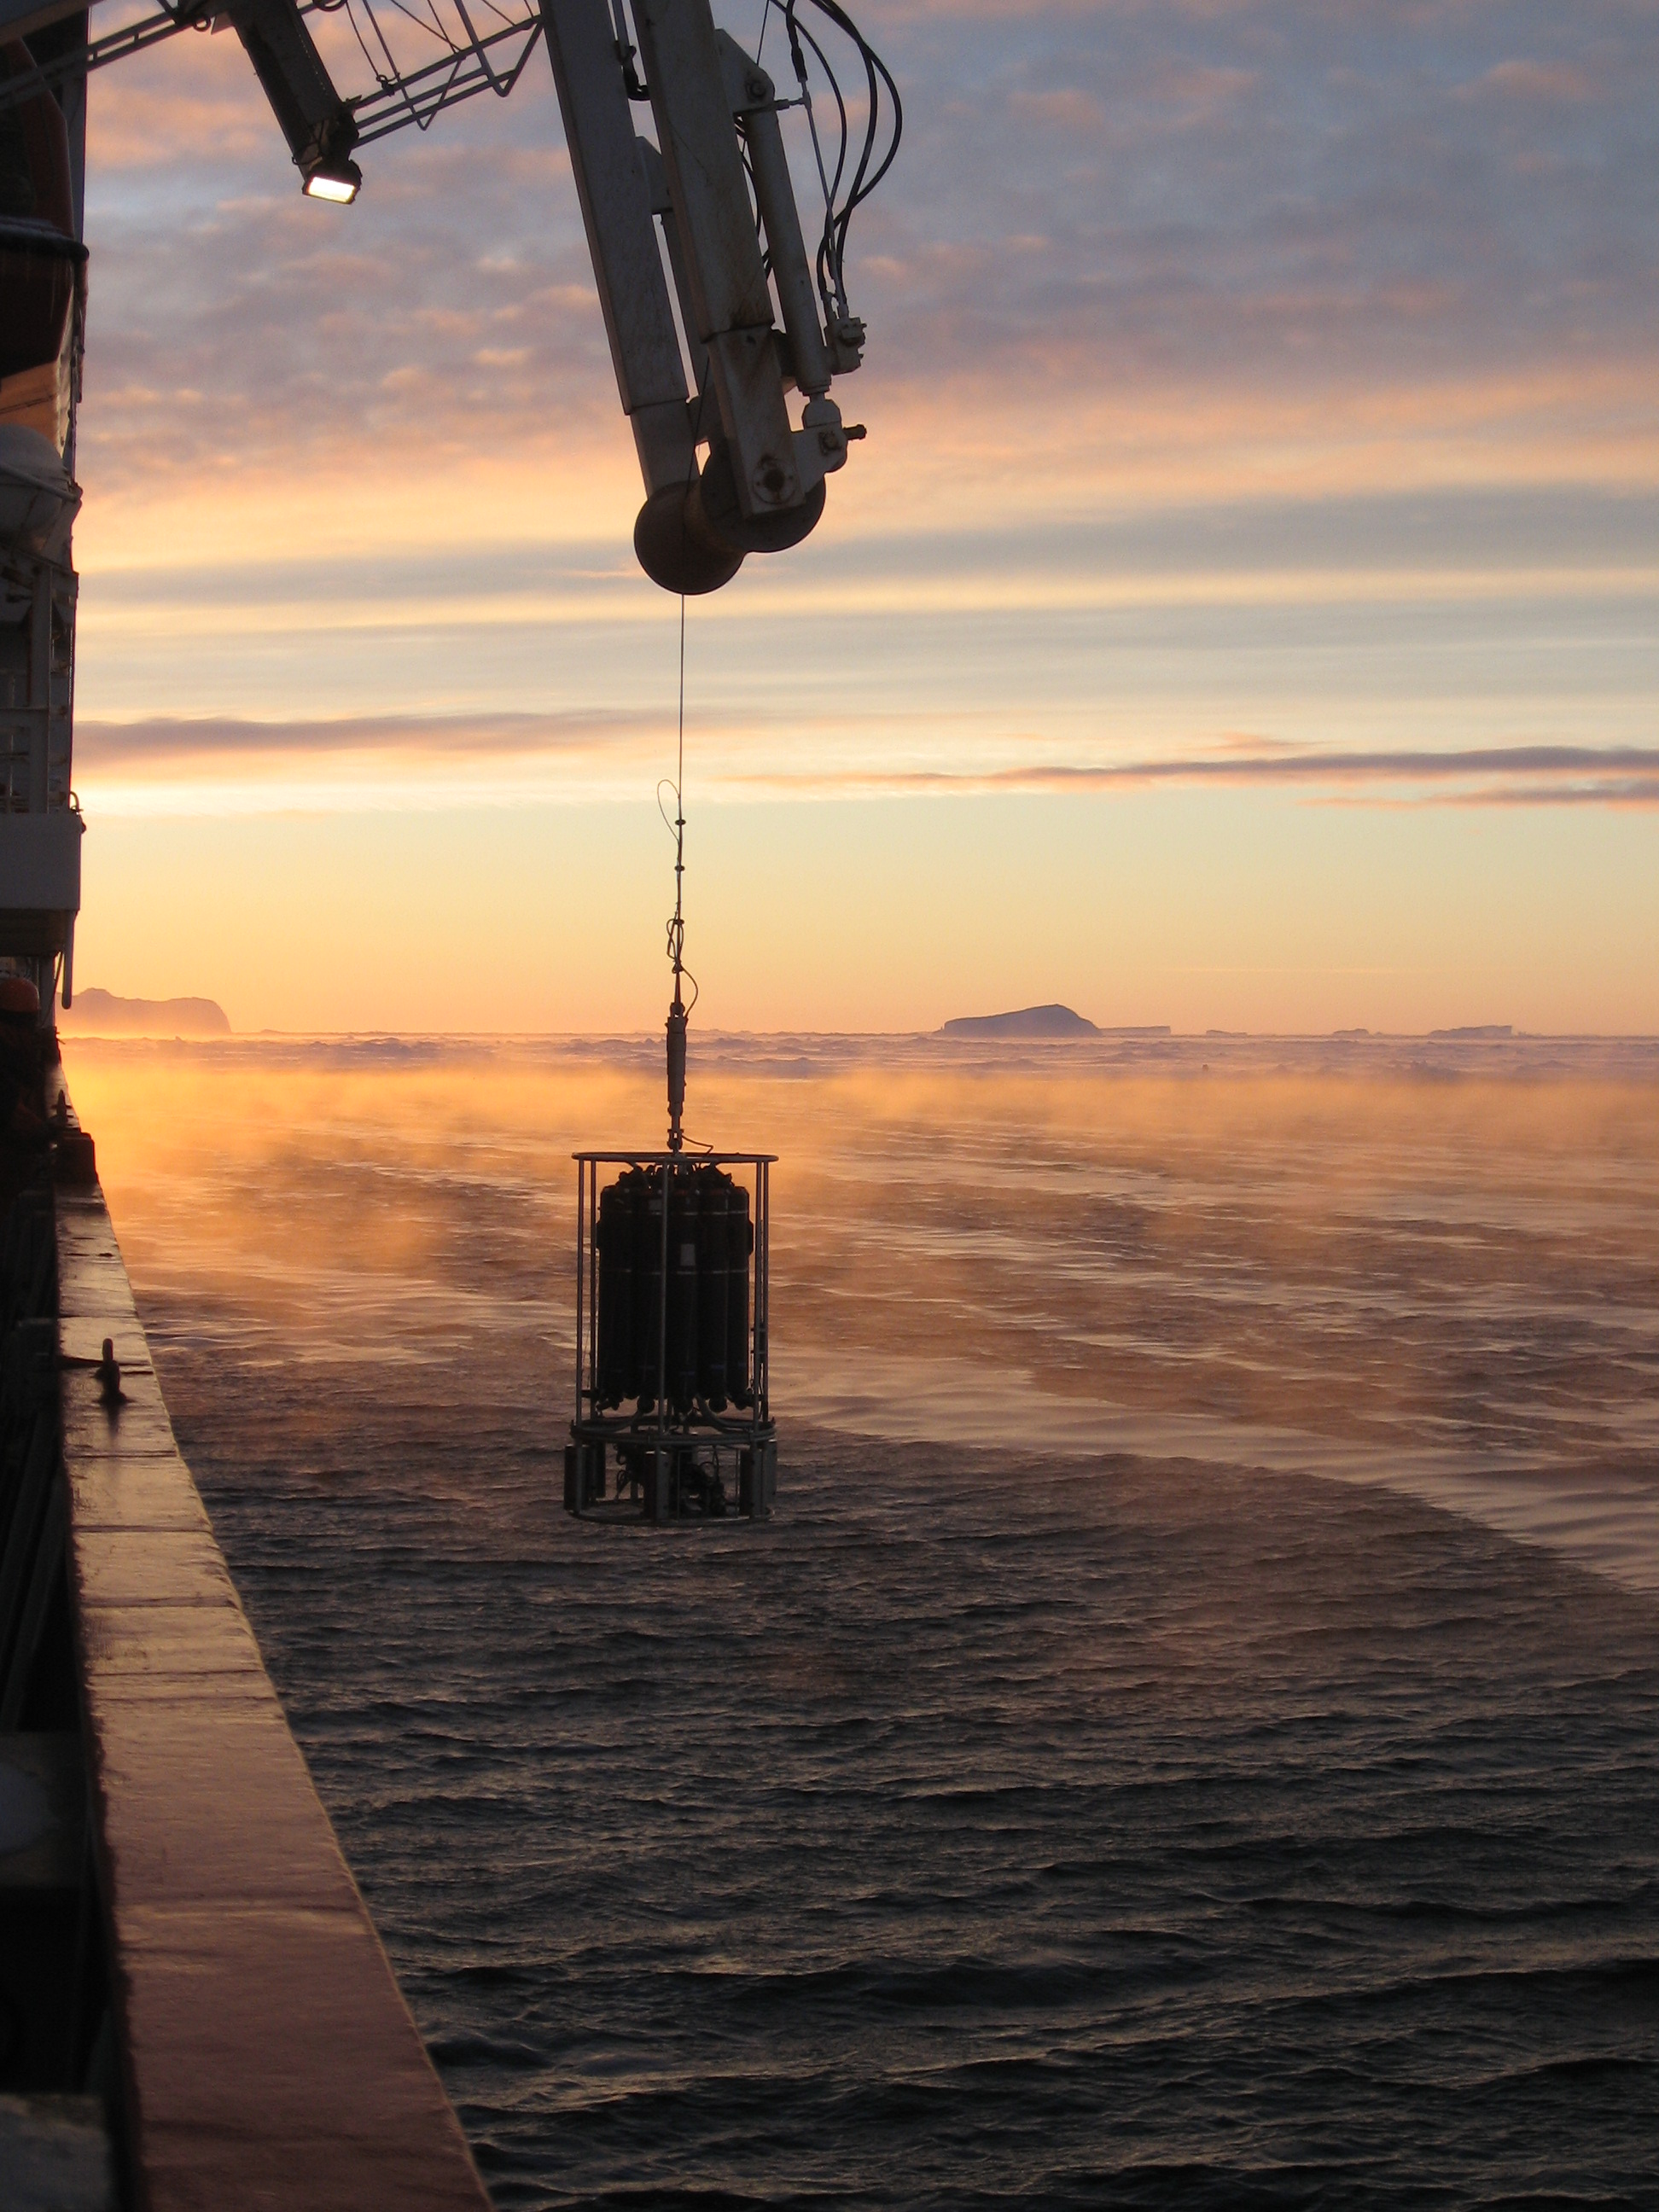
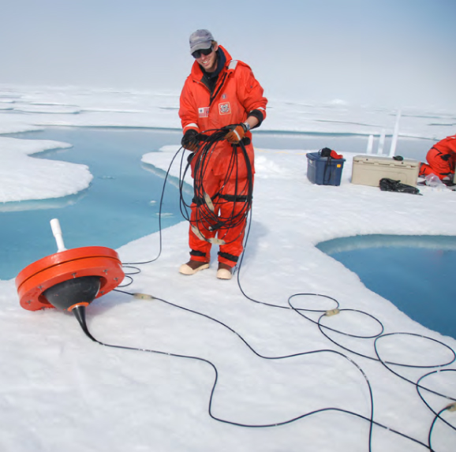
Science Themes
Key science challenges identified as most pressing issues, both scientifically and societally - to be addressed by the SOOS:
Role of Southern Ocean in global freshwater and heat balance
Stability of Southern Ocean overturning circulation
Stability of Antarctic ice sheet and future contribution to sea-level rise
Future of Southern Ocean carbon uptake
Future of Antarctic sea ice
Impacts of global change on Antarctic ecosystems
P. Holland
IPAB
Notes:
6 scientific challenges identified as being the key Southern Ocean issues that need addressing. SOOS will focus efforts along scientific themes
Outline in detail in strategy.
One important step is to articulate key questions within these themes.

Slide 7
Achieving the mission…
Many international/national programmes involved in Southern Ocean observations. SOOS will work with these to:
- Design and implement SO observing system
Advocate and guide development of new technologies
Unify current observation efforts and leverage further resources
Integrate / communicate – between nations, international and national projects, and across traditional disciplinary boundaries
Facilitate and develop a data system with seamless access to essential data and data products
Notes:
focus in on 3 of these statements with specific activities

Slide 8
Design and implement a SO Observing System
End goal is a sustained, coherent, multidisciplinary observing system.
Design optimal sampling plans for all variables
Need quantified targets (number/frequency of required observations)
Some have already been defined, others lag behind.
Determination of stage of readiness of EOVs and platforms
Identification of gaps in knowledge and observations
Notes:
The overall vision for SOOS is to design and implement a sustained, coherent, multidisciplinary observing system that provides the key data and data products required to address the key challenges identified. It will evolve over time, as new technologies develop and automated techniques mature, and will be adaptable as new challenges come to the fore
First step in implementation is to design optimal sampling plans for each variable, and integrate these plans into an overall integrated sampling scheme.
Need quantitative targets for number and frequency of observations that are required.
Already defined for some elements (eg.,, repeat hydrography, Argo). others further work is needed, and will work through Framework for Ocean Observing steps of readiness. this process clarifies what is needed to move towards a sustainable observations network at the systems level.

Slide 9
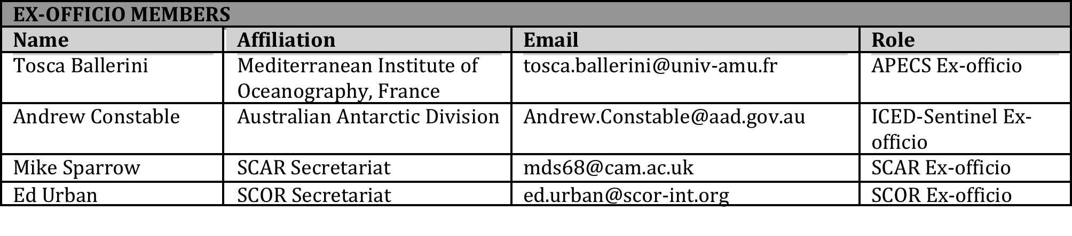
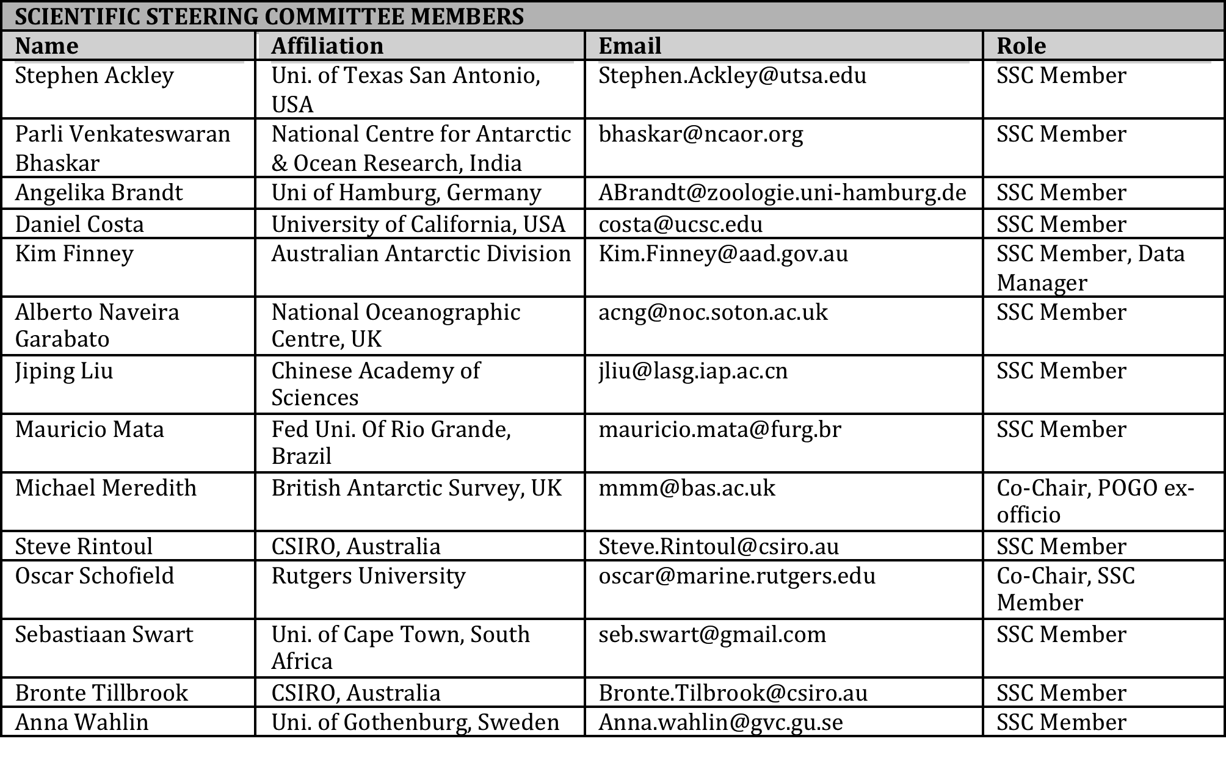
Scientific Steering Committee
Membership:
Expertise
Scientific standing
Programmatic connections
National representation

Slide 10
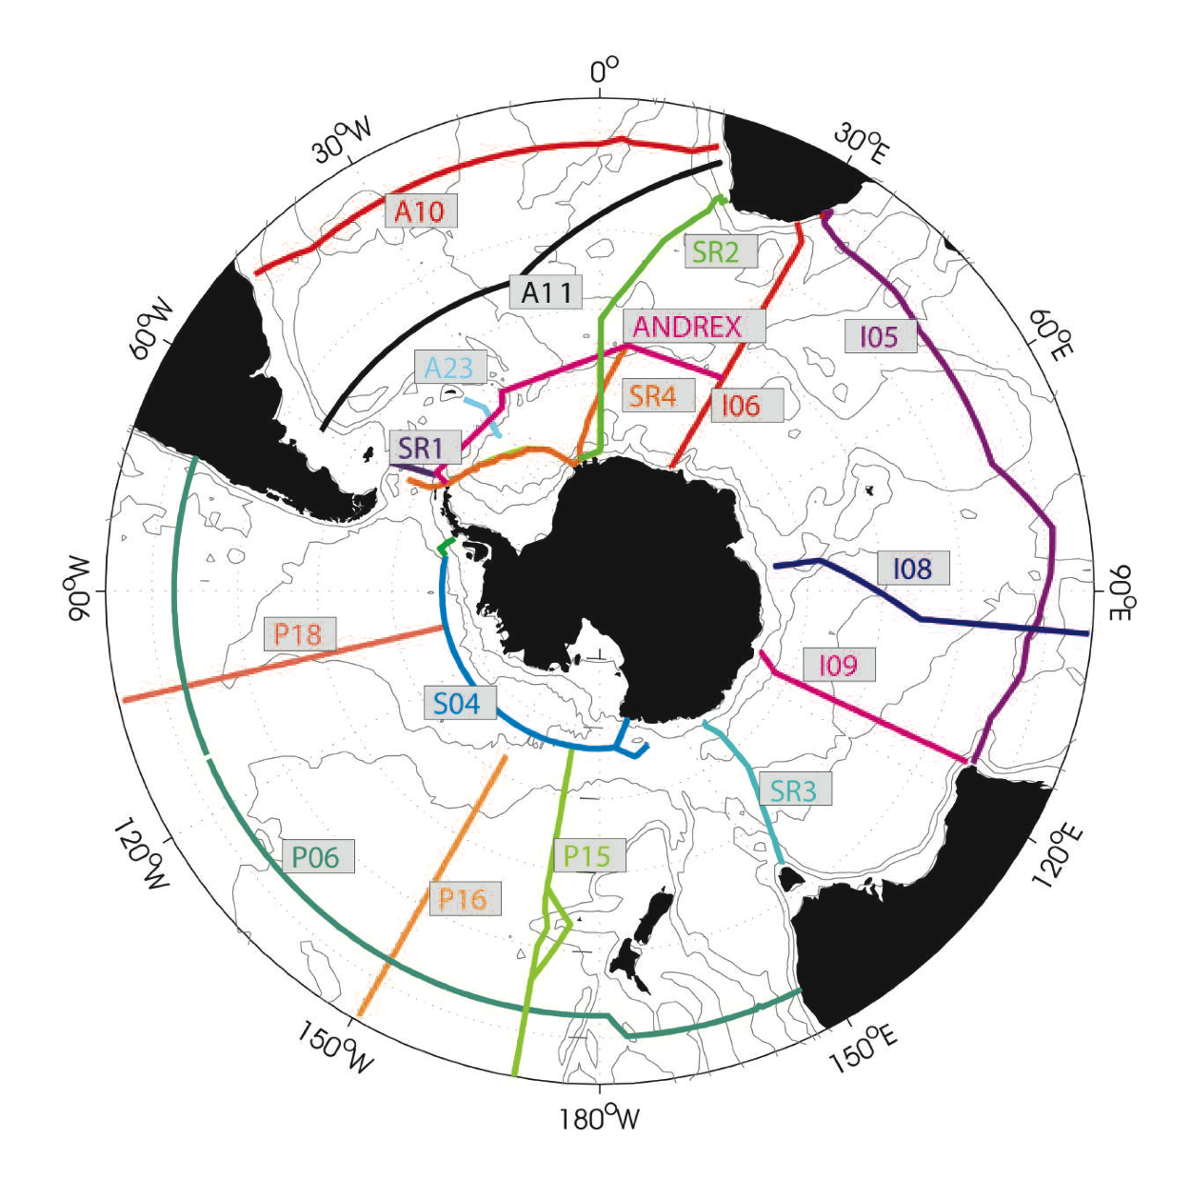
Unify current efforts and leverage resources: Examples
Hydrographic sections
Addition of biological sensors
National “ownership” of sections by countries not yet involved (Korea, China etc)
Extension of sections through the sea ice
Extension of the SOOP
Deployments from fishing vessels through collaboration with CCAMLR
Deployments from tourist vessels, through collaboration with IAATO
Notes:
Many projects and programmes, efforts are rarely coordinated = stretch the limited resources. SOOS will identify where efforts can be combined.
e.g., reoccupation of hydrographic sections will be a key component of the SOOS implementation. Advocate for the inclusion of , for example biological sensors.
Funding for some sections is not secure, countries like China and Korea with resources and interest in contributing = propose national “ownership” of sections.
Sea ice community calling for the sections to be extended into the sea ice zone where possible
SOOS will leverage additional resources through use of ships of opportunity .e.g., CCAMLR = close ties to the international southern ocean fishing community and discussions within CCAMLR for better training of fishery observers. Indications from CCAMLR that they are interested in working with the SOOS towards deployment of platforms on fishing vessels.
Additionally, SOOS will connect with the international association of Antarctic tourist operators to look at options for collaborations and use of their ships for instrument deployment.

Slide 11
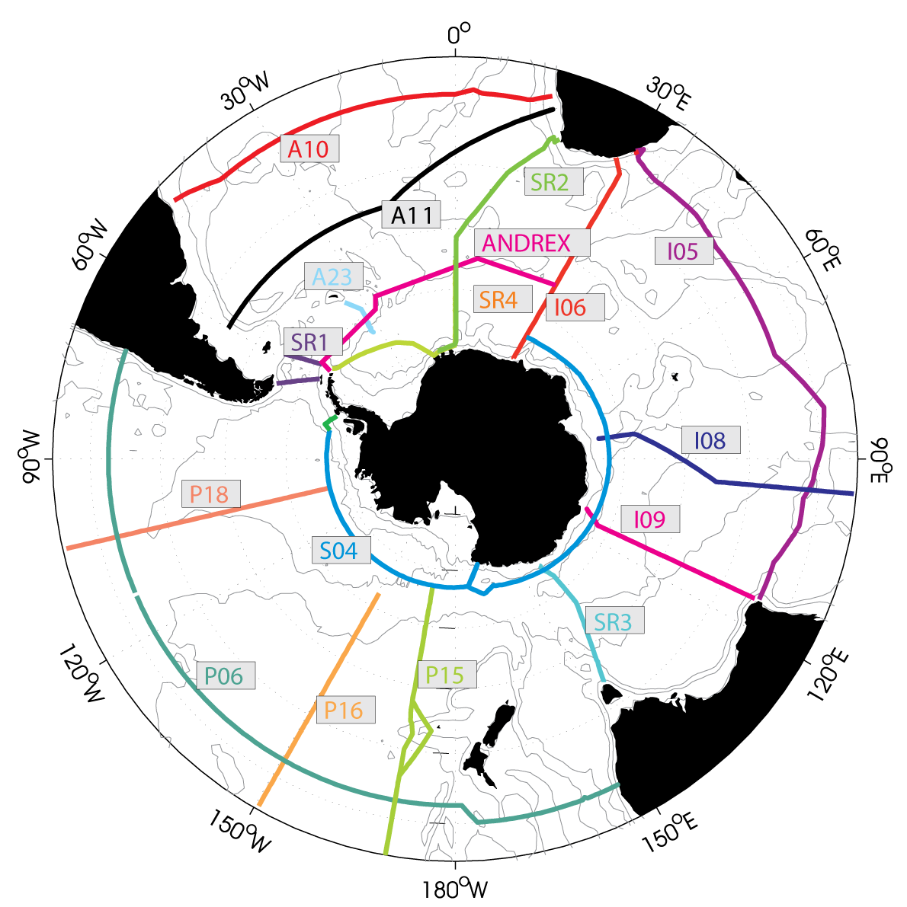
Building blocks of the SOOS: repeat hydrography

Slide 12
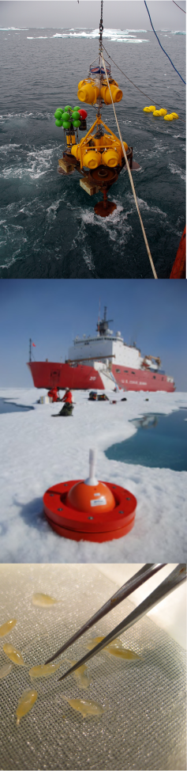
The Southern Ocean is changing…
Regional warming
Decreased salinity in upper and abyssal ocean
Basin-wide acidification
Regional decreases in sea ice
Shifts in ecosystems
Need to monitor and understand the changes in order to predict future changes, and mitigate impacts.
Supports the need for sustained, and internationally coordinated observations of the Southern Ocean
CSIRO
IPAB
AAD

Slide 13
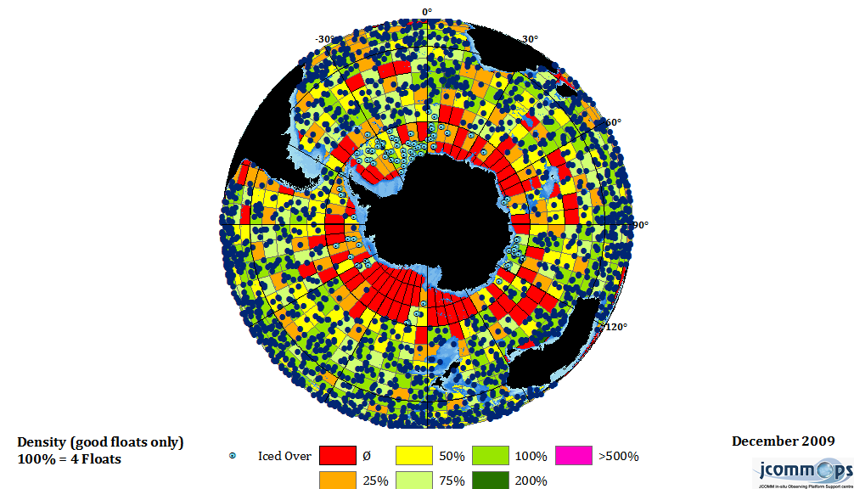
Building blocks of the SOOS: enhanced Argo

Slide 14
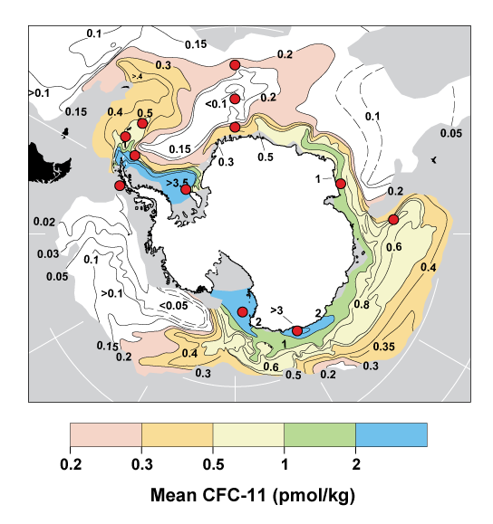
Building blocks of the SOOS: moored time series

Slide 15
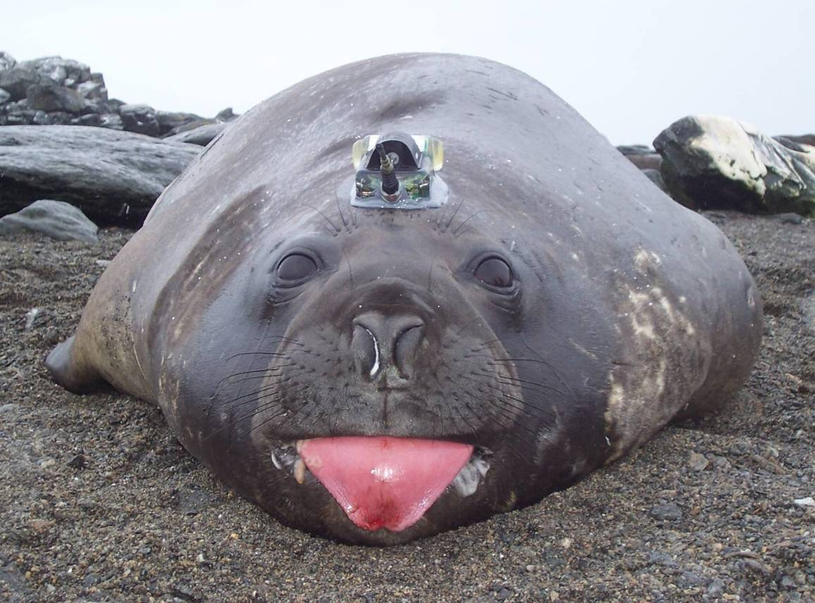
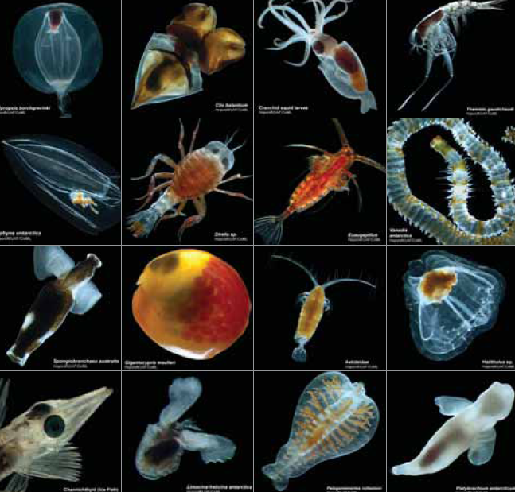
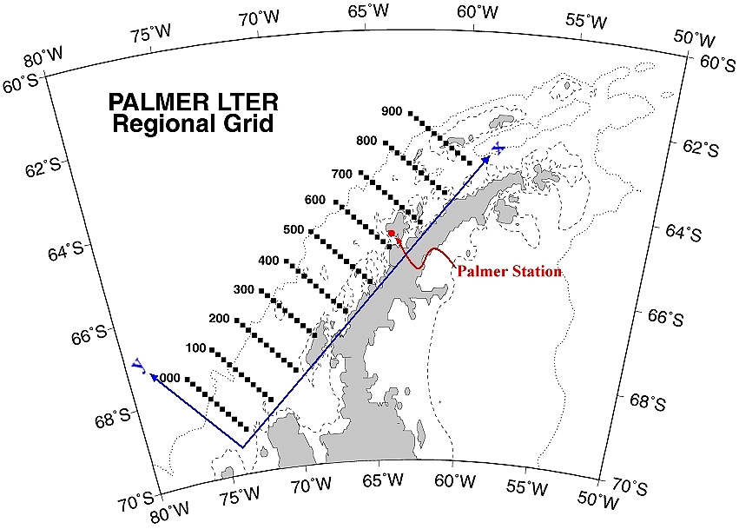
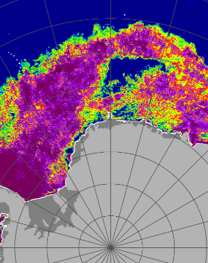
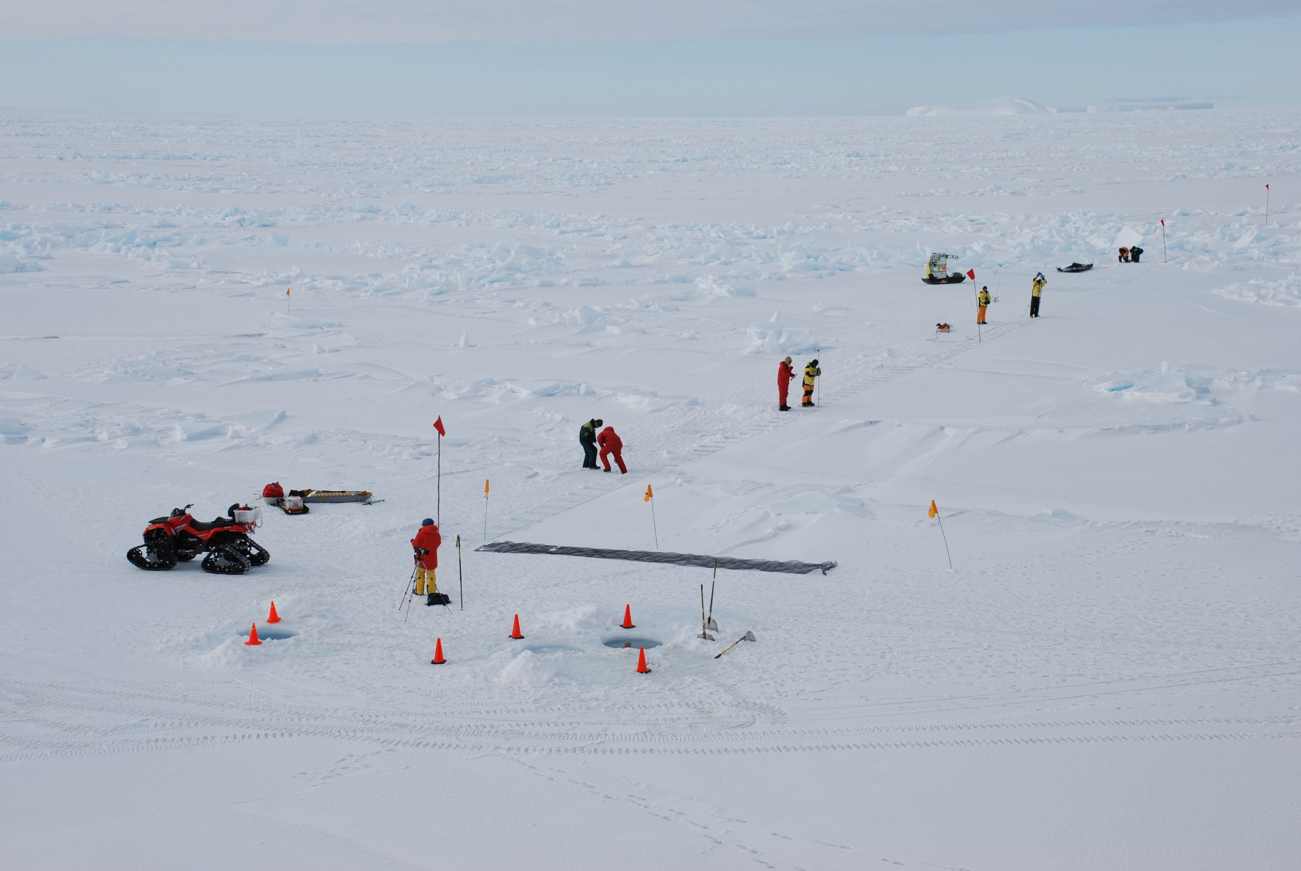
Building blocks of the SOOS: seal tags, biology, satellite, sea ice, data system…

Slide 16
Delivering the outputs
Key goal: develop a unified Southern Ocean data portal to enable easy access to relevant data and data products. This requires investment, but the scientific and societal return would be significantly greater.
Data Management Sub-Committee = representatives from international, national and programmatic data centres.
- Tasked with developing the data policy
- Identifying data products to provide and infrastructure required
- Advocate for data contributions
Notes:
A key goal of the SOOS = provision of easily accessible data. Data portal a priority
Data management sub committee composed of representatives from key international national and programmatic data centres = key goal to identify ways to provide community with information. They will develop the SOOS data policy and advocate for access to data (e.g., China).

Slide 17
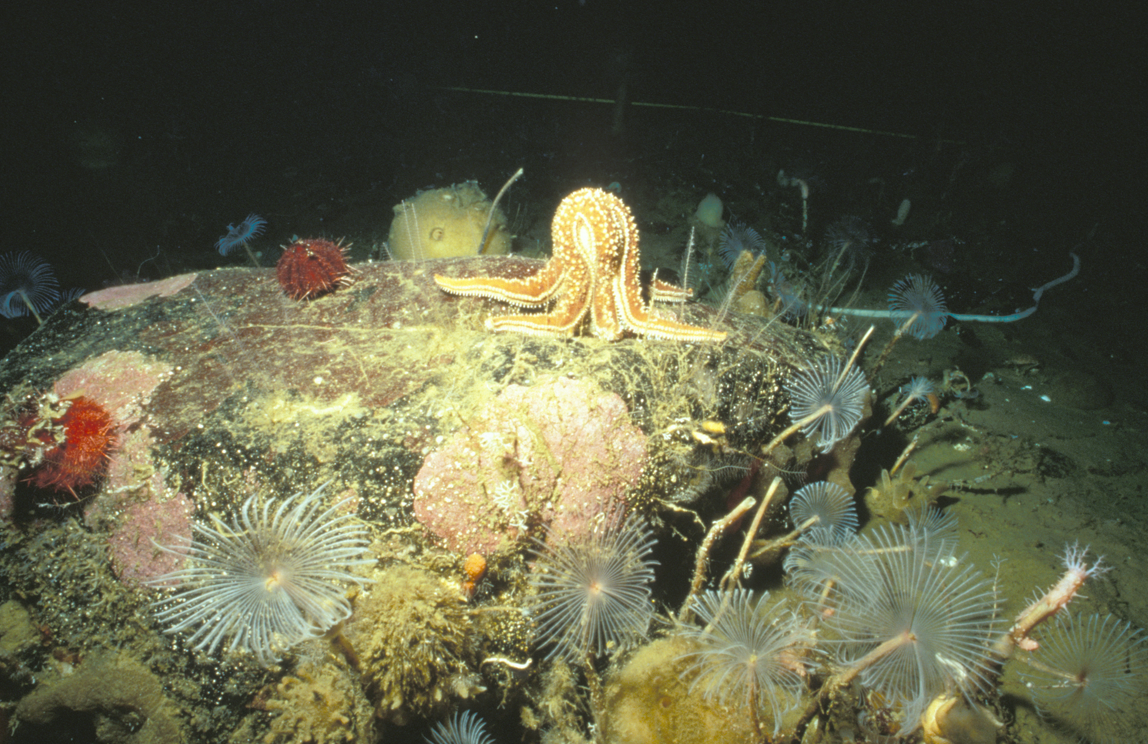
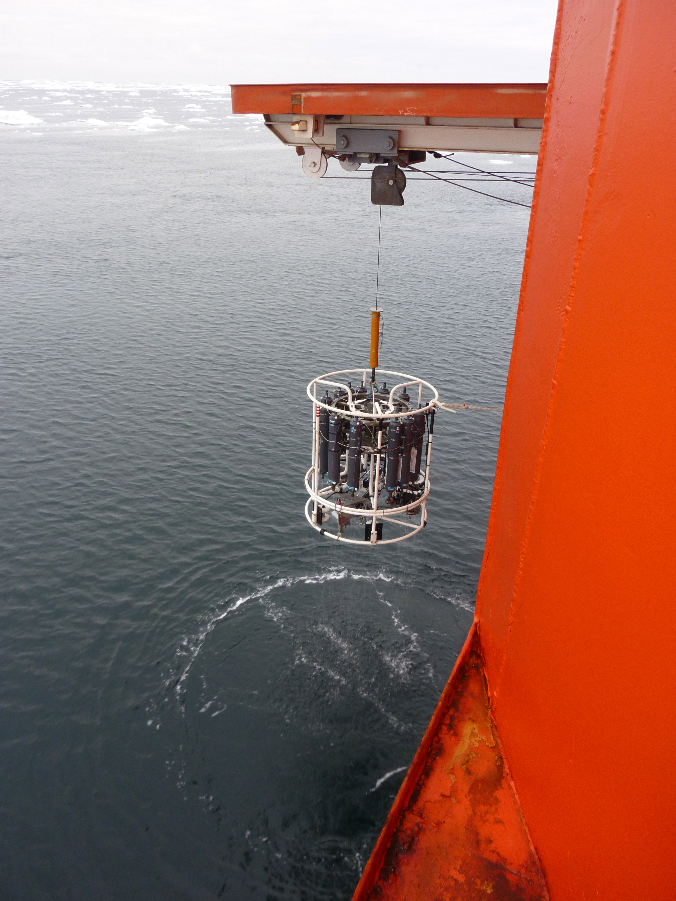
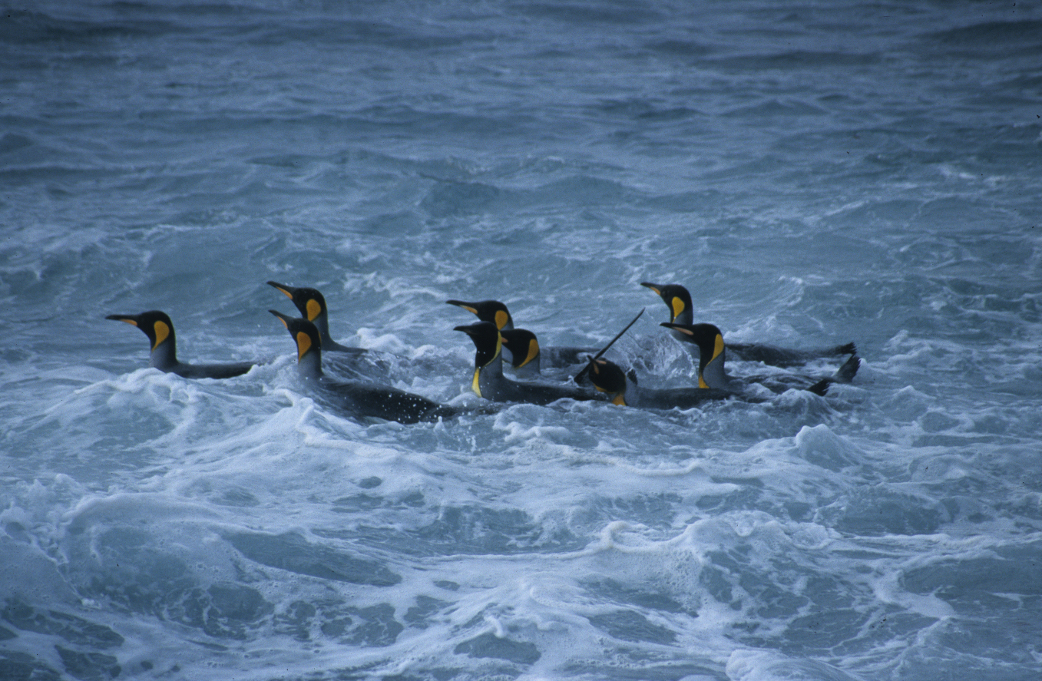
Who would use SOOS and SOOS products?
Research community
Resource managers (e.g., CCAMLR)
Policy makers (when to act? Consequences of not acting?)
IPCC
Local planners (sea-level rise)
Antarctic tourism
Shipping operators
Weather and climate forecasters
Educators
AAD
AAD
AAD

Slide 18








More information?
SOOS Website = www.soos.aq
Contact SOOS International Project Office:
Louise Newman (Executive Officer) newman@soos.aq
SOOS Sponsors::
SOOS Endorsers::
IPO Host:
IPO Sponsors:

