Slide 1
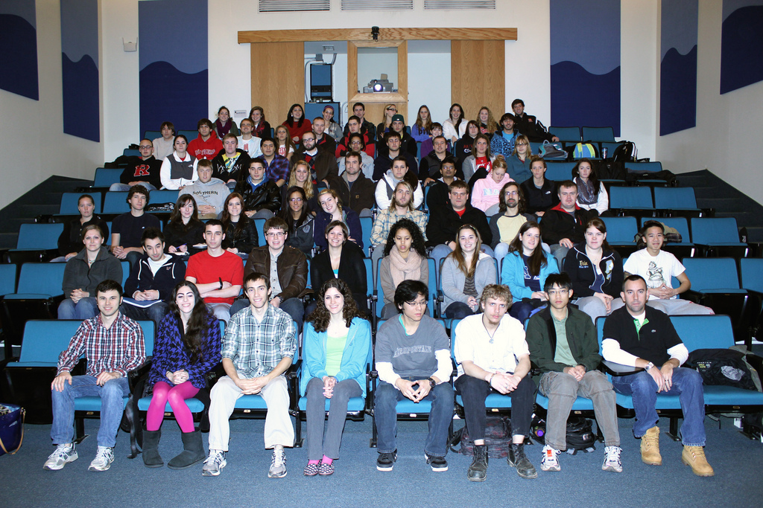
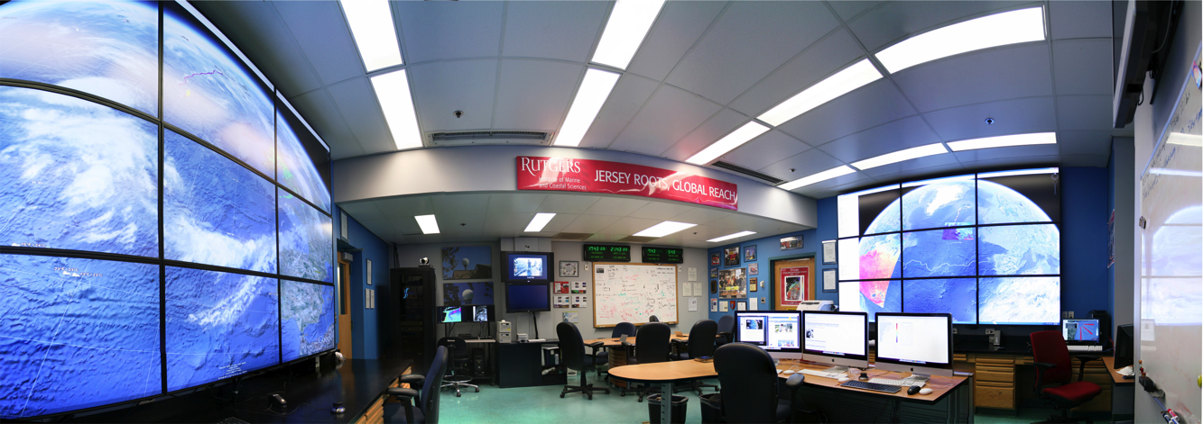
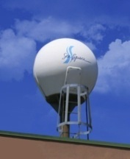
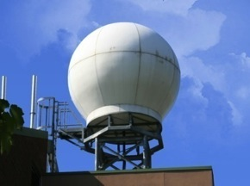
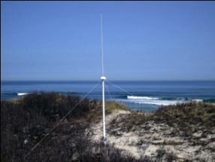
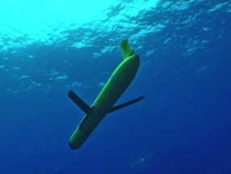
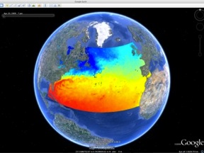
Rutgers University
Coastal Ocean Observation Lab
>20 Researchers, > 100 Undergrads, >$100 M Funding
Satellite Data Acquisition Stations
CODAR Network
Glider Fleet
3-D Forecasts

Slide 2
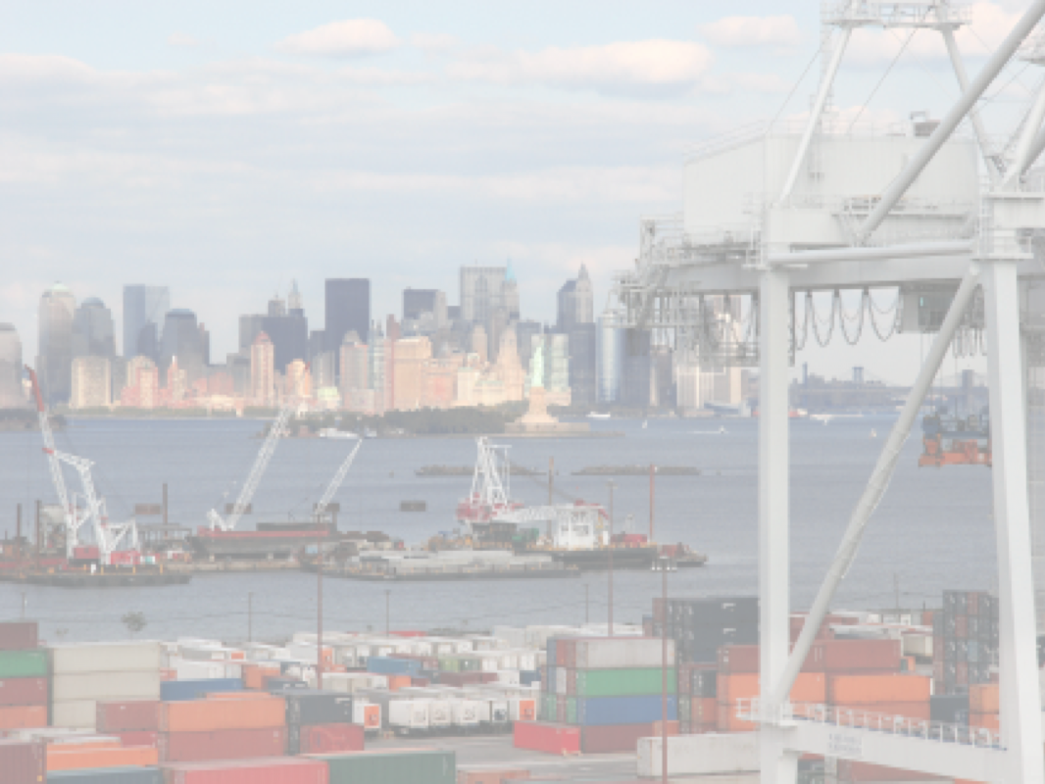






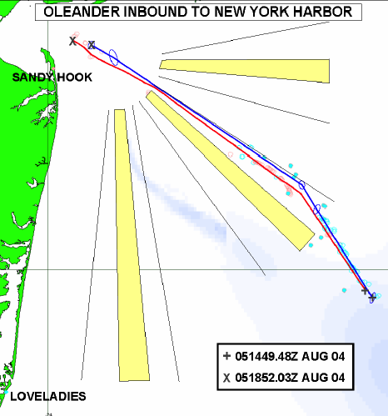





The Center for Secure and Resilient Maritime Commerce (CSR)
HF Radar Team
Rutgers University -
Scott Glenn, Josh Kohut, Hugh Roarty,
Mike Crowley, John Kerfoot, Ethan
Handel, Mike Smith, Colin Evans
CODAR Ocean Sensors -
Don Barrick, Pete Lilleboe, Chad Whelan
Belinda Lipa, Bill Rector, Jimmy Isaacson
University or Puerto Rico – Mayaguez
Jorge Corredor, Julio Morell, Miguel Canals
Applied Mathematics, Inc -
Bill Browning
University of Alaska –
Tom Weingarter, Hank Statscewich
Ocean Power Technologies –
Debbie Montagna, Bruce Downie
Naval Research Laboratory
Michael Lovellette, Dan Newton
Norwegian Defence Research Establishment (FFI)
Terje Johnsen, Walther Asen
CODARNor
Anton Kjelaas
Rutgers University – CODAR Ocean Sensors
Academic – Industry Partnership since 1998
ONR - 2004

Slide 3
Introduction to hf Radar

Slide 4
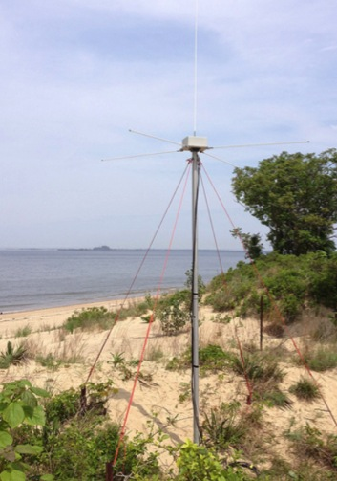
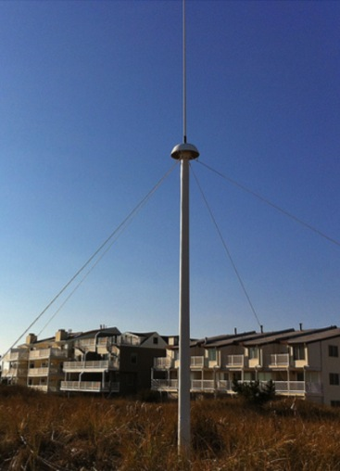
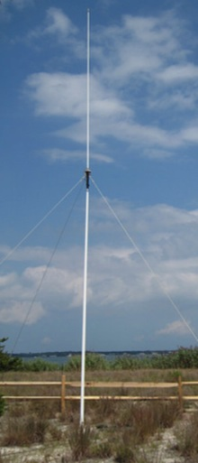
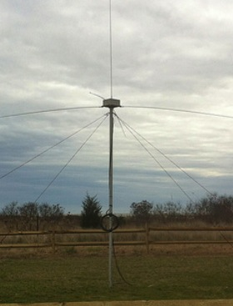
CODAR Compact HF Radar Antennas
25 MHz
13 MHz
5 MHz
Combined Transmitter & Receiver
Separate Transmitter & Receiver

Slide 5
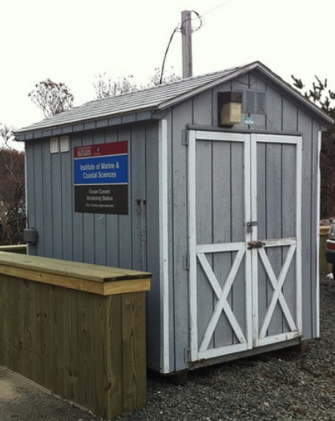
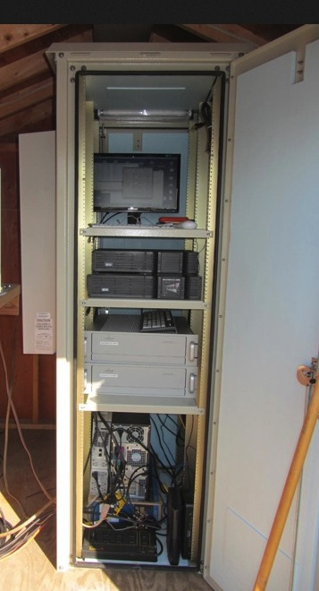
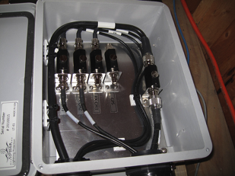
Standard CODAR Shore Site:
Shed, Enclosure, Tx/Rx, Comms, Power, GPS, AIS
monitor
computer & external hard drive
A.C. unit
UPS system
transmitter
receiver
Two lines of Communication
Shed
Enclosure
Lightning Protection

Slide 6
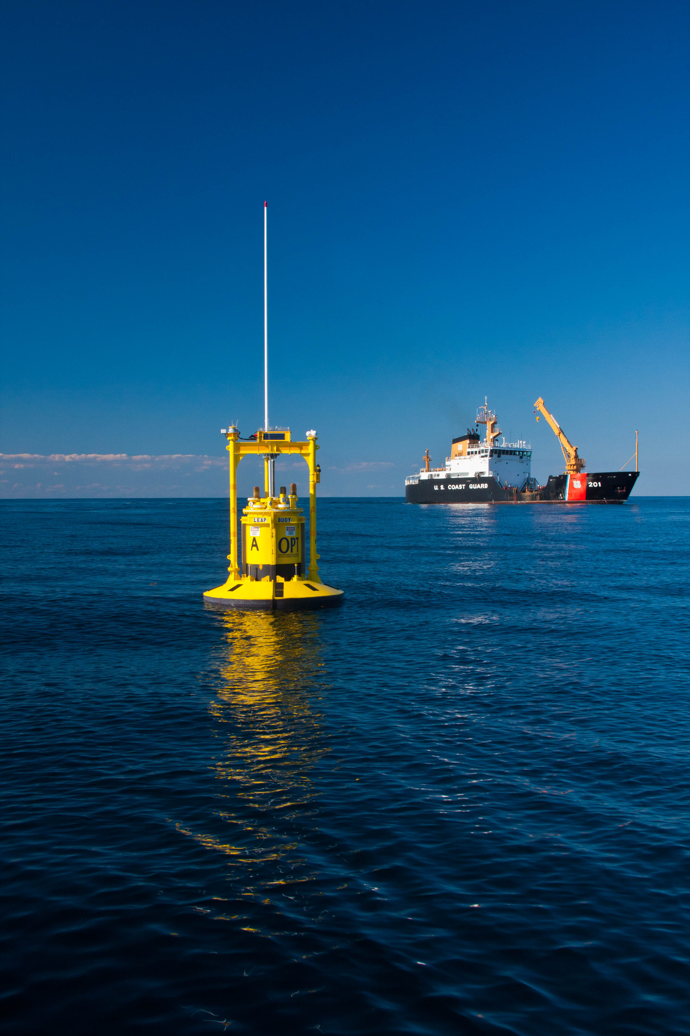
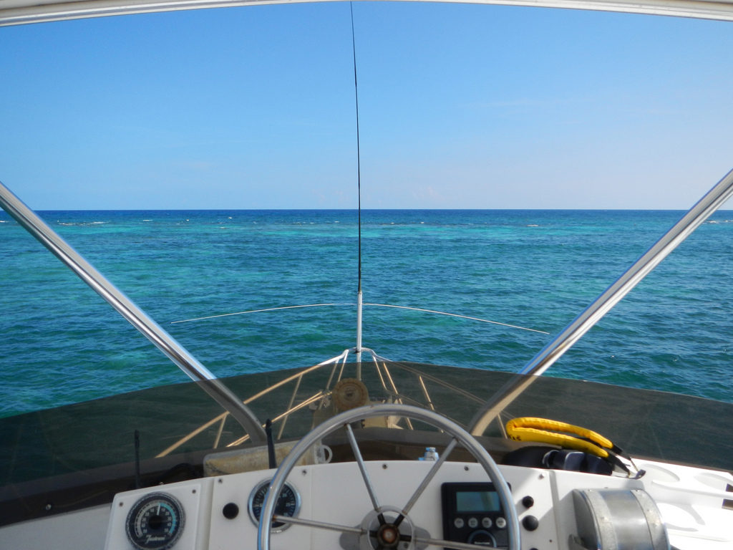
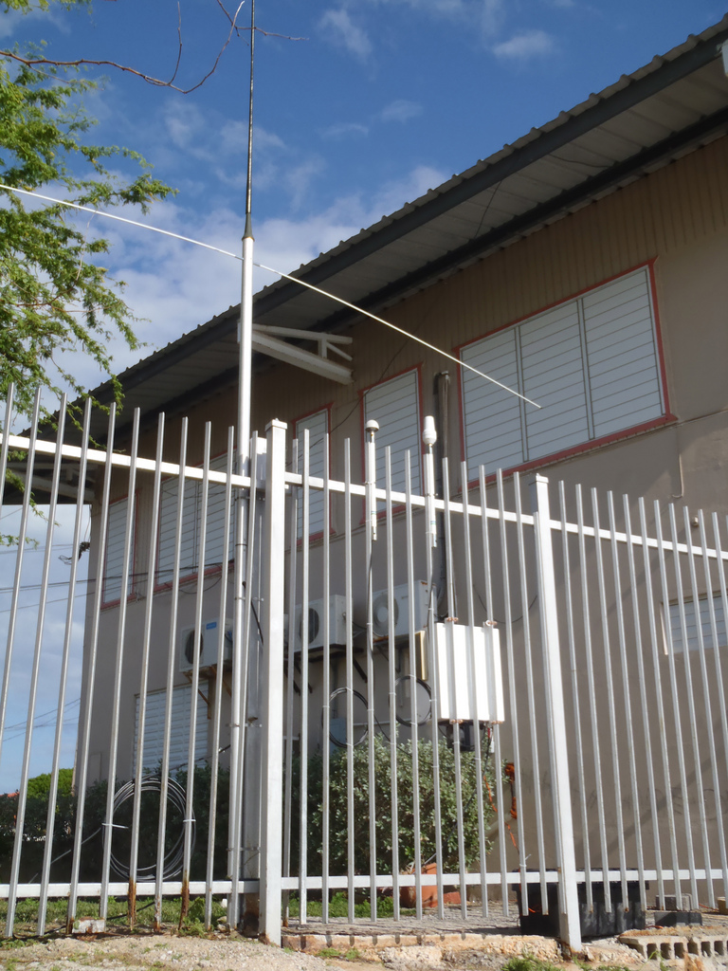
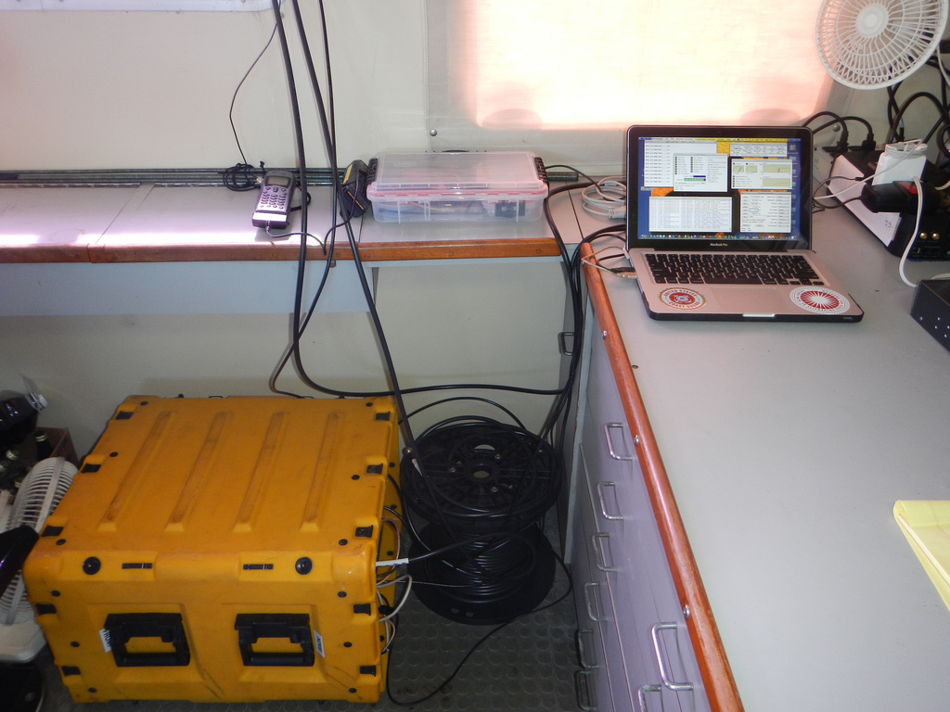
HF Radar Bistatic Transmitters –
Extending Range & Number of Look Angles
On Buoys On Ships On Shore

Slide 7
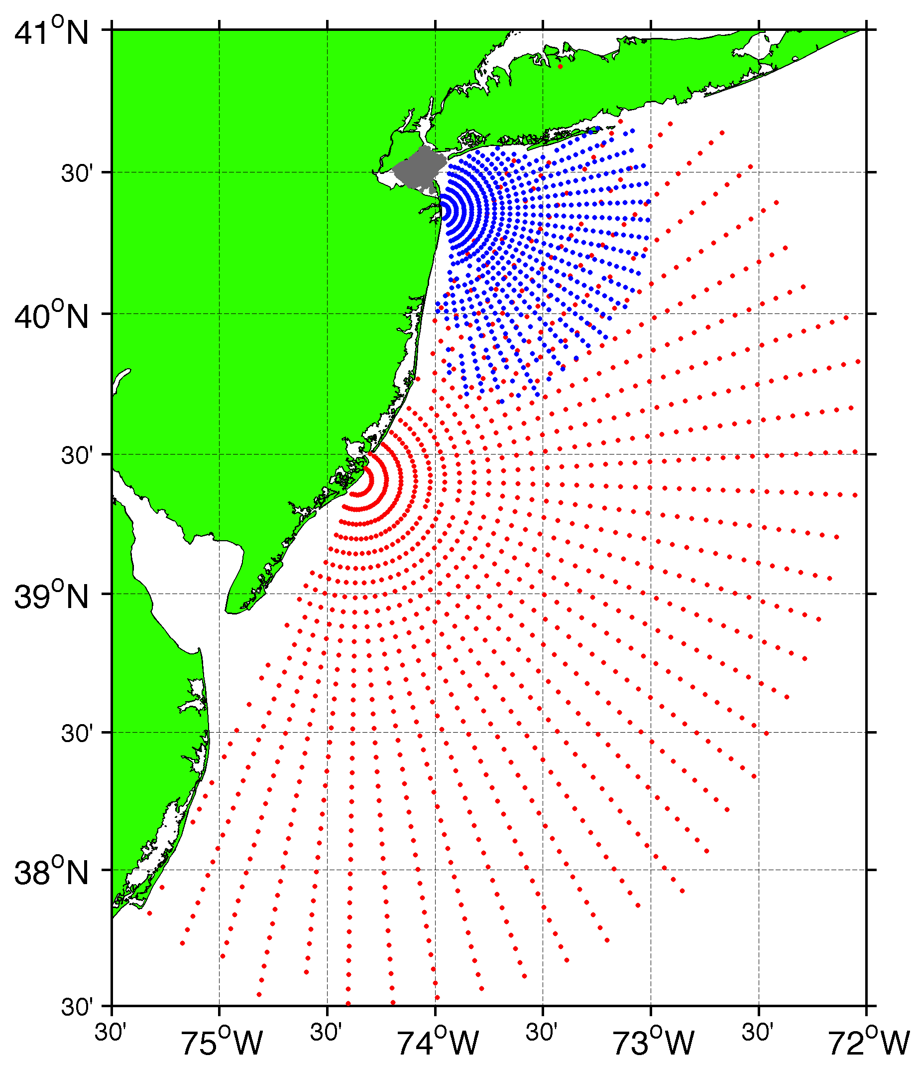
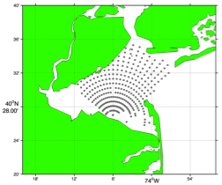
Surface Current Mapping Capability
25 MHz
Radar λ: 12 m Ocean λ: 6 m
Range: 30 km Resolution: 1 km
13 MHz
Radar λ: 23 m Ocean λ: 12 m
Range: 80 km Resolution: 3 km
05 MHz
Radar λ: 60m Ocean λ: 30 m
Range: 180 km Resolution: 6 km

Slide 8
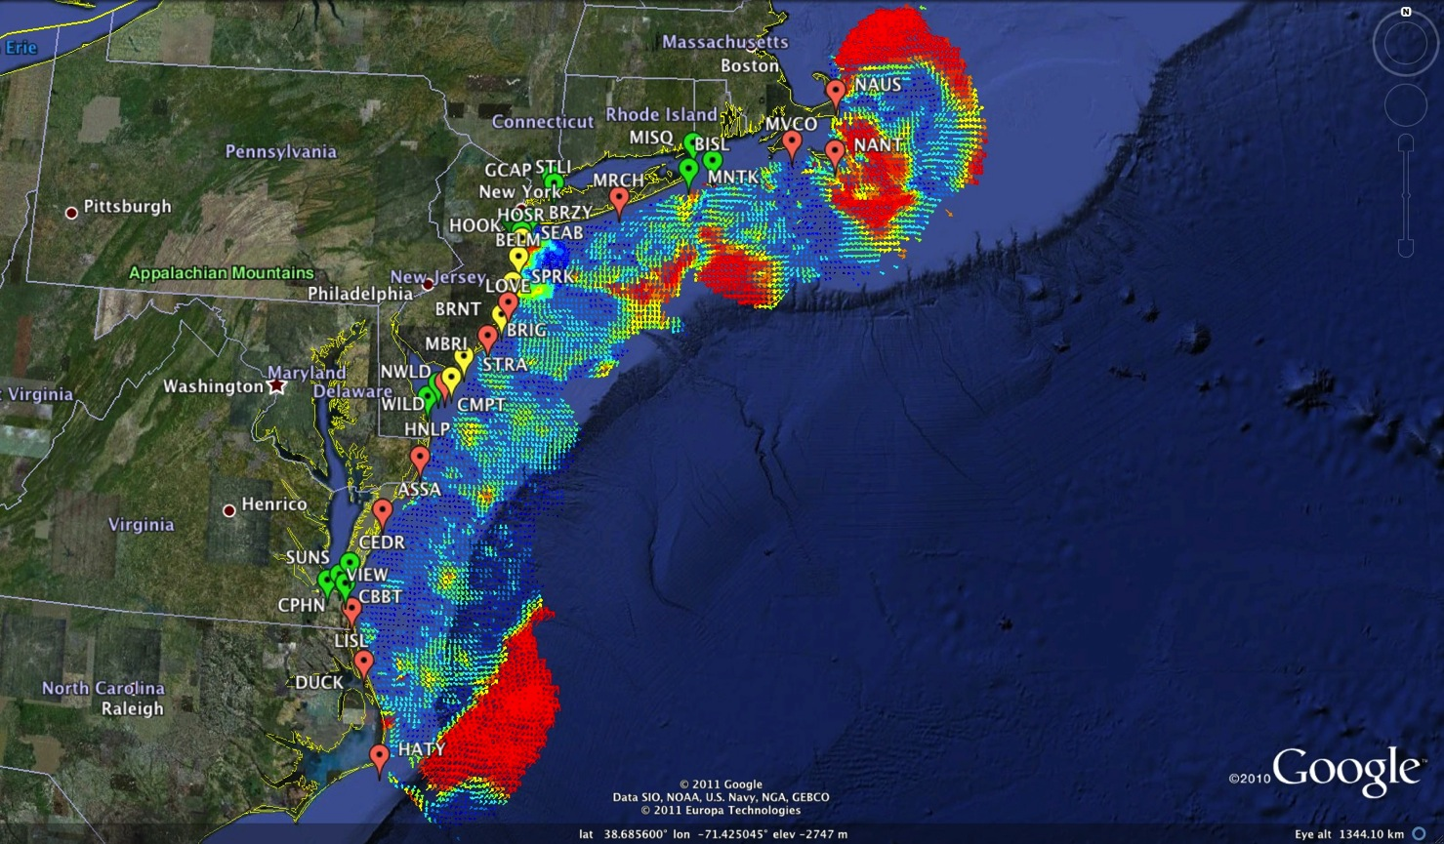
Mid-Atlantic Bight HF Radar Network
1000 km Alongshore Length Scale
Mid-Atlantic HF Radar Network
16 Long-Range CODARs
8 Medium-Range CODARs
17 Short-Range CODARs
41 Total
Triple Nested & Multistatic

Slide 9
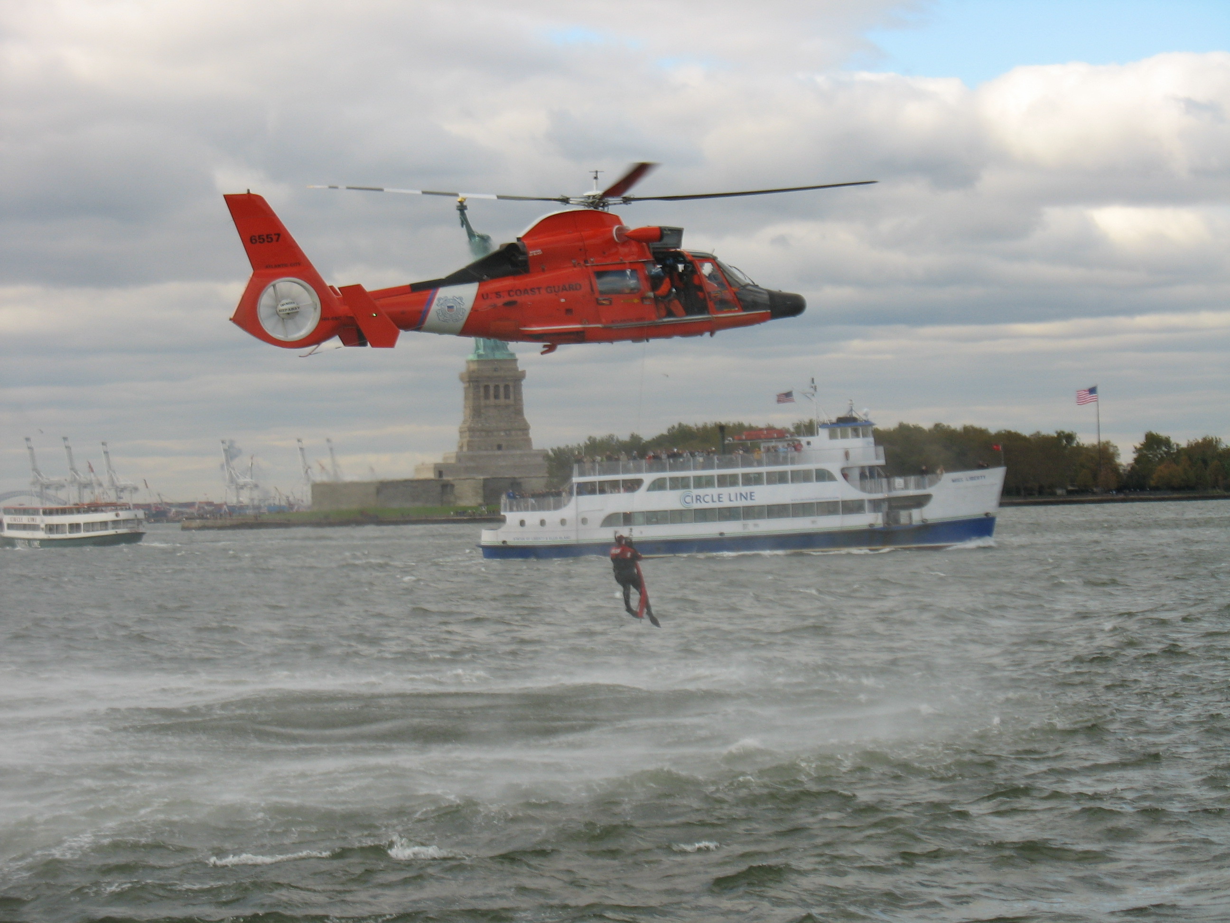
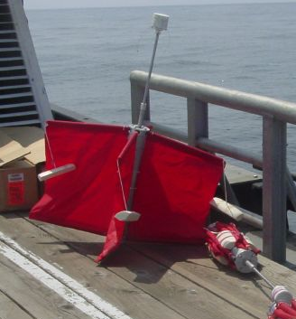
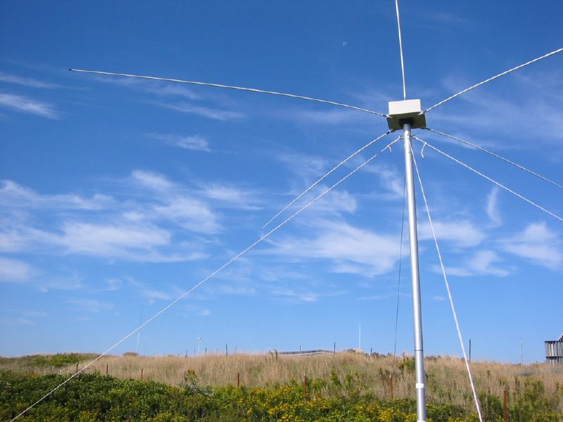
Transition Success Stories – Making a Difference
Optimizing HF Radar for SAR using USCG Surface Drifters
Art Allen
U.S. Coast Guard
Scott Glenn
Rutgers University
Mid-Atlantic Regional Association
Coastal Ocean Observing System

Slide 10
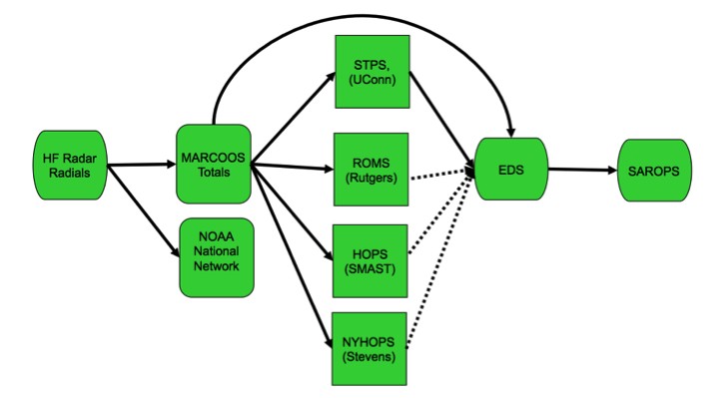
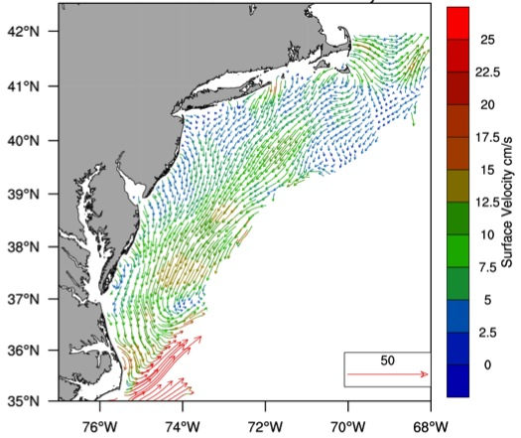
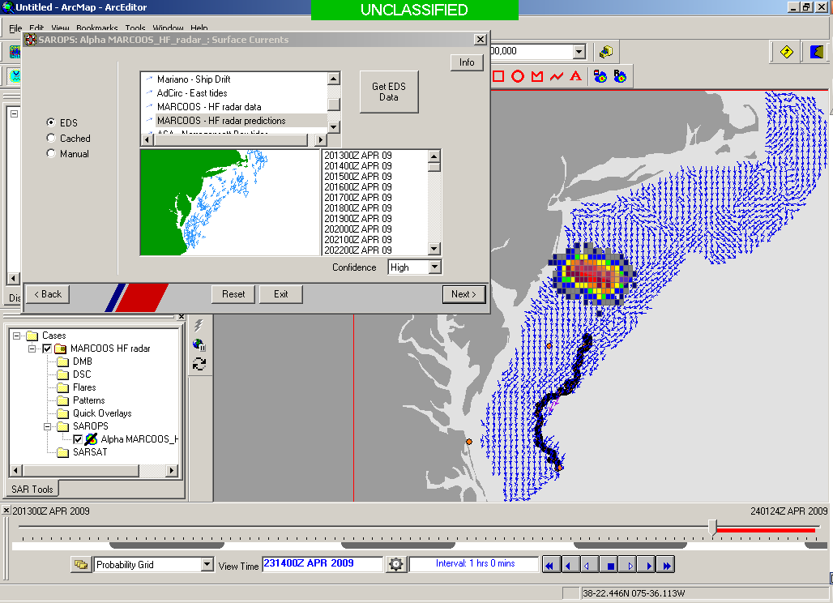
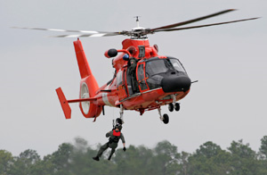

Transition Objective –
Operational Use of HF Radar Surface Currents for Search And Rescue
Surface Currents
Data Acquisition
(MARACOOS)
Data Product Generation & Management
(U.S. IOOS)
Environmental Data Server (EDS)
Search And Rescue Optimal Planning System (SAROPS)

Slide 11

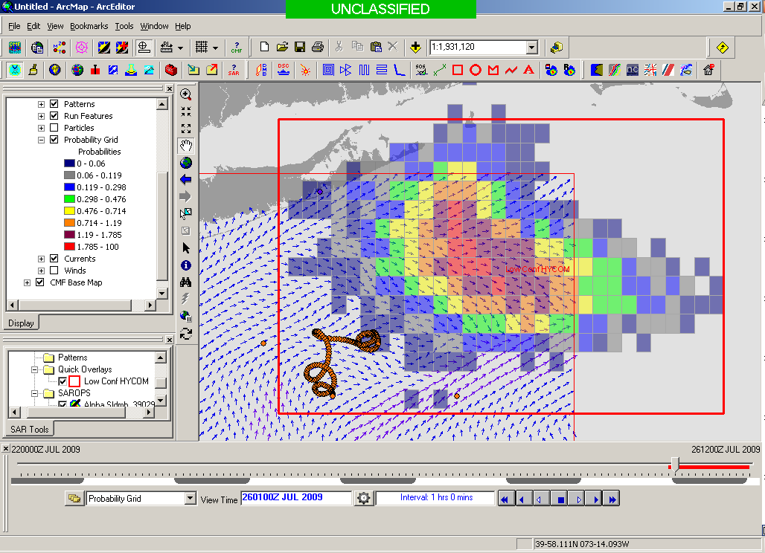
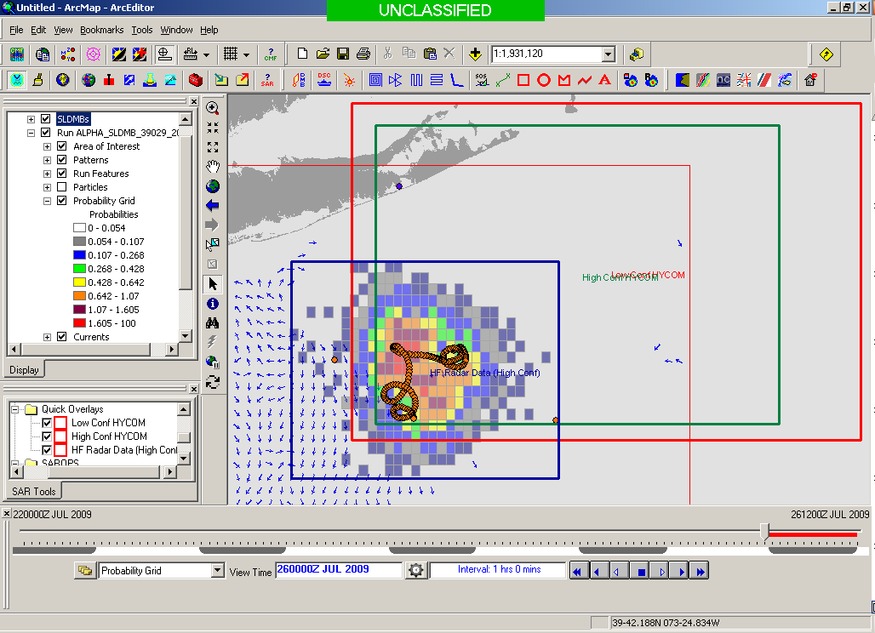
SAROPS Test Case
5000 Virtual Drifters +
1 Real Drifter (Black Line):
Search Area After 96 Hours
154 km
100 km
232 km
123 km
HYCOM
36,000 km²
CODAR
12,000 km²
Notes:
HYCOM (Low Conf) 48 hours

Slide 12
Environmental Data Server (EDS) & SAROPS
Operational May 4, 2009

Slide 13
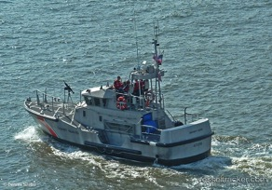
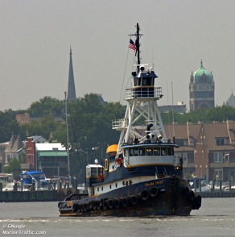
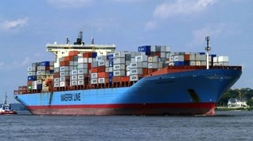
Vessel Detection Capability
25 MHz
Range: 11 nmi
Height >10 ft
13 MHz
Range: 43 nmi
Size: >19 ft
05 MHz
Range: 65 nmi
Size: >49 ft

Slide 14
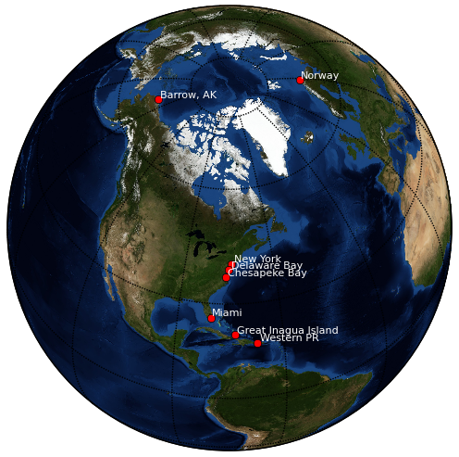
Vessel Tracking
Research Areas
Current Testbeds
New York Harbor
Delaware Bay
Chesapeake Bay
Port of Miami
Western Puerto Rico
Barrow Alaska
Proposed Testbeds
Great Inagua
Norway
San Diego

Slide 15
New YORk HARBOR
TESTBED RESULTS

Slide 16
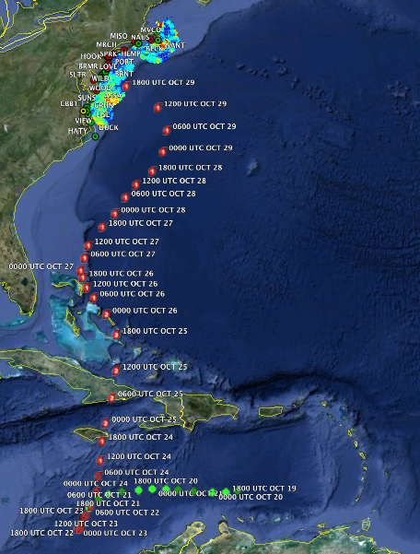
Track of Hurricane Sandy

Slide 17
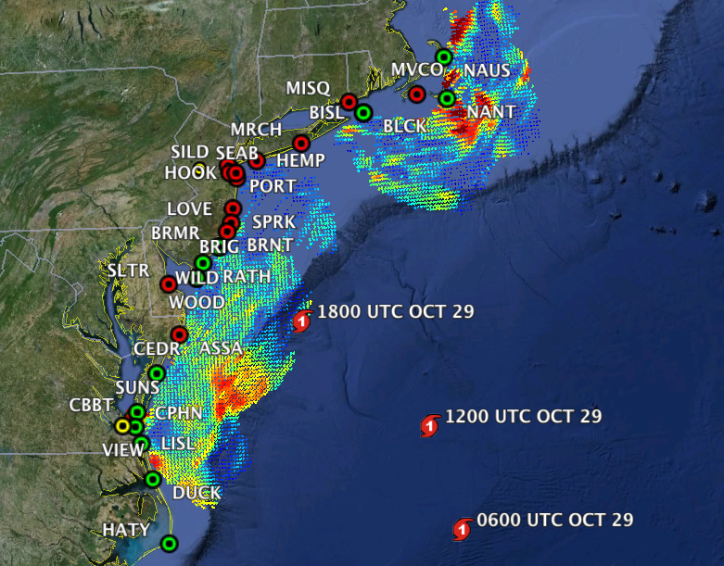

Slide 18
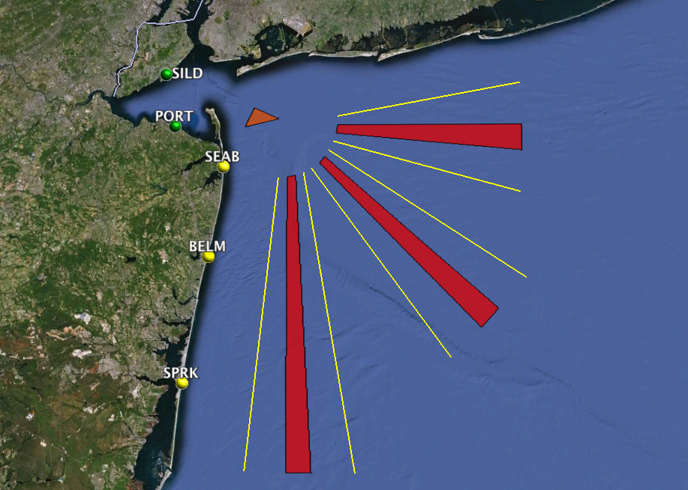

Slide 19
PORT MONMOUTH

Slide 20
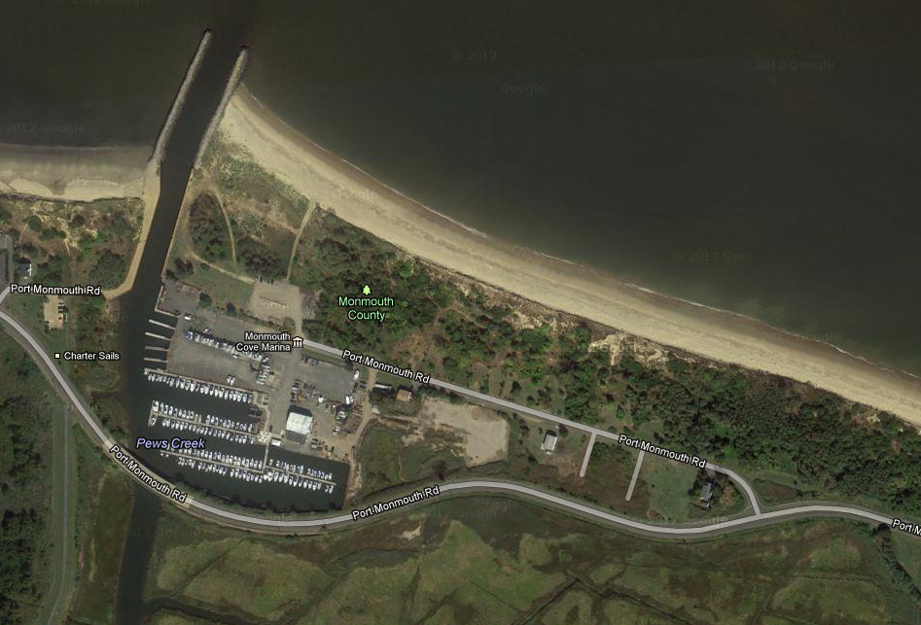
200 m

Slide 21
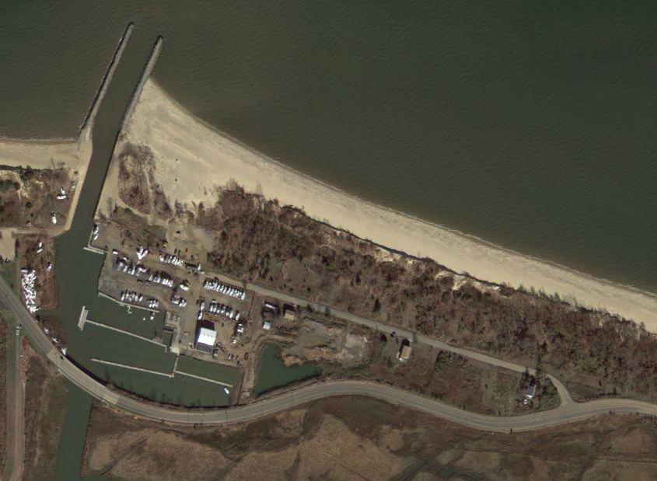

Slide 22
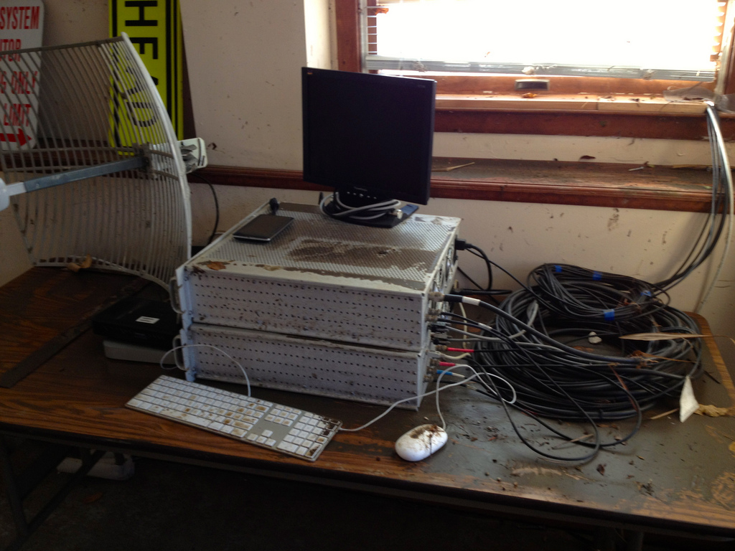

Slide 23
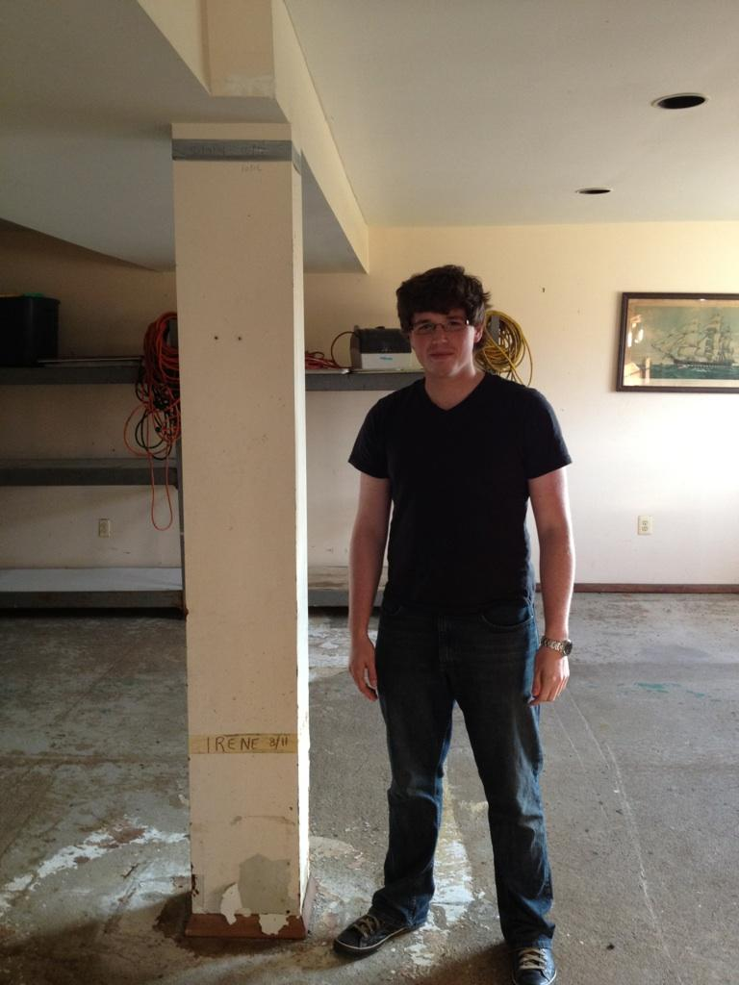
Sandy
2012
Irene
2011

Slide 24
SEA BRIGHT

Slide 25
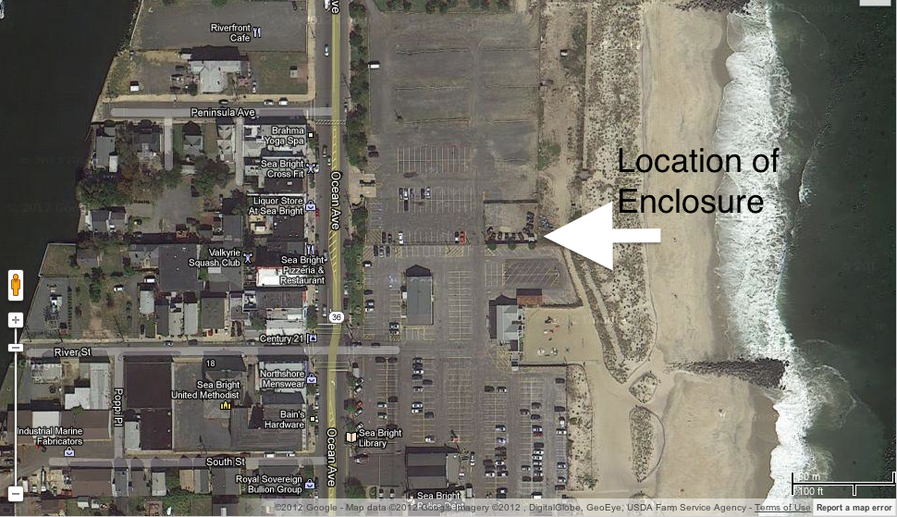
SEAB PRE

Slide 26
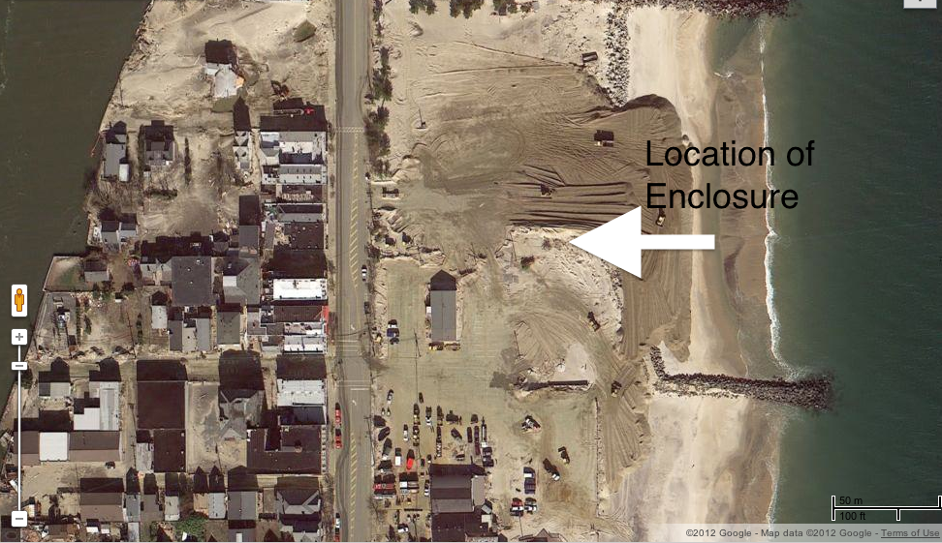
SEAB POST

Slide 27
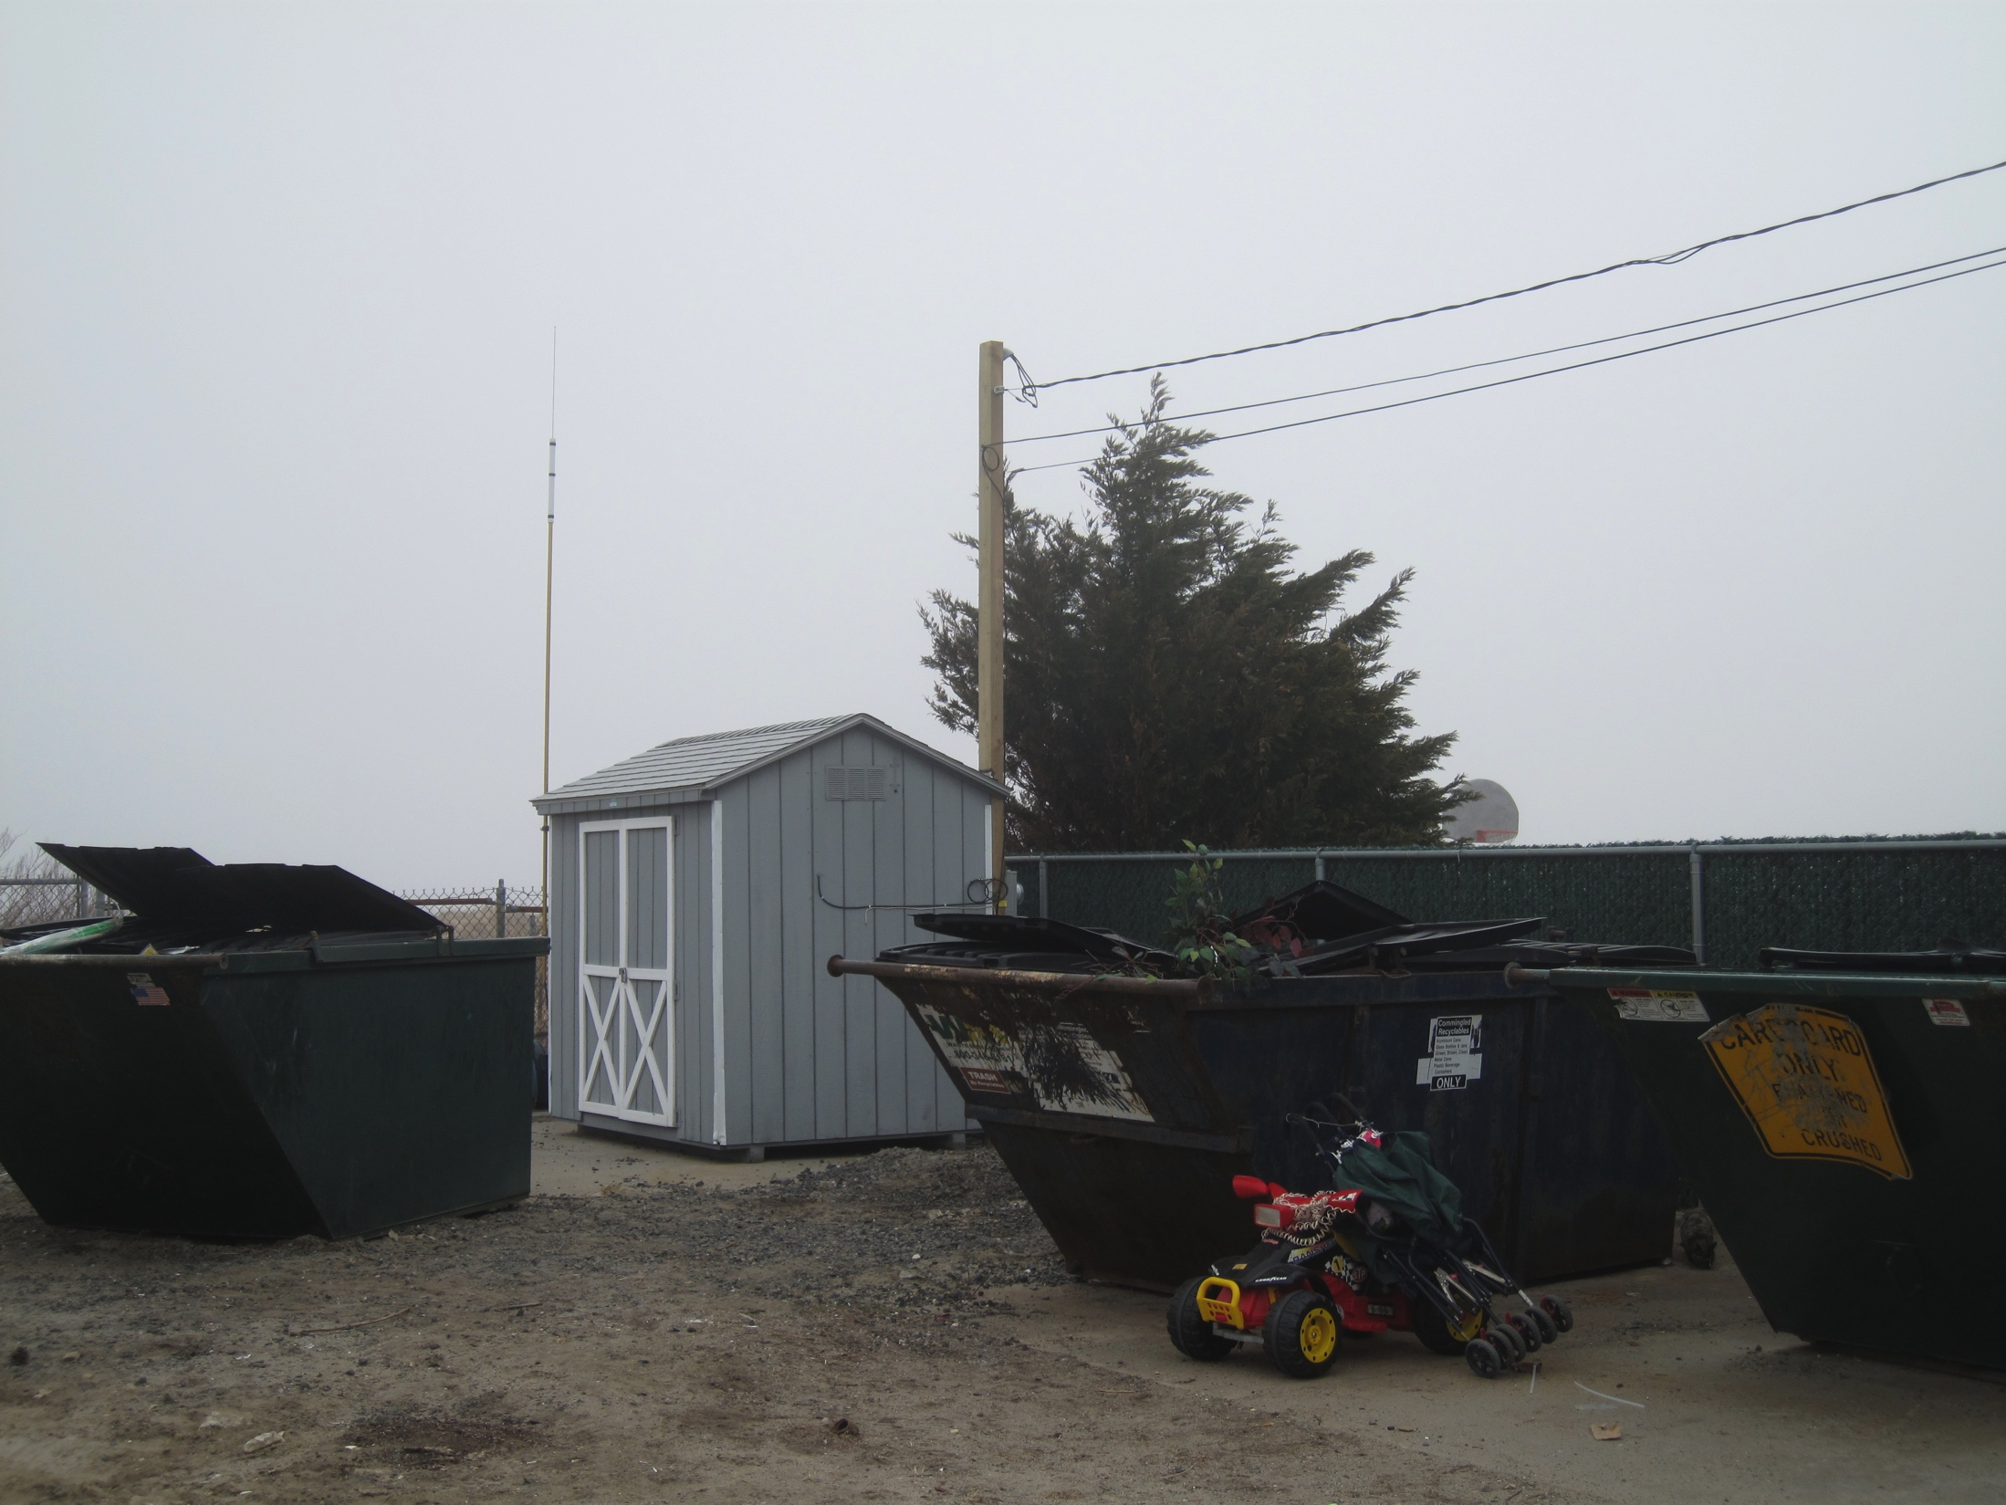

Slide 28
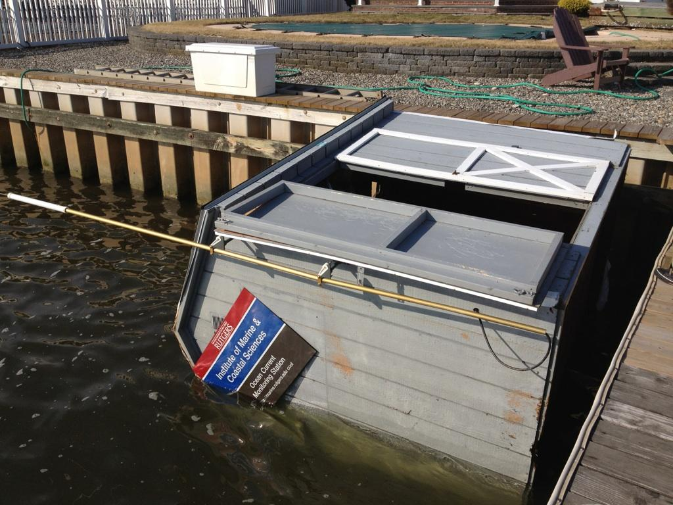

Slide 29
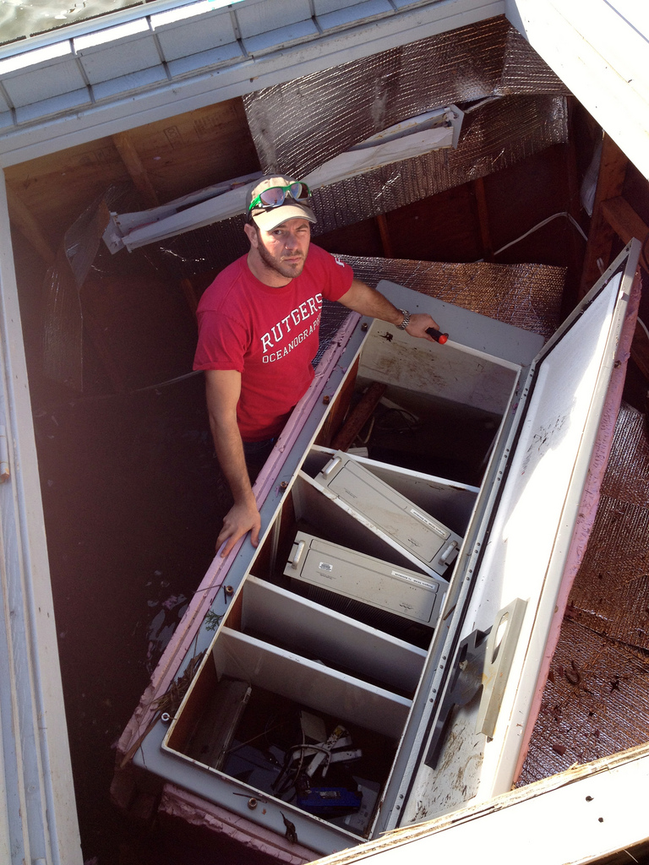

Slide 30
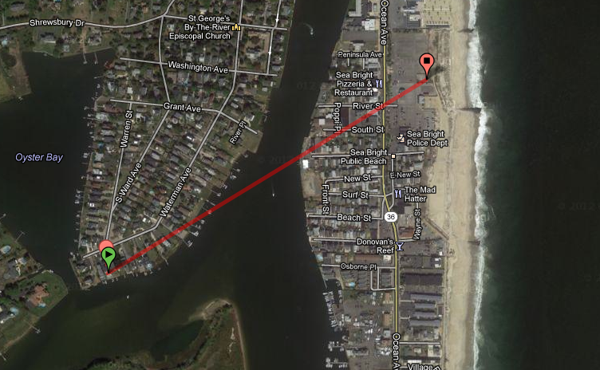
Shed Starting Location
850 m

Slide 31
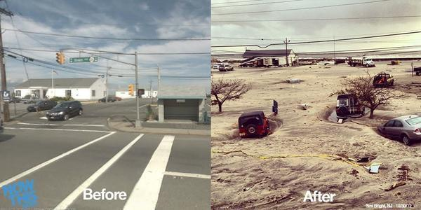

Slide 32


Slide 33


Slide 34
SeaSIDE PARK

Slide 35


Slide 36


Slide 37

SPRK PRE

Slide 38

SPRK POST

Slide 39


Slide 40


Slide 41


Slide 42
Resources
http://google.org/crisismap/2012-sandy
http://www.flickr.com/photos/rutgers_cool/sets/72157631995293198/

Slide 43
NY HARBOR RECENT RESULTS

Slide 44


GPS Track YM Los Angeles
Notes:
44

Slide 45


Pepper Plot
Detections on a Map
Notes:
45

Slide 46

Association of GPS with Detections
Notes:
46

Slide 47


Slide 48
Processing Matrix - YM Los Angeles 11/9/09
Threshold (dB)
 | 6 | 7 | 8 | 9 | 10 | 11 | 12 | 13
16 | NSD | NSD | NSD | NSD | NSD | NSD
32 | 6.6 | 6.1 | 4.1 11.8 | 1.7 9.0 | 0.8 5.8 | NSD 3.0 | 1.4 | 0.3
64 | 21.7 | 20.2 | 17.8 28.9 | 16.2 22.4 | 13.7 15.0 | 10.6 9.3 | 6.1 | 3.1
128 | 41.8 | 41.1 | 39.7 50.3 | 37.4 48.6 | 36.0 46.6 | 34.3 43.0 | 39.0 | 36.1
256 | 42.7 | 41.6 | 39.9 47.1 | 39.2 46.1 | 37.9 45.7 | 35.5 44.0 | 43.0 | 39.9
512 | 33.7 | 32.3 | 30.9 36.5 | 29.8 34.0 | 28.4 32.6 | 26.0 30.5 | 29.5 | 28.8
1024 |  |  | 29.7 | 28.6 | 26.1 | 25.0 | 22.1 | 19.6
FFT Points
IIR – Red Median – Blue NSD = No Ship Detected

Slide 49
NY HARBOR 2012 RESULTS

Slide 50


2012 Summer Research Institute

Slide 51




















































Vessels Detected June 11, 2012
Real time software allows for increased processing

Slide 52

Detections Overlaid on AIS
June 11, 2012
06:00-07:00
Median Background
512 pt. FFT
14 dB SNR

Slide 53

Detections Overlaid on AIS
June 11, 2012
07:00-08:00
Median Background
512 pt. FFT
14 dB SNR

Slide 54


1
2
1 Ambrose / Barnegat
2 Ambrose / Hudson Canyon

Slide 55

AIS Density July 2011 to June 2012

Slide 56






31% of
HF Radar Detections NOT on AIS
Approaches to New York Harbor
16 Vessels per Hour in HFR
5 Vessels NOT on AIS

Slide 57


Calusa Coast Test Case

Slide 58


Slide 59


Slide 60

CSR Ship Detection Visualizer

Slide 61
Selected Recent Publications
HF Radar for Surface Current Mapping:
Roarty, Glenn, Kohut, Gong, Handel, Rivera, Garner, Atkinson, Brown, Jakubiak, Muglia, Haines, Seim, (2010). Operation and Application of a Regional High-Frequency Radar Network in the Mid-Atlantic Bight, Marine Technology Society Journal, V. 44, No. 6, p. 1-13.
Corredor, J. E., Amador, A., Canals, M., Rivera, S., Capella, J.E., Morell, J.M., Glenn, S.M., Roarty, H.J., Handel, E., Rivera, E. (2011) “Optimizing and Validating High Frequency Radar Surface Current Measurements in the Mona Passage” Marine Technology Society Journal, Vol. 45, No. 3, 49-58
Teague, C.C., Barrick, D. E., Lilleboe, P.M., Roarty, H., Holden, D., Goldinger, D. (2011) “Extended-Range RiverSonde Operation on the Hudson River, Current, Waves and Turbulence Measurements (CWTM), 2011 IEEE/OES 10th, 78-80, doi 10.1109/CWTM.2011.5759529
Harlan, J., Allen, A., Howlett, E., Glenn, S.M., Kohut, J.T., Roarty, H., O’Donnell, J., Fake, T., Terrill, E., Kim, S.Y., Otero, M. (2011) “National IOOS HF Radar Search and Rescue Project”, Oceans 2011 MTS/IEEE – Kona

Slide 62
Selected Recent Publications
HF Radar for Surface Current Mapping:
Kohut, Roarty, Randall-Goodwin, Glenn, Lichtenwalner (2012) Evaluation of Two Algorithms for a Network of Coastal Radars in the Mid Atlantic Bight, Ocean Dynamics, Vol. 62, p. 953-968
Roarty, H.J., Riscica, J., Palamara, L., Bowers, L. , Seroka, G., Kohut, J., Glenn, S., Dunk, R. (2012) “Analysis of the Wind Resource off New Jersey for Offshore Wind Energy Development”, Oceans 2012 MTS/IEEE – Hampton Roads
Roarty, H.J., Smith, M., Kerfoot, J., Glenn S. (2012) “Automated Quality Control of High Frequency Radar Data”, Oceans 2012 MTS/IEEE – Hampton Roads
Roarty, H.J., Smith, M., Handel, E., Barrick, D. and Glenn S. (2012) “ Expanding the Coverage of HF Radar Through the Use of Wave Powered Buoys” Oceans 2012 MTS/IEEE – Hampton Roads
Evans, C.W., Roarty, H.J., Kohut, J.T., Glenn, S.M. (2012) ‘Examination of the SeaSonde Wave Processing Settings and the Effects of Shallow Water on Wave Measurements” Oceans 2012 MTS/IEEE – Hampton Roads

Slide 63
Selected Recent Publications
HF Radar for Surface Current Mapping:
Seroka, G, Dunk, R., Glenn, S., Bowers, L., Kerfoot, J., Crowley, M., Roarty, H.J., Palamara, L., Kohut, J., (2012) “Rutgers University Coastal Ocean Observation Laboratory (RU-COOL) Advanced Modeling System Developed to Cost-Effectively Support Offshore Wind Energy Development and Operational Applications” Oceans 2012 MTS/IEEE – Hampton Roads
Schofield, O., Roarty, H., Saba, G., Yi, X., Kohut, J., Glenn, S., Manderson, J., Oliver, M. (2012) “ Phytoplankton Dynamics and Bottom Water Oxygen During a Large Bloom in the Summer of 2011”, Oceans 2012 MTS/IEEE – Hampton Roads
Glenn, Schofield, Kohut, Dunk, Titlow, Roarty, Kerfoot, Palamara, Bowers, Seroka, Miles, Xu, Crowley (2012) “Impact of Ocean Observations on Hurricane Forecasts in the Mid Atlantic”, Oceans 2012 MTS/IEEE – Hampton Roads

Slide 64
Selected Recent Publications
HF Radar for Vessel Tracking:
Roarty, H.J., D. E. Barrick, J. T. Kohut, S. M. Glenn (2010) “Dual-Use of Compact HF Radars for the Detection of Mid and Large Size Vessels” Turkish Journal of Electrical Engineering and Computer Sciences, Vol. 18, No. 3, 373-388
Roarty, Lemus, Handel, Glenn, Barrick, Issacson, (2011). “Performance Evaluation of SeaSonde High-Frequency Radar for Vessel Detection”, Marine Technology Society Journal, V. 45, No. 3, p. 14-24.
Newton, D. (2012) "Observations and Analysis of the Target Detection Performance of the CODAR HF Surface Wave Radar," The Proceedings of the 2012 MSS Tri-Service Radar Conference, Boulder, CO; 18-22 June 2012.
Roarty, Smith, Glenn, Barrick, Whelan, Statscewich, Weingartner (2013) “Expanding Maritime Domain Awareness Capabilities in the Arctic: High Frequency Radar Vessel-tracking” IEEE Radar Conference, Ottawa Canada
Roarty, Glenn, Barrick (2013) “Real-Time Beyond the Horizon Vessel Detection” Radar Sensor Technology XVII, SPIE Paper 8714-36

Slide 65
Selected Recent Publications
Education:
Glenn + 27 Researches + 57 Students, Jan-Feb 2011. The Trans-Atlantic Slocum Glider Expeditions: A Catalyst for Undergraduate Participation in Ocean Science & Technology, Marine Technology Society Journal, V. 45, No. 1, p. 52-67.
International Talks
Spain, Norway, Sweden, Poland, Brazil, United Kingdom, South Korea

