Slide 1
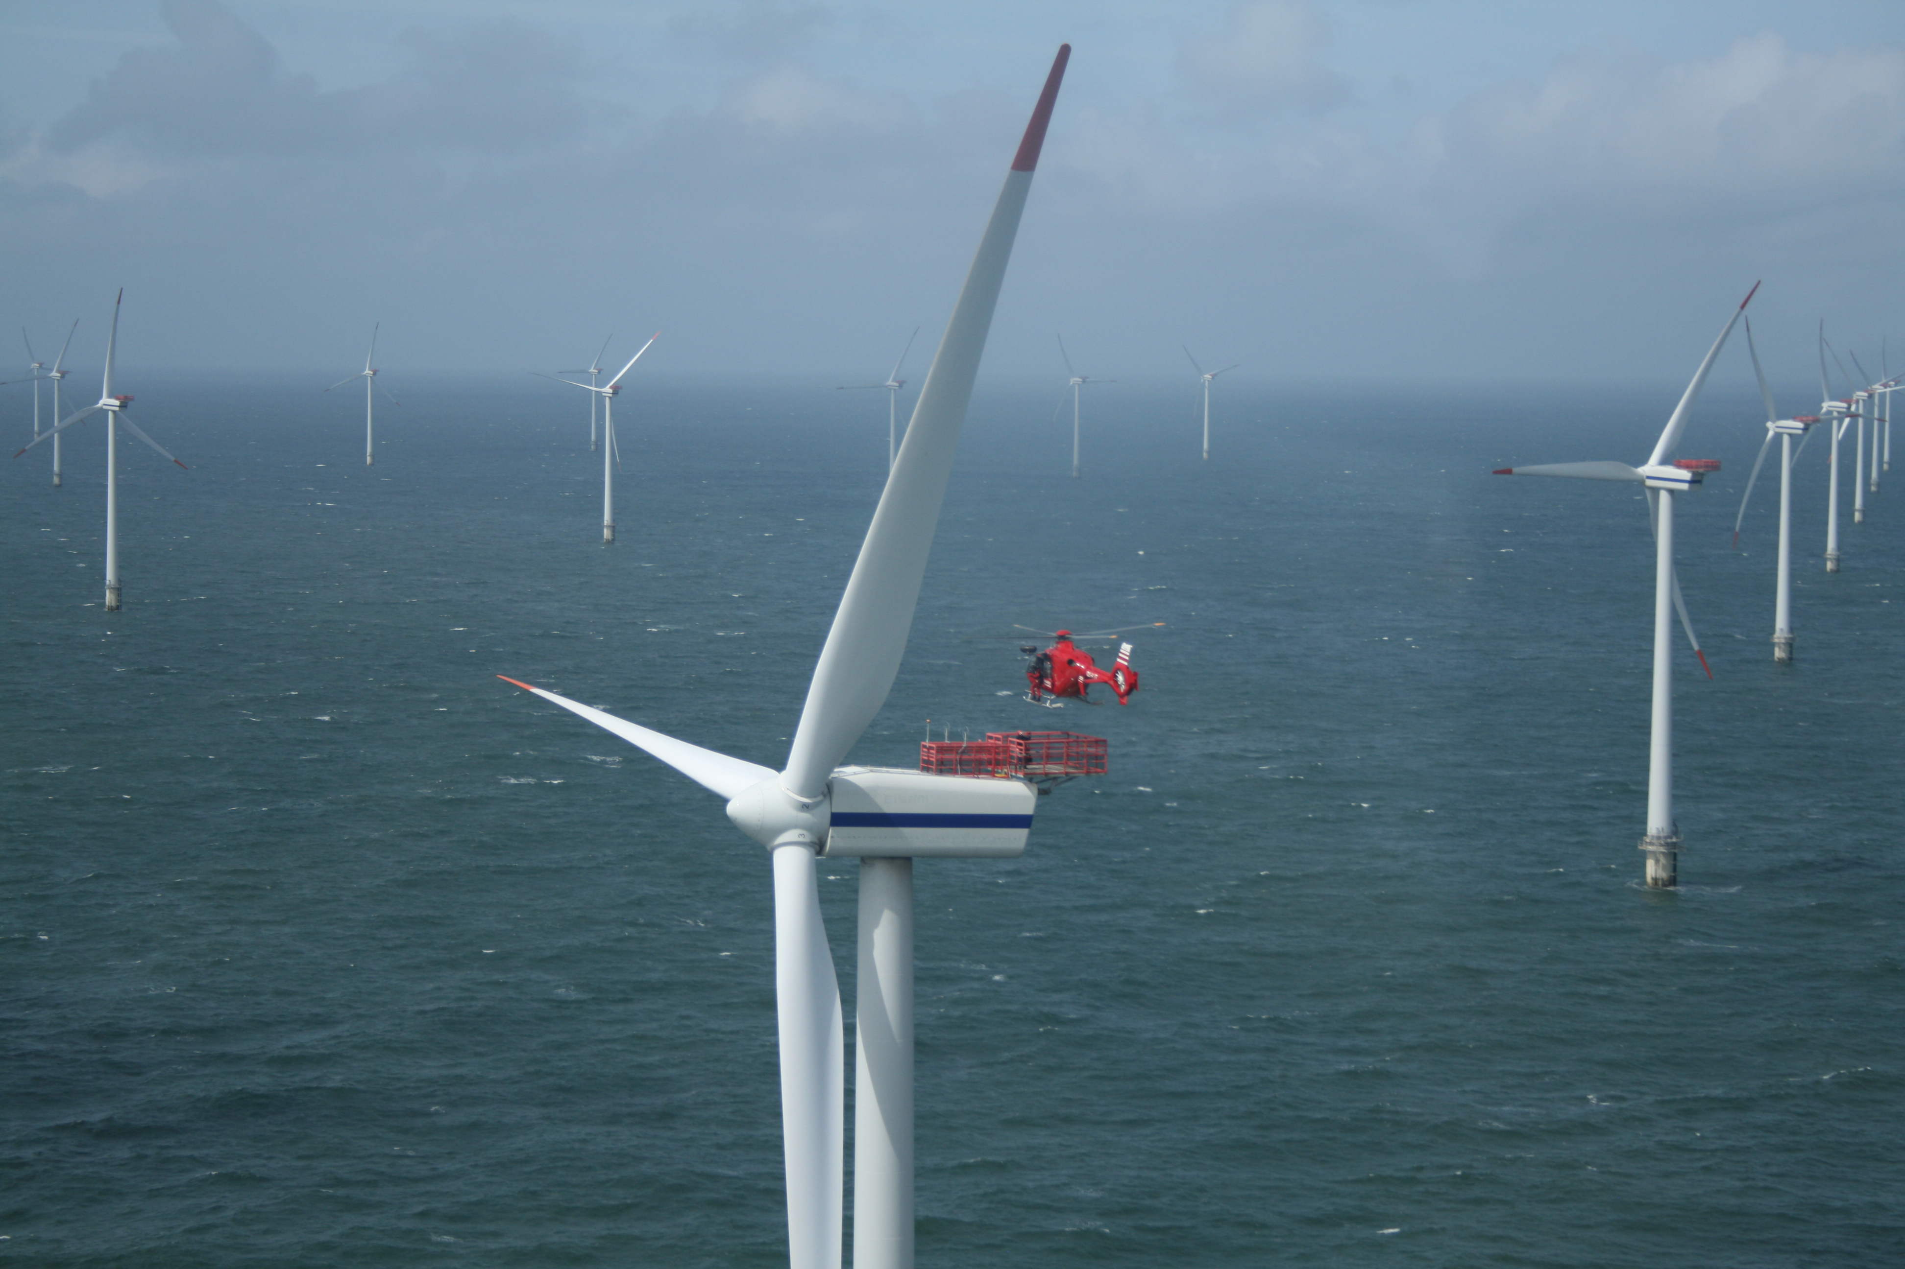






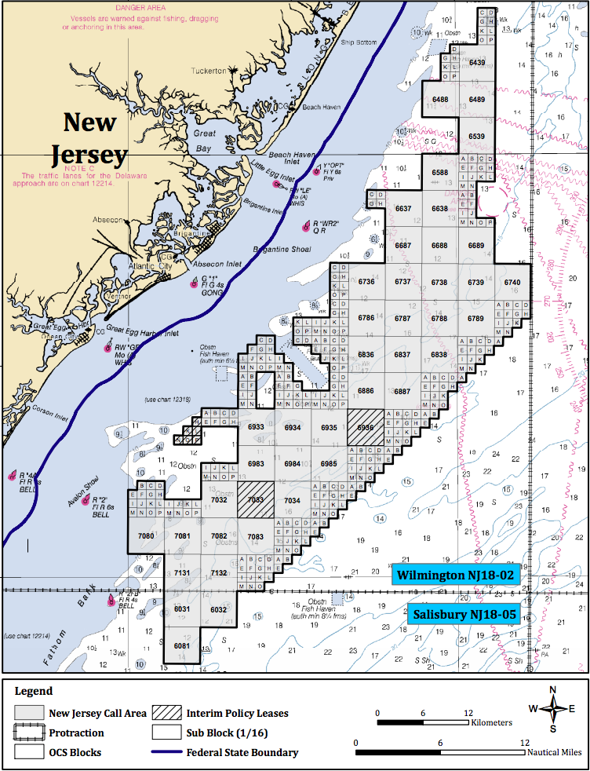
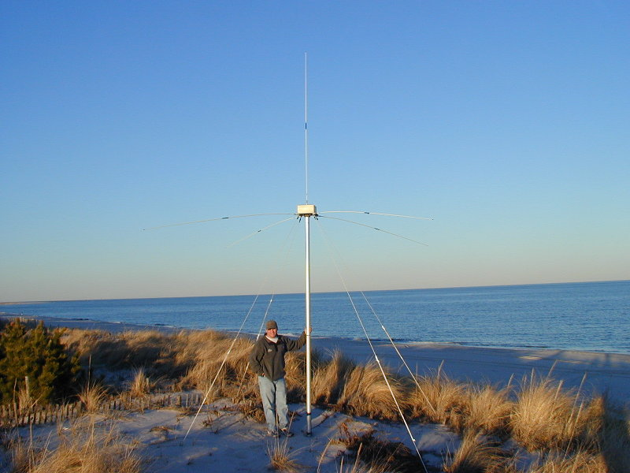
Spatial evaluation of high-resolution modeled offshore winds with estimated winds derived from a network of HF radars
Greg Seroka, Josh Kohut, Laura Palamara, Scott Glenn,
Hugh Roarty, Lou Bowers, Rich Dunk
September 25, 2013
Oceans 2013 MTS Meeting

Slide 2
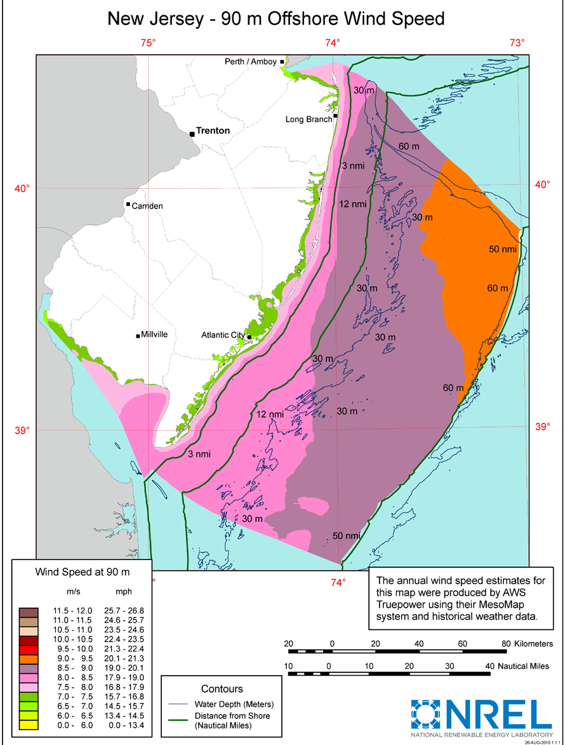
A few notes about
Offshore Wind Energy
Existing DOE and NREL annual average offshore wind resource maps (e.g. to right) fail to represent variability
Supply vs. demand:
  Supply: Wind (variant)
  Demand: Electricity demand (variant)
Prediction of variance in wind will assist:
  Backup generation planning (high costs, emissions b/c of power plant “cycling”)
  Construction, maintenance strategies
  Cost-effective operation in PJM market (power generation forecasting/ next-day trading)
Dearth of offshore observations
  Onshore met tower: $100K
  Offshore met tower: up to $10 million
  No spatial wind variability (yet)

Slide 3
Introduction
Numerical modeling can be used to diagnose and predict variability
  But how does the model do offshore?
Point-by-point temporal assessment of modeled winds simple (esp. on land) with:
  met towers, remote sensing
Spatial evaluation more difficult with existing systems:
  Weather radar (e.g. sea breeze fronts), but mainly on land
  Satellite-based scatterometers (e.g. QuikSCAT)
    Low resolution (25km), land contamination 25-37 km near coast (Chao et al., 2003)
  New Scanning LiDAR
    Not yet validated by wind industry, but promising
  High Frequency (HF) Radar (CODAR), available now

Slide 4
Introduction
Harness surface current mapping capability of
13 MHz CODAR to resolve wind fields
Surface currents forced in Mid-Atlantic Bight by:
  Tides [extracted using standard least squares approaches (Kohut et al., 2004)]
  Buoyancy (e.g. stratification, riverine input) (Chant et al., 2004)
  Local winds (Beardsley et al., 1976; Beardsley and Haidvogel, 1981)
Winter mixed:
  Bottom friction, pressure gradients (isobath-following)
Summer stratification:
  Local winds

Slide 5
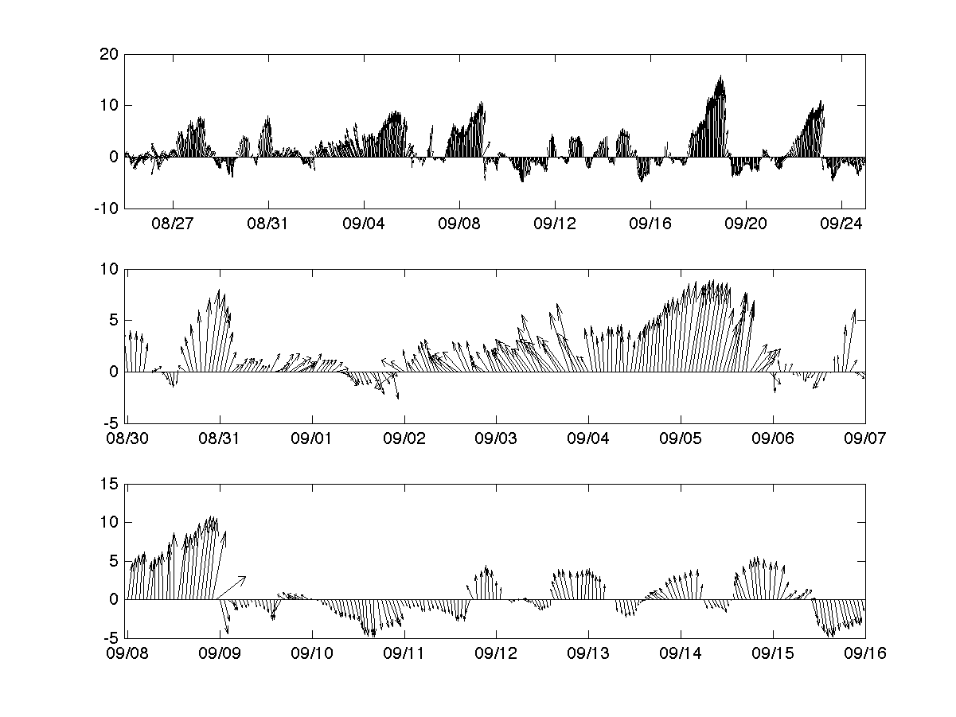
Methods
Chose summer-stratified season to apply current-wind regression model
WeatherFlow’s Ocean City (OC) site (2012):
Full period: 25 Aug-25 Sep
Non-upwelling: 30 Aug-6 Sep
Upwelling: 8-15 Sep
Notes:
-Ocean city centered on site, good coverage
-75-min center averaged winds to be consistent with CODAR processing

Slide 6
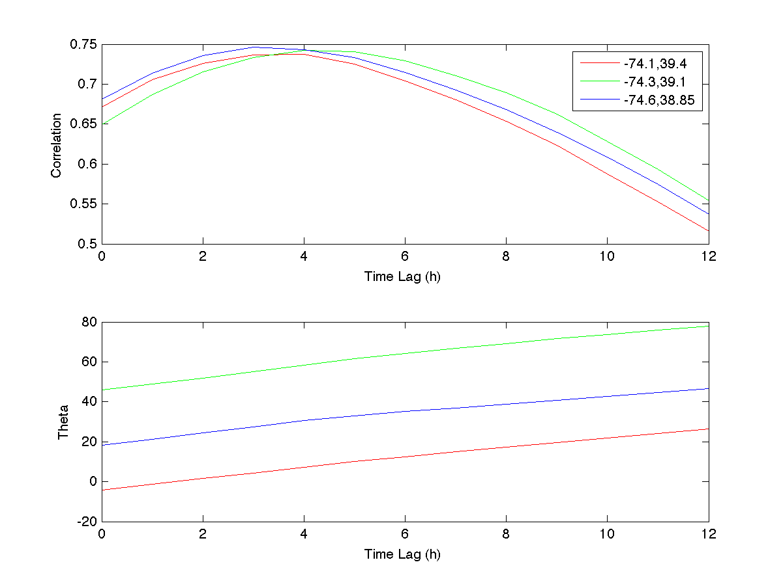
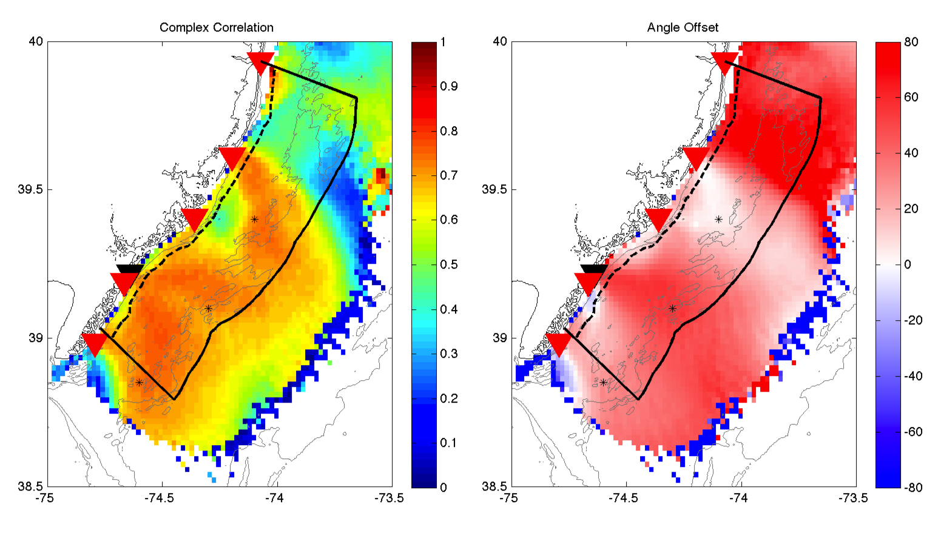
Methods
After Kohut et al. ( 2004)
Complex correlation between OC wind & detided surface current field
Determine time lag for highest correlation
Recalculate complex correlation field w/ 3 h lag
Rotate surface currents,
get best-fit line with OC
winds 3 h earlier
Apply best-fit equations
to rotated currents to
get wind field 3 h earlier
U_{Current}(x,y,t) = slope(x,y)*U_{OCWind}(t-3)
U_{GridWind}(x,y,t-3) = U_{Current}(x,y,t)/slope(x,y)
Notes:
-describe CODAR network, OC site using red and black triangles on bottom right figures
-3 points used to determine optimal lag are in figure at bottom right
-Recalculated complex correlation increased mean from 0.56 to 0.62, 50% region above 0.6 now

Slide 7
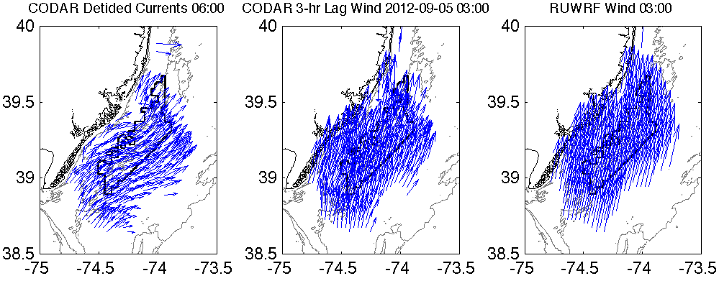
Example 3-Panel Figure
RUWRF is the Rutgers University version of the Weather Research and Forecasting model, a real-time 3km atmospheric model run by the RU Coastal Ocean Observation Lab (RUCOOL) for offshore wind energy
→Now, we can begin to spatially evaluate RUWRF model performance offshore!
But first…

Slide 8
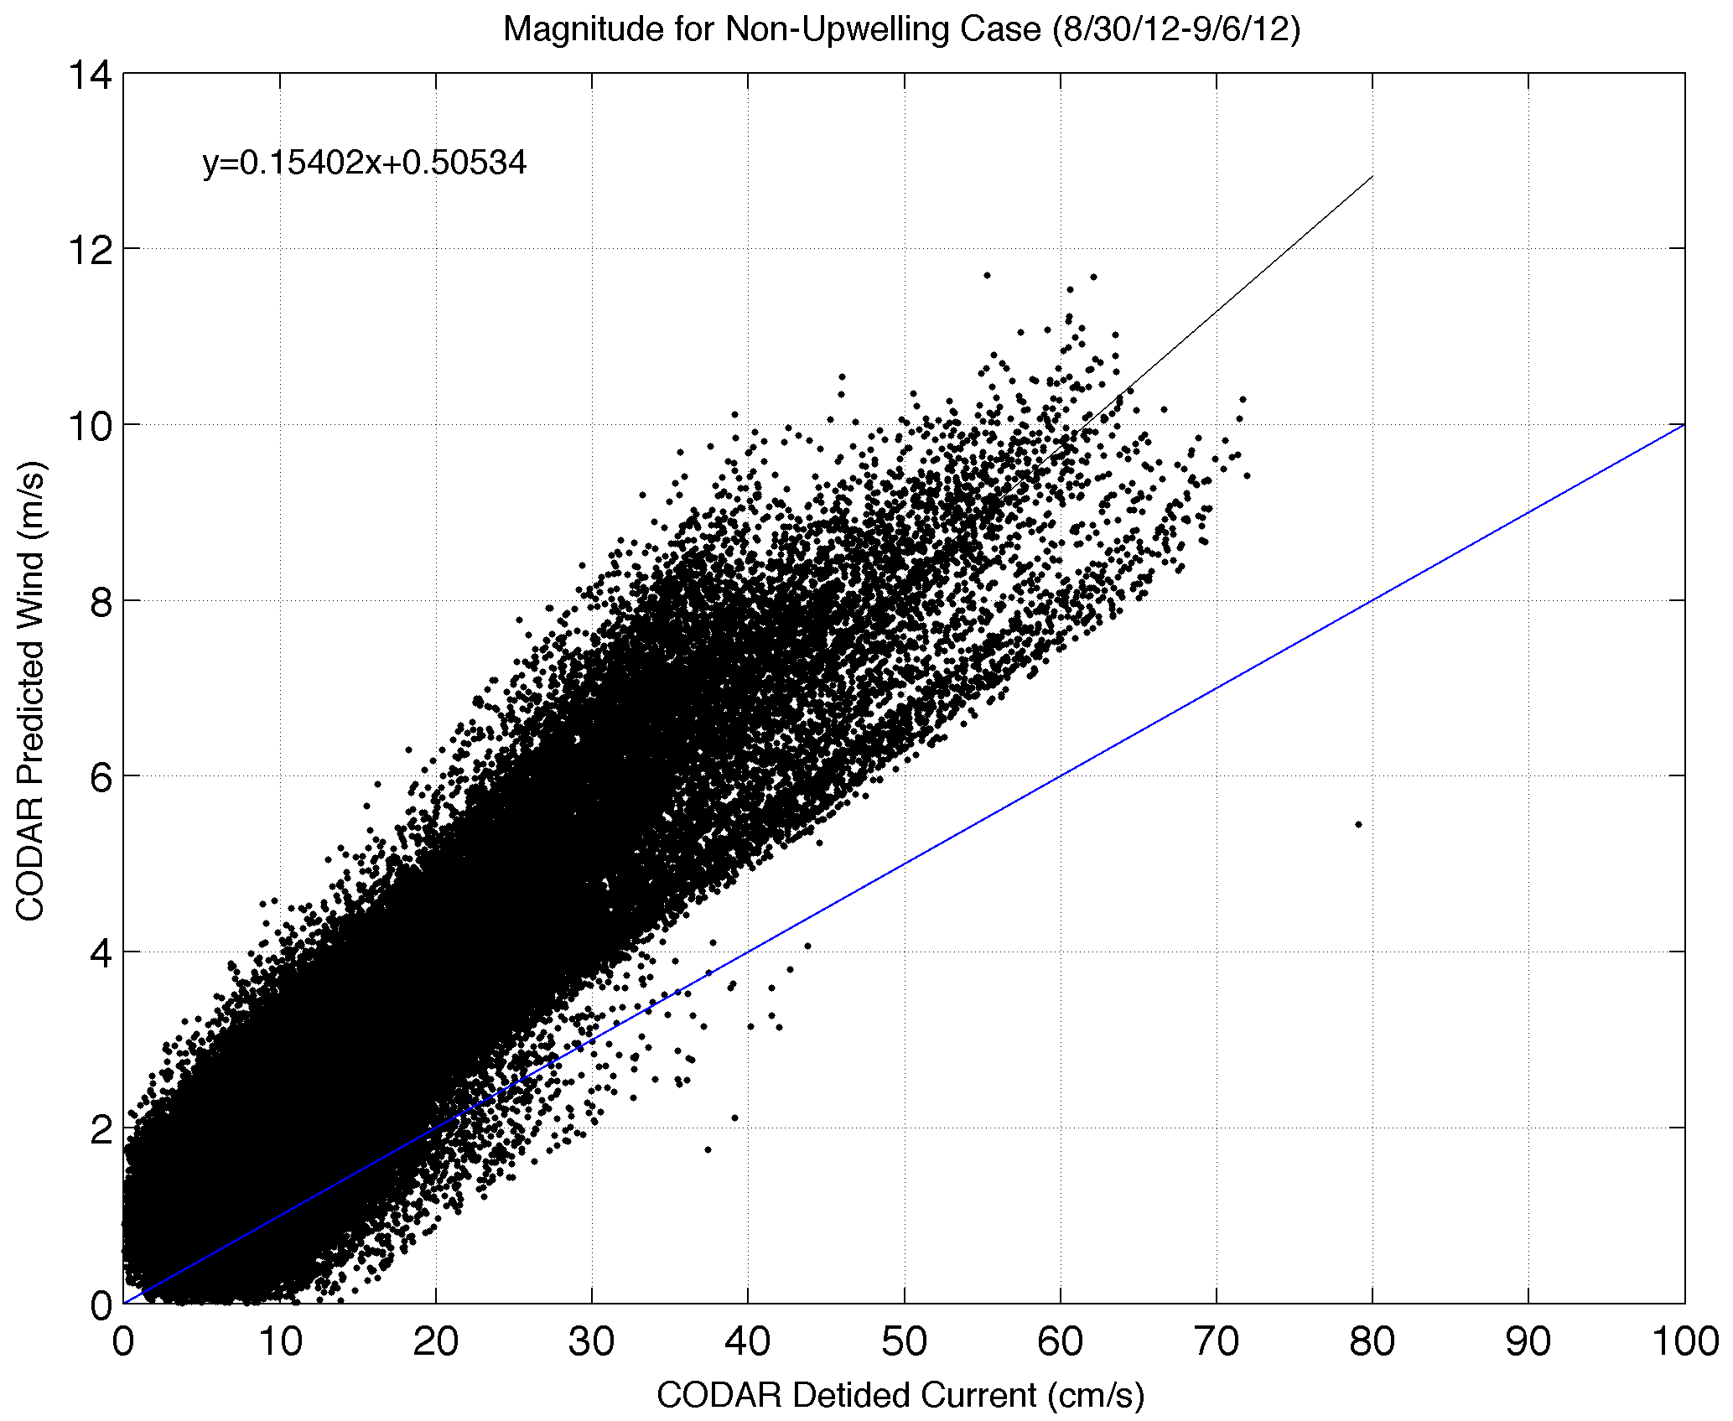
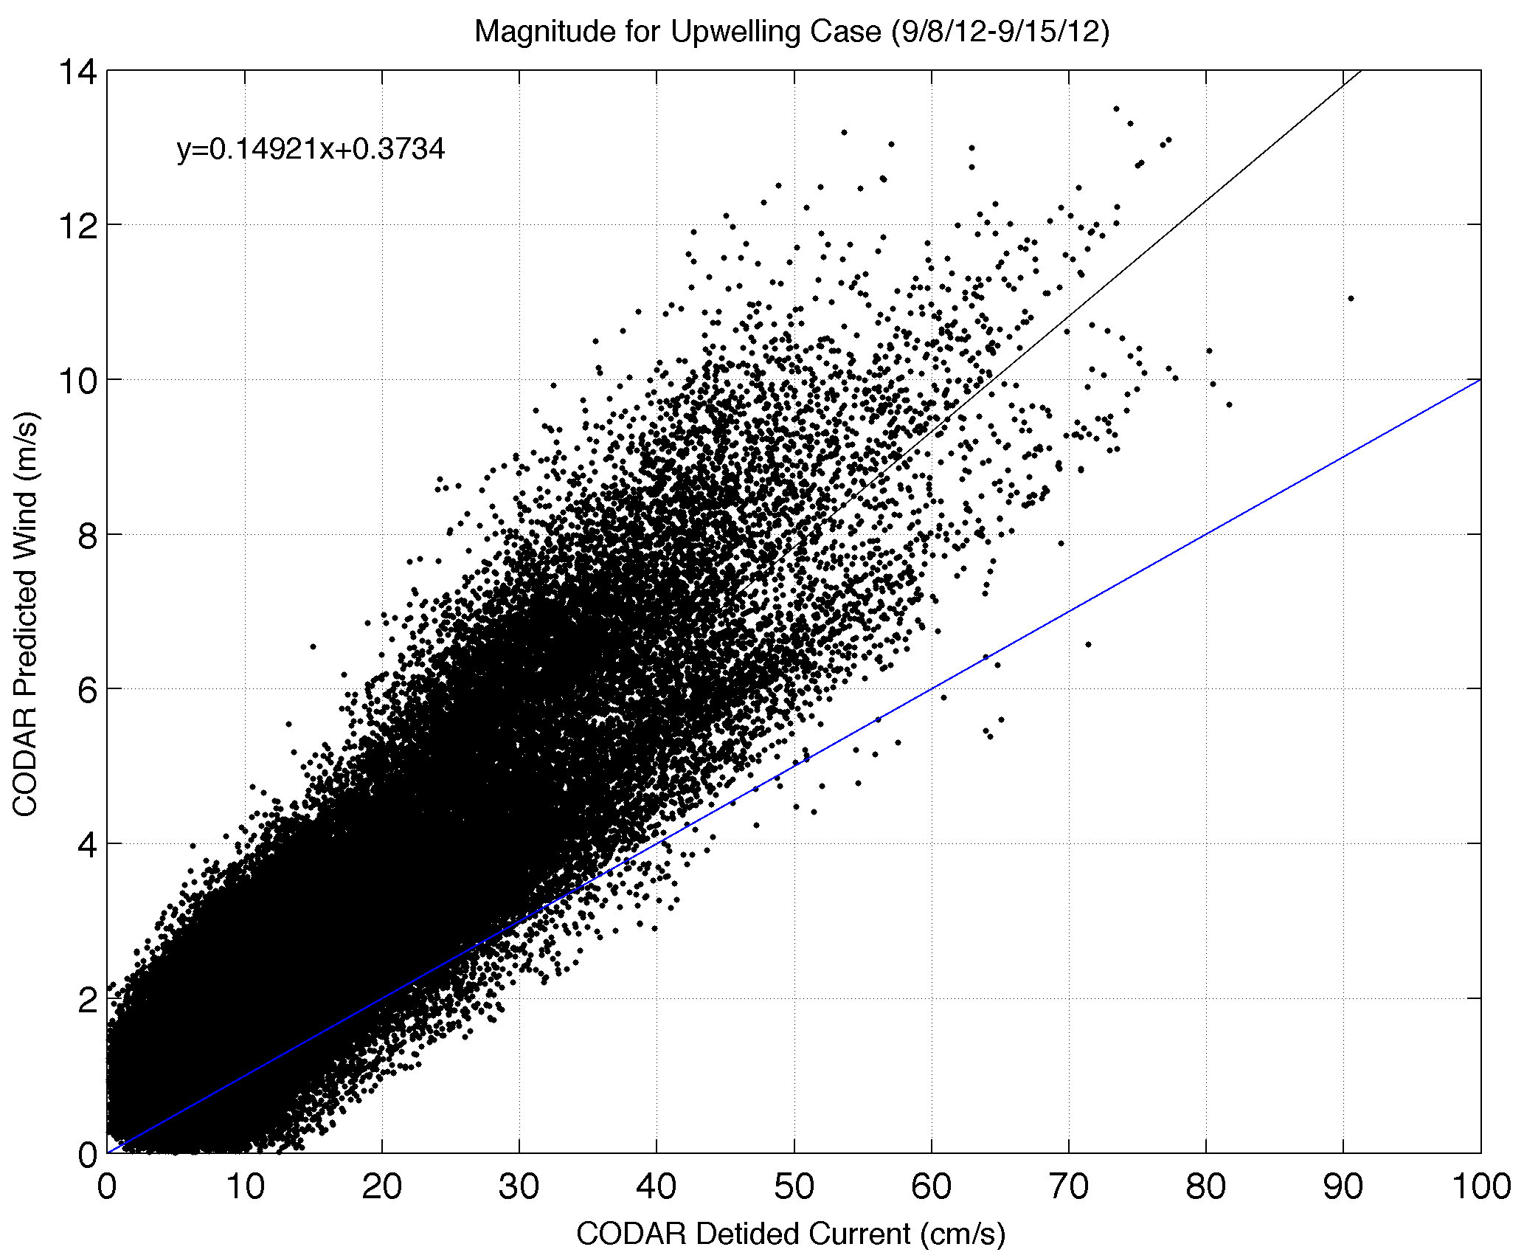
CODAR Wind Uncertainty Estimate
5 MHz HF radar radial uncertainty of O(5 cm/s)
[Kohut et al. (2006), Chapman and Graber (1997)]
Similar (or smaller) for 13 MHz
Result: O(0.75 m/s) uncertainty in CODAR winds

Slide 9
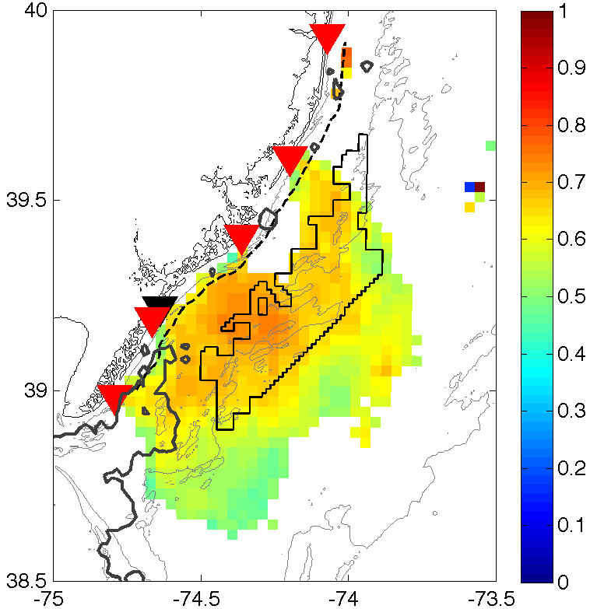
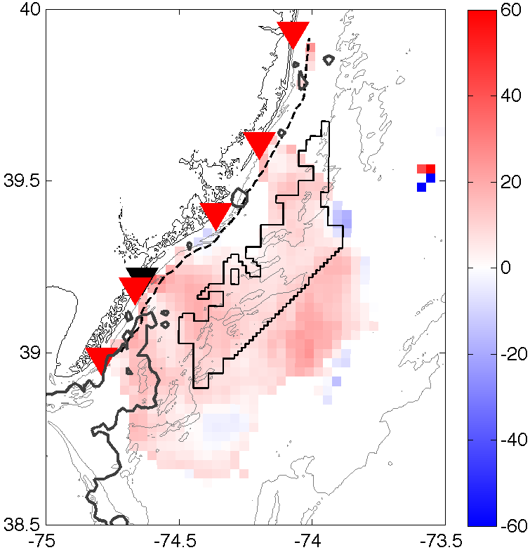
Complex Correlation:
CODAR-derived surface winds vs. RUWRF 10m winds
Non-upwelling: 30 Aug-6 Sep
Magnitude
Angle Offset
Notes:
-Limit comparison to grid points with >=0.6 correlation between CODAR currents and OC winds
-Angle offset values between 0 and 20 degrees, most correlated RU-WRF model wind vector shifted to right of CODAR wind estimate
-Gray contour is 24C isotherm (no upwelling)

Slide 10
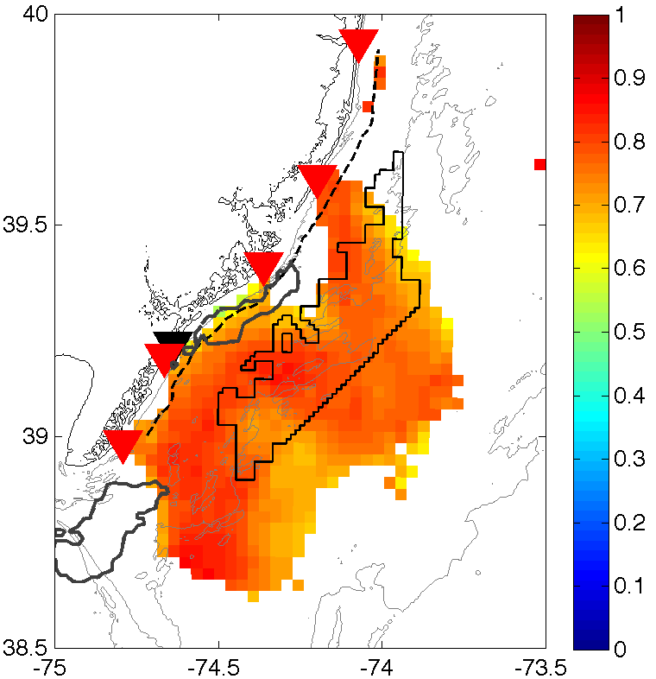
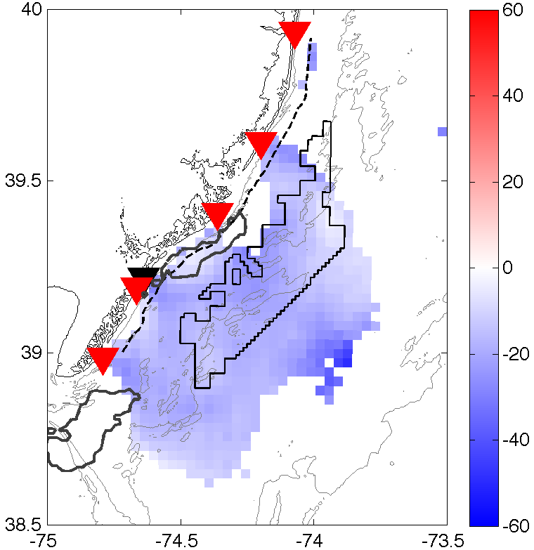
Complex Correlation:
HF radar-derived surface winds vs. RU-WRF 10m winds
Upwelling: 8-15 Sep
Magnitude
Angle Offset
Notes:
-Gray contour is 22C isotherm (upwelling)
-Cross and along-shelf gradient:
-nearshore low correlation→ upwelling (well mixed water column (Chant et al., 2004)→ uncertain CODAR wind estimates rather than inaccurate RU-WRF
-alongshore banding→ 30km apart, match scale of upwelling center→ alongshore velocity jet along offshore edge of surface front
-Closer examination of surface currents offshore flow alongshore near southern boundary of region, turns sharply offshore just south of upwelling center, turn alongshore farther north→ bias CODAR wind estimates
-will be looked into with future work→ look at average currents over time period as in Kohut et al. (2004), also for non-upwelling case- to see why angle is -20 for upwelling versus +20 for non-upwelling
-look at average CODAR winds and RUWRF winds, first in time to get field of vectors, and then space + time to get one overall vector to see angle rotation

Slide 11
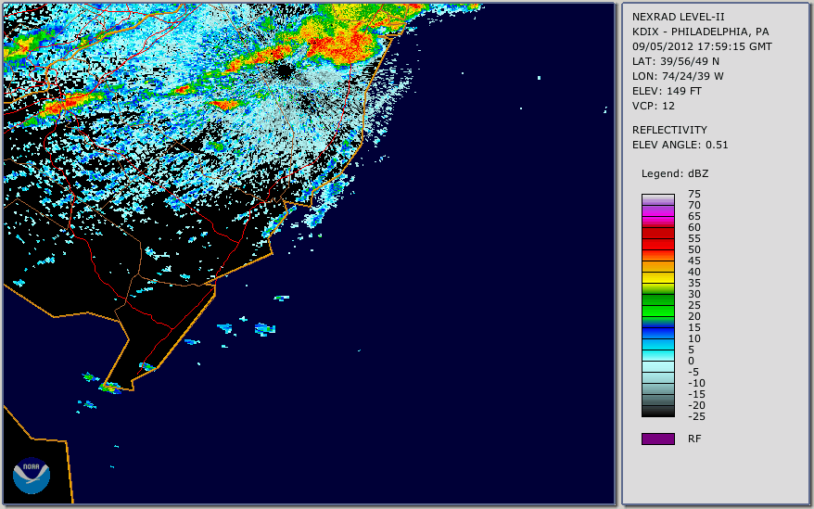
“Feature Tracking”
Focus on non-upwelling case
  Upwelling center could be influencing CODAR wind estimates
Slowly-moving cold front between
1800 GMT on 5 Sep and 0600 GMT on 6 Sep 2012

Slide 12
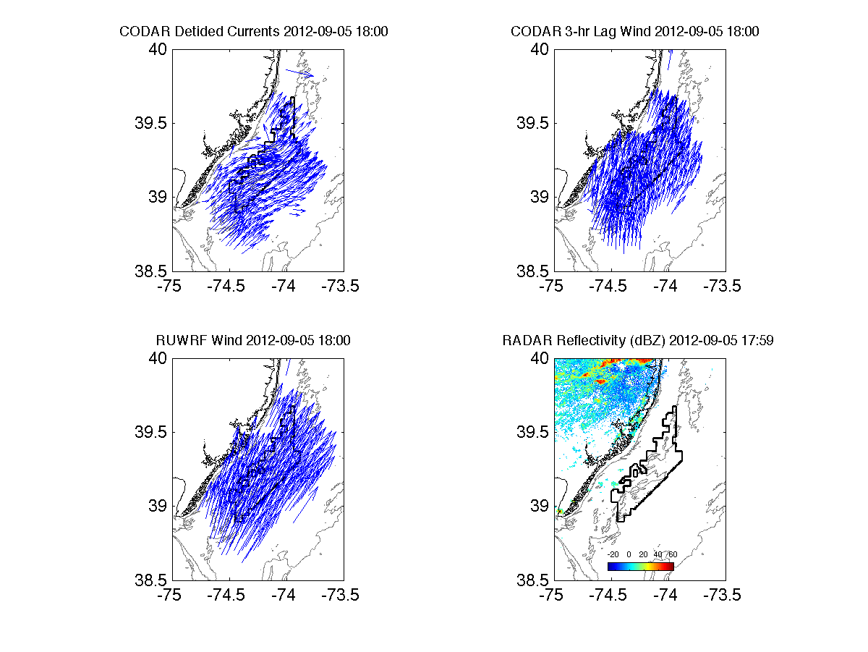
“Feature Tracking”

Slide 13
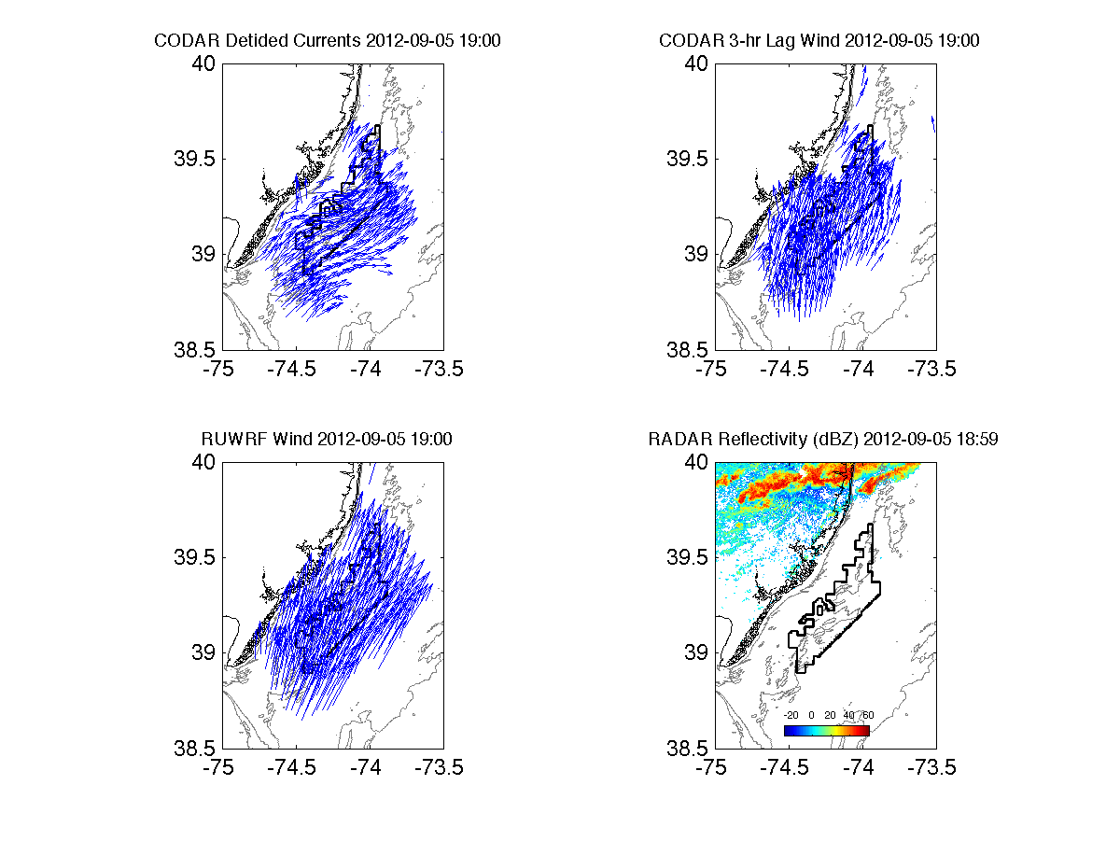
“Feature Tracking”

Slide 14
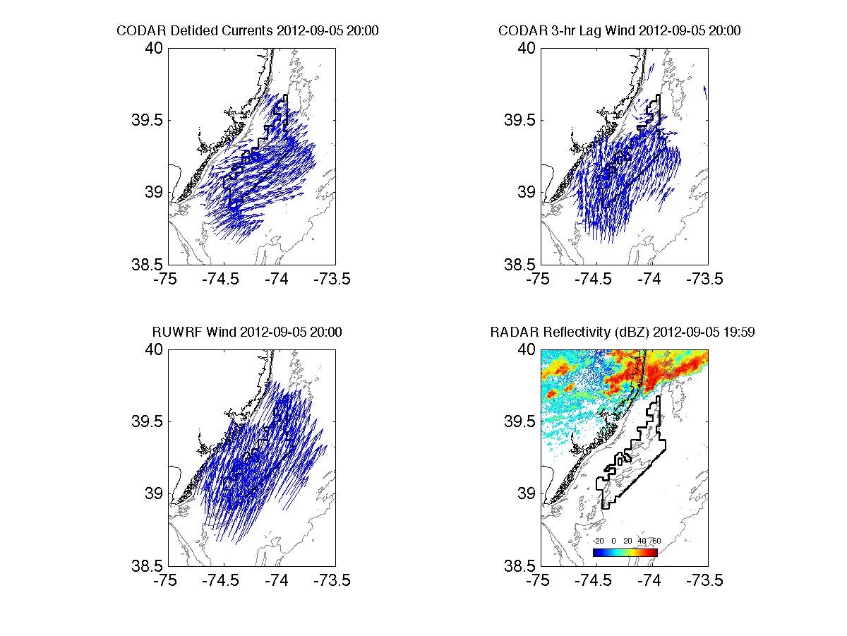
“Feature Tracking”

Slide 15
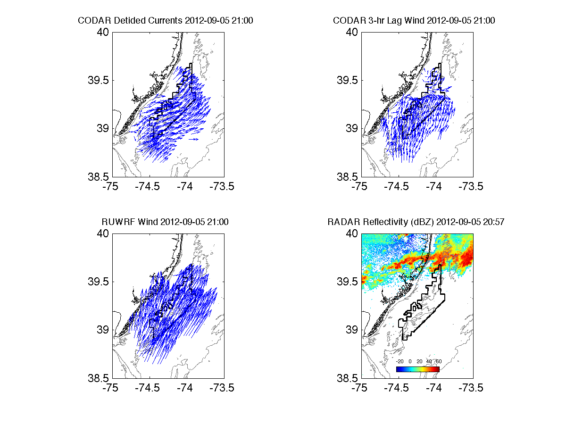
“Feature Tracking”

Slide 16
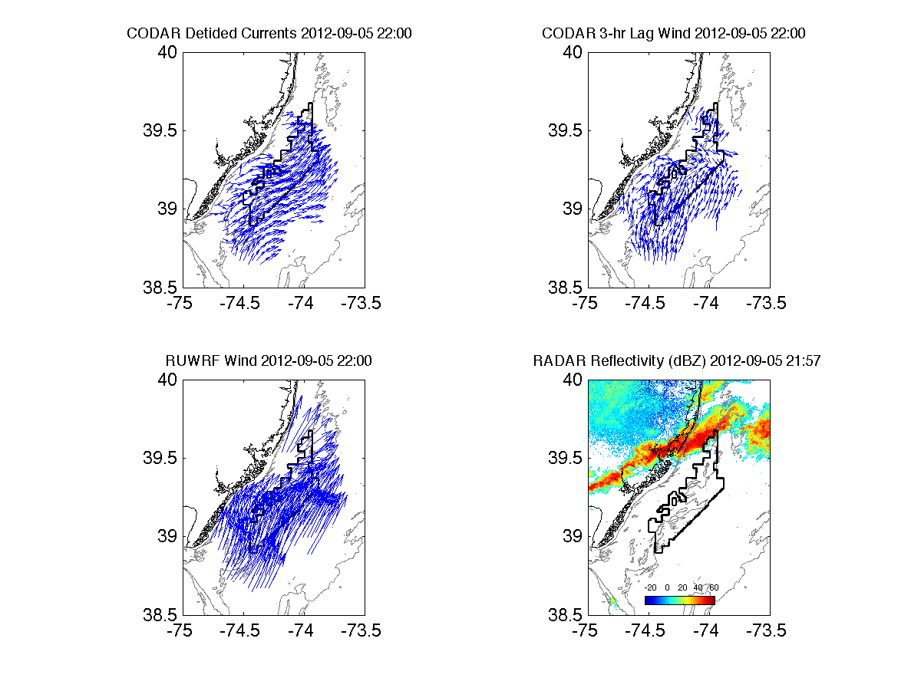
“Feature Tracking”

Slide 17
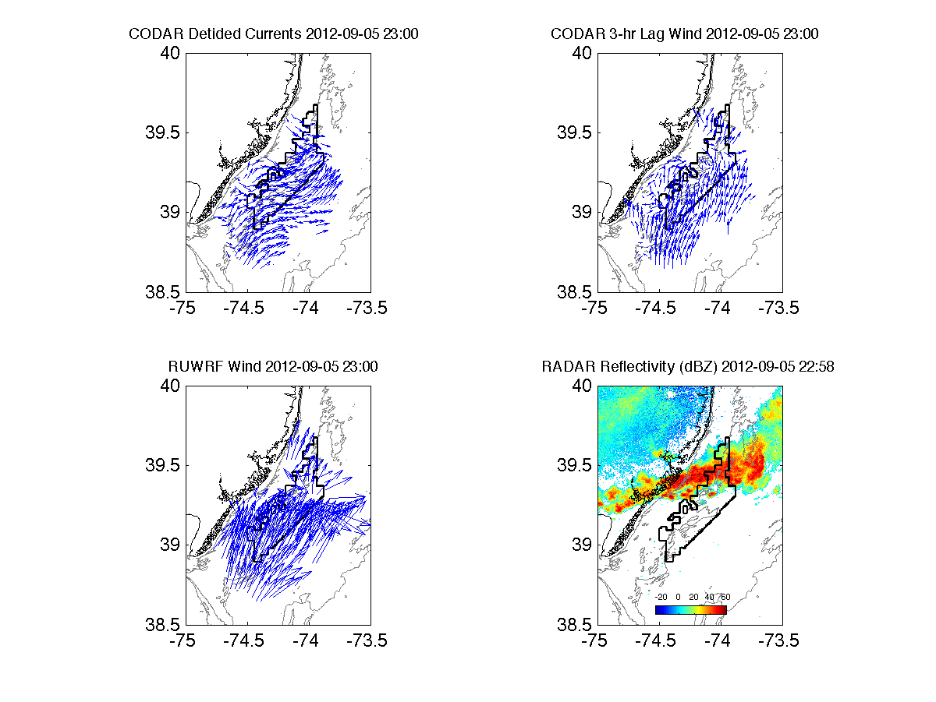
“Feature Tracking”

Slide 18
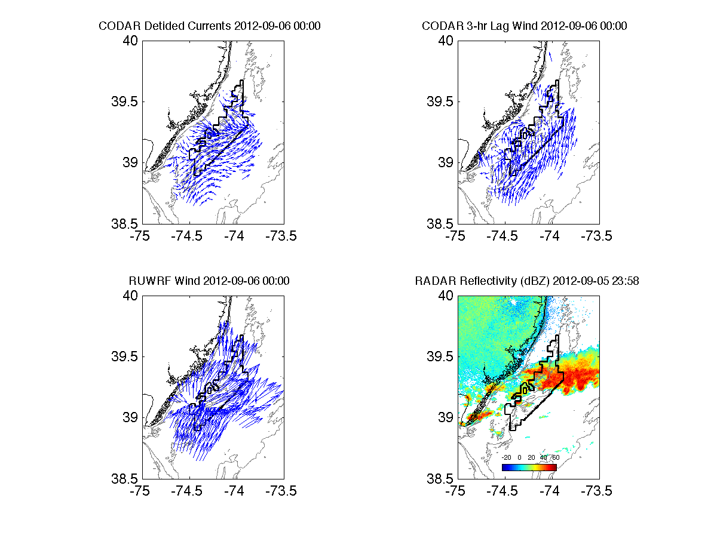
“Feature Tracking”

Slide 19
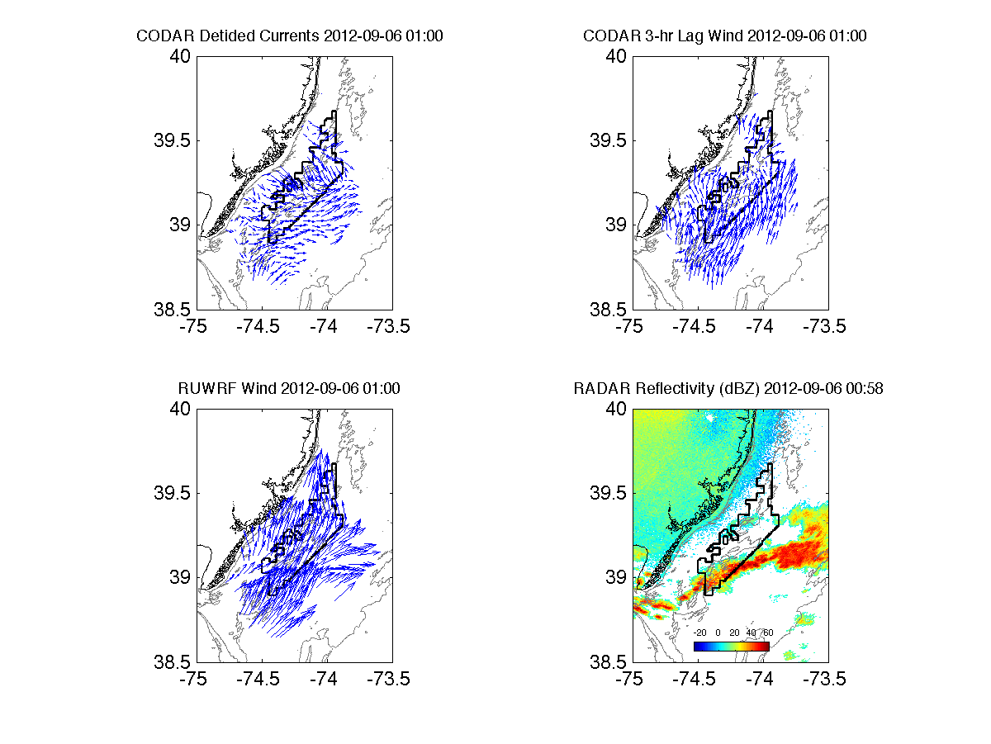
“Feature Tracking”

Slide 20
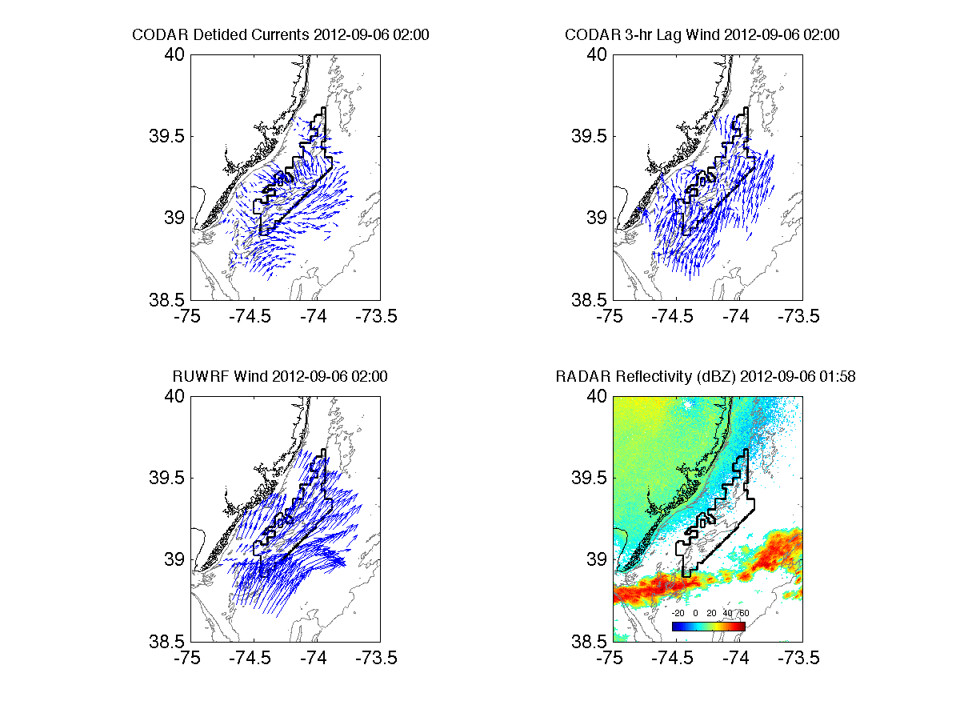
“Feature Tracking”

Slide 21
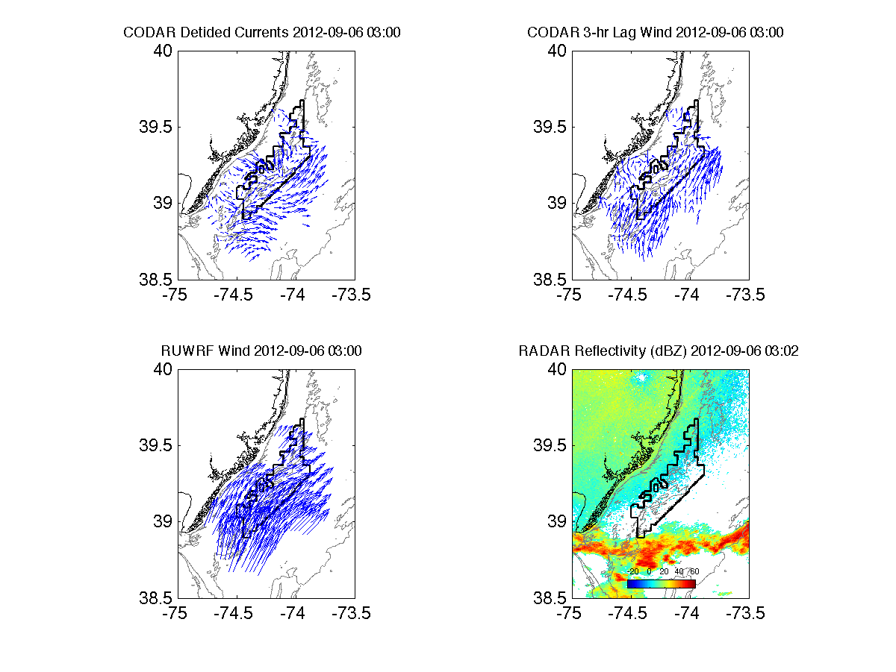
“Feature Tracking”

Slide 22
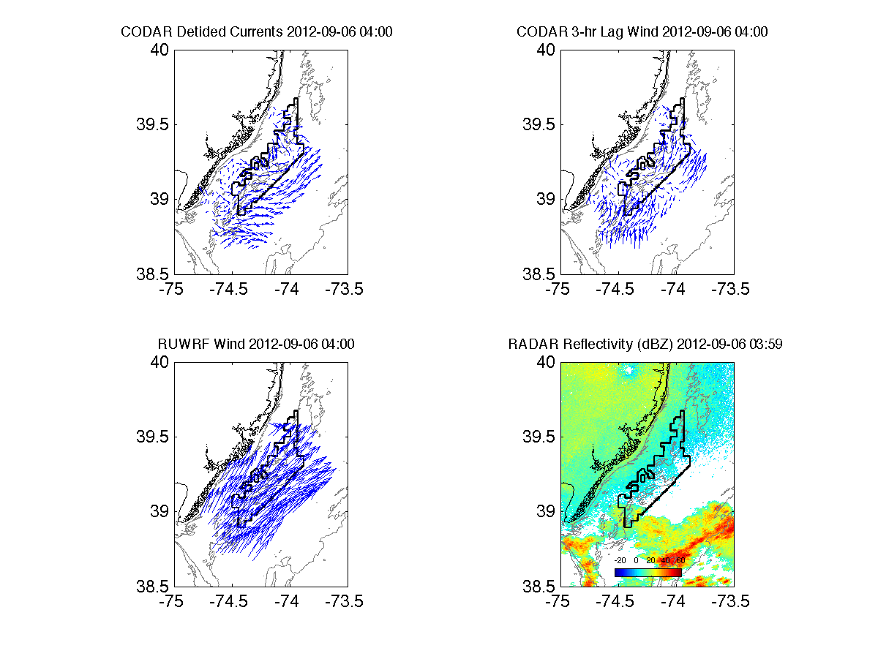
“Feature Tracking”

Slide 23
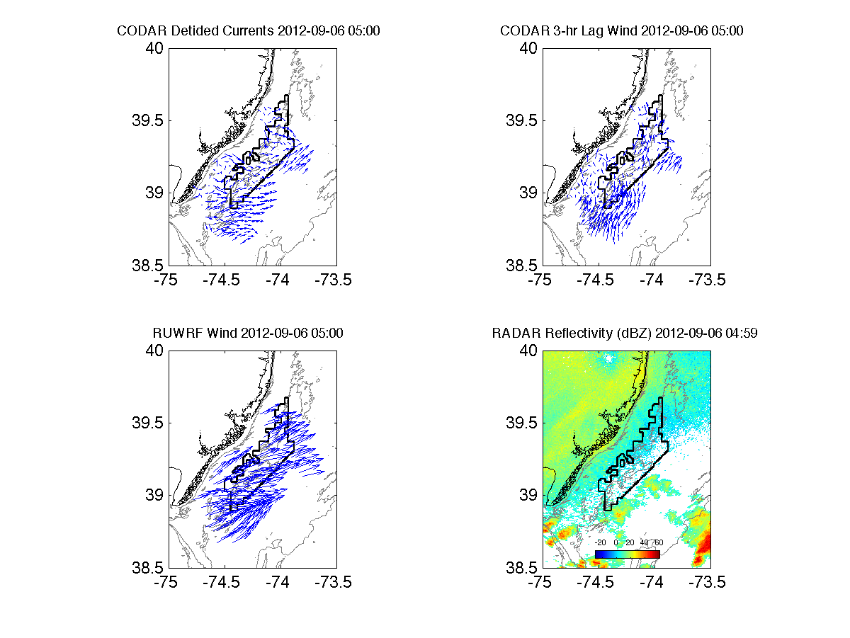
“Feature Tracking”

Slide 24
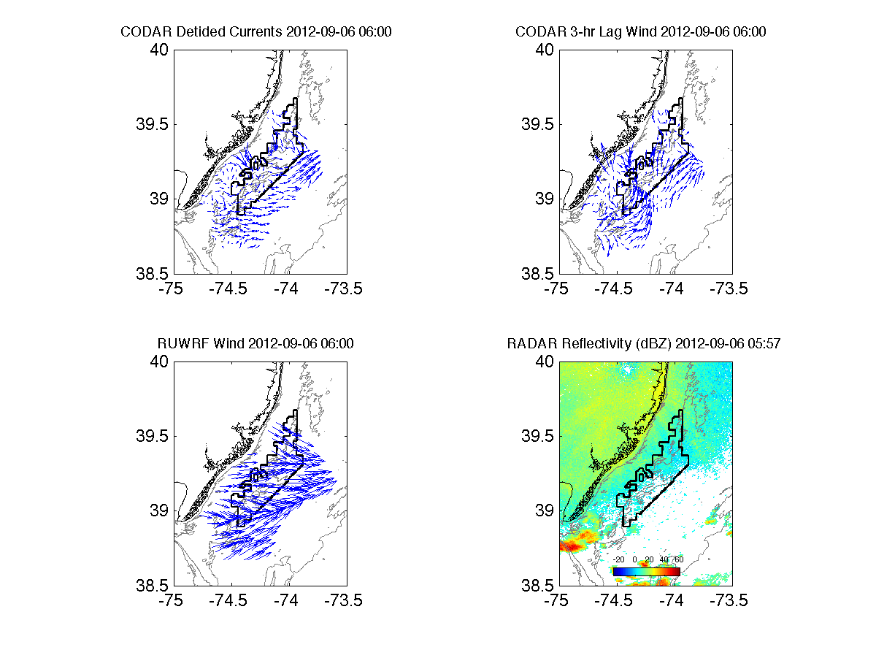
“Feature Tracking”

Slide 25
Conclusions
Existing annual average offshore wind resource maps fail to represent variability
CODAR can be used to help spatially evaluate numerical modeling of offshore winds, incl. variability
Good correlation (0.6-0.8) between CODAR estimated surface winds and RUWRF modeled 10m winds
Excellent correlation displayed over t’storm case, providing confidence in RUWRF’s performance offshore
Scanning LiDAR is the future: spatial offshore winds at hub height (~100m)

Slide 26
References
Beardsley, R. C., and D. B. Haidvogel (1981), Model studies of wind driven transient circulation in the Middle Atlantic Bight, part 1: Adiabatic boundary conditions, J. Phys. Oceanogr., 11, 355 – 375.
Beardsley, R. C., W. C. Boicourt, and D. V. Hansen (1976), Physical oceanography of the Middle Atlantic Bight, Limnol. Oceanogr. Spec. Symp., 2, 20 – 34.
Chant, R. J., S. M. Glenn, and J. T. Kohut (2004), Flow reversals during upwelling conditions on the New Jersey inner shelf J. Geophys. Res., Vol. 109, No. C12, C12S03. 10.1029/2003JC001941.
Chao, Y., Z. Li, J. Kindle, J. Paduan, and F. Chavez (2003), A high-resolution surface vector wind product for coastal oceans: Blending satellite scatterometer measurements with regional mesoscale atmospheric model simulations, Geophys. Res. Lett., 30(1), 1013.
Chapman, R. D., and H. C. Graber (1997), Validation of HF radar measurements, Oceanography, 10, 76 – 79.
Kohut, J. T., S. M. Glenn, and R. J. Chant (2004), Seasonal current variability on the New Jersey inner shelf, J. Geophys. Res., 109, C07S07
Kohut, J., H. Roarty, and S. M. Glenn (2006), Characterizing observed environmental variability with HF Doppler radar surface current mappers and acoustic Doppler current profilers: Environmental variability in the coastal ocean, IEEE J. Oceanic Eng., 31, 876 – 884, doi:10.1109/ JOE.2006.886095.
Michalakes, J., S. Chen, J. Dudhia, L. Hart, J. Klemp, J. Middlecoff, and W. Skamarock (2001), Development of a next-generation regional weather research and forecast model. Developments in Teracomputing, W. Zwieflhafer and N. Kreitz, Eds., World Scientific, 269–296.

Slide 27
Proposed Work
More thorough literature review on thunderstorm downdrafts, outflows and surface ocean response
Additional cases
  26-27 Jul 2012: t’storms, outflow over ocean
  10 Apr 2013: sea breeze afternoon, t’storm outflow evening (ocean unstratified)
Goal: Quantify effectiveness of estimated HF radar winds as spatial model evaluation tool
Notes:
-Lit review to get known physics on this interaction
-Propagation speeds slower in both other cases mentioned

Slide 28
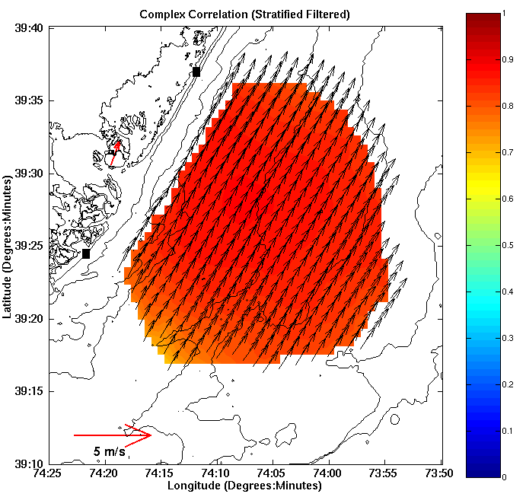
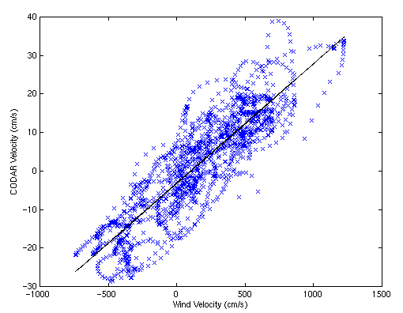
HF Radar Derived Linear Wind Model
Current Transient [U'] (cm/s)
Wind Transient [W'] (cm/s)
Rotate wind vectors according to complex correlation
Calculate the slope and intercept of best fit line
U’(x,y,t) = slope(x,y)*W’_{OC}(t-3)
W’_{grid}(x,y,t-3) = U’(x,y,t)/slope(x,y)

Slide 29
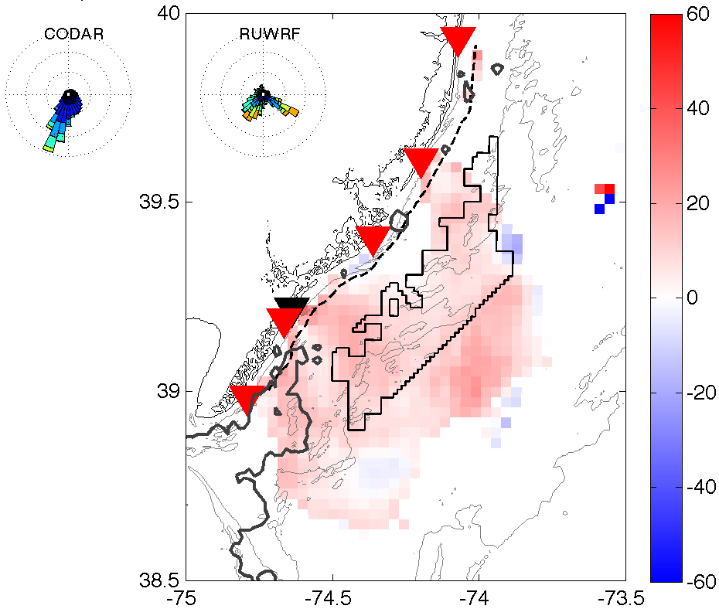
Complex Correlation:
CODAR-derived surface winds vs. RUWRF 10m winds
Non-upwelling: 30 Aug-6 Sep
Angle Offset
Notes:
-Limit comparison to grid points with >=0.6 correlation between CODAR currents and OC winds
-Angle offset values between 0 and 20 degrees, most correlated RU-WRF model wind vector shifted to right of CODAR wind estimate
-Gray contour is 24C isotherm (no upwelling)

Slide 30
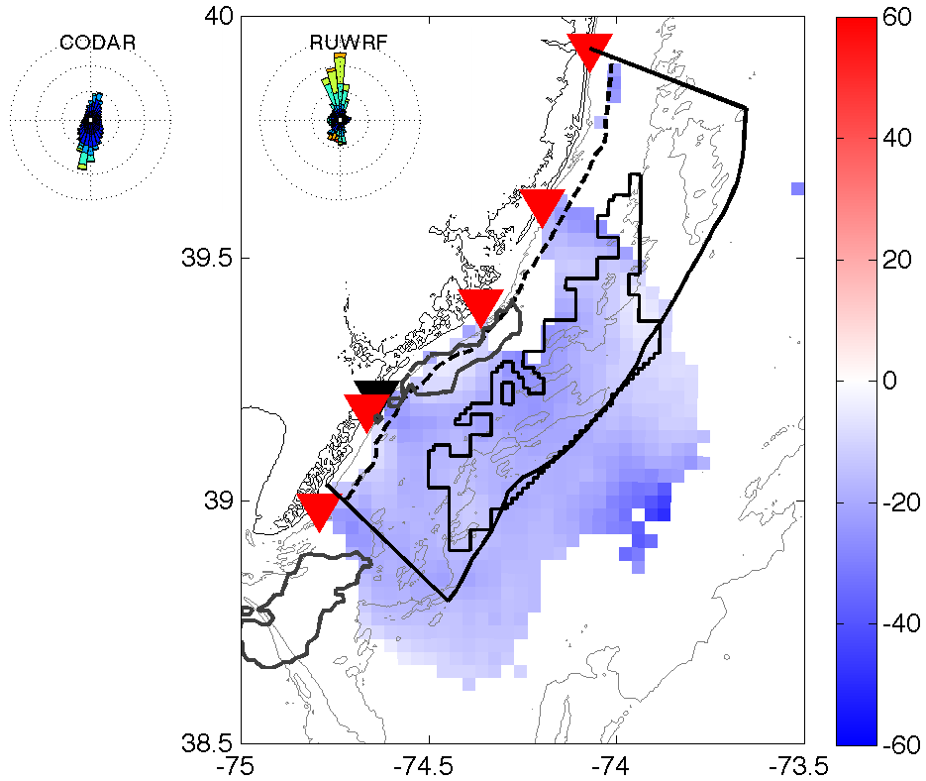
Complex Correlation:
CODAR-derived surface winds vs. RUWRF 10m winds
Upwelling: 8-15 Sep
Angle Offset
Notes:
-Limit comparison to grid points with >=0.6 correlation between CODAR currents and OC winds
-Angle offset values between 0 and 20 degrees, most correlated RU-WRF model wind vector shifted to right of CODAR wind estimate
-Gray contour is 24C isotherm (no upwelling)

Slide 31
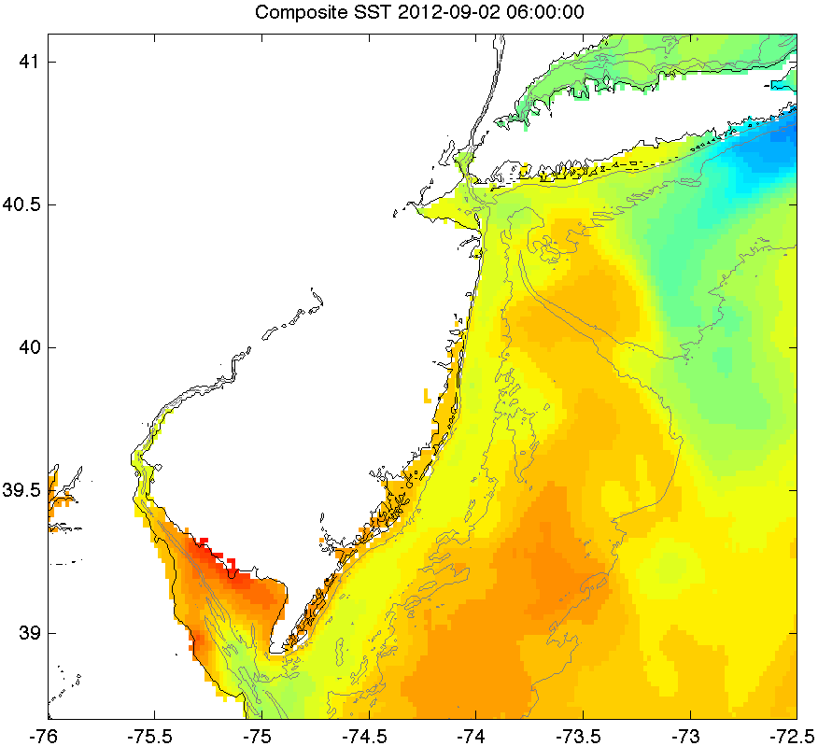
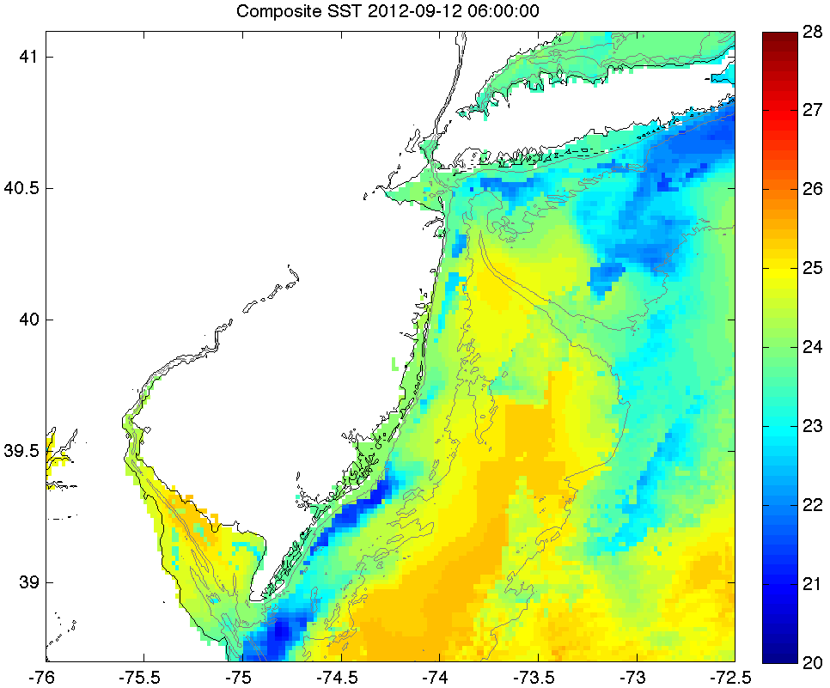
12 Sep 2012: Upwelling
RUCOOL SST Zoomed In
2 Sep 2012: Non-upwelling

Slide 32
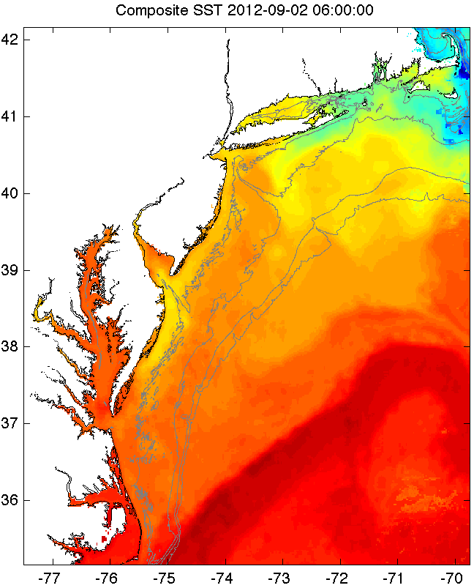
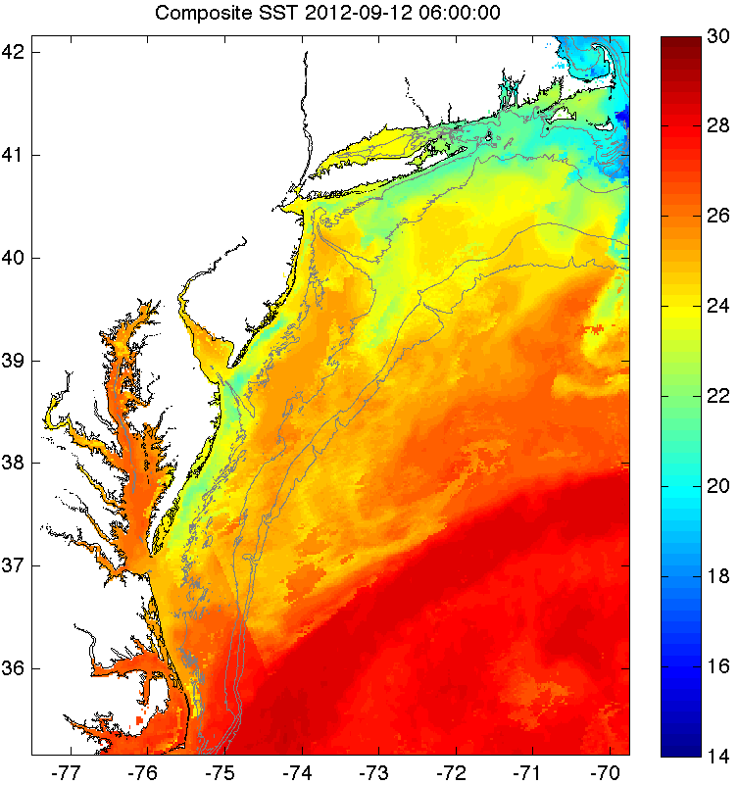
12 Sep 2012: Upwelling
RUCOOL SST
2 Sep 2012: Non-upwelling

Slide 33
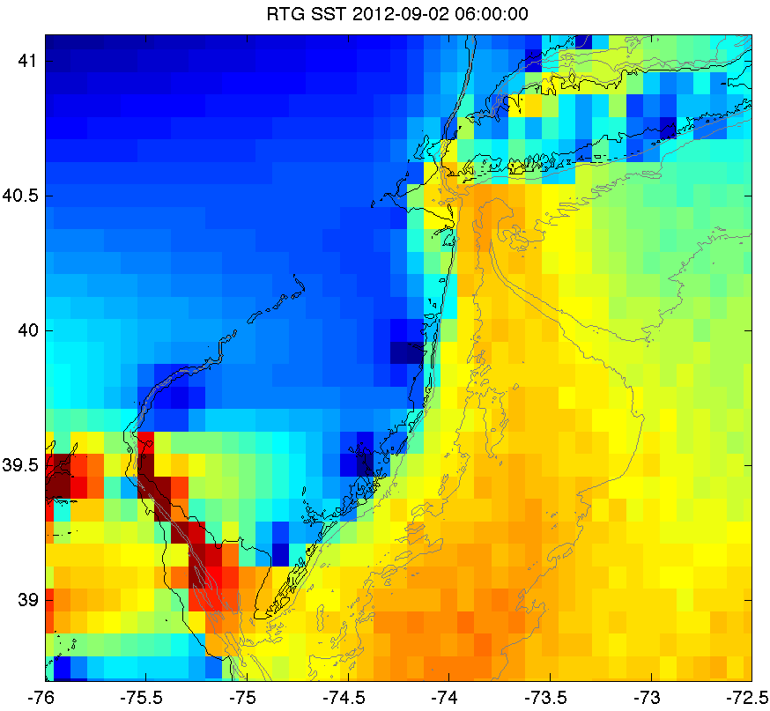
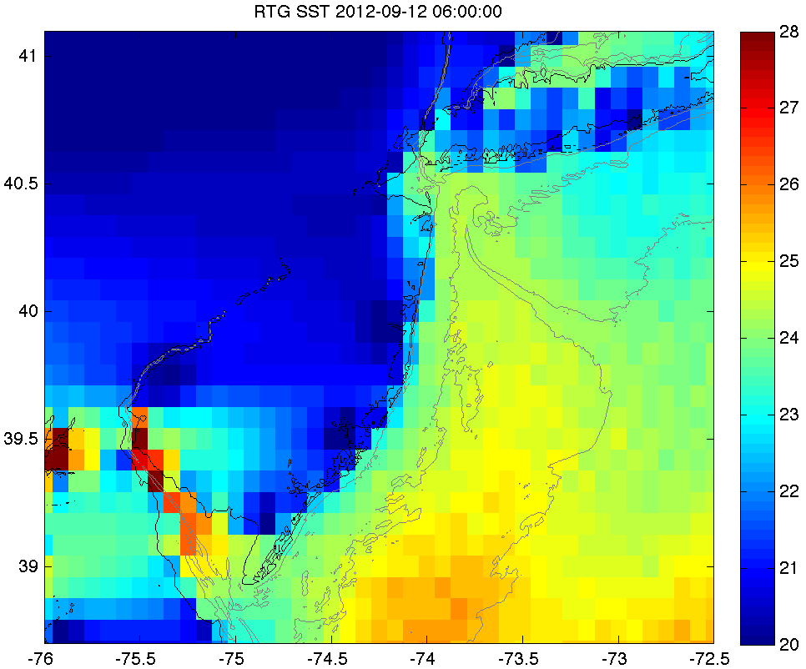
12 Sep 2012: Upwelling
RTG SST Zoomed In
2 Sep 2012: Non-upwelling

Slide 34
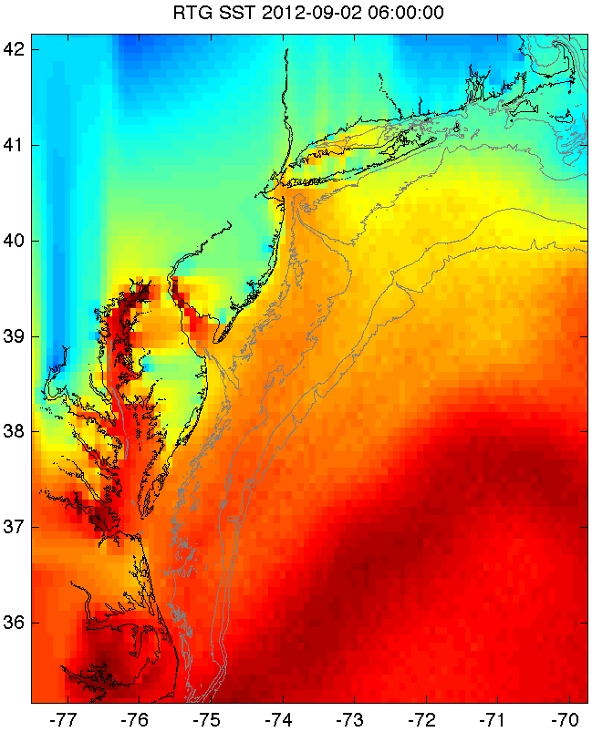
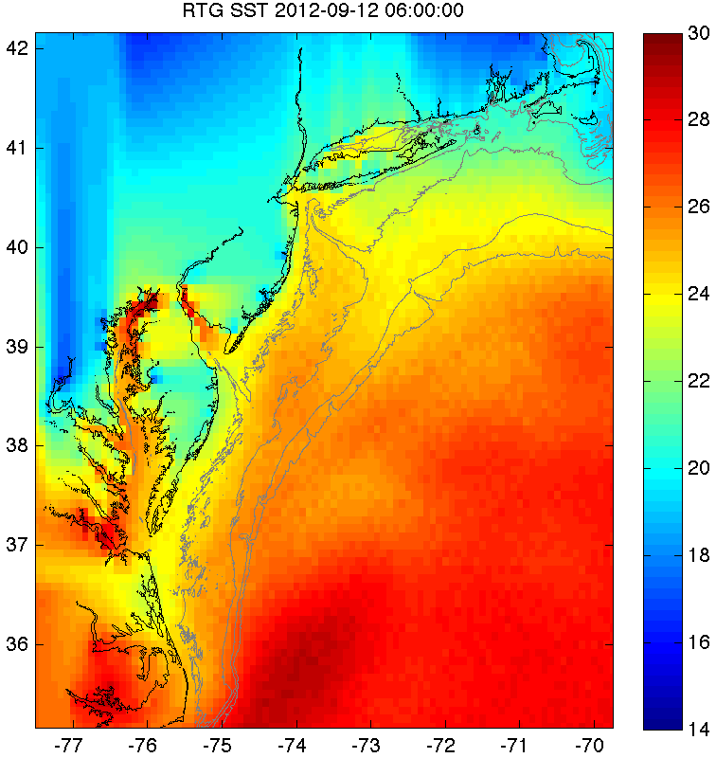
RTG SST
2 Sep 2012: Non-upwelling
12 Sep 2012: Upwelling

