Slide 1
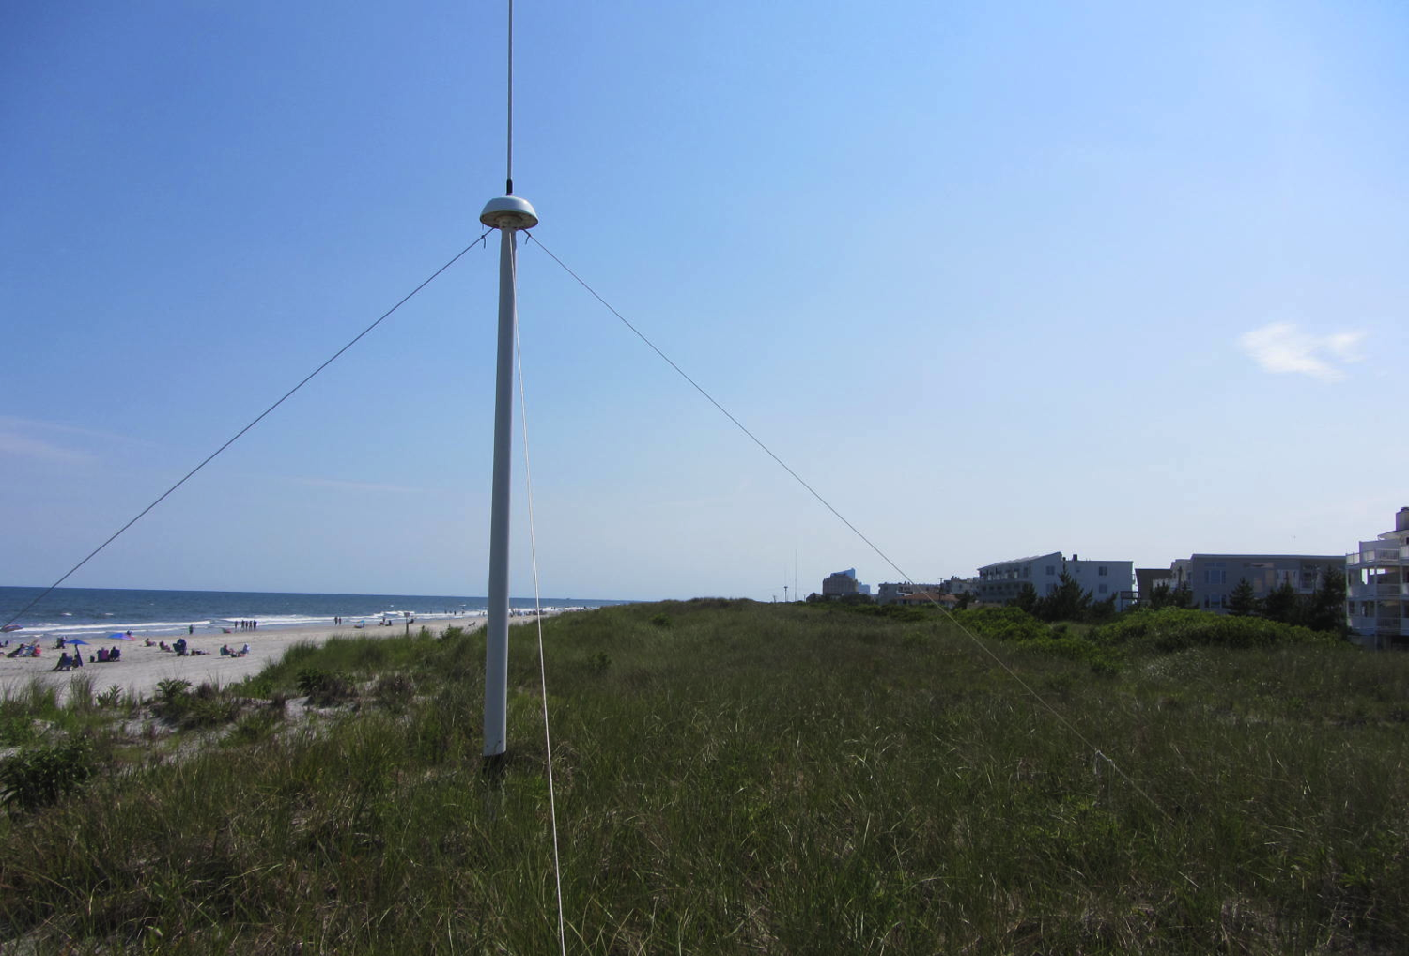


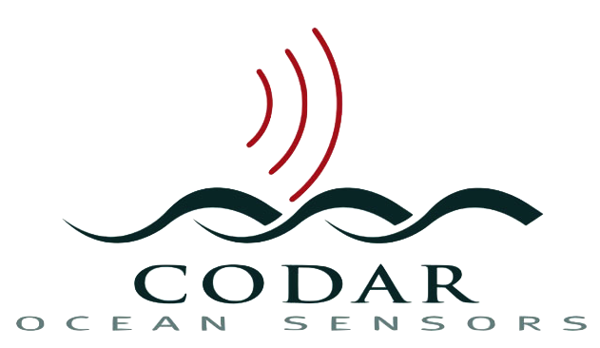



Monostatic Vessel Detection from the CODAR SeaSonde
Collin Dobson, Kristen Holenstein, Michael Smith, Hugh Roarty, Scott Glenn
Chad Whelan, Donald E. Barrick, James Issacson

Slide 2
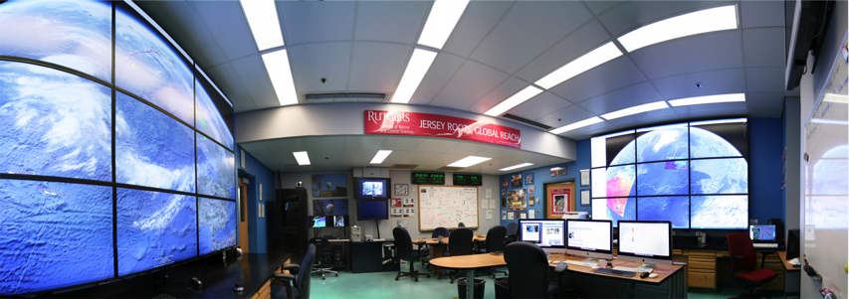

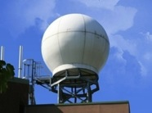
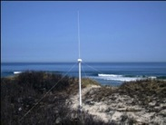
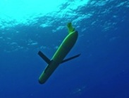
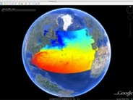
Rutgers University - Coastal Ocean Observation Lab
Operations, Research & Education Center
Vessels -
Satellite
Satellite
CODAR
Ships/ Vessels
Glider
REMUS
Data Vis.
Modeling
Security
Leadership
Education
Satellite Data Acquisition Stations
CODAR Network
Glider Fleet
3-D Forecasts

Slide 3
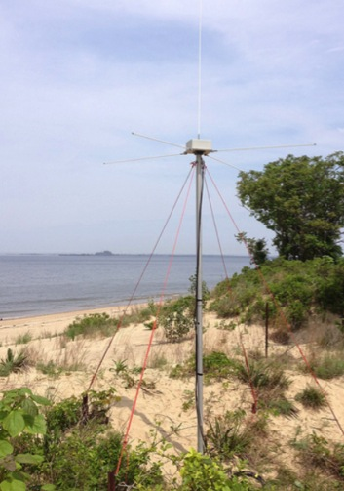
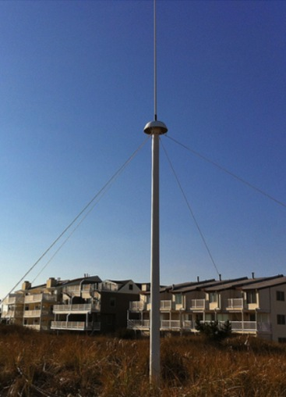
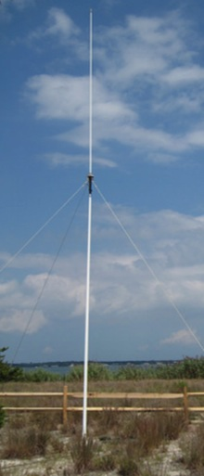
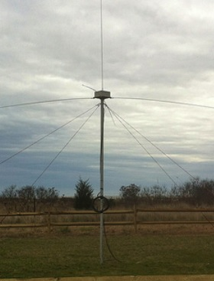
CODAR Compact HF Radar Antennas
25 MHz
13 MHz
5 MHz
Combined Transmitter & Receiver
Separate Transmitter & Receiver

Slide 4
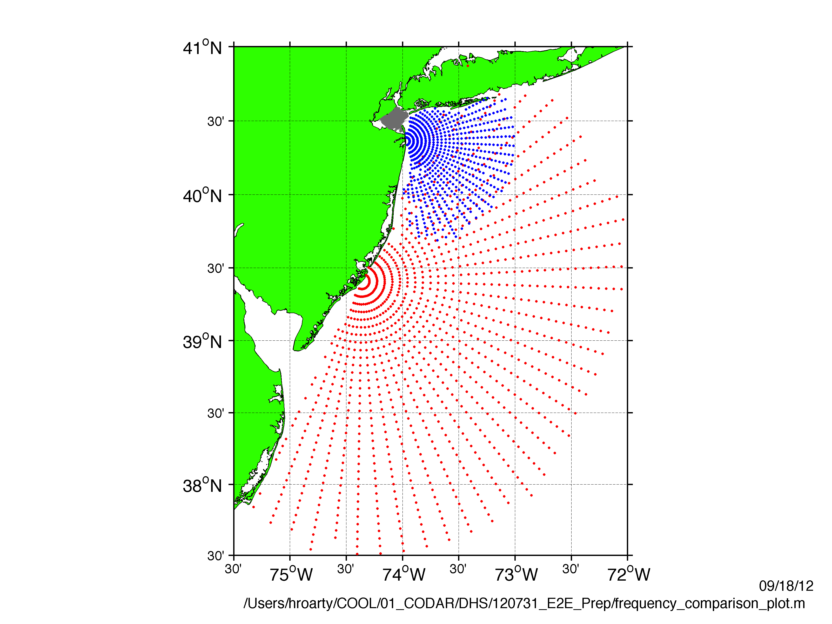
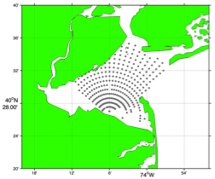
Surface Current Mapping Capability
25 MHz
Radar λ: 12 m Ocean λ: 6 m
Range: 30 km Resolution: 1 km
13 MHz
Radar λ: 23 m Ocean λ: 12 m
Range: 80 km Resolution: 3 km
05 MHz
Radar λ: 60m Ocean λ: 30 m
Range: 180 km Resolution: 6 km

Slide 5
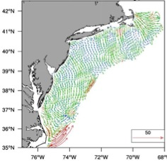
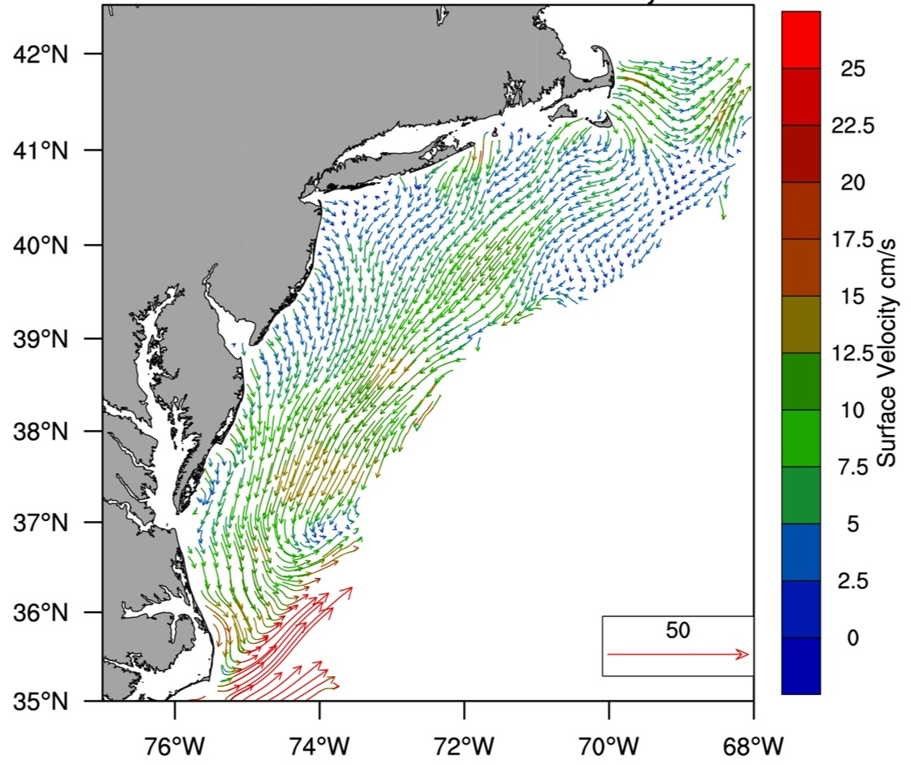
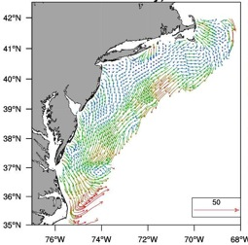
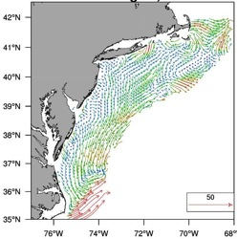
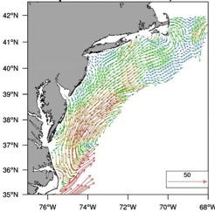
MARACOOS Annual Mean Surface Currents (2009)
Winter
Spring
Summer
Fall

Slide 6
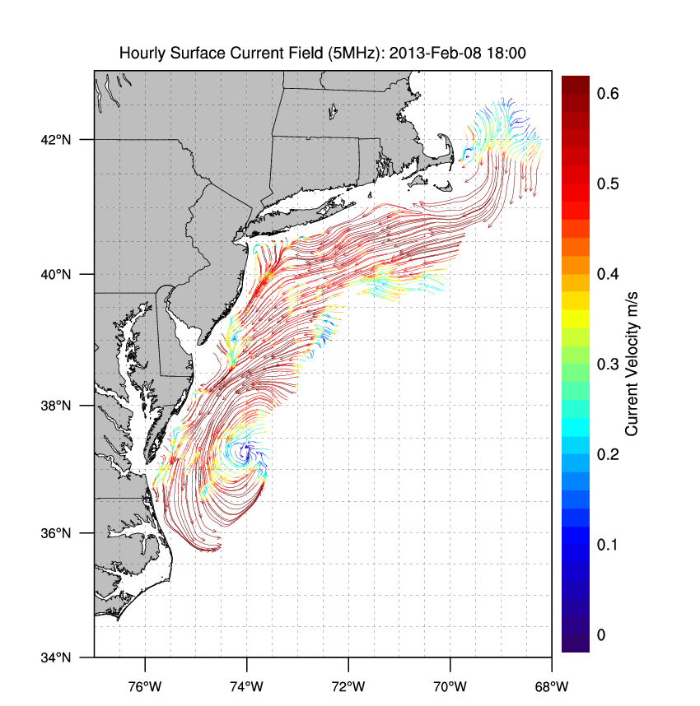
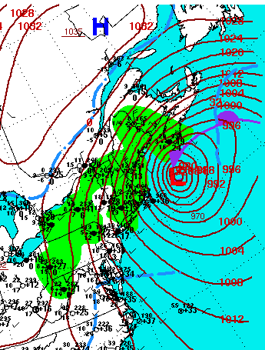

Winter Storm Nemo
February 8, 2013
February 9, 2013

Slide 7
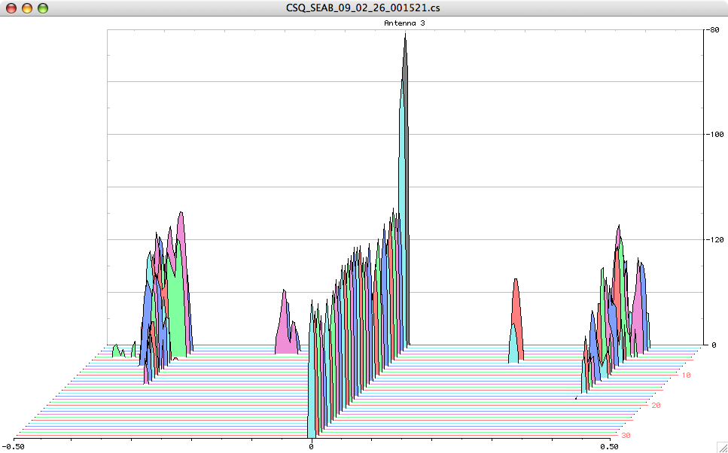
Doppler Spectra from all Range Cells
with Detection Threshold Applied
Fixed Objects & Direct Signals
Bragg Waves
Bragg Waves
Vessel
Vessel
Range
Doppler Frequency

Slide 8
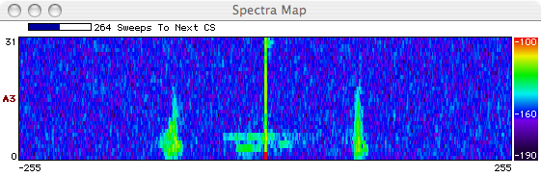
Ships Crossing in the Night

Slide 9
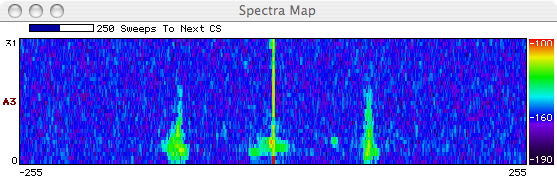

Slide 10
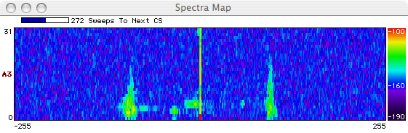

Slide 11


Slide 12
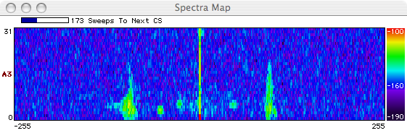

Slide 13
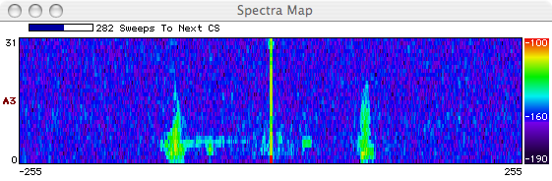

Slide 14
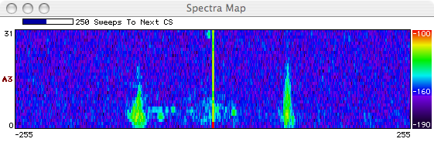

Slide 15
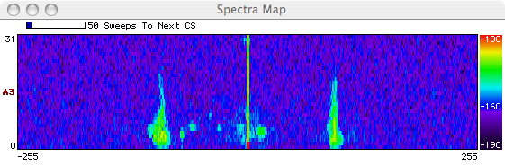

Slide 16
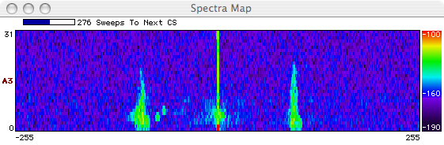

Slide 17
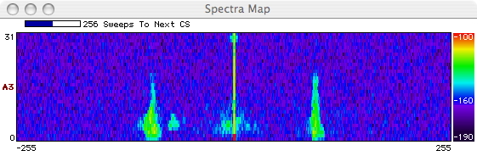

Slide 18
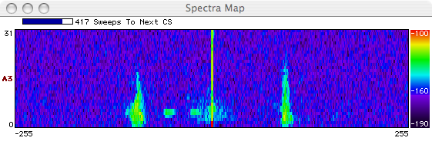

Slide 19
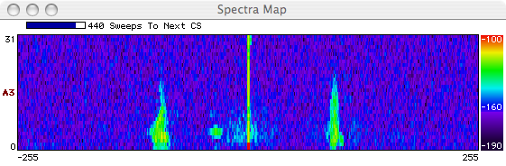

Slide 20
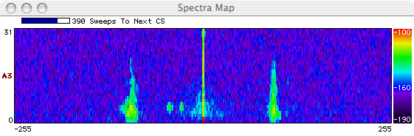

Slide 21
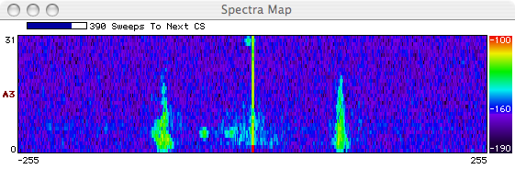

Slide 22
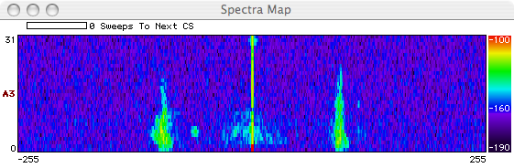

Slide 23
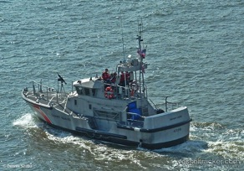
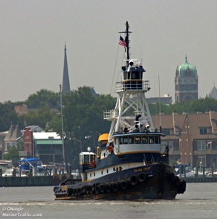
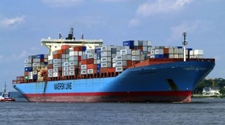
Vessel Detection Capability
Vessel Height Determines Detection
25 MHz
Range: 20 km
Height >10 ft
13 MHz
Range: 60 km
Height: >19 ft
05 MHz
Range: 130 km
Height: >49 ft

Slide 24
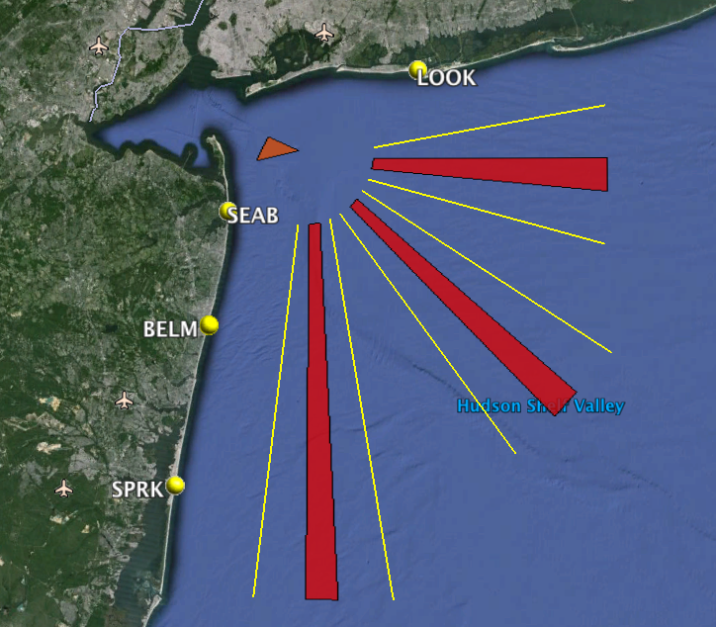

Monostatic Detections

Slide 25
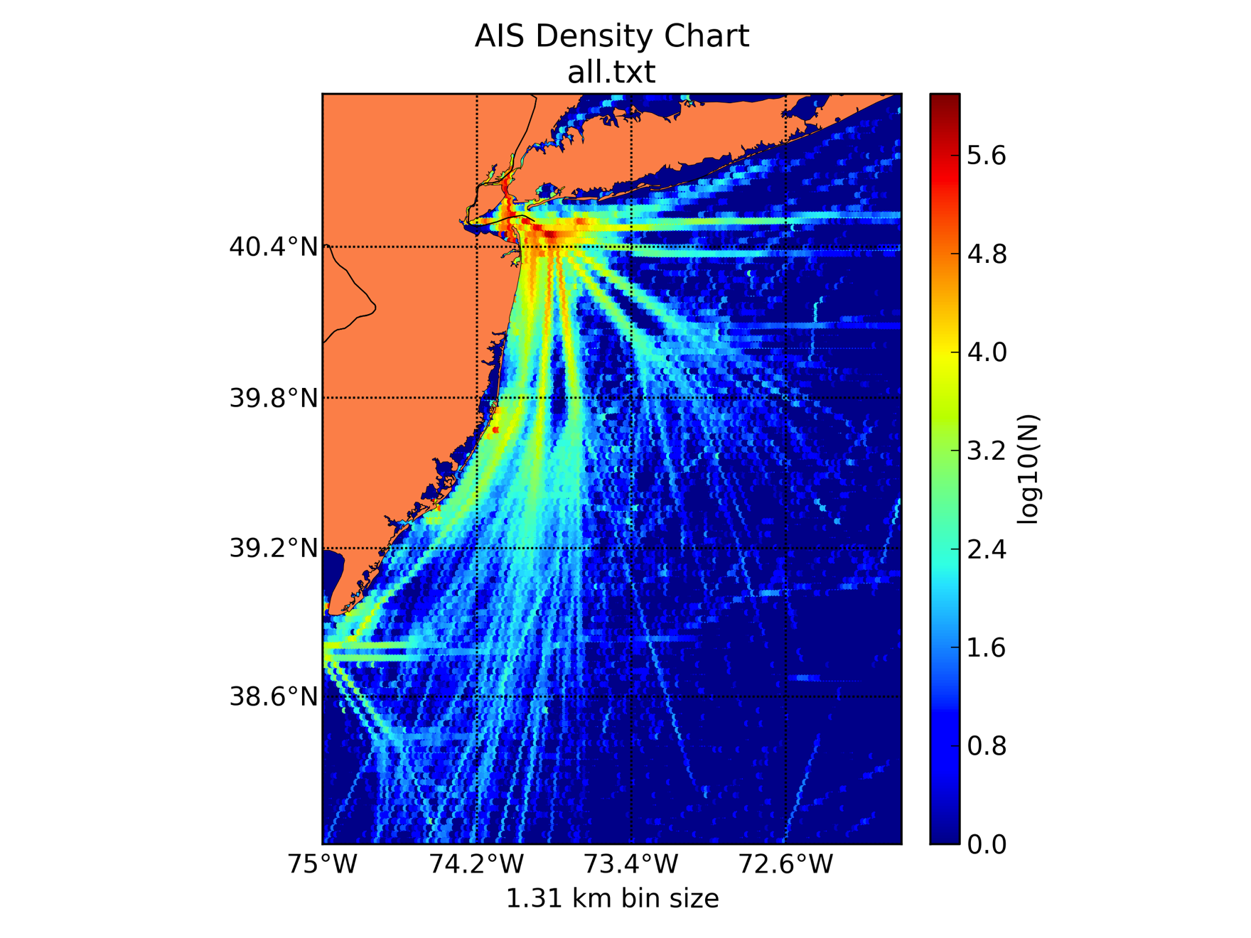
July 2011 to June 2012
Automatic Identification System (AIS) Heat Map
100,000
10,000
1,000
100
10

Slide 26
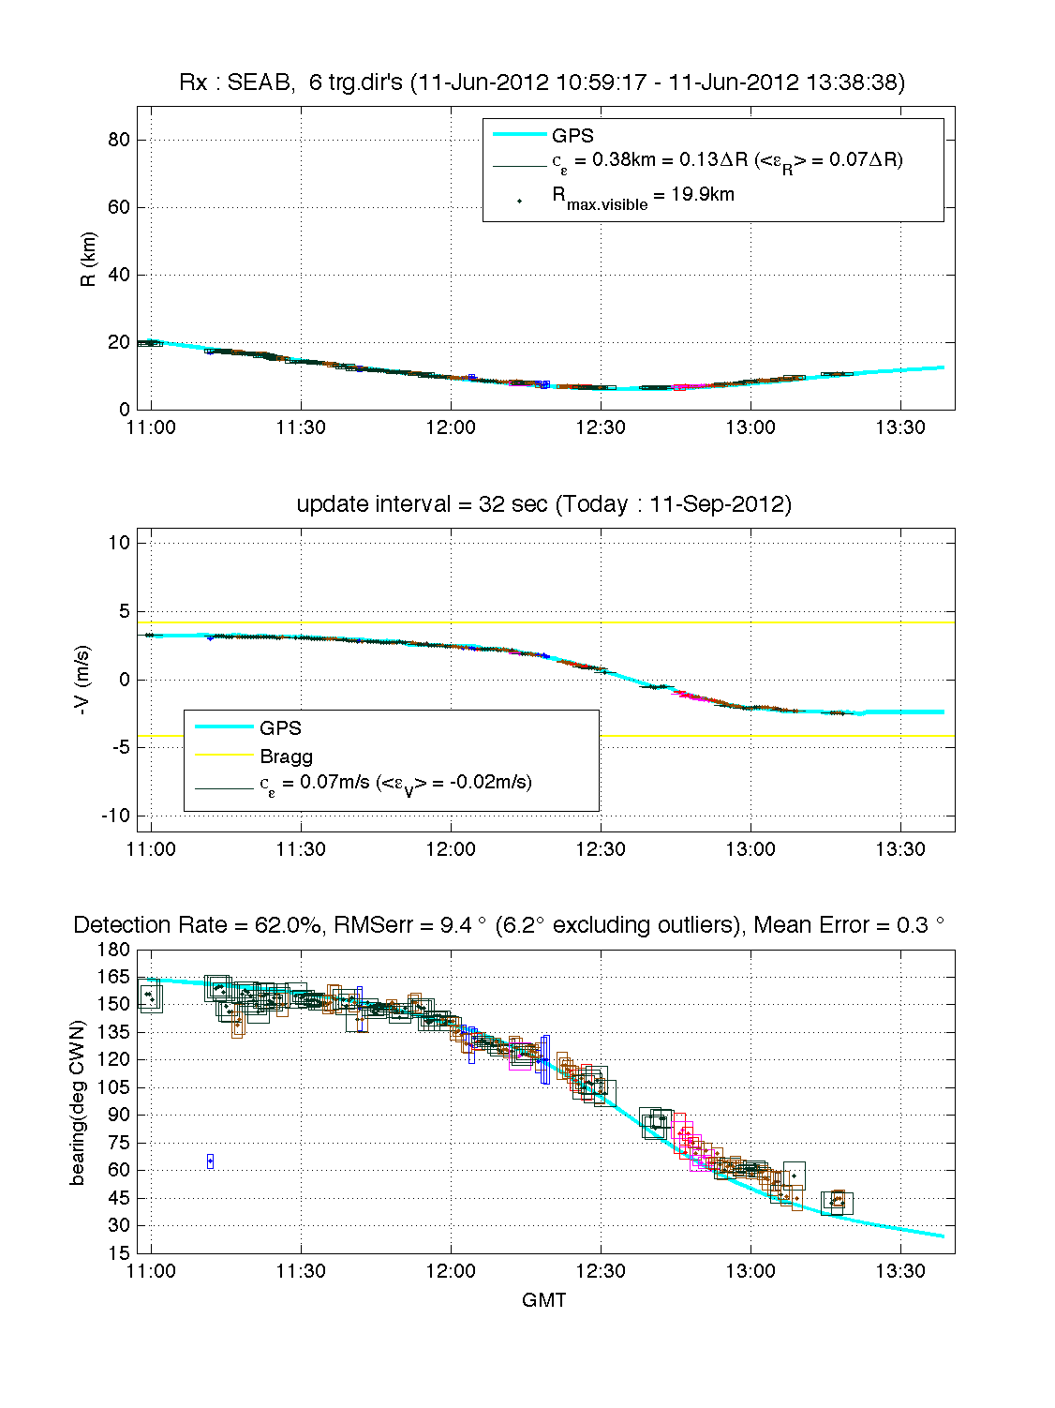
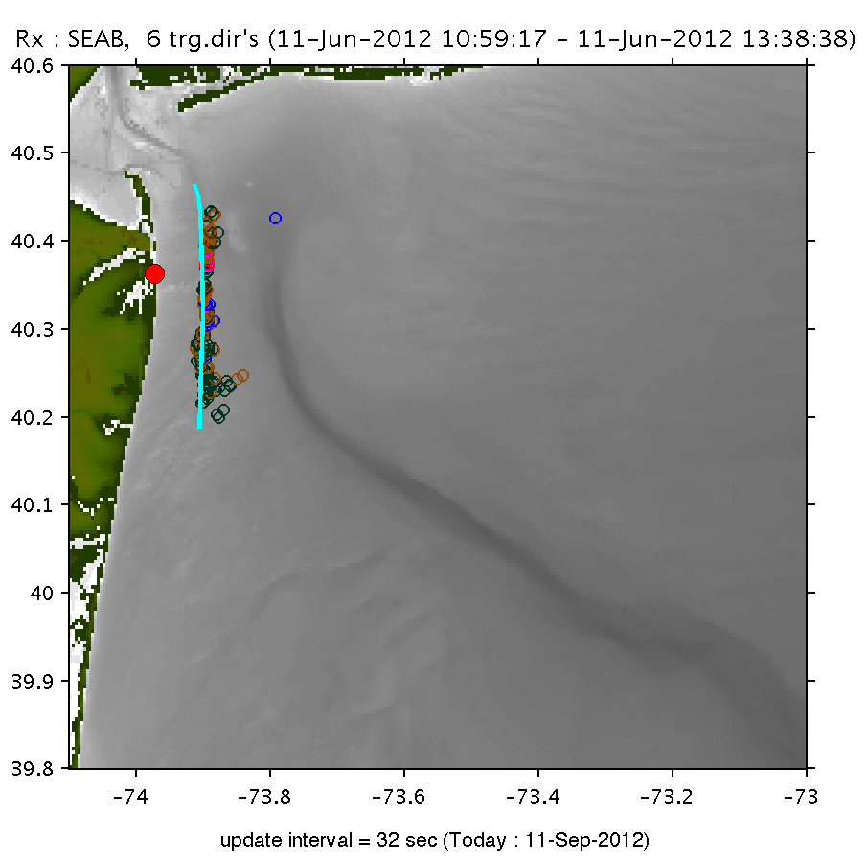
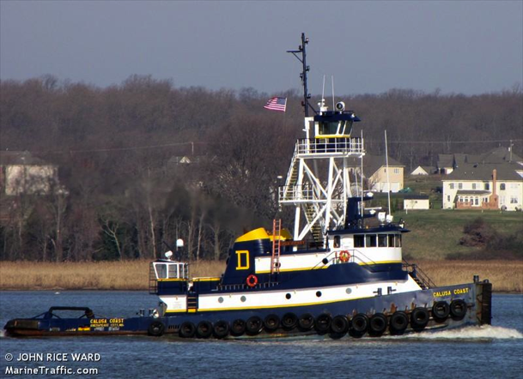
Calusa Coast

Slide 27
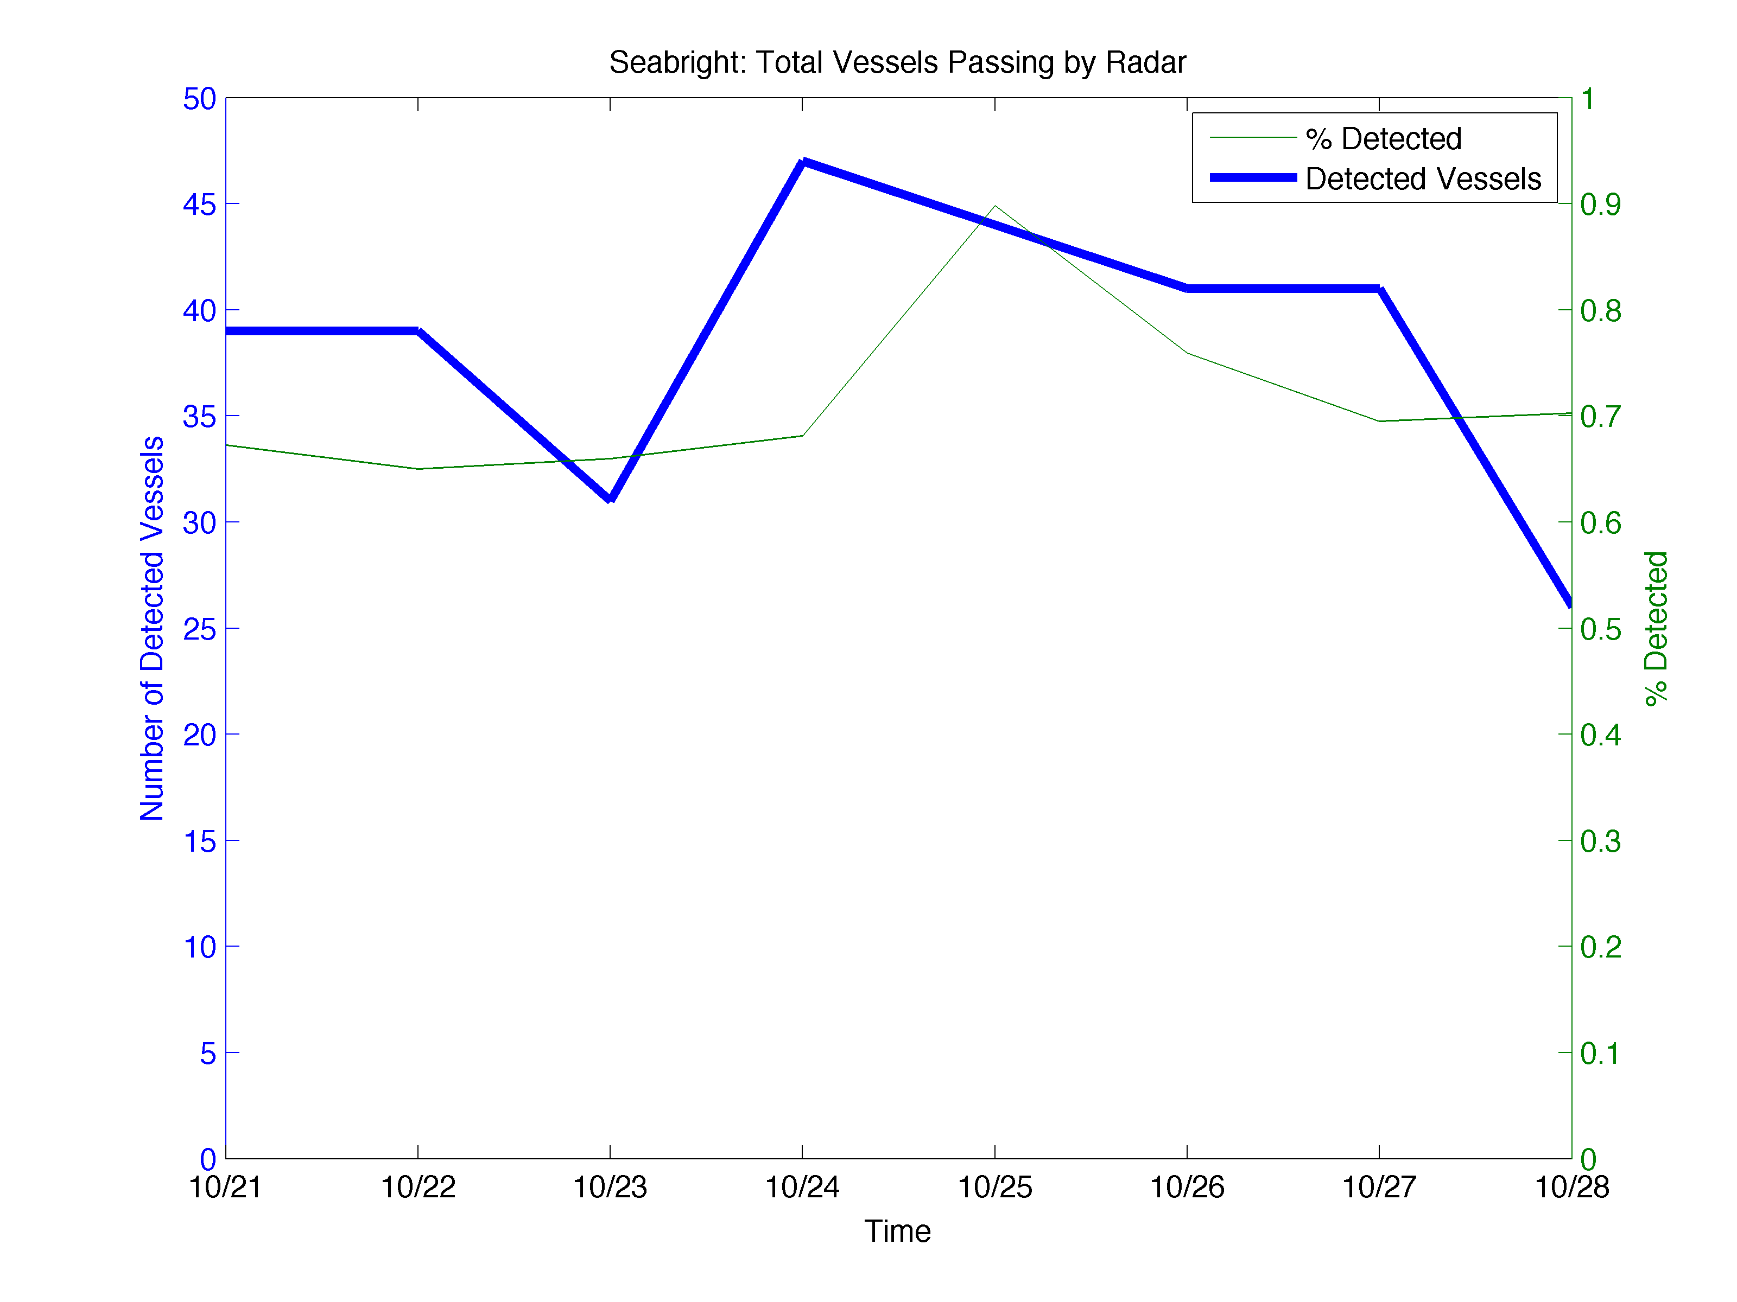
Sea Bright – 308 Vessels Detected

Slide 28
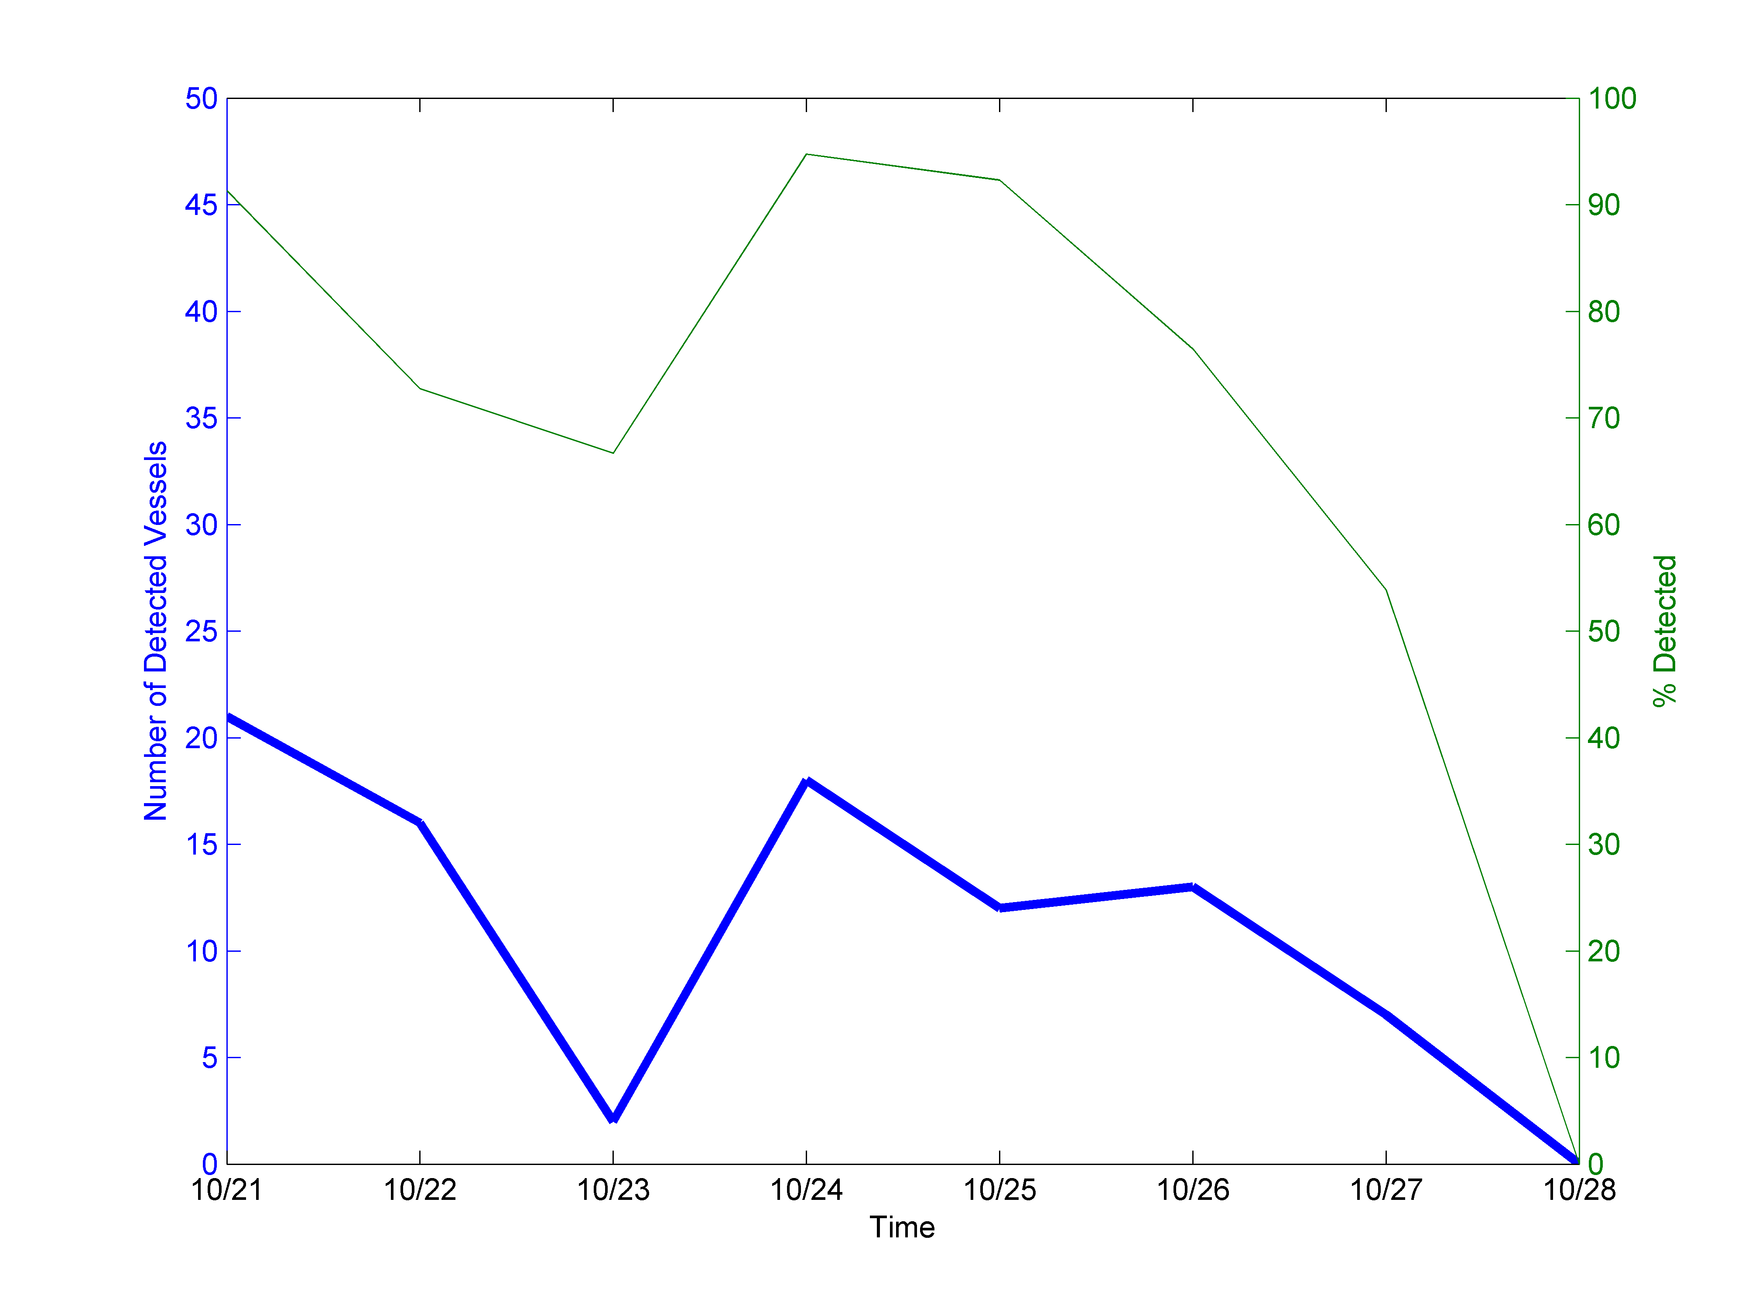
Seaside Park – 89 Vessels Detected

Slide 29
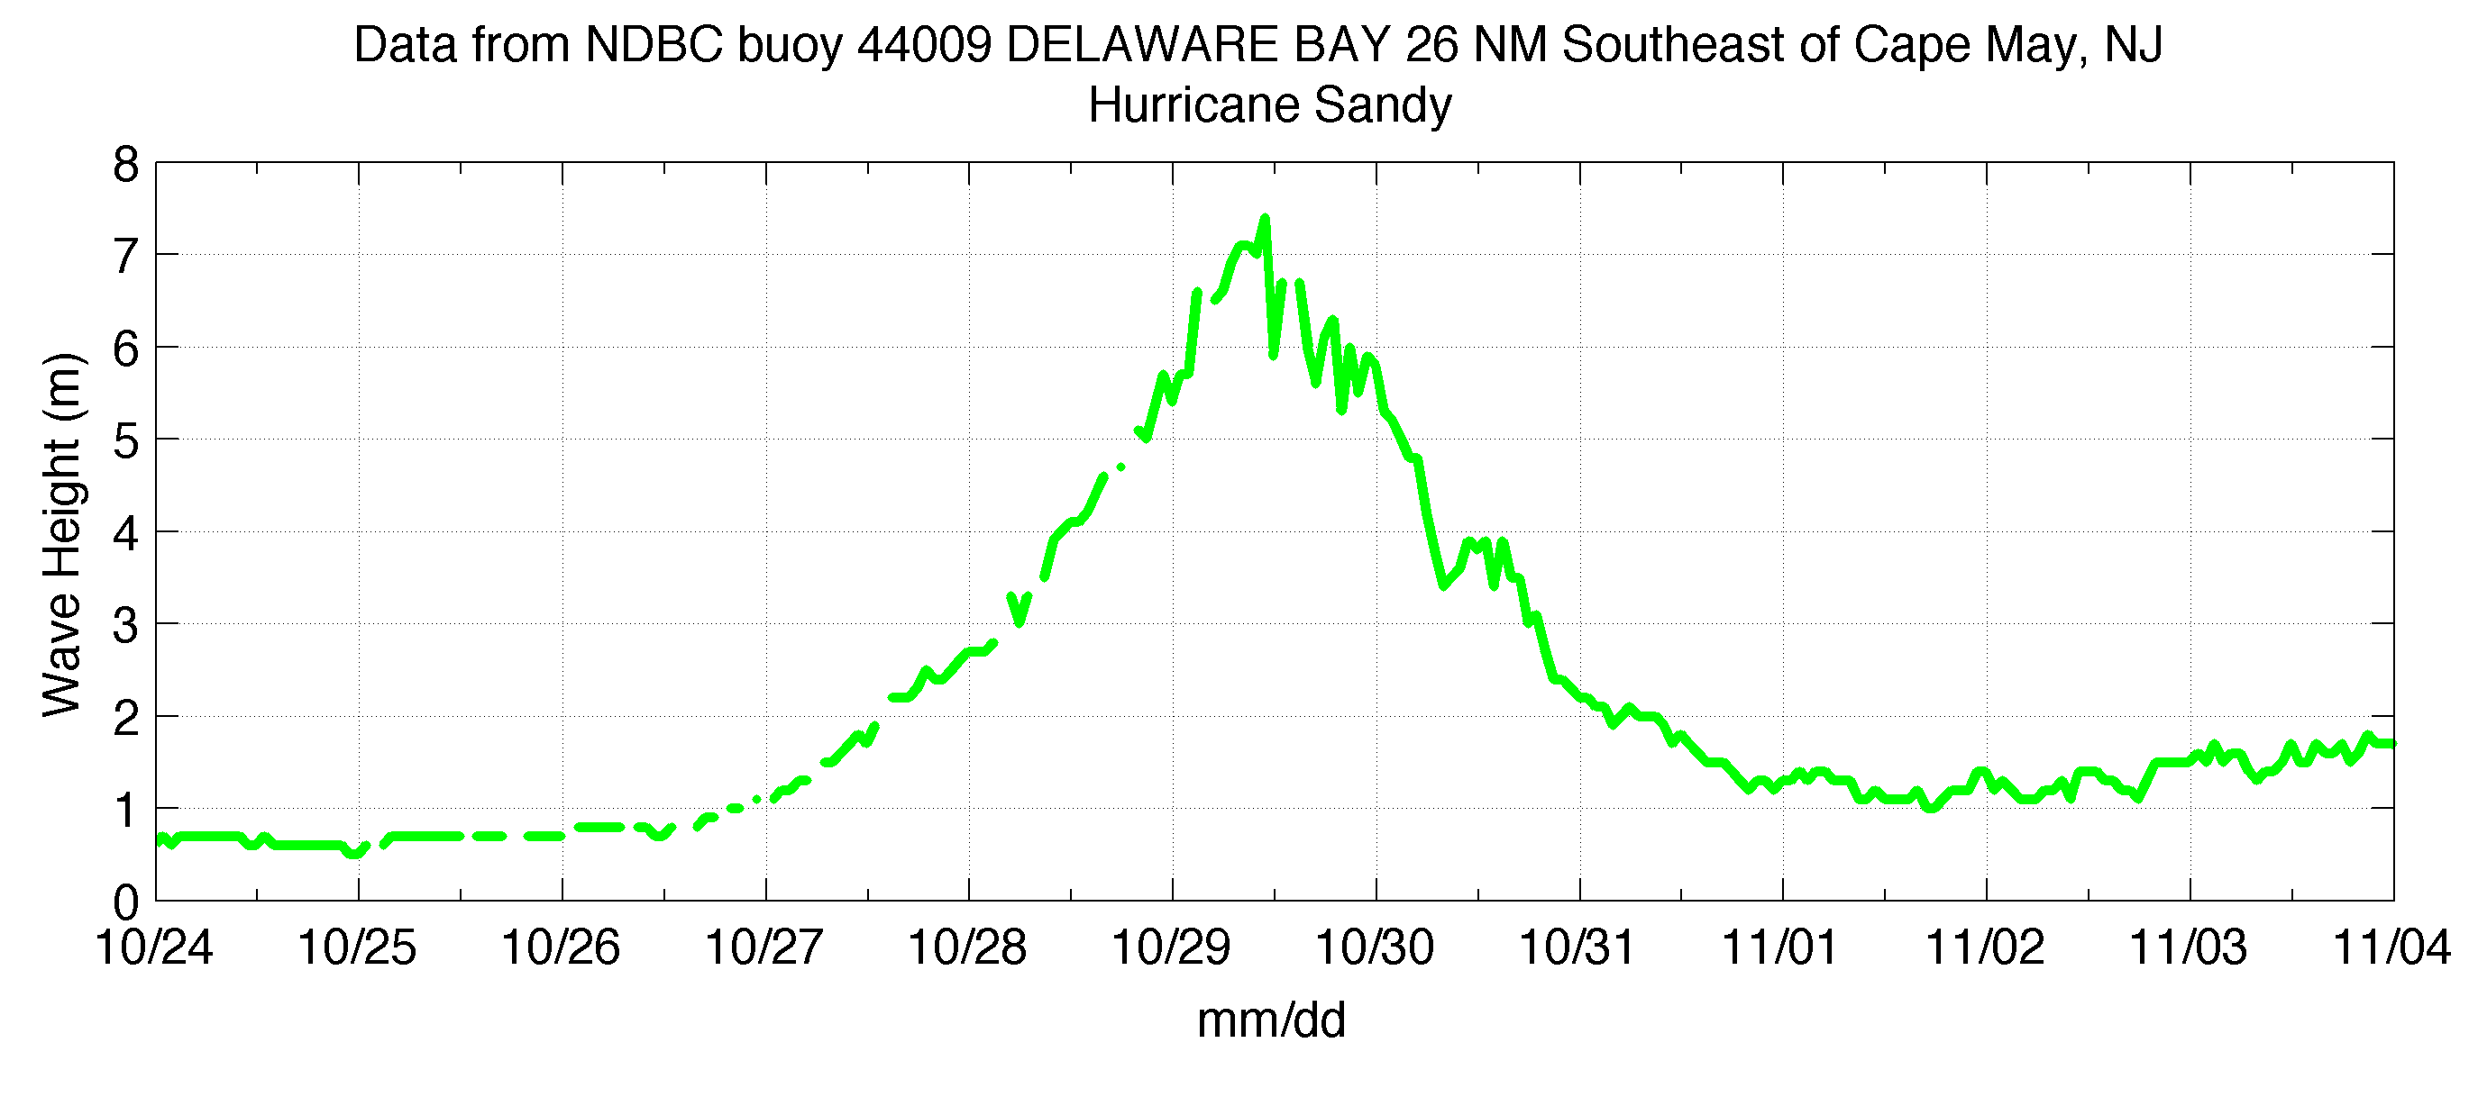
Hurricane Sandy Approaching

Slide 30
Vessels Detected by Radar with No Corresponding AIS
Date | Sea Bright | Seaside Park
10/21/12 | 6 | 1
10/22/12 | 10 | 10
10/23/12 | 6 | 6
10/24/12 | 9 | 3
10/25/12 | 5 | 7
10/26/12 | 8 | 8
10/27/12 | 4 | 11
10/28/12 | 3 | 0
Average | 6.4 | 5.8

Slide 31
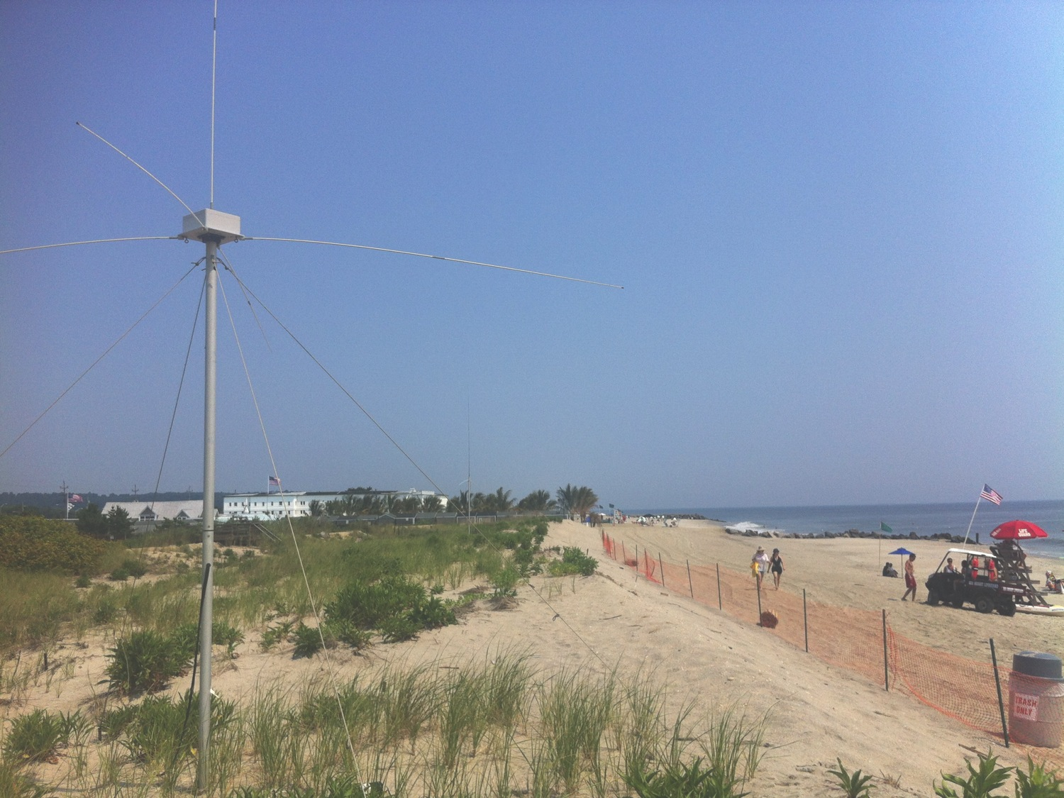
Conclusions
Compact SeaSonde radars are consistently detecting vessels outside New York Harbor
20% of vessels detected not transmitting AIS

