Slide 1


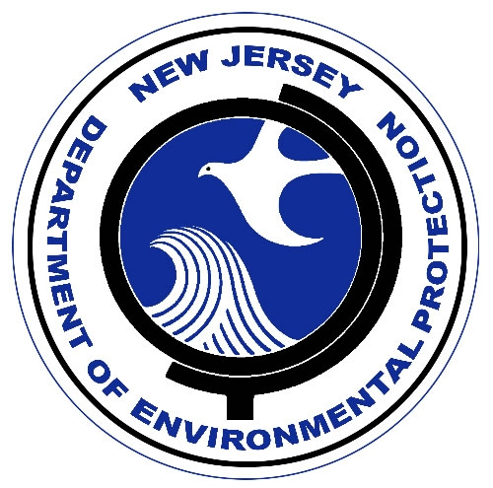
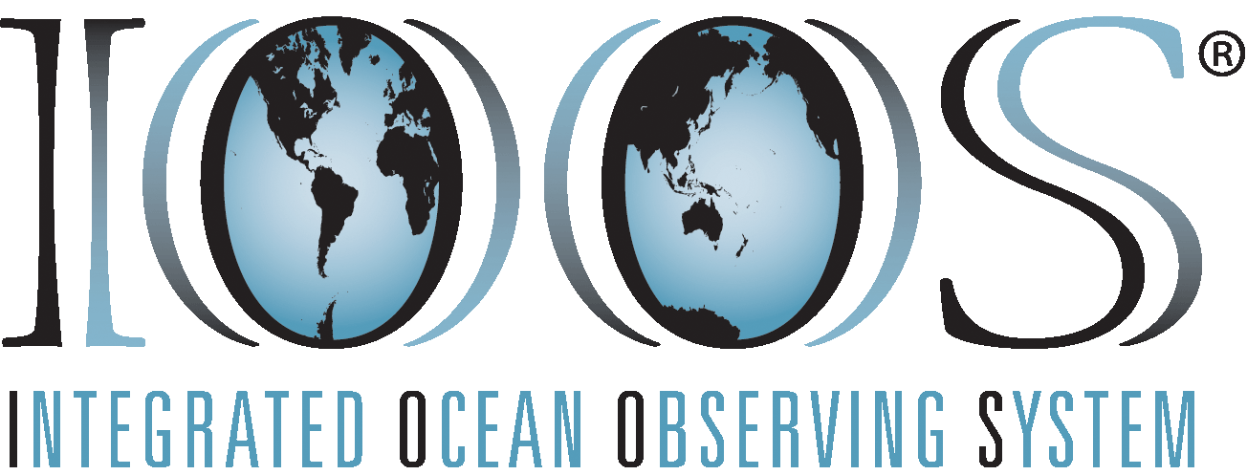

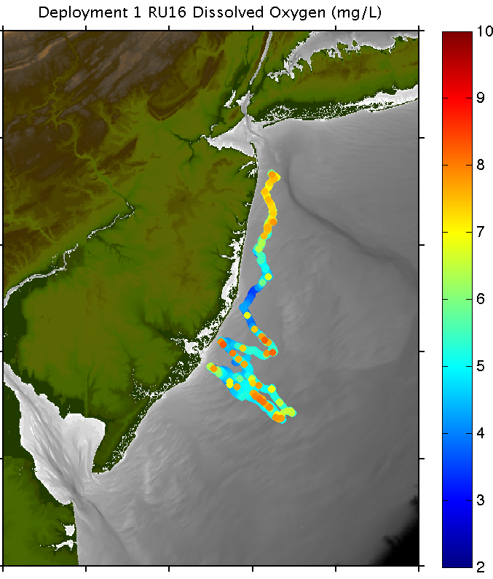
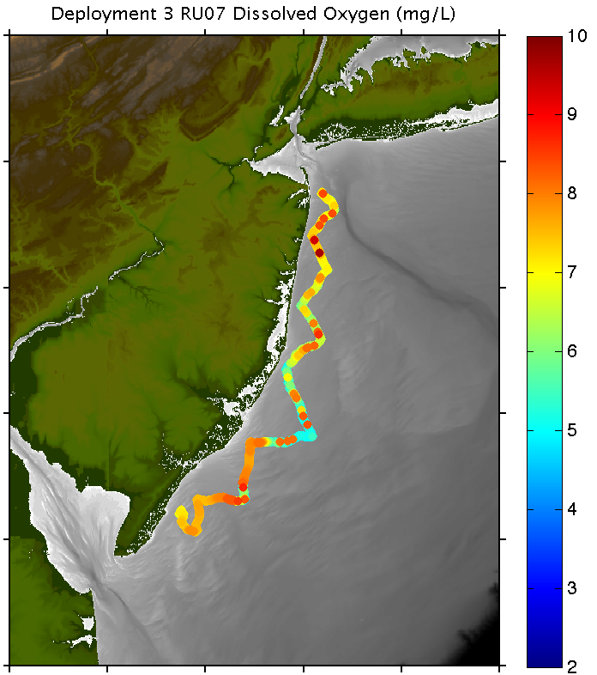
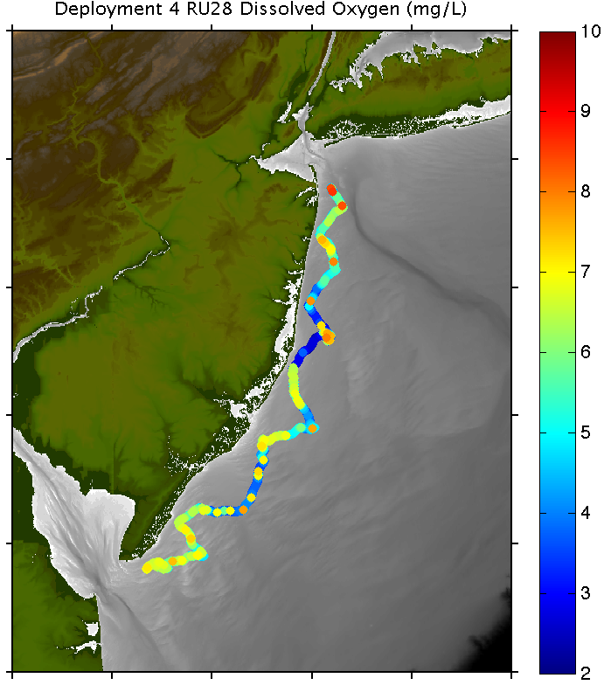
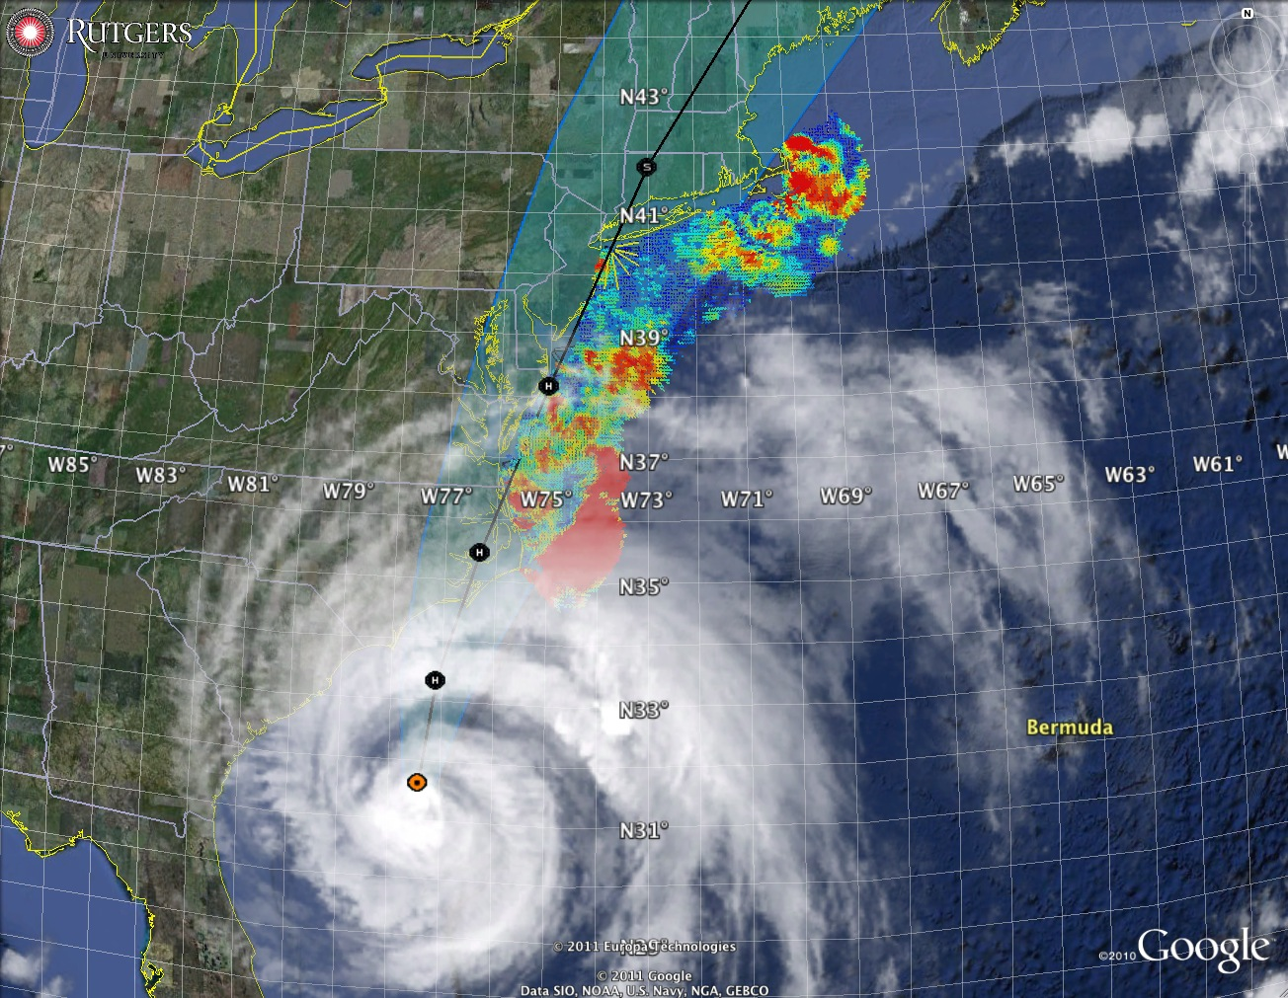
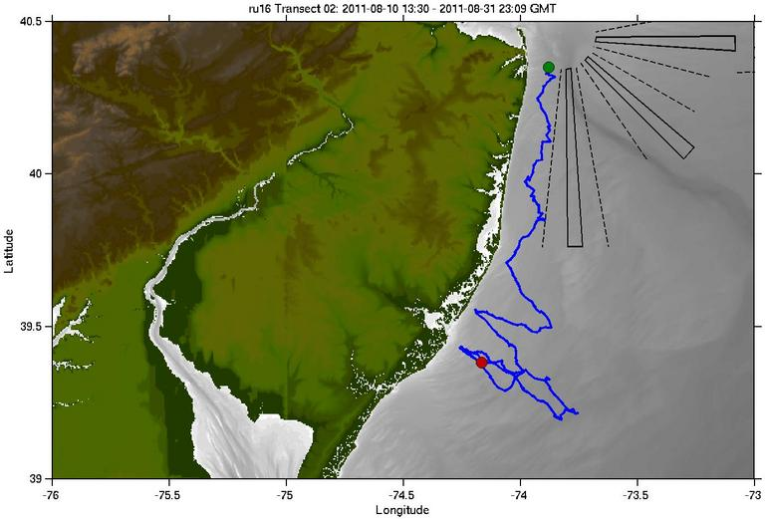
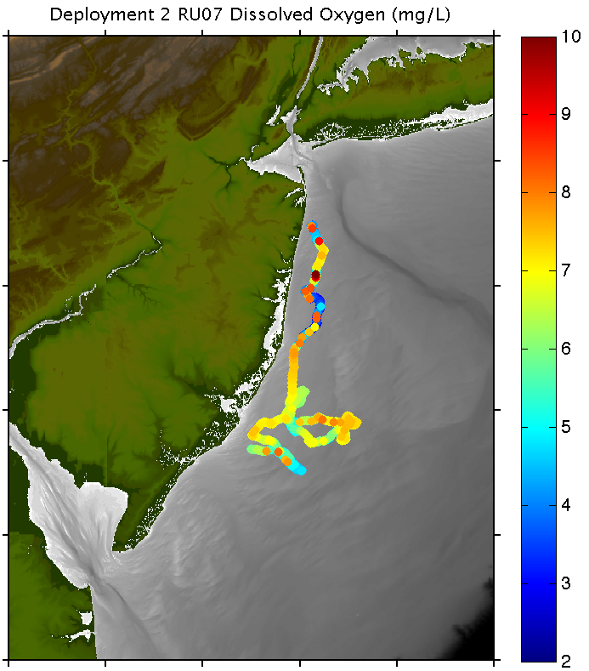
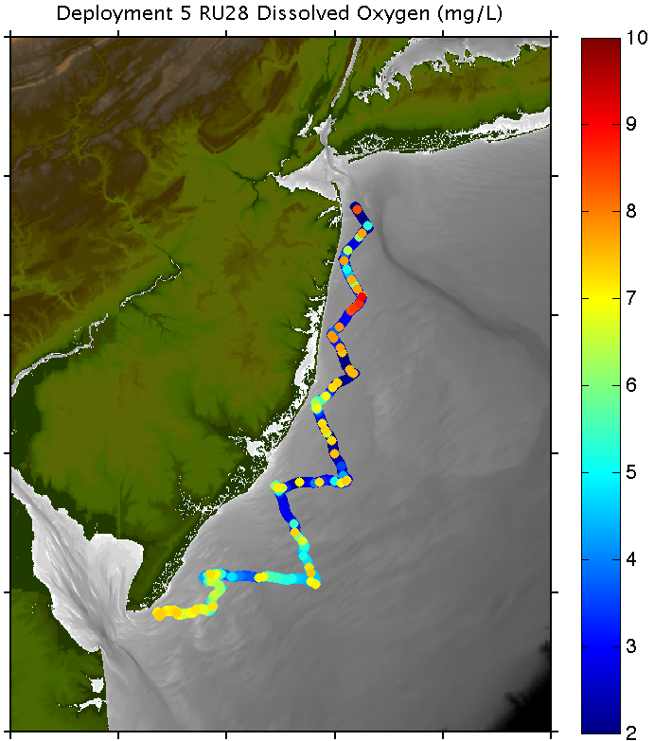
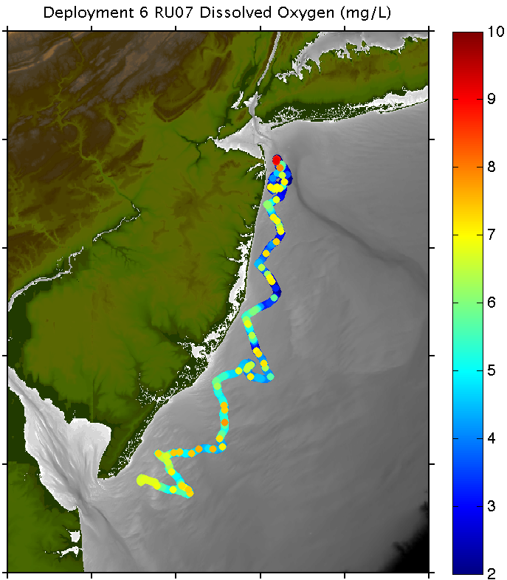
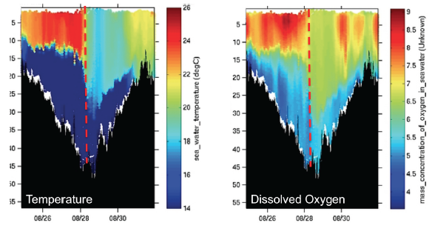
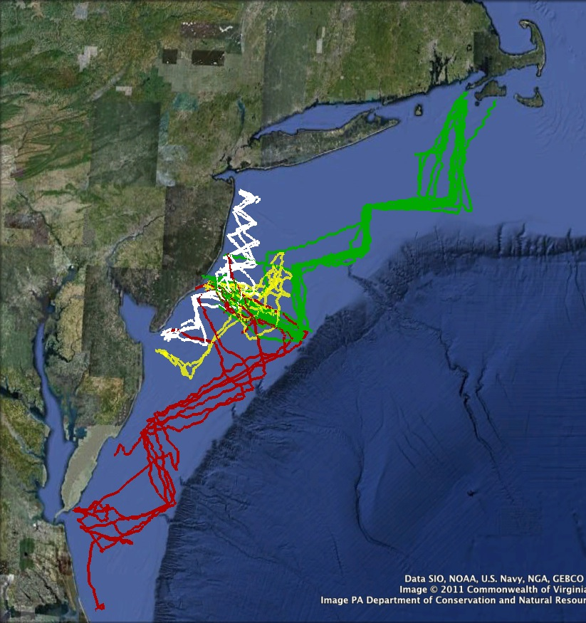
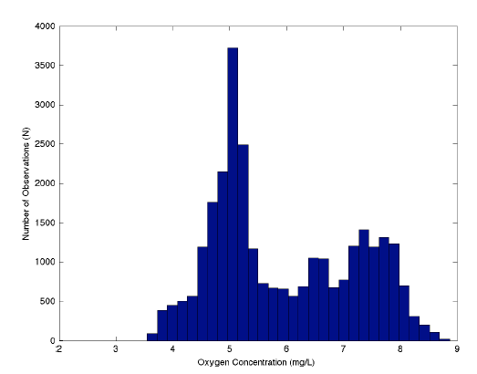
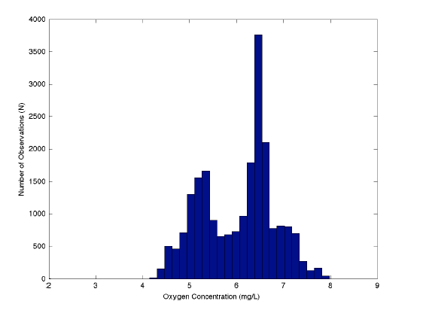
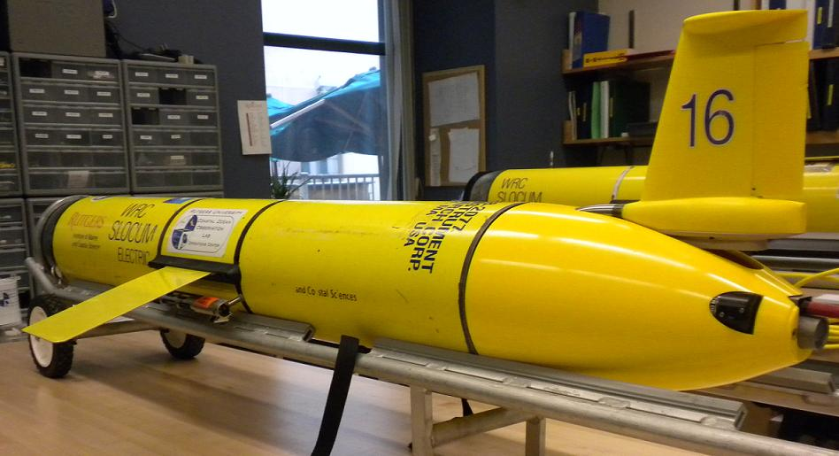
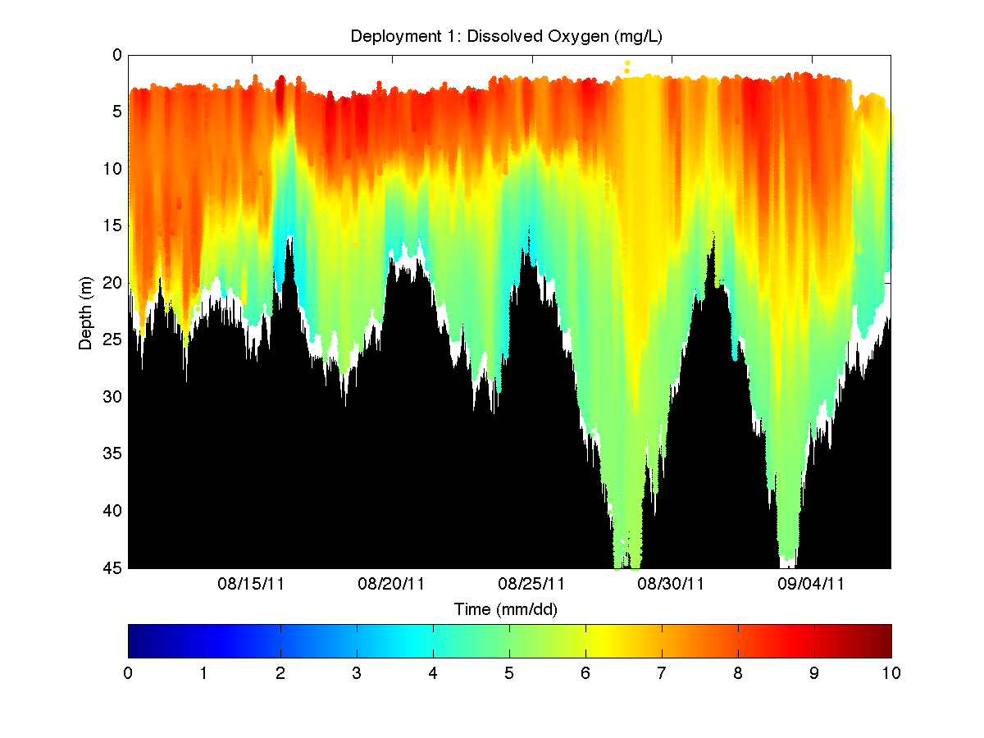
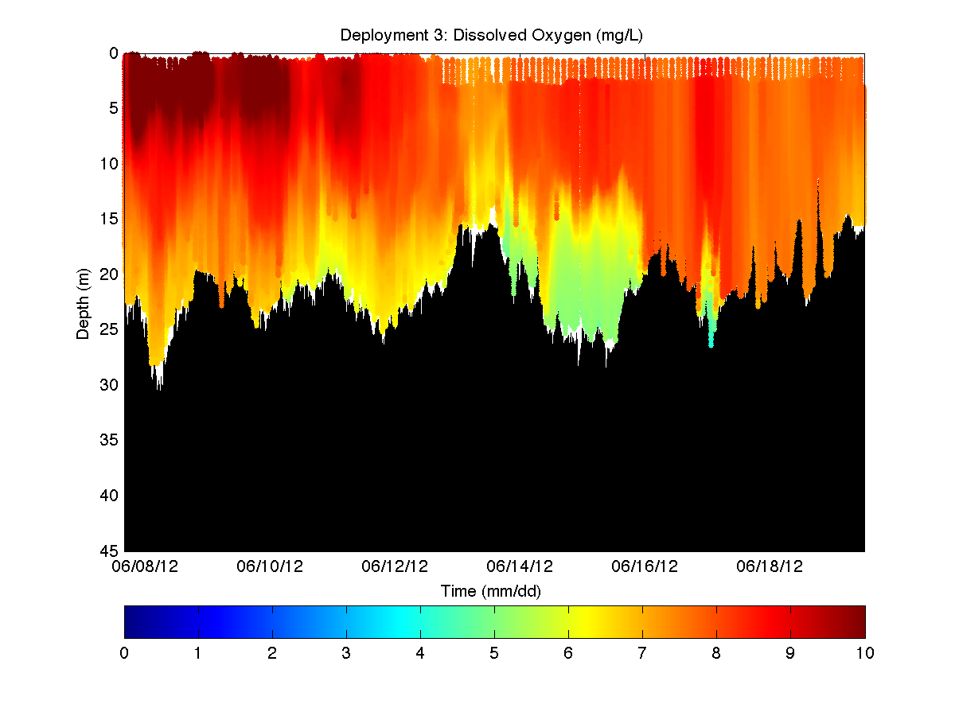
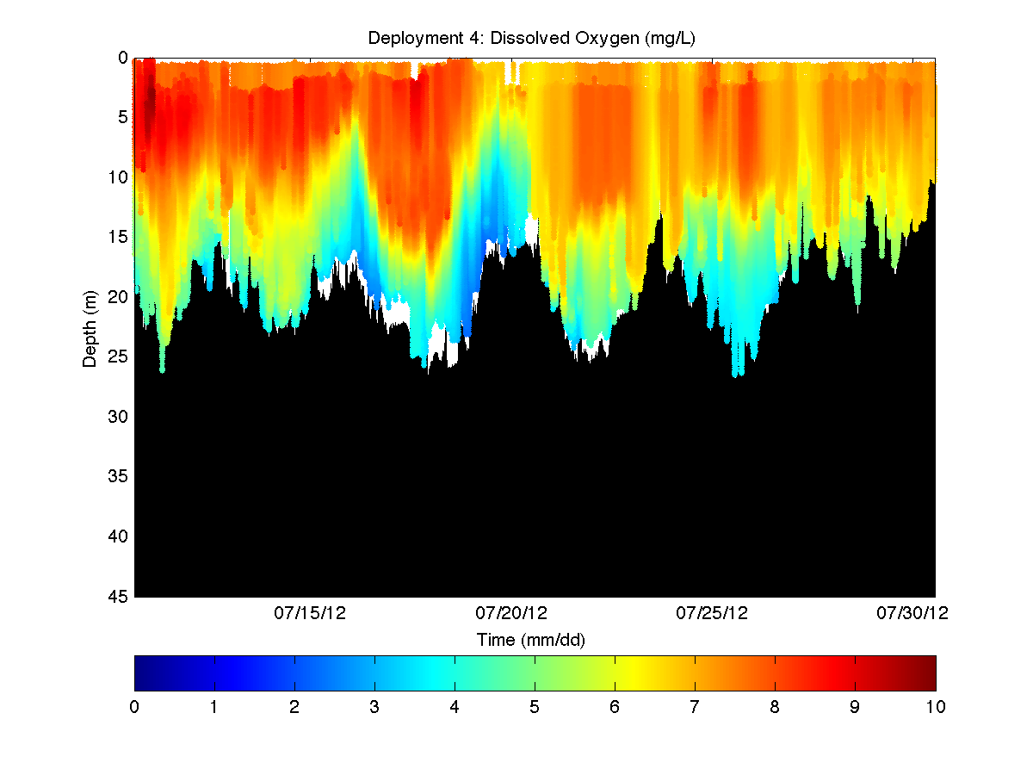
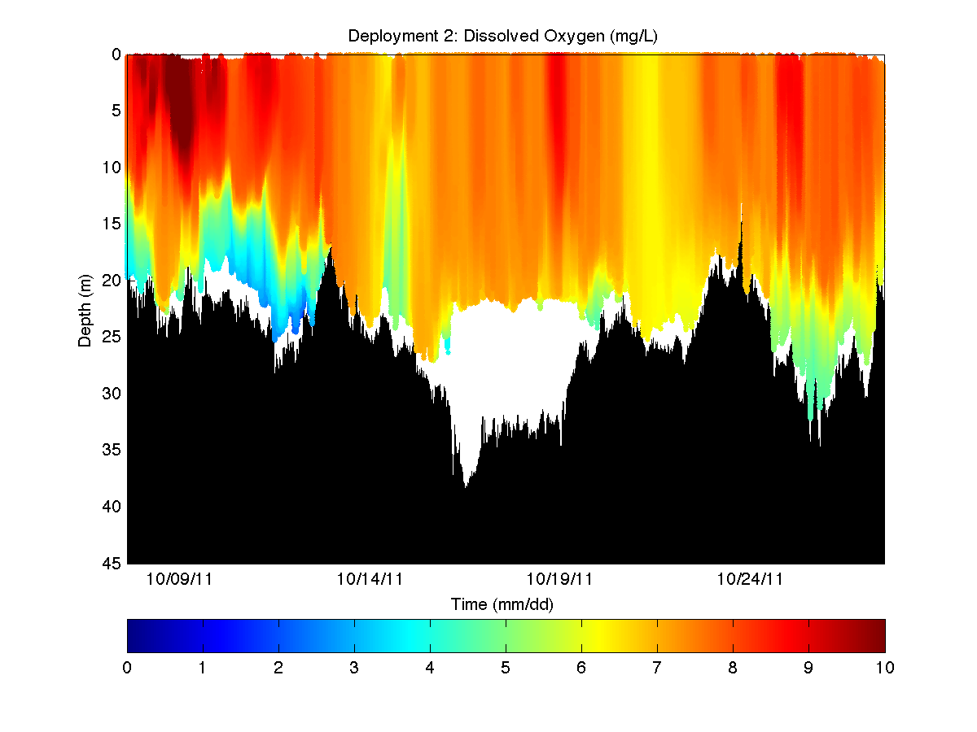
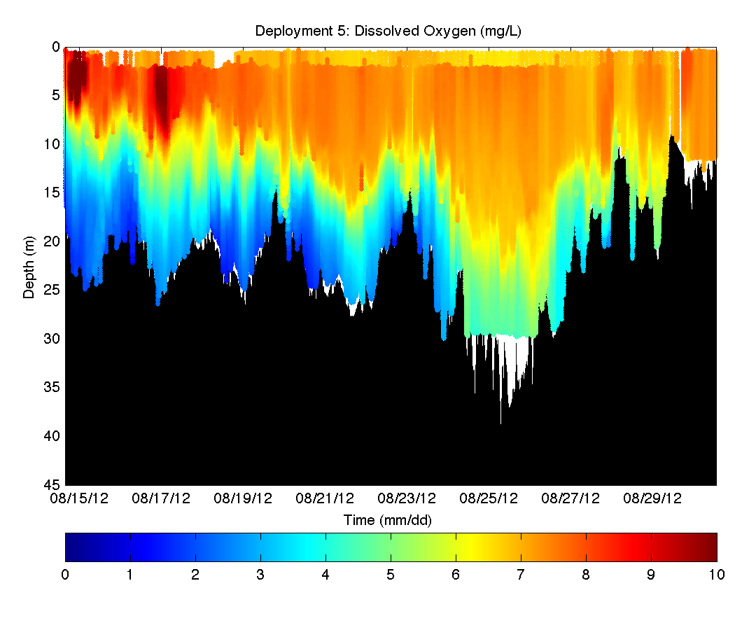
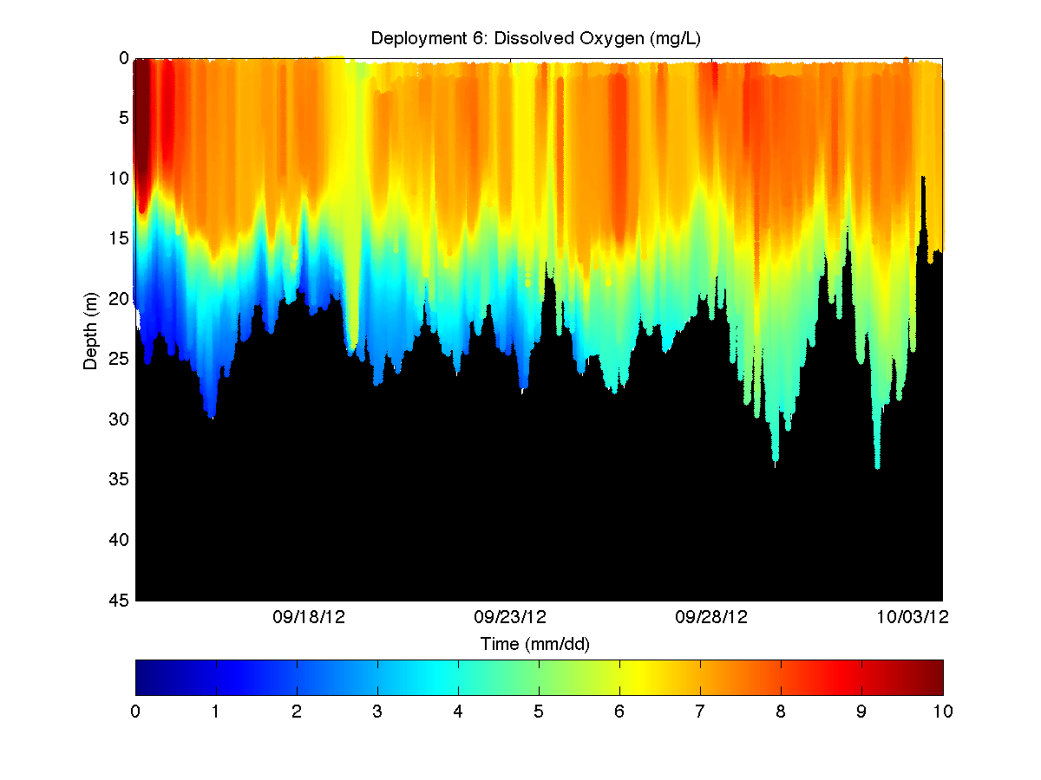
Monitoring Dissolved Oxygen in New Jersey Coastal Waters Using Autonomous Gliders:
Multi-year Trends and Event Response
Josh Kohut¹, Clinton Haldeman¹, John Kerfoot¹, Darvene Adams², Michael Borst², Bruce Friedman³, and Robert Schuster³
¹Institute of Marine and Coastal Sciences, Rutgers University ²Environmental Protection Agency ³New Jersey Department of Environmental Protection
Coastal Dissolved Oxygen Monitoring
Mission Summary 2011-2012
Event Response: Hurricane Irene
The coastal ocean is a highly variable system with processes that have significant implications on the hydrographic and oxygen characteristics of the water column. The spatial and temporal variability of these fields can cause dramatic changes to water quality and in turn the health of the ecosystem. Both the U. S. Environmental Protection Agency (EPA) and the New Jersey Department of Environmental Protection (NJDEP) have prioritized monitoring the coastal waters off New Jersey in their long-term strategic plans as an essential component of the decision-making process. Of particular interest are the spatial and temporal characteristics of dissolved oxygen (DO). In response to this need to better understand the dynamics, we put together a program to augment existing monitoring with targeted deployments of glider Autonomous Underwater Vehicles (AUVs) equipped with sensors to map coastal dissolved oxygen and hydrographic conditions in near-real time along the New Jersey inner-shelf.
In late August 2011 Hurricane Irene tracked directly over the inner New Jersey Shelf. The first deployment of this project captured this significant forcing event. Prior to the storm passing, we modified the glider mission from the zigzag path toward Cape May to one that maintained a cross-shelf line. The cross-shelf line was timed so that the glider was in deeper water at the peak of the storm. In so doing we were able to capture the evolution of the hydrographic and dissolved oxygen fields before, during and after the storm. A subsection of these data centered on the storm are shown below. A dramatic impact of Hurricane Irene is seen in the temperature data.
August 2011
June 2012
July 2012
Project Objectives
Evaluate the use of AUVs as a tool to monitor DO concentrations across a broad spatial area at high spatial and temporal resolution for the purpose of problem identification, diagnosis, and evaluation.
Provide spatially and temporally comprehensive water quality data to be used to assess the coastal ocean as required under section 106 of the Clean Water Act.
Produce Standard Operating Procedures, Quality Assurance procedures, validation data, and a data analysis/data management system for future AUV monitoring.
5
15
25
35
45
55
26
22
18
14
5
15
25
35
45
55
9
8
7
6
5
4
October 2011
August 2012
September 2012
The path for each deployment completed 2011 and 2012. The path color indicates the lowest Dissolved Oxygen concentration (mg/L) observed for each profile along the track.
Partnerships
The coastal monitoring described here is built on significant leveraging and partnership. The presence of MARACOOS, the Mid-Atlantic Regional component of the Integrated Ocean Observing System (IOOS) provided critical facilities and technical expertise to accelerate the adaption of the shelf-wide glider missions to near-shore missions with a specific focus on water quality monitoring. EPA Region II and NJDEP identified the need and provided the necessary resources to support these coastal missions. It is only through partnerships initiated and maintained through IOOS that these applications can be identified and implemented.
08/26 08/28 08/30
08/26 08/28 08/30
The temperature (C) (above left) and dissolved oxygen concentration (mg/L) (above right) collected during Hurricane Irene along the cross-shelf line at the southern end of the path. The timing of the storm is shown as a red dashed line in each cross-section.
Before
After
Mission Summary: Vertical Structure (mg/L)
Quality Assurance Project Plan (QAPP)
Distribution of dissolved oxygen measurements collected in the above cross-sections before (above left) and after (above right) the passing of Hurricane Irene.
All the glider missions were completed in accordance to the operating procedures described in the QAPP. The QAPP was approved by the project participants at EPA, Rutgers, and NJDEP. The document clearly states the pre- and post-deployment steps needed to ensure the quality of the data collected during each mission. In addition, decision making criteria are defined to take advantage of the adaptive capabilities of the glider sampling and reduce the risk on the glider given changing ocean and atmospheric conditions. The QAPP with details of the operating procedures will be particularly useful as the government agencies move forward with incorporating AUV data into environmental decision-making. This QAPP has already informed the development of an IOOS document on Quality Assurance and Control Standards for Real-Time Dissolved Oxygen Measurements.
August 2011
June 2012
July 2012
Acknowledgments: The coastal monitoring described here is built on significant leveraging and partnership. With the support of EPA we filled a critical observing gap along the inner shelf of the New Jersey coast. The presence of MARACOOS, the Mid-Atlantic Regional component of IOOS provided critical facilities and technical expertise to accelerate the adaption of the shelf-wide glider missions to near-shore missions with a specific focus on water quality monitoring. EPA Region II and NJDEP identified the need and provided the necessary resources to support these coastal missions. We would like to specifically acknowledge Michael Borst (EPA), Darvene Adams (EPA), Bruce Friedman (NJDEP), and Robert Schuster (NJDEP) for all their help with planning and logistics. The captain and crew of the R/V Clean Waters provided the deployment support and the EPA and NJDEP crews helped with the recoveries. Throughout the project there is consistent communication to both adapt the glider mission given the near-real time data and coordinate a response if needed.
October 2011
August 2012
September 2012

