Slide 1
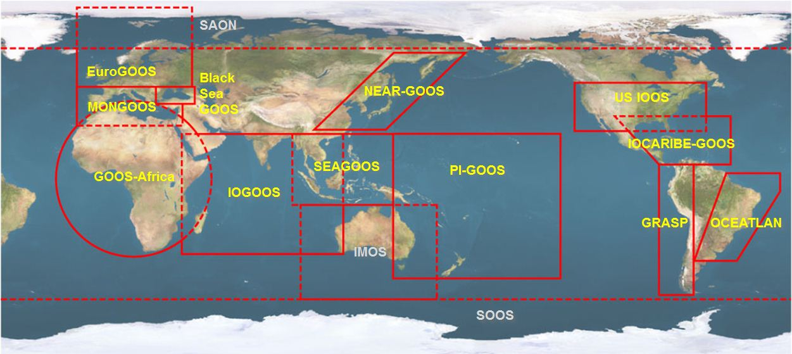

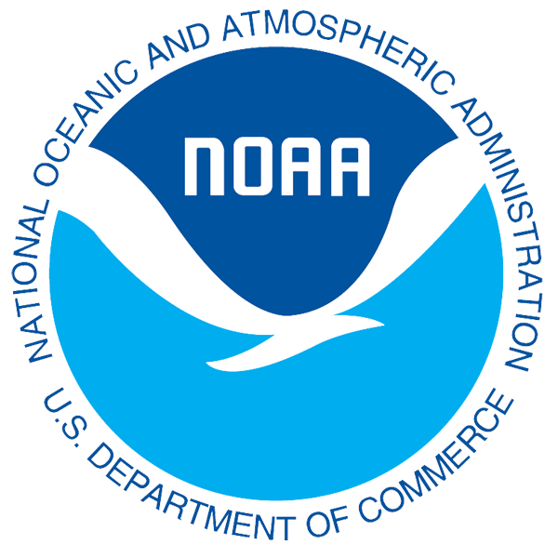



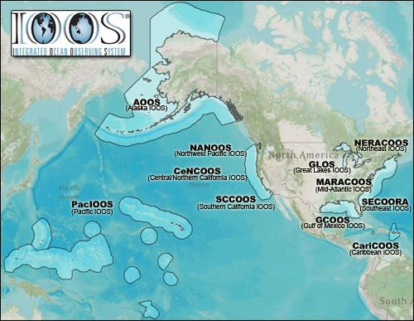


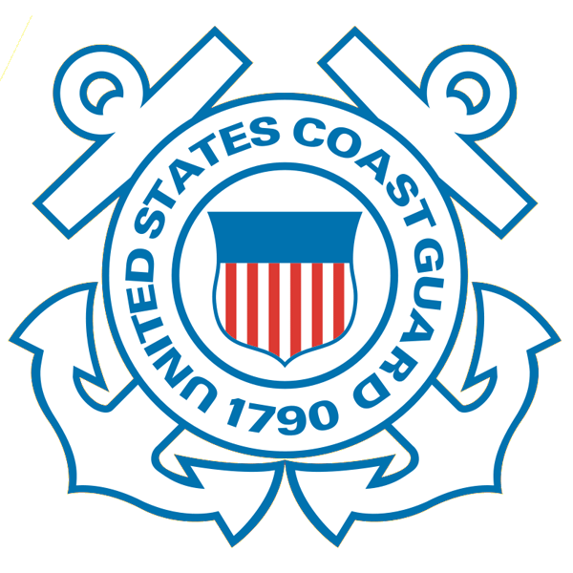










U.S. Integrated Ocean Observing System (IOOS)
Global Component
National Component
Regional Component
15 Regional Alliances in GOOS
Vessels -
Satellite
Satellite
CODAR
Ships/ Vessels
Glider
REMUS
Data Vis.
Modeling
Security
Leadership
Education
11 Regional Associations
17 U.S. Federal Agencies
http://ioos.gov

Slide 2
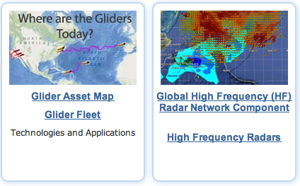
U.S. Integrated Ocean Observing System (IOOS)
Global Component
National Component
Regional Component
Globally Coordinated Initiatives
Vessels -
Satellite
Satellite
CODAR
Ships/ Vessels
Glider
REMUS
Data Vis.
Modeling
Security
Leadership
Education
11 Regional Associations
17 U.S. Federal Agencies
http://ioos.gov

Slide 3
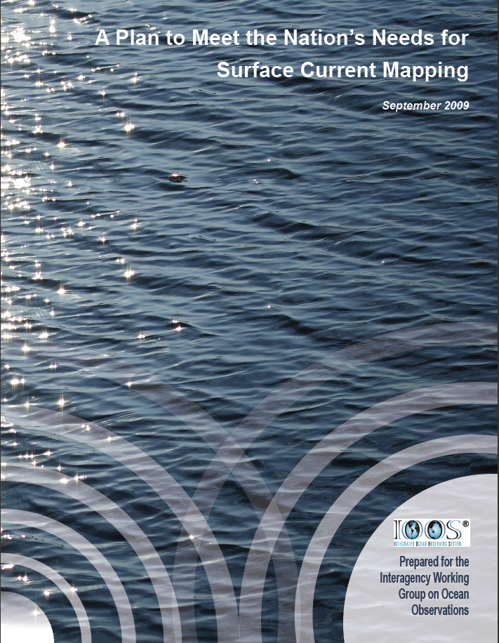
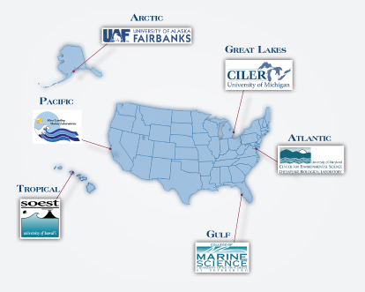

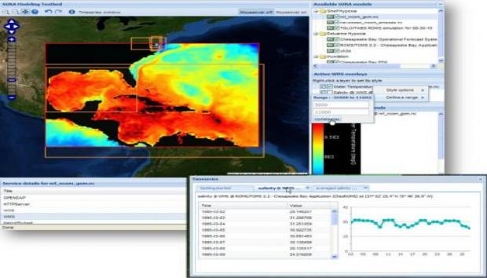
U.S. Integrated Ocean Observing System (IOOS)
Global Component
National Component
Regional Component
15 Regional Alliances in GOOS
Vessels -
Satellite
11 Regional Associations
Nationally Coordinated Initiatives
http://ioos.gov

Slide 4
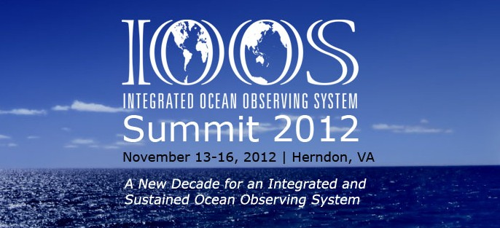
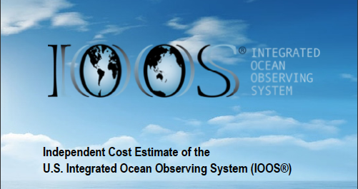
U.S. Integrated Ocean Observing System (IOOS)
Global Component
National Component
Regional Component
15 Regional Alliances in GOOS
Vessels -
Satellite
Satellite
CODAR
Ships/ Vessels
Glider
REMUS
Data Vis.
Modeling
Security
Leadership
Education
Guidance for the next decade
17 U.S. Federal Agencies
http://ioos.gov

Slide 5
U.S. Integrated Ocean Observing System (IOOS)
Global Component
National Component
Regional Component
15 Regional Alliances in GOOS
Vessels -
Satellite
Satellite
CODAR
Ships/ Vessels
Glider
REMUS
Data Vis.
Modeling
Security
Leadership
Education
11 Regional Associations
17 U.S. Federal Agencies
http://ioos.gov

Slide 6
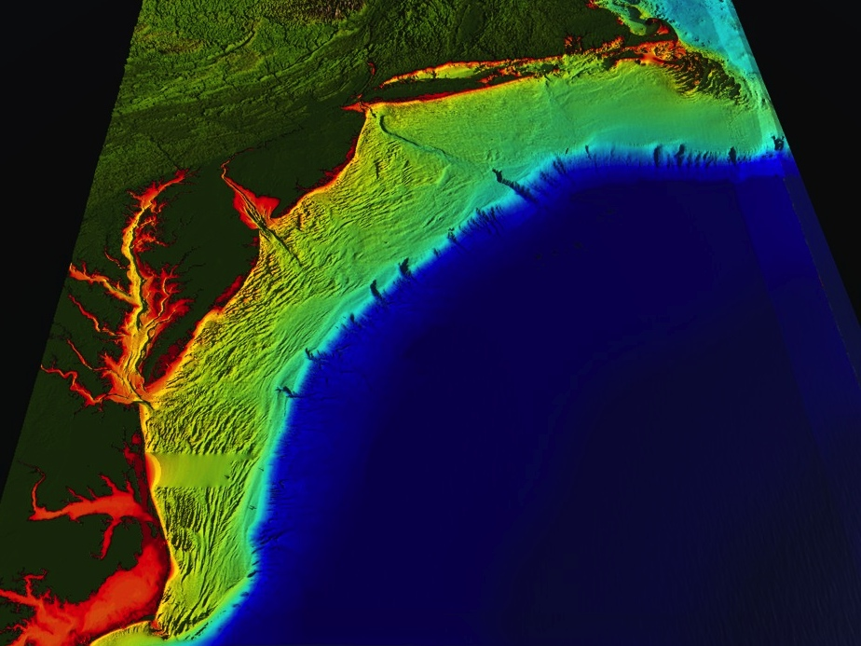
















RI
U..
Middle Atlantic
Regional Association
Coastal
Ocean Observing System
1000 km
Cape to Cape
CT
Cape
Cod
MA
NY
10 States
1/4 U.S. Population
PA
NJ
MARACOOS:
A Sustained Real-Time
Regional-Scale Observation and Forecast System
MD
DE
>40 PIs
>20 Institutions
>50 Members
Est.
2004
Scott Glenn + Many
VA
NC
Cape
Hatteras
http://maracoos.org
Notes:
6

Slide 7
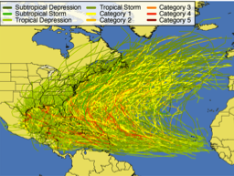
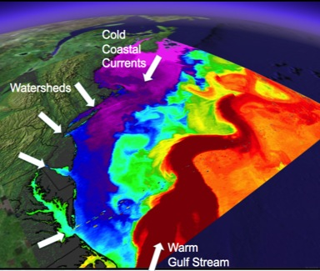
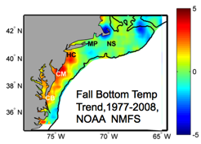
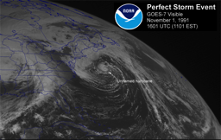
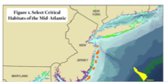
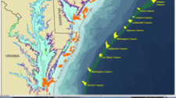
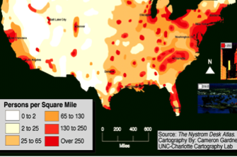
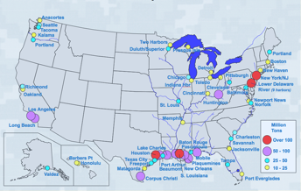
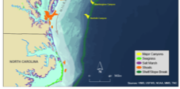
MID-ATLANTIC REGIONAL DRIVERS
Tropical Storms
Climate Change
Ocean Circulation
Critical Habitat
Northeasters
Ports
Population

Slide 8
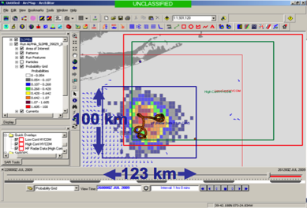
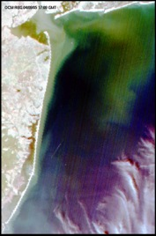
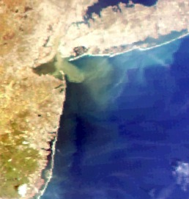
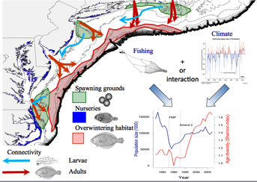
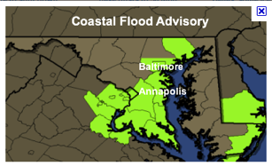
MARACOOS REGIONAL THEMES
1) Maritime Operations – Safety at Sea
3) Water Quality – a) Floatables, b) Hypoxia, c) Nutrients
2) Ecosystem Decision Support - Fisheries
5) Energy – Offshore Wind
4) Coastal Inundation - Flooding
Since 2007

Slide 9
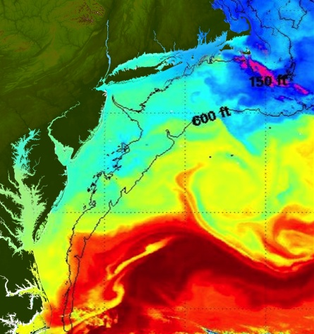
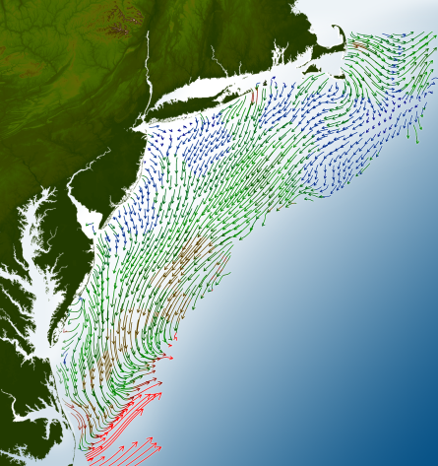
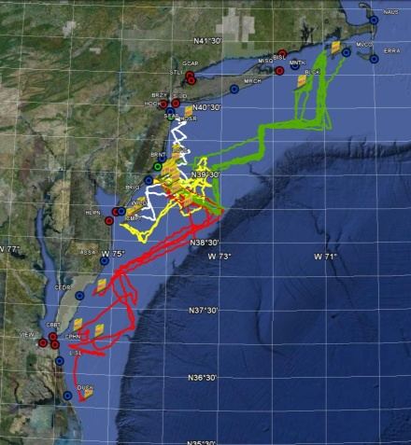
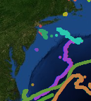
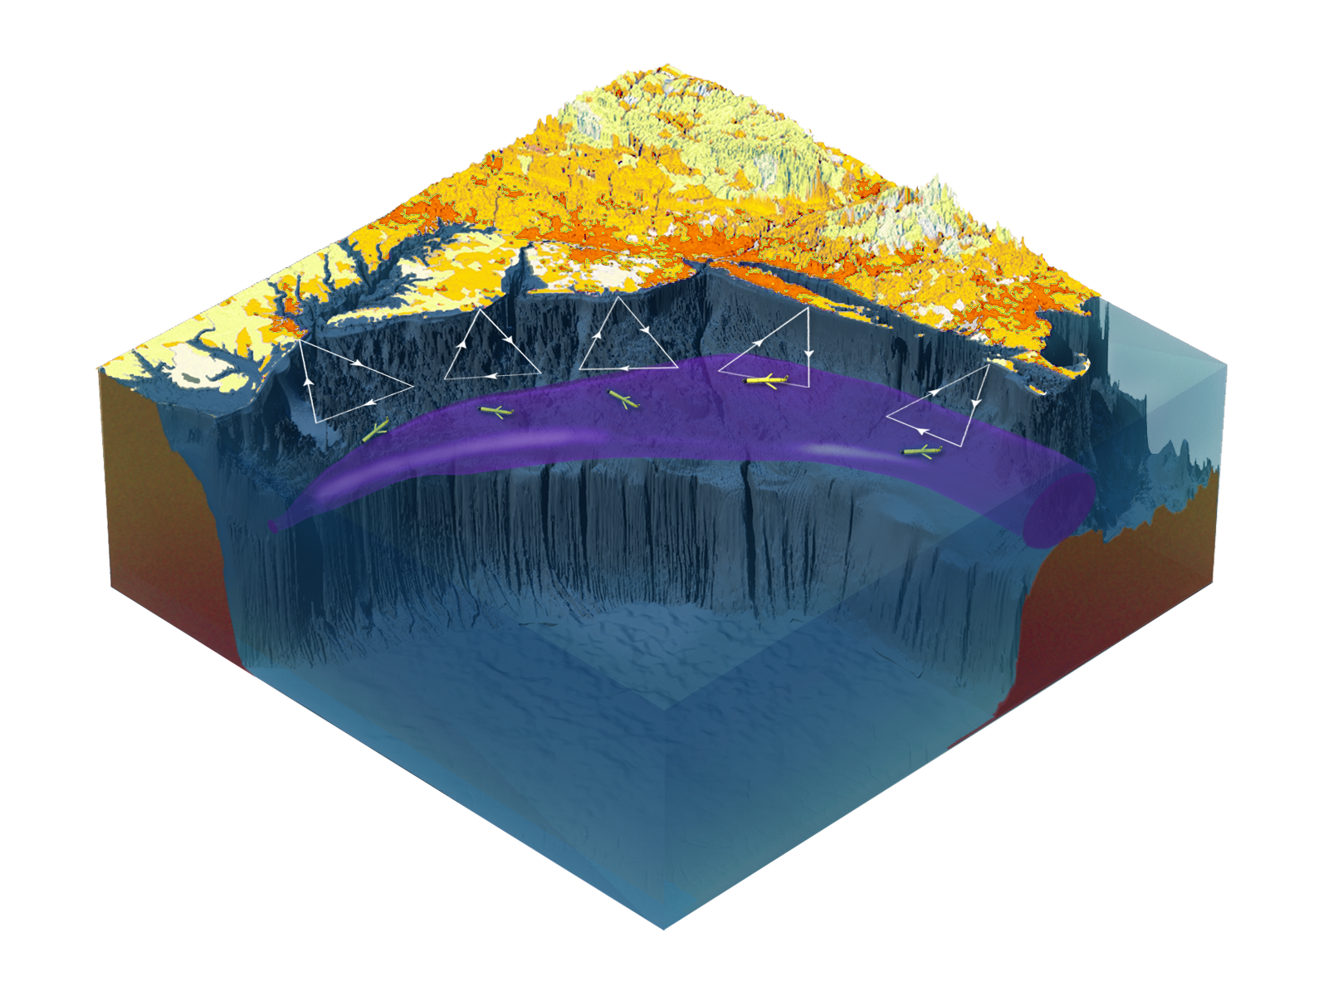

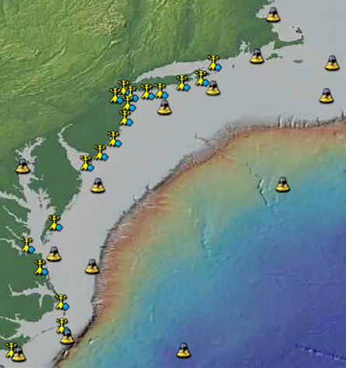
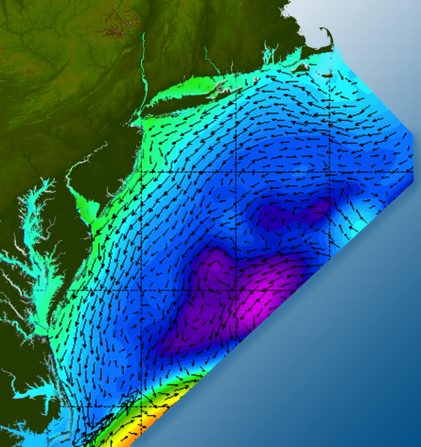

Satellites
HF-Radar
Gliders
Drifters
Population Density
To seek, discover & apply
new knowledge & understanding
of our coastal ocean
Weather Stations
Ocean Forecast Ensemble
Notes:
Need to cut off cold pool in south and bend offshore
Need to experiment with dulling down the colors in the pop density. Maybe orange/tan to white like the box I put in?
Put gliders just below the lines in 3 of them, and increase their angles facing up and down randomly. I stuck in cheesy examples
I already put the shadow and 80% clear line around the two new maps in the upper right, so we are good there.

Slide 10
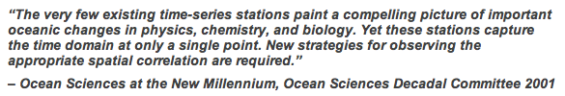
Satellites
HF-Radar
Gliders
Drifters
Population Density
To seek, discover & apply
new knowledge & understanding
of our coastal ocean
Weather Stations
Ocean Forecast Ensemble
IOOS Summit Theme:
Notes:
Need to cut off cold pool in south and bend offshore
Need to experiment with dulling down the colors in the pop density. Maybe orange/tan to white like the box I put in?
Put gliders just below the lines in 3 of them, and increase their angles facing up and down randomly. I stuck in cheesy examples
I already put the shadow and 80% clear line around the two new maps in the upper right, so we are good there.

Slide 11
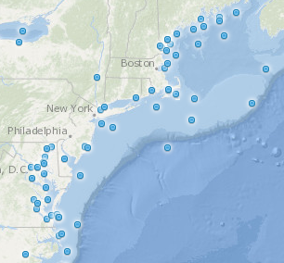
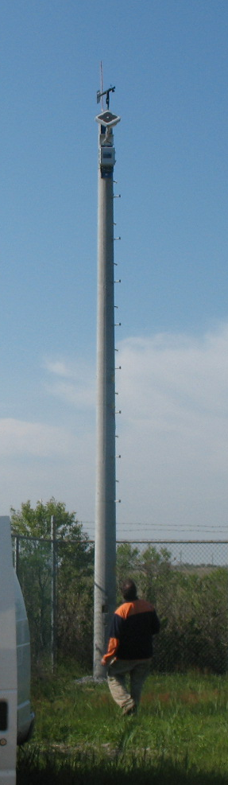
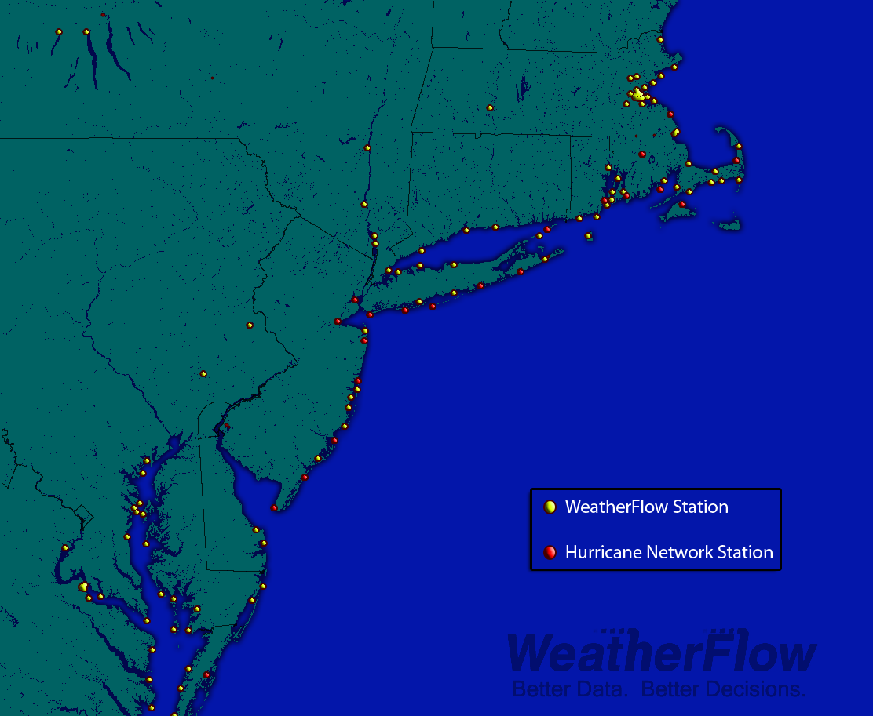
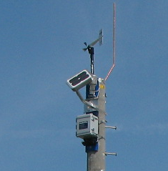
MARACOOS Weather Network
NDBC
Backbone
> 50 sites
Regional Industry
Enhancement
> 100 sites

Slide 12
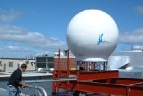
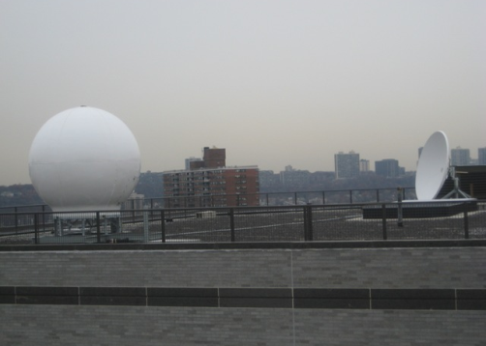
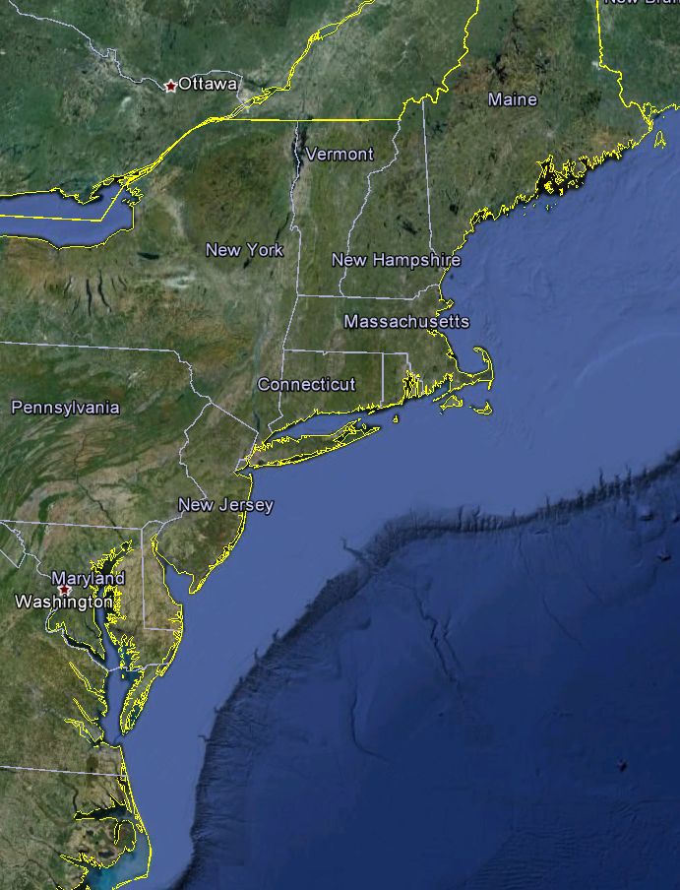
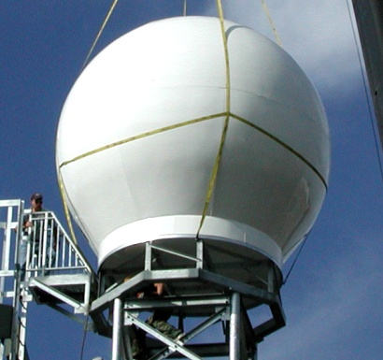
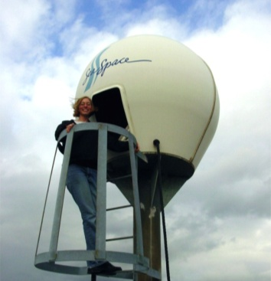
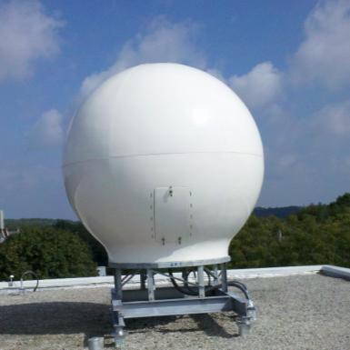
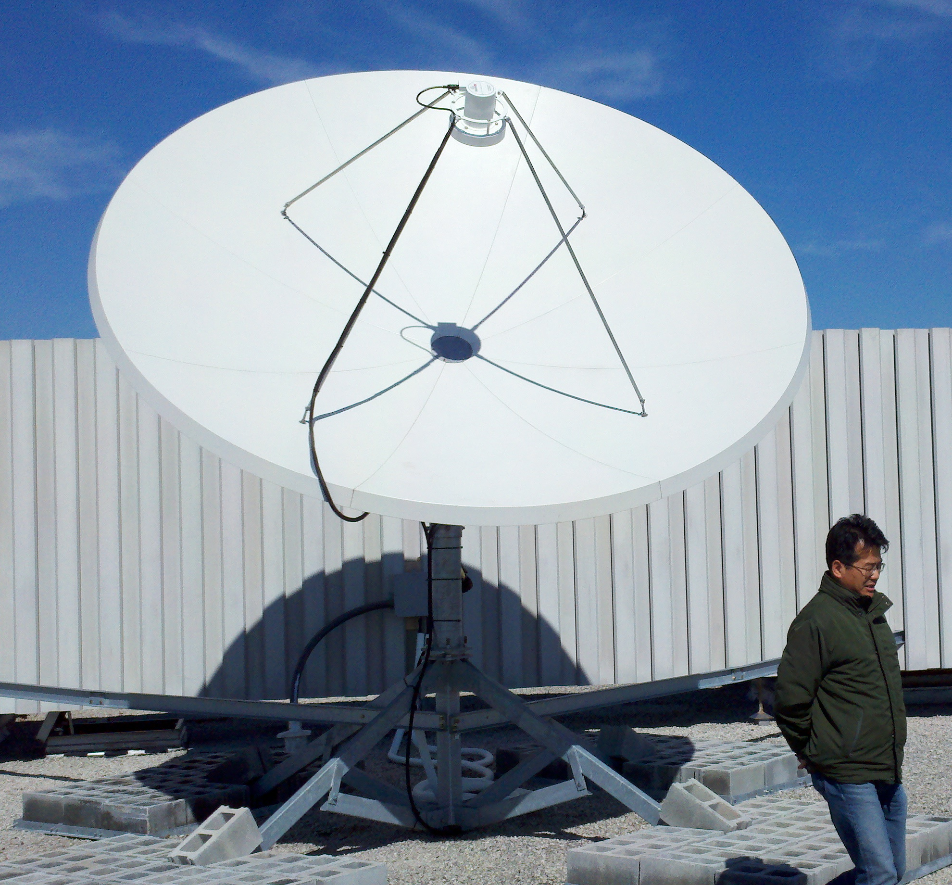
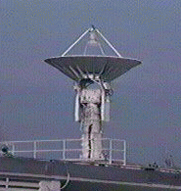
Real-Time Satellite Ground Stations in the Northeast U.S.
Satellites: NPP, Terra, Aqua, NOAA Polar Orbiters, Metop & GOES
U. Maine
City College of N.Y.
Rutgers
U. Delaware
Johns Hopkins

Slide 13
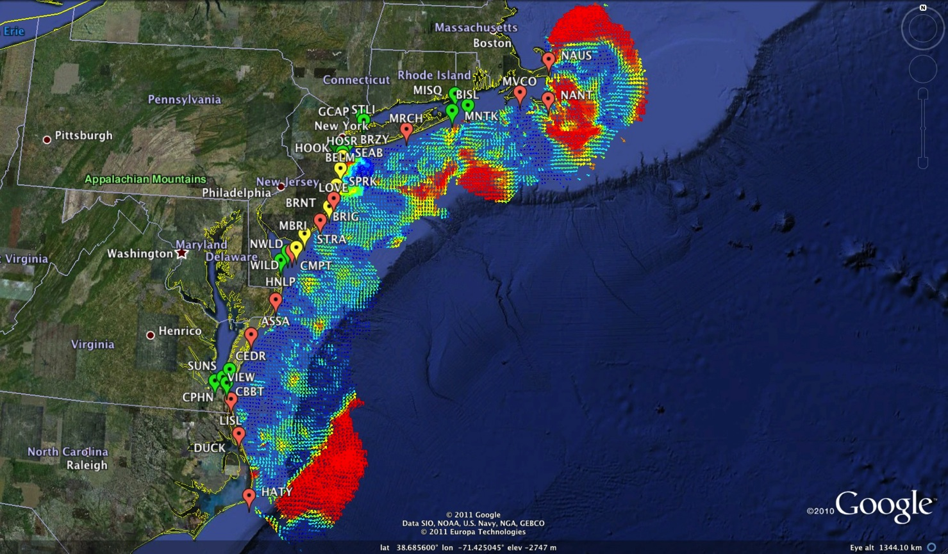
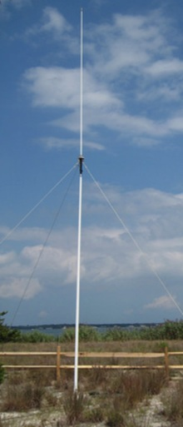
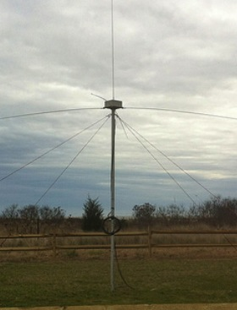
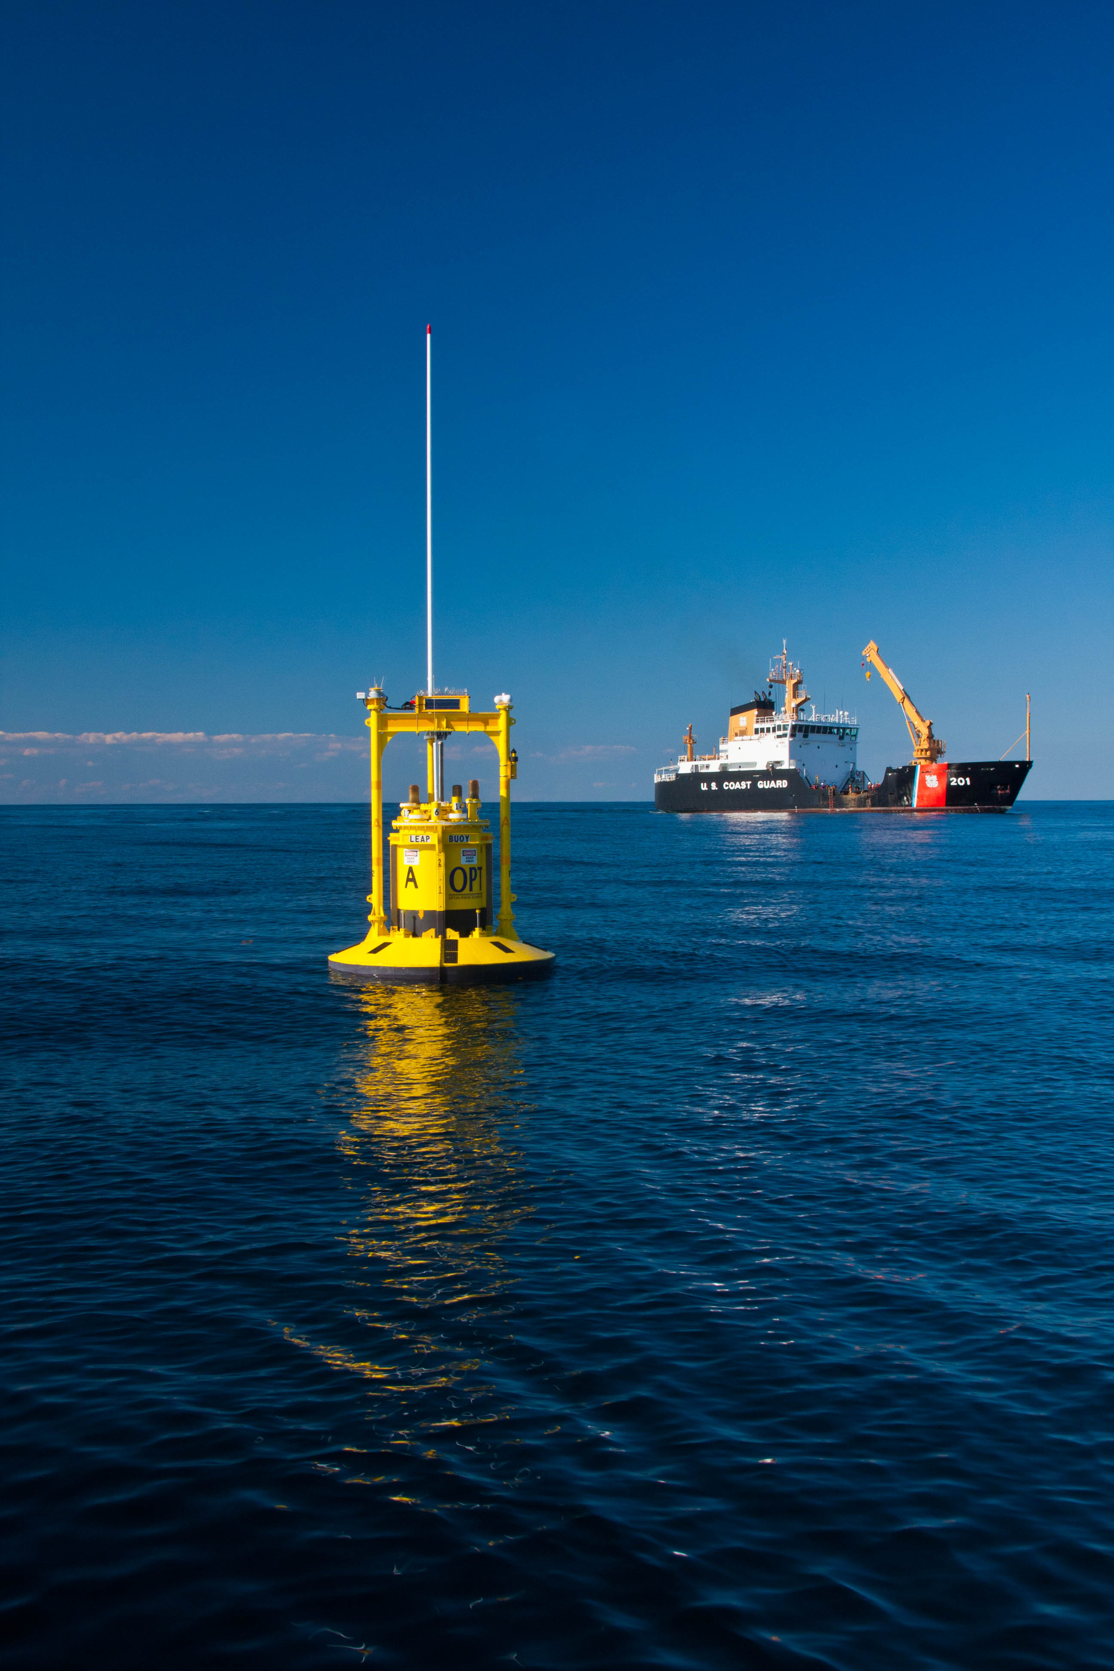
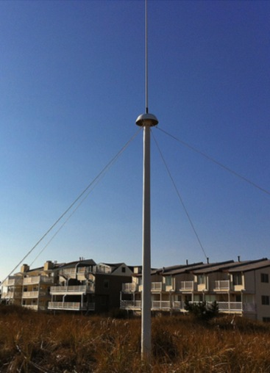



Mid-Atlantic Bight HF Radar Network
1000 km
Cape to Cape
Mid-Atlantic HF Radar Network
16 Long-Range CODARs
8 Medium-Range CODARs
17 Short-Range CODARs
41 Total
Triple Nested, Multi-static, Multi-use
Industry Partner: CODAR Ocean Sensors

Slide 14





Mid-Atlantic Glider Network
Satellite Ocean Color
MARACOOS
MURI
Intl. Missions
EPA & NJDEP
Cblast
Endurance
OSSE
SW06
Satellite SST
Subsurface
Glider
Data
Many Missions,
Many Agencies
Industry Partner: Teledyne Webb Research

Slide 15

RU-WRF Domain
6km over region
2km over NY Bight
0.67km over study area
Model will run in
real-time, for precise
comparison to onsite
met towers
Data will be extracted
from the model at an
array of gridpoints,
Representing locations
5 miles, 10 miles, 15 miles,
and 20 miles offshore at
10 mile intervals northward
along the NJ coast
Weather Forecast Ensemble
0.67km
2km
6km

Slide 16




Improved Predictive Modeling and Data Assimilation
1) STPS
U. Connecticut
2) NYHOPS
Stevens Institute of Technology
3) ROMS
Rutgers University
4) HOPS
U. Massachusetts, Dartmouth

Slide 17






MARACOOS Operations Center
Rutgers University - Coastal Ocean Observation Lab
Satellite Data Acquisition Stations
CODAR Network
Glider Fleet
3-D Forecasts

Slide 18












ONR Shallow Water 2006 Joint Experiment
HiSeasNet
>12 Satellites
48 Senior
PI’s & PM’s
Communication
7 Ships
3 Groundstations
10 Gliders
1 Aircraft
62 Moorings

Slide 19

MACOORA + MARCOOS = MARACOOS
5 IOOS Subsystems

Slide 20
Mid-Atlantic Bight HF Radar Network
1000 km
Cape to Cape
Mid-Atlantic HF Radar Network
16 Long-Range CODARs
8 Medium-Range CODARs
17 Short-Range CODARs
41 Total
Triple Nested, Multi-static, Multi-use
Industry Partner: CODAR Ocean Sensors

Slide 21
CODAR Compact HF Radar Antennas
25 MHz
13 MHz
5 MHz
Combined Transmitter & Receiver
Separate Transmitter & Receiver

Slide 22



Standard CODAR Shore Site:
Shed, Enclosure, Tx/Rx, Comms, Power, GPS, AIS
monitor
computer & external hard drive
A.C. unit
UPS system
transmitter
receiver
Two lines of Communication
Shed
Enclosure
Lightning Protection

Slide 23

Remote Power Module

Slide 24

Receive Antenna

Slide 25





Rapid Response Capability - Norway
Self Contained
Transportable
Propane generator
Satellite Communications

Slide 26


Mona Bistatic Experiment
November 7-9 2012
Field logistics, computational and communications support provided by CariCOOS, UPRM and RU COOL

Slide 27


Surface Current Mapping Capability
25 MHz
Radar λ: 12 m Ocean λ: 6 m
Range: 30 km Resolution: 1 km
13 MHz
Radar λ: 23 m Ocean λ: 12 m
Range: 80 km Resolution: 3 km
05 MHz
Radar λ: 60m Ocean λ: 30 m
Range: 180 km Resolution: 6 km

Slide 28






LONG RANGE NETWORK
2003
2003
2001
2010
2003
2012
2013
2000
2007
2001
2001
2006
2006
2009
2003
2003

Slide 29





MARACOOS Annual Mean Surface Currents (2009)
Winter
Spring
Summer
Fall

Slide 30


Winter Storm Nemo
February 9, 2013

Slide 31



Success Stories – Making a Difference
Optimizing HF Radar for SAR using USCG Surface Drifters
Art Allen
U.S. Coast Guard
Scott Glenn
Rutgers University
Mid-Atlantic Regional Association
Coastal Ocean Observing System

Slide 32





Transition Objective –
Operational Use of HF Radar Surface Currents for Search And Rescue
Surface Currents
Data Acquisition
Data Product Generation & Management
Search And Rescue Optimal Planning System (SAROPS)

Slide 33

HF Radar vs
HYbrid Coordinate Ocean Model or (HYCOM)
Currents in SAROPS
Date | Time
22 July 2009 | 00 hours
23 July 2009 | 24 hours
24 July 2009 | 48 hours
25 July 2009 | 72 hours
26 July 2009 | 96 hours
High Confidence (HF Radar)
  sigma (1 std dev) = 0.22 knots
  Tau (half life) = 264 minutes
Low Confidence (HYCOM)
  sigma (1 std dev) = 0.37 knots
  Tau (half life) = 264 minutes
Number of particles = 5000
SLDMB 39029

Slide 34


24 Hours Into Search
HYCOM
Low Confidence
CODAR
High Confidence
Notes:
HYCOM, (low Conf) 24 hrs

Slide 35


48 Hours Into Search
HYCOM
Low Confidence
CODAR
High Confidence
Notes:
HYCOM, (low Conf) 24 hrs

Slide 36


72 Hours Into Search
HYCOM
Low Confidence
CODAR
High Confidence
Notes:
HYCOM, (low Conf) 24 hrs

Slide 37


96 Hours Into Search
HYCOM
Low Confidence
CODAR
High Confidence
Notes:
HYCOM, (low Conf) 24 hrs

Slide 38


Search Area After 96 Hours
154 km
100 km
232 km
123 km
HYCOM
36,000 km²
CODAR
12,000 km²
Notes:
HYCOM (Low Conf) 48 hours

Slide 39

May 4, 2009: After a year of testing, NOAA Announces on
U.S. Department of Commerce Website that
MARACOOS CODAR is Operational in SAROPS
U.S. IOOS Goal for 2010-2011:
Bring all
sustained regional-scale HFR networks up to operational status in USCG SAROPS
3 West Coast Regions for
California & Oregon

Slide 40



Deepwater Horizon Oil Spill: Coordinated Rapid Response
Contributed Assets:
HF Radar Networks
USF, USM
Gliders
iRobot, Mote, Rutgers,
SIO, UDel, USF, Navy
Drifters & Profilers
Horizon Marine, Navy
Satellite Imagery
CSTARS, UDel, Rutgers
Ocean Forecasts
Navy, NCSU
Data/Web Services
ASA, Rutgers, SIO
Tropical Storm Bonnie crosses the Gulf of Mexico
USM HFR
TS Bonnie
USF HFR
USM HFR validation of SABGOM Forecast
in region with satellite detected oil slicks
HFR used for Oil Slick Forecasts by NOAA/NOS/OR&R

Slide 41



Deepwater Horizon Information Flow
Tools developed for education during the trans-Atlantic mission of RU27 adapted to coordinate response to the oil spill:
Collaborative web portal established as an aggregation center for information
Google Earth data/model interactive interface used for environmental analysis & glider path planning
Blog established to share analyses and provide comments – 127 briefs posted
Google Earth
Interactive Interface
Web Portal
Briefing Blog

Slide 42

Feedback from the Deepwater Horizon
Incident Command Center
Composite of Satellite Observed Oil Spill Locations
“All - Greetings from Unified Area Command in New Orleans. I couldn't agree more - the IOOS community has acquitted itself very well during this entire incident. Not only has everyone provided valuable information - you have done it without getting in the way of the ongoing operations. It's been a pleasure to represent IOOS here and see all the great contributions from the larger IOOS community. “
- Sam Walker (IOOS representative to Deepwater Horizon Unified Command Center), June 18, 2010
“… AWESOME JOB - that call that we had last week was a very good thing. You are taking a huge burden off of the team here who is trying to simply capture the deluge of assets now being deployed. “
- Sam Walker (IOOS representative to Deepwater Horizon Unified Command Center), July 2, 2010
“…Thanks to everyone for all of your efforts to support the Response and the very professional and competent manner in which you have executed your efforts. IOOS has played a huge role in informing the modeling teams and the Unified Command through your extraordinary service. “
- Sam Walker (IOOS representative to Deepwater Horizon Unified Command Center), August 6, 2010

Slide 43
Feedback from the Deepwater Horizon
Incident Command Center
Composite of Satellite Observed Oil Spill Locations
“All - Greetings from Unified Area Command in New Orleans. I couldn't agree more - the IOOS community has acquitted itself very well during this entire incident. Not only has everyone provided valuable information - you have done it without getting in the way of the ongoing operations. It's been a pleasure to represent IOOS here and see all the great contributions from the larger IOOS community. “
- Sam Walker (IOOS representative to Deepwater Horizon Unified Command Center), June 18, 2010
We did not get in the way
“… AWESOME JOB - that call that we had last week was a very good thing. You are taking a huge burden off of the team here who is trying to simply capture the deluge of assets now being deployed. “
- Sam Walker (IOOS representative to Deepwater Horizon Unified Command Center), July 2, 2010
We reduced the burden
“…Thanks to everyone for all of your efforts to support the Response and the very professional and competent manner in which you have executed your efforts. IOOS has played a huge role in informing the modeling teams and the Unified Command through your extraordinary service. “
- Sam Walker (IOOS representative to Deepwater Horizon Unified Command Center), August 6, 2010
We informed modeling teams & leadership

Slide 44

From Page 10:
Also in support of oil spill response, NOAA requests a $5.0 million increase to implement the U.S. Integrated Ocean Observing System (IOOS®) Surface Current Mapping Plan using high frequency (HF) radar surface current measurements. HF radar provides information vital to oil spill response, national defense, homeland security, search and rescue operations, safe marine transportation, water quality and pollutant tracking, and harmful algal bloom forecasting.
www.legislative.noaa.gov/Testimony/Lubchenco033111.pdf

Slide 45

The Mid Atlantic’s Autonomous Underwater Glider Network
Developing a
Sustained Ocean Presence

Slide 46






Dive: Pump In,
Batteries Forward
Glider Flight
Climb: Pump Out, Batteries Back
Rudder for Steering

Slide 47



Glider Communications
GPS for Position, Iridium for 2-Way, ARGOS for Emergencies
Glider Surfaces
2-Way Satellite Communications in Tail
Data Ribbon Transmitted to Shore

Slide 48













Glider Sensors
Inside Payload Bay or External

Slide 49
Mid-Atlantic Glider Network
Satellite Ocean Color
MARACOOS
MURI
Intl. Missions
EPA & NJDEP
Cblast
Endurance
OSSE
SW06
Satellite SST
Subsurface
Glider
Data
Many Missions,
Many Agencies
Industry Partner: Teledyne Webb Research

Slide 50

Gliders Enable a Global Presence
Rutgers Gliders since 2003

Slide 51



Challenger Glider Mission:
A Global Ocean Predictive Skill Experiment
16 Global-Class Gliders
5 Ocean Gyres: 16 gliders x 8,000 km/glider = 128,000 km

Slide 52





Challenger Glider Mission:
A Global Ocean Predictive Skill Experiment
Dobson, Mart, et al., 2013

