Slide 1
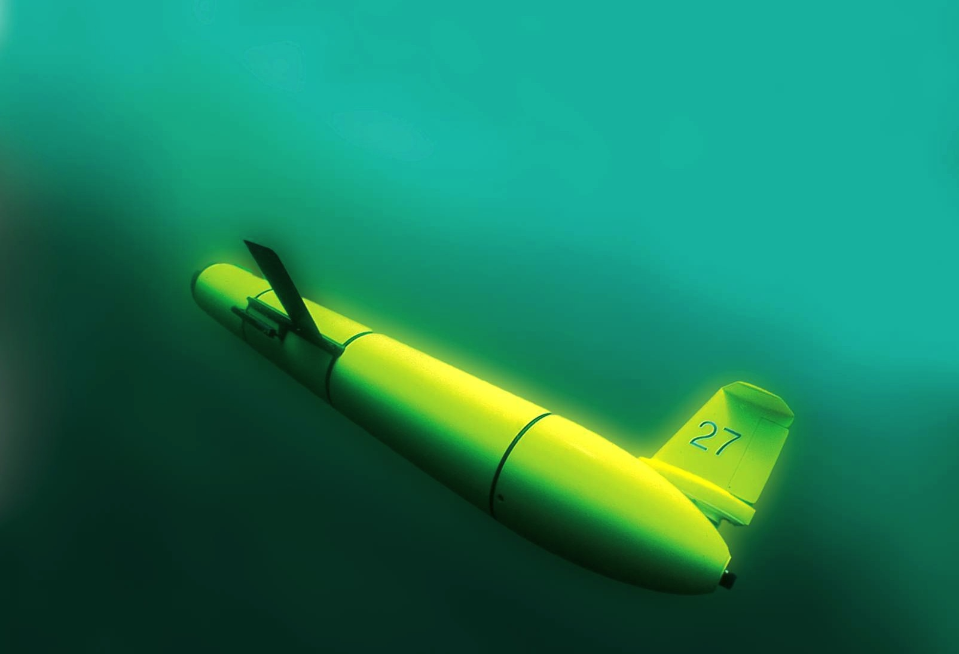
UK-IMON International Workshop on New Monitoring Technologies
Theme 2: Autonomous Platforms
Buoyancy Gliders
Scott Glenn,
Oscar Schofield,
Josh Kobut
Rutgers University
Coastal Ocean Observation Lab
http://rucool.marine.rutgers.edu/

Slide 2

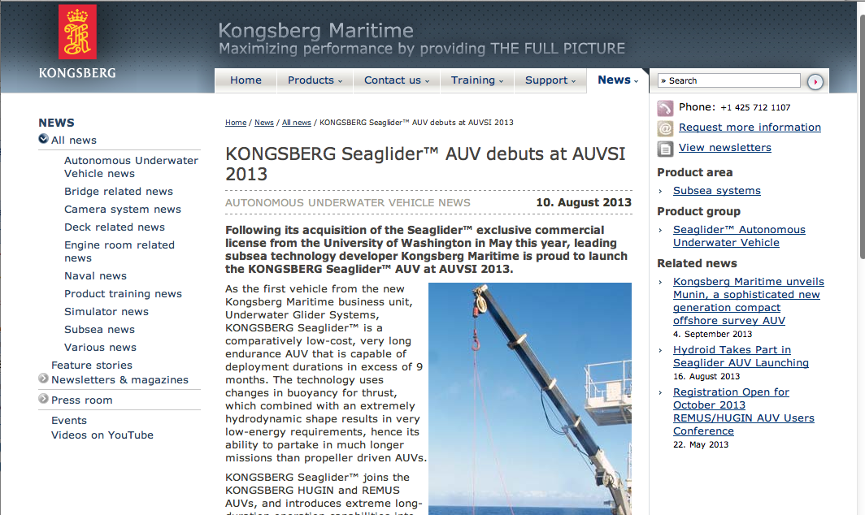
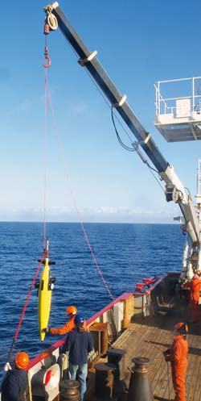
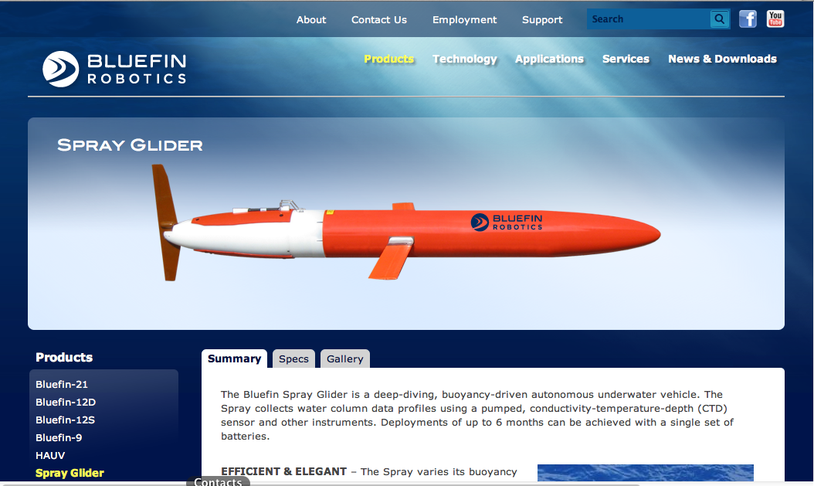
3 Commercial Buoyancy Glider Platforms
Seaglider – Kongsberg
Slocum Glider – Teledyne Webb Research
Spray Glider – Bluefin Robotics

Slide 3
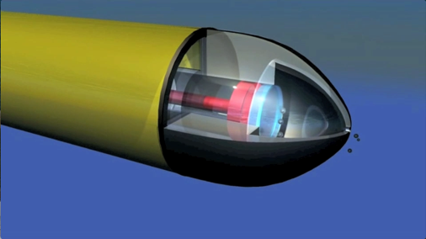
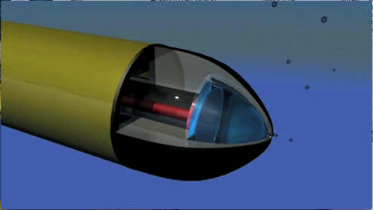
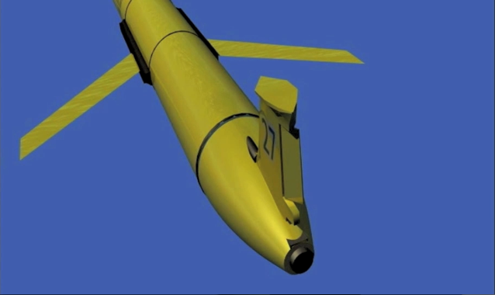
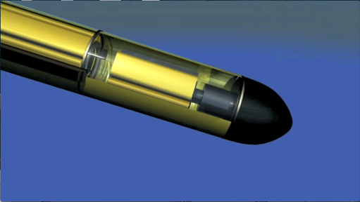
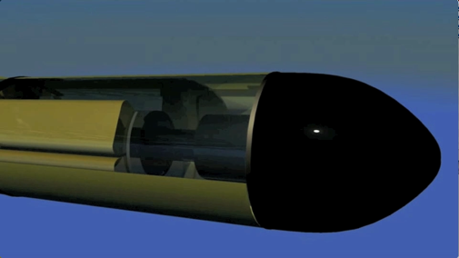
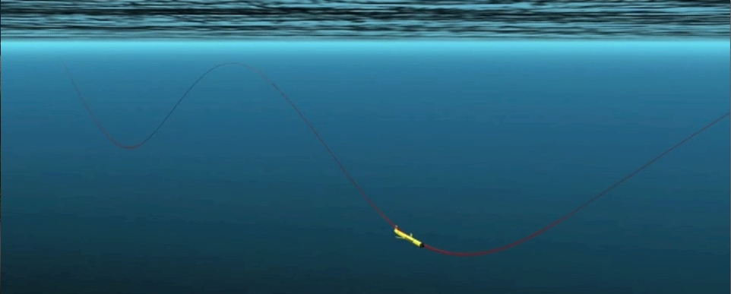
Dive: Pump In,
Batteries Forward
Glider Flight
Climb: Pump Out, Batteries Back
Rudder for Steering

Slide 4
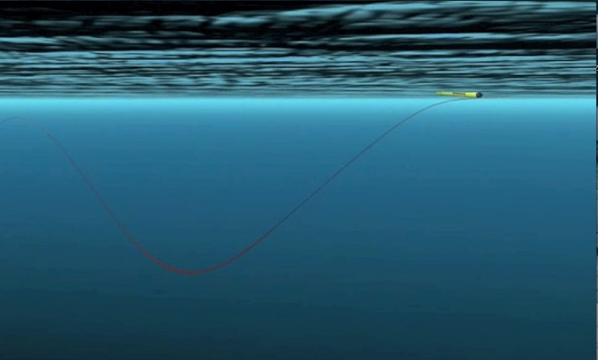
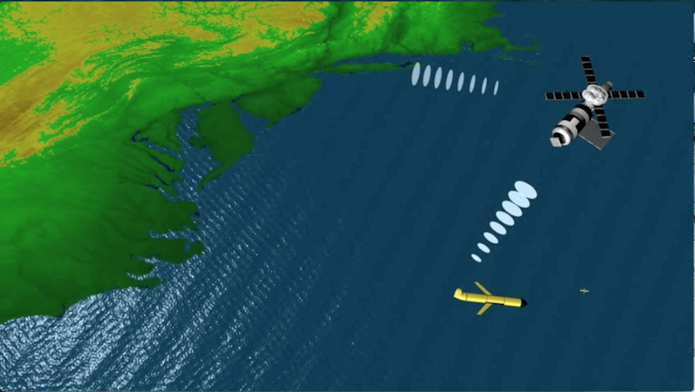
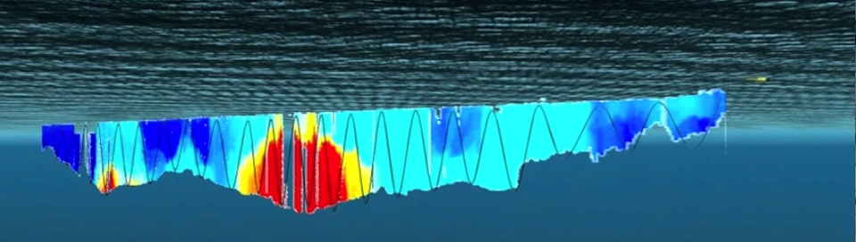
Glider Communications
GPS for Position, Iridium for 2-Way, ARGOS for Emergencies
Glider Surfaces
2-Way Satellite Communications in Tail
Data Ribbon Transmitted to Shore

Slide 5
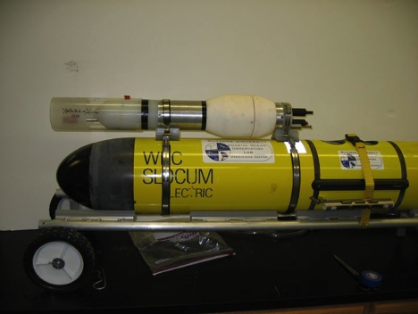
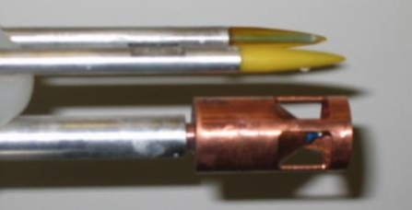
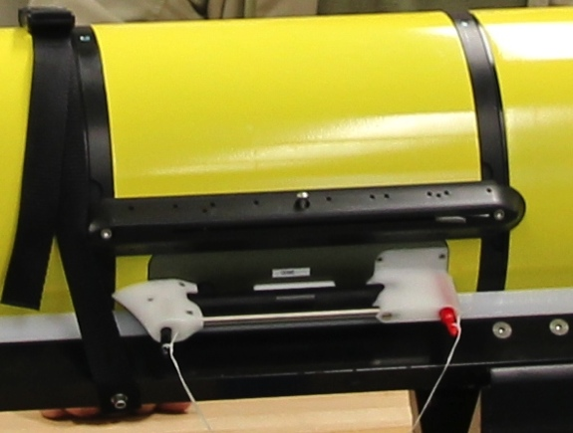
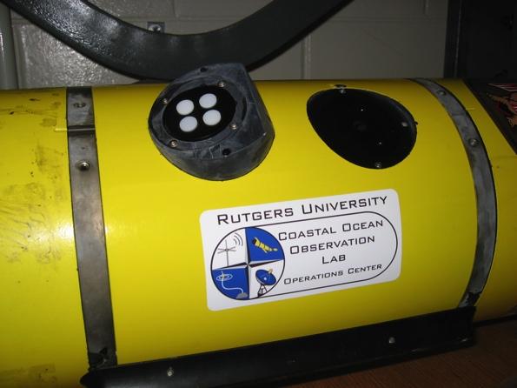
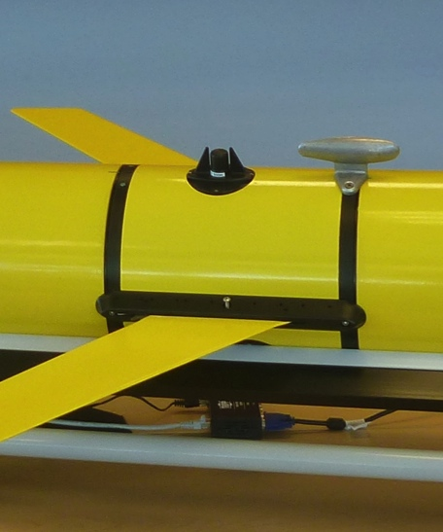
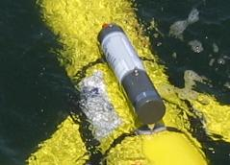
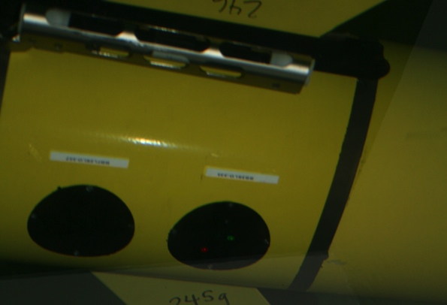
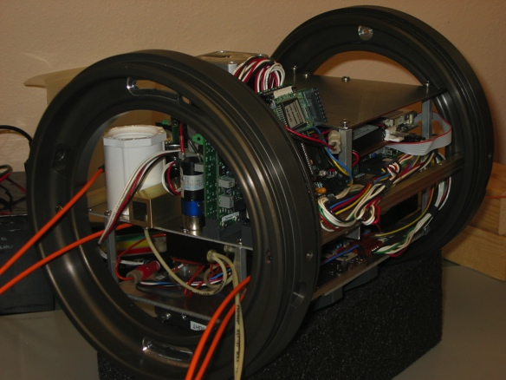
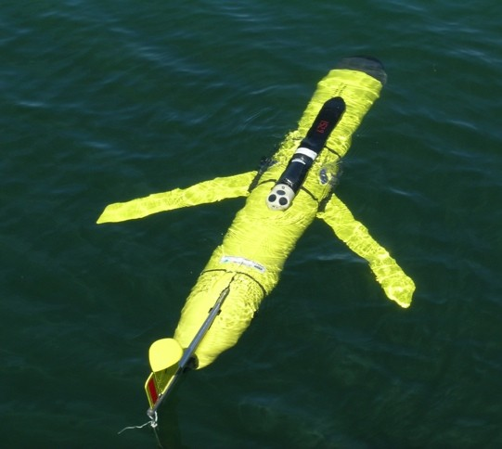
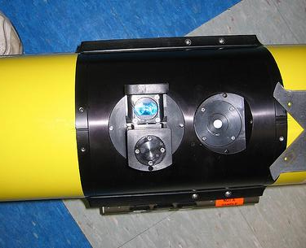
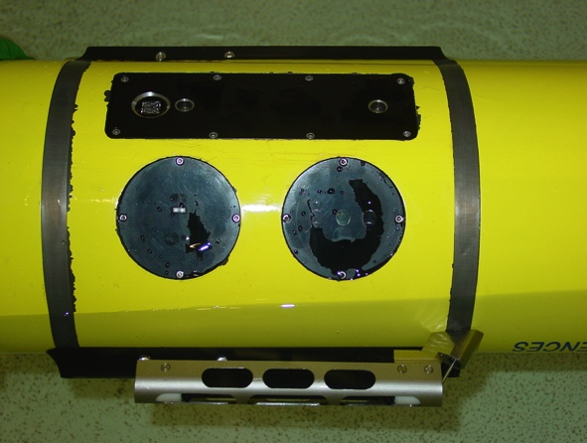

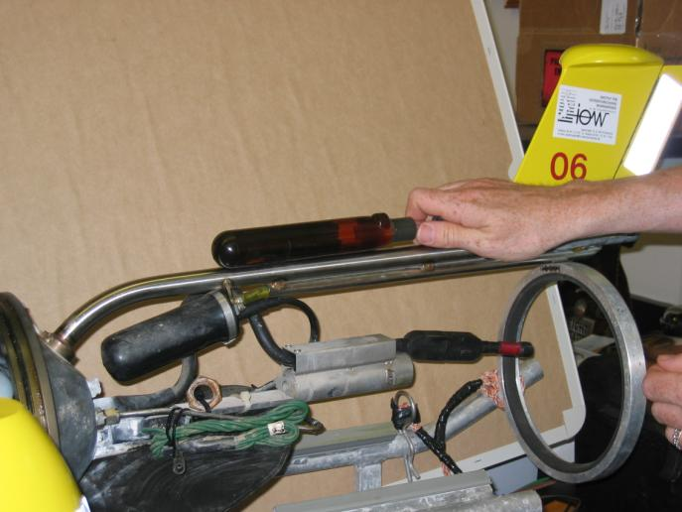
Glider Sensors
Inside Payload Bay or External

Slide 6
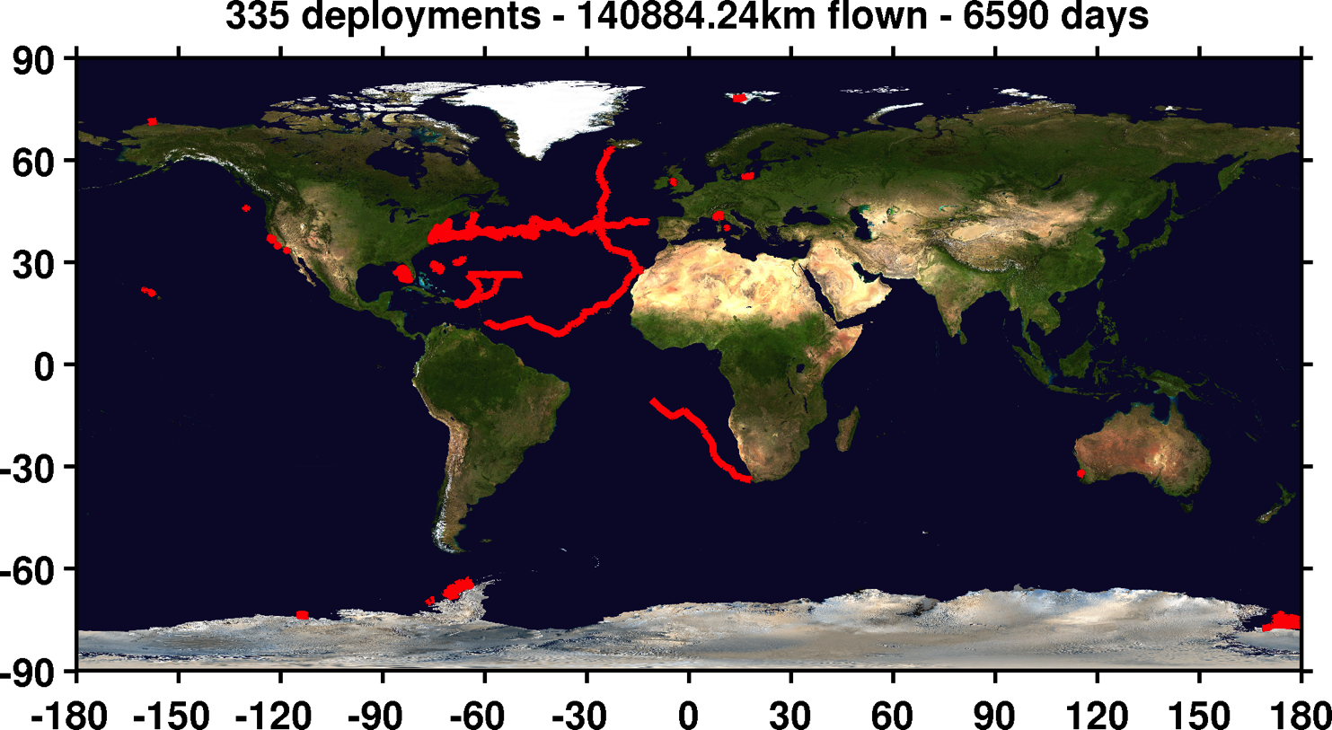
TRL 5: Independent, third party evaluation or application
that demonstrates reliable long-term field operations?
Rutgers+Partners Glider Deployments since 2003

Slide 7
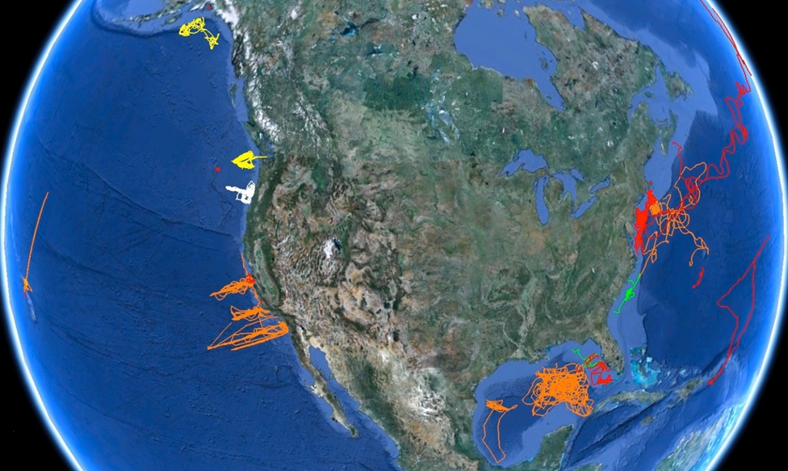
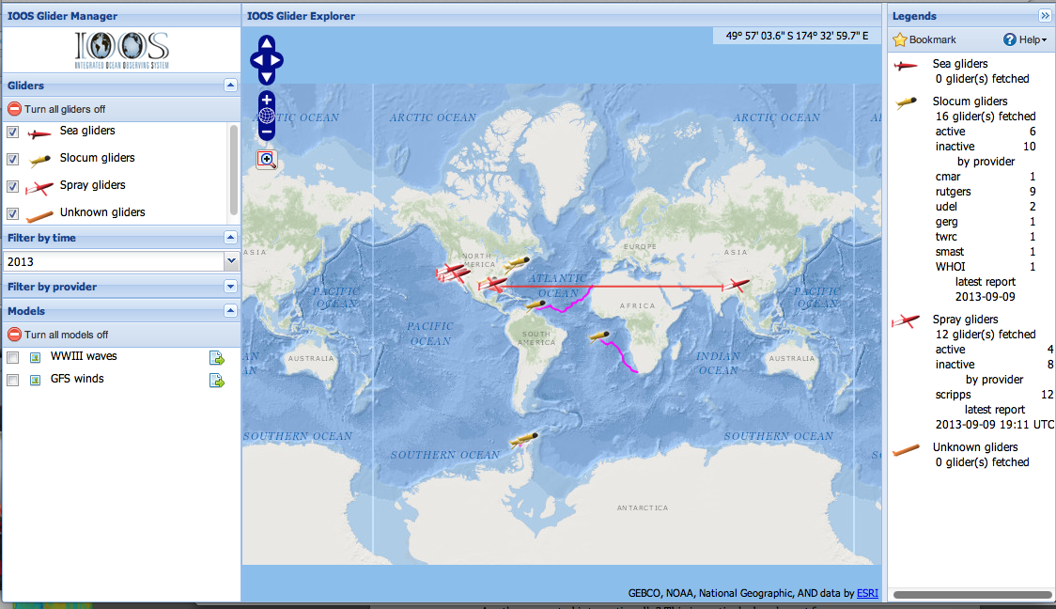
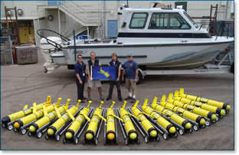
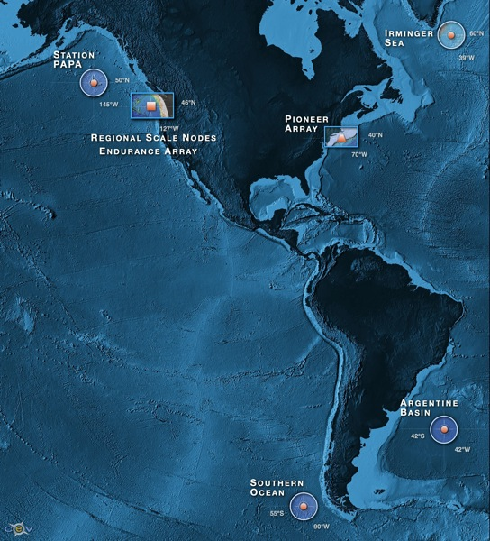


U.S. National Glider Activities
U.S. IOOS National Glider Network:
U.S. Coastal Deployments since 2003
U.S. IOOS Real-time Glider Asset Map
U.S. Navy Operational Fleet – 150 Gliders
NSF OOI Glider Fleet – 48 Gliders

Slide 8
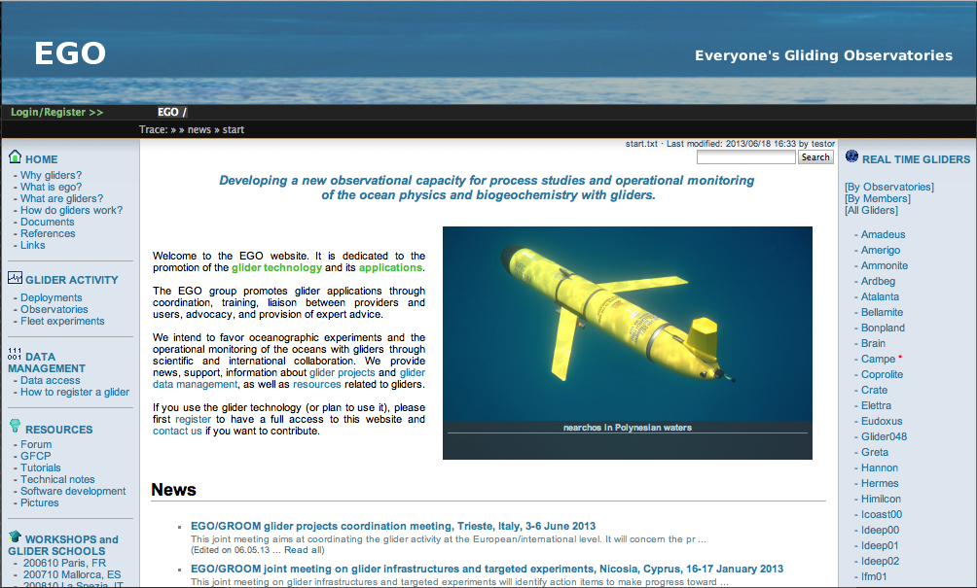
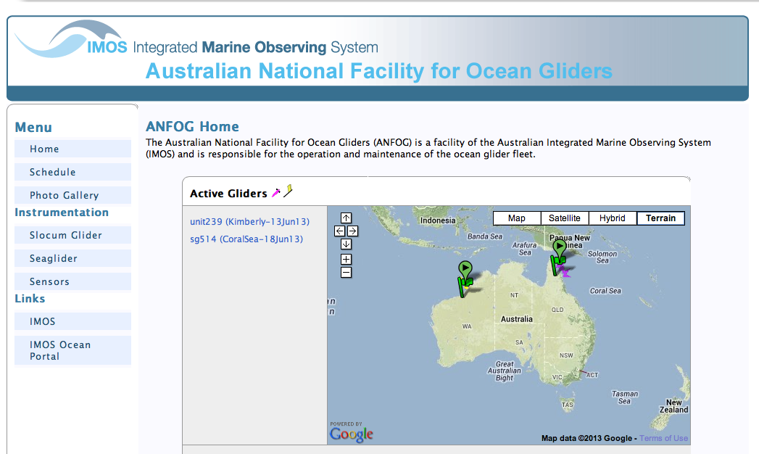
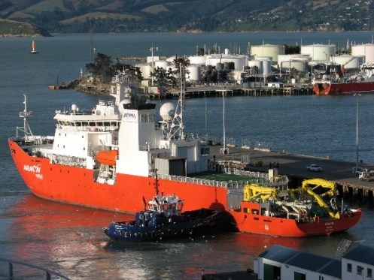
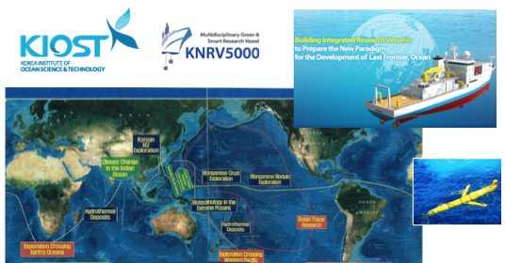

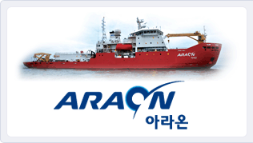
International Glider Activities
EGO - Everyone’s Gliding Observatories
ANFOG – Australian National Facility
Korea – U.S. Polar Gliders
Korea – U.S. Global Gliders

Slide 9

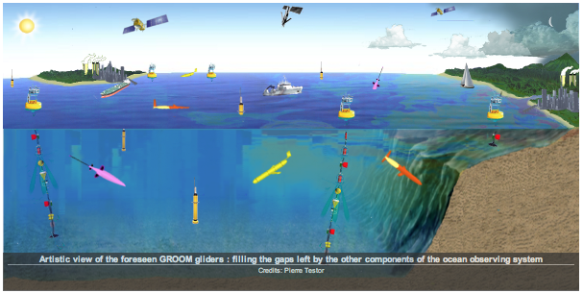
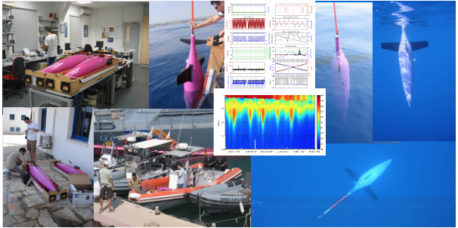
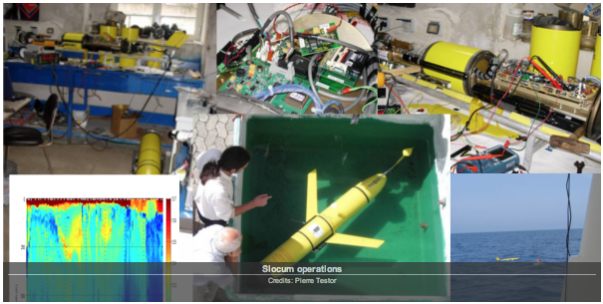
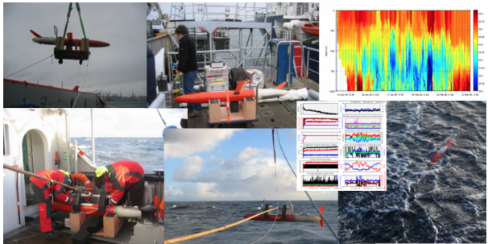
IMON Criteria: Relevance to requirements of policy, operational and research end users.
GROOM Evaluation: Buoyancy gliders fill a gap left by other observing components.

Slide 10
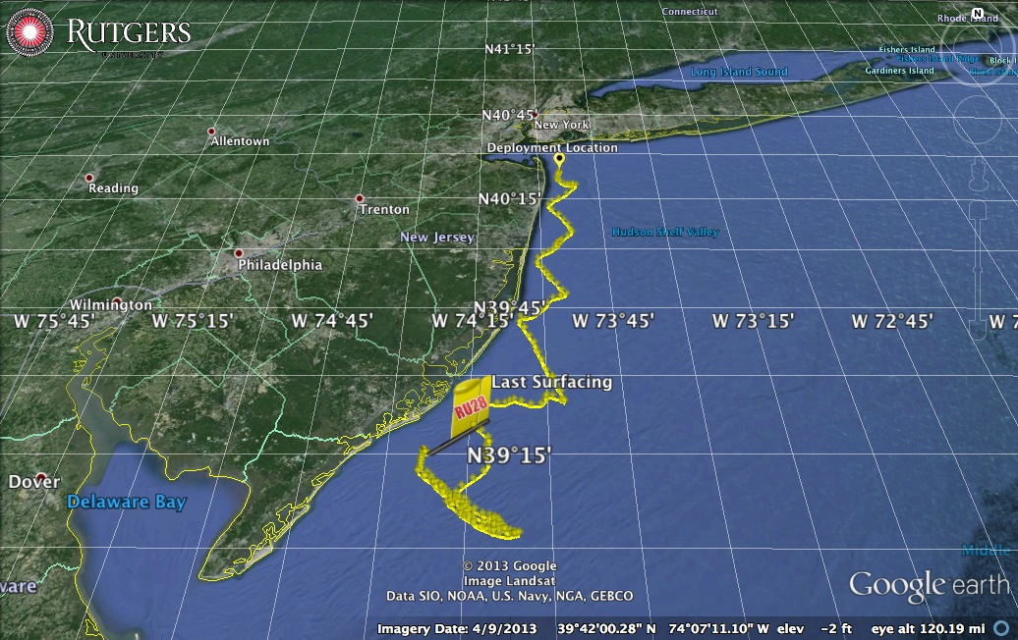
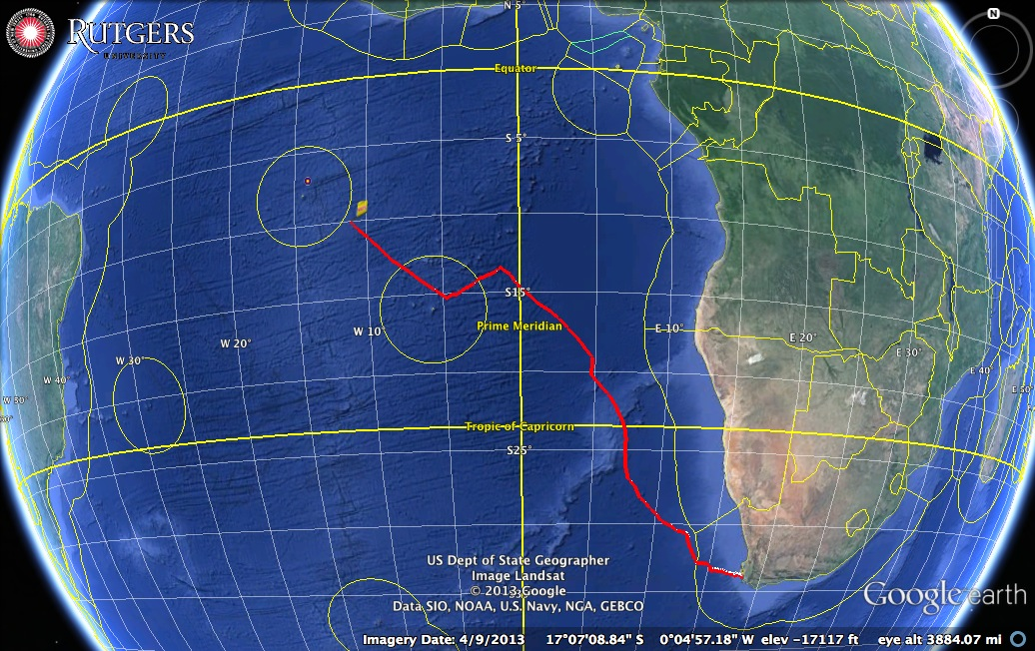
Typical Glider Mission Costs
Coastal
1 Month
Global
1 Year
Glider Procurement: $130,000 to $175,000
O&M Costs:
Coastal < Boat Day
Global << Ship Day
O&M Tasks | Coastal | Global
Preparation | $14,132 | $24,641
Deployment | $3,329 | $25,041
Piloting | $19,389 | $24,958
Recovery | $3,329 | $22,025
Post deployment | $14,775 | $8,127
Total | $54,954 | $104,793
Cost/day | <$2000 | <$300

Slide 11
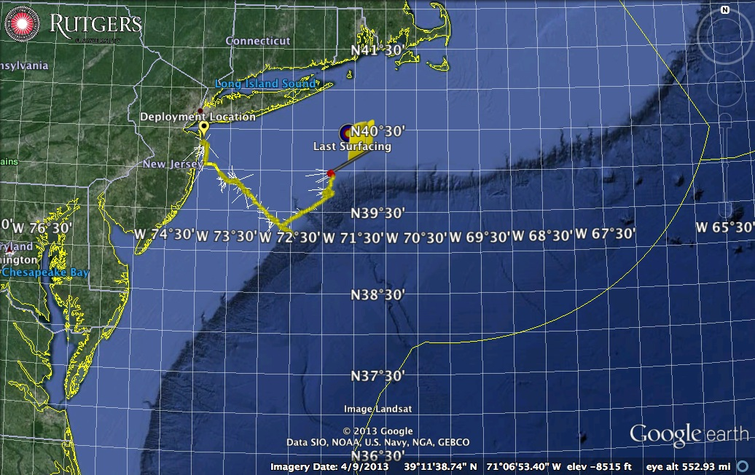
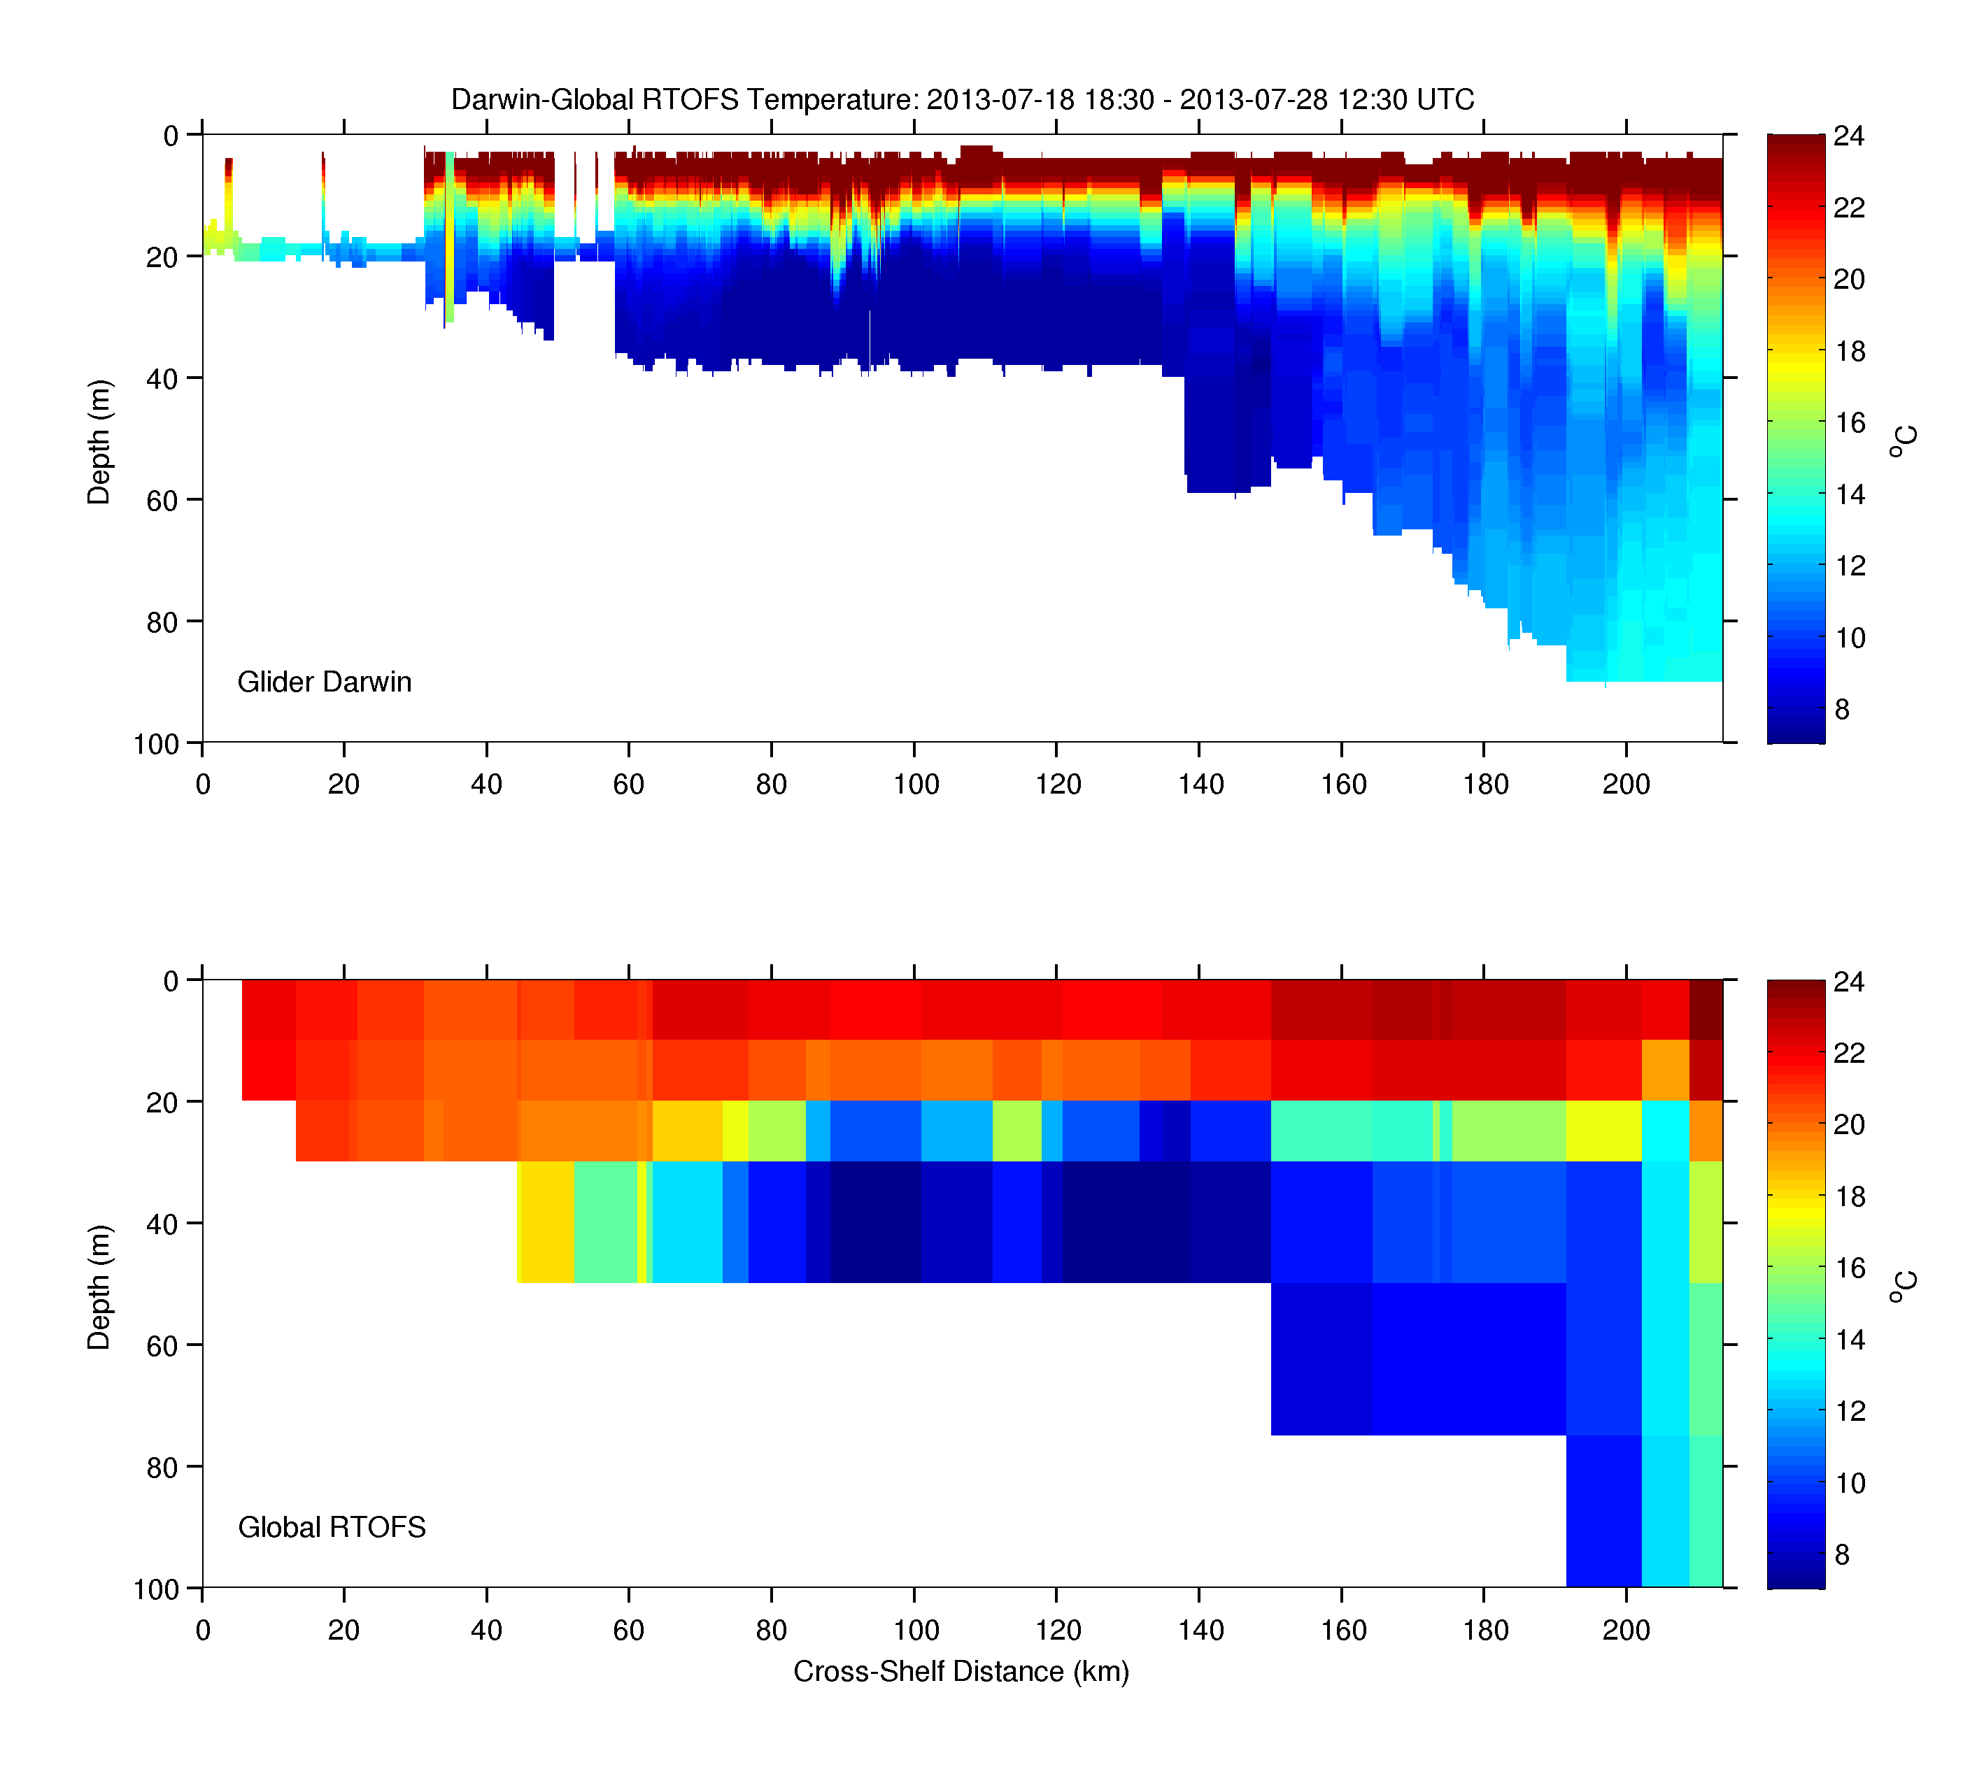
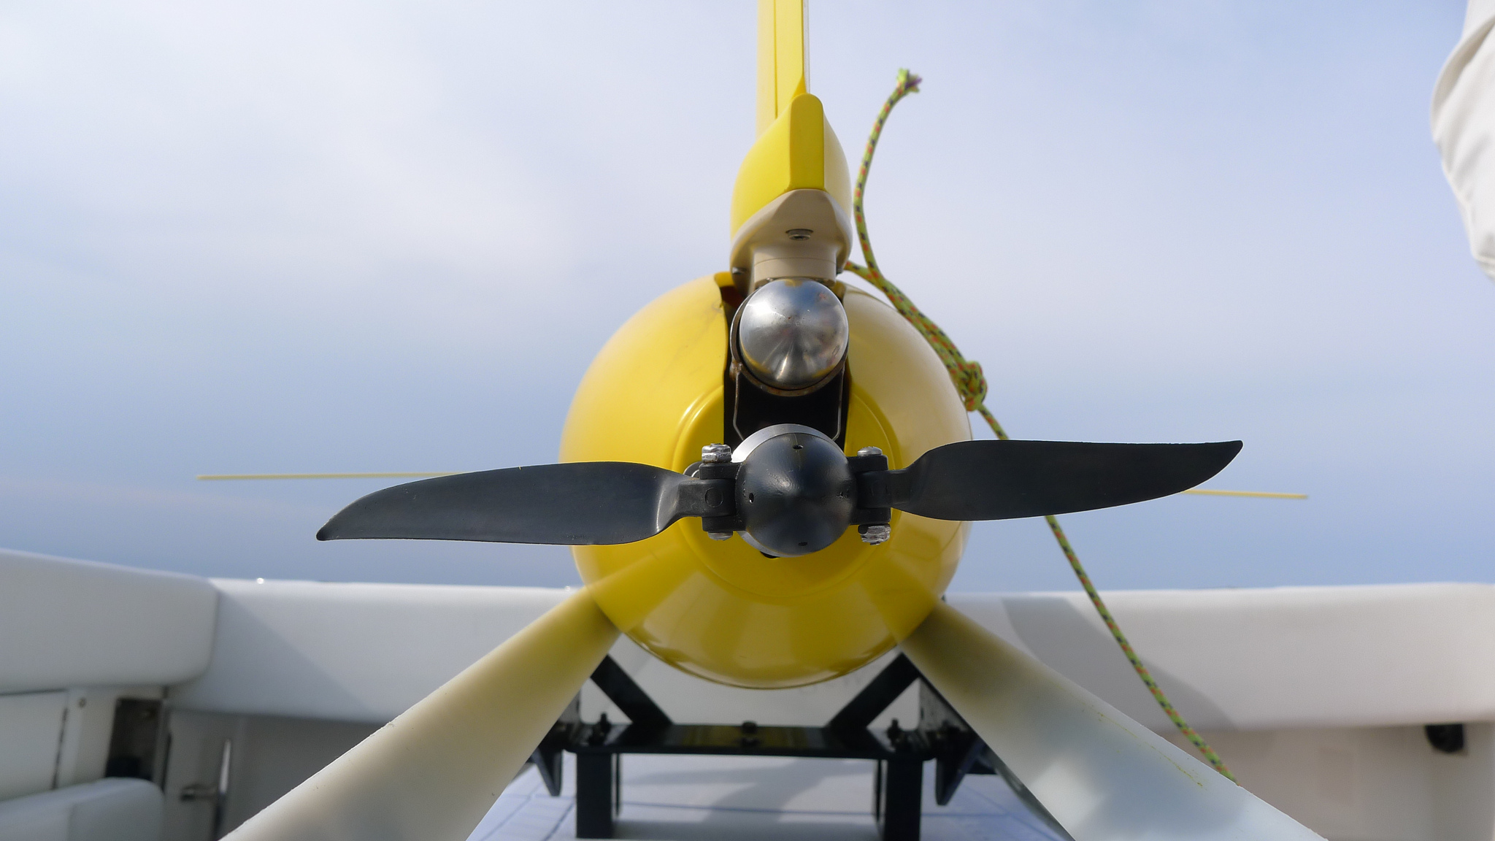
IMON Criteria:
Multi-purpose?
Summer 2013: Current Mid-Atlantic
Temperature
Glider Data
Hybrid Glider
w/ Propeller
Global Model Forecasts

Slide 12
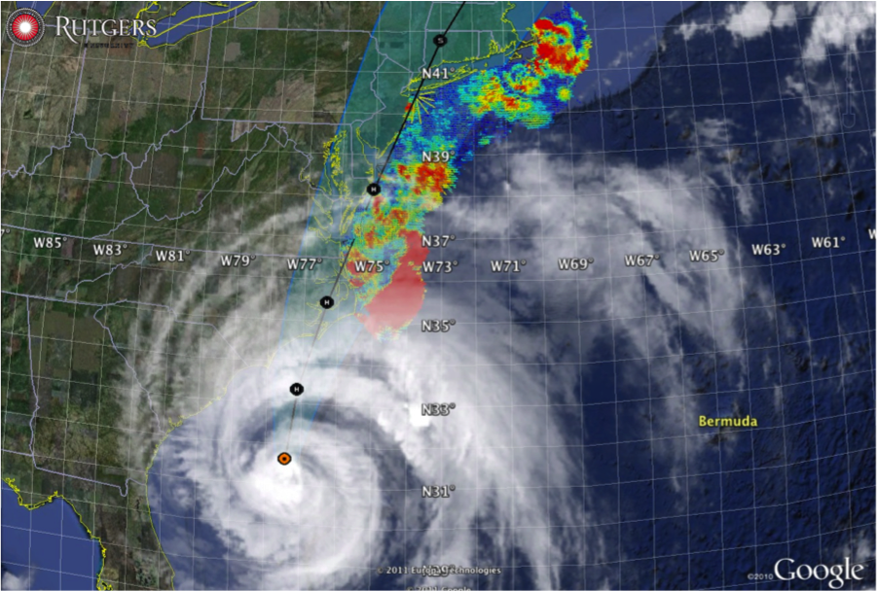
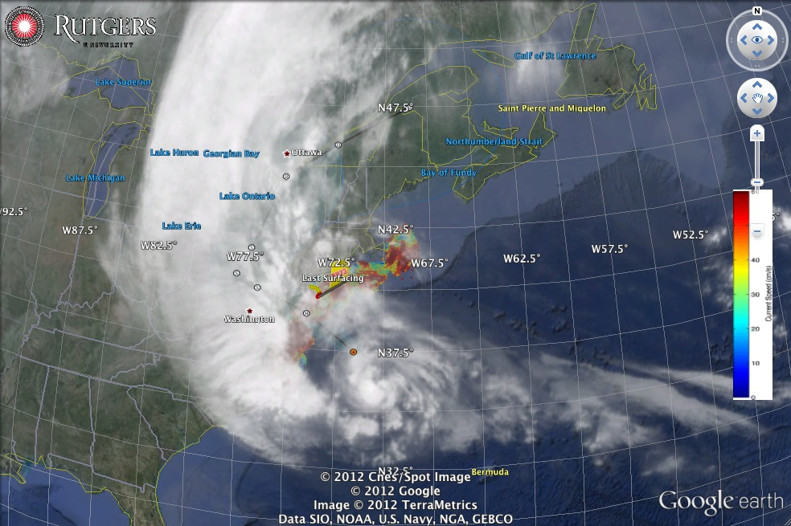
Hurricane Irene
August 26, 2011
NOAA/NHC Damage:
#8 with >$15 Billion.
Track Accurate;
Intensity Over-predicted.
Hurricane Sandy
October 29, 2012
NOAA/NHC Damage:
#2 with >$60 Billion.
Track Accurate;
Intensity Under-predicted.

Slide 13
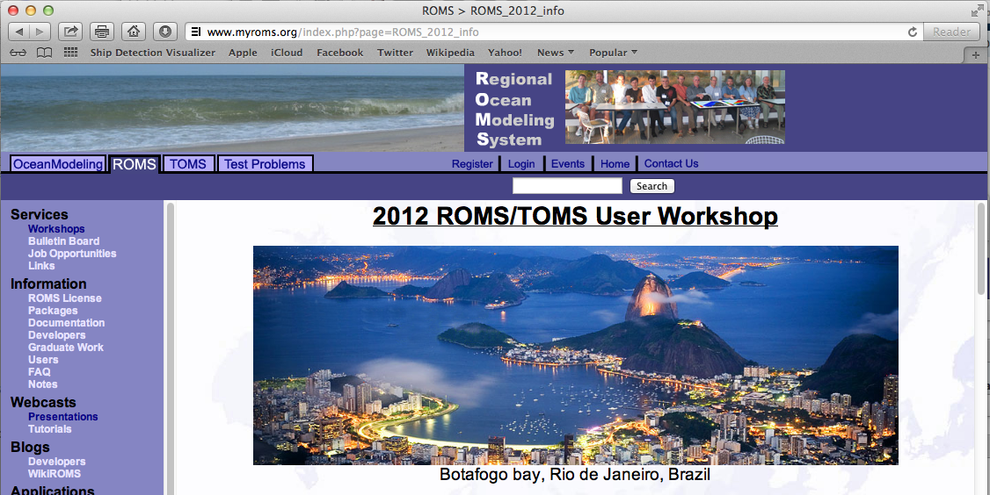
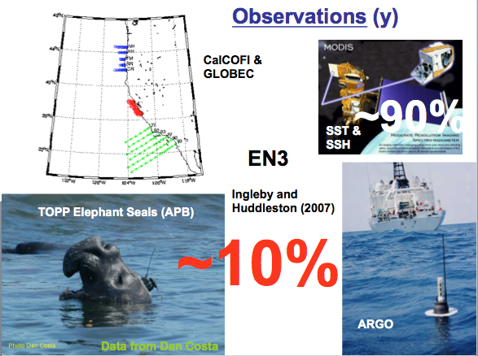
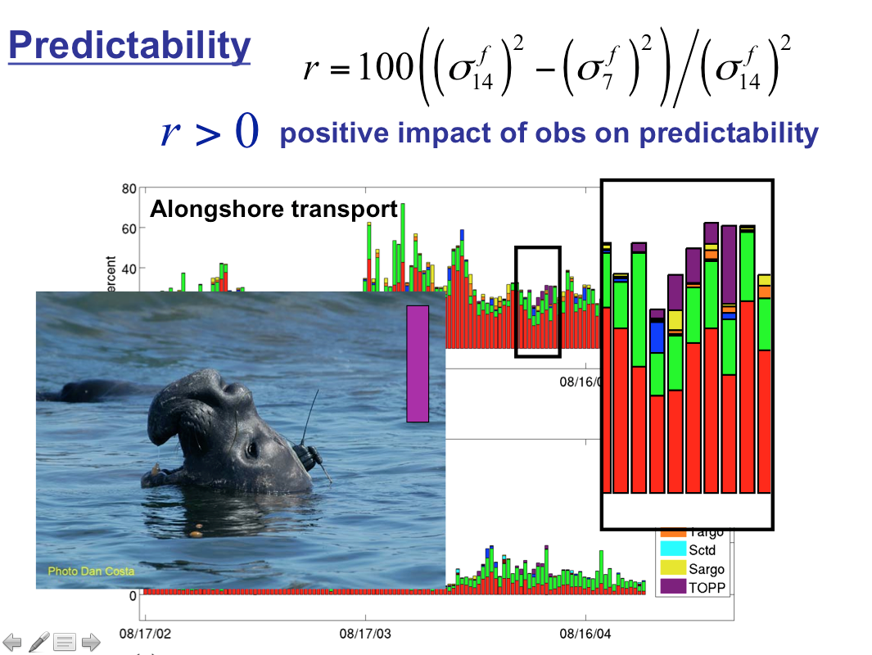
Annual ROMS Users Meeting
Rio de Janeiro, 2012
Brian Powell: Quantifying how observations inform our models
John Wilkin: An evaluation of real-time forecast models of MAB continental shelf waters
Andy Moore: Observations & ocean state estimation: Impact, sensitivity & predictability
SSH
SST
CTD

Slide 14
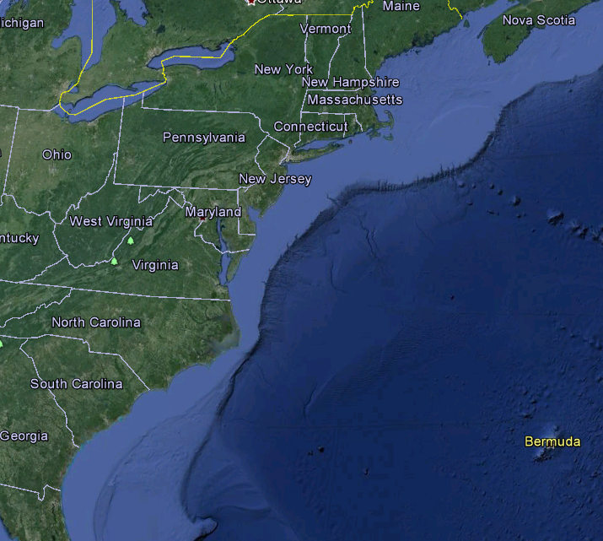
IMON Criteria:
Multi-purpose?
Penobscot
OTN201
OTN200
Darwin
Saul
RU28
Blue
To Date:
13 Gliders,
11 Participants,
11 Funding Sources
Otis
RU23
RU22
VIMS
Salacia
Gliderpalooza
Sept-Oct 2013
Deployments
Modena
Multiple Goals:
1) provide a unique assimilation dataset for ocean models
2) provide standardized dataset over ecological scales
3) provide information on fish/mammal migrations
4) provide a 3-D snapshot of the MAB cold pool,
5) demonstrate a community surge capacity through the peak fall storms & hurricanes
6) demonstrate data flow from Academics to IOOS to NDBC to GTS via DMAC, and
7) engage undergraduates in ocean observing efforts.

Slide 15





A Global Challenge – The Challenger Glider Mission
December 9, 2009 – Baiona, Spain
Ralph Rayner & Rick Spinrad’s Global Challenge:
Build a Global Glider Fleet
and Coordinate the First
Robotic Circumnavigation.
Revisit the Historic Track of the
HMS Challenger –
And inspire a global network
of students along the way.
HMS Challenger Voyage
First Scientific
Circumnavigation
1872-1876
128,000 km =
= 16 gliders
x 8,000 km/glider

Slide 16




Glider Silbo, RTOFS & MERCATOR Temperature Sections
Glider Slibo
Glider Slibo
RTOFS
Mercator

Slide 17

Glider Silbo, RTOFS & Mercator
Temperature and Salinity Time Series
200 m
800 m
Temperature
Salinity

Slide 18



RTOFS and MERCATOR
Temperature and Current Maps at 200 m
RTOFS 200m temperature and currents on April 18th, 2013. The glider position is marked by the red dot.
MyOcean 200m temperature and currents on April 18th, 2013. The Gliders position is marked by a red dot.

Slide 19



Global Challenger Glider Mission
16 Global-Class Gliders
5 Ocean Gyres: 16 gliders x 8,000 km/glider = 128,000 km

