Slide 1
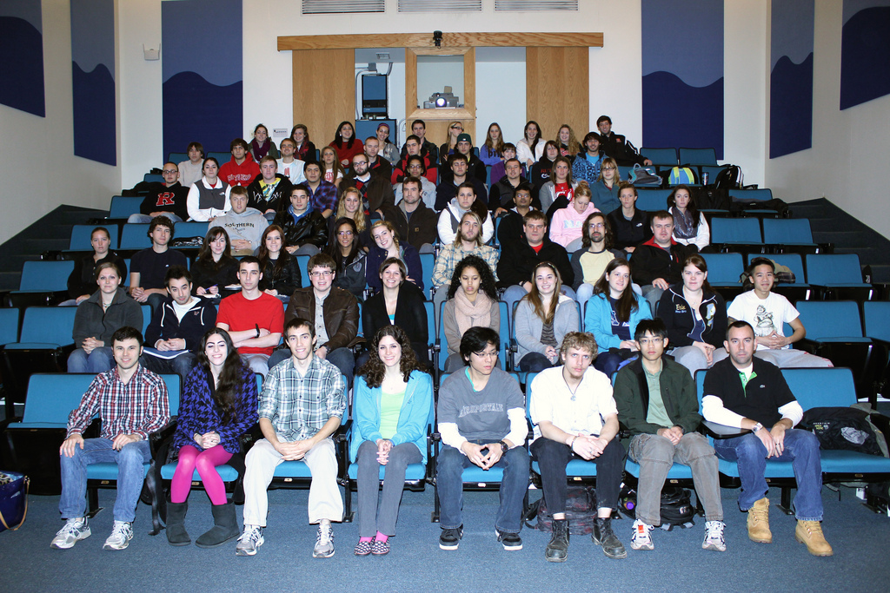
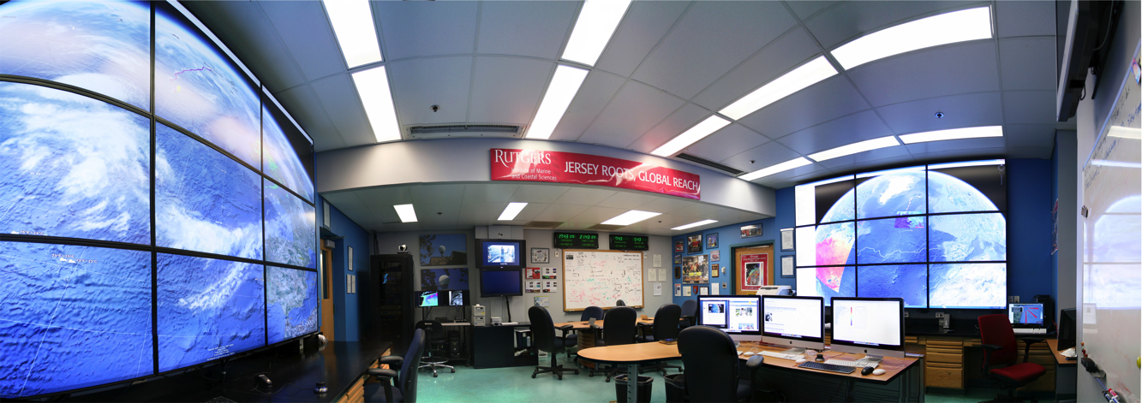
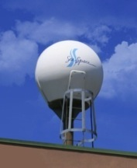
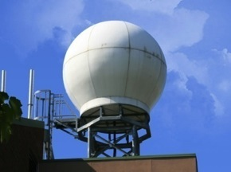
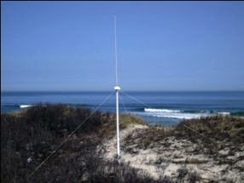
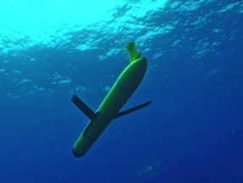
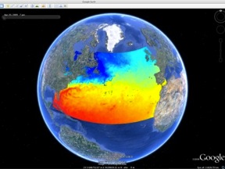
Rutgers University
Coastal Ocean Observation Lab
>20 Researchers, > 100 Undergrads, >$100 M Funding
Satellite Data Acquisition Stations
CODAR Network
Glider Fleet
3-D Forecasts

Slide 2
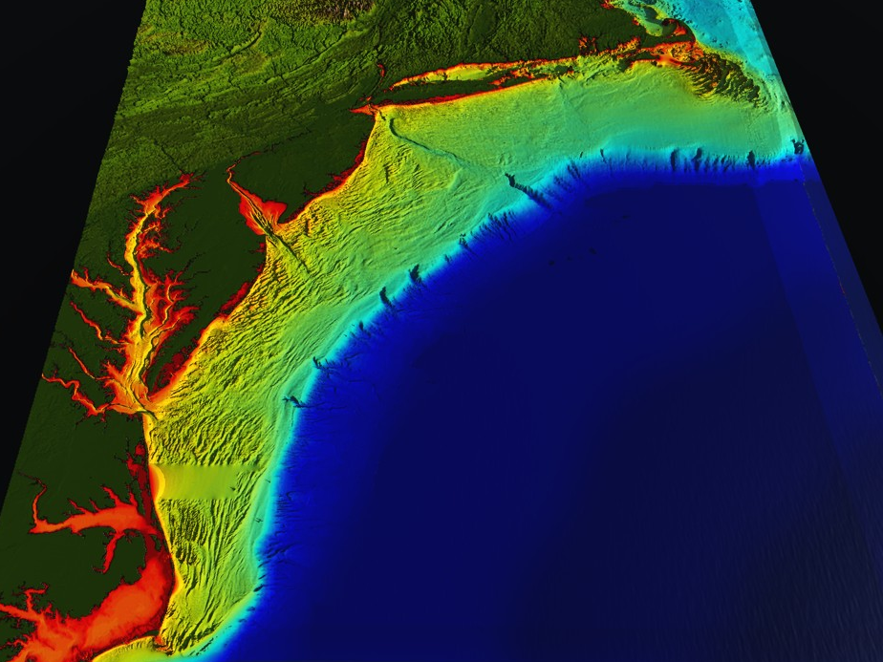













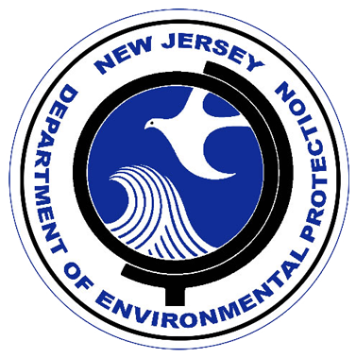


U..
Middle Atlantic
Regional Association
Coastal
Ocean Observing System
1000 km
Cape to Cape
CT
RI
Cape
Cod
MA
NY
10 States
PA
NJ
MD
DE
Regional-scale Ocean Observatories for Science, Society & Security
>40 PIs
>20 Institutions
>50 Members
Scott Glenn + Many
VA
NC
Cape
Hatteras
Notes:
2

Slide 3
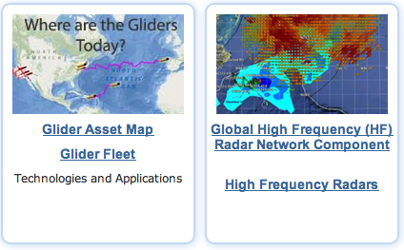

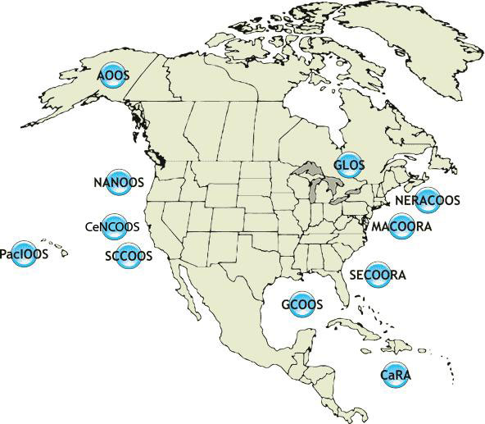
















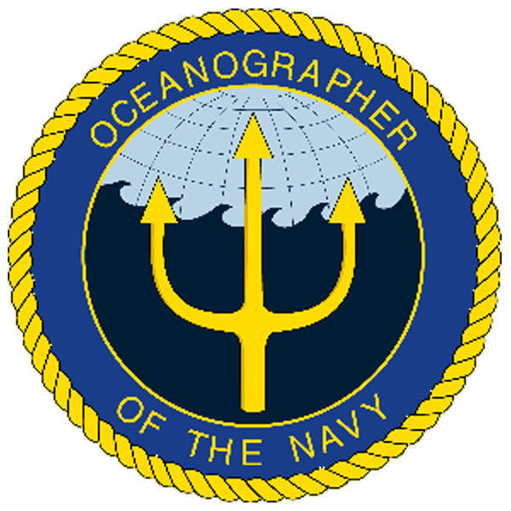
U.S. Integrated Ocean Observing System
IOOS Relationships
International Component
National Component
Regional Component
Globally Coordinated Initiatives
Vessels -
Satellite
Satellite
CODAR
Ships/ Vessels
Glider
REMUS
Data Vis.
Modeling
Security
Leadership
Education
11 Regional Associations
17 U.S. Federal Agencies
http://ioos.gov

Slide 4
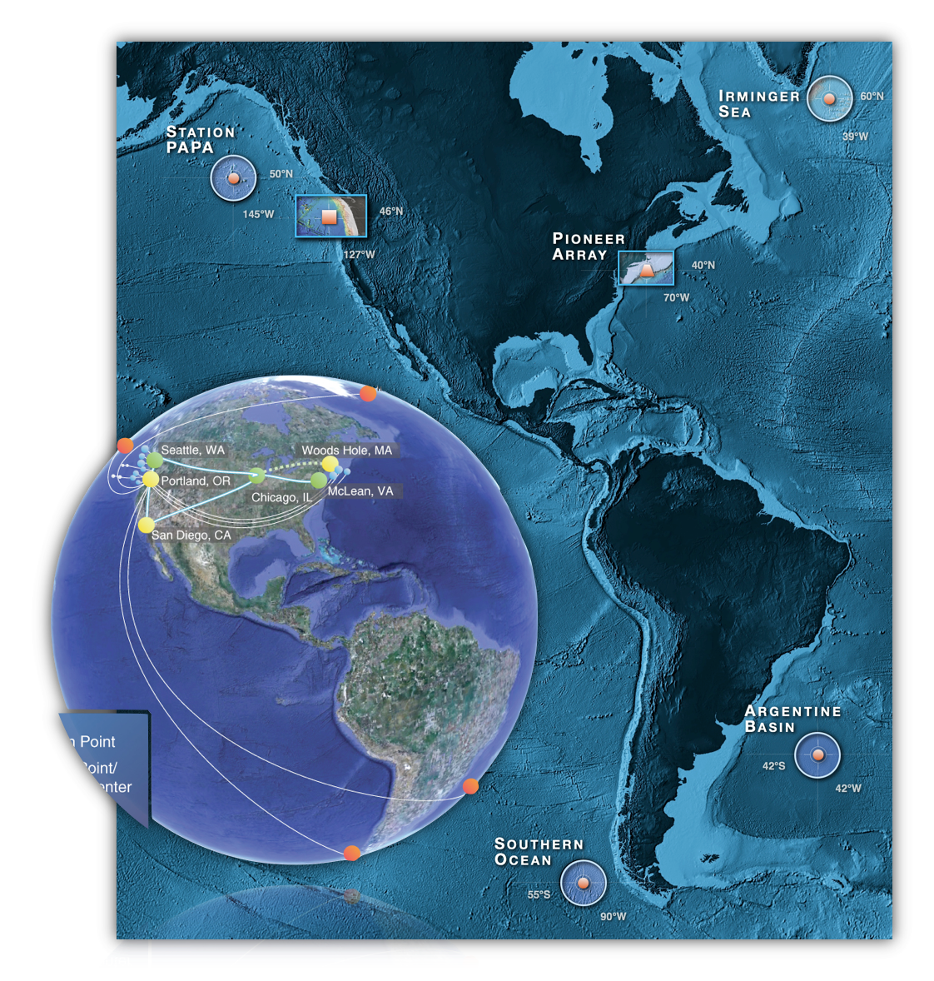

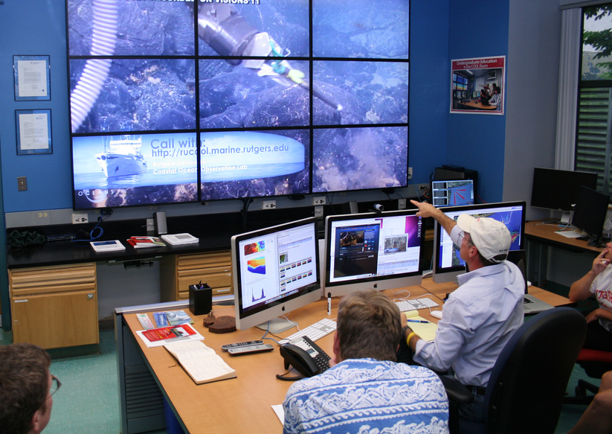


National Science Foundation
Ocean Observatories Initiative
Construction Phase: $386 M
Implementing Organizations:
-Marine (Global, Regional,
Endurance, Pioneer)
-Cyber Infrastructure
-Education

Slide 5
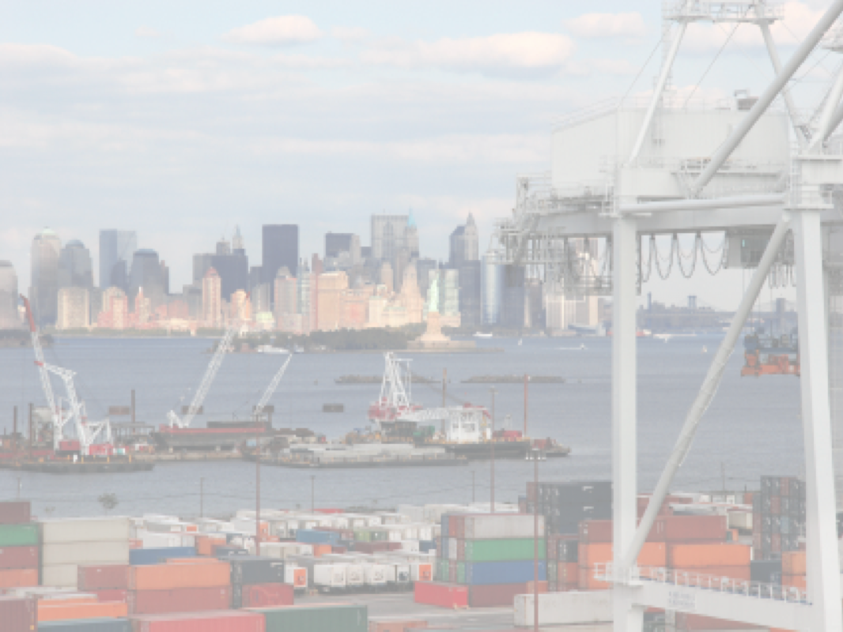












The Center for Secure and Resilient Maritime Commerce (CSR)
Rutgers University – CODAR Ocean Sensors
Academic – Industry Partnership since 1998
CSR’s HF Radar Mission:
Develop & Verify the HF Radar Multi-Use Capability for Current Mapping & Vessel Tracking.
Transition these Capabilities to Operational Use for Search And Rescue (SAR) and Maritime Domain Awareness (MDA).
Educate the Workforce Required to Operate these National Systems.

Slide 6
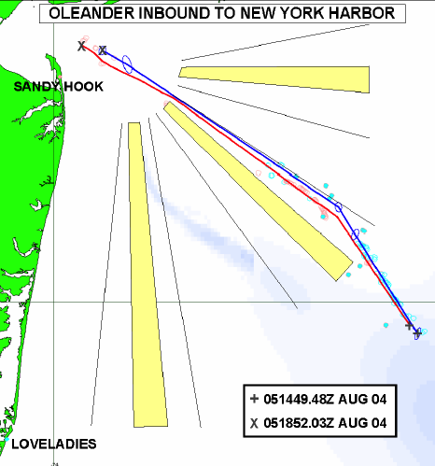
The Center for Secure and Resilient Maritime Commerce (CSR)
HF Radar Team
Rutgers University -
Scott Glenn, Josh Kohut, Hugh Roarty,
Mike Crowley, John Kerfoot, Ethan
Handel, Mike Smith, Colin Evans
CODAR Ocean Sensors -
Don Barrick, Pete Lilleboe, Chad Whelan
Belinda Lipa, Bill Rector, Jimmy Isaacson
University or Puerto Rico – Mayaguez
Jorge Corredor, Julio Morell, Miguel Canals
Applied Mathematics, Inc -
Bill Browning
University of Alaska – Fairbanks
Tom Weingarter, Hank Statscewich
Ocean Power Technologies –
Debbie Montagna, Bruce Downie
Naval Research Laboratory
Michael Lovellette, Dan Newton
Norwegian Defence Research Establishment (FFI)
Terje Johnsen, Walther Asen
CODARNor
Anton Kjelaas
Rutgers University – CODAR Ocean Sensors
Academic – Industry Partnership since 1998
ONR - 2004
27 Researchers @ 9 Institutions

Slide 7
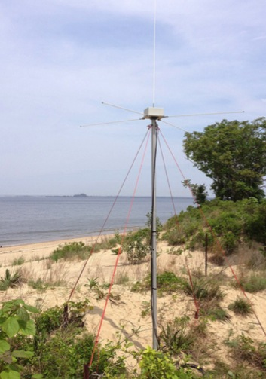
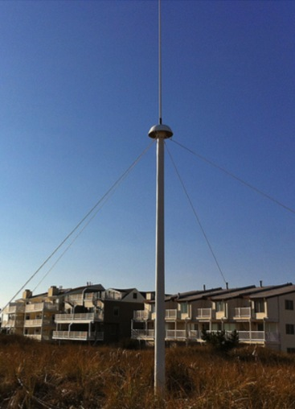
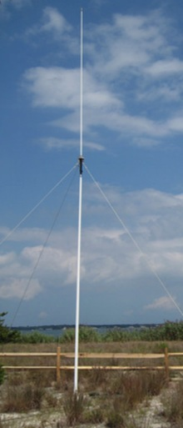
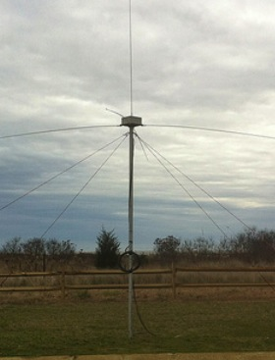
CODAR Compact HF Radar Antennas
25 MHz
13 MHz
5 MHz
Combined Transmitter & Receiver
Separate Transmitter & Receiver

Slide 8
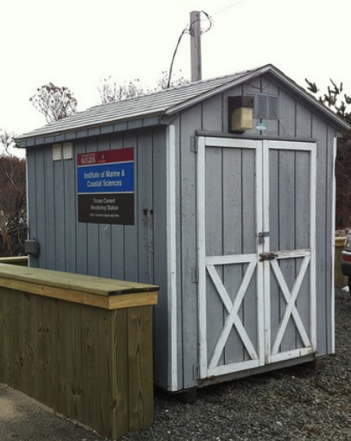
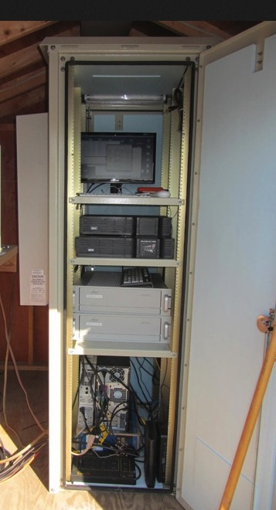
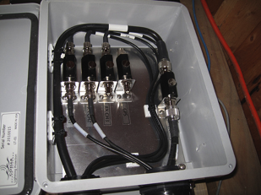
Standard CODAR Shore Site:
Shed, Enclosure, Tx/Rx, Comms, Power, GPS, AIS
monitor
computer & external hard drive
A.C. unit
UPS system
transmitter
receiver
Two lines of Communication
Shed
Enclosure
Lightning Protection

Slide 9
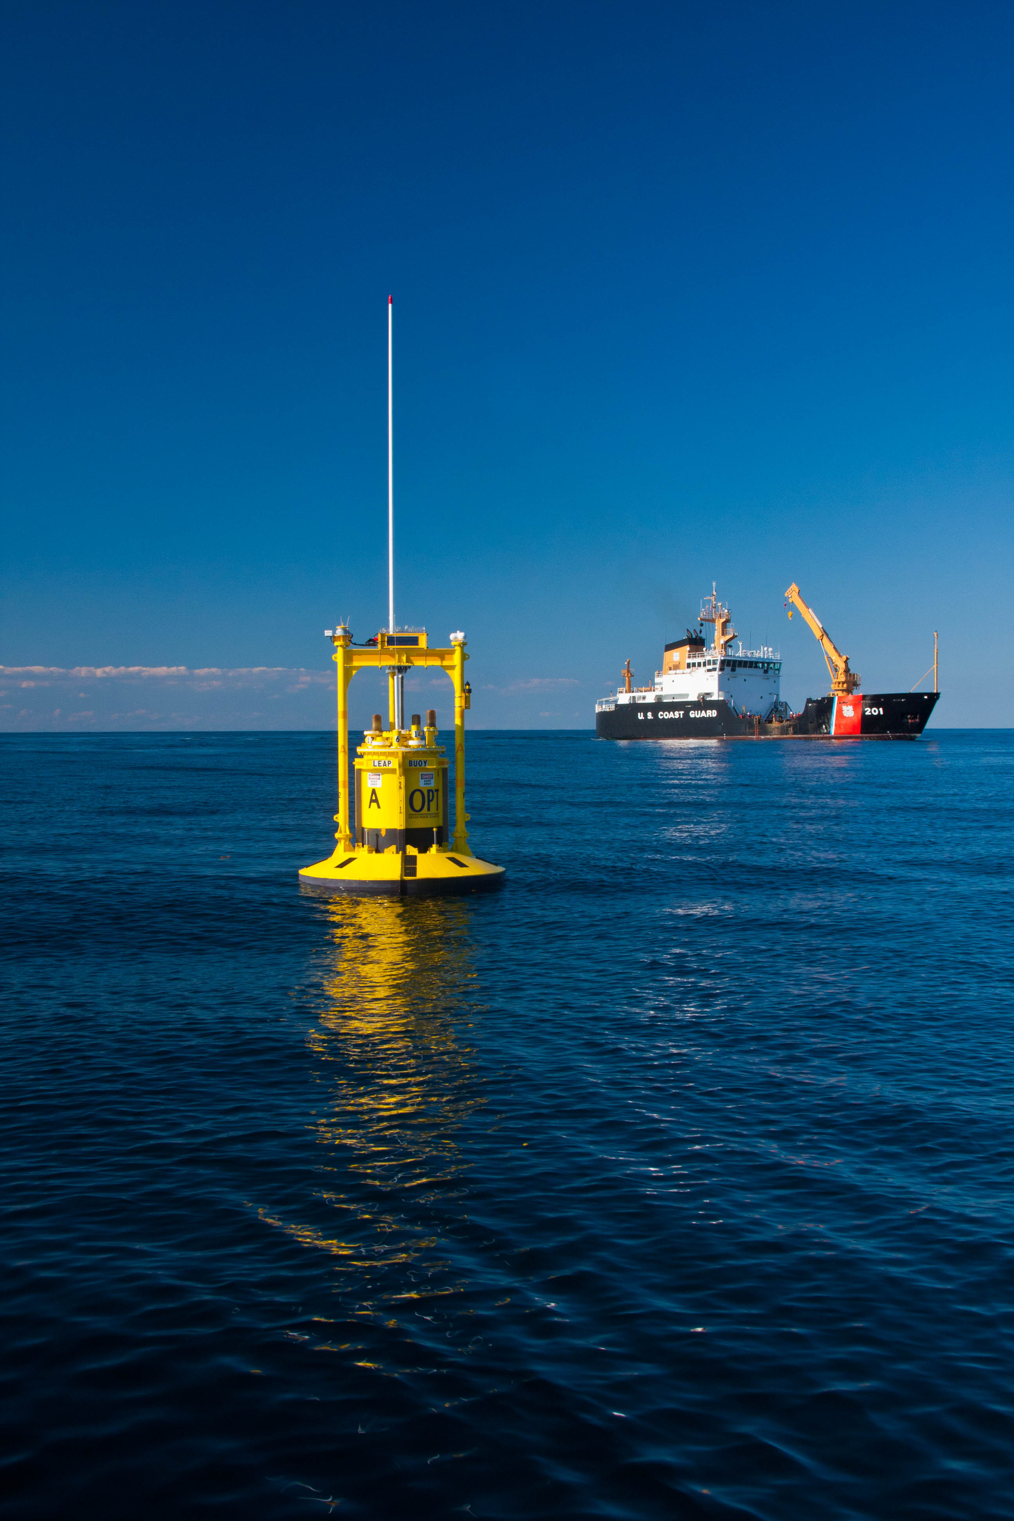
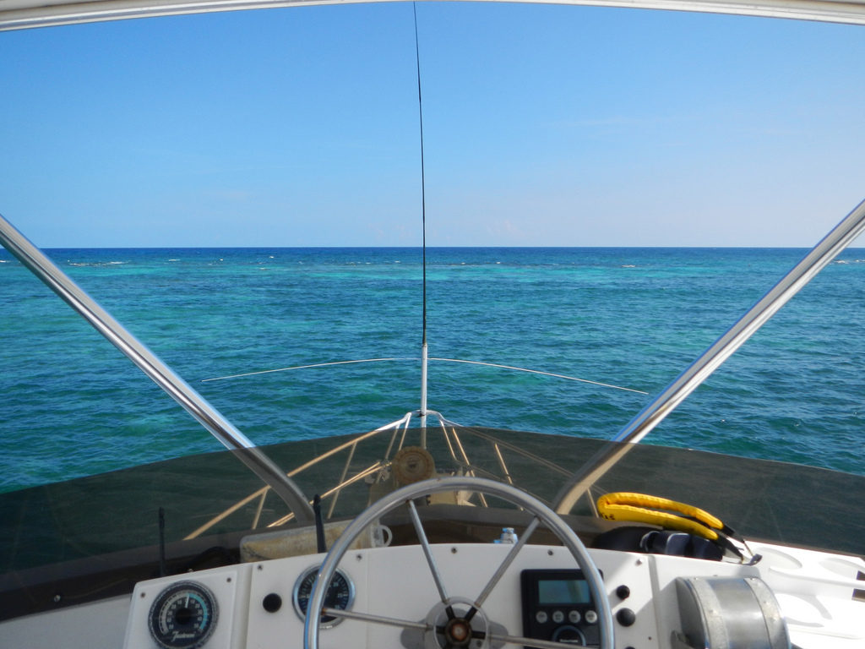
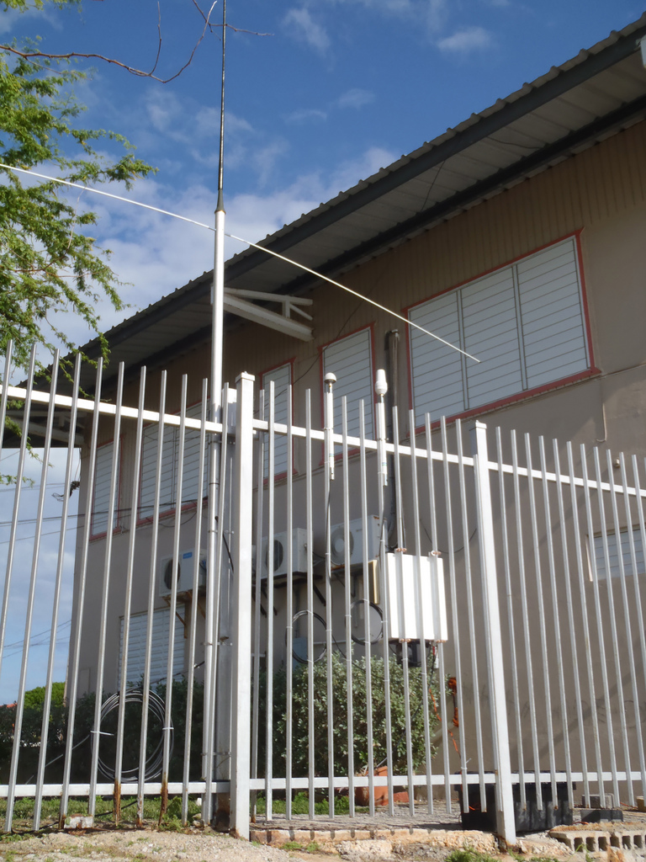
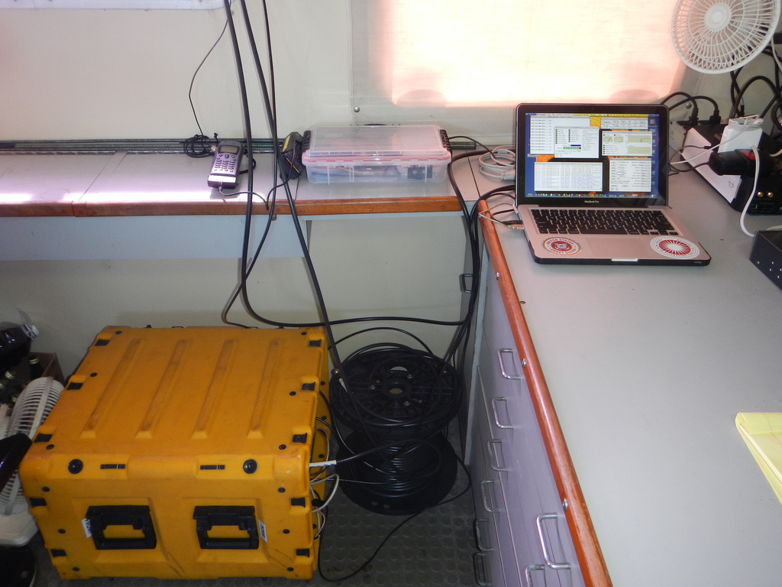
HF Radar Bistatic Transmitters –
Extending Range & Number of Look Angles
On Buoys On Ships On Shore

Slide 10
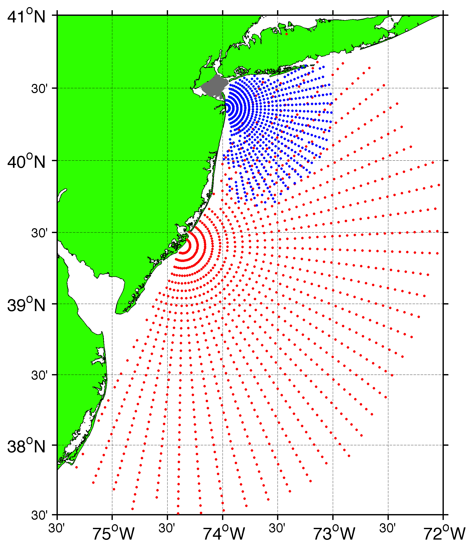
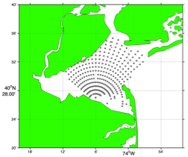
Surface Current Mapping Capability
25 MHz
Radar λ: 12 m Ocean λ: 6 m
Range: 30 km Resolution: 1 km
13 MHz
Radar λ: 23 m Ocean λ: 12 m
Range: 80 km Resolution: 3 km
05 MHz
Radar λ: 60m Ocean λ: 30 m
Range: 180 km Resolution: 6 km

Slide 11
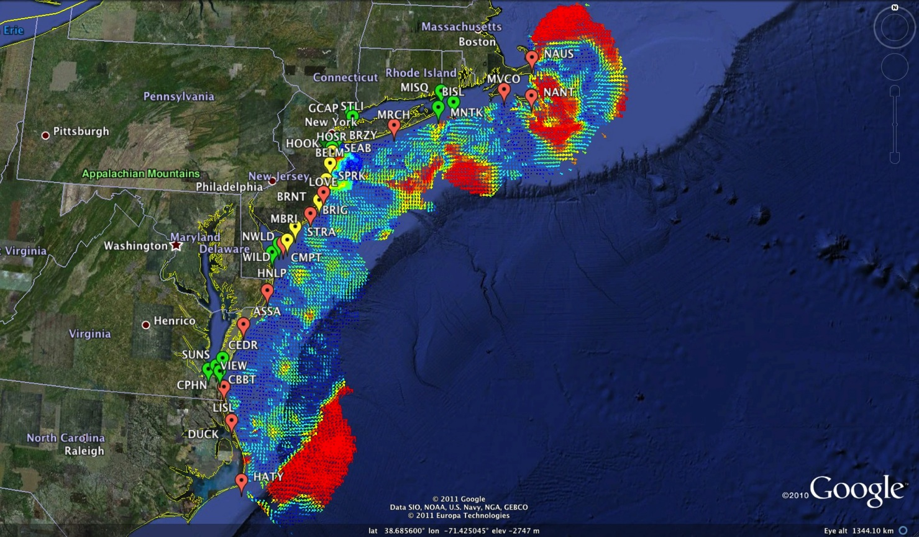
Mid-Atlantic Bight HF Radar Network
1000 km Alongshore Length Scale
Mid-Atlantic HF Radar Network
16 Long-Range CODARs
8 Medium-Range CODARs
17 Short-Range CODARs
41 Total
Triple Nested & Multistatic

Slide 12
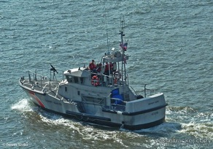
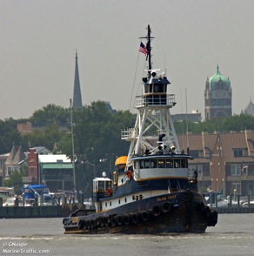
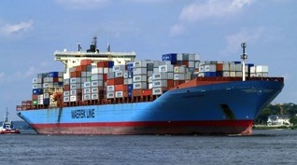
Vessel Detection Capability
25 MHz
Range: 11 nmi
Height >10 ft
13 MHz
Range: 43 nmi
Size: >19 ft
05 MHz
Range: 65 nmi
Size: >49 ft

Slide 13
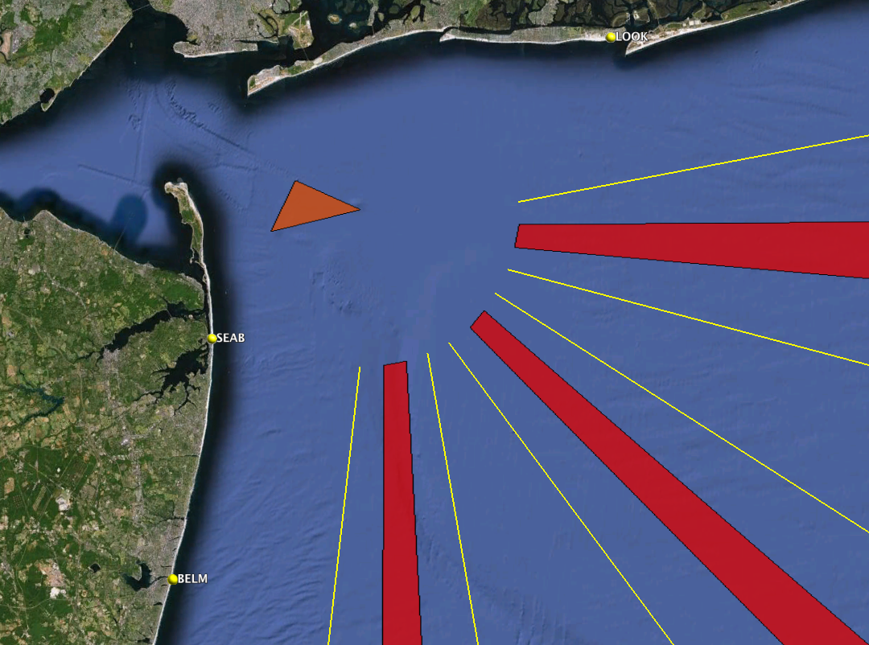





31% of
HF Radar Detections NOT on AIS
Approaches to New York Harbor
16 Vessels per Hour in HFR
5 Vessels NOT on AIS

Slide 14
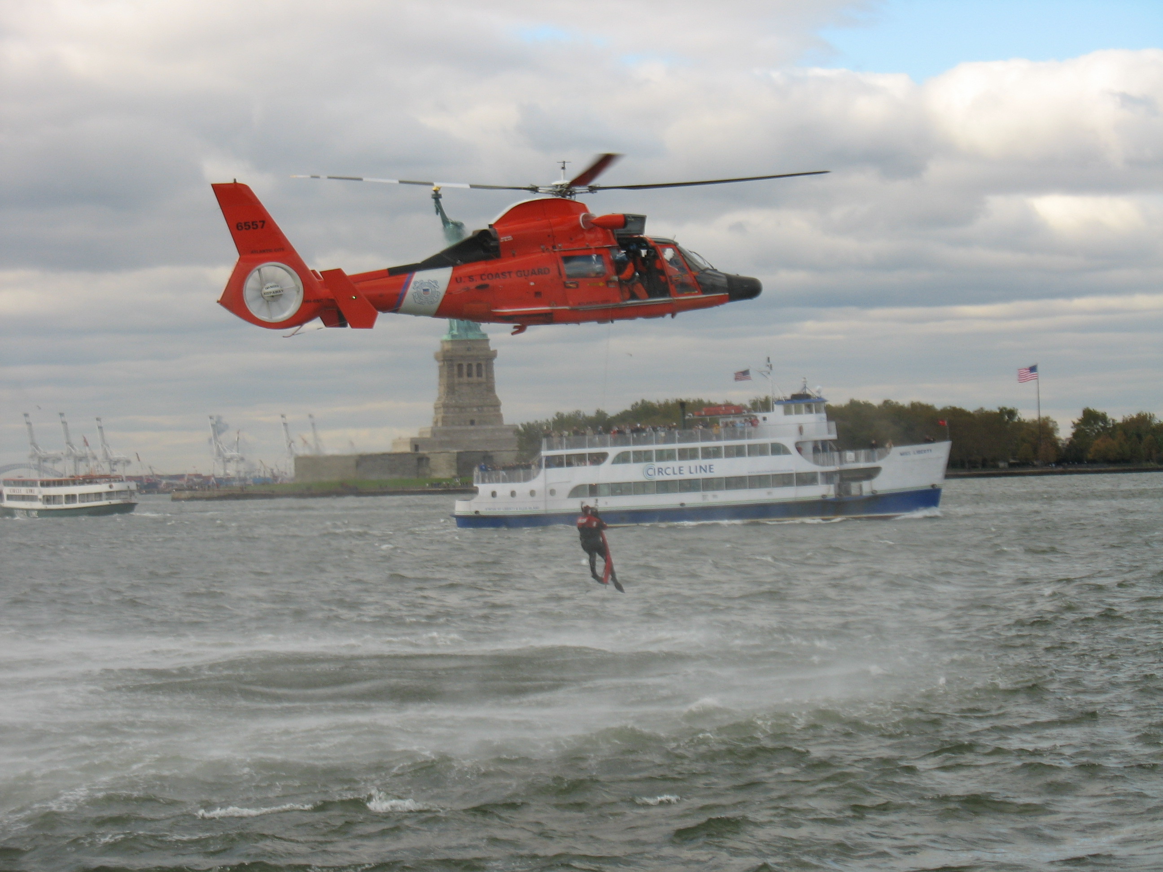
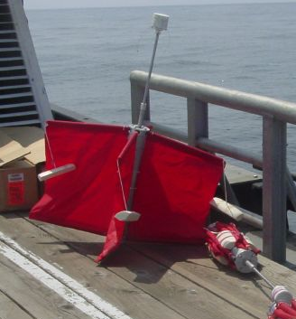
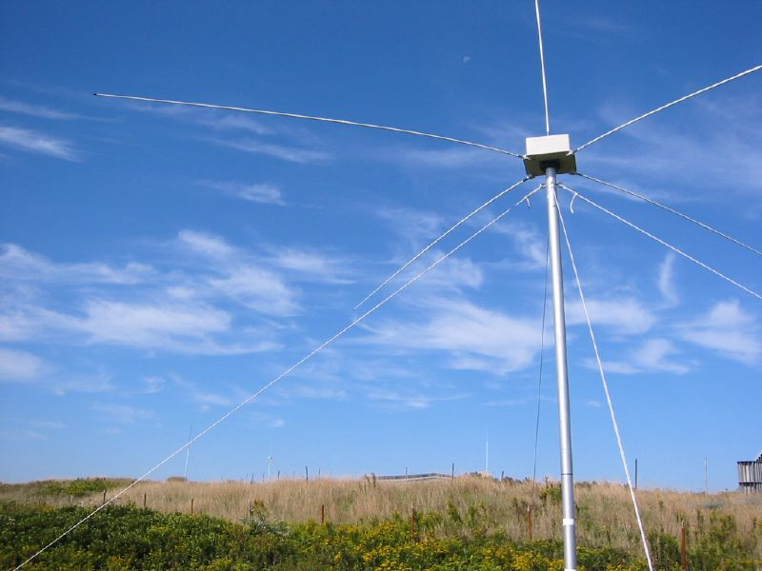
Transition Success Stories – Making a Difference
Optimizing HF Radar for SAR using USCG Surface Drifters
Art Allen
U.S. Coast Guard
Scott Glenn
Rutgers University
Mid-Atlantic Regional Association
Coastal Ocean Observing System

Slide 15
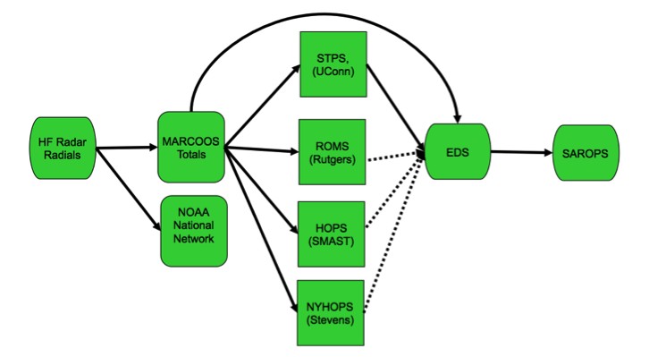
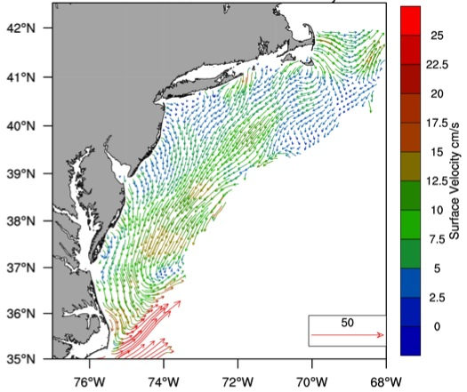
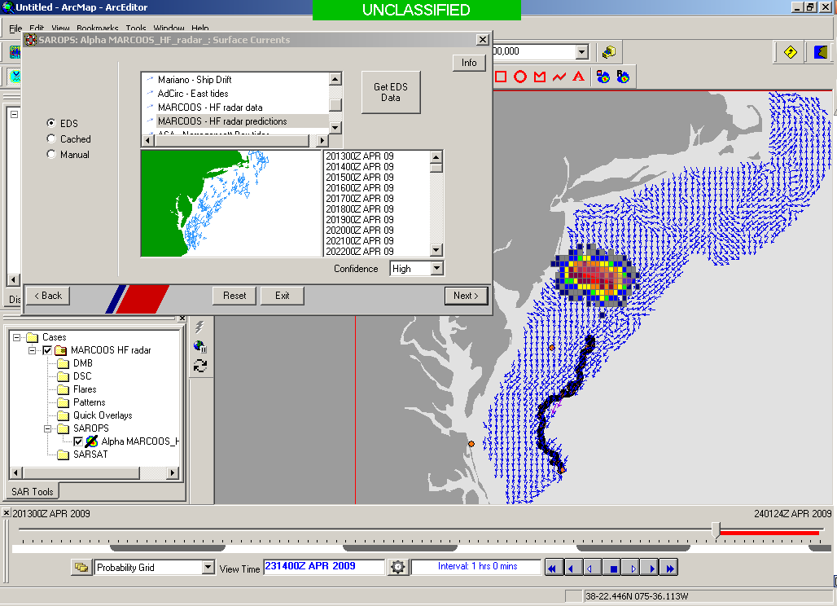
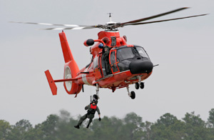

Transition Objective –
Operational Use of HF Radar Surface Currents for Search And Rescue
Surface Currents
Data Acquisition
(MARACOOS)
Data Product Generation & Management
(U.S. IOOS)
Environmental Data Server (EDS)
Search And Rescue Optimal Planning System (SAROPS)

Slide 16
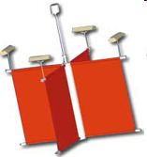
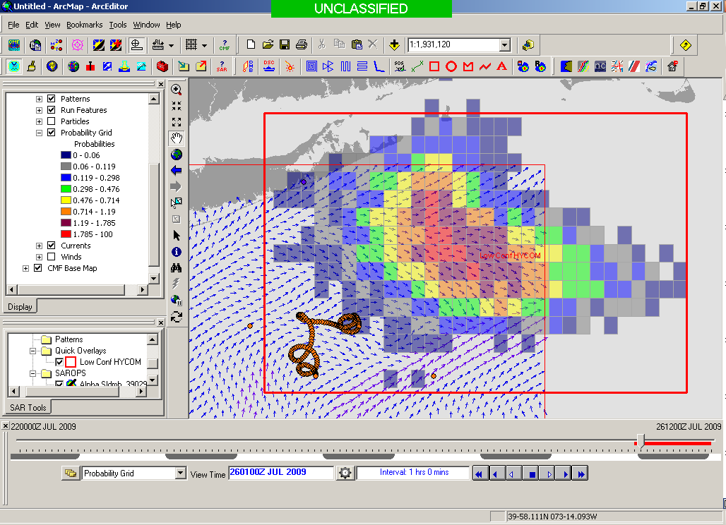
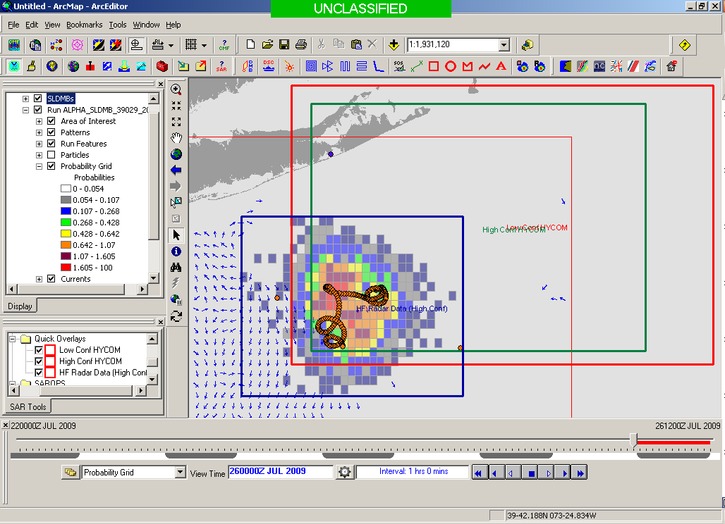
SAROPS Test Case
5000 Virtual Drifters +
1 Real Drifter (Black Line):
Search Area After 96 Hours
154 km
100 km
232 km
123 km
HYCOM
36,000 km²
CODAR
12,000 km²
Notes:
HYCOM (Low Conf) 48 hours

Slide 17
Environmental Data Server (EDS) & SAROPS
Operational May 4, 2009

Slide 18
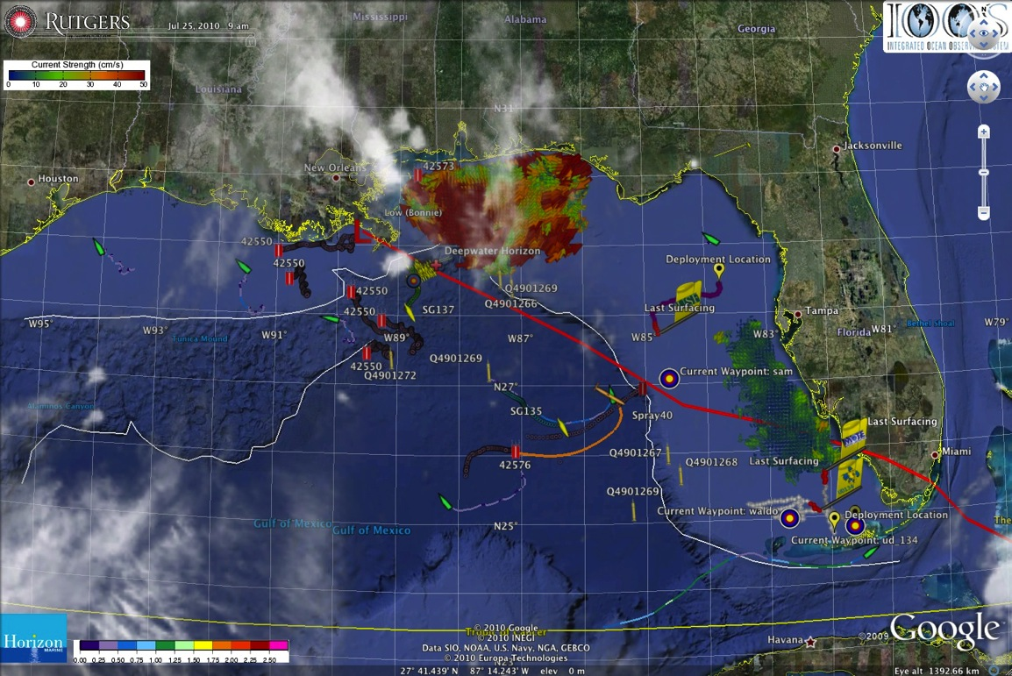
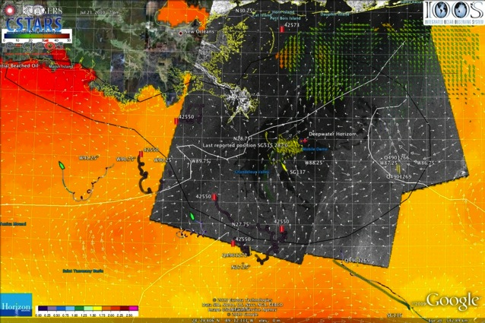
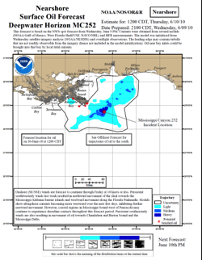
IOOS Coordinated Rapid Response: Deepwater Horizon Oil Spill
Contributed Assets:
HF Radar Networks
USF, USM
Gliders
iRobot, Mote, Rutgers,
SIO/WHOI, UDel, USF
Drifters & Profilers
Horizon Marine, Navy
Satellite Imagery
CSTARS, UDel
Ocean Forecasts
Navy, NCSU
Data/Web Services
ASA, Rutgers, SIO
Tropical Storm Bonnie crosses the Gulf of Mexico
USM HFR
TS Bonnie
USF HFR
USM HFR validation of SABGOM Forecast
in region with satellite detected oil slicks
HFR used for Oil Slick Forecasts by NOAA/NOS/OR&R

Slide 19
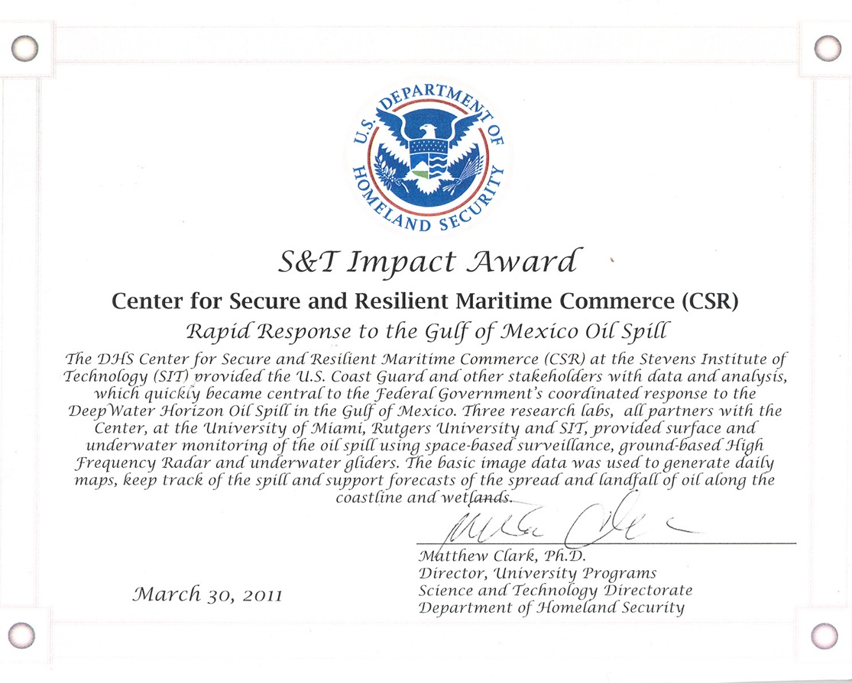
IOOS Coordinated Rapid Response: Deepwater Horizon Oil Spill
Contributed Assets:
HF Radar Networks
USF, USM
Gliders
iRobot, Mote, Rutgers,
SIO/WHOI, UDel, USF
Drifters & Profilers
Horizon Marine, Navy
Satellite Imagery
CSTARS, UDel
Ocean Forecasts
Navy, NCSU
Data/Web Services
ASA, Rutgers, SIO
Tropical Storm Bonnie crosses the Gulf of Mexico
USM HFR
TS Bonnie
USF HFR
USM HFR validation of SABGOM Forecast
in region with satellite detected oil slicks
HFR used for Oil Slick Forecasts by NOAA/NOS/OR&R

Slide 20
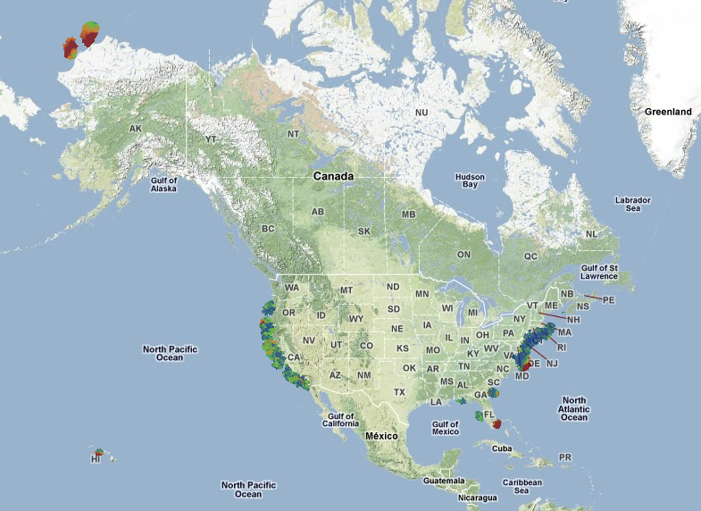
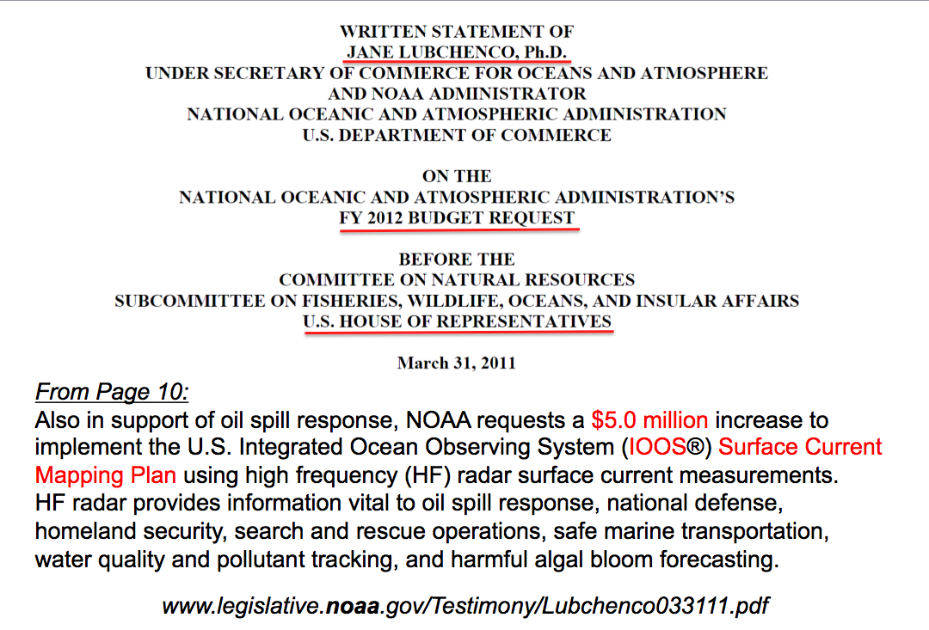
U.S. National HF Radar Network
$5 M First Year Investment
$20 M/Year for 5 Years for Full Buildout
Summer
2011 Coverage
131 Radars

Slide 21

Multi-Level Access and Information Sharing with Open Mongoose (MDA CONOP)
(U) Multi-Level Enclaves Provide Appropriate Level Data to Customers

Slide 22






Bohemia AIS Track SNR>9
HF Association one σ
HF Association two σ
HF Association three σ
HF Detection >20dB
20dB>= HF Detection >12dB
AIS Contact
Time: 0:25:00
Distance travelled: 11.3km
7.2km
AIS Bohemia Velocity Range: 10.3KTS up to 10.4KTS. Several HF Radar detections associated by one, two and three standard deviations, Radar Characteristics: SNR>9, Distance from radar when tracked: 7.2 km

Slide 23


Watchkeeper
Watchkeeper pulls data from EDS

Slide 24

U.S. Integrated Ocean Observing System: Interactive Asset Map
Comprehensive General Purpose and User Specific Versions

Slide 25

Vessel Tracking
Research Areas
Current Testbeds
New York Harbor
Delaware Bay
Chesapeake Bay
Port of Miami
Western Puerto Rico
Barrow Alaska
Proposed Testbeds
Great Inagua
Norway
San Diego

Slide 26

Doppler Spectra from all Range Cells
with Detection Threshold above Background Applied
Fixed Objects & Direct Signals
Bragg Waves
Bragg Waves
Vessel
Vessel
Range
Doppler Frequency
(Target Speed)

Slide 27

DOLPHIN
Median Method FFT 256 Threshold 11 dB
Range (km)
Step 1
Raw Detections
From each HFR:
Radial Velocity (most accurate)
Range
Bearing (least accurate)
Radial Velocity (m/s)
Bearing (°CWN)

Slide 28

Adjusting the Signal to Noise

Slide 29



Step 2 Association:
MAAS TRADER
DOLPHIN

Slide 30

Step 3 Track Fitting: M/V Victorius
M/V VICTORIOUS: GPS Track, CODAR Data, and Ship Tracker Solution with Uncertainty Ellipses

Slide 31






CSR Tropical HF Radar Testbed
AIS
Detections of CGC Cushing

Slide 32

CSR Tropical HF Radar Testbed
AIS Data November 4 -9, 2012
84 vessels captured on AIS
36 vessels within 100 km of the radar station
23 vessels detected by the radar that were on AIS
13 vessels detected by the radar NOT on AIS

Slide 33


Basilica Duckling Detections
Masked due Zero Doppler clutter
Masked due to Bragg clutter
Detected for ~ 1 hour
Detected out to 46 km

Slide 34






CSR High Latitude HF Radar Testbed
Objective:
Test the capability of the SeaSonde HF Radar as a detection and surveillance sensor at high latitudes in anticipation of the polar ice cap melting and the increased usage of the Northwest Passage.
Sponsor:
Participants:
Remote Power Module
AIS traffic near Barrow, AK
Northwest passage routes

Slide 35




Point Barrow Detections
All AIS vessels detected. Range to
70 km.

Slide 36

CSR Ship Detection Visualizer

Slide 37





Rapid Response Capability
Self Contained
Transportable
Propane generator
Satellite Communications

