Slide 1
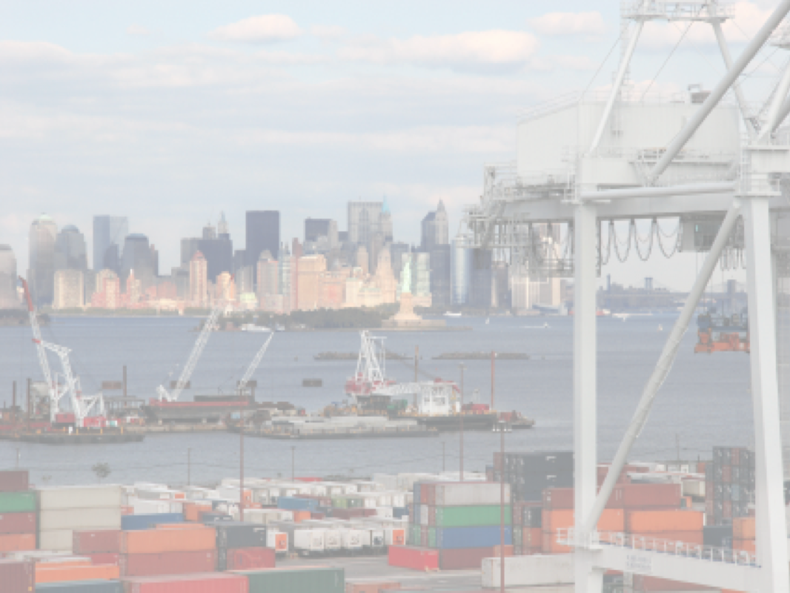






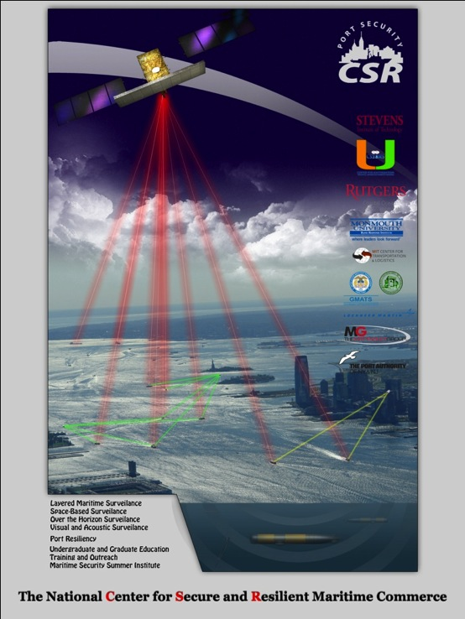






The Center for Secure and Resilient Maritime Commerce (CSR)
DHS Center of Excellence for Port Security
11 Institutions – Maritime Domain Awareness & Resiliency
Maritime Domain Awareness
Approach –
Multi Use Technologies
Demonstrate Nested Vessel Detection
Global > Approaches > Port
University of Miami –
Global Satellite Coverage,
Visible & Microwave
Rutgers University –
Over-the-Horizon Compact
High Frequency Radar Networks
Stevens Institute of Technology –
Local High-Resolution Optics &
Shallow Underwater Acoustics

Slide 2
The Center for Secure and Resilient Maritime Commerce (CSR)
Rutgers University – CODAR Ocean Sensors
Academic – Industry Partnership since 1998
CSR’s HF Radar Mission:
Develop the HF Radar Multi-Use Capability for Current Mapping & Vessel Tracking.
Transition these Capabilities to Operational Use for Search And Rescue (SAR) and Maritime Domain Awareness (MDA).
Educate the Workforce Required to Operate these National Systems.

Slide 3
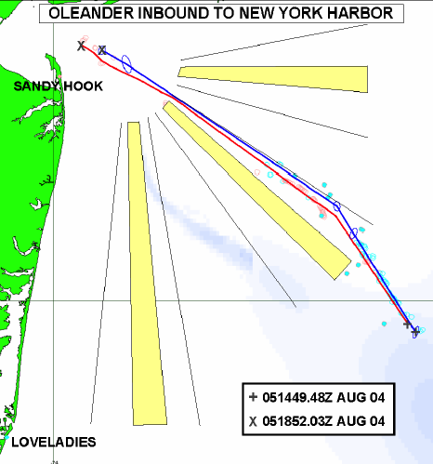
The Center for Secure and Resilient Maritime Commerce (CSR)
HF Radar Team
Rutgers University -
Scott Glenn, Josh Kohut, Hugh Roarty,
Mike Crowley, John Kerfoot, Ethan
Handel, Mike Smith, Colin Evans
CODAR Ocean Sensors -
Don Barrick, Pete Lilleboe, Chad Whelan
Belinda Lipa, Bill Rector, Jimmy Isaacson
University or Puerto Rico – Mayaguez
Jorge Corredor, Julio Morell, Miguel Canals
Applied Mathematics, Inc -
Bill Browning
University of Alaska –
Tom Weingarter, Hank Statscewich
Ocean Power Technologies –
Debbie Montagna, Bruce Downie
Naval Research Laboratory
Michael Lovellette, Dan Newton
Norwegian Defence Research Establishment (FFI)
Terje Johnsen, Walther Asen
CODARNor
Anton Kjelaas
Rutgers University – CODAR Ocean Sensors
Academic – Industry Partnership since 1998
ONR - 2004

Slide 4
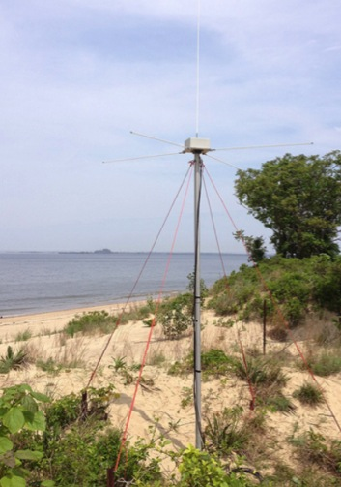
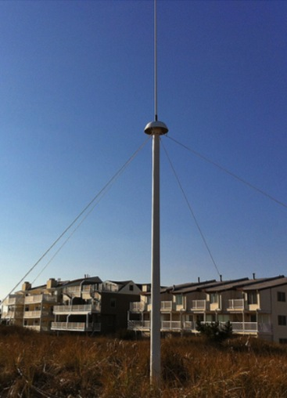
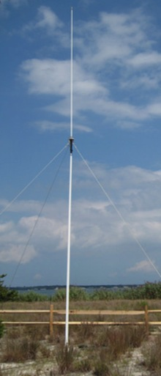
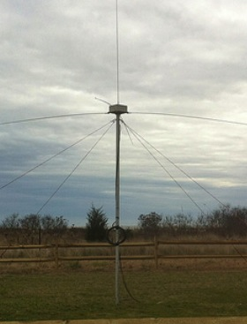
CODAR Compact HF Radar Antennas
25 MHz
13 MHz
5 MHz
Combined Transmitter & Receiver
Separate Transmitter & Receiver

Slide 5
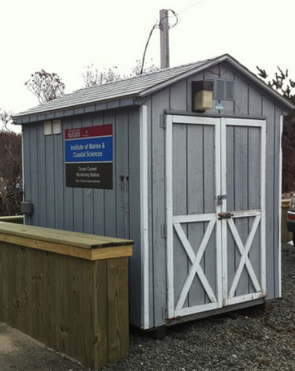
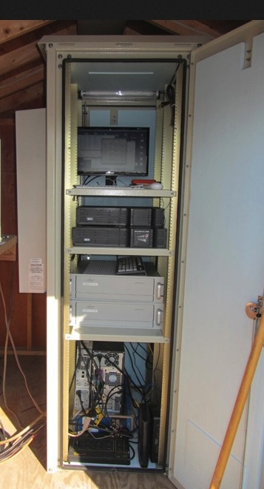
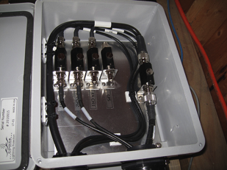
Shed and Enclosures
monitor
computer & external hard drive
A.C. unit
UPS system
transmitter
receiver
Two lines of Communication
Shed
Enclosure
Lightning Protection

Slide 6
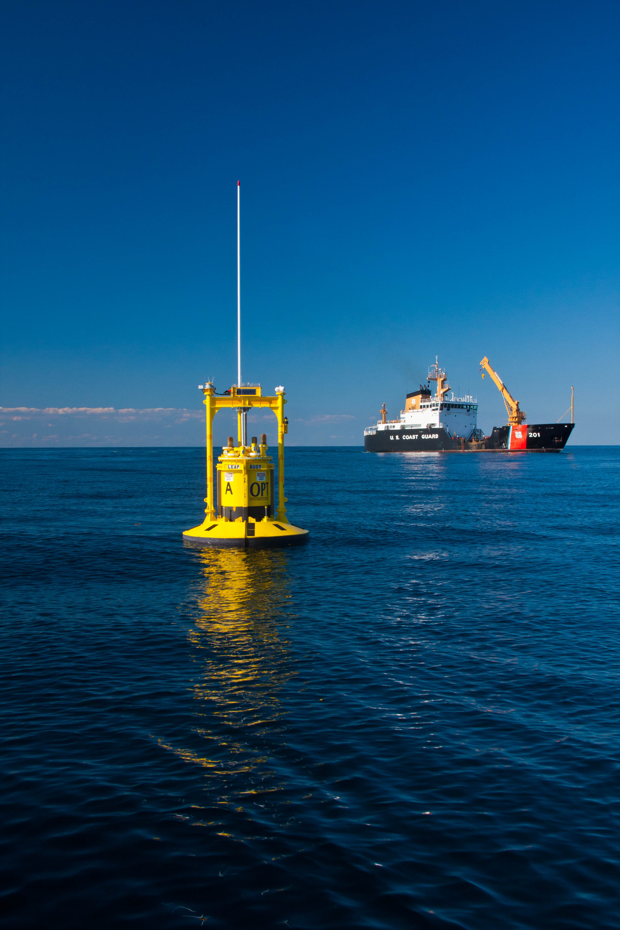
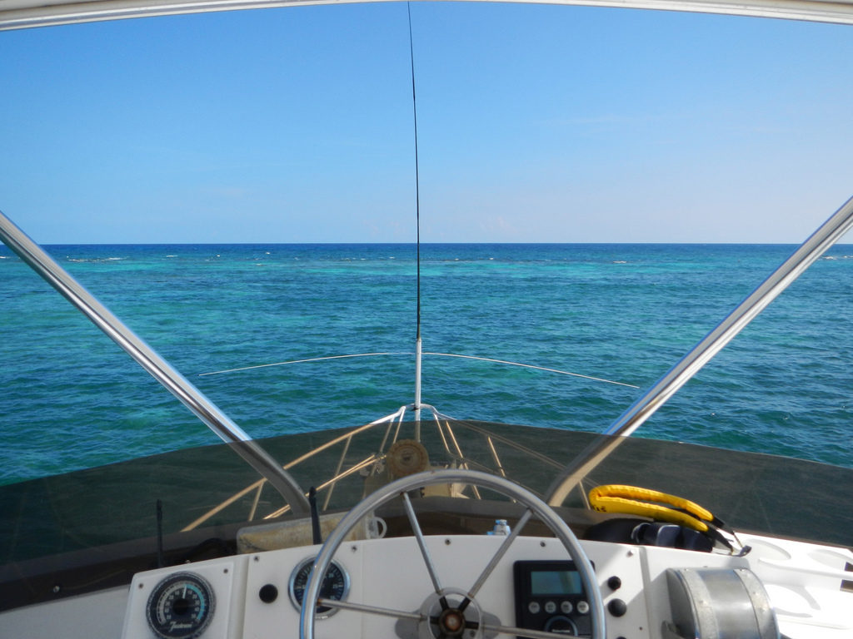
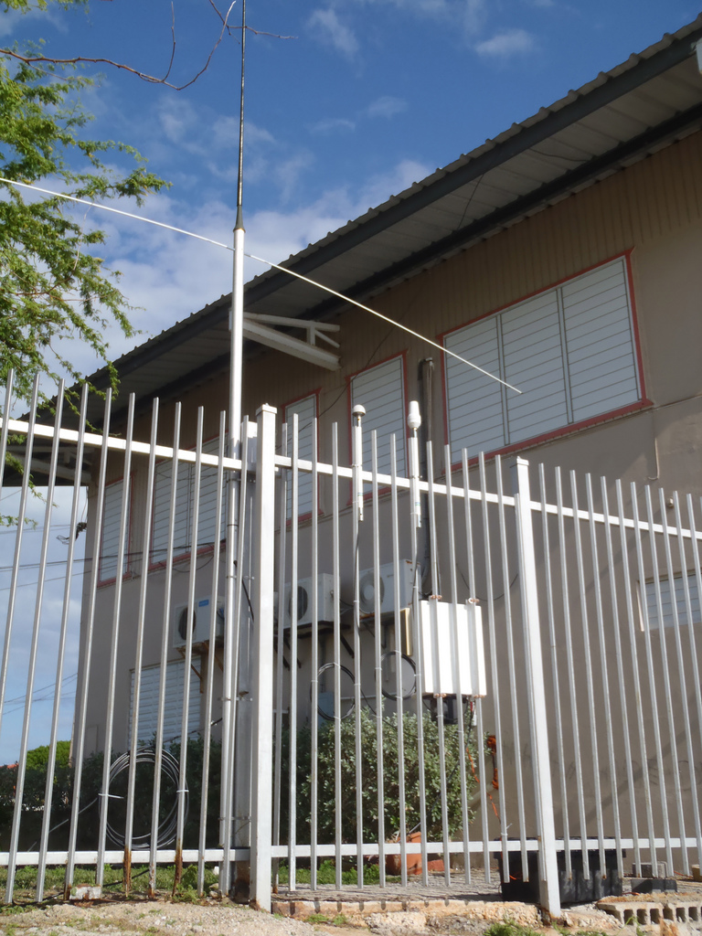
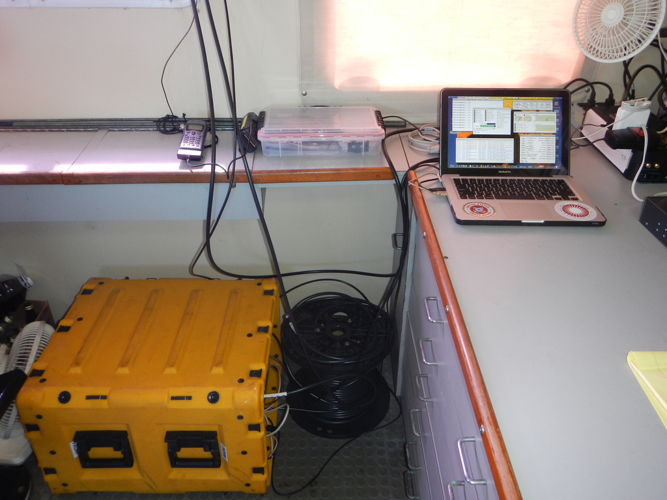
Bistatic Transmitters

Slide 7
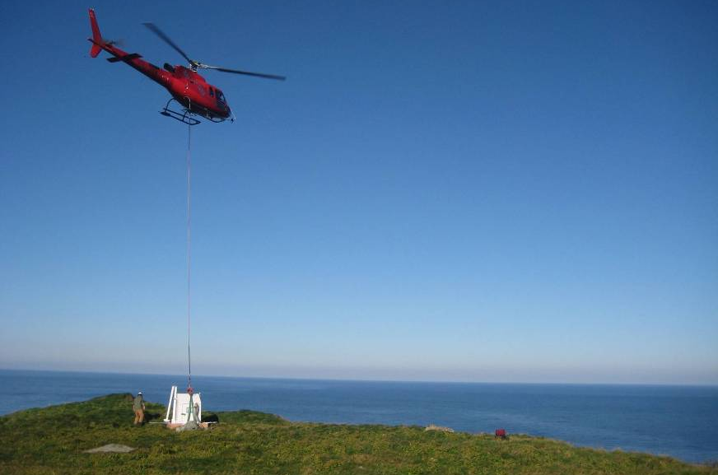

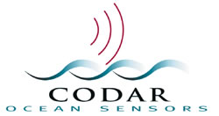
Oil Spill Rapid Response
Norwegian Clean Seas Association for Operating Companies (NOFO)
Propane generator
Satellite Communications

Slide 8
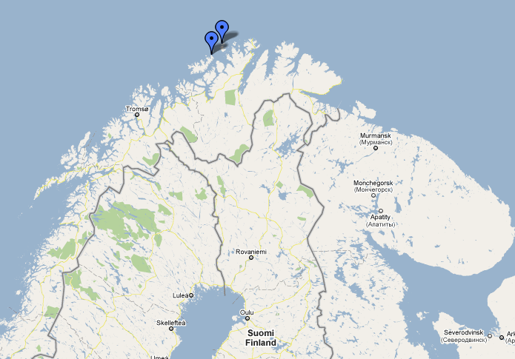
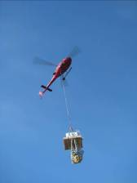
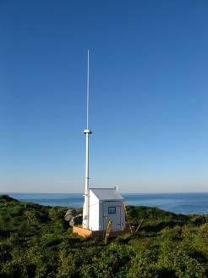
Oil Spill Rapid Response

Slide 9
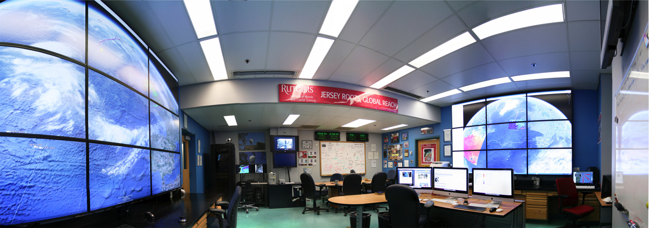
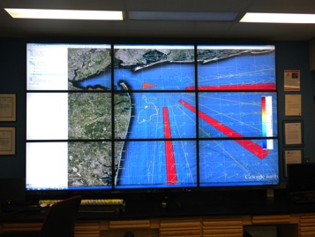
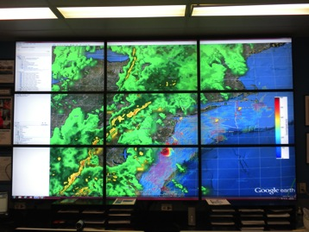
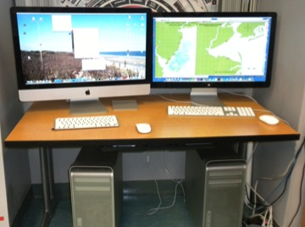
Data Aggregation Center

Slide 10
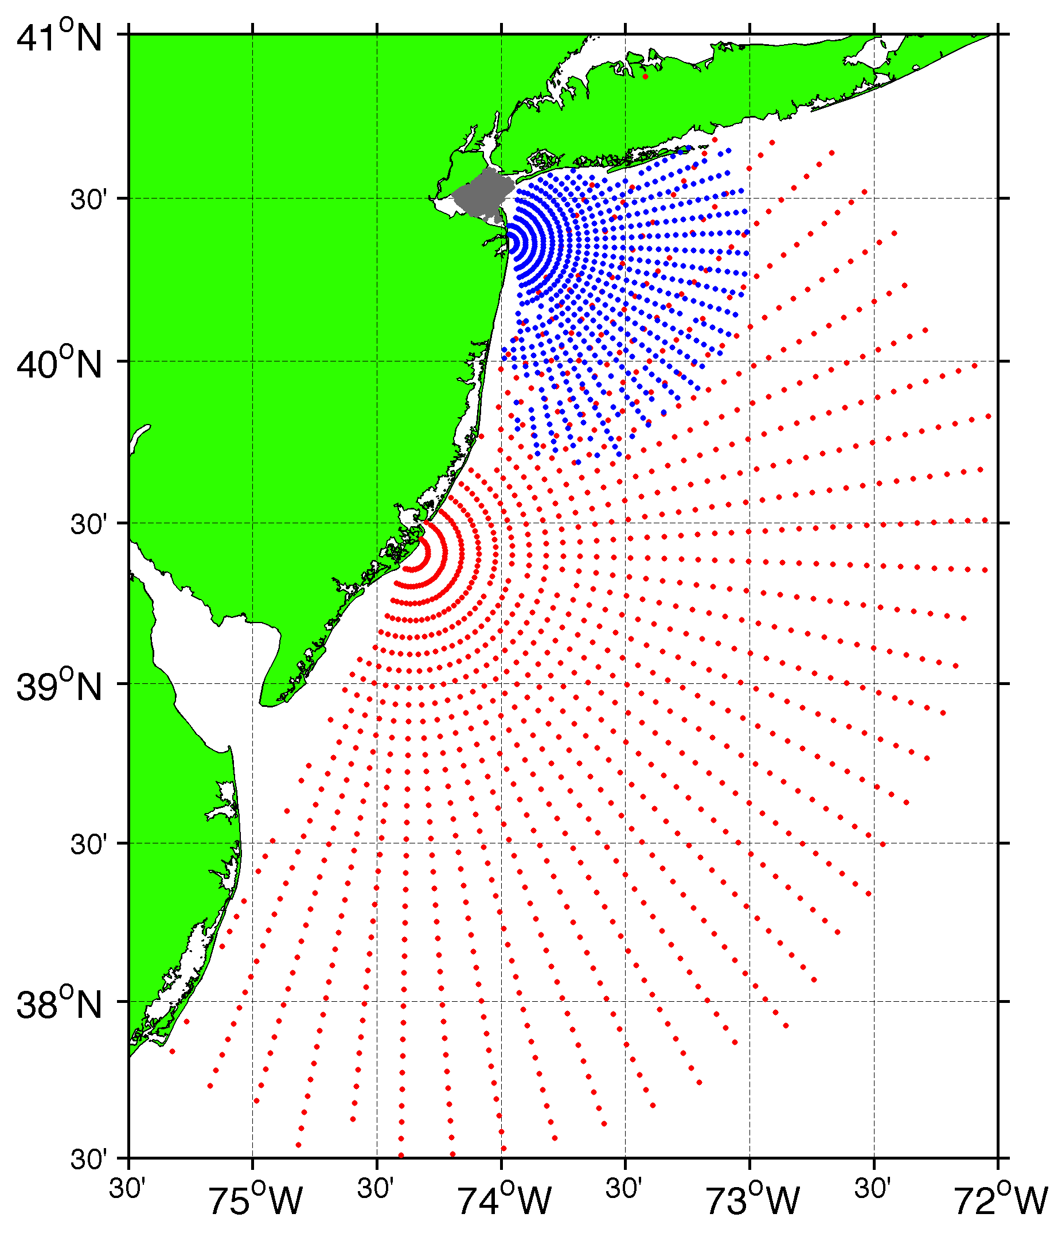
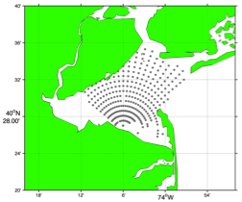
Surface Current Mapping Capability
25 MHz
Radar λ: 12 m Ocean λ: 6 m
Range: 30 km Resolution: 1 km
13 MHz
Radar λ: 23 m Ocean λ: 12 m
Range: 80 km Resolution: 3 km
05 MHz
Radar λ: 60m Ocean λ: 30 m
Range: 180 km Resolution: 6 km

Slide 11
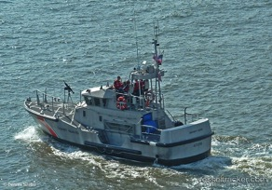
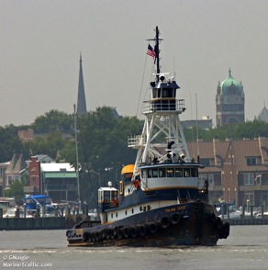
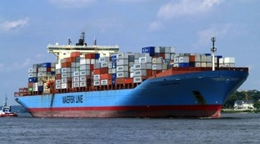
Vessel Detection Capability
25 MHz
Range: 11 nmi
Height >10 ft
13 MHz
Range: 43 nmi
Size: 19 ft
05 MHz
Range: 65nmi
Size: 50 ft

Slide 12
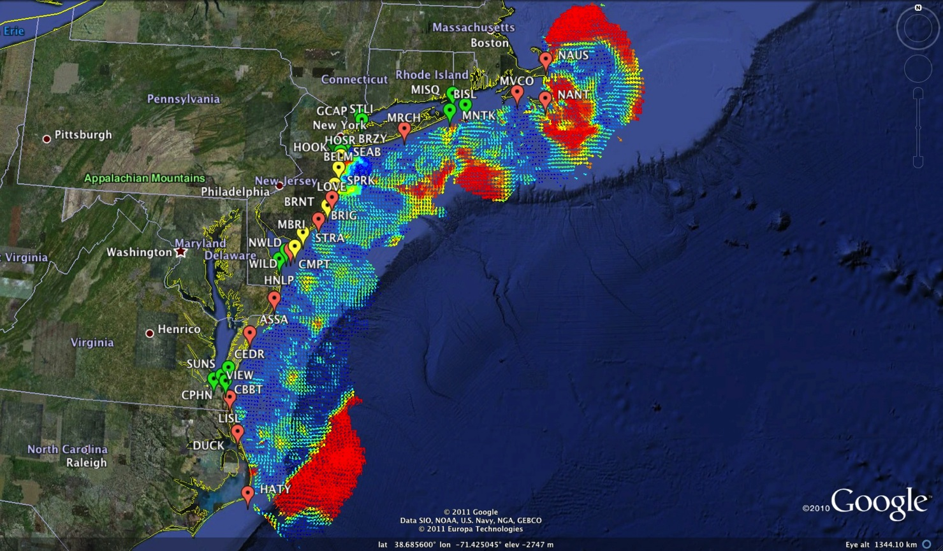
Mid-Atlantic Bight HF Radar Network
1000 km Alongshore Length Scale
Mid-Atlantic HF Radar Network
16 Long-Range CODARs
8 Medium-Range CODARs
17 Short-Range CODARs
41 Total
Triple Nested & Multistatic

Slide 13
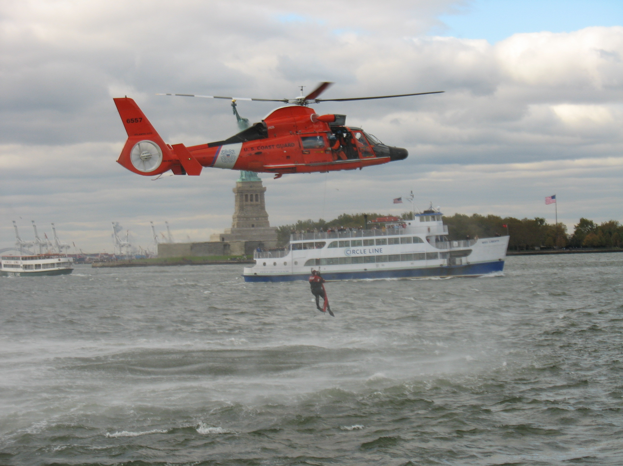
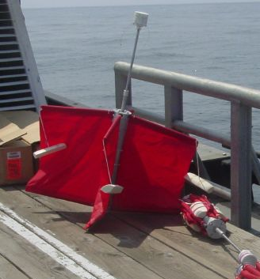
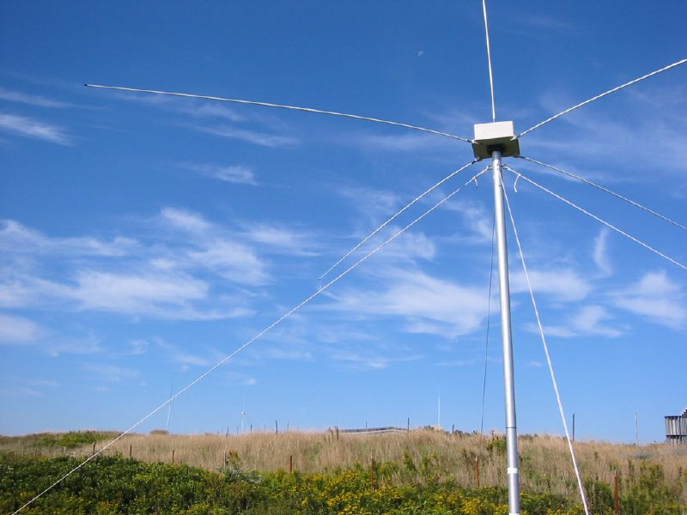
Success Stories – Making a Difference
Optimizing HF Radar for SAR using USCG Surface Drifters
Art Allen
U.S. Coast Guard
Scott Glenn
Rutgers University
Mid-Atlantic Regional Association
Coastal Ocean Observing System

Slide 14
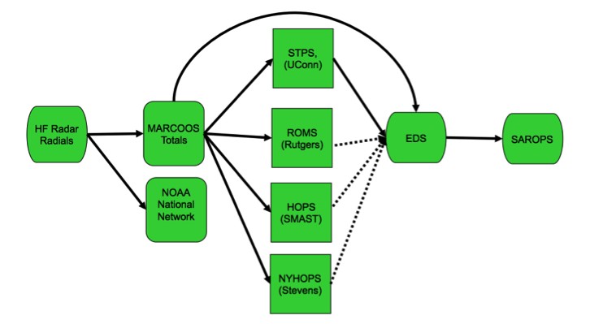
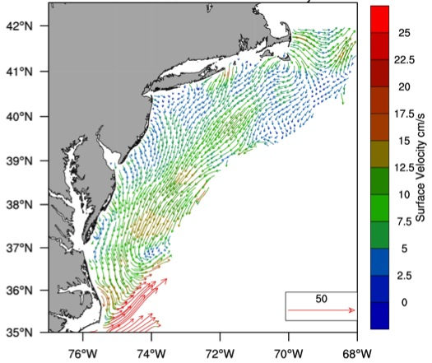
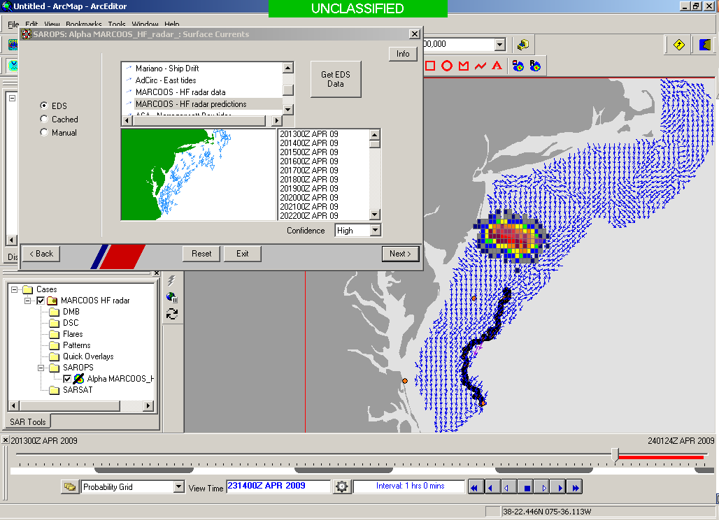
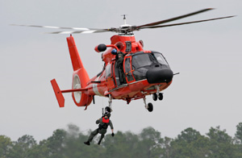

Transition Objective –
Operational Use of HF Radar Surface Currents for Search And Rescue
Surface Currents
Data Acquisition
Data Product Generation & Management
Search And Rescue Optimal Planning System (SAROPS)

Slide 15

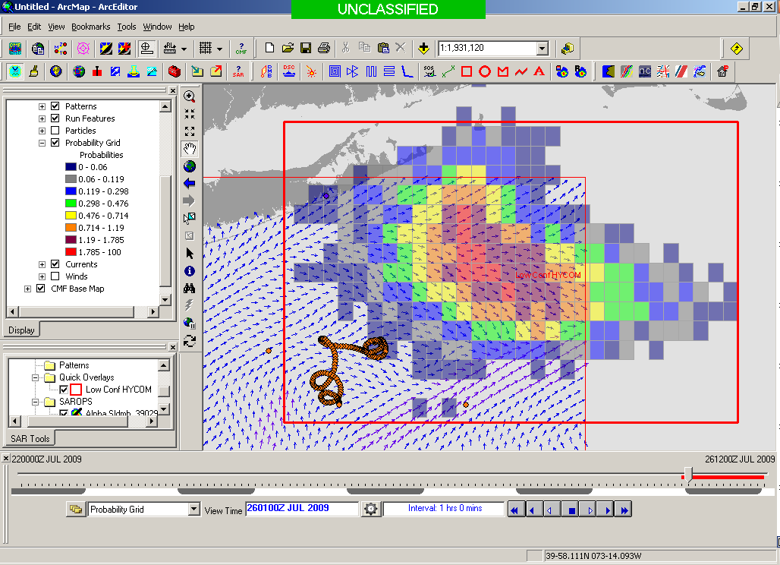
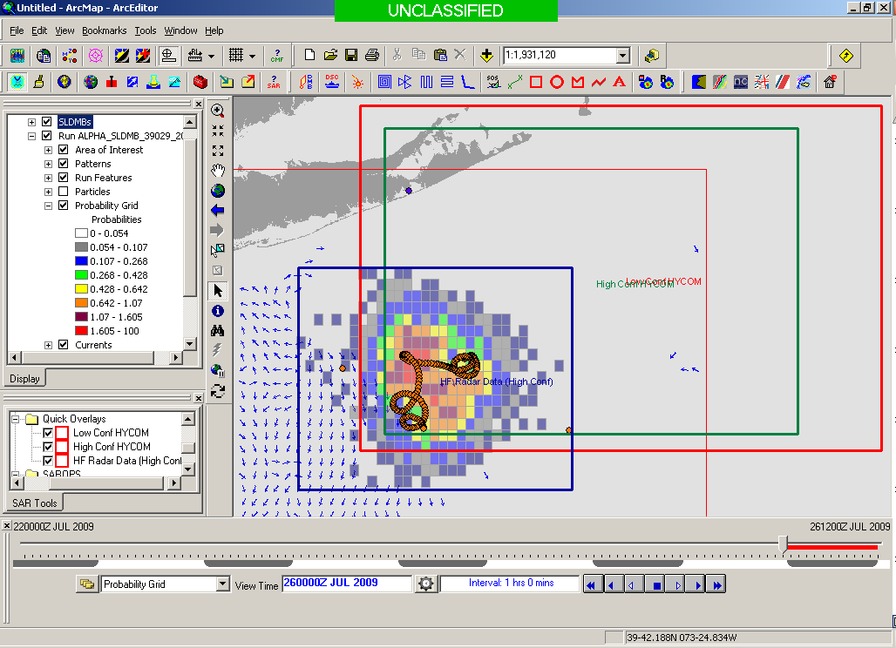
5000 Virtual Drifters –
Search Area After 96 Hours
154 km
100 km
232 km
123 km
HYCOM
36,000 km²
CODAR
12,000 km²
Notes:
HYCOM (Low Conf) 48 hours

Slide 16
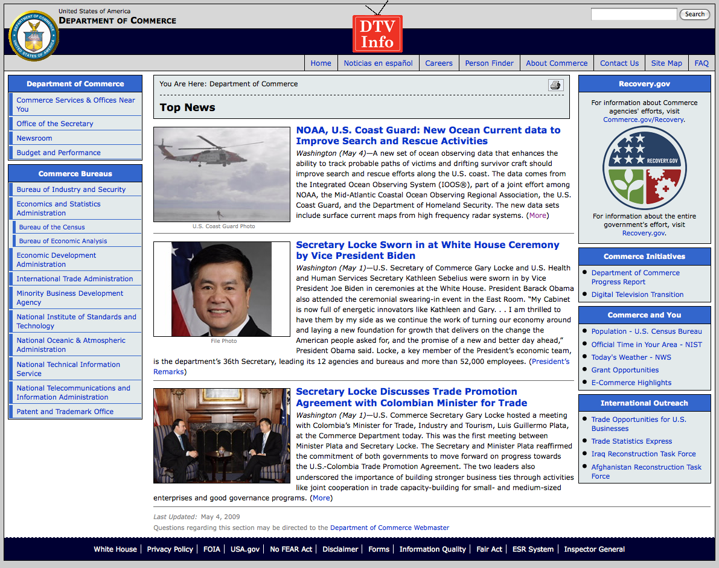
May 4, 2009: After a year of testing, NOAA Announces on
U.S. Department of Commerce Website that
Rutgers CODAR is Operational in SAROPS
Present Activity:
Bring all
sustained regional-scale HFR networks up to operational status in USCG SAROPS
3 West Coast Regions for
California & Oregon are ready.

Slide 17
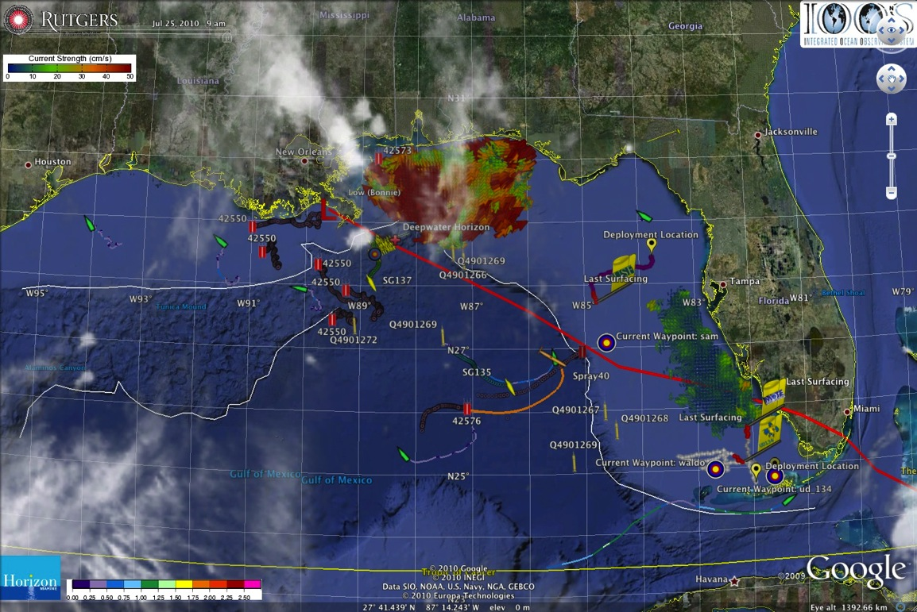
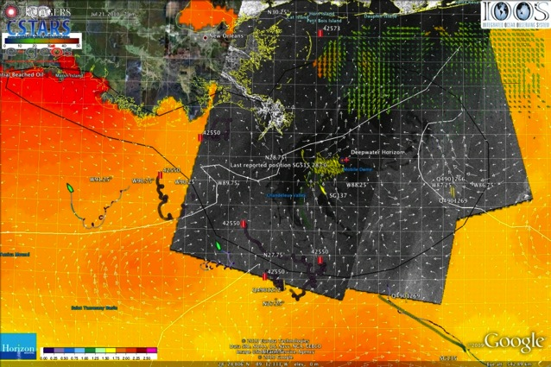
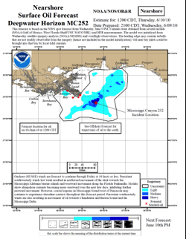
IOOS Coordinated Rapid Response: Deepwater Horizon Oil Spill
Contributed Assets:
HF Radar Networks
USF, USM
Gliders
iRobot, Mote, Rutgers,
SIO/WHOI, UDel, USF
Drifters & Profilers
Horizon Marine, Navy
Satellite Imagery
CSTARS, UDel
Ocean Forecasts
Navy, NCSU
Data/Web Services
ASA, Rutgers, SIO
Tropical Storm Bonnie crosses the Gulf of Mexico
USM HFR
TS Bonnie
USF HFR
USM HFR validation of SABGOM Forecast
in region with satellite detected oil slicks
HFR used for Oil Slick Forecasts by NOAA/NOS/OR&R

Slide 18
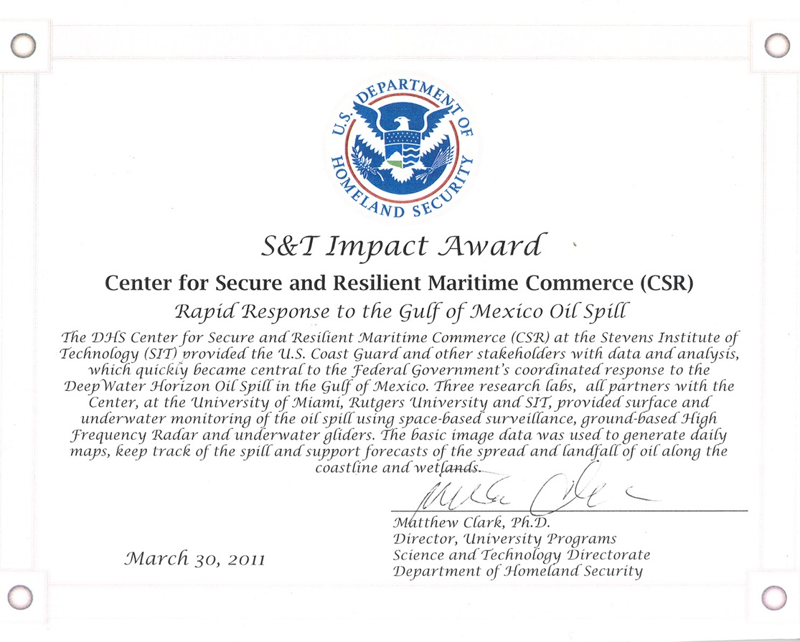
IOOS Coordinated Rapid Response: Deepwater Horizon Oil Spill
Contributed Assets:
HF Radar Networks
USF, USM
Gliders
iRobot, Mote, Rutgers,
SIO/WHOI, UDel, USF
Drifters & Profilers
Horizon Marine, Navy
Satellite Imagery
CSTARS, UDel
Ocean Forecasts
Navy, NCSU
Data/Web Services
ASA, Rutgers, SIO
Tropical Storm Bonnie crosses the Gulf of Mexico
USM HFR
TS Bonnie
USF HFR
USM HFR validation of SABGOM Forecast
in region with satellite detected oil slicks
HFR used for Oil Slick Forecasts by NOAA/NOS/OR&R

Slide 19
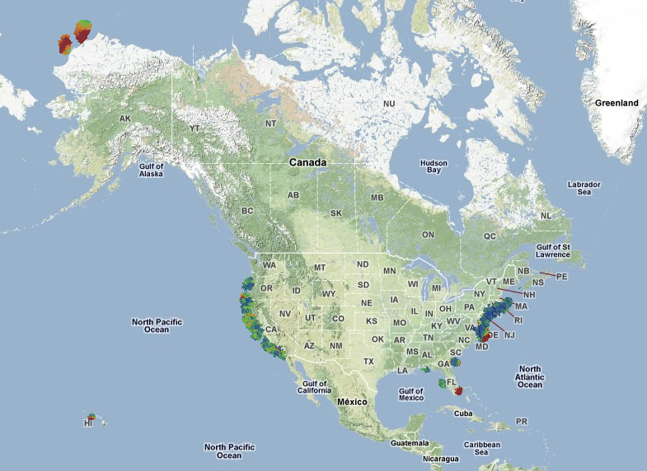
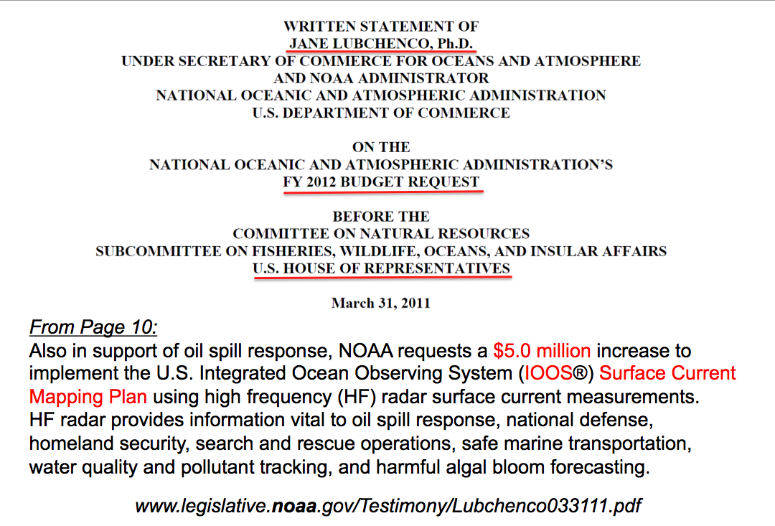
U.S. National HF Radar Network
Summer
2011 Coverage
131 Radars

Slide 20
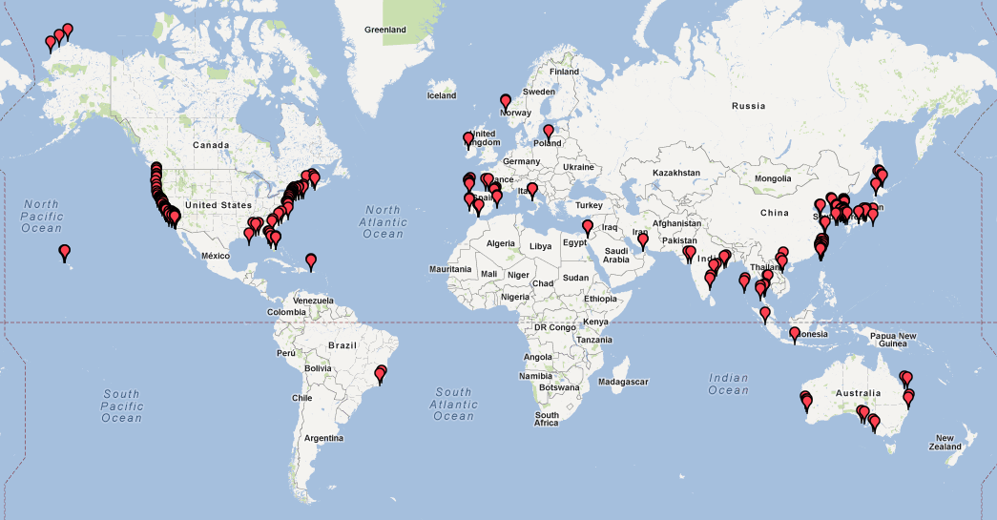
Global HF Radar Coverage
258 Stations in 21 Countries

Slide 21

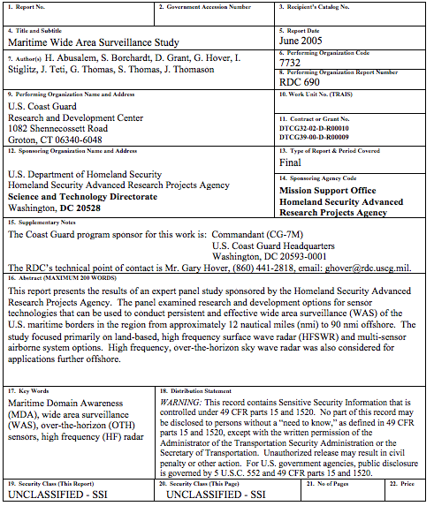
Maritime Wide
Area Surveillance
2005 Report
Network of compact sensors more effective than few large phased arrays
POC Mr. Gary Hover

Slide 22
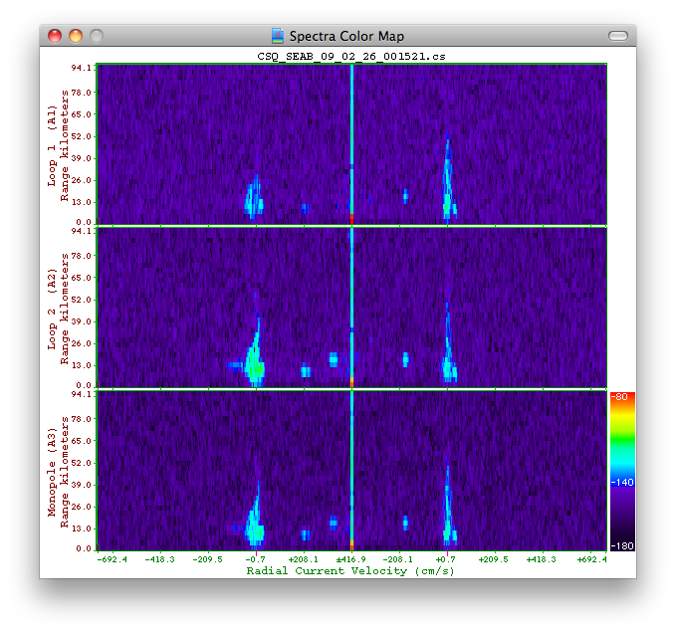
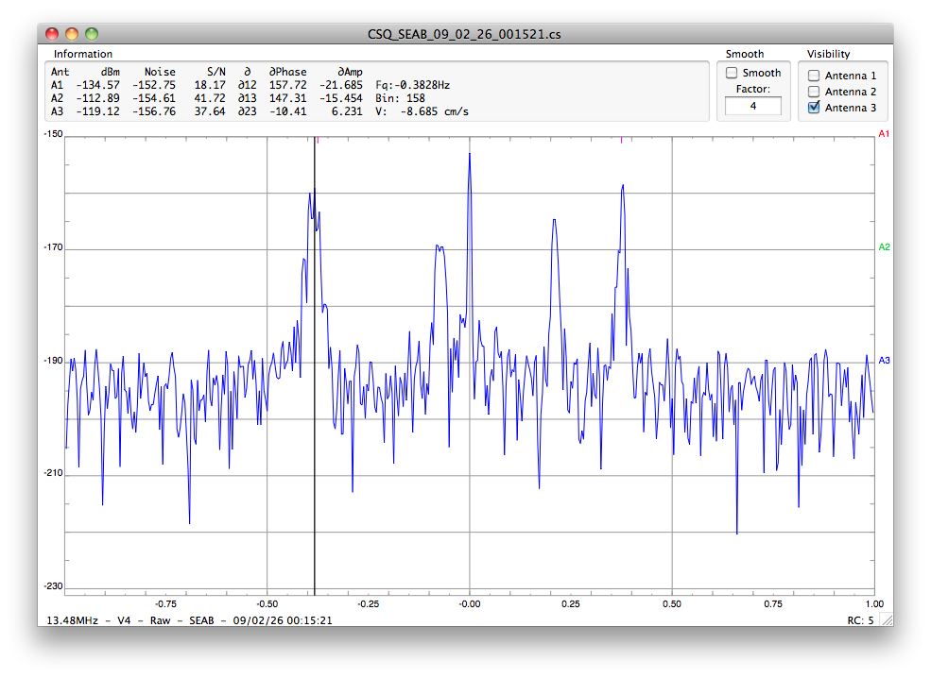
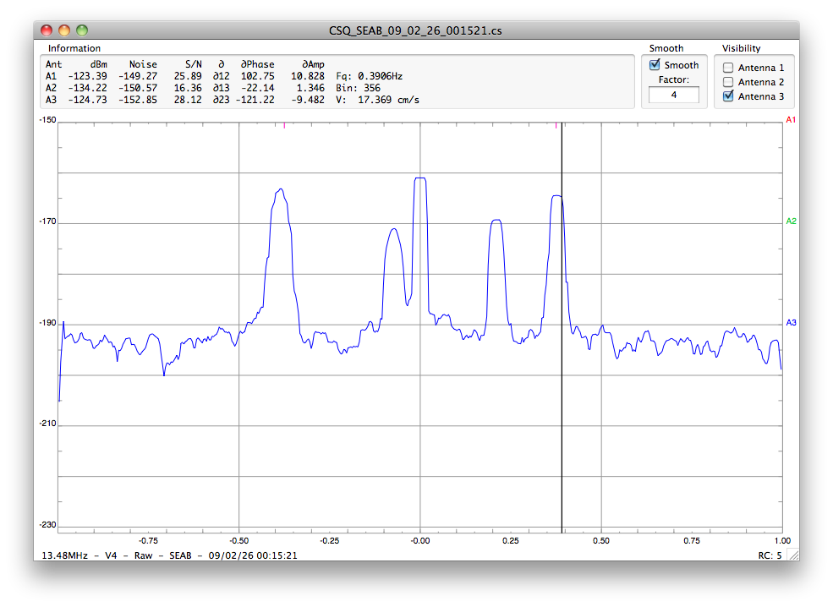


Slide 23

Doppler Spectra from all Range Cells
with Detection Threshold Applied
Fixed Objects & Direct Signals
Bragg Waves
Bragg Waves
Vessel
Vessel
Range
Doppler Frequency

Slide 24

DOLPHIN
Median Method FFT 256 Threshold 11 dB
Range (km)
Radial Velocity (m/s)
Bearing (°CWN)

Slide 25



MAAS TRADER
DOLPHIN

Slide 26

M/V Victorius: Tracking Results
M/V VICTORIOUS: GPS Track, CODAR Data, and Ship Tracker Solution with Uncertainty Ellipses

Slide 27

Adjusting the Signal to Noise

Slide 28

Current Testbeds
New York Harbor
Delaware Bay
Chesapeake Bay
Port of Miami
Western Puerto Rico
Barrow Alaska
Proposed Testbeds
Great Inagua
Norway
San Diego

Slide 29






31% of radar detections not on AIS
New York Harbor Results
16 Vessels Per Hour
5 Vessels Not on AIS

Slide 30
Current Activities

Slide 31

Multi-Level Access and Information Sharing with Open Mongoose (MDA CONOP)
(U) Multi-Level Enclaves Provide Appropriate Level Data to Customers

Slide 32






Bohemia AIS Track SNR>9
HF Association one σ
HF Association two σ
HF Association three σ
HF Detection >20dB
20dB>= HF Detection >12dB
AIS Contact
Time: 0:25:00
Distance travelled: 11.3km
7.2km
AIS Bohemia Velocity Range: 10.3KTS up to 10.4KTS. Several HF Radar detections associated by one, two and three standard deviations, Radar Characteristics: SNR>9, Distance from radar when tracked: 7.2 km

Slide 34


Watchkeeper

Slide 35

CSR Ship Detection Visualizer

