Slide 1
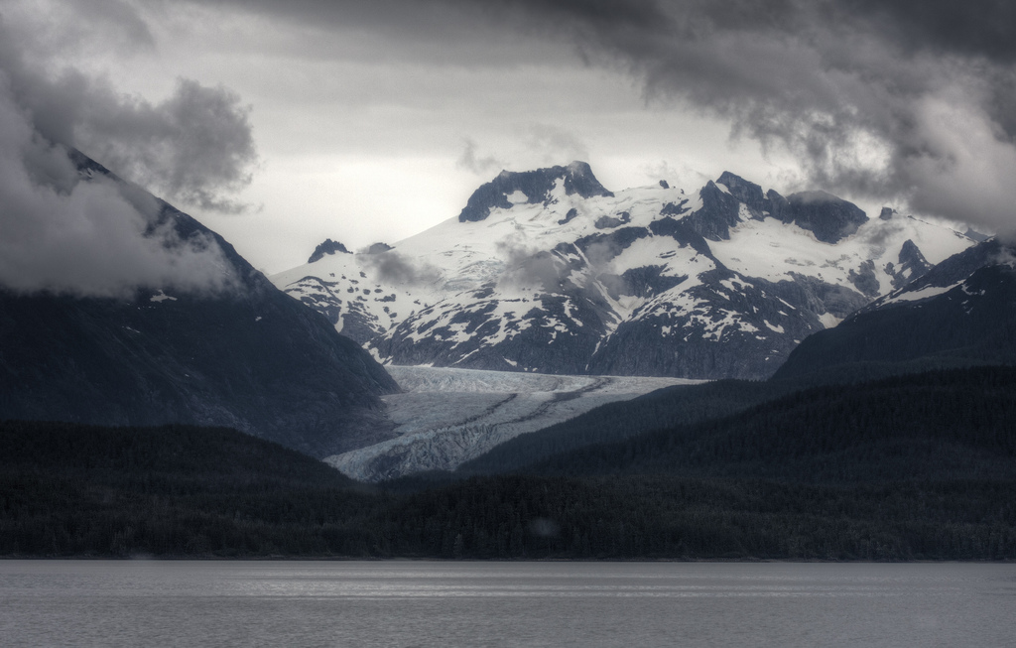
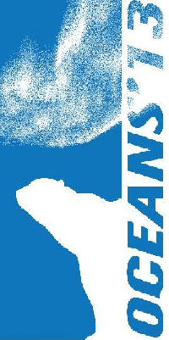

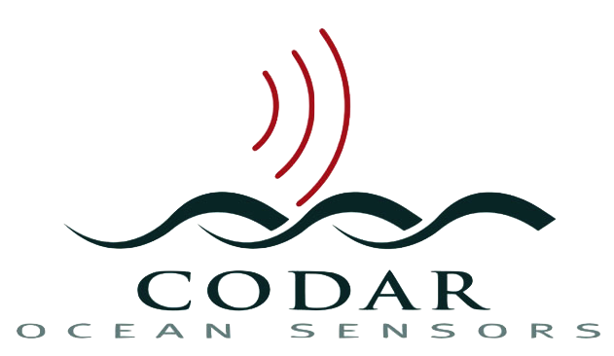


Multi-Use HF Radar for Arctic Maritime Domain Awareness
Hugh Roarty, Mike Smith, Scott Glenn
Chad Whelan, Donald E. Barrick
Hank Statscewich, Tom Weingartner

Slide 2
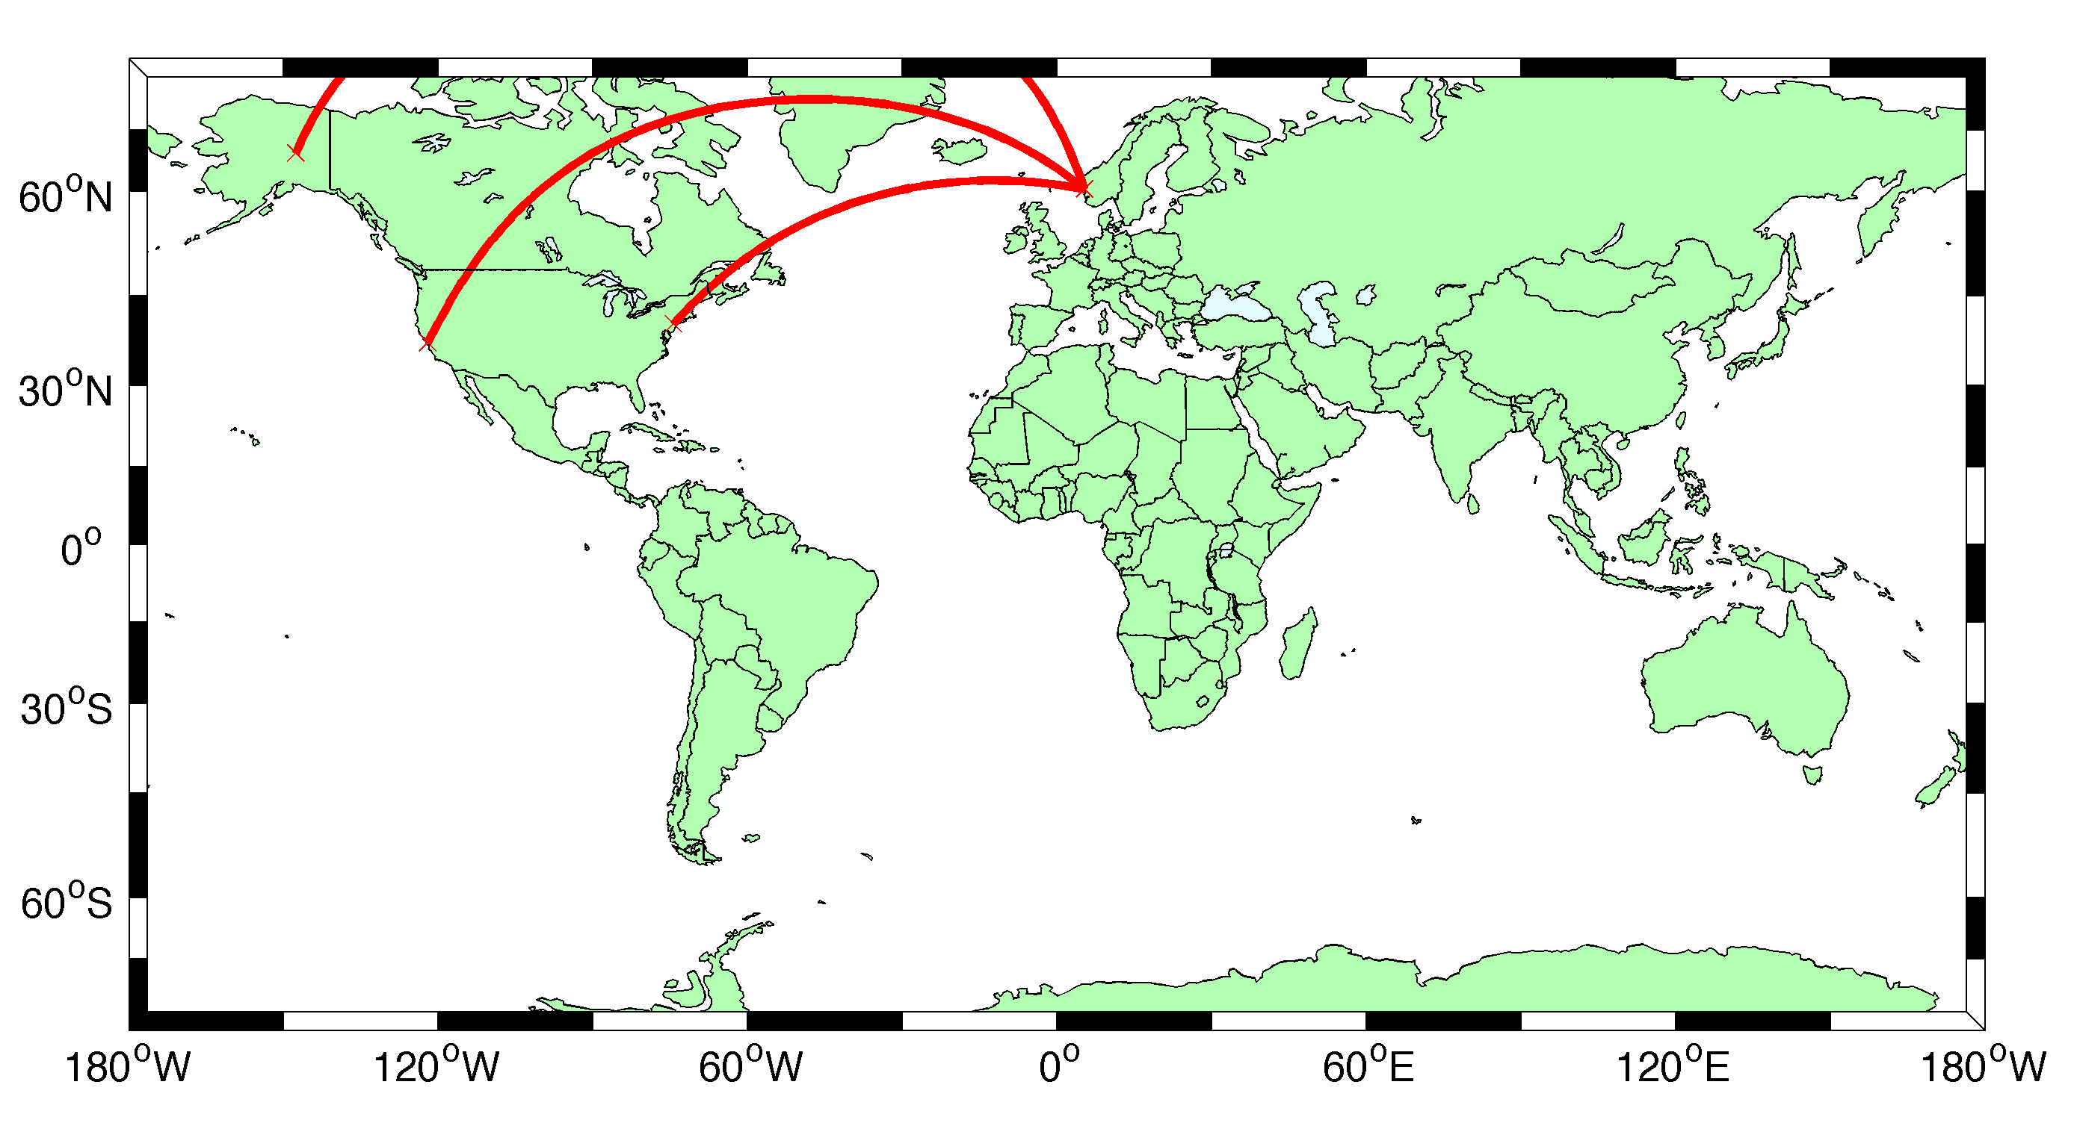

Slide 3
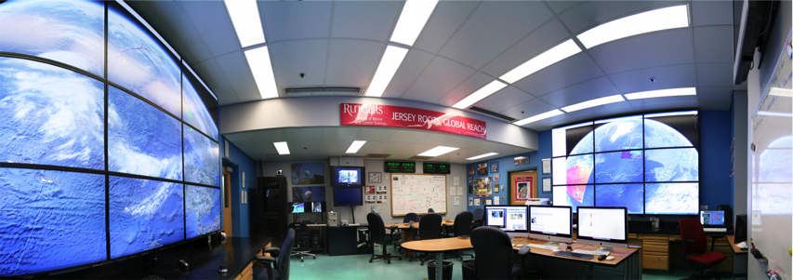

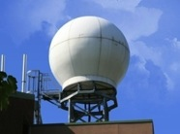
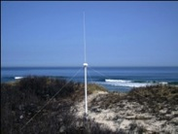
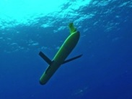
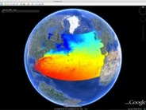
Rutgers University - Coastal Ocean Observation Lab
Operations, Research & Education Center
Vessels -
Satellite
Satellite
CODAR
Ships/ Vessels
Glider
REMUS
Data Vis.
Modeling
Security
Leadership
Education
Satellite Data Acquisition Stations
CODAR Network
Glider Fleet
3-D Forecasts

Slide 4
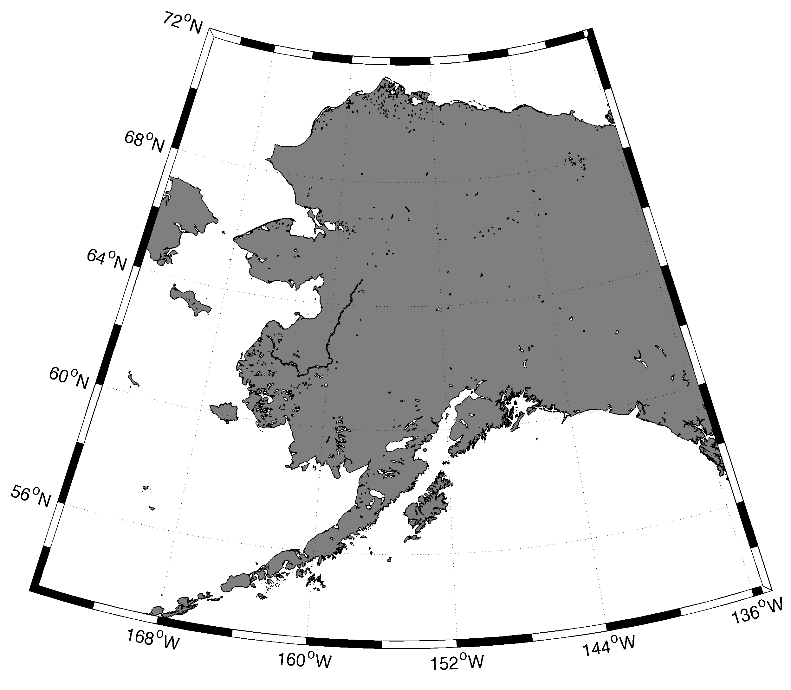
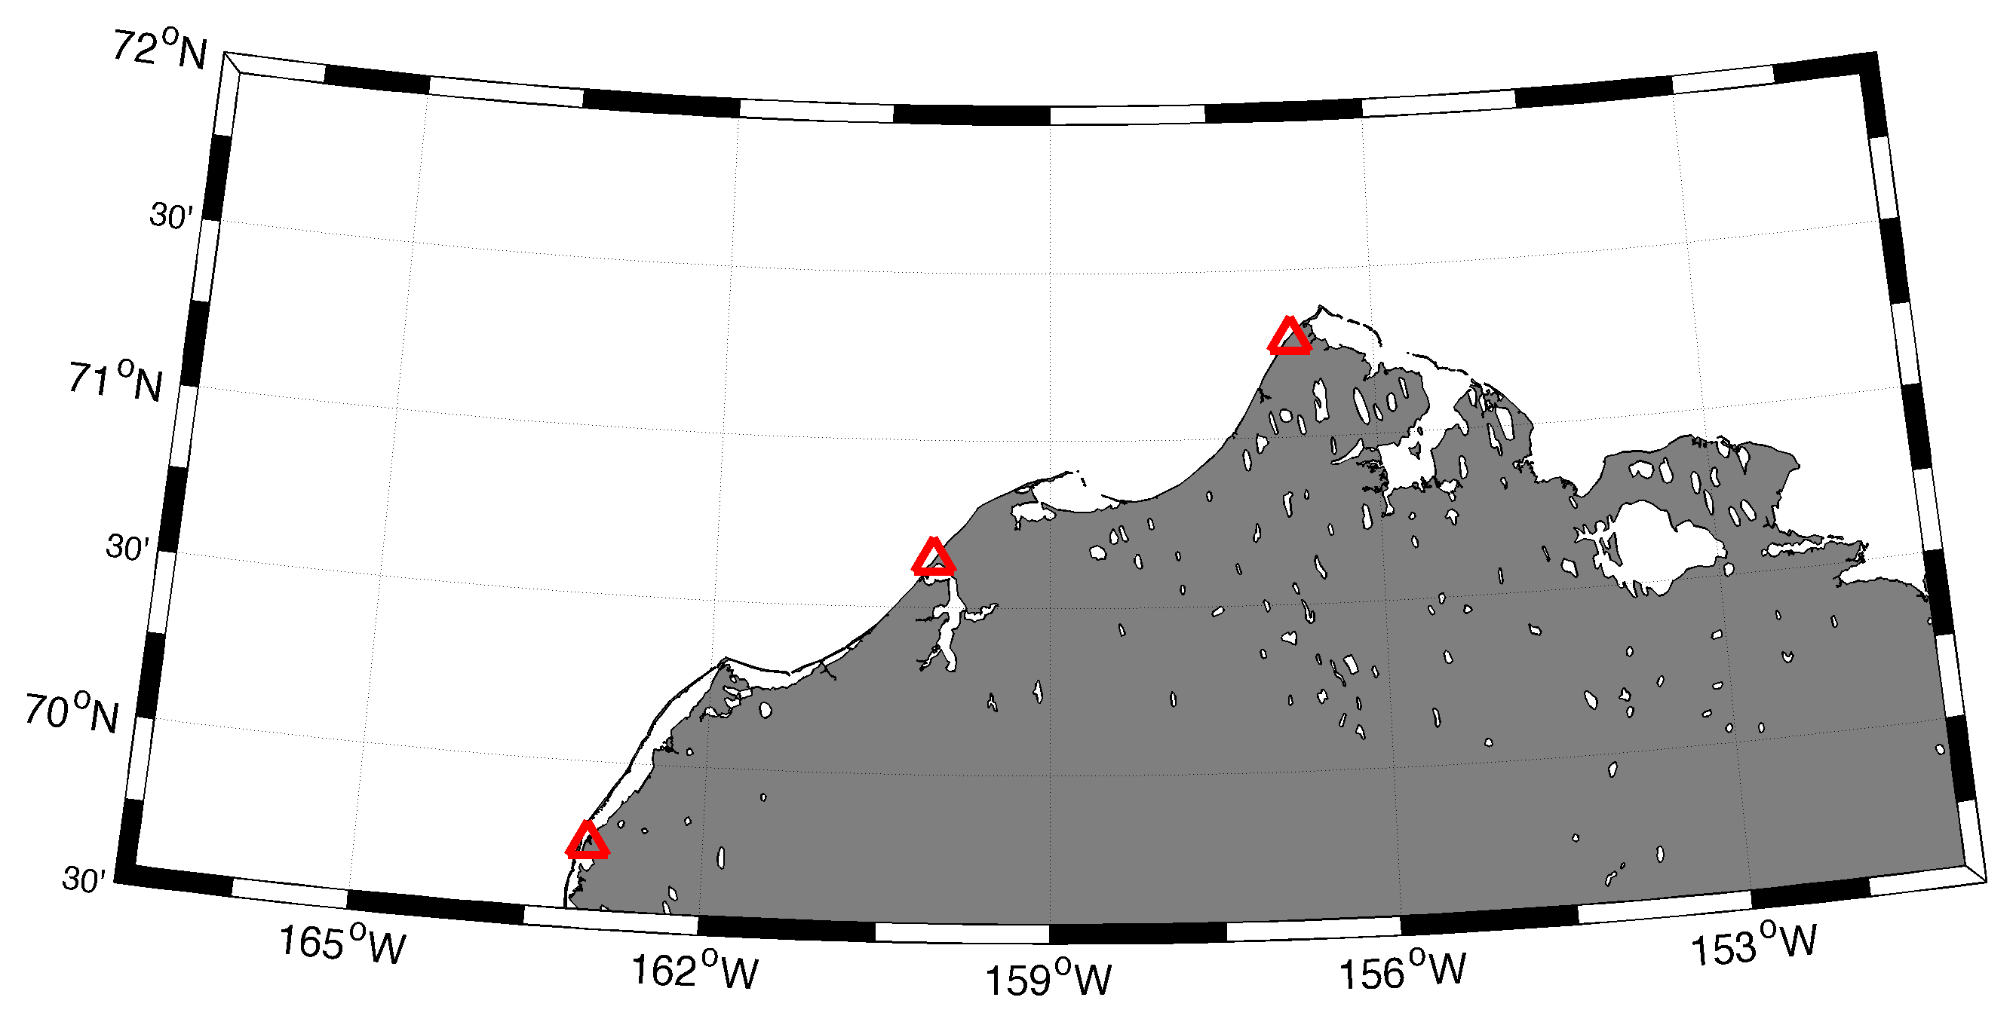
Alaska
Barrow
Wainwright
Point Lay

Slide 5
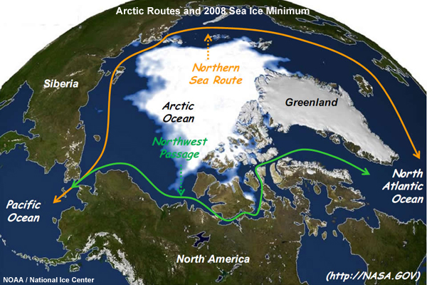

Slide 6
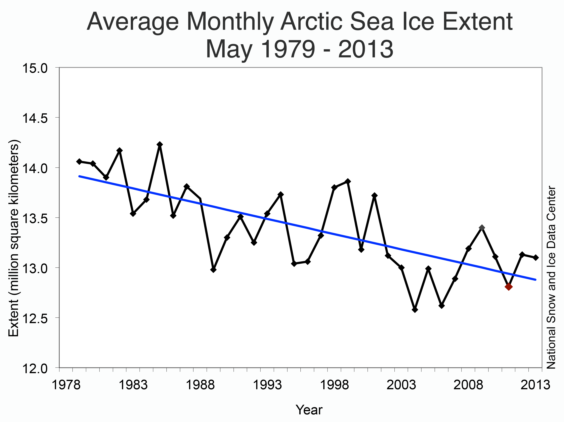

Slide 7
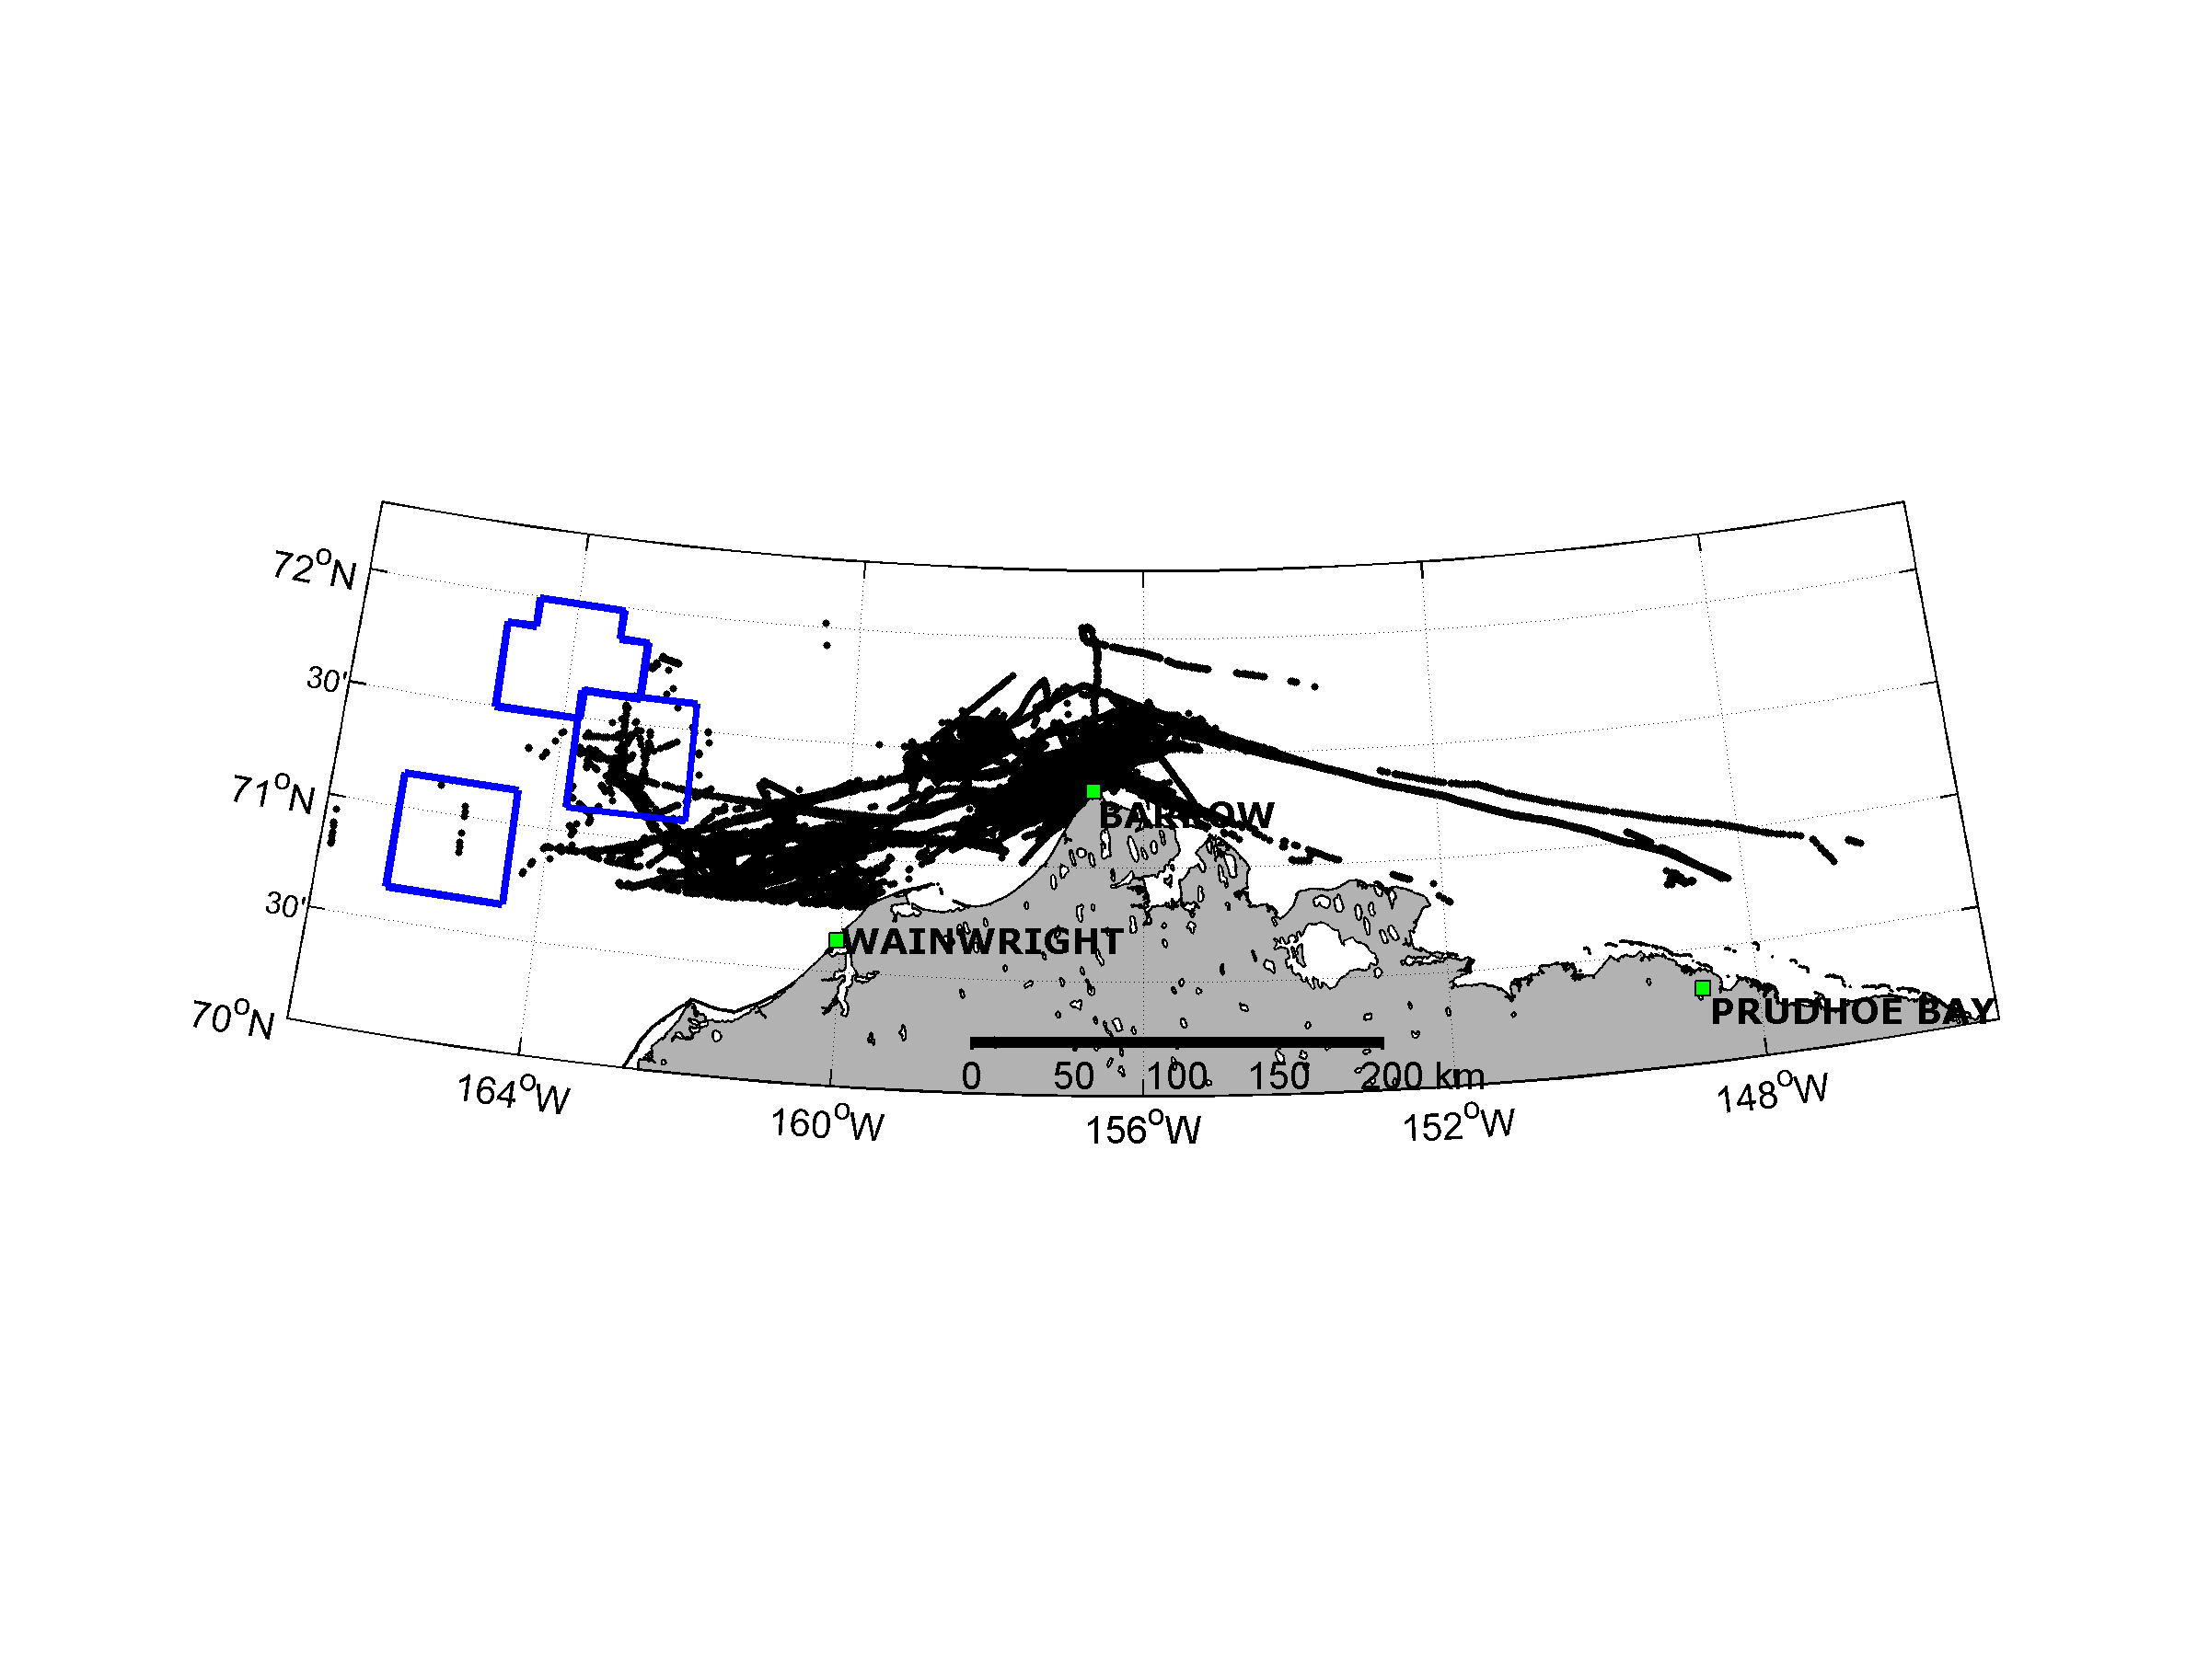
AIS Aug. 10 to Sept. 10 2012
81 Unique Vessels Operating in the Area

Slide 8
Alaska Experiment
Installed radars in June 2012
Surface Current Measurements conducted from June to October 2012

Slide 9
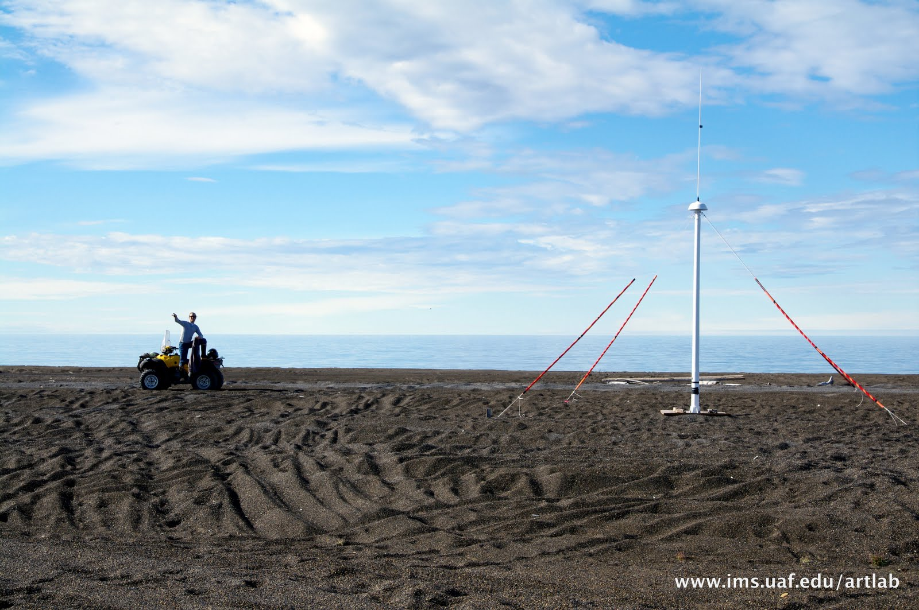
Receive Antenna

Slide 10
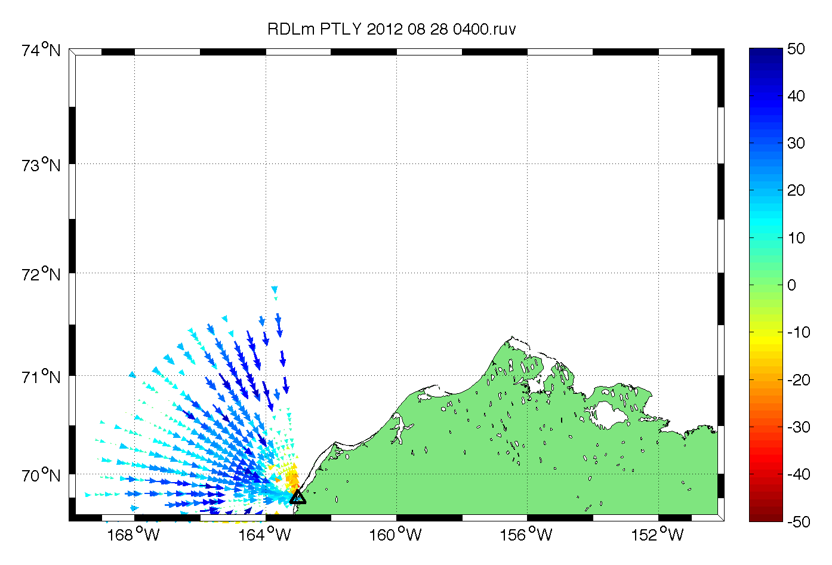

Slide 11
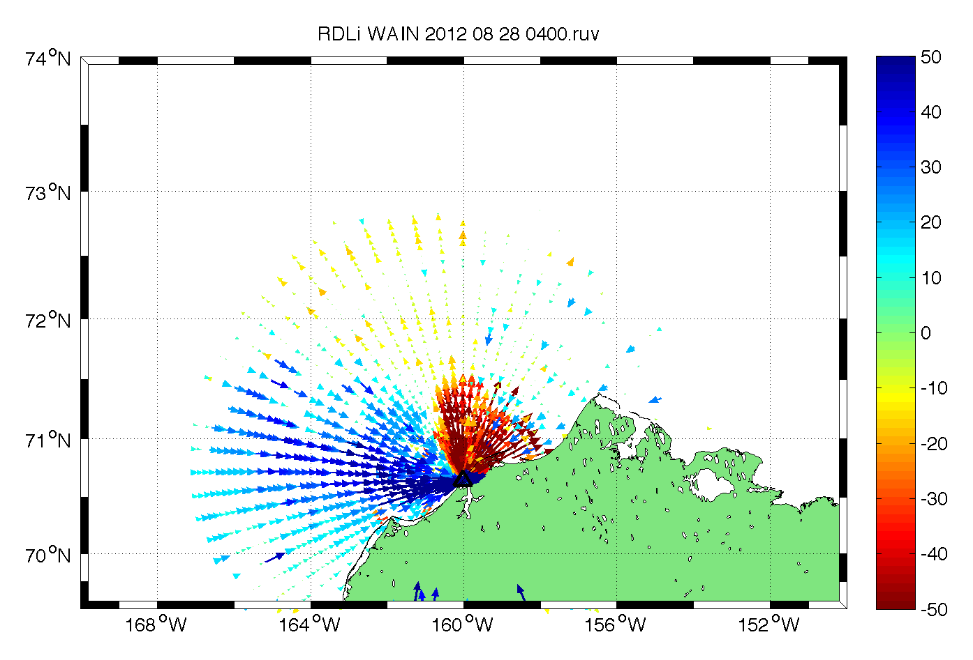

Slide 12
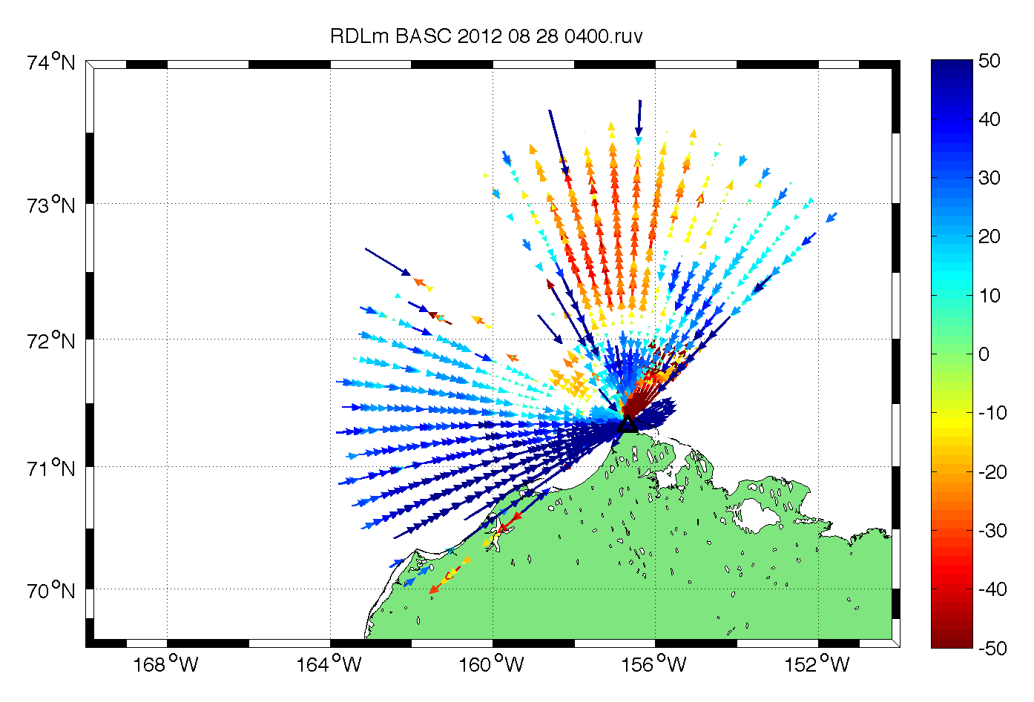

Slide 13
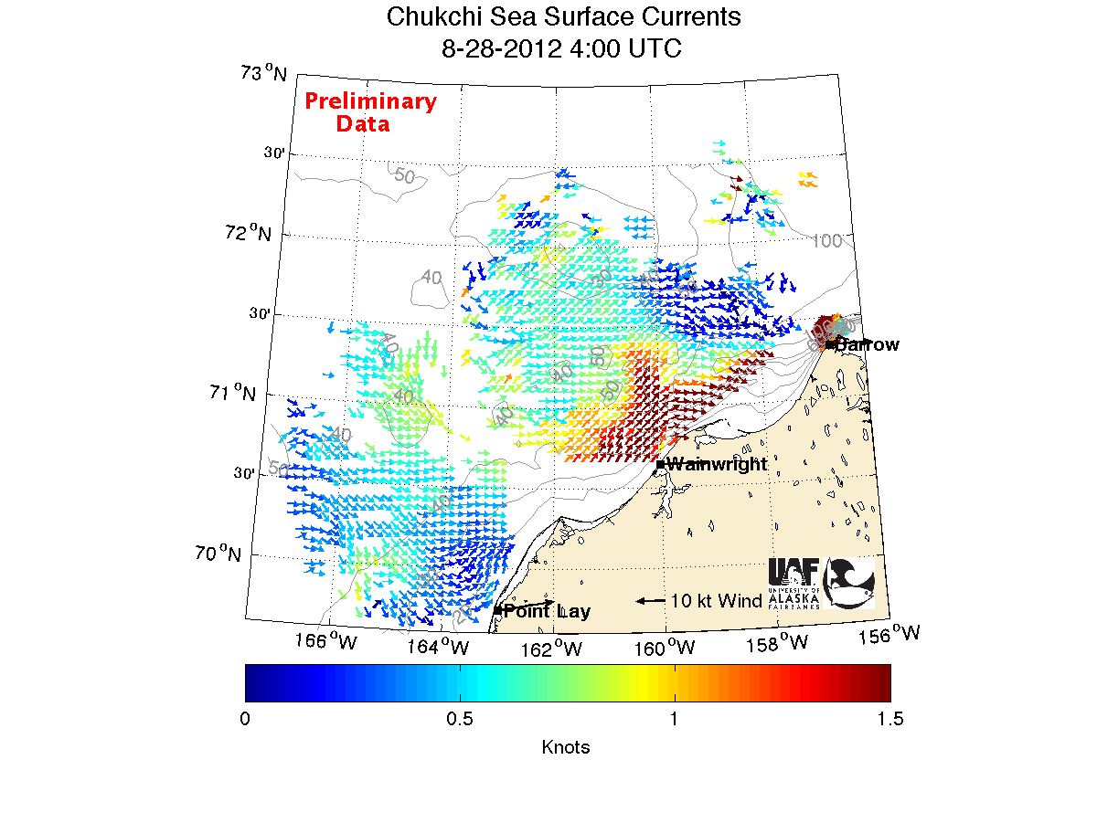

Slide 14
Daily Average Aug 29, 2012
5 MHz Long Range Network

Slide 15
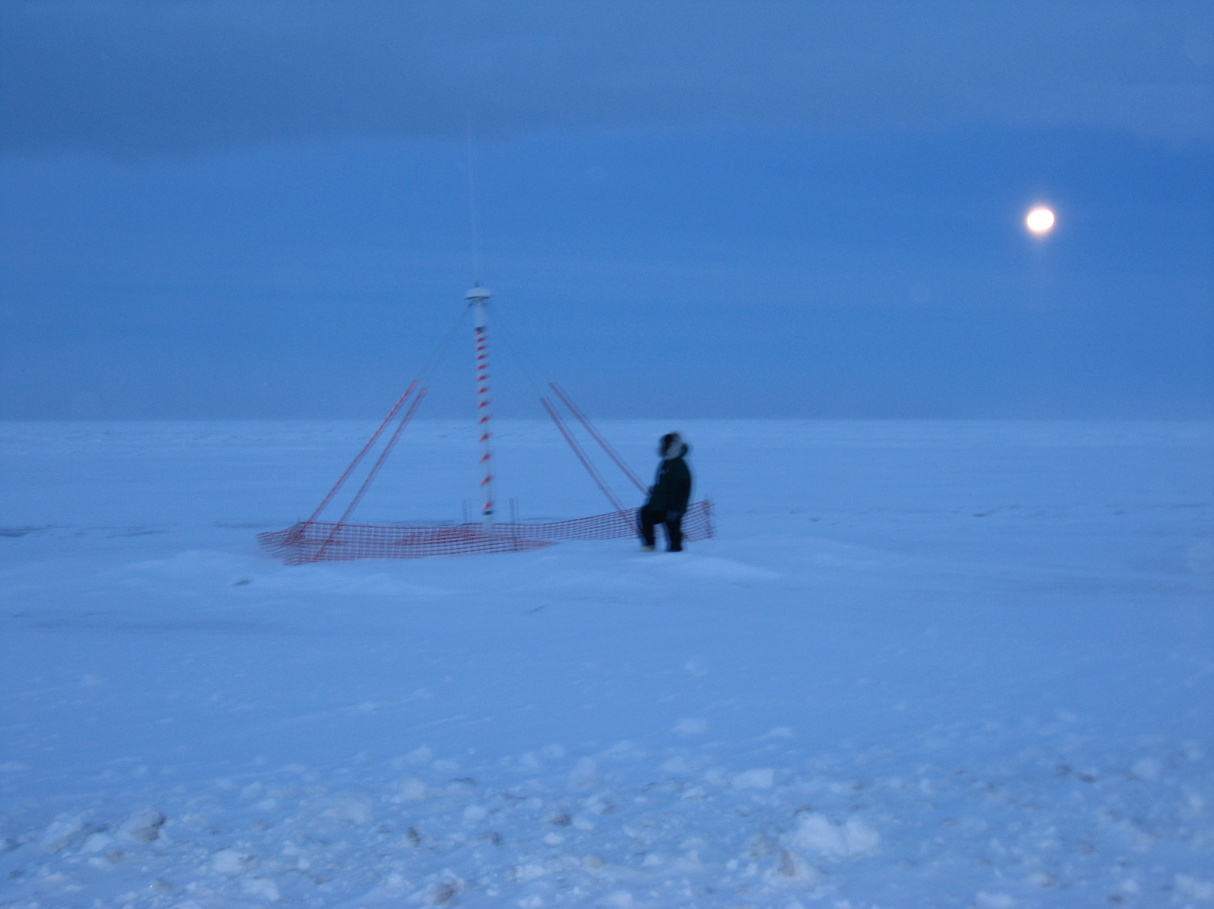
December 7, 2012

Slide 16
Receive Antenna

Slide 17
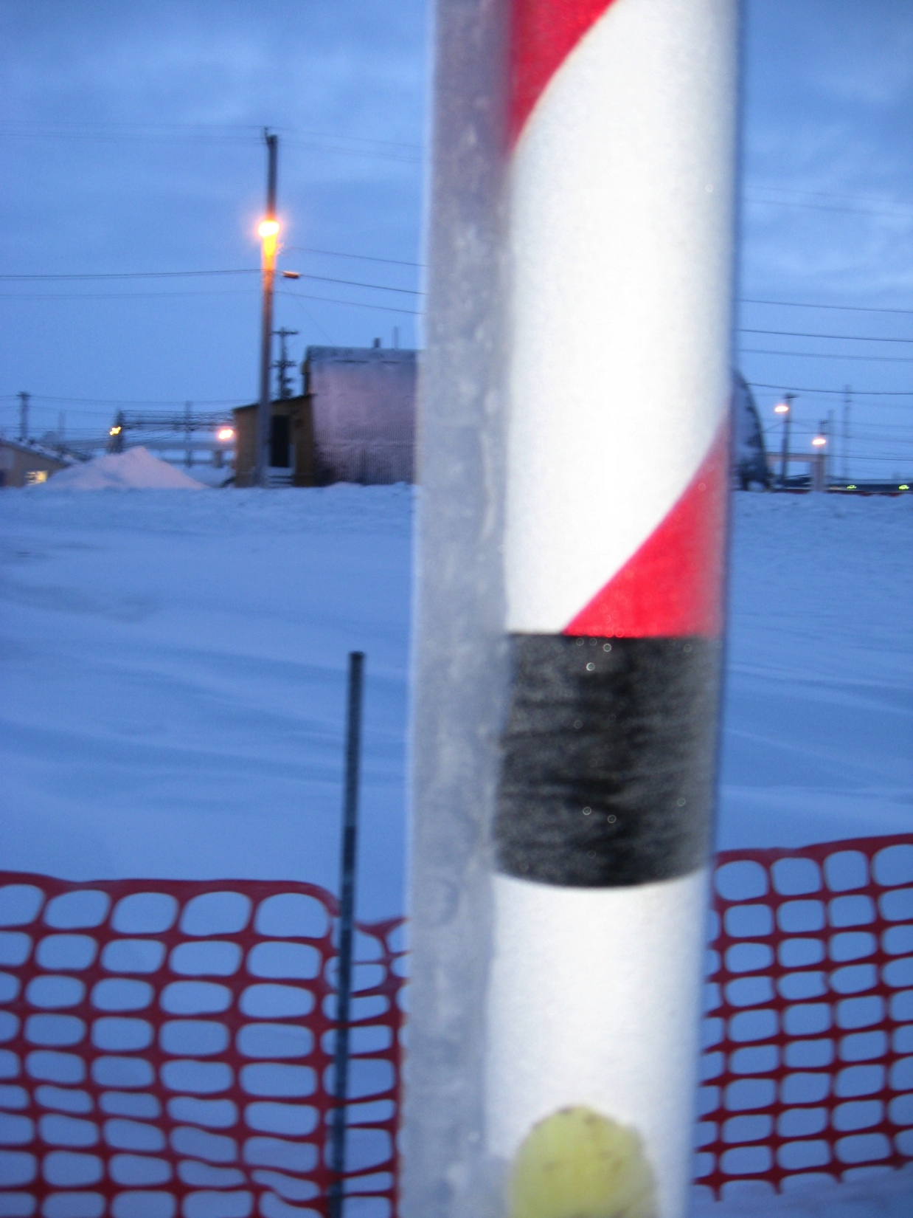

Slide 18
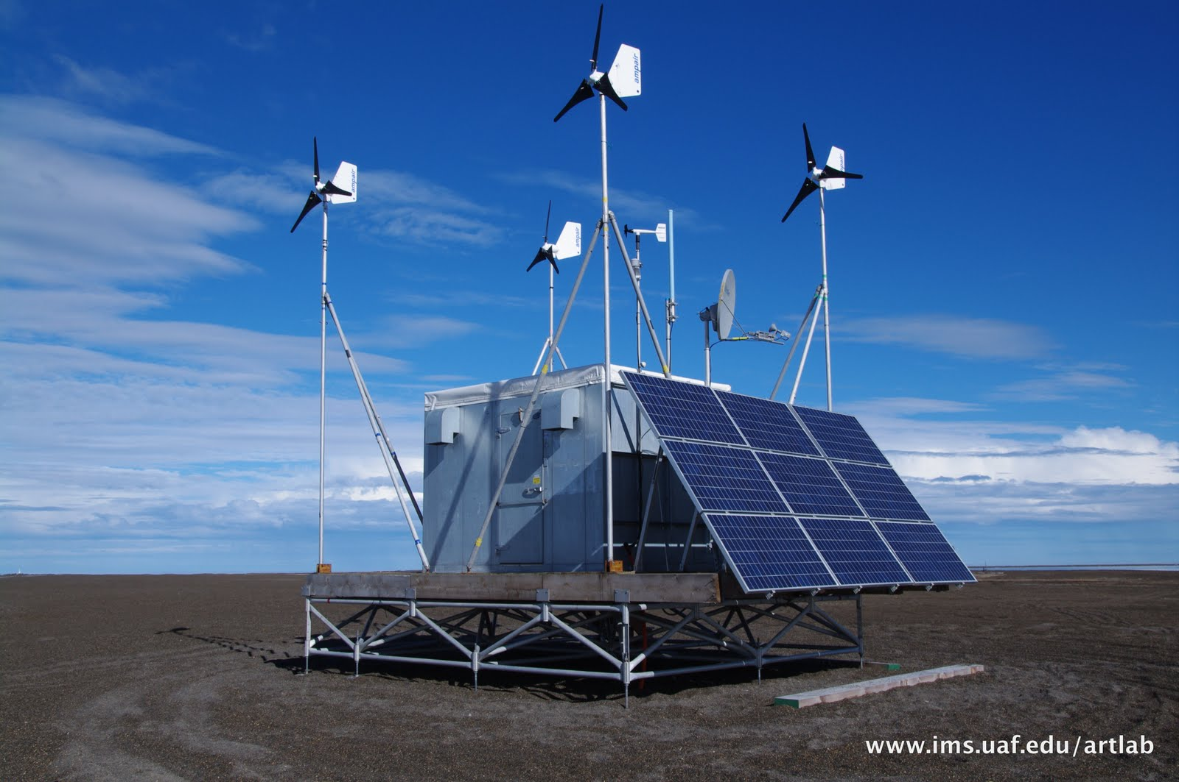
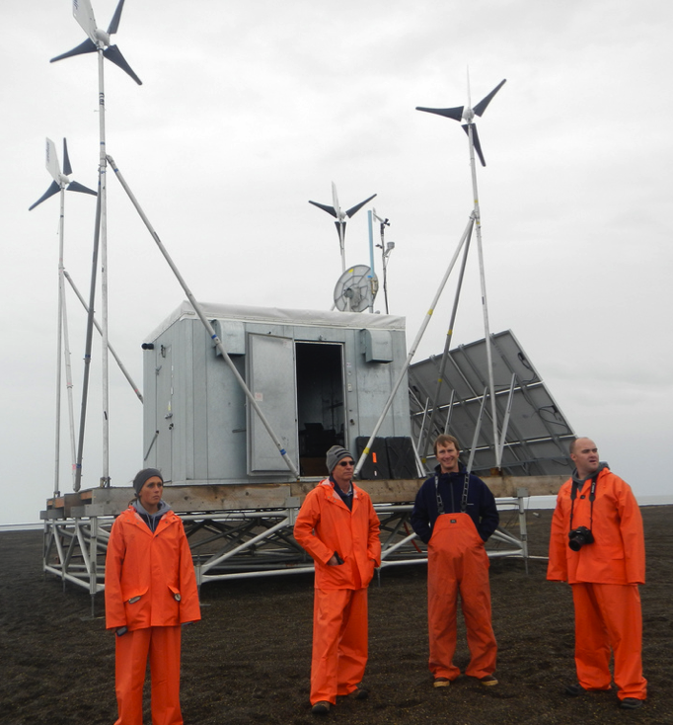
Remote Power Module

Slide 19
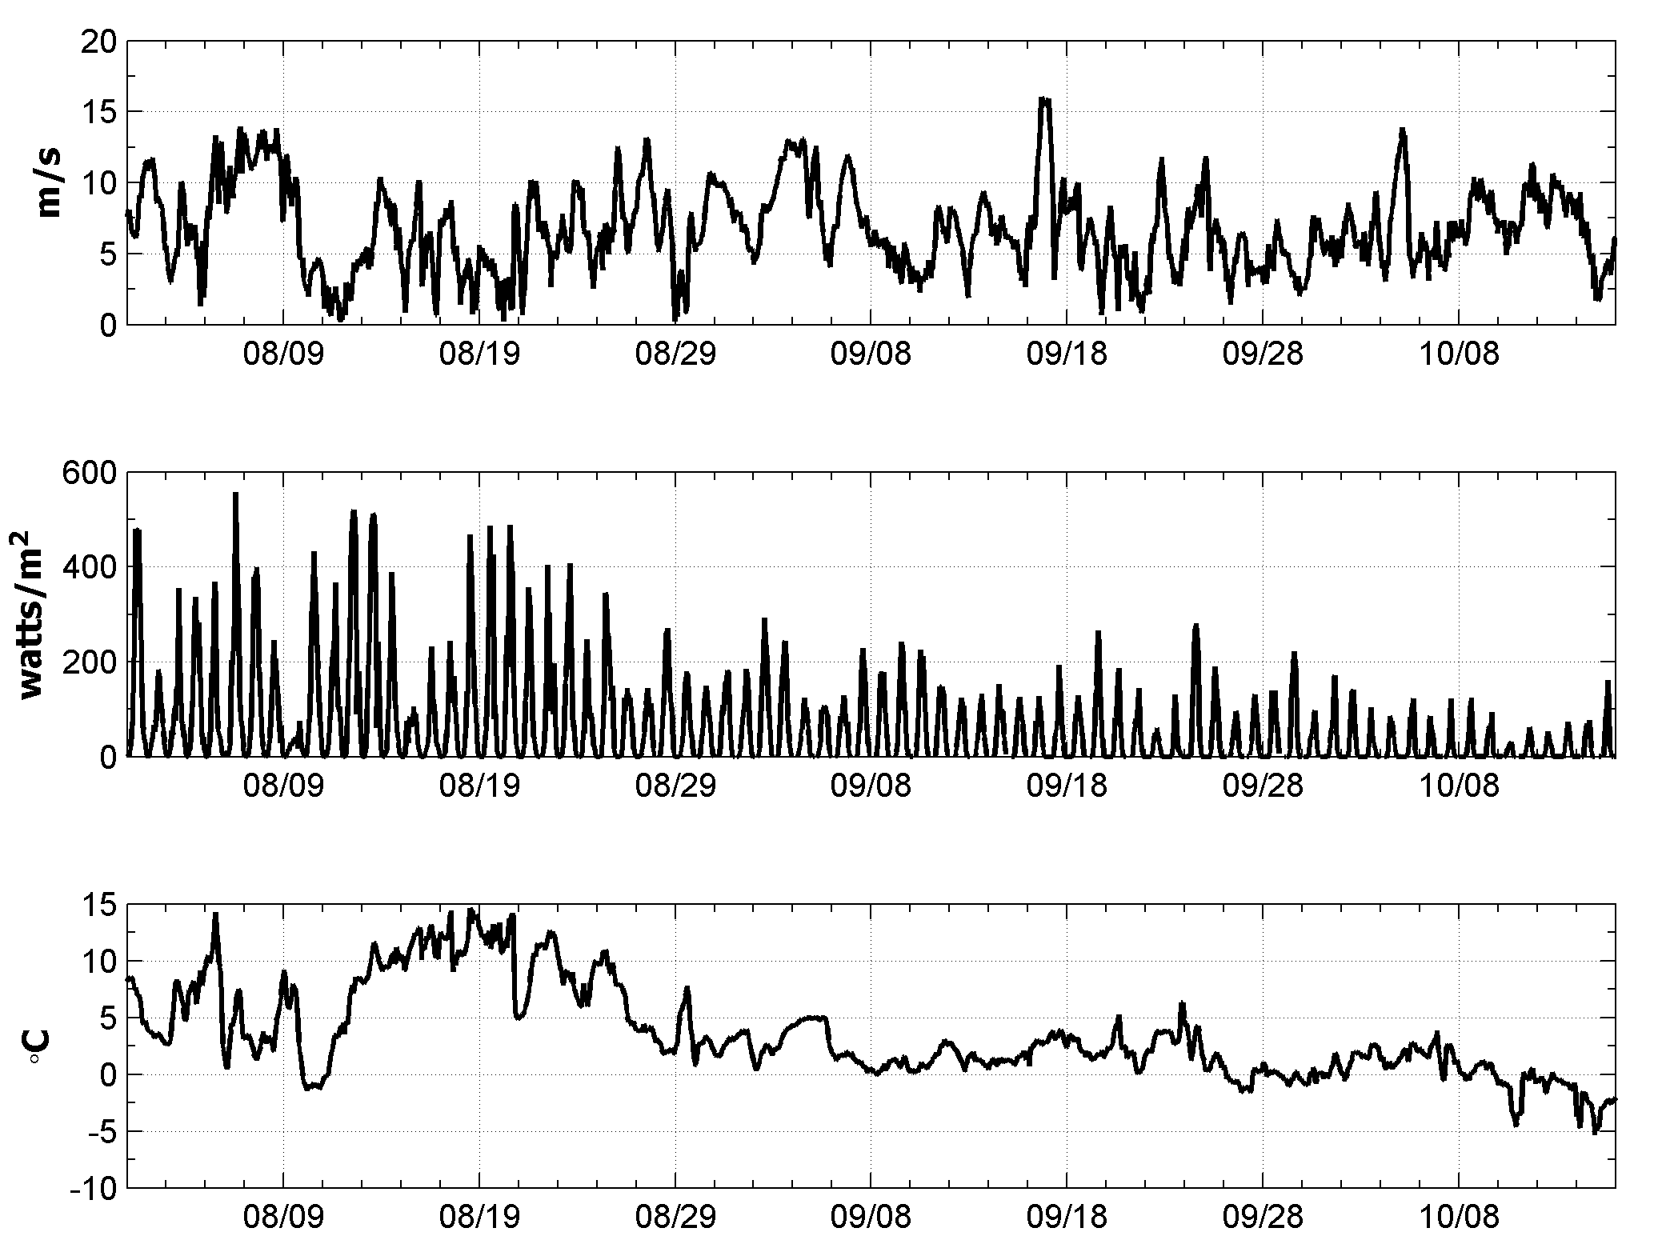
Measurements at RPM
Wind Speed
72% of Power Delivered by Wind Turbines
Solar Radiation
Air Temperature

Slide 20
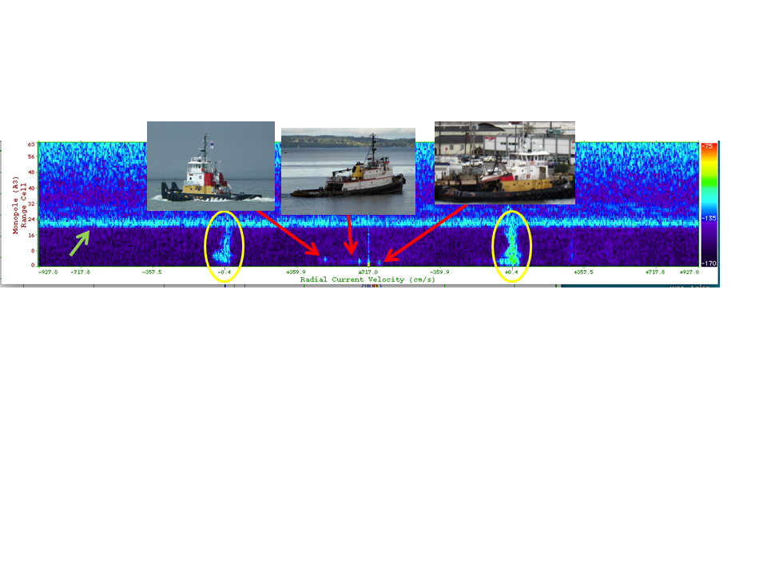
Radar Doppler Spectra

Slide 21
Alaska Experiment
Installed radars in June 2012
Collected vessel real time vessel detection data starting on July 9
Data transferred back to Rutgers in real time
Focused analysis on September 9 and 10

Slide 23
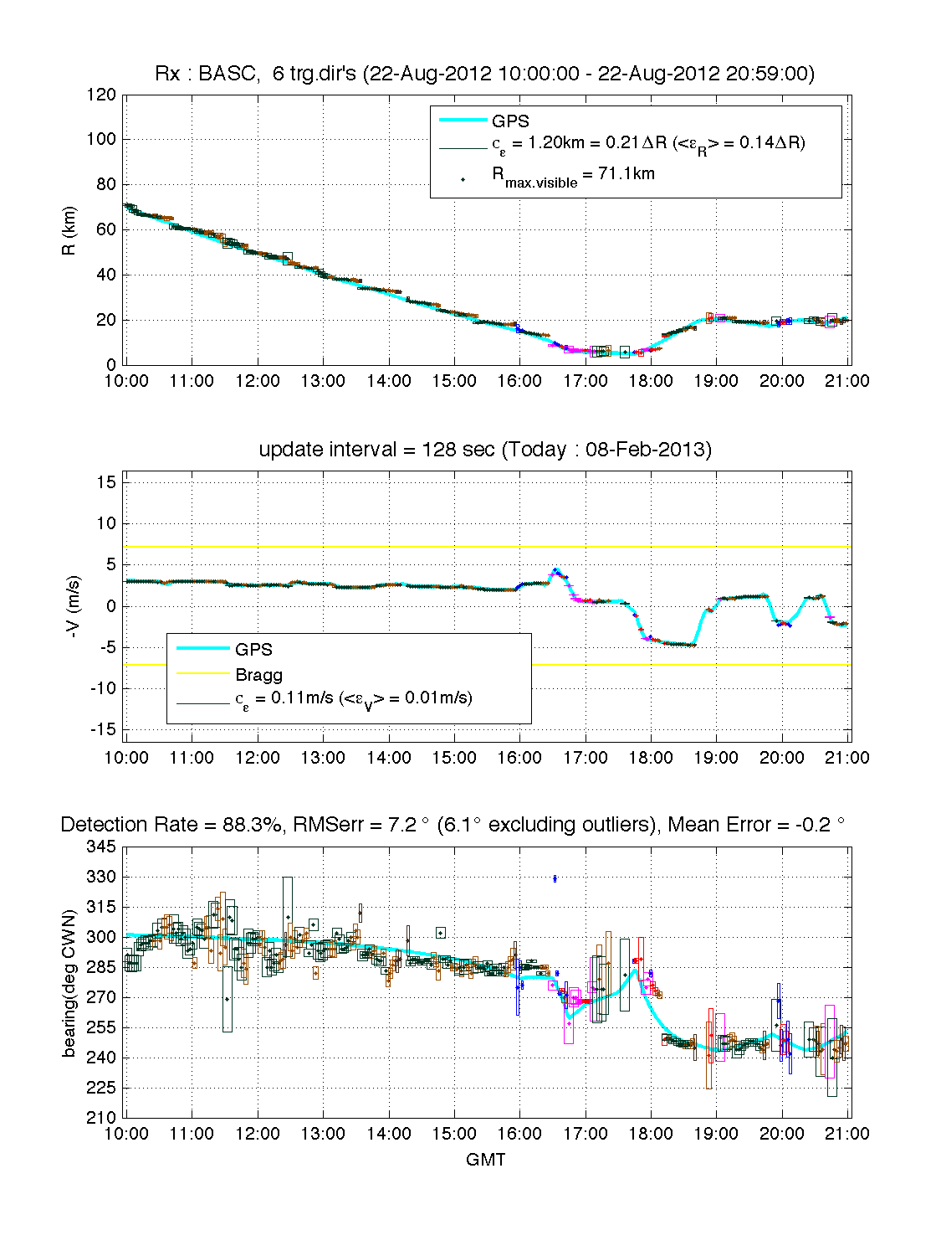

Slide 24
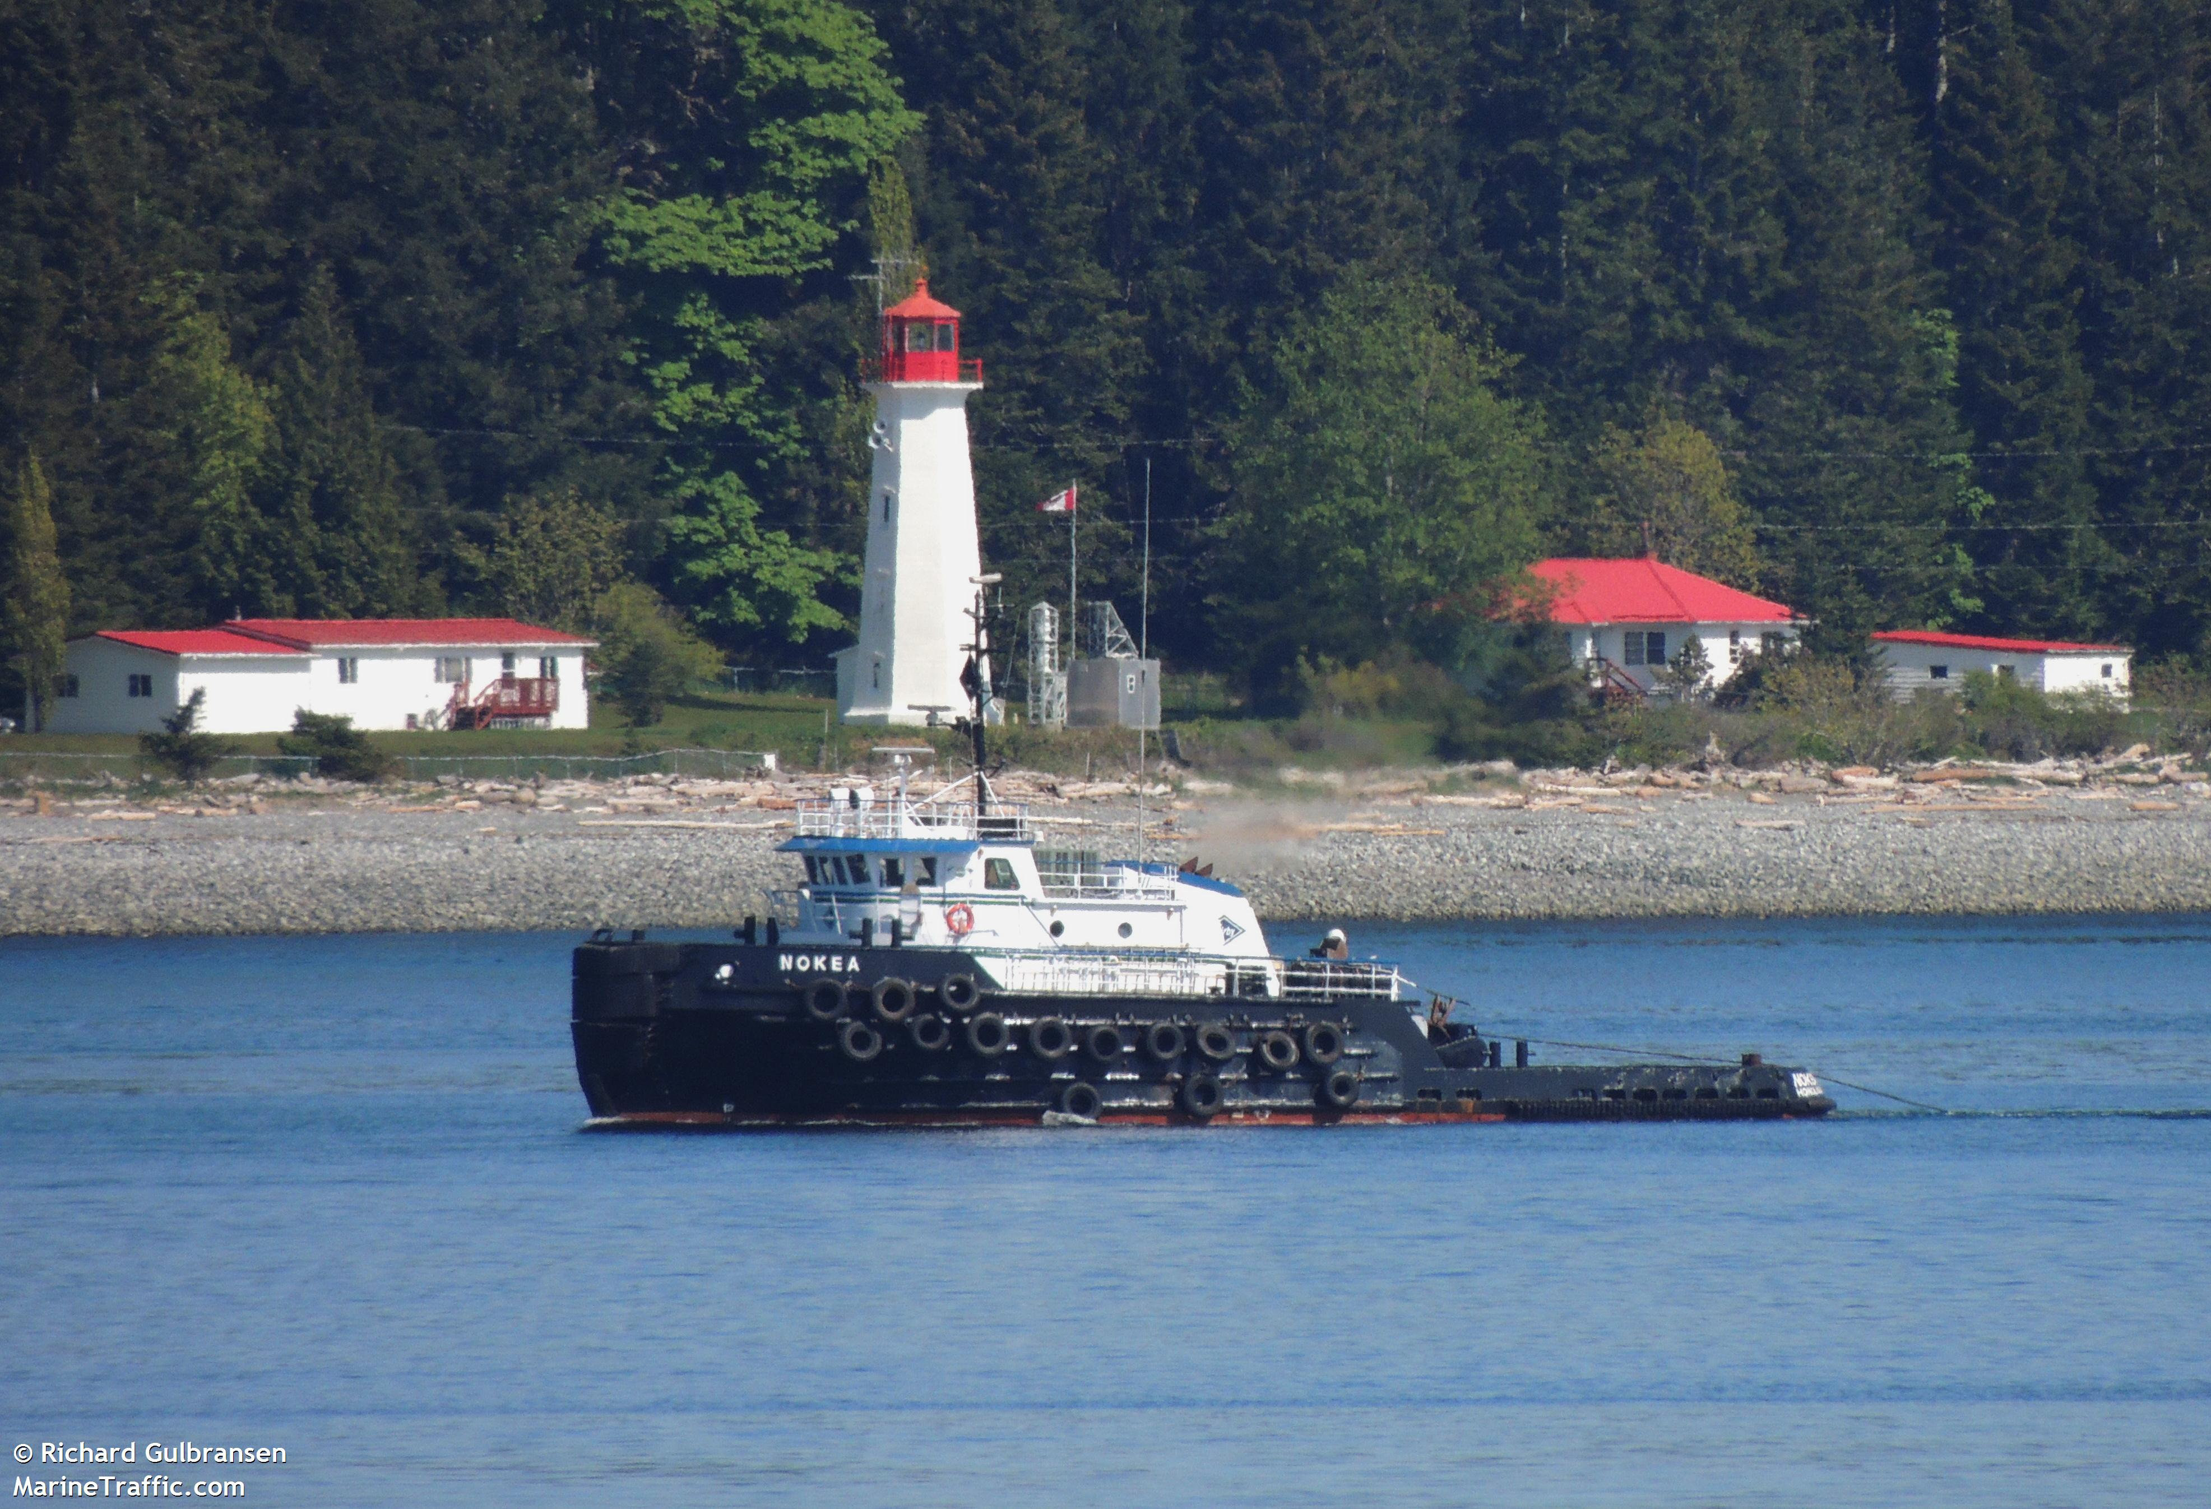
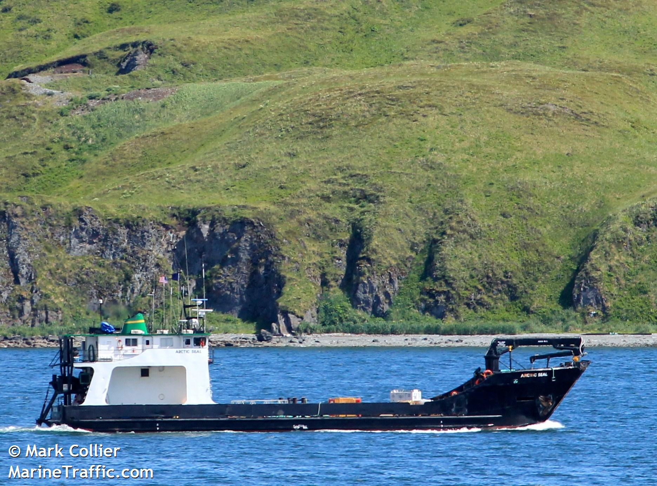
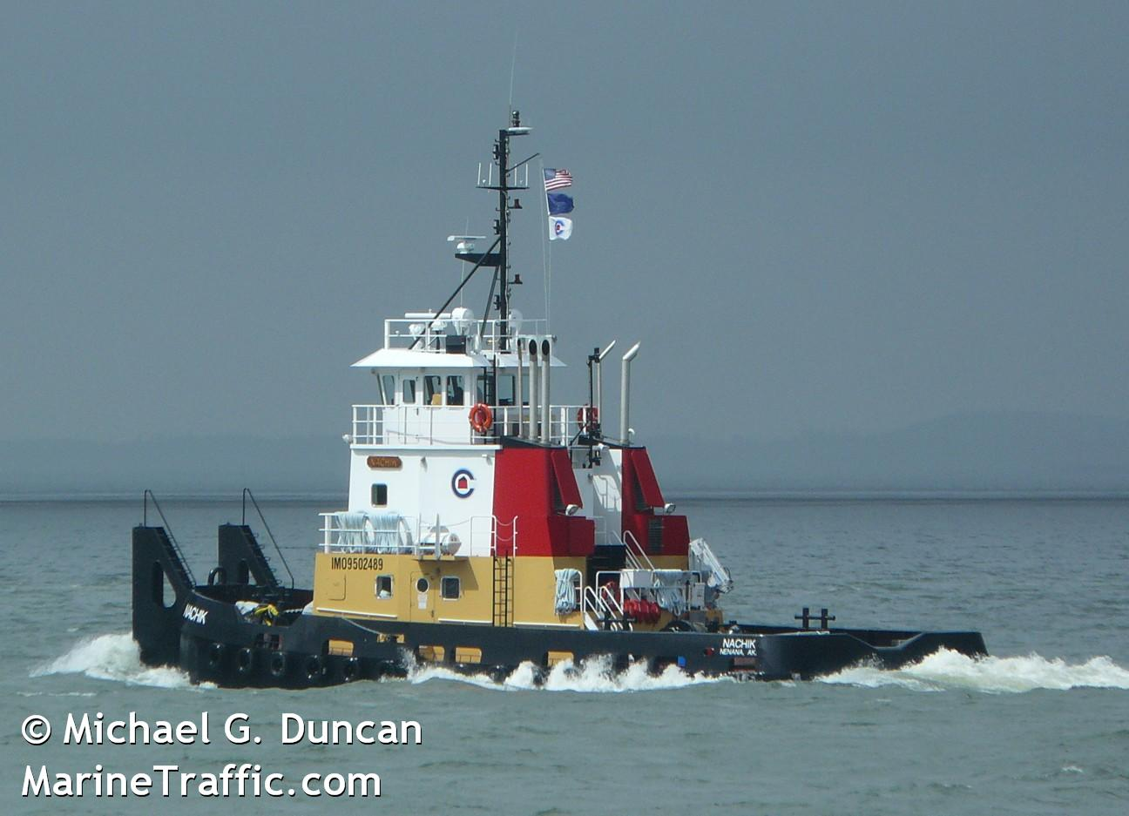
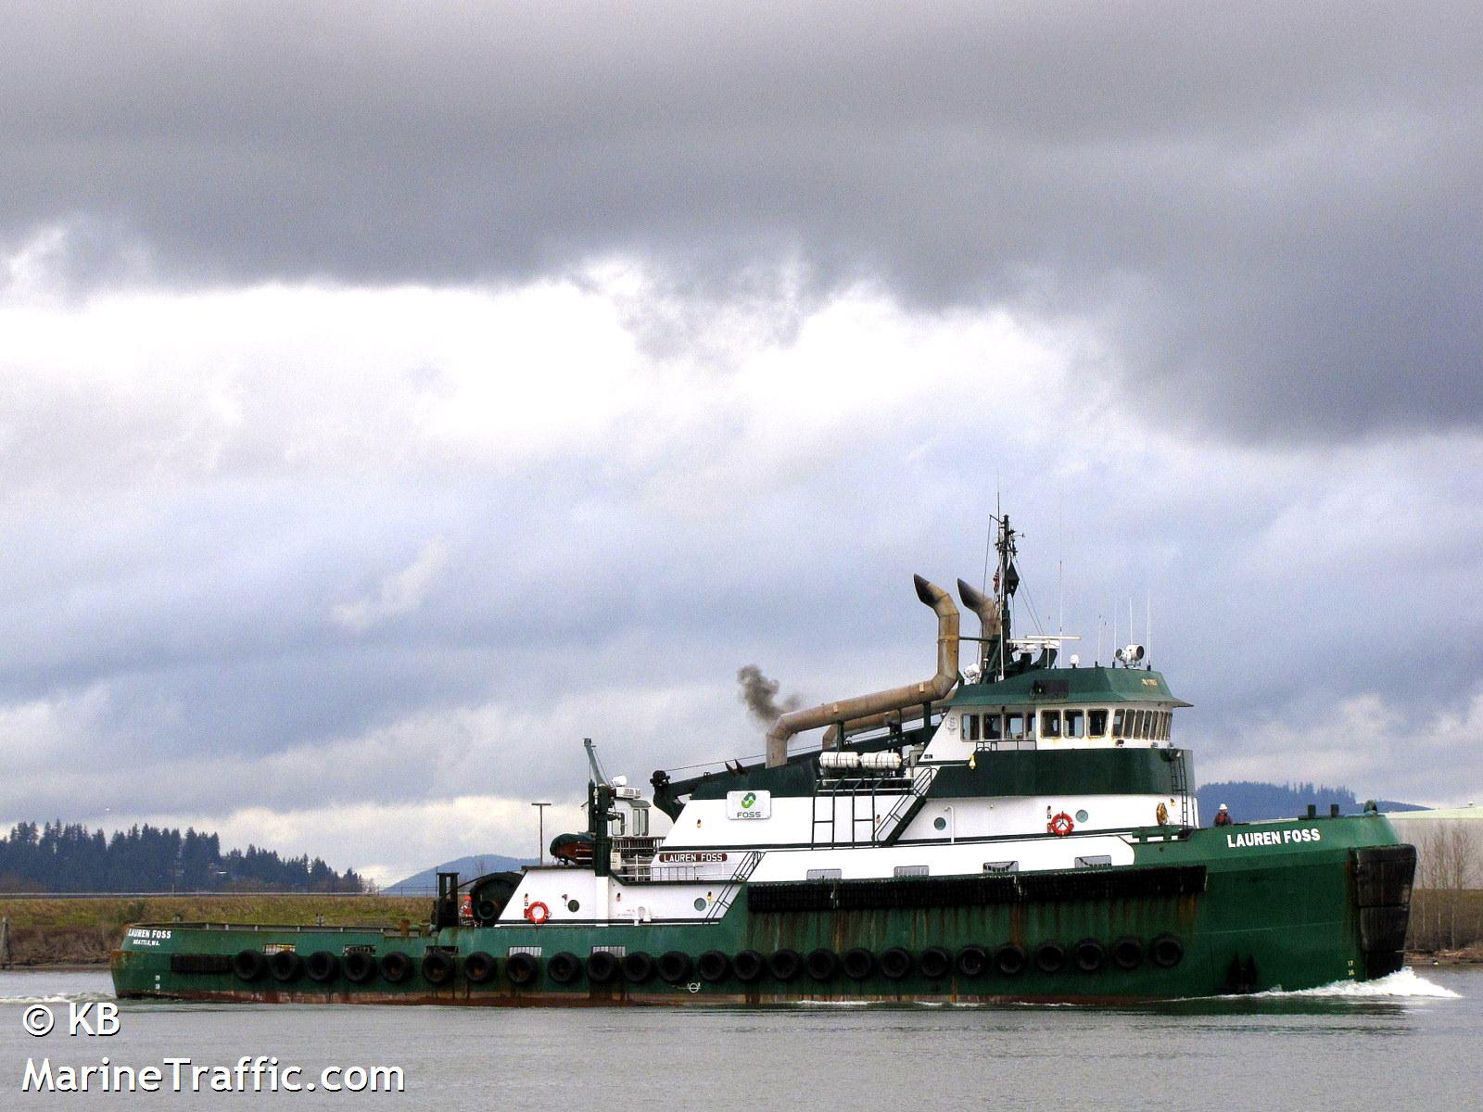
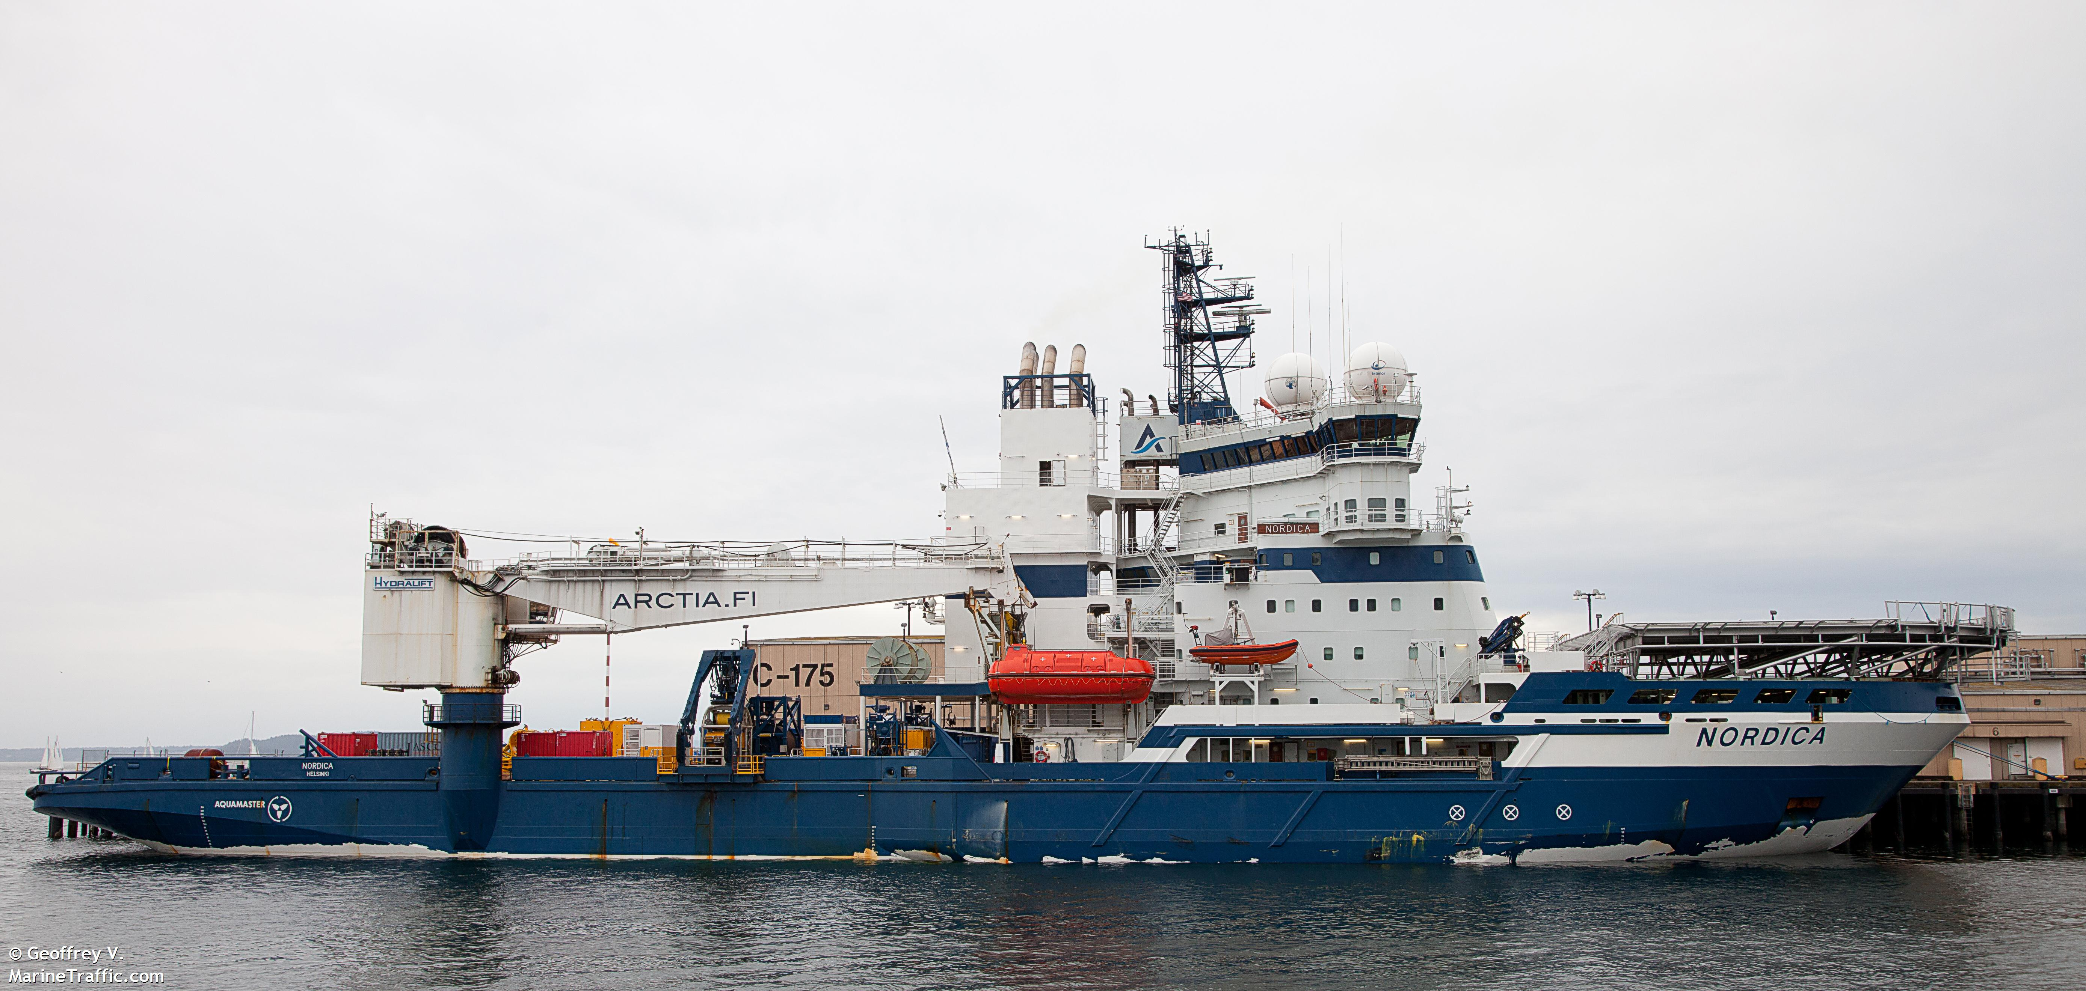
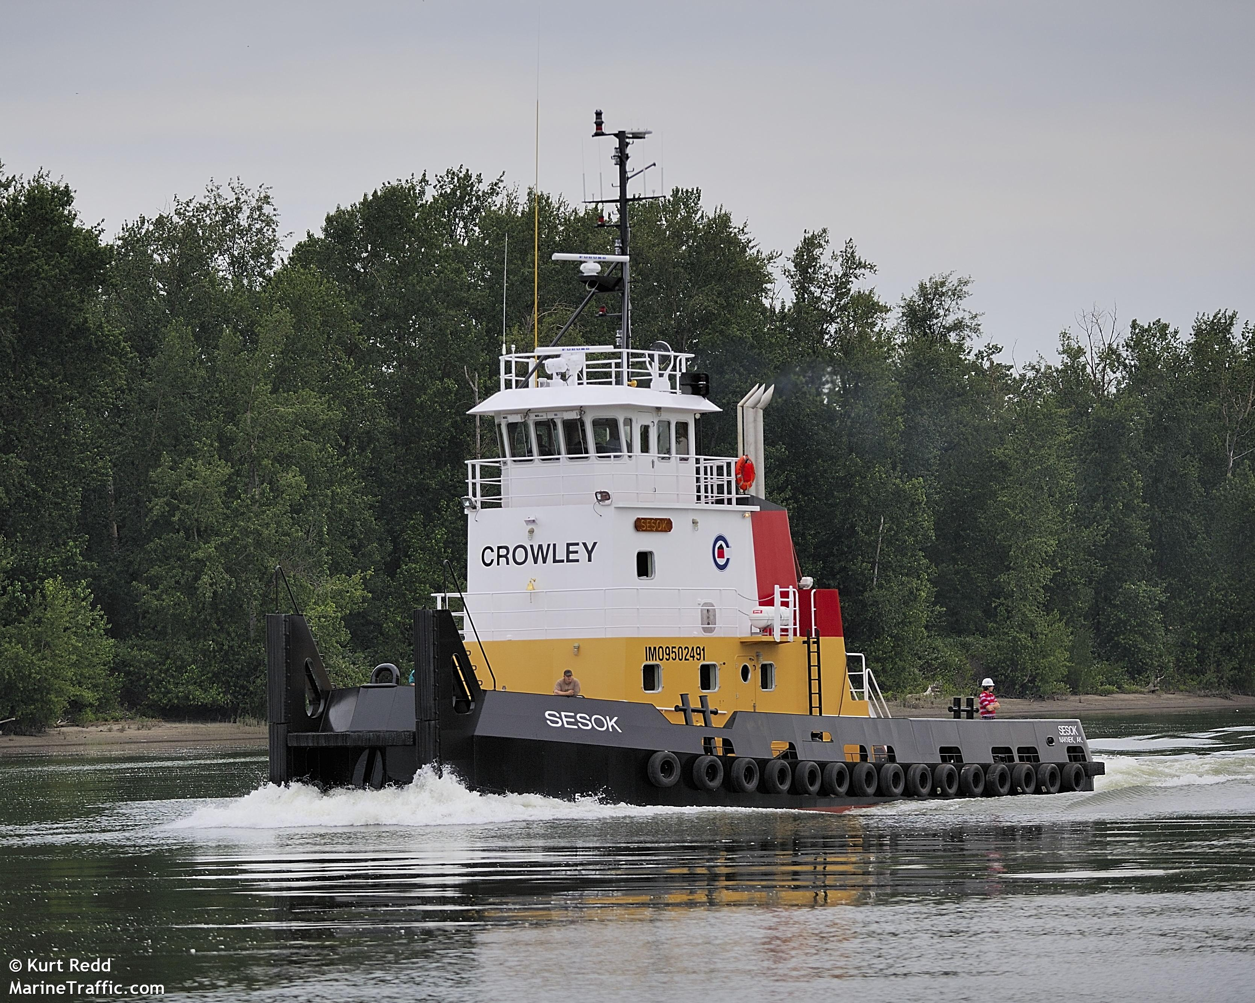
Vessels Detected During
September 9 and 10

Slide 25
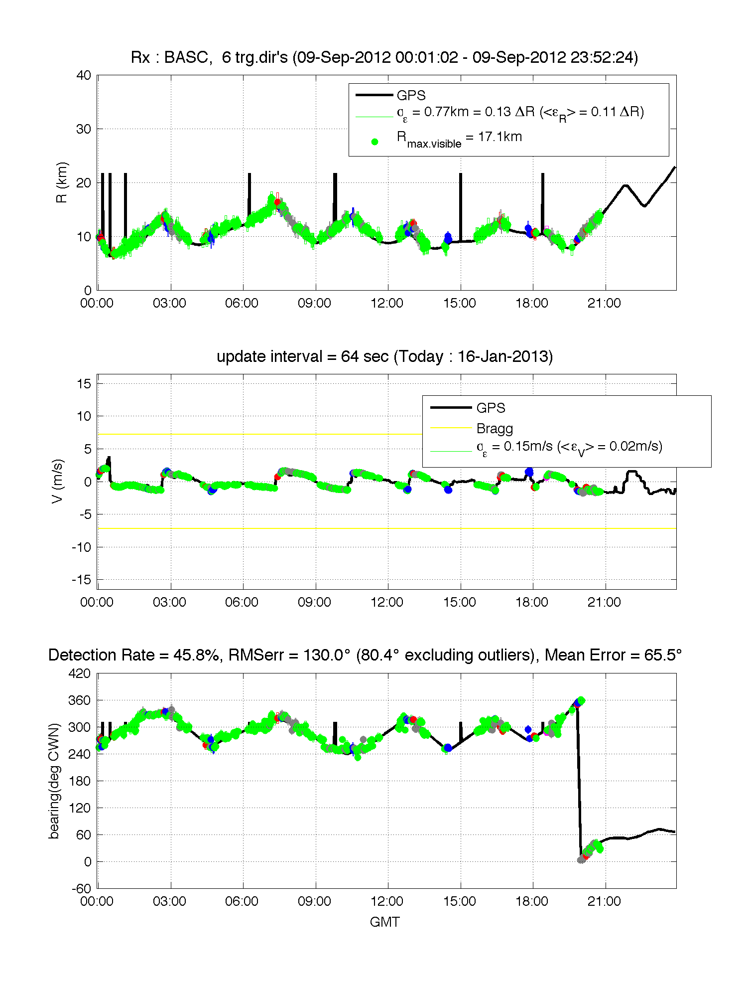
21 hours of Detection for Tug Boat Nokea

Slide 26
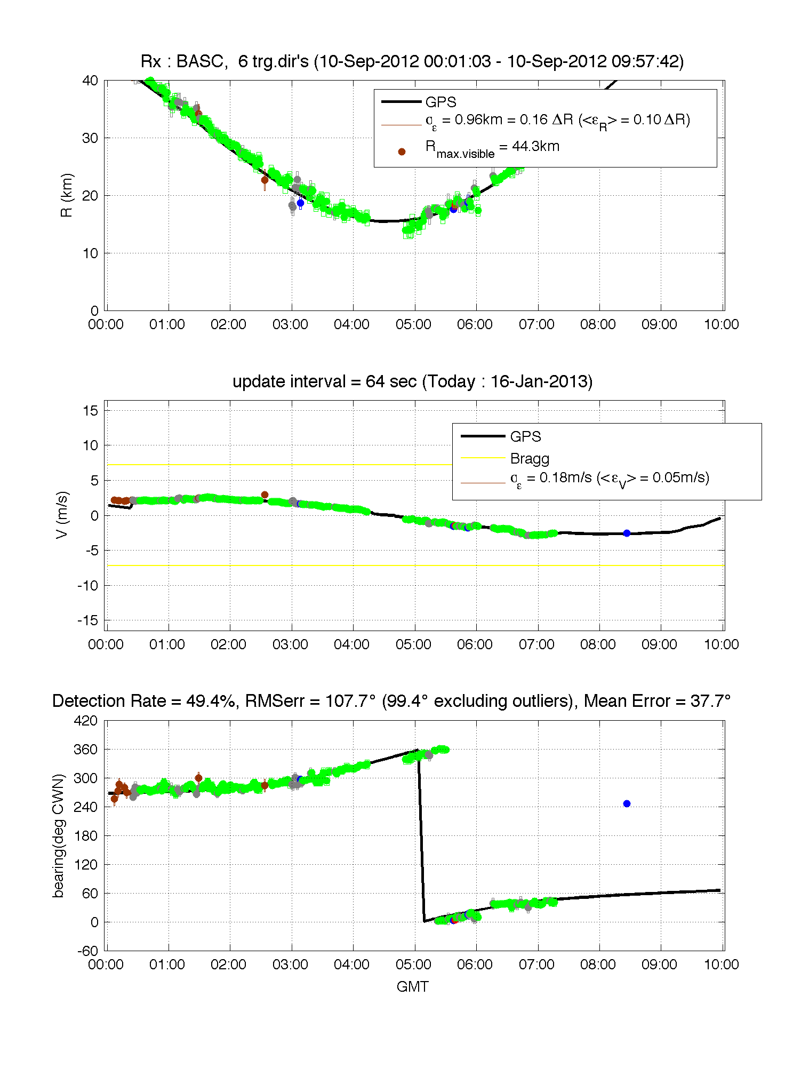
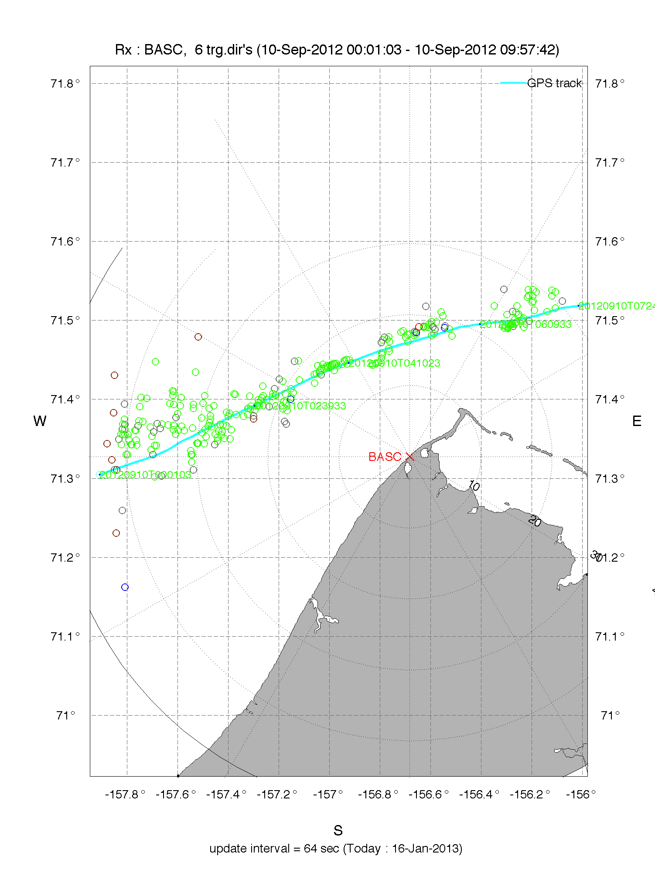
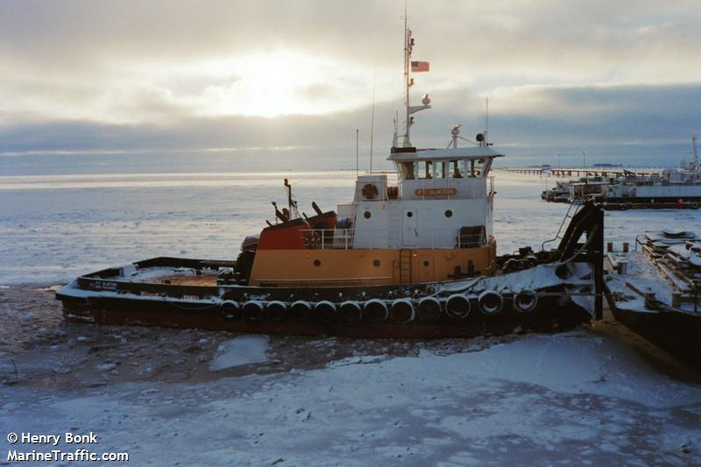

Slide 27
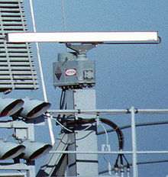
Detection Range (km)
Mean 51 km
200 m

Slide 28

Conclusions
HF radars on the North Slope of Alaska made simultaneous measurements of surface currents and vessel detections for Maritime Domain Awareness

