Slide 1



Towards a Global HF Radar Network
Applications and Success Stories
Hugh Roarty
June 5, 2013

Slide 2
Outline for Talk
Introduction to GEO and Global HF Radar Network
Applications for HF Radar
Application Stories

Slide 3
Group on Earth Observations
HF Radar

Slide 4
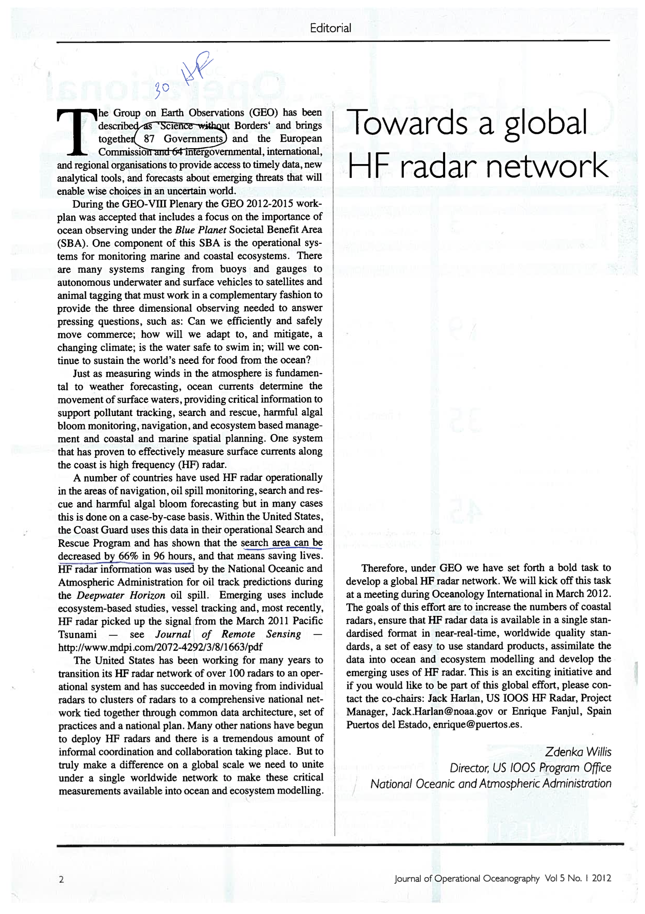
Global HF Radar Network
Established in March 2012
Goals of this effort:
  Increase the number of radars
  Ensure HF radar data is available in a single standardized format
  Develop worldwide quality standards
  Assimilate the data into ocean models
  Develop standard product suite and advance the emerging applications

Slide 5

There are 89 entities in the Group on Earth Observations
72 countries have a salty coast
35 of those countries have High Frequency radars on their coastline
Approximately 349 radars worldwide

Slide 6
CODAR SeaSonde Worldwide 2012
United States 130
Canada 8
Mexico 2
Brazil 2
Bahamas 2
Honduras 2
Norway 6
Portugal 4
Italy 6
Croatia 2
Spain 16
Ireland 2
Russia 1
France 2
Israel 2
Japan 22
Korea 24
China 8
Thailand 6
Malta 2
Taiwan 20
India 12
Vietnam 3
Indonesia 2
Jordan 1
UAE 2
Egypt 2
Azerbaijan 2
Australia 5
Total Sales: ~298

Slide 7
WERA Worldwide 2012
USA: 12
Mexico: 2
France: 6
Australia: 8
Germany: 5
UK: 2
Chile: 2
Oman: 2
Greece: 2
China: 4
Korea: 2
Total Sales: 47

Slide 8
Number of HF Radar Stations in Each Country
35 Countries with HF radar for oceanographic purposes

Slide 9
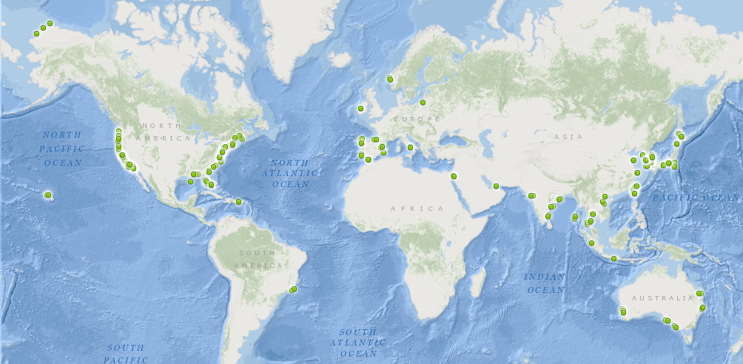
258 Stations Located So Far

Slide 10
Frequency Statistics
We’ve been able to locate 258 of the 349 (74%)
05 MHz 86 stations
13 MHz 83 stations
25 MHz 69 stations
42 MHz 20 stations
Inventory of stations here
https://docs.google.com/spreadsheet/ccc?key=0AiQGzbMafH40dGkybFFQOEdMcGVpc011bEM4SXlHY0E#gid=0
IOOS GEO HF
http://www.ioos.noaa.gov/globalhfr/welcome.html

Slide 11
GEO HF Radar Mailing List
Global HF geo.global.hfradar@ucsd.edu
292 names currently on the list
To join send email to geo.global.hfradaradm@ucsd.edu

Slide 12
Number of Individuals on
GEO HF Radar Mailing List By Country
42 Countries Represented on the Mailing List
Countries With Radars Not on Mailing List
Azerbaijan
Bahamas
Chile
Egypt
Honduras
Oman

Slide 13
Applications of hf Radar

Slide 14
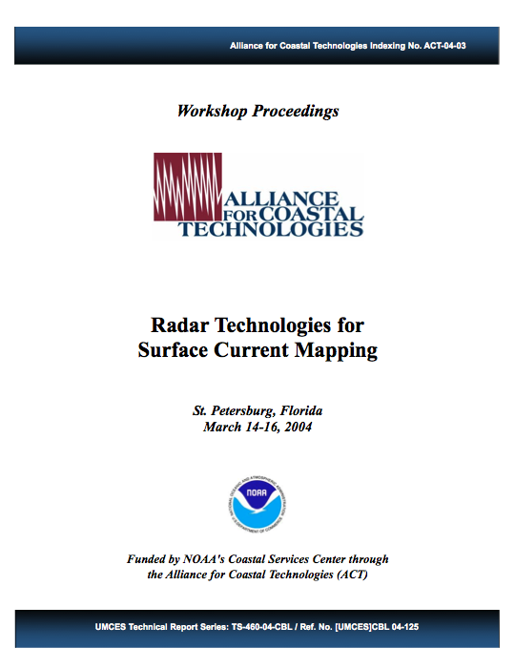
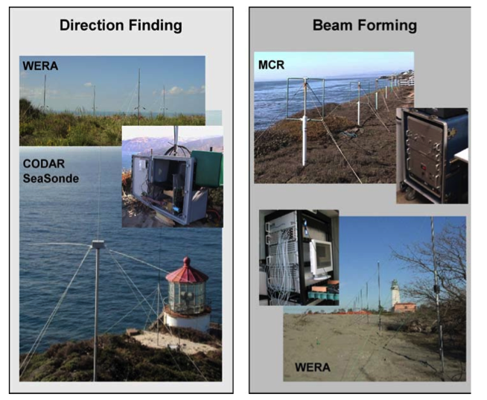
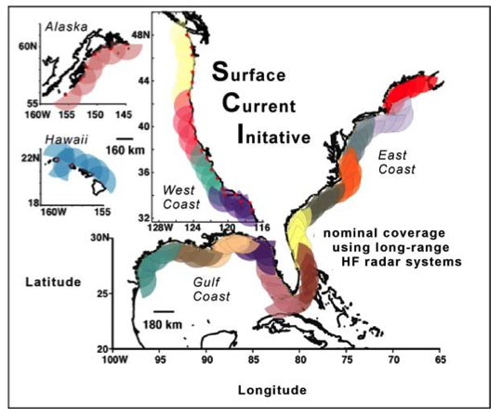

Slide 15
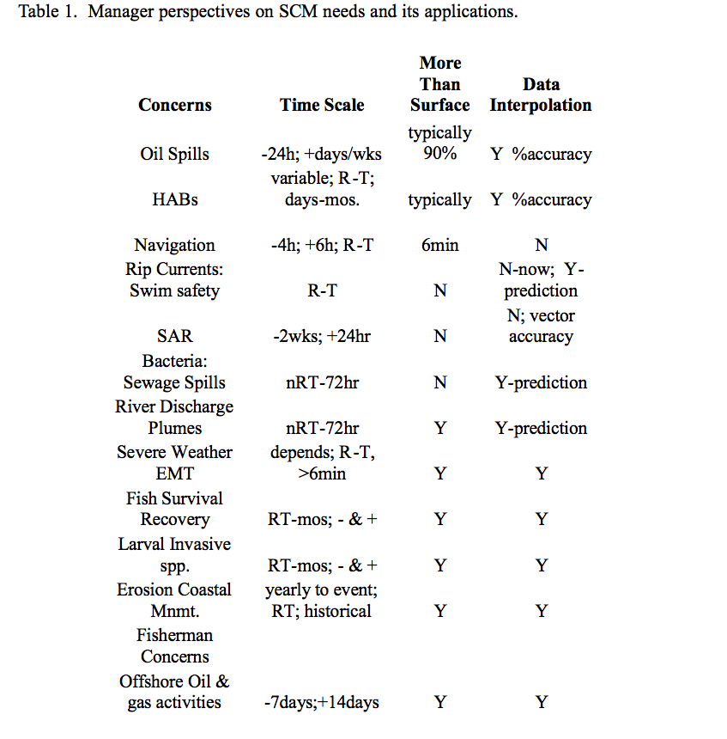
1
2
3
4
5
6
7
8
9
10
11
12

Slide 16
Application Stories by Type

Slide 17
Application Stories by Country

Slide 18
Application Stories
63 stories can be found here
https://docs.google.com/spreadsheet/ccc?key=0ApJVYVXQvIe0dDBPcWFGZll0UTRBS3VaMERYUXhKT2c#gid=0
Please send us more stories

Slide 19

There’s an APP for that

Slide 20
Application stories

Slide 21
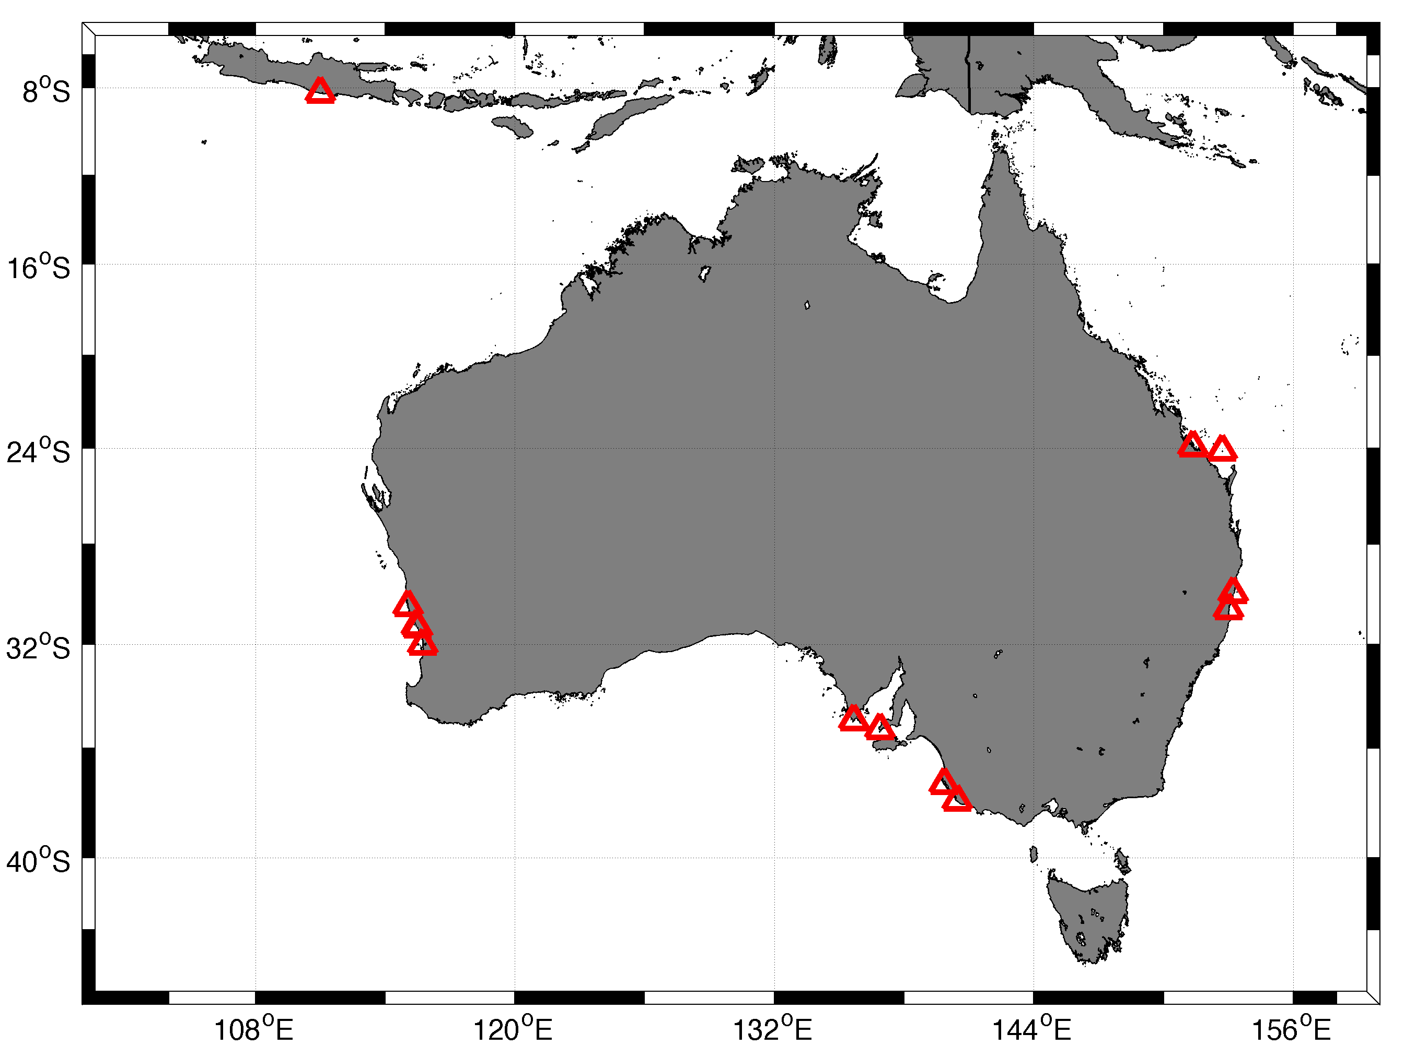
Australia – 13 HF radars

Slide 22
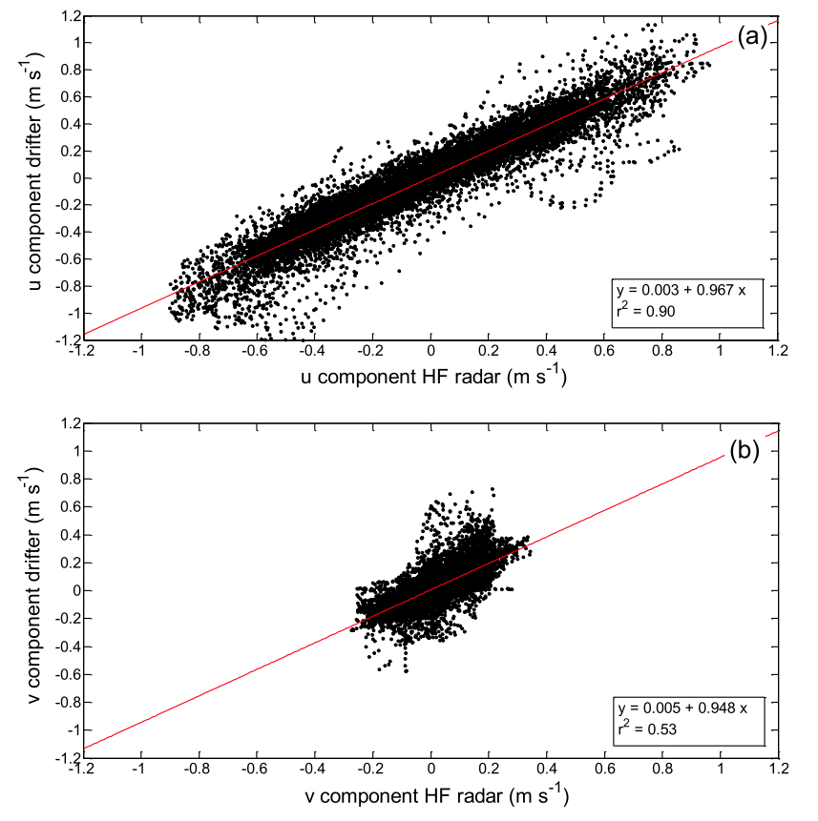
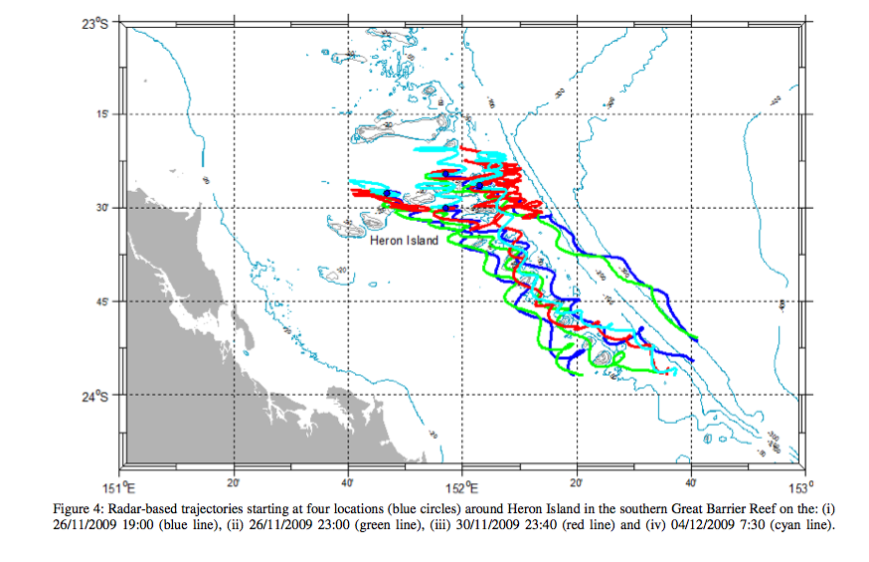
Radar Based Tracking of Pollutants/Larvae in the Coral Sea

Slide 23
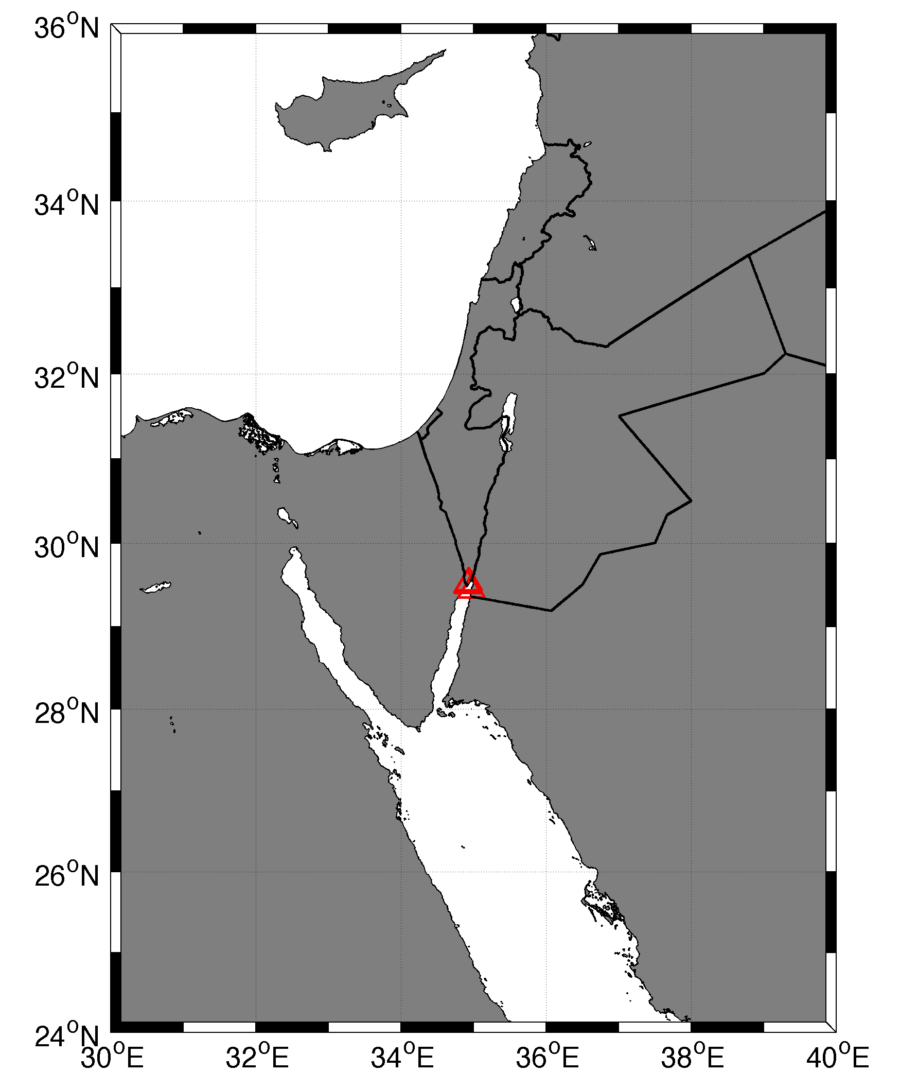
Israel – 2 HF radars

Slide 24
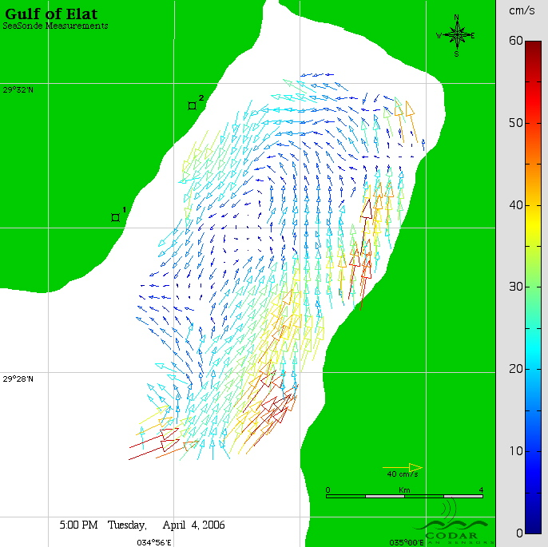
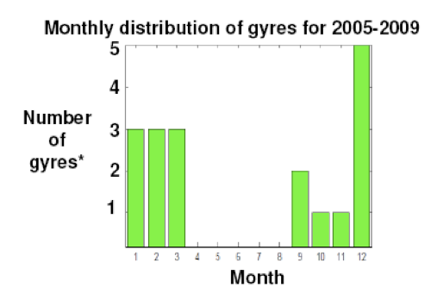
The Gulf of Eilat: a natural driven cavity?
Coherent eddies are rare and appear only a few times a year, from November to April, when the wind is relatively calm

Slide 25
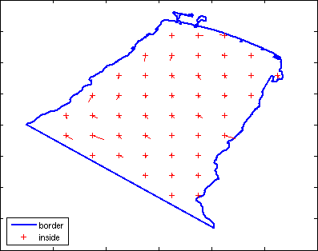
Submesoscale barriers to horizontal mixing from current measurements and aerial-photographs
Methodology
Analyses are based on measurements of surface velocity field by HF Coastal radar.
Ensembles of Lagrangian particle trajectories deployed in the observed velocity fields enable to quantify the spatial and temporal variations of the Lagrangian dispersion.
Previous studies of single- and two-particle dispersion were based on drifters and have been restricted to limited regions and periods.
We use 1000s
of trajectories

Slide 26
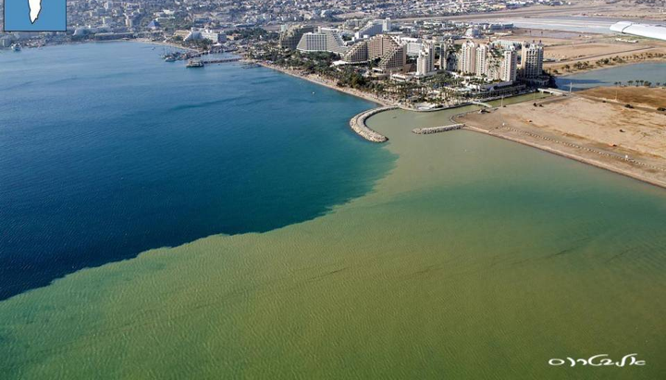
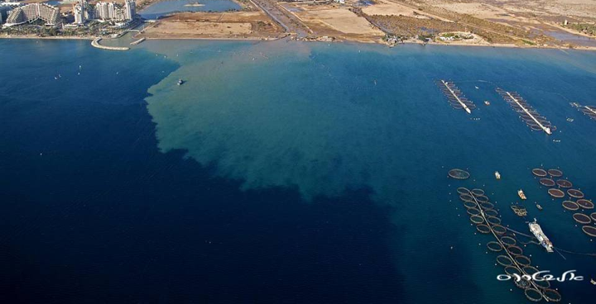
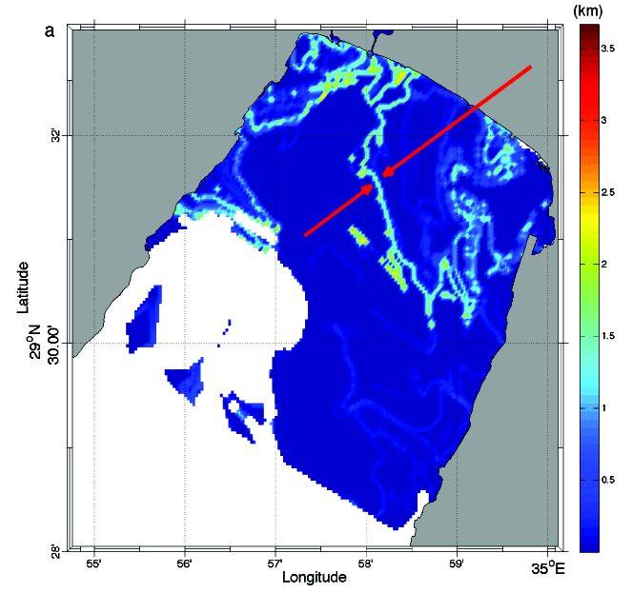
Aerial photographs: persisting barriers to mixing
After two days, Feb. 5, 2006
Spatial variations of the relative dispersion and the Lyapunov exponents seem to explain the observed sharp front.
This implies non-uniform mixing, unlike what most models use …

Slide 27
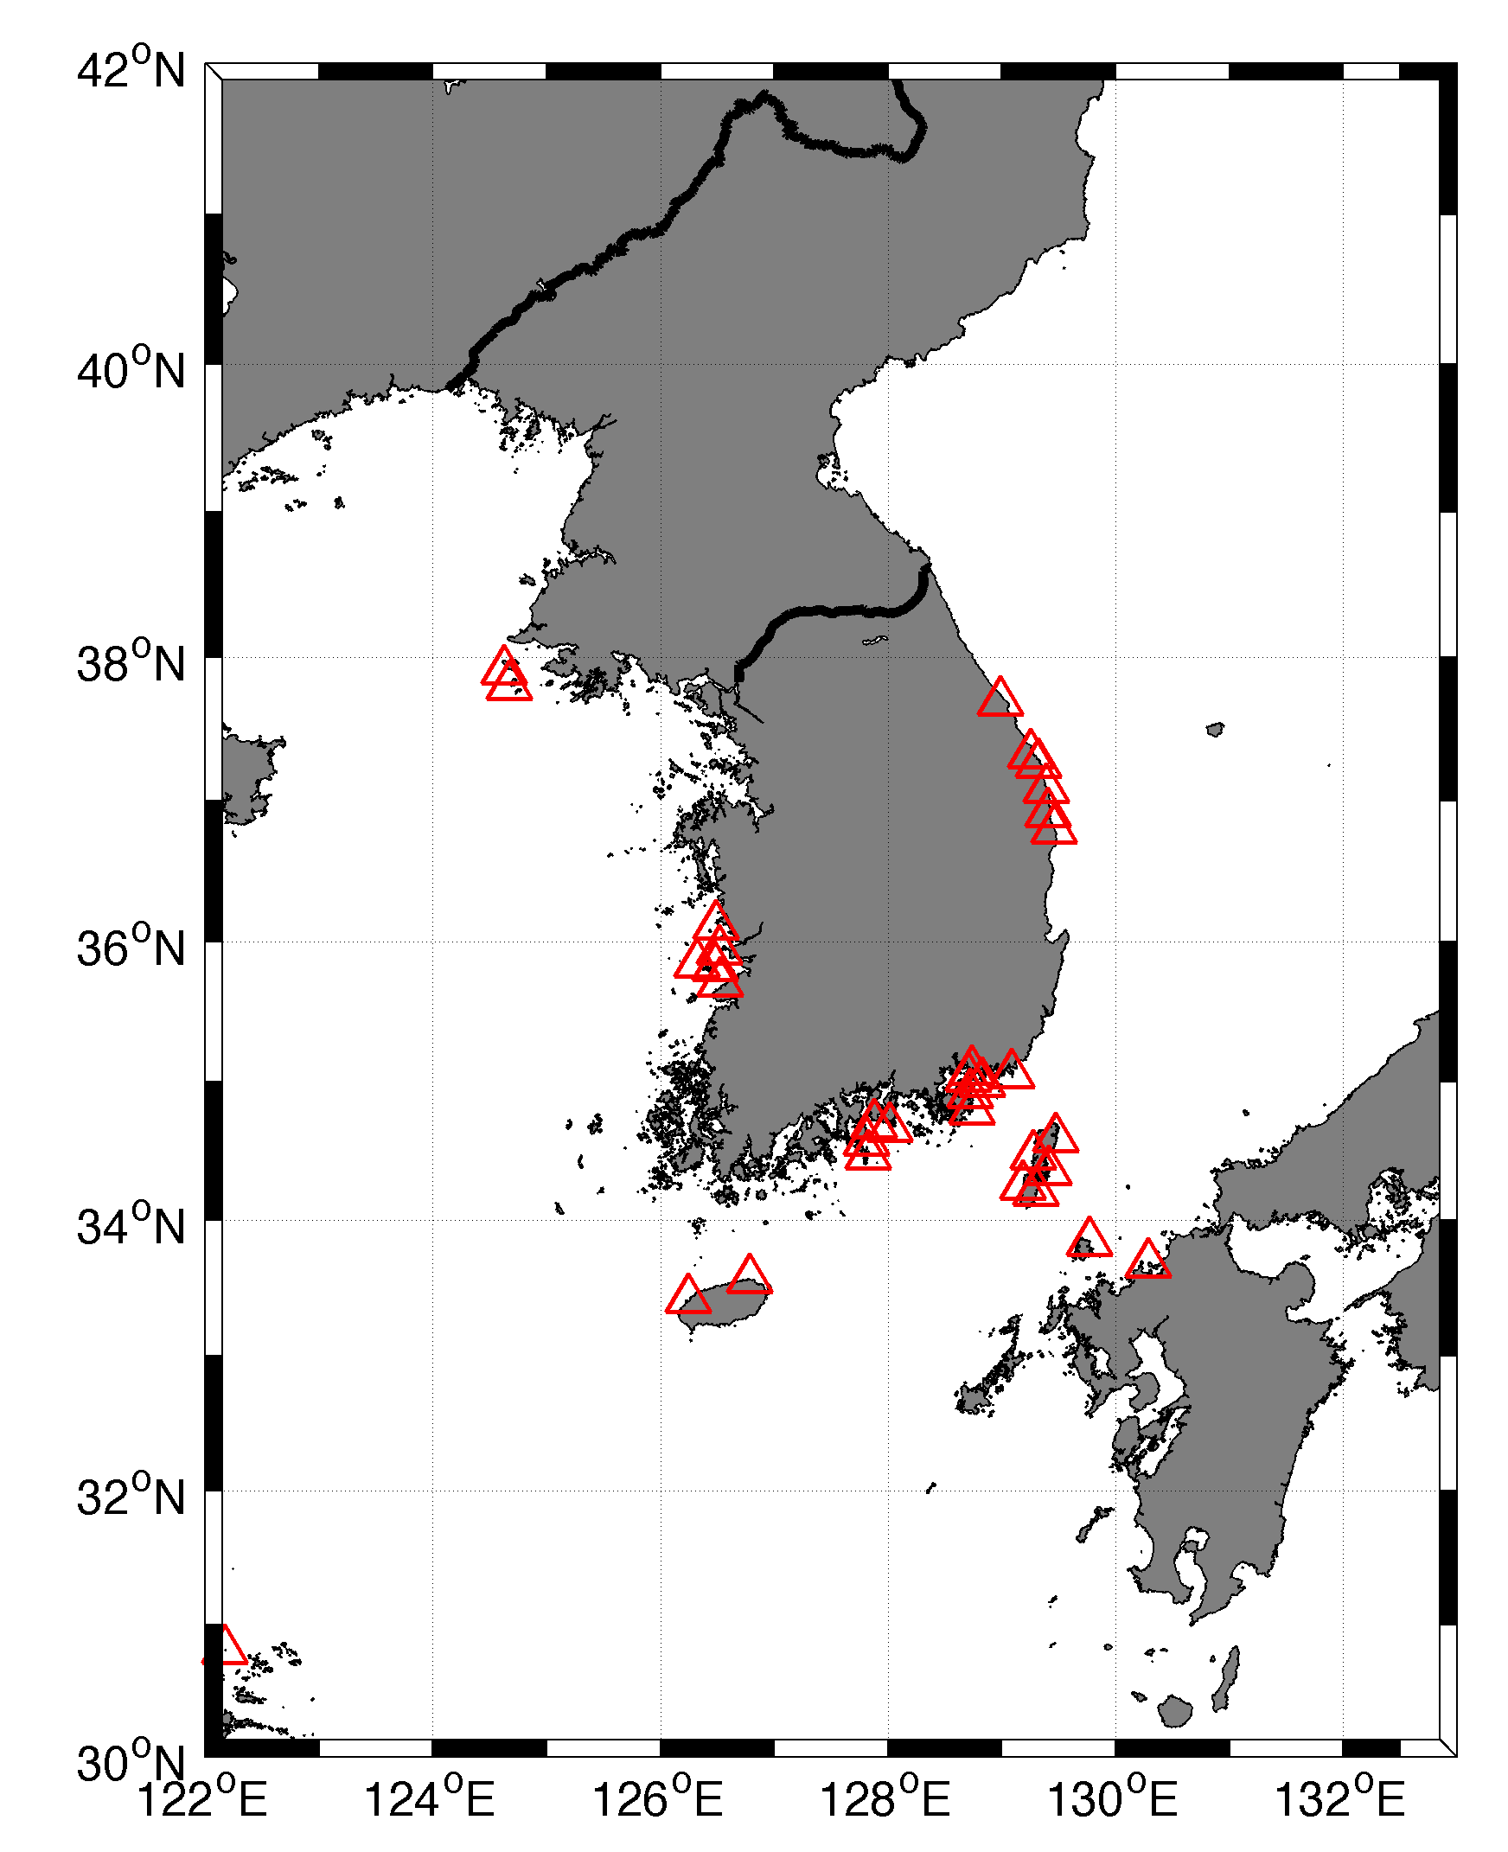
South Korea -28 HF radars

Slide 28
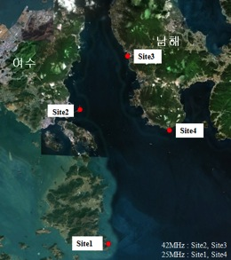
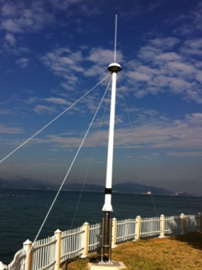
Surface Current Validation with HF-Radar
Spring Flood
Spring Ebb
Site 3

Slide 29
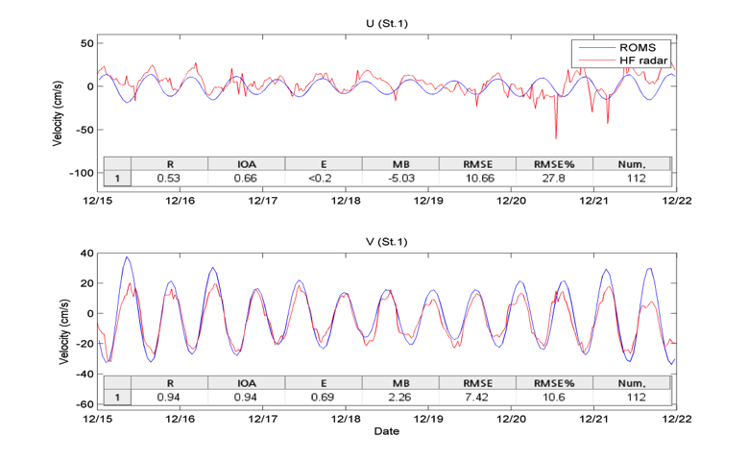
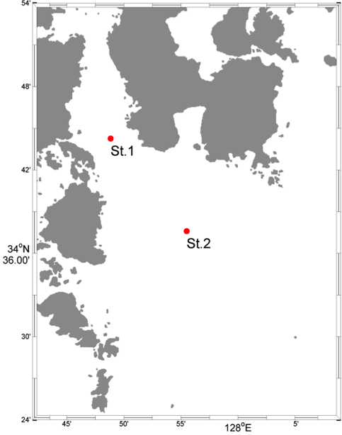

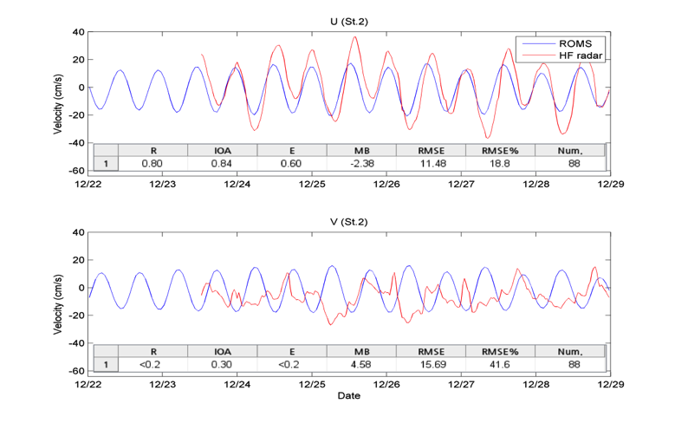
Surface Current Validation with HF-Radar
(2011.12.15 ~ 12.22)
St.1
(2011.12.22 ~ 12.29)
St.2

Slide 30
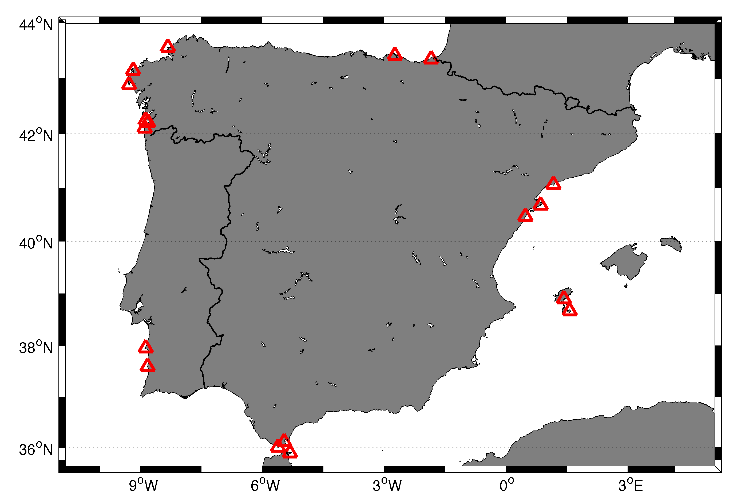
Spain- 16 HF radars

Slide 31
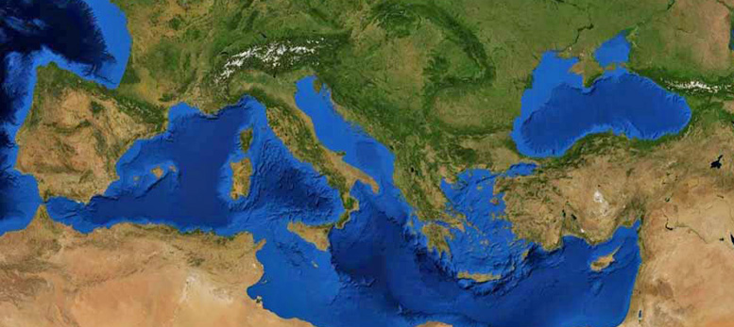

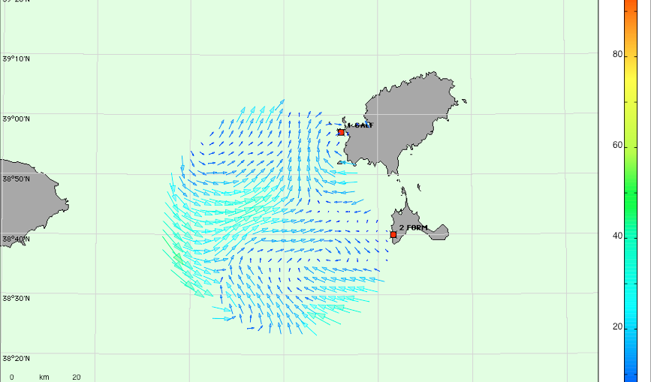
SOCIB HF Radar (1)
Location
Ibiza Channel: a hot spot of biodiversity, interaction between Atlantic & Mediterranean waters.
2. Radial Stations
Combined TX-RX antennas
TX Frequency: 13.5 Mhz
bandwidth: 90 kHz
Grid resolution: 3 km
Averaging radius (radials): 6 km
Temporal coverage: 75 min,
hourly data.
Working since 1st June 2012
3. Data Centre
Quality control, web access, open source
Effective data archiving, international accepted protocols, delivery and communication

Slide 32
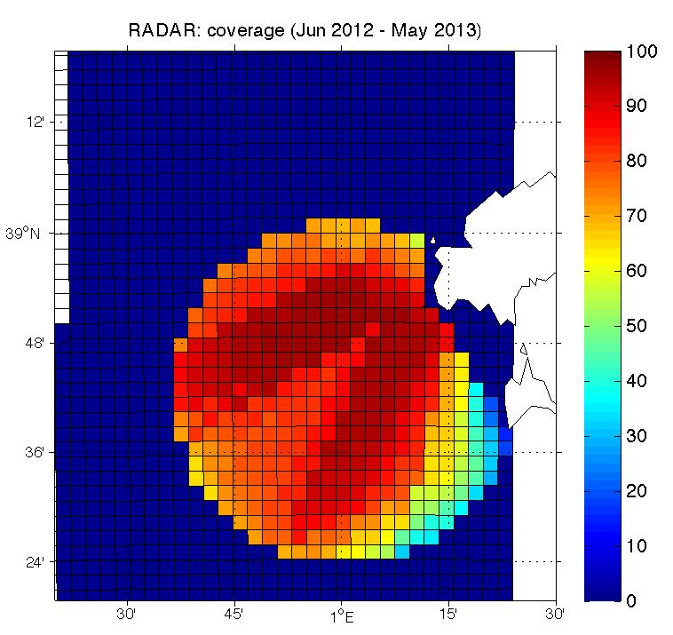
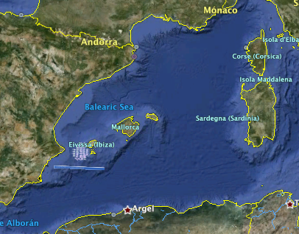
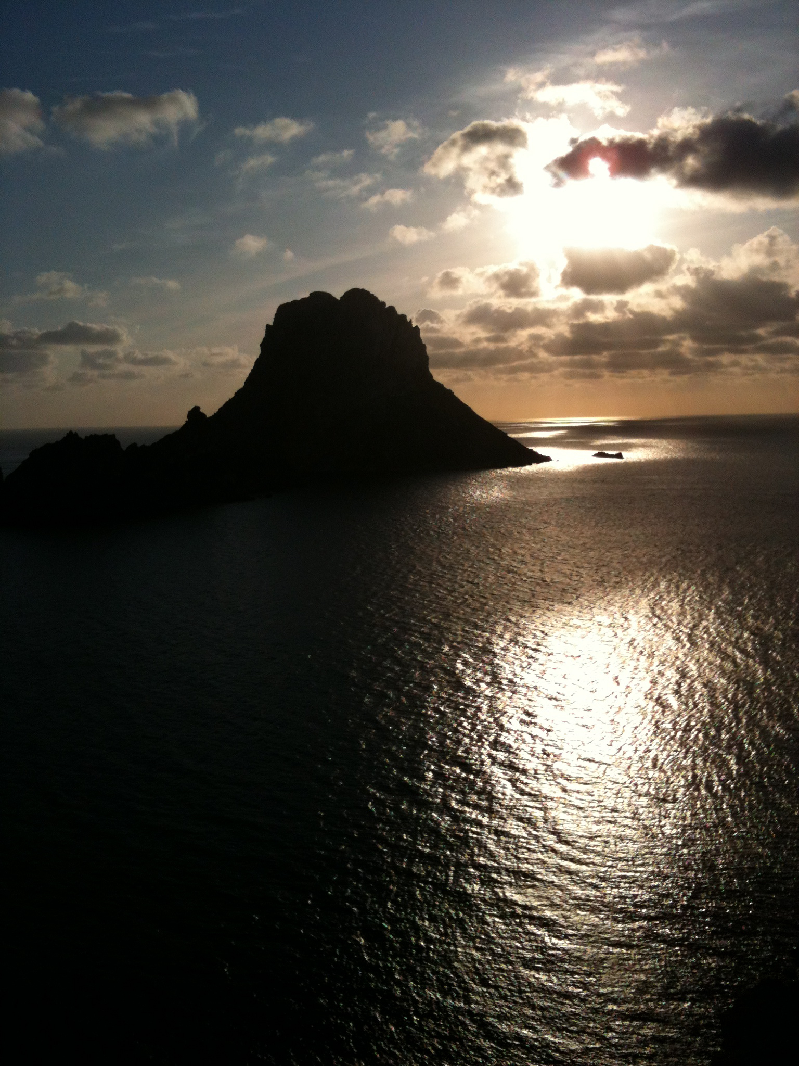


SOCIB HF Radar (2)
Resolution: 3 km.
Mean Range: 80 km
- Rea time data are available since June 2012 in NetCDF format and can be visualized through SOCIB web page www.socib.es .
- Some hardware problems. Mean total coverage, aprox.80 %

Slide 33
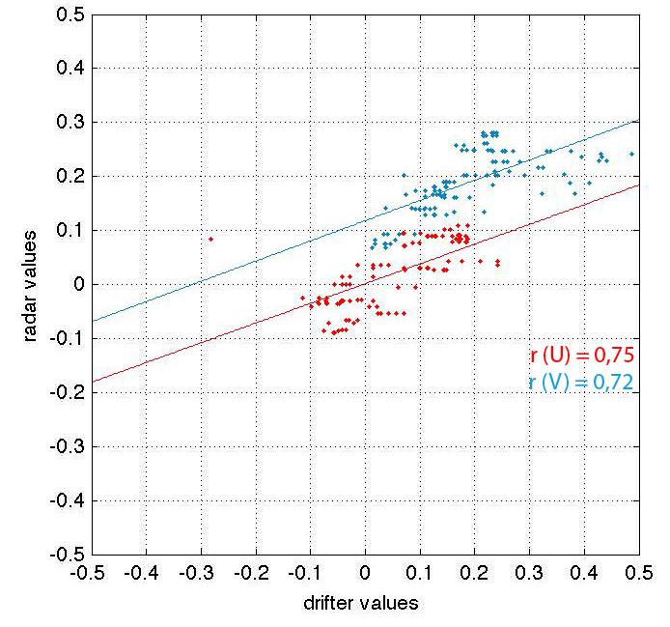
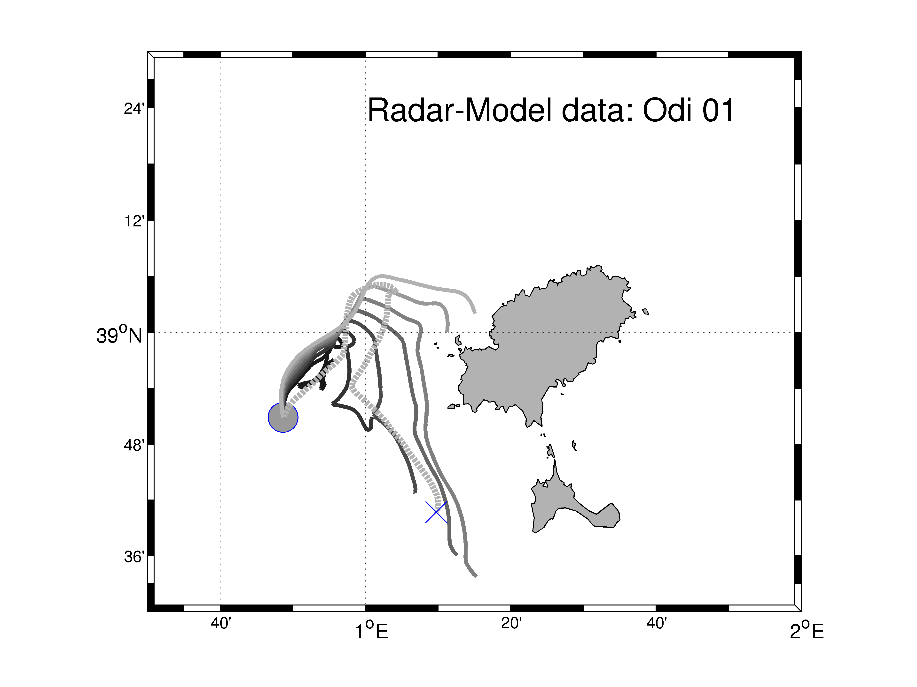
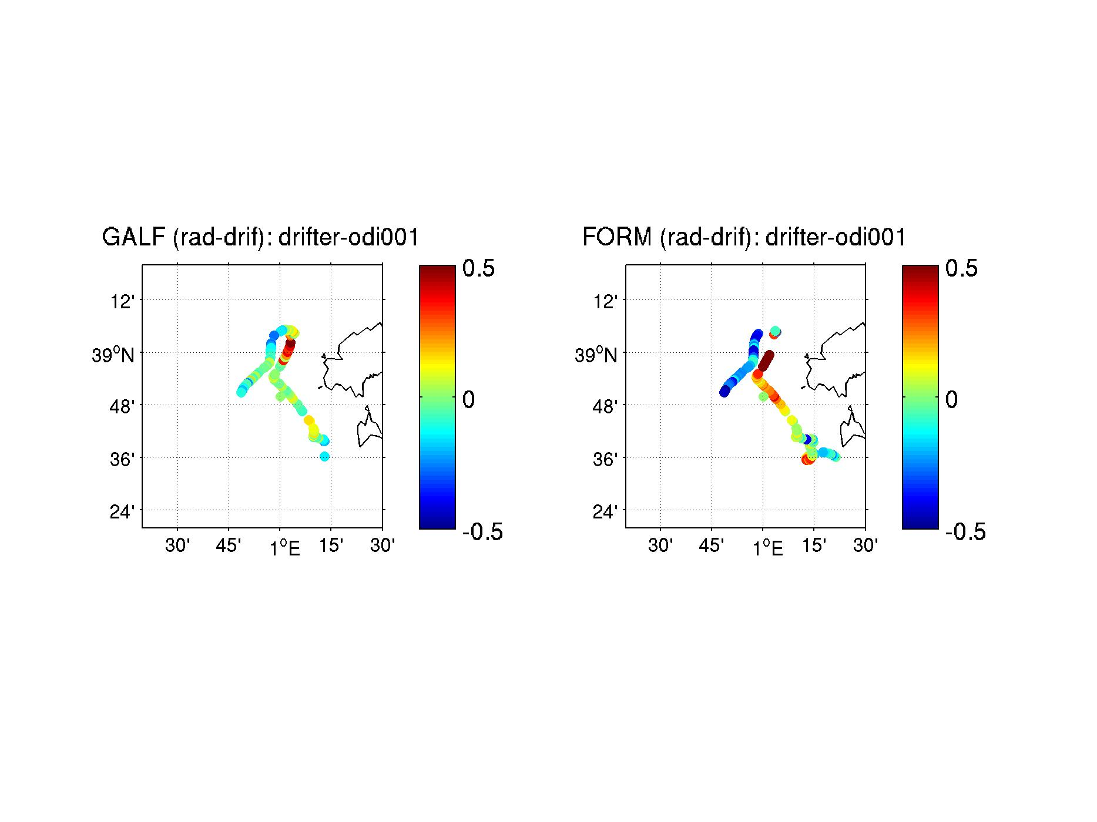
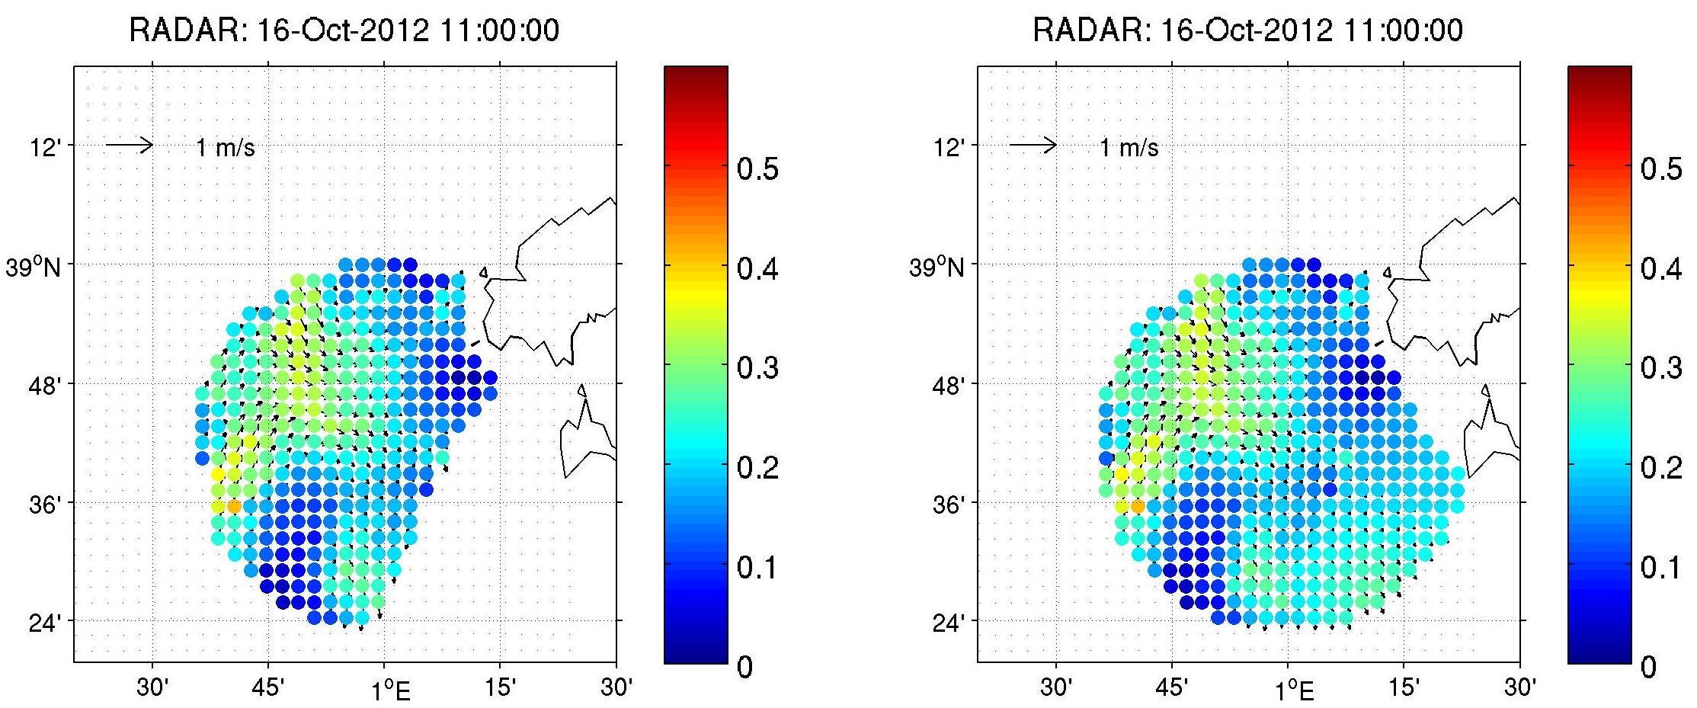
HF RADAR (3) - On-going studies
Validation studies using drifters: launched in the Ibiza Channel provide surface current data valuable to compare with total and radial data for each antenna.
Radar-model-drifter: advected lagrangian particles using both HF-Radar and model data. Comparison with the drifter path.
Filling gaps: different techniques to fill gaps allow us use missing data and estimate the accurate method.

Slide 34
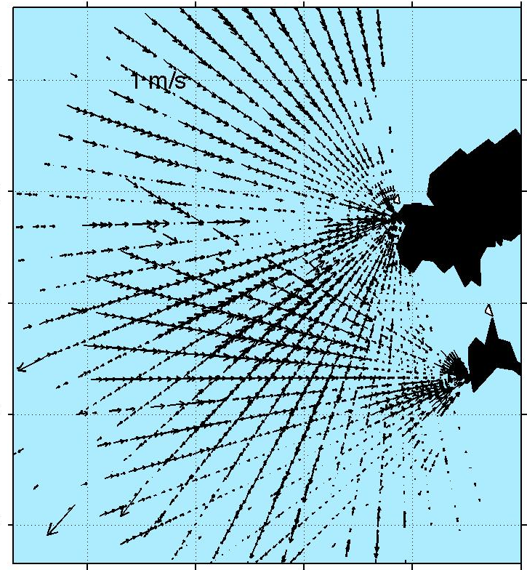
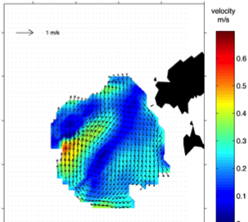
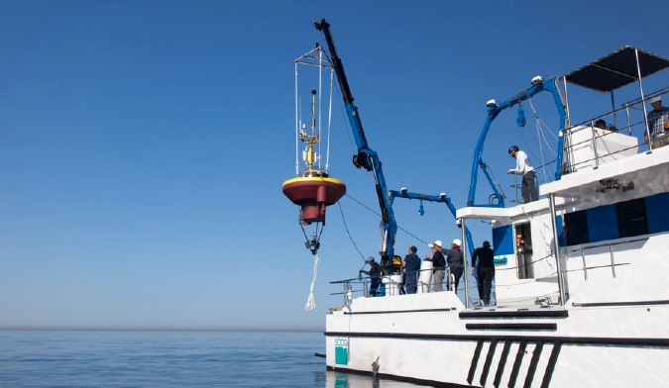
HF RADAR (4) On-going studies
Quality control: influence of interpolation radio and number of radials in the generation of total currents.
Identification of small structures: use of drifters, gliders, modeling and HF Radar surface data is a valuable tool to identify the formation of small- scale structures.
Validation: The use of an Eulerian buoy just installed in the Ibiza Channel, will allow continuous validation of HF Radar data.

Slide 35
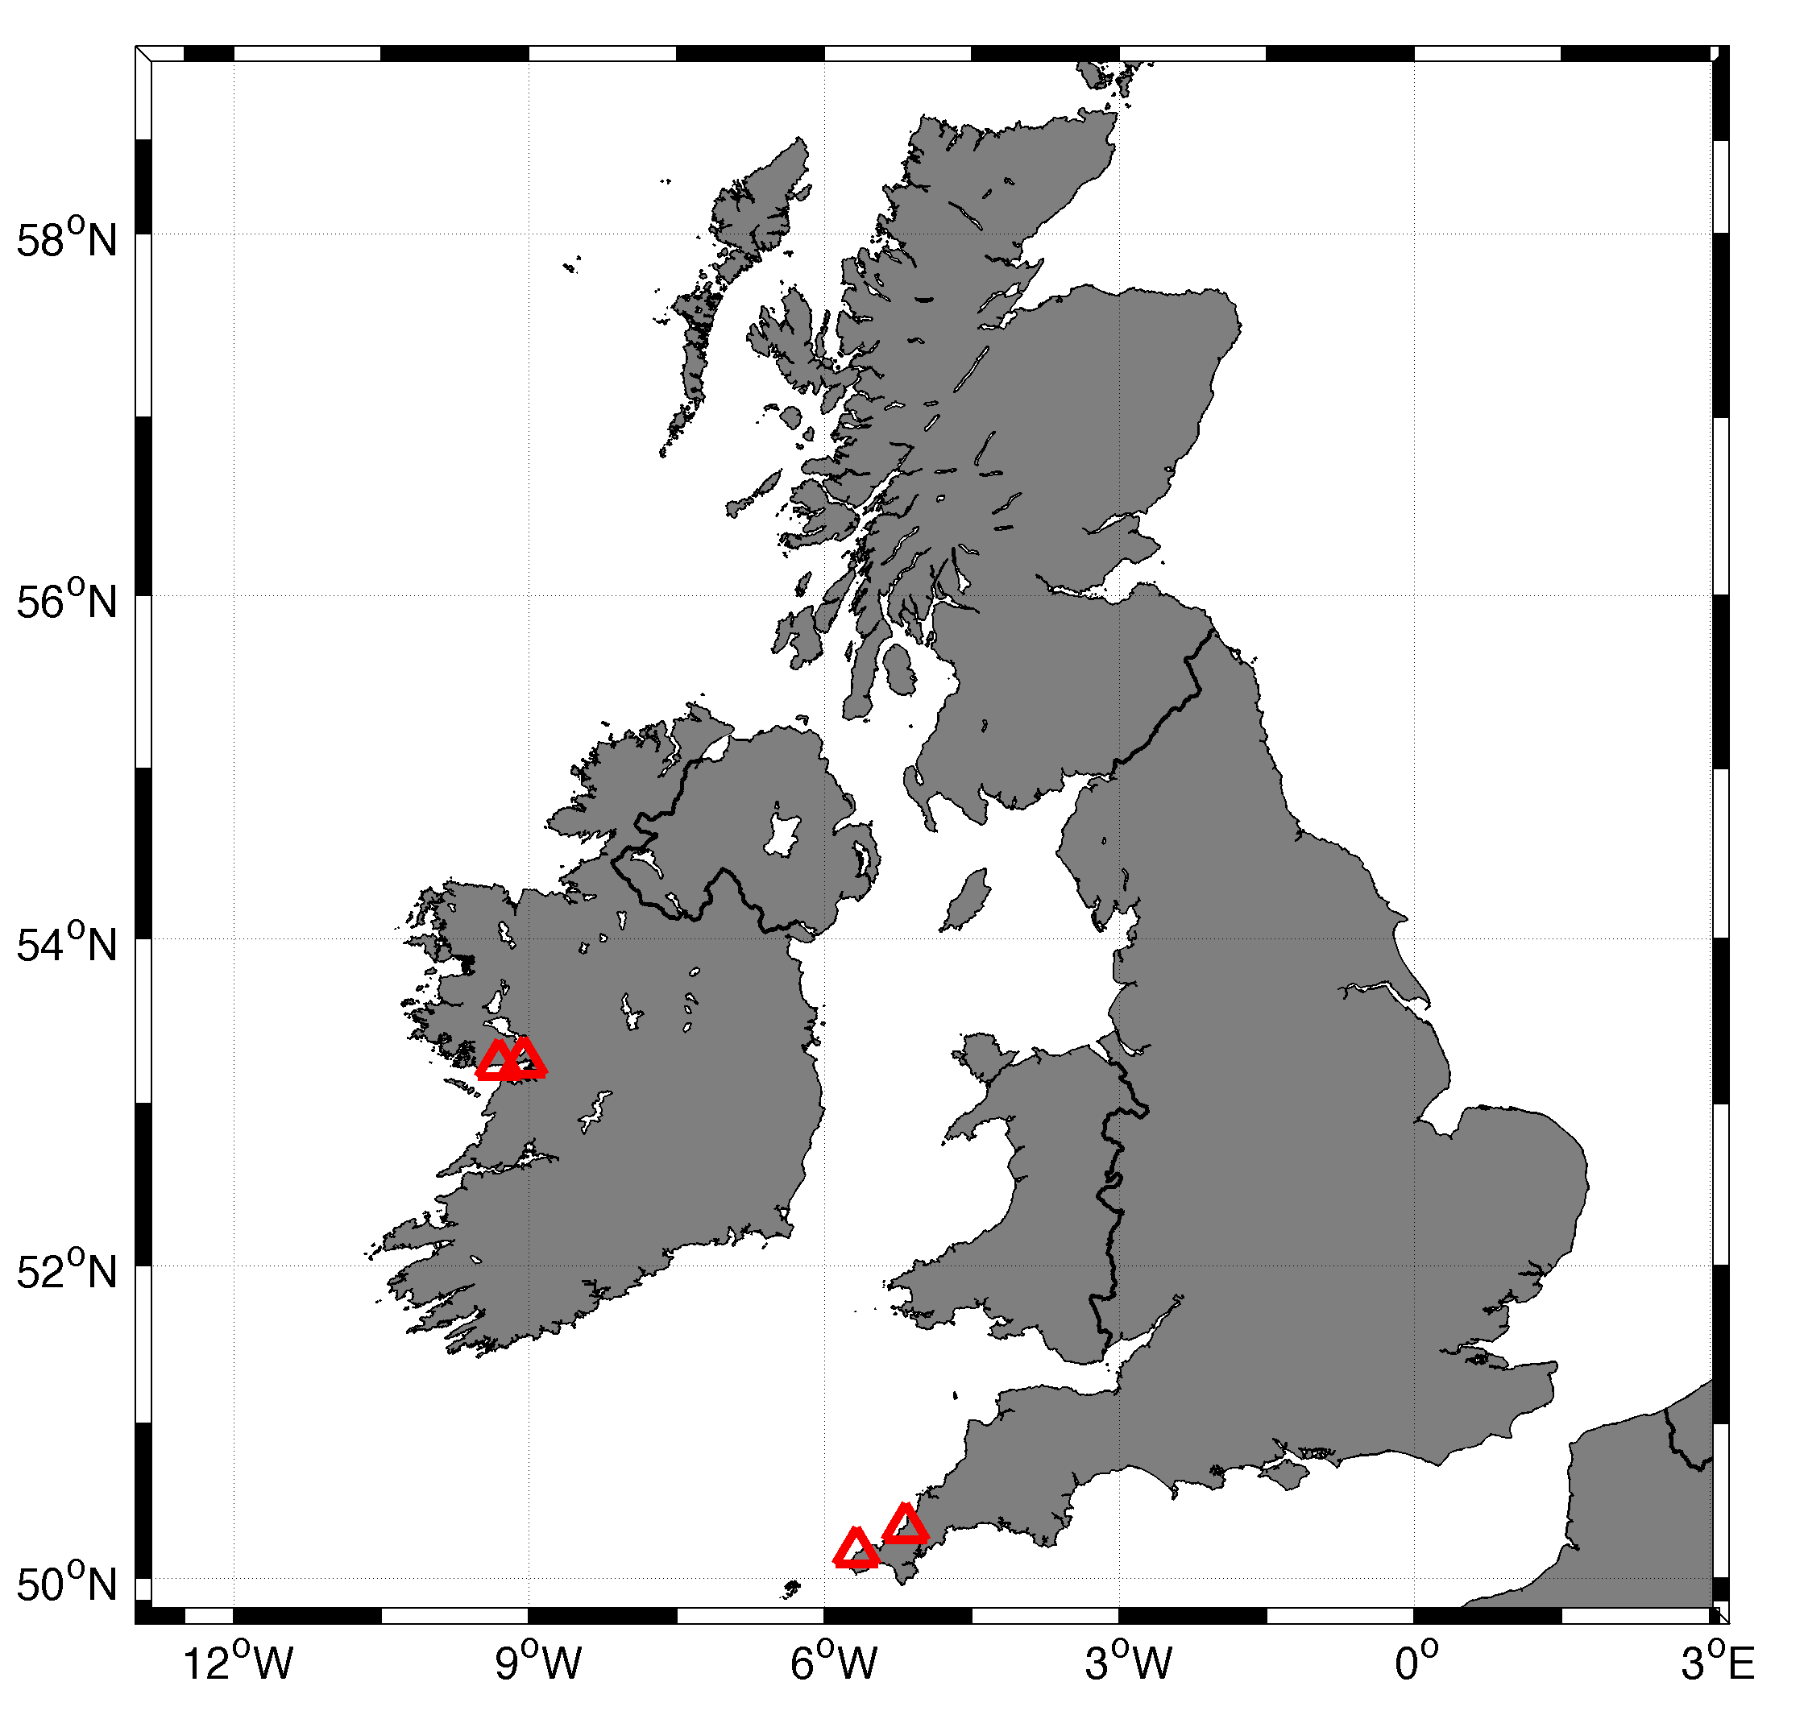
United Kingdom-2 HF radars

Slide 36
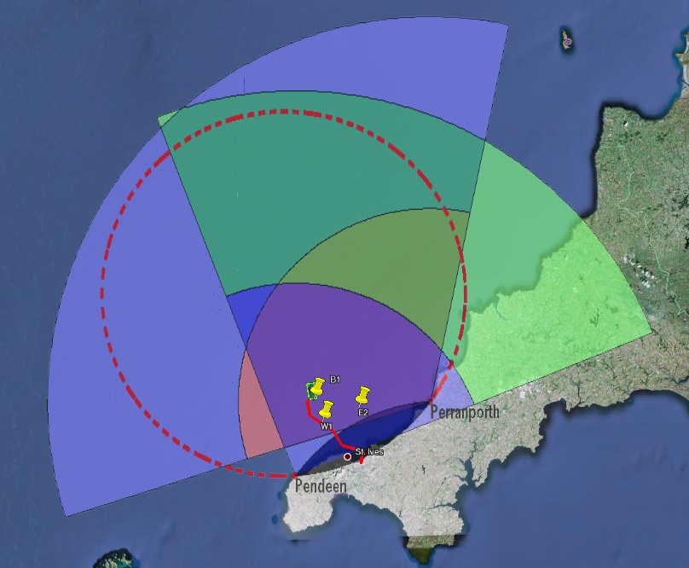
Wave Hub Radar Installation
Mean expected data coverage.
Directional estimates exist for intersections of colors.
Wave coverage half of current coverage.
Provides map of independent wave estimates with range resolution at 0.6km and azimuthal at 10% range

Slide 37
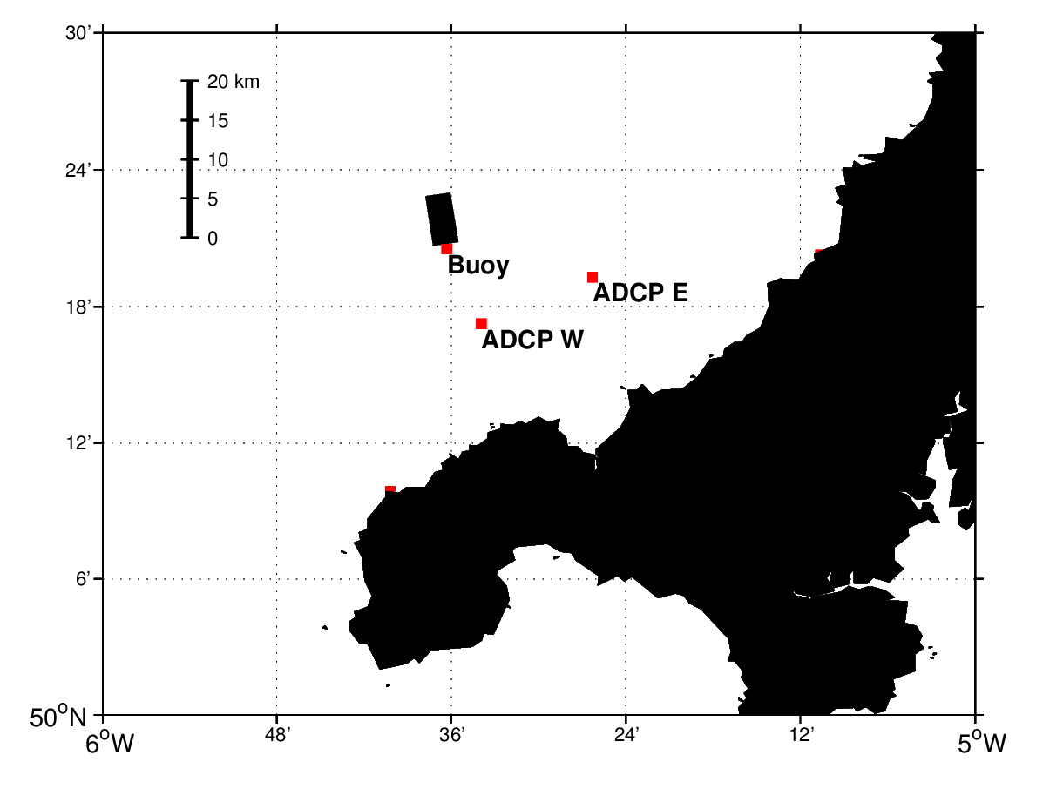
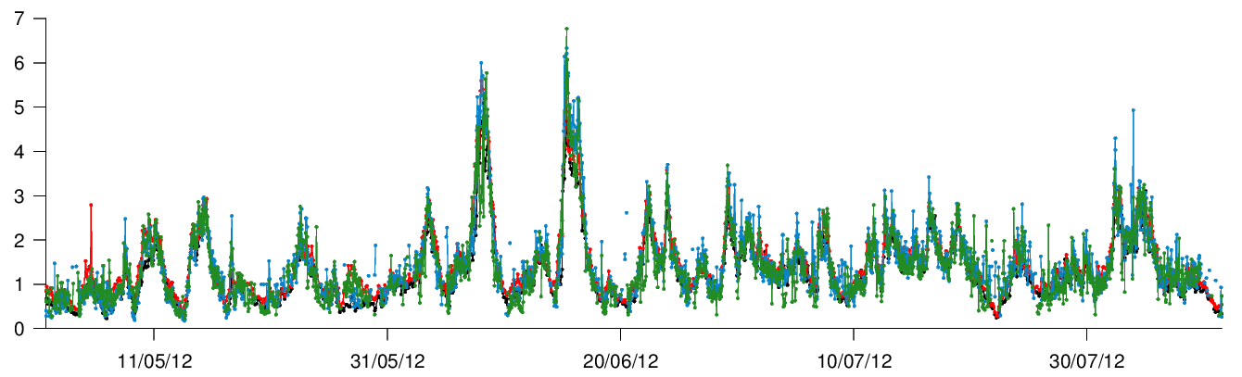
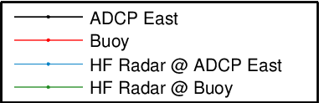
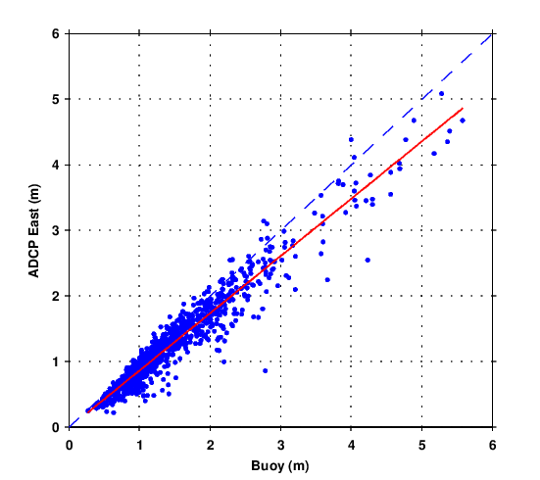
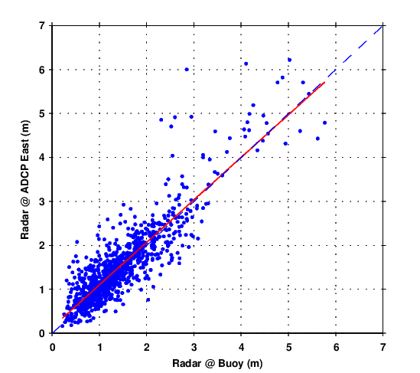
Hs (m)
Location | R | RMSE | Bias | Obs
Buoy – ADCP East | 0.96 | 0.19 | 0.20 | 1015
Radar@Buoy - Radar@ADCP East | 0.88 | 0.43 | -0.08 | 940

Slide 38
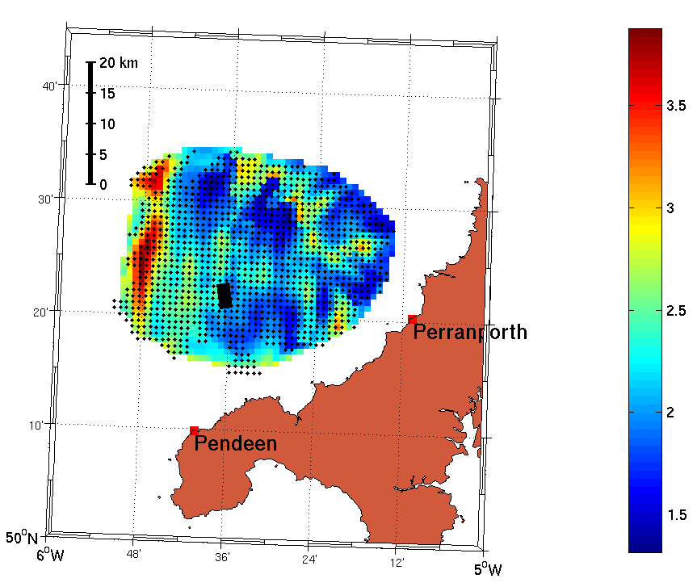
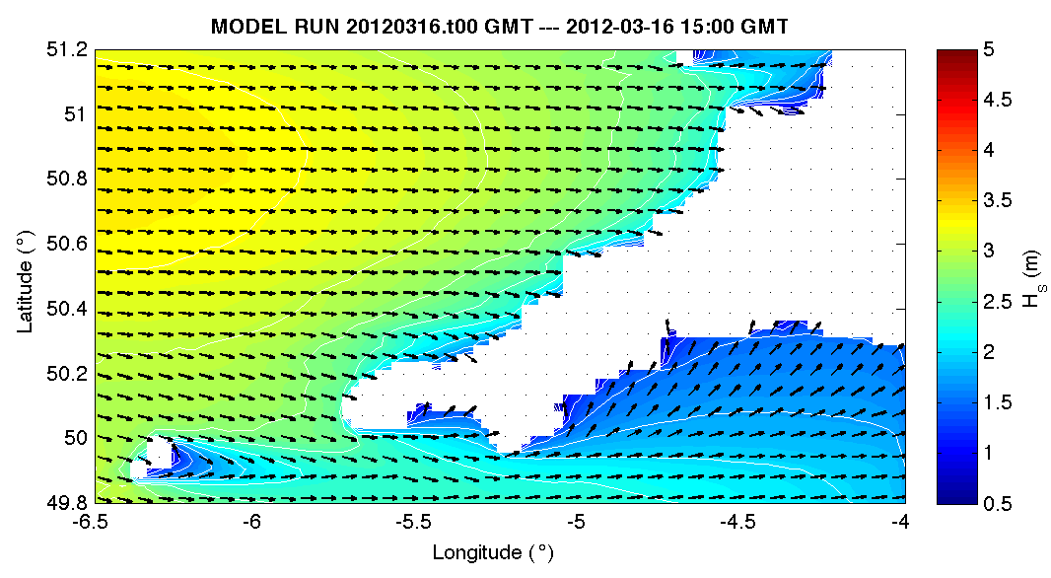
Wave Results
Preliminary Hs Results
Plymouth SWAN model
(Martin Austin)
16 May 2012, 15:00 GMT

Slide 39
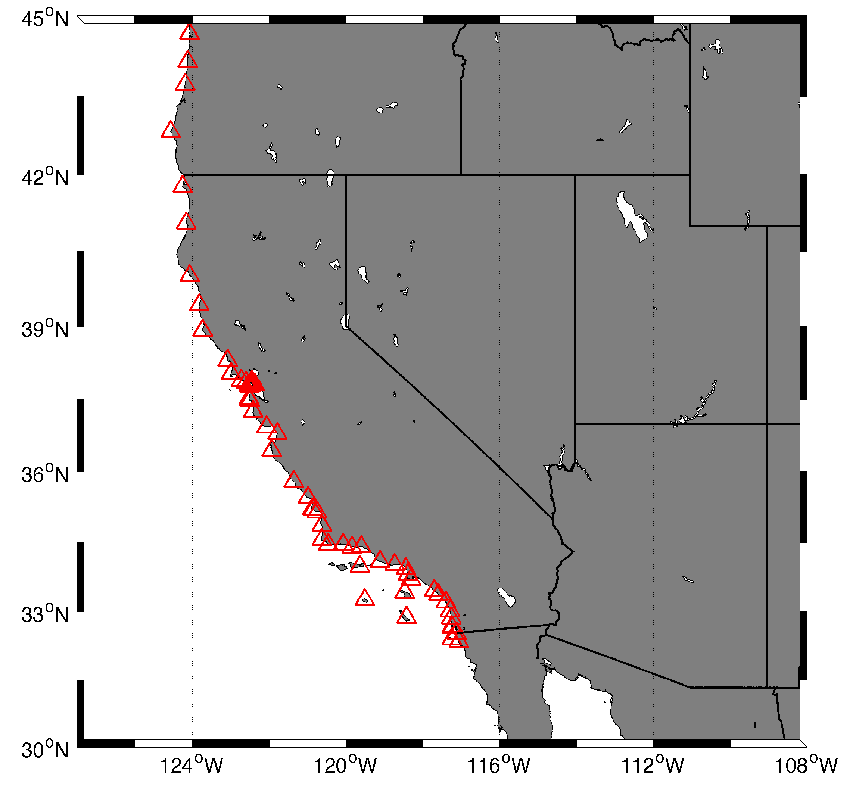
United States - 142 HF radars

Slide 40
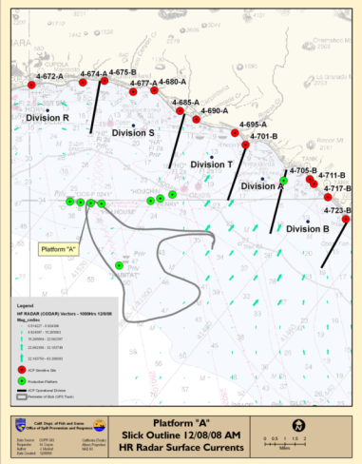
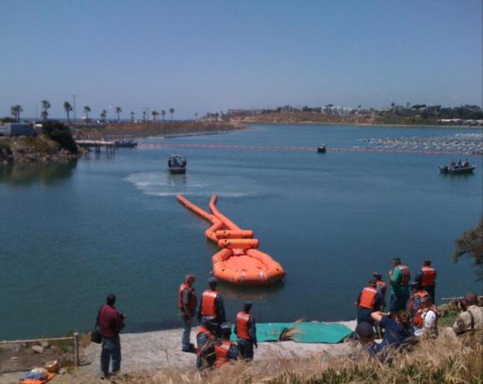

Oil Spill Response: Southern California
Surface currents are integrated into California’s Office of Spill Prevention and Response maps for oil spills and National Preparedness for Response Exercise Program (NPREP) drills.
Santa Barbara, December 2008
San Diego, May 2011
Courtesy of Coastal Observing Research and Development Center (CORDC)
Notes:
Within California, investigators participated in several exercises including Safe Seas 2006, a NOAA-led multiagency simulated spill off the San Francisco coast; and the National Preparedness for Response Exercise Program simulation involving over 200 participants off the coast of Santa Barbara and San Diego in 2008 and 2009 respectively. These simulations allow the many state and federal regulatory agencies involved in oil spill response to practice working together in the event of an actual spill, and demonstrate the value of real-time surface currents maps and forecasts in response management and decision-making. Because repeated demonstrations have highlighted the accuracy and importance of surface current data to oil spill response, HF radar data are now being integrated with NOAA spill response models, and will enable spill responders to predict the pathway of a spill, allowing pinpoint targeting for containment and clean-up. An oceanographer with the Minerals Management Service writes that COCMP “greatly enhances our ability to calculate oil spill trajectories.”¹

Slide 41
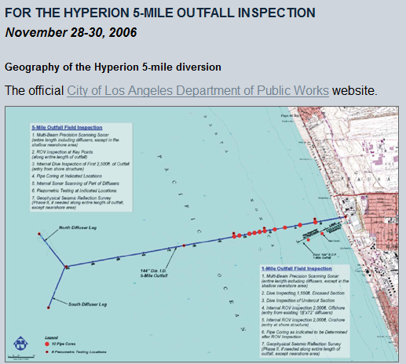
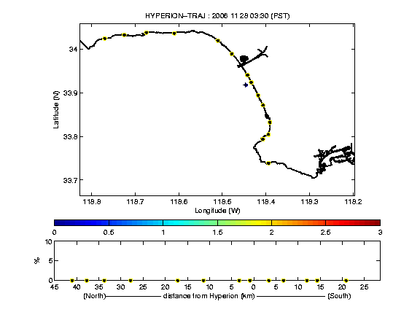
2006 Hyperion Ocean Outfall Diversion
http://www.sccoos.org/projects/hyperion/
Real-time tracking: Los Angeles Hyperion sewage outfall diversion
Near real-time tracking: Los Angeles Hyperion sewage outfall diversion
Courtesy of Coastal Observing Research and Development Center (CORDC)
Notes:
Map of Hyperion outfalls in Santa Monica Bay. In November of 2006, the City of Los Angeles diverted the flow from Hyperion—its oldest and largest wastewater treatment plant—from an outfall five miles from the shoreline to a rarely used pipe one mile offshore to allow inspection of the five-mile pipe. The diversion lasted three days, and approximately 800 million gallons of secondary-treated wastewater was released one mile off the coast of Santa Monica. A division manager for the City of Los Angeles, Bureau of Sanitation’s Environmental Monitoring Division writes that the City’s monitoring effort greatly benefited from information provided through the HF radar system, and that “the real-time current information provided through [the program] enabled us to adaptively modify our sampling grid to better track the discharge plume and to predict the dispersion of the plume.”²
During November 28-30, the Hyperion sewer discharge was diverted from the 5 mile pipe to the shorter One-Mile Outfall to allow inspection of the longer outfall pipe. The discharge is typically 300-350 million gallons per day, with a total estimated volume of discharge to approach 875 million gallons. The Southern California Coastal Ocean Observing System has created this web site to provide up-to-date ocean environment information to assist coastal managers during this discharge event.
Environmental Data Support
Requested by City of Los Angeles.
SCCOOS acted as clearing house of information for
city monitoring staff
regional board
environmental health officers
NGOs
public / media
local scientists
INFORMATION SUPPORT
Surf-zone wave height and currents in Santa Monica Bay
Surface current maps
plume transport model implemented in realtime
Remote sensing data: both ocean color and synthetic aperture radar
shipboard sampling of biota and nutrients
weather forecasts
41

Slide 42
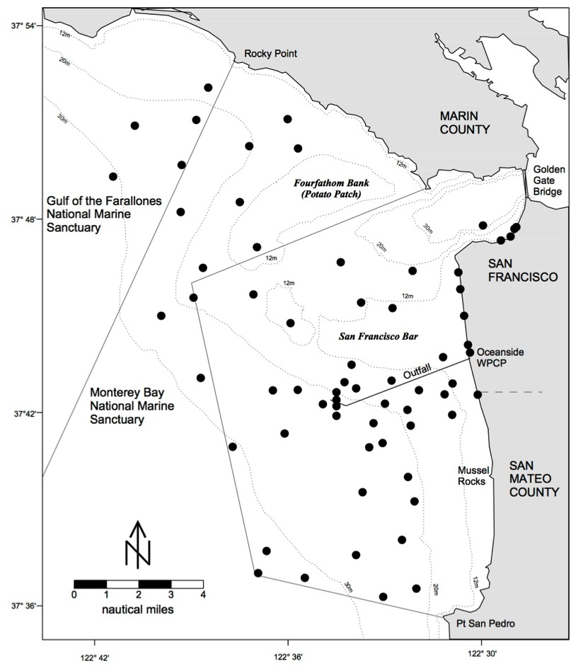

To close or not to close the beaches inshore of SF outfall?
The end cap on the main San Francisco municipal outfall was accidently dropped during maintenance; diffusers were temporarily shunted for ten days in October 2007

Slide 43

1-10 October 2007
Statistics of surface particle movements helped to show that beaching of the sewage plume was unlikely
6hr drift
12hr drift
24hr drift

Slide 44



Cosco Busan Tanker Spilled 58,000 gal of oil into San Francisco Bay 8 Nov 2007

Slide 45


http://www.cencoos.org/sections/news/SF_oil_spill_2007.shtml
Cosco Busan Fuel Oil Spill, San Francisco Bay, CA
Notes:
When the container vessel Cosco Busan collided with the base of the Bay Bridge in San Francisco Bay in November of 2007, spilling over 53,000 gallons of fuel oil, managers used surface current maps from HFR data to monitor the spill trajectory, predicting movement as far north as Angel Island and westward along the San Francisco waterfront. This closely matched visual reports of oil on the shorelines of Alcatraz, Angel Island, San Francisco, and on a map produced by the National Oceanographic and Atmospheric Administration (NOAA) Office of Response and Restoration. Once the oil moved into the Gulf of the Farallones, the HF radar data accurately showed that the oil would not beach there. As HF radar capabilities are integrated into California oil spill response, spills like the Cosco Busan’s (which occurred in dense fog) can be more effectively tracked, with mitigation efforts unimpeded by lack of visual data.

Slide 46


HF radar observations in the Gulf of the Farallones were able to predict which beaches were vulnerable as the oil exited the Golden Gate
Predictions allowed responders to focus assets effectively

Slide 47

United States - 142 HF radars

Slide 48







U.S. Coast Guard: Search And Rescue Optimal Planning System SAROPS
Mid-Atlantic Operational Data Flow to SAROPS
SAROPS User Interface
SAROPS 96-Hour Search Area: HYCOM = 36,000 km²
SAROPS 96-Hour Search Area: HF Radar = 12,000 km²

Slide 49



IOOS Coordinated Rapid Response: Deepwater Horizon Oil Spill
Contributed Assets:
HF Radar Networks
USF, USM
Gliders
iRobot, Mote, Rutgers,
SIO/WHOI, UDel, USF
Drifters & Profilers
Horizon Marine, Navy
Satellite Imagery
CSTARS, UDel
Ocean Forecasts
Navy, NCSU
Data/Web Services
ASA, Rutgers, SIO
Tropical Storm Bonnie crosses the Gulf of Mexico
USM HFR
TS Bonnie
USF HFR
USM HFR validation of SABGOM Forecast
in region with satellite detected oil slicks
HFR used for Oil Slick Forecasts by NOAA/NOS/OR&R

Slide 50

Doppler Spectra from all Range Cells
with Detection Threshold above Background Applied
Vessel Detection for Maritime Security
Fixed Objects & Direct Signals
Bragg Waves
Bragg Waves
Vessel
Vessel
Range
Doppler Frequency
(Target Speed)

Slide 51


Slide 52
Thanks to
Lucy Wyatt
Hezi Gildor
Dan Conley
Hak Soo Lim
Joaquin Tintore
Eric Terrill
Lisa Hazard
Jeff Paduan
Jack Harlan

Slide 53


Conclusions
Thank You
Please send me your application stories hroarty@marine.rutgers.edu
Please send the url if you are posting your data to the Internet
See you in Bergen

