Slide 1
Surface and water-column response to extreme storms in the coastal ocean: observations on the Mid-Atlantic Bight and Western Antarctic Peninsula.
Travis Miles
Rutgers University
Institute of Marine and Coastal Sciences
Thesis Proposal Defense
August 15th 2012
Committee members and contributors
Oscar Schofield (Rutgers University) – Committee co-chair
Scott Glenn (Rutgers University) – Committee co-chair
Josh Kohut (Rutgers University)
Sharon Stammerjohn (University of Colorado Boulder – INSTAAR)
Doug Martinson (Columbia – LDEO)

Slide 2
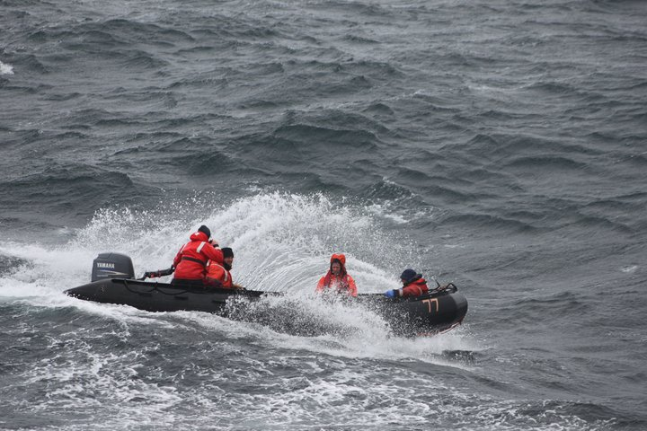
Introduction
Extreme storms are the costliest weather events in the developed world.¹
  Hurricane Katrina totaled $125 Billion economic losses.
  Hurricane Irene cost over $ 7 Billion.
  Nor’easter Nor’Ida cost over $100 Million.
  Due to the concentration of wealth and population on coastlines, even a small increase in storm intensity or frequency can result in massive damage and cost increases.²

Slide 3
Storms also play a disproportionately important role in mixing, heat transport and sediment transport compared to their relatively short duration and low frequency.
  Winter storms constituted over 60% of sediment transport on the New Jersey shelf over a 2-year period [Styles and Glenn 2005].
  In one year a study by Emanuel [2001] showed roughly 1.4 X 10¹⁵ W of energy is removed from the water-column in the wake of storms. Leads to heating at high-latitudes.
  Fall transition storms on the Mid-Atlantic Bight (MAB) breakdown stratification allowing for nutrient replenishment in surface waters.
  Changes in wind forcing can have large scale ecosystem impacts in extreme environments in places like the Western Antarctic Peninsula [Fraser, personal communication].

Slide 4
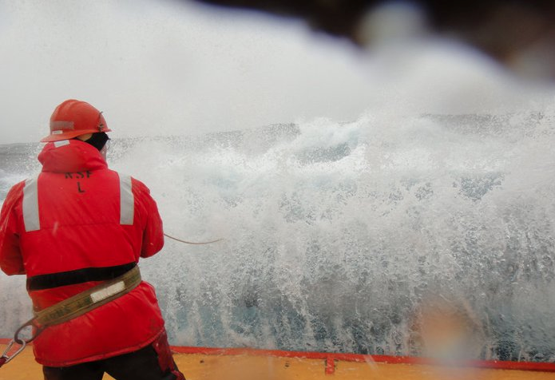
Difficult to sample!
Notes:
Despite the importance of these events, they are notoriously difficult to sample using traditional techniques. Using a combination of coastal ocean observing tools, such as gliders, met stations, high-frequency radar, and other products I proopse to answer the following questions.

Slide 5
How do storms affect the local and regional characteristics of the coastal ocean?
What are the larger temporal and spatial impacts of storms on coastal ocean systems on the Mid-Atlantic Bight and the Western Antarctic Peninsula?

Slide 6
Chapter One: Temporal and spatial variability in fall storm induced sediment resuspension on the Mid-Atlantic Bight (in press).
[Glenn et al., 2008]
Notes:
Glenn et al., 2008 shows two storms a September Hurricane w/ stratification and a November Nor’easter without stratification.
Each storm has one glider with optics. Resolves variability in time and with different stratification. Spatial variability still unresolved. Is this happening everywhere on the shelf? Is it different at different locations within the same storm?

Slide 7
I propose to:
Document spatial and temporal variability in storm-induced sediment resuspension on the NJ shelf.
Identify the mechanism for local differences in sediment resuspension and transport during extreme storms.

Slide 8
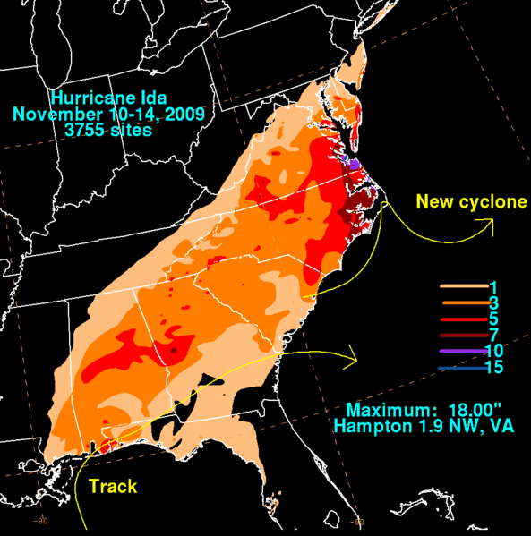
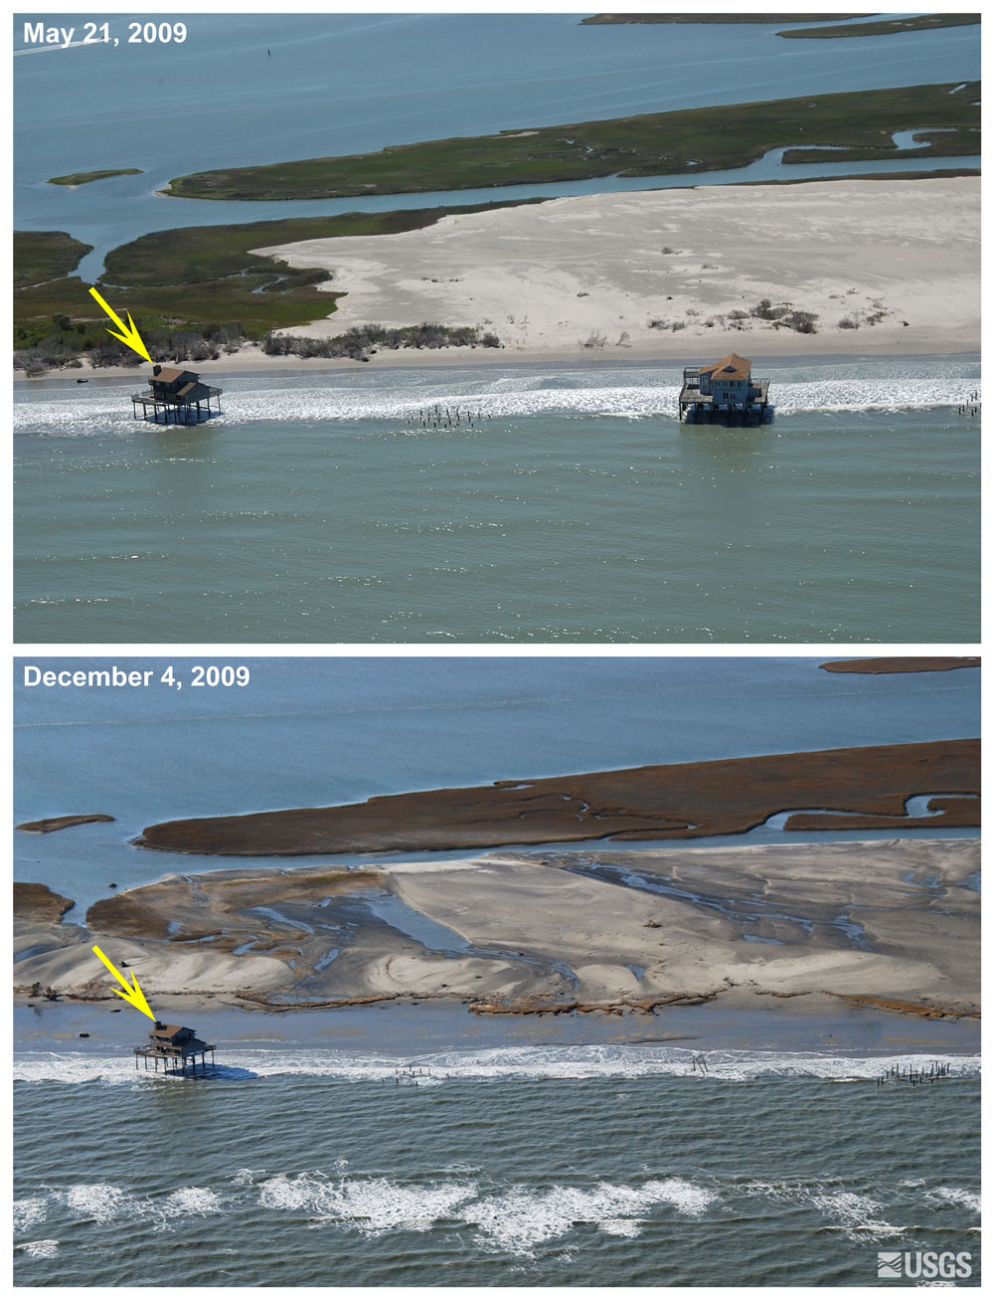
Nor’Ida
http://coastal.er.usgs.gov/hurricanes/norida/photo-comparisons/virginia.html
Notes:
Nor’Ida began as Hurricane Ida over the gulf of mexico. It tracked through the Southeast and eventually developed into a Nor’easter as it merged with a front coming across the U.S. It flooded large portions of the east coast and destroyed numerous homes. You can see a before and after picture on the right… w/ a missing house…

Slide 9
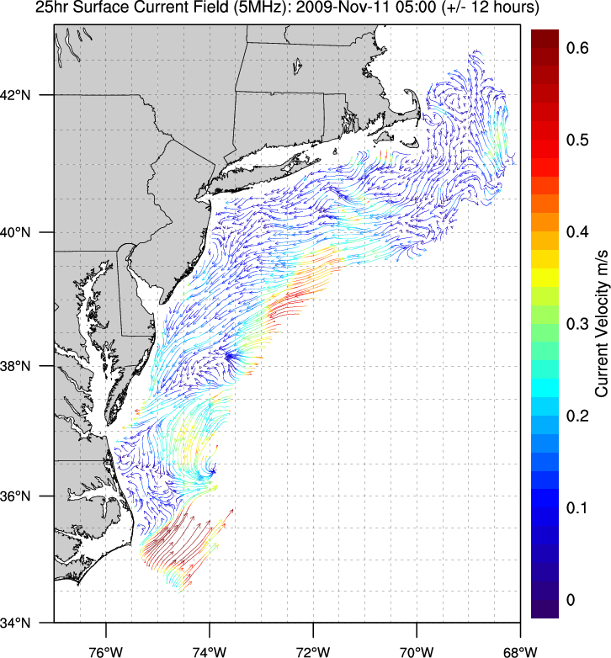
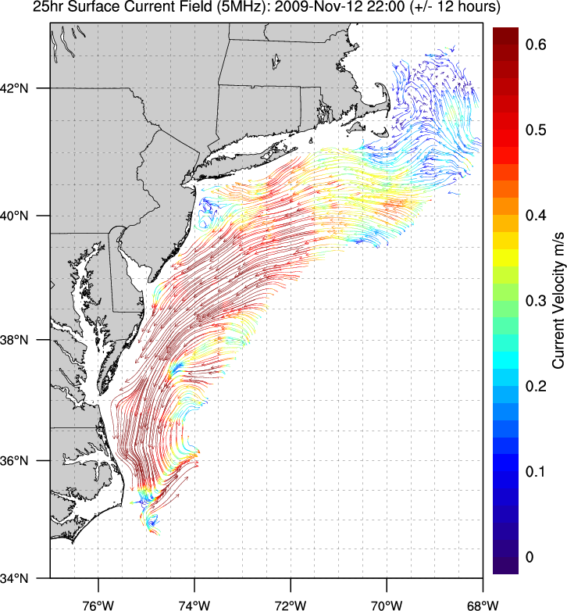
High Frequency Radar (CODAR) currents
Notes:
Plots of CODAR surface currents before and after nor’ida. On the left pre-storm currents are relatively low and variable. Right Currents during the storm on the 12th are toward the southwest and in excess of 0.5 m/s

Slide 10
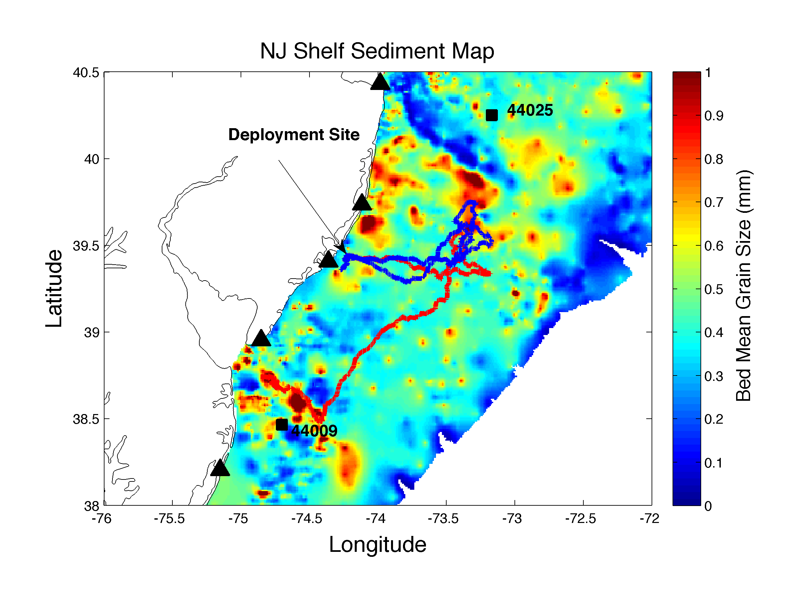
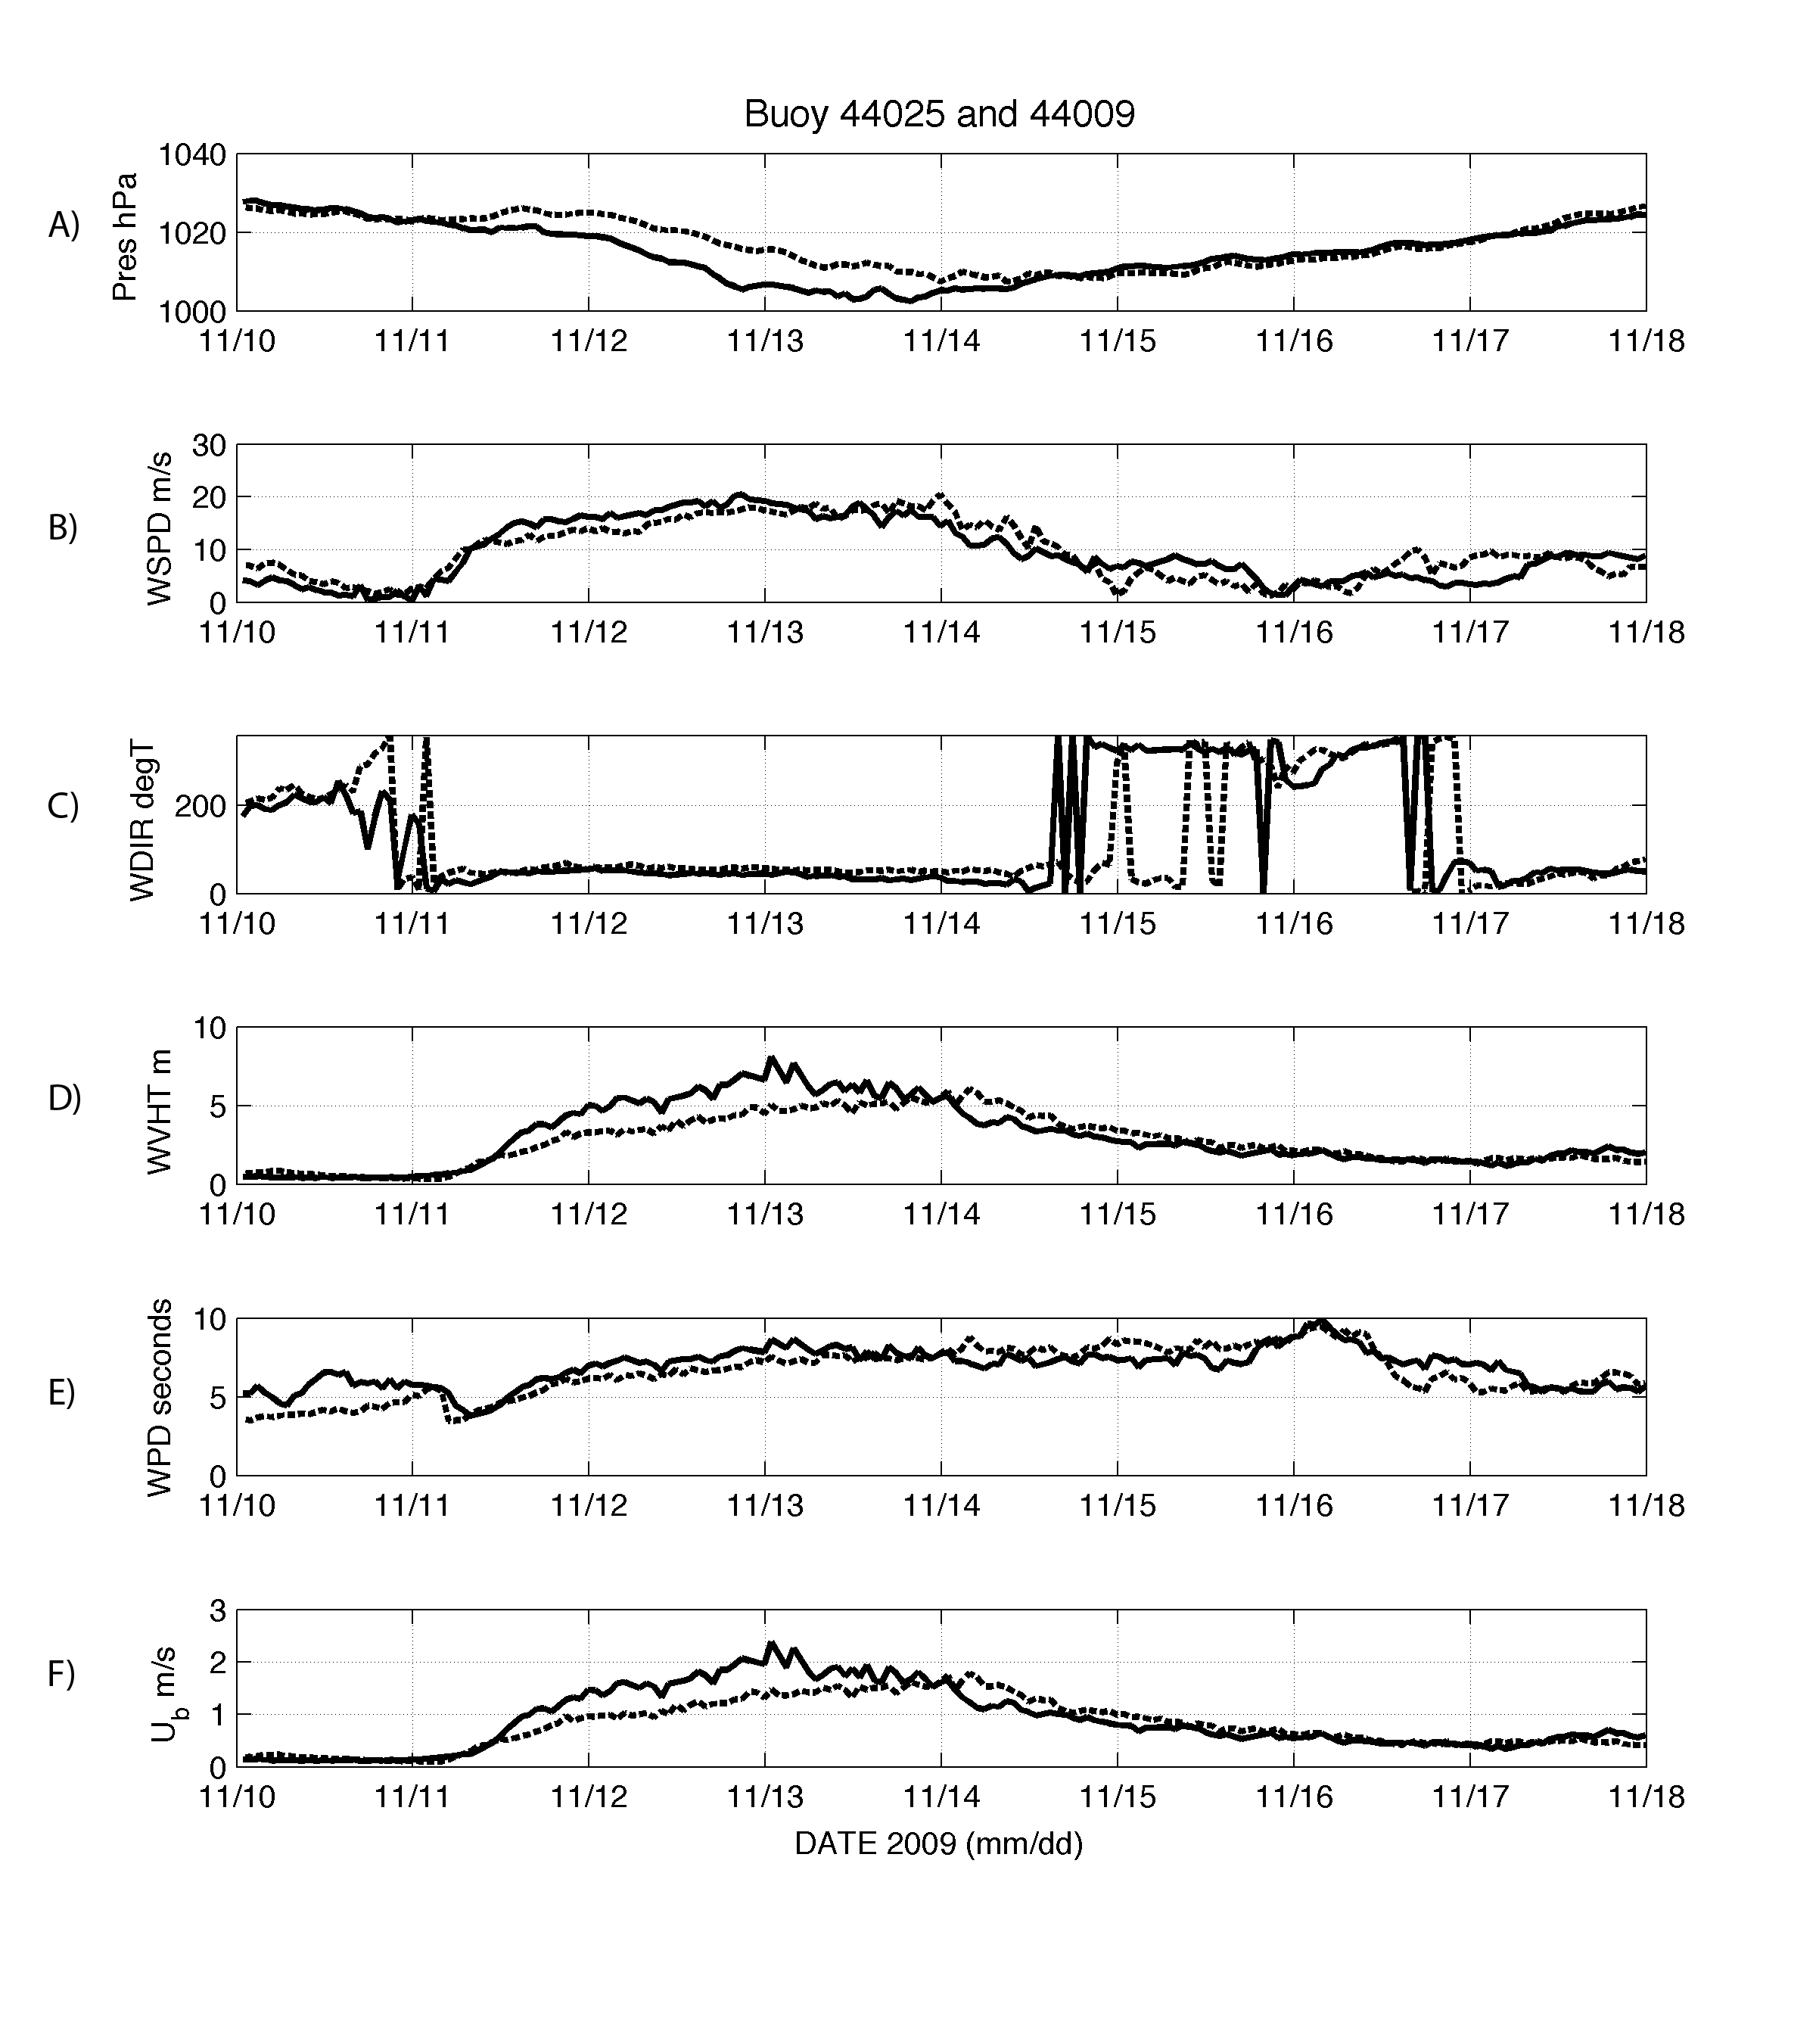
44025
44009
Winds start near midnight on the 11th.
Waves and bottom orbital velocities start a few hours later.
  Wave bottom shear-stress can be order of magnitude higher than current shear stress (smaller boundary layer) [Grant and Madsen,1979].
Notes:
Two gliders were deployed, RU05 in red and RU21 in blue during this experiment. We also pull data from two buoys, 44009 in the south and 44025 in the north.
44025 is the dashed lines. Red denotes the storm duration spanning the 11th to the 15th. Winds start near midnight on the 11th and are predominantly from the North, north-east
Waves start a few hours. The important process for sediment resuspension are wave bottom orbital velocities, as these can be similar in magnitude to currents but over a much smaller boundary layer, so they have an order of magnitude higher shear stress. We calculate these from linear wave theory and you can see them in the bottom panel.
Winds increase mainly from the North East and approach 20 m/s
Waves build to near 8-9 meters at their peak.
Waves generally resuspend sediment through bottom orbital velocities, as they have high shear due to their small bounday layer
Bottom orbital velocities are calculated from linear wave theory.

Slide 11
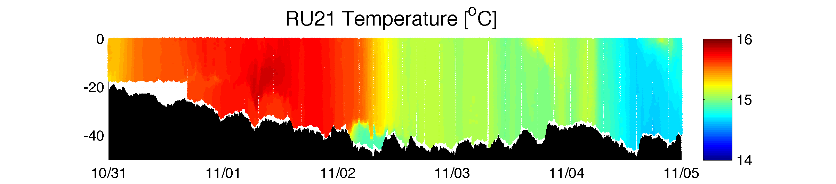
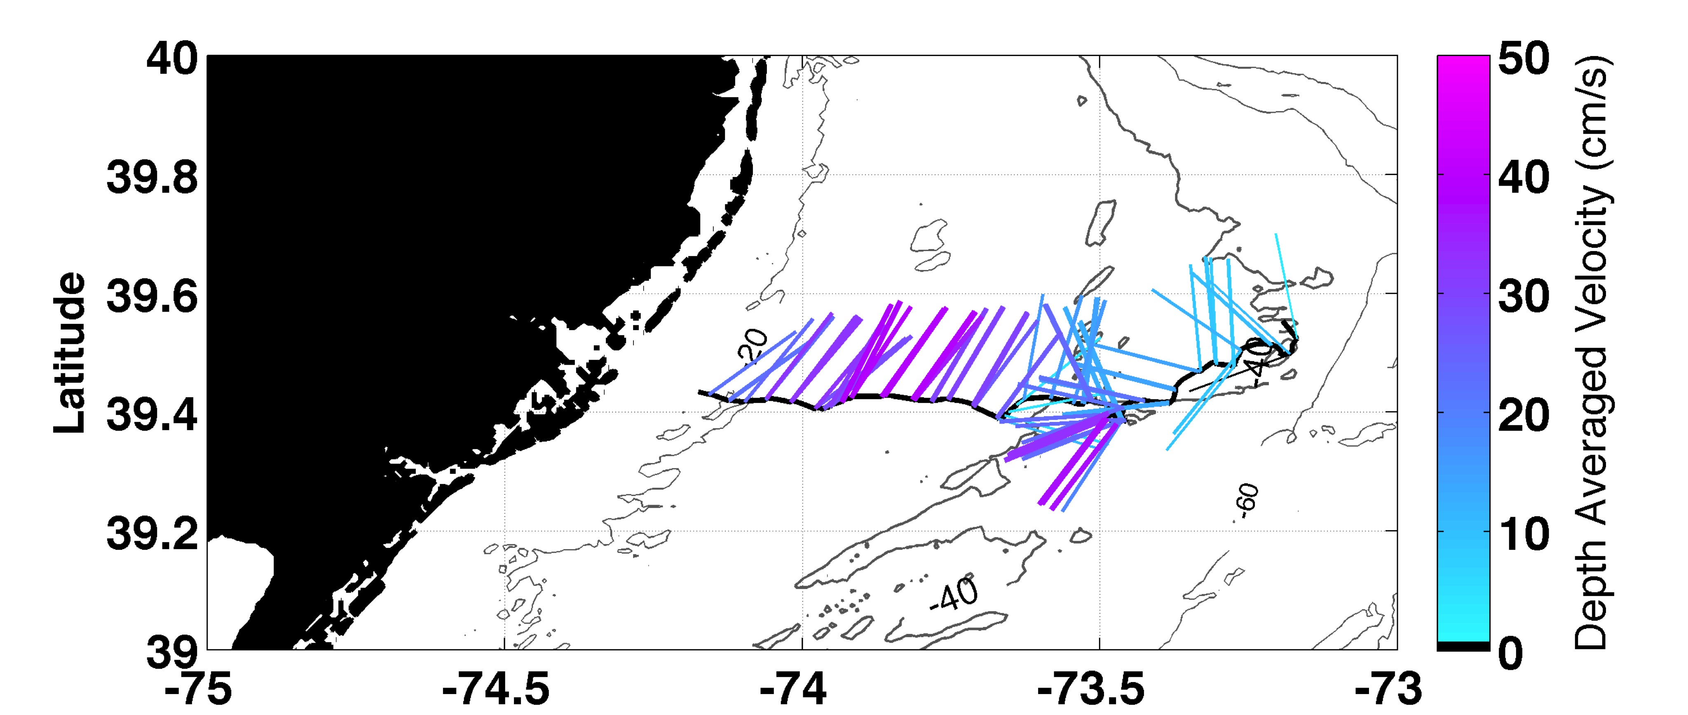
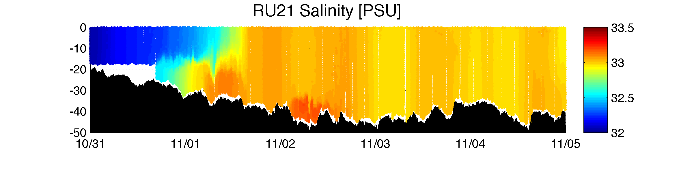
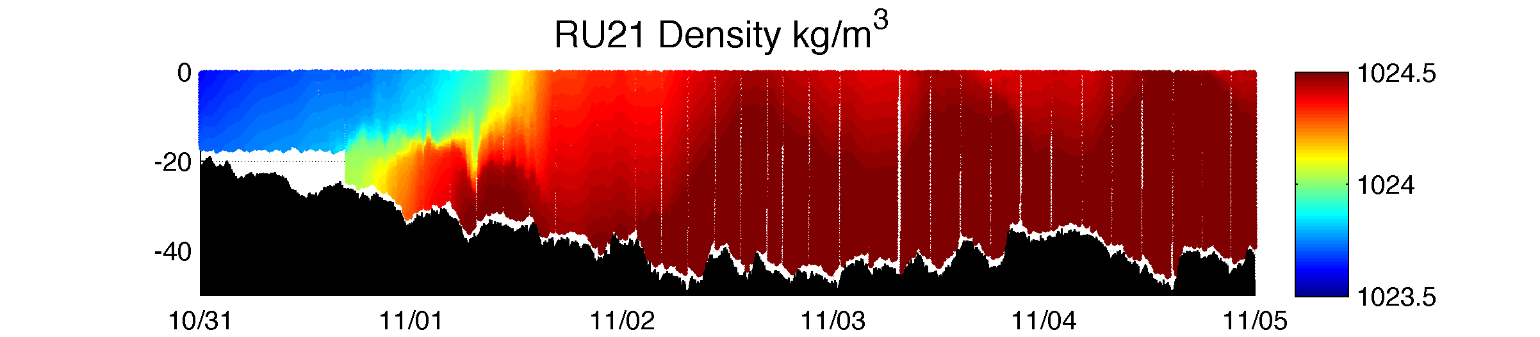
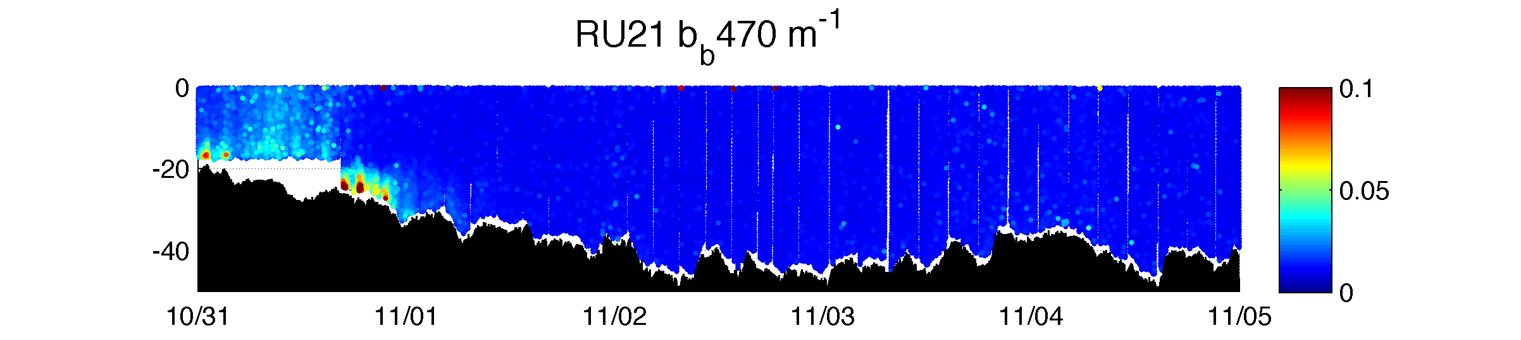
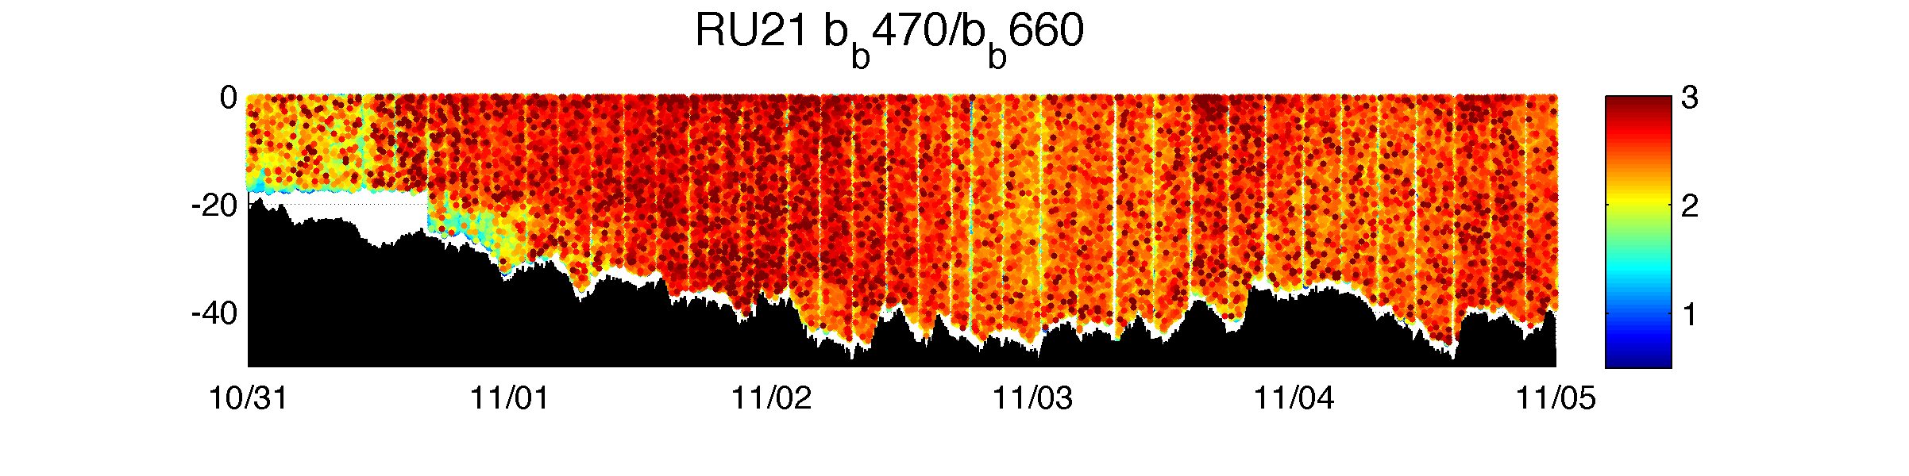
Pre-storm offshore transect:
Vertically well-mixed.
Warm/fresh water onshore
Salty/cooler water offshore
Optically clear
Depth (m)
Date (mm/dd)
Notes:
What’s going on in the ocean? Pre-storm RU21 goes offshore

Slide 12
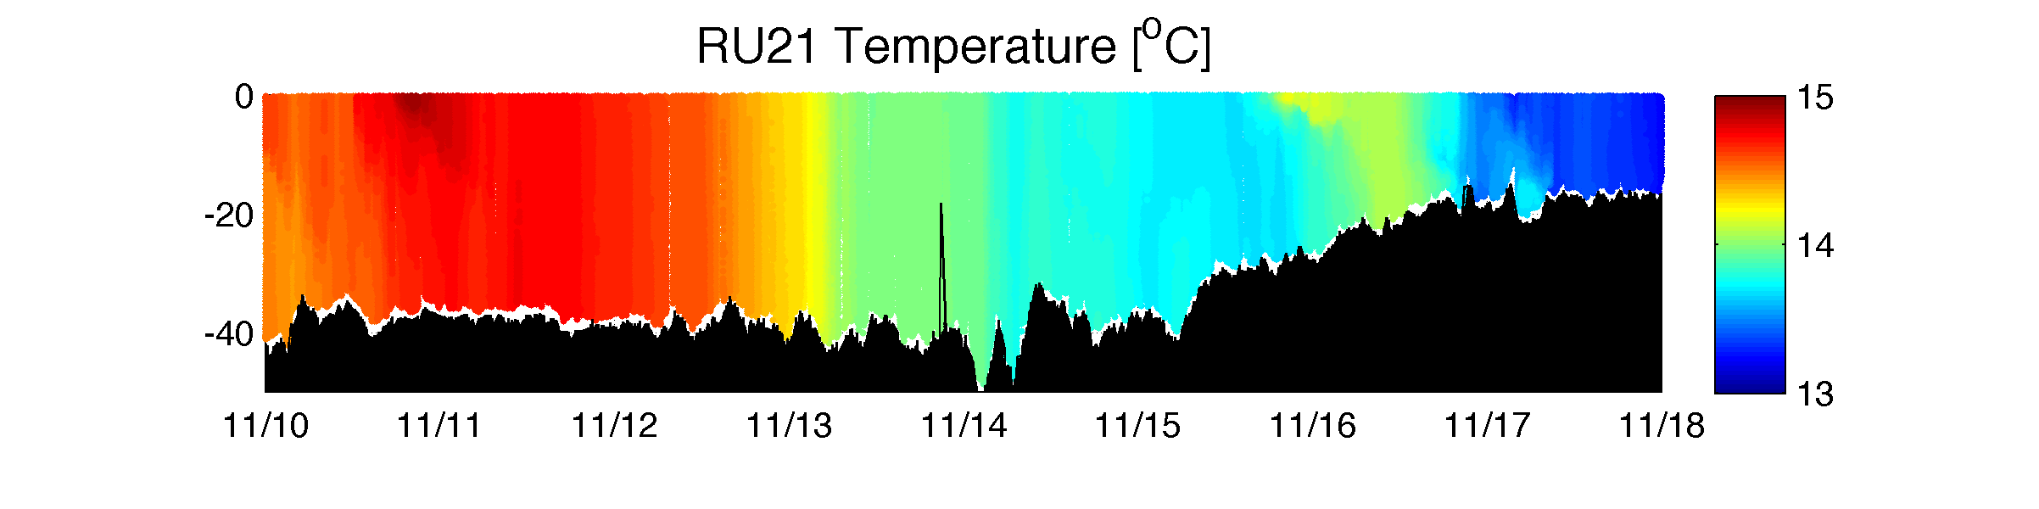
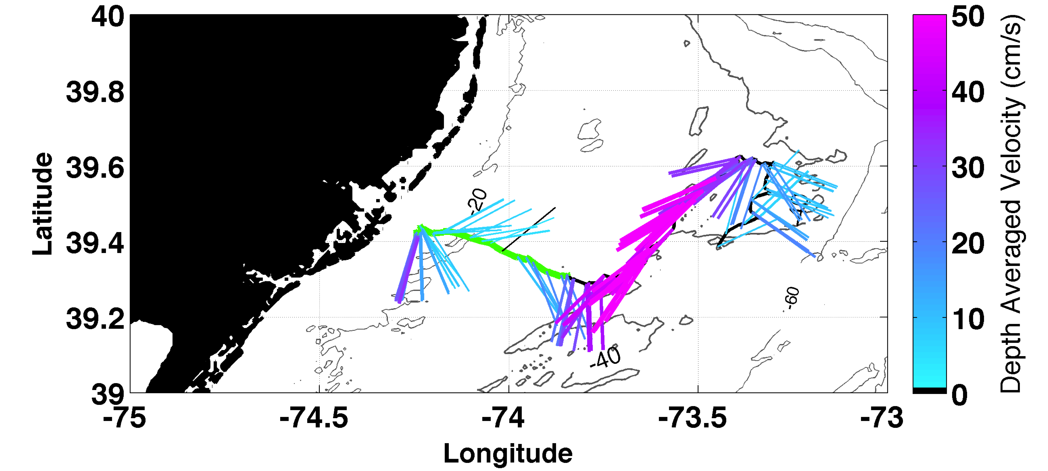
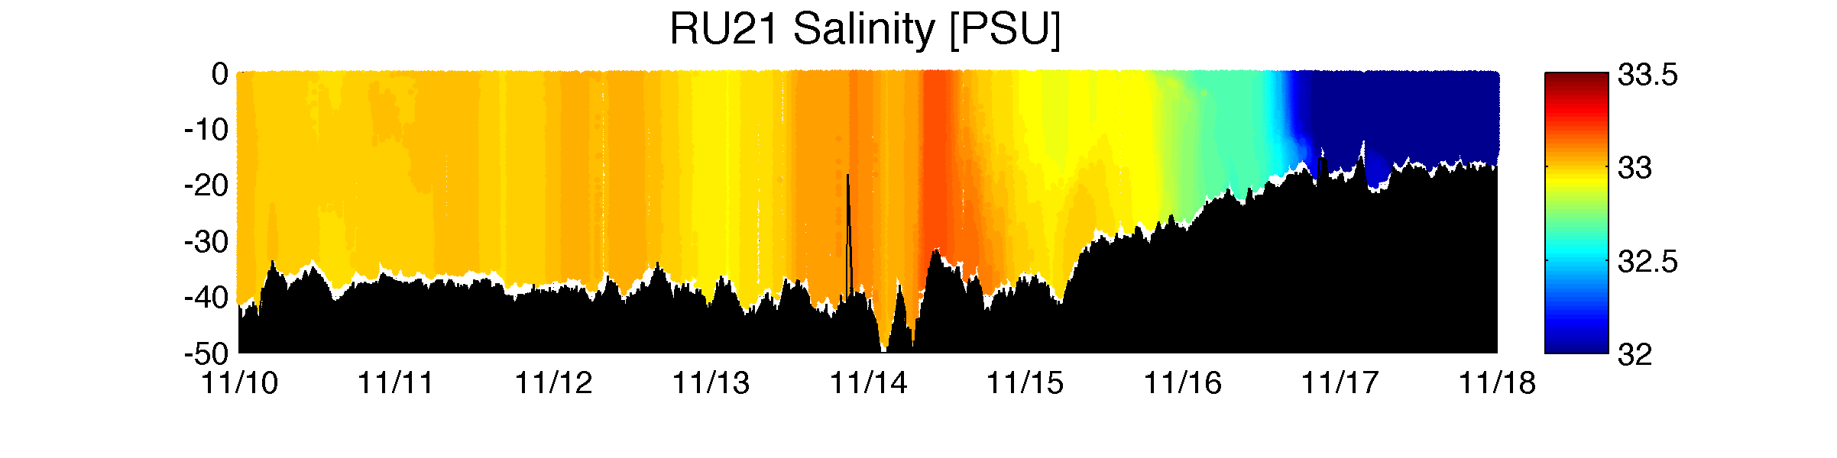
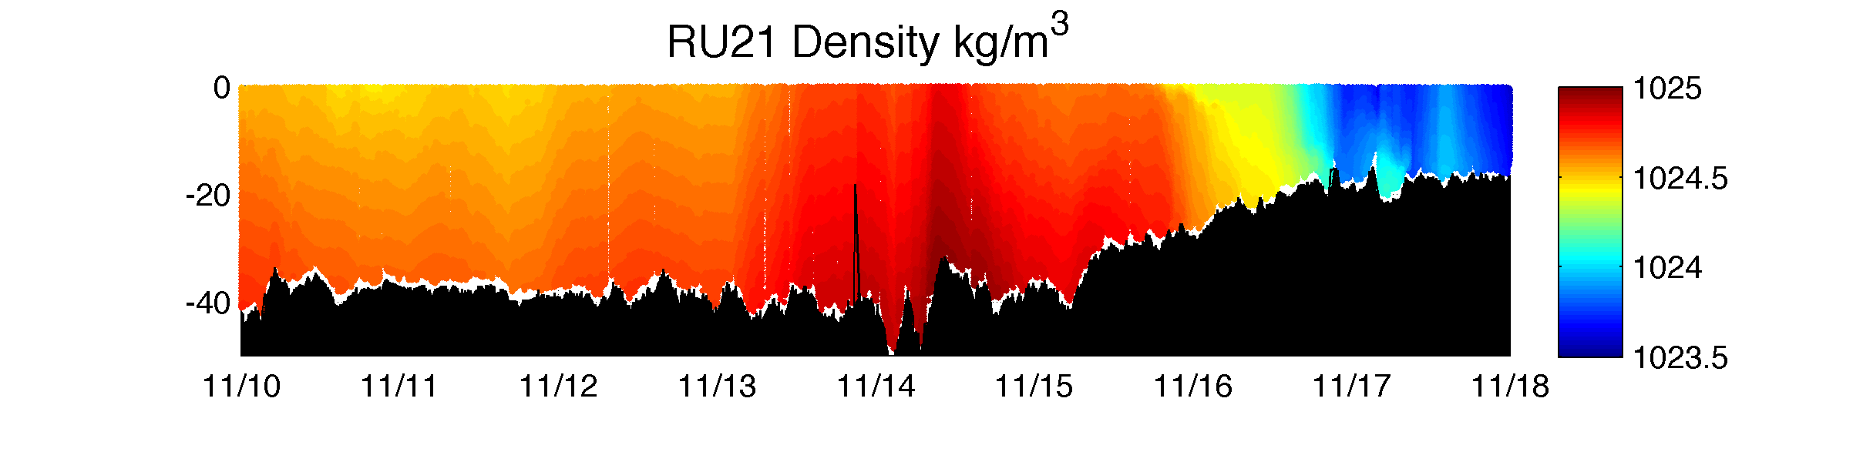
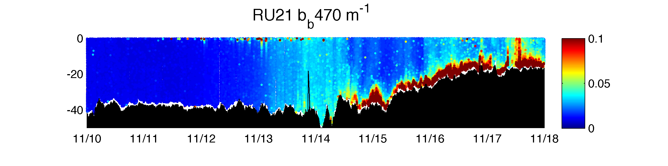
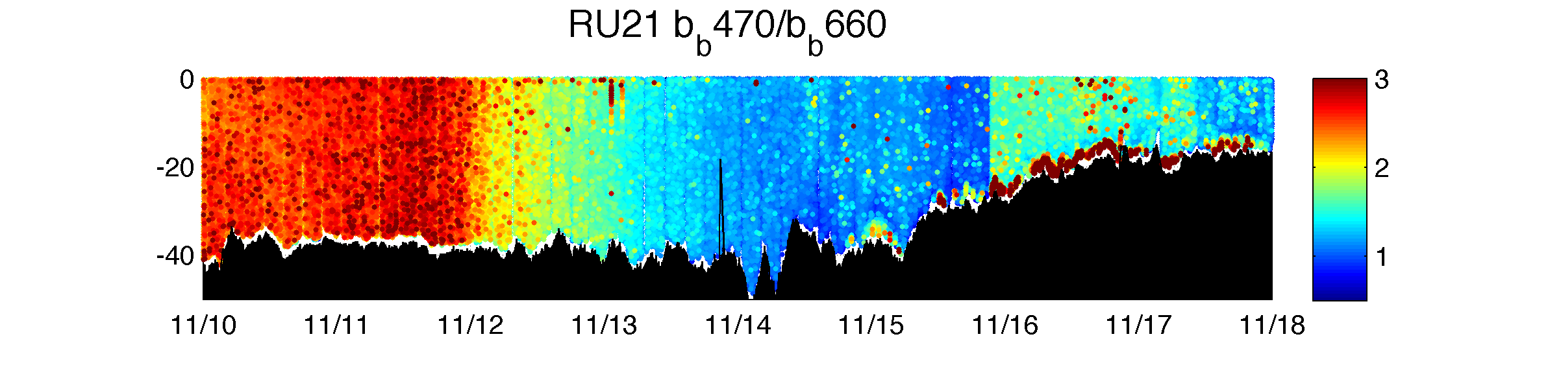
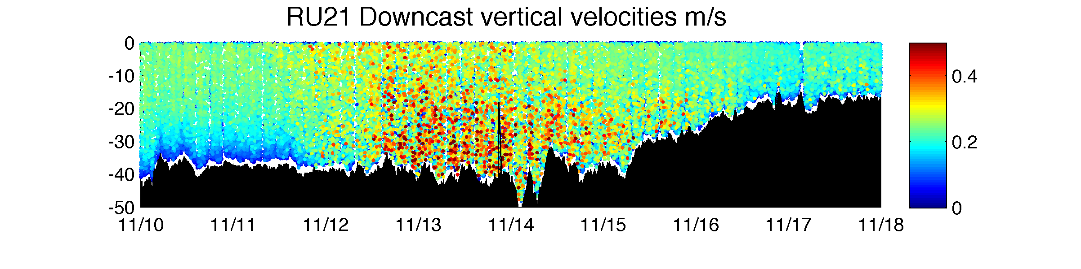
Depth (m)
Sediment is resuspended throughout the water-column shortly after vertical velocities reach the bed.
Glider vertical velocities increase from the surface over ~ 20 hours.
Date (mm/dd)
Notes:
What’s happening during the storm?
Along-shore transect southwestward
Black box is storm conditions.
Go through each plot slowly
Why does sediment resuspend on the 13th and not earlier?
Vertical velocities (maybe a proxy for turbulence, Scott currently doing work to check this)!
During the storm things change. Black box covers the storm duration. Glider tracks alongshore toward the south along the 40 m isobath during the storm. T,S,D similar to before but with increase in salinity, and density late n the storm, change in about 0.25 kg m3 (small)
We use optical backscatter as a proxy for sediment resuspension.
Sediment suspends on the 13th – 14th.
Glider vertical velocities show increasing variability mixing down from the surface and resuspension initiating as soon as that reaches the bed

Slide 13
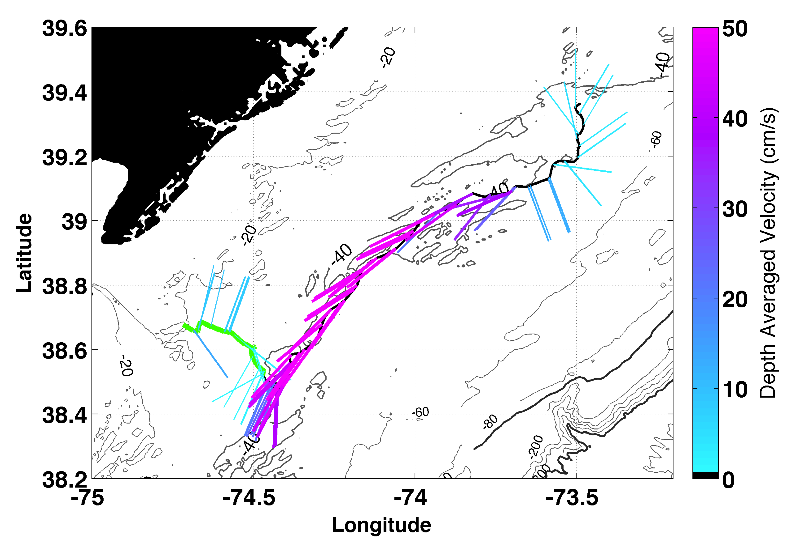
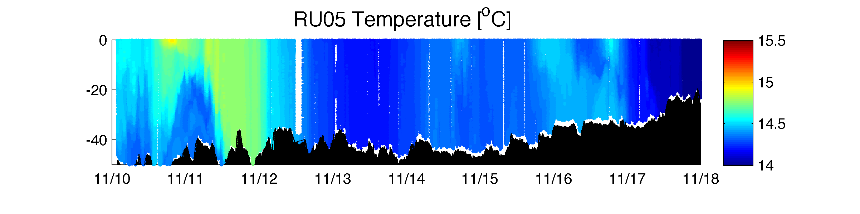
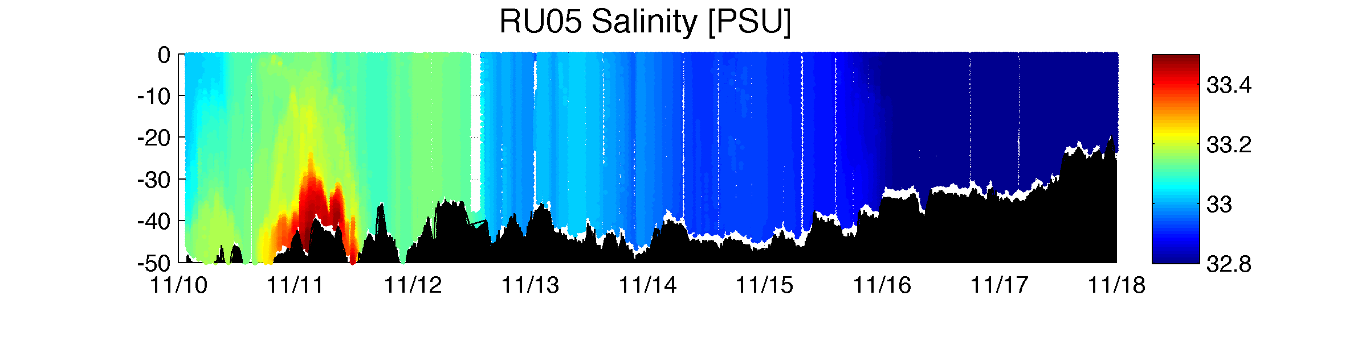
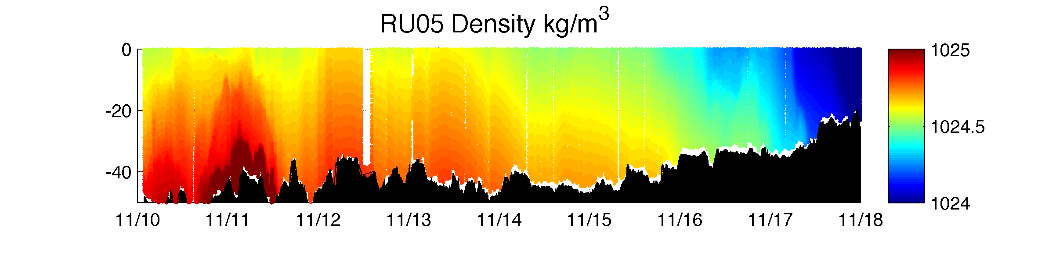
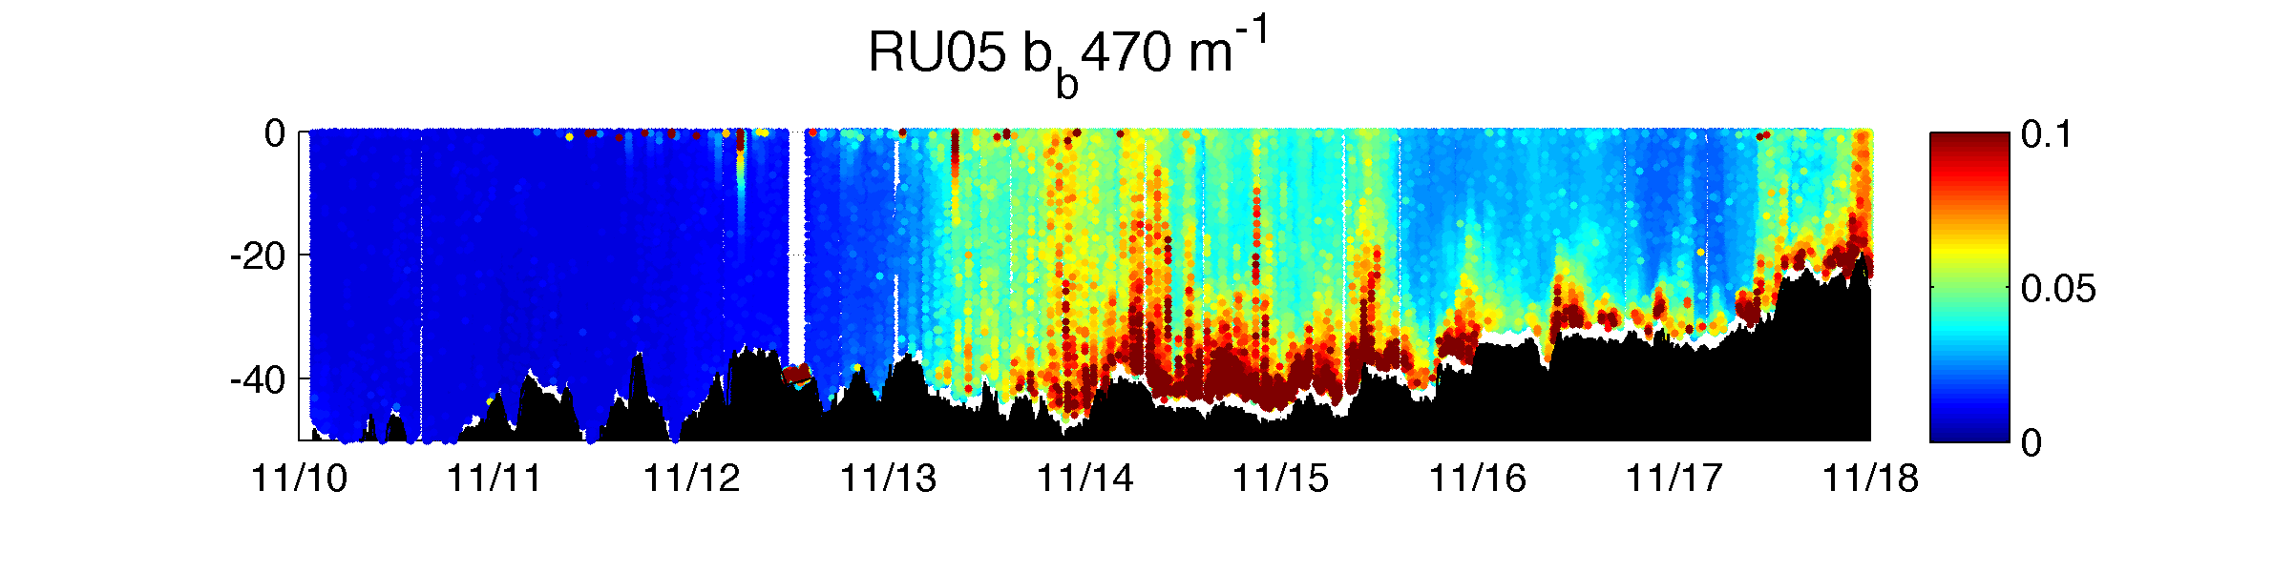
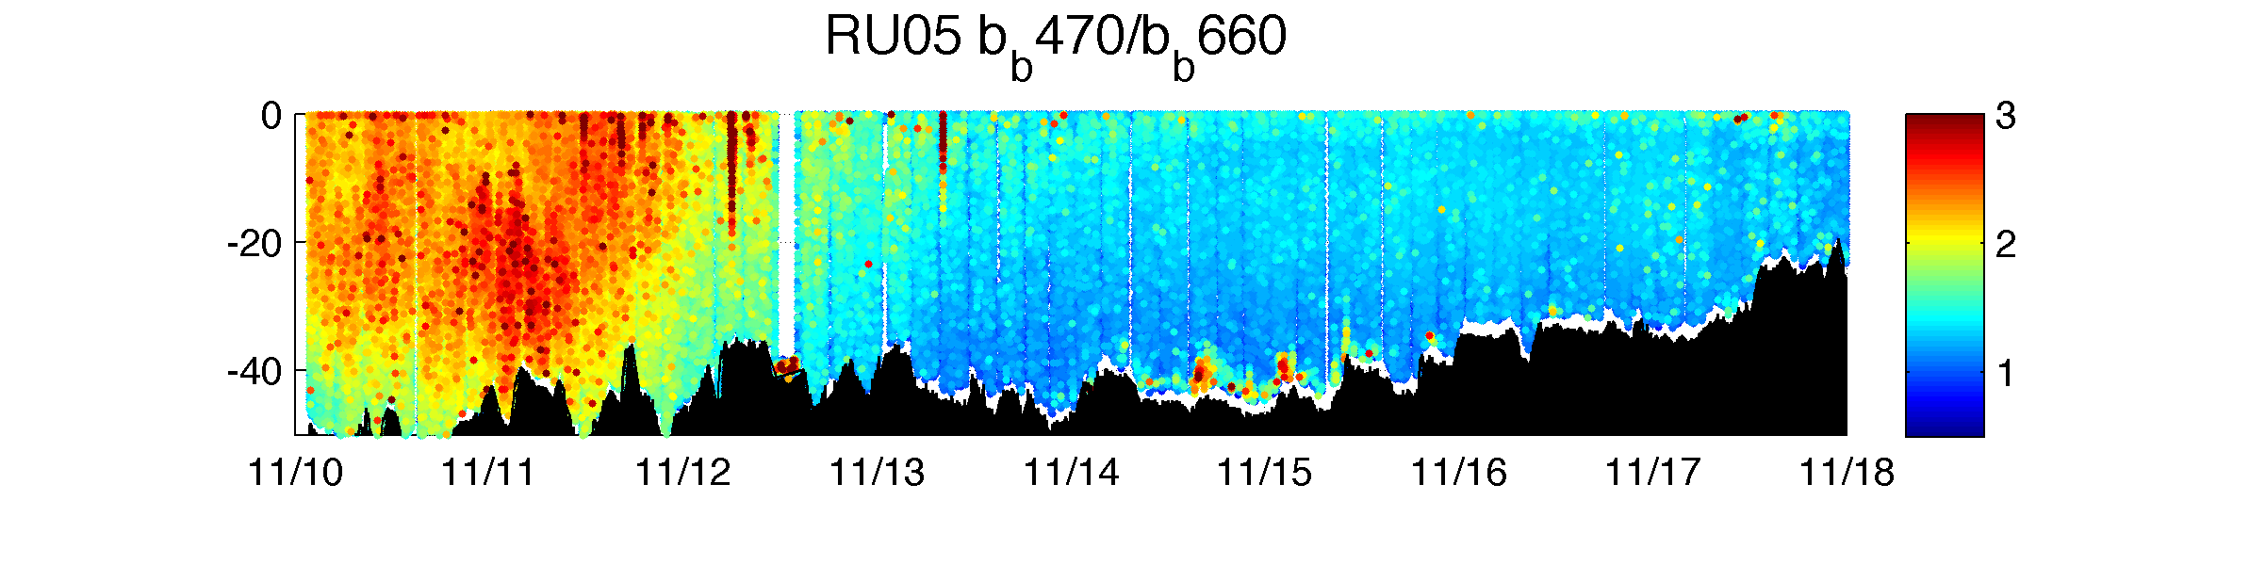
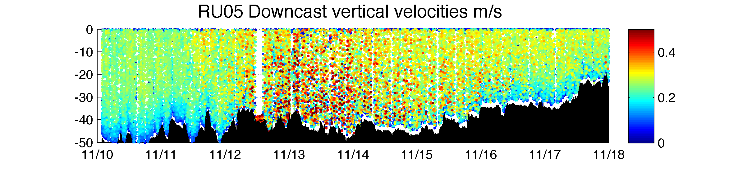
Depth (m)
Timing is similar to RU21 but magnitude is higher at RU05 during the peak of the winds and waves.
Date (mm/dd)
Notes:
RU05 more southerly, also along-shore southwest
Go through each plot
Highlight early bulge. (no effect on sediment) Potentially remnant cold pool
Similar but higher magnitude
Vertical velocities similar
RU05 was a more southerly glider also tracking along the 40m isobath. Bulge of cool, salty dense water is sampled at the beginning of the storm. Likely remnant cold pool water as we’re further offshore in slightly deeper water.
Timing of resuspension is similar but magnitude is higher.

Slide 14
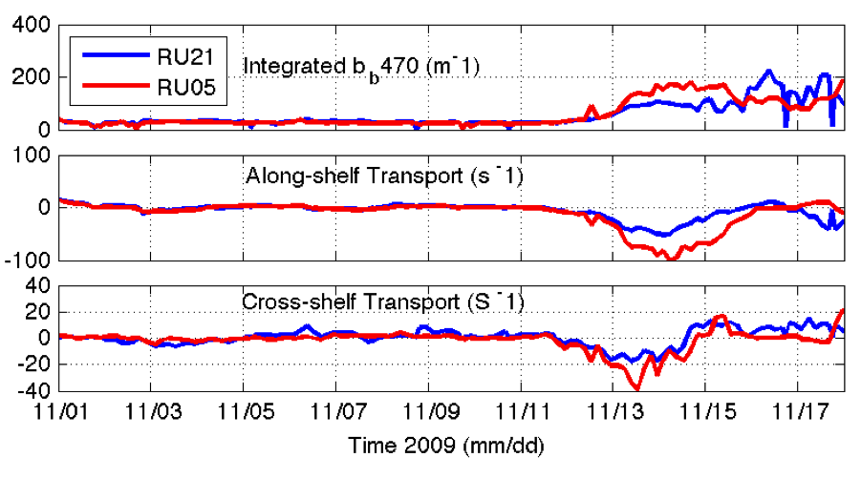
RU05 has double optical backscatter during the storm event, and double the along-shelf transport. Why is there a difference?
Notes:
To compare the two gliders resuspension and transport
Integrate optical backscatter to represent suspended sediment concentration
Multiply by currents for transport
Describe plots
Why are they different?
We depth integrate optical backscatter values for both glider, and multiply them by depth-averaged currents to estimate transport.
More sediment resuspended in RU05 and more transported. Negative is alongshore southwestward, and onshore.
Why different?

Slide 15
Sediment concentration at depth z
W_{f} or fall velocity is the tendency for sediment to fall out of suspension.
U* represents turbulent shear or the tendency for particles to remain in suspension.
[Glenn et al., 2008; Styles and Glenn, 2000; Glenn and Grant, 1987]
Notes:
We have to go back to the equations to figure this out.
Describe equation (sed conc., reference depth, depth/ref depth, gamma is a constant ratio of eddy viscosities, k is von karmans constant.)
If we vary wf or u* we see differences in suspended sediment.
Read slides
Fall velocities and turbulent shear. If wf is large suspended sediment is low and vice versa or if U* is small then suspended sediment is low)
Sediment concentration is represented by this equation. The important part we focus on is wf/u. wf is the tendency of sediment to fall out of suspension, u is the turbulent shear or tendency for particls to remain in suspension. How do we get at these numbers?

Slide 16
Sediment concentration at depth z
W_{f} or fall velocity is the tendency for sediment to fall out of suspension.
U* represents turbulent shear or the tendency for particles to remain in suspension.
Agrawal and Pottsmith (2000)
a = grain size
U* is proportional to depth-averaged velocity. [Lentz et al., 1999], which we can get from glider depth-averaged velocities.
[Glenn et al., 2008; Styles and Glenn, 2000; Glenn and Grant, 1987]
Notes:
Local representation of fall velocities from Agrawal and Pottsmith(2000)
Agrawal and Pottsmith have a local model for fall velocities developed at LEO-15 right near where we’re deployed. Wf is equal to fall velocity and A is a function of sediment grain size.
U* is proportional to depth averaged velocity, which we can get from glider depth averaged velocities. But where can we get grain size? Not from glider data?

Slide 17
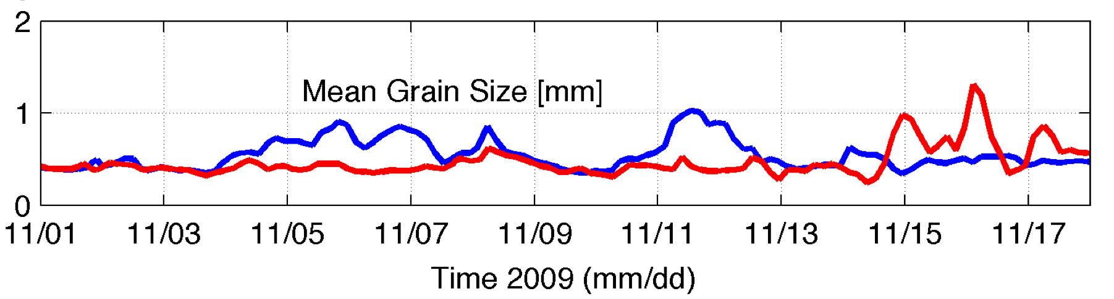
RU21 – Blue
RU05 - Red
Goff et al., 2008 (http://walrus.wr.usgs.gov/usseabed/)
Notes:
We estimate suspended grain size from the mean bed grain size below the glider.
Describe figure
Reference time-series as below the glider
Now with this tool we can estimate wf
Goff et al. compiled a sediment map based on assimilating survey data into a high resolution dataset. We then pull out the data directly beneath each glider.

Slide 18
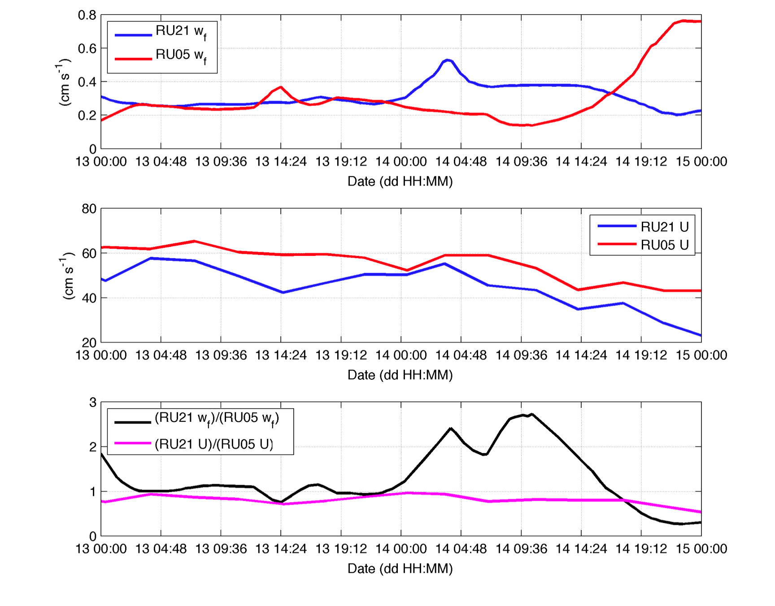
Notes:
If we plot fall velocities for the resuspension event we see higher fall velocities in RU21 than RU05
We also plot Currens and see RU05 continually has slightly higher currents
Ratio of these two properties for RU21:RU05 show increasing RU21 fall velocities while current ratios between the two locations are largely constant.
With this plot we can see that fall-velocities and sediment size are likely the dominant factor for spatial differences in resuspension and transport on the continental shelf

Slide 19
Conclusions
Even during the largest storms sediment resuspension and transport is not spatially coherent.
Estimates of mean grain size show that sediment fall velocities dominate spatial variablity during shelf-scale storms in the absence of stratification.
Direct measurements of turbulence, suspended sediment grain-size and concentration are necessary to monitor sediment transport and feed data into predictive models.

Slide 20
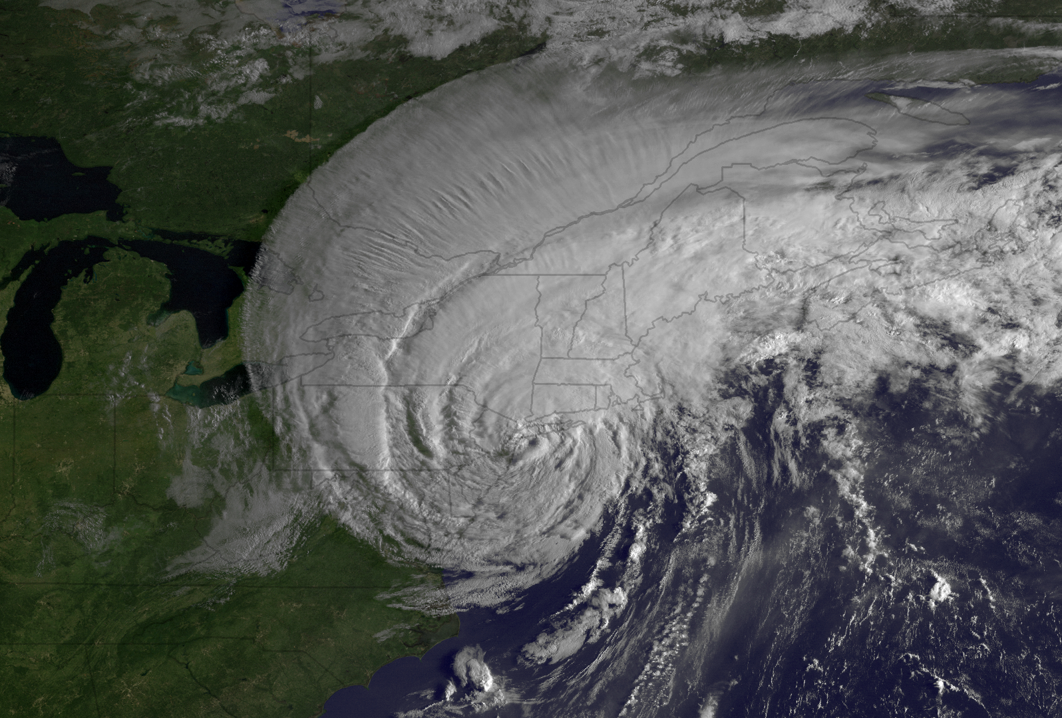
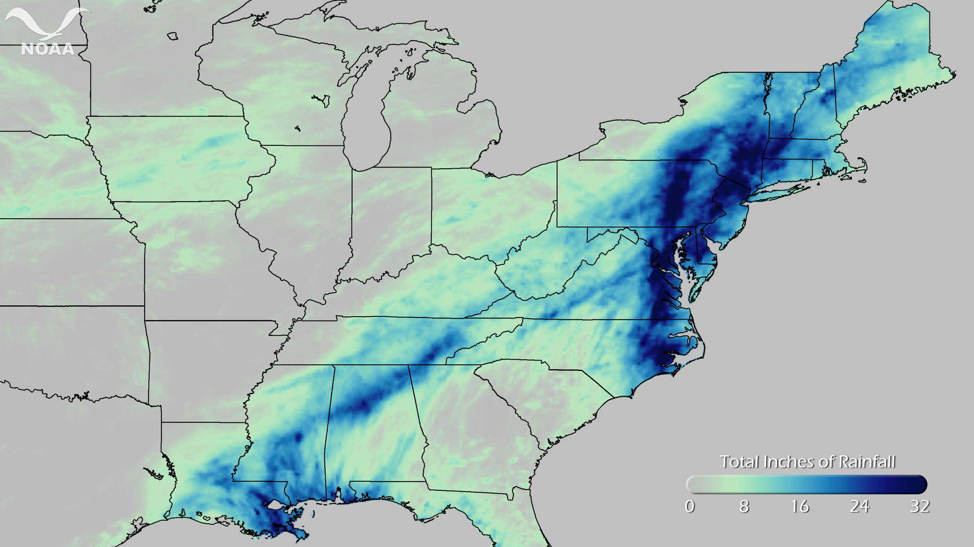
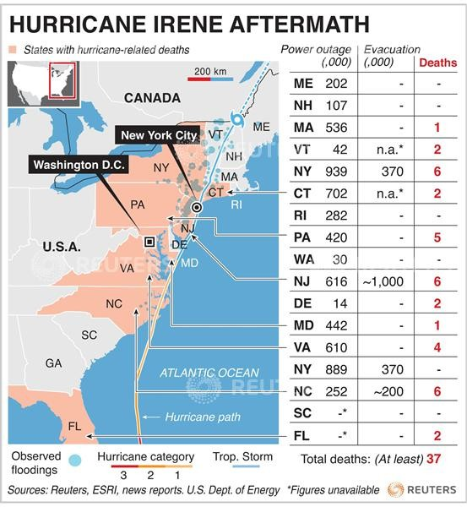

Chapter Two: Storm observations of near-inertial surface currents on the Mid-Atlantic Bight.
Aug 20-29
Total inches of rainfall
0
32
First tropical storm to threaten NYC since Hurricane Gloria in 1985
Flooding records broken in 26 rivers
Caused at least 56 deaths
Damage nearly $8 billion
Notes:
Second chapter will be Storm observations of:
Hurricane Irene is first tropical storm to threaten NYC since 1985. As mentioned earlier high cost $8 billion. Massive flooding and 56 deaths.

Slide 21
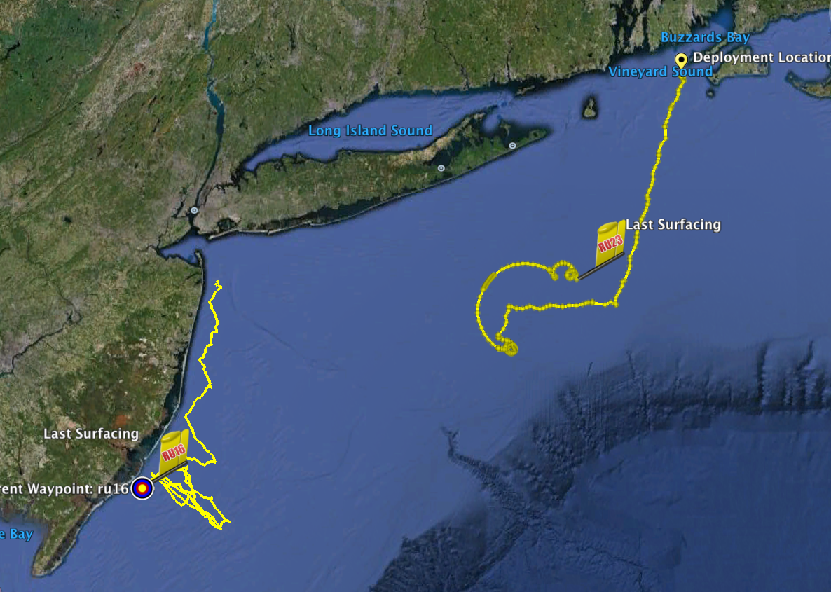
Two Gliders
Deployed by MARACOOS
in Hurricane Irene
RU23
Deployed to map subsurface T/S structure for fisheries.
Damaged early - drifter
Recovered by fisherman
Provided data on inertial currents during storm.
RU16
Deployed for mapping bottom dissolved oxygen.
Provided data on mixing during storm.
Notes:
Fortunate to have 2 gliders deployed during the storm

Slide 22
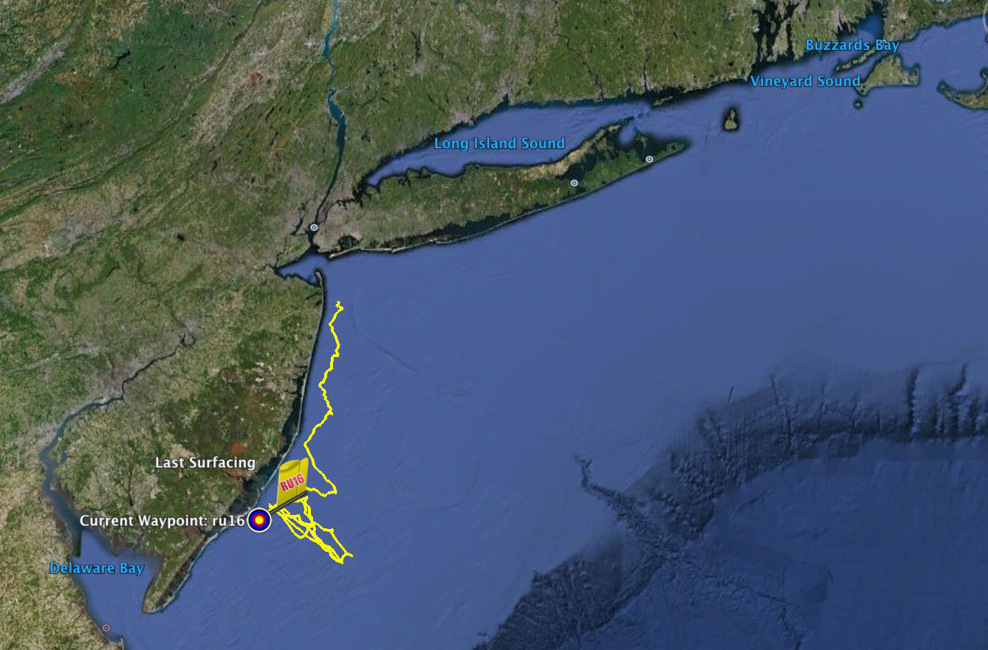
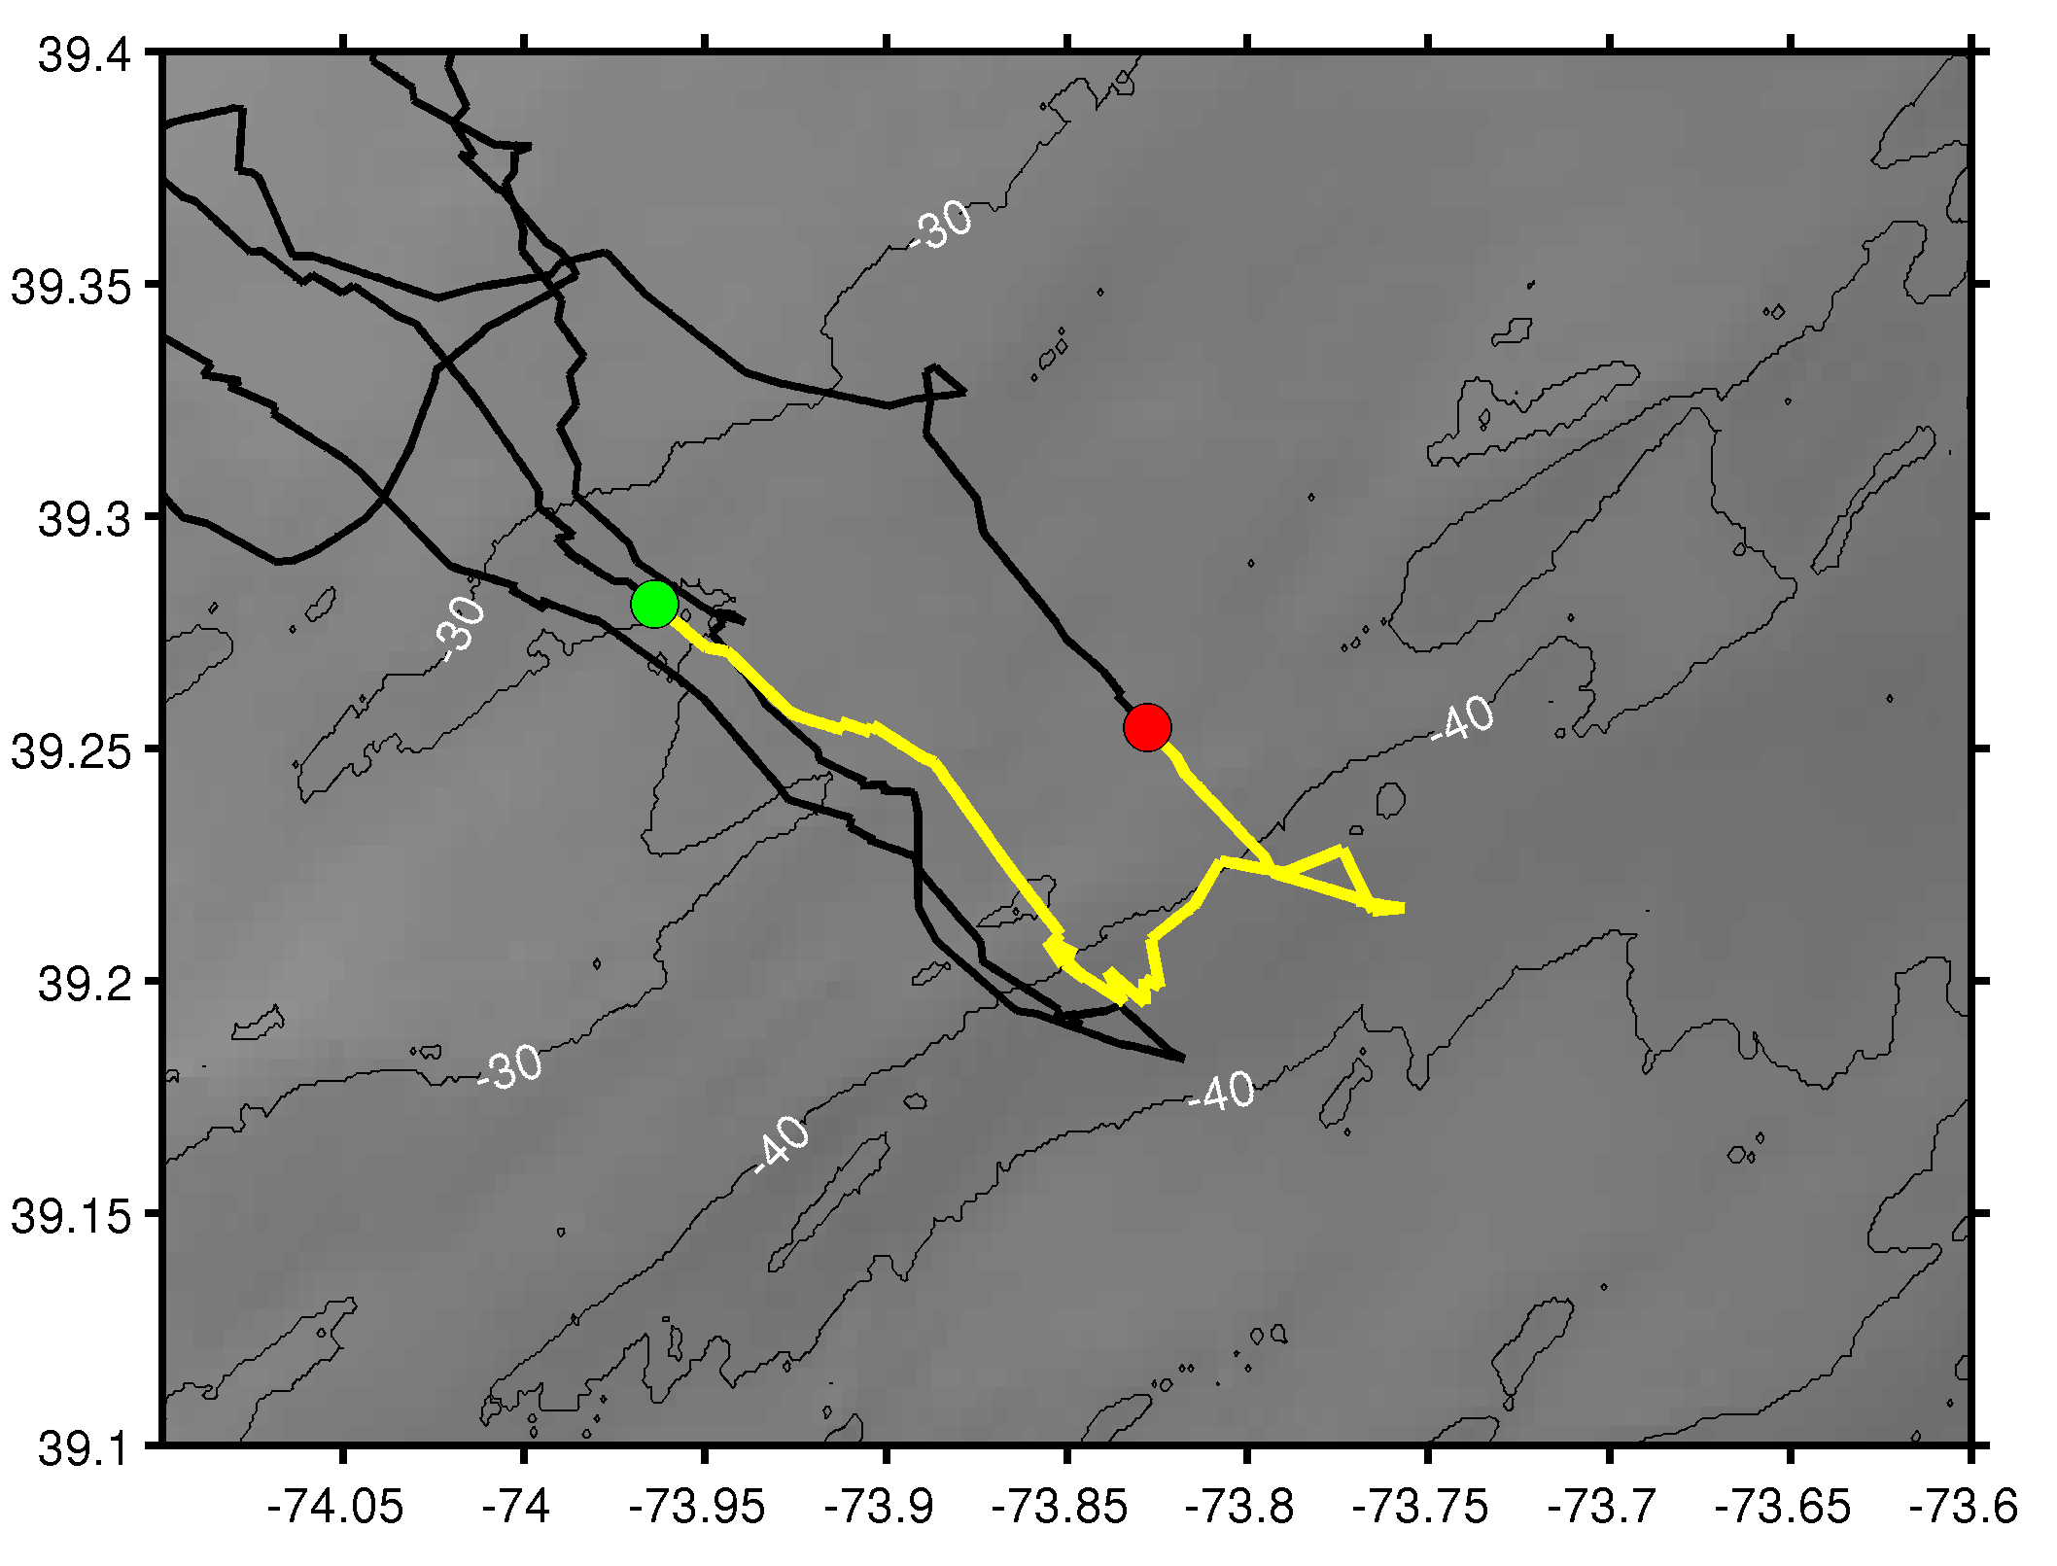
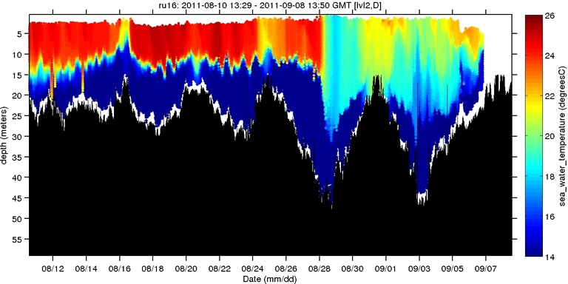
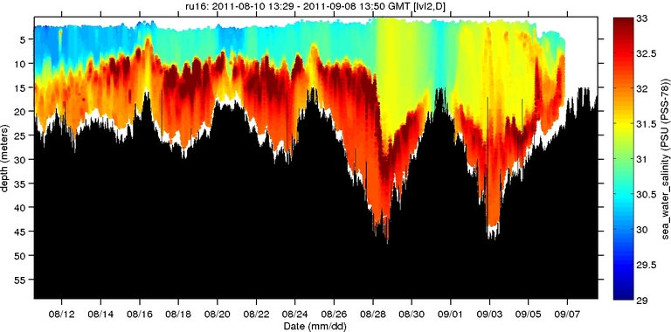
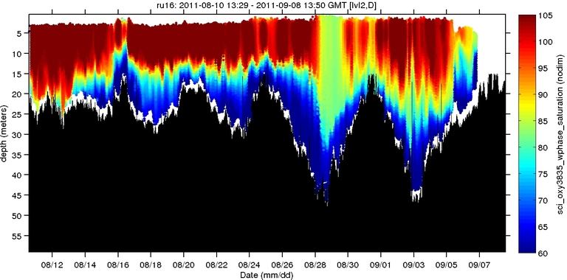
Hurricane Irene
Hurricane Irene
0
26
depth
temperature
55
14
0
33
depth
salinity
55
29
0
105
depth
% oxygen
55
60
8/12
date
9/07
Notes:
First glider RU16 performing cross-shelf transects. Clear storm signal showing temperature salinity and oxygen with an increased MLD that persisted following the storm passage

Slide 23
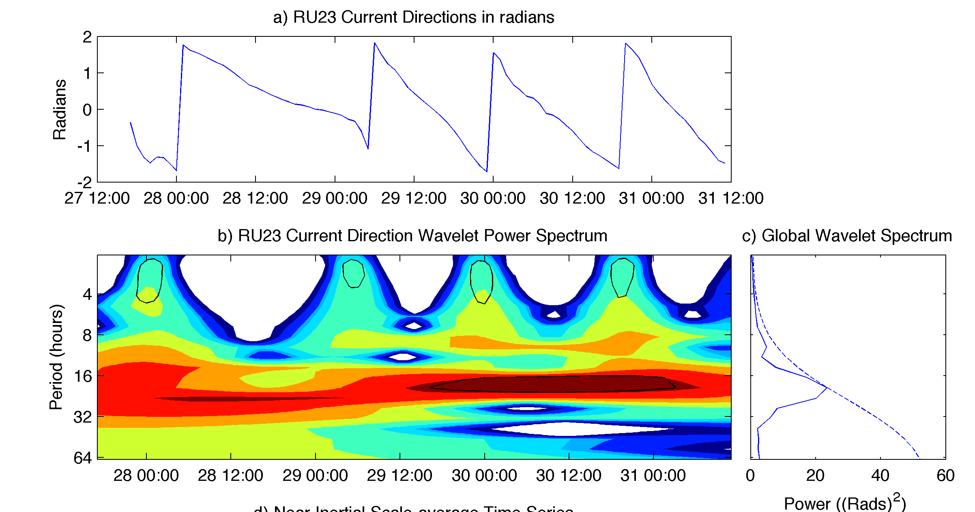
Notes:
Second glider broke down as mentioned and showed classic inertial circles. To further look into this I performed wavelet analysis on current directions based on gliders drift.
Top is time-series in radians after the glider broke down.
Center is wavelet analysis showing energy at differen periodicity. Strong signal in the near-inertial band (~18 hrs)
Focused

Slide 24
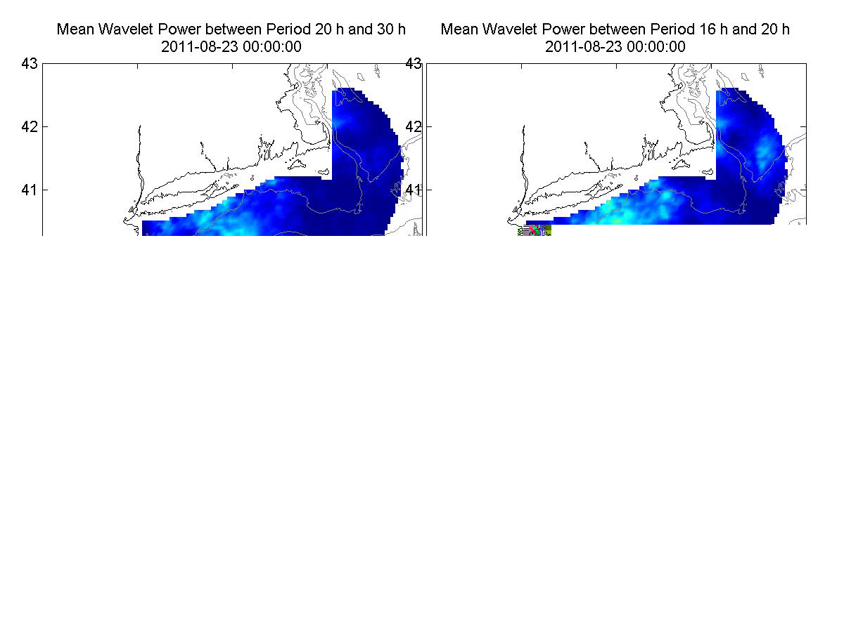
Courtesy of Laura Palmara
Notes:
Seeing inertial currents in glider drift inspired us to investigate further. Laura Palmara made this movie, which is essentially calcualted from wavelet analysis at CODAR grid points every 6 hrs.
Left is super-inertial period, right is near-inertial band. Storm track will travel across in gray.

Slide 25
Wind-driven near-inertial currents are an important component of mixing and energy budgets on the continental shelf [Paduan et al., 1989] .
Inertial currents are a source of large vertical shears throughout the water column and a source of turbulent energy production that disperse energy days after a storm has passed [Sanford et al., 2010].
Synoptic scale storms such as hurricanes [Gill, 1984] and extratropical cyclones [Thomson and Hugget, 1981] play a particularly important role in mixing.
Understanding inertial currents impact on mixing the thermocline will aid in model validation and improve storm predictions and forecasts.
Notes:
Background (read)

Slide 26
I propose to:
Determine the near-inertial surface response of the coastal ocean to three different storm events on the MAB.
identify the length- and time- scales of inertial current dissipation for different storm and hydrographic conditions (primarily stratification).
Track vertical propagation of energy in the near-inertial band underneath a storm.
Notes:
To further understand these I Propose to

Slide 27
Planned work:
Analyze CODAR fields and glider deployments from three storms with differing stratification.
  Irene (Stratified)
  Nor’Ida (Unstratified)
  Storm to be sampled this year
Future Glider deployment (September – October) with a vehicle mounted Acoustic Doppler Current Profiler (ADCP) and optical sensors in the vicinity of a bottom mounted ADCP for calibration and sustained measurements.
  Provide direct measurements of current profiles in a storm. Estimates of shear and mixing.
  Acoustic backscatter data to be compared with optical backscatter for sediment transport and resuspension.
Notes:
To do this I will

Slide 28
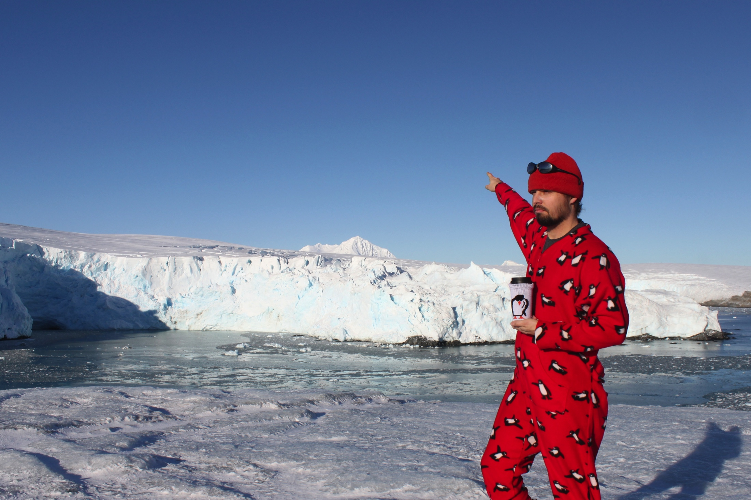
Chapter Three: Physical forcing of a Western Antarctic Peninsula ecosystem: observations of local circulation and storm-driven mixing at Palmer Station.
Notes:
So far I’ve focused on the local temporal and spatial impacts of storms on coastal ocean of the MAB. Switching gears a bit

Slide 29
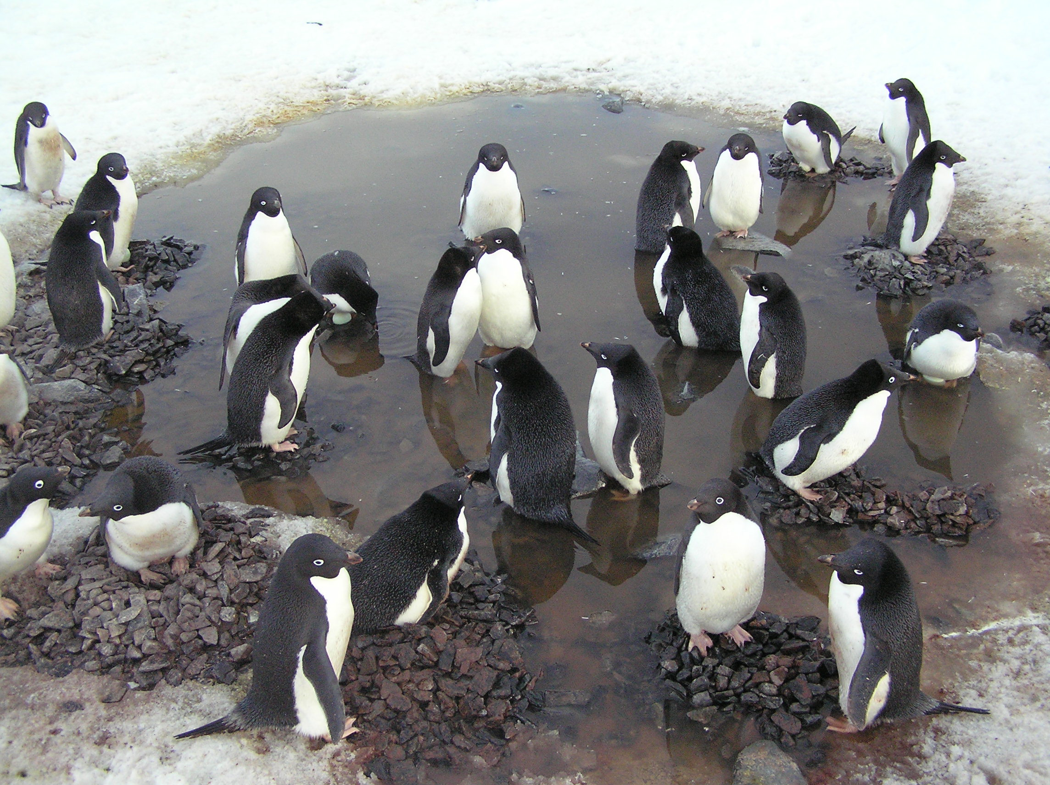
Things are changing on the Western Antarctic Peninsula [Ducklow et al., 2007].
Increasing atmospheric temperatures [Meredith and King, 2005].
A shortening of of sea-ice duration [Stammerjohn et al., 2008].
Glacial retreat [Cook et al., 2005].
Increased heat content on the shelf [Martinson et al., 2008]
The effects of these changes are seen at all levels of the marine food web: Bacteria, phytoplankton, krill, penguins, etc.

Slide 30
Palmer Station

Slide 31
Palmer Station
Notes:
Why do we see all these changes?
Sea-ice advance and retreat can be directly related to wind conditons
Trend of increasing winds leading to later sea-ice advance and earlier sea-ice retreat.
Decreasing extent of sea-ice.Directly related to increasing more poleward meridional winds, which have a northerly expression on the WAP due to it’s geometry.
Northerly winds compact ice and lead to higher thickness and thus longer duration (Massom/stammerjohn)

Slide 32
Palmer Station
[Massom et al. 2008]
Notes:
For WAP and palmer station – sea-ice decline is directly related to this region of increasing Winds from the north.

Slide 33
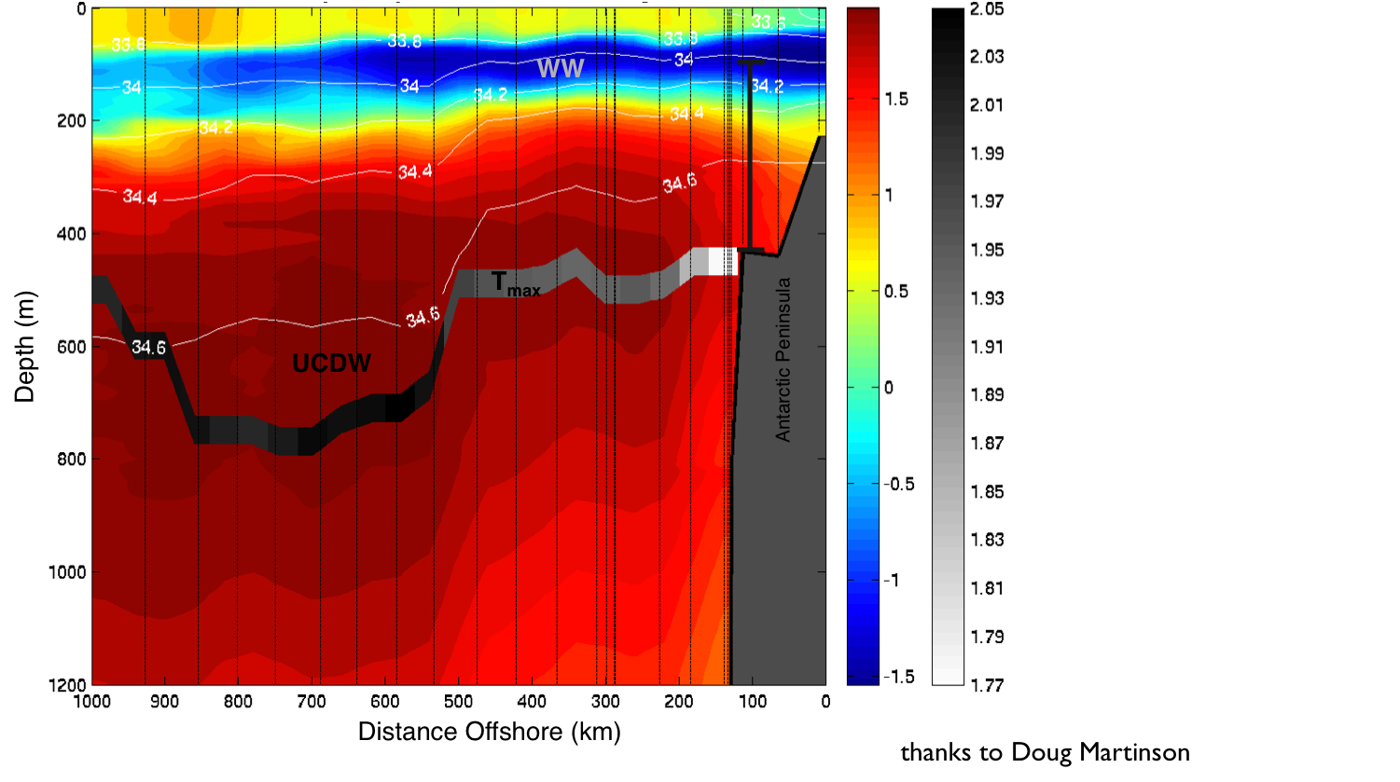
Summer foraging areas for Adelie penguins.
Modeling and observational studies have shown Upper Circumpolar Deep Water (UCDW) penetrating onto the shelf, particularly through submarine troughs and canyons, such as those found at Palmer Station, a Penguin foraging hotspot [Martinson et al., 2008, Dinniman et al., 2011].
Notes:
In addition to seeing changes in ice we see changes in heat content on the continental shelf.
Here is a cross-section of temperature (color) and salinity (contours) with distance offshore by Doug Martinson.
UCDW or Upper-Circumpolar Deep Water water is near the bottom and into the continental shelf edge.

Slide 34
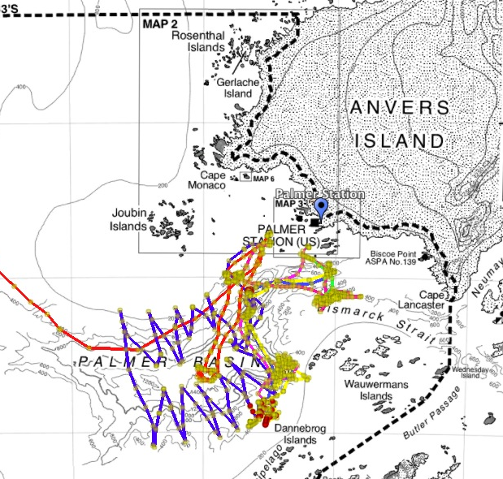
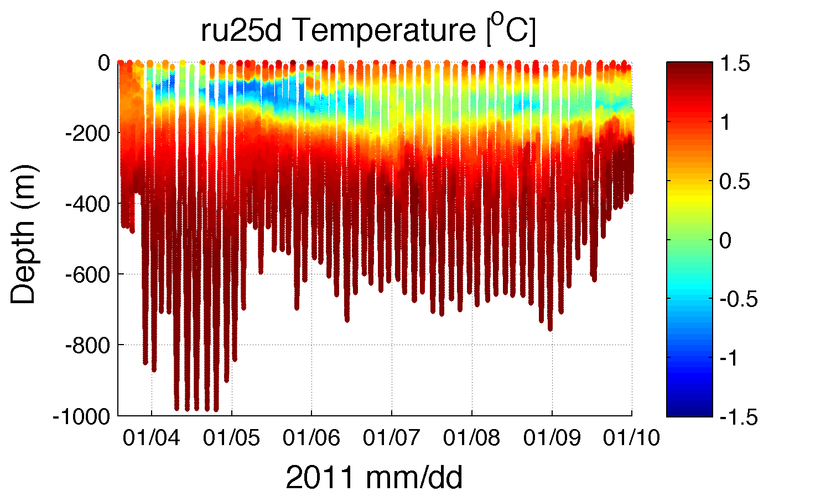
Summer foraging areas for Adelie penguins.
Notes:
While extensive study has been done on the WAP continental shelf, the local circulation and mechanisms for heat/nutrients to make it into surface waters are unclear.
So if we zoom in on Palmer Station/Anvers Island. You can see multiple glider deployments we’ve performed in the region.
One deployment shows warm waters extending from the deep ocean all the way to the surface with some apparent mixing through the WW layer as well.
How does that warm UCDW water get into the surface layers to directly affect the atmosphere and eco-system?

Slide 35
I propose to:
Describe the general circulation patterns in the Palmer region.
Identify the local water-column response to one possible forcing mechanism, summer storms.
Determine the implications of changes in the atmospheric and oceanic circulation on the local region.
Notes:
In order to get at this issue I propose:

Slide 36
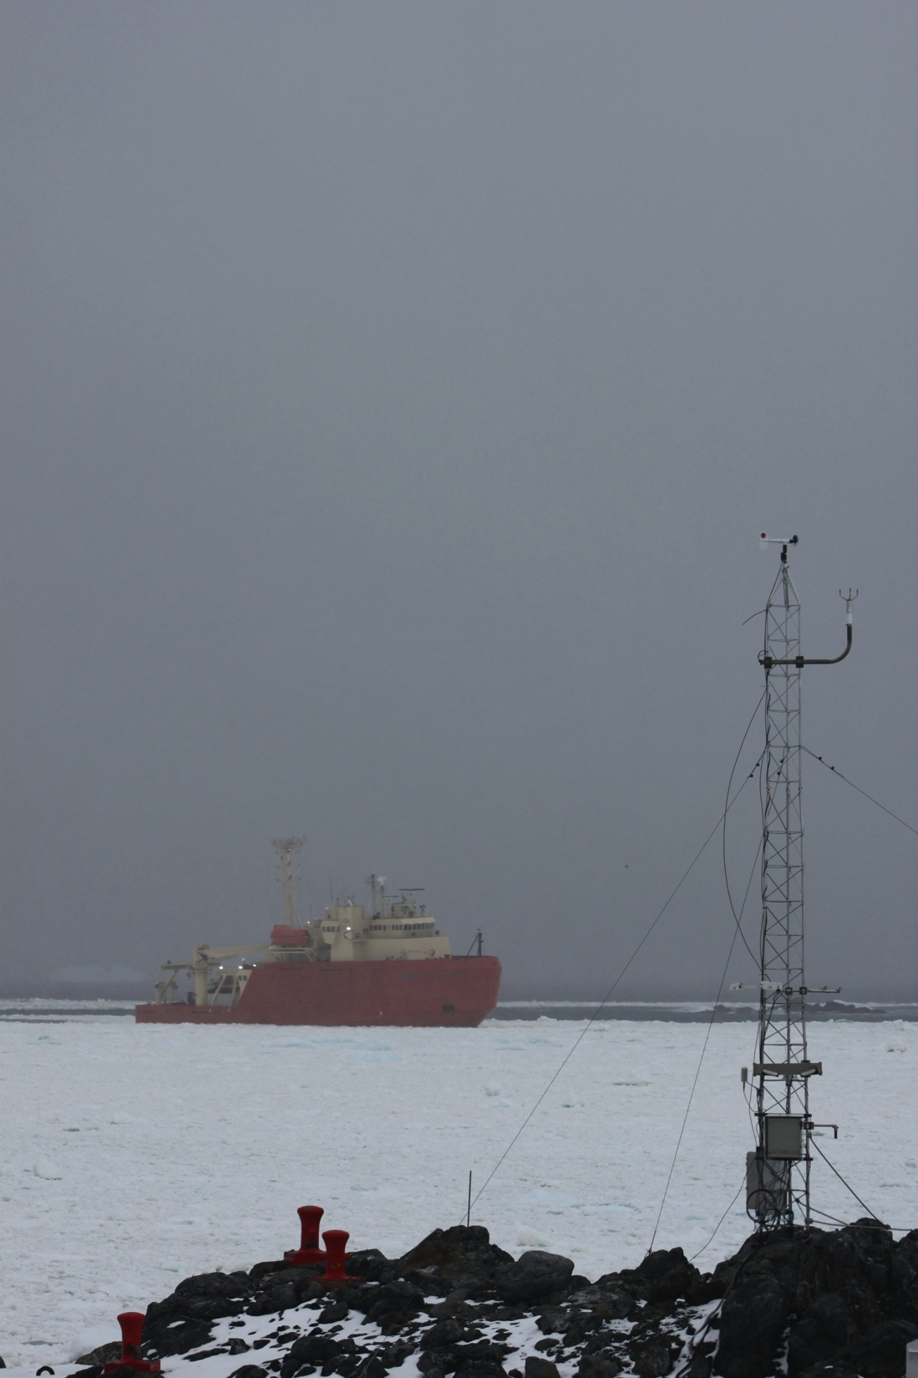
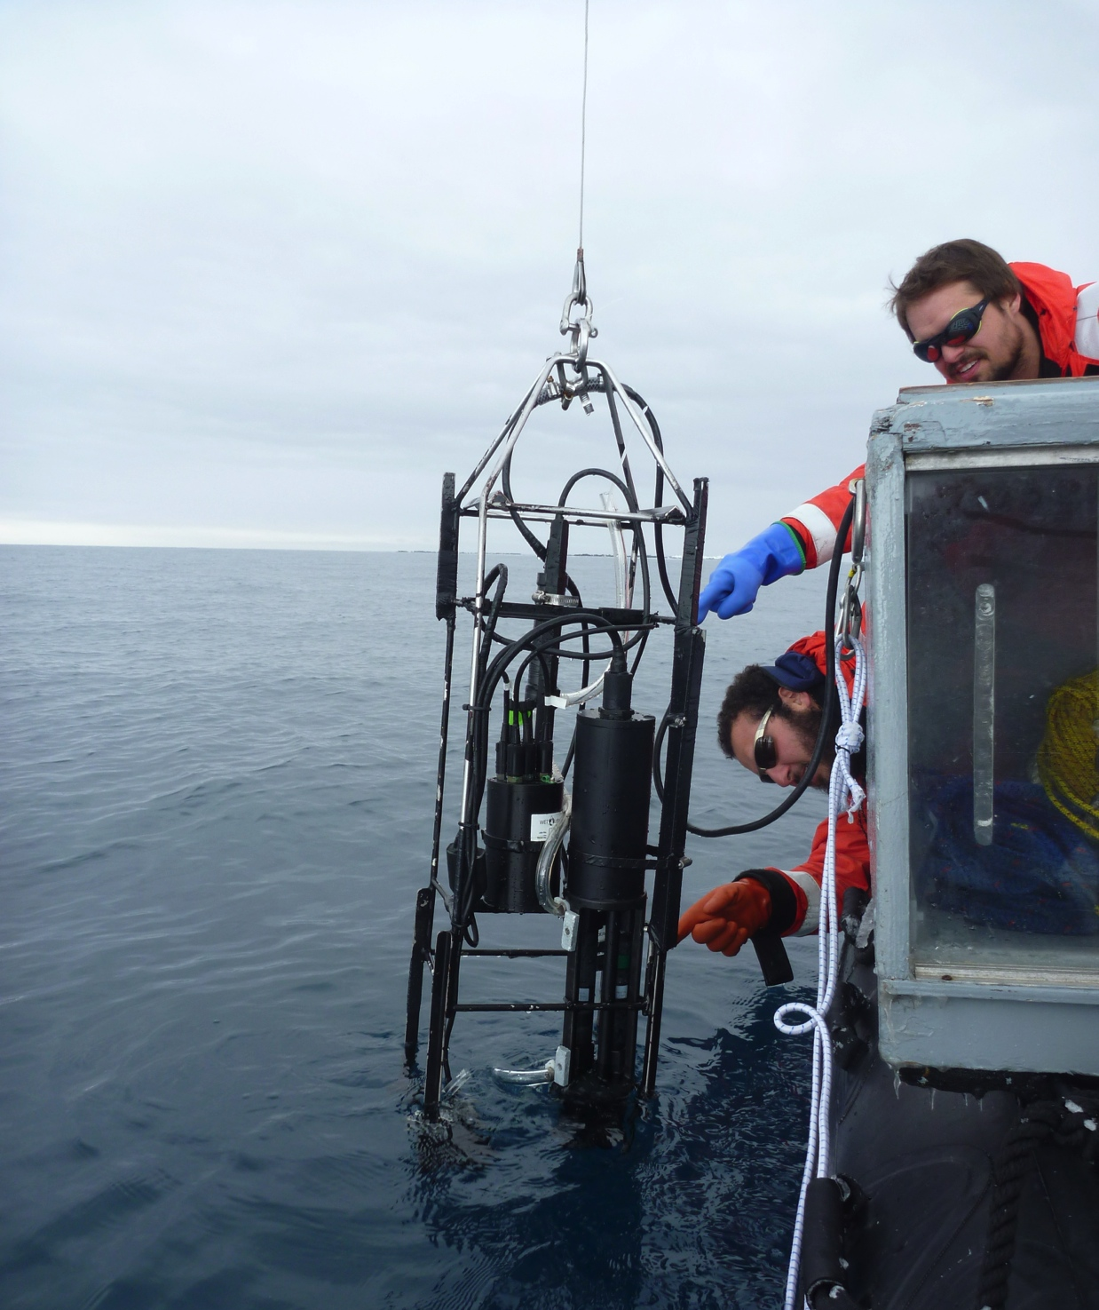
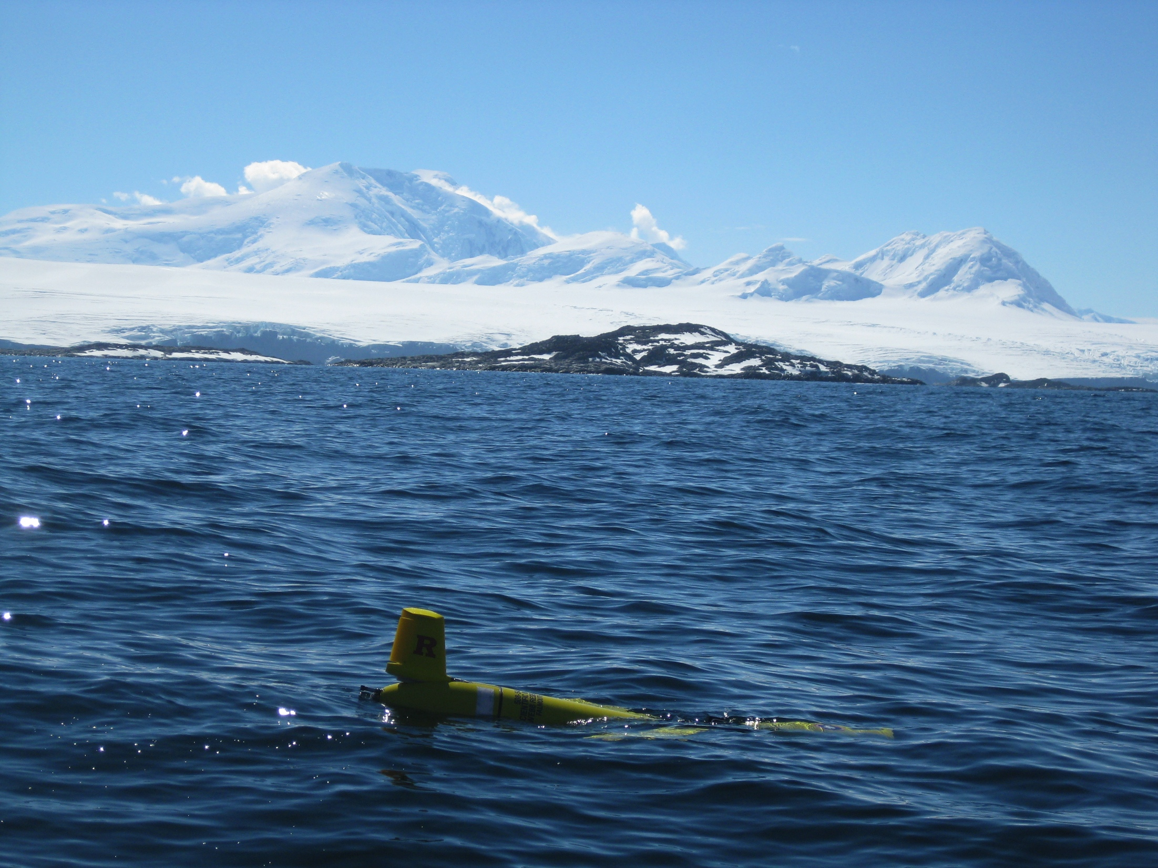
Planned work
Over 20 years of hydrographic data collected twice/week at two locations off of Palmer w/ co-incident biological data.
Over 20 years of local MET data.
Over 50 years of 2.5º gridded atmospheric data from the National Center for Environmental Prediction (NCEP).
32 Glider deployments in the last 3 years, with over 100 days of data collected in the past season.
  All equipped with CTDs
  All calculating depth-averaged currents
  2 deployments with ADCPs
Notes:
I will be using many of the same technologies we’ve applied to the MAB in addition to longer data records collected as part of the Palmer Long-term Ecosystem Research project

Slide 37

Planned Work
Potentially linked to large scale atmospheric patterns such as Southern Annular Mode, Semiannual Oscillation and El Nino Southern Oscillation. Much more analysis needed!.
Notes:
Further analysis of long-term datasets
Performed wavelet analysis on 50 years of Monthly mean pressure data.
Time-series at the top 980 -1000
Wavelet analysis shows a strong signal at 8 months, 12 months and approximately 32 months Band pass the time series in 24-36 month range and you see some signals with large variability increasing in the 1990s and dropping off post 2004.

Slide 38


[Martinson et al., 2008]
Jan
Dec
Feb
Notes:
Identify water masses. Upper left is a T-S plot of all Palmer station zodiac CTD casts from 1990-2007.
Temp, salinity, and depth in color. Highly variable surface, with consistent deep water.
Comparing this data to historic profiles from multiple cruises on the shelf, show WW near 34 salinity and -1.5 C
Potentially modified UCDW water at 34.5 and +1C then a range of surface temperatures at lower salinities.
From glider deployments lat year you can see the development of the water-column in T-S space. Three gliders last season, 1 each month. Cold surface in December, broad January surface temps and then really warm February surface temps.

Slide 39

Notes:
Other analysis will include specific glider deployments such as this one during a January storm with an equipped ADCP during a storm. Winds over 15 m/s on the 17th show increase East velocities with likely tidal fluctuations.
Complete reversal in North-south velocities , which persist following the storm event throughout the water-column.
Analysis like-these and those similar to chapter one and two will provide insights into the local physics and implications of global scale changes on the Palmer region

Slide 40
Summary
Through a combination of developing ocean observation technologies I propose to identify the impact of storms on a number of processes on the Middle Atlantic Bight and Western Antarctic Peninsula.
These observations will provide a much needed analysis of small scale local processes which are difficult, dangerous or too costly to study using traditional techniques.

Slide 41

Thank you!
Committee members
  Josh Kohut
  Doug Martinson
  Sharon Stammerjohn
Advisors
  Scott Glenn
  Oscar Schofield
Coastal Ocean Observation Lab
National Science Foundation
Teledyne-Webb
Nortek USA
Ocean Observing Initiative (OOI)
United States Antarctic Program
Palmer Station
Crew of the Laurence M. Gould

Slide 42

Questions?

