Slide 1
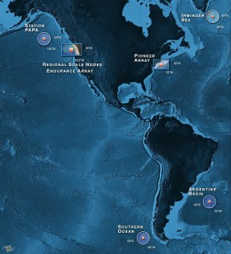
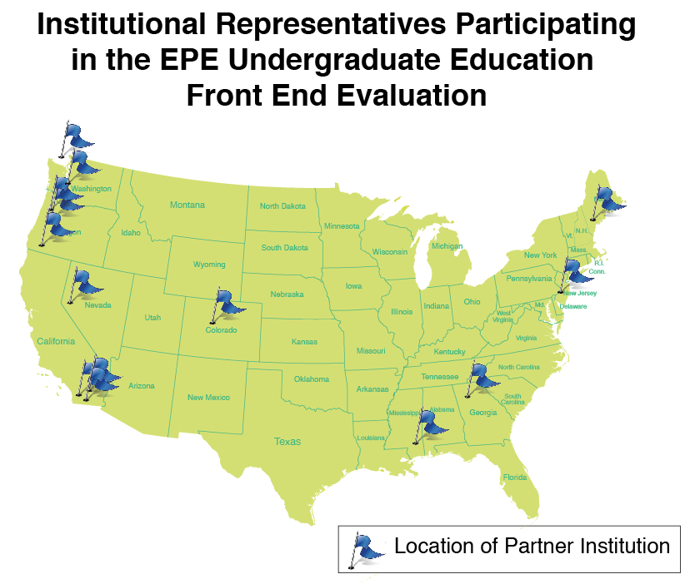
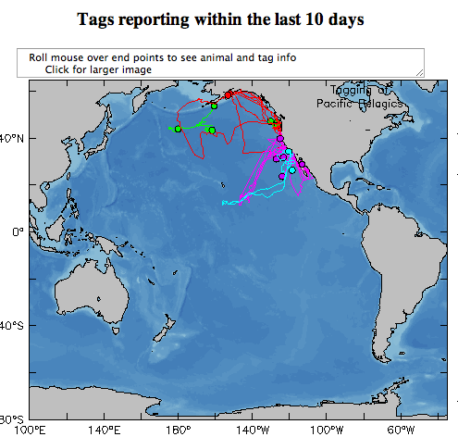
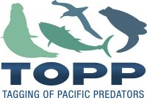
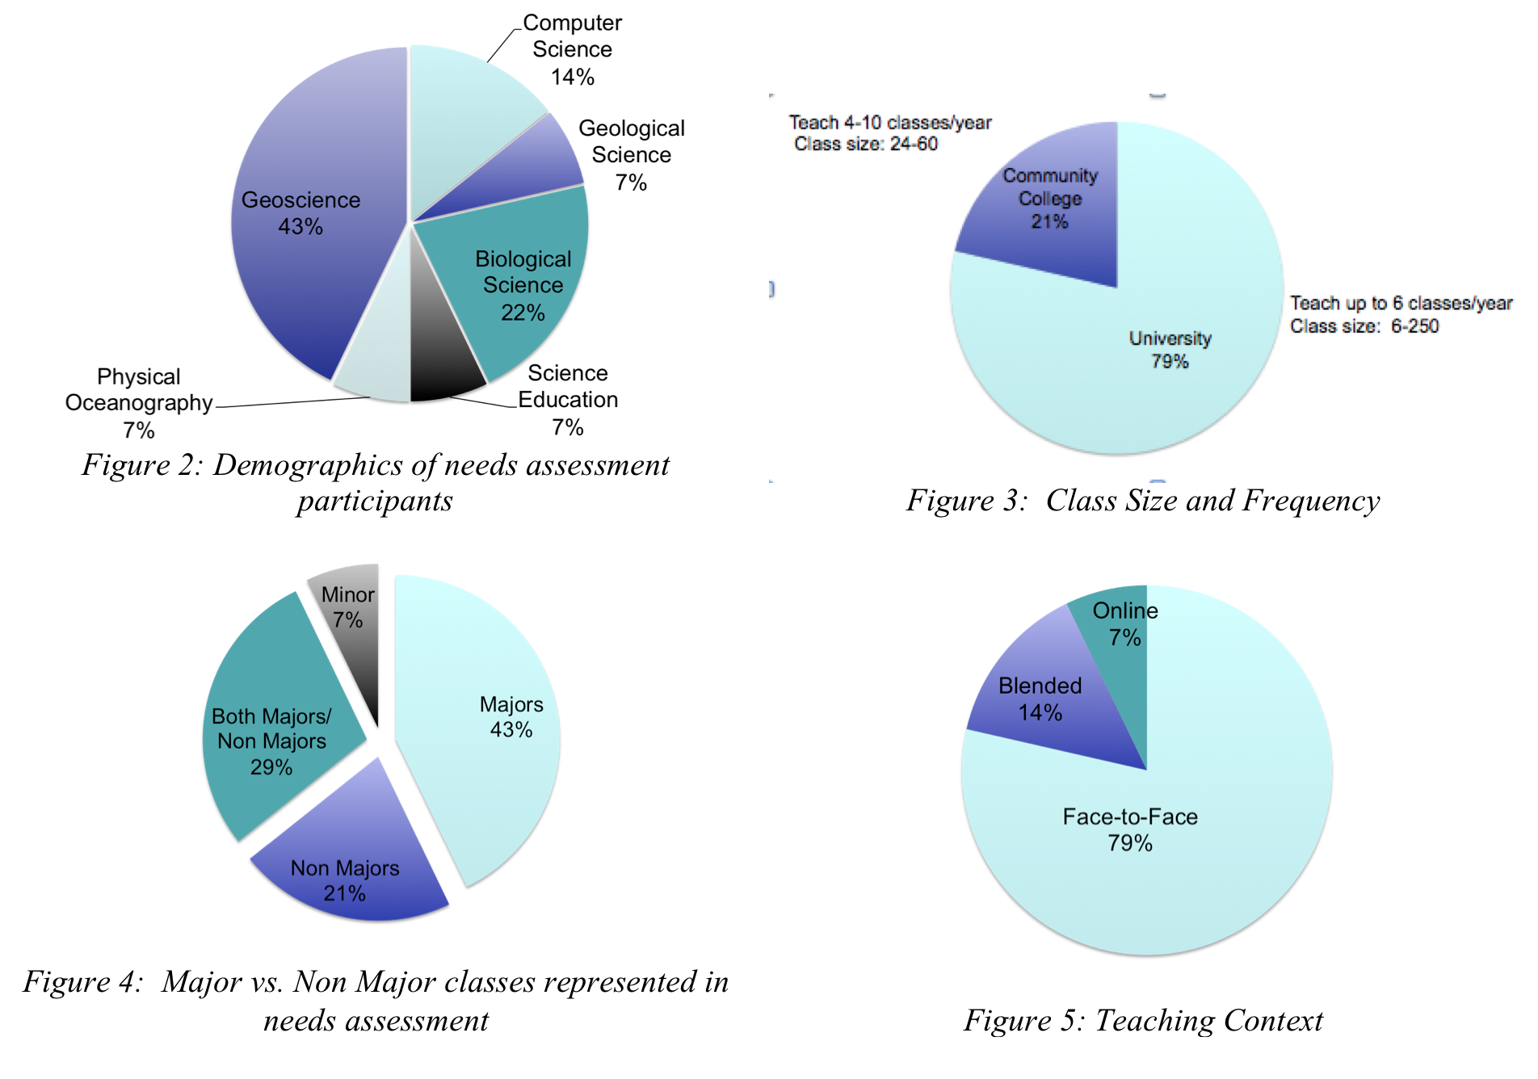
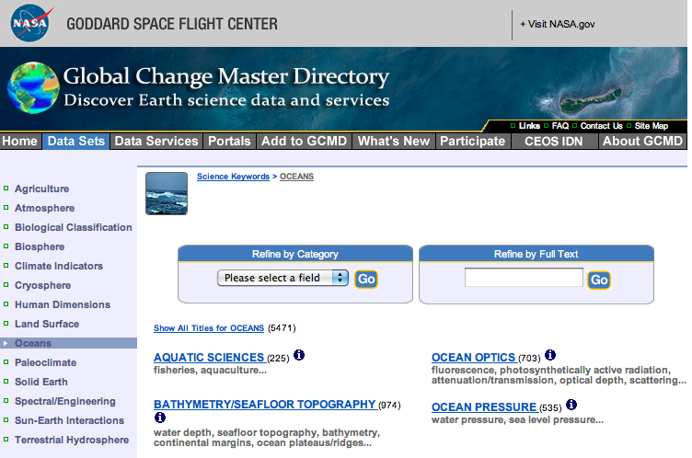
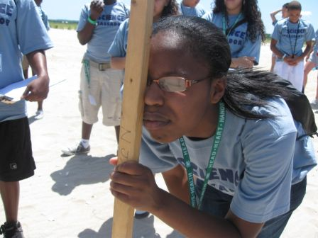
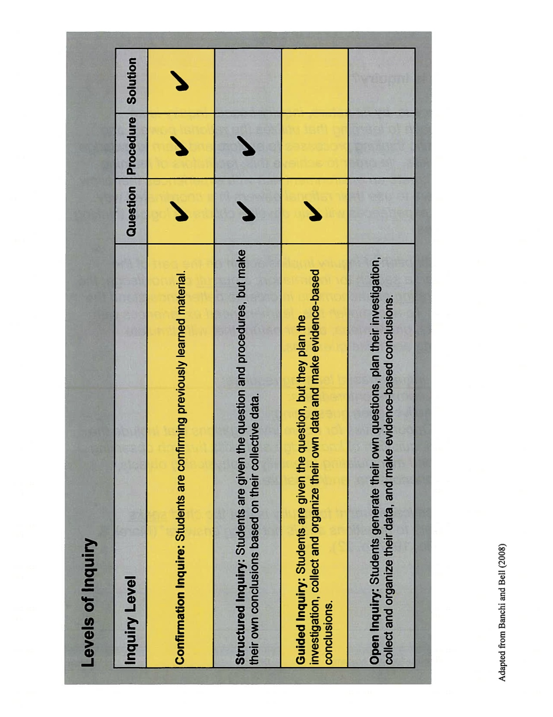
An Assessment of Real-Time Data Use in Undergraduate Classrooms
McDonnell¹, J.D., C.S. Lichtenwalner¹, A. deCharon²,
C. Companion², A. Fundis³, A. McCurdy⁴, C. Risien⁵, D. Kilb⁶, S. Glenn¹
Abstract ID:11695
¹Rutgers University, ²University of Maine, ³University of Washington, ⁴Consortium for Ocean Leadership, ⁵Oregon State University, ⁶University of California – San Diego
Introduction
bring real and near-real time data, images, and video of our oceans into both formal and informal learning environments.
The EPE IO conducted a needs assessment of undergraduate professors teaching oceanography with data. A three-part interview protocol was developed to:
Understand current teaching practices using data;
Summarize how data is used in classrooms; and
Synthesize recommendations on how to design tools to improve students’ ability to interpret and analyze data.
Data Collection and Analysis
Fourteen professors from community colleges and universities, teaching both science and non-science majors were interviewed for the study. Interview sessions were conducted online using WebEx collaborative software. This allowed us to screen share examples of education tools and to voice record the sessions for later analysis. Interview responses were synthesized and categorized to determine general trends and recommendations.
Current Data Use in the Classroom
Lecture
content being discussed. This type of application was used universally in classes for non-majors and majors, predominately in face-to-face teaching contexts.
Writing Prompts and Homework
primarily from distillations of peer review publications and other credible sources. Most professors were not using streaming data in these types of applications.
Laboratory and Field Work
Conclusions
The EPE IO will use this information to develop requirements for the six proposed data tools. We will continue to welcome professors to provide comments on the tools as they are iteratively developed over the coming years.
Acknowledgements: Special thanks to: Leslie Sautter, Chris Parsons, Michael Crowley, Joe Wieclawek, Steve Levenson, Oscar Schofield, Carrie Ferraro, Jim Yoder, Kristin Hunter-Thomson, and our 14 participants.
The National Science Foundation’s Ocean Observatories Initiative (OOI) is constructing observational and computer infrastructure that will provide sustained ocean measurements to study climate variability, ocean circulation, ecosystem dynamics, air-sea exchange, seafloor processes, and plate-scale geodynamics for the coming decades. The Education and Public Engagement Implementing Organization (EPE IO) for OOI is developing tools for educators to
Audience Description
The professors create static plots to include in their lecture presentations. These example plots are offered to help students see the application of the concept or content they are teaching and to check for understanding of the
Participants represented:
Geographically diverse regions
Different teaching contexts (non-major courses to upper level research)
A range of science disciplines: oceanography (physical, geological, chemical, biological), earth science, computer science, etc.
Varied knowledge of the OOI program
Geographic distribution of needs assessment participants.
Professors described using data in homework assignments, writing prompts, and activities during lecture. This type of application occurred in both non-major and major classes in predominantly face-to-face teaching contexts. The sources of the data for
these kinds of applications were
Teach 4-10 classes/year
Class size: 24-60
Teach up to 6 classes/year
Class size: 6-250
Demographics of need assessment participants
Class Size and Frequency
Evaluation Questions
Identify participants' work-specific goals:
What subjects do they teach?
What approaches or styles do they use?
Identify the tools, tasks, and task flows they use - specifically in crafting and presenting lectures, labs, or homework.
Identify data practices that are failing – how and why?
Identify data practices that are succeeding – how and why?
Identify needs and wishes.
Characterize the potential usage of OOI datasets:
What science themes do they connect to?
Where in the curricula can they be incorporated?
How are datasets like these presently used? How might they be used in the future?
Solicit feedback on the rough concepts of the 6 proposed tools.
Professors reported using data to contextualize student learning through real world data collection and data comparison examples. Students collect data (e.g. beach profile, pressure), and then plot, analyze and interpret the data using software applications such as Matlab. Professors noted that they are using near real-time data streams to put student collected data into context (e.g. in the
field/on the ship during field work).
Major vs. Non-Major classes represented in needs assessment
Teaching Context
Teaching Style & Inquiry
Professors commented on their teaching style and the level of inquiry they teach with in their classrooms. 86% of the professors were very aware of their teaching style and their use of data to fulfill teaching goals and objectives in the classroom.
(Banchi and Bell 2008)
Eleven professors reported teaching in a mixed style including confirmation, structured and guided inquiry depending on the teaching context (lecture, laboratory, or discussion).
Funding for the OOI is provided by the National Science Foundation through a Cooperative Agreement with the Consortium for Ocean Leadership. Any opinions, findings, and conclusions or recommendations expressed in this material are those of the authors and do not necessarily reflect the views of the National Science Foundation.

