Slide 1
Hawaii to Guam
Notes:
For this project I was not given a specific time, type of glider used or purpose of mission…

Slide 2
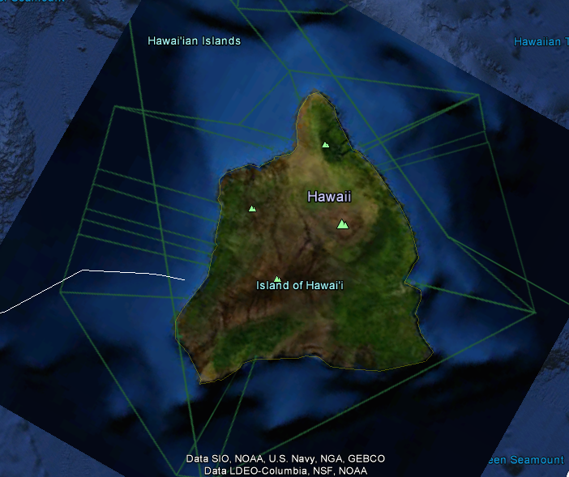
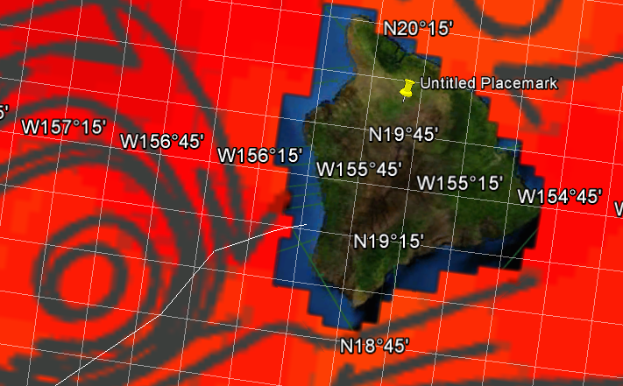
Deployment
Notes:
*Off of west coast of Big Island
Take ship out of Kuhulu Rock and deploy glider approximately 12 miles off of coast
This region has the largetst gap between shiping lanes
It is ideal as it leads straigh into a warm core eddie that will take glider into the North Equatorial current.

Slide 3
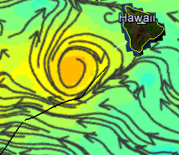
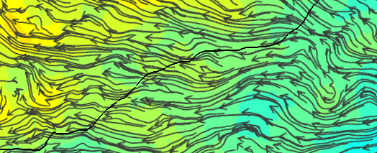
Track
Notes:
Glider exits the Eddie and enters the Westward flowing current

Slide 4
Track continued
Total length: 6,283 km
Notes:
Using this track, the glider will enter an Eddie right off the coat of Hawaii’s Big Island
Then exit the Eddie Straight into the North Equatorial current
Ride the current all the way till approximately 100 miles off the coast of Guam

Slide 5
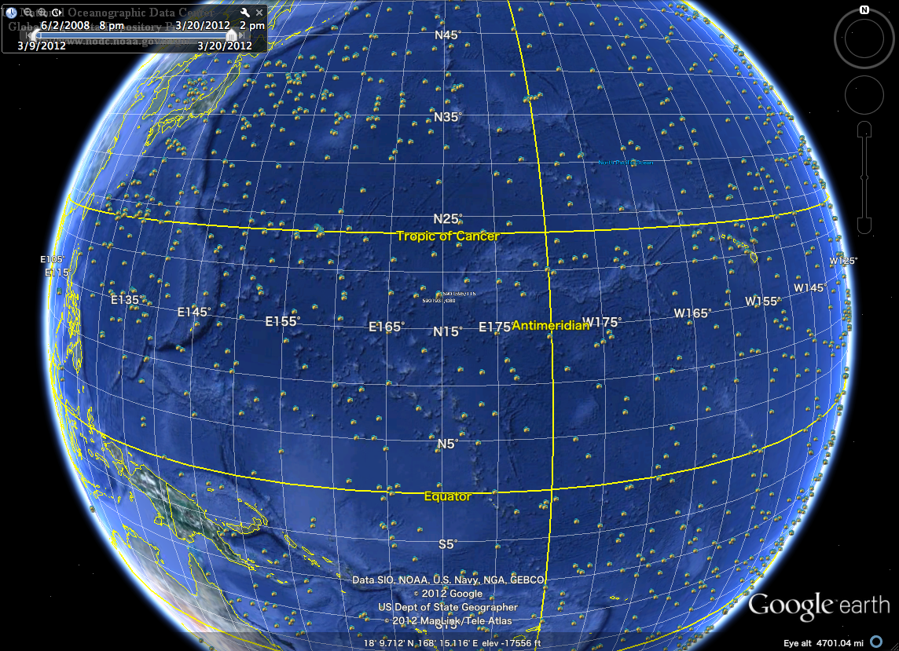

Slide 6
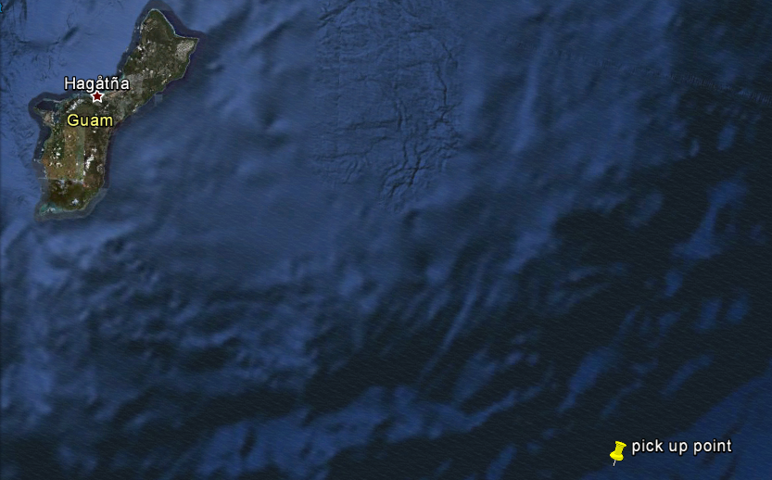
Pick up
Reasons for location:
*insufficient data about shipping traffic
*lack of data about fishing zones
*avoid shallower water
Notes:
Pick up glider approximately 90 miles off of East coast of Guam.
This way to avoid the heavy traffic in the shallower waters.
This way the glider is picked up before going over the shelf into shallower waters.

Slide 7
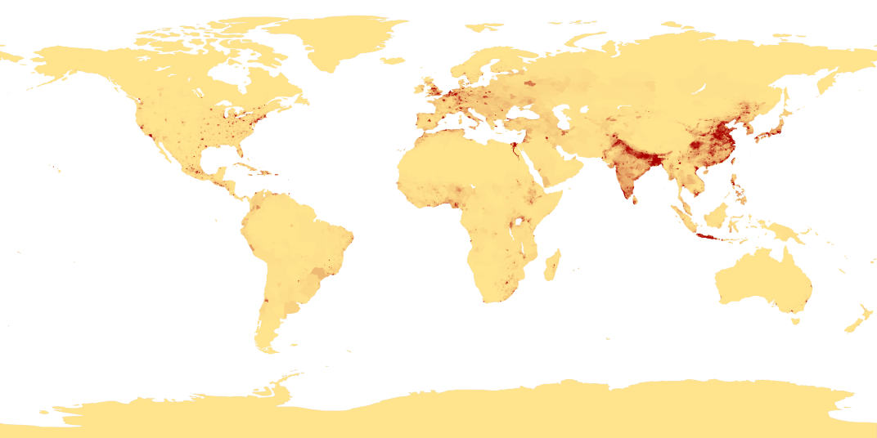
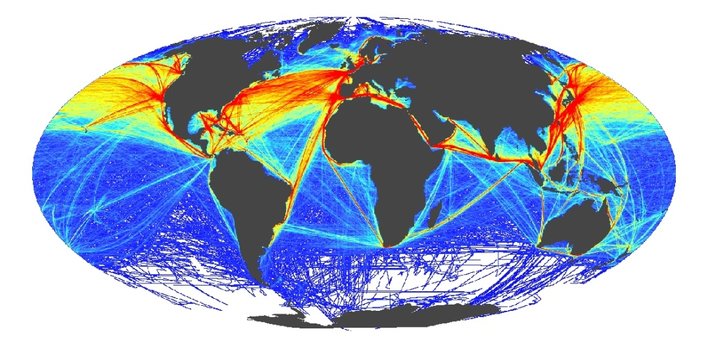
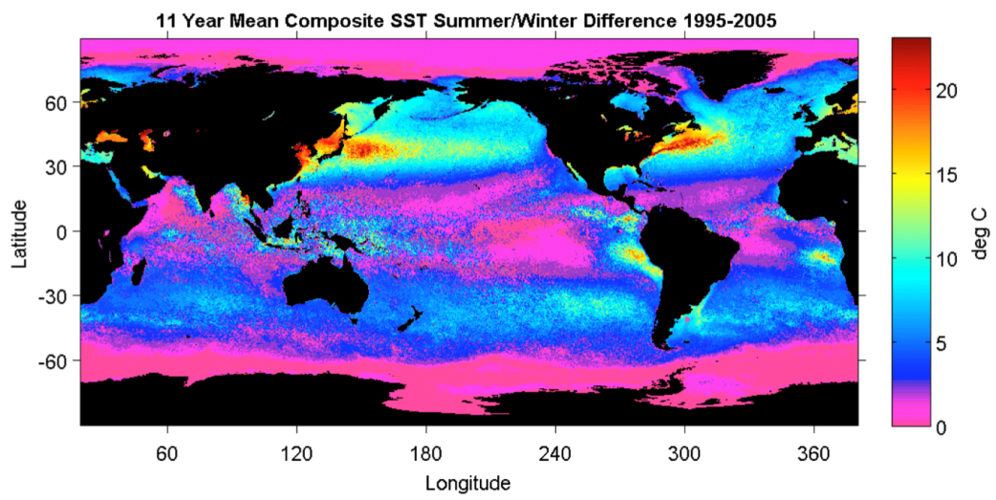
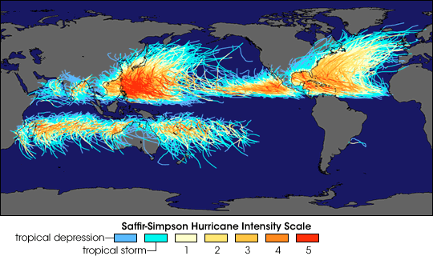
Global Drivers
Coastal Population Centers
International Commerce
Ocean Seasonality
Tropical Cyclones

Slide 8
Additional Considerations
Need shipping lanes off of coast of Guam
Need to know positions of commercial fishing spots
Specify what time of year the glider will be deployed
Specify what types of missions the glider will be running

Slide 9
Questions?
Notes:
This project was really vague…open to any suggestions

