Slide 1
RU07 NJDEP MISSION
Mission Report

Slide 2
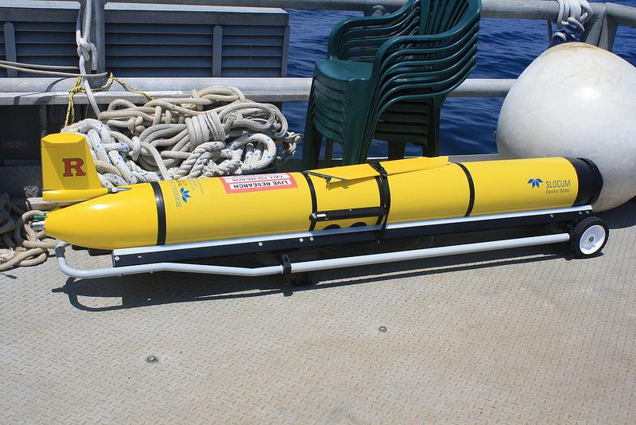
RU07

Slide 3
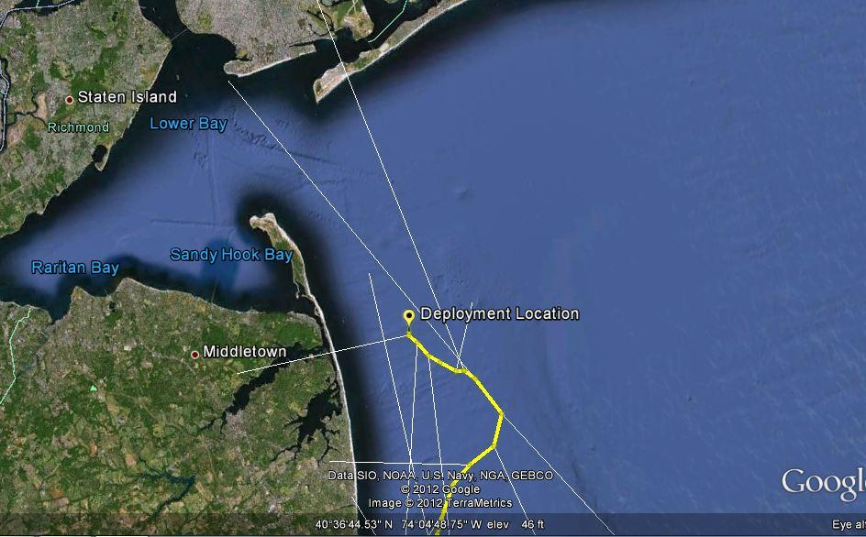

Slide 4
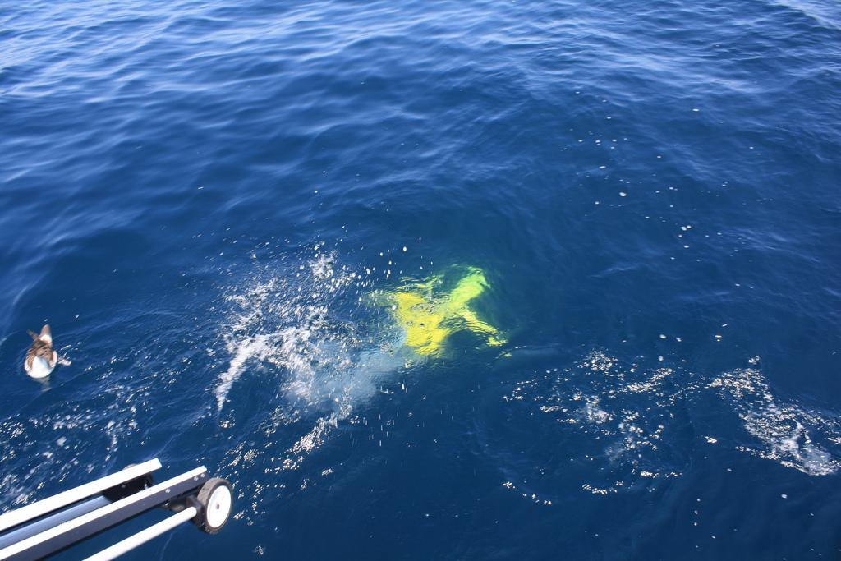
Deployment Pictures

Slide 5
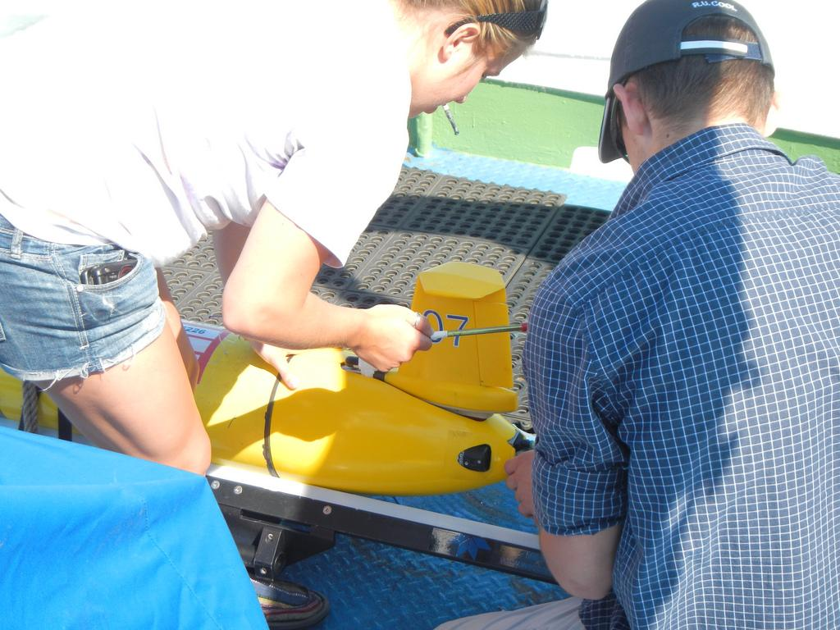
Deployment Pictures Con't

Slide 6
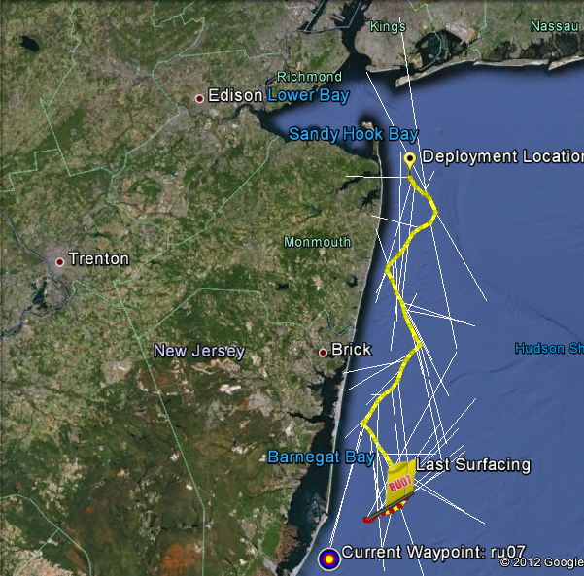
RU07 Track 6/13/12

Slide 7
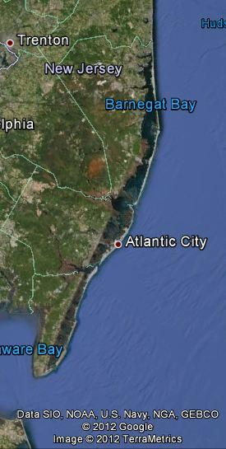
Measuring Anoxic conditions

Slide 8
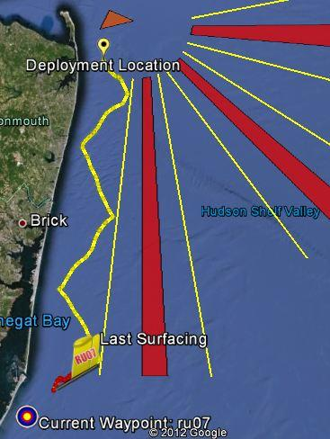
Avoiding shipping lanes

Slide 9
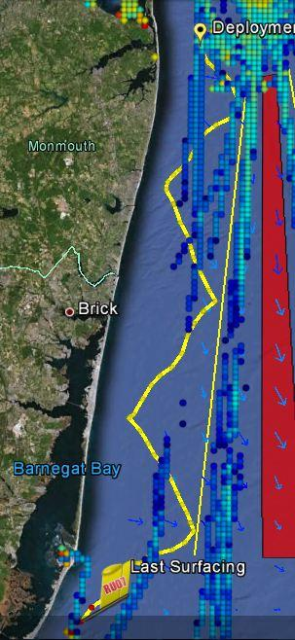
Alternate view of shipping

Slide 10
Problems so far
Altimeter and pressure sensors discrepancy
Battery draining
Current interference

Slide 11
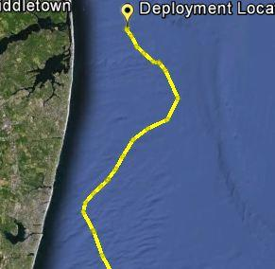
Altimeter and pressure gauge discrepancy

Slide 12
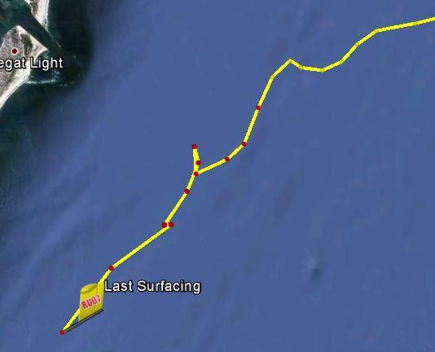
Battery Draining

Slide 13
Energy Saving
Range of the top of the YO
  Lowered the height of the top of the YO to five meters under the surface
    Gps
    Argos
    Iridium
Sensor Selectivity
  Science pucks
    Turned off the chlorophyll and color dissolved organic material sensors

Slide 14
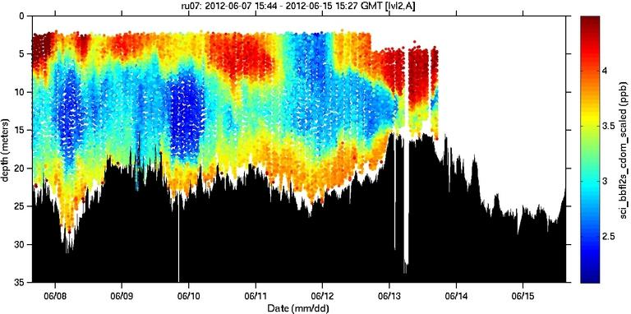
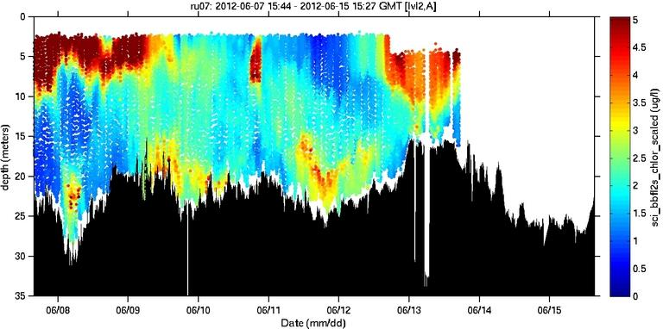
Examples
CDOM
chlorophyll

Slide 15
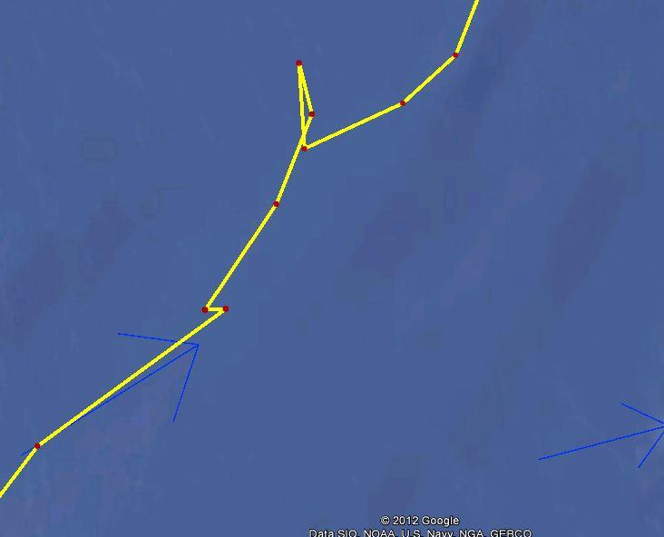
Current interference

Slide 16
Collected Data
Dissolved Oxygen
Density
Salinity
Temperature

Slide 17
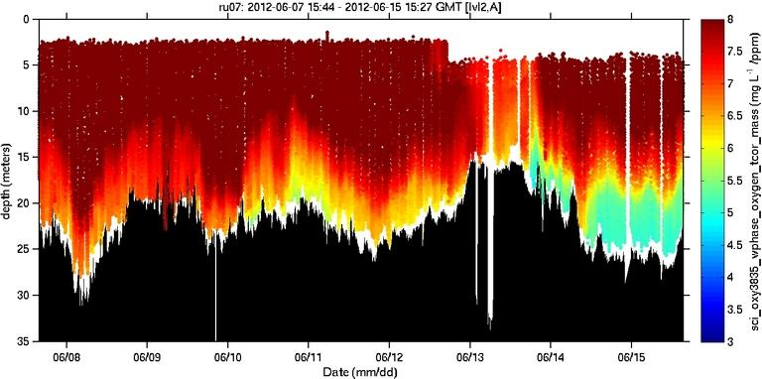
Dissolved Oxygen

Slide 18
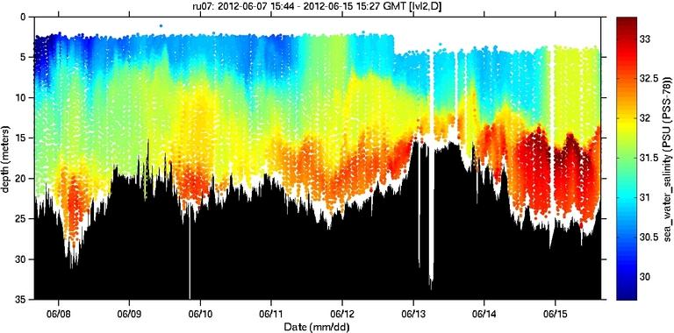
Salinity

Slide 19
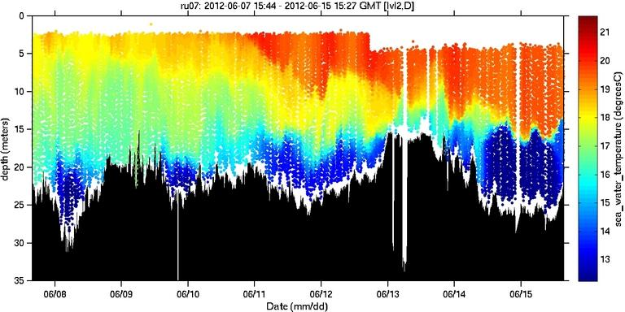
Temperature

Slide 20
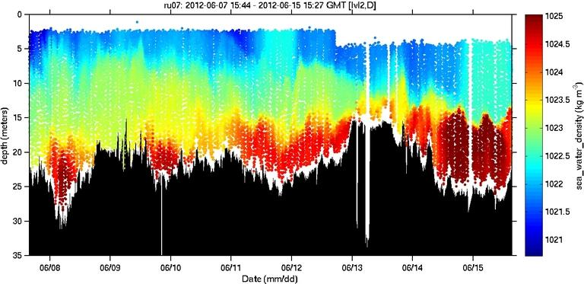
Density

Slide 21
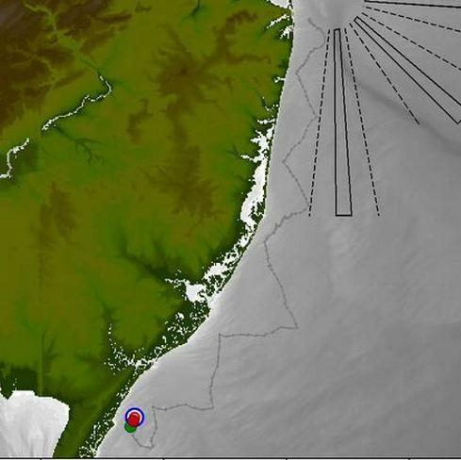
Final Track

Slide 22
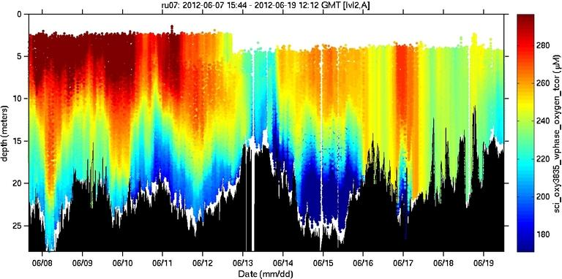
Final Dissolved Oxygen

Slide 23
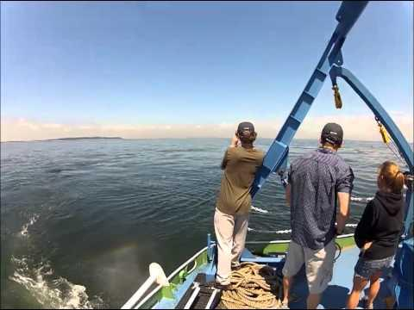
Deployment Video

Slide 24
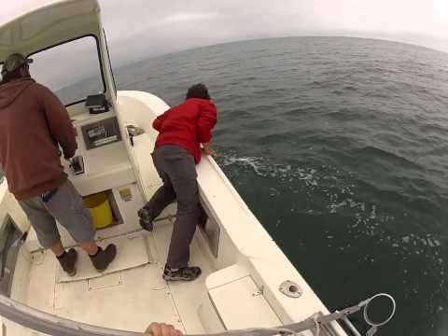
Recovery Video

