Slide 1
RU-29 E-Line Mission
By Brittany Henley

Slide 2
Introduction
Deployment location: Off of Tuckerton, South Jersey
Date: Tuesday, 19JUNE2012
~50 km off the coast
Shelf: ~90 km off deployment location
Future Mission: Capetown, South Africa, to the Ascension Island to Brazil.

Slide 3
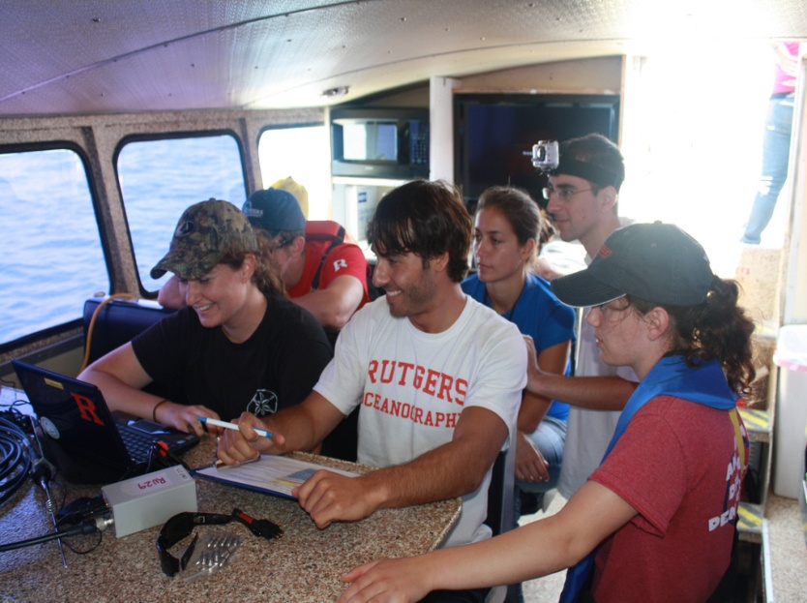
Weather on Deployment Day
Partly sunny
High of 77
South wind between 6 and 10 mph
Calm Seas

Slide 4
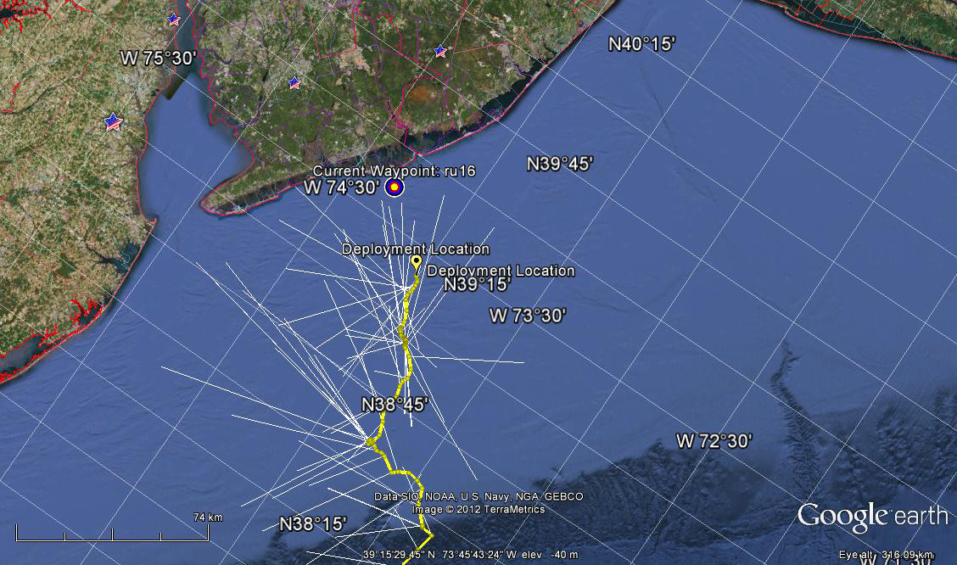
E-line
E-LINE of RU-27
Follow initial track of RU-27

Slide 5
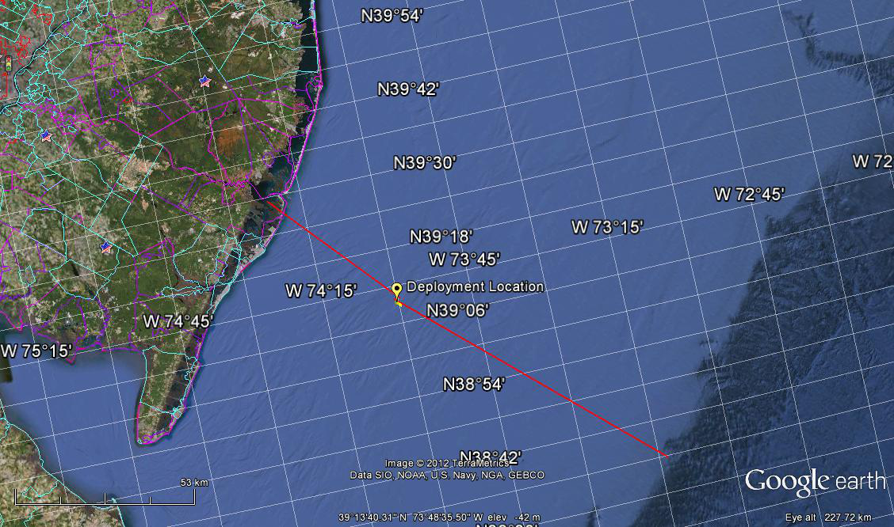
E-Line Example
E-Line Example
50 km
GPS: 3909.35N / -7400.43W
Tuckerton
GPS: 38°35'5 5.46"N/
73°13'26.84"W
90 km
Notes:
I followed the track of RU-27. I attempted to make the legs as straight as possible to minimize distance travelled and thus time.

Slide 6
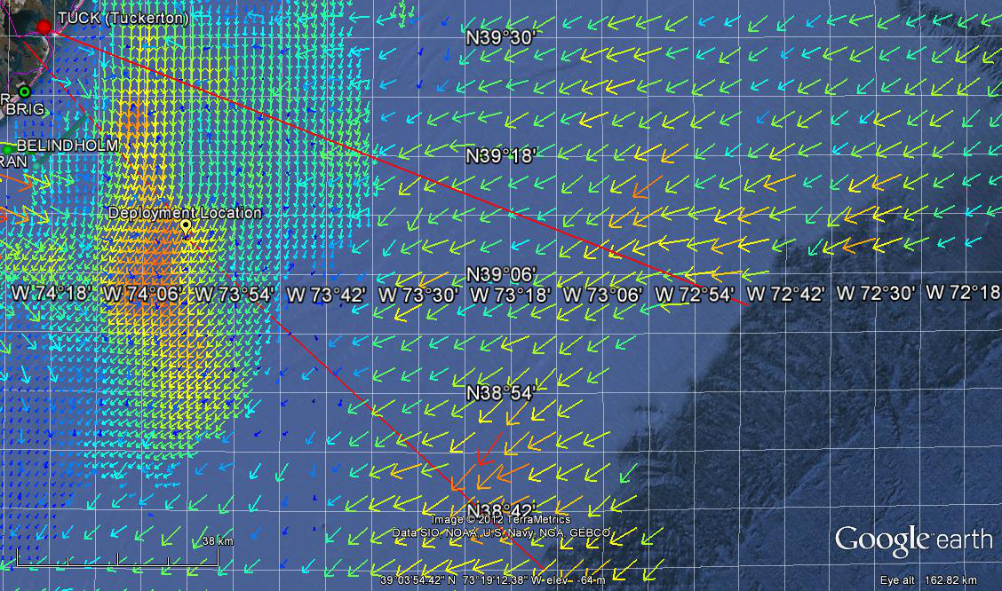
E-Line After Considering Currents
Conversion: 1 centimeter / second = 0.0194384449 knots
Notes:
The arrows represent currents. The strength of the currents are represented by color and length. For color, blues and greens are the weakest while reds and yellows are the strongest. The currents are in centimeters per second. For my original track, the glider would have travelled through red and yellow arrows which represent strong currents. Therefore, I moved my track up, so the glider would travel through weaker currents.

Slide 7
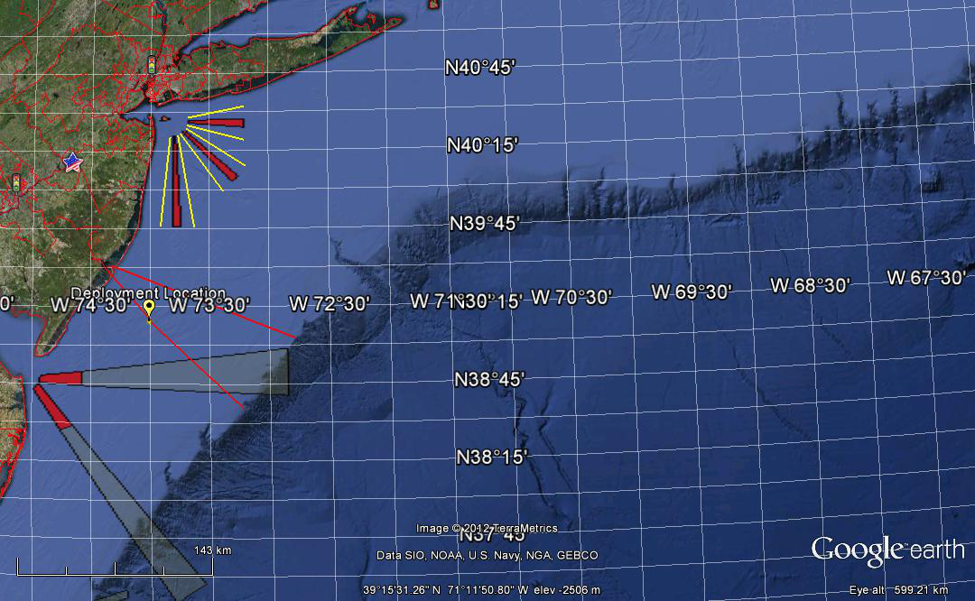
Shipping Lanes
Notes:
By moving my track upward, the glider will not only go through weaker currents but will also miss the shipping lanes as shown above. The red represents the actual shipping lanes while the black lines with gray shading are the ships’ projected paths.

Slide 8
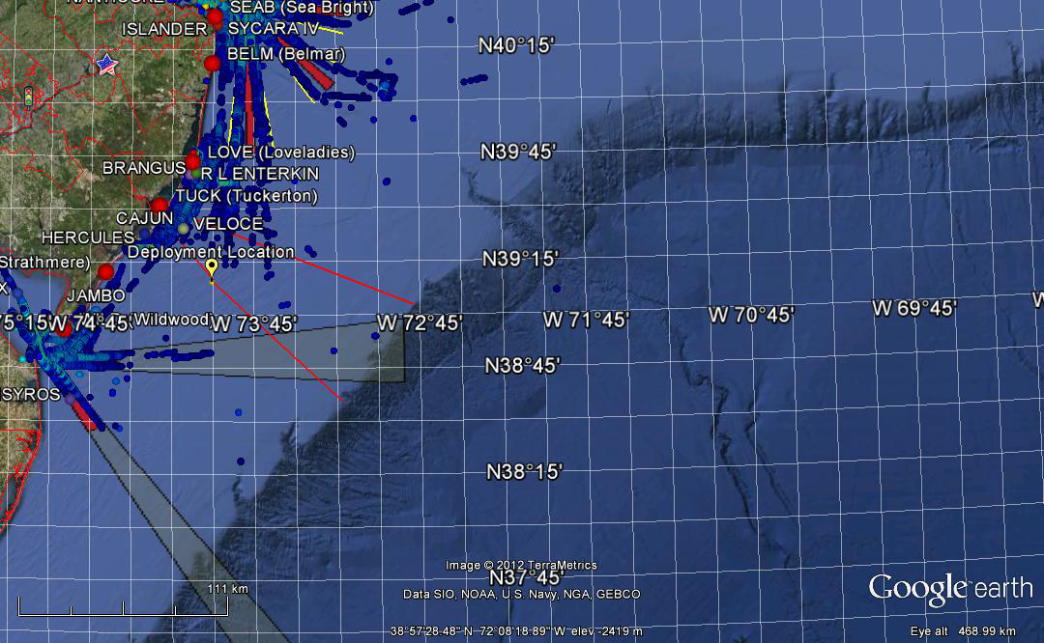
Shipping Lanes with Ship Density
Notes:
The blue dots represent the number of ships in the area. Therefore, dark areas represent spots of high ship density.

Slide 9
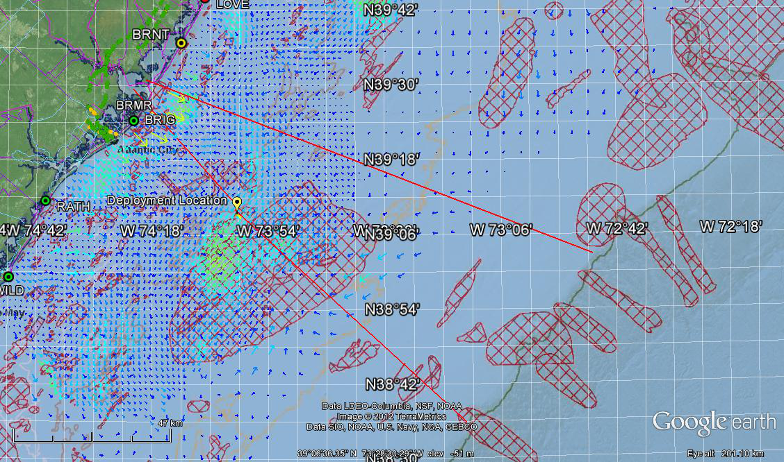
Fishing Locations
Notes:
The red shapes with grid lines represent prime fishing areas. These are near canyons. These should be avoided, so the glider does not get caught in nets or hit by boats. For the original track, the glider would have gone straight through one of these areas. The second path avoids strong currents and these fishing areas.

Slide 10
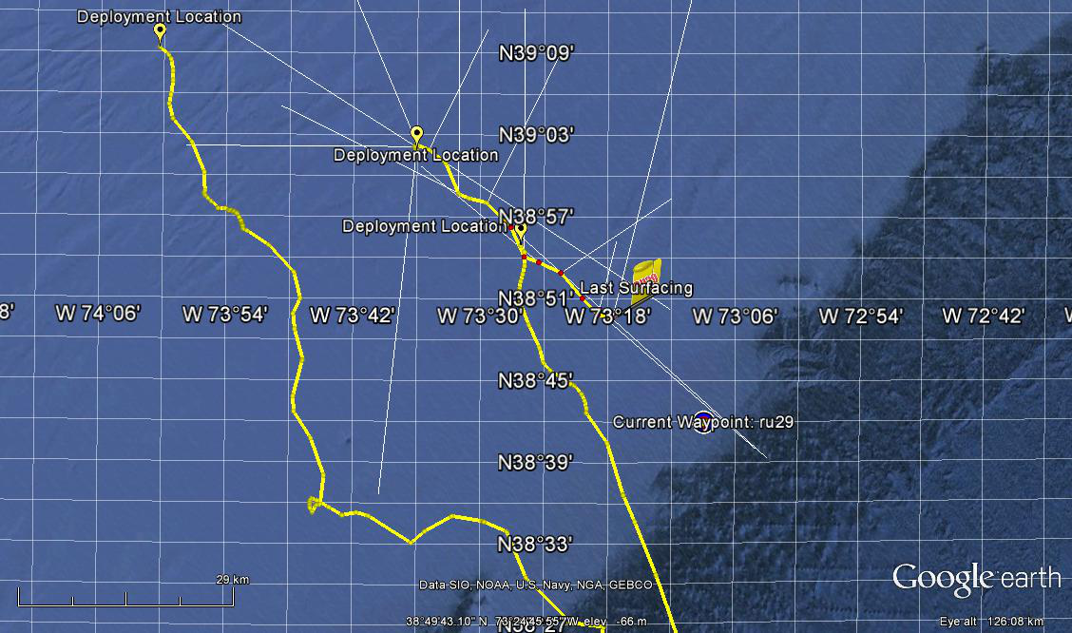
E-Line Comparisons
RU-29
RU-27
RU-17
Notes:
This shows the endurance line tracks of RU-17, RU-27, and RU-29. My hypothetical track followed the track of RU-27. However, the beginning of the track of RU-29 more resembled the initial track of RU-17. Now, however, the current waypoint of RU-29 is 14.5 km to the right of the track of RU-17.

Slide 11
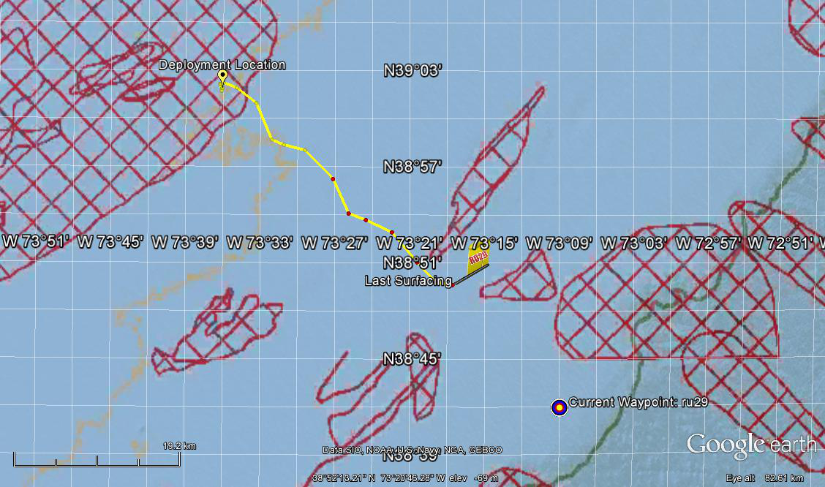
RU-29 Track and Fishing Areas
Notes:
This is the current track of RU-29, and the prime fishing areas. Presently, RU-29 should miss all fishing areas.

Slide 12
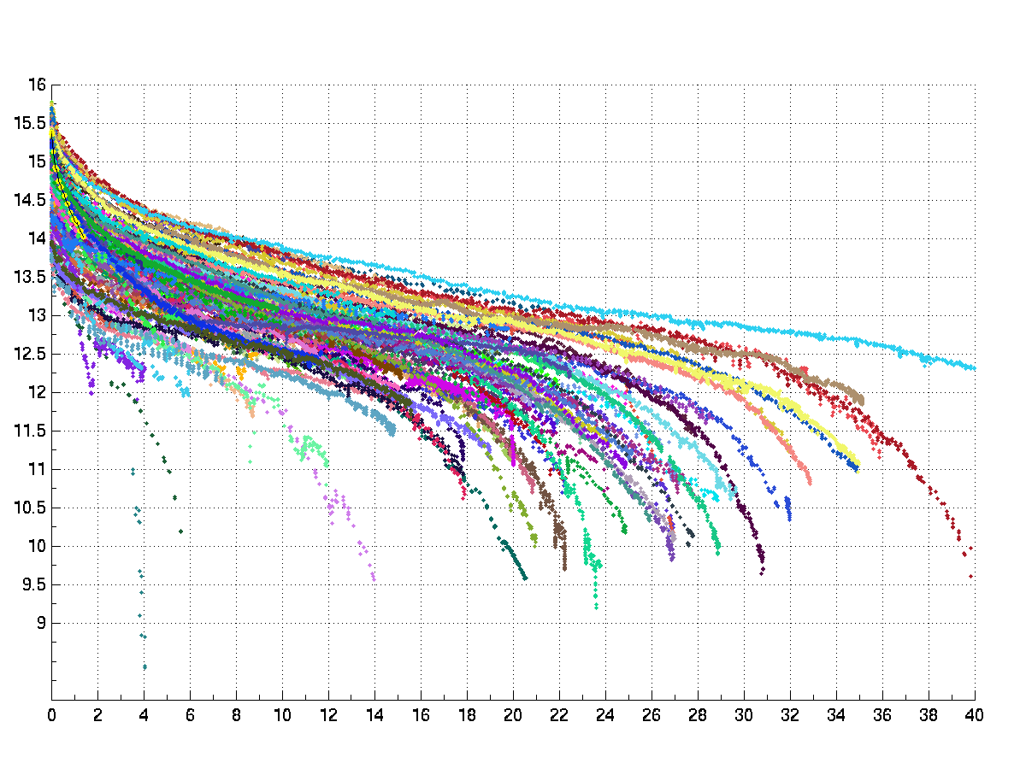
Battery Voltage
Notes:
This graph gives an estimate of the decay of the glider’s battery over time. So far the battery looks good. After two days, the battery will be at a little less than 14 volts. Hopefully the battery’s path, depicted in yellow, will become less steep. If so, it will probably follow a path between the dark blue and green slopes. On this path, the battery will be at 12 volts in around 20 days. If needed, sensors such as the GPS can be turned off in order to preserve battery life.

Slide 13
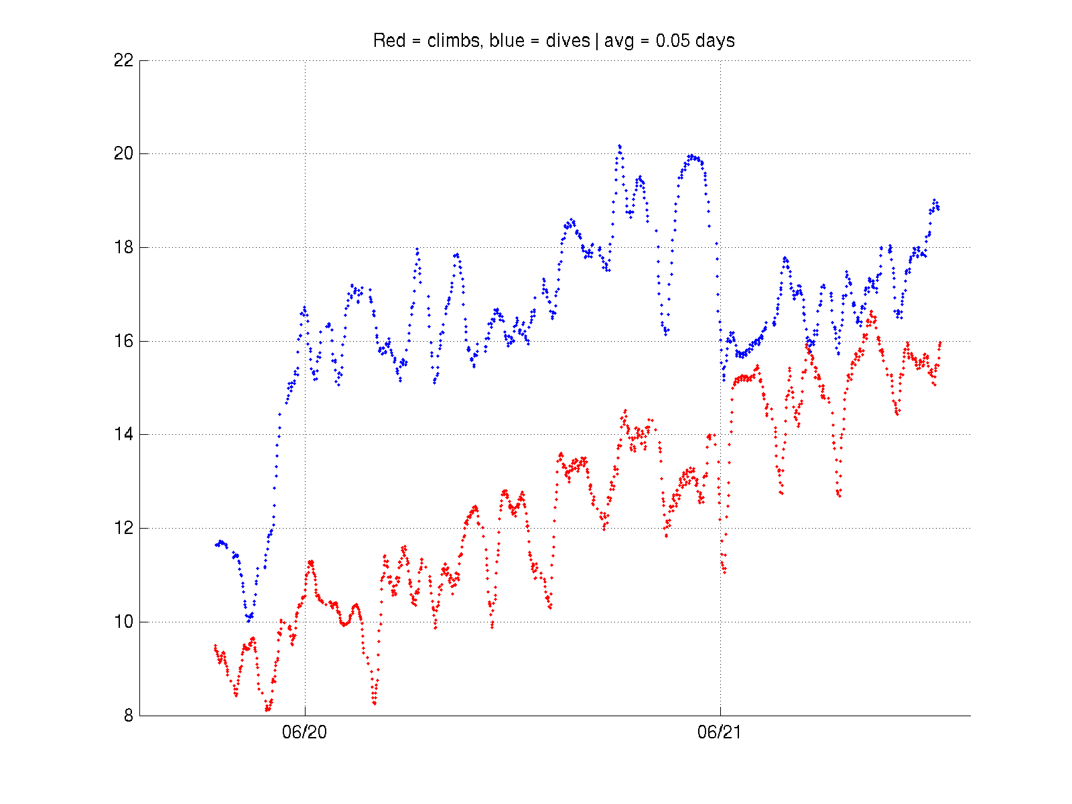
Vertical Velocity
Notes:
The blue dots represent the glider dives while red represents the climbs. For 20JUN12, the glider was diving more quickly than climbing. This could be due to the glider being nose heavy. On 21JUN12, the vertical velocities for diving and climbing were about the same at 15 volts. The lab team changed the position of the pitch battery and volume pumped to do so.

Slide 14
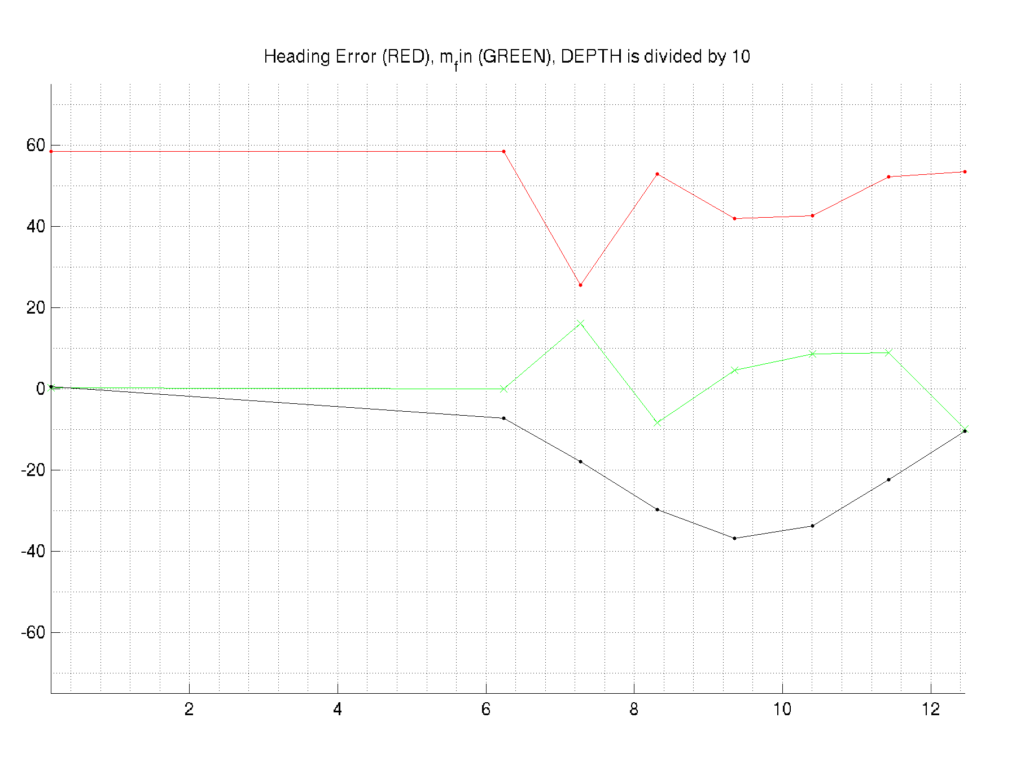
Heading Error on 20JUN12 at 0241

Slide 15
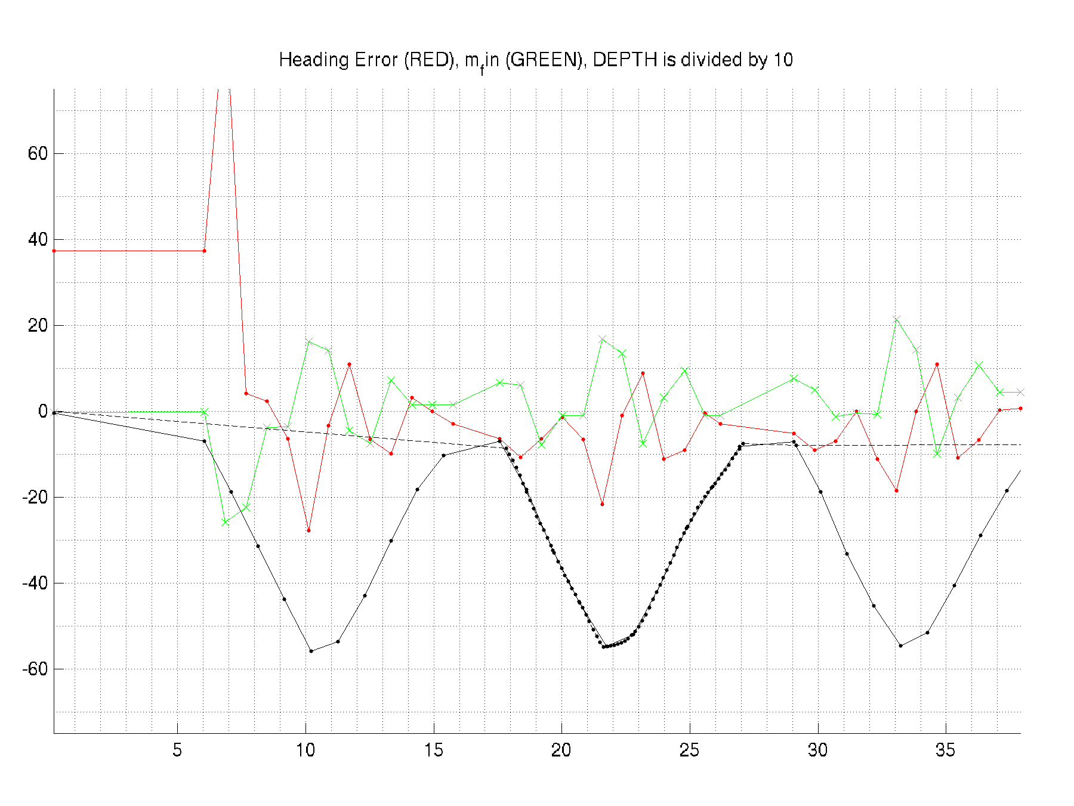
Heading Error on 21JUN12 at 0041
Notes:
Over only one day, the heading error has improved substantially. Ideally, the heading error should be around 0 degrees. On 20JUN12, the heading error on average was about 40 degrees. On 21JUN12, the heading error on average was less than 10 degrees. The green lines represent the movement of the fins. The black lines represent the depth the glider is at. When the glider travels closer to the surface, the fin has difficulty controlling the movement of the glider because the glider is travelling at a slower speed. Therefore, the heading error increases.

Slide 16
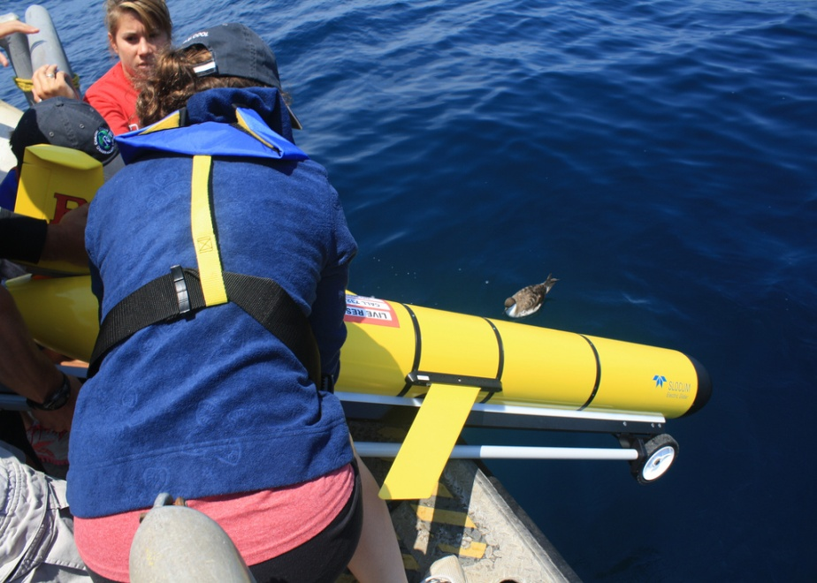
Current Issues/Observations
Glider is nose heavy
Sinks slowly
Is travelling at 1 km/hr which is fast.
Distance from current location to next waypoint: ~18.85 km.
Distance from current location to shelf: ~25 km.
Notes:
Because the glider is nose heavy, more battery power is needed to climb. From observations when deploying the glider, it has trouble diving quickly also. This is common for deep sea gliders, but it may also be a little light. To solve these issues, the pitch battery can be moved forward to help the glider dive or backward to help it climb. The pump may also suck in or release water to help it do so.

Slide 17
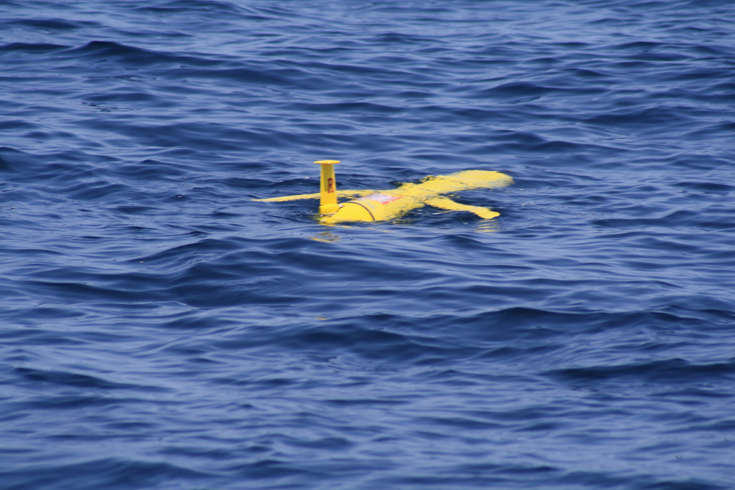
QUESTIONS?

