Slide 1
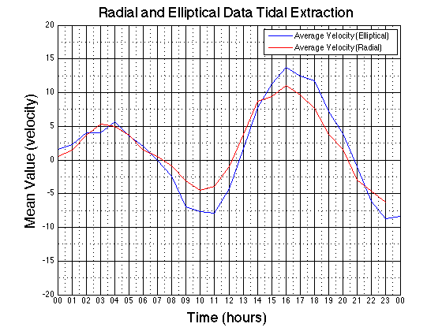
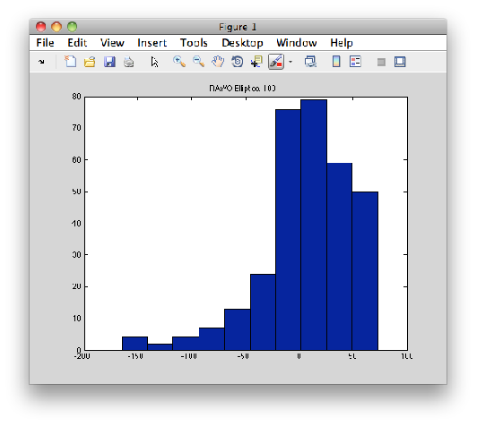
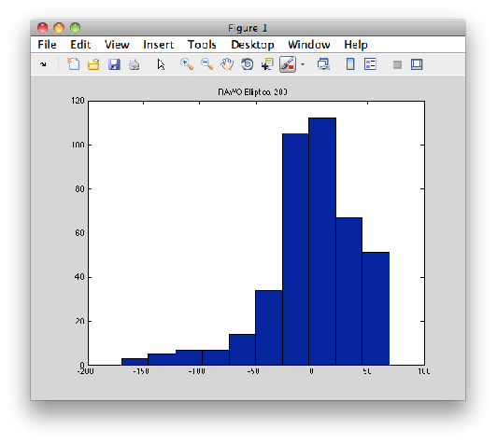
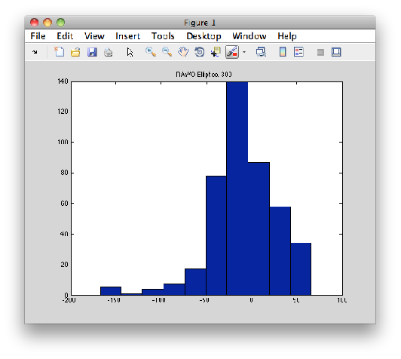
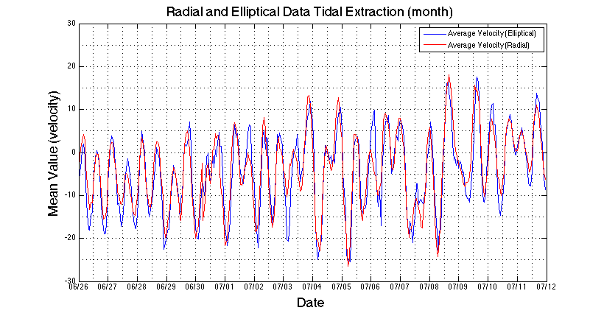
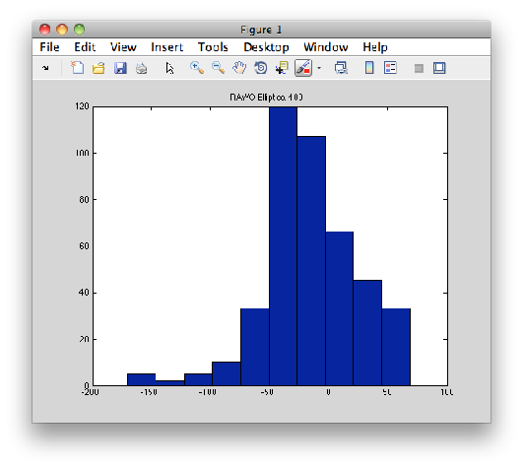
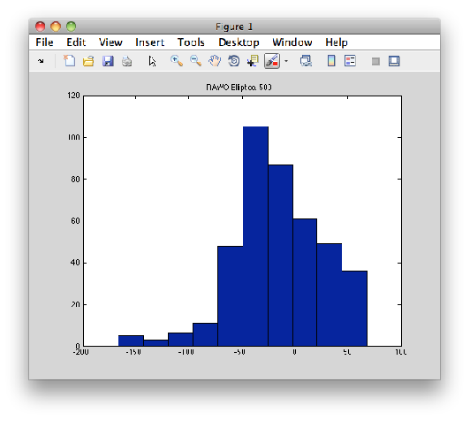
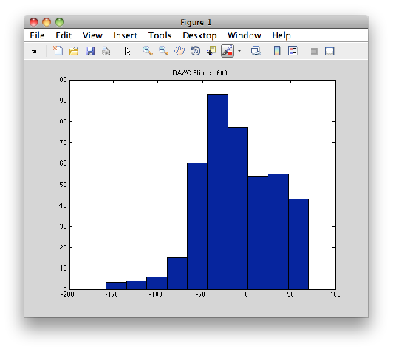
Bistatic Systems: Preparing for Multistatic
Robert K. Forney, Hugh Roarty, Scott Glenn
roberttheforney@yahoo.com
Coastal Ocean Observation Laboratory
Institute of Marine & Coastal Sciences
Rutgers University
ABSTRACT
INITIAL EVALUATION
TIDAL EXTRACTION
The improvement of HF radar is integral to the advancement of knowledge of the ocean. It is one of the primary sources of ocean data, and is an excellent tool for measuring the bearings and velocities of waves, currents, and near-surface winds. It is used in a variety of applications, from marine research to vessel tracking to search and rescue operations. All applications of coastal radar benefit from its improvement, and there is room for improvement. HF radar systems use the monostatic setup, which produces radial data that estimates the bearing and velocity of waters in its radius relative to a single point. There is also a bistatic setup that produces elliptical data, which allows many more look angles at any given point and a different estimate of velocity. This setup is not as common, and is very valuable in the quest for more accurate coastal radar maps. I present my findings on the reliability and peculiarities of bistatic systems, and my hopes of combining monostatic and bistatic systems to produce a high-quality multistatic system for high-accuracy, high-resolution radar maps.
Once the data was confirmed to be good, it was compared to radial data for the same time period. The velocities were averaged and plotted against time to produce a plot of velocity components that persist across the entire 24-hour period in question—that is, they extract the tides and other long-term effects, possibly
Above are two plots of our first elliptical data from between RATH and WOOD. On the left is the raw initial plot—there are many errant vectors, indicating some sort of error at work. After analysis of the settings of the elliptical suite it was found that the range cells were off by 5 from where they should have been, and once they changed the data produced the plot on the right. It wasn't perfect so we continued quality control.
Including the effects of the elusive sea breeze. The correlation between radial and elliptical data is strong enough to indicate that elliptical data is just as good as radial data, and that the ellipticals particularly from this site are without error.
QUALITY CONTROL
FIRST STEPS
Just to confirm that this trend wasn't only during that day, data from a fifteen day period was plotted as shown above, and the trends persisted. Radials are smoother and have lower amplitude overall; ellipticals produce a plot like the radials but with highlighted the bumps and oddities, and a greater overall amplitude. This could indicate that monostatic underestimates current velocities, while bistatic overestimates the velocity.
First the SeaSonde Elliptical Suite was installed on the 13-MHz systems in Wildwood (WOOD) and Strathmere (RATH). The components of bistatic systems listen for each other in a set order. Since radio signal attenuates as it travels it was important to determine a transmit-listen sequence that minimizes distance traveled during transmission. This was calculated in Microsoft Excel. The sites were picked to transmit in order of least distance between sites; in the event of the same distances, the lower standard deviation was chosen as in the chart below. After picking the transmit-receive order, Multistation Sync was used to approximate the timing, which was then adjusted by visual inspection of the spectra for optimal timing for max signal.
The histograms show velocity versus number of vectors of that velocity for six hours of elliptical data. They demonstrate that errant vectors occur consistently and occur during a long period of time—indicating that there is an error to be fixed. So I plotted the number of vectors of each velocity to identify whether or not a range cell was causing the problem (below). Range cells 51 and 52 were producing errant vectors (left), and when we excluded those cells the plot cleaned up (right). This is likely due to shallow water interference.
CONCLUSION
Monostatic and bistatic HF radar systems produce different estimates of current velocity. The differences shown in this analysis demonstrate that the look angle differences between radial (head-on) and elliptical (varying angles) cause magnitude differences in the estimates. The 13-MHz system operates relatively far from shore so theoretically the tides should be moving in a ‘circular’ pattern and radials should not differ much from ellipticals, yet there is a notable difference indicating a foundation for research in improved tide modeling. Hopefully more discoveries in the differences between radials and ellipticals will point to new modeling techniques and methods of processing HF radar data.
 | BRNT | BRMR | RATH | WOOD
BRNT | 0 | 27 | 61 | 87
BRMR | 27 | 0 | 34 | 60
RATH | 61 | 34 | 0 | 26
WOOD | 87 | 60 | 26 | 0
AVERAGE | 44 | 30 | 30 | 43
STDEV | 38 | 25 | 25 | 38
The table (left) displays the distance between the four BPU sites, the average of the distances for each site, and the standard deviation of those distances. The average distances were similar, so STDEV was used to decide transmission order; RATH was about 0.5 below BRMR and our first choice as a result.
Notes:
1

