Slide 1
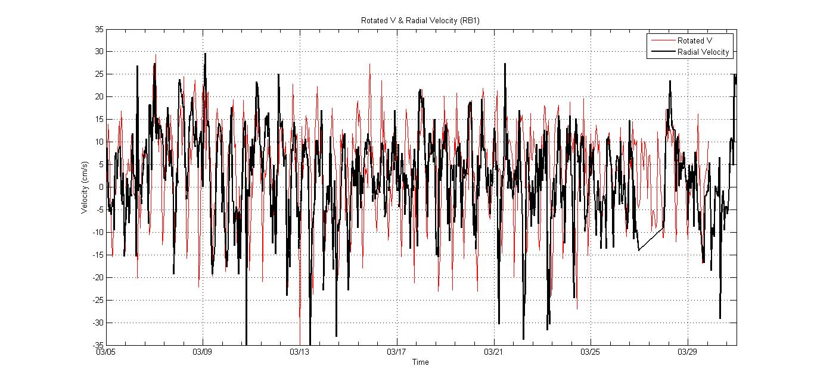
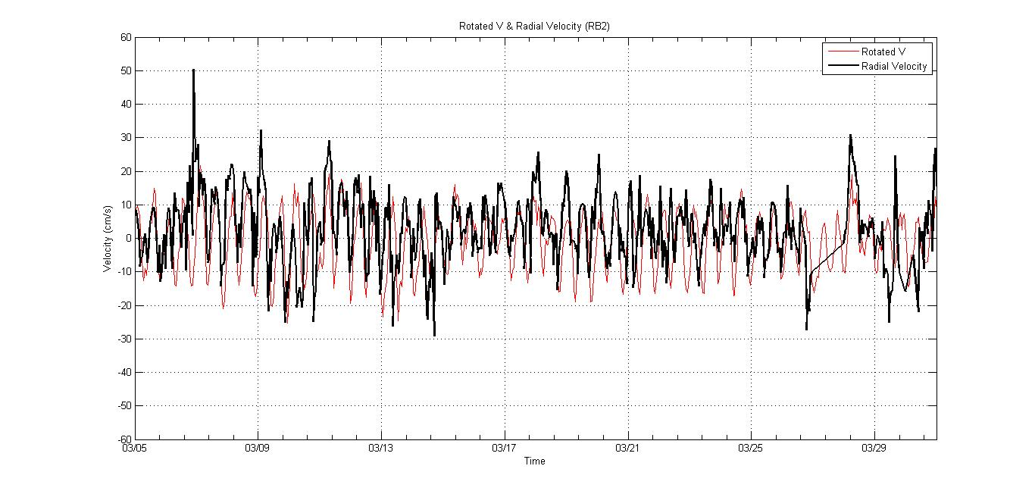
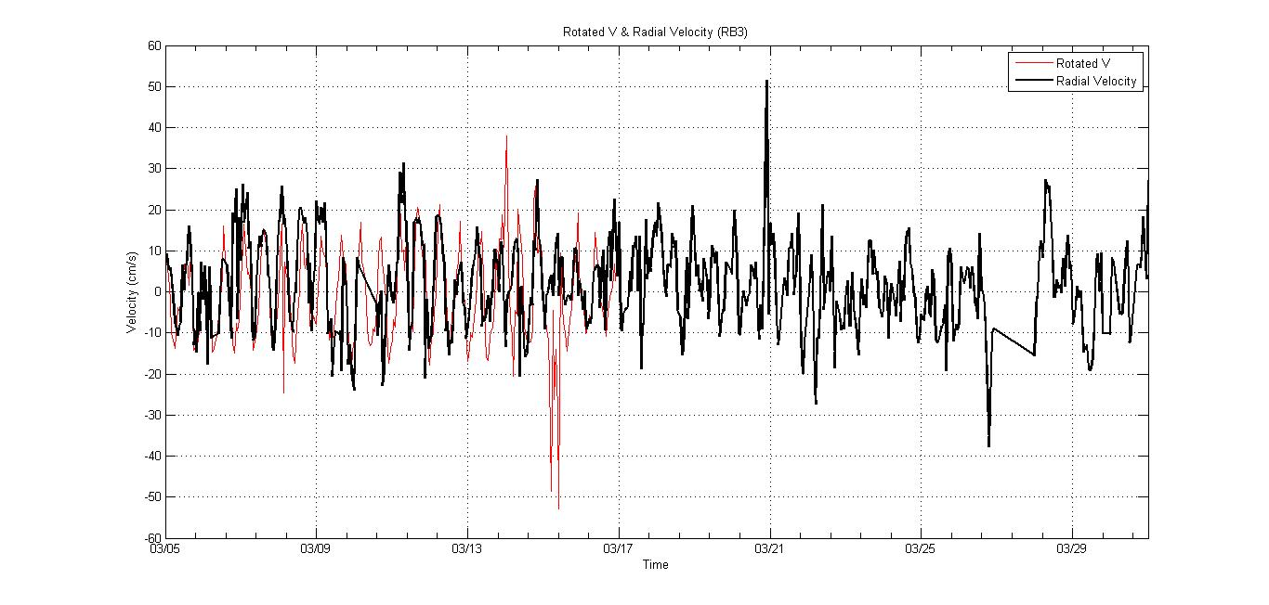
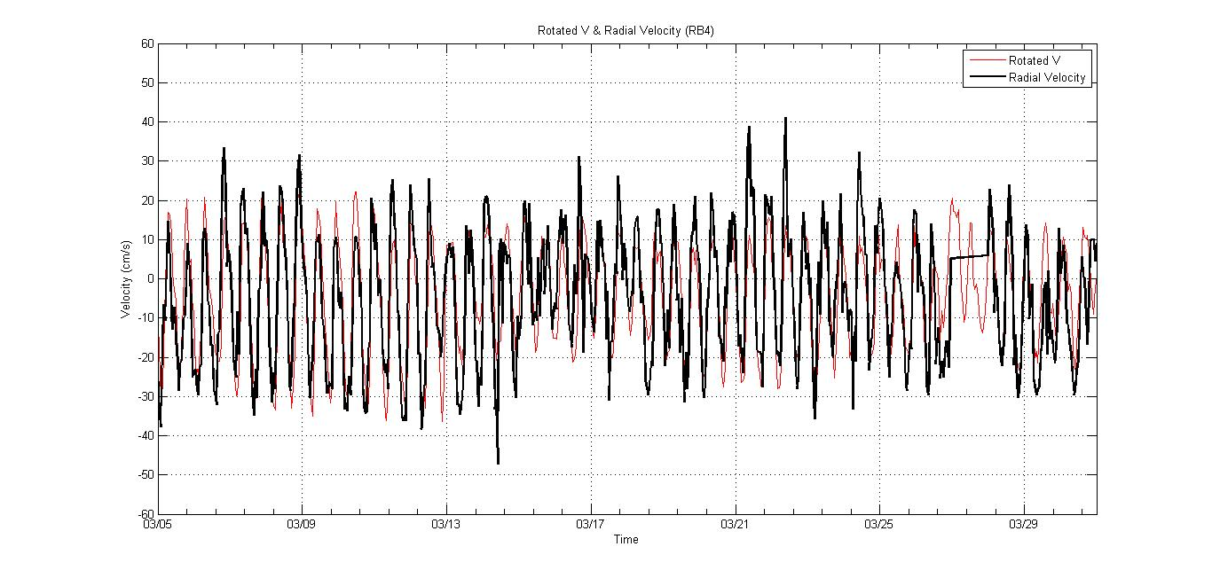
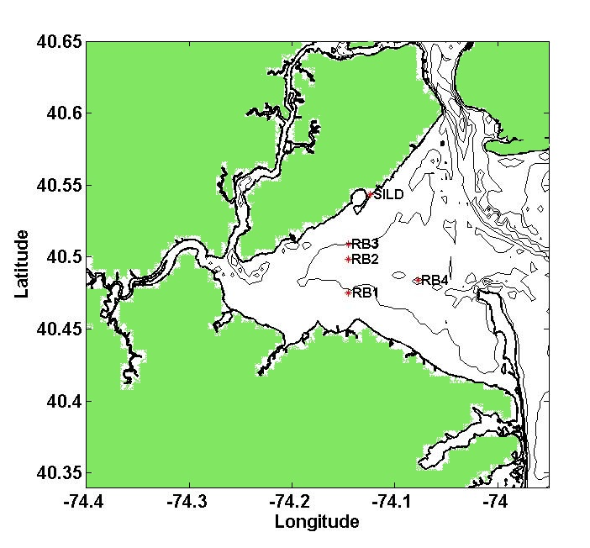
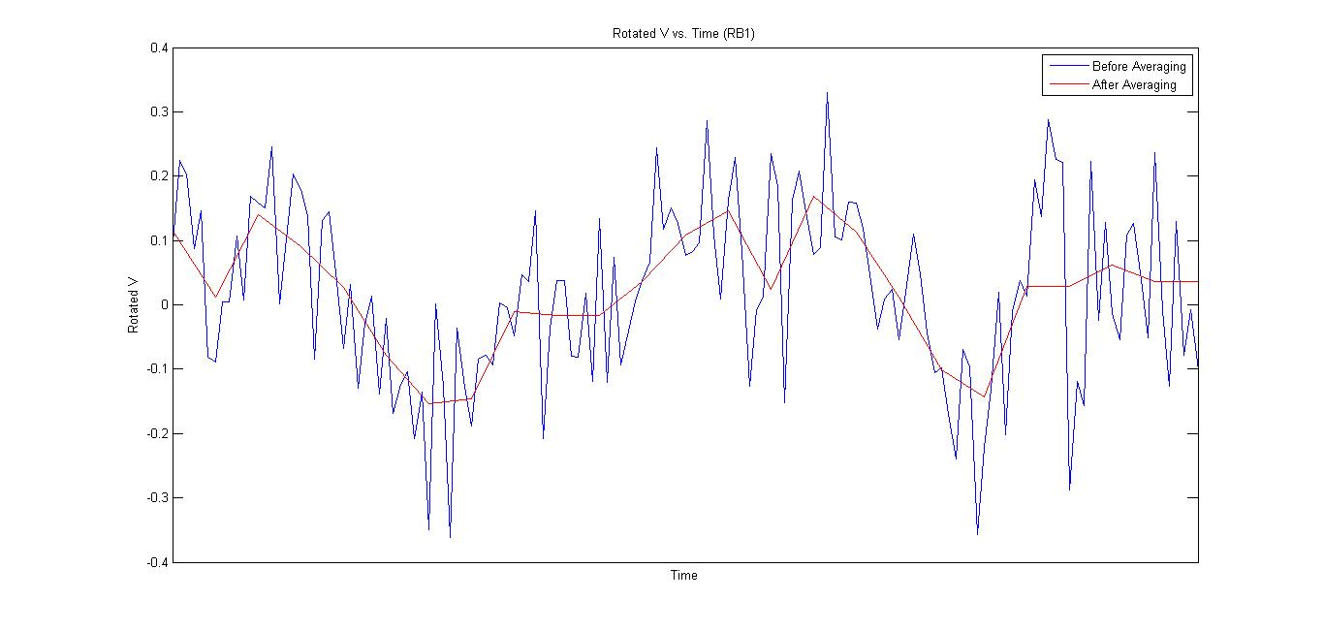
Comparison of CODAR and ADCP Surface Current Velocity Data Kristen Holenstein
Introduction and Purpose
Data for March 5-31, 2012
An Acoustic Doppler Current Profiler (ADCP) uses sonar to measure current velocity. It is attached to a mooring buoy and rests at the bottom of the water column. An ADCP takes readings of the current velocity directly above it at multiple depths.
Coastal Ocean Dynamics Applications Radar (CODAR) uses radio waves to measure surface current velocity. A radio wave is transmitted from an antenna located along the shore and is then received and measured by a second antenna. The measurements obtained by the second antenna are used to determine surface current velocity.
While an ADCP can be used to take current velocity readings at multiple depths, CODAR is used only for surface current velocity. CODAR determines currents in a large area while an ADCP only measures directly above it. A CODAR site could be used to observe currents off the coast without the need of a boat or multiple ADCP’s. By comparing the data of surface current velocity from ADCP’s and a CODAR site, it can be determined if CODAR can be used in place of an ADCP, and whether the location of the ADCP is a factor in correlation.
The moorings used for this project are located in Raritan Bay. The CODAR site used is located in Staten Island, NY (SILD). SILD uses a 25 MHz radar and an idealized pattern.
Figure 5. Graph of Rotated V & Radial Velocity vs. Time for RB1, RB2, RB3, & RB4
Figure 1. Map of Raritan Bay showing locations of moorings RB1, RB2, RB3, & RB4 and the SILD CODAR site
Figure 6. Graph of Radial Velocity vs. Average Hourly with correlation and slope for RB1, RB2, RB3, & RB4
Radial Velocity data is from the radial file and Average Hourly is from the ADCP data
Methods
Results
Determined the start and end dates for the ADCP data and obtained data from SILD that fell within that range
Used the latitude and longitude of the moorings to find a point in the radial grid closest to the moorings
The longitude and latitude of the point found was located in the radial file and the corresponding range and bearing were recorded
Bearing had to be converted from a compass coordinate system to the coordinate system used by MATLAB
The new bearing and the range were used to find the time and radial velocity in the radial files
Using the ADCP data for each mooring, values of u and v closest to the surface were found
The degree between SILD and the moorings was calculated and a rotation function was used to find the new u and v values in line with SILD
A graph of the new rotated v with time was made
Time had to be averaged to an hour because the ADCP takes readings every ten minutes while the CODAR takes readings every thirty minutes
Mooring | Correlation
RB1 | 0.3729
RB2 | 0.6974
RB3 | 0.7065
RB4 | 0.8207
Mooring | Correlation
RB1 | 0.3224
RB2 | 0.3798
RB3 | 0.3931
RB4 | 0.7959
Figure 7. Correlation results for March 5, 2012
Figure 8. Correlation results for March 5-31, 2012
The correlation between the ADCP and the CODAR varied. It was determined that a good correlation between the moorings and the HF Radar is above 0.6. For March 5, 2012 RB2, RB3, and RB4 had correlations above 0.6. RB4 had the highest correlation. For March 5-31,2012 only RB4 had a correlation above 0.6. RB4 having the highest correlation on a daily basis and the only correlation above 0.6 for the month may be due to its location. RB1, RB2, and RB3 are grouped near each other in Raritan Bay, while RB4 is located on its own. It is also possible for other factors to have influenced the correlation results, such as weather.
This data shows that on a daily basis the CODAR data has an acceptable correlation with the ADCP data. It is a possibility that CODAR can be used in place of ADCP moorings to record surface current velocity in a larger area and more cost effectively.
Figure 2. Graph of Rotated V vs. Time before and after averaging time to 60 minutes for RB1
Made graphs of radial velocity and rotated v with time
Rotated v values were converted from m/s to cm/s
Made graphs of radial velocity with the averaged time, made a least squares fit line, and calculated the correlation

