Slide 1
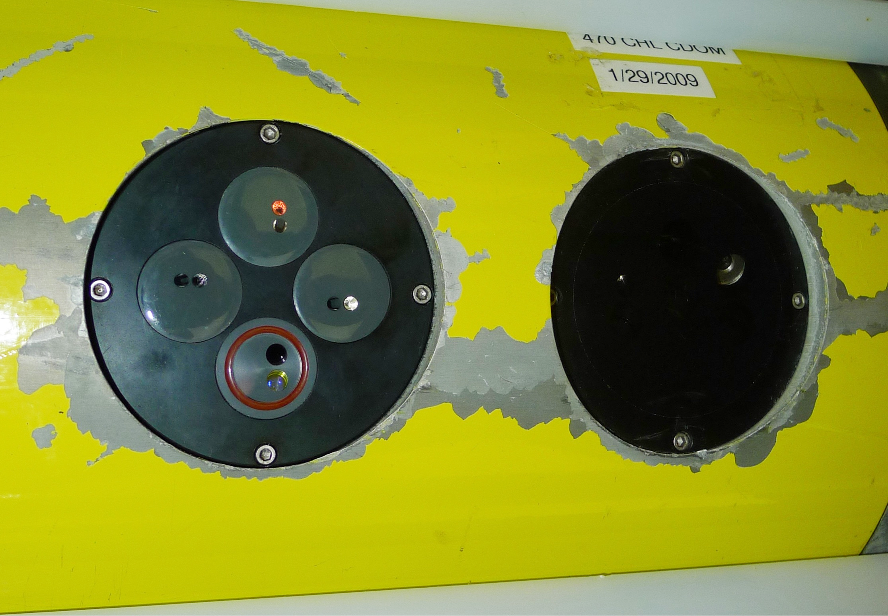
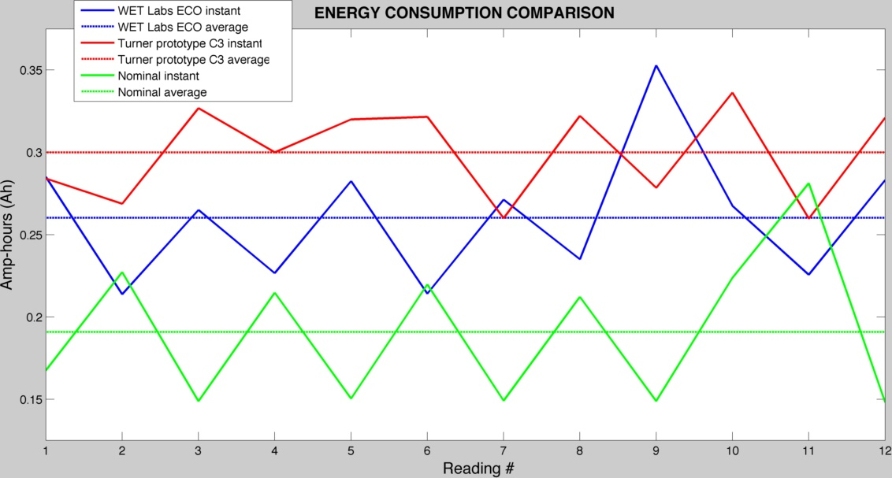
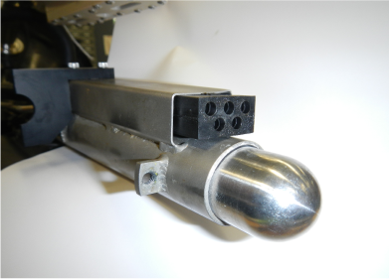
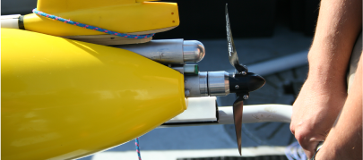
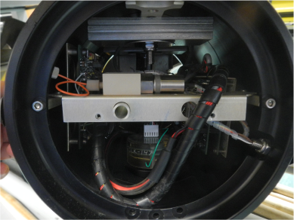
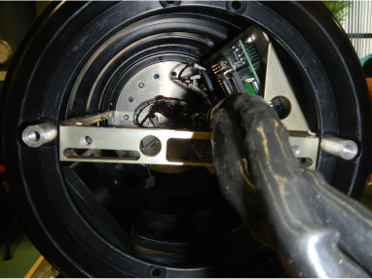
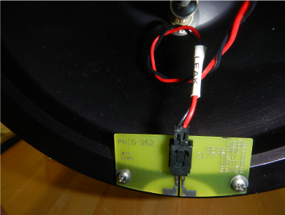
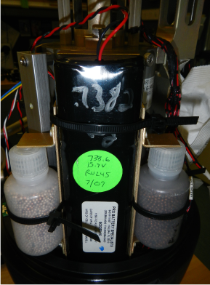
INTEGRATION OF NEW FLUOROMETRY SENSORS AND PROPULSION TECHNOLOGIES INTO SLOCUM GLIDERS
Dave Kaminsky¹, Shannon Harrison¹, Ben Allsup², Christopher DeCollibus², Scott Glenn¹, Oscar Schofield¹
¹Rutgers University Institute of Marine and Coastal Sciences, ²Teledyne Webb Research
INTRODUCTION:
The glider’s onboard coulomb counter was used during lab and field tests to measure the energy usage by both the ECO Puck™ and the C3™ puck. The C3™ puck was ran both with and without the onboard temperature and depth sensors. During the tests, both pucks were operating at the same sample rate and for the same sample time under the same conditions.
Teledyne Webb Research (TWR) and Rutgers University have been collaborative partners for over a decade, pushing the boundaries of TWR Slocum Gliders’ operational possibilities via research and development testing. This summer, the first official Teledyne Webb Research-Rutgers University Institute of Marine and Coastal Sciences joint internship program was developed for two students: Dave Kaminsky & Shannon Harrison.
The incorporation of new sensors and technologies into Slocum Gliders have been top priority for glider technology evolution. For sensor evolution, WET labs manufactures compact, integrated 3-channel fluorometers for gliders, called ECO Pucks™ which have been the predominant fluorometer thus far. Turner Designs manufactures their own standalone 3-channel fluorometer, called the C3™ puck, which are currently being integrated into Slocum Gliders as 4-channel fluorometers. For technology evolution, integrated active energetic propulsion systems, called thrusters, are being tested on Slocum Gliders. The addition of thrusters onto gliders deems them as hybrid vehicles, as they possess the ability to operate under passive, low-power buoyancy drive, or active, high-power thruster propulsion. These new technologies were installed and tested in Darwin, a TWR 100-meter Slocum Glider, with a science payload bay owned by Rutgers University which has had the WET labs ECO Puck™ and Turner Designs prototype C3™ puck installed side-by-side, and a thruster also installed.
The new and upgraded science payload bay installed in Darwin. The sensor on the right is the WET Labs ECO Puck™ and the sensor on the left is the new prototype Turner C3™ puck.
FLUOROMETRY:
Fluorescence is a significant and sensitive property of water, from which we can better understand essential characteristics of marine and freshwater environments by measuring specific fluorescent compounds. Fluorometers use specific amounts and wavelengths of light to excite the fluorescent compound of interest. This excitation then causes the compound to emit light, usually at a different, longer wavelength. Every compound has its own unique fluorescent signature unlike any other compound, rendering fluorometry a reliable and significant method of research.
Integration of reliable fluorometers into gliders, an autonomous underwater vehicle, is paramount to the evolution of fluorometric research potential. This project was developed to prepare an analytical comparison between an ECO Puck™, an already glider-integrated fluorometry system developed by WET Labs, and a prototype glider-integrated fluorometry system developed from the C3™, a standalone fluorometer developed by Turner Designs. Although both fluorometry systems have the same basic sensor capabilities, their currently available options vary. The reliability of their data also must be well understood, verified and trusted.
APPROACH:
THRUSTER:
As glider technologies evolve, their integration into the fixed volume an layout of the glider must evolve as well. Darwin’s original science payload bay had a non-pumped CTD along with four sensor pucks. Darwin, a hybrid G1/G2 glider, was very heavy to begin with, and with its original four puck bay, the glider was too heavy to properly ballast. Therefore, a new, lighter two puck science payload bay was installed. The new science bay was upgraded and rebuilt as an XC science payload bay, which mounts the science computer electronics vertically on the sides of the bay allowing for more room for the C3™ and ECO Puck™ sensors. The sensors were installed side-by-side in the downward facing position to allow for an analytical data comparison.
The image to the left shows the glider’s standard ejection weight with power plug on top. The image to the left is Darwin’s ejection weight assembly with the thruster; the thruster takes the original place of the ejection weight assembly, which is moved above the thruster.
FLUOROMETRY SENSORS:
The image to the left shows the original payload chassis, which takes up more room within the payload. The image to the right shows the XC payload chassis, which puts the sensors boards to the side of the payload, leaving more room for the sensors in the payload.
An ECO Puck™ and prototype C3™ puck were installed side-by-side into Darwin, a Teledyne Webb Research 100-meter Slocum Glider science payload bay in the standard downward facing position. Darwin will be piloted from Cape Cod, Massachusetts to Tuckerton, New Jersey simultaneously collecting data from both sensors in order to perform an analytical comparison.
The ECO Puck™ has three channels for sensors, while the prototype C3™ puck has four channels. The channels used in the ECO Puck™ in Darwin were chlorophyll, CDOM (colored dissolved organic matter), and backscatter, while the channels used in the prototype C3™ puck were chlorophyll, phycoerythrin, CDOM, and turbidity. The backscatter and turbidity channels, which are comparable, are not specifically fluorometry, but rather methods of measurement of the total suspended solids in the water column. The sensor still uses the emission of light to achieve this measurement of particulate concentrations, but rather than light penetrating the compound and then re-emitting light, the compound scatters and absorbs the light.
The C3™ puck also has the ability to sense temperature and depth, while the ECO Puck™ does not. The ability to sense temperature and depth within the fluorometry system itself can lend additional data and confidence in sensor calibration, accuracy, and vertical data point location either in addition to the glider’s native temperature and depth sensors or in place of them in the event of a failure or discrepancy of the native systems. This gives the C3™ puck a clear advantage over the ECO Puck™. However, this could potentially require additional power, which is or considerable importance.
FUTURE QUESTIONS:
How does the fluorometry sensor data compare? Is there a correlation between the data of both sensors?
Is there a difference in power consumption between the sensors? With and without the temperature and depth sensors running on the C3?
Does one sensor integrate into gliders more easily?
How much weight and volume does the thruster add to a standard glider? Does this pose ballasting problems?
Are there more efficient or more powerful blade angles?
How much energy does the thruster use?
How long can the thruster run for?
How fast can the thruster go?
What is the most efficient speed to run the thruster at?
Can a glider with a thruster move in a straight line at depth? What added stabilizing technologies may be needed to optimize the thruster potential?
Can a glider successfully operate with sensors and the thruster? How much power does this use?
How is the use of the fin affected when using the thruster?
Darwin was fitted with lithium batteries so no nose batteries were installed in the nose section like a standard glider. The battery sections in the nose section were used to put lead weights in to make the glider heavier for proper ballasting.
The hybrid G1/G2 glider, using G1 hulls, was fitted with lithium batteries. Since the G1 hulls are shorter than G2 hulls, which are designed for lithium batteries, the leak detect had to be moved higher up the aft section to enable the glider to close and seal.
REFERENCES:
http://www.turnerdesigns.com/products/submersible/c3-submersible
http://www.turnerdesigns.com/t2/doc/brochures/S-0096.pdf
http://www.turnerdesigns.com/t2/doc/manuals/998-2300.pdf
http://www.turnerdesigns.com/t2/doc/appnotes/998-0050.pdf
http://www.wetlabs.com/products/pub/eco/tripletpuckh.pdf

