Slide 1
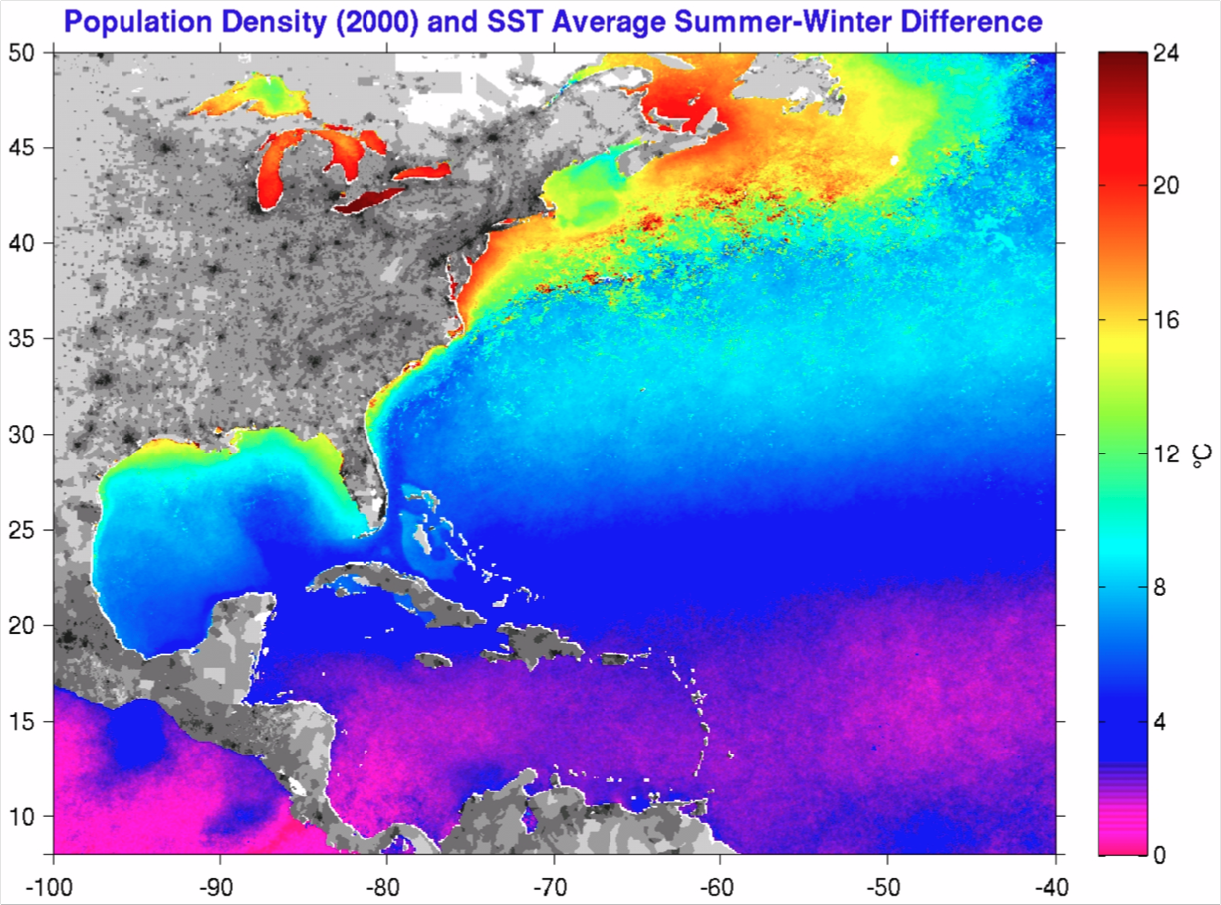
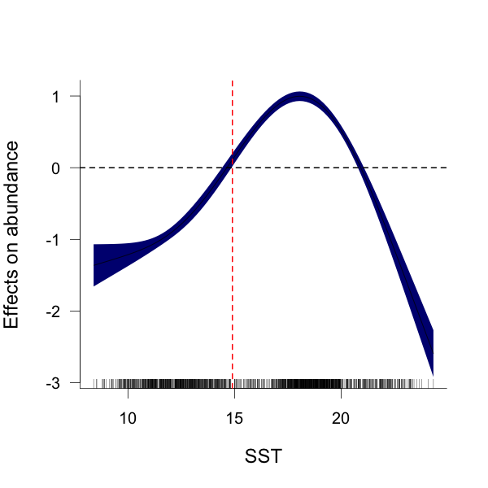
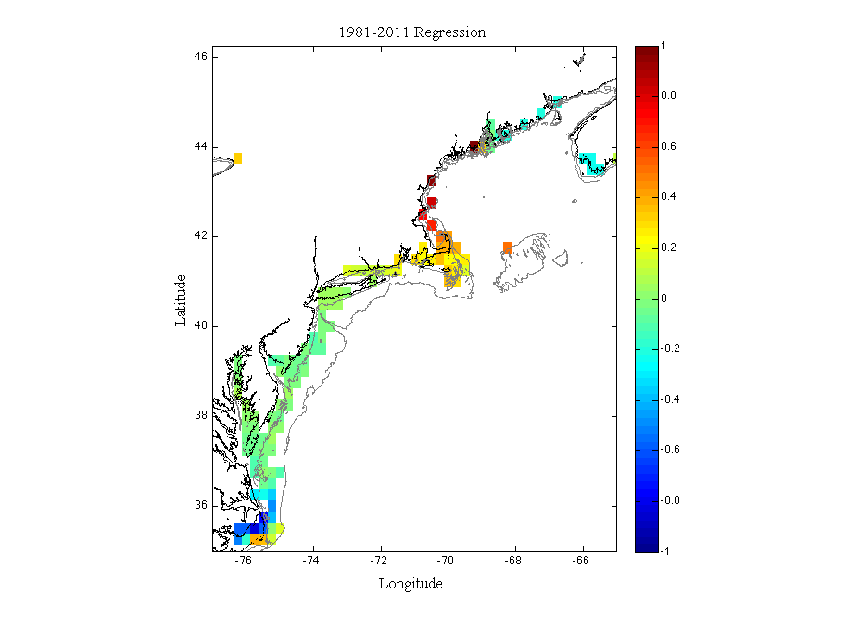
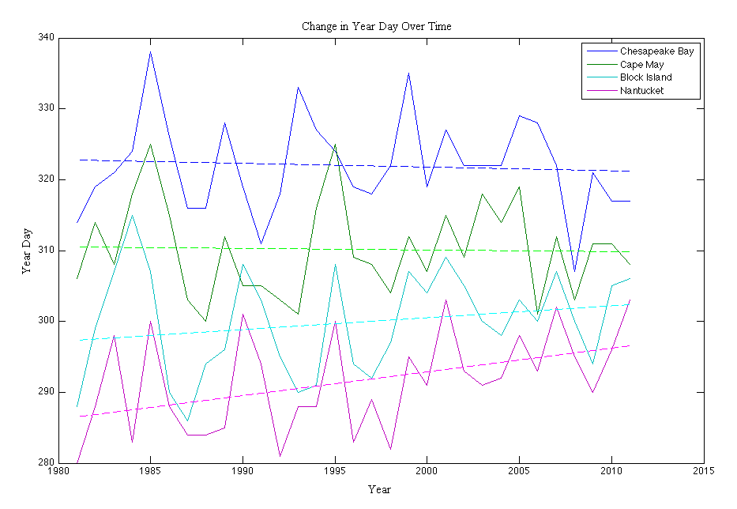
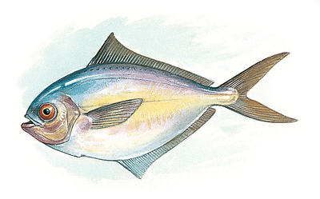
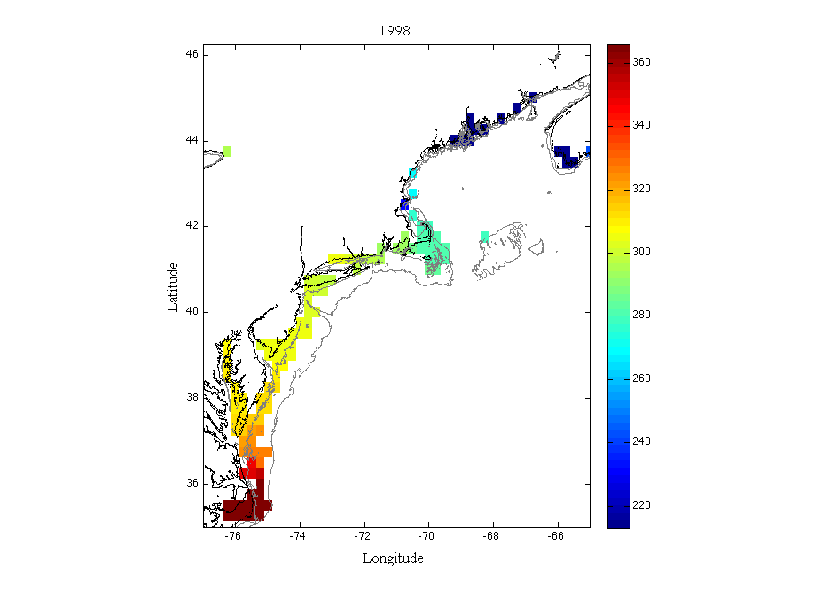
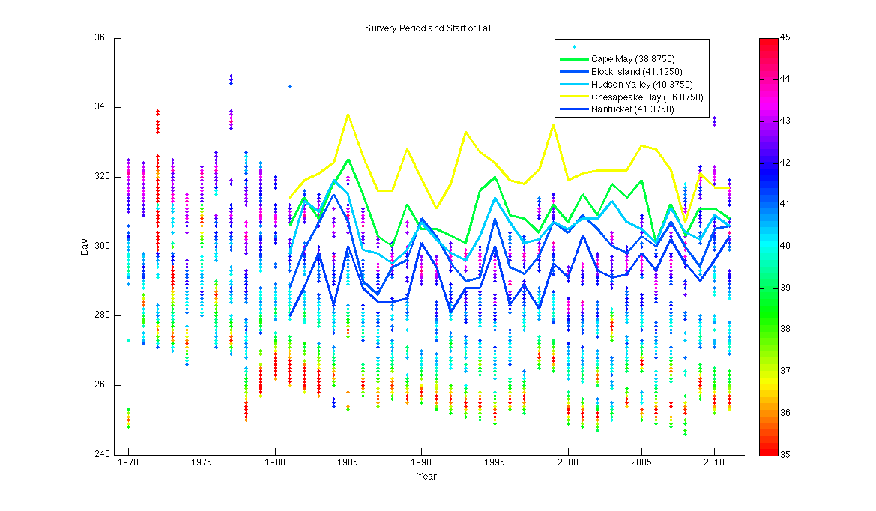
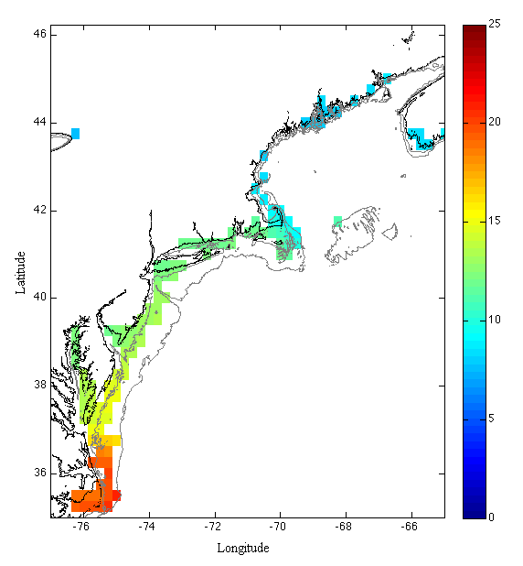
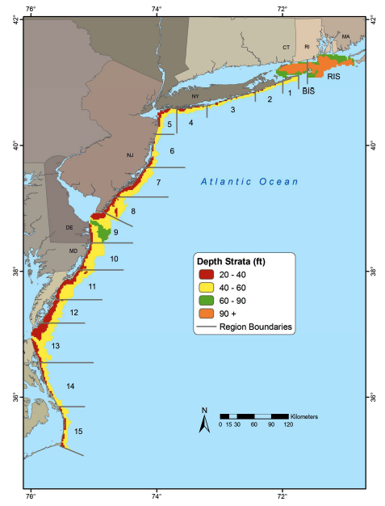
Sea Surface Temperature as a Trigger of Butterfish Migration: A Study of Fall Phenology
Amelia Snow¹, John Manderson², Josh Kohut¹, Laura Palamara¹, Oscar Schofield¹, Collin Dobson¹
¹Rutgers, the State University of New Jersey
²James J. Howard Marine Laboratory, National Oceanic Atmospheric Administration
Background and Significance
General Additive Model (GAM)
Conclusions
The Mid-Atlantic Bight (MAB) is a temperate region along the U.S Northeast where sea surface temperature shows large seasonal variability. This variability is among the highest in the world. Habitat in this region also varies in both space and time (daily, monthly, seasonal, annual, and decadal time scales). Many species in the MAB undertake long distance migrations at different stages in their life with timing of these migrations being determined by change in the environment, such as photoperiod, temperature, and dynamic water column processes.
Many butterfish use inshore habitats (depths <20m) as summer feeding and/or nursery ground. During the fall, butterfish migrate offshore to over-winter near the continental shelf break.
Effective spatial and temporal analysis is necessary to understand changes in habitat. Knowledge of shifts in habitat can help to improve conservation strategies.
A General Additive Model (GAM) is a nonparametric technique used to model habitat relationships between multiple environmental features and a species response
NEAMAP GAM shows threshold at 15ºC
Use GAM to relate butterfish abundance measured from inshore NEAMAP surveys to the measured sea surface temperature
15C
Slope of arrival of fall over 30 year time interval, depicting trend by pixel
Difference in summer and winter sea surface temperature. Along the Mid-Atlantic Bight, temperature differences can reach 20ºC or higher.
NEAMAP GAM showing butterfish response to SST, with a positive response starting at 15ºC
Thermal Threshold
m=-0.0516
m=0.0226
The thermal threshold for butterfish fall can be determined using the GAM
It was determined that butterfish fall is triggered at 15ºC, the lowest temperature to generate a positive response
Once the temperature drops below 15ºC, butterfish are expected to move offshore
m=0.1665
m=0.3371
Change in year day for four locations (Chesapeake Bay, Cape May, Block Island, and Nantucket) with trend lines showing slope over time.
Butterfish (Peprilus triacanthus)
Fall Transition
Sea surface temperature in Mid-Atlantic Bight is changing over space and time
Lots of inter-annual variation in day on which butterfish fall (SST<15ºC) occurs
Nearshore areas in Southern New England warmer later which could affect migration patterns
The trend is negligible compared to inter-annual variability in regions outside of Southern New England
Objectives
Fall transition occurs on the year day when the five day sea surface temperature running average drops below 15ºC
Year day of fall transition plotted for each pixel in Mid-Atlantic Bight over 30 year time period
Blue pixels show transition earlier in year (mid-August)
Yellow and green pixels show transition in fall (early October)
Red pixels show transition later in year (early December)
This allows for visual representation of changes over time (1981-2001) and space (Chesapeake Bay to Gulf of Maine )
Combine measure of thermal habitat with nearshore butterfish distribution
Define transition to butterfish fall using habitat relationships
Determine the inter-annual variability and spatial dependence of butterfish fall index
Future Work
Materials and Methods
Use OISST data to look at phenology of spring and winter and summer duration
Determine how well the timing of butterfish fall, based on SST, corresponds with butterfish migrating offshore
Compare butterfish fall to trawl survey indices
Daily Optimum Interpolation Sea Surface Temperature from 1981-2011 provided by National Oceanic and Atmospheric Administration (NOAA)
Resolution is 1/4º
Northeast Area Monitoring and Assessment Program (NEAMAP)
Inshore bottom trawl survey conducted by the Virginia Institute of Marine Science (VIMS), which provides data for completion of stock assessments
Butterfish fall for four locations (lines) related to days of trawl surveys (dots). Colors show latitude.
Year day of start of spring transition in Mid-Atlantic Bight for 2011
Acknowledgements
One day of 1/4º resolution NOAA Optimum Interpolation Sea Surface Temperature Data (OISST) in Mid-Atlantic Bight
NEAMAP sampling area including strata depth and boundaries of regions
Source: NEAMAP data report 2011
Year date of start of fall transition in the Mid-Atlantic Bight for 1998 and 2001. 1998 transitioned early and 2001 transitioned late
I would like to acknowledge the Cooperative Institute for the North Atlantic Region (CINAR) for providing funding and NEAMAP and NOAA for supplying data for this project . I would also like to acknowledge the Rutgers University Coastal Ocean Observation Laboratory for making this project possible.

