Slide 1
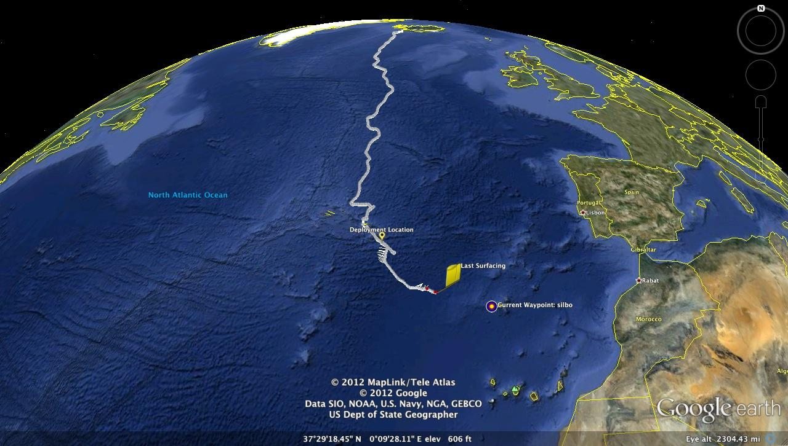
Heat Flux in the North Atlantic derived from Slocum Glider Silbo
Nilsen Strandskov, Mak Weston, John O'keefe, Taylor Bachorski

Slide 2
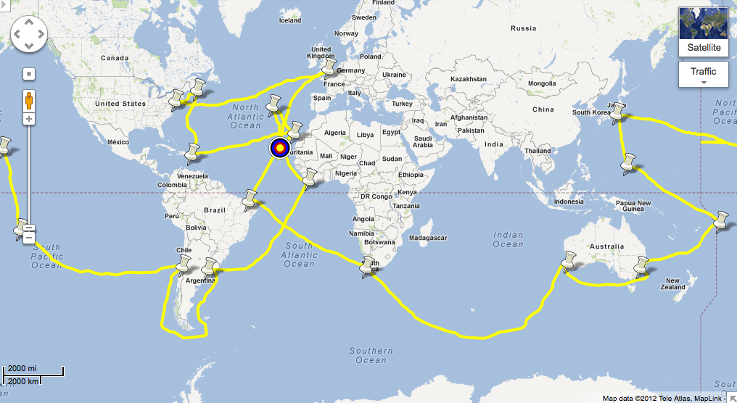
Description of the Challenger Mission
1872-1876
First Government Funded Science Expedition
4,500 new aquatic species
Discovered the Mariana Trench to be deepest point
first time the term "oceanography" was used
263 temperature casts
1989 Stomels Vision:
A fleet of 1,000 'Slocums' throughout the ocean focusing on the main question of is the ocean warming
Our goal is to combine these two:
Oceans are changing on rapid timescales that we will see in our lifetime, yet we know very little about it. Rutgers COOL group has proven the Slocum Gliders are capable of long duration flights from the first international flight of RU15 to the historic transatlantic crossing of RU27
Goal: 16 gliders. "The ocean is the most undersampled and least understood aspect of the climate system. The Challenger Glider Mission will focus new attention on the oceans, and the important role they play in short-term weather patterns and long-term climate change."

Slide 3
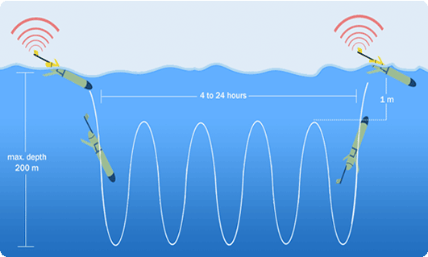
The Tool: Slocum Electric Glider
Buoyancy Driven:
by changing buoyancy, the glider rises and falls in the water column
the wings allow for the vertical movement to be applied to the horizontal axes. It changes buoyancy by altering its volume through the movement of the pump found in the nose of the glider. By taking in about half a cup of sea water, the resulting change in buoyancy allows for the glider to sink, falling forward with the help of the wings.

Slide 4
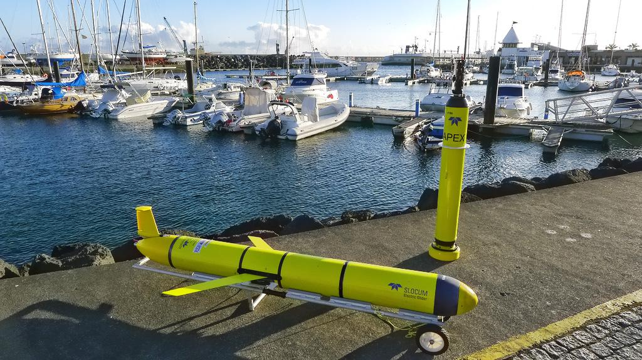
Application of the data collected:
Detailed data sets of temperature, salinity and density from around the globe allow us to calculate changes from starting location to end location, change in heat content in any storms encountered, and apply thermal wind equation to measure heat transport across the glider track
Silbo
Heat Fluxes:
North- South
Atmosphere- Water
Thermal Wind across Track

Slide 5
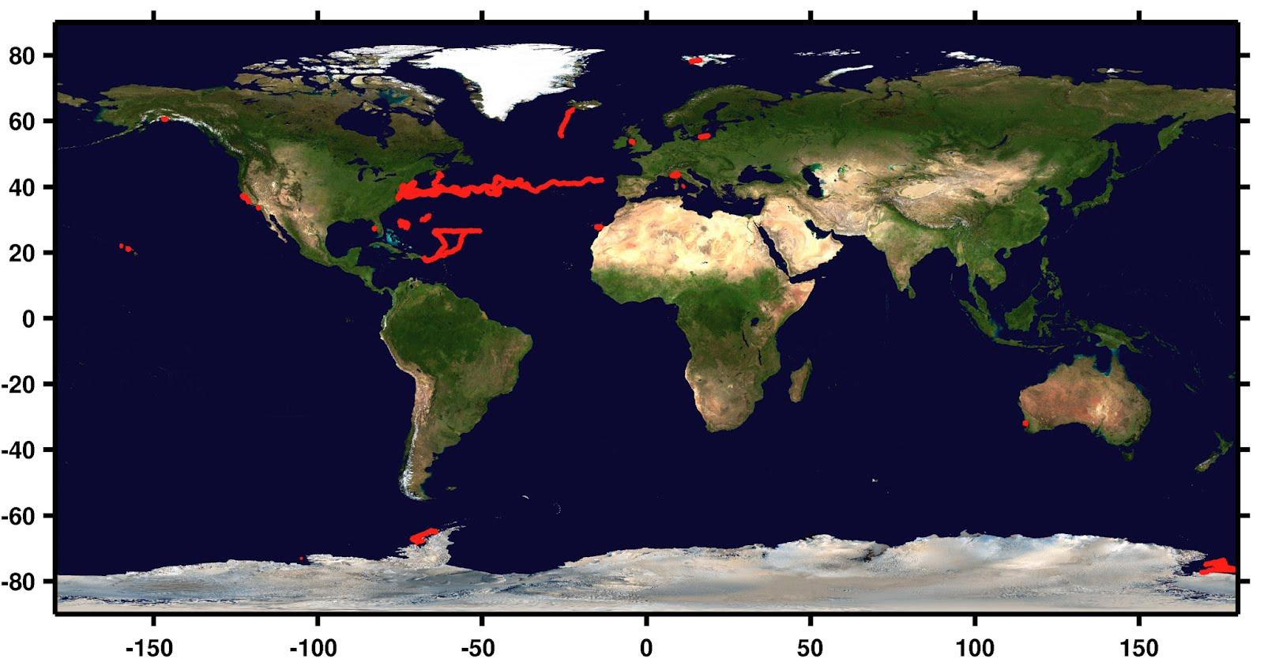
Rutgers has been paving the way to make this mission a reality. Over the past decade it has been involved with over 100 missions deploying gliders all over the world all the while developing technologies and building partnerships that will be key to the success of this mission.

Slide 6
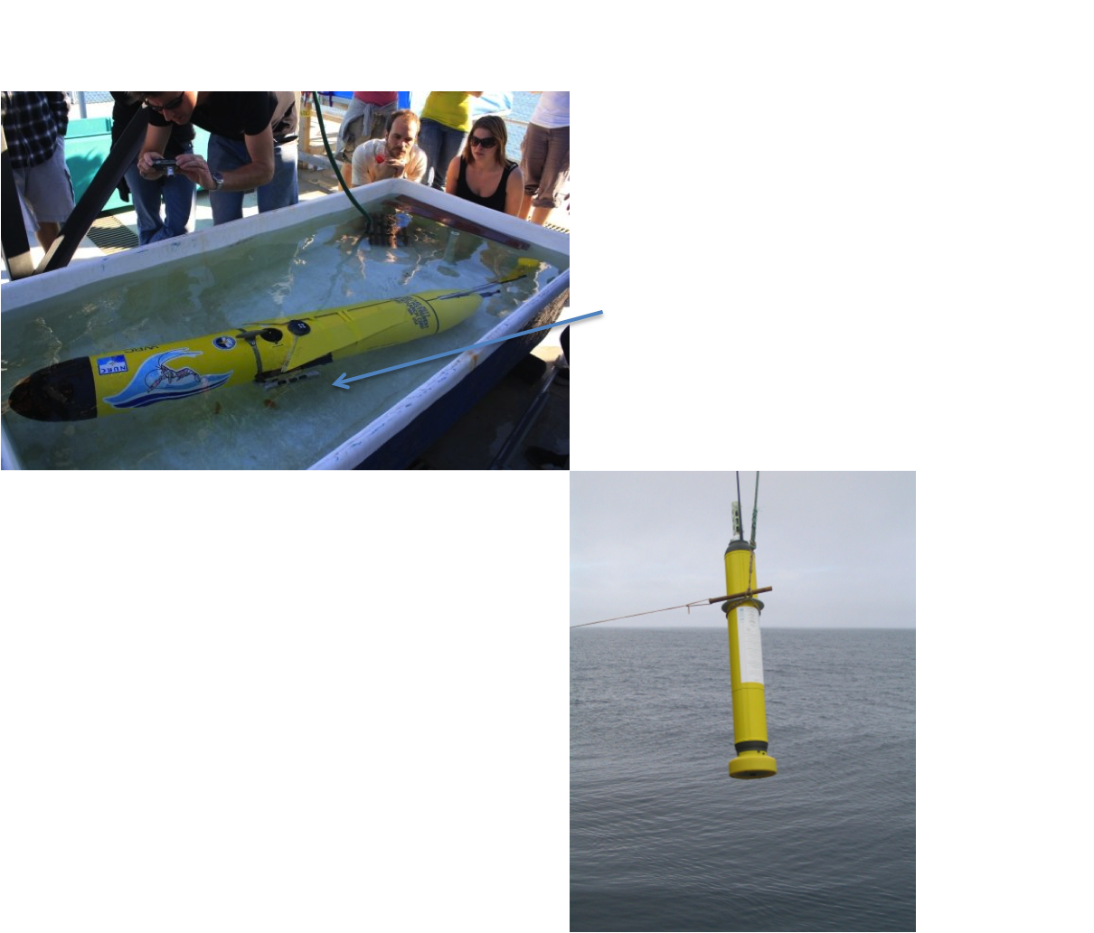

Slide 7
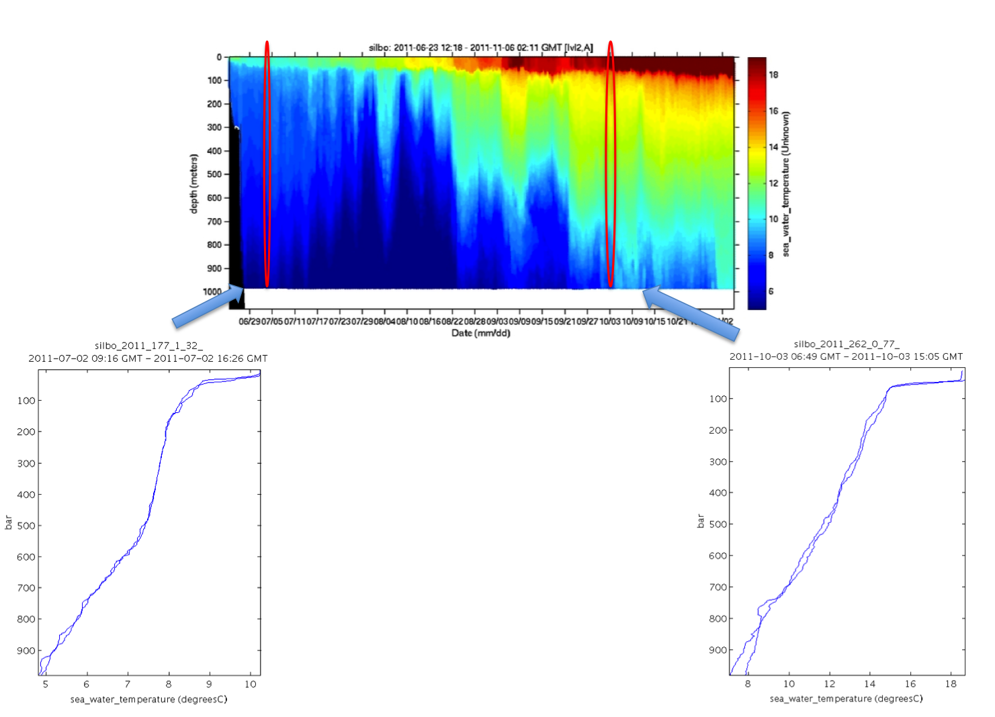
Notes:
Iceland: Thermocline begins at about 20m. Temp range from surface to 1000m is from 10 to 5
October: Thermoclie has dropped to 40m. temp range is 7-18

Slide 8
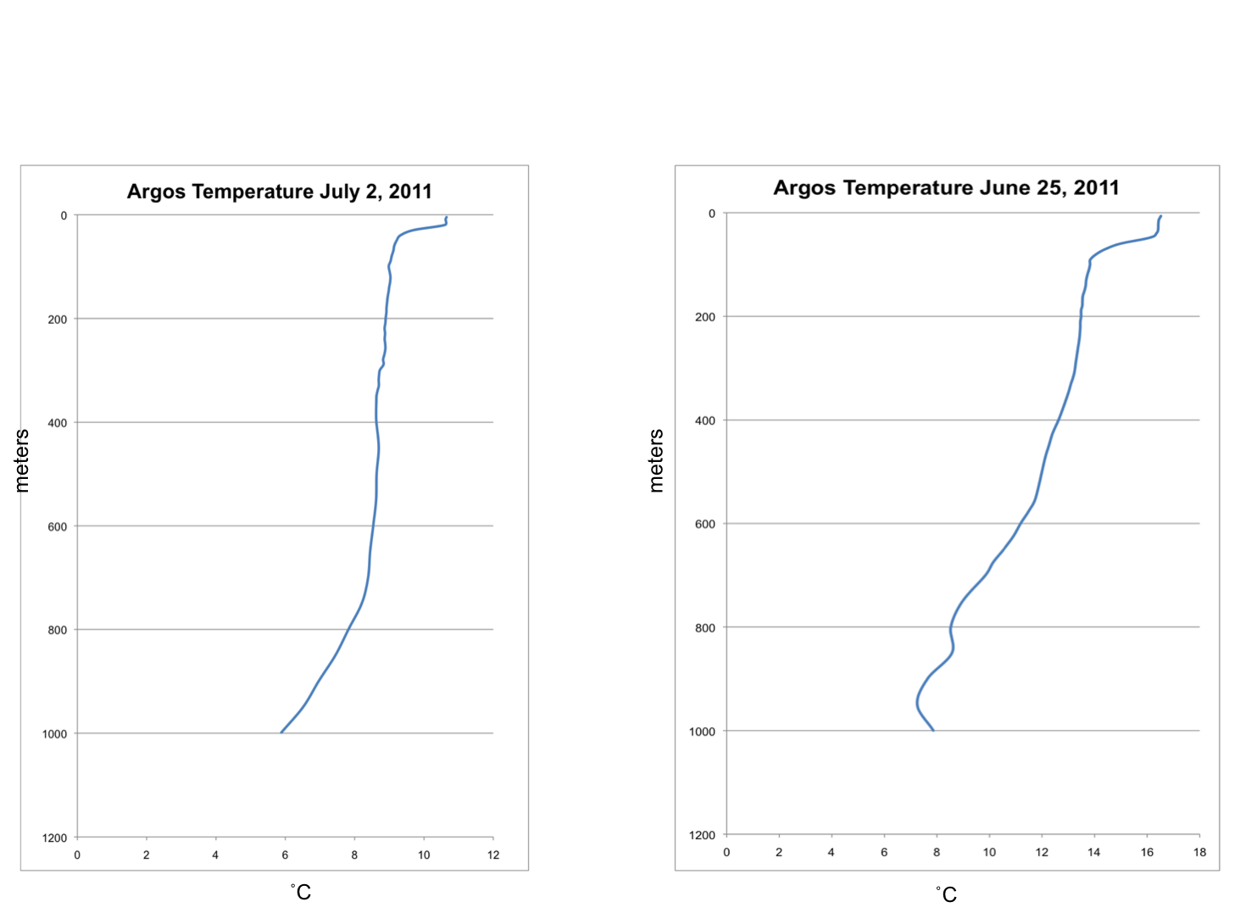
Notes:
Argos Drifter shows same profile as Silbo off of Iceland for June. For the same time period, the other drifter shows a range of 7-16

Slide 9
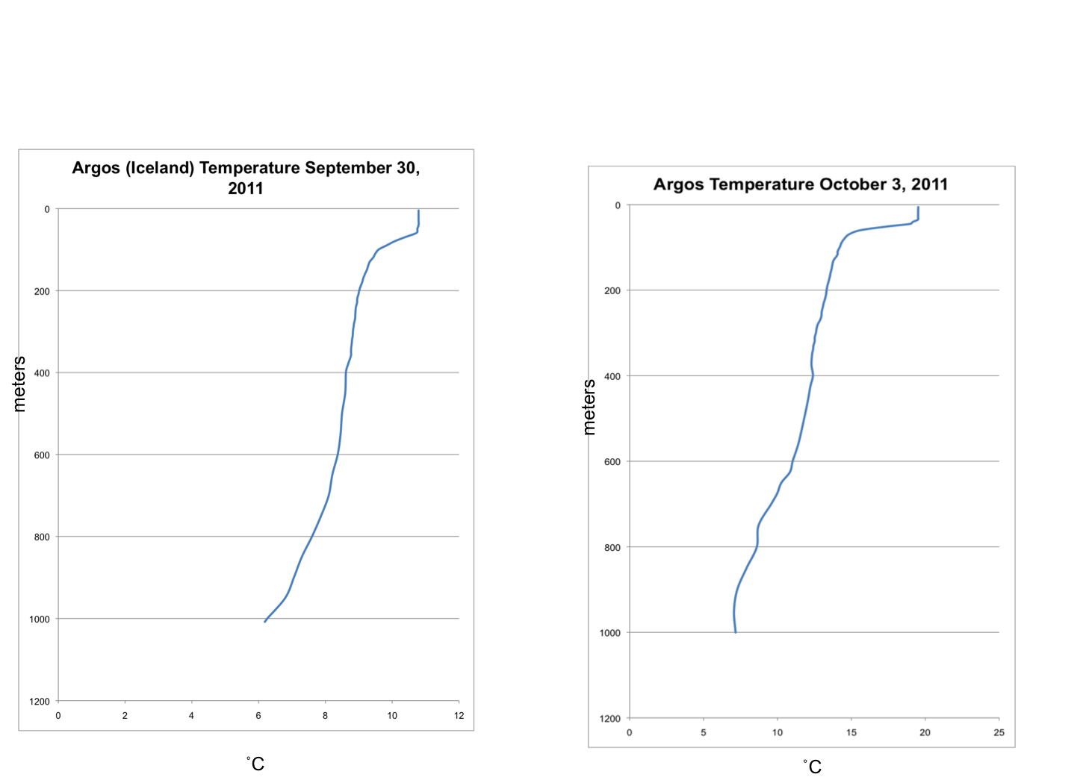
Notes:
Iceland 6-10 thermocline has deepend, october position 7-19

Slide 10
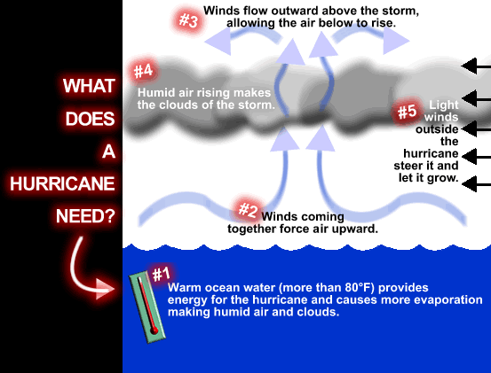
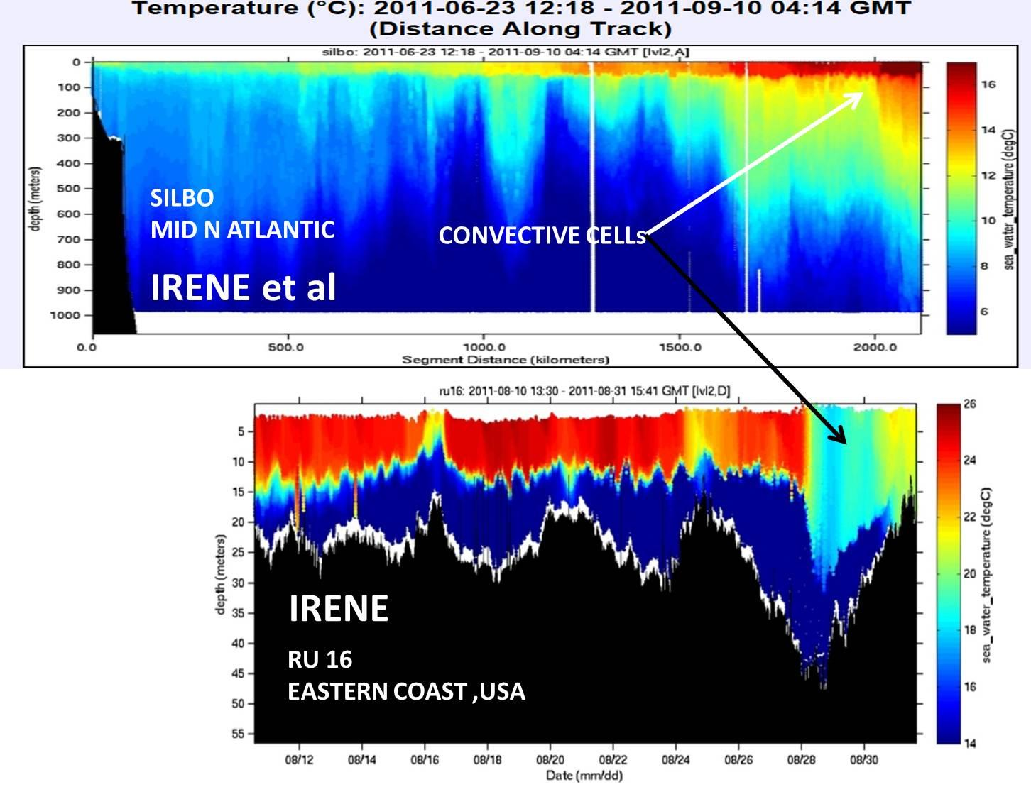
Heat Content Calculation:
The Ocean is warming resulting in the noticeable increase in the number and intensity of tropical storms and hurricanes along the Eastern Seaboard down through the Gulf and Caribbean.
Over the past 10 years countries on the eastern side of the North Atlantic Basin have begun to feel the effects of the Tropical Storms

Slide 11
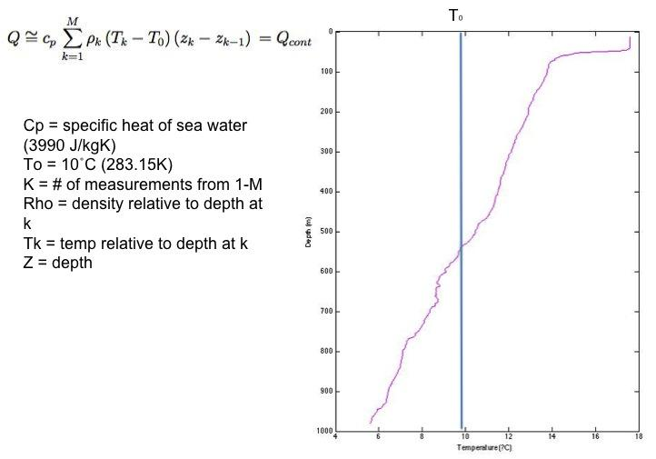
Heat Content Calculation:

Slide 12
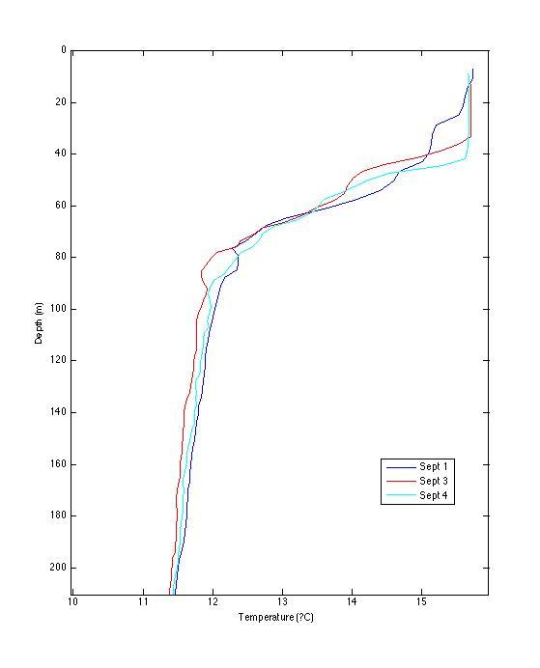
Heat Content of Hurricane Irene over the North Atlantic
Applying rough calculation of heat content equation
Sept 1:
Sept 3:
Sept 4:

Slide 13
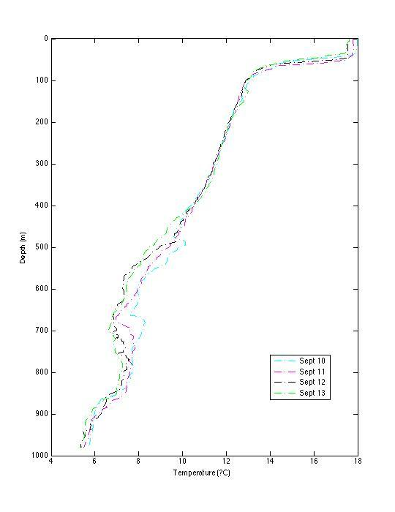
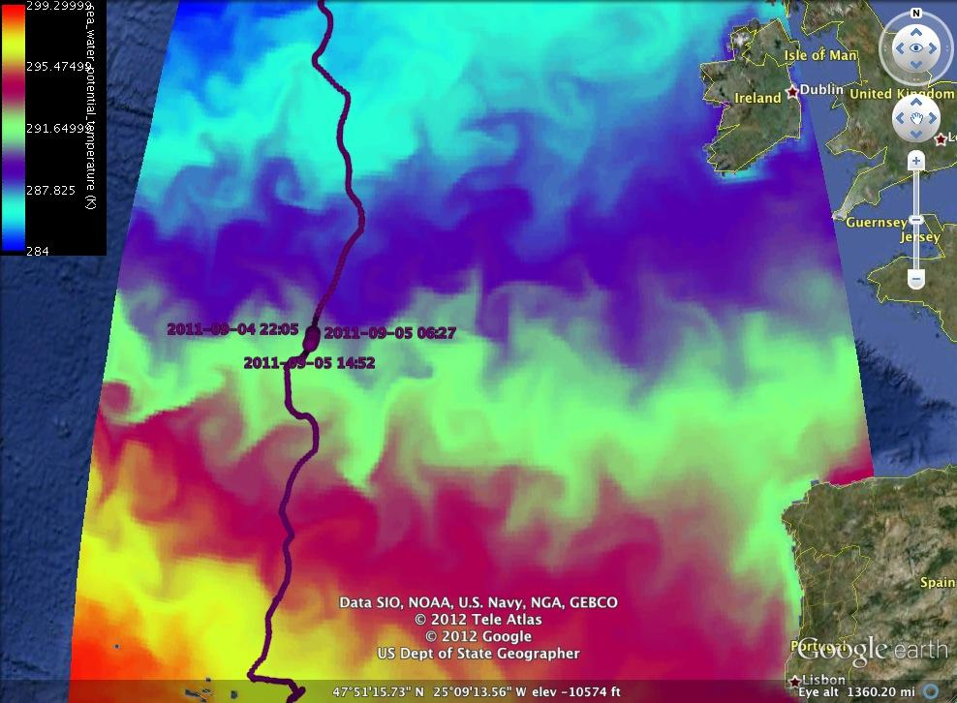
Heat Content of Tropical Storm Katia over the North Atlantic
Data distorted due to crossing of a band of the Gulf Stream causing the temp to rise.

Slide 14
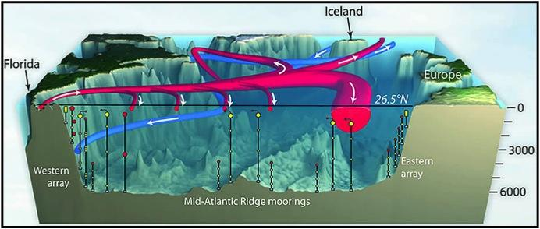
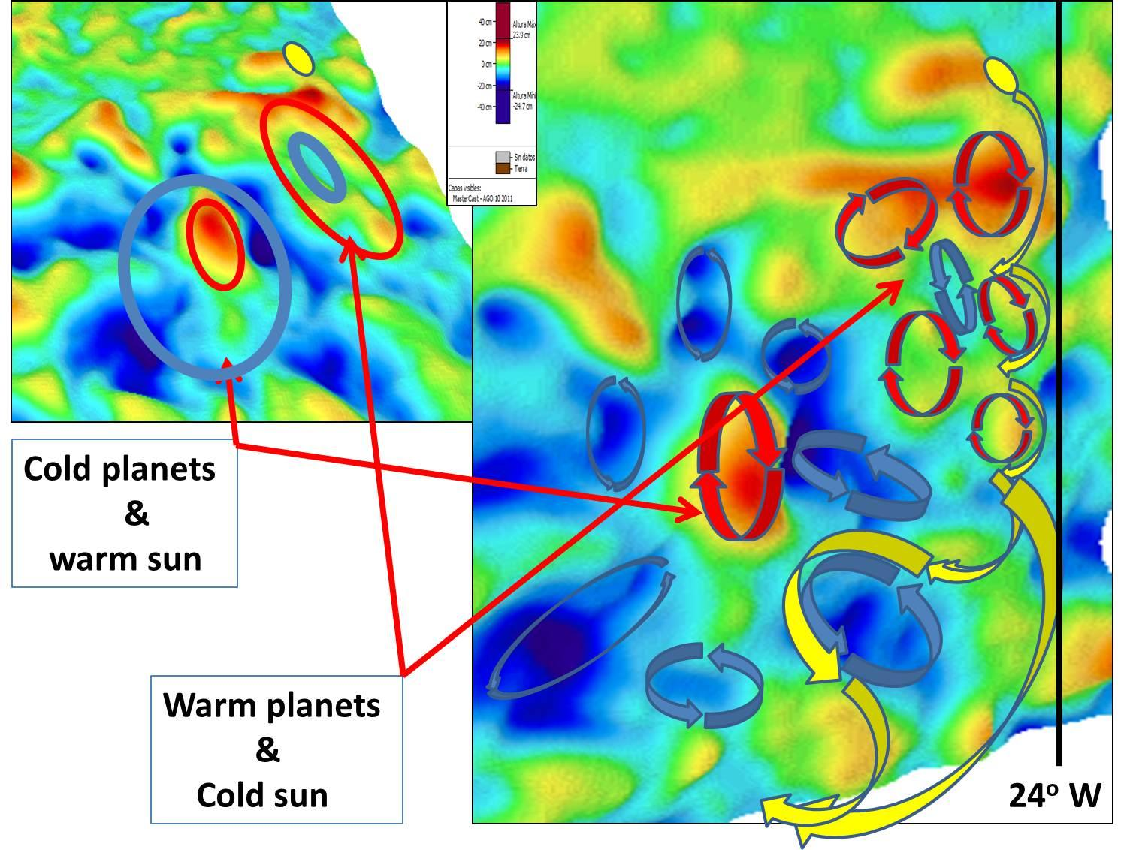
Drivers in the N. Atlantic Encountered by Silbo
Currents: Gulf Stream
top speed of 9km/hr (5.6mi/hr) and transports 4 billion cubic ft/sec. This water caries very warm water from the Gulf of Mexico across to Europe and dictates their climate
Eddies:
Warm- High Pressure, clockwise spinning
Cold- Low Pressure, counterclockwise

Slide 15
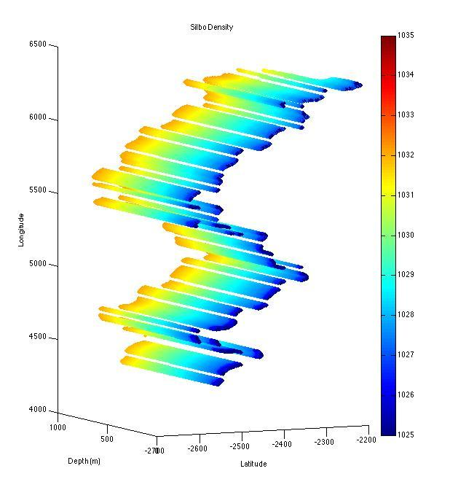
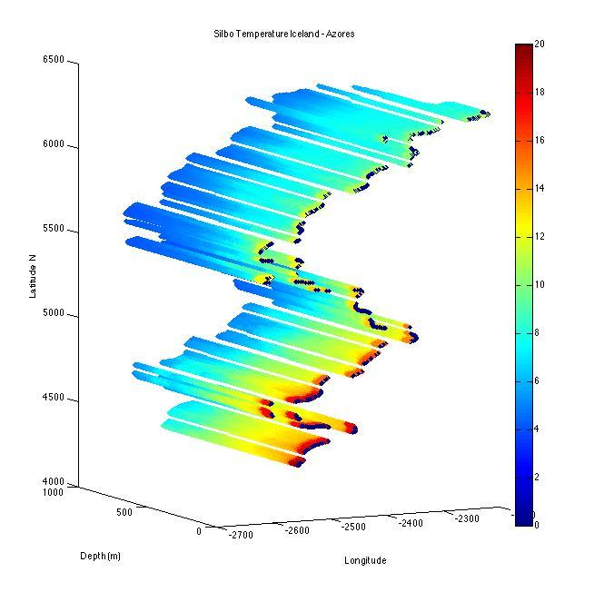

Slide 16
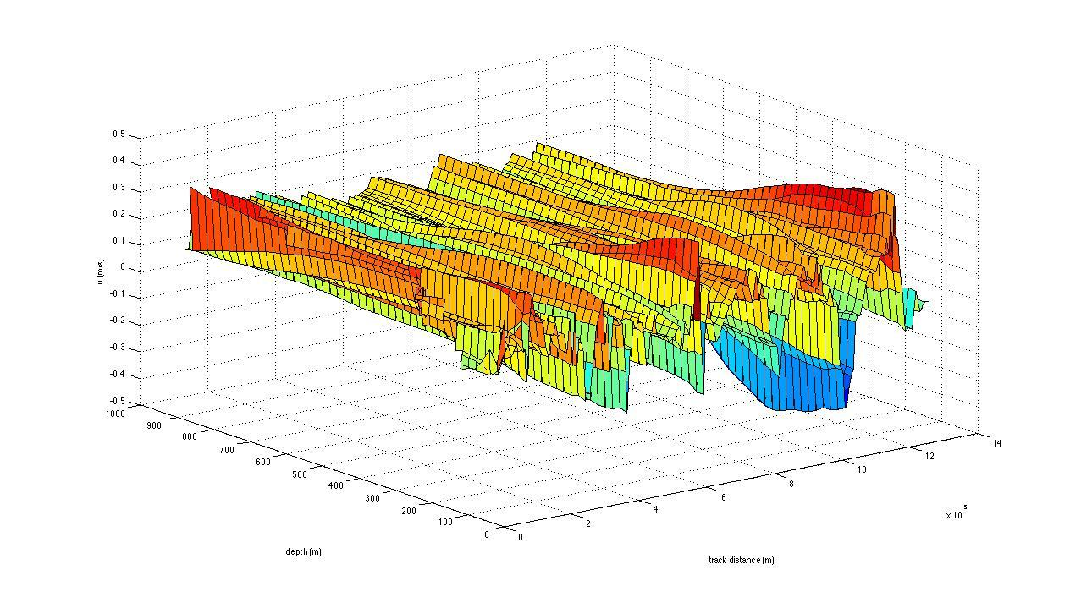
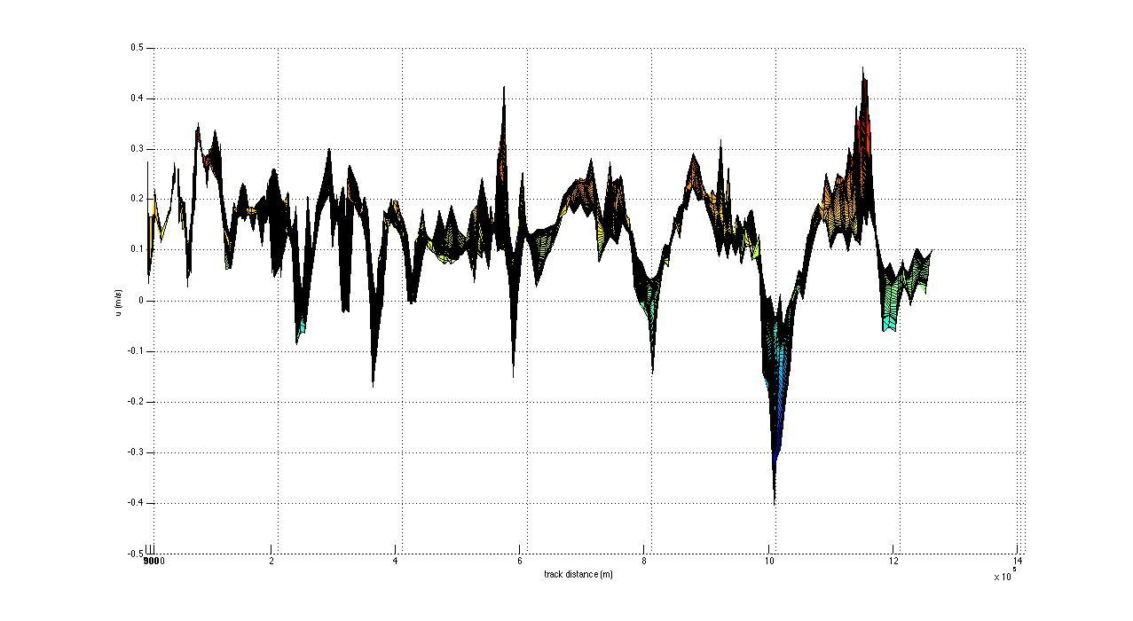

Slide 17
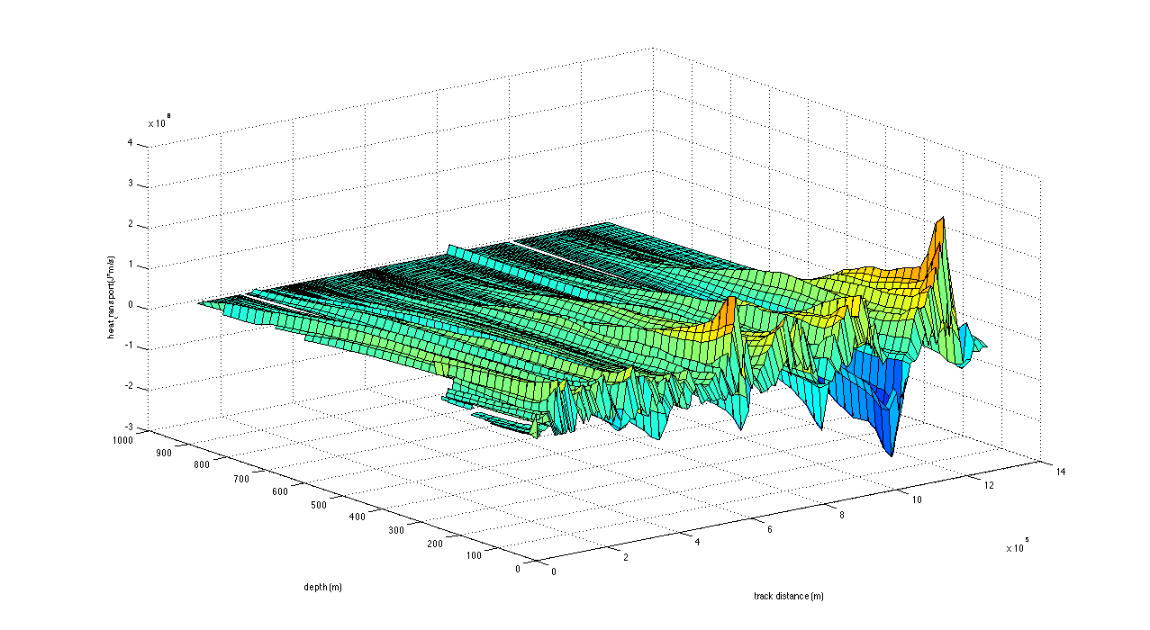
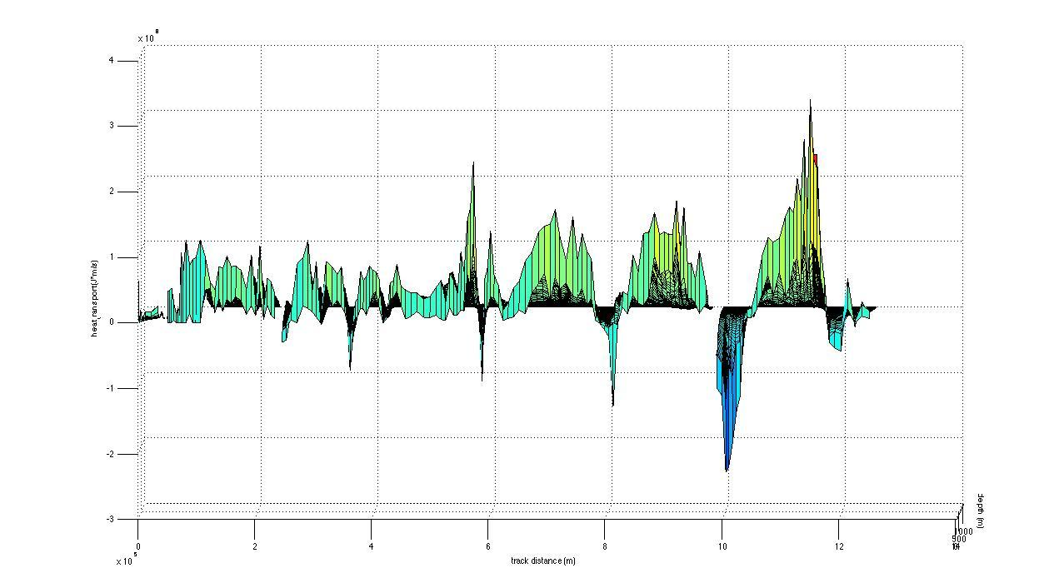

Slide 18
In Conclusion:
The oceans are changing on shorter timescales than we could have expected. It is now more important than ever to study how it is changing so we can make more accurate predictions for the future.

Slide 19
Special Thanks to:
Dr. Scott Glenn, Dr. Oscar Schofield, Dr. Josh Kohut, John Kerfoot, Dr. Antonio Ramos Kaycee Coleman, Ben Allsup, Alberto Gonzalez & Ruben Marrero

