Slide 1







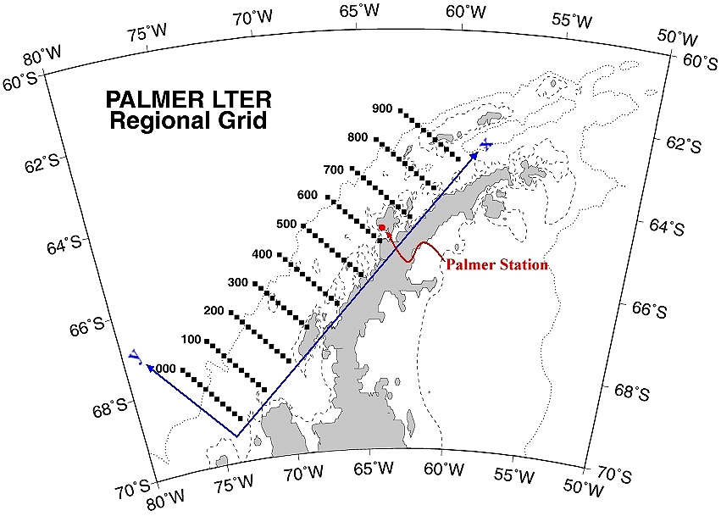
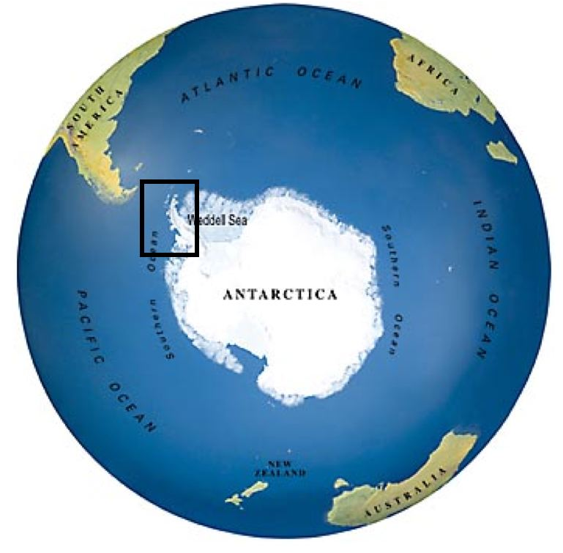
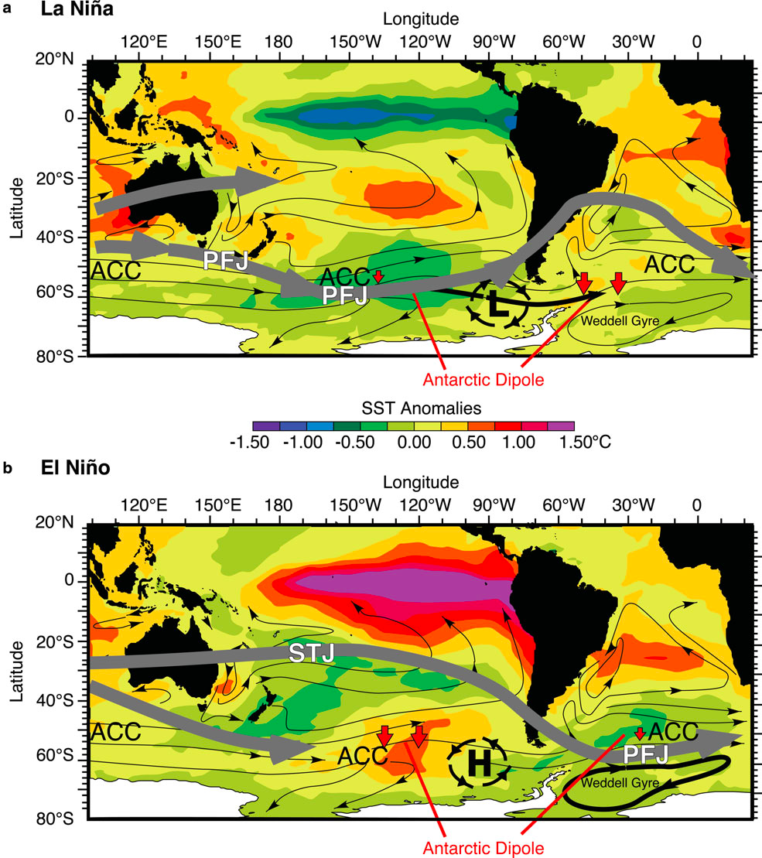
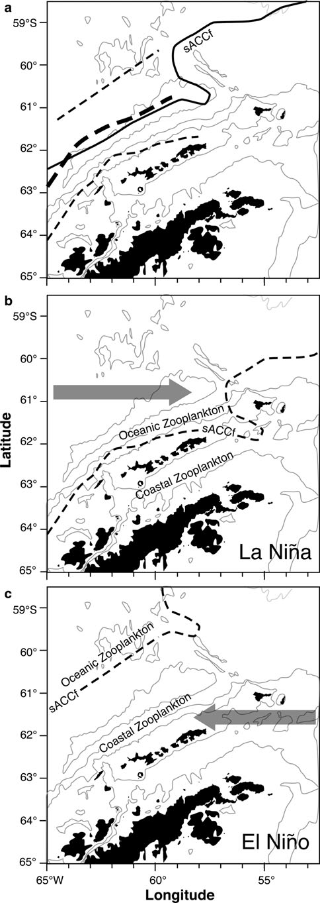
Large-scale forcing through the Antarctic food web:
Physical drivers of the interannual variability at Palmer Station
Grace K. Saba*, Vincent S. Saba, William R. Fraser, Sharon E. Stammerjohn, Hugh W. Ducklow, Douglas G. Martinson, Deborah K. Steinberg, & Oscar Schofield
*Rutgers University, Institute of Marine and Coastal Sciences
71 Dudley Road, New Brunswick, NJ 08901
Introduction
Mechanisms
Plankton dynamics in the West Antarctic Peninsula (WAP), the northernmost part of the mainland of Antarctica extending into the Southern Ocean, are characterized by high interannual variability (Smith et al. 2008; Loeb et al. 2009), yet the underlying physical mechanisms behind these fluctuations are unresolved. Previous studies have demonstrated the influence of large scale forcing (i.e., Multivariate ENSO index, MEI; Southern Annular Mode, SAM) on physical changes in the Southern Ocean (Yuan 2004). However, linking ENSO/SAM events with changes in physical water column properties is difficult due to the hydrographic and ecological complexity of the WAP region (Loeb et al. 2009). Here we examine phytoplankton bloom cycles and krill population dynamics associated with variability in the Southern Annular Mode (SAM) and Multivariate ENSO index (MEI) over the 20-year time series of Palmer LTER (PAL LTER). We also discuss our ongoing investigation into the physical mechanisms causing interannual variability, which we hypothesize is a result of changes in the mixed layer depth, sea ice, and nutrient supply due to the cyclical inshore-offshore fluctuation of the polar frontal system.
Below are the three leading spatial modes (A-C) and their corresponding eigenvectors (D-F; red lines) of SeaWiFS surface Chl a variability, which account for 33% of the total variability for the region from 1997-2010. Regional Chl a variability shows strong inshore-offshore and North-South differentiation and is correlated with MEI and SAM indices (D-F; black lines).
A
SeaWiFS Chl-a EOF 1 15.8%
-63
B
SeaWiFS Chl-a EOF 2 9.3%
-63
C
SeaWiFS Chl-a EOF 3 7.8%
-63
-64
-64
-64
-65
-65
-65
-66
-66
-66
-69
-67
-65
-63
-61
-59
-67
E
-69
-67
-65
-63
-61
-59
-67
-69
-67
-65
-63
-61
-59
-67
Study Site
D
F
In 1990, PAL LTER was designated as the first polar biome LTER site in the Southern Hemisphere. The WAP region has undergone dramatic climate change in the past decades (Schofield et al. 2010). Scientific research is
centered in and around Palmer Station, located in the northern WAP region (right), and an annual January cruise has been conducted along the entire peninsula since 1992. Palmer Station study sites include an inshore station (Station B) and an offshore station (Station E).
Palmer Station (Station B) seasonal depth-integrated Chl a (below; red squares) is slightly inversely correlated to MEI and SAM indices, and in general, Chl a peaks occur during neutral or slightly negative (-SAM and or La Niña) events.
SeaWiFS Chl a (below; red line) is positively correlated to sea surface temperature (SST; black line), and in general, Chl a was higher in warmer water.
Interannual Variability
During the 20-year PAL LTER time-series, peaks in chlorophyll a (Chl a) concentration and bacterial production at Palmer Station have occurred every 4-6 years (below). These high Chl a anomalies corresponded to large krill spawning events, which produced the start of a new krill cohort the following season, evidenced in penguin gut contents.
Yuan (2004; and references therein) describes a quasi-stationary wave, the Antarctic Dipole, which is a variability in the air-sea-ice system that strongly responds to ENSO variability. During La Niña events (below; top left panel), high temperatures and less ice occur in the Atlantic sector of the Dipole due to increased heat flux from the Antarctic Circumpolar Current (ACC) while colder temperatures and more sea ice occur in the Pacific sector of the Dipole. Additionally, the Polar Frontal Jet (PFJ) is intensified and the Southern ACC Front (sACCf) is displaced South-Eastward, closer to the continent (below; top right panel). The opposite occurs during El Niño events (below; bottom panels).
z-int Chlorophyll a anomaly (mg m⁻²)
z-int Bact Prod anomaly (mg C m⁻² d⁻¹)
WARM WATER
56-65
(Yuan 2004)
(Loeb et al. 2009)
51-55
46-50
41-45
Size Class (mm)
36-40
31-35
COLD WATER
26-30
16-25
Anomaly | 1998-1999 | 2005-2006
Depth-integrated chlorophyll a (mg m⁻²) | (-)75 | (+)107
Diatoms (% total phytoplankton) | (-)11 | (+)23
Cryptophytes (% total phytoplankton) | (+)12 | (-)9
SAM (DJF) + Yearly MEI | (+)2.31 | (-)0.02
SAM (DJF) | (+)1.47 | neutral
Yearly MEI | (+)0.84 (El Niño) | neutral
Actual Measured Value | 1998-1999 | 2005-2006
SST (°C; WAP Average) | 0.25 | 0.55
Average depth of Chl a max (m) | 48 | 15
Average depth of 1% surface irradiance (m) | 41 | 25
Depth of Tmin (m) | 77 | 34
Case study: We compared an anomalously low Chl a season (98-99) to a high Chl a season (05-06) (Table 1; left). The peak Chl a season was characterized by diatom dominance, warmer water, ample light at Chl_{max} depth, and neutral MEI and SAM events. In contrast, an El Niño event occurred in 98-88. Small cryptophytes dominated, and the depth at Chl_{max} was at or below the 1% light depth, potentially limiting productivity.
We hypothesize that during La Niña events and possibly transitional phases (neutral MEI/SAM), when the sACCf is displaced closer to WAP, the increased circulation of warm water reduces sea ice (influx of warm water), increases water column stratification (enhanced light; due to shoaling of Upper Circumpolar Deep Water, UCDW), and/or supplies macronutrients and iron the water column at Palmer Station, favoring biological activity. In contrast, during El Niño events, the north-westward displacement of the sACCf creates an entrainment of cold water along the shelf, increases sea ice and deepens the mixed layer (light limitation), and/or reduces nutrient supply. As a consequence, phytoplankton productivity is decreased, which reduces recruitment of Antarctic krill and the availability of krill to penguins and other predators.
Future Work
Acknowledgments: We acknowledge the LTER scientific teams, the captain and crew of the R.V. Laurence M. Gould, and Raytheon Polar Services for excellent field support. This work was done in cooperation with the Palmer Long Term Ecological Research project and was supported by the LTER Program of the U. S. National Science Foundation (OPP-02-17282), the Gordon and Betty Moore Foundation, and the NASA Biodiversity Program.
References:
Loeb, V.J., Hofmann, E.E., Klinck, J.M., Holm-Hansen, O., and W.B. White. 2009. ENSO and variability of the Antarctic Peninsula pelagic marine ecosystem. Ant. Sci. 21: 135-148.
Schofield, O., Ducklow, H.W., Martinson, D.G., Meredith, M.P., Moline, M.A., and W.R. Fraser. 2010. How do polar marine ecosystems respond to rapid climate change? Science 328, 1520-1523.
Smith, R.C., Martinson, D.G., Stammerjohn, S.E., Iannuzzi, R.A., and K. Ireson. 2008. Bellingshausen and western Antarctic Peninsula region: Pigment biomass and sea-ice spatial/temporal distributions and interannual variability. Deep Sea Res. II 55: 1949-1963.
Yuan, X. 2004. ENSO-related impacts on Antarctic sea ice: a synthesis of phenomenon and mechanisms. Ant. Sci. 16: 415-425.
Investigations are ongoing to determine how biology is directly tied to water column properties and sea-ice dynamics, and the collective teleconnection of these parameters to large scale forcing:
Analysis of sea-ice anomalies.
Analysis of wind and CTD data to determine mixed layer depths for the length of the time series.
Analysis of long-term nutrient data.
Analysis of North-South and inshore-offshore variabilty in plankton dynamics with respect to large climactic and local physical forcing.

