Slide 1
Challenger Mission: Power Consumption
Shannon Harrison, Jessica Castoro, Joseph Nardella, Austin Melillo, Jocob Werman, Doran Shapiro, and Dylan Bozel

Slide 2
Battery Shipping
Lithium batteries are considered by to be a flammable solid, spontaneously combustible, and dangerous when wet.
Preapproval must be obtained in order to ship lithium metal batteries.
The following information must be sent to dgadmin@fedex.com
FedEx account number
Company name and complete address
Contact name(s) and phone number
Type of preapproval requested
Fully regulated UN 3090, lithium metal batteries
Detailed description and digital photos of inner packaging
Certain packaging requirements must also be met
The batteries must be packaged such that no two batteries can touch or touch any item capable of conducting electricity.
The package must be fully labeled, marked and certified in accordance with the International Air Transport Association (IATA) dangerous goods regulations.
We must contact FedEx Express Dangerous Goods Administration to certify that the package complies with the lithium battery standard.

Slide 3
FedEx
Service to South Africa is done via FedEx International Priority Freight.
Skids exceeding 70" in height or 119" in length or 80" in width require prior approval. Unlimited total shipment weight.
Advance confirmation required. Book space using FedEx Ship Manager® at fedex.com or by calling 1.800.332.0807.
To lessen the possibility of damage or delay, follow these packaging guidelines when preparing your express freight shipment:
Individual pieces over 150 lbs. must be banded to the pallet with either metal strapping or unbreakable plastic straps applied around the box or skid freight on all sides.
Hardened containers (plywood, metal) that are not banded must have an exterior lock or clamp (glue, nails and screws are not sufficient).

Slide 4
Coulomb Meter
COULOMBS LAW= LAW OF PHYSICS DESCRIBING THE ELECTROSTATIC INTERACTION BETWEEN ELECTRICALLY CHARGED PARTICLES
1C= 1A TIMES 1 SECOND
Comparisons:
1 LIGHTING BOLT= 15 COULOMB’S
1 ALKALINE AA BATTERY= 5KC= 5000C= 1400 mAh
Ah= Amphers per Hour
Kc= Kili Coulomb
COULOMB DEFINED BY AMPERES AND SECONDS

Slide 5
HOW MANY BATTERIES CAN RU29 FIT?
This specific glider will contain three battery packs.
One in the aft section, and two pitch packs in front of the science bay towards the nose.
The two pitch packs contain 36 batteries each, and the aft pack contains 42, combining for a total of 114 lithium batteries.

Slide 6
RU27 Power Usage

Slide 7
Silbo Power Usage

Slide 8
Potential ways to keep power output low
Lessen the frequency of the times the glider dives
Lower the frequency of the gliders reports
Decrease the depth of dives
Less technology (science sensors) on board

Slide 9
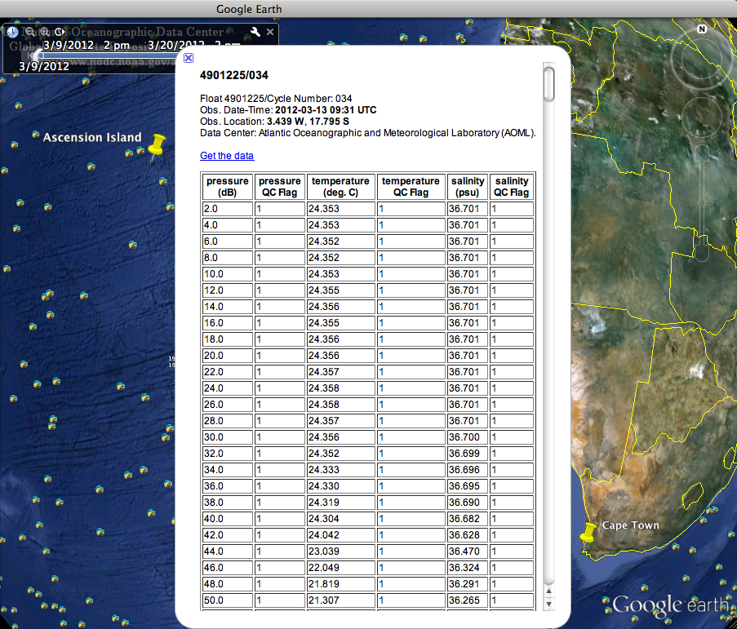
ARGOS floats were used to collect the average temperature data that was used to calculate battery usage.

Slide 10
RU29 Power Consumption
38- 3 series batteries
Glider uses 12 V
Batteries give 30 Ah
Average water temperature: 10°
Shelf life: 3% a year
38- 3 series= 1076 Ah
If the glider uses 2 Ah per day:
538 days (12,912 km)
If the glider uses 3 Ah per day:
307.43 days (7,378 km)

Slide 11
Special thanks to:
Scott Glenn
Oscar Schofield
Josh Kohut
Dave Aragon
Tina Haskins
Ben Allsup

