Slide 1
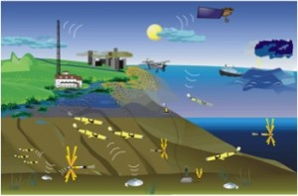
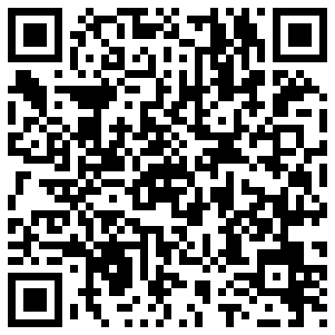
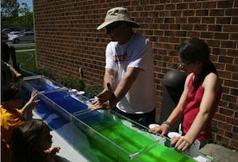
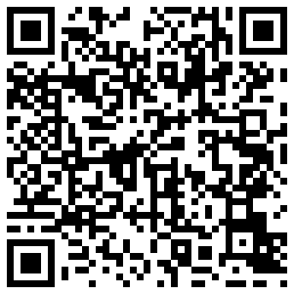
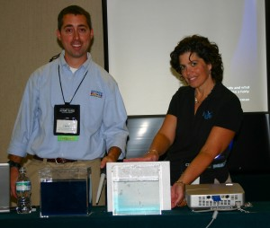
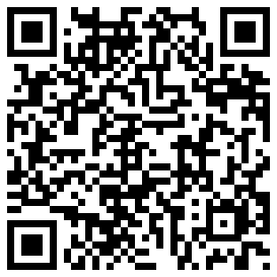
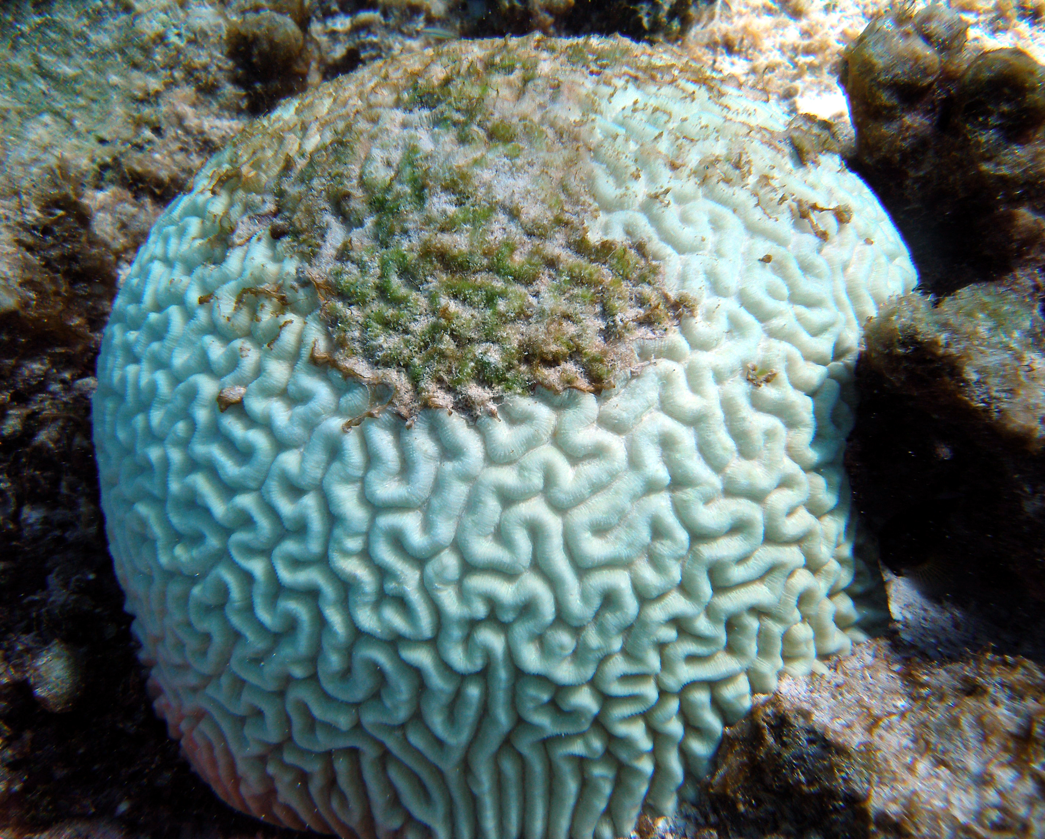
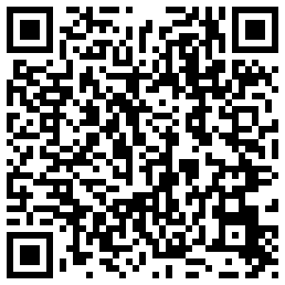
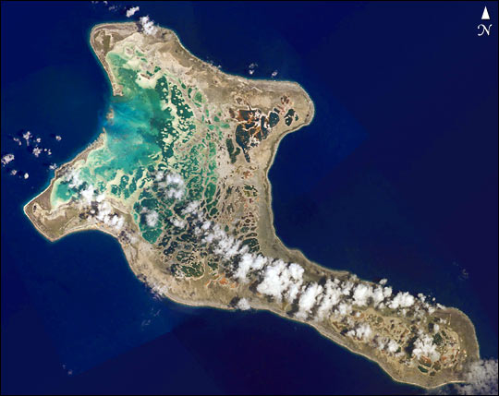
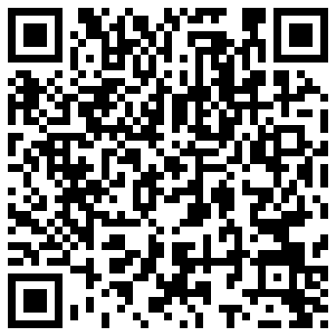
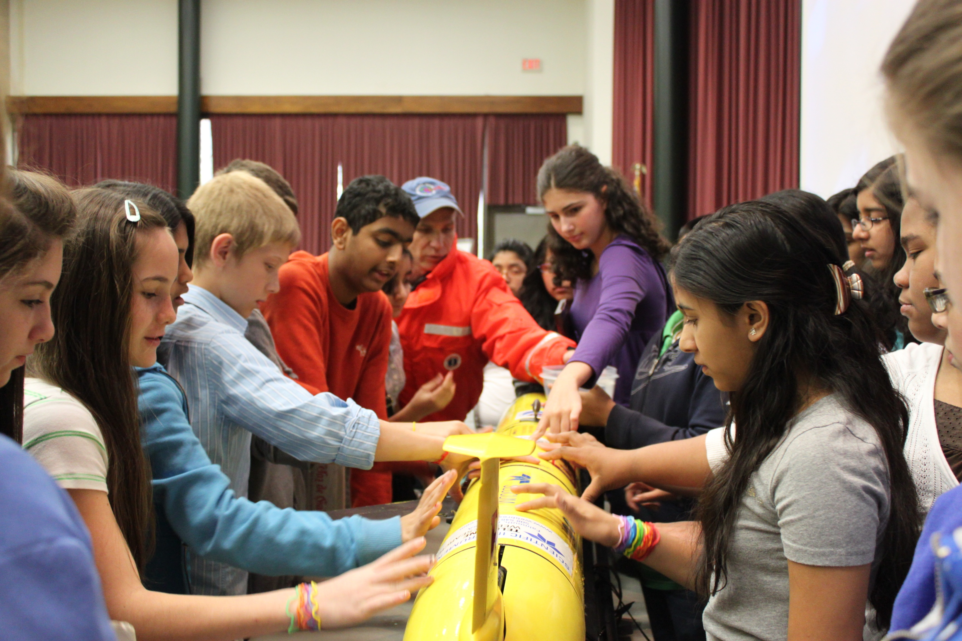
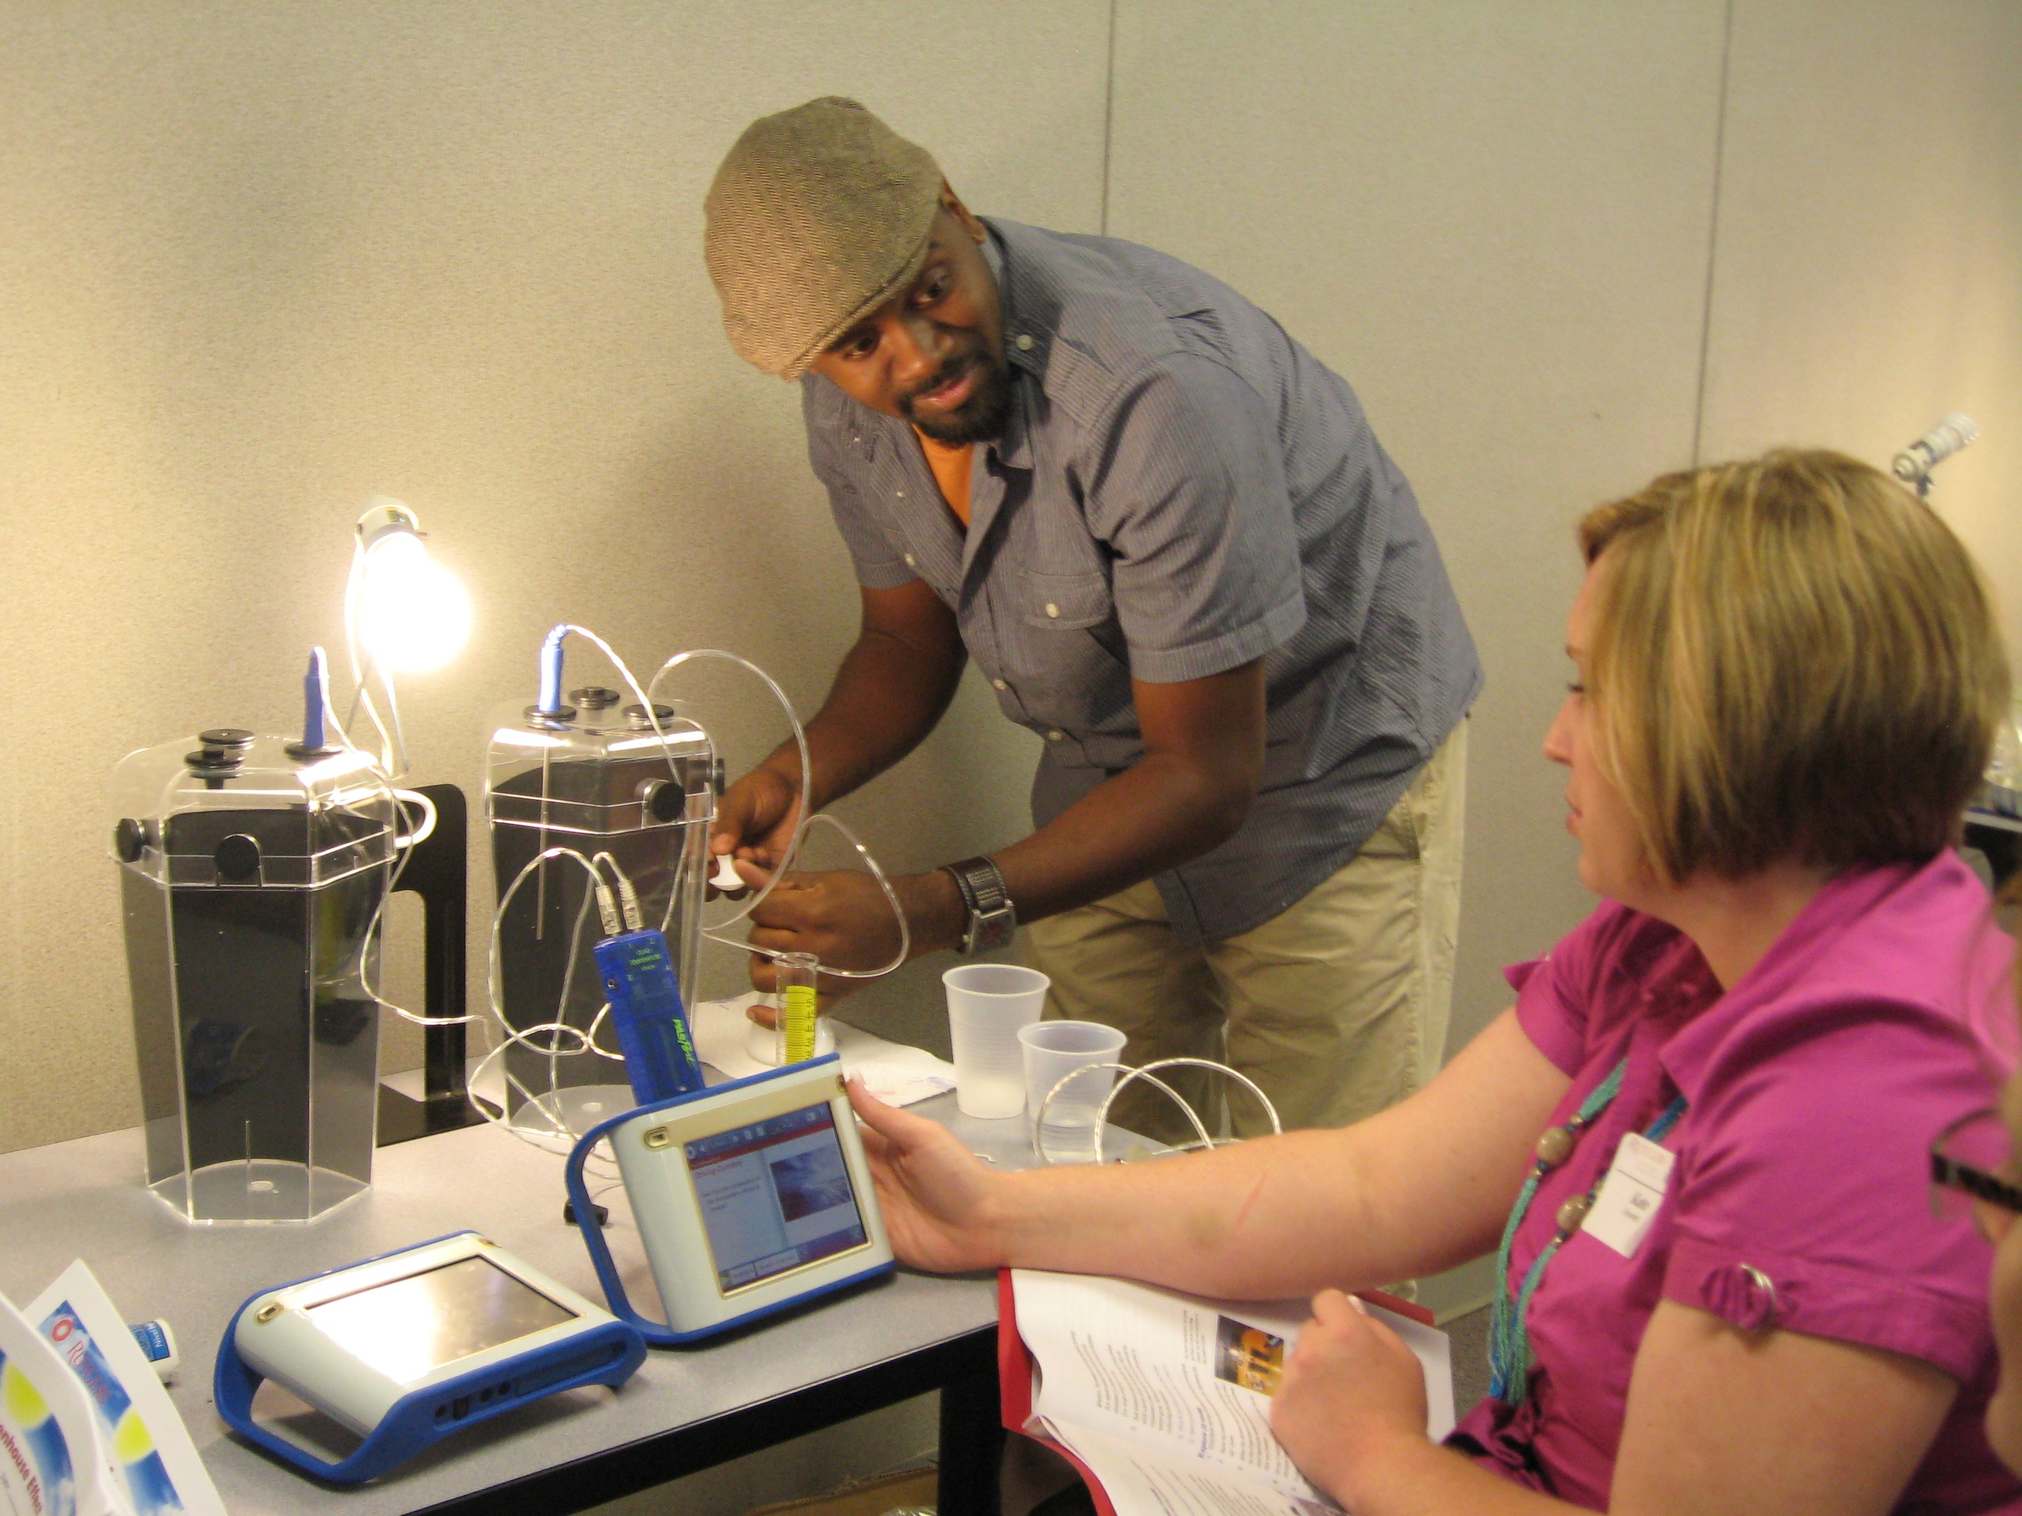
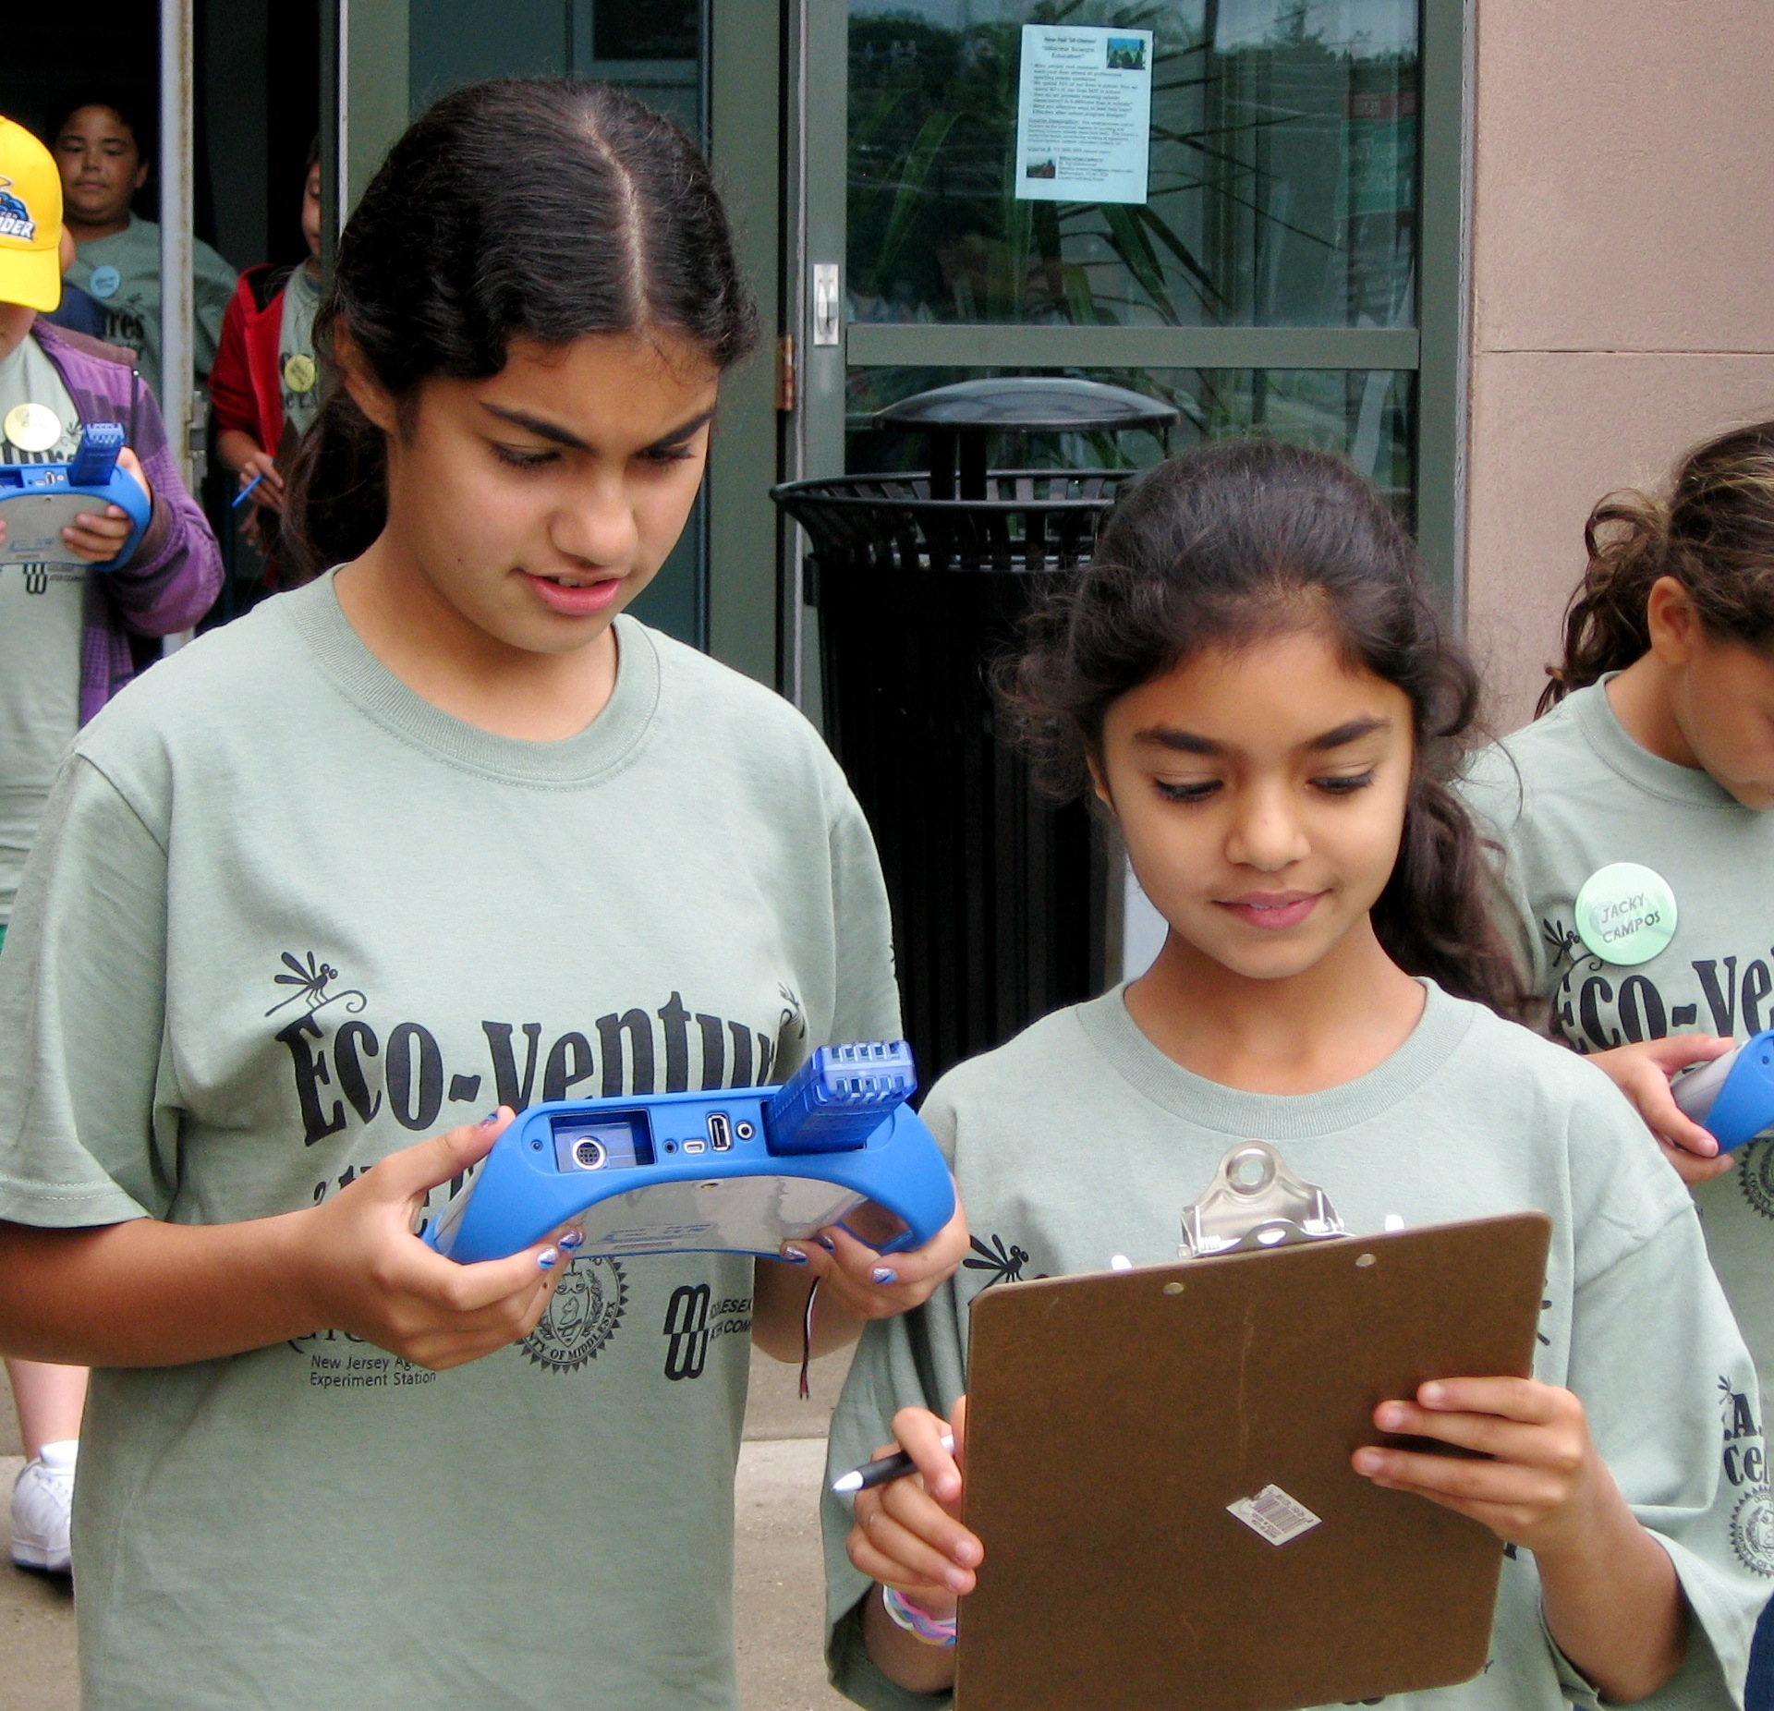
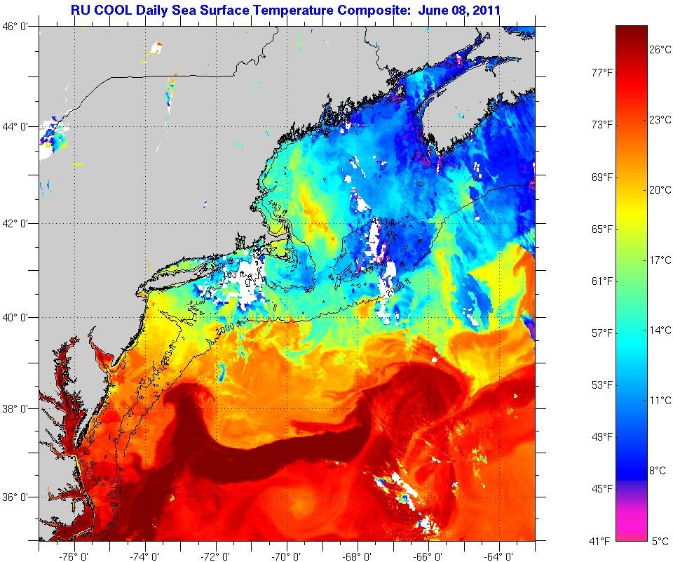
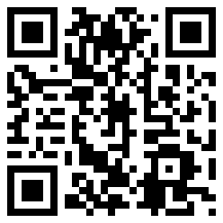




Constructing a Framework to Classify Ocean Data Activities:
A Tool for Content Developers, Data Translators and Educators (B0680)
Sage Lichtenwalner¹, Kate Florio², Janice McDonnell¹, Katie Gardner², Harold Clark², Chris Parsons³, Liesl Hotaling⁴
1 Rutgers University 2 Liberty Science Center 3 Word Craft 4 University of South Florida
Introduction
The world we live in is increasingly characterized by data. In oceanography, the Ocean Observatories Initiative (OOI), the Integrated Ocean Observing System (IOOS) and other efforts are spurring advances in sensor technologies and cyberinfrastructure that are changing the way oceanographers conduct research and share their results with the world.
As we look to train the next generation of scientists, it is imperative that students have the opportunity to develop the skills necessary to collect, analyze and understand data.
To meet this challenge, COSEE Networked Ocean World (NOW) has collaborated with scientists and educators to develop a framework to categorize and describe classroom activities that utilize ocean datasets and visualizations. The framework is designed to:
make data activities more accessible to both formal and informal educators by facilitating the discovery of ocean data and data products appropriate for their audience of learners.
assist content developers by providing them a means to guide their development efforts towards suitable presentation formats for various inquiry styles.
The model framework is currently being reviewed with classroom educators and lesson developers in the COSEE NOW online community.
What do you think?
Learner Independence
Example COSEE NOW Activities
Please place a dot on the framework:
Where you feel your students learn best
Where you typically teach
Learner
Generated
Data
1
Ships, Ocean and Satellites
Includes simulated collection & interpretation of averaged data and an introduction to SST RTD products
2
Lab/Field Experiments
2
Water Density and the Ocean
Learners create water samples of different densities, collect data about them, and observe them interacting in a density tank
Real Time
Data and
near RTD
3
Don’t even Sink About it
Includes hands-on experiences and brief introduction to buoyancy and its implications on commercial shipping
Lecture
3
5
Online Labs
Place your 2nd dot here if you do not currently teach with data
4
Coral Bleaching
Learners use SST graphs created from archived data to determine the threat of coral bleaching
Archived
Data
4
Writing Prompts & Homework
5
Christmas Island RTD Activity
Provides a series of questions and relevant data sources for students to investigate their own questions about weather at various locations in the world
Simulated
Data
1
Complexity
Using the Framework to Improve RTD Education
The COSEE NOW team is currently
building out the framework to include
guidance for educators and content
developers for each box. This includes
defining the skills learners need to have
to use activities in each category, and
the skills educators need to effectively
build skills in their students.
COSEE NOW is using this framework
to inform several current and future
activities, including:
Defining Pathways to Learning: What is the best approach to develop data literacy in students and educators? Can the framework be used to designed scaffolded curriculum (i.e. a pathway through the boxes)?
Informing Curricula Development: The framework can be used to classify existing curricula and to find niches that are not well covered.
Professional Development: The framework can provide educators with a context for using RTD in their teaching, as well as selecting, adapting and developing lessons that use best practices to teach data literacy.
The framework does not include all of the possible ways to teach with data, nor all of the nuances of different data types. If you are an educator who is using or aspires to use data in your classroom, we hope that this framework can help you identify and grow the data analysis skills and inquiry capabilities of your students.
References
Adams, L. G. and G. Matsumoto (2009). Enhancing Ocean Literacy Using Real-Time Data. Oceanography.
Hug, B. and K. McNeill (2008). Use of First-hand and Second-hand Data in Science: Does data type influence classroom conversations? International Journal of Science Education.
McDonnell, J. D. et al (2012). An Assessment of Real-Time Data Use in Undergraduate Classrooms. Ocean Sciences 2012. (see poster in this session)
McGrath, E. (2001). Is it Unique & Compelling? Momentum Magazine.
Parsons, C. (2006). SWMP/IOOS Real-Time Data in K-12 Classrooms: A Front-end Evaluation.
http://coseenow.net/files/2008/12/rtd_exec_sum.pdf
Acknowledgements
This project is a collaborative effort by members of the Centers for Ocean Sciences Education Excellence Networked Ocean World (COSEE NOW). This project is supported by the National Science Foundation under Grant No. OCE-0730719.
Visit and join our online community of real-time
data educators at http://coseenow.net/groups/rtd/
Delivery Modes
These boxes show the potential intersection of several teaching styles within the framework
Orientation
Interpretation
Construction
Y axis: Data Types
Learner Generated Data
Data that is measured and/or calculated by learners as part of an activity, lesson, or project. This can take place in the lab, field, or classroom.
Real Time Data and near-RTD
Data that you can access as the data is collected (or shortly thereafter) to study current conditions or events. Generally these datasets are collected on an ongoing basis. The most recent data available are considered “real-time” (for example, the current month for data accumulated on a monthly basis). This can include data in which confusing features or outliers have been removed, or by averaging multiple data sets to create a generalization, composite or advanced data product.
Archived Data
Data that documents past conditions or events that is used to put present conditions in context, generally older than 5-10 sampling periods. This can include data in which confusing features or outliers have been removed, or by averaging multiple datasets to create a generalization, composite or advanced data product.
Simulated Data
Data that looks realistic, but was created or manipulated using real data or a model approximation to emphasize a particular science concept with minimal confusion.
X axis: Learner Engagement Level
Orientation
At this level, learners use of data is highly guided by the educator. Students need to be told what data is, what it tells them about the world, and how data representations communicate information. Students can identify specific answers within their existing knowledge base. For example, they can answer simple, focused questions about a data set or visualization (e.g. verify a value, or which of the following things are true).
Learners begin to identify data as useful information that can be interpreted and practice basic data literacy skills. They can use data to find answers that support concepts being discussed, but are not yet able to build understanding.
Interpretation
Learners can parse out information from data with less scaffolding from the educator. They can begin to apply (often with guidance and/or prompting) how information gained from data applies to the topic they are studying, as well as what they already know about the world.
Learners become aware of how to get information from basic data representations (i.e. without guidance they can decipher information from the title, axes, key, and legend) and continue to build their skillset.
Construction
Learners at this level can use data as supporting evidence to construct their own conclusions without requiring step-by-step guidance. They are able to interpret data on their own, and look to their educator for confirmation of their analysis.
Learners should also be able to identify which datasets or pieces of information within a larger set are relevant to the question being asked. The use of data is integrated into their understanding of the topic.
4-H educators learn how to collect real-time environmental data during a professional development workshop.
At Rutgers Ocean Day events, middle school students learn how scientists are utilizing new technologies like underwater gliders to study the ocean in real-time.
Students can use probeware to easily collect their own data
Background
Several educational studies have shown that using authentic real-time data (RTD) from scientific institutions can enhance student motivation and investment in the concepts being explored (Adams and Matsumoto 2009, McGrath 2001, Hug & McNeill 2008). The experience can also engage students directly in the scientific process. Unfortunately, relatively few K-12 or undergraduate educators currently integrate data analysis into their curriculum. Many are highly motivated to do so, in part thanks to the ongoing effort to implement new science standards at the K-12 level (McDonnell 2012, Parsons 2006).
This framework is intended to categorize the skills needed by students at different levels of engagement with data, as well as the teaching styles necessary for educators to use to effectively engage students in using and understanding data. It also provides examples of how different types of data (i.e. raw, visualizations, models and simulations) and delivery methods (static images, interactives, first-hand data collection) can fit into various educational settings. Finally, it will include recommended pathways for educators to increase the data literacy level of their students.
Potential Uses of the Framework
To provide a roadmap for creating Professional Development programs for educators.
To help Content Developers create lessons, matched with appropriate datasets and visualizations, focused on specific learning objectives.
To provide Educators, who haven’t taught with data, with suggested pathways to integrate data activities into their teaching.
To help Educators, who are already teach with data, find lessons.
Student can use real-time or archived daily SST composites to learn about ocean conditions
Climatology SST imagery with generalized scales is useful for introducing students to basic ocean patterns
What is Data?
In this framework, we consider data in several forms, including data measurements (e.g. information from instruments), data visualizations, and data products (e.g. calculated or modeled measurements), all of which can be used by students to conduct scientific investigations.
The Skill of Graphing
Graphing data is a basic skill students need to learn and practice. Graphing itself does not fall under any one particular learner use on this framework; the framework is more concerned with what students do with the graph once it is constructed.

