Slide 1


Virtual Tools to Aid Scientists in Developing Broader Impact Projects
            Carrie Ferraro
Liesl Hotaling
Janice McDonnell
Sage Lichtenwalner
Jim Yoder
Ari Daniel Shapiro
Chris Parsons
February 20, 2012

Slide 2


Scientist’s Concerns about Broader Impacts (BI)
It will take too much time & money
It is unclear what is required
Notes:
As most of you are aware, since 1997, NSF attempted to diversify and enrich science research and education in the USA through the Broader Impacts Criterion (BIC), also known as “Criterion Two” or the “Second Criterion”. However, even 15 years later researchers are still unclear about what is required to fulfill this criteria and worry that it will take too much time and effort.

Slide 3
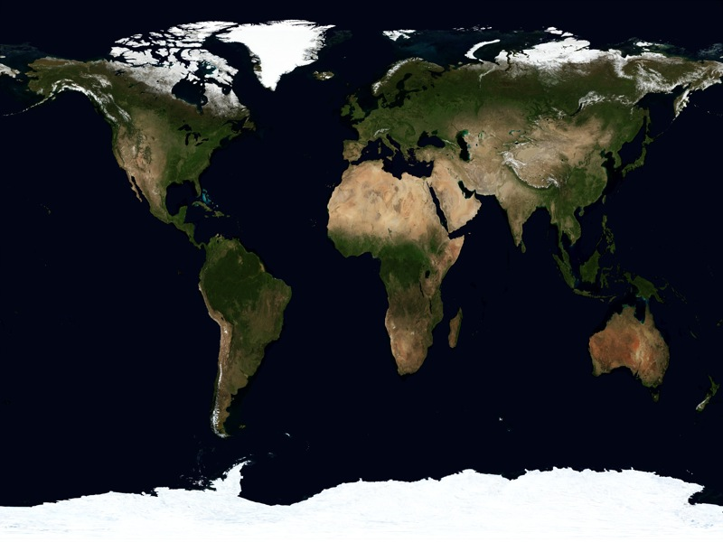
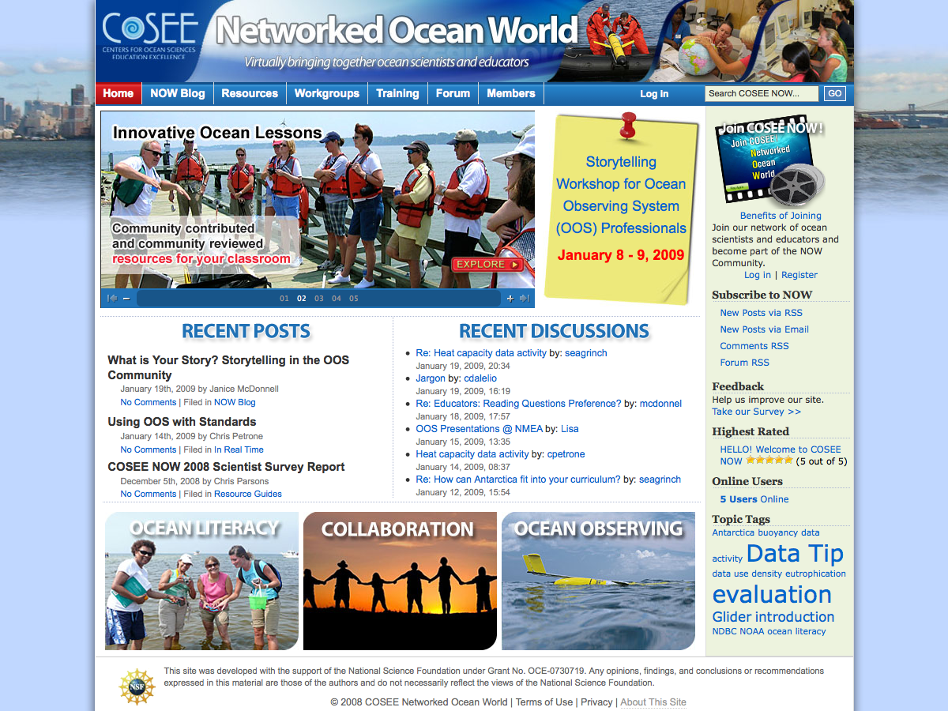
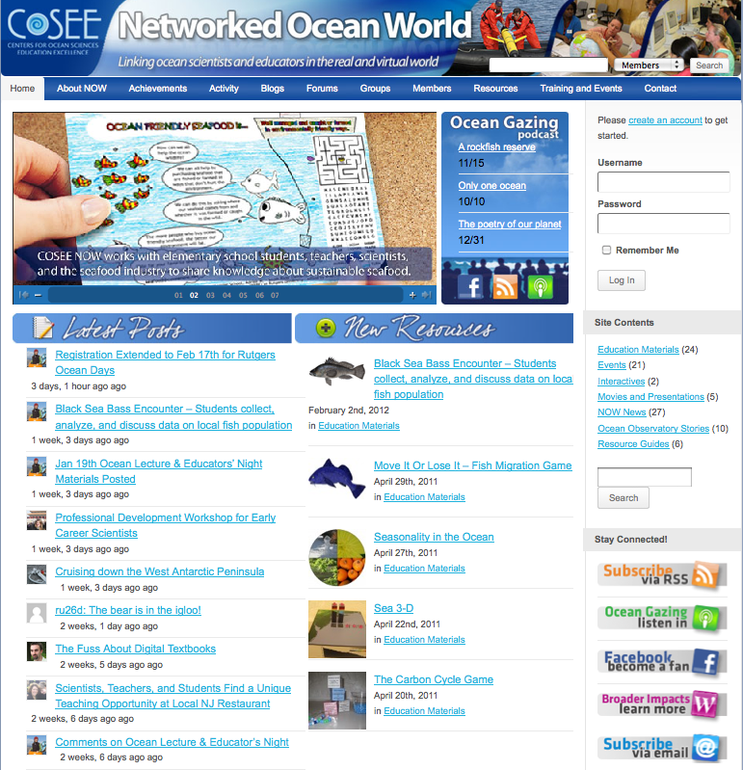

COSEE – Networked Ocean World (NOW)
Lead Institutions
Rutgers
WHOI
VIMS
Liberty Science Center
Florida State University
Monterey Peninsula College
Word Craft
http://coseenow.net
Notes:
To help assuage these concerns, COSEE Networked Ocean World (COSEE NOW) has dedicated itself to supporting ocean scientists in successfully communicating the broader impacts (BI) of their research. To achieve this goal, we have built an online community that expands the collaborative capabilities of scientists and education and public outreach (EPO) professionals. Our online social networking portal (http://coseenow.net) provides a virtual meeting place, where members (scientists and EPO professionals) can work together on innovative ocean education projects.

Slide 4
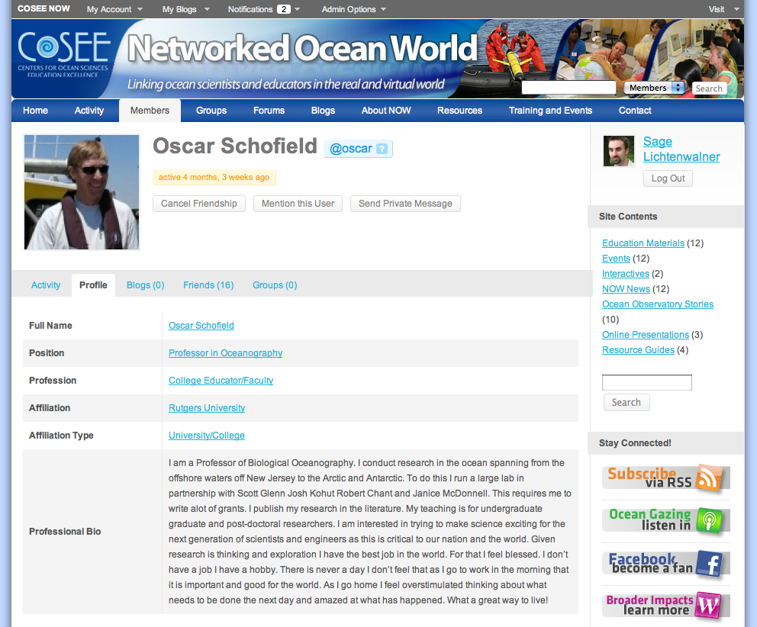
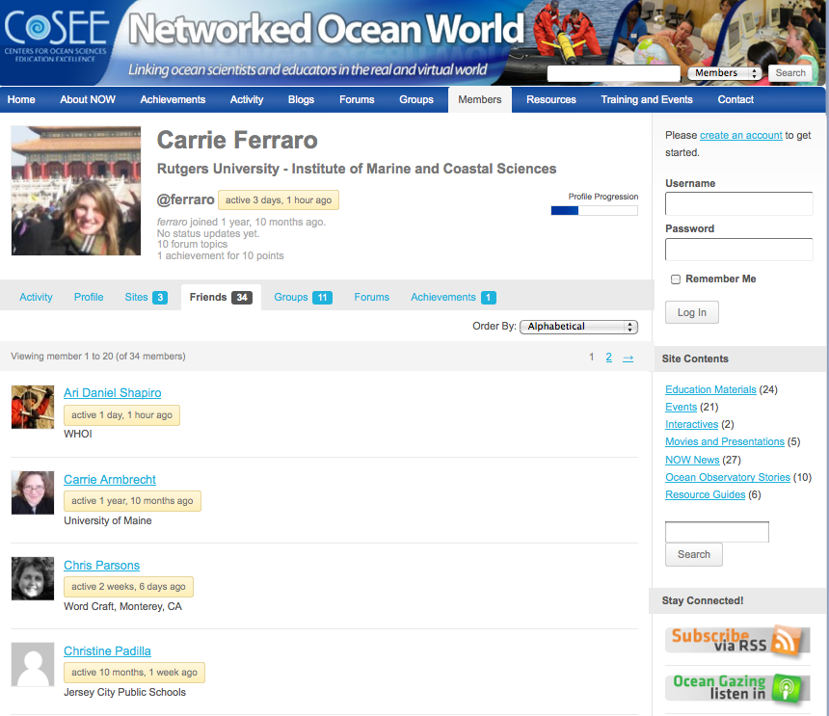
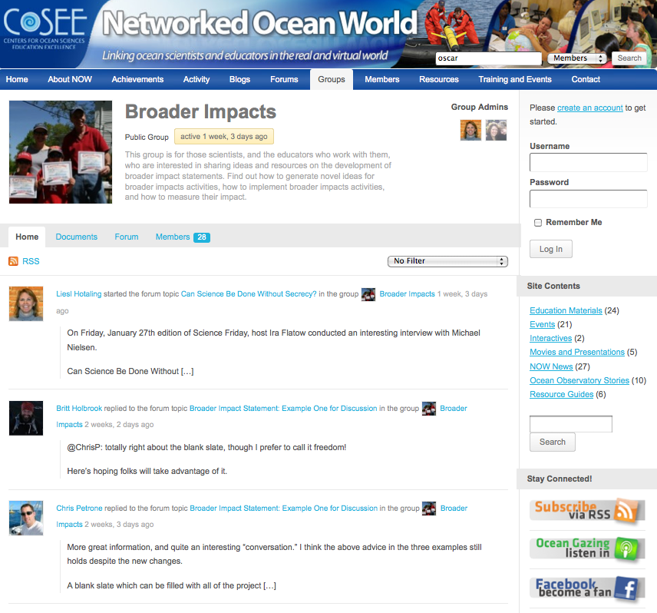
Online Collaboration Tools
Member Profiles
“Friending” Capabilities
Topical Workgroups & Blogs
Notes:
On coseenow.net members can create their own profiles and search for colleagues and potential collaborators to add as contacts or “friends.” To further facilitate collaboration, the site also features collaborative workgroups (both public and private) and topical blogs, where users can discuss relevant issues and share resources.

Slide 5

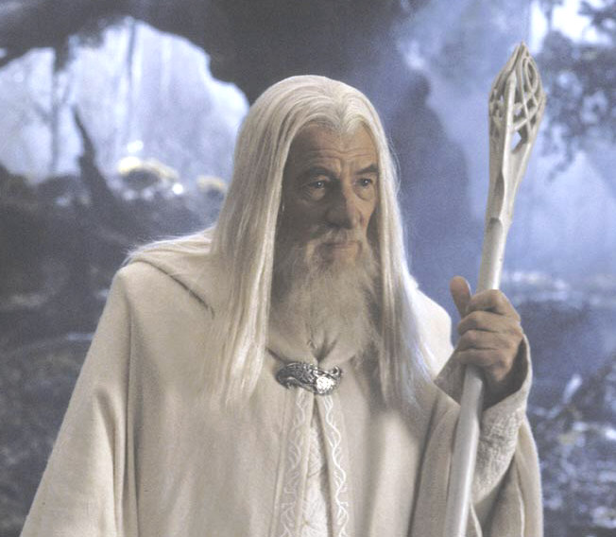
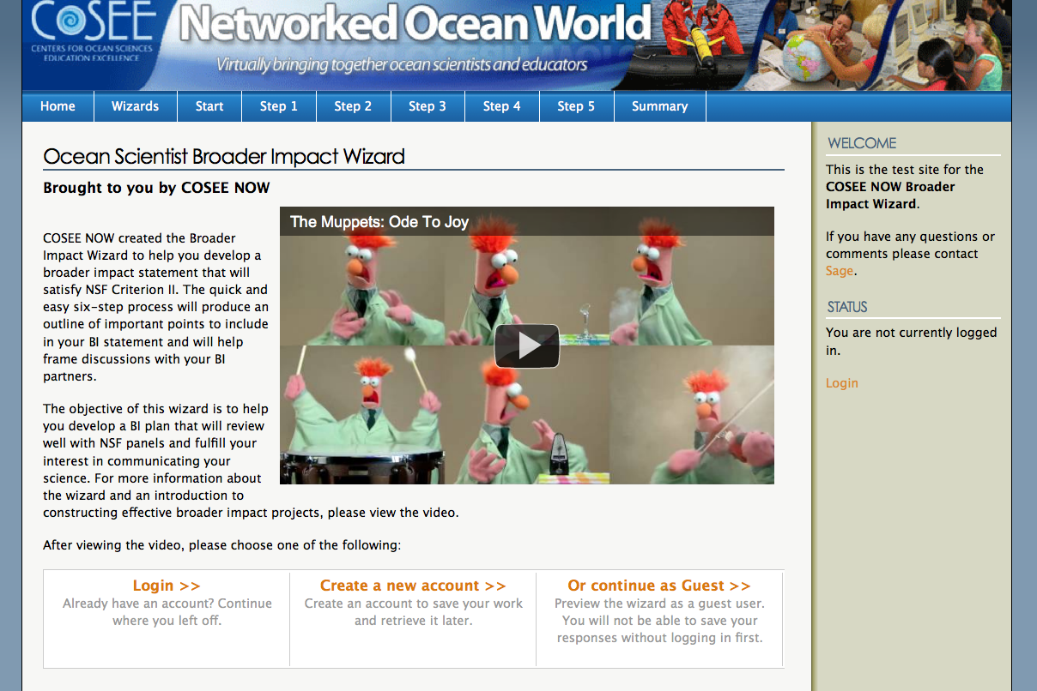
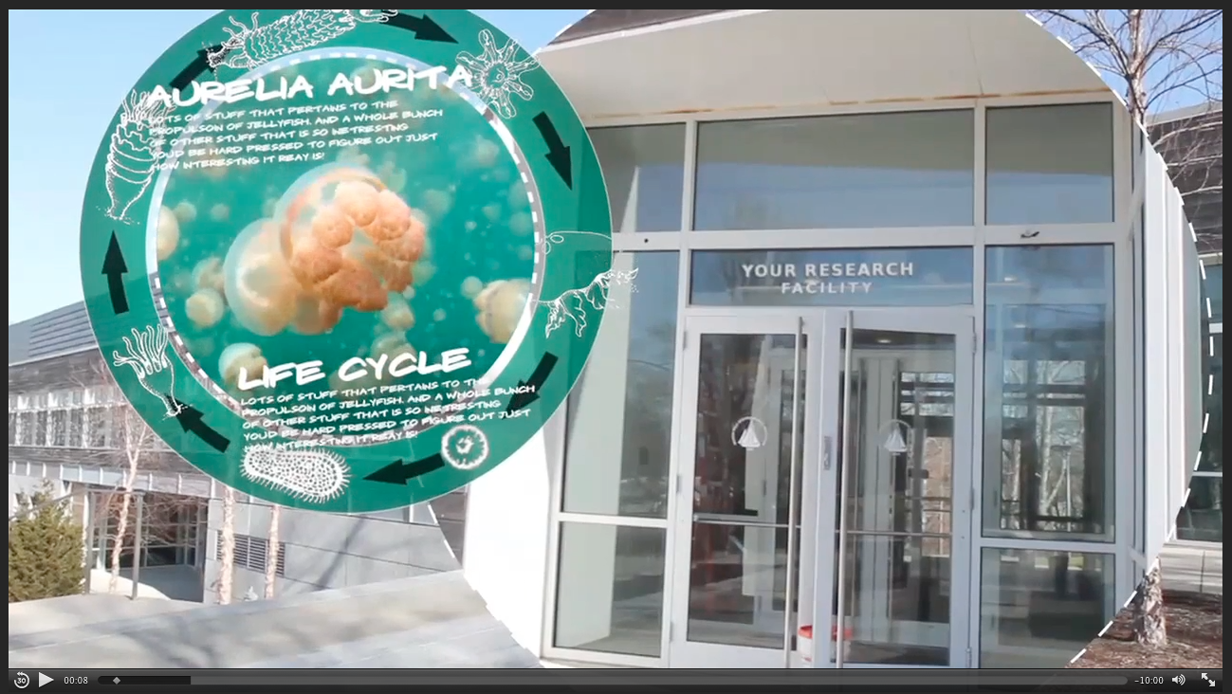
Broader Impact Wizard
Notes:
Today, I will be focusing on a new application that we are adding to this suite of online tools. The Broader Impact Wizard… is smart software which support users in the construction and implementation of successful broader impact statements.

Slide 6
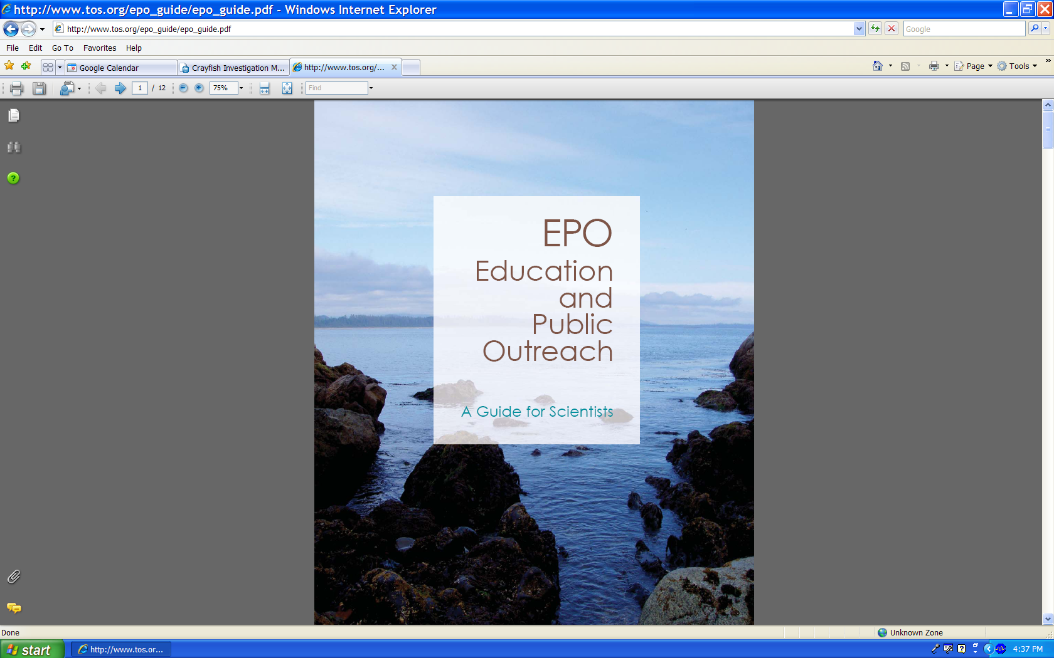
Background
COSEE NOW’s recommendations for success:
1) Core objective (who and why)
2) Connection with an “educational player/partner”
3) Statement of uniqueness – relate to educational literature
4) Evaluation plan
5) Budget for your proposed work.
Notes:
In the wizard, we’ve taken general background information on how to develop and enact robust BI projects and operationalized and personalized this knowledge. Basically, we’ve taken this key document, which was developed by a number of you in this room, and recommendations from COSEE NOW’s BI professionals, such as … and tried to personalize this for the user so that they can write their BI statement.

Slide 7
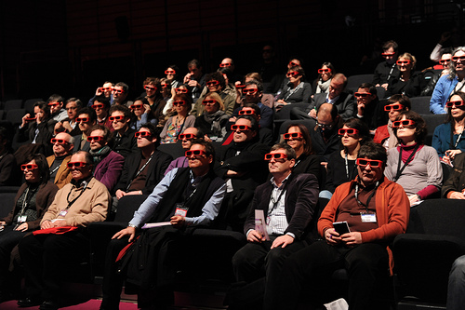

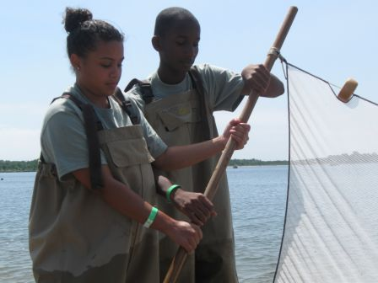

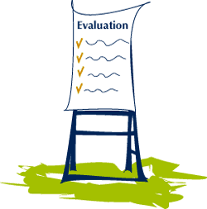
5 Steps
1: Audience
2: Budget
3: Activity
4: Objectives
5: Evaluation
Notes:
The BI Wizard walks the user through five steps (list them) and from the information inputed intp by the user forthese steps, provides them with a summary report to help plan and draft their proposed broader impact project and/or share this information with a potential partner

Slide 8
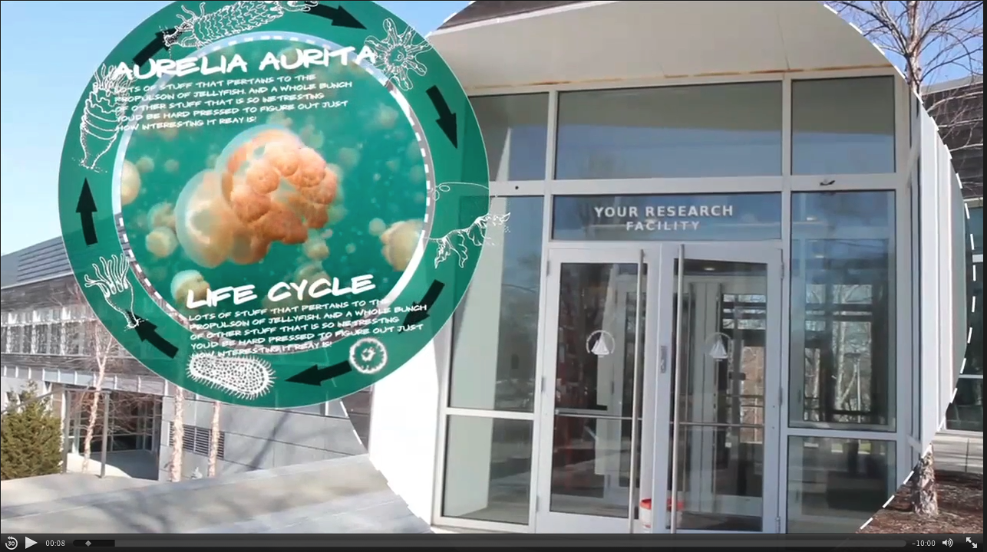
Notes:
Mention log in and videos

Slide 9
Notes:
Mention log in and videos

Slide 10
Notes:
Mention log in and videos

Slide 11

Step 1: Audience
“To begin with the end in mind means to start with a clear understanding of your destination.” – Stephen Covey
Audience
Notes:
In Understanding by Design, Wiggins and McTighe begin the first chapter with the a quote from Stephen Covey that says "To begin with the end in mind means to start with a clear understanding of your destination.” In this case, in order for scientists to determine what broader impacts project they want to take on, they need to first consider their destination, their audience. More specifically, they should consider who they would be comfortable working with, who would benefit from their message and who they would like their message to reach.

Slide 12
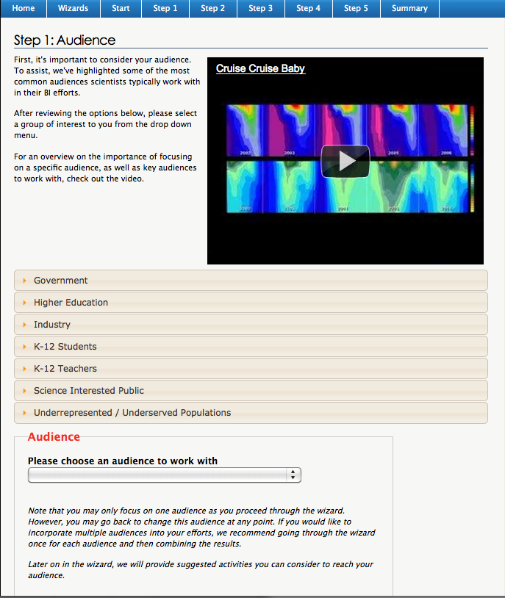
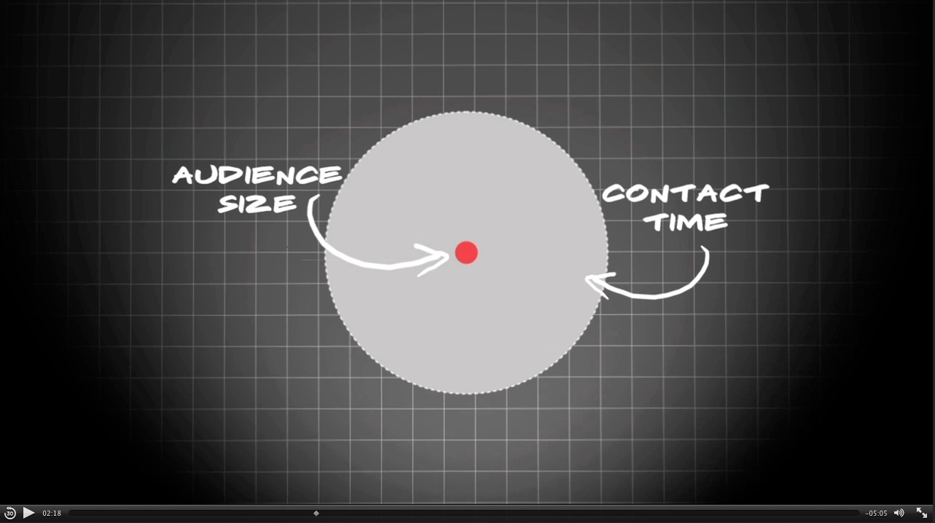
Step 1: Audience
Notes:
To assist the user in selecting an audience, we've provided a video on working with different audiences and highlighted some of the most common audiences scientists work with in their BI efforts. If we were to zoom in here. You can see hat for each audience, we’ve provided a description of the audience and summarized why it is important to work with them. After reviewing the options we ask the user to select an audience of interest to them. Of course if they would like to change this choice at any point, they can always go back and do so.

Slide 13
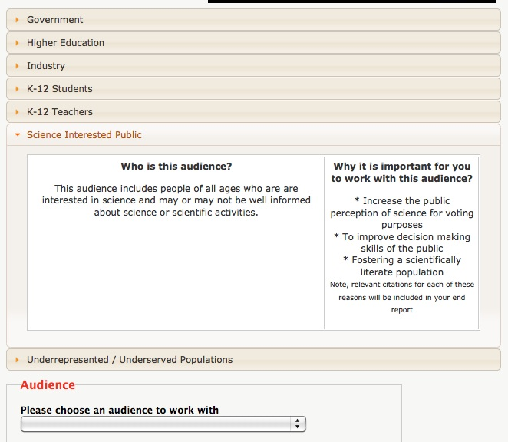
Step 1: Audience
Notes:
To assist the user in selecting an audience, we've provided a video on working with different audiences and highlighted some of the most common audiences scientists work with in their BI efforts. If we were to zoom in here. You can see hat for each audience, we’ve provided a description of the audience and summarized why it is important to work with them. After reviewing the options we ask the user to select an audience of interest to them. Of course if they would like to change this choice at any point, they can always go back and do so.

Slide 14
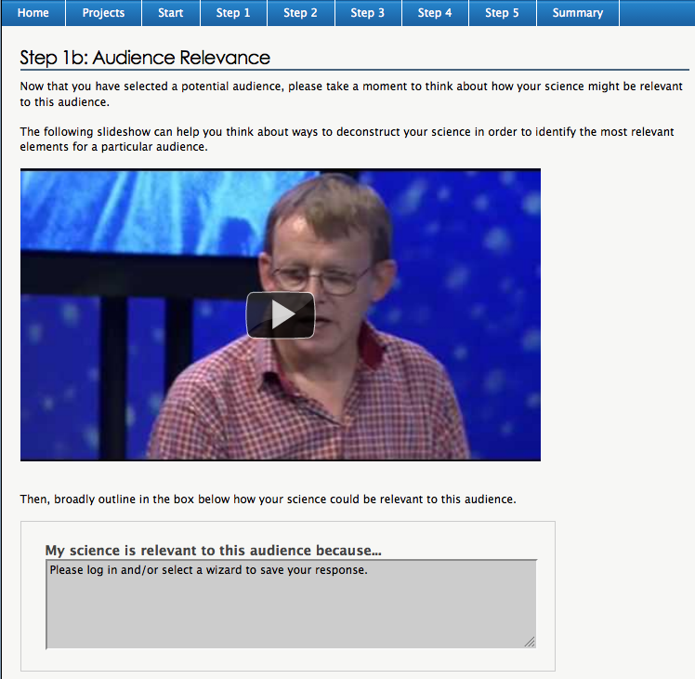
Step 1: Audience
Slideshow on deconstructing your science
Notes:
Once they have a group identified, we ask the user to discuss how their science is relevant to this group. Going through this exercise will help the user determine the key points of their message and will help ensure that make they will be working with a group that would benefit from their message.

Slide 15
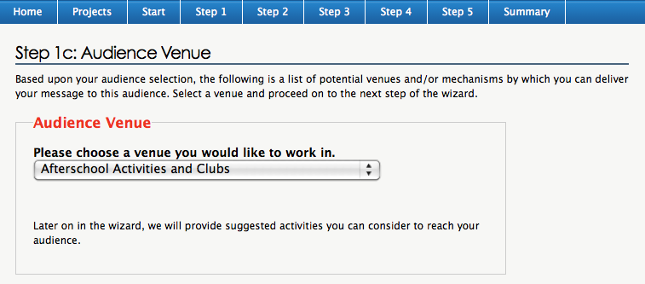
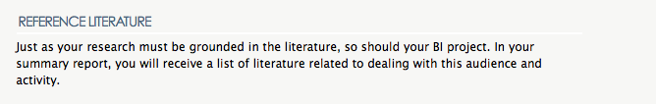
Step 1: Audience
Notes:
Once they have their group identified and their basic message, we ask them to choose a venue or mechanism by which they can delivery this message. The options are tailored for each specific audience group and are based upon who they selected as their target group at the beginning of step 1. I should also mention at this point that we let the user know that we will be providing them with a list of educational literature dealing with their chosen audience and venue or delivery mechanism.

Slide 16
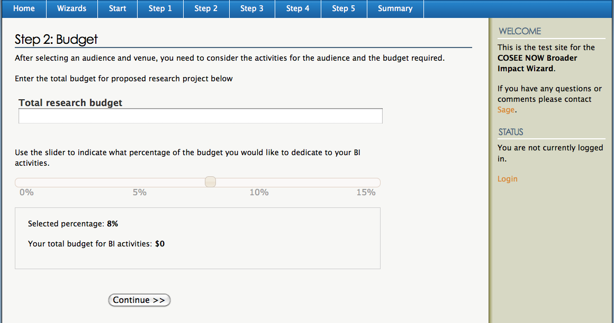
Step 2: Budget
Notes:
After selecting an audience and venue, we ask the scientist to think about how much money they will be dedicating to their BI efforts. As most of you probably know, a successful BI project will have an realistic budget. Therefore, the budget will be a major factor in determining what activities they can do with their audience. Users can enter their total research budget and then use the slider to determine what percentage of this total budget that they would like to dedicate to their BI activities.
As a reference point, we have also included a note explaining that based upon our experience, we have found that a typical BI budget is about 10% of the total research budget.

Slide 17
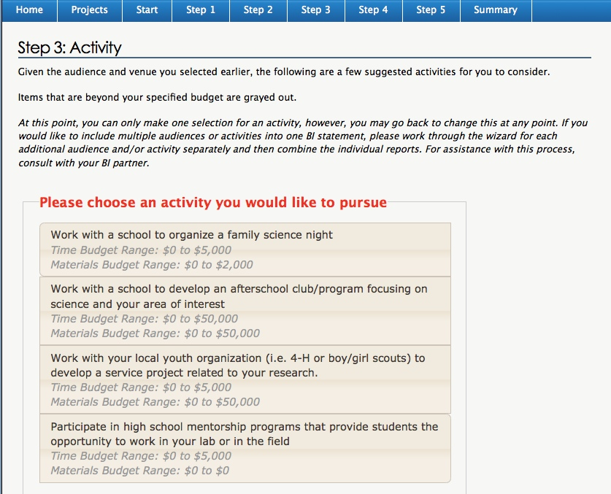
Step 3: Activity
Notes:
Based upon the audience and budget that the user selected in the previous steps, the wizard then outputs suggested BI activities for them to consider when working with this audience. Included with the information for each activity are rough estimates of the costs Both time and material) that are associated with each activity. Options that are beyond the specified budget from the previous are grayed out and cannot be selected by the user. This helps to ensure that the user has allotted an appropriate budget for their desired activity. If the user would like to select one of the grayed out activities, they must go back and adjust their budget accordingly. Of course, values listed are typical costs and depending on the specifics of the activity, these values may vary. Which leads me to another important function on this page, the partner section.

Slide 18
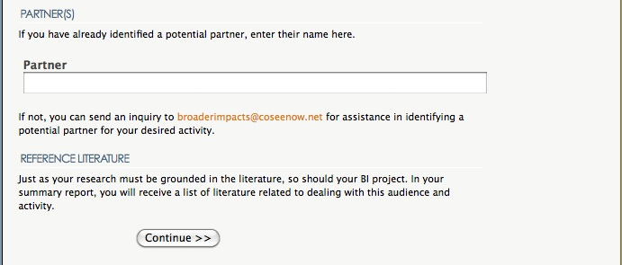
Step 3: Activity
Notes:
To get a true sense of what the activity is, including how much it will cost, we highly recommend to the user that they find an education and outreach partner. In the wizard, we explain that not only can their E&O partner help find the best way to translate and present the science, but they can also help with the implementation of the project. As you can see, currently, we have an e-mail account set up such that those without partners can e-mail us for help finding one, but eventually we would like to have a list of potential partners included within the software. If you are interested in this, please contact me or anyone from COSEE NOW.

Slide 19
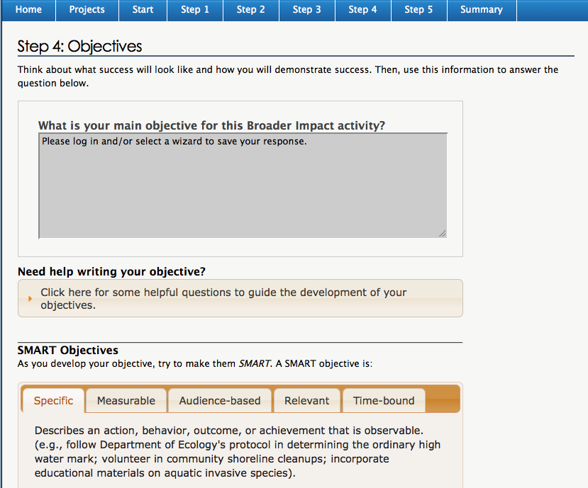
Step 4: Objectives
Notes:
Once the user has decided who they are working with and has an idea of what they are doing, we ask them to write core objectives for their BI project. For some people, including myself, writing objectives can be extremely difficult. Therefore, to help the users with this process, we have provided them with some guide questions that they can use to develop their objectives and information on writing SMART objectives (Specfic, Measurable, Audience Based, Relevant, and Time- bound).

Slide 20
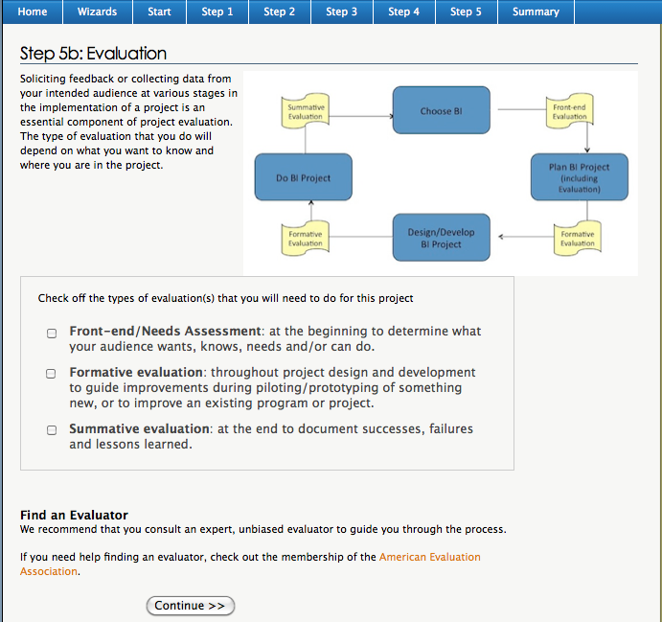
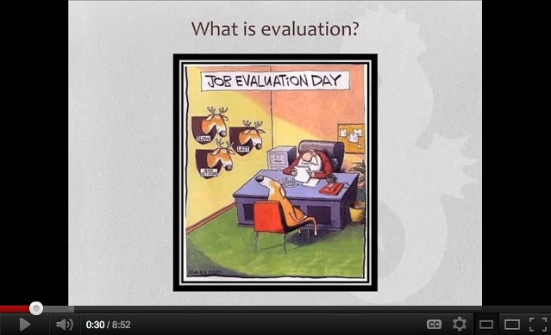
Step 5: Evaluation
Notes:
The last step in the process is the evaluation step. For this step, we provide a video and text describing the basics of evaluation and the types of evaluation that may be involved in their project. As with the partner page, we also encourage them to consult an expert evaluator to guide them through the process. In this step, we also ask them to consider which forms of evaluation that they might need and to check these off for inclusion into the summary report at the end.

Slide 21
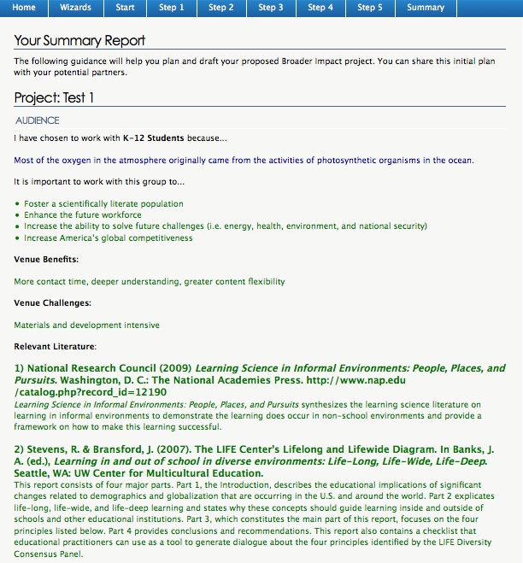
Notes:
As I mentioned previously, after they go through the steps, the user is provided with a summary report. This report is intended to help the user plan and draft their proposed broader impact project can also be shared with a potential partner to help with planning. Due to the size, I had put it on two slides. Here is the first part. All of the information that the user entered is included in this report along with some additional information that they may find helpful, including an annotated bibliography with references dealing with their specific audience and venue.

Slide 22
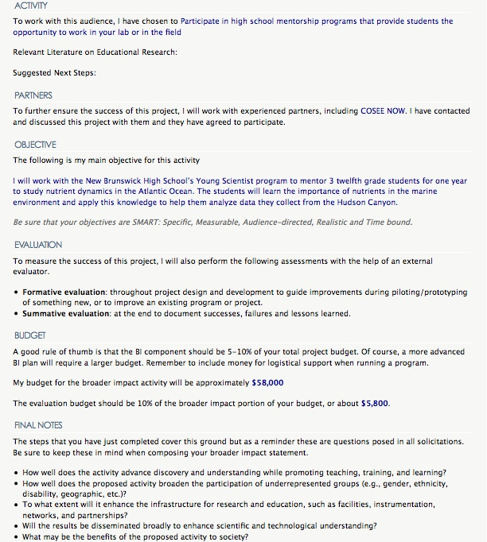
Notes:
And this is the second section. Note that along with the information that they entered, we have also reminded them of the 5 questions included in all NSF solicitations regarding broader impacts.

Slide 23

Scientist Feedback
Notes:
Currently, the BI Wizard is in beta testing to find out whether this tool was something that scientists would use and whether it was helpful, we asked 6 ocean scientists from different career levels at Rutgers to test out the Wizard. Overall the feedback was very positive. They all said it seemed like a very helpful tool and could see themselves using it. They really liked the activity and budget suggestions and the help writing objective. However, there were two aspects which particularly intrigued all them.

Slide 24
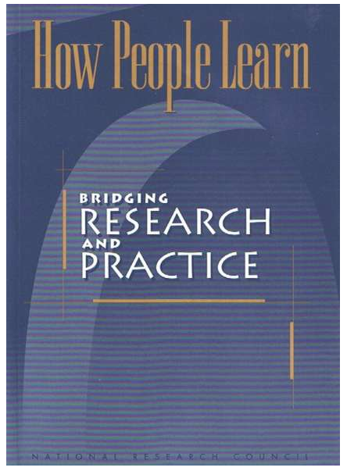
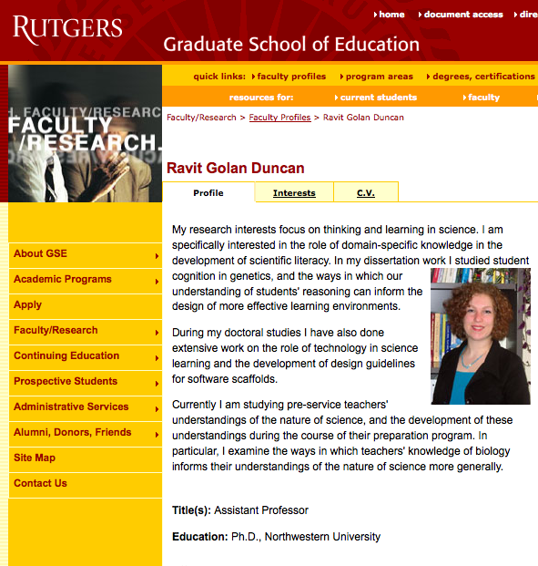

Educational literature
Notes:
The first thing was the educational literature. Some were unaware that there was educational literature that they could use and all were excited that the wizard provided literature that they could cite in their broader impact statement, just as they do with their science.

Slide 25
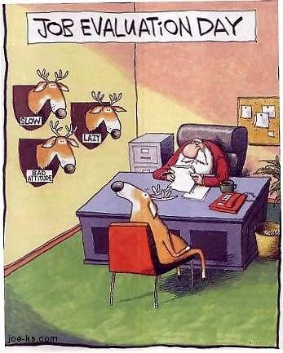
Evaluation?
Copyright joe-ks
http://www.joe-ks.com/archives_dec2003/SantaJobEvaluation.htm
Notes:
A second area that really intrigued them was the evaluation. Many hadn’t even thought about including evaluation in their projects and almost all of the information presented on evaluation was all new to them. Many were excited about using evaluation to gauge their success.

Slide 26
SUMMARY
COSEE Networked Ocean World (COSEE NOW) has created a suite of new online resources for scientists, which compliments and enhances our existing social networking portal (http://coseenow.net)

Slide 27
SUMMARY
COSEE Networked Ocean World (COSEE NOW) has created a suite of new online resources for scientists, which compliments and enhances our existing social networking portal (http://coseenow.net)
The “BI Wizard” provides a user interface that guides users through a series of well-defined steps necessary for the construction and implementation of a broader impact statement

Slide 28
SUMMARY
COSEE Networked Ocean World (COSEE NOW) has created a suite of new online resources for scientists, which compliments and enhances our existing social networking portal (http://coseenow.net)
The “BI Wizard” provides a user interface that guides users through a series of well-defined steps necessary for the construction and implementation of a broader impact statement
Scientist feedback has been very positive, especially regarding the activity, objectives, literature and evaluation sections

Slide 29


CASE STUDIES
The Ross Sea Connection: Linking broad audiences to an Antarctic Ecosystem
TEAM:
Josh Kohut, Janice McDonnell, and Sage Lichtenwalner (Rutgers University)
Chris Parsons (Word Craft)
Harold Clark, Kate Florio, and Katie Gardner (Liberty Science Center)
Chris Linder (Chris Linder Photography)
Notes:
Before I finish, I also wanted to mention another resource coming soon to coseenow.net that builds upon the BI Wizard. We will be adding case studies which provide specific examples of how high quality education and public outreach (EPO) projects could work and who was involved. The studies can act as an example of how a scientist can take a strong BI plan and successfully implement it. For example, we will have one case study on the Ross Sea project done last year. I won’t go into too many details because there will be presentations on this project tomorrow morning in session 35 and you can get additional information then. Just a quick plug.

Slide 30
Thank you!
Development:
Liesl Hotaling
Janice McDonnell
Sage Lichtenwalner
Chris Parsons
Kristin Hunter-Thomson
Jim Yoder
Literature Review:
Adrienne Sponberg
Phil Bell
Suzanne M. Perin
Ravit Golan Duncan
Video Production:
Joshua Kurz
Ari Daniel Shapiro
Chris Meltzer

Slide 31
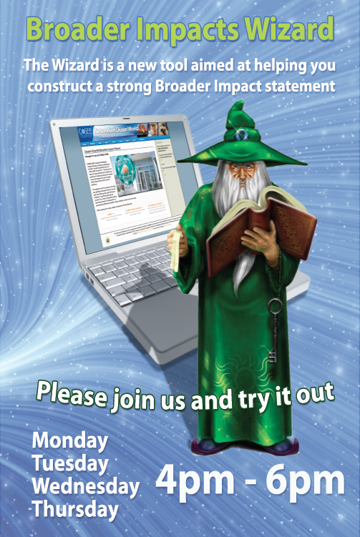

Slide 33
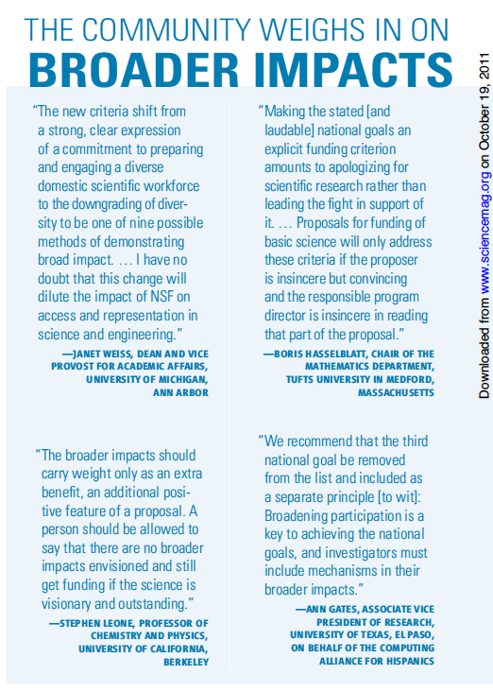
Beyond the Data, Science 2011, Vol 334
Notes:
The latest attempt to clarify how NSF assesses grant proposals for possible impacts beyond the expected scientific results has not ended a long-running debate

Slide 34


Slide 35
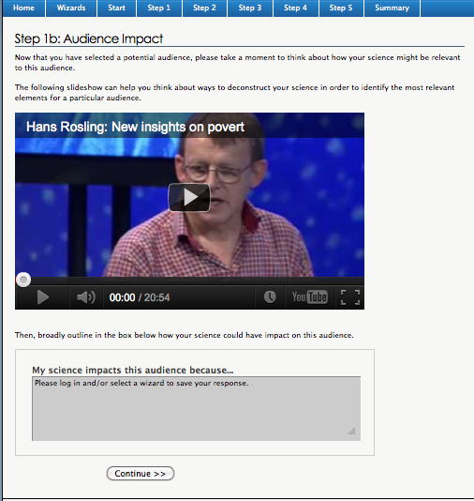
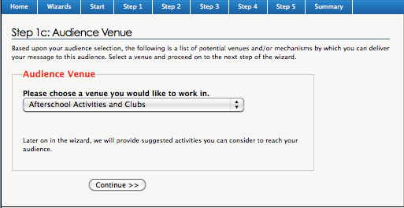
Step 1: Audience
Finding the relevance of your research
Notes:
Once they have a group identified, we ask the user to discuss how their science is relevant to this group. Going through this exercise will help the user determine the key points of their message and will help ensure that make they will be working with a group that would benefit from their message. Once they have their group identified and their basic message, we ask them to choose a venue or mechanism by which they can delivery this message. The options are tailored for each specific audience group and are based upon who they selected as their target group at the beginning of step 1. I should also mention at this point that we let the user know that we will be providing them with a list of educational literature dealing with their chosen audience and venue or delivery mechanism.

